Slide 1
Website & Booklet Imagery 2018 Summer
Project Short Title here
Node Name here

Slide 2
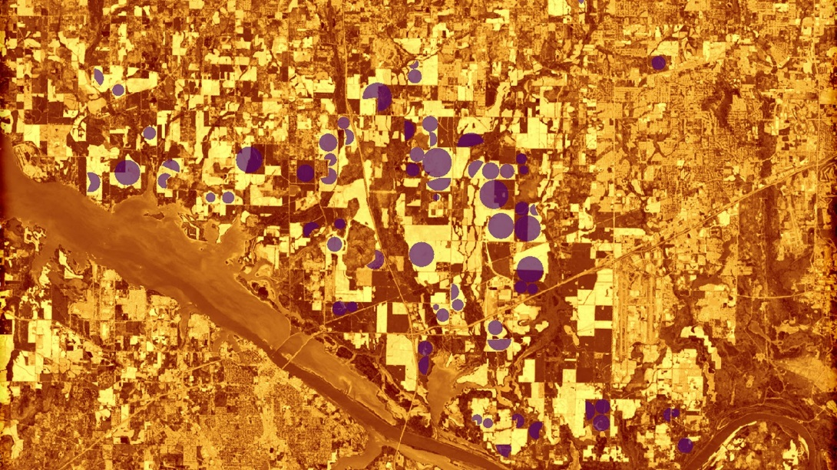
Purpose & Overview
This image should be an attractive, processed image of your study area that will be used to represent the project. This image will be used as a cover image on the project page of the DEVELOP website, the project’s presentation, project image on NASA’s Applied Sciences eBooks website, Summer Booklet image, and as Earth imagery that can be used by DEVELOP’s graphic design team for future publications and promotional materials.
1920 px
1080 px
Delete this slide before submission
Notes:
These notes should be thorough enough for someone not familiar with the project to clearly present the material.
NOTE: For every image on the slide include an image source in the speaker notes (ex. URL; Name, Affiliation, etc.)
Image Source: http://commons.wikimedia.org/wiki/File:Claude_Monet_-_The_Magpie_-_Google_Art_Project.jpg

Slide 3
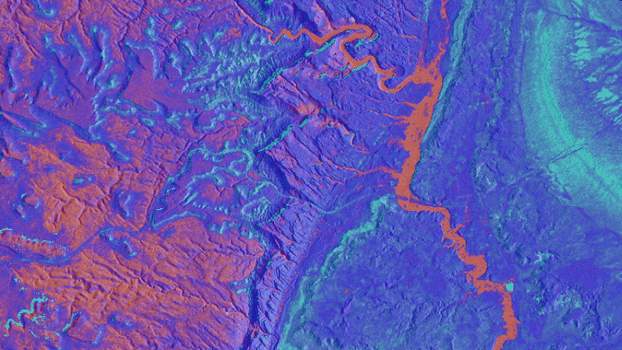
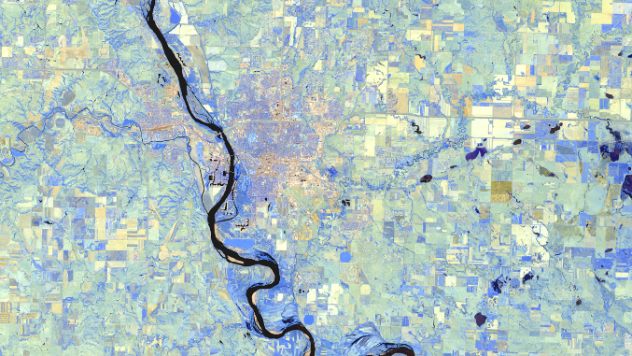
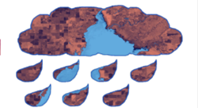
Web/Booklet Image Checklist: Requirements
High-resolution, 1920 x 1080 (over 300 dpi) – landscape orientation
Not sure how to size your image? Use an online resizer like this one -> http://resizeimage.net/
Entire frame is filled with imagery – NO white space
Saved as a JPEG or PNG
Text, legends, etc. must be separate items that are typed and created in PowerPoint (NO imported legends or text)
No images that are clipped to a shape or clip art style overlays (see bottom right)
No use of photographs
The team actually created the image – NO outside content included
There are map resources available on DEVELOPedia
For examples: https://develop.larc.nasa.gov/projects.php
Yes! →
Yes! →
NO! →
Delete this slide before submission
Notes:
These notes should be thorough enough for someone not familiar with the project to clearly present the material.
NOTE: For every image on the slide include an image source in the speaker notes (ex. URL; Name, Affiliation, etc.)
Image Source: http://commons.wikimedia.org/wiki/File:Claude_Monet_-_The_Magpie_-_Google_Art_Project.jpg

Slide 4
Web/Booklet Image Checklist: Requirements
Yes! →
Derived from recent data (2017-2018)
Image is derived from NASA sensor data
Why? DEVELOP is a NASA-funded program that is focused on highlighting NASA data applications. These images are used by NASA in a variety of communication materials.
Exception: NC projects can use CDR data if necessary
Some kind of processing has taken place
Not just a raw satellite image or simple re-order of spectral bands (e.g. false color composite)
The team actually created the image – NO outside content included
Including non-NASA data along with NASA data in the creation of your image is fine, but you can’t take a map or diagram someone else made and include it.
Yes! →
NO! →
Delete this slide before submission
Notes:
These notes should be thorough enough for someone not familiar with the project to clearly present the material.
NOTE: For every image on the slide include an image source in the speaker notes (ex. URL; Name, Affiliation, etc.)
Image Source: http://commons.wikimedia.org/wiki/File:Claude_Monet_-_The_Magpie_-_Google_Art_Project.jpg

Slide 5
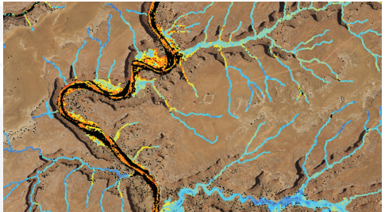
Web/Booklet Image Checklist: Captions
Questions to answer:
What satellite & sensor do the data come from?
What is the date(s) of data?
What is the data showing? (i.e. precip, turbidity, land cover, etc.)
Where is the image?
What is the general interpretation and/or analysis of data
What does the color scale represent?
Not so great captions:
“Las Cruces Heat”
“CERES data overlaid on a solar site development suitability map.”
“Segmented tree canopies colorized by heights, showing stem density within the study area.”
“Slope raster embedded with bison image.”
Great captions:
“Sea level anomaly from OTSM/Jason 2 satellite altimeter in 2017. The Republic of the Marshall Islands Exclusive Economic Zone is shaded blue. Sea level anomaly heights range from low (dark blue) to high (dark orange).”
“Average turbidity across the San Francisco Bay-Delta derived from Landsat 8 OLI (2016). Turbidity concentrations can be used to track Delta smelt throughout the region.

Slide 6
Delete this box and place image here
Project Short Title Here
Caption: 25 word limit.
Metadata Tags: List any keywords, or project participant names that you would like included in the photo’s metadata.

