Slide 1
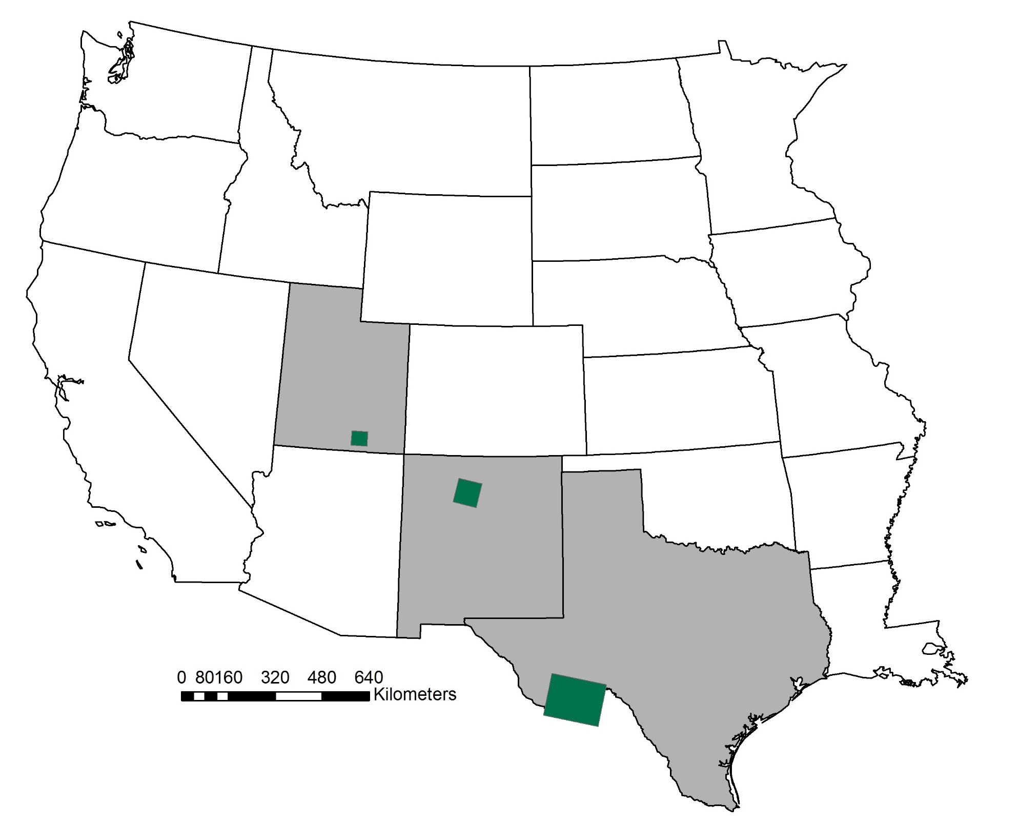
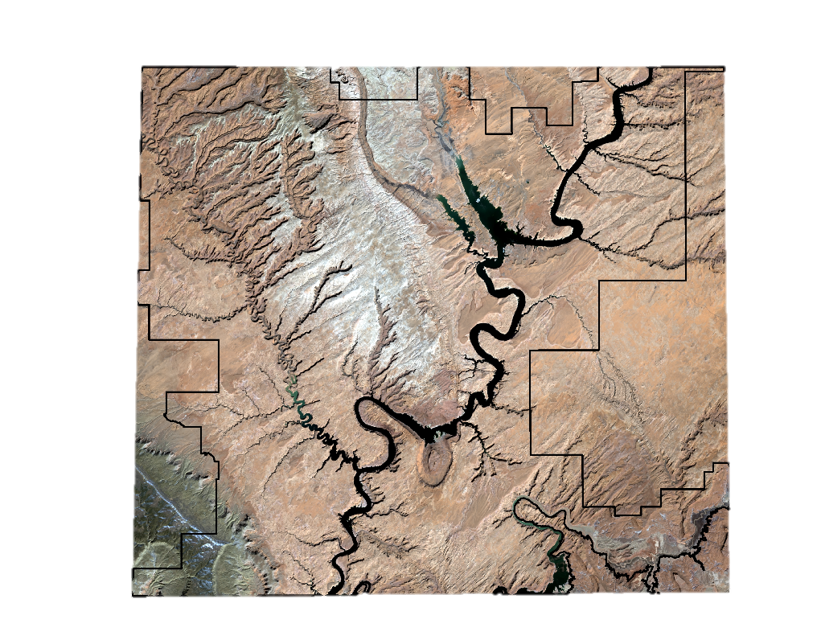
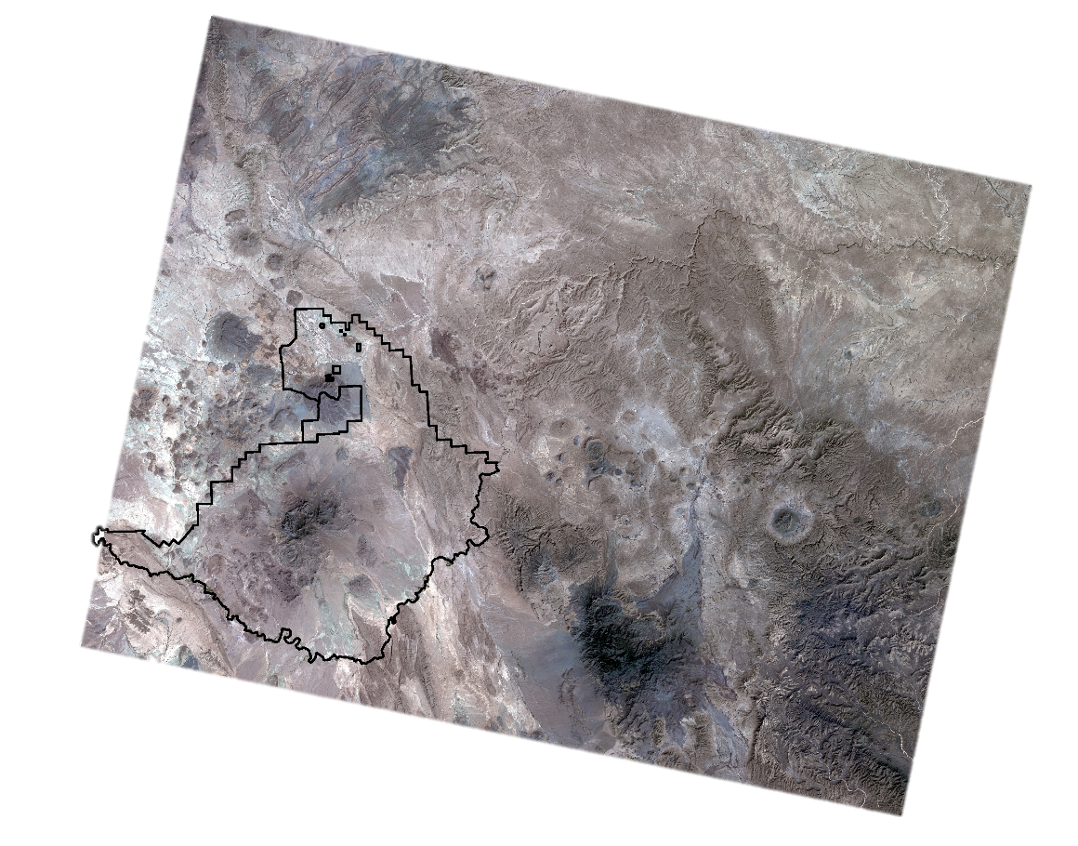
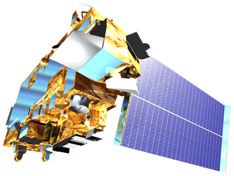
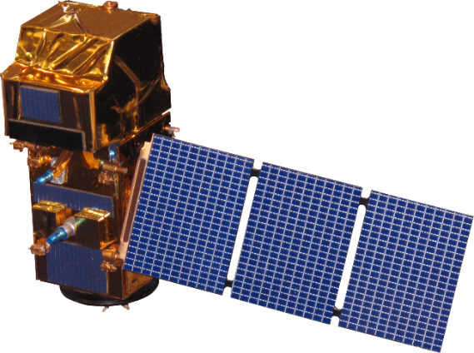
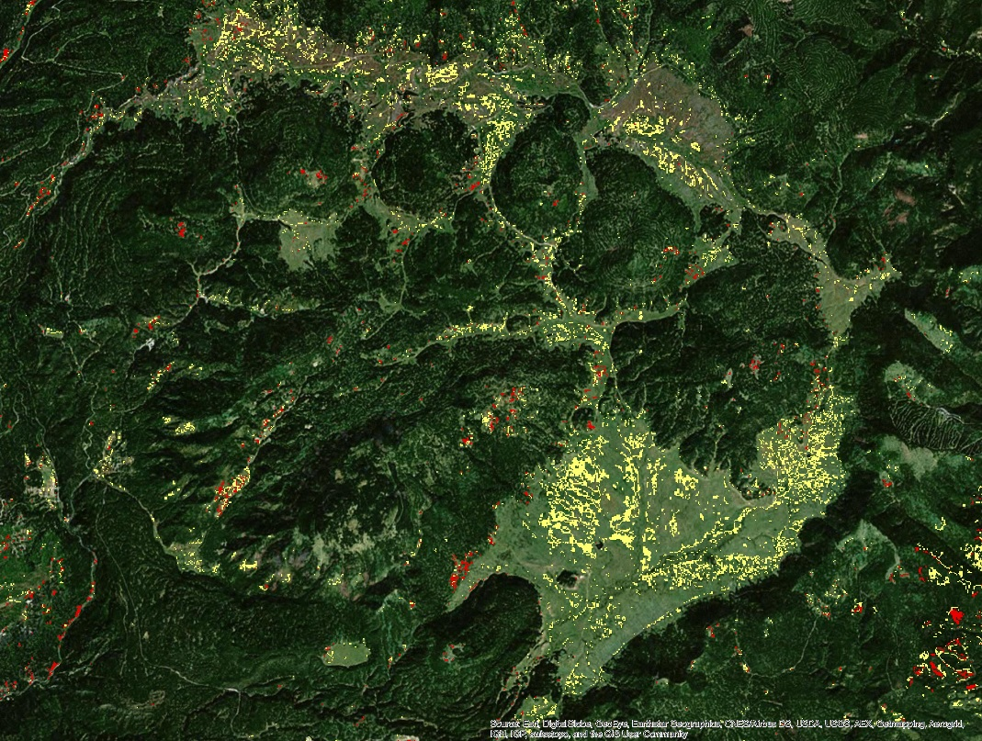
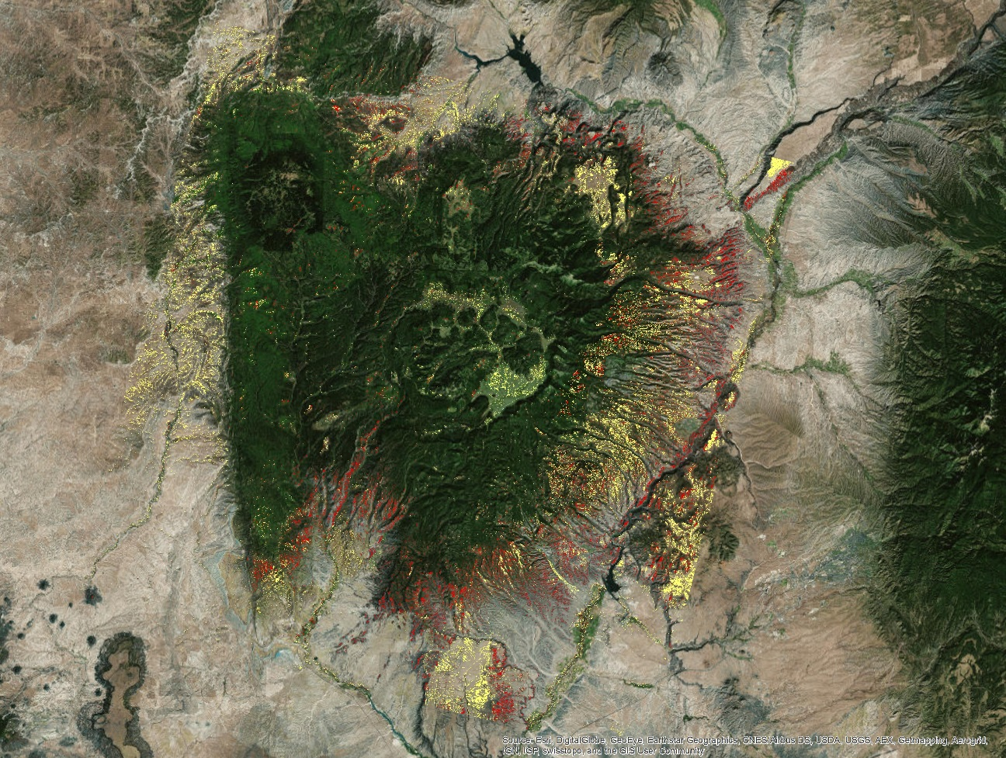
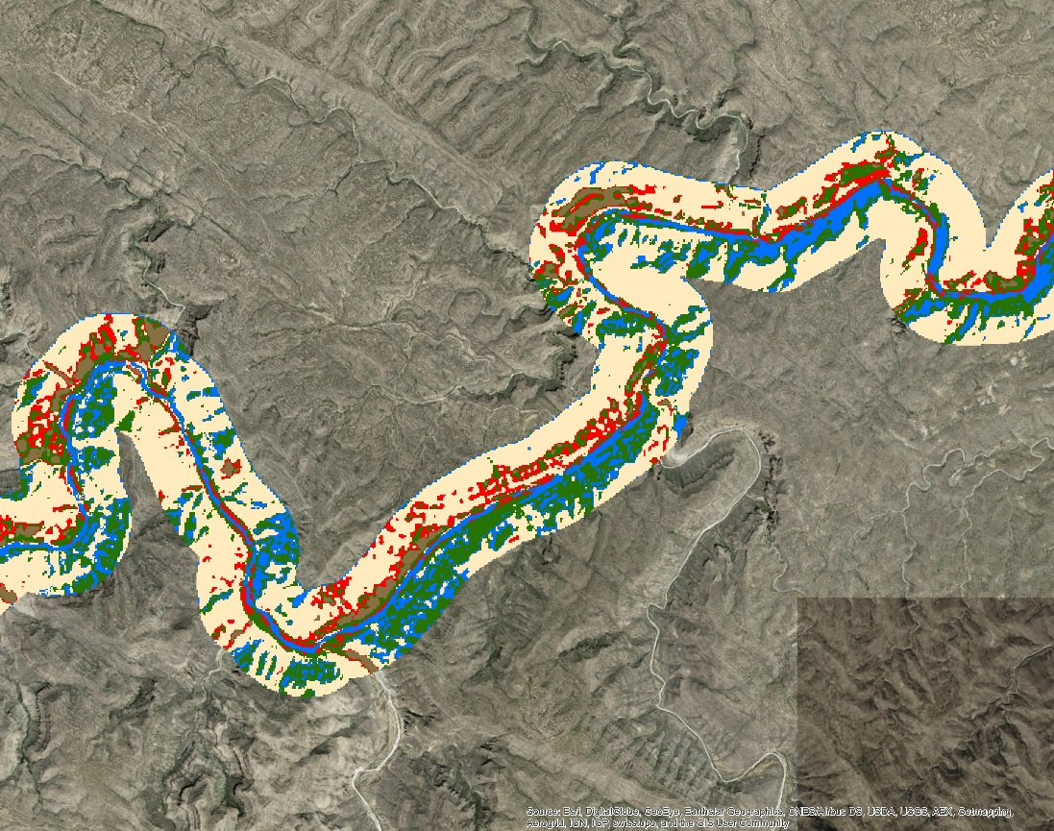
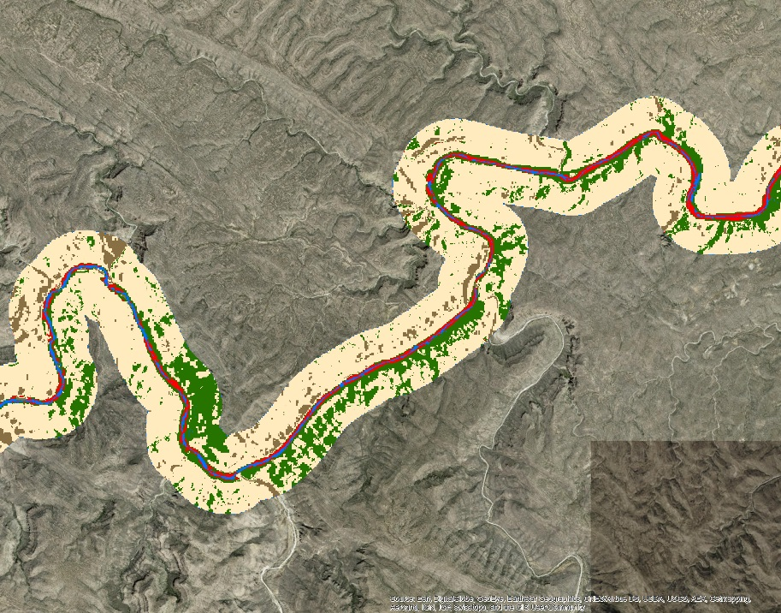
Mapping Invasive Species to Efficiently Monitor Southwestern National Park Areas
Abstract
Objectives
The southwestern United States spans six states, over 55 national parks, and a wide range of ecosystems, historical landmarks, and culturally significant landscapes. Of these parks, Bandelier National Monument (NM), Big Bend National Park (TX), Glen Canyon National Recreation Area (AZ, UT), and Valles Caldera National Preserve (NM) are threatened by three particularly problematic invasive plant species: cheatgrass (Bromus tectorum), ravenna grass (Saccharum ravennae), and giant reed (Arundo donax). Currently, park management uses field observations to monitor these species, which requires a significant investment in time, effort, and money by the National Park Service (NPS). The NPS is interested in mapping and predicting the presence of these invasive species using NASA’s Earth observations. To this end, the Southwest US Ecological Forecasting team created classified species distribution maps using Moderate Resolution Imaging Spectroradiometer (MODIS) data, and Landsat 5 and 8, Operational Land Imager (OLI) data for the years 2002 and 2016. This project also used vegetation and topographic indices as well as field data to predict invasive species presence using a Species Distribution Model (SDM) for each national park area and generated likelihood maps of species presence/absence.
Map the current distribution of cheatgrass, giant reed, and ravenna grass in the Southwest U.S. National Park areas
Forecast where these invasive species may spread to in the future
Model the habitats of the invasive species in order to predict their distribution
Provide the National Park Service with an alternative method of management by utilizing NASA Earth observations
Study Area
Valles Caldera National Preserve and Bandelier National Monument
Glen Canyon National Recreation Area
Methodology
Data Acquisition
Data Processing
Data Analysis
Landsat 5/7/8
ForWarn MODIS
Sentinel-2A
Elevation (NED)
Field observations
Big Bend National Park
Computed NDVI difference images from Landsat bands
Derived aspect and slope from NED elevation data
Graphed seasonal variation using the ForWarn data and derived indices to use in tuning classification models
Used unsupervised classification to model cheatgrass presence in Bandelier and Valles Caldera
Variables included Landsat bands and ForWarn
Used supervised classification to model giant reed around the Rio Grande in Big Bend National Park
Variables included Landsat bands and Sentinel-2 bands
Earth Observations
Southwest US Ecological Forecasting
Results
Landsat 5 TM
Landsat 8 OLI
Terra MODIS
Sentinel – 2A
Conclusions
Although the grasslands within Valles Caldera did not drastically change between the two years, the forested areas surrounding it did, and having more field observations in 2016 improved classification of potentially invaded grasslands.
Because cheatgrass proved difficult to classify with significant certainty it was problematic to forecast its future distribution.
Landsat’s 30m pixels are at too large of a resolution to classify giant reed along the Rio Grande; all tested supervised classifications using Landsat bands did not map open water in this area accurately.
Due to the lack of field observations for Glen Canyon, ravenna grass was unable to be accurately modeled or predicted.
2002 potential cheatgrass areas
2016 potential cheatgrass areas
Unsupervised classification of Valles Caldera and Bandelier
Giant
Reed
Project Partners
Other
Vegetation
National Park Service
Charles Schelz, Program Manager/Ecologist
Southwest Exotic Plant Management Team (EPMT)
Todd Chaudhry, Research Coordinator
Colorado Plateau Cooperative Ecosystem Studies Unit
Steven Buckley, Ecologist
Shrubland
Bare Soil
Supervised Classification with Landsat 8 bands (left) and Sentinel-2 Bands (right)
Water
Team Members
Acknowledgements
Dr. Kenton Ross NASA DEVELOP National Program Science Advisor
Emily Gotschalk NASA DEVELOP Langley Center Lead
Tyler Rhodes NASA DEVELOP Langley Center Lead
Dr. Kathleen Moore NASA DEVELOP Langley Assistant Center Lead
Carrie Kelley NASA DEVELOP Langley Assistant Center Lead
Any opinions, findings, and conclusions or recommendations expressed in this material are those of the author(s) and do not necessarily reflect the views of the National Aeronautics and Space Administration. This material is based upon work supported by NASA through contract NNL11AA00B and cooperative agreement NNX14AB60A.
Ryan Avery
Project Lead
Katherine
Landesman
Timmera
Whaley
Jordan
Vaa
Dakoyta
Greenman
NASA Langley Research Center – Summer 2016

