Slide 1
Atlanta Water Resources
Identifying Key Urban Areas to Reduce Stormwater Runoff and
Maximize Conservation Efforts in Metropolitan Atlanta
Christopher Cameron (Project Lead)
Jason Reynolds Wenjing Xu
Beatriz Avila
Alex Smith
Veronica Fay
Jacob Spaulding
Notes:
This is the first term of a 2-term project with The Nature Conservancy of Georgia and the UGA DEVELOP Node.

Slide 2
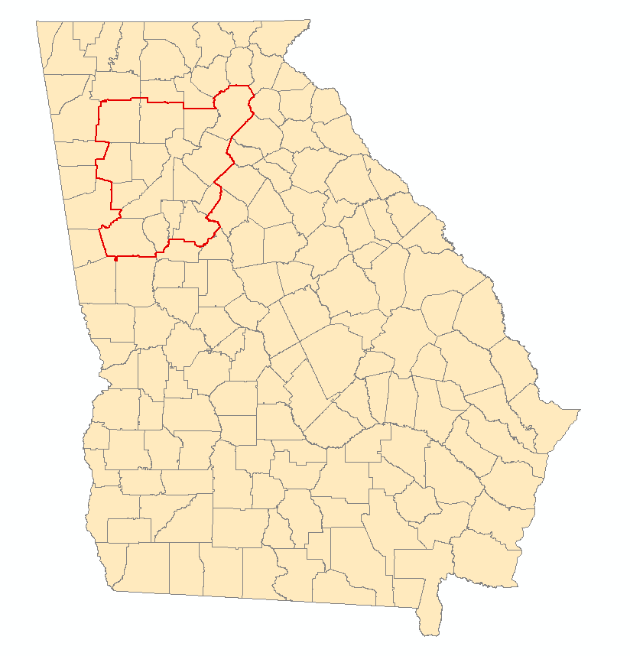
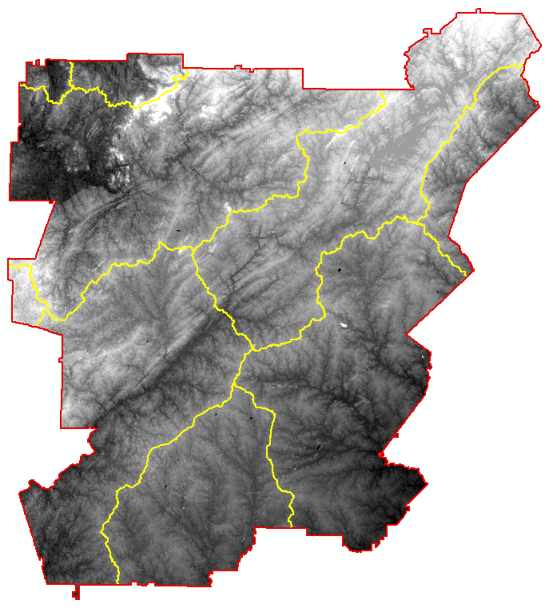
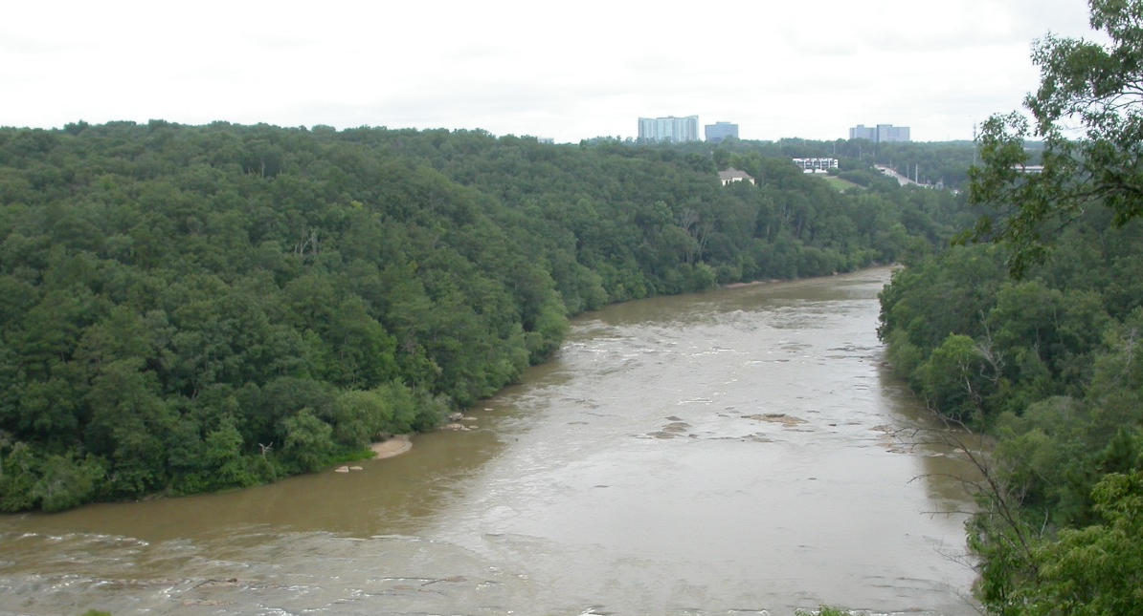
Study Area & Period
Metropolitan North Georgia Water Planning District (MNGWPD)
15 counties
9 major watersheds
Contains the greater Atlanta area
Population of approximately 5.2 million (U.S. Census, 2010)
Atlanta
Upper Chattahoochee
Etowah
Middle
Chattahoochee
Ocmulgee
Flint
Notes:
The study area focuses on the Metropolitan North Georgia Water Planning District, which is composed of the following 15 counties in GA: Bartow, Cherokee, Clayton, Cobb, Coweta, DeKalb, Douglas, Fayette, Forsyth, Fulton, Gwinnett, Hall, Henry, Paulding, and Rockdale.
Atlanta is one of the largest and most populated cities in the USA
The 9 major watersheds that cross/are contained in the MNGWPD are: Upper Chattahoochee, Middle, Chattahoochee, Upper Ocmulgee, Flint, Upper Tallapoosa, Etowah, Upper Oconee, Coosawattee, and Oostanaula.

Slide 3
Objectives
Identify reforestation targets to help reduce harmful stormwater runoff
Analyze watershed processes using the Soil Water Assessment Tool (SWAT)
Model multiple land allocation scenarios for reforestation purposes using the Land Use Conflict Identification Strategy (LUCIS)
Image Credit: David Cotten
Notes:
The objectives of this project were designed to assist The Nature Conservancy in their on-going work in the Atlanta region and to provide a spatial analysis for their proposed reforestation efforts. The goal of this term of the project is to identify areas within the MNGWPS for further investigation as a reforestation site. Additionally, this project term attempted to produce a hydrologic characterizations of the MNGWPD watersheds to identify at-risk/vulnerable areas.

Slide 4
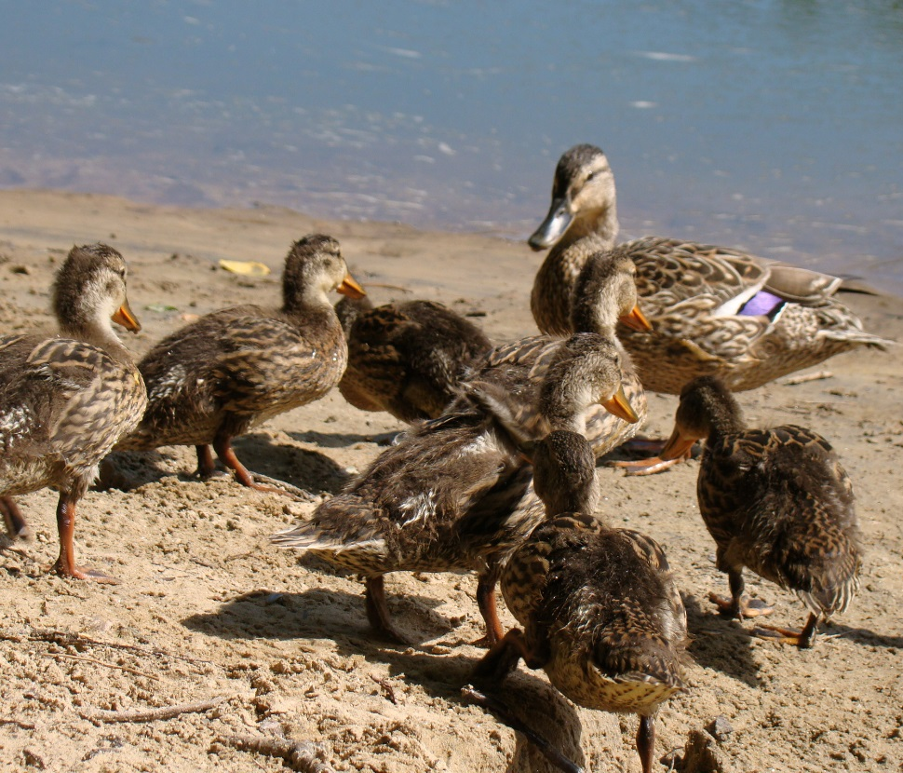
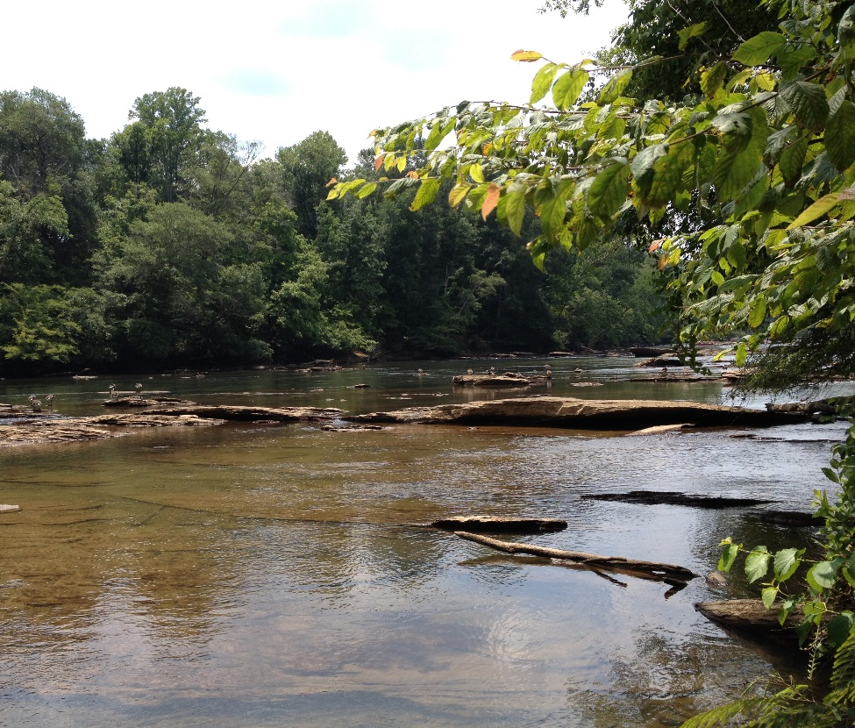
Image Credits: David Cotten
Community Concerns
Costs of municipal water management in the metropolitan Atlanta area are rising due to an increased demand of infrastructure required to handle stormwater runoff
Rapid, continued development in the city of Atlanta and its suburbs will expand areas of impervious surface cover, exacerbating stormwater management problems
Notes:
Atlanta is one of the fastest growing cities in the nation. As the largest city in GA, key player in regional water resource use discussions, primarily due to the fact that the Chattahoochee river flowing through the heart of the city. .

Slide 5
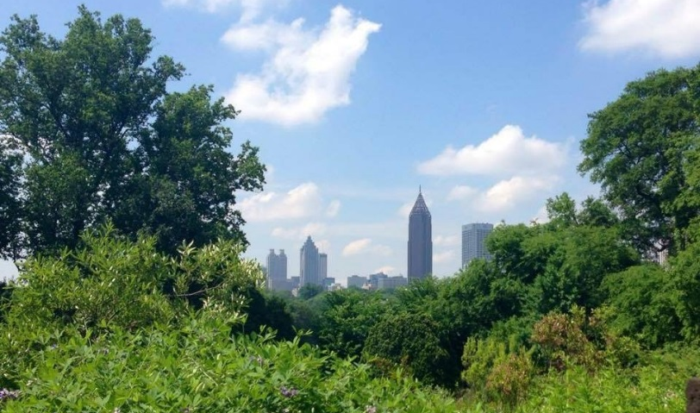
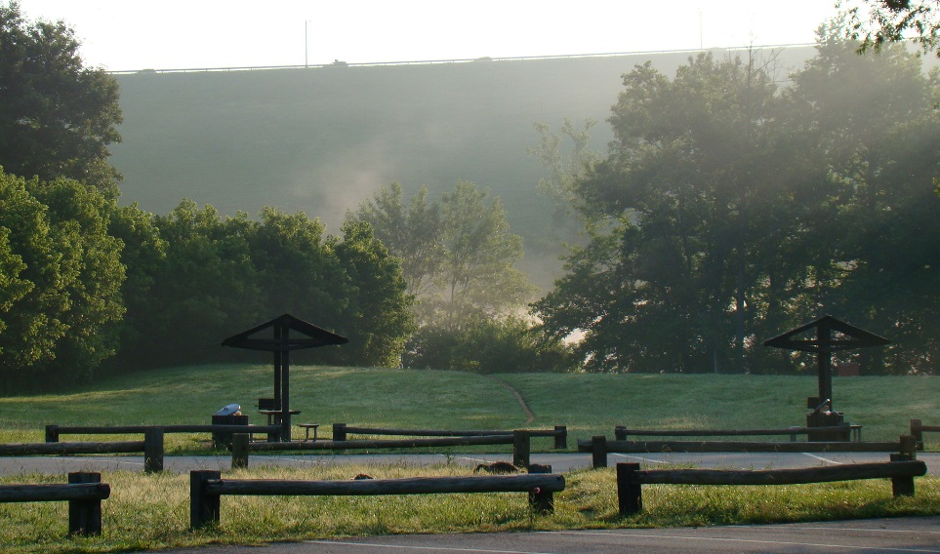
Green Infrastructure & Reforestation
Green infrastructure refers to a network of forests, wildlife habitats, parks, and natural areas within urban landscapes (McMahon, 2000)
Green spaces enrich the quality of life for local residents, provide recreational use, and enhance biodiversity (McMahon, 2000)
By decreasing pollution in waterways, green infrastructure is an effective tool for managing water quality in cities (Livesly et. al., 2011)
Urban forests are known to decrease stormwater runoff by allowing water to infiltrate and soil to absorb particles and contaminants
Image Credit: Hillary Essig
Notes:
Green infrastructure has a variety of direct and indirect benefits for local communities. Additionally, reforestation efforts are being pursued in Atlanta specifically due to on-going decision and policy regarding the construction of spaces such as the Atlanta Greenway

Slide 6
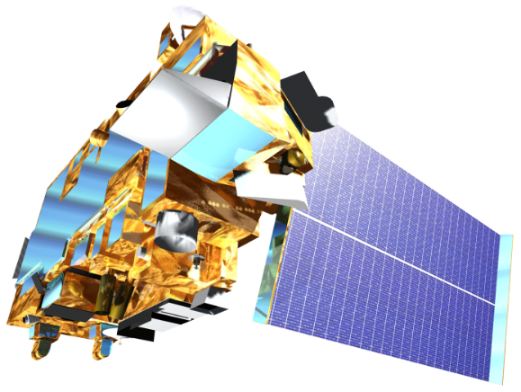
Landsat 8, OLI
Terra, ASTER
NASA Earth Observing Systems
Landsat 8 and Terra satellites were utilized in this project to produce land cover and topographic datasets
Notes:
We obtained cloud-free Landsat 8 OLI images from October, 2015. Images were obtained for 2 Landsat scenes corresponding to the coverage of the MNGWPD by path-row.
30m ASTER DEMs were used for elevation data
Both datasets were acquired through the USGS EarthExplorer website.

Slide 7
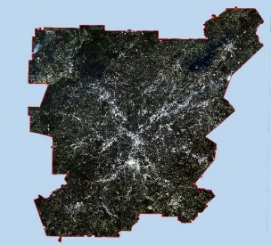
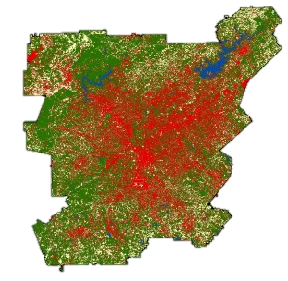
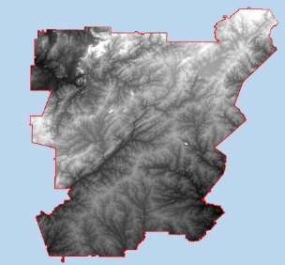
Methodology
Data Acquisition
Processing and Analysis
End Products
Landsat 8 Images
Atmospheric Correction
Supervised Land Cover Classification
Land Cover Classification
ASTER DEMs
SWAT
LUCIS
Hydrologic Processes Model
Ancillary Datasets
LUCIS Suitability Maps
Notes:
The general methodology of the Atlanta Water Resources team is to integrate NASA EO datasets into both the LUCIS and SWAT models as necessary to produce suitability

Slide 8
Land Cover Classification
Processing
Mosaic
Atmospheric Correction
Classification
Urban
Agriculture
Training Sets
Maximum Likelihood Classification
Water
Forest
Bare
Validation
0
40
Km
Accuracy Assessment
Confusion Matrix
Image Credit: Atlanta Water Resources Team
End-Product
Supervised 2015 Land Cover Classification
Notes:
The supervised land cover classification was performed in ENVI on our Landsat 8 images. This classification scheme is meant to reflect the major land use allocations in LUCIS. The accuracy assessment was done by generating 150 random points and interpreting them using NAIP imagery.

Slide 9
Soil and
Water
Assessment
Tool (SWAT)
Combines weather, surface runoff, evapotranspiration, water storage, groundwater flow, and agricultural data to characterize hydrologic processes
Predicts long term impacts of land use in river basins and can be used to evaluate best management practices
Assesses the effects of pollution sources and contaminant inputs to local watersheds
Notes:
SWAT is a widely used model created by Texas A&M for the USDA. In this project, we used SWAT for watershed characterization and contaminant mapping.

Slide 10
Land
Use
Conflict
Identification
Strategy (LUCIS)
Integrates a broad range of input datasets to create suitability data layers based on defined goals and objectives for primary land use categories (urban, agriculture, and conservation)
Locates areas of potential land use conflict based on suitability prioritization and ranking
Produces flexible land use allocation scenarios based on goals and objectives that can be adapted to a range of stakeholder and community preferences
Notes:
LUCIS was developed by Carr and Zwick at the University of Florida. It was previously used in the UGA DEVELOP Miami Ecological Forecasting project (2014). LUCIS is a flexible model that can account for variations in stakeholder and local interest groups as it relates to land use allocation.

Slide 11
Suitability: Urban
Goal:
Minimize untreated stormwater flow into the Chattahoochee from impervious surfaces
Objectives:
Identify location of stormwater retention ponds and outfalls (into the river)
Identify Location of Brownfields, Abandoned Construction sites and open bare land
Identify areas or locations of greater preference or suitability for construction (property zone values)
NPDES
sites
Superfund
sites
Old vs. New Neighborhoods
Floodplain
Zoning
Urban
Land
Cover
Notes:
Objective reasoning:
Higher compliance per watershed is preferred for retention ponds. Residential and commercial property owners can reduce impact fees by as much as 50% by demonstrating compliance. Easements granted to the city for future sanitary outfalls shall be executed by the landowner (less outfalls equals more access to city sewer for developers and less cost)
The City of Atlanta has managed several programs and initiatives aimed at identifying, assessing and remediating brownfield sites throughout the city. Brownfields is a real property whose expansion, redevelopment, or reuse may be complicated by the presences of potential hazardous substance, pollutant, or contaminant. Abandoned subdivision land is one large contiguous piece of property which make it more suitable than older neighborhoods to construct new development. Developers would prefer such property because of reduced purchasing cost and construction cost. Newer neighborhoods are preferred over older neighborhoods because the property is more “elastic”. Elastic meaning that it lacks the same repetitive patterns of older neighborhoods, which are more “static”.
The City Areas with lower property values can be of higher interest for development, as well as conservation. The reduced property value serves as an incentive for purchasing certain areas for development, but this is not always the case with a number of factors contributing to buyer preference. These lands are also of value for conservation and reforestation. Areas of lower property values and limited vegetation provides a unique opportunity for creating an equitable environment for people and to utilize under value land. Floodplain protection. The commissioner shall not authorize the approval of any permit authorizing the placement of fill or stored materials, or the construction of any building or other structure within the floodplain.

Slide 12
Suitability: Agriculture
Goal: Identify agricultural lands with a high potential to impact local water quality and stormwater runoff
Objectives:
Identify regions in close proximity to streams & other waterways
Identify regions with high topographic gradients
Identify regions with highly permeable soils
Agricultural Land Cover
Waterways
Soil Permeability
Slope
Notes:
Reasoning for Objectives:
Agricultural lands that are in a close proximity to streams and other waterbodies, have a higher risk of introducing organic nutrients, pesticides, and eroded sediment to these waterways during precipitation events.
2. Agricultural lands that have a higher slope will increase the amount of surficial runoff during a precipitation event. It is a hydrologic principle that water will always travel from
a higher elevation to a lower elevation.
3. Low permeability soils, such as soils with high clay content, have low infiltration rates during precipitation events. Low infiltration rates increase surficial ponding and surficial
runoff. Agricultural lands that have these types of soil have a higher risk of introducing higher volumes of surficial runoff and agricultural related nutrients to surrounding
waterways.

Slide 13
Suitability: Conservation
Goal: Protect existing green infrastructure and identify opportunities to increase or expand green spaces
Objectives:
Identify existing protected areas/green spaces
Analyze existing proportions of local vegetation and forests
Identify associated land cover types for potential reforestation areas
Prioritize reforestation targets
Forested Land
Cover
Development Density
Distance to
Water Bodies
Protection Status
Slope
Notes:
Objective Reasoning:
Locating areas near existing protected lands or green spaces could facilitate expansion of conservation management locally and provide existing conditions for reforestation plots.
Composition of existing vegetation communities could affect decisions related to reforestation – such as what types of trees to plant
Significant changes in adjacent land cover could affect the suitability (particularly soils and pollution) for forestation
Self explanitory

Slide 14
Results: Land Cover Classification
 | Urban | Agriculture | Water | Vegetation | Bare Land | User Accuracy
Urban | 25 | 2 | 0 | 6 | 0 | 76%
Agriculture | 6 | 31 | 0 | 4 | 7 | 65%
Water | 0 | 0 | 6 | 0 | 0 | 100%
Vegetation | 2 | 1 | 0 | 57 | 1 | 93%
Bare Land | 0 | 1 | 0 | 0 | 2 | 67%
Producer Accuracy | 78% | 89% | 100% | 85% | 20% | 81%
Kappa |  |  |  |  |  | 0.75
Notes:
Kappa measures the strength of classification on a 0 to 1 scale- a 0.75 value is considered substantially accurate.
The majority of misclassification came from the bare land class. This is likely due to the low number of accuracy assessment points (total of 3) compared to the other classes.

Slide 15
Results: LUCIS
Conflict Identification Maps
Multiple allocation scenarios empathizing each of the major land use categories
Reforestation suitability
Image Credit: Monet
Notes:
The results of the LUCIS model analysis will provide project partners with an understanding of potential land use conflicts from a spatial and stakeholder perspective. Additionally, these results will allow The Nature Conservancy to identify lands for future conservation efforts relating to reforestation.

Slide 16
Results: SWAT
Pollution source mapping
Hydrologic processes
Impacted areas
Notes:
SWAT results will assess how land use is affecting the MNGWPD watersheds in addition to identifying how contaminants flow through the system from various pollution sources.

Slide 17
Conclusions
Coming soon!
Image Credit: Monet
Notes:
Image Source: http://commons.wikimedia.org/wiki/File:Claude_Monet_-_The_Magpie_-_Google_Art_Project.jpg

Slide 18
Errors and Uncertainties
Land cover classification?
LUCIS weights?
SWAT outputs?
Image Credit: Monet
Notes:
Image Source: http://commons.wikimedia.org/wiki/File:Claude_Monet_-_The_Magpie_-_Google_Art_Project.jpg

Slide 19
Future Work
Term 2 is scheduled for summer 2016
Image Credit: Monet
Notes:
Image Source: http://commons.wikimedia.org/wiki/File:Claude_Monet_-_The_Magpie_-_Google_Art_Project.jpg

Slide 20
Advisors
Dr. Marguerite Madden, UGA Center for Geospatial Research
Dr. Rosanna Rivero, UGA College of Environment and Design
Partners
Myriam Dormer, The Nature Conservancy
Sara Gottlieb, The Nature Conservancy
Others
David Cotten, UGA Center for Geospatial Research
Caren Remillard, NASA DEVELOP

