Slide 1
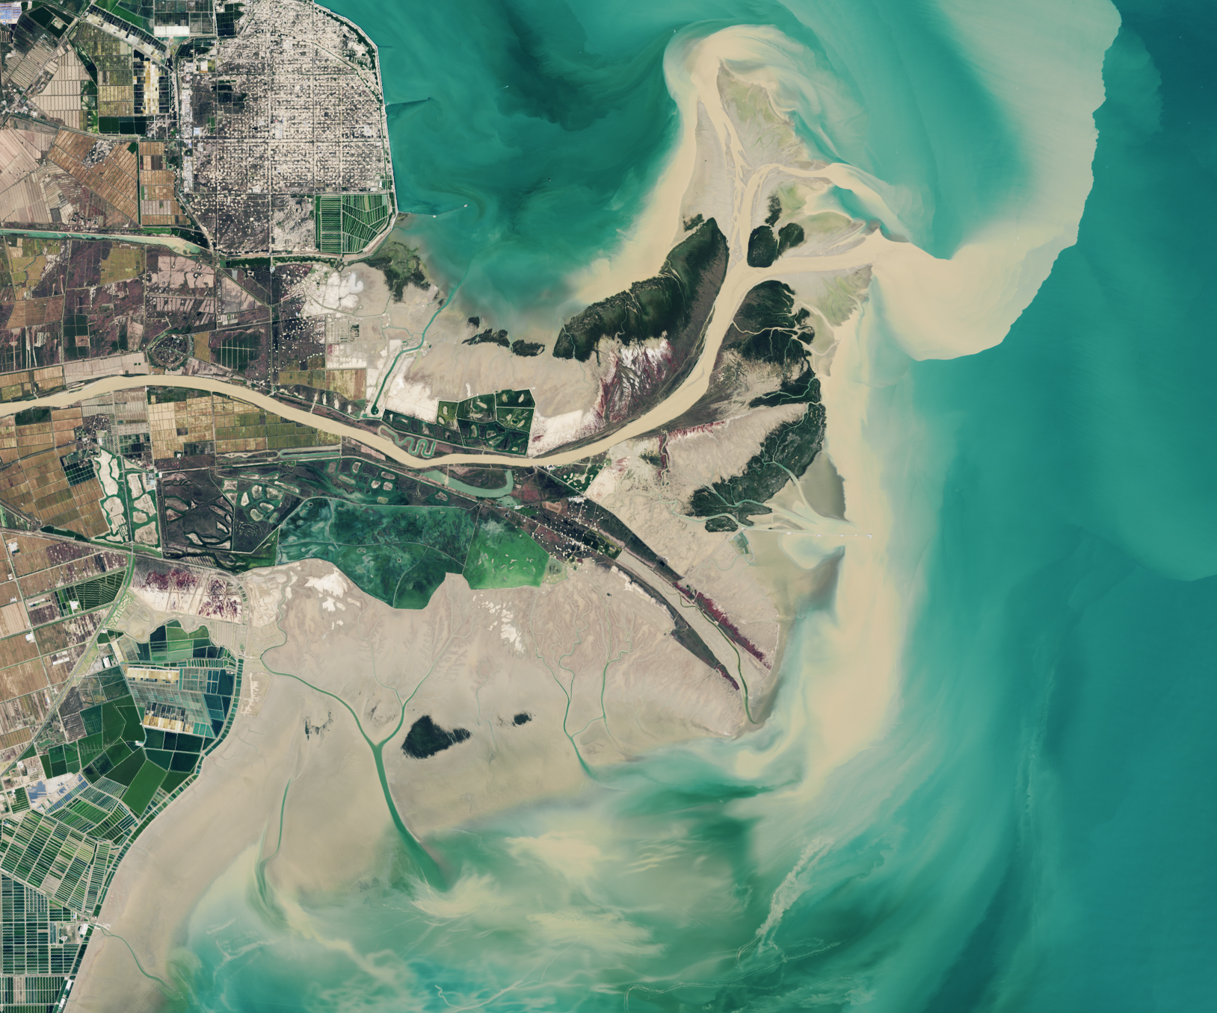
DEVELOP National Orientation (2022)
Module 6. Partners

Slide 2
Partner Types

Slide 3


Partner Types
Partner: Umbrella term for any outside organization DEVELOP engages with through projects, nodes, or other activities
Two distinct types of partners:
  End User: Organization that receives results and methodologies from DEVELOP (either directly from a DEVELOP project team or through a collaborator/boundary organization) and can use the project’s products or methodologies to make a decision or policy; they may also provide some kind of resources (advising, data, model, software, funding, etc.), but it is not required
      Ex. The Texas Forest Service’s Predictive Services that can use the products/methodologies from the DEVELOP project in their risk mapping creation
  Collaborator: Organization or individual that works directly with a DEVELOP project team and provides some kind of leveraged resource (advising, data, model, software, funding, etc.), but are not actually using the project’s products or methodologies to make a decision or policy
      Ex. A researcher from a university who provides a team with an ancillary dataset to validate their results
By The Way
All partners are either end users (using the results/products to make a decision) OR collaborators (not using the results or products to make a decision)

Slide 4



Partner Types
There is a third, additional classifier that can be attributed to both types: a “boundary organization”
Boundary Organization: Organization or individual that disseminates the project’s results to other end users, decision-makers, policy-makers, etc.
Ex. The Smithsonian Conservation Biology Institute works with local groups in Myanmar and helped DEVELOP disseminate results from the Myanmar Ecological Forecasting project to those in-country groups.
All Partners
Collaborators
End Users
Boundary Organizations

Slide 5
Communicating with Partners

Slide 6

Partner Engagement & Communication
A cornerstone of DEVELOP projects is the engagement of management and policy makers who can benefit from the integration of NASA Earth observations in their decision-making process. All DEVELOP projects strive to engage at least one decision-making organization to hand off project results and methodologies to.
Communication strategies commonly employed
  Team-partner greeting telecon during the first or second week
  Weekly or bi-weekly telecons & emails with status updates
  Hand-off event at the end of the term
By The Way
As participants, YOU are the face of DEVELOP to our partners, so professionalism and open communication are of the utmost importance!

Slide 7

Comm Best Practices
Dependability – If you say you are going to call partners Thursday at 1 PM, then be sure to call them at 1 PM on Thursday. If you say you are going to find them a piece of information, then be sure to find it and send it to them.
Honesty – Being candid with your partner is critical to gaining their trust. We all like sharing good news, but bad news is also important in a partnership. Don’t omit information just because you feel that it won’t please the partner. Don’t mask the truth just to paint the picture that you think they want to see.
Passion – Show your enthusiasm for your work and their partnership. If they believe you are personally invested in the project and them as a partner, then they are much more likely to put their trust in you.
By The Way
It’s a best practice to have one representative from the project serve as the primary liaison for communication with partners – to schedule meetings, calls, share data, schedule hand-offs, etc.

Slide 8
Checklist: Working with Partners
Ensure professionalism in all interactions - you are representing yourself, your team, your advisors, your node, DEVELOP, Applied Sciences, and NASA!
Have a plan and schedule.
Be realistic in what you promise and the expectations of the partner. In fact, don’t “promise” anything, but ensure the plan you are working towards is clear and that there is a healthy understanding of challenges and potential obstacles/risks.
Keep in mind the limitations of resolution (spatial and temporal) of NASA data and work within them.
Understand the partner’s needs – what kind of data/tools are useful, what software do they have access to, what tutorials or products would be helpful? The proposal should identify this for the team.
Keep communication lines open and ensure the team follows through. Generally speaking, the Project Lead should be the POC for communicating with a partner unless it is specifically delegated to another team member.
All emails to partners should be approved by your node Lead, and you should always CC the Lead.
Include your project’s Science Advisor in partner communication as much as is possible, per your advisor’s availability.

Slide 9
Meeting with Partners
To prepare for your first team communication with your partner:
  Discuss previous comms with your Fellow
  Look at responses to the pre-project form (if submitted)
  Read the full proposal
  Compile questions
General questions to help you prepare & understand your partner’s needs:
  We’ve read the proposal, but can you talk us through the issue at hand and your decision-making process?
  What is the economic impact of the issue you are facing? (ex. cost of fighting a wildfire or drought impacts to crops in a region)
  Does your organization currently use GIS or any spatial analysis?
  What software programs do you typically use?
  What types of data do you currently work with?
  What organizations do you partner with (if any) to combat this issue?
  What are your expectations of our project?
  What products could our team create that would be the most useful to you?
  What format should end products be in to be useful?
  What is the best transition approach? Email, telecon, Videocon. Will you be able to meet with us weekly or biweekly so we can share updates and get feedback throughout the term?

Slide 10
International Partners
When working with international partners, care must be taken than appropriate approvals and communication lines are followed.
If a potential end user sits in a designated country (see next slide), NO direct communication can happen between the DEVELOP team and that organization/individual. A DEVELOP project will never have an end user located in a designated country. (Exception: Bhutan projects)
For projects with international study areas, if a partner organization sits in the US or a non-designated country, the team can have direct communication with the partner, but NPO and advisors must be included in all email and telecon correspondence.
NASA’s Office of International and Interagency Relations (OIIR) supports DEVELOP when interacting with international organizations and must be included and aware of all international engagement.
NPO coordinates with and involves OIIR reps when needed. This is primarily (although not exclusively) when embassies and foreign government officials are involved.
By The Way
DEVELOP projects often include international participants who may have contacts in a foreign country where the study area lies. Be mindful that any communication with others outside the US relating to the project involves your Fellow and NPO.

Slide 11
Designated Countries
What is a ‘Designated Country’? This list of “Designated Countries” is a compilation of 35 countries with which the United States has no diplomatic relations, countries determined by Department of State to support terrorism, countries under Sanction or Embargo by the United States, and/or countries of Missile Technology Concern.
What does this mean to me? It means that for any project deliverables, products, decision support tools, etc. to be transferred to any partner (domestic or international), a review must take place first. The NPO ensures that DEVELOP works within NASA Export Control guidelines. The NPO must be made aware of any presentations, publications, or information transfer that take place before they occur. A “transfer” includes an email, publication, presentation, telecon, webinar, etc. Communication with partners in designated countries is restricted, so coordinate with NPO ahead of opening communication lines with any foreign nationals.
But my partner is domestic/not in a designated country? While your project partner may be in the United States or not on the designated country list, the assumption is that anything that leaves the Agency/DEVELOP could be in turn transferred to any individual or organization anywhere, and thus, we must ensure that all material is appropriate for a global audience.

Slide 12
Quiz Time
How many partner types are there?
What is a good cadence for tag ups with partners?
Ahead of your first meeting with your partner(s), you should do what?
If you have international partners, what NASA organization needs to be involved in communications?

Slide 13
Thank You.
Joining the DEVELOP family means being part of NASA’s Legacy.
Learn it. Know it. Live it.

