Slide 1
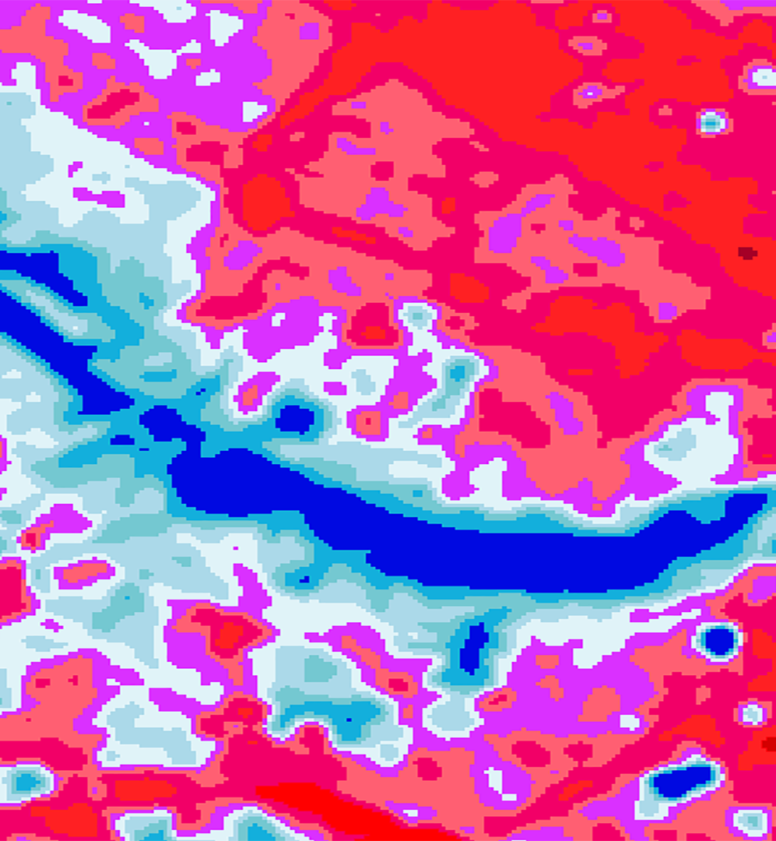
2018 Summer | Virginia – Langley
RICHMOND HEALTH & AIR QUALITY
Synthesizing Temperature, Reflectance, and Socioeconomic Data to Provide Spatial and Temporal Temperature Analyses in Richmond, Virginia
Meg Fredericks
Simeon Brown
Patricia Abduragimova
Josh Turner
Notes:
Introductions
And we’ll be talking to you today about our project concerning the urban heat island effect in Richmond, Virginia.

Slide 2
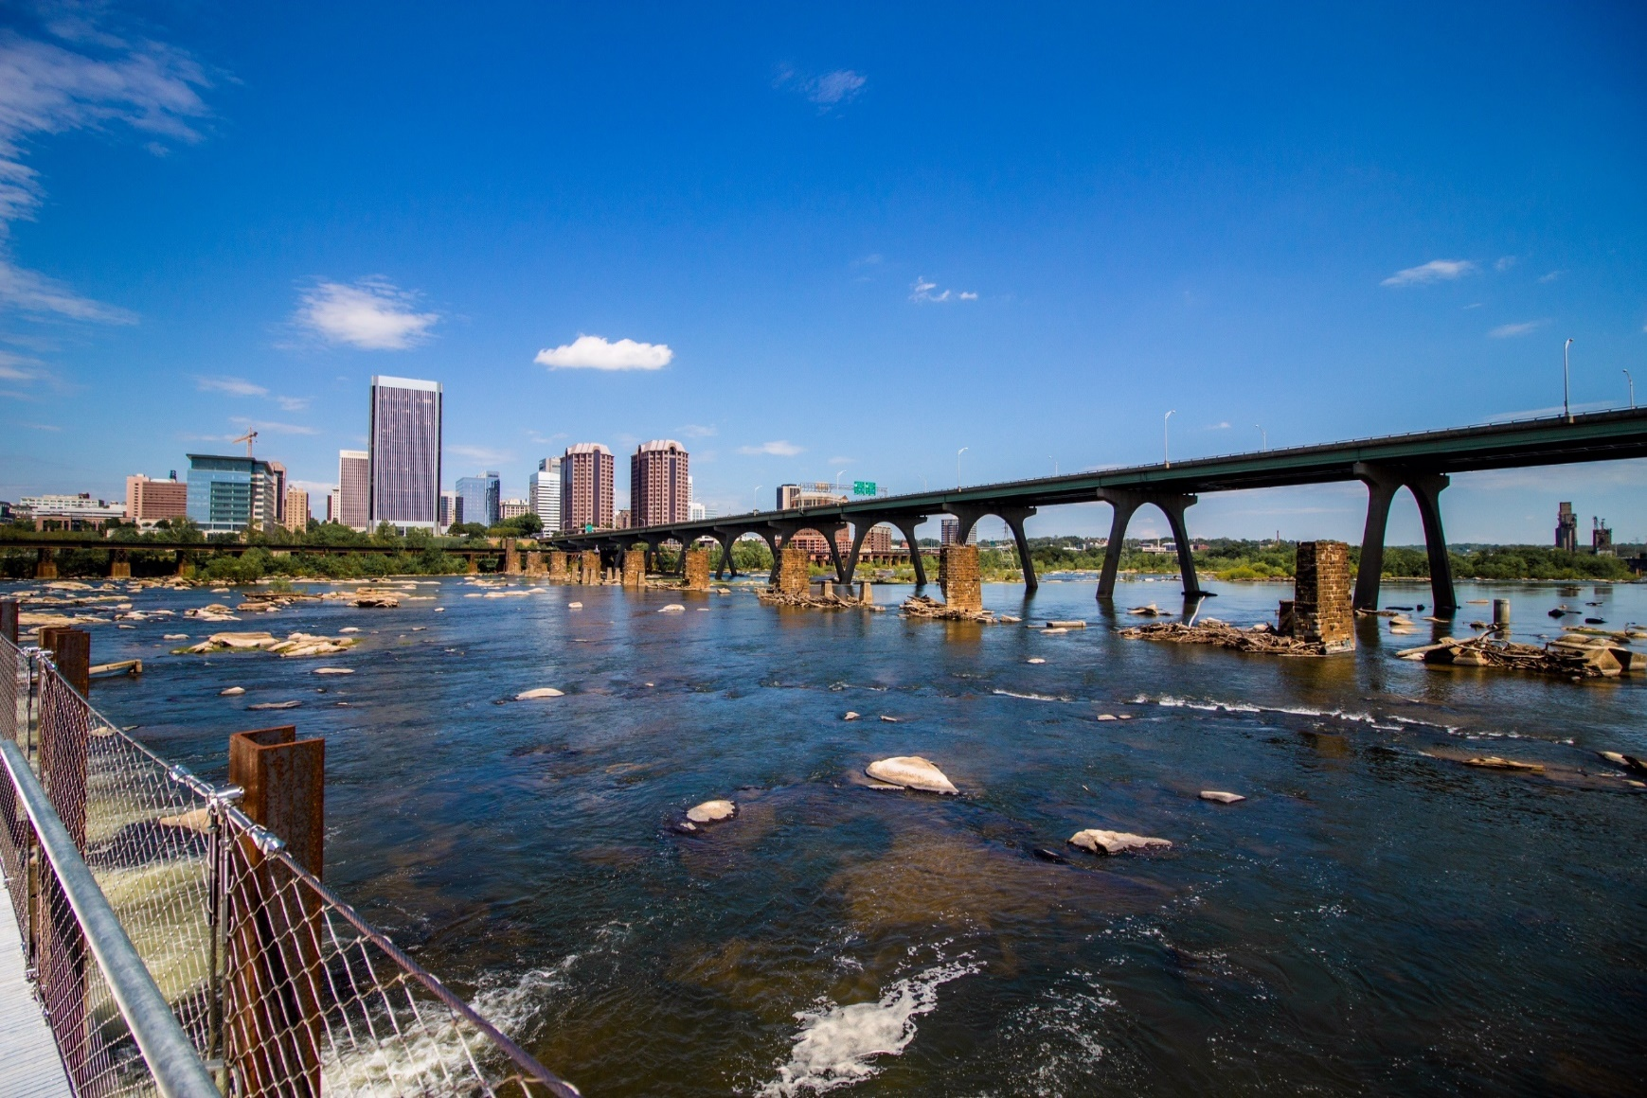
Background
Richmond, Virginia
Fourth most populous city in VA: 223,170 (2016)
Population increased by about 11% from 2010 - 2017
Inequality
25% of families below poverty line
14.1% experience extreme poverty
Discrepancies in healthcare access
CC0: Pixabay
Notes:
Meg
Just for a quick background, the city of Richmond is the state capitol of Virginia, and among the oldest cities in the United States. It is the fourth most populous city in the state, and growing quickly – which is driving rapid urbanization and development.
For the context of our project, it’s worthwhile to mention that Richmond, along with its history, is notable for its inequalities with regards to income level, as well as access to healthcare.
Image Source: https://pixabay.com/en/water-bridge-travel-architecture-3314160/

Slide 3
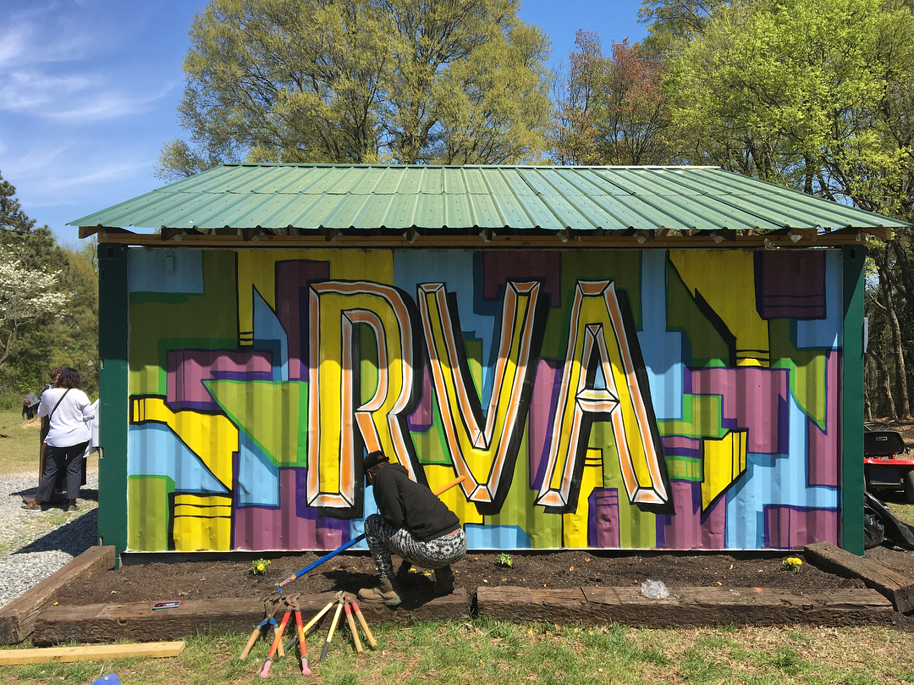
Project Partner: Groundwork RVA
Projects involving environmental, economic, and social well-being
Focused on youth involvement
Concerned with the Urban Heat Island Effect
Throwing Shade in RVA
Collaboration with the Science Museum of Virginia
City-wide Heat Mapping
Next Steps: Working with Bike Walk RVA to cool down Richmond’s hottest bike lanes
Groundwork USA
Groundwork RVA
Notes:
Meg
Our project was partnered with Groundwork RVA, a local trust of the national organization Groundwork USA. They’re an environmental nonprofit focused on youth involvement, and they’re particularly concerned with the urban heat island effect.
Last year, they conducted a city-wide project in collaboration with the Science Museum of Virginia to assess variation in temperatures across the city. This project, called “Throwing Shade in RVA,” will continue to address the impacts of extreme heat in new ways in the next few years.
Our results will help Groundwork RVA prioritize regions of the city for green infrastructure installation, as well as give them new insights in conversations with the Richmond Planning and Development Office for large-scale, long-term interventions.
Image credit: https://groundworkusa.org/network/groundwork-richmond-va/

Slide 4
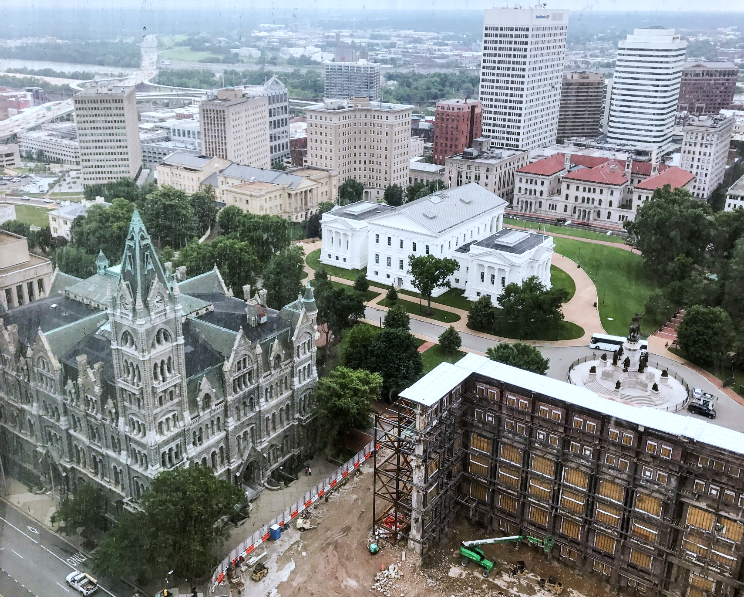
Community Concerns
The Urban Heat Island Effect:
Correlates with urbanization and development
Is directly related to prevalence of impervious surfaces
Is mitigated by the cooling effect of the urban canopy
Uneven spatial distribution of land cover type means that Richmond residents experience urban heat differently.
Notes:
Meg
The urban heat island effect refers to the entrapment of heat radiation in cities due to the disproportionate amount of urban structures and impervious surfaces like asphalt and concrete. Conversely, urban tree cover and green space retain less heat and have a cooling effect on urban spaces. Our project looked at the intersection of the hottest areas of the city, and areas where populations most vulnerable to extreme heat reside.
Image Source: Personal photo by DEVELOP participant

Slide 5
Study Area and Period
Study Period: 1994 to 2017, May -September.
Specific years are based on peak temperatures and data quality.
0
50
100
Miles
Water
Impervious Surface
Tree Cover
Turf/Grass/Shrub
0
2
4
Miles
1997
2001
2005
2008
2014
1994
2017
1999
2004
2006
2010
2015
Notes:
Patricia
Script:
This is a map of our study area – Richmond, VA. Our study period was from 1994 – 2017, based on availability of data. We picked years based on the quality of the imagery, and which years were the hottest within our timeframe (because we wanted to see how maximum summer temperatures have changed over the decades).

Slide 6
Objectives
Acquire Landsat 5 (TM) & Landsat 8 (OLI/TIRS) imagery from USGS Earth Explorer portal
Utilize a cloud mask to pre-process images containing significant amounts of cloud cover
Determine Land Surface Temperature and classify urban land cover
Observe change in intensity of summer heat in Richmond over the past two decades
Create a Heat Vulnerability Index to identify the populations most affected by increased urbanization and heat
Compile an assessment of the extent and impacts of the UHI on different groups of Richmond residents
Notes:
Patricia
Script:
Our objectives were to acquire the Satellite data from Earth Explorer, utilize a cloud mask to remove significant amounts of cloud cover, determine land surface temperatures and classify urban land cover.
This allowed us to observe the change in intensity of summer heat and create a heat vulnerability index to identify how different populations experience extreme heat events.
We then compiled the results to assess the impact of the UHI effect on different groups of Richmond residents.
Not included in final presentation but will be included for partners.

Slide 7
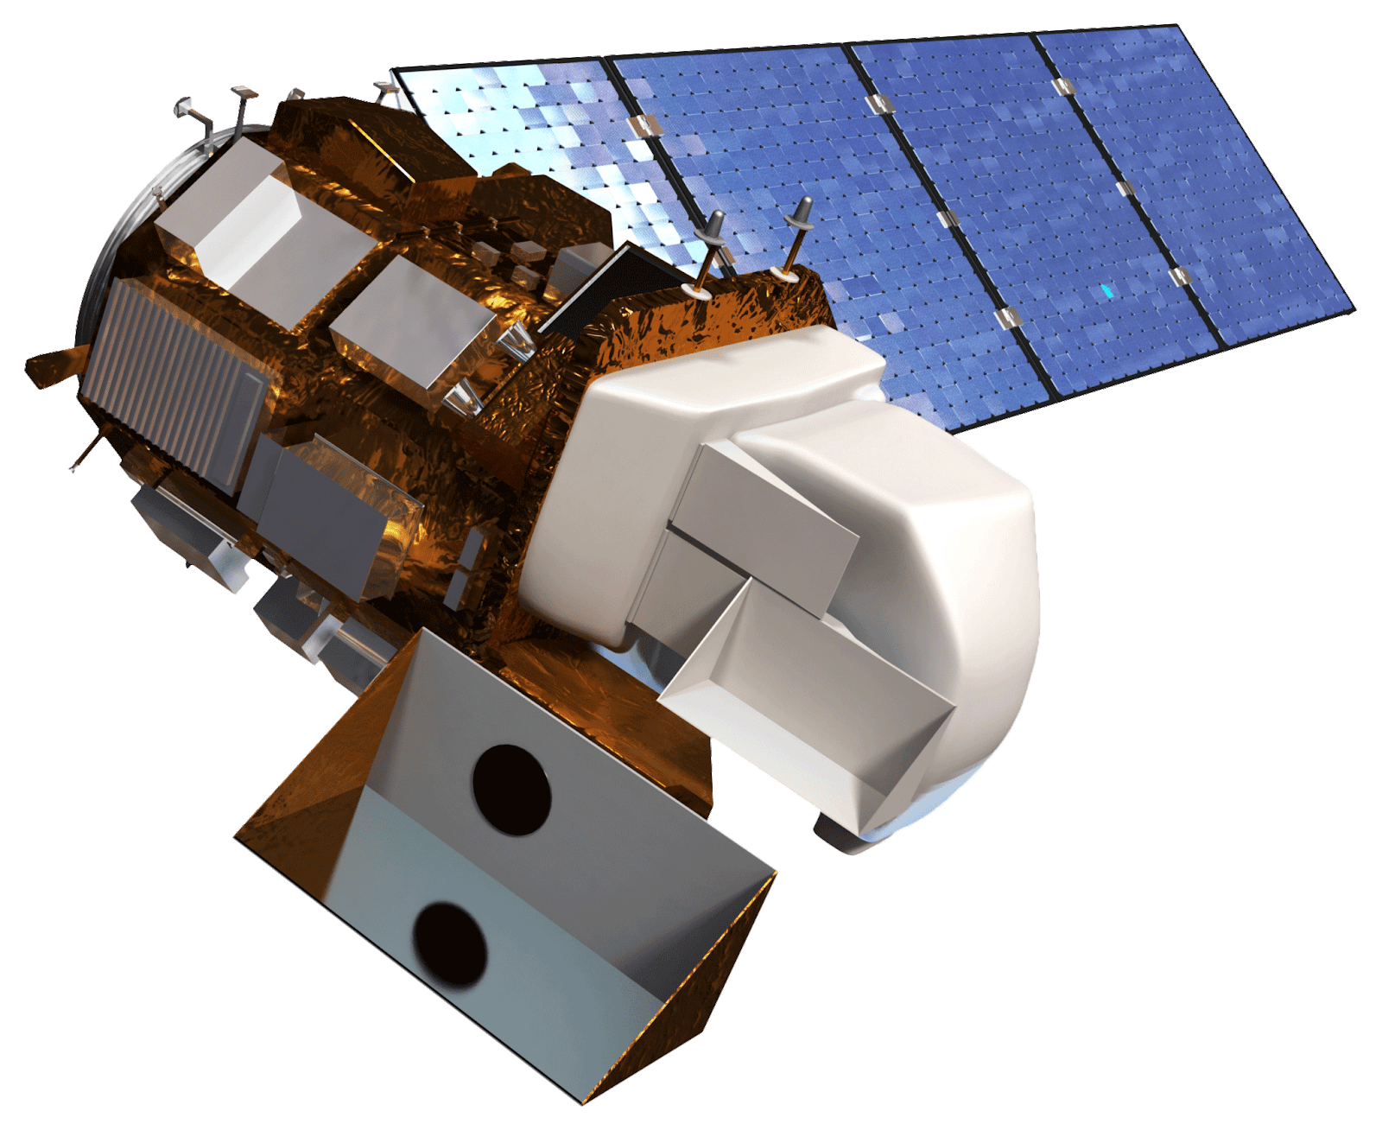
Data Acquisition: Earth Observations
Terra ASTER
Active 1999 - Present
Data Used: Terra Advanced Spaceborne Thermal Emission and Reflection Radiometer
Emissivity
Land
Surface
Temperature
Emissivity
Landsat 5 TM
Landsat 8 OLI/TIRS
Active 1984 – 2011 Data Used: Thematic Mapper (TM)
TOA,
Radiance,
Reflectance
Active 2013 – Present Data Used: Operational Land Imager (OLI) and Thermal Infrared Sensor (TIRS)
Notes:
Patricia
We downloaded the thermal, near infrared, and red bands of landsat 5 and landsat 8 imagery for our 10 selected years and clipped them to our study area. Ultimately, we selected 39 images from which to create 10 yearly composites, and calculated land surface temperature using those images. We used ASTER imagery to validate our findings by comparing our calculated images to observed land surface temperatures and emissivity.

Slide 8
Methodology
Notes:
Patricia: Now we’ll take a look at an outline of our methodology

Slide 9
Methodology
Landsat Imagery
(1994 – 2017)
Brightness Temperature
NDVI Calculation
Land Surface Temperature
Time Series
NAIP Imagery (2016)
False Color Composite
Land Cover Classification
Land Cover Change Maps
Aggregated Heat Vulnerability Assessment
Identify Social Variables
Data from CDC and US Census Bureau (2016)
Percentile Rank Data to Create Index
Vulnerability Maps by Theme
Notes:
Patricia
This is a brief outline of our methodology, organized into three workflows: one for each data type and output.
We used NAIP (national agriculture imagery program) imagery to classify land cover, Landsat imagery to calculate land surface temperatures, and designed a heat vulnerability index based on data from the CDC and the US Census Bureau.
Finally, our Land Surface Temperature data and Heat Vulnerability Index were synthesized to create a heat vulnerability assessment.

Slide 10
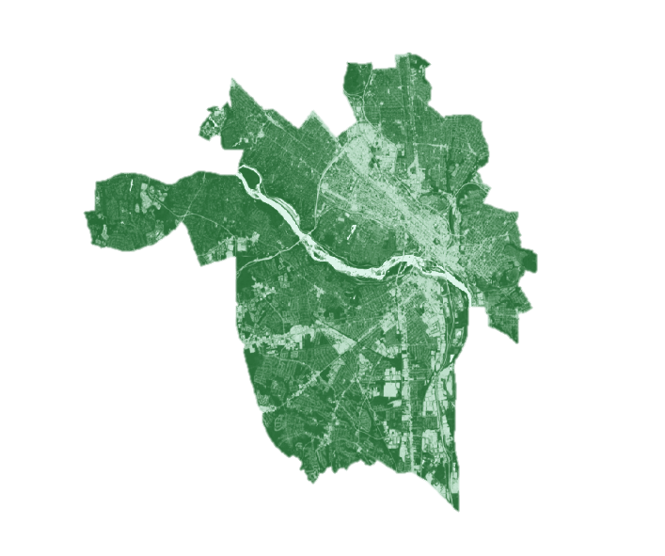
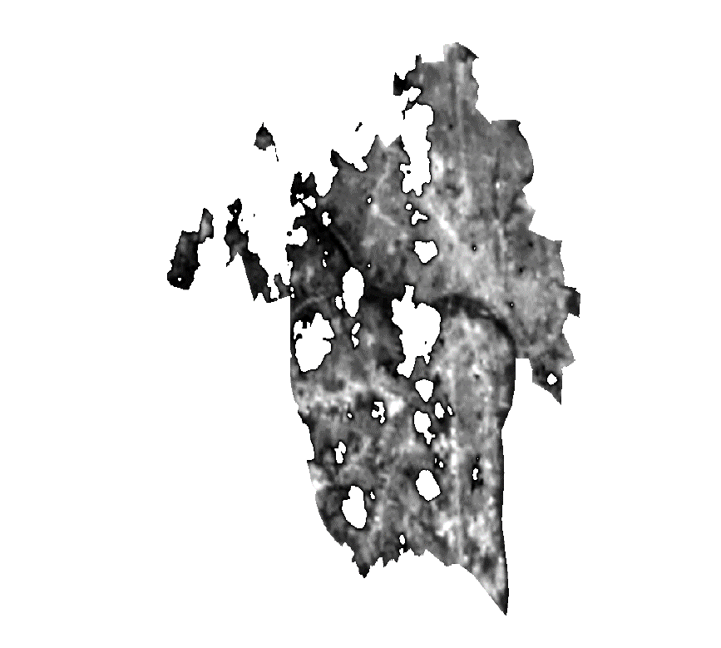
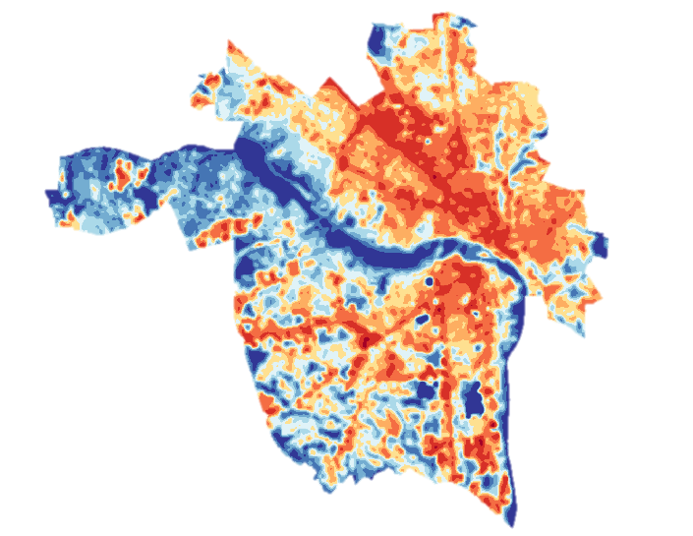
Calculating Land Surface Temperature
Thermal Band Clip
NDVI
Cloud Detection/Removal
Land Surface Temperature
Notes:
Meg
As Patricia mentioned, we used the thermal, near-infrared, and red bands of our Landsat imagery to calculate LST. First, thermal bands were pre-processed to remove low levels of cloud cover using a python script. From there, we performed a series of calculations, including top-of-atmosphere radiance, reflectance, brightness temperature, NDVI, percent vegetation, and estimated emissivity. This resulted in a time series of land surface temperature maps.

Slide 11
Calculating Land Surface Temperature
Land Surface Temperature
Landsat Thermal Band
Top-of-Atmosphere Radiance
Brightness Temperature
Landsat NIR Band
Top-of-Atmosphere Reflectance
NDVI
Percent Vegetation
Emissivity
Landsat Red Band
Notes:
Not included in final presentation but will be included for partners.

Slide 12
Land Cover Classification
2003 & 2016 NAIP Imagery
Virginia GIS Clearinghouse and National Agriculture Imagery Program data were used for classification in 2003 and 2016.
Mosaicked and Clipped tiles to study area
Segment Mean Shift to group similar pixels into objects
15-25 Training Sites for each of 6 classes
Open water, extracted impervious, barren, forest, scrub/shrub, turf/grass
Maximum Likelihood algorithm for supervised classification
Mosaic Tiles
Clip to Richmond Shapefile
Segment Mean Shift
Assign Training Sites
Maximum Likelihood Algorithm
Supervised Classification
Notes:
Josh
Script:
To classify land cover, we downloaded 2003 and 2016 1 meter resolution NAIP imagery.
We then simplified the data with segment mean shift based off of maximum likelihood, grouping similar spectral pixels into objects.
We used the output to assign training sites for all 6 classes and ran the supervised classifications.

Slide 13
Heat Vulnerability Index
Themes:
Age 5-14 years old, > 65 Years old
Minority Status Language Proficiency, Race
Socioeconomic Status Income, Education, Poverty, Transportation, Unemployment
Health Insurance, Arthritis, High Blood Pressure, Asthma, CHD, Diabetes, High Cholesterol, Mental Health, Obesity, Stroke
Stroke | Stroke Rank | Percentile Rank
4.2 | 30 | 0.45
6.7 | 9 | 0.12
2.6 | 42 | 0.63
3.5 | 36 | 0.54
4.5 | 24 | 0.35
Stroke Prevalence
Notes:
Patricia
Script:
To calculate the Heat Vulnerability Index, we selected 35 variables indicative of vulnerability to extreme heat, based on literature review and discussion with the partners.
These variables were grouped into four themes: Age, Minority Status, Socioeconomic Status, and Health.
The data were partitioned by census tracts, and each census tract was assigned a rank based on the severity of each variable, with rankings being reversed for variables where higher values indicate lower vulnerability (income, employment, education, etc.).

Slide 14
Heat Vulnerability Index
We used a percentile rank on a scale of 0-1 to calculate heat vulnerability scores per census tract.
Theme Sum | Ranked Sums | Theme Percentile Rank
6.42 | 33 | 0.49
2 | 57 | 0.86
7.2 | 27 | 0.4
6.83 | 29 | 0.43
5.49 | 36 | 0.54
Percentile Rank $\text{= }\frac{\text{Rank}\text{ −1}}{\text{66−1}}$
Theme 4: Health
Notes:
Patricia
Script:
Percentile values were then calculated for each census tract over each of the variables using this formula. Each theme also received a cumulative score by aggregating the percentiles of each variable in a similar process, with aggregated ranks being flipped so that higher percentile values would correspond with higher vulnerability. Overall vulnerability was calculated using the same method.

Slide 15
Results
Notes:
Meg: Now, we’ll go over some of our results.

Slide 16
Results: Land Surface Temperature
Land Surface Temperature (°F)
75 and under
75 - 77
77 – 79
79 – 81
81 – 82
82 – 84
84 - 86
86 – 90
90 – 97
97 – 104
0
2
4
Miles
Notes:
Meg
As I mentioned, the central task of our project was generating a time series of Land Surface Temperature Maps. This animation shows how the urban heat profile of Richmond has grown and intensified over time throughout the last 20 years.

Slide 17
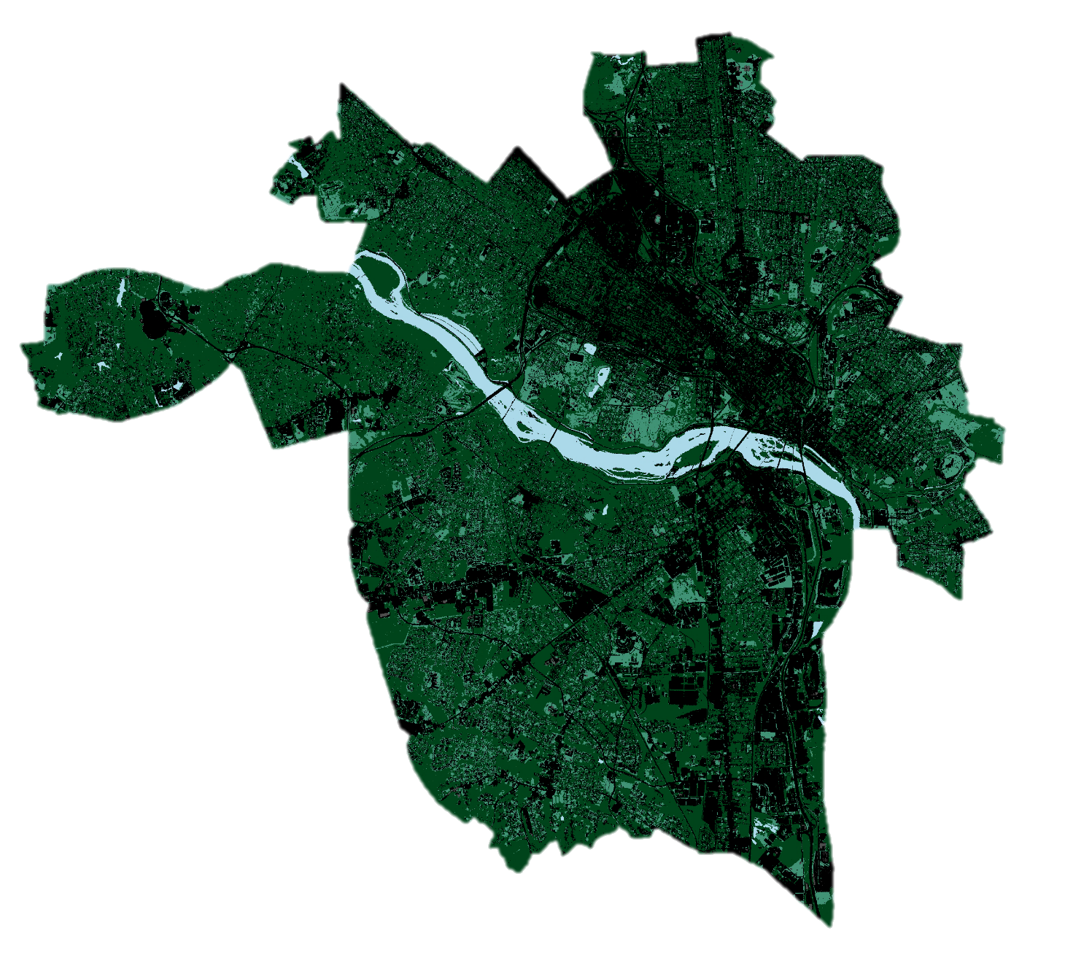
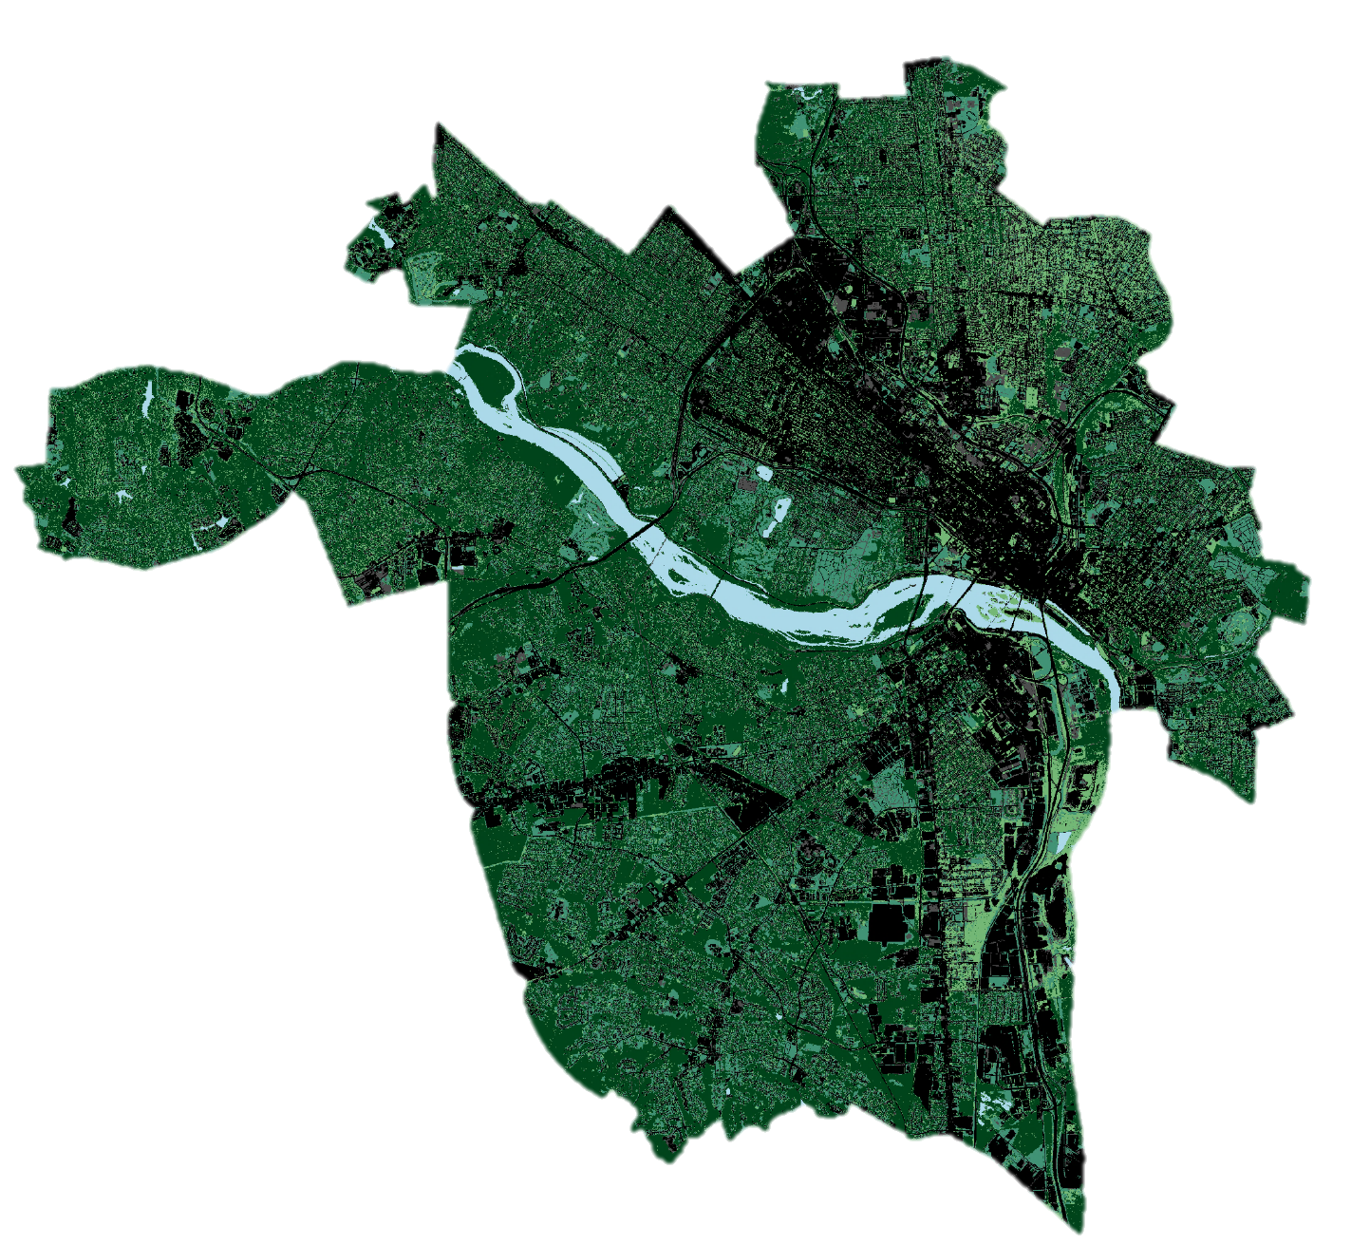
Results: Land Cover Overlay
2003
2016
Water
Impervious
Barren
Forest
Scrub/Shrub
Turf/Grass
0
2
4
Miles
Notes:
Josh: These are the results of our land cover classifications for the years 2003 and 2016. We were mostly concerned with the spatial extent of tree cover, and impervious surfaces, which are represented in the darkest green and black, respectively. These layers were used for further analysis in comparison with land surface temperatures.

Slide 18
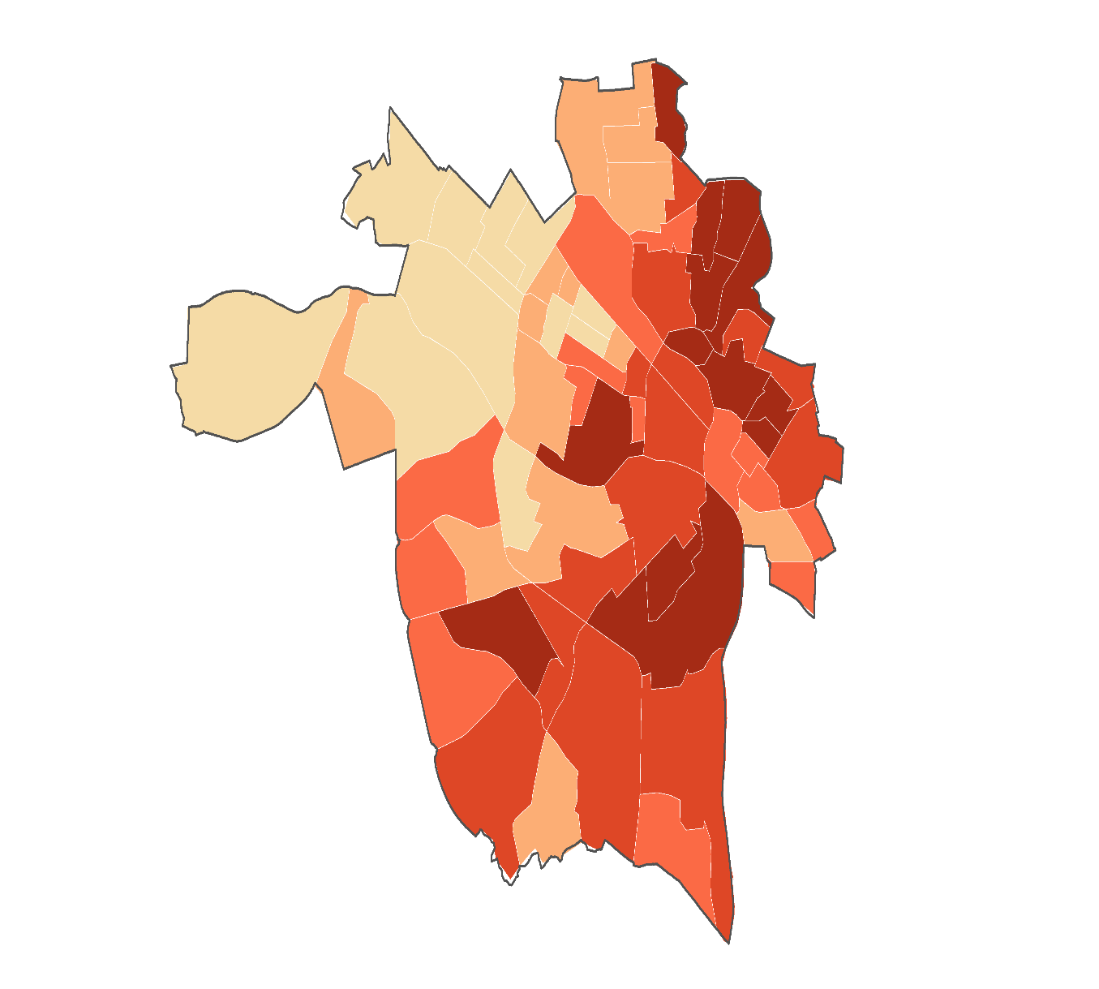
Results: Heat Vulnerability Assessment
Overall Heat Vulnerability
Health
Minority Status
Socioeconomic Status
Age
Low Vulnerability
0 – 0.18
0.18 – 0.38
0.38 – 0.58
0.58 – 0.78
0.78 - 1
High Vulnerability
Notes:
Patricia
Script:
These are the results of our Heat Vulnerability Index, represented on a scale from 0 – 1 for each theme.
These results show the differing levels of vulnerability in each census tract by theme, along with the overall most vulnerable census tracts.
The areas in darker red depict higher vulnerability.

Slide 19
Analysis
Notes:
And lastly, we’ll go over some of our maps created for analysis.

Slide 20
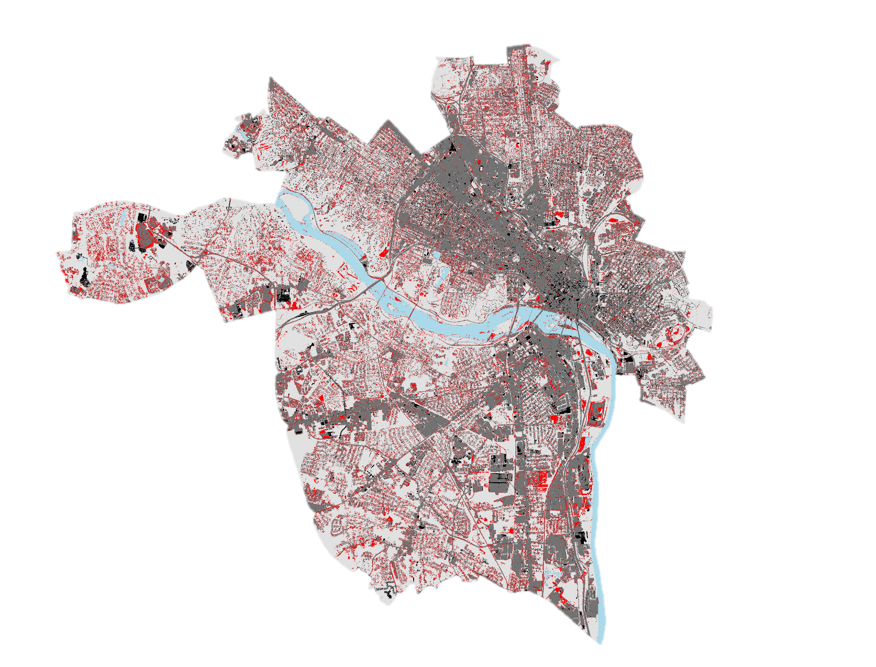
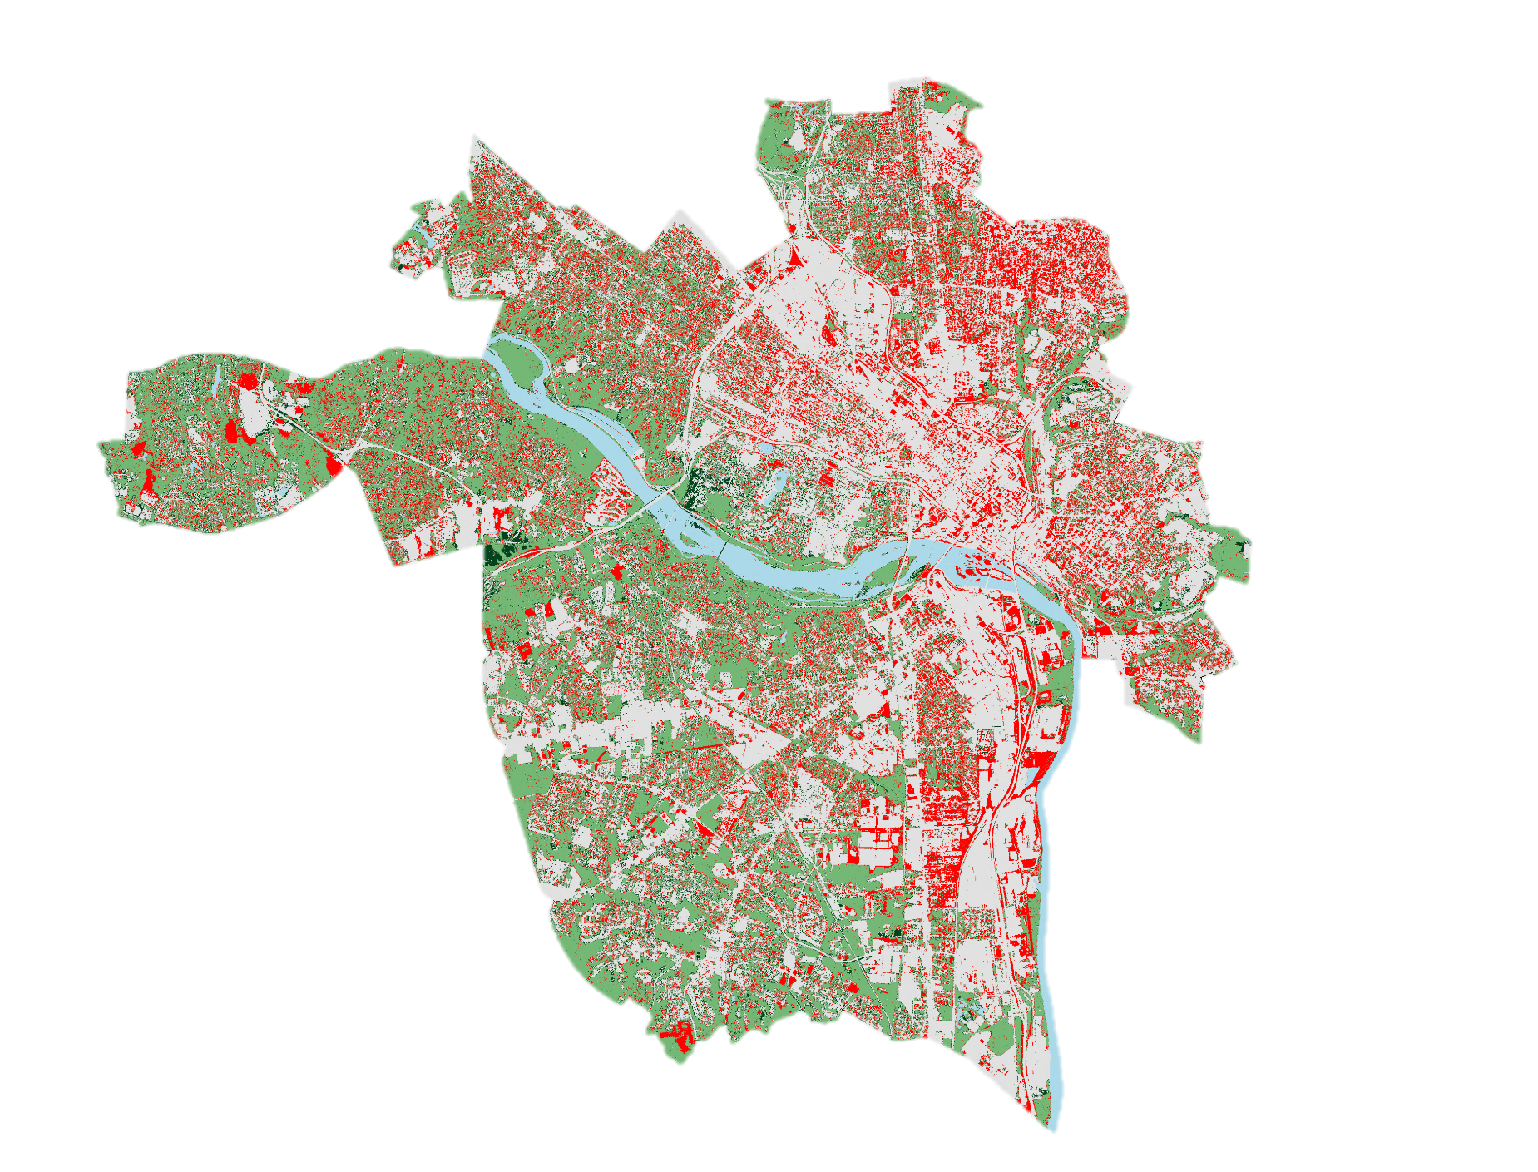
Analysis: Land Cover Change
Tree Cover Change
Impervious Surface Change
Tree Cover (2003)
Impervious Surfaces (2003)
Tree Loss
Impervious Loss
Tree Gain
Impervious Gain
James River
James River
0
2
4
Miles
Notes:
Josh
Using our land cover classifications, we were able to create change maps for both tree cover and impervious surfaces. These maps indicate that between 2003 and 2016, tree loss occurred in some of the hottest regions of the city, while impervious surface cover increased in these same areas.

Slide 21
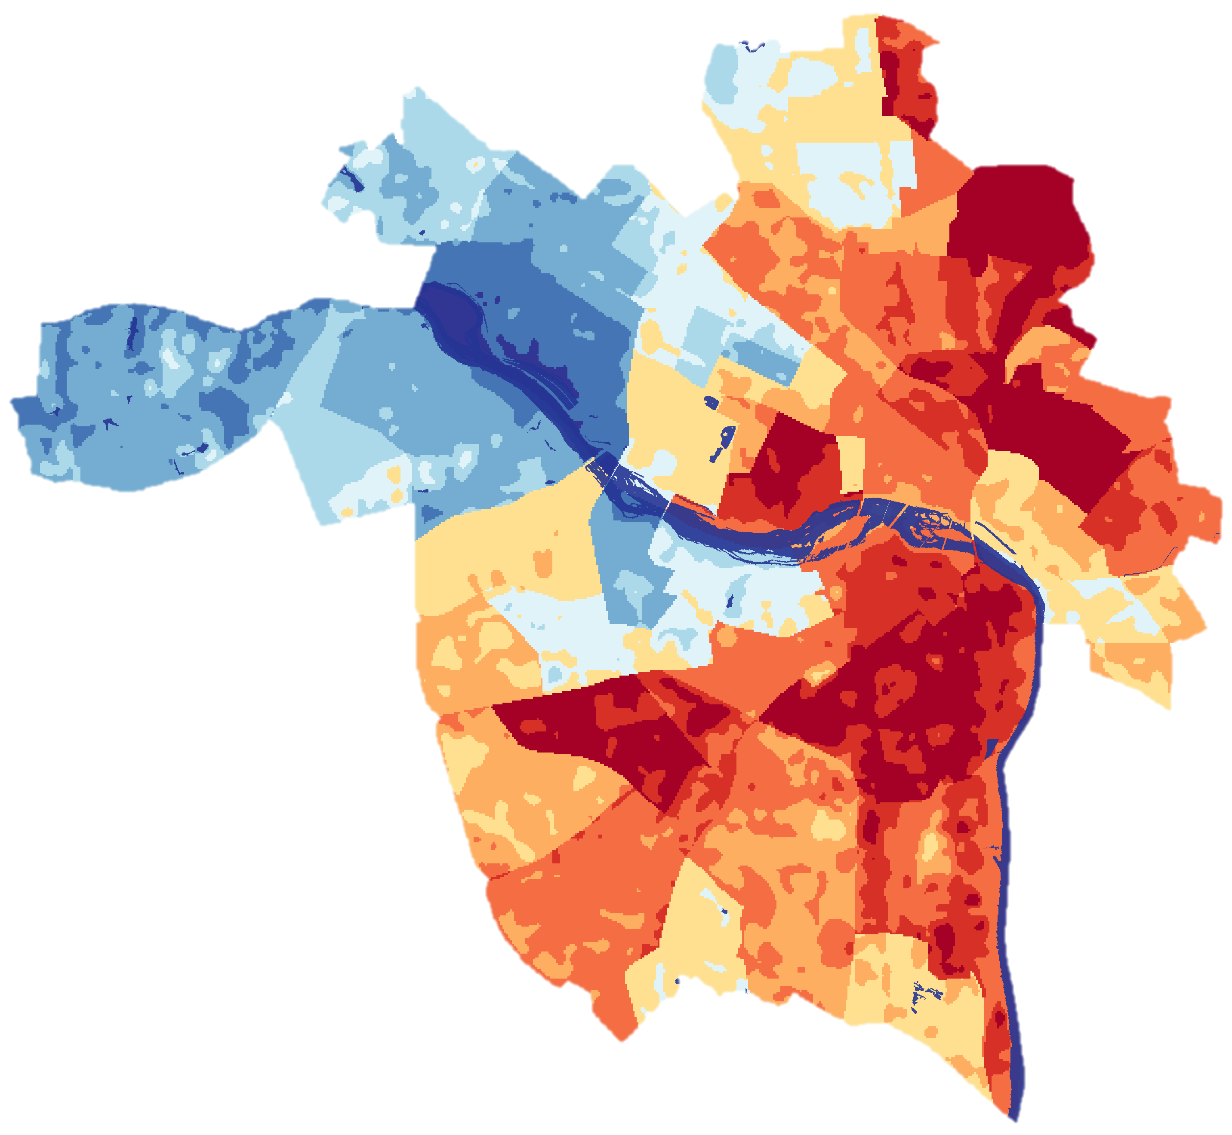
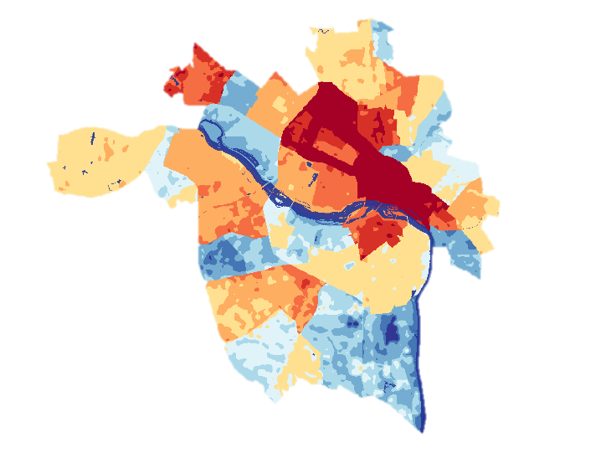
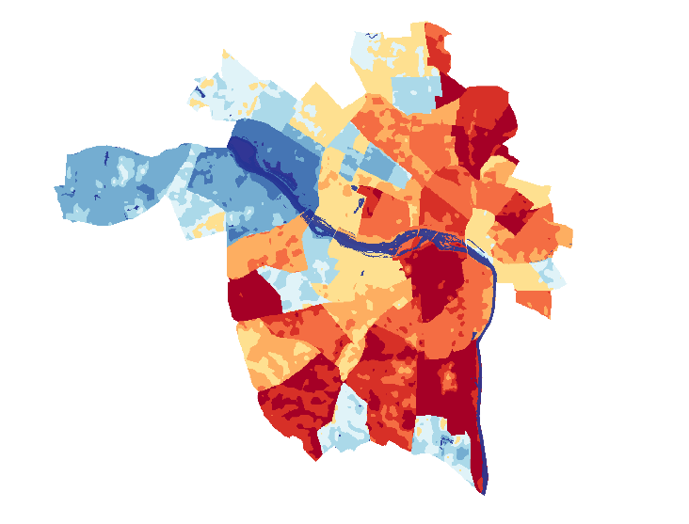
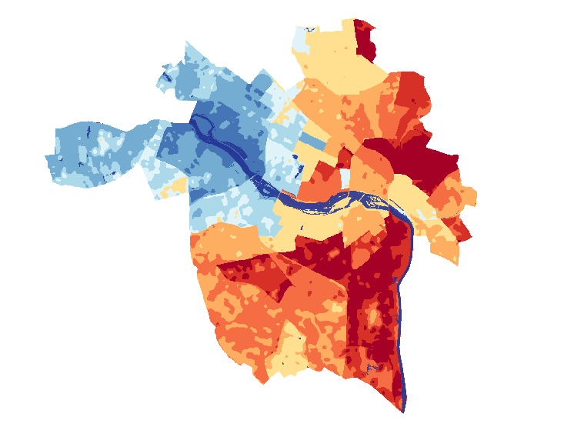
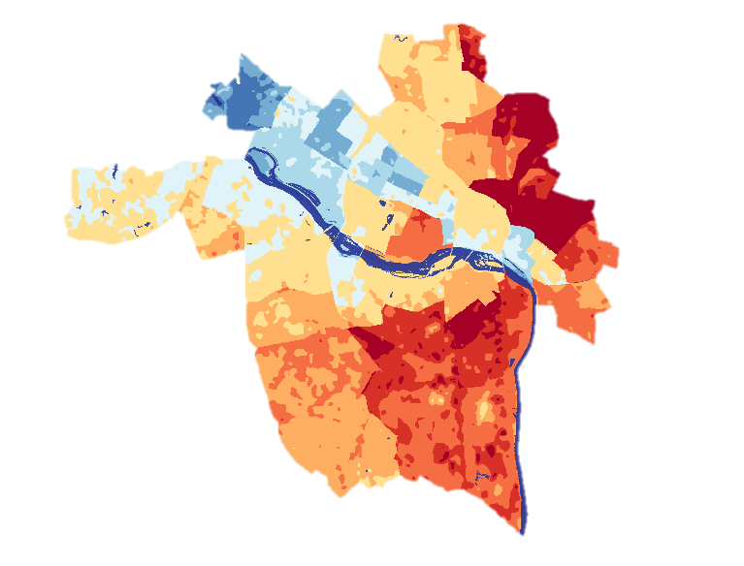
Analysis: Heat Vulnerability Assessment
Overall
Vulnerability
Age
Minority Status
0.6 and lower
0.6 – 0.7
0.7 – 0.8
0.8 – 0.9
0.9 – 1
1 – 1.2
1.2 – 1.35
1.35 – 1.5
1.5 – 1.6
1.5 – 2
James River
Socioeconomic Status
Health
0
2
4
0
2
4
Miles
Miles
Notes:
Meg
When we combined our heat vulnerability index with our land surface temperature data, we were able to create a heat vulnerability assessment for 2017 on an index from 0 – 2. Our overall heat vulnerability assessment provides insight into where populations most impacted by extreme heat reside, as well as how that coincides with the measured land surface temperatures across the city. The areas shown in the darkest red are the areas of the city where the most vulnerable populations are experiencing the highest temperatures.

Slide 22
Conclusions
Along with increasing urbanization, Richmond has:
Experienced changes in the extent of certain types of land cover
An increase in summer temperatures, especially in areas with high impervious surface cover
Correlation between vulnerable census tracts and extreme urban heat
CC0: Photo by STEPHEN POORE on UnSplash
Notes:
Meg
Based on our results and analysis, we were able to draw several conclusions about patterns of heat and vulnerability in Richmond in the last 20 years. Firstly, increased urbanization has correlated with a higher prevalence of impervious surfaces and lesser prevalence of tree cover in the city. Concurrently, summer heat intensity has also increased measurably in this region over time; particularly in areas with high impervious surface cover. Lastly, areas exposed to the highest summer temperatures often coincide with census tracts that are home to some of Richmond’s most vulnerable populations. These areas will be key priorities for cooling interventions in the future.

Slide 23
Acknowledgements
Giles Harnsberger, Executive Director – Groundwork RVA
Jeremy S. Hoffman, Ph.D., Climate & Earth Science Specialist – Science Museum of Virginia
Kenton Ross, Ph.D., Lead Science Advisor – NASA DEVELOP (LARC)
Jonathan O’Brien, Center Lead – NASA DEVELOP (LARC)
Summer 2018 Washoe County Urban Development Team – NASA DEVELOP (AZ)
Team Members
Meg Fredericks
Project Lead
Simeon Brown
Patricia Abduragimova
Josh Turner
Notes:
Patricia: We’d like to acknowledge all of our team members, including Simeon, who is not here today, as well as our partners and collaborators from Groundwork RVA and the Science Museum of Virginia, and our advisors at DEVELOP.

