Slide 1
SOUTHEASTERN US DISASTERS
Early Detection of Bark Beetle Outbreaks in the Southeastern United States Using Earth Observations
Jacob Armistead
Dionne Blanks
Madison Murphy
Danielle Quick
Haley Ritger
Larissa Robinov
Notes:
Map image created by the DEVELOP Southeastern US Disasters Team using Arc Pro 2.0
Service Layer Credits: Esri, DigitalGlobe, GeoEye, Earthstar Geographics, CNES/Airbus DS, USDA, USGS, AeroGRID, IGN, and the GIS User Community

Slide 2
Community Concerns
Image Credit: Kenny Frick, USDA Forest Service
Image Credit: USDA Forest Service
Bark beetle-induced mortality:
Causes estimated annual losses of $43 million
Affects 45 times more forest area than wildfires
Increases fuel for wildfires
Effective intervention requires early detection that can be aided by remote sensing
Image Credit: Kenny Frick, USDA Forest Service
Notes:
Bark beetles in the Southeastern US, especially Ips and Southern Pine Beetle species, can cause extensive damage to important forest resources. Forests provide ecosystem services such as water filtration, wildlife habitat, timber and recreational opportunities. But bark beetle outbreaks can kill large patches of forests and have detrimental effects. In the U.S., insects and pathogens impact 45 times more forest area than wildfire. Bark beetle-induced forest mortality in the Southeast is estimated to cost $43 million annually while also increasing fuel, and therefore risk, for wildfires. For effective intervention to protect our important Southeastern forest resources, managers need to be able to detect bark beetle outbreaks in the early stages.
Image Sources: Kenny Frick, USDA Forest Service; https://www.fs.fed.us/foresthealth/applied-sciences/mapping-reporting/gis-spatial-analysis/spb-hazard-rating-maps.shtml
References:
Logan, J. A., Regniere, J., & Powell, J. A. (2003). Assessing the impacts of global warming on forest pest dynamics. Frontiers in Ecology and the Environment, 1(3), 130-137.
Pye, J. M., Holmes, T. P., Prestemon, J. P., & Wear, D. N. (2011). Economic impacts of the southern pine beetle. Southern pine beetle II, 213-222. Retrieved from https://www.srs.fs.usda.gov/pubs/gtr/gtr_srs140/gtr_srs140.pdf

Slide 3
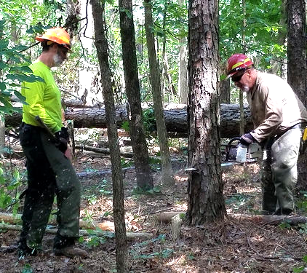
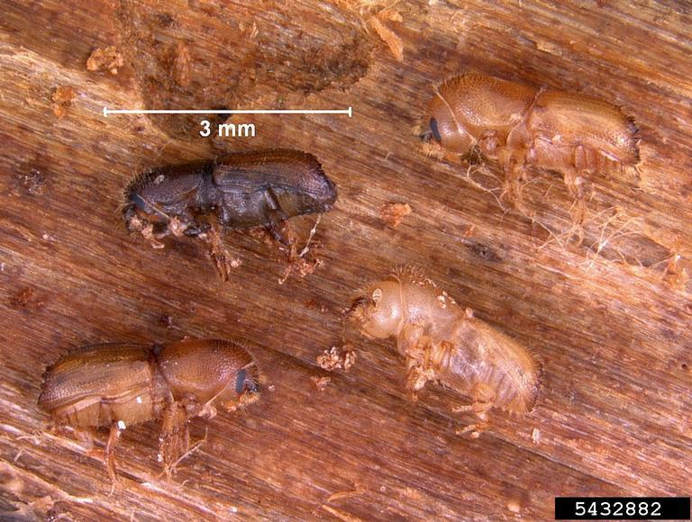
Bark Beetle Ecology & Management
Image Credit: Erich G. Vallery, USDA Forest Service - SRS-4552, Bugwood.org
Image Credit: USDA Forest Service
Image Credit: Monet
Native bark beetles attack weakened or stressed conifers
Use aggregation pheromones to increase their population rapidly and overwhelm defenses of healthy trees
Drought, predicted to increase in frequency and severity in the southeast, can stress coniferous forests
≥ 30 bark beetle-infested trees require mechanical intervention
Notes:
Bark beetles, smaller than grains of rice, are native insects that typically attack stressed or weakened trees. The beetles bore into the bark to reproduce and the larvae feed on phloem, disrupting the flow of water and nutrients and killing the tree. As trees start to die, their needles fade and eventually turn red. This color change is detectable through remotely sensed multispectral imagery. When conditions are favorable for bark beetles, such as after prolonged drought and with many stressed trees on the landscape, their populations can grow quickly. As populations build, they use aggregation pheromones to mass attack healthy trees and create a “spot” of impacted trees in the forest. Once about 30 trees have been attacked by either Southern Pine Beetle or Ips, the outbreak is considered a threat and managers need to act by cutting infested trees plus a buffer zone to stop the spread.
Image Sources: https://www.fs.fed.us/foresthealth/applied-sciences/mapping-reporting/gis-spatial-analysis/spb-hazard-rating-maps.shtml; https://www.usda.gov/media/blog/2017/12/21/forest-crews-mississippi-implement-aggressive-restoration-strategy-beetle; https://www.insectimages.org/browse/detail.cfm?imgnum=5432882#collapseseven

Slide 4
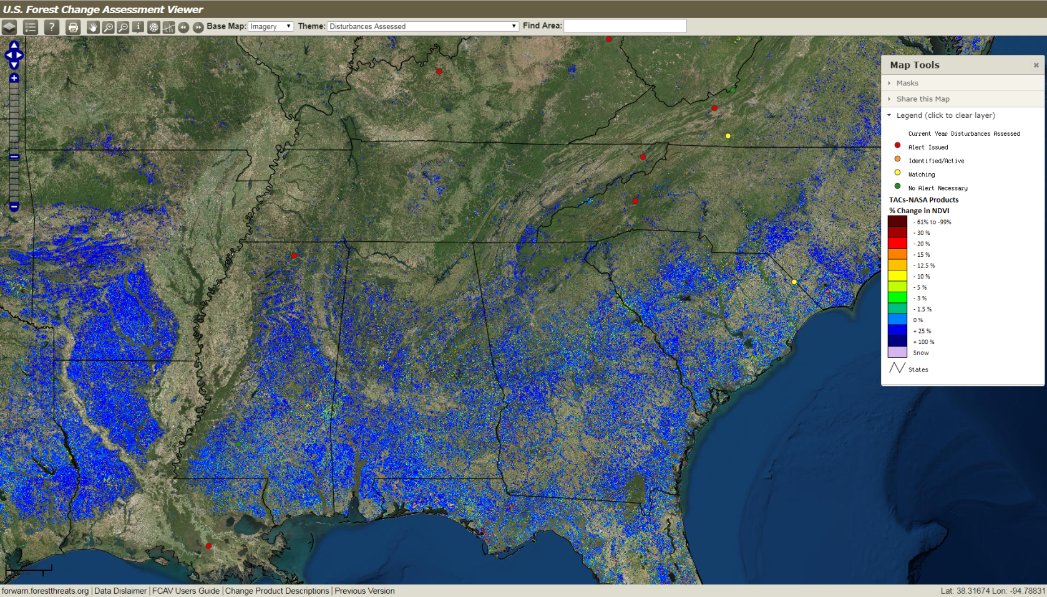
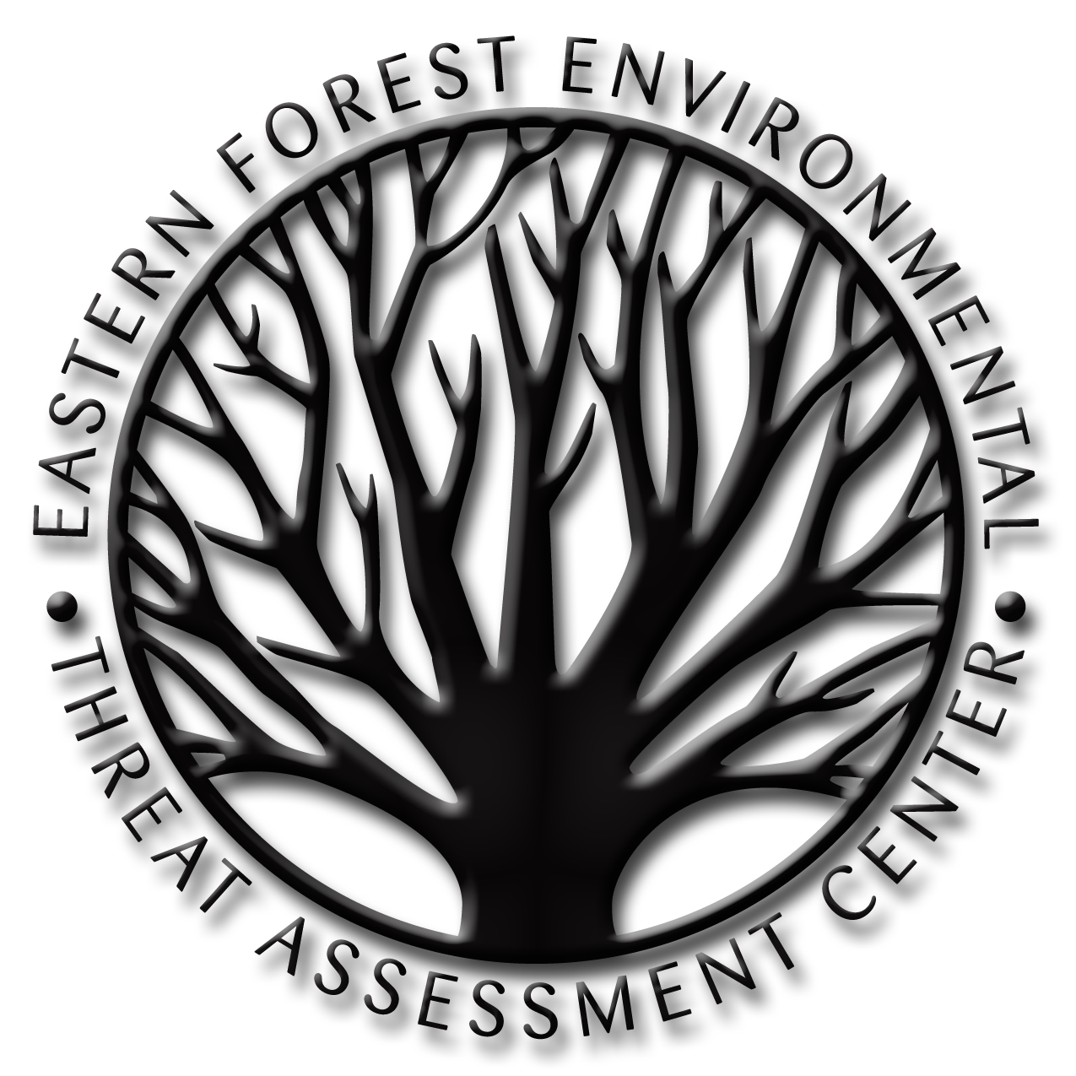
Partner
EFETAC’s mission is
“to generate knowledge and tools needed to anticipate and respond to environmental threats”
ForWarn is a counterminous US monitoring system based on MODIS NDVI data
USFS uses MODIS NDVI data to monitor and assess biotic (e.g., bark beetle) and abiotic (e.g., drought) forest disturbances
The 250m MODIS pixels are too coarse to detect bark beetle outbreaks in time for early treatment of affected forests
Image Credit: USDA Forest Service
Image Credit: USDA Forest Service
Notes:
NASA DEVELOP partnered with scientists from the Forest Service’s Eastern Forest Environmental Threat Assessment Center to develop a tool that would allow for earlier identification of bark beetle spots. Currently, the Center utilizes a forest disturbance detection tool called ForWarn. This system uses MODIS observations to calculate vegetation index changes over time that indicate forest disturbances such as wildfire, weather and insects. Unfortunately, the pixel size of MODIS imagery is 250m, which contains a lot of trees. This means that once enough tree crowns are red for detection at the scale of ForWarn maps, widespread mortality has already occurred.
Image Source: https://forwarn.forestthreats.org/fcav2/

Slide 5
Objectives
Assess satellite data processing algorithms to detect early Ips and Southern pine beetle outbreaks in the southeastern United States using remotely sensed data from Landsat 8 OLI and Sentinel-2 MSI
Compare Landsat 8 OLI and Sentinel-2 MSI data for improving detection of forest damage from bark beetles
Validate our results and methodology with available aerial, satellite, and in situ survey data
Notes:
Our objectives as the NASA DEVELOP Southeastern US Disasters team were: to assess satellite data processing algorithms to detect early Ips and Southern Pine Beetle outbreaks in the Southeastern United States using remotely sensed data from Landsat 8 OLI and Sentinel-2 MSI; to compare Landsat 8 OLI and Sentinel-2 MSI data for improving detection of forest damage from bark beetles; and to validate our results and methodology with available aerial, satellite, and in situ surveys data.

Slide 6
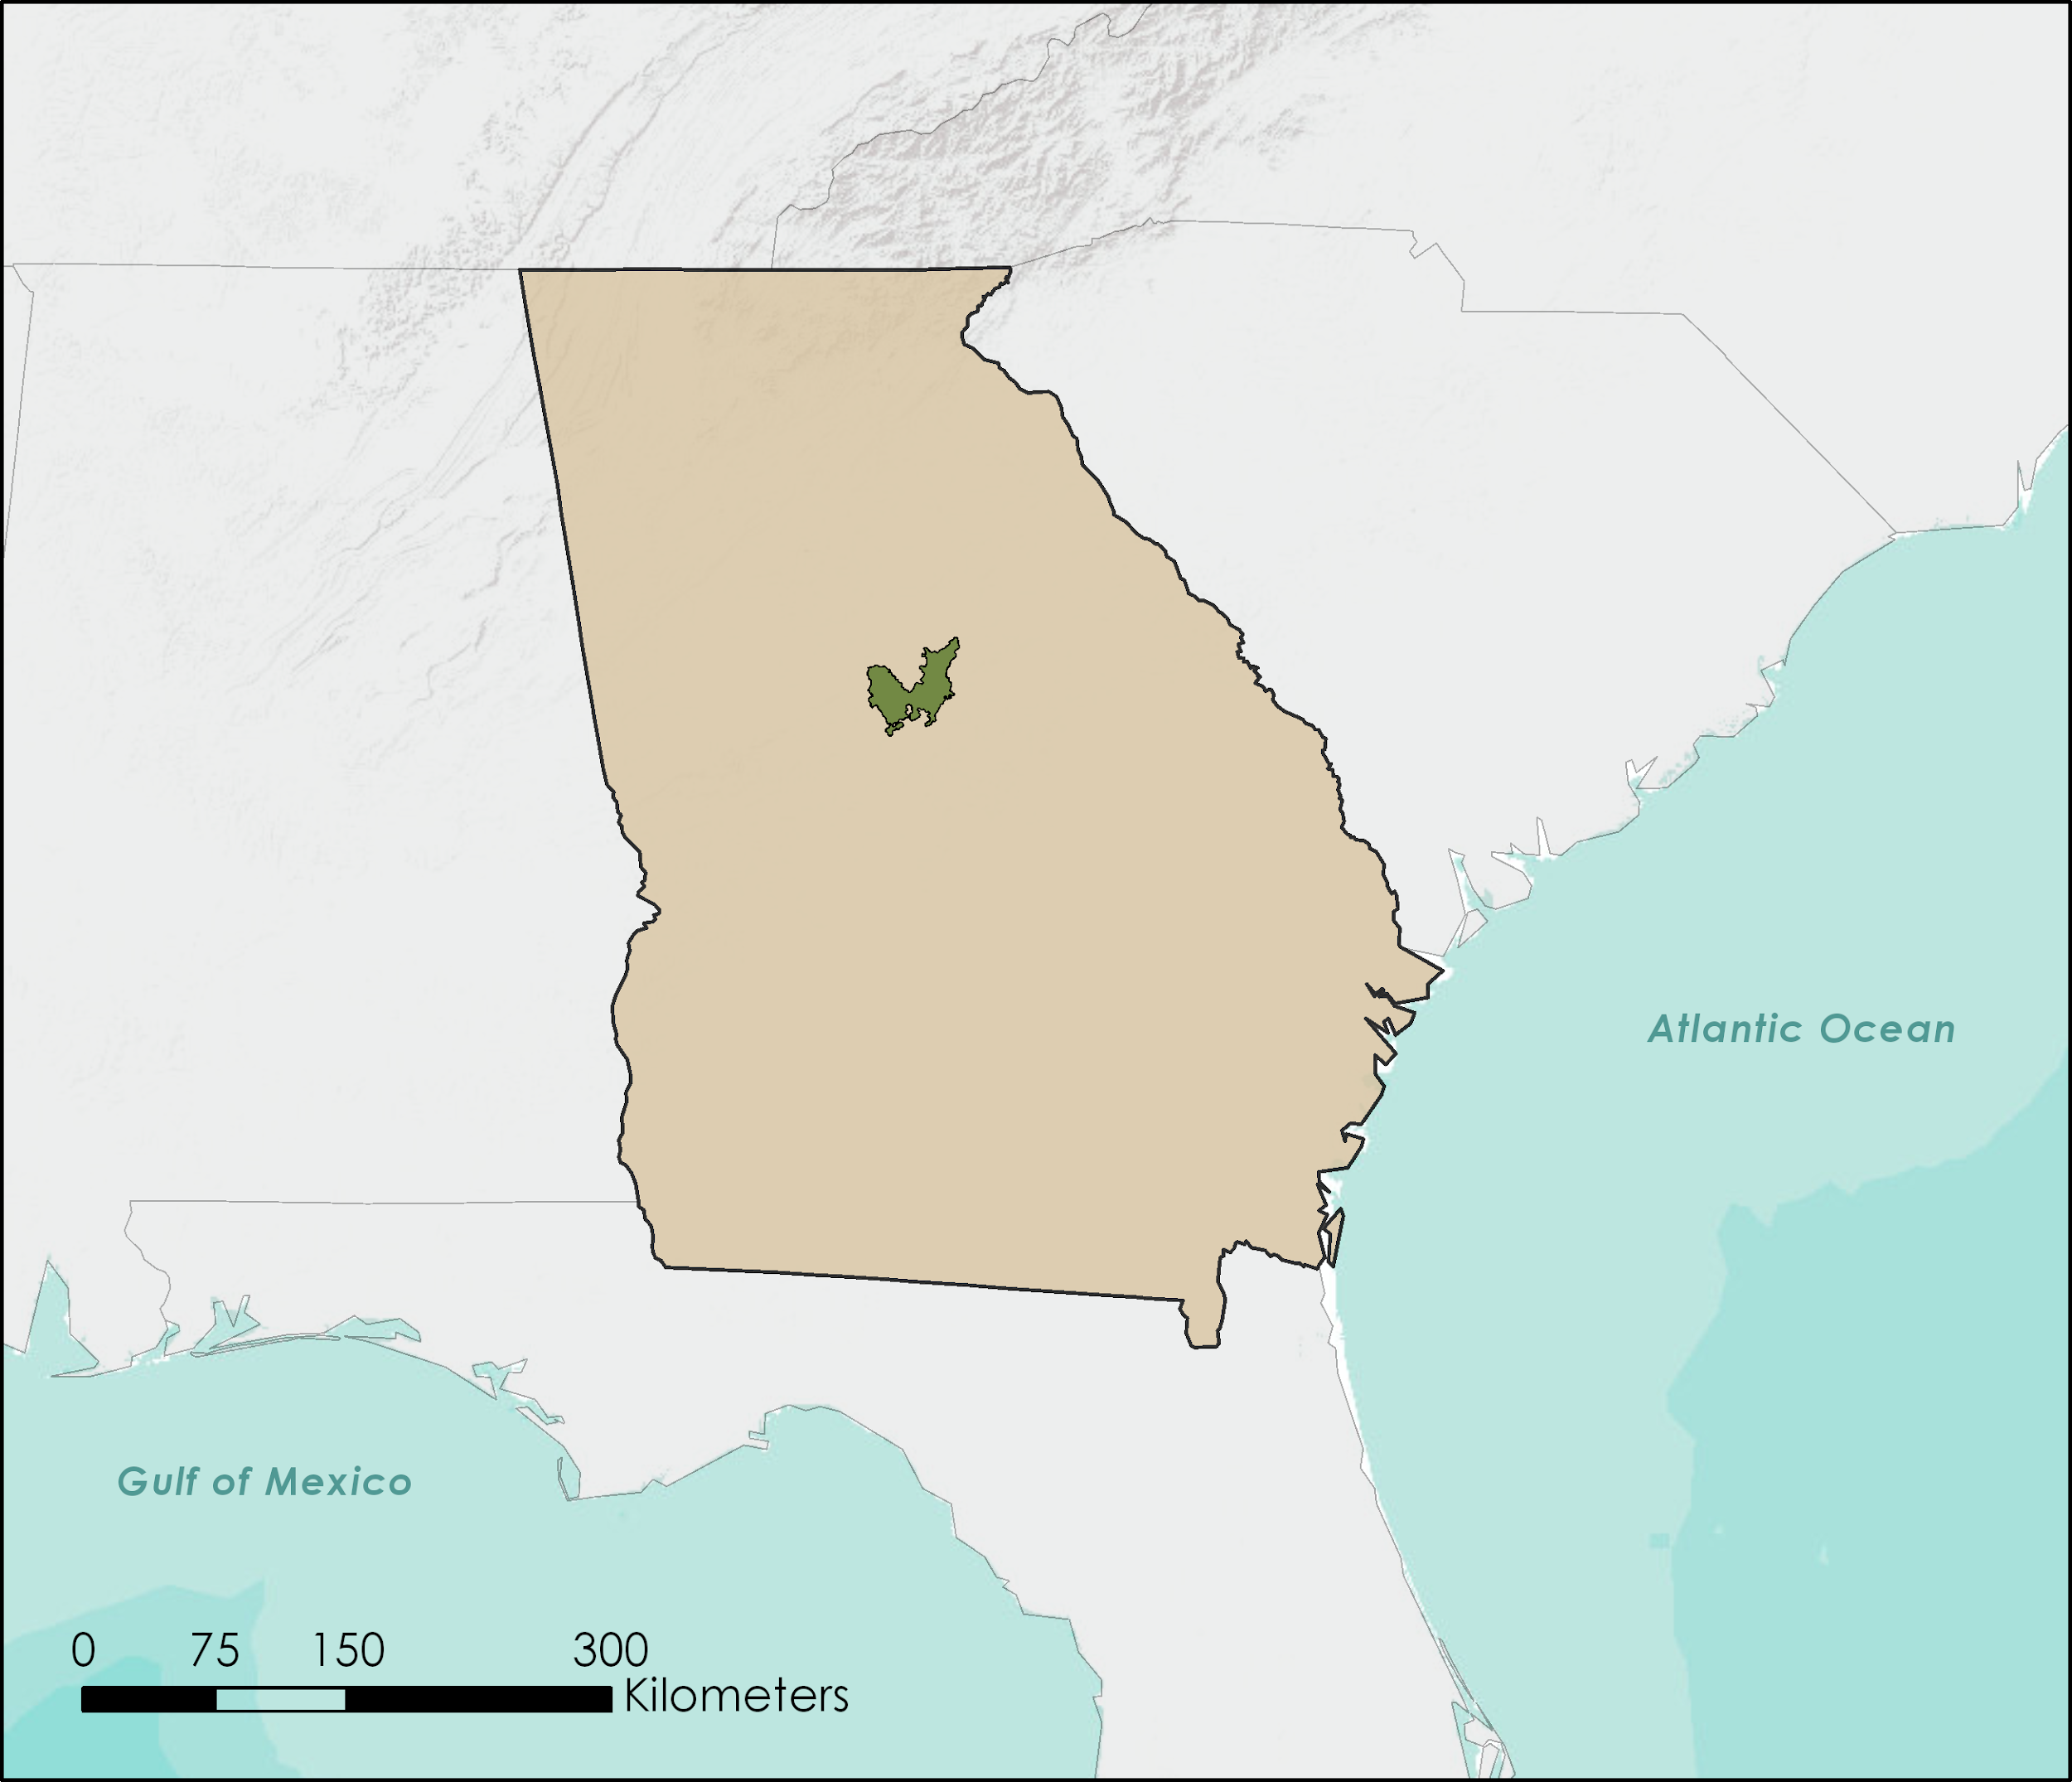
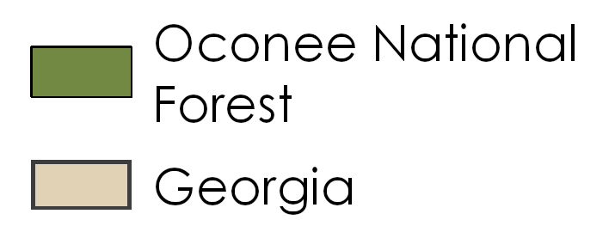
Study Area & Study Period
Oconee National Forest, GA
Forest type: Mixed oak-hickory-pine with surrounding pine plantations
Loblolly pine (Pinus taeda)
Shortleaf pine (Pinus echinata)
Analyzed high incidence of bark beetle outbreaks from 2016 to 2017 by comparing:
Annual change
April/May 2016 to May 2017
Seasonal change (winter)
Dec 2016 to March 2017
Seasonal change (late spring/early summer)
April/May 2016 to June 2016
Notes:
Our research focused on the Oconee National Forest in Georgia looking at high incidence bark beetle outbreaks occurring between 2016 and 2017. The Oconee National Forest sits in the Piedmont region of the southeast and is a mixed pine-hardwood forest surrounded mainly by privately owned pine plantations. Modeled after ForWarn’s current monitoring methods, three sets of dates were chosen for comparison. We created an annual comparison looking at the change that occurred over the span of a year as well as two seasonal comparisons. This allowed us to investigate at what timescales changes in the vegetation indices indicated bark beetle outbreaks.
Map image created by the DEVELOP Southeastern US Disasters Team using Arc Pro 2.0
Service Layer Credits: Esri, DigitalGlobe, GeoEye, Earthstar Geographics, CNES/Airbus DS, USDA, USGS, AeroGRID, IGN, and the GIS User Community

Slide 7
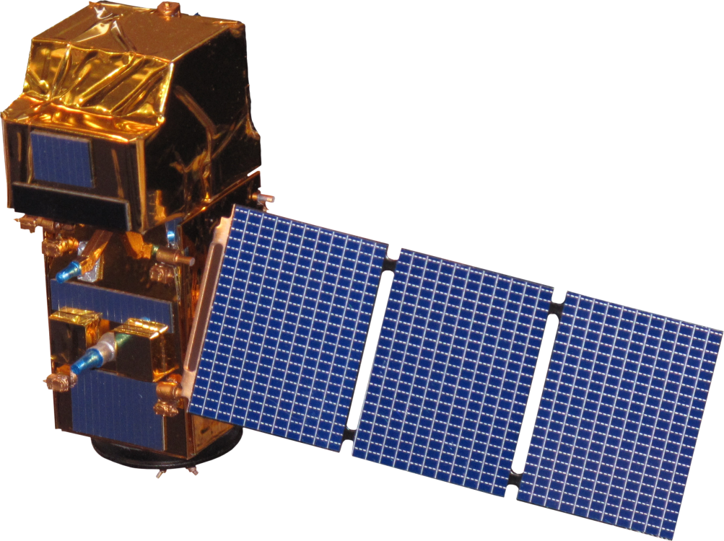
Earth Observations
Landsat 8 OLI
Sentinel-2 MSI
Aqua/Terra MODIS
Temporal Res. - 16 days
Spatial Res. - 30 meters
NASA/USGS Mission
Temporal Res. - 5 days
Spatial Res. - 10 meters
European Space Agency Mission
Temporal Res. - 8 days
Spatial Res. - 250 meters
NASA Mission
Image Credit: NASA
Image Credit: European Space Agency
Image Credit: NASA
Notes:
We used imagery from Landsat 8 Operational Land Imager and Sentinel-2 MultiSpectral Instrument, selecting scenes from our study period that had 10% cloud coverage or less. Images were downloaded from USGS Earth Explorer and ESA Copernicus Open Access Hub with Level 2 processing - meaning the data were already processed for top of atmospheric reflectance. We also obtained MODIS 8-day NDVI products from our partner to create change maps comparable to what is available to managers accessing ForWarn.
Image sources: http://www.devpedia.developexchange.com/dp/images/c/c2/03_Landsat8.png, http://www.devpedia.developexchange.com/dp/images/d/dd/24_Sentinel2.png, http://www.devpedia.developexchange.com/dp/images/b/bf/06_Aqua.png, http://www.devpedia.developexchange.com/dp/images/9/91/05_Terra.png

Slide 8
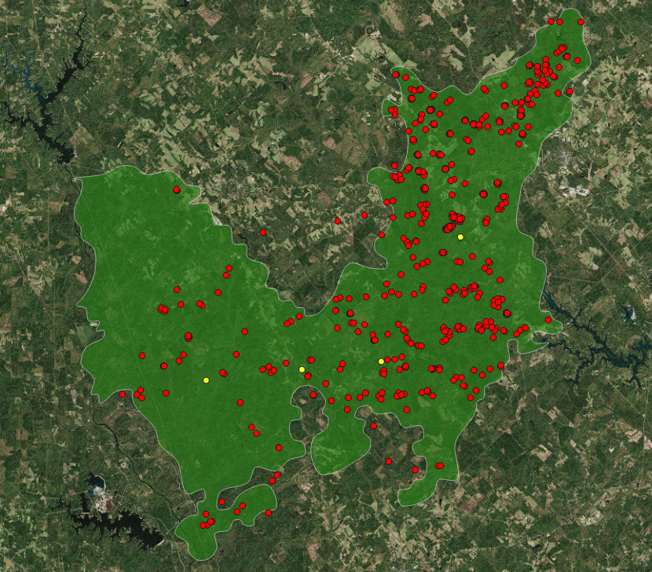
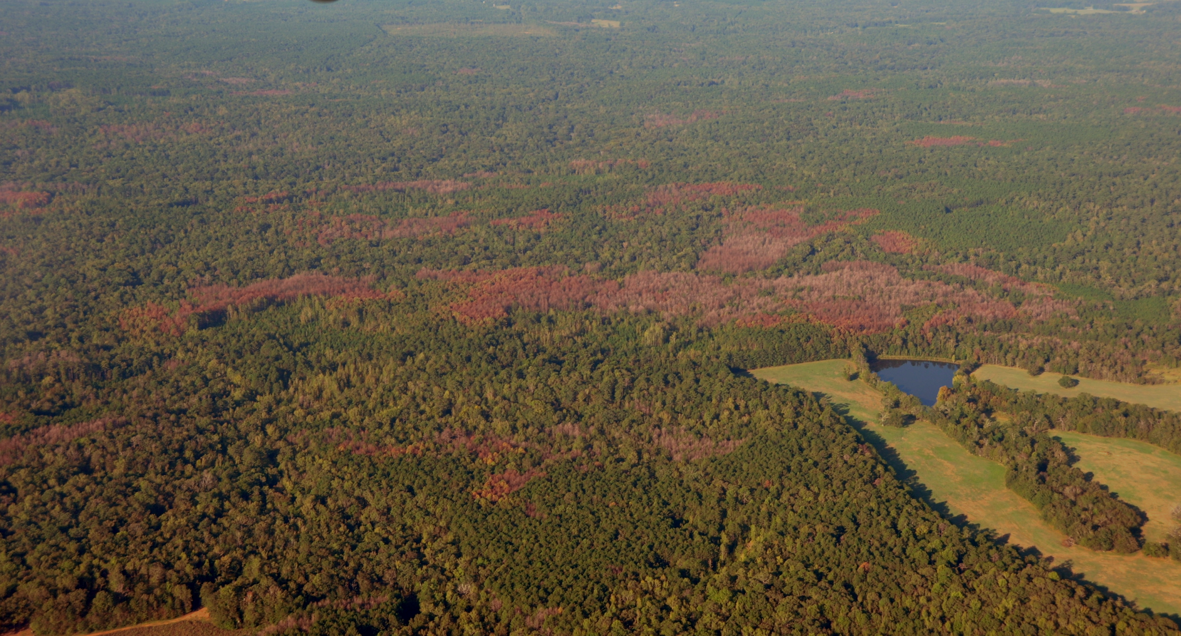
Ancillary Datasets
2016 Oconee National Forest Aerial Oblique Photography
US Forest Service Southern Research Station
2017 beetle spot locations from:
Georgia Forestry Commission
US Forest Service Forest Health and Protection
Image Credit: Kenny Frick, USDA Forest Service
Notes:
Our partners provided us with ancillary datasets to use for validating our methods. Oblique aerial photography with geolocation tags identified beetle-induced mortality in September of 2016. 2017 beetle outbreak spots were provided as a shapefile of points from a Forest Service aerial survey and beetle damage locations recorded by the georgia Forestry Commission.
Image Sources: Kenny Frick, USDA Forest Service
Map image created by the DEVELOP Southeastern US Disasters Team using QGIS 2.18 and data provided by USDA Forest Service and the Georgia Forestry Commission.
Service Layer Credits: QGIS Development Team (2018). QGIS Geographic Information System. Open Source Geospatial Foundation Project. http://qgis.osgeo.org

Slide 9
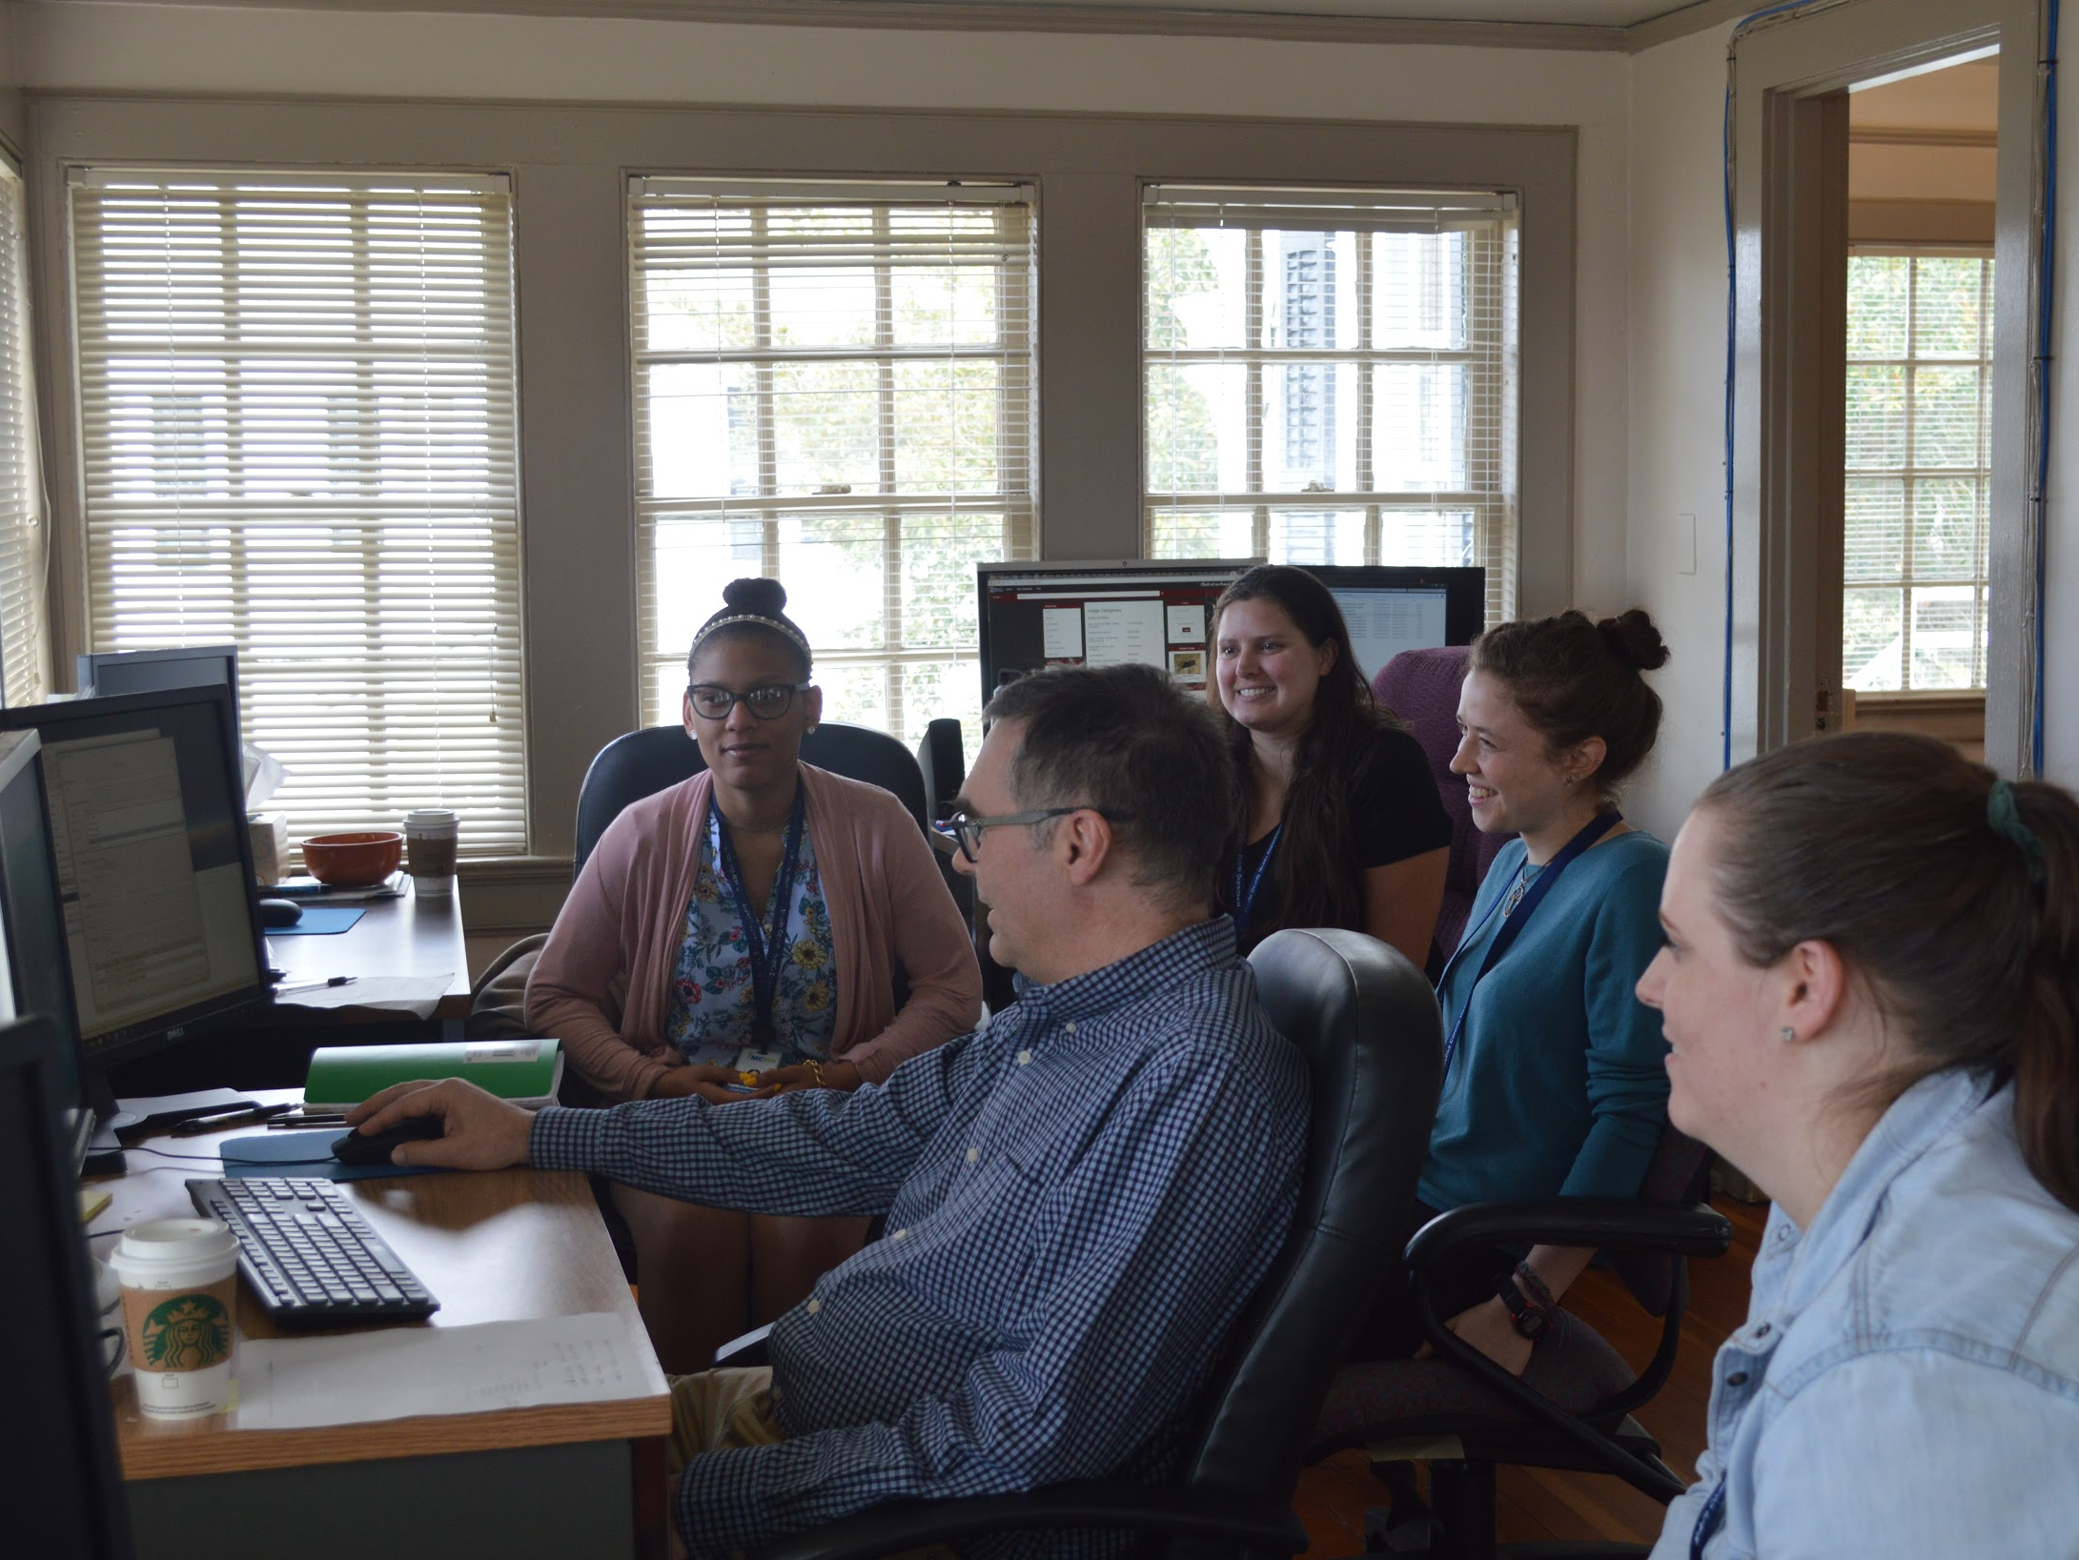
Methods
Classify evergreen forest to create a host map
Calculate:
ΔNDVI
ΔNDMI
ΔIREC
Identify outbreak areas on maps
Assess accuracy
Compare utility of map products
Image processing software:
ArcPro 2.0
ArcMap 10.5
QGIS 2.18
Create a host map
Unsupervised classification
Sentinel-2 MSI image from April 2016 (pre-outbreak)
Isolate areas of forest that could be affected by bark beetles
Image Credit: NASA DEVELOP Southeastern US Disasters Team
Notes:
Our methods required several data processing steps to create comparable map products for meeting our objectives. We used ArcPro 2.0, ArcMap 10.5, and QGIS 2.18 for image processing and data analysis throughout the project. After acquiring images of interest, the next step was to create a map layer to identify where host trees for bark beetles are within our study area. We created this evergreen forest mask using unsupervised classification so that when evaluating our vegetation change indices we focused only on areas relevant to our goals of identifying bark beetle outbreaks using remotely sensed imagery.
Image Source: NASA DEVELOP Southeastern US Disasters Team

Slide 10
Methods
Classify evergreen forest to create a host map
Calculate:
ΔNDVI
ΔNDMI
ΔIREC
Identify outbreak areas on maps
Assess accuracy
Compare utility of map products
NDVI
NDMI
IREC
Normalized Difference Vegetation Index
Currently used by ForWarn to detect forest disturbance
Utilizes:
red band
infrared band
Normalized Difference Moisture Index
Utilizes:
near infrared band
shortwave infrared band
Inverted Red Edge Chlorophyll
Used with Sentinel-2 MSI
Utilizes:
red edge bands
red band
Notes:
The three indices we examined in this project are the Normalized Difference Vegetation Index, or NDVI; the Normalized Difference Moisture Index, or NDMI; and the Inverted Red Edge Chlorophyll Index, or IREC. These indices are all various ways of assessing vegetation health status. To maximize their utility in this project, we calculated the change in the indices between dates of interest to see if certain parts of the evergreen forest had become more unhealthy, indicated by a negative change in the index for that time period.

Slide 11
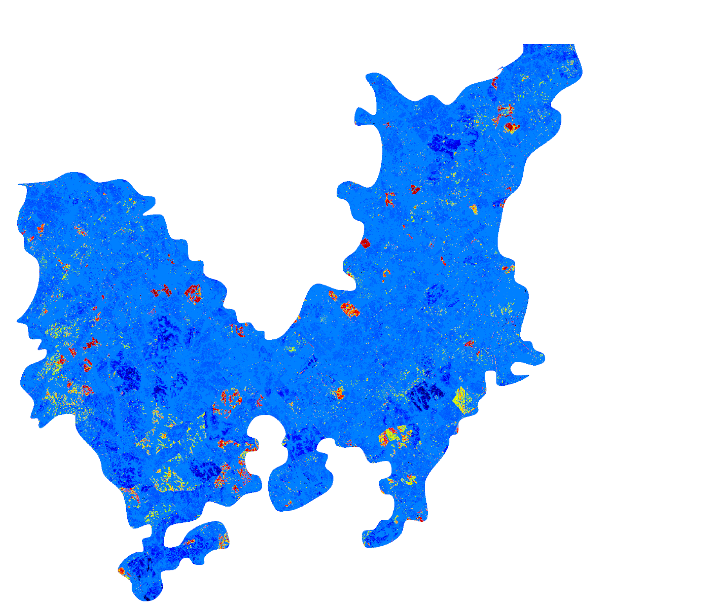
Methods
Classify evergreen forest to create a host map
Calculate:
ΔNDVI
ΔNDMI
ΔIREC
Identify outbreak areas on maps
Assess accuracy
Compare utility of map products
ΔNDVI
May 2016 to May 2017
Sentinel-2 MSI
Beetle Damage Spot
Locations
True Color Composite
Sentinel-2 MSI
+Δ
–Δ
Notes:
To visualize the detected changes in indices in a comparable way across all maps produced and with ForWarn, we created a standard color table in the ForWarn color scheme that shows the relative magnitude of the changes. Negative changes are depicted in a scale from green to yellow to red, while no change or positive change appear in shades of blue. We identified areas of the map with clusters of pixels depicting negative change and as indicative of bark-beetle related disturbance.
Map images created by the DEVELOP Southeastern US Disasters Team using QGIS 2.18 and data provided by USDA Forest Service and the Georgia Forestry Commission.
Service Layer Credits: QGIS Development Team (2018). QGIS Geographic Information System. Open Source Geospatial Foundation Project. http://qgis.osgeo.org

Slide 12
Methods
Classify evergreen forest to create a host map
Calculate:
ΔNDVI
ΔNDMI
ΔIREC
Identify outbreak areas on maps
Assess accuracy
Compare utility of map products
ΔNDVI
May 2016 to May 2017
Sentinel-2 MSI
Beetle Damage Spot
Locations
True Color Composite
Sentinel-2 MSI
+Δ
–Δ
Notes:
To assess the accuracy of our derived change maps, we randomly selected damage points from our ancillary datasets and checked for agreement with areas of negative change in our maps for each index. We also checked these areas against a true color composite map derived from Sentinel-2 imagery to make sure the area of negative change detected by the index was not a clearcut, man-made structure, water body, or other potentially misleading geological oddity.
Map images created by the DEVELOP Southeastern US Disasters Team using QGIS 2.18 and data provided by USDA Forest Service and the Georgia Forestry Commission.
Service Layer Credits: QGIS Development Team (2018). QGIS Geographic Information System. Open Source Geospatial Foundation Project. http://qgis.osgeo.org

Slide 13
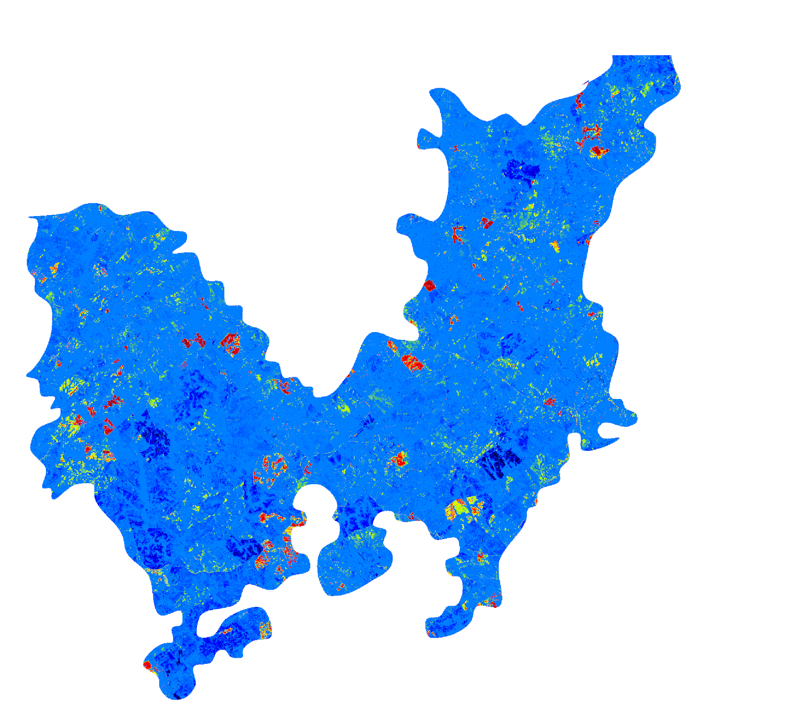
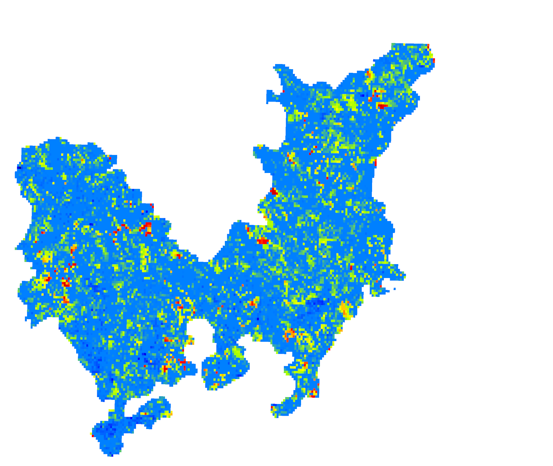
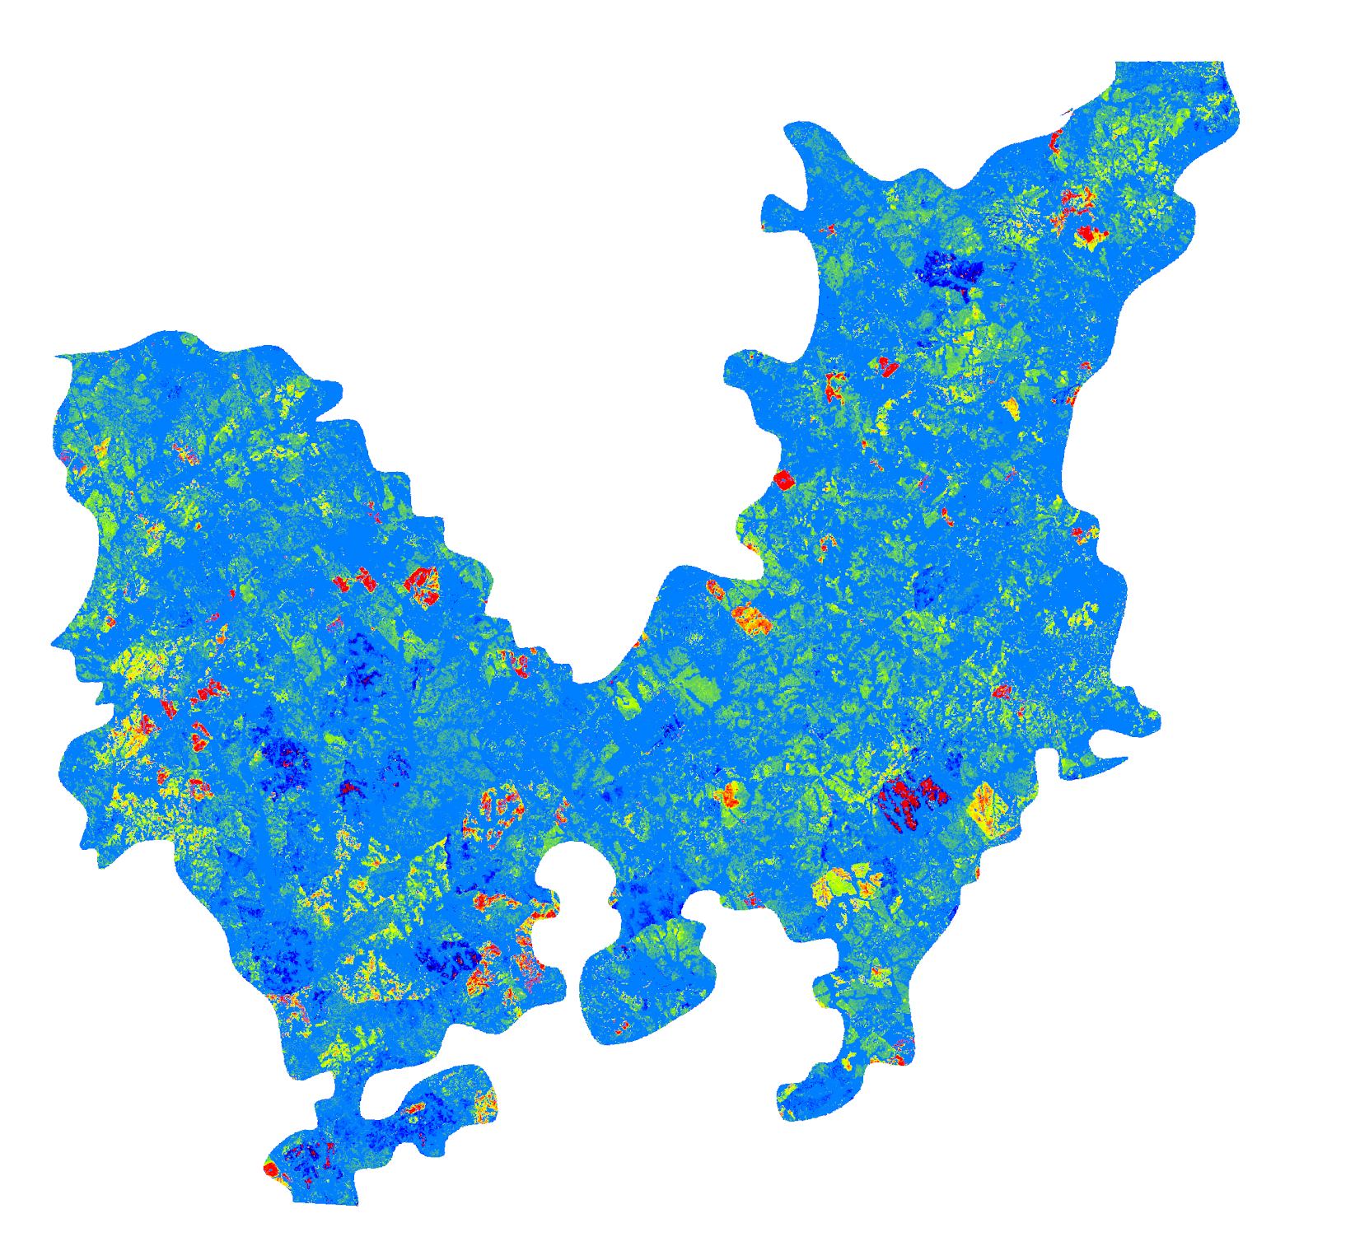
Methods
Classify evergreen forest to create a host map
Calculate:
ΔNDVI
ΔNDMI
ΔIREC
Identify outbreak areas on maps
Assess accuracy
Compare utility of map products
Sentinel-2 MSI NDVI Change
Landsat 8 OLI NDVI Change
ForWarn NDVI Change
-100%
-100%
-100%
-20%
-20%
-20%
-10%
-10%
-10%
-5%
-5%
-5%
0%
0%
0%
May 2016 to May 2017
20%
20%
20%
100%
100%
100%
Sentinel-2 MSI NDMI Change
Landsat 8 OLI NDMI Change
Inverted Red Edge Chlorophyll Change
-2000%
-2000%
-100%
-100%
-100%
-20%
-50%
-50%
-10%
-25%
-25%
-5%
0%
0%
0%
100%
100%
20%
2000%
2000%
100%
Notes:
After creating and validating all of our change maps, we were able to conduct side-by-side comparisons to contrast the differences in resolution as well as the effectiveness and sensitivity of the various indices. Here you can see all the maps we created for detecting the changes from May 2016 to May 2017 alongside the ForWarn map product currently available to managers.
Map images created by the DEVELOP Southeastern US Disasters Team using QGIS 2.18.
Service Layer Credits: QGIS Development Team (2018). QGIS Geographic Information System. Open Source Geospatial Foundation Project. http://qgis.osgeo.org

Slide 14
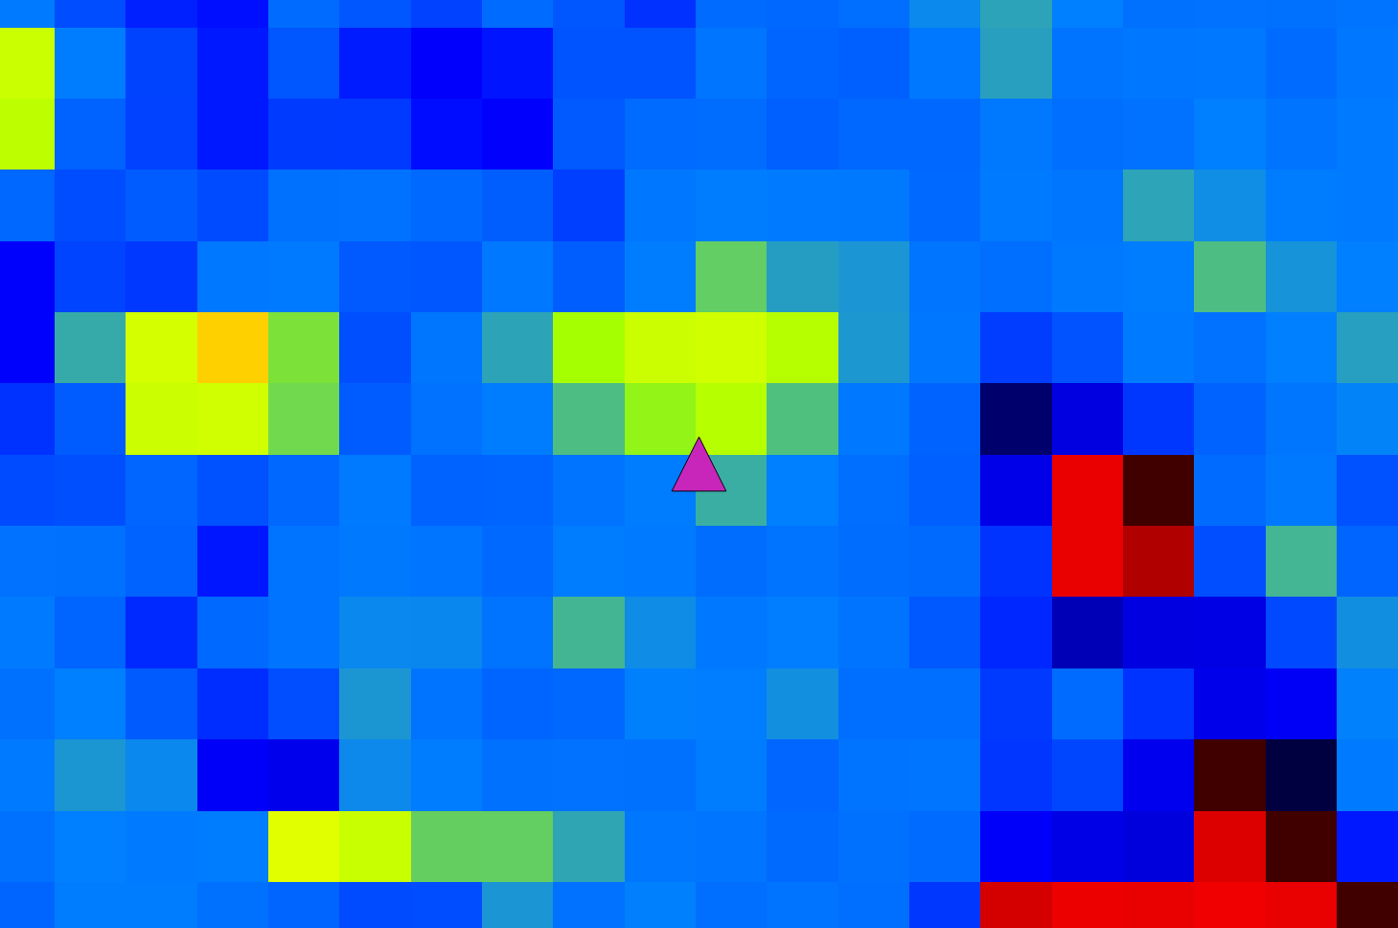
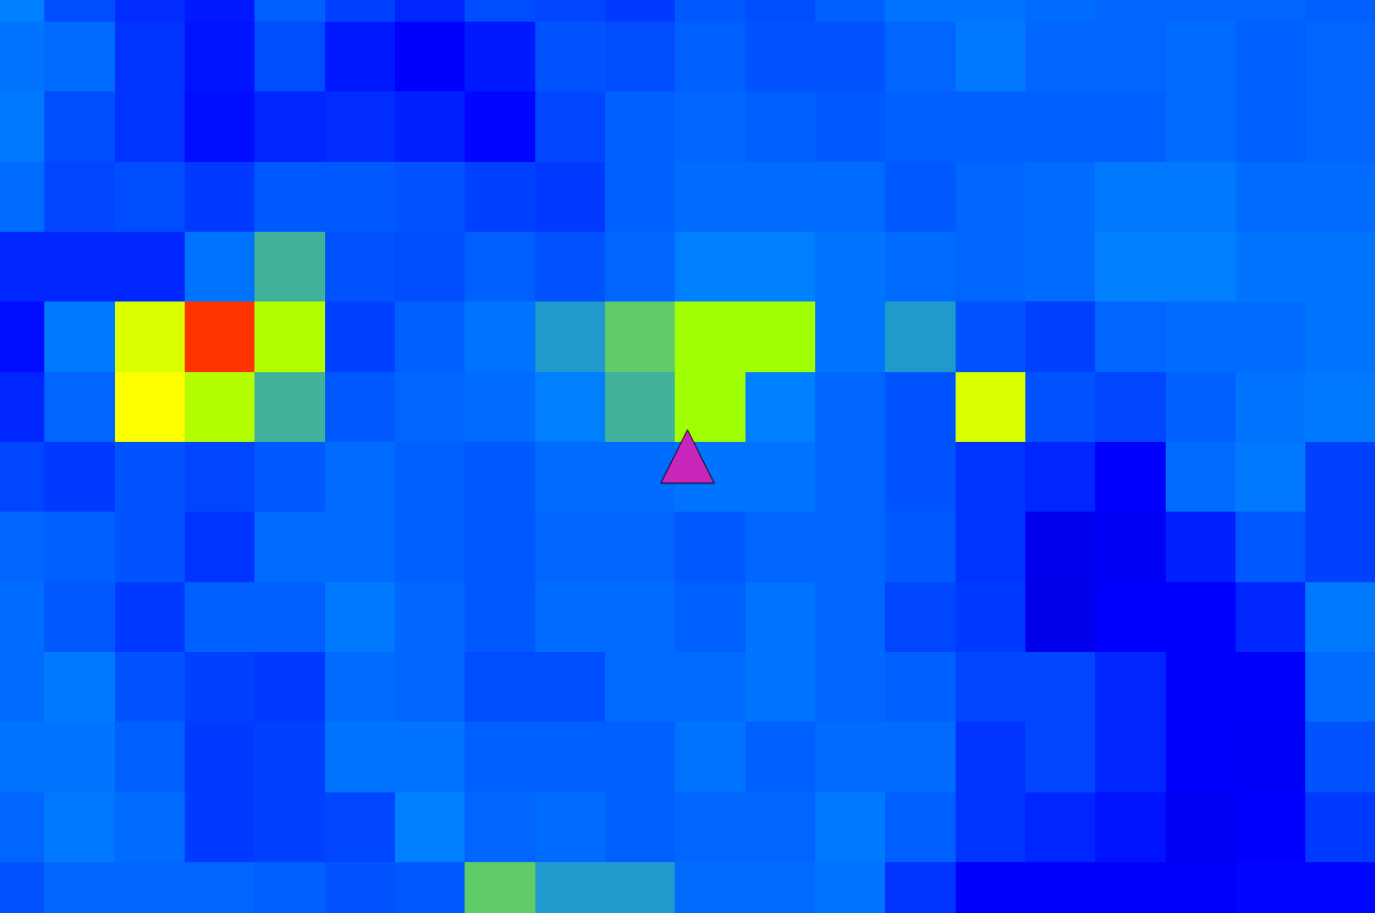
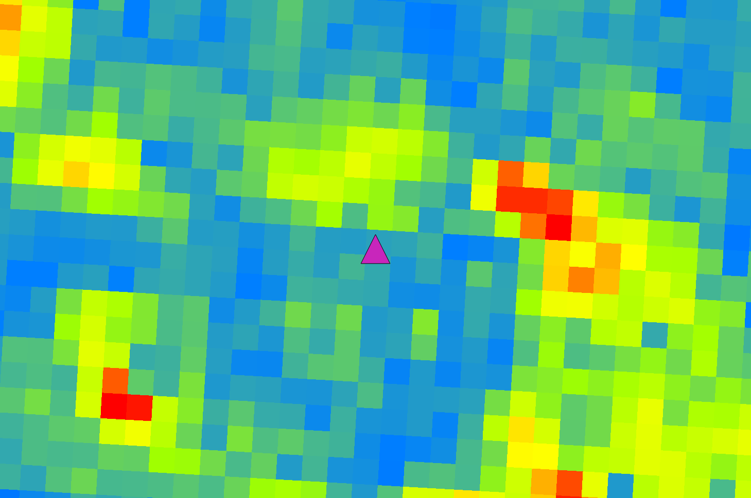
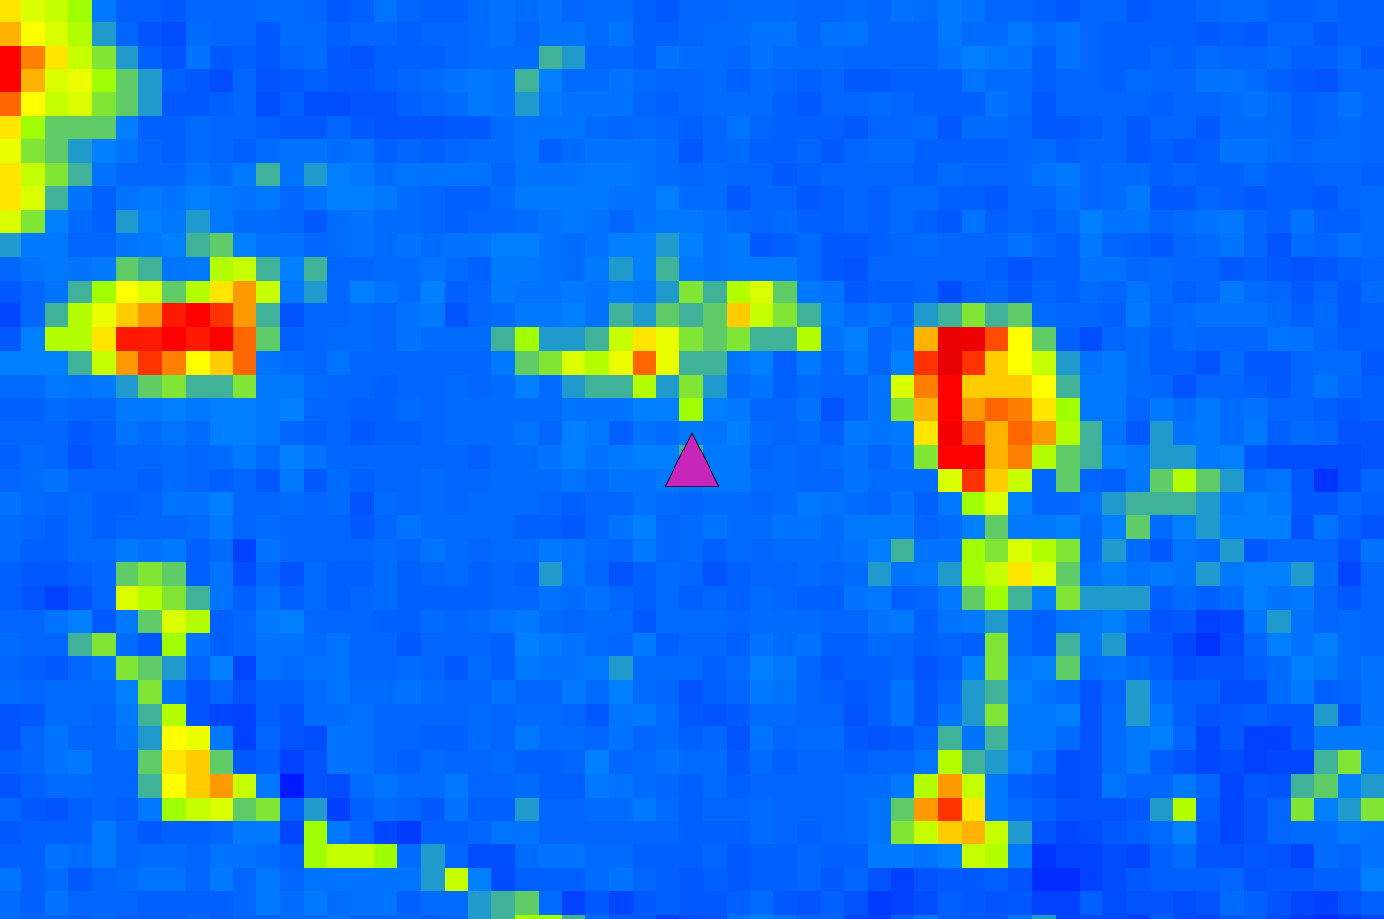
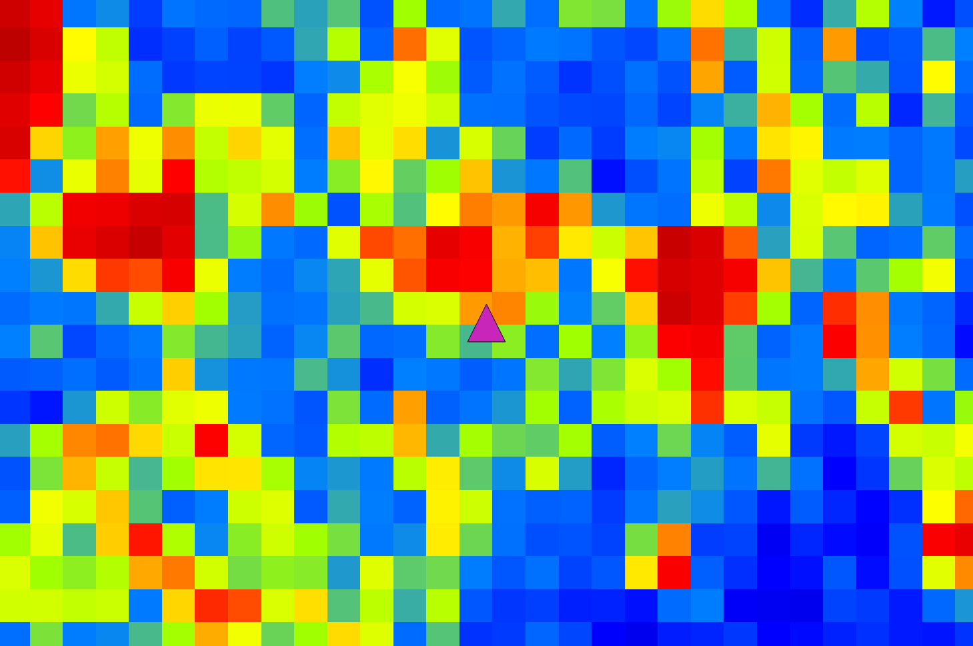
Results
ForWarn ΔNDVI
Landsat 8 OLI ΔNDMI
All change maps produced averaged about 70% agreement with in situ data
However, in situ survey data are not highly precise and may include location errors
Higher spatial resolution change maps derived from Landsat 8 OLI and Sentinel-2 MSI provided more precision in disturbance location detection
Some indices are more sensitive to forest canopy color changes, but all assessed indices provide some disturbance detection capability
Landsat 8 OLI ΔNDVI
Sentinel-2 MSI ΔNDMI
Sentinel-2 MSI ΔNDVI
Sentinel-2 MSI ΔIREC
Notes:
All of the change maps we produced and tested averaged about 70% agreement with the available in situ survey data. It is important to note that damage locations are approximated from a moving plane and are not ground-truthed, so take that result with a grain of salt. Higher resolution imagery from Landsat 8 OLI and Sentinel-2 MSI improve precision in locating smaller patches of disturbed forest. Some of the indices we calculated, like NDMI and IREC, are more sensitive to changes in forest condition, but all indices appear useful.
Map images created by the DEVELOP Southeastern US Disasters Team using QGIS 2.18.
Service Layer Credits: QGIS Development Team (2018). QGIS Geographic Information System. Open Source Geospatial Foundation Project. http://qgis.osgeo.org

Slide 15
Conclusions
Negative NDVI, NDMI, and IREC changes are correlated with known bark beetle activity and drought impacts.
Landsat 8 OLI and Sentinel-2 MSI data products offer a higher spatial resolution view of bark beetle activity compared to MODIS NDVI products used by ForWarn.
Sentinel-2 IREC index change maps appeared to show greater potential for identifying early indications of disturbance by bark beetles compared to non-red edge NDVI and NDMI change maps.
Notes:
Negative NDVI, NDMI, and IREC changes are correlated with known bark beetle activity and drought impacts. Landsat 8 OLI and Sentinel-2 MSI data products offer a higher spatial resolution view of bark beetle activity compared to MODIS NDVI products used by ForWarn. Sentinel-2 IREC index change maps appeared to show greater potential for identifying early indications of disturbance by bark beetles compared to non-red edge NDVI and NDMI change maps.
Map images created by the DEVELOP Southeastern US Disasters Team using QGIS 2.18.
Service Layer Credits: QGIS Development Team (2018). QGIS Geographic Information System. Open Source Geospatial Foundation Project. http://qgis.osgeo.org

Slide 16
Acknowledgements
Mentors/Science Advisors:
Bernard H. Eichold II, M.D., Dr.P.H. (Mobile County Health Department)
Joe Spruce (Science Systems & Applications, Inc)
Dr. Kenton Ross (NASA Langley Research Center)
Partners:
Dr. William “Bill” Hargrove (USDA, US Forest Service, Eastern Forest Environmental Threat Assessment Center)
William “Bill” Christie (USDA, US Forest Service, Eastern Forest Environmental Threat Assessment Center)
Dr. Steven P. Norman (USDA, US Forest Service, Eastern Forest Environmental Threat Assessment Center)
Ancillary Data Providers:
Michael Torbett, Georgia Forestry Commission
Paul Merten, USDA, US Forest Service
Kenny Frick, USDA, US Forest Service
AL – Mobile Node:
Farnaz Bayat, Center Lead
Danielle Quick, Assistant Center Lead, Impact Analysis Fellow
Notes:
Thank you to our mentor, science advisors, partners, and our center leadership--we could not have done this project without your support and guidance.

Slide 17
Questions?

