Slide 1
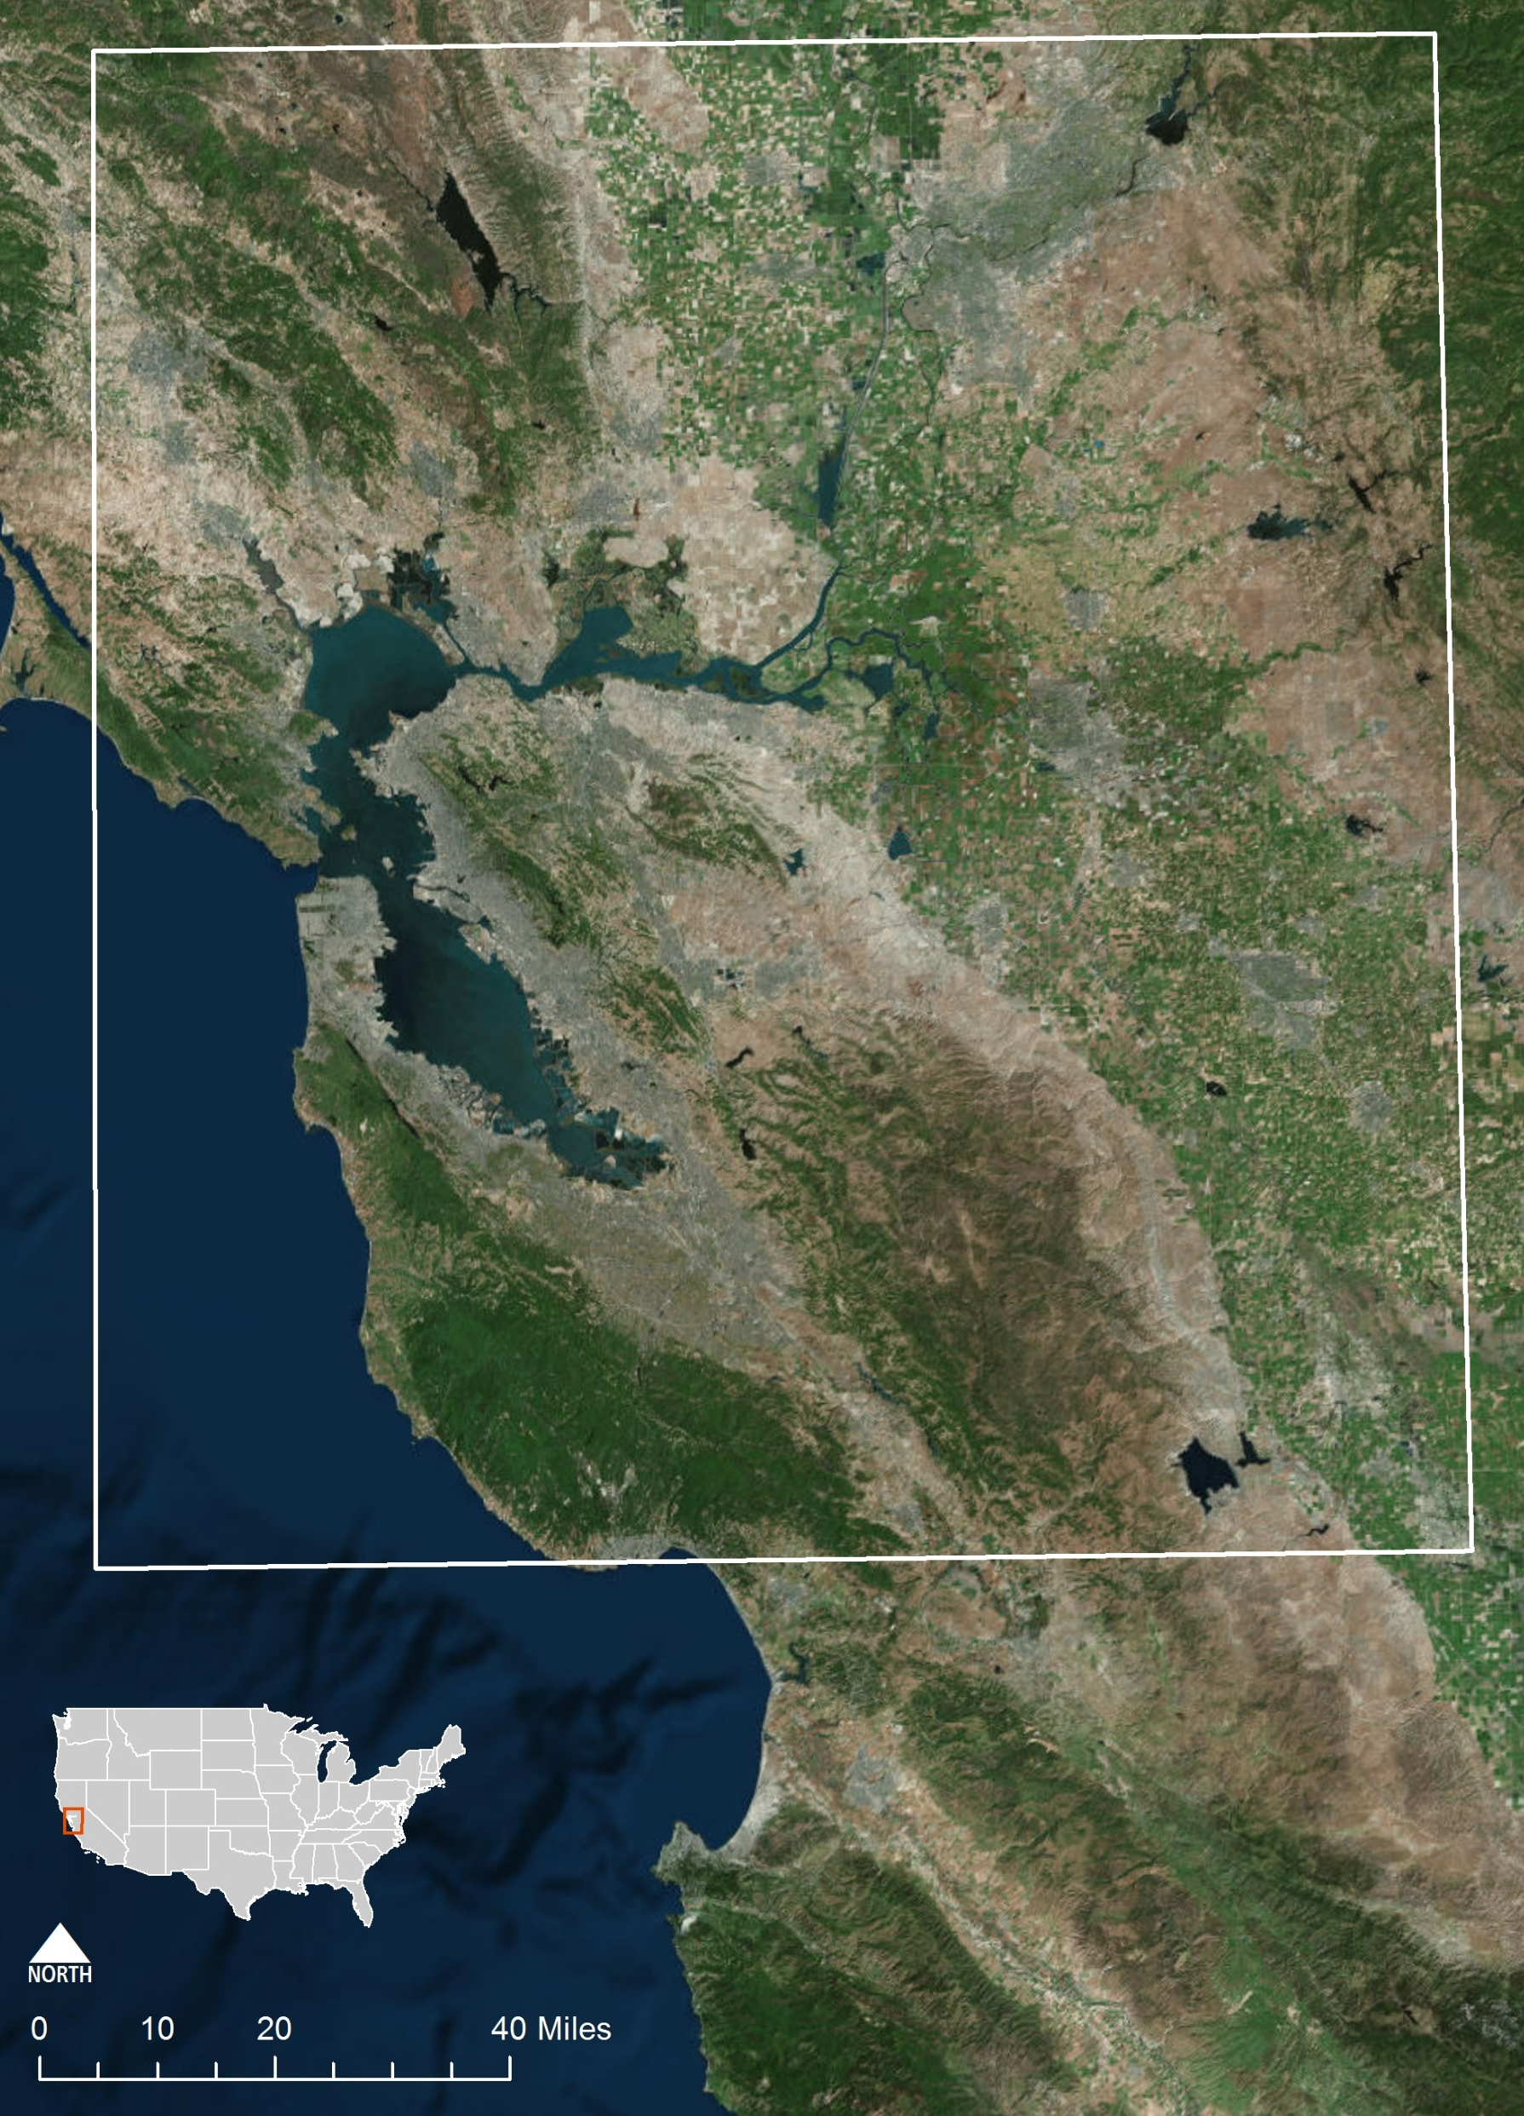
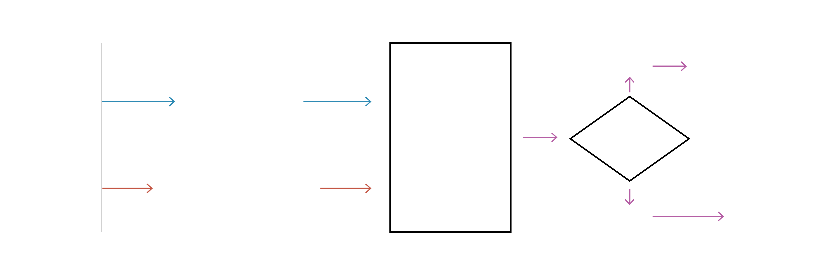
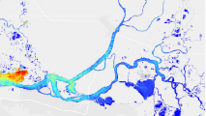
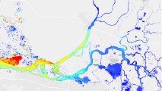
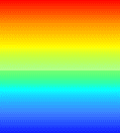







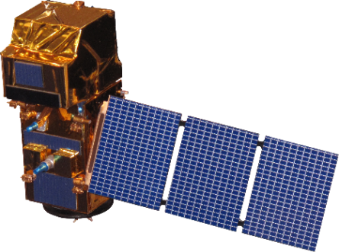




Utilizing NASA and ESA Earth Observations to Monitor Turbidity Distribution in the
San Francisco Bay-Delta
Objectives
Abstract
Investigate the utility of remote sensing data for turbidity monitoring and resource management in the San Francisco Bay-Delta
Generate time-series turbidity maps, validating remotely-sensed data with in situ monitoring stations
Water quality is a critical element of freshwater supply, particularly in times and areas of drought. Limited water resources can be further strained if water quality concerns are not effectively and efficiently addressed. While there are measures in place to protect human and environmental health from poor and risky water quality conditions, implementation of these measures is frequently reliant on physical water samples and fixed station data, both of which have gaps in spatial and temporal coverage of water quality conditions. This consideration is especially important in environments that are highly complex and heterogeneous, such as the San Francisco Bay-Delta, as well as in budget-constrained areas or sites that are remote and are challenging to access. Remotely sensed information can help supplement existing data, supporting more informed water management practices and representing a wealth of information that has yet to be fully leveraged. In this project, we evaluated the application of remote sensing-derived turbidity from three Earth observing satellites in the San Francisco Bay-Delta and conducted comparisons with in situ turbidity data from USGS and CDEC water quality stations. The Semi-Empirical Single Band Turbidity Algorithm yielded a 1:1 relationship with in situ turbidity when calculated values were less than 15 to 20 FNU. This relationship did not extend to higher turbidity values, which yielded significantly lower slopes. Incorporating site-specific constants into the algorithm to correct for this deviation must be explored further.
Study Area
CALIFORNIA
Methodology
In Situ Station Data
Data
pre-processing & cleaning
Turbidity comparisons (time-series maps, plots & correlations)
NO
Explore the use of additional satellite inputs
High correlations
?
Satellite Imagery
ACOLITE (atmospheric corrections, applying turbidity algorithm)
Model validation
YES
Results
Pacific Ocean
Turbidity (FNU)
San Francisco Bay-Delta Water Resources
High > 15
Low 0
Sentinel-2
Landsat 8
Overlapping Satellite Paths
Landsat 8 vs. in situ
Linear (Landsat 8 vs. in situ)
Satellite-Derived Turbidity vs. In Situ Values
Earth Observations
Sentinel-2 vs. in situ
Linear (Sentinel-2 vs. in situ)
1:1
Optimal Smelt Turbidity (12 FNU)
Sentinel-2 | y = 1.19x - 6.20 | R² = 0.77
Landsat 8 | y = 0.66x + 1.49 | R² = 0.47
Turbidity derived from Sentinel-2 was more highly-correlated with in situ values, exhibiting a slope slightly over 1. Landsat 8, on the other hand, was less correlated, having a slope under 0.7.
Sentinel-2 data were more accurate than Landsat 8 in the smaller tributaries of the Bay-Delta, as the satellite has a smaller spatial resolution.
Satellite-Derived Turbidity (FNU)
Landsat 8
Sentinel-2
Project Partner
Conclusions
In situ Turbidity (FNU)
Metropolitan Water District of Southern California:
Dr. David Fullerton, Principal Resource Specialist
Dr. Shawn Acuna, Environmental Scientist
Russell Ryan, Sr. Engineer
The limitations of in situ monitoring necessitates ancillary data sources. High spatial resolution satellite data are a promising way to fill in the gaps between monitoring sites.
These data and other higher-resolution imagery can be incorporated into models to predict turbidity movement and better track smelt while providing for adequate municipal water resource demand.
Team Members
Acknowledgements
Dr. Christine Lee (Jet Propulsion Laboratory, California Technical Institute)
Dr. Michelle Gierach (Jet Propulsion Laboratory, California Technical Institute)
Dr. Nick Tufillaro (College of Earth, Ocean, and Atmospheric Sciences, Oregon State University)
Ben Holt (Jet Propulsion Laboratory, California Technical Institute)
34 North
Kate Cavanaugh
Team Lead
Leah Kucera
Molly Spater
NASA Jet Propulsion Laboratory – Summer 2017

