Slide 1
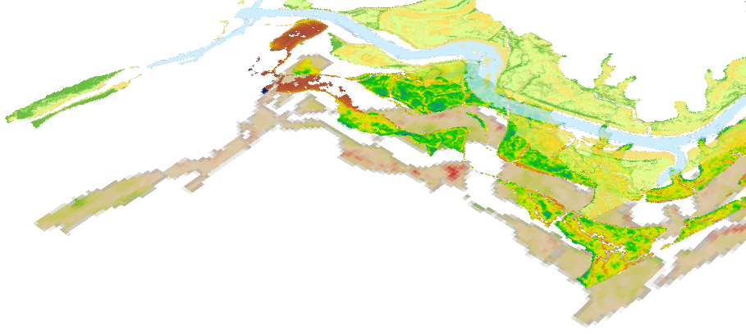

ELKHORN SLOUGH ECOLOGICAL FORECASTING II
Melanie Feen
(Point of Contact)
Past, Present, and Future Assessment of Marsh Resilience
Hannah Friedrich
Stephanie Ly
Notes:
Introduce project title and team members.

Slide 2
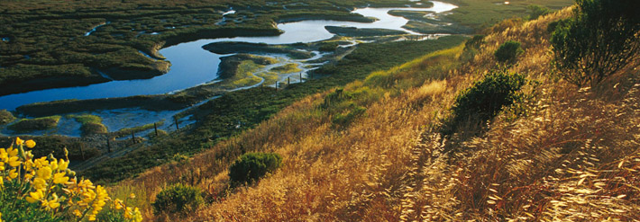
Background Information - Marshes
Provide ecosystem services
  Blue carbon sequestration
  Water filtration
  Flood abatement
  Habitat
Facing local and global threats
  Development
  Sea level rise
  Water pollution
Image Credit: Elkhorn Slough Foundation
Notes:
Marsh ecosystems are important to all species across the globe. Marshes serve many purposes such as water filtration, flood abatement, they also act as blue carbon sequestration systems and are host to a verity of habitats. However, they are experiencing tremendous stress and loss due to sea level rise, water pollution, and human development.
Image Source: http://www.elkhornslough.org/gallery/index.php?/category/2

Slide 3
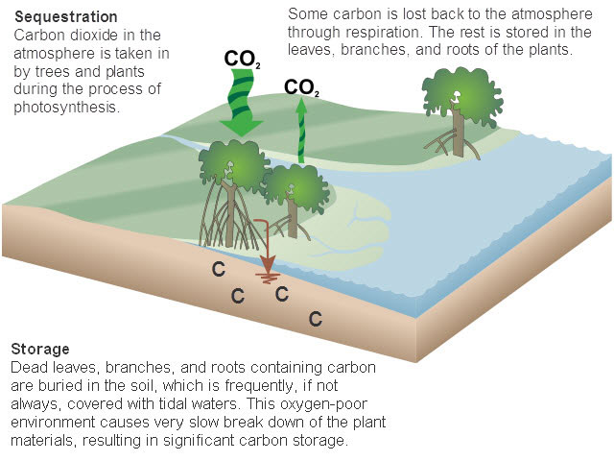
Community Concerns
Marshes cover 140 million ha. Of Earth’s surface (Crooks et al., 2011)
Disappearing at a rate of 1-2% annually – 50% lost historically (Crooks et al., 2011)
Marshes are important to the global carbon cycle because they sequester what is referred to as blue carbon
Image Credit: NOAA Habitat Conservation National Marine Fisheries Service
Notes:
Marshes need to be studied for a number of reasons. Across the world they are disappearing because they are unable to keep up with sea level rise, carbon stored in plants and soil can be released into atmosphere increasing the amount of green house gasses directly impacting the global carbon cycle.
Cite: Crooks et. Al (2011)
Image Source: http://www.habitat.noaa.gov/images/carbon_cycle.jpg

Slide 4
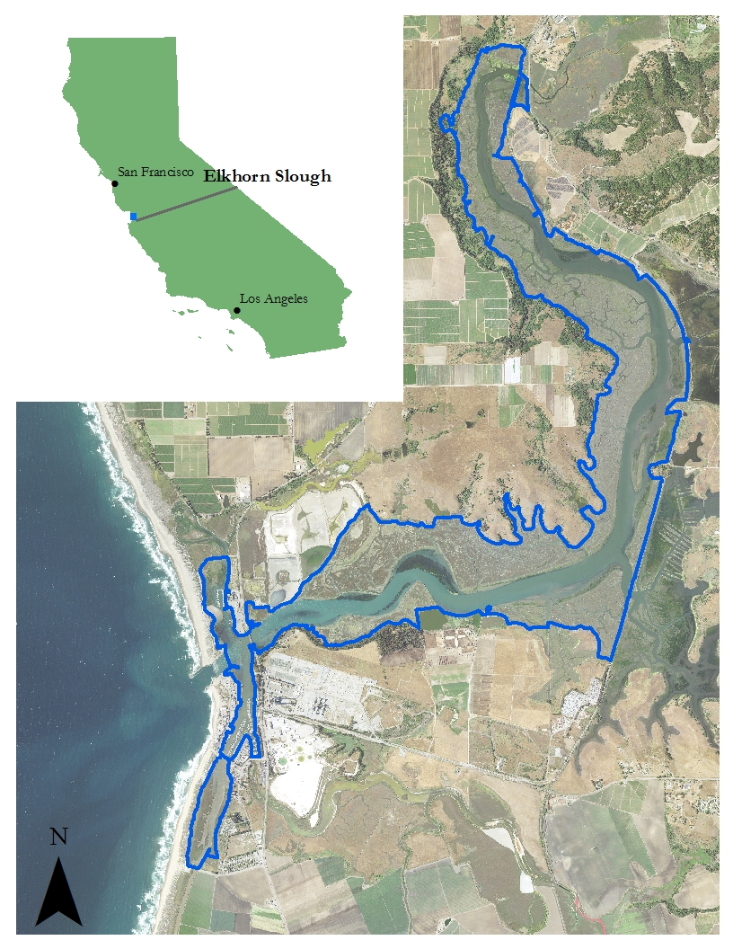
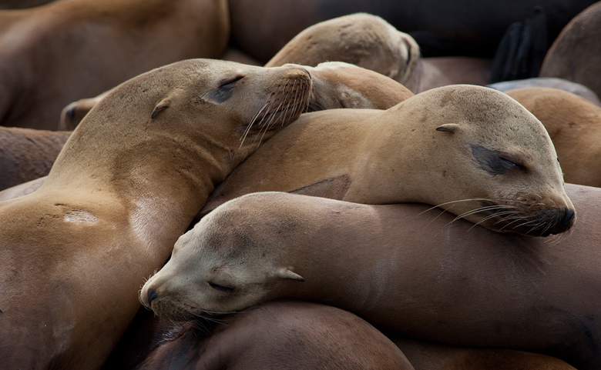

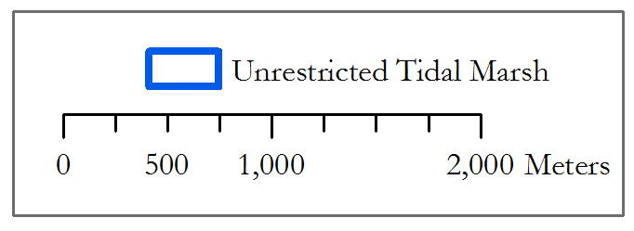
Study Area
Second largest tidal salt marsh in California (ESNERR, 2016)
Located in Monterey Bay
State Ecological Reserve and Wildlife Management Area (ESNERR, 2016)
Research underway to restore marsh and habitat
Image Credit (left to right): PBS, Elkhorn Slough Foundation
Notes:
This project focued on the Elkhorn Slough that is located in Monterey Bay, California. The Elkhorn Slough is a designated wildlife area for endangered species like southern sea otter, and important migratory stop for birds and is managed by two entities: CA Department of Fish and Wildlife and the State Ecological Reserve and Wildlife Management Area also known as ESNERR. For this project we partnered with ESNERR and leveraged in-situ datasets as well as explored how Earth observations can be used to improve protection and restoration efforts throughout the Slough.
Image Source: http://www.pbs.org/big-blue-live/live-cams/elkhorn-slough-otter-cam/
http://media.gettyimages.com/photos/sea-otter-in-elkhorn-slough-california-picture-id623360615?k=6&m=623360615&s=170667a&w=0&h=4A7ulGOJcJ2wMKiPadzbSDvaeXdva-6feVNKS6slQYc
Image Source: http://www.pbs.org/big-blue-live/live-cams/elkhorn-slough-otter-cam/
http://media.gettyimages.com/photos/sea-otter-in-elkhorn-slough-california-picture-id623360615?k=6&m=623360615&s=170667a&w=0&h=4A7ulGOJcJ2wMKiPadzbSDvaeXdva-6feVNKS6slQYc=
http://www.elkhornslough.org/photography/image_gallery/
Map Base Imagery: National Agricultural Imagery Program
Map “Unrestricted Tidal Marsh” layer provided by our partner, Elkhorn Slough Estuariene Research Reserve (ESNERR)

Slide 5
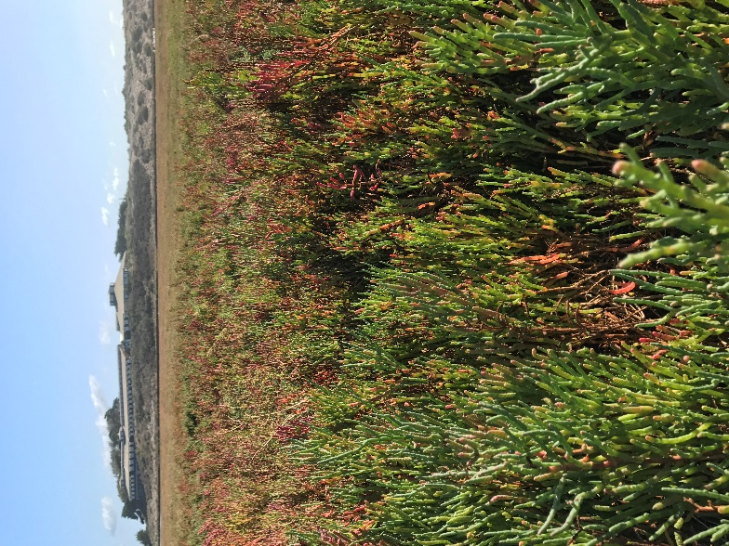
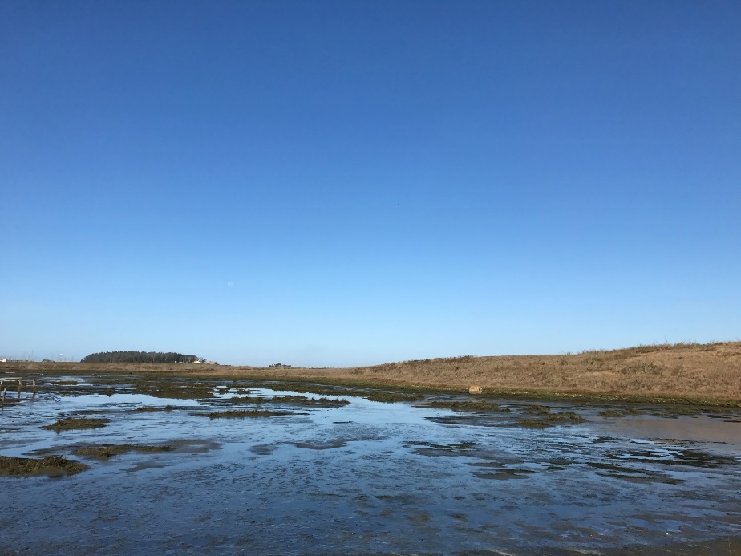
Project Scope
What are the effects of different scenarios of sea level rise and climatic patterns on marsh vegetation health?
A subsiding marsh in Elkhorn Slough that is partially flooded.
Pickleweed (Sarcocornia pacifica) is the dominant vegetation species in Elkhorn Slough.
Notes:
Our project seeks to identify effects of climatic variations in past, present, and future on Elkhorn Slough’s vegetation health and extent. On the left is a picture of healthy pickleweed vegetation, dominant species type in our study region. And on the right is a recent photo is a image of a subsiding marsh within the Elkhorn Slough.
Images taken from Elkhorn Slough Ecoforecasting II Team during site visit to Elkhorn Slough.

Slide 6
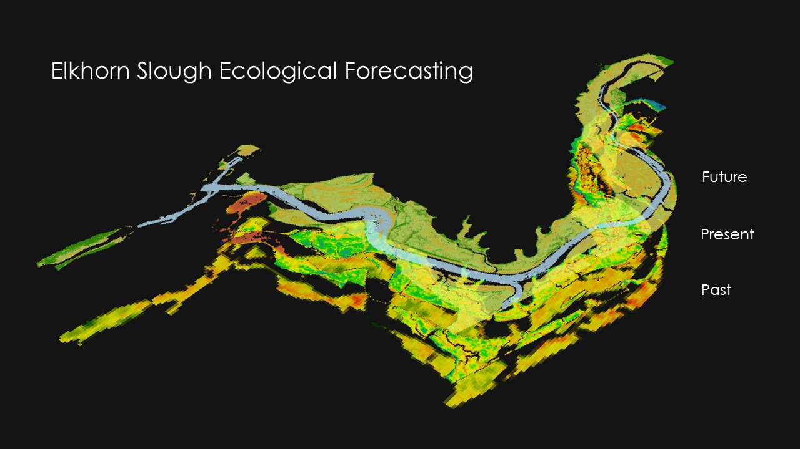
Objectives
Identify historical spatial and temporal trends for marsh vegetation using NASA Earth observations and Google Earth Engine
Detect current vegetation health in comparison to in situ data
Forecast future marsh resilience to different sea level scenarios
Notes:
The three main objectives of this study were to create a historical time-series of vegetation health following El Nino events within Geoogle Earth Engine utilizing historical Landsat observations, detect present-day vegetation health by comparing to in situ data provided by ESNERR with Sentinel 2A satellite imagery and work to forecast future marsh resilience using the Marsh Equilibrium Model to forecast different sea level scenarios.

Slide 7
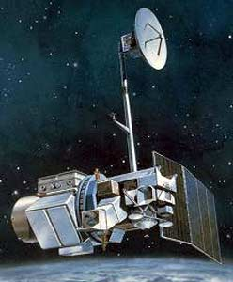

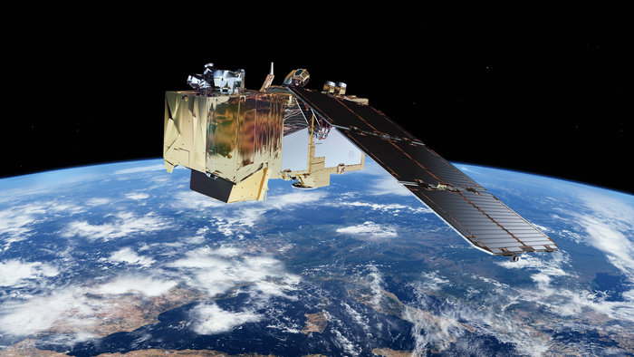
NASA Satellites & Sensors
Landsat 5 TM
30m Resolution
March 1984 – January 2013
Landsat 8 OLI
30m Resolution
February 2013 - present
Sentinel-2 MSI
10m, 20m, 60m Resolution
June 2015 - Present
Image Credit: NASA, European Space Agency (ESA)
Notes:
The Earth observations used in this study were Landsat 5 and Landsat 8 for historical analysis from 1997 to 2016 and Sentinel 2 for present-day analysis acquired from August 2016.
1. http://landsat.gsfc.nasa.gov/wp-content/uploads/2013/06/nu_611.jpg
2. http://landsat.gsfc.nasa.gov/wp-content/uploads/2012/12/L7_satellite2.png
http://www.esa.int/spaceinimages/Images/2015/03/Sentinel-2

Slide 8




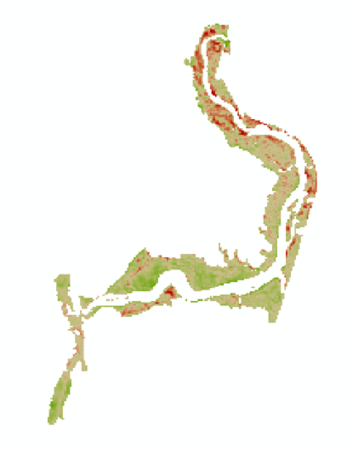
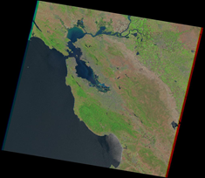
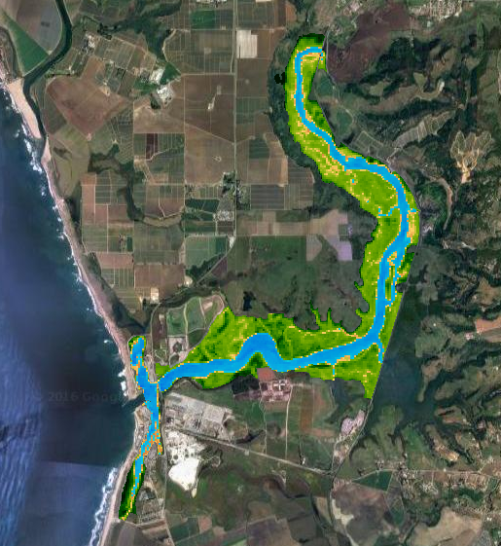
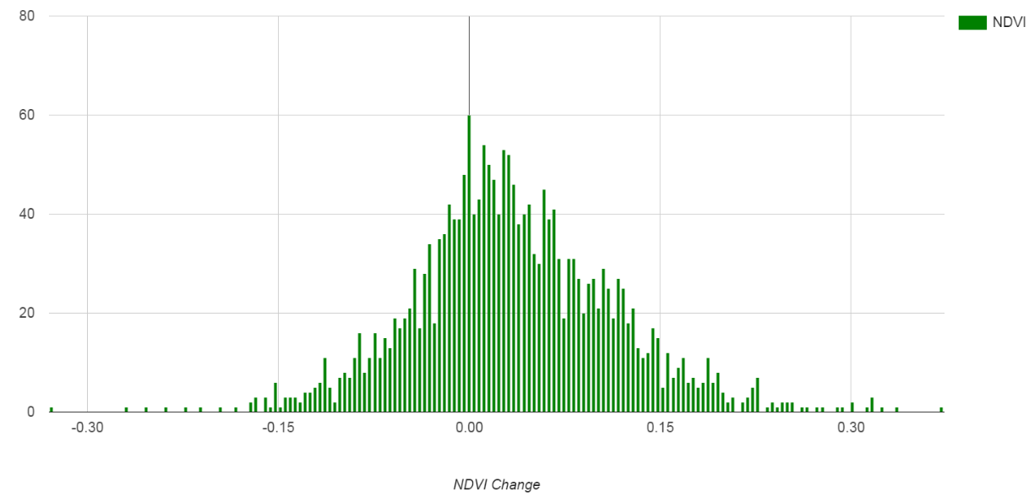
Methods: Historical Time Series
Notes:
The methodology employed in the historical time series analysis was first to acquire Landsat imagery from Google Earth Engine (GEE), apply NDVI index to Landsat imagery, and then export these layers to ArcMap in order to compare vegetation health between El Nino years.

Slide 9

Landsat Images
Landsat Earth Observation System | Date of Image
Landsat 5 Thematic Mapper (TM) | 06/23/1997 06/26/1998 06/05/2002 06/24/2003 04/05/2009 04/08/2010
Landsat 8 Operational Land Imagery (OLI) | 06/25/2015 06/27/2015
Landsat scenes were acquired during peak biomass season between April to June.
Notes:
The Landsat images were acquired during peak biomass season (April to June). The Fmask algorithm applied to mask out cloud and cloud shadows, all images were calibrated Top-of-Atmosphere (TOA) Reflectance, and prior to download we made sure that each image was taken at low tide was by verifying the dates with NOAA’s Historic Tides & Water Levels data for the Monterey Station.

Slide 10
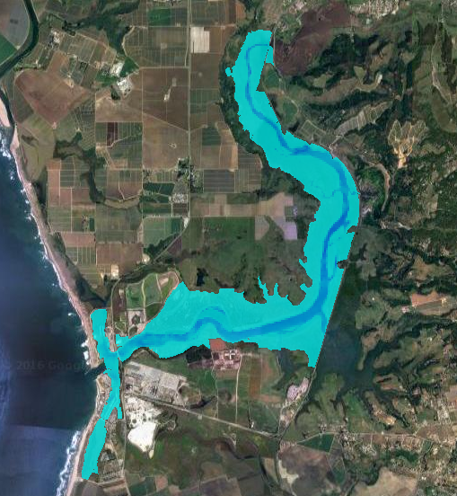
Utilizing Google Earth Engine
Applying Normalized Difference Water Index (NDWI)
  Masks out known water areas from study area
Calculating Normalized Difference Vegetation Index (NDVI)
  (NIR – RED) / (NIR + RED)
Notes:
To mask out water and remove algae as reduce error we apply NDWI to mask and then preformed an NDVI on each image to better understand how vegetation health within the slough has changed over time.

Slide 11
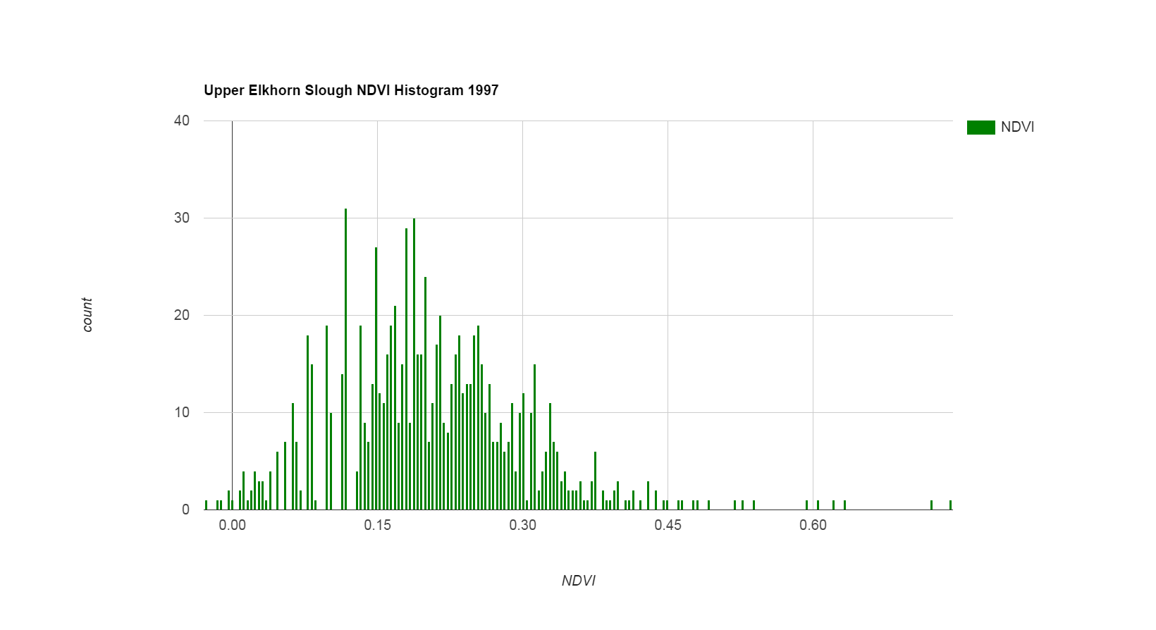
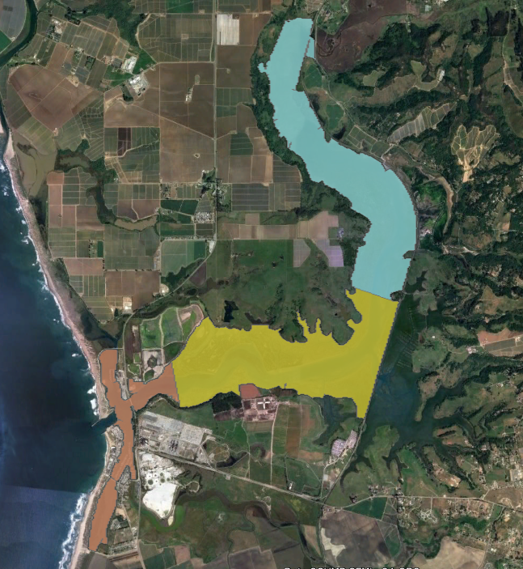
Regional Analysis of NDVI
Cut study area polygon into regions: lower, middle, and upper marsh.
Import into GEE and clip image by region for each study year.
Produce NDVI Histogram in GEE to identify vegetation trends by region.
Notes:
In addition to analyzing the entire study area, we did a regional analysis by splitting study area into three parts: upper, middle, lower marsh. We calculated NDVI values for each region to produce histograms in GEE and produced histogram NDVI values that were then downloaded as CSV files and NDVI averages for each region were calculated using Excel.
-

Slide 12
ENSO Index and NDVI Comparison
Notes:
We pursued this approach in an attempt to identify a correlation, but the r-squared values indicates there is generally random correlation between NDVI and ENSO index throughout the El Nino years for each region and the entire study area. Due to these low r-squared values we cannot derive any conclusion without further analysis. A limitation factor in this analysis may be the 30 m spatial resolution of Landsat however this realization does open up future avenues of research for our partners at ESNERR to explore other indices for comparison with NDVI, since ENSO is unpredictable.

Slide 13
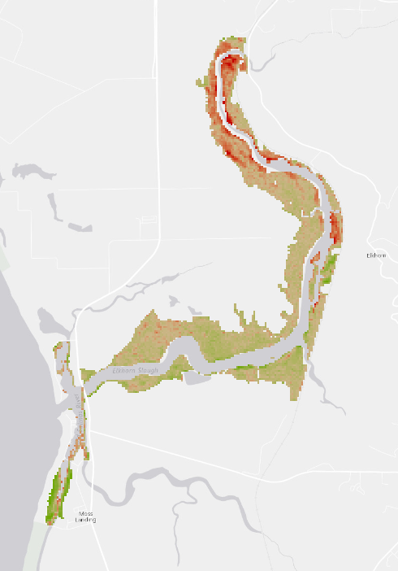
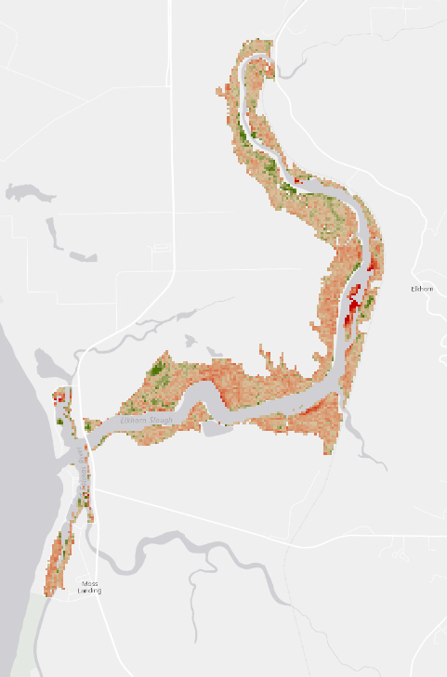
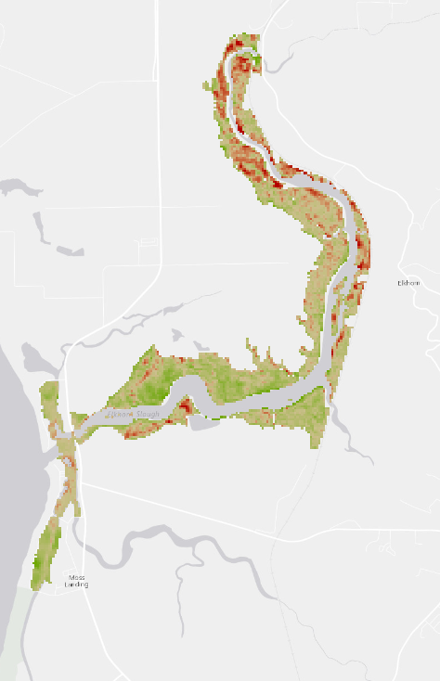
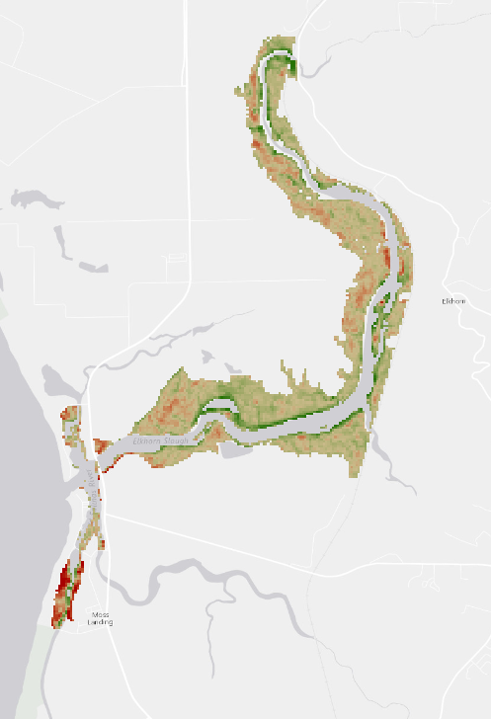
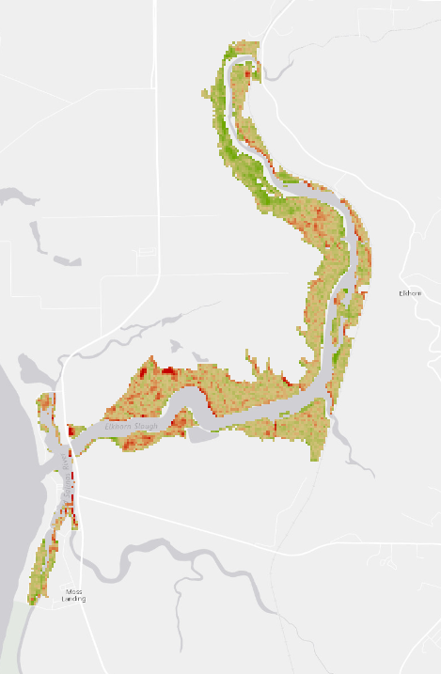
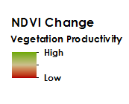
Time-Series of 1997-2016 NDVI Change
1997 to 1998
2002 to 2003
2009 to 2010
2015 to 2016
1997 to 2016
Notes:
We visualized a time-series of NDVI change between 1997 to 2016 to examine how vegetation productivity varied by year and by region. Overall, map of 1997 to 2016 identifies slight increase in vegetation productivity.

Slide 14
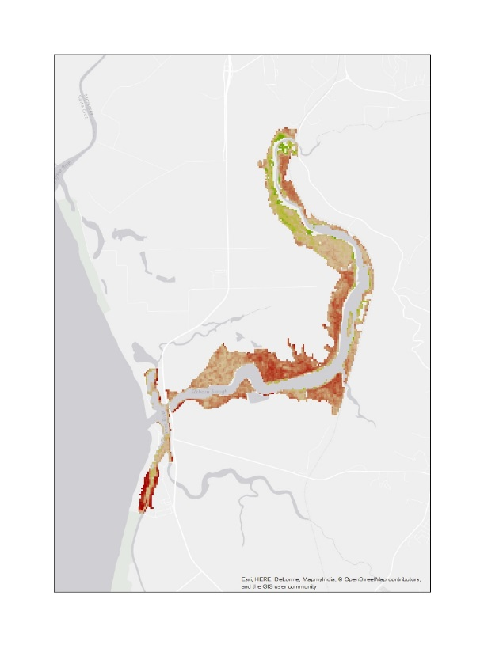
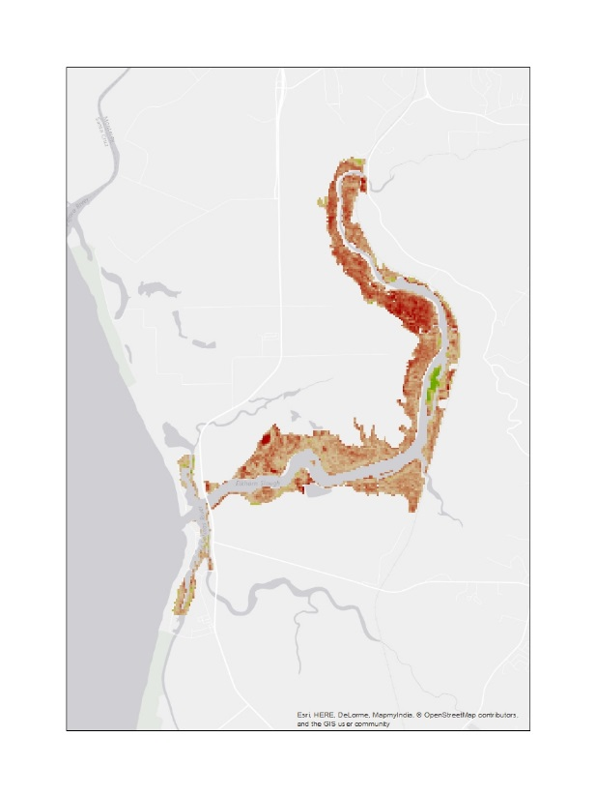
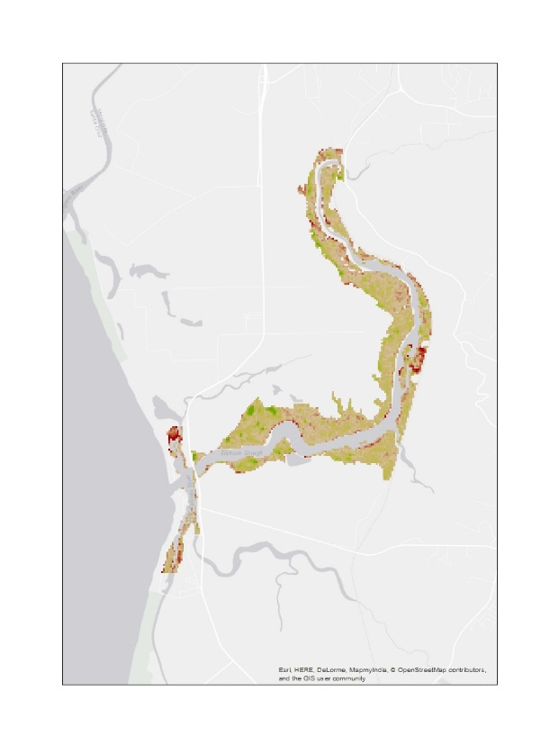
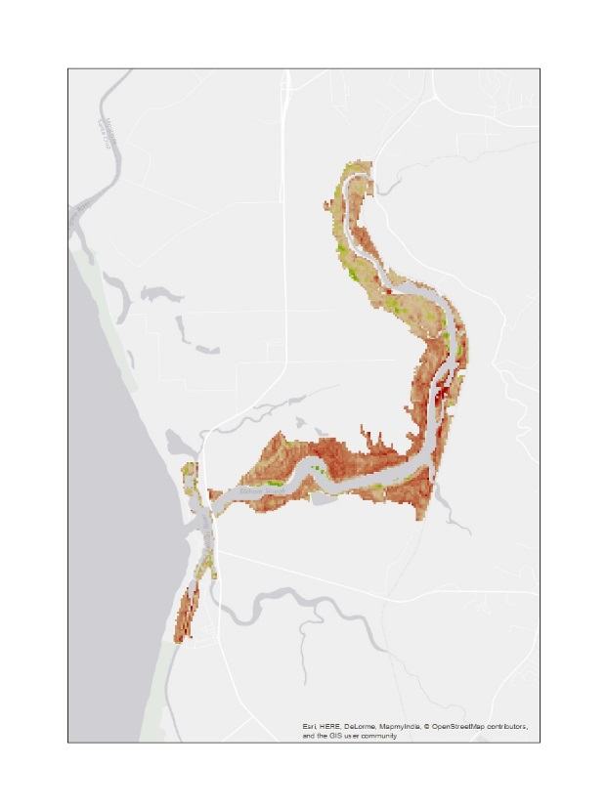
Results: Historical Time-Series Analyses
Overall, there was positive NDVI productivity between 1997 to 2016.
There was a weak negative correlation between El Niño Southern Oscillation Index (ENSO) and Normalized Difference Vegetation (NDVI) averages taken from the entire study area and three delineated regions for each El Niño year.
Vegetation productivity decreased in years without ENSO.
1996 to 1997
2001 to 2002
2006 to 2009
2013 to 2015
Notes:
An unexpected finding occurred when we compared vegetation health during “normal” years preceding El Nino. We saw that vegetation health was much worse in comparison to ENSO years. This could be due to a lag effect following El Nino events, again further analysis is encouraged in the future to consider other climatic variables or identify possibility of lag effect.

Slide 15
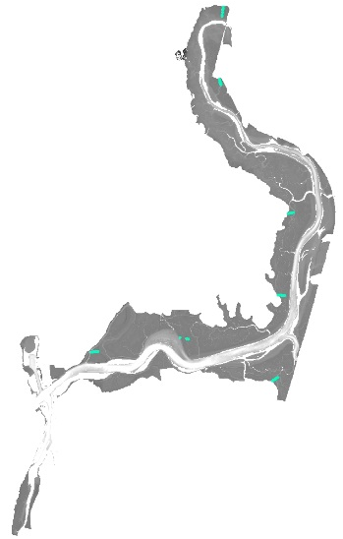
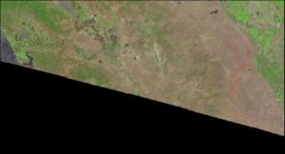
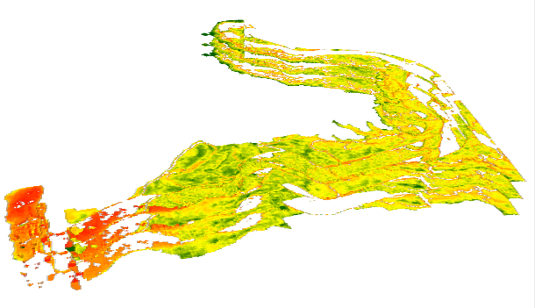

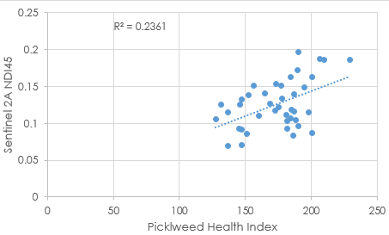
Methods: Present Day Comparison
Vegetation Indices Applied (GEE) to clipped,
water masked out Study Area
Plot data and run regression to detect trends between imagery and in situ data
Import in situ point level vegetation transect data
Extract Vegetation Index Values to in situ points
Acquire
Sentinel 2A Image
(August 13, 2016)
Notes:
For the present day comparison the methods employed were to acquire Sentinel 2A imagery from August 13, 2016 in GEE, apply vegetation indices to masked image, import in situ data to imagery, and plot regression analyses in Excel to compare vegetation indices with in situ data.

Slide 16
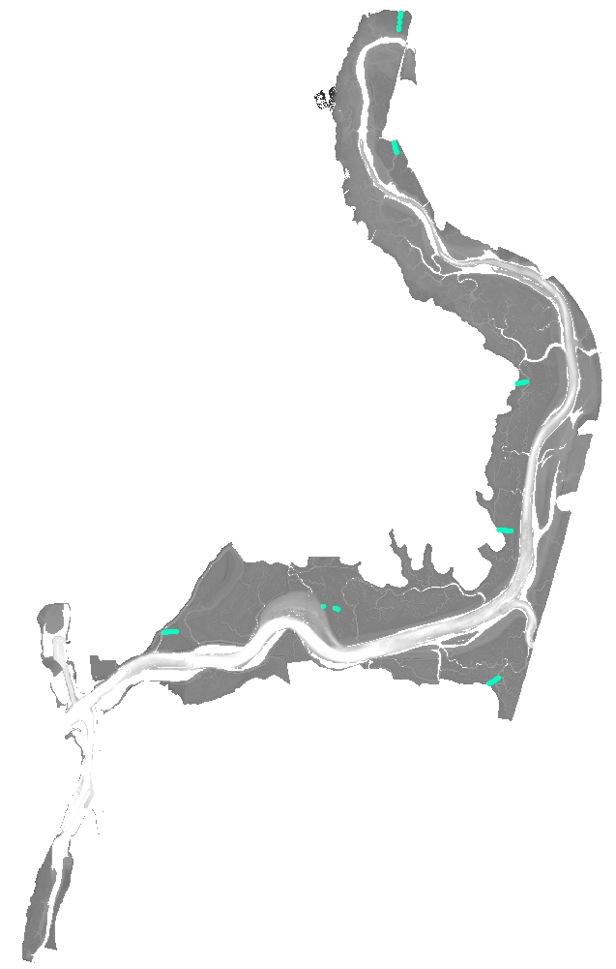
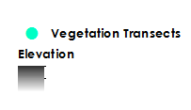
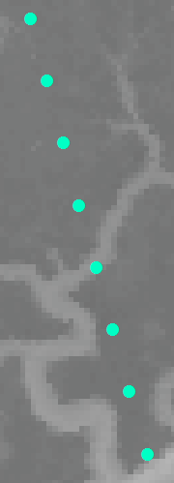
In situ Transect Data
All 49 Quadrants distributed across Study Area
In situ data gathered by ESNERR September 2016.
Of the total 80 quadrants of data collected, 49 quadrants were used that were:
Within Study Area (unrestricted tidal marsh)
Pickleweed Health Index > 0
Pickleweed Health Index =
Canopy Height
+
% Cover
+
% that is Juicy
8 quadrants distributed across 1 transect (Azevedo Marsh)
Notes:
The In situ data was gathered by ESNERR in September 2016 with eight transects total and 10 quadrats per transect. Our criteria for including which quadrats to analyze was that the individual quadrat had to be within the study area and have a Pickleweed Health Index value greater than zero. The Pickleweed Health Index = canopy height + percent cover of pickleweed + percent cover of juicy pickleweed. The figure on left shows distribution of the 48 quadrats we included in the analysis and figure on the right shows a close up view of the transects in Azevedo Marsh.

Slide 17
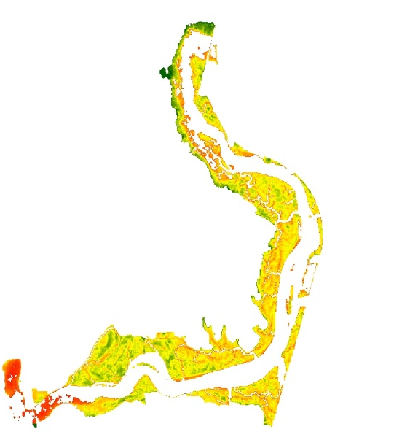
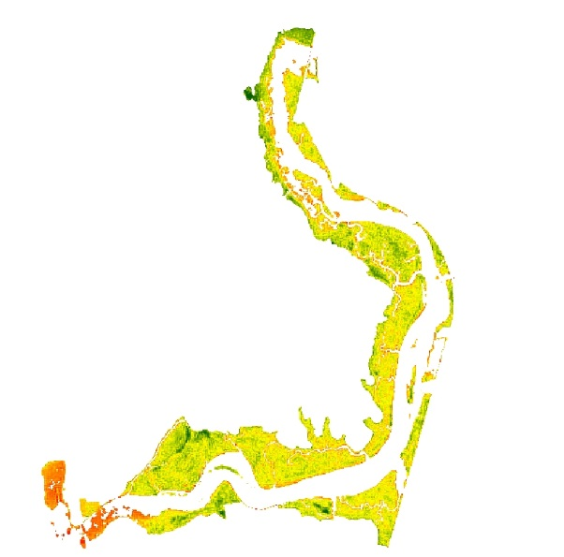
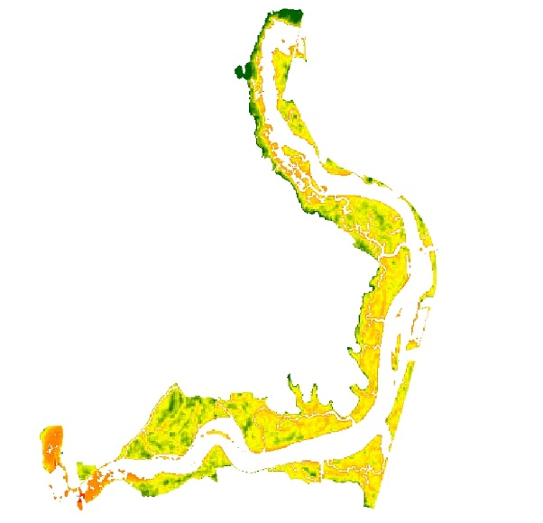
Results: Present Day Analysis
Sentinel 2A Image from August 13th, 2016 (all 10m resolution)
Normalized Difference Vegetation Index (NDVI)
(NIR - R)/(NIR + R)
Normalized Difference Index 45(NDI45)
(NIR - R)/(NIR + R)
Inverted Red-Edge Chlorophyll Index (IRECI)
(NIR - R)/(RE1/RE2)
Notes:
These are visualizations of the three vegetation indices (NDVI, NDI45 and IRECI). Like the historical analysis we preformed NDVI on the Sentinel 2A imagery. We also utilized the second near inferred band on this instrument to preform other vegetation indices to see which on would provide our partners with the most accurate and useful information. The equations for calculating indices shown below each visualization

Slide 18
Results: Present Day Analysis
NDVI R-squared
0.22
NDI45 R-squared
0.27
IRECI R-squared
0.22
Notes:
Shown here is the R-squared values for study area and pickleweed health index values vs all vegetation indices. The graph is of Pickleweed Health Index vs NDI45. Despite a weak, positive correlation, the low r-squared values indication that the relationship between the Pickleweed Health Index and vegetation indices is not statistically significant. We’ll get to why this may be in a couple slides.

Slide 19
Results: Present Day Analysis
For all indices, stronger correlation in higher elevation marsh (>156 cm) than lower elevation (<156 cm) marsh.
High Elevation Marsh R-squared
0.16
Low Elevation Marsh R-squared
0.06
High Elevation Marsh R-squared
0.14
Low Elevation Marsh R-squared
0.15
High Elevation Marsh R-squared
0.33
Low Elevation Marsh R-squared
0.08
Notes:
Here are the histograms and R-squared values for each of the three indices. You will notice that they are consistently low when broken down by elevation but there is a trend among the higher elevation relationships indicating that using vegetation indices are better suited for identifying productive vegetation in higher elevation marsh than in lower elevation marsh.

Slide 20
Results: Present Day Analysis
Inverted Red-Edge Chlorophyll Index (IRECI) among the three indices correlates the strongest with high elevation marsh
High Elevation Marsh R-squared
0.18
High Elevation Marsh R-squared
0.16
High Elevation Marsh R-squared
0.34
Notes:
When we just focused on the high elevation correlations we found that the IRECI index shows the highest r-squared value at 0.34 but again, to reiterate these are such low r-squared values that we can not conclude that the relationship between the vegetation indices and the Pickleweed Health Index for these quadrats is statistically significant.

Slide 21
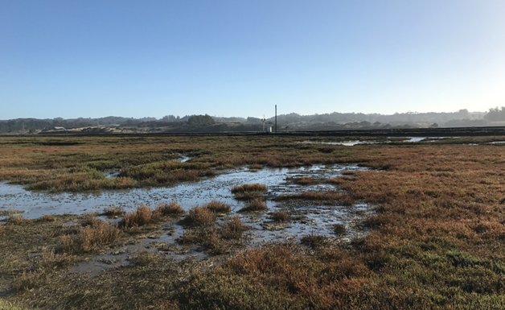
Results: Present Day Analysis
Question of scale – size of quadrat vs. size of pixel
Pickleweed Health Index the most comprehensive measure?
Future field work – different in situ plots?
Notes:
What this really comes down to is a question of scale. The size of quadrat plot is 50 cm squared and the size of the vegetation indices is 10 m squared. Because Elkhorn Slough is so variable in a small area, the possibility of finding a strong relationship between the vegetation indices and the quadrat in situ data is minimal. Also it is important to note that the Pickleweed Health Index is not a quantitative measurement and future studies should consider using another index to analyze Pickleweed health.

Slide 22
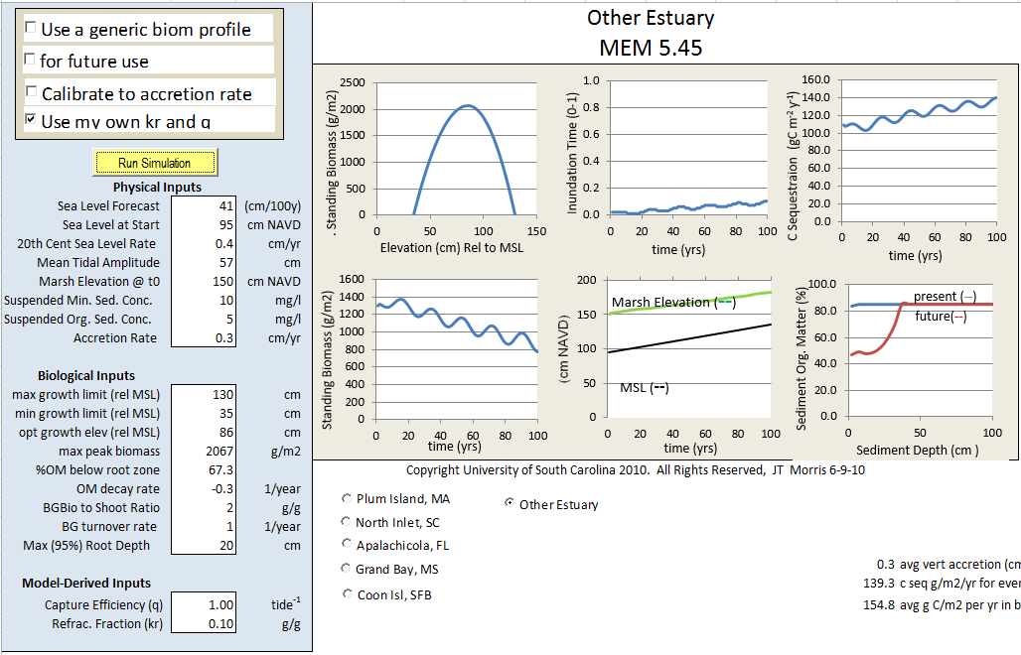
The Marsh Equilibrium Model (MEM)
Incorporates in situ data to predict marsh resilience to sea level rise and carbon sequestration capabilities
Hindcasting can be used to site specific calibration
Forecasting100 years with varied sea level rise scenarios
Image Credit: JT Morris, University of South Carolina, 2010
Notes:
The Marsh Equilibrium Model (MEM) was developed by Dr. James Morris at the University of South Carolina and it is designed to predict marsh resilience to sea level rise. This slide shows the user interface and on the left panel are all of the inputs. The model incorporates a mix of physical and biological inputs. The physical inputs include the forecasted sea level rise and biological inputs include a variety of data measured in situ. One of the important biological inputs is shown in the upper left image of standing biomass vs. elevation. This is important because marsh vegetation grows at a range of elevations and different types of vegetation will respond differently --- something to keep in mind for later in the presentation.

Slide 23
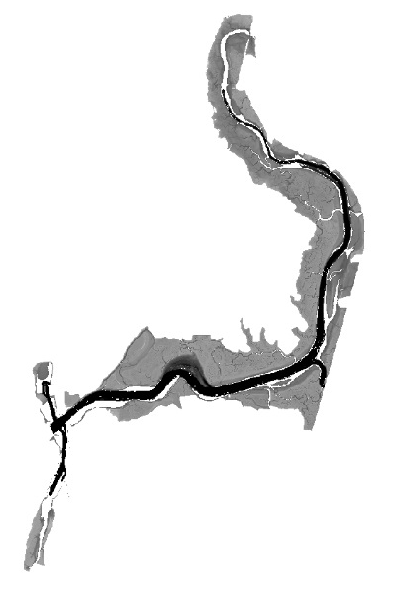
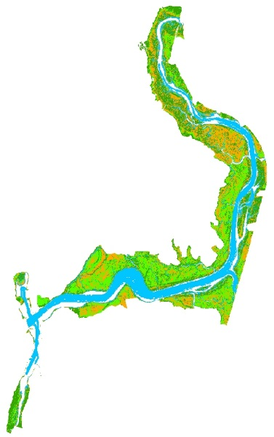
Methods: Resilience to Climate Change
The Marsh Equilibrium Model (MEM) (Morris et al., 2002) was run with data provided by ESNERR, Schile et al. (2014) and NOAA mean sea level trends
Acquired
2013 NOAA Coastal California TopoBathy Merge Project DEM and corrected the DEM using code created by Buffington et al. (2016)
MEM output was overlaid onto the DEM using the ArcMap Model builder created by Schile et al., 2014
Image Credit: JT Morris, University of South Carolina, 2010
Notes:
This slide outlines the methods used to forecast marsh resilience to sea level rise using the Marsh Equilibrium Model. Data from the model was used from ESNERR in situ measurements, a study of China Camp State Park by Schile et al. (2014) (a good proxy site because it also has pickleweed and is in a similar climate), and NOAA mean sea level trends. Since the MEM does not have a spatial component, we followed methods outlined by Schile et al. (2014) and the model builder Lisa Schile created to display the outputs onto a digital elevation model (DEM).

Slide 24

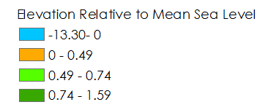
Results: DEM Correction
Ran code provided by Buffington et al. (2016) with an NDVI threshold of -0.5 improved RMSE 0.2 to 0.07
Notes:
Since the MEM does not have a spatial component, we followed methods outlined by Schile et al. (2014) and the model builder Lisa Schile created to display the outputs onto a DEM. However, marshes have such dense vegetation, the LIDAR returns can make the elevations falsely high, so we have this intermediate step to correct the DEM using code provided by Buffington et al. (2016)

Slide 25
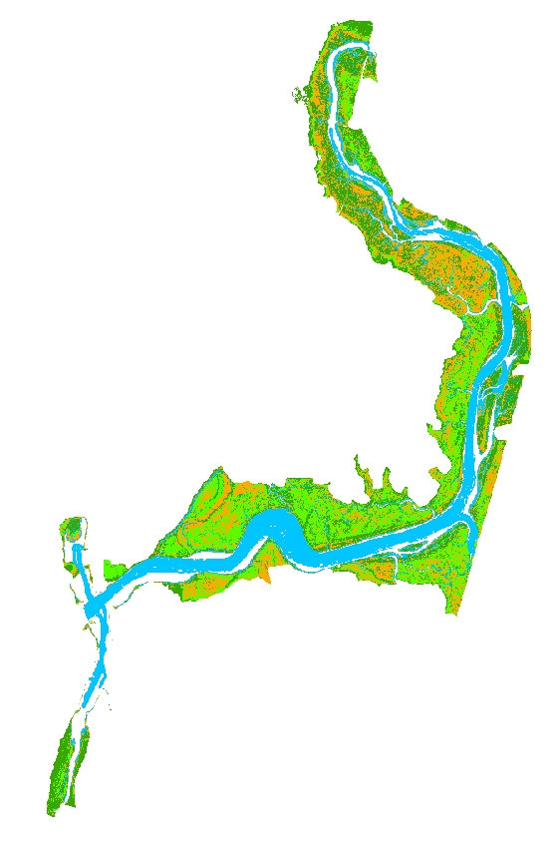
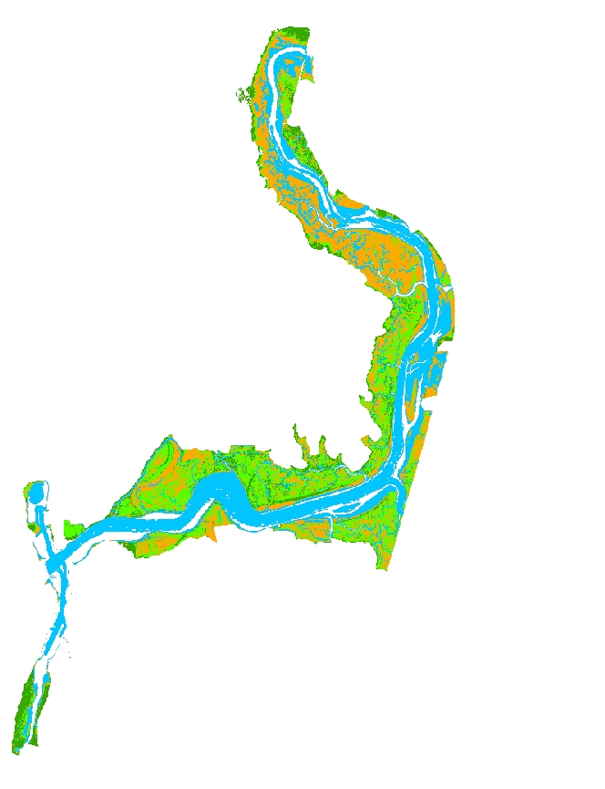
Results: Resilience to Climate Change
14 cm
100 cm
Corrected DEM
14 and 100 cm sea level rise scenarios over a century
Subsidence of 27 cm was added to the total sea level rise
Marsh improved with a small amount of sea level rise
Marsh appeared unchanged with 100 cm sea level rise
Notes:
Here are results from running the MEM at a sea level rise scenario of 14 cm in a century – the long term sea level rise based on NOAA mean sea level trends and 100 cm to show a higher sea level rise scenario. Since the model does not incorporate subsidence (sinking of the marsh), we added this to the sea level rise to increase the relative sea level rise. The marsh does better in the model with small amounts of sea level rise. One thing to note is that the organic suspended sediment concentration were lower in the simulation for 100 cm than 14 which could also contribute to the worse conditions in addition to the increased sea level rise.

Slide 26

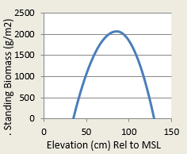
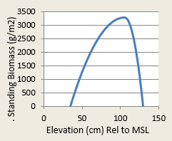
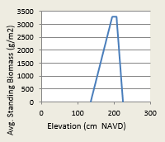
Discussion: Resilience to Climate Change
Why does the model not capture Elkhorn Slough’s decline?
  Elkhorn Slough is dynamic and not in equilibrium
  Vegetation type impacts the standing biomass curve (Janousek et al., 2016)
  Parameters may need adjustments to accommodate marsh variability
Images Created using the Marsh Equilibrium Model
Notes:
This photo shows how the slough is already declining, so it is unlikely that with sea level rise the marsh will improve since it is already vulnerable. Future studies should tweak parameters and run different simulations to better match the slough’s current state.
The biomass curve is an input that should be looked at because the figure on the left shows a parabolic relation used for the model, however pickleweed has been found to have more of a wedge shaped relationship (Janousek et al., 2016). When we were using the higher biomass and wedge shaped curve (shown in the other two images), the model would overflow.
Image taken from Elkhorn Slough Ecoforecasting II Team during site visit to Elkhorn Slough.

Slide 27
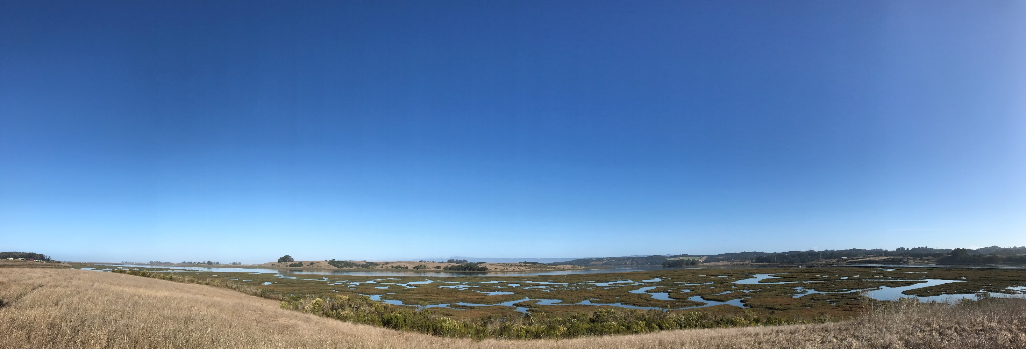
Conclusion & Future Work
Analyze the effects of other climatic variables
In situ scale is important
Apply different vegetation indices to hyperspectral imagery for following years
Adjust MEM parameters and perform additional simulations to assess the slough’s resilience to climate change
Notes:
To conclude we determine that further research analysis for years without the presence of El Niño would be beneficial in identifying the possibility of a lag effect on vegetation health. Our partners should also consider the size of the satellite pixel and the scale of future in situ points. Also, gathering in situ data specific to Elkhorn Slough for unknown MEM physical/biological inputs may result in more information predictions.
Image taken from Elkhorn Slough Ecoforecasting II Team during site visit to Elkhorn Slough.

Slide 28
We would like to thank the following for their continued support and guidance:
Bay Area Environmental Research
Institute (BAERI)
Dr. Juan Torres-Perez
Dr. Sherry L. Palacios
Elkhorn Slough National Estuarine
Research Reserve (ESNERR)
Dr. Kerstin Wasson
Charlie Endris
Andrea Woolfolk
Monique Fountain
ARC DEVELOP
Brittany Zajic
Jenna Williams
Past Contributors: Irma Caraballo Álvarez, Abigail Childs, Kirsten Jurich
US Geological Survey (USGS)
Dr. Kristin Byrd
Notes:
We would like to thank all of those who help make this project a success.

Slide 29
References
Buffington, K.J., Dugger, B.D., Thorne, K.M., & Takekawa, J.Y. (2016). Statistical correction of lidar-derived
digital elevation models with multispectral airborne imagery in tidal marshes. Remote Sensing of Environment, (186), 616-625.
Crooks, S., Herr, D., Laffoley, D., Tamelander, J., & Vandever, J. (2011). Regulating Climate Change Through
Restoration and Management of Coastal Wetlands and Near-shore Marine Ecosystems: Mitigation
Potential and Policy Opportunities. World Bank, IUCN, ESA PWA, Washington, Gland, San Francisco.
Elkhorn Slough: Conservation. (n.d.). Retrieved September 29, 2016, from
http://www.elkhornslough.org/conservation/index.htm
Janousek, C.N., Buffington, K.J., Thorne, K.M., Guntenspergen, G.R., Takekawa, J.Y., & Dugger, B.D. (2016). Potential effects of sea-level rise on plant productivity:species-specific responses in northeast Pacific tidal marshes. Marine Ecology Progress Series, 548, 111-125.
Morris, J.T., Sundareshwar, P.V., Nietch, C.T., Kjerfve, B., & Cahoon, D.R. (2002). Responses of coastal
wetlands to rising sea level. Ecology, 83(10), 2869-2877.
Schile, L. M., Callaway, J. C., Morris, J. T., Stralberg, D., Parker, V. T., & Kelly, M. (2014). Modeling tidal
marsh distribution with sea-level rise: Evaluating the role of vegetation, sediment, and upland habitat
in marsh resiliency. PloS one, 9(2), e88760.
Van Dyke, E., & Wasson, K. (2005). Historical ecology of a central California estuary: 150 years of habitat
change. Estuaries, 28(2), 173-189.

