Slide 1
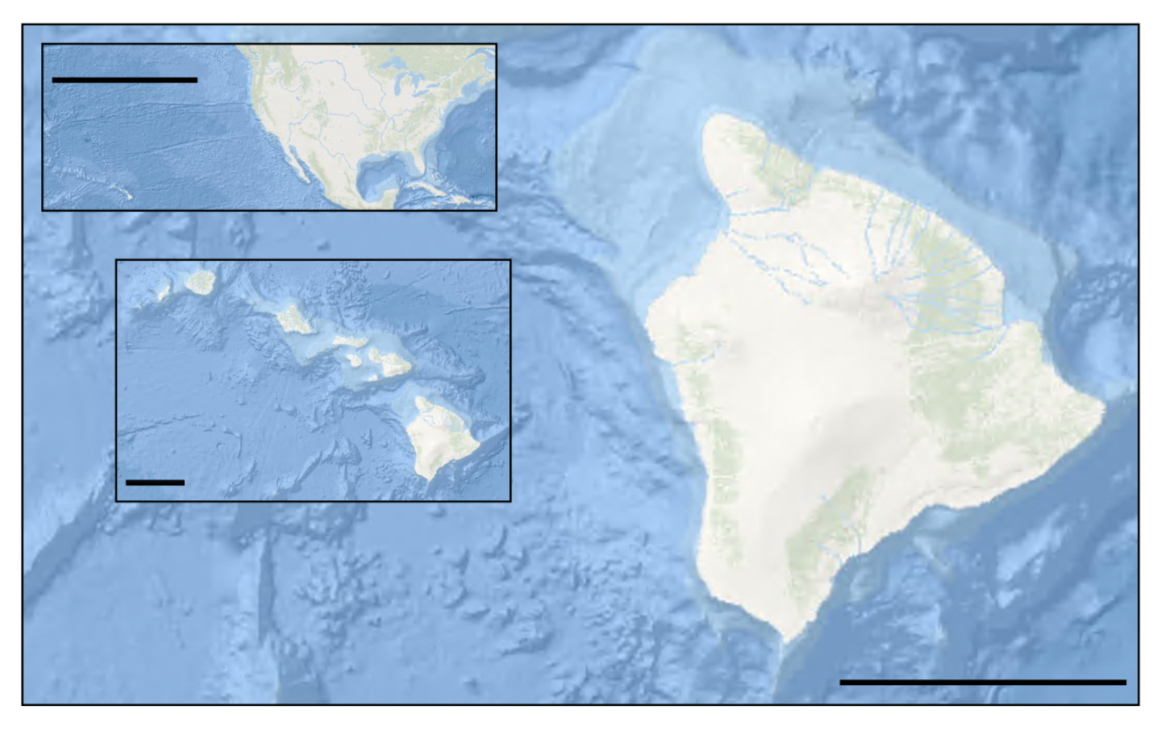
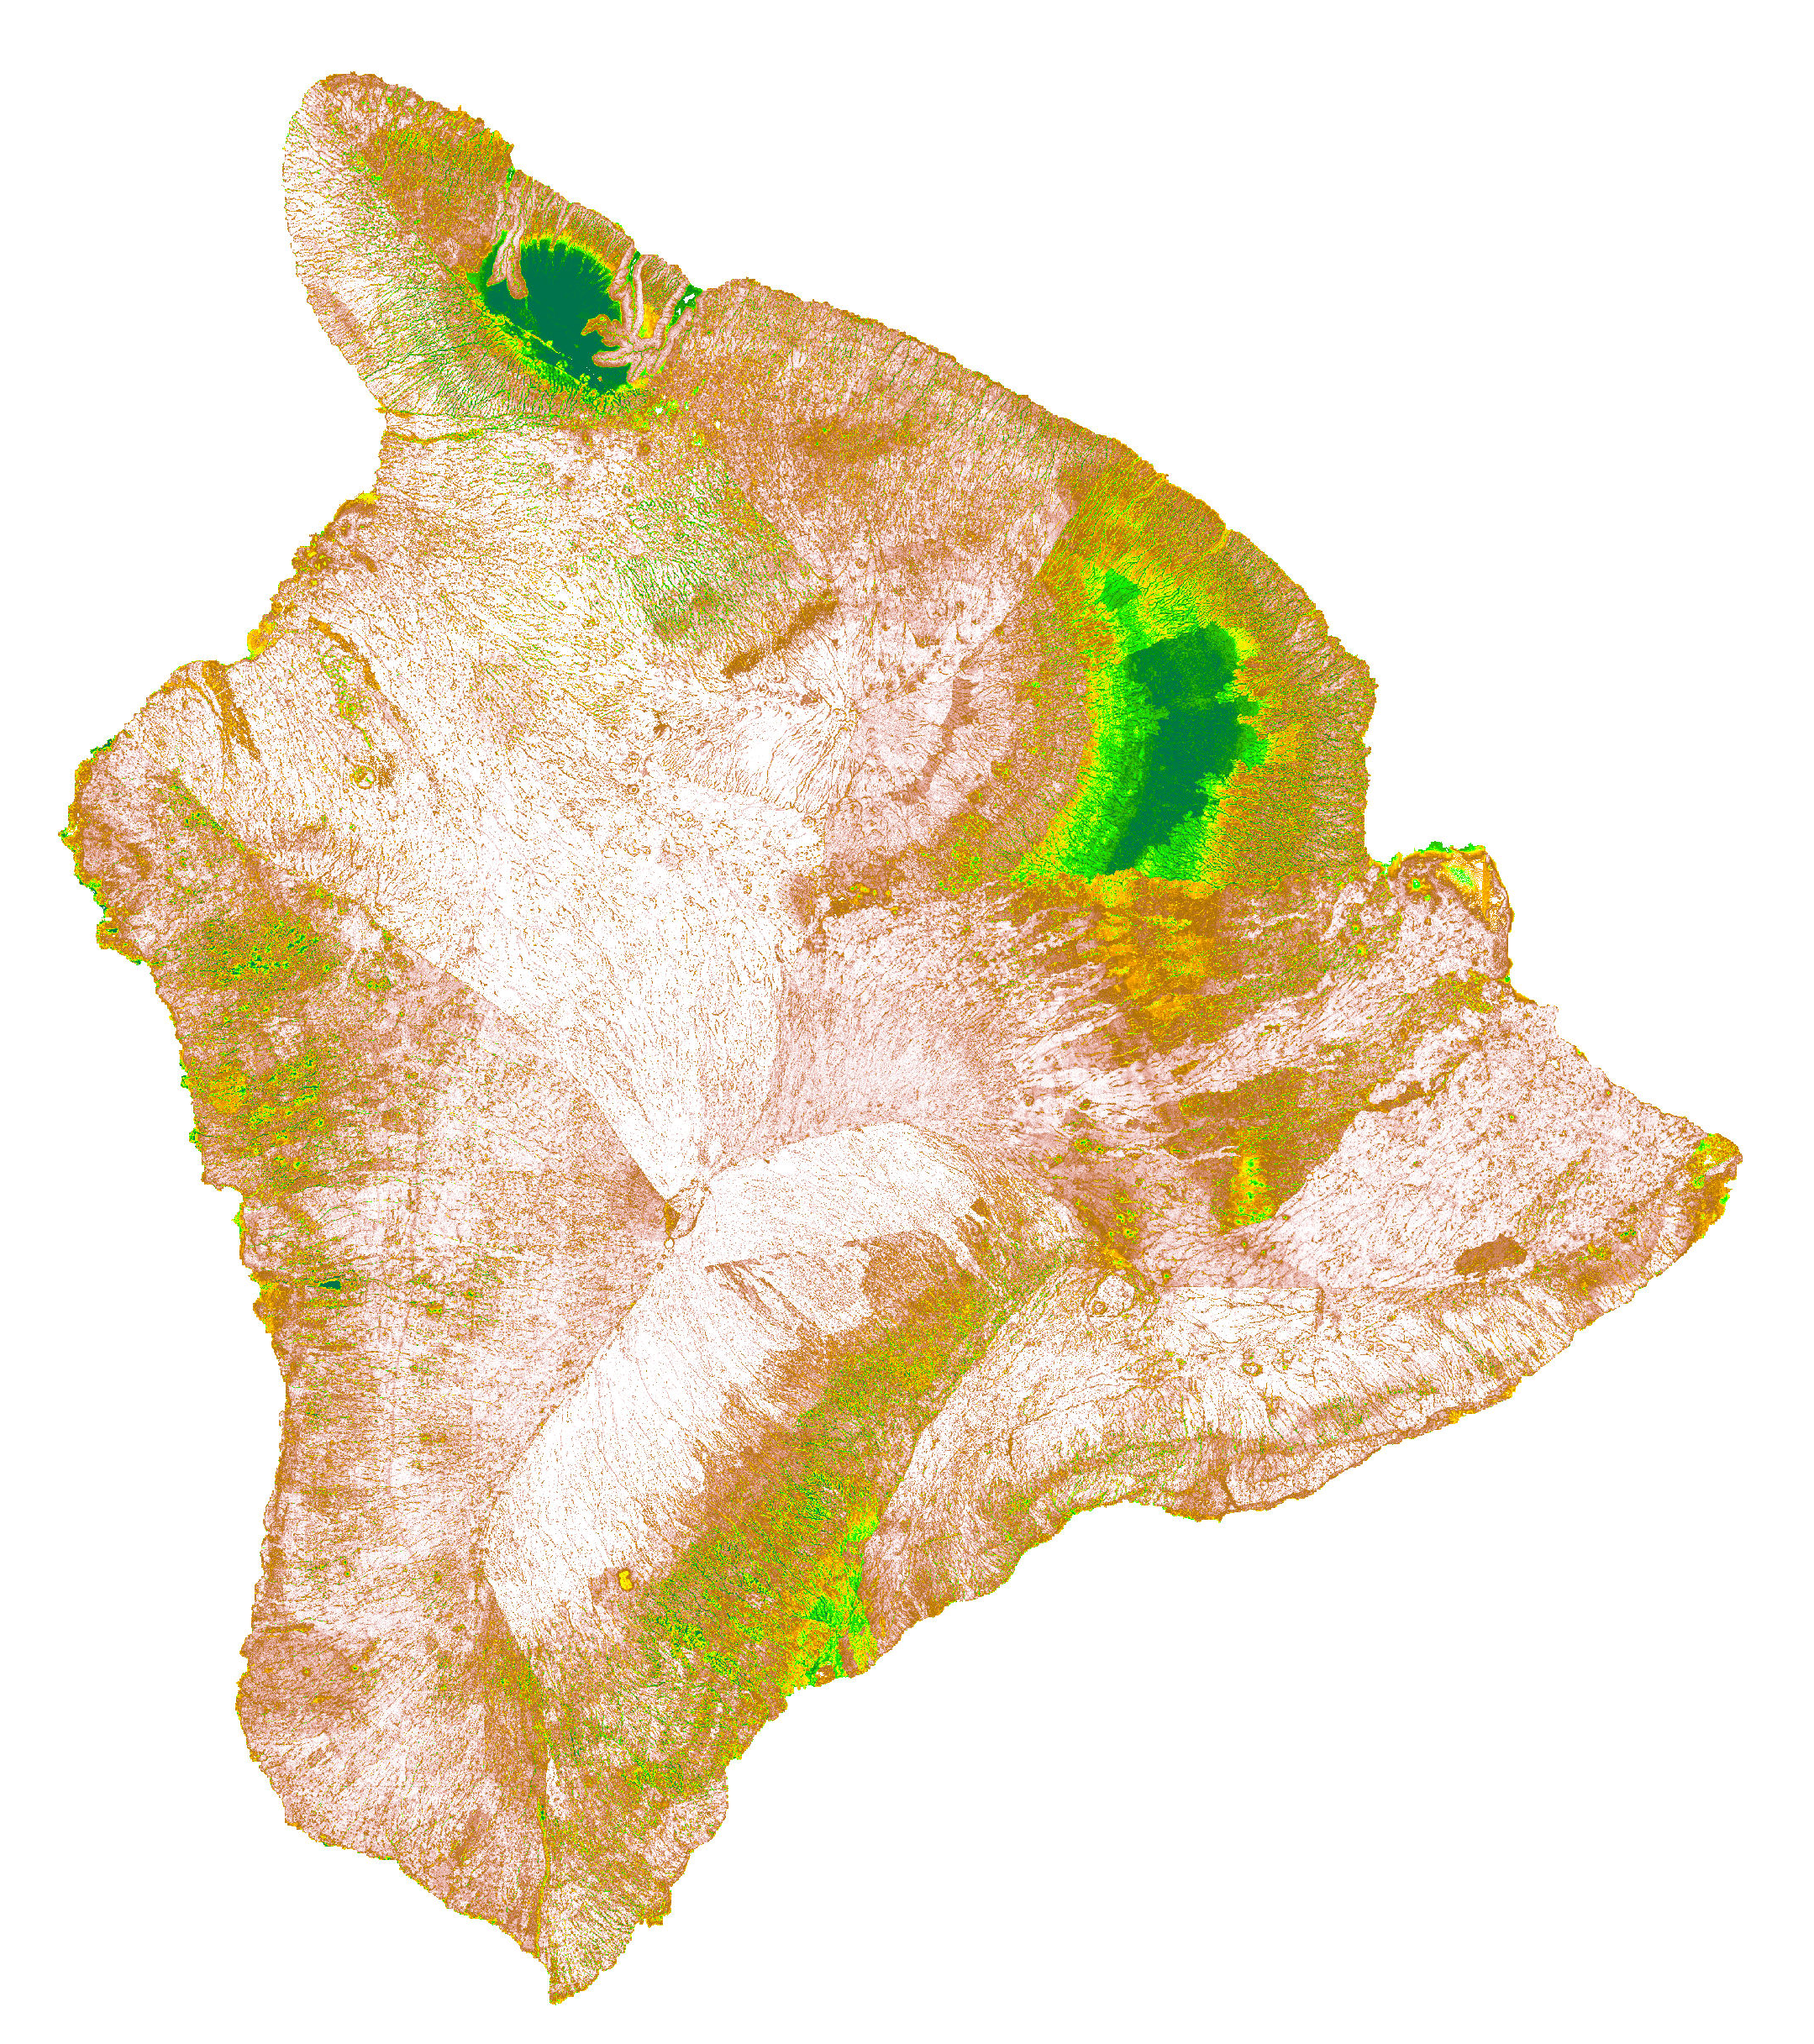
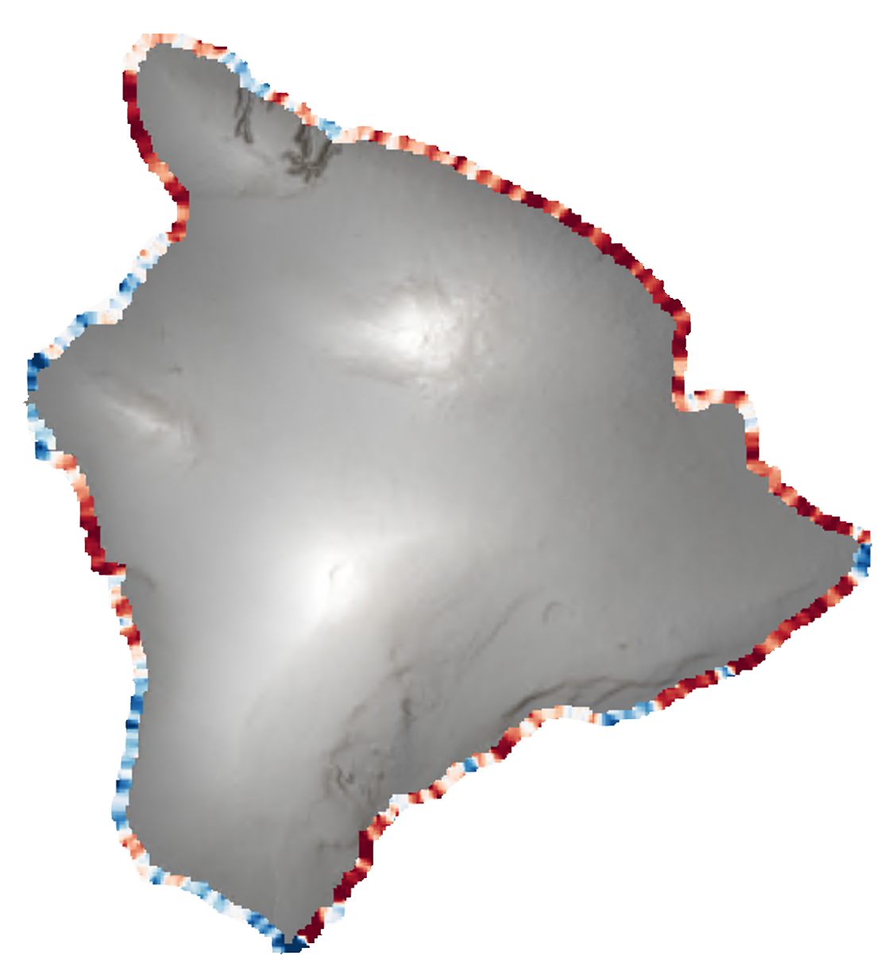
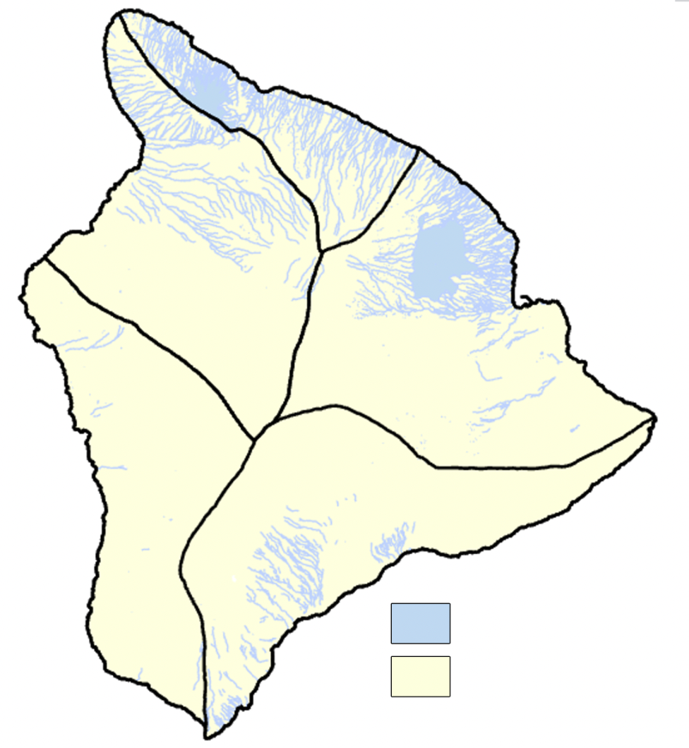
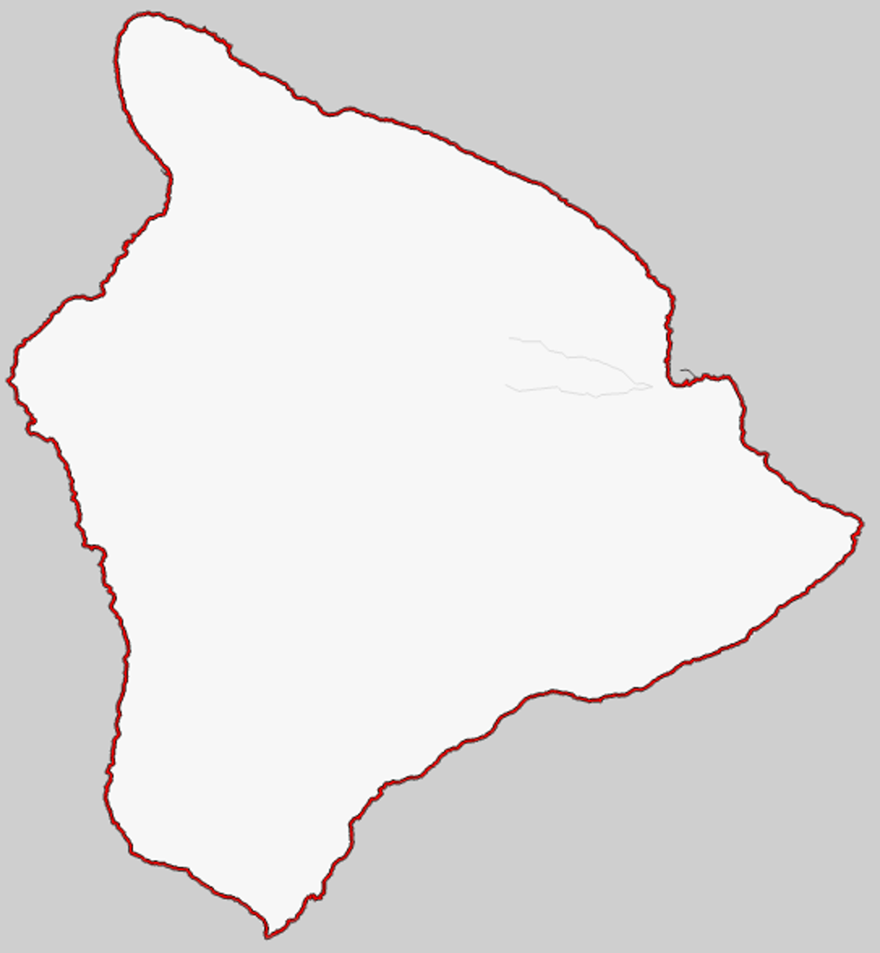
Utilizing Earth Observations to Delineate Wetland Extents, Model Sea-Level Rise Inundation Risk, and Assess Impacts on Historic Hawaiian Lands
Abstract
Objectives
Hawaii Island Climate
Climate induced sea-level rise poses a risk to coastal areas on the Island of Hawaii and many of the island’s historic cultural lands are in danger of becoming inundated. In partnership with the County of Hawaii, the State of Hawaii Department of Land and Natural Resources, and Arizona State University, NASA DEVELOP modeled near-term sea-level rise inundation risk and wetland extent. The team utilized NASA Earth observations over a 10-year span (2013-2022) that included data from NASA MEaSUREs Gridded Sea Surface Height Anomalies (SSHA) and the Group for High Resolution Sea Surface Temperature (GHRSST) to model sea level rise inundation risk. We used a random forest model to classify near-term inundation risk along the entire coast of Hawaii for 5 known local flood events from 2019 – 2021, using physically related features like sea surface height anomalies and soil permeability. Additionally, the team compared the in situ local tidal gauge data around Hawaii to the SSHA data. Current wetland extents and probabilistic locations of new wetlands were modeled with data from PlanetScope Surface Reflectance optical imagery (2022), United States Geographic Survey (USGS) 3D Elevation Program 10m DEM (2013), temperature and precipitation data from the Hawaii Climate Atlas (2021), and soils data from the Hawaii Soil Atlas (2014) using the Wetland Intrinsic Potential (WIP) tool. Results indicated locations with the highest probability of wetlands. The project deliverables will assist our partners in their efforts to meet regulatory requirements for wetlands protection, evaluate near-term sea level inundation risk, and guide decision-making for Shoreline Setback and Climate Adaption plans.
Create an up-to-date coastal wetlands extent map of Hawaii, showing the probability of potential and current coastal wetland extents of the study area
Model short-term inundation risk of present-day Hawaii to generate risk indexes (e.g., high, medium, low risk of inundation/flooding)
Compare mean sea level height data from in situ tidal gauges to the sea surface height anomaly data for correlative and predictive analysis.
Earth Observations
NASA MEaSUREs
Making Earth Science Data Records for Use in Research Environments
PlanetScope
Sea Surface Height Anomaly
Jason-1 Microwave Radiometer/POSEIDON-2, Jason-2 Advanced Microwave Altimeter/POSEIDON-3, Jason-3 POSEIDON-3B/AMR, and TOPEX POSEIDON TMR/SSALT.
Sea Surface Temperature Anomaly
Terra MODIS, Aqua MODIS AMSR-E, CORIOLIS WINDSAT, NOAA-19 AVHRR-3, and GCOM-W1 AMSR2
Results
Study Area
Wetland Extent Map Ranked importance for all wetland models showed that both climate and soils data variables scored highly. All probability models were tuned to achieve a less than 10% Out of Bag Error.
Sea Level Rise Inundation Map The simple random forest model had a 90% (and 10% OOB) for intra-event classification, with sea surface temperature anomalies (SSTA) and precipitation being the most important features.
4,000 km
Hawaii
Hawaii
Island
Wetland Extent Map
Sea Level Rise Inundation Map
75 km
Elevation
-1
4,200
80 km
Methodology
Inputs
Wetland Extent Map
Hydrologic Inputs
Topographic Wetness Index (TWI)
Depth to Water (DTW)
Imagery
Inputs
Normalized Difference Vegetation Index (NDVI)
Train
Model
Processing
Probability
Flood Risk
Topographic Inputs
(each at scale of 50m, 150m, and 300m)
Gradient
Plan Curvature
Profile Curvature
Local Relief (DEV)
Wetland Intrinsic Potential Tool
Low High
Very
Low
Very
High
Hawaii Soil Atlas Inputs
Water Permeability
PH
Organic Matter Content
Wetlands
Conclusions
Hawaii Climate Atlas Inputs
Monthly Mean Precipitation (June & December 2021)
Monthly Mean Temperature (June & December 2021)
Uplands
Wetland Extent Map
Soils and climate data continually ranked highly in model importance statistics
Volcanic activity causes frequent landscape changes and having the most recent and highest resolution elevation data would increase model accuracy and mitigate false positives
Sea Level Rise Inundation Map
Feasibility study that support past findings (Nieves, V., Radin, C., & Camps-Valls, G., 2021), showing the potential of using RF for flood prediction
Much more data still needed to make inter-event and future predictions possible
Sea Level Rise Inundation Map
Inputs
Processing
Elevation
Compute input values at coastline transects
Precipitation
Training Data
Sea Surface Height
Anomaly
Buffers:
500 m inland,
15 km seaward
Random Forest Model
Project Partners
Water Permeability
Flood Risk
County of Hawaii Planning Department
State of Hawaii Department of Land and Natural Resources
Arizona State University Center for Global Discovery and Conservation Science.
Sea Surface Temperature Anomaly
Coastline
Transect
Team Members
Acknowledgements
We thank our science advisors Dr. Roberta Martin, Dr. Jiwei Li, and Dr. David Hondula from Arizona State University. We thank Ryan Hammock, our NASA DEVELOP Fellow.
Tool developers and support:
WIP Tool: Meghan Halabisky, University of Washington and Dan Miller, TerrainWorks.
Global Flood Mapper: Pratyush Tripathy and Teja Malladi, Indian Institute for Human Settlements
This material contains modified Copernicus Sentinel data (2015-2022), processed by ESA and modified PlanetScope data (2022) processed by Planet.
Nieves, V., Radin, C., & Camps-Valls, G. (2021). Predicting regional coastal sea level changes with machine learning. Scientific Reports, 11(1), 1-6. DOI: 10.1038/s41598-021-87460-z
Lisa Tanh
Project Lead
Ian Lee
Connor Racette
Matilda Anokye
Arizona – Tempe

