Slide 1
Assessing Landscape Vulnerability to Drought and Climate Change in National Parks of the Western United States
Western US Water Resources
Kelly Meehan (Project Lead)
Teresa Fenn
Kaylie Taliaferro
Molly Spater
Thomas Smith
Grant Jaccoud
Image Credit: NPS
Notes:
Hi we are the Western US Water Resources Team, my name Kelly Meehan and I’m the project lead, I have a master’s degree from Duke University in Environmental Management. Hi I’m Teresa Fenn, I have a bachelor’s degree from the University of Mary Washington in Environmental Science. Hi I’m Molly Spater, I have a bachelor’s degree from UCLA in Geography. I’m Kaylie Taliaferro, I am at Biola University studying mathematics . I’m Grant Jaccoud and I have an Associates Degree from Mercer County Community College in Computer Science. Hi I’m Tom Smith, and I am currently at Clark University studying geography.

Slide 2
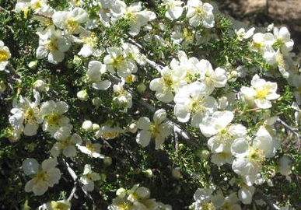
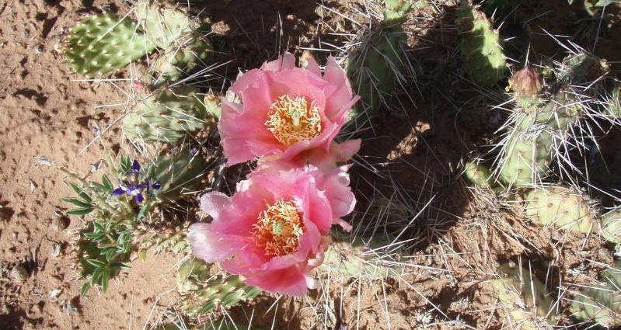
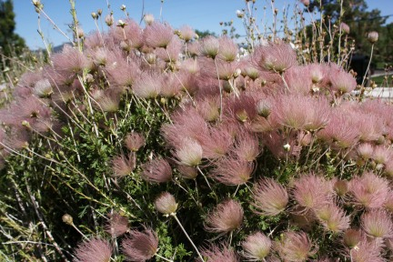
Community Concerns
The West has been experiencing drought for over a decade
Much of the vegetation in the American West is water limited
Vegetation shifts are the early warning signs of: Environmental thresholds
Image Credit: BiodiversityWarriors
Image credit: NPS
Image Credit: Garden of Edith
Notes:
Much of the American West has experienced drought in 11 of the past 14 years. Combined with rising temperatures, water availability is of increasing concern to land managers in this region.
Prolonged disturbances, such as drought, could push an ecosystem past a threshold which signifies an irreversible change from one type of ecosystem to another.
TOM
Left Image Credit: http://images.fineartamerica.com/images-medium-large-5/cliff-rose-charles-robinson.jpg
Center Image Credit: https://www.nps.gov/common/uploads/photogallery/imr/park/care/68CA8441-155D-451F-67E9CF2651D2E1AB/68CA8441-155D-451F-67E9CF2651D2E1AB-large.jpg
Right Image Credit: Image Credit: http://www.garden-of-edith.com/wp-content/uploads/2015/05/IMG_5065ApachePlumeCloseUpAfterBloom.jpg

Slide 3
Objectives
Pivot Point
+
Determine climate pivot points
Evapotranspiration
Precipitation
Temperature
0
Delta NDVI
Formulate a methodology to determine vegetation response
-
Low
Precipitation
High
Image Credit: Virgin Town, Utah
Notes:
Climate pivot points are early warning signs of such an approaching irreversible threshold. Specifically, they are indicators of when vegetation productivity may either begin to increase or decrease.
The primary objective of this study was to determine climate pivot points of different plant communities for various environmental factors – including evapotranspiration, precipitation, and temperature. These environmental factors were related to water availability, which is critical in this semi-arid region. Our methodology will be offered to land managers at the National Park Service in the western United States to better understand the response of vegetation to a changing climate.
TOM
Image Credit: http://www.virginutah.org/files/PHOTOS/PHOTOGALLERY/MESA_VIEW1.jpg

Slide 4
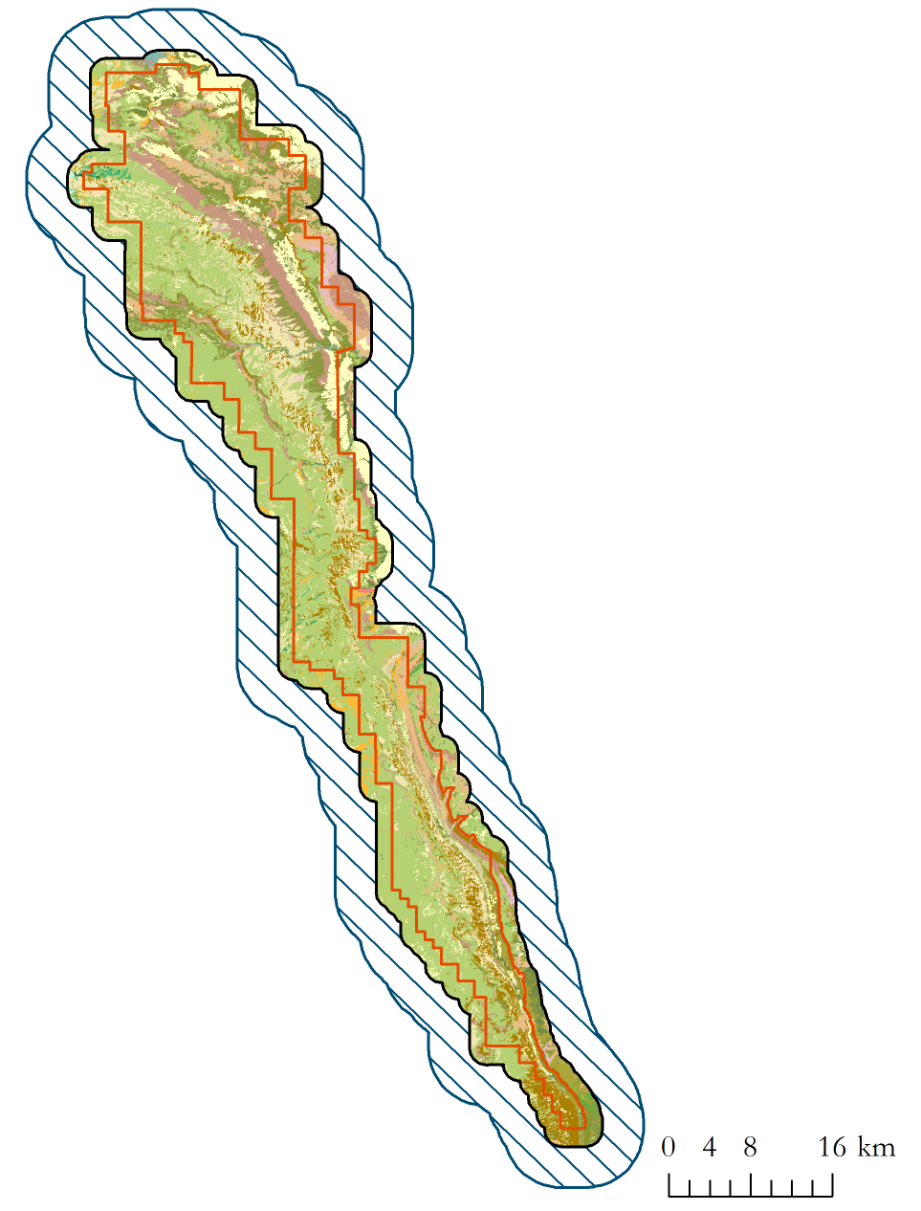
Study Area and Period
Capitol Reef National Park, Utah
2000
2014
Notes:
The study area for our project was Capitol Reef National Park in south-central Utah. The study period ranged from the years 2000- 2014, corresponding to the availability of MODIS data.
Grant

Slide 5
Methodology
Data acquisition and
pre-processing
Multiple Linear Regression Model
Pivot Point Extraction
Data Analysis
Image Credit: Travel Around USA
Notes:
Our analysis consisted of four main parts: data acquisition and pre-processing, data analysis, creating a multiple linear regression, and extracting pivot point values.
Grant
http://www.travelaroundusa.com/capitol-reef-national-park-ut.html

Slide 6
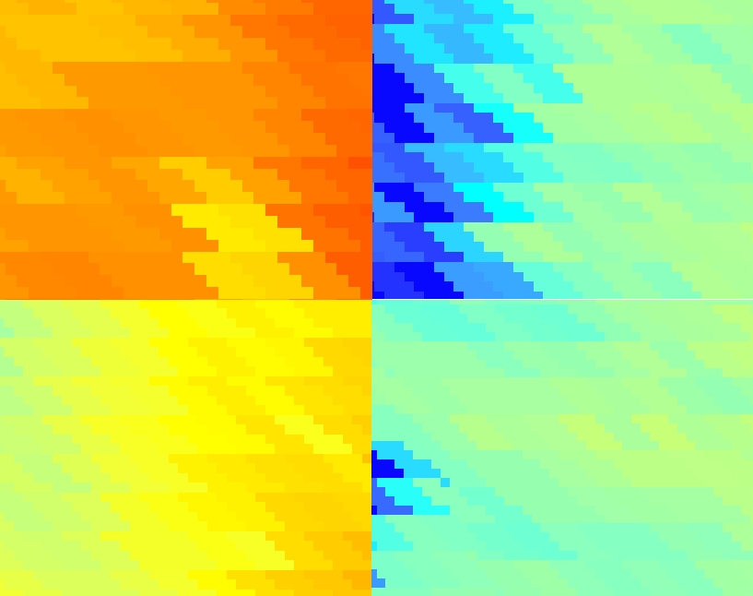
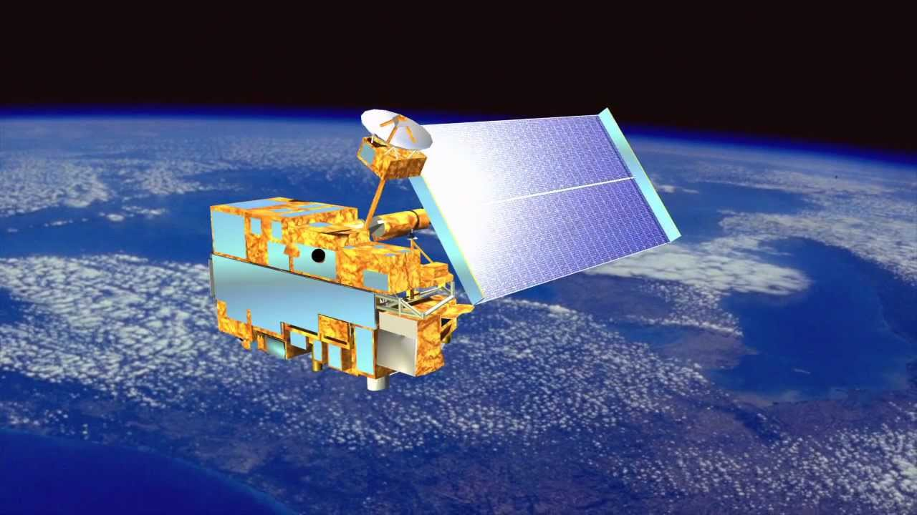
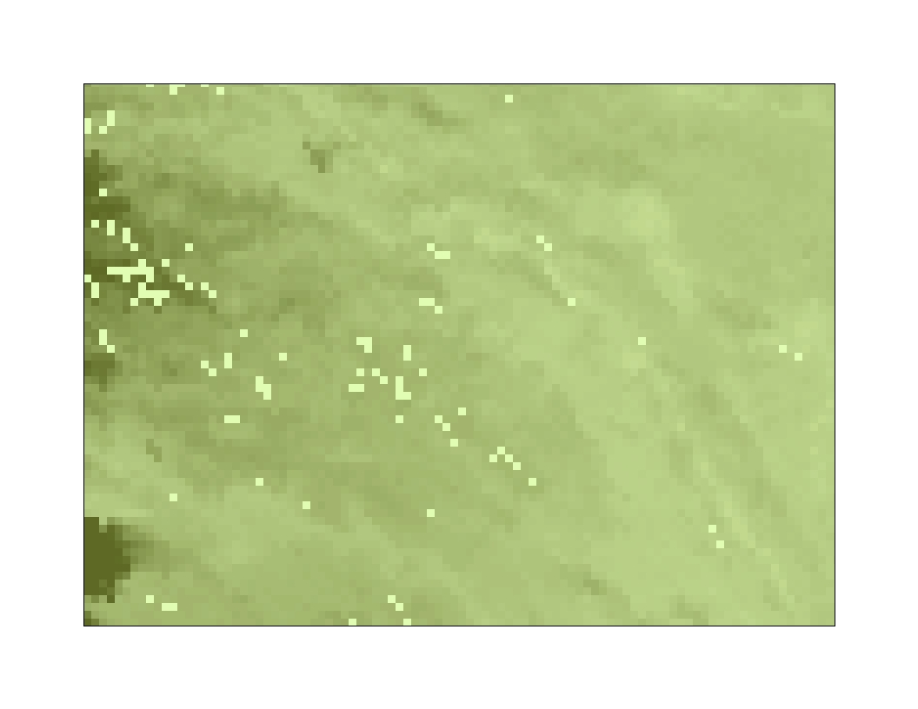
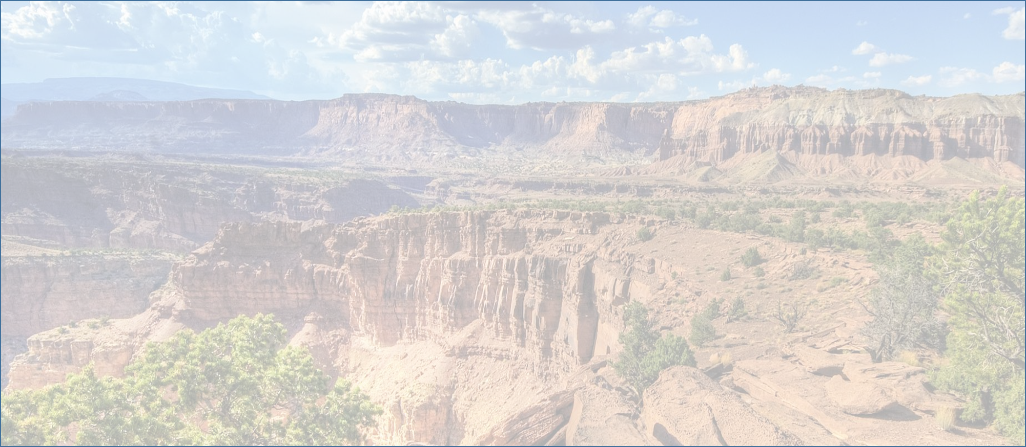
MAX NDVI and Evapotranspiration
Moderate
Resolution
Imaging
Spectroradiometer
MODIS Global
Evapotranspiration Project
University of Montana
Image Credit: retostockli’s channel
Notes:
For our dependent variable, we utilized the US Forest Service’s ForWarn dataset, which is derived from the MODIS sensor onboard TERRA. These datasets are processed to correct for errors caused by cloud cover. We used NDVI as a proxy for vegetation productivity.
For one of our independent variables, predicted actual evapotranspiration, we used MOD16 data, derived from MODIS by the University of Montana.
Kaylie
Image Credit: https://www.youtube.com/watch?v=_t6elBIN-Wc

Slide 7
PRISM Climate Group
Temperature
Precipitation
January
December
December
November
Growing Season
November
October
May
October
October
September
September
August
August
July
Notes:
Mean Temperature and Precipitation data were downloaded from the PRISM Climate Group.
To account for the time necessary for vegetation to respond to precipitation events, we tested lag times by shifting the 12-month time period ahead from one to six months. We tested each of these lag times against delta NDVI, identifying the one with the strongest correlation.
We also evaluated alternative measures of temperature and identified mean growing season temperature as having the strongest correlation with delta NDVI.
Kaylie

Slide 8
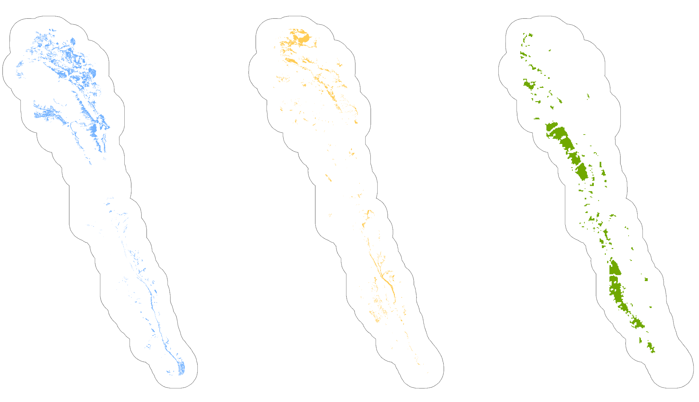
NPS Inventory & Monitoring Program
Pinyon-
Juniper
Woodland
Sagebrush
Shrubland
Capitol Reef Classes Vegetation
Semi-Desert
Grassland
Notes:
In order to investigate each vegetation type individually, we utilized a vegetation classification dataset provided by the National Park Service’s Inventory and Monitoring Program. In this project we looked at three classes of vegetation: Colorado Plateau Sagebrush Shrubland, Inter-Mountain Basins Semi-Desert Grassland, and Colorado Plateau Pinyon-Juniper Woodland.
Molly

Slide 9
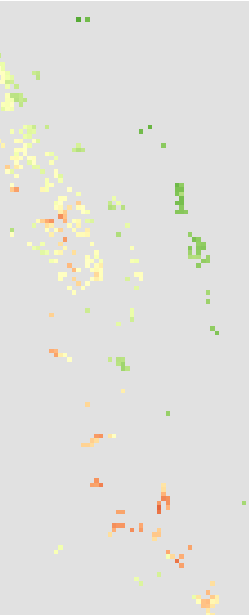
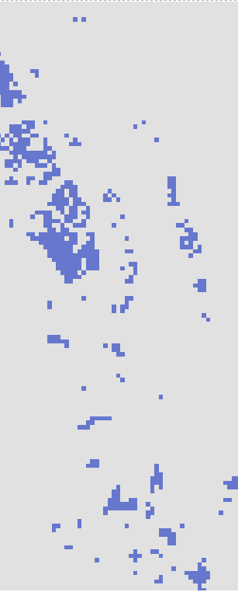
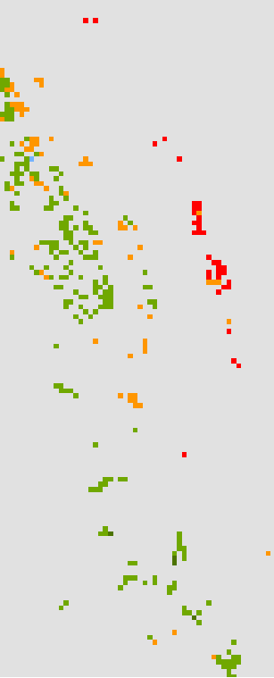
Methodology
Part 2: Data Analysis
Pinyon-
Juniper
Woodland
Observed
Sagebrush
Shrubland
Theoretical
Delta NDVI
Sagebrush
Shrubland
Semi-Desert
Grassland
Pinyon-Juniper
Woodland
Semi-Desert
Grassland
Image Credit:
Travel
Around USA
Notes:
In order to select pixels to represent each of the three vegetation types, we removed pixels that potentially contained vegetation outside the class of interest.
Calculating slope from a USGS digital elevation model, we also eliminated pixels within high slope areas which may have possible errors in the imagery.
Second, we calculated delta NDVI for each year in the study period by taking the observed maximum value for a particular year and subtracting a theoretical NDVI value. The theoretical value was calculated as the average maximum NDVI value for that vegetation group over the course of the study period.
Molly

Slide 10
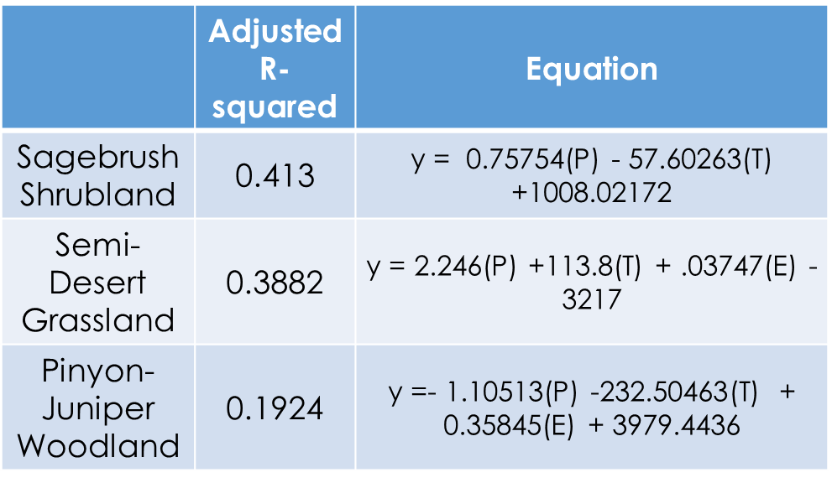
Methodology
Part 3: Multiple Linear Regression
∆NDVI ~ Temperature + Precipitation + Evapotranspiration
Image Credit: Travel Around USA
Notes:
For each vegetation type, we ran a multiple linear regression with delta NDVI as our dependent variable, and with our climate factors as our independent variables in order to determine which variables had a statistically significant correlation with delta NDVI.
Molly

Slide 11
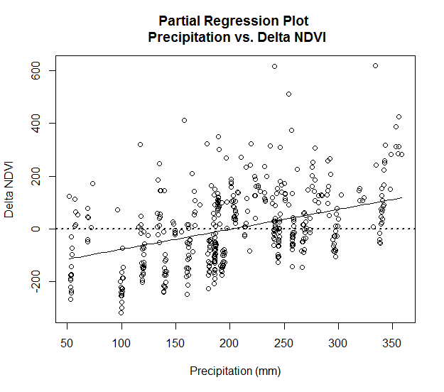
Methodology
Part 4: Pivot Points
Image Credit: Travel Around USA
Notes:
The equation from this model can be used to predict delta NDVI values, as well as to extract pivot point values.
We extracted pivot point values for one variable at a time. We solved for each variable by setting Delta NDVI to 0 and all other variables to their mean value over the study period.
Teresa

Slide 12
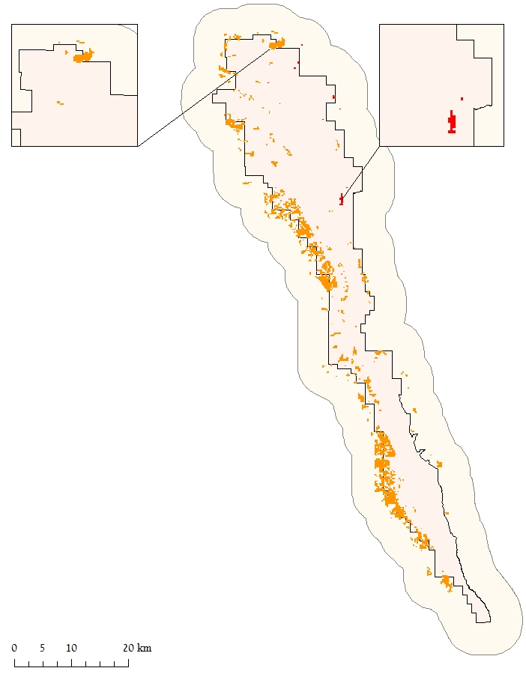
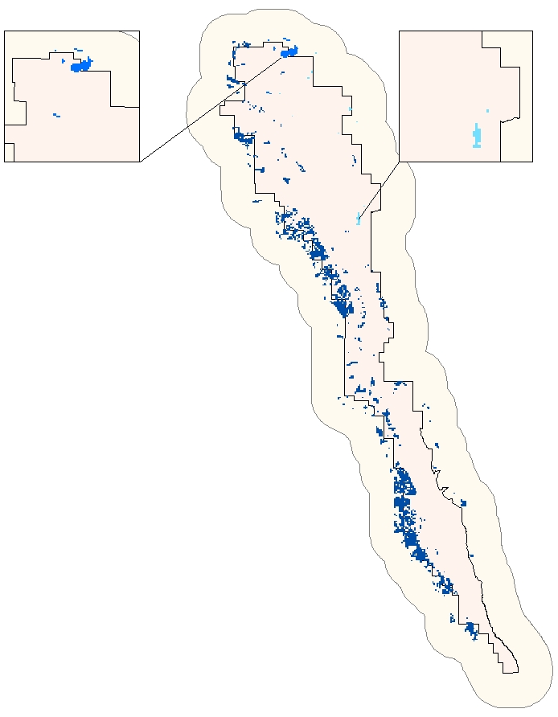
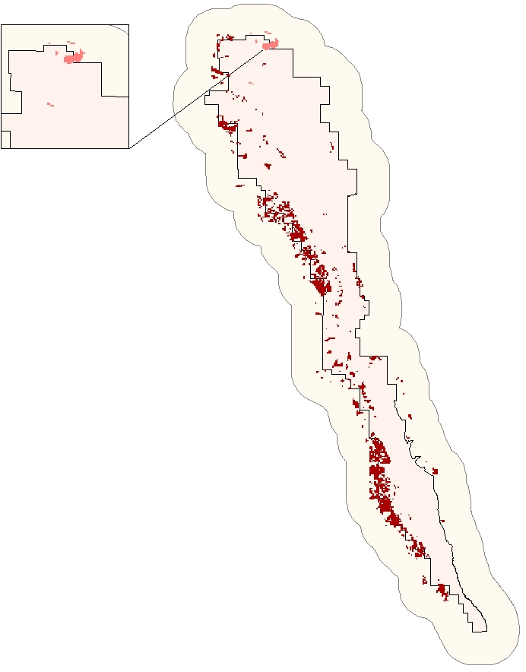
Results
Temperature (°C)
Precipitation (mm)
Evapotranspiration
(0.1mm/yr)
Grassland: 18.08
Sagebrush: 202.59
Pinyon - Juniper: 18.64
Grassland: 216.48
Grassland: 1783.19
Sagebrush: 20.18
Pinyon-Juniper: 230.64
Pinyon-Juniper: 1798.78
4km Buffer
Park Boundary
Notes:
Vegetation types with lower precipitation pivot point values, or higher temperature and evapotranspiration values are more resistant to drought as these plant communities can potentially experience periods of low precipitation or high temperature and evapotranspiration without crossing a pivot point.
Based on our results, we anticipate Shrublands to be more resistant to higher temperatures and lower precipitation. Woodlands and grasslands seem to be similar in terms of resistance to temperature. However, in terms of precipitation, Woodlands are more vulnerable to lower precipitation rates.
Teresa

Slide 13
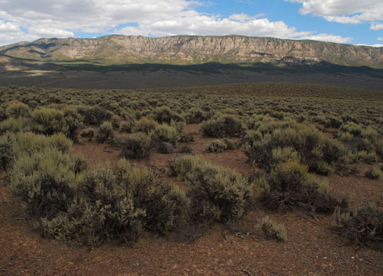
Conclusions
Pivot Point framework successful utilizing remote sensing
Plant communities respond differently to a changing climate
Pivot points can inform land management decisions
Image Source: BLM
Notes:
Our analysis demonstrates that the pivot point framework can be successfully carried out with remote sensing. The varying pivot points derived from this research indicate that plant communities will respond differently to a changing climate. Land managers can utilize this information to understand how the vegetation in their parks will react to warming and drying conditions, and to influence and prioritize their restoration decisions.
Kelly
Image Source:http://www.blm.gov/style/medialib/blm/ut/natural_resources/Colorado_Plateau/landCoverGallery.Par.56058.Image.500.360.jpg

Slide 14
Limitations
Possible vegetation shifts
Resampling
Adjusted r-squared value for Pinyon Juniper Woodland
Image Credit: NPS
Notes:
Possible limitations of this project were that the vegetation shifts could have occurred over the course of our study period.
Additionally, all of our independent variables were resampled to the finer resolution of our NDVI data.
Lastly, the r-squared values corresponding to certain vegetation regions were low indicating that this type of analysis might be more complicated for certain vegetation types.
Kelly
Image Source: https://www.nps.gov/colm/learn/nature/images/Utah-Juniper.JPG

Slide 15
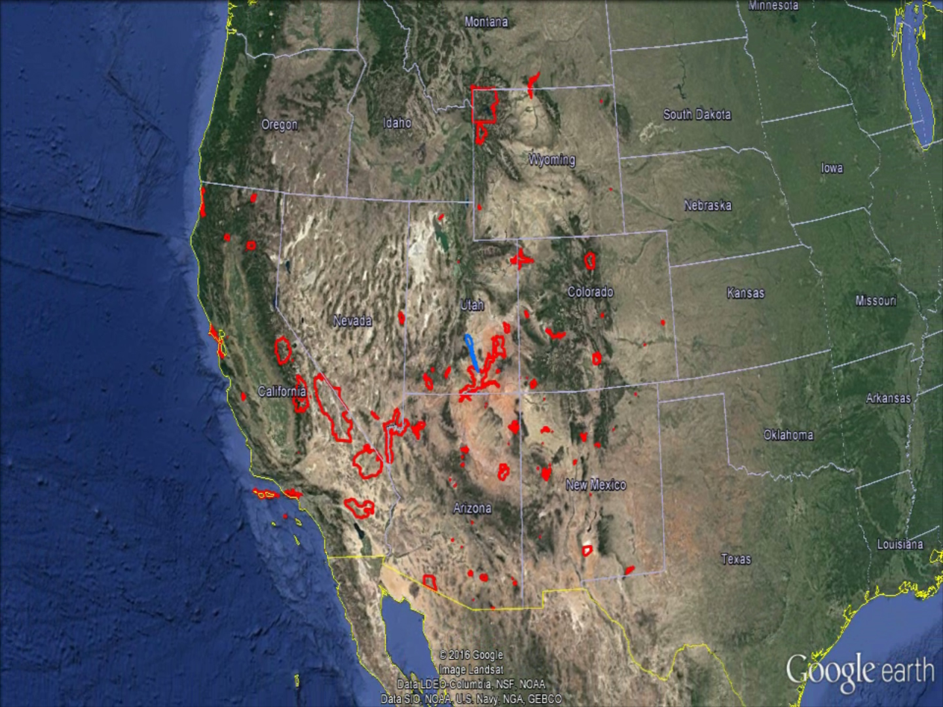
Future Work
Alternative vegetation index
Additional parks
Vegetation Classifications using remote sensing
Higher resolution imagery
Notes:
Future work might explore alternative vegetation indices, expanding to more parks in the West, creating vegetation classes via remote sensing, and using higher resolution imagery amongst other things.
Kelly

Slide 16
Dr. Seth Munson, Plant Ecologist, United States Geological Survey Southwest Biological Science Center
Dr. David Thoma, Ecologist, National Park Service Inventory and Monitoring Program
Dr. Kenton Ross, Lead Science Advisor, NASA National DEVELOP Program
Emily Gotschalk and Tyler Rhodes, Center Leads, NASA Langley Research Center
Notes:
We would like to thank our partners, Dr. Seth Munson and Dr. David Thoma, our Science Advisor, Dr. Kenton Ross, and our Center Leads, Emily Gotschalk and Tyler Rhodes.
Kelly

