Slide 1

Texas Water Resources II
Utilizing NASA Earth Observations to Assess Soil Moisture in Texas for Wildfire Mitigation
Greg Hoobchaak (Project Lead)
Jessica Jozwik
Alyx Riebeling
Notes:
We are the Texas Water Resources II team, and we partnered with the Texas Forest Service to use Earth Observations to Assess Soil moisture in texas for wildfire mitigation.
Greg
Jess
Alyx

Slide 2
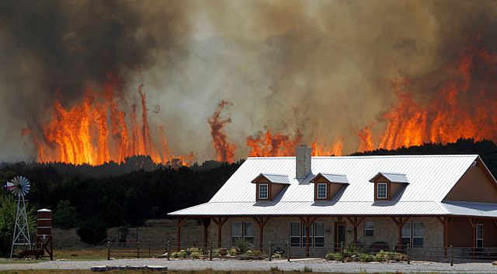
Image Credit: State Farm
Community Concerns
Droughts
Wildfires
Environmental Degradation
Economic Losses
Damages
Economic
Losses
Notes:
Alyx: In recent years, droughts have increased in both severity and frequency. Droughts beget wildfires by decreasing soil moisture and drying out vegetation, thus increasing fuel loads and potential to burn. 80% of these fires occur within two miles of a community. These wildfires damage property, infrastructure, and threaten safety. They result in soil degradation, soil erosion loss of biodiversity, and agricultural losses. Ultimately, there are incredible economic losses as a result of rampant wildfires. In 2011, an estimated $5.2 billion was lost in agricultural resources and damaged roads and infrastructure.
Image Link: https://www.flickr.com/photos/statefarm/12333738624/in/photolist-jMTCMW-9Aho7S-eLSsDv-9LZzo2-akjGEf-ajTPu9-A2nGa8-AhFQko-aHBBpi-9GNWvP-9GNWug-ak3aLc-62GcYX-ajFkug-ajYTZG-aeeiQN-aAzb59-ak32BB-9AdmyZ-cQ44R1-v2p2H3-62GgfF-9d5RQ-9cTJZ-9cTHo-9cTHQ-9cTKi-9cTEP-ak8SZx-62GBnk-ajgmEi-9d5Rz-an7r4y-9d5PU-9d5QW-9d5Ps-9d5Pg-9d5Qw-aT3Guc-64pGEu-6fH7ZL-63hKQB-62HiTX-aejc7w-awWmmw-ajhUXn-aeDLb8-ajS8MM-ajS6yt-ajS6a8

Slide 3
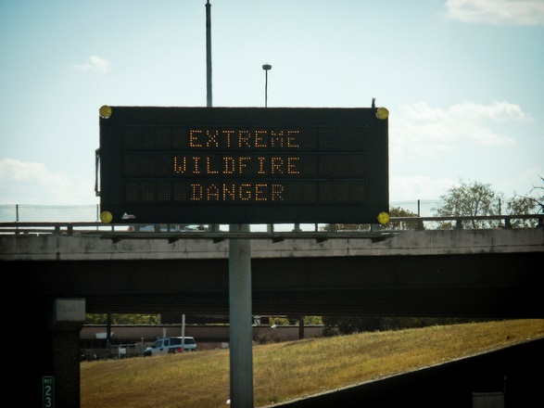
Current Practices
Texas A&M Fire Assessment Risk Assessment Portal
Prediction using Keetch-Byram Drought Index
  Limited
Image Credit: VXLA
Notes:
Alyx: The Texas Forest Service currently operates a Risk Assessment Portal that is free and open to the public. Individual users or community planning bodies can calculate their Fire Risk Potential and respond according to the threat. The TFS uses the Keetch-Byram Drought Index in these calculations, which utilizes precipitation and temperature readings to estimate evaporation, soil moisture, fuel ignition potential, etc. The KBDI is limited, however, because it assumes a full recharge of water during the winter. Also, cooler temperatures in the summer may keep the KBDI low, while actual fire risk is high.
Image Credit: https://www.flickr.com/photos/vxla/6144739838/in/photolist-amZp5j-9zZwhX-9zZyyk-9zZyov-9zZyt2-9A3x7C-9zZyvP-9A3wQj-9zZwQt-9zZxH4-9zZx7e-9A3wt9-9A3wvC-9zZxED-9zZx22-9zZx58-9A3wjo-9zZxC8-9zZyDM-9zZxhp-9A3wof-9zZxuB-9zZyGc-9zZxwH-9zZxzv-9A3wEA-9A3vUQ-9A3xhA-9A3vRu-9zZyJg-9A3xJw-9zXdtB-b5GcCa-aHxHAp-ajTPuE-jMTCMW-9Aho7S-eLSsDv-9LZzo2-akjGEf-ajTPu9-A2nGa8-AhFQko-aHBBpi-9GNWvP-9GNWug-ak3aLc-62GcYX-ajFkug-ajYTZG

Slide 4
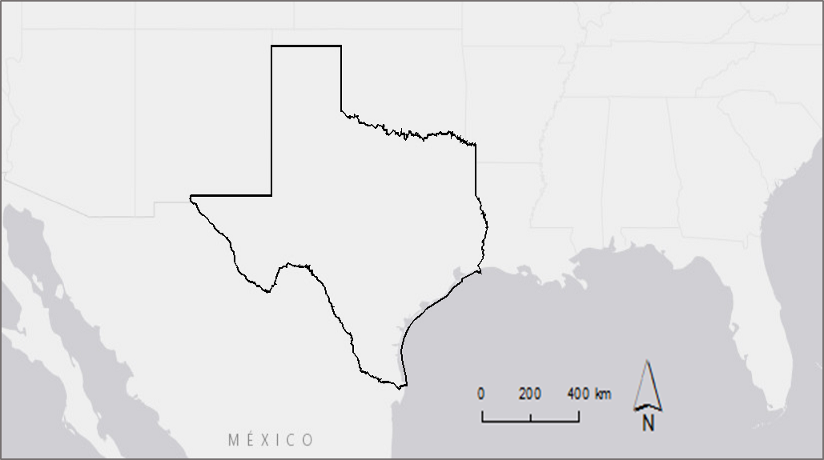
Study Area and Period
Study Area: Texas
Study Period: January 1, 2014-February 1, 2016
Notes:
Alyx: We partnered with the Texas Forest service to incorporate data from the Soil Moisture Active Passive (SMAP) Satellite into their Texas wildfire predictions. Since the satellite was launched in 2015, our study period was relatively recent—January 1, 2014-February 1, 2016.

Slide 5
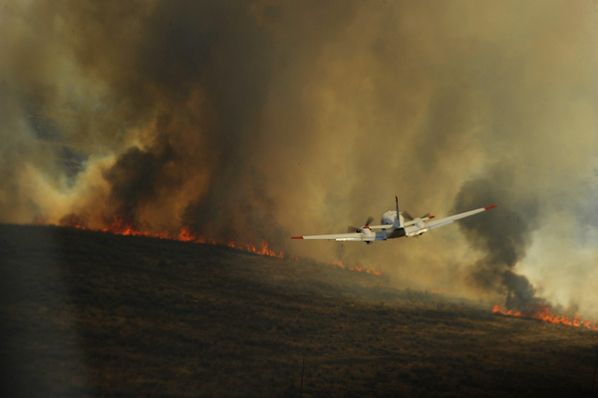
Objectives
Relate satellite data and in situ data
Develop a method to compare satellite data to historical averages
Image Credit: Staff Sgt. Eric Harris
Notes:
Jess: We had two main objectives for our project. The Texas Forest Service requested a method to relate daily soil moisture readings with historical records to identify changes or particularly high or low values, So we created a Day of Year Baseline Climatology. We also needed to validate the SMAP data. The Soil Climate Analysis Network has daily soil moisture sensors throughout Texas, which allowed us to validate the SMAP data. Thirdly, we wanted to create a three day minimum data set so the Texas Forest Service can the entire state of Texas without gaps in the data. Finally, we identified a (number) for the Forest Service to utilize in future analysis of SMAP data.
Image Link: https://www.flickr.com/photos/dvids/5664249483/in/photolist-9CwL2R-8tVDvo-9d5Qe-amD2x7-9A3xuN-9A3wLJ-9A3wHy-9A3wWf-9zZwvt-9zZwrV-9zZwmT-9zZz2x-9zZy6H-9A3uHA-zWHboS-8zTqVs-aeeiFs-9A3xXL-9A3weC-aJ6n3X-9zZy9Z-9A3xoW-9zZyPn-9zZwzi-9A3xRj-9zZwCK-9zZwNe-9A3vnE-9zZwWe-9zZwEe-amZp5j-9zZwhX-9zZyyk-9zZyov-9zZyt2-9A3x7C-9zZyvP-9A3wQj-9zZwQt-9zZxH4-9zZx7e-9A3wt9-9A3wvC-9zZxED-9zZx22-9zZx58-9A3wjo-9zZxC8-9zZyDM-9zZxhp

Slide 6
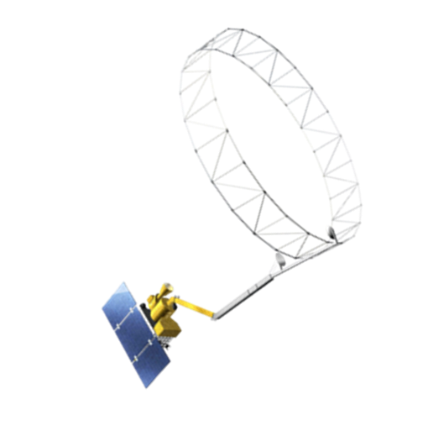
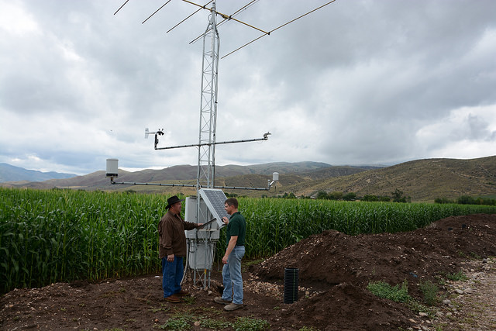
Data
Earth Observations
In situ data
USDA
Soil Moisture Active Passive (SMAP)
36 km resolution
492 pixels
Soil Climate Analysis Network (SCAN)
15 Stations
8 within Texas, 7 border states
Notes:
Greg:
These are our two data sources. We used the Soil Moisture Active Passive Satellite, or SMAP. SMAP was launched in January 2015 to gauge soil moisture and temperature at a 5 cm depth with hopes of helping scientists better understand the water, energy and carbon cycles, as well as predict and monitor natural disasters like flooding and drought. In July of 2015, one of the radar instruments on the satellite failed, decreasing the resolution of the data. However, the radiometer still functions and can be used to transmit data with a 36 km resolution.
Our in situ data came from the Soil Climate Analysis Network, or SCAN. Samples are taken daily at various soil depths, one of which is 5 cm, which corresponds to SMAP. We used this data to both validate the satellite data and create our historical climatology.

Slide 7
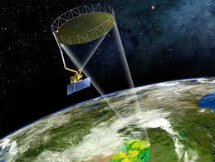
Objective:
Relate SMAP and SCAN Data
NASA
US Department of Agriculture
Notes:
First, we needed to determine the validity of SMAP as a soil moisture dataset and understand any inconsistencies between SMAP and SCAN data.
http://www.scpr.org/news/2015/01/08/49152/nasa-to-track-soil-moisture-from-space-with-smap-s/
https://www.flickr.com/photos/usdagov/15234258199/in/photolist-pdcyd8-bSyvaR-x23Fnq-wEnTtv-x3c8h4

Slide 8
Methodology:
Relate SMAP and in situ data
Using Excel:
-Created individual daily files
Using ArcMap:
-Matched Raster to point values
Using Excel:
-Created one table with SMAP and SCAN
-Correlated
Notes:
We did this by organizing the SCAN data by date, then geographically referenced them using ArcMap. We then matched the SMAP raster to each Point Values using Extract by Value. After creating a table with both SCAN and SMAP data, we used excel to find correlations between the data.

Slide 9
Results:
Season | R Squared
Yearly | 0.575
Summer | 0.436
Fall | 0.778
Winter | 0.621
Spring | 0.598
Notes:
As you can see, SMAP and SCAN are related, with seasonal variation. The correlations were highest in the fall months and lowest in the summer months. July and August in particular were quite lower than any other month. Attempts were made to understand the relationship between SMAP and SCAN and adjust, but nothing yielded significantly better results.

Slide 10
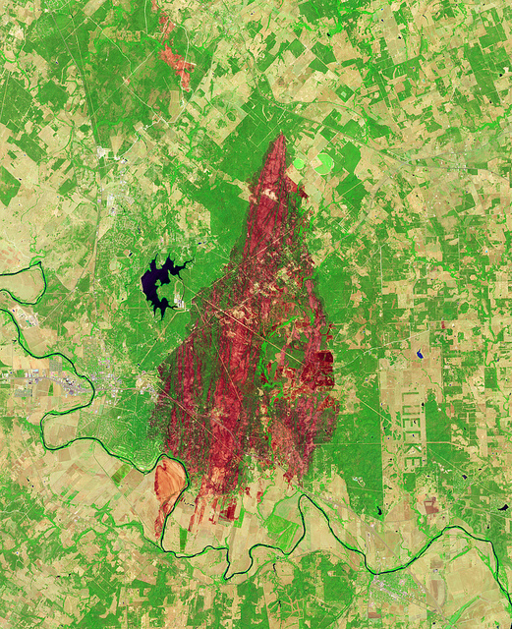
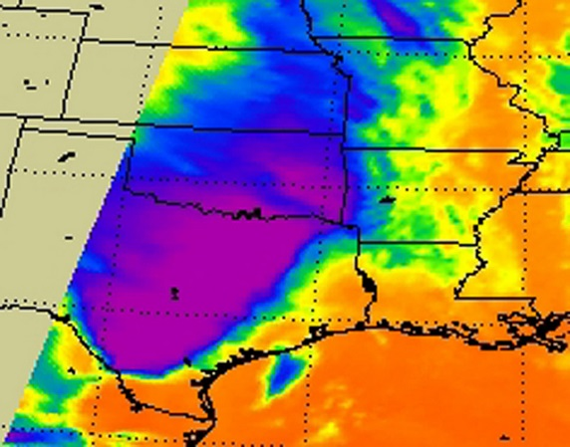
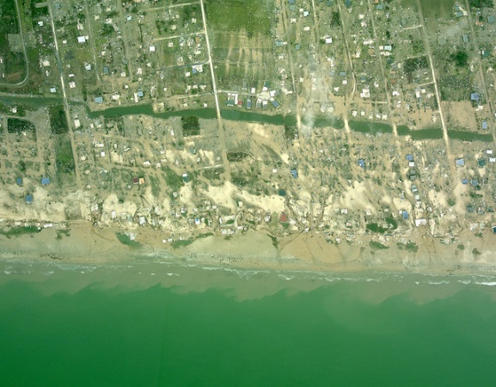
Errors and Future Work:
Longer Dataset
Explore spatial and temporal variables
Validated data released April 2016
Vegetation
Land Surface Temperature
Distance from Water
NASA
NASA
NASA
Notes:
Additional work with a longer SMAP dataset would improve our understanding of SMAP and its ability to measure soil moisture in both wet and dry conditions.
Future studies could also examine the relationship between specific variables and their impact on SMAP measurements, like surface temperature, vegetation, or distance from water. Since these are spatially and temporally varied, they may explain some of the fluctuations in SMAP measurements throughout the year.
https://www.flickr.com/photos/gsfc/6147392845/in/photolist-andZHP-nWrP3Q-85pwUH-9AeSdA-9uhjBa-e2He2U-egfT2o-csbUzN-bEdQF7-87qajQ-uGwFy-cR9JN7-bEdQEh-9vwkXa-cR9LvE-azUNfP-cR9L7u-9zGE8E-9Kan9c-9yxsLg-7WJ4wa-boYkMX-bT8zgz-8XcMyC-pFdW24-9FcnDN-9qS4F9-ra3yte-cR9KNh-bK53s2-9bNFdQ-8TYDpd-rnZtSJ-9BXY79-ahJpKa-4AynEF-dfM9hx-9dkK5C-bBCy2u-pXDNt8-8KTCU3-pXtGPt-7JB9Mc-bzWpg3-8aV4px-4sideE-cQUPNq-6oZw2K-q2nSD7-pKjChU
https://www.flickr.com/photos/noaaphotolib/5033921718/in/photolist-52EMn-8xhFHP-9LZzo2-9HQpoy-8ELZpe-8EQaxL-rp6Zxo-8WVApu-r44t9E-vrpn96-8pdxKX-8ptYwC-9jBK7b-7qZdsS-dxz9aj-AwceTa-wPHn7Z-xtYzLo
https://www.flickr.com/photos/gsfc/7000796835/in/photolist-2vVkpu-nMecA2-iYUMJ5-faDX44-aXSY1Z-9zGE8E-bECV2k-bECUZH-8rX44q-4Hef7v-4HeeRz-4HeeYX-ai7xfm-fa36jF-uTD2ny

Slide 11
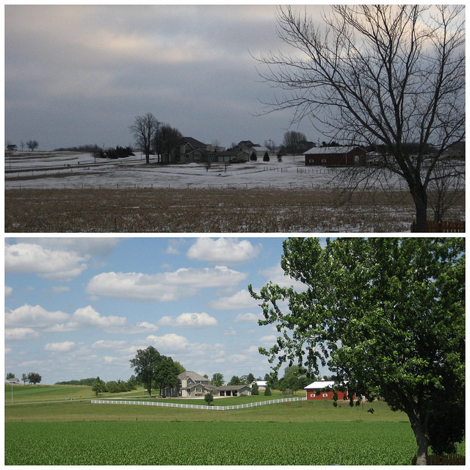
Objective:
Compare SMAP to Climatology
Denise Krebs
Notes:
Next, we wanted to create a baseline climatology so the Texas Forest Service can compare SMAP measurements with historical averages.
https://www.flickr.com/photos/mrsdkrebs/12657537895/in/photolist-khvc2Z-e6gSti-iydM4S-c9QXjf-hEEXys-hRPoVD-e6nvCC-932Fxj-spLeo-pBCCAT-spLen-r6XBdg-qLpRUr-zZWn-bkzP7Q-o7tX3d-egkXRd-qu2zR1-5RCzB1-fykJVW-6sfAfr-rBYL7b-4jomkK-kAoKHK-qdzCP4-dKk9e9-dKvMPq-nD7Syd-6DKJCA-8kpEAE-mzGbBt-aaJRsX-ir6sy8-tyfp5d-jbfHkP-ozDMp-kBi2D9-9cZxQu-9bw56X-92NJAV-q8SgsN-qmwTx3-qZxCzd-7LPk6T-jZRYLg-jtaisX-qsn2g9-qBbcHX-4Az7vY-fHYi8V

Slide 12
Methodology:
Compare SMAP to climatology
Created rolling 3 day dataset
Kriged and calculated baseline climatology
Divided SMAP by climatology
Notes:
This process was two-fold. First, we needed to create a rolling 3 day dataset. Then we needed to calculate a baseline climatology by kriging, then normalize the SMAP data.

Slide 13
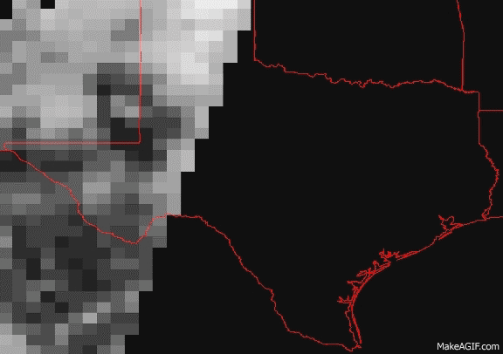
Rolling 3 Day Dataset
Notes:
Alyx: As you can see, when looking at one day’s SMAP data, there areas of the image in Texas without data. In order to get a complete image of Texas without these gaps, we created a data set comprised of minimum values within a 3 day period.

Slide 14
Methodology:
Create a rolling 3 day minimum data set
Using ArcGIS Model Builder:
-Mosaicked to new raster using minimum values
-Manually set rolling window
Notes:
We mosaicked three dates of SMAP together, using the minimum values when the pixels overlapped since we were interested in dry conditions. We then automated this process in model builder and created a dataset for the entirety of SMAP data through February 1, 2016.

Slide 15
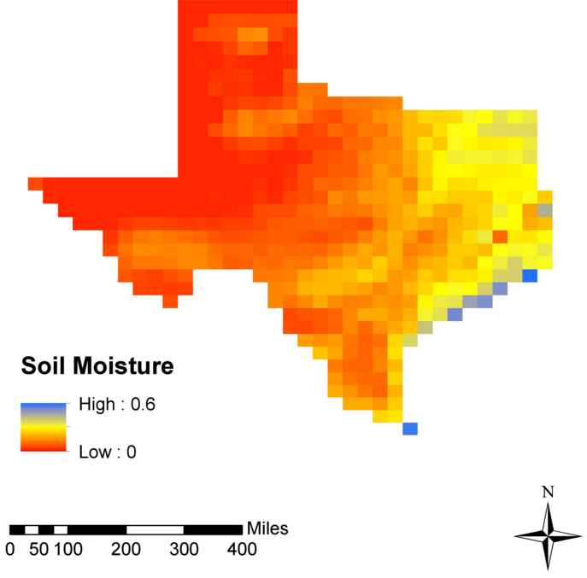
Results
Notes:
Here is an example of the images we created. This alone is important because it allows the Texas Forest Service to see the entire state of Texas in one image. It also became useful when comparing SMAP to historical SCAN data, which Greg will talk about next.

Slide 16
Methodology:
Establish baseline climatology
Using Excel:
-Established Day of Year (DOY)
- Averaged for each DOY using a pivot table
Using ArcMap:
-Ordinary kriging
-Created a 7 day rolling average
-Calculated baseline climatology
Notes:
Next, we created a baseline climatology. In Excel, we organized the data by date, then found the average for each date using a Pivot Table. Using ArcMap, we geographically interpolated within the data to measure the variance relationship between data points. Our data had many gaps in between points, so this will allow the Texas Forest Service to use satellite data to “fill in the blanks” between testing stations. We then created semi-variograms in Arc to create a model that will account for distance between points. Then we used Ordinary Kriging to interpolate within the data and create an estimated image of soil moisture throughout Texas by Day of Year.

Slide 17
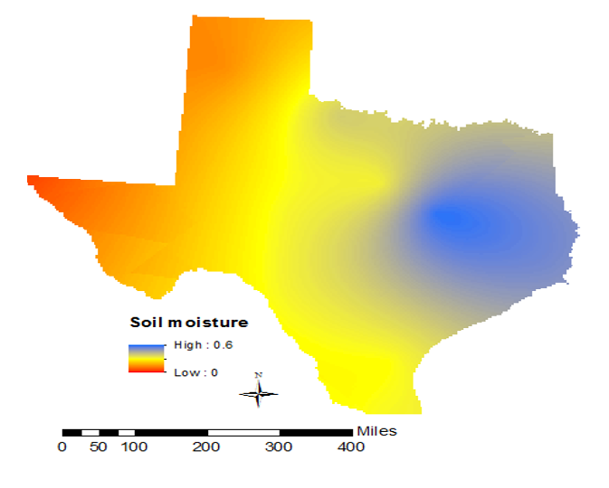
Results
January 1
Notes:
This is one of 365 images we created in our baseline climatology. It shows that West Texas has a history of being dry, and that East Texas has a history of having higher soil moisture. This is important because it allows researchers to compare SMAP data to historical averages and determine if that particular date is drier, average, or wetter compared to historical precident.

Slide 18

Methodology:
Normalize SMAP
Notes:
We then divided the SMAP data by the baseline climatology to understand the relationship between SMAP and historical averages.

Slide 19
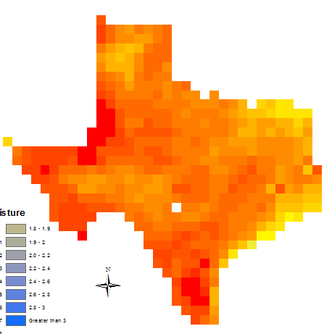
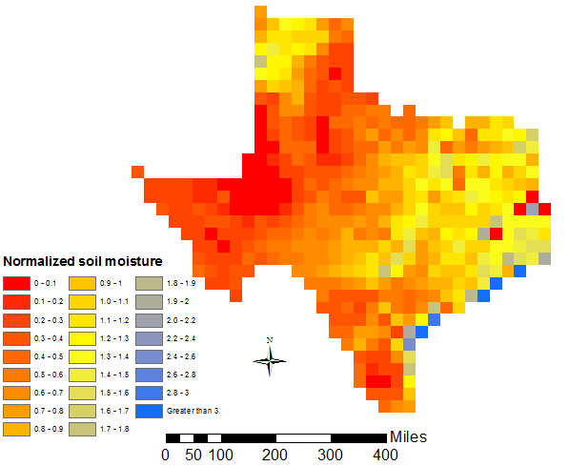
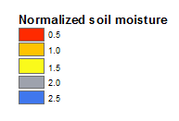


Results
February 1, 2016
August 12, 2015
Notes:
As you can see, certain areas of the states have soil moisture values consistent with historical precedent. But some dates have abnormal soil moisture. August 12 has some areas that are abnormally dry and some areas that are abnormally wet. Putting SMAP values in historical context allows the Texas Forest Service to better understand changes in soil moisture values.

Slide 20
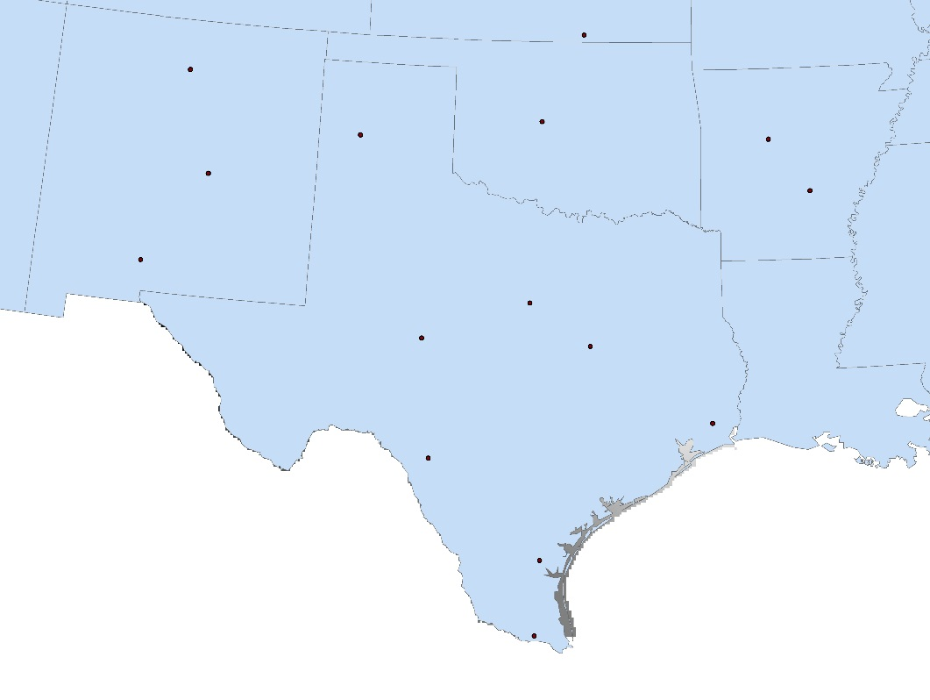
Limitations and Future Work:
SMAP Comparison
Distribution and number of SCAN stations
“Smoother”
Continue to build climatology
Notes:
When kriging, the distribution and number of testing stations is incredibly important. As you can see, we had few data points with many miles between them. Because kriging “smoothes” the data, it reduces short scale variability as it interpolates between the data points.
Kriging “smoothes” the data, meaning it reduces short scale variability in its interpolation between data points. This local variation is important to understand.
Bolstering the SCAN data stations and creating a longer climatology would improve the krige. Eventually, once enough SMAP data has been released, a climatology based solely on SMAP would be beneficial, for it would remove the need to “fill in the blanks” between sparse testing stations.

Slide 21
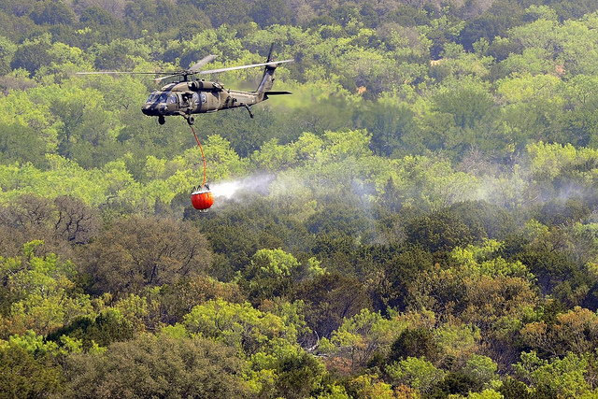
Conclusions
SMAP Knowledge and dataset
Highlight areas to explore
Drought Prediction
  Incorporate into models
Texas Military Department
Notes:
Overall, we learned a lot about working with SMAP data, which we will be able to pass off to the Texas Forest Service. We will also provide them with a dataset allowing them to visualize the entire state in one image, as well as a historical climatology for future comparison. SMAP data allows for researchers to better visualize local variations in soil moisture data, and should be pursued as a tool in future drought mitigation efforts.
We also have discovered some additional areas to explore, like impact of vegetation or temperature on SMAP’s ability to measure soil moisture.
Once enough SMAP data has been collected, we would hope to see it incorporated directly into the existing drought models, rather than current soil moisture estimates.
https://www.flickr.com/photos/dvids/5638811206/in/photolist-9Aho7S-9A3xRj-9A3xJw-cR3u63-an2z1U-9A3wWf-aJ6n3X-9A3xoW-zWHboS-9A3xXL-9A3xuN-9zZyt2-9zZyPn-9A3x7C-9Ynt7A-9zZyJg-9zZyDM-9YnsmJ-9zZyyk-9mDzr5-9zZyvP-9zZyGc-fxQFeo-62FZ3D-aAVnWF-9U2ggc-9zZwEe-9zZy6H-9zZwzi-ajTPuE-9zV3bp-ajTPu9-9zZwWe-9zY2ds-ajFbWY-9zZwNe-b5XxsM-9A3wLJ-adQM8g-adQQgK-adQPai-9yWLKL-9zY2pf-9mDzjE-akh5kx-9zZxcz-9zZwhX-axz8x6-9zV3fv-adTwj3

Slide 22
Advisors
Dr. Kenton Ross, DEVELOP National Program
Partners
Texas Forest Service
Curt Stripling,Geospatial System Coordinator
Tom Spencer,Department Head,Predictive Services
Others
Emily Adams,
Center Lead, DEVELOP Langley Research Center
DEVELOP Texas Water Resources I Team:
Megan Buzanowicz
Laura Lykens
Zacary Richards
Jeff Close

