Slide 1
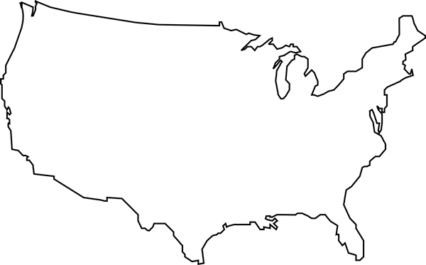
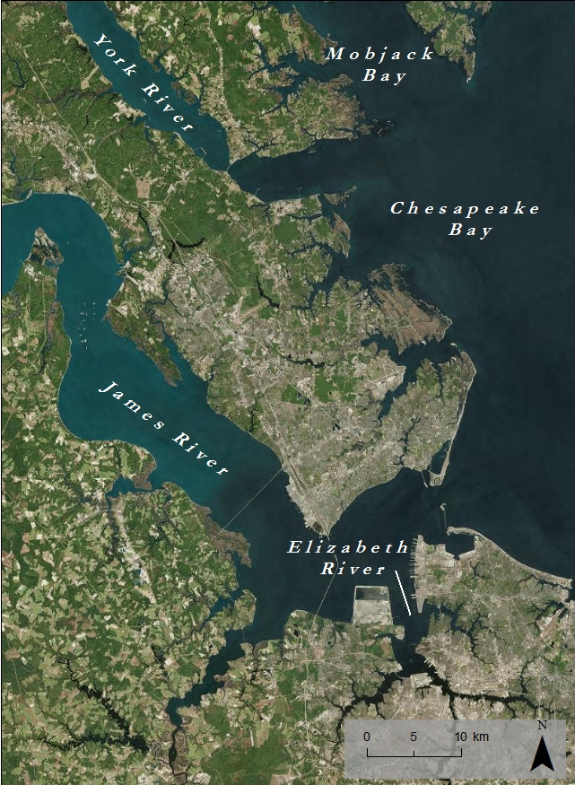
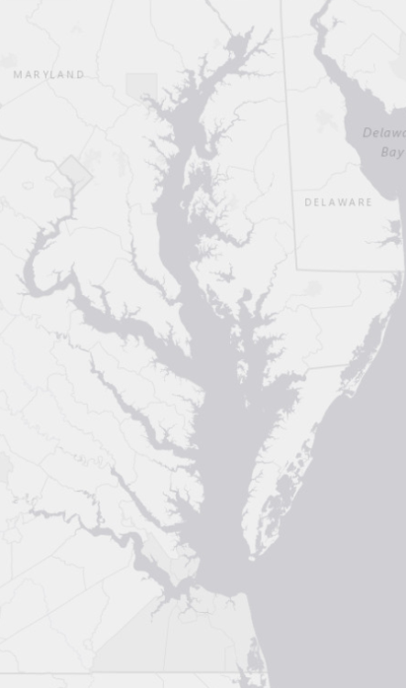
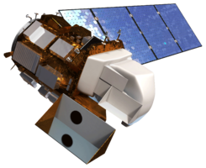
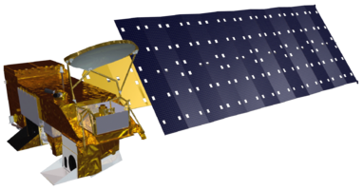
Virginia Water Resources II
Utilizing NASA Earth Observations to monitor the extent of harmful algal blooms in the lower Chesapeake Bay Watershed
Arika Egan (Project Lead), Zachary Tate, Jakub Blach, Jessica Jozwik, Tyler Rhodes
NASA DEVELOP National Program at ¹Wise County and ²Langley Research Center
Abstract
Objectives
Keep this blank for now.
Body text point size should be at least 24.
Caption text point size should be at least 16.
Feel free to rename, move, and resize sections as needed.
Create a python tool to estimate chlorophyll-a concentrations for the Chesapeake Bay Watershed, using data from Landsat 8 OLI
Cultivate a better understanding of the causes and impacts of Harmful Algal Blooms to better inform policies that combat pollution of the Chesapeake Bay.
Improve routine and emergency assessment of Harmful Algal Blooms in the Chesapeake Bay
Extra space to utilize
Methodology
Acquisition
Landsat 8 OLI surface reflectance
VECOS in situ water quality data
ArcGIS
Masks were created to remove land and clouds
R
Ran linear and nonlinear regression models
Aqua MODIS chlorophyll a
Matched Landsat, MODIS, and bathymetry pixels
NOAA Bathymetry data
Created true color reflectance images for Landsat 8 bands 1-5
Combined layers into data table
Plotted data on scatter plot
Used best fit relationship as predictive model
Study Area
Study Period: May 2011 - October 2015
Earth Observations
Python
Chesapeake Bay Chlorophyll Hotspot Identifier
Landsat 8 OLI
Aqua MODIS
Results
Conclusions
Use images.
Make sure that it has some sort of flow, that it makes sense. Show your results in a logical order.
No bullets.
Use bullets.
Use complete sentences with periods.
Team Members
Project Partners
Acknowledgements
Arika Egan, Jakub Blach, & Zachary Tate
Wise County Clerk of Court
Jessica Jozwik & Tyler Rhodes
Langley Research Center
Dr. Kim Reece, Virginia Institute of Marine Science
Russ Baxter, Virginia Deputy Secretary of Natural Resources for the Chesapeake Bay
Will Hunley, Hampton Roads Sanitation Department
Todd Egerton, Department of Biological Sciences, Old Dominion University
Advisors
Dr. Kenton Ross, NASA DEVELOP National Science Advisor
Bob VanGundy, University of Virginia’s College at Wise
Dr. DeWayne Cecil, Global Science and Technology Inc.
Melanie Salyer, Mentor at Wise County Clerk of Court’s Office
Previous Contributors
Dr. Sara Lubkin and Cassandra Morgan
Wise County Clerk of Court’s Office and NASA Langley Research Center
Landsat 8 OLI

