Slide 1
El Salvador Ecological Forecasting
Utilizing NASA Earth Observations to Develop a Historically Based Trajectory of Deforestation and Degradation in El Salvador
Jordan Ped (Team Lead)
Susannah Miller
Stephen Zimmerman
Clarence Kimbrell
Courtney Duquette

Slide 2
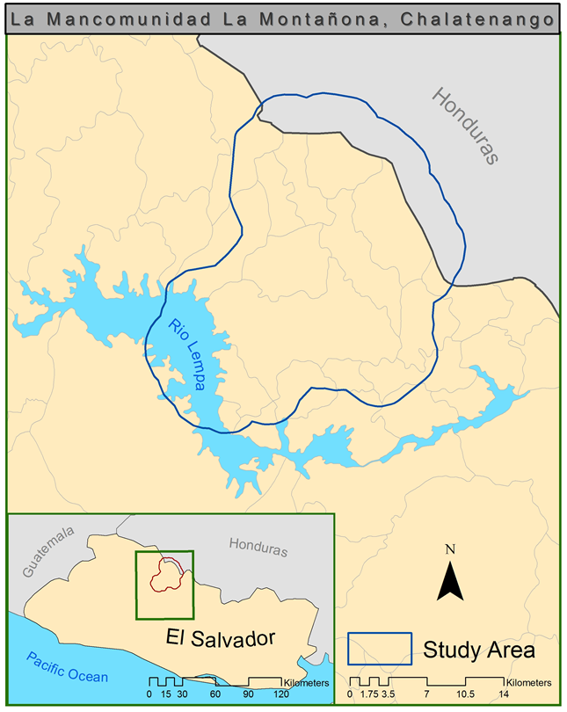
Study Area and Period
Study Area: La Mancomunidad La Montañona, Chalatenango, El Salvador
Study Period: 1986-2015
Notes:
Notes:
The study area
based on DEVELOP’s collaboration with the Earth Institute at Columbia University, Agroforestry for Biodiversity and Ecosystem Services (ABES) project.
Ministerio de Medio Ambiente y Recursos Naturales (MARN), El Salvador’s agricultrual minstry is concerned about deforestation and forest degradation in their densely populated country (300 people/km2) given the prevelance of slash and burn agriculture and the limited forest cover (121,000 hectares the lowest in Central America).
MARN, ABES, and DEVELOP are working on this scale to develop a methodology which can be applied nationally.
The study period
The earliest landsat data for the region
Creating a historical trajectory from all the avaialble information
Forecasting future change

Slide 3
Some Kind of Picture Here… Picture of LULC and RFI??
Objectives
Land Use/Land Cover
Regional Forest Inventory
Forecasting Model
Notes:
Land use Land Cover (LULC)
The first objective is to use the information gathered by ABES to create a LULC map with the available Landsat imagery and ground truth from high resolution data (Quickbird and Rapideye) that can serve as a baseline for the Regional Forest Inventory and the Forecasting Model
Regional Forest Inventory
The LULC classification was applied to the region to break down the forest into a more detailed classification scheme
This RFI methodology is designed to be easily replicable, allowing MARN to easily compare this baseline year and observe changes in forest cover
Forecasting Model
The historical trajectory of forest cover change was used to forecast deforestation
The model will allow MARN to assess areas that are at a high risk of degradation and deforestation

Slide 4
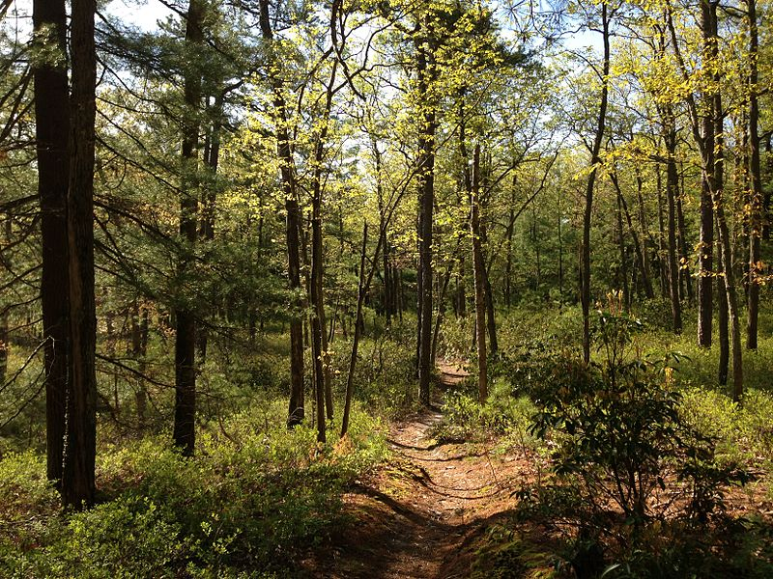
Insert Pictures of Trees
https://commons.wikimedia.org/wiki/File:2013-05-10_08_55_25_View_east_down_the_Batona_Trail_through_mixed_White_Pine_and_oak_forest_in_Brendan_T._Byrne_State_Forest.jpg
Community Concerns
Forests remove carbon dioxide from the atmosphere
High population density in El Salvador and low forest canopy cover
Critical to maintaining healthy springs and rivers
Forests provide soil stability
Notes:
Notes:
1) The pine oak forests are an important part of the ecosystem in La Mancomunidad La Montañona, surrounding regions, and are relevant to maintaining the global carbon budget.
3) Forests can remove carbon dioxide from the atmosphere which is emitted by human activity. The forests in El Salvador, and especially in this region specifically are being destroyed at an alarming rate through “slash and burn” agriculture. This agricultural method is unsustainable with large populations or for intensive farming in tropical regions. El Salvador has one of the highest population density in Central America with one of the lowest forest canopy covers.
2) Locals are reliant on healthy forests to maintain the water quality for a major national watershed and provide soil stability to prevent landslides and add nutrients for more agriculture.

Slide 5
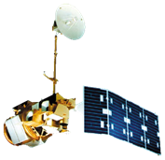

NASA Satellites & Sensors
Landsat 4/5 TM
Landsat 8 OLI
Notes:
Notes:
Using Landsat 4, 5, and 8 scenes from path 19, row 50, historical data was collected for analysis between 1986 to 2015.
USGS Earth Explorer was used to download the climate data record, which accounts for top of atmosphere reflectance and radiometric variation, for a more accurate and standardized analysis.
Landsat 7 was not used because the study region is relatively small and the outcome would be affected by the data gaps.
The ABES Project were able to provide RapidEye and QuickBird imagery from 2012, which proved useful in developing ground truth and satellite calibration data.

Slide 6
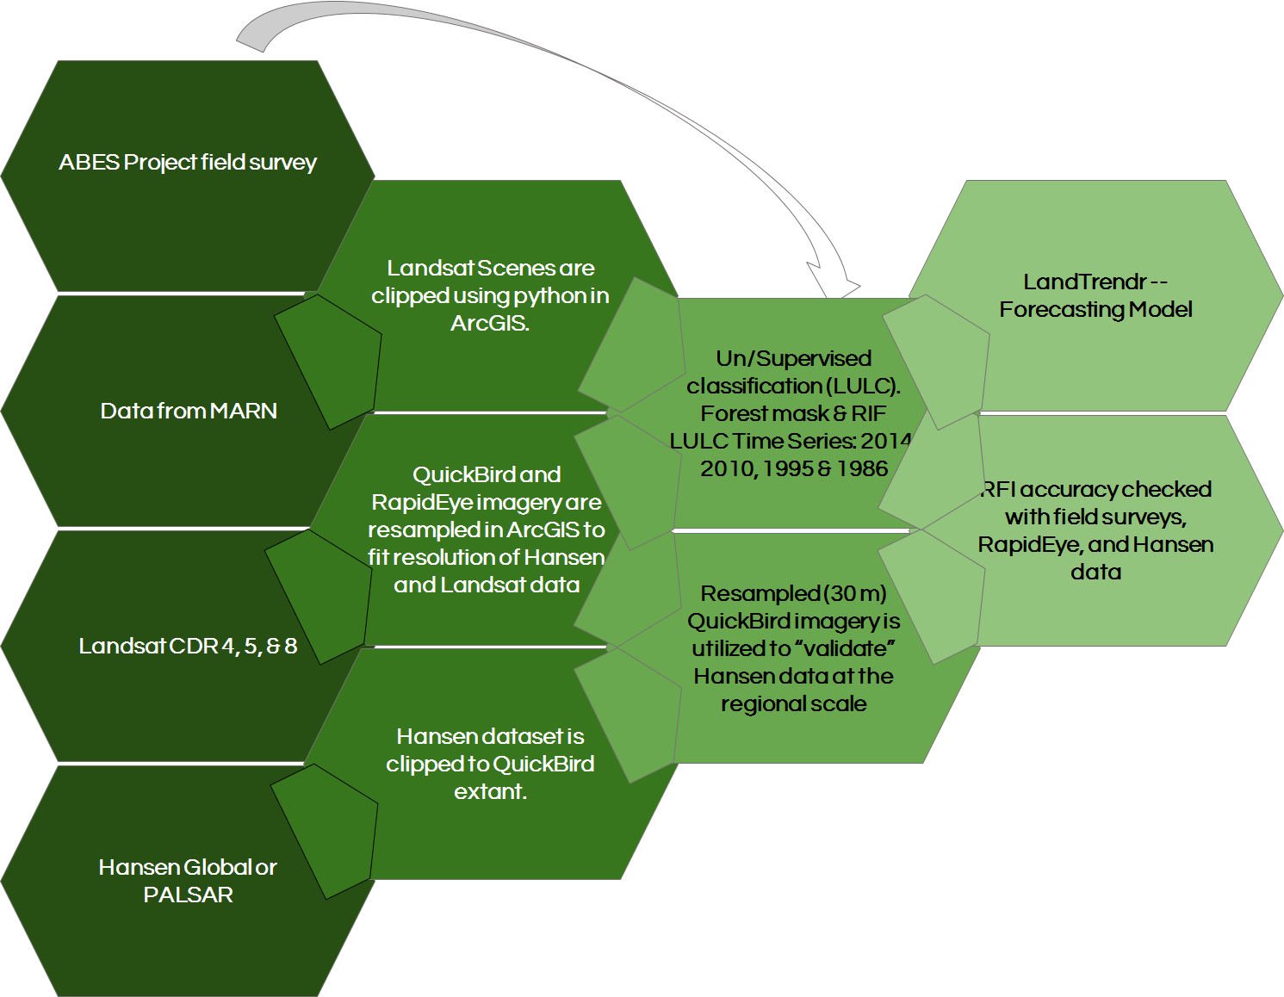
Methodology
DATA ACQUISITION
DATA PROCESSING
END PRODUCT
DATA ANALYSIS
Notes:
Notes:
Data Acquisition:
1) The project collaborators at the Earth Institute of Columbia University ABES project provided the El Salvador Ecological Forecasting team with 0.1 ha and 1.0 ha survey plots, 2.4 meter regional QuickBird imagery for 2012, and 5 meter national RapidEye imagery for 2012. This data is used as ground truth for our classification.
2) MARN has yet to give us any data, we’re waiting to hear back from them
3) Landsat Climate Data Record (CDR) 4/5TM and 8 OLI images during the dry season (~December, winter) for each year of the study period, this imagery was used to run our supervised and unsupervised classifications
4) An additional global forest data set from Hansen et al. (University of Maryland) was downloaded for our region, the purpose of this data set is to have a global forest cover which can be used to validate a Regional Forest Inventory across the nation
Data Processing:
1) Landsat CDR imagery was projected to the proper coordinate system and projection, then the imagery was clipped to the extent of our study area in ArcGIS.
Band rations [TBD]
Band combinations [TBD]
Band indices [TDB]
2) QuickBird data was resampled to fit the Hansen data set in preparation to validate Hansen data
3) Hansen data is projected to the proper coordinate system and projection, then the data is clipped to the extent of the QuickBird imagery for validation
Data Analysis:
We haven’t gotten there yet
End Product:
No end product to discuss at this moment in time

Slide 7
Results

Slide 8
Conclusions

Slide 9
Errors and Uncertainties

Slide 10
Future Work

Slide 11
Advisors
Dr. Kenton Ross, NASA DEVELOP National Program
Collaborator:
The Earth Institute, Columbia University (ABES Project)
POC: Dr. Sean Smukler & Sean Kearney
End Users:
La Mancomunidad La Montañona, Chalatenango
POC: Arnulfo Alberto
Ministerio de Medio Ambiente y Recursos Naturales (MARN)
POC: Giovanni Molina
Others
Colorado Agriculture, NASA DEVELOP, Fort Collins, Summer 2105

