Slide 1
Yellowstone
Ecological Forecasting
Assessing Change in
Aspen Extent in
Northern Yellowstone National Park
Kyle Steen (Project Lead)
Vanessa Bailey
Gabriella Boodhoo
Barry McLaughlin
Georgia – Athens
Notes:
Speaker: Kyle
Hello everyone and thank you for joining us today!
We are the Yellowstone Ecological Forecasting team, and today we are going to talk about our project: Assessing Change in Aspen Extent and Health in Northern Yellowstone National Park.
My name is Kyle Steen
(Vanessa speaking): Hi I'm Vanessa Bailey
(Gabby speaking): Hi I'm Gabriella Boodhoo,
(Barry speaking): Hi I'm Barry McLaughlin.

Slide 2
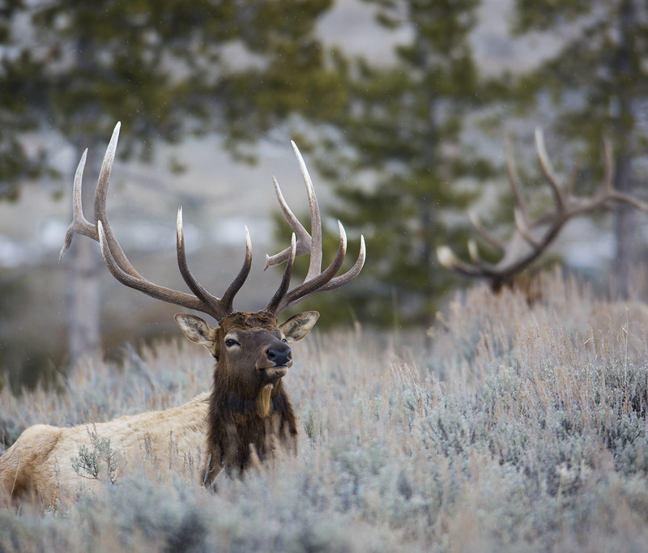
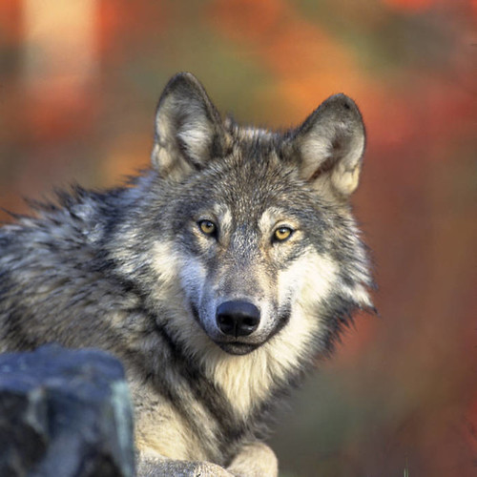
Image Credit: Yellowstone National Park
Trophic Cascade Effects
Extirpation of wolves
Increase in elk population
Reintroduction of wolves
Decrease in elk population
Potential aspen recovery
Greater browsing of aspen
Image Credit: Gary Kramer/ USFWS
Notes:
Speaker: Barry
Yellowstone National Park has become a textbook example of the effect of trophic cascades following the removal and reintroduction of the gray wolf.
In the 1900s, wolves were extirpated from the park which caused a major growth in the elk population.
Greater elk numbers, increasing browsed on aspen more significantly, making it difficult for aspen to survive.
In the mid 1990s with a reversal of policy to "rewilding," wolves were reintroduced in Yellowstone.
As a result, the elk populations have decreased and there are signs that aspen may be recovering.
This is where our team hopes to shed light on the outcome in northern Yellowstone.
Image credits
Wolf image: Gary Kramer/USFWS, CC BY 2.0, https://www.flickr.com/photos/53349312@N07/5039506344
Elk image: Yellowstone National Park, Public domain, https://www.flickr.com/photos/80223459@N05/16027635922

Slide 3
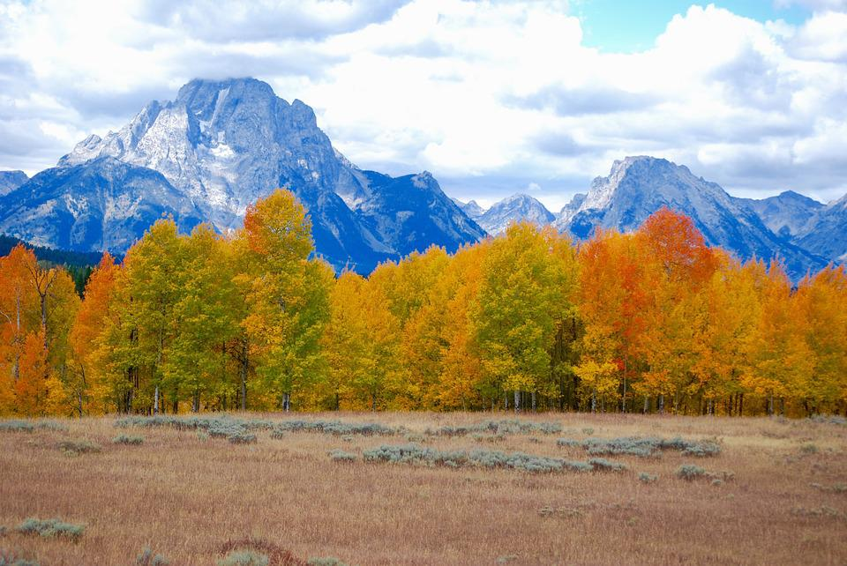
Aspen
Keystone species
Yellowstone National Park
~1% of land area
~95% of aspen stands are over 80 years old
Ecosystem services at risk
Image Credit: Max Pixel
Notes:
Speaker: Kyle
The trophic cascade context emphasizes our interest in aspen in Yellowstone.
Aspen (or Quaking Aspen (Populus tremuloides)) is a keystone species that is widely distributed throughout North America.
It provides a vital food source, habitat and shelter for a variety of wildlife.
Aspen is a deciduous tree with vibrant yellow colors in the fall.
Interestingly, it is a clonal species, with stands representing a single, connected organism.
It is a shade intolerant species and is an aggressive pioneer species following fire.
While the average lifespan of an individual tree is approximately 40-60 years, aspen can live up to 150 years.
Aspen only covers about 1% of the total land area in Yellowstone (Brown et al., 2006), and it is estimated that over 95% of aspen stands in the park are over 80 years old (Larsen & Ripple, 2005).
Given its importance in providing habitat and increasing biodiversity in the region, understanding its health is critical. Without aspen, key ecosystem services may be lost, which is why there is concern over its decline.
Image credit: Max Pixel, CC0 1.0, https://www.maxpixel.net/Park-Yellowstone-Mountains-Aspen-National-Storm-2166868

Slide 4
Partner Organizations
End User
National Park Service, Yellowstone
Dr. Daniel Stahler, Wildlife Biologist
Collaborators
Utah State University
Dr. Daniel MacNulty, Professor
Nicholas Bergeron, Researcher
University of Wisconsin – Stevens Point
Dr. Eric Larsen, Professor
Image Credit: GPA Photo Archive
Notes:
Speaker: Vanessa
Because of aspen's importance and its relationship with wolves and elk, our partners are interested in how aspen has changed over time.
The end user of our results is Yellowstone National Park.
Dr. Dan Stahler, a wildlife biologist, is interested in how wolves have affected other ecosystem processes in the park following their reintroduction.
Other collaborators are Dr. Dan MacNulty and his student Nicholas Bergeron at Utah State University.
Dr. Eric Larson at the University of Wisconsin – Stevens Point has tracked aspen in northern Yellowstone since 1999.
All are interested in the trophic cascades driven by wolves.
Image credit: GPA Photo Archive, CC BY-NC 2.0, https://www.flickr.com/photos/iip-photo-archive/29221532895

Slide 5
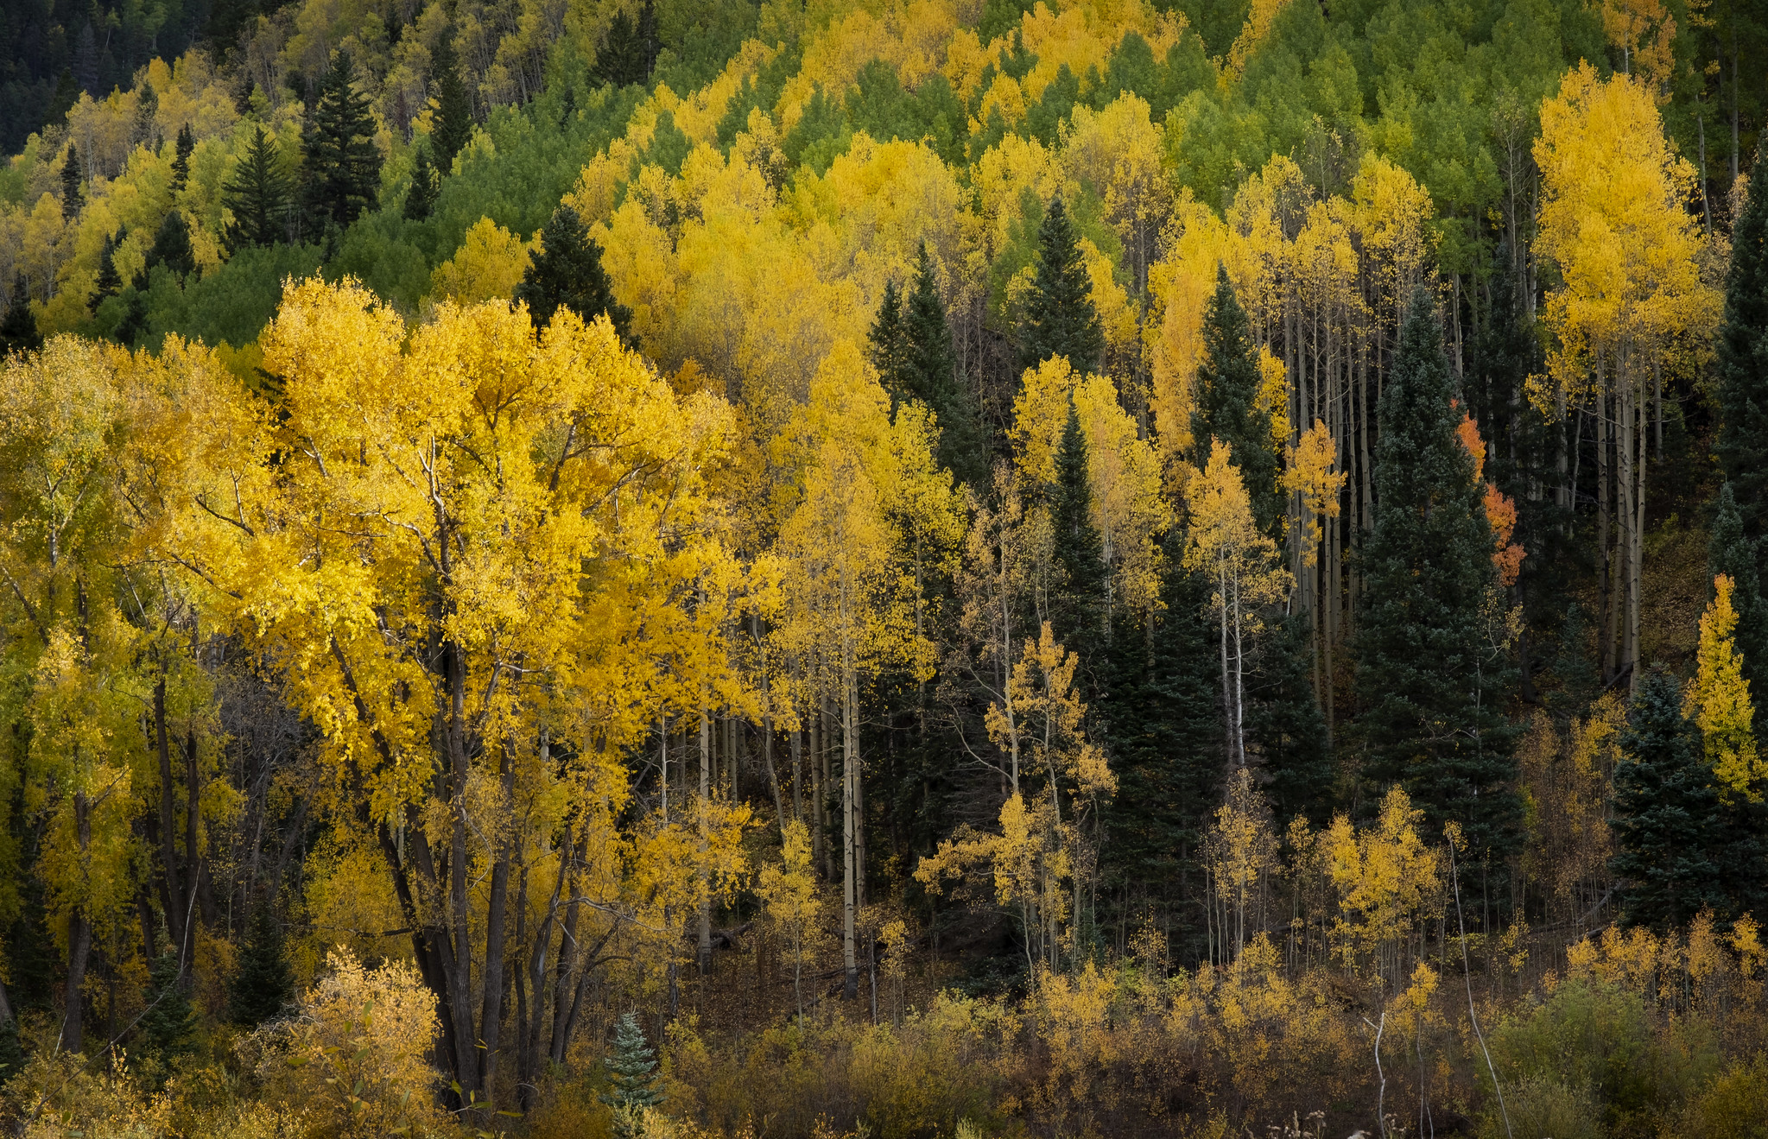
Project Objectives
Derive
multiple color composites
Analyze
vegetation indices and spectral signatures
Explore
canopy height data
Depict
aspen stand extent
Image Credit: Tranquiligold Jin
Notes:
Speaker: Gabby
With this project, we hoped to inform our partners about the state of aspen in northern Yellowstone.
To do that, we produced maps and time-series of aspen extent and health.
We derived multiple color composites (RGB and False Color) and vegetation indices (NDVI, EVI, and Tasseled Cap Transformation – Greenness. Wetness, and Brightness).
Second, we analyzed the derived indices with random forest and phenological approaches.
Third, we explored the use of ISS GEDI data for potential canopy height analysis.
These products increase partner understanding of aspen within the trophic cascade and help with future decision making.
Image credit: Tranquiligold Jin, CC BY-NC-SA 2.0, https://www.flickr.com/photos/9766401@N03/51754655992/in/photolist-2mRo983-2mCH1Hi-2mA8NrT-2mMHbHH-2mLd8Cp-2mD2yGn-2mLAKij-2myvsnE-2mC18Ym-2mzANa5-2mFJdMe-2mB943P-2mWCo2F-2mCr5i9-2mVFFSs-2mLU6fe-2mDBUdR-2mGQ6s2-2njQUhU-2mKpMwp-2mwKg8Z-2n7UZGT-2mum442-2mGogVx-2mynSfy-2nonNNp-2mQYzMK-2mXNvMH-2mDfYnQ-2mWz4tA-2mNZic2-2mMCA39-2mzRGj6-2mumoX1-2mv8ZzU-2mu7EZZ-2mwP1sD-2k1KAnD-2jQ16g2-2mv3ZNR-2muPgSD-2niBvaV-2k3z4Mr-2jXfvJV-2mQgBuD-2mMQ8ZU-CTcaFa-2mGPBqa-2mHhnNc-2jQzUc1

Slide 6
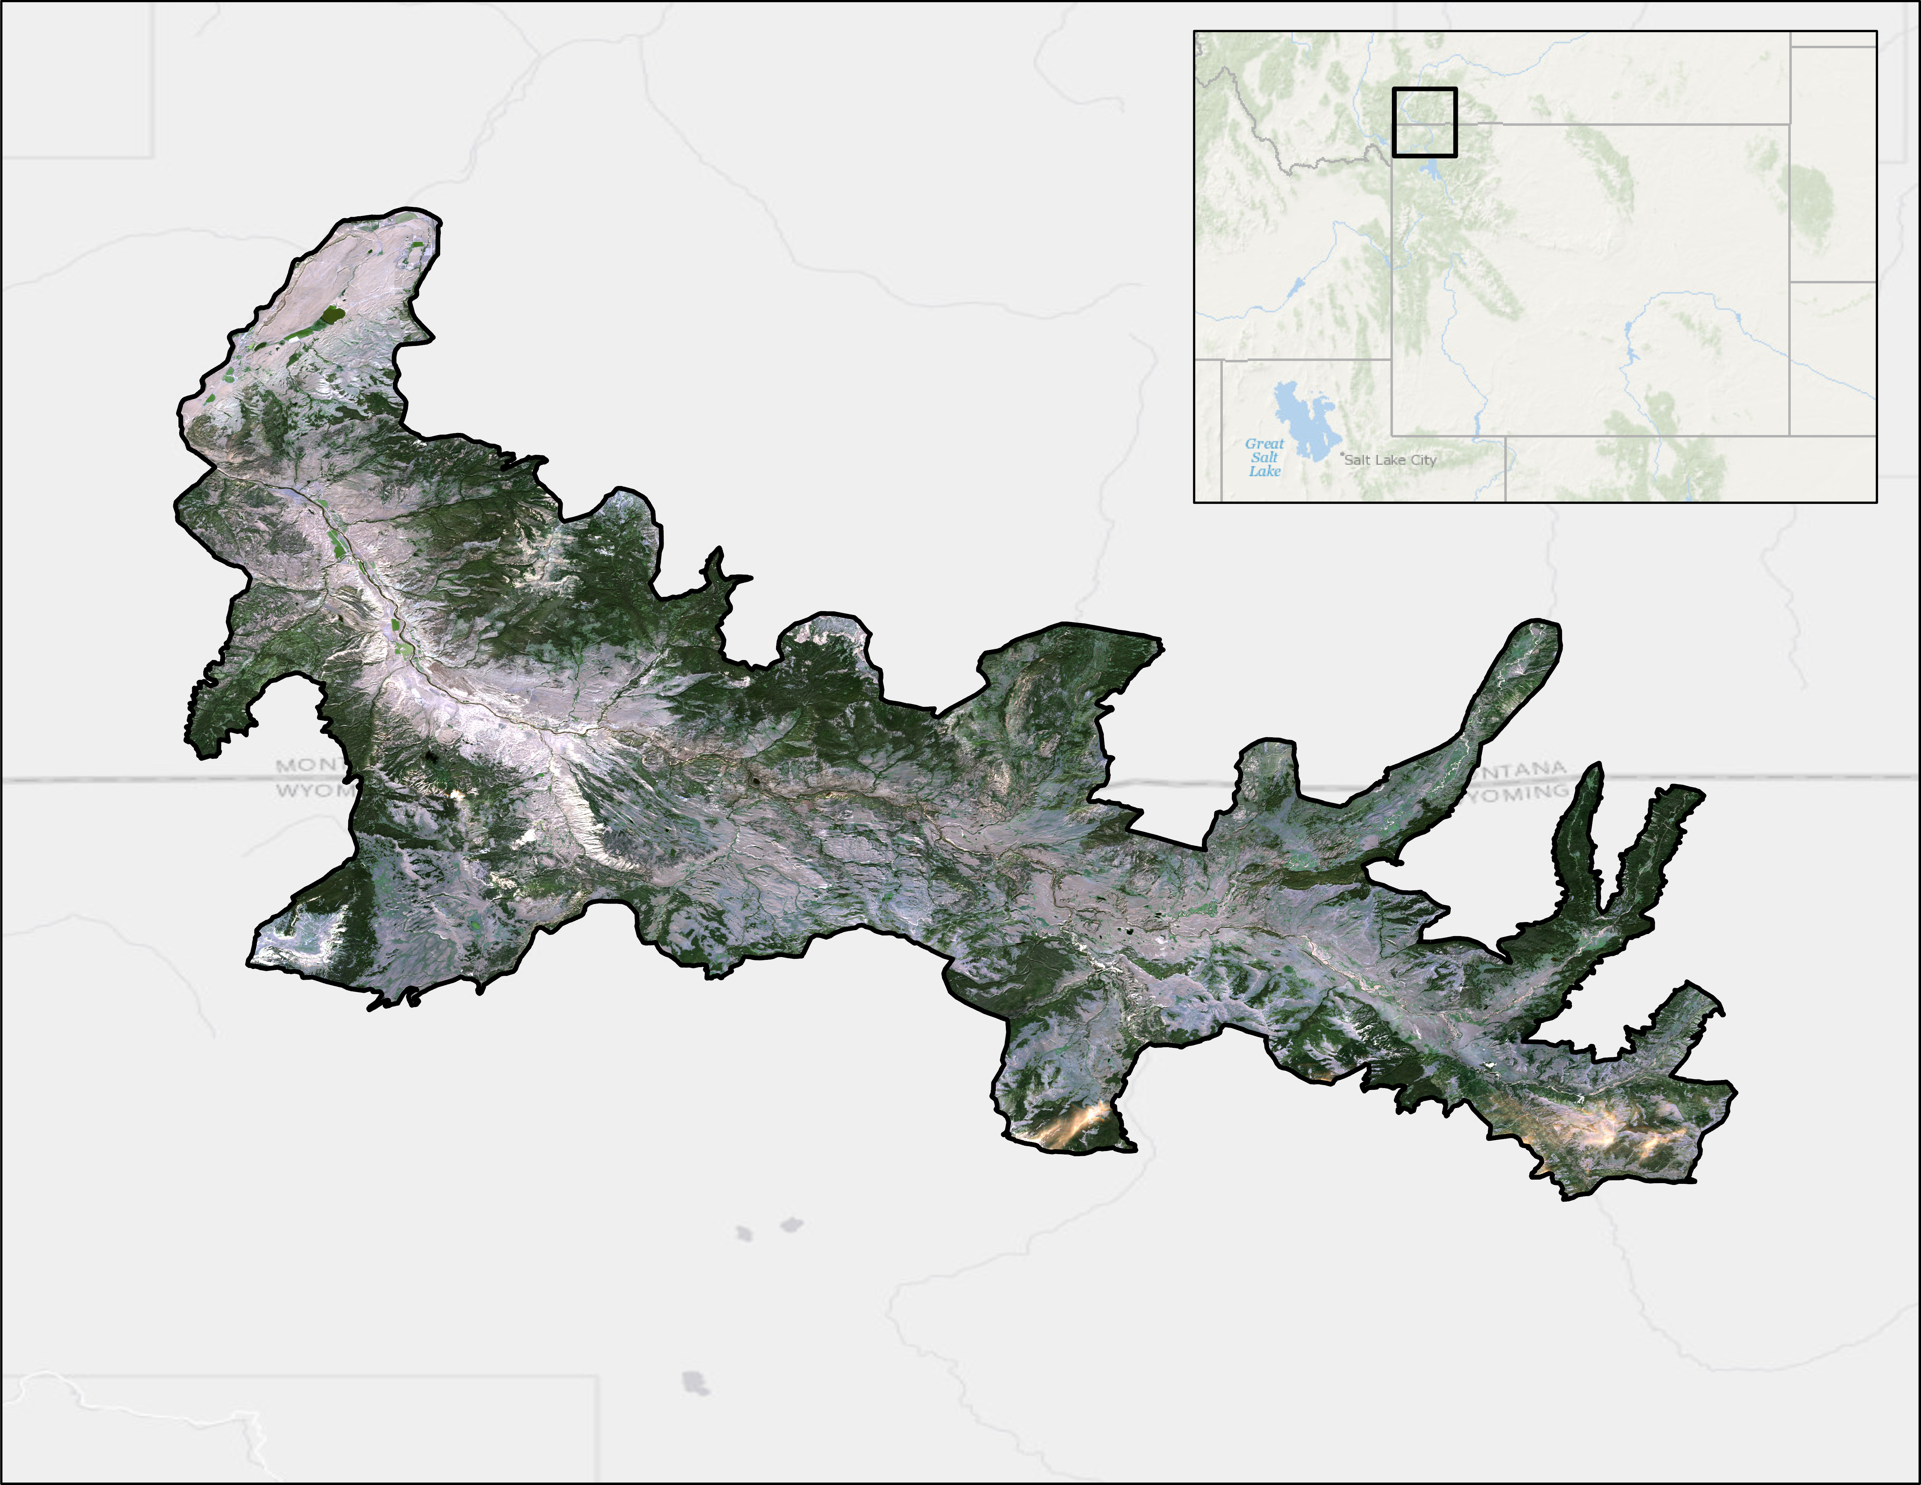
Study Area
Study Area Imagery
MONTANA
WYOMING
0
10
20
40
60
80
Kilometers
Notes:
Speaker: Kyle
Our study area is the Northern Yellowstone Elk Wintering Range, which extends beyond Wyoming & Yellowstone's borders into the southern portion of Montana. It is approximately 1,530 km2. The elevation is approximately 1,498m to 3,214m above sea level.
The landscape has steppe vegetation with forests including conifers, aspen, and other deciduous vegetation such as cottonwood.
Service Layer Credits:
Esri, GEBCO, DeLorme, NaturalVue, IHO-IOC, NGS, Bureau of Land Management, HERE, Garmin, USGS, EPA, NPS.

Slide 7
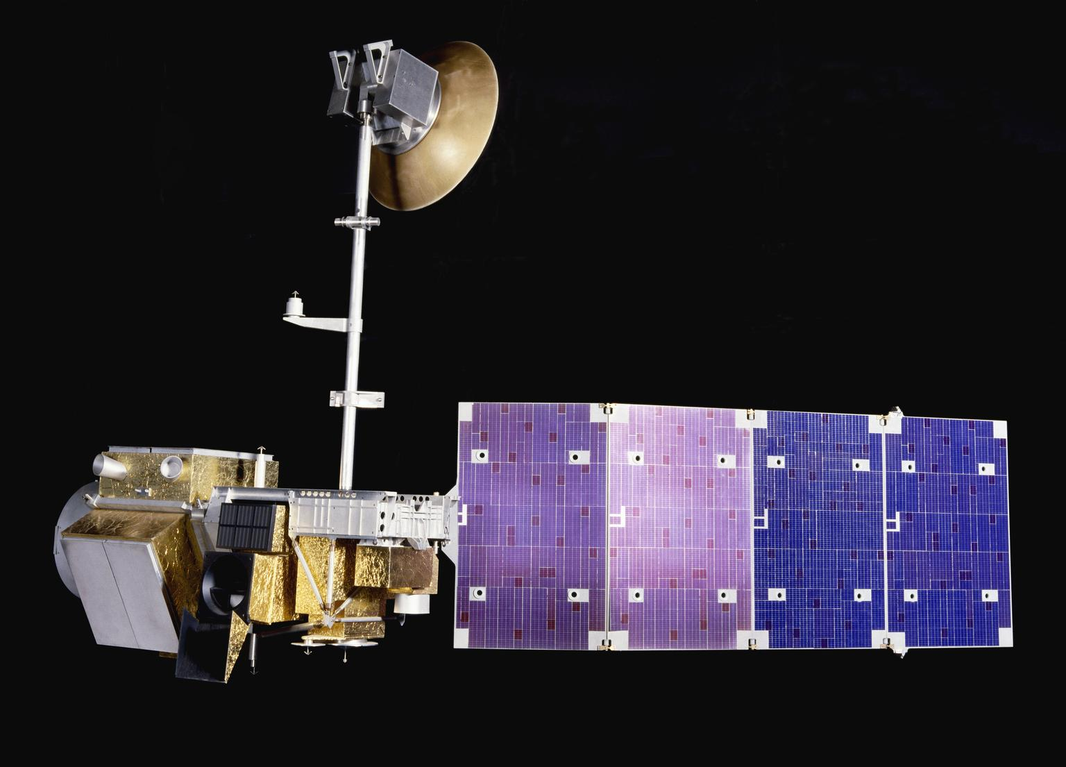
Datasets
Earth Observations
Vegetation Indices
Landsat 5 TM
Sentinel-2 MSI
Canopy Height
ISS GEDI
Ancillary
Aspen Plot and Landcover Data
Partner-provided points
Image Credit: Science Museum
Image Credit: NASA Goddard
Notes:
Speaker: Barry
For vegetation indices (NDVI, EVI, Tassel Cap), we primarily used Landsat 5, Sentinel 2, and PlanetScope.
Landsat: coarsest spatial resolution (30m), but longest temporal coverage (since 1984) .
Sentinel: finer spatial resolution (10m), but shorter temporal coverage (since 2015, 2018 over this study area).
For plant profile metrics (e.g., relative height and plant area index (PAI)), we used ISS GEDI data.
GEDI: since 2018, 25m footprints, every 60m, in paths 600m apart
Our partners provided us with aspen information in the belt transects that they monitor. They also provided us with point locations of a range of landcover types to help with our analysis.
Image Credits
Landsat 5: Science Museum, CC BY-NC-SA 4.0, https://collection.sciencemuseumgroup.org.uk/objects/co40056/model-of-landsat-5-satellite-1986-artificial-satellite
GEDI: NASA Goddard, CC BY 2.0, https://www.flickr.com/photos/24662369@N07/44319764090

Slide 8
Methodology | Random Forest
Image Collection
Select
dates
Find
suitable imagery
Clip
to area
Data Processing
Visualize
color composites
Calculate vegetation indices
Choose
predictors
Data Analysis
Train using
known landcover
locations
Build
random forest classification model
Assess
accuracy
Notes:
Speaker: Gabby
We used two different methodologies this term: random forest classification and a phenological approach. We also analyzed canopy height data.
To begin, we will discuss the random forest classification.
The main tool that our team used was Google Earth Engine (GEE); a cloud based platform for geospatial analysis.
First, we collected images with low or zero cloud cover and clipped them to the study area.
Then, we calculated vegetation indices in GEE. These were NDVI, EVI, and Tasseled Cap – Greenness, Wetness, and Brightness. After that, we used training data for aspen and other landcover classes (e.g., conifers, water, bare ground, and grassland, shrubland, and other deciduous) to classify aspen presence or absence.
Finally, we checked for accuracy by comparing the random forest classification with known aspen locations.

Slide 9
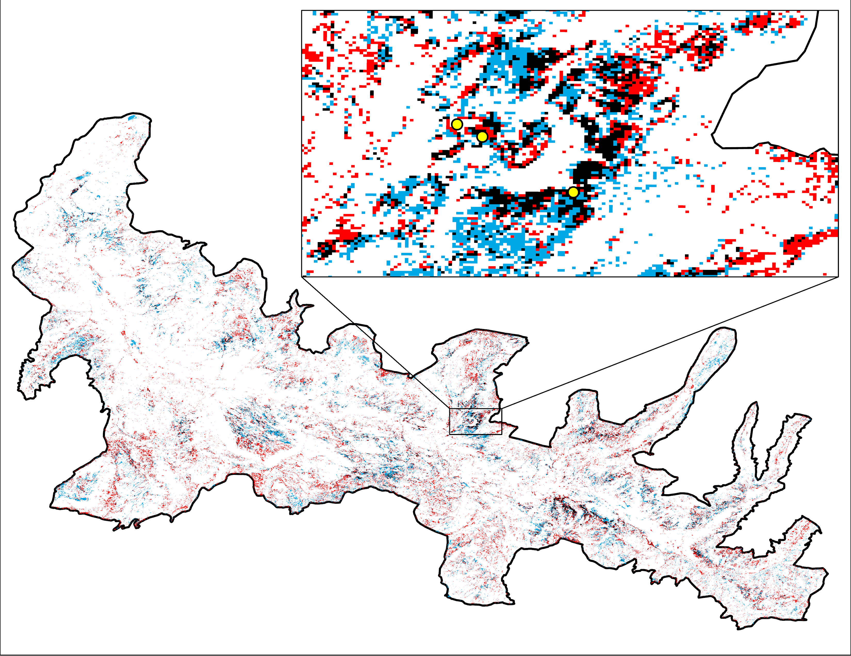
Results | Random Forest
Known Aspen
Location
Both
2011
1986
0
5
10
20
30
40
Kilometers
Notes:
Speaker: Gabby
We produced maps detailing the presence and absence of aspen for several years, but we are highlighting years at the beginning and end of our study period here.
The random forest classification identified changes in aspen in the study region at the start of the study period (1986) to modern-day (showing 2011)
Landsat images were used and is shown in this RF approach. The Sentinel-2 MSI data for later years were also used but it is different from Landsat imagery in that the pixel resolution ranges from 10-20 m.
The RF Classification Model is heavily dependent on the suitability of the training data.
Image Credit: YEF Team

Slide 10
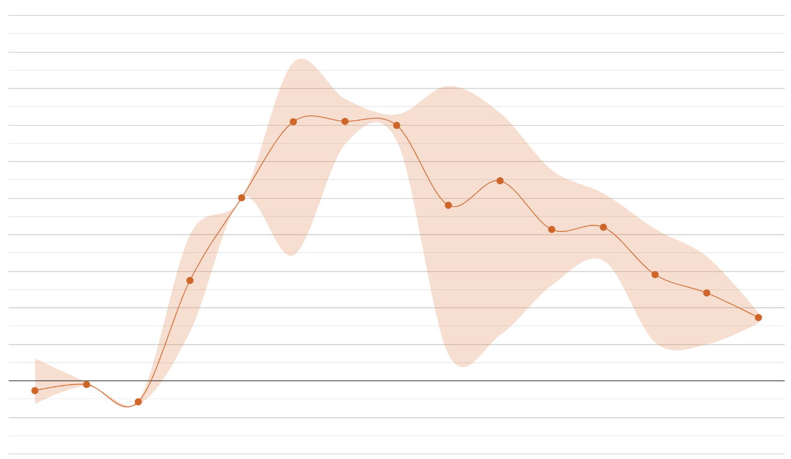
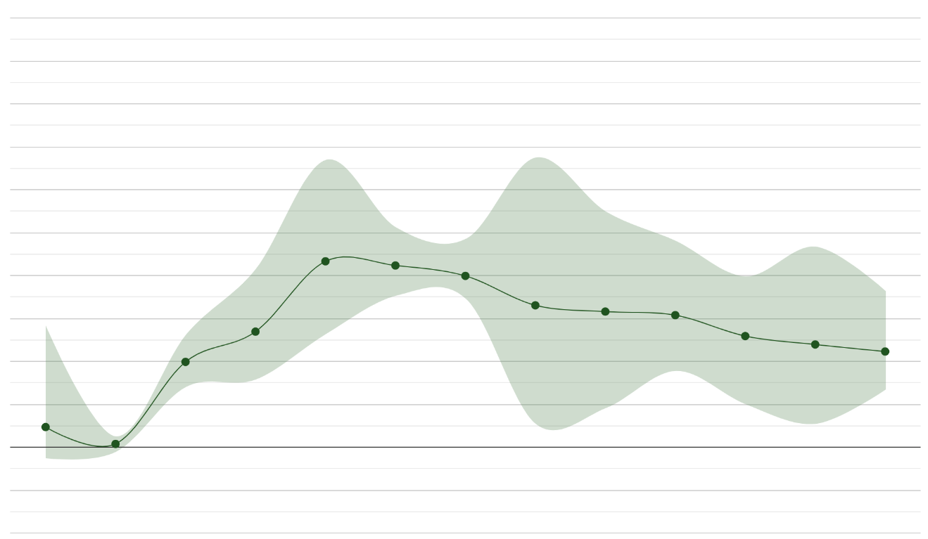
Methodology | Phenological Approach
2011 NDVI Change Over Time
Aspen
Conifer
0.5
0.5
0.4
0.4
0.3
0.3
0.2
0.2
Mean NDVI
0.1
0.1
0.0
0.0
-0.1
-0.1
1-11-2011
3-9-2011
5-12-2011
6-4-2011
6-27-2011
7-6-2011
7-15-2011
8-16-2011
8-23-2011
9-8-2011
9-24-2011
10-1-2011
10-3-2011
10-26-2011
11-4-2011
1-11-2011
3-9-2011
5-12-2011
6-4-2011
7-6-2011
7-15-2011
8-16-2011
8-23-2011
9-8-2011
9-24-2011
10-3-2011
10-26-2011
11-4-2011
Date
Notes:
Speaker: Vanessa
We used another approach to determine if one more accurately identified aspen stands.
The phenological approach uses a unique spectral signature from the value difference in peak greenness (summer) and the late senescence period (Sept/Oct). We utilized google earth engine to observe the phenological changes in NDVI.
Aspen leaves change during fall. We can monitor this change to differentiate aspen from conifers and other deciduous vegetation. We created a graph depicting the change in the NDVI parameter over the year.
One significant strength of the phenological approach is that, unlike out Random Forest Classification, we do not need training data to acquire the distinct spectral signature of aspen throughout the year. With this method we mapped aspen presence and absence by observing the difference in spectral signatures between summer and senescence.
Image Credit: YEF Team

Slide 11
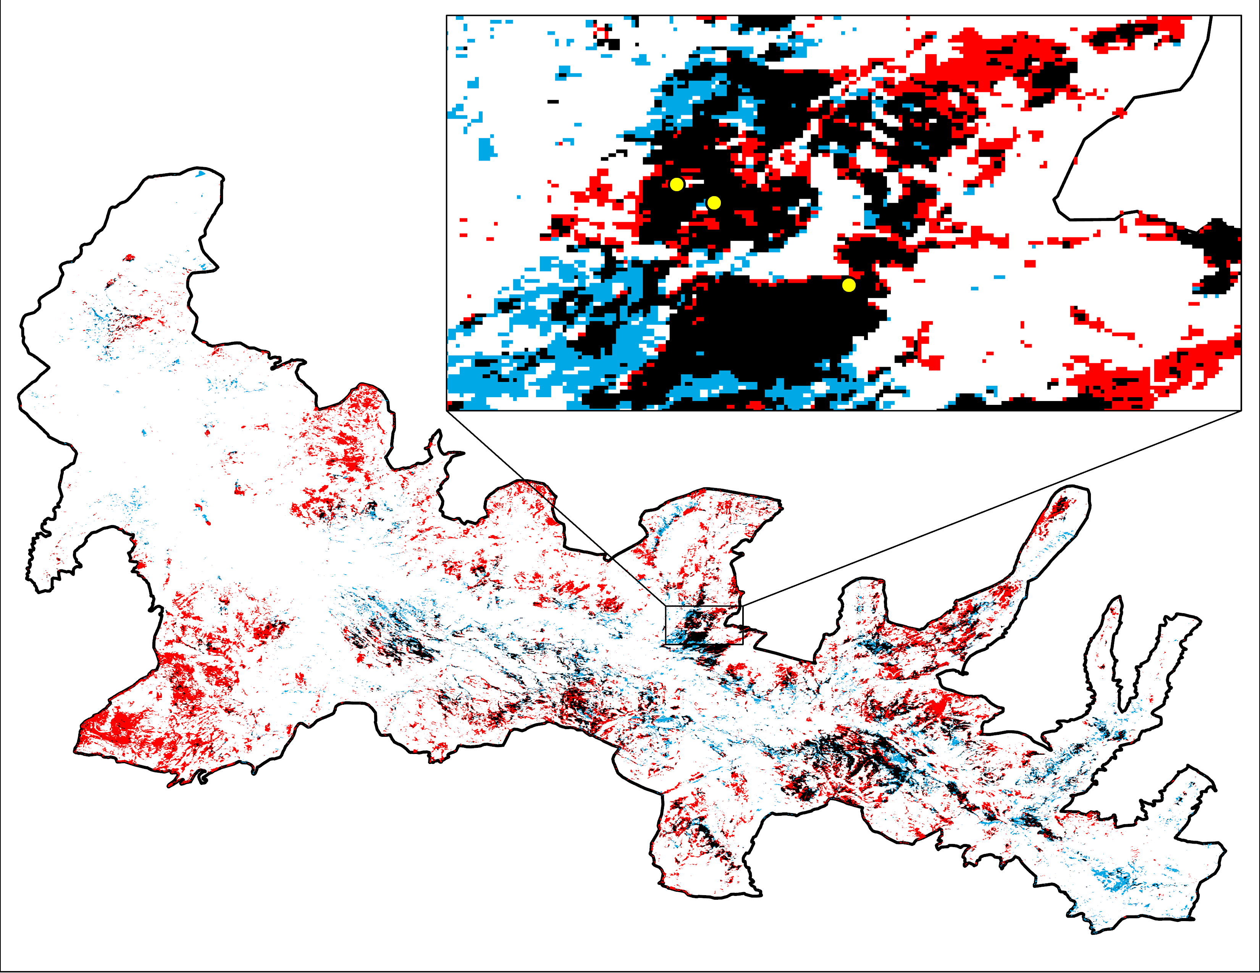
Results | Phenological Approach
Known Aspen
Location
Both
2011
1986
0
5
10
20
30
40
Kilometers
Notes:
Speaker: Kyle
After creating NDVI change over time graphs for several vegetation types, we used the difference between seasons to identify areas that showed the same change as those in our identified pure aspen stands.
You can see the results here. They are different from the random forest approach in that not all the areas match the ones in the RF Model.
Image Credit: YEF Team

Slide 12
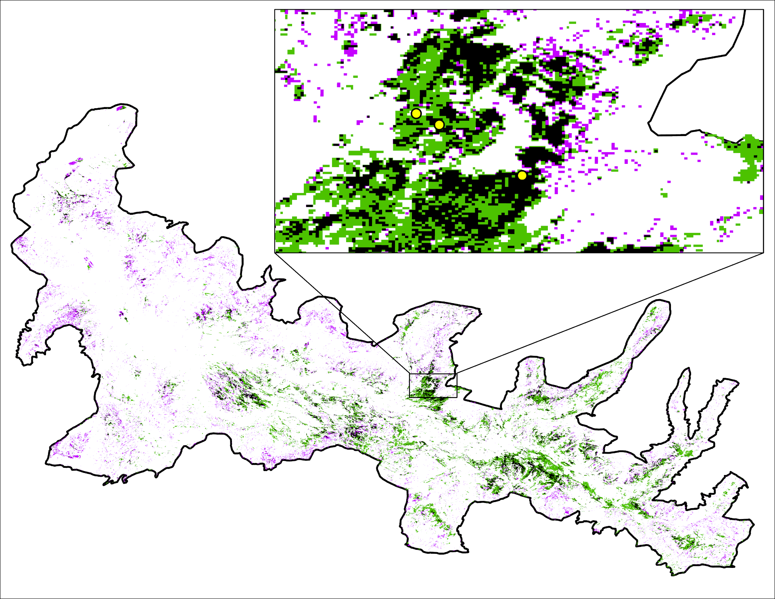
Results | Comparison
Both Methods
Random Forest
Phenological Approach
Known Aspen Location
0
5
10
20
30
40
Kilometers
0
5
10
20
30
40
Kilometers
Notes:
Speaker: Kyle
This composite image shows the intersection and union of both methods. This image is for 2011 and used Landsat 5 TM imagery.
Here, you can see both the RF and phenological results visually displayed in one image. As you can see, there is overlap in certain areas and these are especially evident in areas that had aspen training points. With comparison to areas that did not have aspen training points, there is definitely more sporadic overlap, if any.
Image Credit: YEF Team

Slide 13
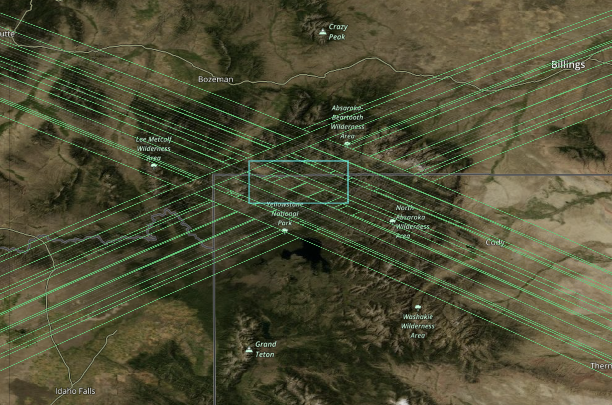
Methodology | Canopy Profile
NASA Earthdata Search
rGEDI (Silva et al., 2020)
Visualization of profile metrics
Export of data as shapefiles
Image Credit: GEDI Science Team
Image Credit: NASA Earthdata Search
Notes:
Speaker: Vanessa
NASA Earthdata Search engine to find tree canopy height data from NASA’s GEDI mission
For this preliminary exploration, used data collected on August 25th, 2021 to include deciduous leaf area measurements that would be lost in winter
Specific data from the product are canopy height and plant area index (PAI)
R package rGEDI (Silva et al., 2020) to process the GEDI data
Primary purpose is processing and visualization of GEDI data
Conversion from the Heirachical Data Format (HDF) 5 file
Export of point data as shapefiles (shot locations within the beam paths) with plant metric attributes (e.g., elevation, relative height, and PAI)
Preliminary analysis of tree canopy height and PAI in both QGIS and R
Image credits
GEDI logo: GEDI Science Team Image, https://www.earthdata.nasa.gov/learn/articles/first-gedi-data-available
Earthdata screenshot: NASA Earthdata Search, https://search.earthdata.nasa.gov/search

Slide 14
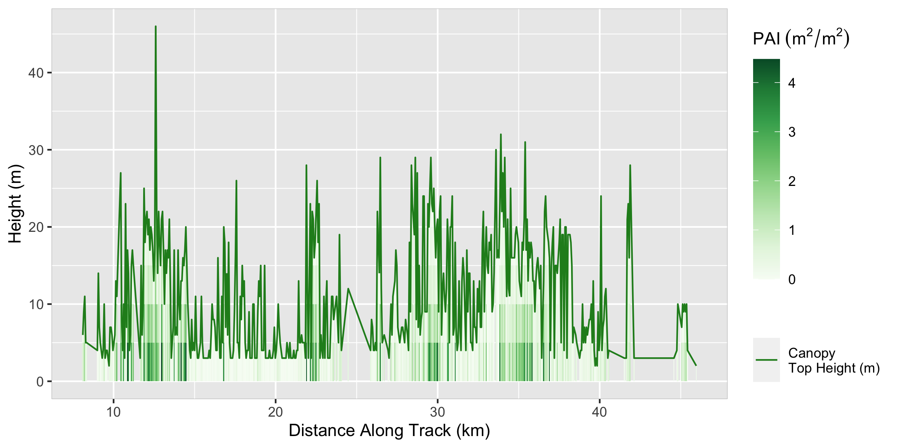
Results | Canopy Profile
Canopy Profile Transect in Study Area
Plant Area Index (m²/m²)
40
4
30
3
Height (m)
2
20
1
10
0
Canopy Top Height (m)
0
10
20
30
40
Distance Along Track (km)
10
Notes:
Speaker: Vanessa
The GEDI data are useful for observing canopy height and plant area index, as well as other metrics.
Here we can see an example profile through the study area showing how canopy height and plant area index vary.
With further analysis, these data can be compared to field measurements and our aspen identification.
The second term team can perform more detailed analysis using the ISS GEDI data.

Slide 15
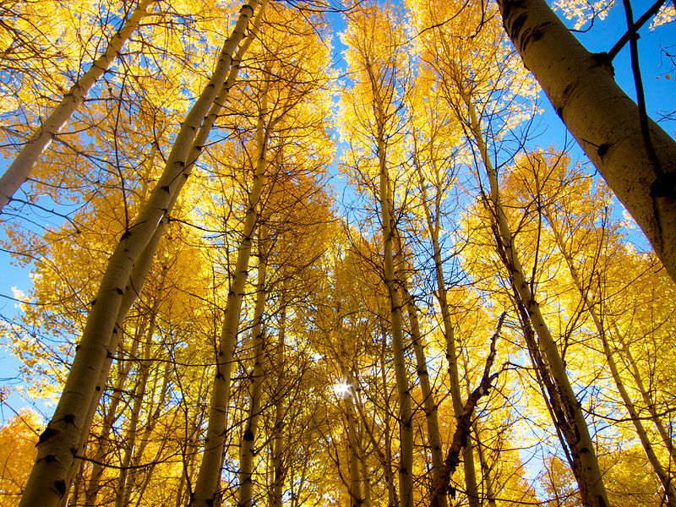
Conclusion | Project Takeaways
Aspen expanse changed in the study area
Better understanding of how trophic cascades affect aspen
Image Credit: Jonathan Cook-Fisher
Notes:
Speaker: Barry
To reiterate, our findings indicate that aspen in northern Yellowstone has changed expanse.
The random forest and phenological approaches showed marked differences.
Our maps and time-series provide information on aspen health and extent.
When combined with other datasets from the NPS, the results from the satellite imagery could provide insights on the impact of rewilding decisions and inform future decision making.
Image credit: Jonathan Cook-Fisher, CC BY 2.0, https://www.flickr.com/photos/jcookfisher/10388721565/in/photolist-gQ1UZ4-dgf36W-aqJ6VF-c9mmFA-puLg7V-dhEeXv-gEkoJz-dg1KGX-pu22Ha-pcwCgW-8GZf9s-5DSa79-3brXkG-awNThC-5vgy6i-3brWLS-7CPBKm-aqJ6u2-gQ2aCJ-dgKJxf-qwPgim-9nHAun-3m3aM-aqLL7y-6g2tMq-hnQ2rT-diTcqE-YpqkKn-X94VH1-X8yrrQ-XbwixP-MxFbJJ-5Dc3Ur-GXF3hh-dgoVPr-qCZ3g8-8Jynag-MceBx4-drR676-4mgRXq-LKj5Ds-q3wjgk-dmpGHu-drRdgN-aDKBQR-8GLjYz-73X578-anAgmC-73WWZT-asqAA9

Slide 16
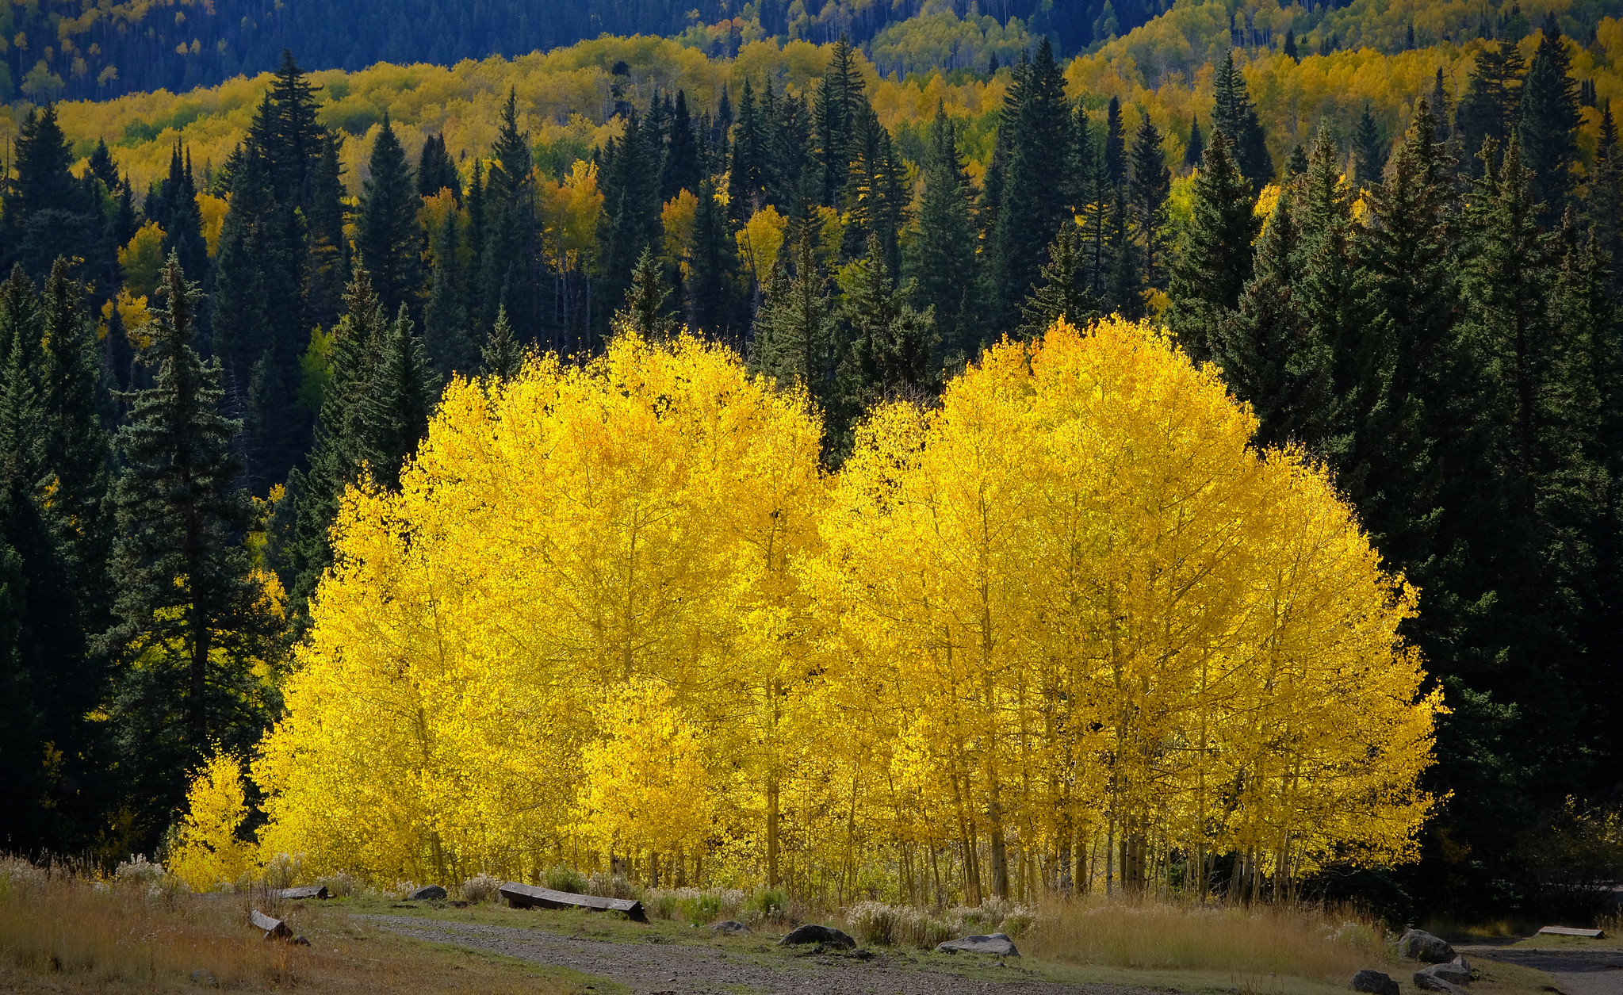
Limitations
Spatial
Temporal
Data Quality
Aspen Site Variability
Image Credit: Tranquiligold Jin
Notes:
Speaker: Barry
Spatial Limitations: The resolution of satellite imagery does not match the size of aspen trees or stands (i.e., aspen stands are smaller, so the signature from satellite data is not as specific to aspen).
Temporal imitations: Data not available for all the years we were interested in, finer spatial resolution only available for more recent years (GEDI too).
Data Quality: Sometimes data obtained from the sensors (e.g., GEDI) were flagged for other issues, making the data unusable though it was collected. Clouds, cloud shadows, and snow also complicated data analysis and had to be resolved.
Aspen Variability: Taking into consideration how aspen change with elevation and aspect are other things to consider. These influence temperature and moisture availability, making selecting appropriate imagery (or imagery from a range of dates) necessary.
Image credit: Tranquiligold Jin, CC BY-NC-SA 2.0, https://www.flickr.com/photos/9766401@N03/51713105875/

Slide 17
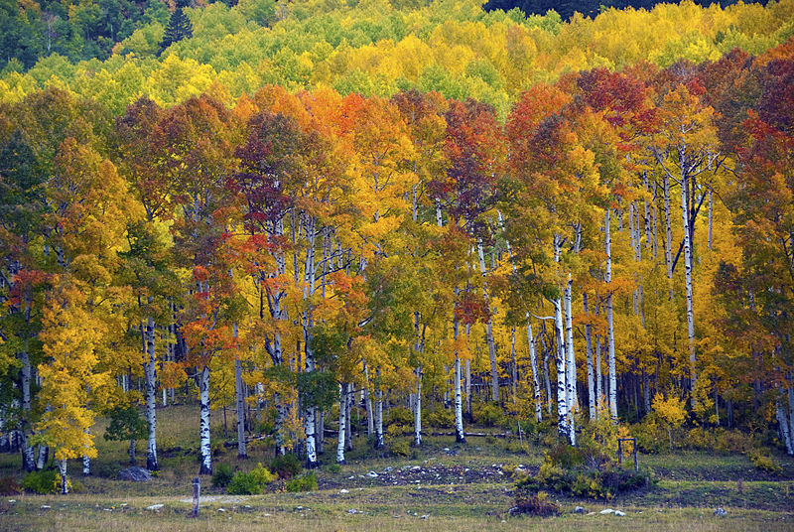
Future Work
Refine spatial and temporal resolutions
Compare canopy height data and profile metrics with identified aspen stands
Image Credit: John Fowler
Notes:
Speaker: Gabby
YNP is a two term project; fall 2022 will be the second (and final) term for the YNP project and the second term team will build upon the first team term's work.
Explore other satellite imagery with finer spatial resolution like PlanetScope (especially for more recent years)
Expand on years analysis is conducted for to refine temporal resolution (e.g., annually) back to 1985
Analyze ISS GEDI canopy height data and profile metrics that correspond with aspen stands identified in this team’s maps
Image credit: John Fowler, CC BY 2.0, https://en.m.wikipedia.org/wiki/File:Aspens_at_Sunset,_Purgatory.jpg

Slide 18
Partners
Dr. Daniel Stahler, Wildlife Biologist
Yellowstone National Park
Dr. Daniel MacNulty, Professor
Utah State University
Dr. Eric Larsen, Professor
University of Wisconsin – Stevens Point
Nicholas Bergeron, Researcher
Utah State University
Science Advisors
Dr. Marguerite Madden
University of Georgia, Center for Geospatial Research
Dr. Kunwar Singh
William & Mary, AidData & Global Research Institute
Special Mention
Sarah Payne, Fellow
NASA DEVELOP National Program
This material contains modified Copernicus Sentinel data (2019), processed by ESA. ​
Maps throughout this work were created using ArcGIS® software by Esri. ArcGIS® and ArcMap™ are the intellectual property of Esri and are used herein under license. All rights reserved. ​
Notes:
Speaker: Kyle
We would like to thank our Partners, Science Advisors, Node Fellow, and everyone else who contributed to the success of our project this term.

Slide 19
For Reviewers: Following slides are just for Applications Week.

Slide 20
Aspen in Yellowstone
Keystone species
Ecosystem services at risk
Objectives
Determine aspen extent over time
Image Credit: Tranquiligold Jin
Notes:
Aspen provides a vital food source, habitat, and shelter for a variety of wildlife, and therefore, is a keystone species that is widely distributed throughout North America.
Aspen is a deciduous tree with vibrant yellow colors in the fall.
Aspen in Yellowstone only only covers about 1% of the total land area (Brown et al., 2006), but it is estimated that over 95% of aspen stands in the park are over 80 years old (Larsen & Ripple, 2005).
Because the majority of the stands are so old, they are more vulnerable to decline.
Given its importance in providing habitat and increasing biodiversity in the region, understanding its health is critical. Without aspen, key ecosystem services may be lost, which is why there is concern over its decline.
The main objective of our project was to determine aspen extent over the last few decades to understand the role of trophic cascades on its success.
Image credit: Tranquiligold Jin, CC BY-NC-SA 2.0, https://www.flickr.com/photos/9766401@N03/51754655992/in/photolist-2mRo983-2mCH1Hi-2mA8NrT-2mMHbHH-2mLd8Cp-2mD2yGn-2mLAKij-2myvsnE-2mC18Ym-2mzANa5-2mFJdMe-2mB943P-2mWCo2F-2mCr5i9-2mVFFSs-2mLU6fe-2mDBUdR-2mGQ6s2-2njQUhU-2mKpMwp-2mwKg8Z-2n7UZGT-2mum442-2mGogVx-2mynSfy-2nonNNp-2mQYzMK-2mXNvMH-2mDfYnQ-2mWz4tA-2mNZic2-2mMCA39-2mzRGj6-2mumoX1-2mv8ZzU-2mu7EZZ-2mwP1sD-2k1KAnD-2jQ16g2-2mv3ZNR-2muPgSD-2niBvaV-2k3z4Mr-2jXfvJV-2mQgBuD-2mMQ8ZU-CTcaFa-2mGPBqa-2mHhnNc-2jQzUc1

Slide 21
Methodology
Random Forest
Phenology
Predictors
Training Data
Summer NDVI
Fall
NDVI
Classification
Difference
Validation
Validation
Notes:
We used two different methods to try to identify aspen
First, we used a random forest approach.
We created several predictors (e.g., NDVI, tasseled cap indices, true color, shortwave infrared, and near infrared) to feed into the model.
We also used partner provided points of a variety of landcover classes to run the classification.
We then checked for model accuracy by comparing with known aspen locations.
The other approach we used required an assessment of phenology.
We plotted NDVI for aspen and conifer sites over the year to identify periods of peak greenness and senescence.
Subtracting the summer and fall NDVI images allowed us to determine change in NDVI for those two key time periods.
Deciduous (greater change) and coniferous (relatively constant) species display different changes in NDVI which makes it possible to classify areas that could be aspen.
We again compared to known aspen locations.

Slide 22
Results & Conclusions
Aspen changed expanse in the study area
Better understanding of how trophic cascades affect aspen
Both Methods
Random Forest
Phenological Approach
Known Aspen Location
0
5
10
20
30
40
Kilometers
Notes:
Our findings indicate that aspen in northern Yellowstone changed expanse in the study area.
The random forest and phenological approaches showed marked differences.
These maps show a comparison of the two methods for the year 2011, but we also performed analysis to see how aspen extent has changed since the mid 1980s (not shown here).
When combined with other datasets from the NPS, the results from the satellite imagery could provide insights on the impact of rewilding decisions and inform future decision making.

