Slide 1

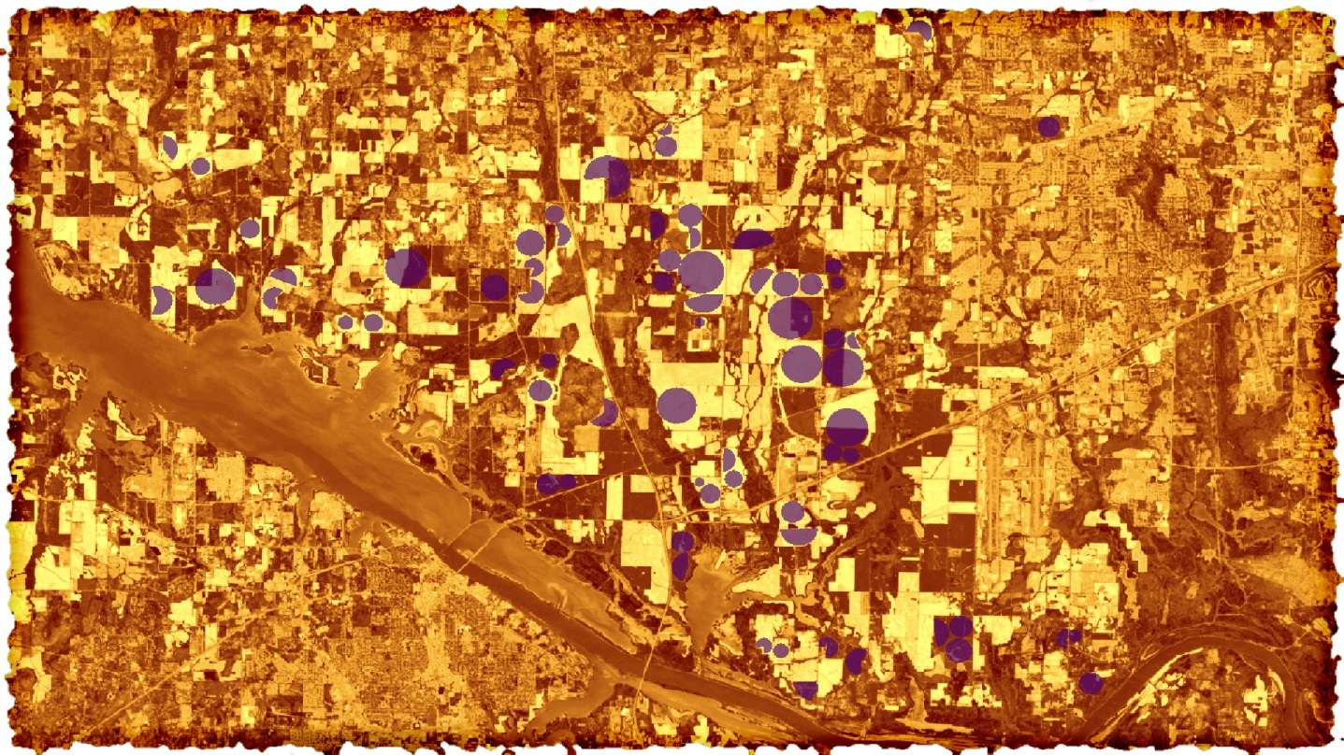
Chris Ploetz (Project Lead)
Olivia Callaway
ALABAMA AGRICULTURE
Maggi Klug
Using NASA Earth Observations to Assess Vegetative Stress of Row Crops in Irrigated and Non-Irrigated Plots in Alabama
Emilene Sivagnanam
NASA Marshall Space Flight Center
2017 Spring
Notes:
Good afternoon, we are the Alabama Agriculture team: Our Project was an exploratory using NASA Earth Observations to Assess Vegetative Stress of Row Crops in Irrigated and Non-Irrigated Fields in Alabama. My name is Chris Ploetz, I am the project lead. I have bachelors degrees from Auburn university in Anthropology and Geography and received a Masters of Science from the University of Georgia.
My name is Olivia Callaway and this is my second term of DEVELOP. I am an undergraduate student here at UAH in the Atmospheric Science department.
Hi my name is Maggi Klug, this is my fifth term of DEVELOP. I am an undergraduate student at UAH in the Earth Sciences department with a focus on remote sensing and GIS
Hi my name is Emilene Sivagnanam, this is my first term of DEVELOP. I have a B.S. in Earth Science from Oregon State University and a M.A. in Climate and Society from Columbia University.

Slide 2
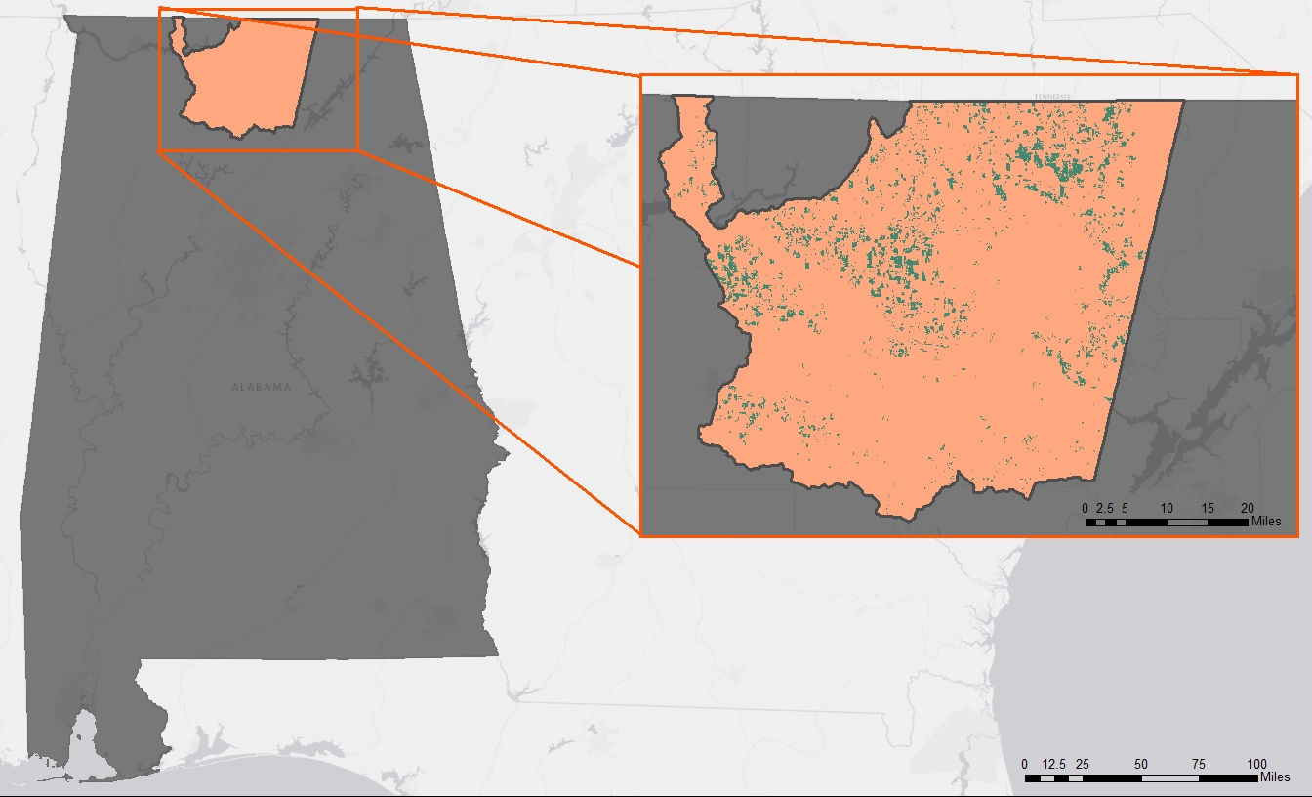
Study Area
Study Period:
  2009, 2011, and 2016
  March – September
Study Area:
  Wheeler Lake HUC-8
  Counties: Limestone, Lauderdale, Lawrence, Morgan, Marshall, Jackson, and Madison
Notes:
CP
We decided to look at irrigated and non irrigated farming in the HUC- wheeler lake area which comprises these counties. We chose this area in part because of the availability of irrigation (center Pivot) Data for multiple years. Originally we were going to look at a larger area, but decided to focus on the areas of the wheeler lake HUC that were encompassed within one Landsat tile. We chose to look at the 2011 and 2016 growing seasons, as these years experienced drought. As a baseline wet year we choose to look at 2009 as it was a relatively wet year with little to no drought conditions around the study area and there were sufficient cloud free days.

Slide 3
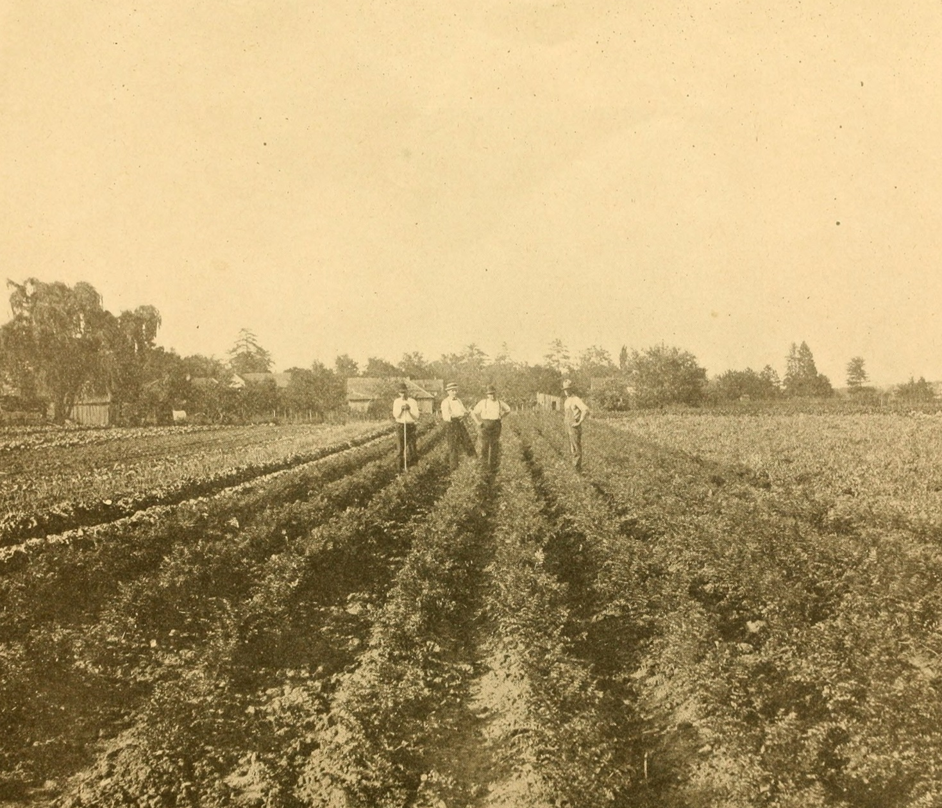
Project Partners
Dr. John R. Christy
  Alabama Office of the State Climatologist (AOSC)
Cameron Handyside
  University of Alabama in Hunsville, Earth Systems Science Center (ESSC)
Image Credit: Wikipedia Commons
Notes:
CP
Our study partnered with Dr. John Christy at the Alabama Office of the State Climatologist and Cameron Handyside at the Earth Systems Science Center at University Alabama at Huntsville
Image Source: https://upload.wikimedia.org/wikipedia/commons

Slide 4
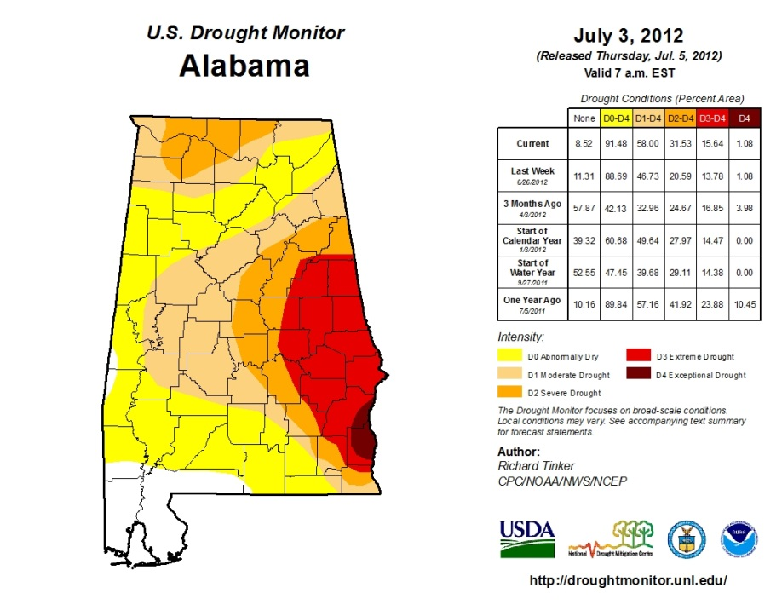
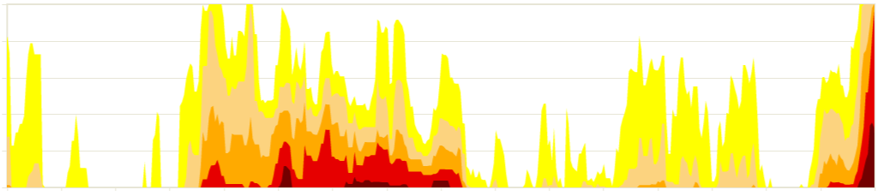
Background
Alabama is subjected to frequent droughts (prolonged and flash droughts)
Drought conditions impact agriculture
Category | Description
D0 | Abnormally Dry
D1 | Moderate Drought
D2 | Severe Drought
D3 | Extreme Drought
D4 | Exceptional Drought
Alabama’s Percent of Area Affected by Drought, 2009-2016
Image Credit: U.S. Drought Monitor
100%
0%
6-1-2009
6-1-2011
6-1-2016
Notes:
CP
Alabama has been subject to frequent droughts over the past decade. Some long term and some shorter known as flash droughts. These flash droughts can still impact crops although they are more difficult to pick up and classify. Droughts can lead to lower crop yields and sometimes failed crops.
Image Source: http://droughtmonitor.unl.edu

Slide 5
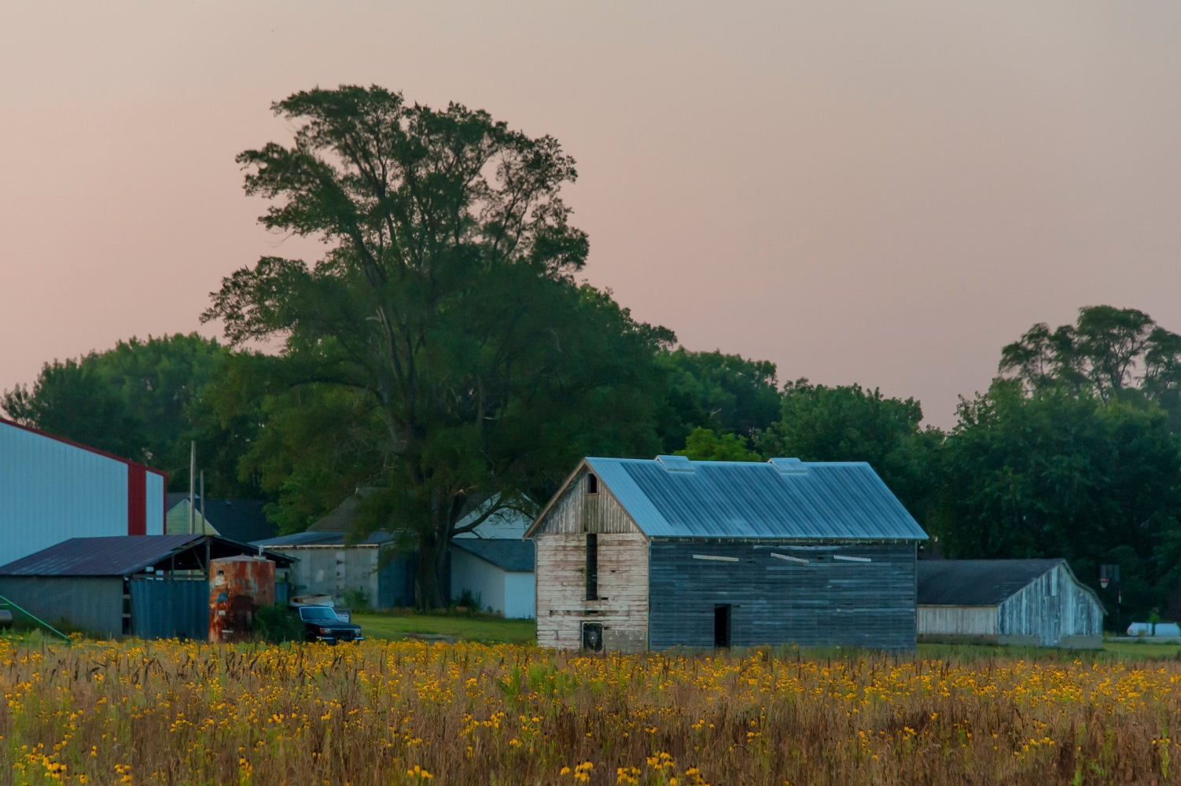
Community Concerns
In 2012…
21,283 farms harvested crops
  Corn: 2,112 farms
  Soybeans: 1,502 farms
  Cotton: 925 farms
Average precipitation was ~380 millimeters below normal
1,172 farms had failed crops or were abandoned
1,747 farms (5.5%) were irrigated
Image Credit: Carl Wycoff, 2014
Notes:
ES
Based on information from the latest USDA National Agricultural Statistics Service, which was in 2012,
21,283 farms harvested crops in the state of Alabama,
of which, 2,112 produced corn,
1,502 produced soybeans, and 925 produced cotton.
These three crops, which are the focus of our study, are what we consider “Row Crops.” Alabama also produces other crops, such as peanuts, grains, blueberries.
This year was a particularly harsh year for farmers, with a type of severe drought conditions that are now categorized as “flash droughts.”
During this period, average precipitation was 380 millimeters (15 inches) below normal and 1,172 farms had failed harvests or were forced to abandon their crops.
Of the harvesting farms in Alabama, only 1,747 farms, or 5.5%, were irrigated during this severe drought period
Image credit: https://www.flickr.com/photos/carlwwycoff/14604388377/in/photolist-ofxiRB-d7Z7Uw-nz7UW9-8HW2sb-eimGWp-7uJ2uh-jryxN-nXjFSM-8HSCXt-am9ffM-cdkfvw-dpjL5V-cQXPRb-5WWdUn-5DBCfo-djDbgX-36Syj-9GFzv-nNn4gg-djD987-djCPST-ez8w3A-HAGUF-6TZD5w-6kpj3H-4z8SYE-4anVEj-5DxjJ4-dvQihW-6ktvBm-nbcTne-5S7KSp-2cPNNy-8CwR4q-8xFAe-QnwB12-2YvWwK-4z8R8q-8HVjfA-8HRNcV-5KVJc2-8HRLEv-7KEsd6-5fYKPy-8HVXpU-n8xLRW-7W1JCq-8HT6Lt-nHpCXi-8HT8Pv
Sources: USDA National Agricultural Statistics Service, 2012

Slide 6
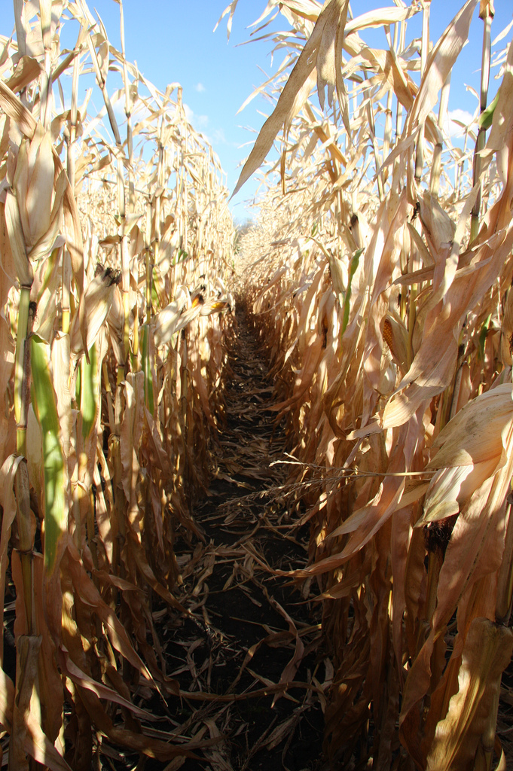
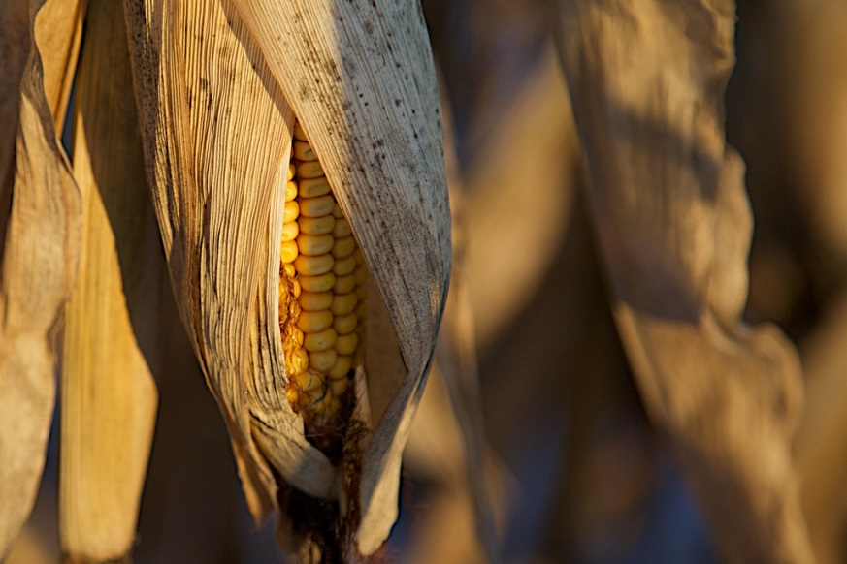
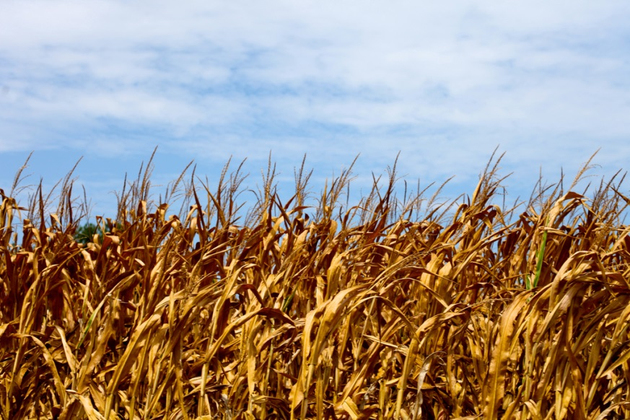
Community Concerns cont.
In 2016, 5 million people lived in drought affected areas
Drought affects:
  Farmer’s income
  Local economy
  Water availability
  Food systems
  Food availability
  Livestock food availability
  Next season’s insect and diseases
Image Credit: Perry McKenna, 2009
Image Credit: Tom Woodward, 2011
Image Credit: Alternative Heat, 2009
Notes:
ES
Unfortunately, Alabama was struck with another severe drought in 2016. In early December 2016, all of Alabama was in severe drought conditions or worse —additionally, nearly 5 million people in the state lived in drought affected areas
Drought affects the community in the following ways:
Farmer’s income
Local economy
Water availability
Food systems
Food availability
Livestock food availability
Next season’s insect and diseases
https://www.ncdc.noaa.gov/sotc/drought/201204#det-agri-hydro
Image credit: tom woodward, 2011: https://www.flickr.com/photos/bionicteaching/6057415319/in/photolist-aegQxa-cQz8ud-Sz2G8a-cH67Y5-aejc7w-aejccN-aejbzu-aego96-cNEnyQ-JYYQ4r-cz68gL-a1bvHi-9Q1wwJ-9PXEGH-9Q1wDG-9Q1wSS-9Q1wM1-J3ArKL-enq1fW-53ce5o-oavqYi-daKPep-aegnWr-ovrFQM-aegojz-cAwx63-cz68WY-cz681S-cz66FU-JxkGdL-cCthpj-cz68Cw-cJNo43-LzhvJY-dnKNjq-cz66V5-nVbADf-7DfQ7M-hhTR8N-cvNt57-9H17yK-JW2iAW-JxkH4J-JYYTiT-63C2Qm-czp8uW-faW8HW-cEeC3d-cz67Ed-czp8Mf
Perry McKenna, 2009: https://www.flickr.com/photos/63567936@N00/4206107726/in/photolist-cqDpyh-aoMPvm-avbTFM-fkmpbw-hcZ72A-hbwYGe-p3LFmZ-cqDCxw-hP2w1y-fbgER9-hbyrMc-hcp8Xh-pornoU-59UzC3-56zMYG-oZ9wp8-4ZgrpJ-7pFphJ-JbVrz-35WQdj-6B6gTp-aveyiG-29CDAh-fwX7w8-9QmjAN-7sEbjV-8rBFib-o2MpG5-a7M87Y-5pviTW-8vevX7-hd1fRB-bZ7uRb-a7Yv1f-dBDtjJ-6k4KBD-4ivnnw-hbx2kk-hC4Xpy-6JRfPT-7qHJSV-6XmwdG-gr9Hii-7fCBA1-nFtPqF-hbxbou-hcZ1rQ-8CgLgR-awDRvx-hbxdJd/
Alternative Heat: https://www.flickr.com/photos/alternative_heat/6237518385/in/photolist-avbUUr-avbSdr-9PNfAh-6Vdm89-eSnHH3-nsHJho-6Xn9F3-h6gy6m-giuVSB-5vfLbe-b3Yn38-9PNi7A-avexS3-aveA83-avbUqa-5uyfpY-9PNhXf-pQU5e-9PNkph-9PKnJx-aqSZth-9PKmQg-5tu2cd-2hTTV3-9cw58h-9PKtcp-9PNjUs-bqbTx1-9PNf5A-7dgpCW-9PNkku-eSbiPB-B4i2N-9PNje9-9PKkEP-9PNeTy-9PNhTd-9PKpAT-9PNepL-7rVXe8-9PKqEz-9PNeto-avbT2Z-aveBtY-cLjRVh-dmKVZj-aoMPou-9PKoTM-9PKpu8-9PNfXJ

Slide 7
Objectives
Is there an opportunity to reduce the number of farms with failed crops?
1. Determine relevant indices for monitoring drought in Alabama
2. Create time series for multiple vegetation and water indices
3. Assess suitability of the Landsat satellites for monitoring drought conditions
4. Compare indices to ESSC’s GriDSSAT crop model
Notes:
MK
Our objectives of this project were to 1. determine the relevant indices derived from satellite data for monitoring drought in Alabama, 2. Create time series of these several vegetation and drought indices, 3. Determine if the Landsat satellites are useful in monitoring drought conditions, and finally compare the indices to the Earth System Science Center’s GriDSSAT model, which I will talk about more in the next slide.

Slide 8
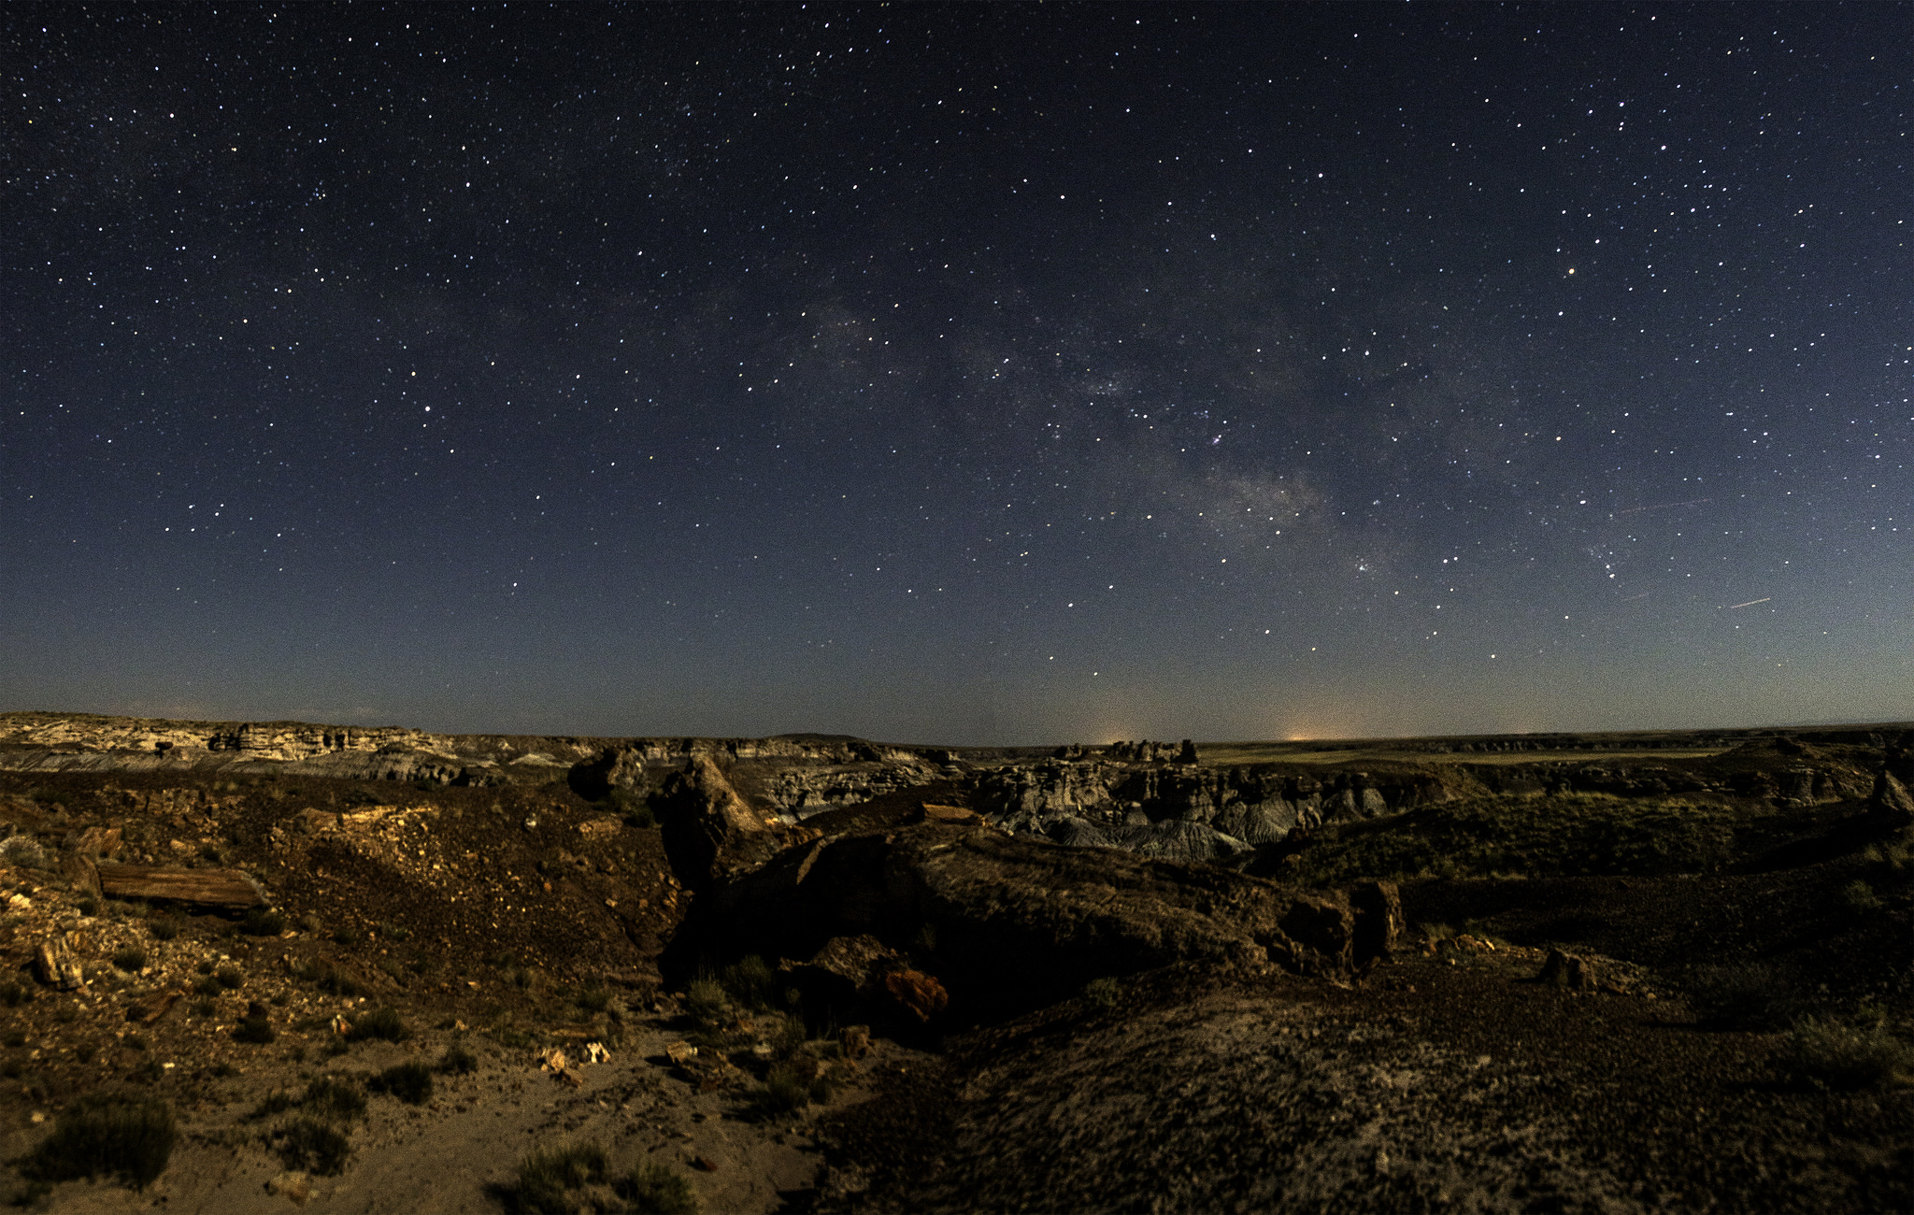


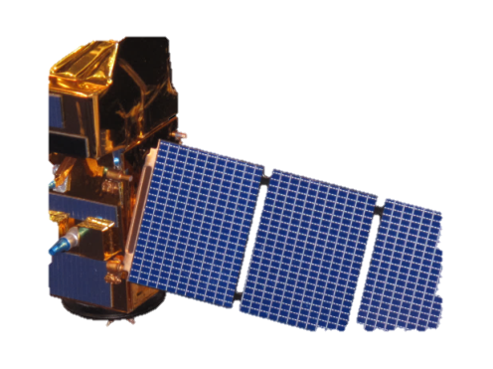
Satellites/Sensors and Data
Satellite Data
Landsat 5, Thematic Mapper (TM) – Surface Reflectance
Landsat 8, Operational Land Imager (OLI) – Surface Reflectance
Sentinel 2, Multi-Spectral Instrument (MSI)
Ancillary Data
USDA CropScape data layers
ESSC center pivot survey shapefiles
GriDDSAT water stress index
Landsat 5 (TM)
Landsat 8 (OLI)
Sentinel 2 (MSI)
Image Credit: NASA; Credit NPS/Andrew V Kearns
Notes:
MK
For this project we used the 30m Surface Reflectance products of Landsat 5 Thematic Mapper and Landsat 8 Operational Land Imager as well as 10m Surface Reflectance Sentinel 2 MultiSpectral Instrument data. Additional datasets that were used were the USDA’s global Cropscape 30m data to determine the crop types, The Earth System Science Center’s Center Pivot Survey shapefiles which show areas of irrigation in Alabama, and GriDSSAT, the Gridded Decision Support System for Agrotechnology. GriDSSAT comprises of crop simulation models for over 28 crops and is supported by database management programs for soil, weather, and crop management. The water stress index within this model was used to compare with our drought indices.
Stars: https://www.flickr.com/photos/petrifiedforestnps/32719774623/in/photolist-RRkp4e-RCxQmo-RtPMbh-T2xjEA-fio4Tv-S1YcqZ-RHuKp1-SzMD5f-fpw3yp-QMzDZw-RRkUzP-sZ7Pqh-RDQv2F-RP7kbG-RFk62U-aE5xLy-RUpUAJ-fuDkg4-T3RVCD-QYUCDv-od2YSj-QZvrWZ-f7njD9-QVkH5t-8YpvCK-kTJmdi-sto9s8-RUV1fR-QShNHs-nEQpNW-ib8Ry3-S91o67-irgQTv-dzYhwa-dSryYh-sbttir-S3rZZa-RSAGii-RRvWsz-RMqgao-Rar2uk-QZHLoe-pDx1Yo-redM5b-pQE6bx-hmPqup-FmovTG-gATmcc-qKK3kb-T6jbRF

Slide 9
Methodology
Download Landsat imagery
Download CropScape data
Retrieved irrigation data
Retrieved GriDSSAT model
Project imagery
Clip imagery
Create time series of GNDVI, NDVI, and NDWI
Time series
Analysis
Landsat 5 2009
Landsat 5 2011
Landsat 8 2016
GNDVI, NDVI, NDWI
Cropland Data Layer
Time series
Center-pivot Irrigation
Results
GriDSSAT
Statistics Comparison
Notes:
OC
Downloaded landast 5 imagery from ‘09(wet year) and ‘11(drought) and landsat 8 of ‘16(drought)
Retrieved cropscape cropland layer data for the same years
Pivot irrigation data and the GriDSSAT crop model were provided by project partner C. Handyside
Projected and clipped landsat tiles to create base imagery
Created NDVI GNDVI and NDWI
Overlaid cropscape and irrigation data to get just the area being used for farming
Compared drought years to wet year to make a change detection series
Compared our results to the GriDSSAT crop model
Ran statistical comparissons

Slide 10
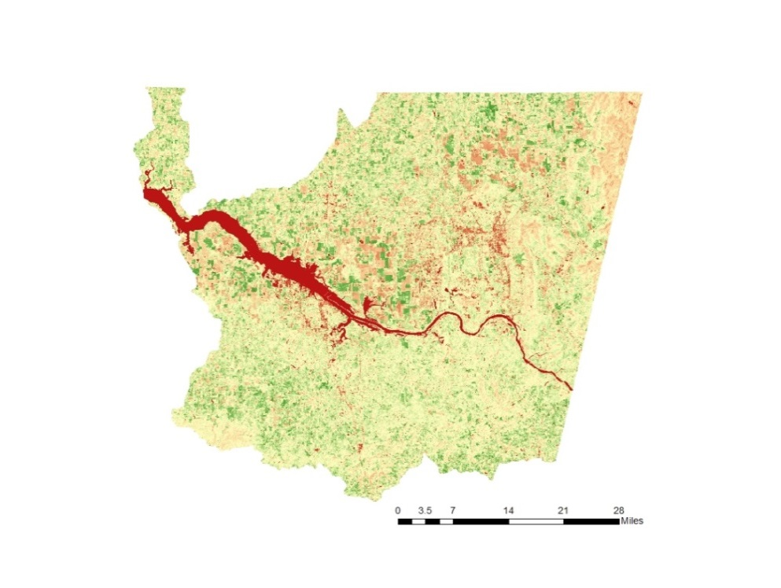
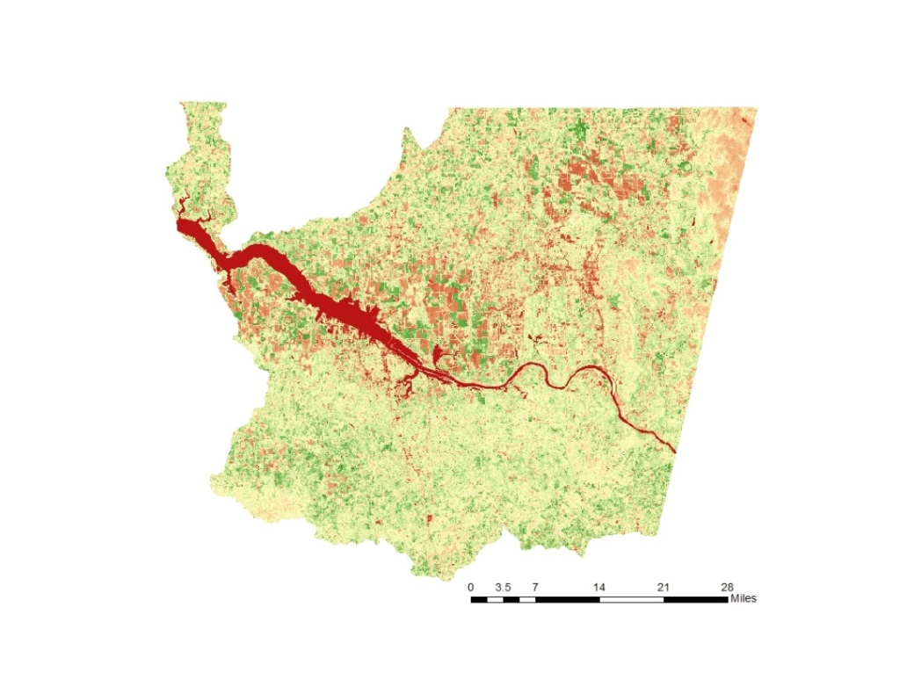
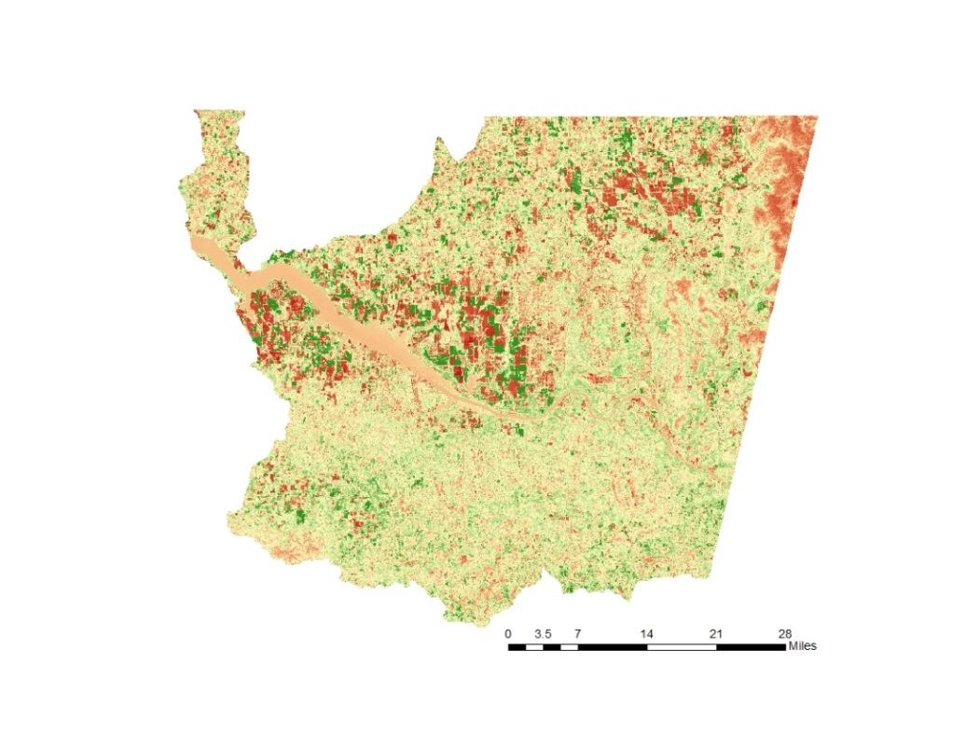
Results
1. Determine relevant indices for monitoring drought in Alabama
GNDVI: Indicates when water isolation occurs or varies throughout a field
NDVI: Effective for quantifying green vegetation
NDWI: Enhances water information well
GNDVI
NDVI
0.6
-0.4
April 2016
0.7
-0.3
NDWI
0.5
-0.6
Notes:
OC
Indices we chose were GNDVI, NDVI, and NDWI
GNDVI because it indicates when water isolation occurs or varies throughout a field
NDVI, the most well-known and used vegetation index, is effective for quantifying green vegetation
NDWI, most widely used water index, determines vegetation and water content based on physical principles, Enhances water information well

Slide 11
Results
2. Create time series for multiple vegetation and water indices
Notes:
OC
Objective 2 was to Create time series for multiple vegetation and water indices
A time series of each index was made for all 3 years in our study period
The GNDVI is represented in green, NDVI in yellow and NDWI in blue
Any NDVI values between 0.2 and 0.6 are classified as row crops
We expected there to be less variability under the pivots, which you can see on the 2016 graphs
Also on the 2016 graphs you can see the drastic decline in water in the rainfed areas whereas it remains positive under the pivots

Slide 12
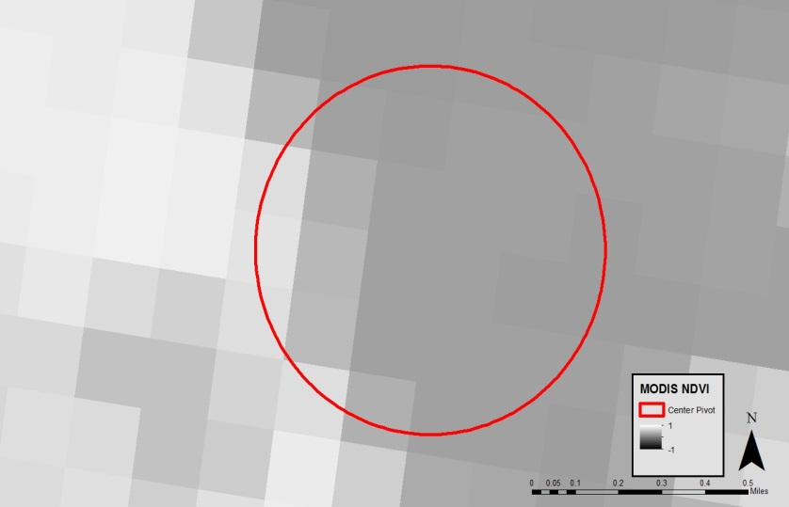
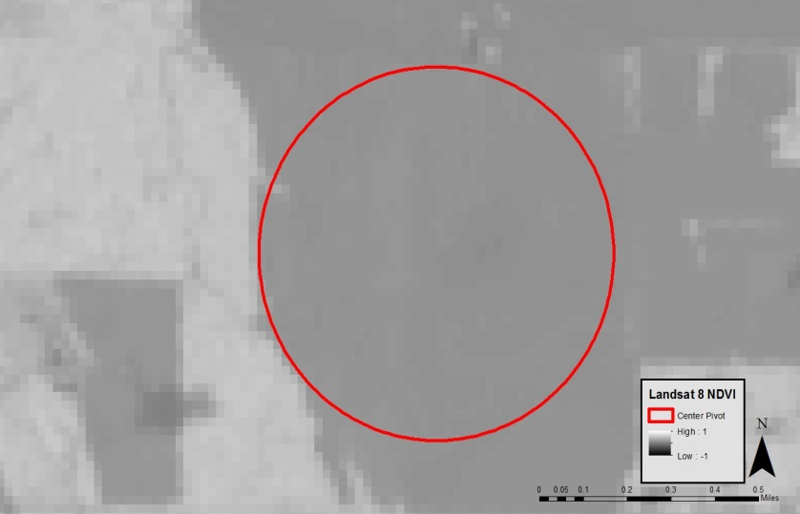
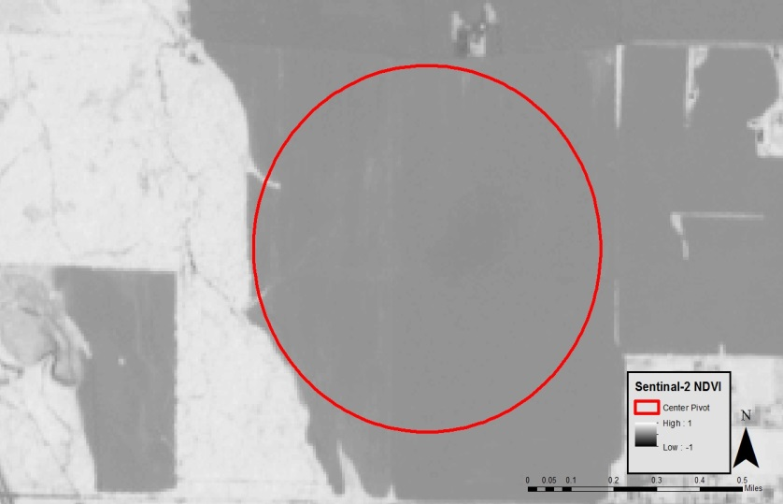
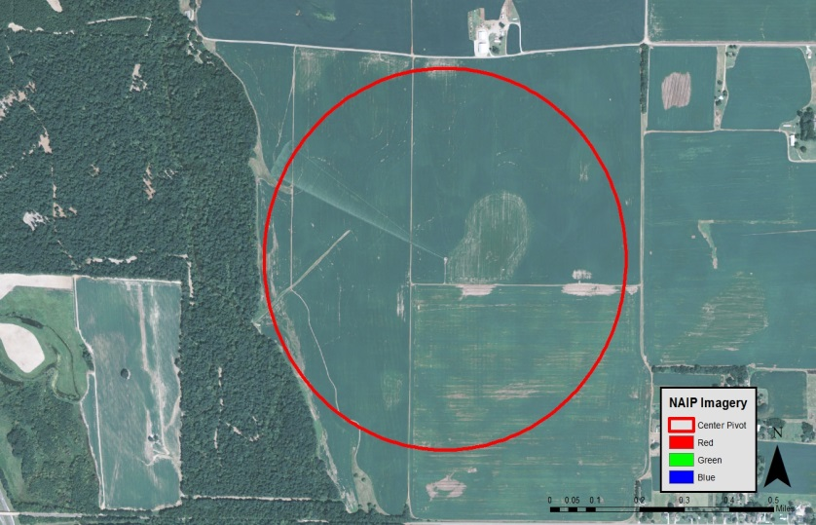
Results
3. Assess suitability of Landsat for characterizing water-stressed crops in Alabama
MODIS
Landsat 8
Sentinel-2
NAIP
Notes:
MK
MODIS, Landsat, Sentinel, NAIP files

Slide 13
Results
4. Compare indices to AOSC’s GriDSSAT crop model
Remote Sensing Indices Compared to GriDSSAT, 2016
Date | Proxy Month | GNDVI | NDVI | NDWI | WSGI | USDM
7-Apr | APR 2016 | 0.359 | 0.364 | 0.153 | 0
23-Apr | MAY 2016 | 0.359 | 0.364 | 0.108 | 0 | 0
10-Jun | JUN 2016 | 0.385 | 0.417 | 0.132 | 0.510 | 2
26-Jun | JUL 2016 | 0.394 | 0.429 | 0.178 | 0.520 | 3
Notes:
ES
Finally, we were interested in exploring whether or not our remote sensing indices added value to the GriDSSAT crop model.
First, I would like to briefly mention that there were two limitations: Landsat’s temporal resolution restricted the number of days we could compare the indices to GriDSSAT, and
Second, despite the GriDSSAT having daily outputs, the GriDSSAT model only provides data for the WSGI when there is actual corn growing, so our comparison was narrowed down to four dates.
We found two interesting dates when the GriDSSAT reported no water stress when NDVI and NDWI detected stress in the crops

Slide 14
Uncertainties
Uncertainties
  Temporal resolution
  Weather and climate
  Spatial resolution
  Data uncertainty (CropScape)
  Assumptions about:
    Irrigation
    Timing of planting and harvesting
  Infrequent Landsat data to compare
  with GriDSSAT
Cloud cover April 2011
Notes:
CP Over the course of this project we found several challenges and uncertainties that should be addressed. The temporal resolution of LandSat (16 day refresh) coupled with the frequency of cloud cover during the growing season makes it difficult to get data to match up. The spatial resolution also impedes the ability to identify crop health. Row crops typically have less visible baron soil that can impact the amount of green per pixel. Forested Areas often surround crop lands and stay green even through dry seasons. There are also uncertainties with correctly identifying crop types. We used Cropscape which while a very good product may not be as accurate down at the scale we are looking at. We made assumptions that may have negatively impacted the results as well. We choose to look at Center Pivot Irrigation as the sole identifier to classifying a crop as irrigated however there are other less visible forms of irrigation. As a result some of the crops we labeled rain fed may not be. We also were unable to identify the planting tie and harvesting time of crops. As these can vary from seasons to season and farm to farm the results of the indices may have been skewed. Tying back into the temporal resolution again, Landsat was unable to provide as many points to correlate to gridssat.
NDVI does tend to saturate over dense vegetation and is sensitive to underlying soil color

Slide 15
Conclusions
1. Determine relevant indices for monitoring drought in Alabama
NDVI has merit with high spatial and temporal resolution
2. Create time series for multiple vegetation and water indices
Expectation: less variability under pivots
3. Assess suitability of Landsat for characterizing water-stressed crops in Alabama
4. Compare indices to AOSC’s GriDSSAT crop model
GNDVI has similar values to NDVI
NDWI provided valuable data for GriDSSAT comparison
Not suitable for characterizing water-stressed crops due to high density of coniferous vegetation
30 m spatial resolution is too coarse
16 day temporal resolution only not suitable for flash droughts
Able to compare trends
Unable to quantify
Result: Inconclusive; need higher temporal resolution
Notes:
CP
For objective 1. NDVI showed Promise as an indicator for vegetation stress although given the scale of our study area and the spatial and temporal resolution of Landsat it is hard to draw any definitive conclusions. GNDVI showed similar values to NDVI and didn’t offer much in the way of new information. NDWI did provide some useful information in conjunction with NDVI and in comparisson with Gridsat, though again more data is needed.
Objective 2. We would have expected to find less variability for crops under center pivots and more variability in the rain fed crops, however we didn’t not always find this to be the case and a more thorough time series should be conducted with a greater frequency than once a month.
Objective 3.
We determined that Landsat is not suitable for use in this type of study due to high density of coniferous venation surrounding the crop areas and spatial resolution being too course and the temporal resolution being too lengthy
Given the lack of data points were unable to quantify the comparisons although the few data points we have suggest there may be a correlation and should be further studies with a finer resolution.

Slide 16
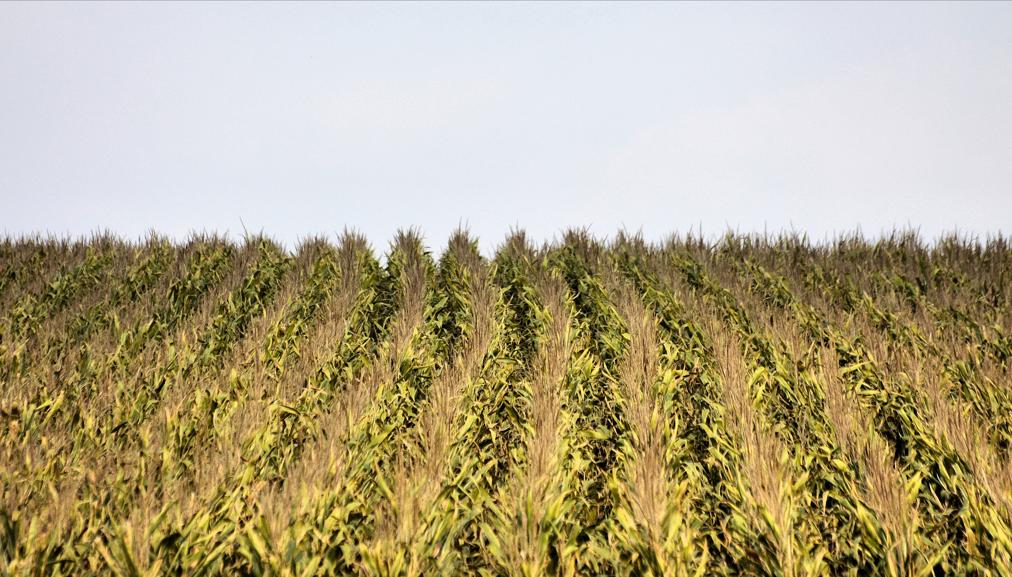
Future Work
Expand the number of indices used :
  TIR-Evaporative Stress Index (ESI)
  Evaporative Demand Drought Index (EDDI)
Develop a standardized scale to compare indices, GriDSSAT, and USDM
Incorporate SMAP and/or Worldview-2
Include policy recommendations
Image Credit: Phil Roeder
Notes:
ES
Throughout the progression of our project, we identified four areas that could use further research.
First, we identified two other indices that would be useful for the USDM to include in their classification algorithm.
The Thermal Infrared Evaporative Stress Index, or ESI, is a relatively new index that is pursued as a reliable indicator of rapid drought onset (or a flash drought.)
It uses remotely sensed thermal infrared imagery to estimate evapotranspiration
According to Otkin et al. 2013, incorporation of the ESI as a data layer in the USDM may improve timely depictions of moisture conditions and vegetation stress associated with flash drought events.
The ESI uses the Atmospheric Land Exchange Inverse, or ALEXI model, and because of time constraints, we were not able to incorporate this index.
Additionally, the Evaporative Demand Drought Index, or EDDI, would be a useful index to include because it measures the relationship between atmospheric evaporative demand and actual evapotranspiration. For further information on how EDDI offers early warning signals on drought, reference Hobbins et al. 2016. Again, because of time constraints, we were unable to utilize EDDI.
After processing our data, we found it was difficult to compare the remote sensing indices with GriDSSAT and the USDM because all three methods have varying classifications and categories for measurement. Therefore, the development of some sort of standardized or normalized quantification ensures the quality of drought depiction.
We also believe that the data from Soil Moisture Active Passive, or SMAP Mission, would have been great because it measures the amount of water in the top 5 cm of soil. We unfortunately were not able to utilize this tool because the soil-moisture sensor broke.
Our team also looked into WorldView data as a possible source for remotely sensed imagery because it has higher spatial and temporal resolution, however, because of time constraints, we were not able to expand our project.
Finally, future work on this topic should include policy recommendations that accounts for water use and regulation in the state of AL.
Image credit: https://www.flickr.com/photos/tabor-roeder/10595366295/in/photolist-h9h2ge-2m61Ec-5ELVUs-djyjWv-o5BFj-6VCMTy-bveWLi-5ciJnW-gNeG2A-fcCynf-b3Y5Z2-nWFVyT-axja86-8DZRmA-f3bgrt-cyA5ed-afD2mQ-nYorb6-p3adhX-f3quUb-4VDptj-6BNMMp-3zGdAR-8DWJfi-6FGFRv-a54gVb-dAqbm5-7TSsN1-cbpdt-aE4duD-ctH8Ty-5irnUn-8yvxLz-7iyTMj-cR1fMw-czBuEq-p6XspE-bjHz2g-nVaT9y-6vFeXW-PFp32-cuPFYU-4gtw4i-dpAHFc-5d5ew2-7LxPBi-a7Yv1f-wx3e29-5nyfgQ-aoNQAZ

Slide 17
Advisors
Dr. Jeffrey Luvall, NASA Marshall Space flight Center
Dr. Robert Griffin, University of Alabama in Huntsville
Cameron Handyside, University of Alabama in Huntsville, Earth System Science Center
Leigh Sinclair, University of Alabama in Huntsville, Information Technology and Systems Center
Partners
Dr. John Christy, Alabama Office of the State Climatologist
Others
Dashiell Cruz, NASA DEVELOP MSFC Assistant Center Lead/Impact Analysis Fellow
Notes:
MK
We would like to acknowledge our advisors, Dr. Luvall, Dr. Griffin, Mr. Handyside, and Leigh Sinclair, as well as Dr. John Christy and Dashiell Cruz.

