Slide 1
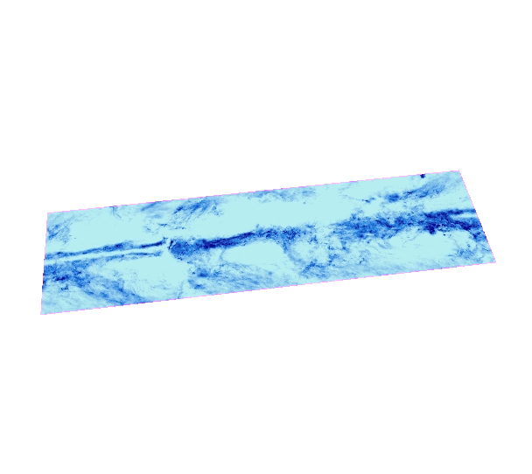
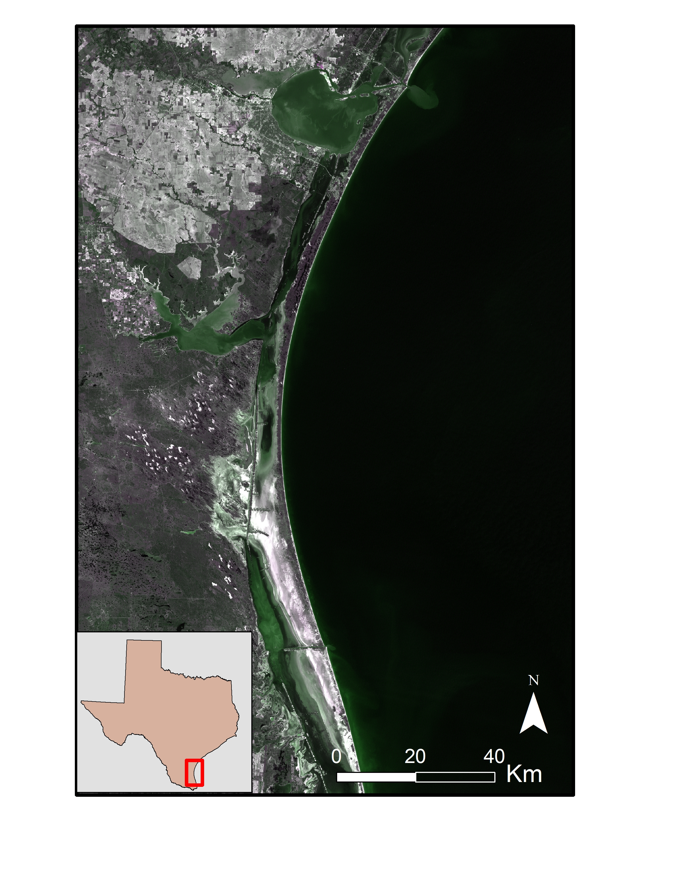
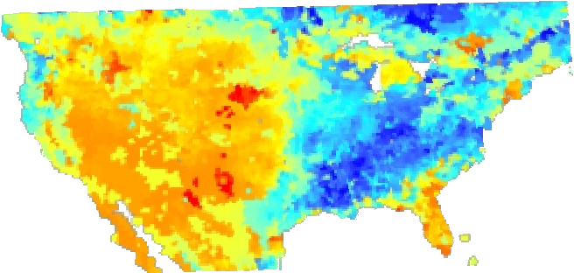
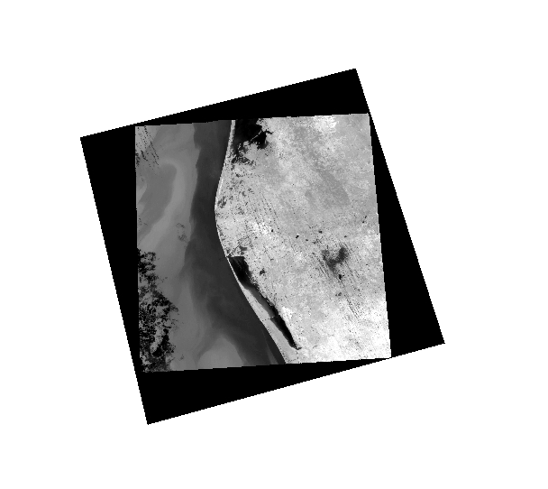
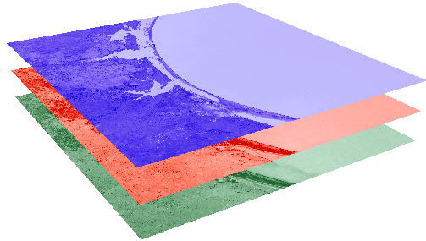
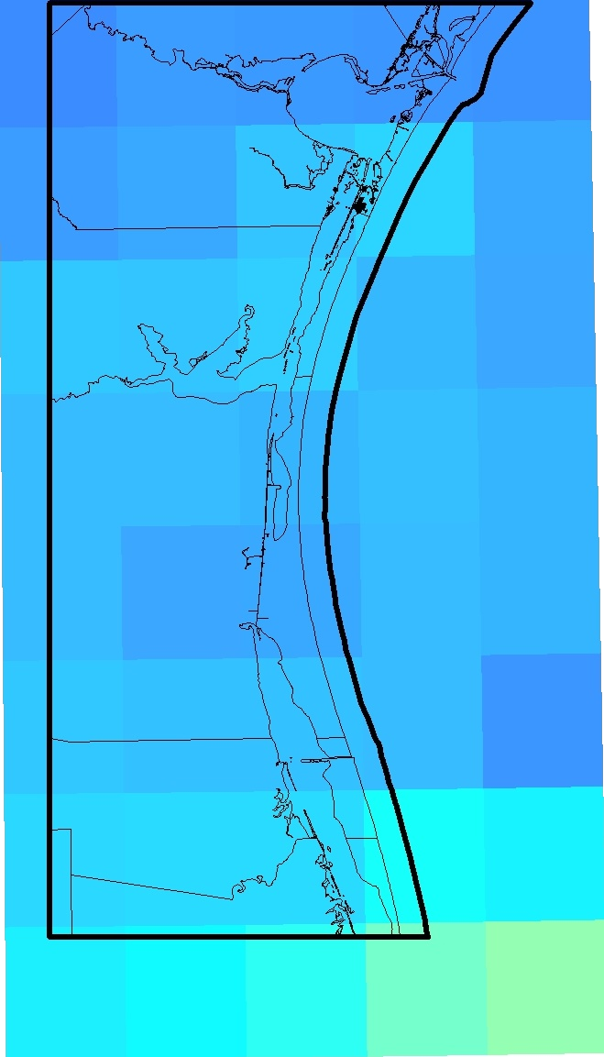

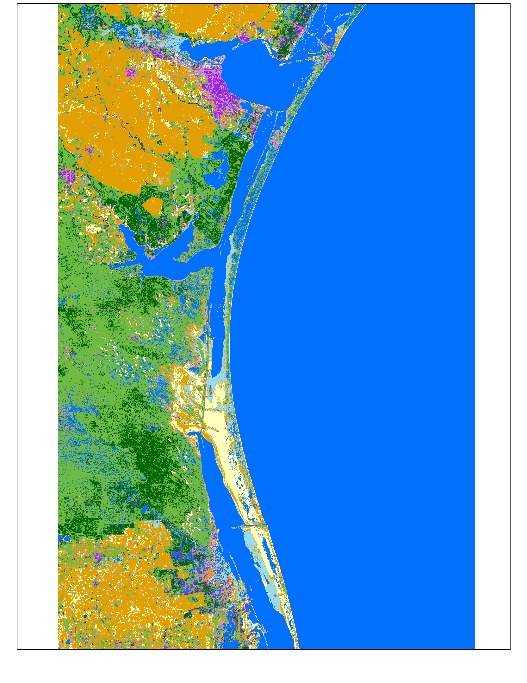
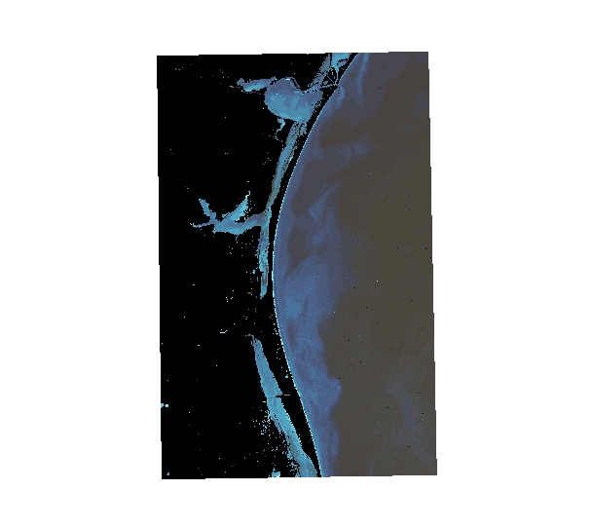
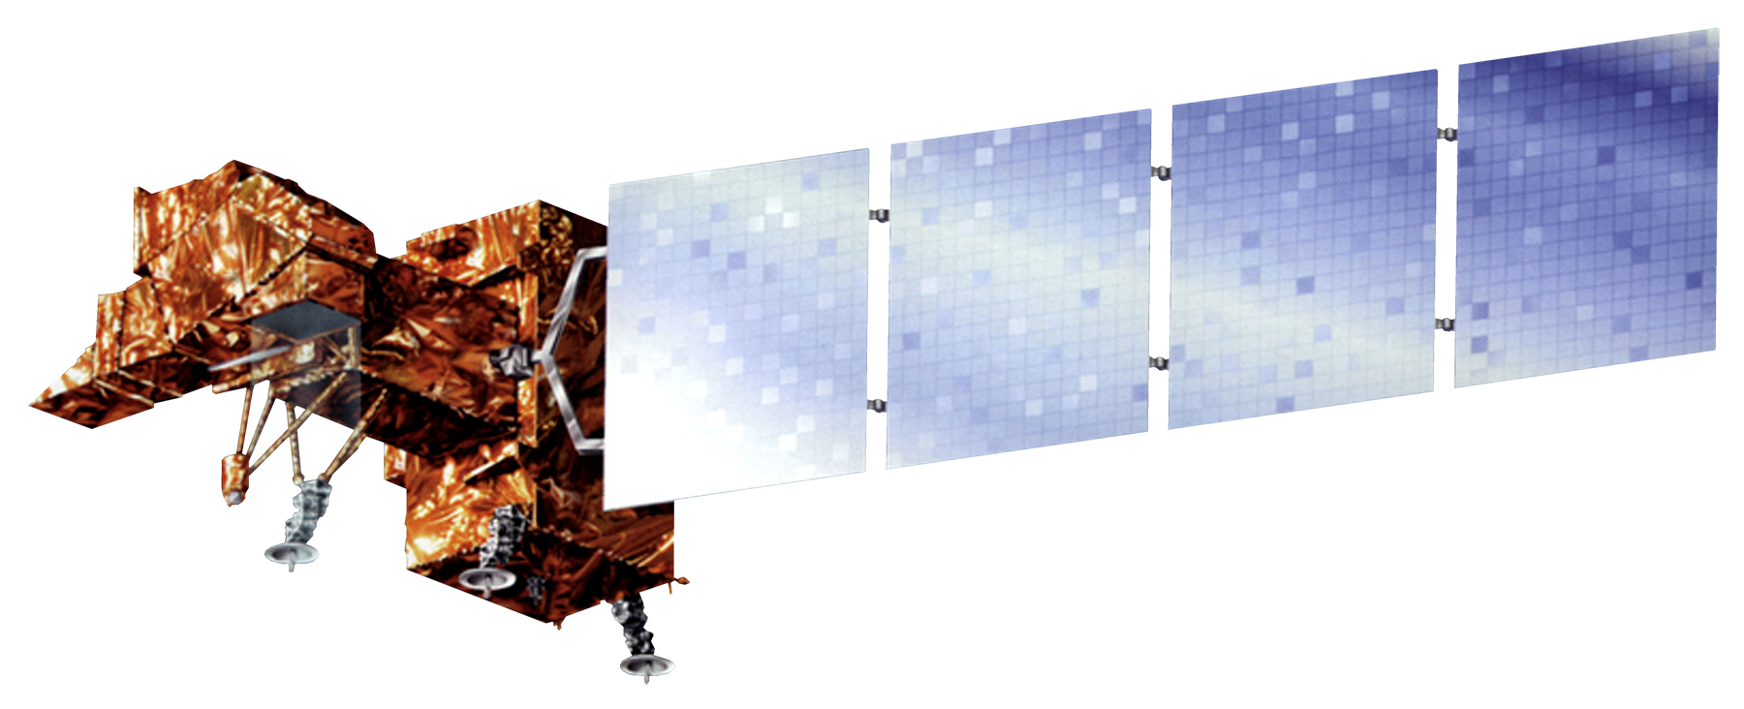
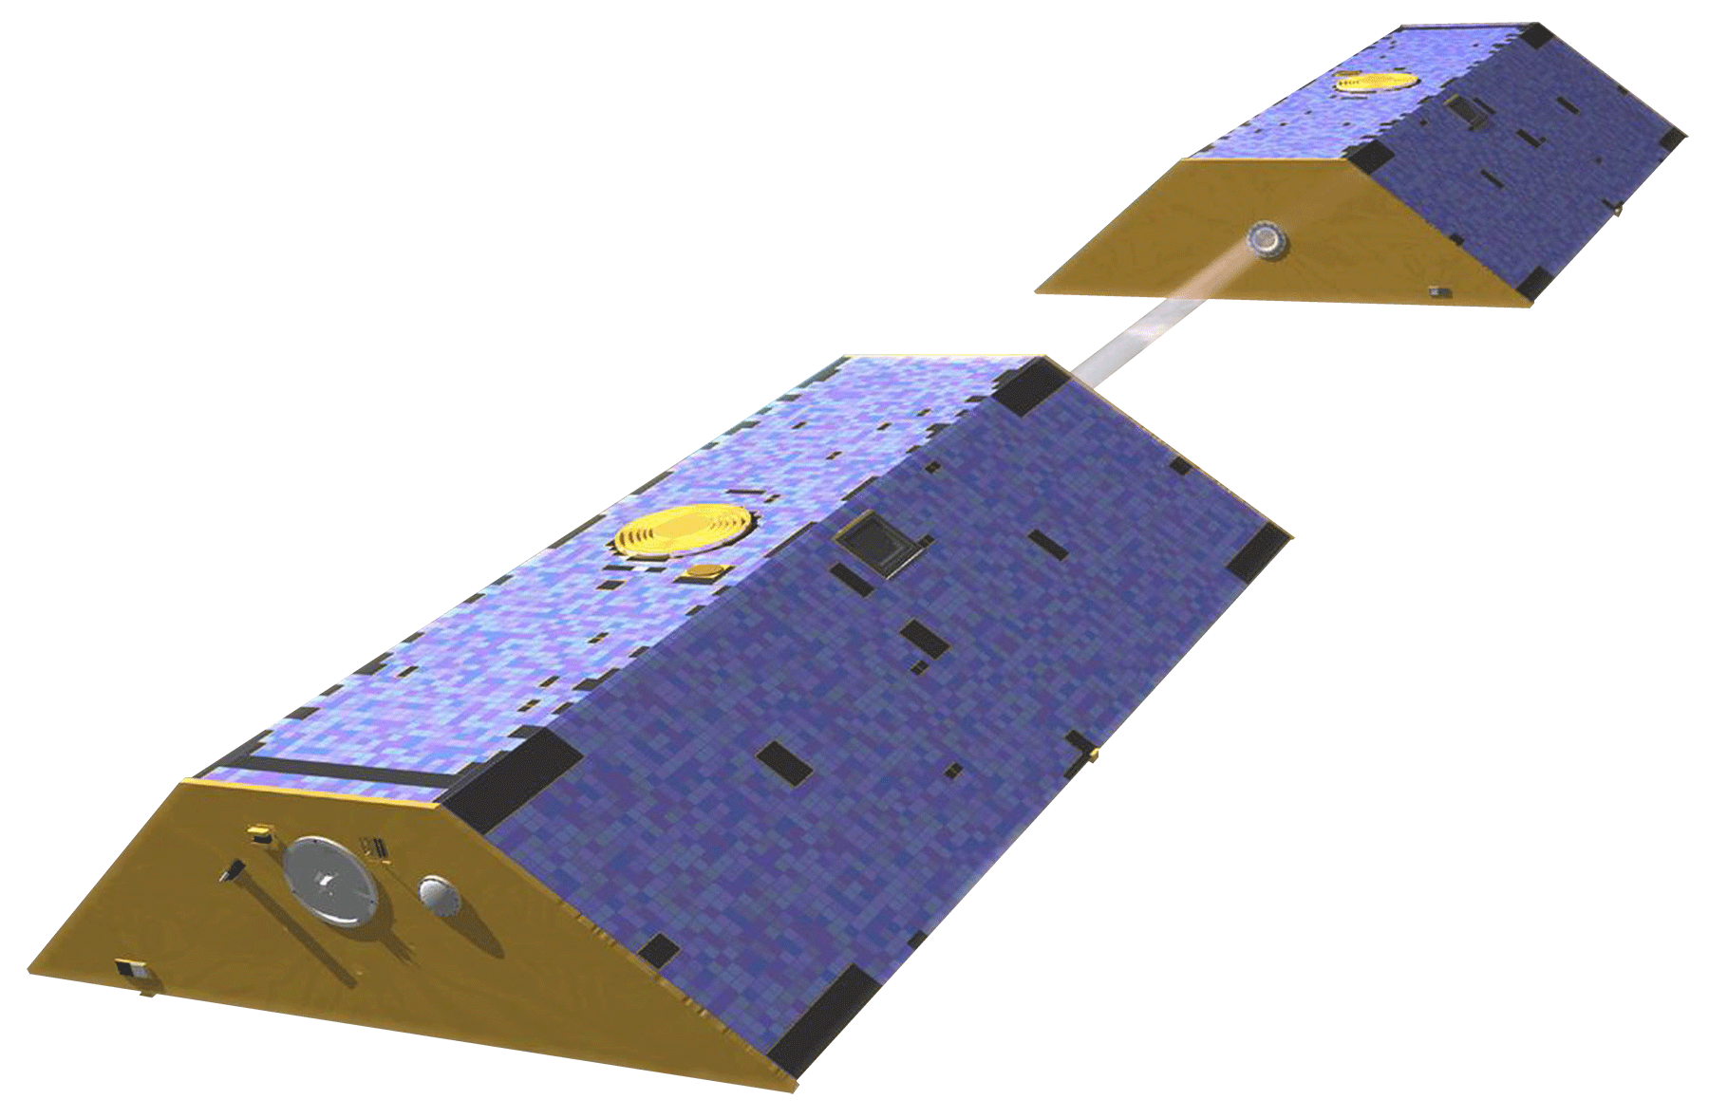
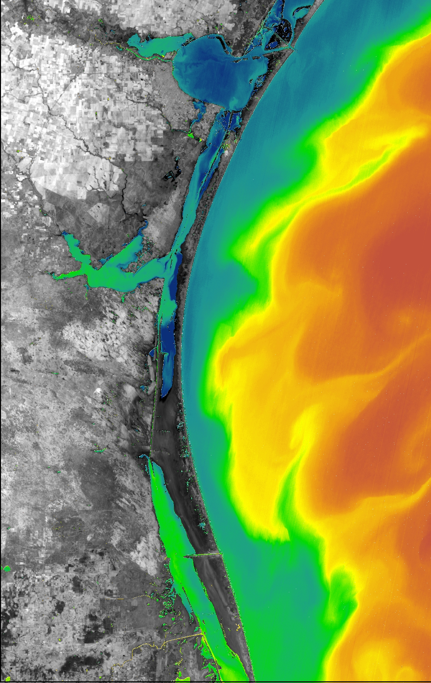

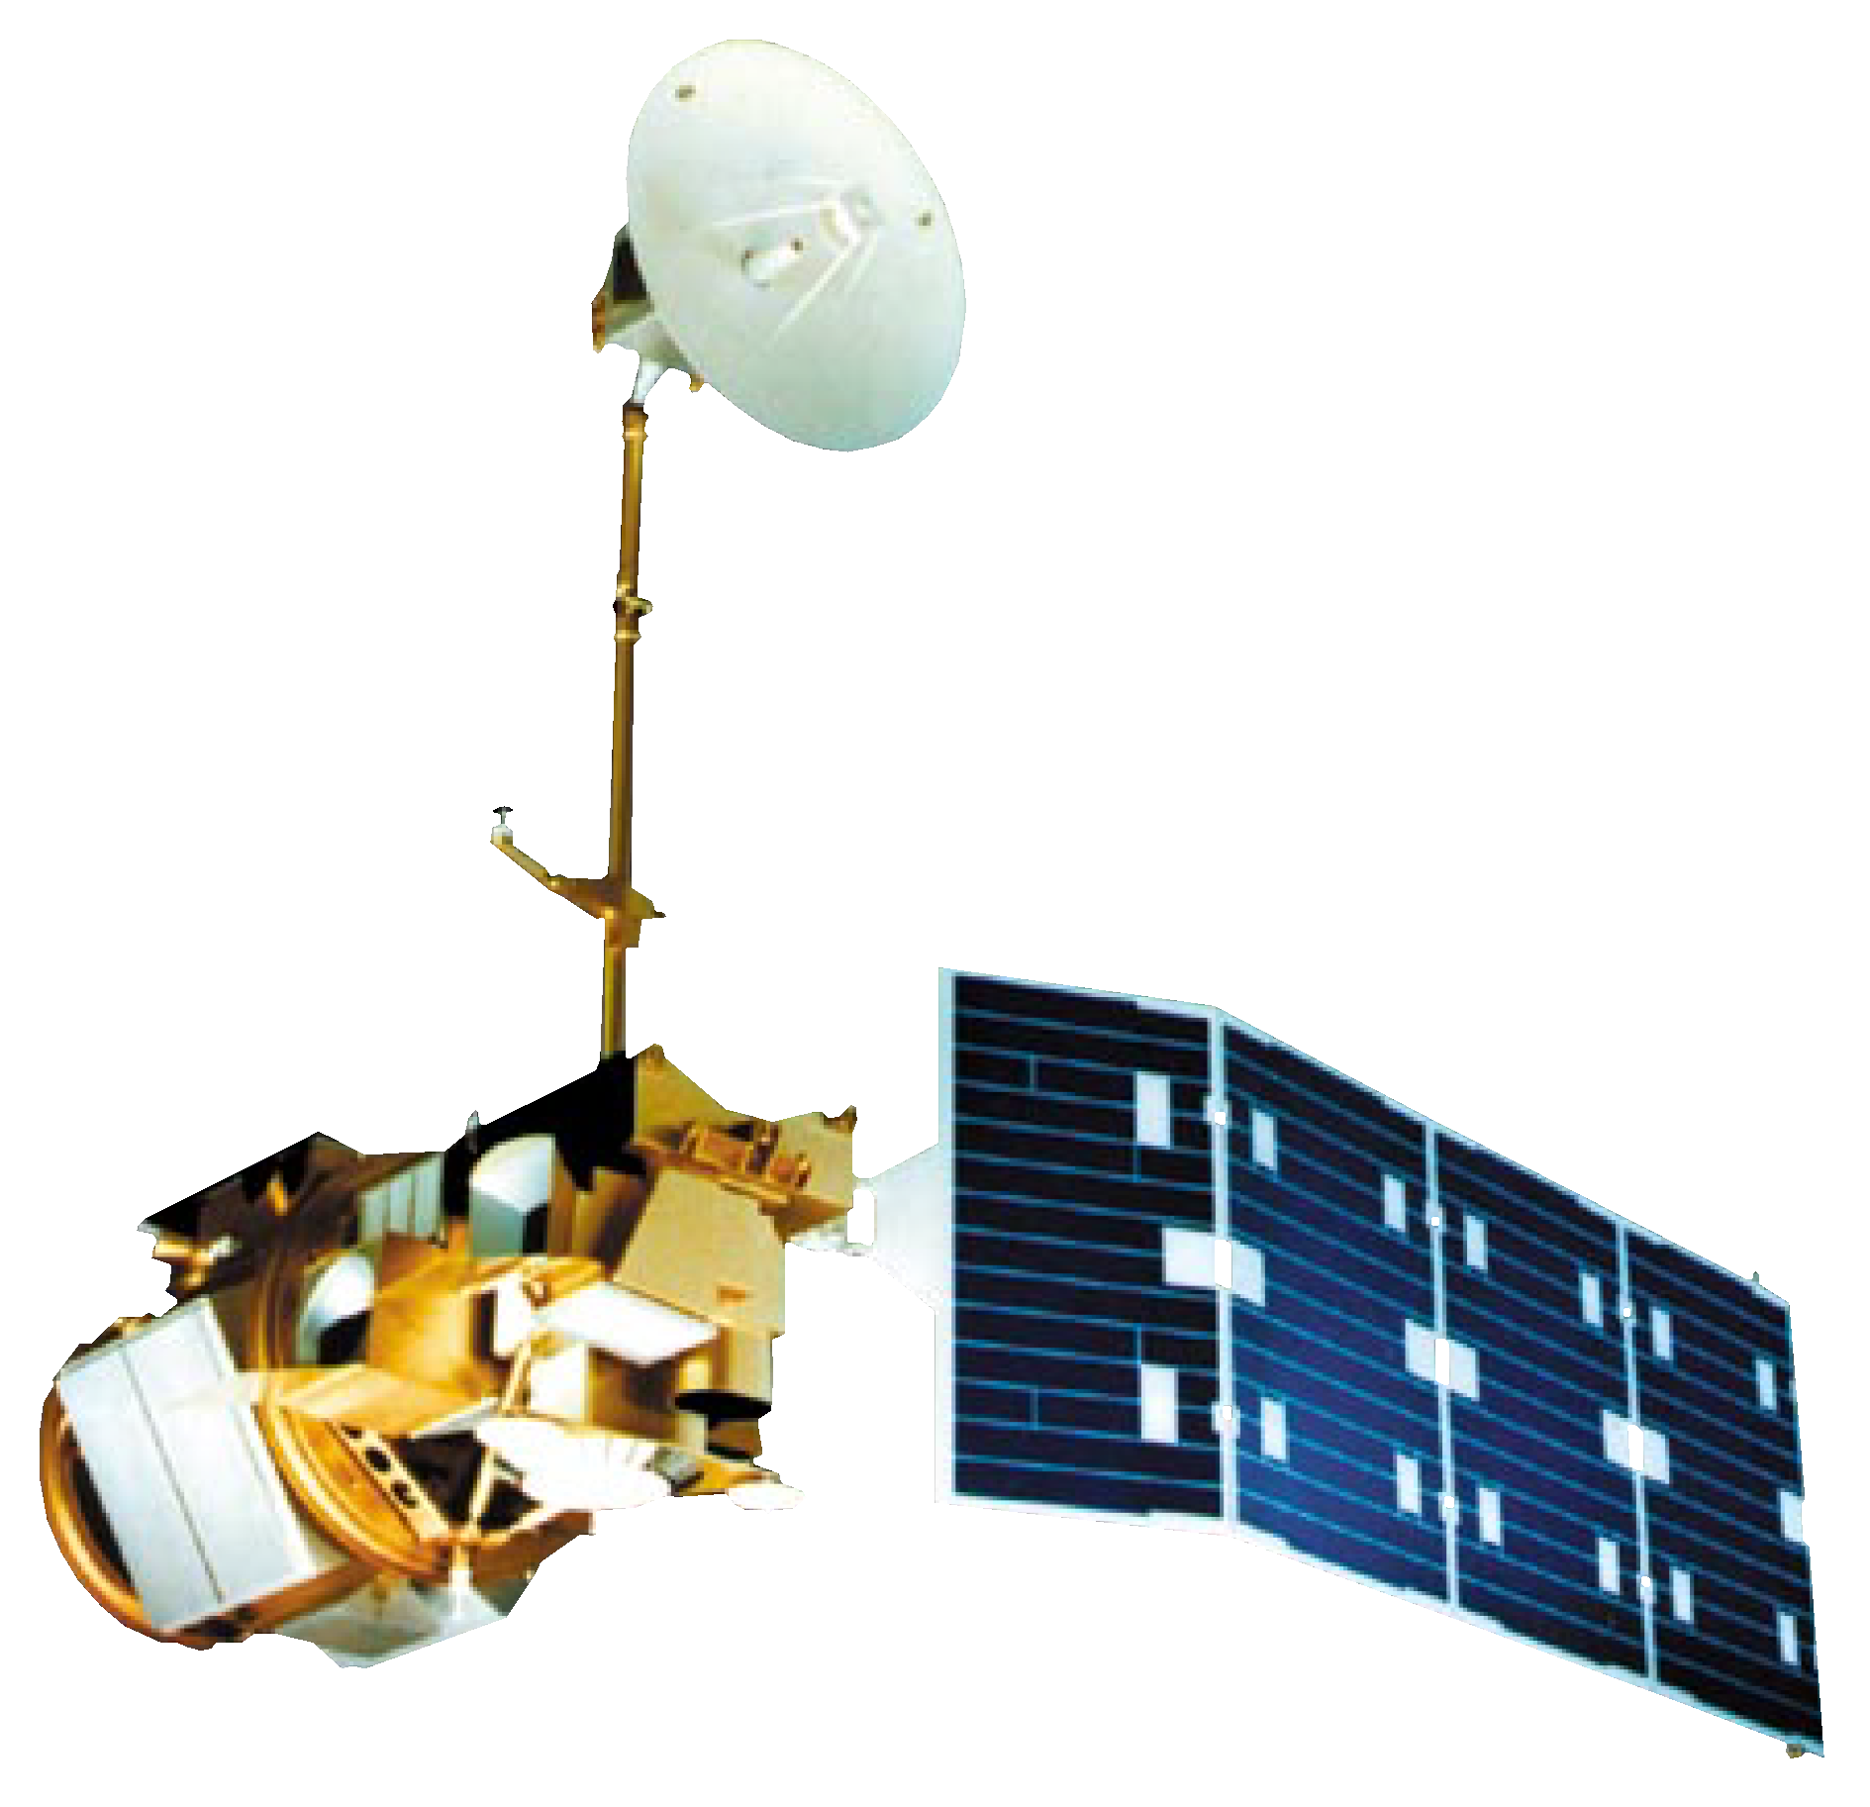
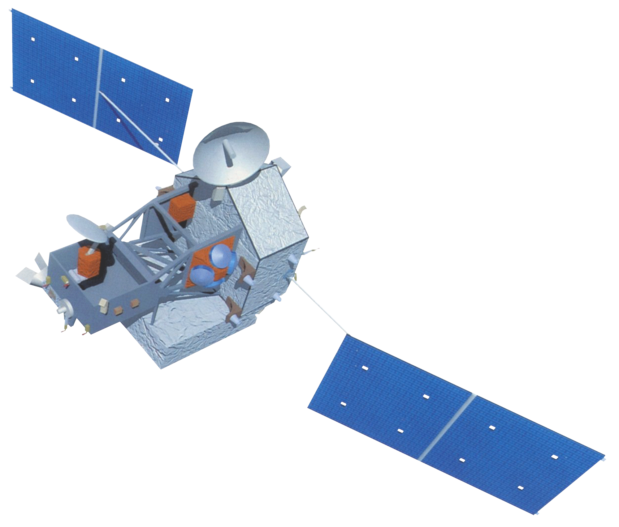
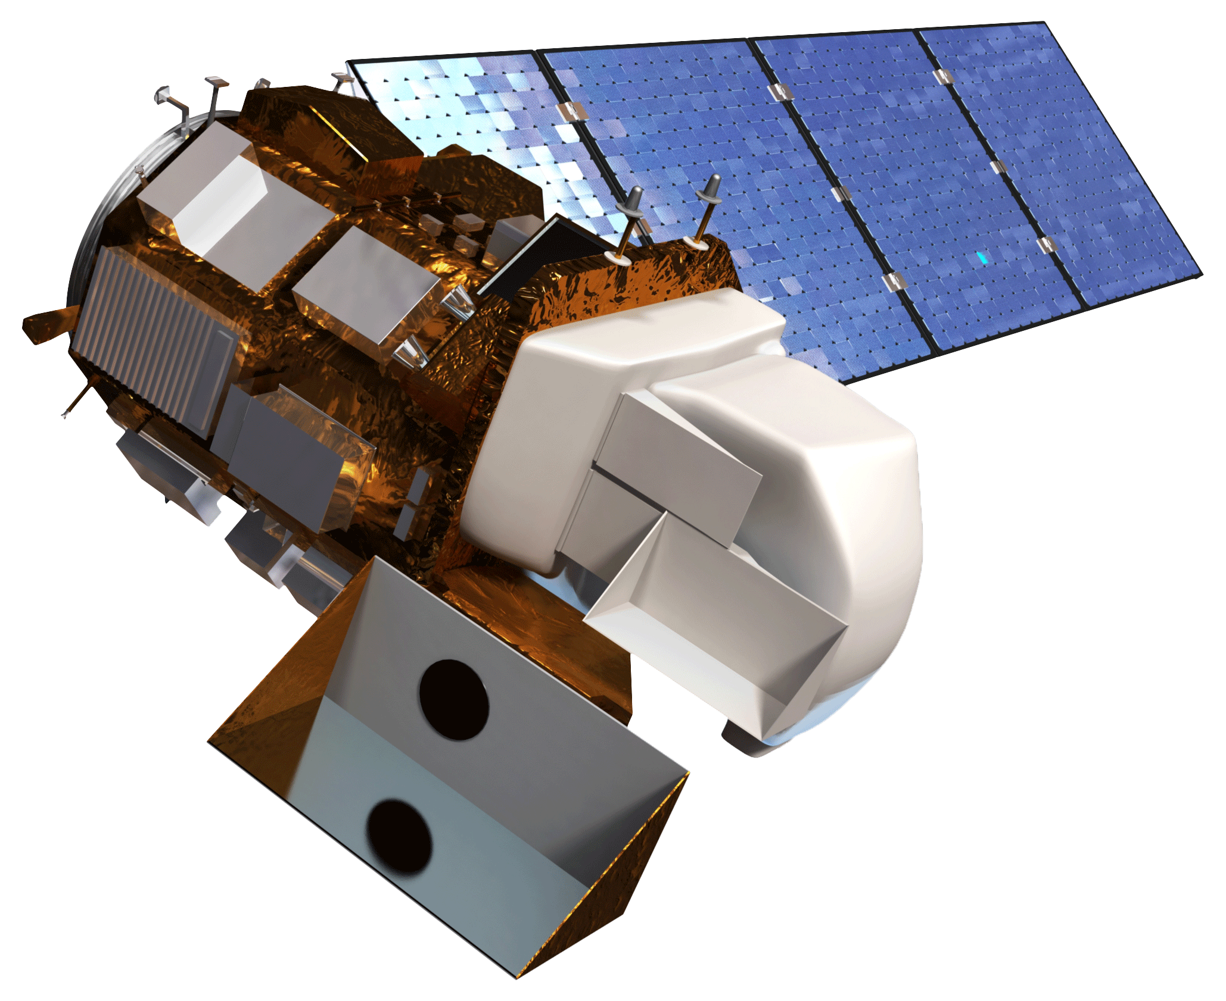

Coastal Texas Water Resources
Utilizing NASA Earth Observations to Assess Estuary Health and Enhance Management of Water Resources in Coastal Texas through Land Cover and Precipitation Mapping
Elaina Gonsoroski (Co-Project Lead), Tyler Lynn (Co-Project Lead), Georgina Crepps, Rodrigo Pereira da Silva, Ryan Schick
NASA DEVELOP Program, Mobile County Health Department
Abstract
Objectives
Keep this blank for now.
Body text point size should be at least 24.
Caption text point size should be at least 16.
Feel free to rename, move, and resize sections as needed.
Create land use/land cover, precipitation, thermal, and groundwater maps of the study area
Explore the suspected correlation of increasing salinity of the Laguna Madre and the increasing number of mesquite trees in the surround area
Create a systematic method for studying the relationship between the mesquite trees, groundwater, and lagoon to aid in land management decisions
Methodology
Study Area
Laguna Madre of the Padre Island National Seashore
Study period: 2000 - 2015
Land Use/ Land Cover
Thermal Mapping
Water Analysis
Landsat 5, 7, & 8
TRMM
GRACE-derived Root Zone Soil Moisture Content
Laguna Madre
TOA Radiance → Kelvin → Fahrenheit
Earth Observations
LULC Map
Calculate Averages & Clip
GRACE
Landsat 7
Land Change Modeler
Landsat 5
Results
TRMM
Landsat 8
TBD
Conclusions
TBD
Thermal maps show warm, fresh water flowing into the cold lagoon in winter months
Data compared to monthly averages over time to look for decreasing groundwater flow trends
Team Members
Project Partners
Acknowledgements
Dr. Bernard Eichold, M.D., Dr. PH (Mobile County Health Department)
Joe Spruce (NASA Stennis Space Center)
James “Doc” Smoot (NASA Stennis Space Center)
Dr. Kenton Ross (NASA Langley Research Center)
Joe Meiman (National Park Service)
National Park Service
Include a caption that states the team members’ names.

