Slide 1
Texas Disasters II
Utilizing NASA Earth Observations to Assist the Texas Forest Service in Mapping and Analyzing Fuel Loads and Phenology in Texas Grasslands
Michael Brooke (Project Lead)
Meredith Williams
Teresa Fenn
Notes:
We are the Texas Disasters II team. My name is Michael Brooke, this is Meredith Williams and Teresa Fenn remotely participated from DEVELOP Langley. We utilized NASA Earth Observations to assist the Texas Forest Service in mapping and analyzing fuel loads and phenology in Texas grasslands.

Slide 2
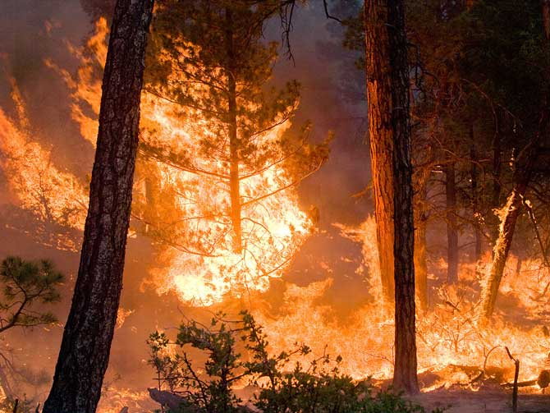
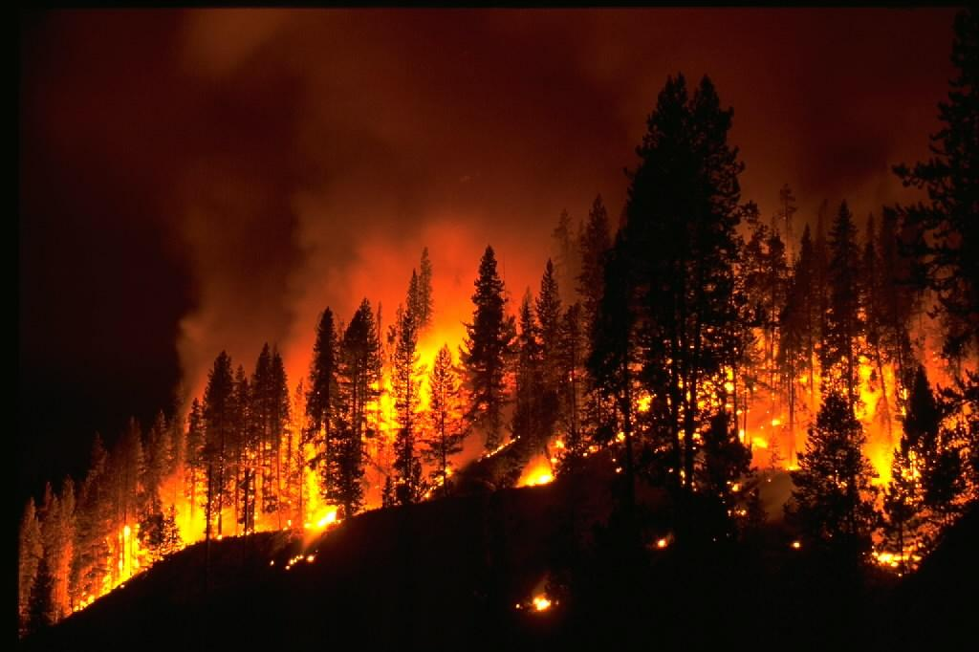
Objective
Image Credit: NASA
Image Credit: NASA
Image Credit: National Weather Service
Assist the Texas Forest Service in Mapping and Analyzing Fuel Loads and Phenology in Texas Grasslands
Notes:
The objective of the project was to assist the TFS in mapping and analyzing fuel loads and phenology in Texas grasslands.
http://www.nasa.gov/images/content/710936main_climate-fire-670.jpg
http://scijinks.jpl.nasa.gov/review/imet/imet-6.jpg

Slide 3
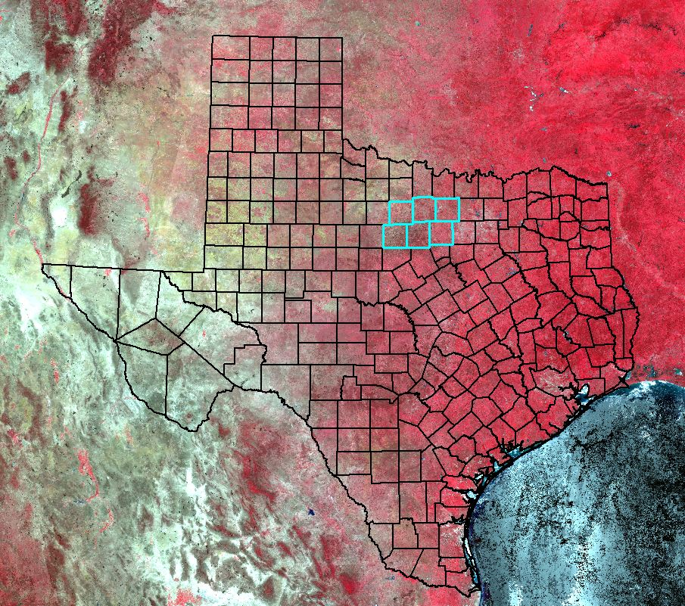
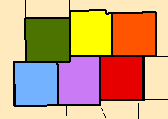
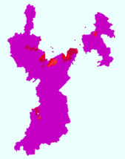
Study Area
Study Period
January 2000-November 2015
Young County
Jack County
Wise County
Stevens County
Palo Pinto County
Parker County
Background image: MODIS false color
composite 6/17/14
Notes:
The study area for our project consisted of 6 counties in the state of Texas: Young, Jack, Wise, Stevens, Palo Pinto and Parker counties with an emphasis on a 2011 wildfire called the Possum Kingdom Complex. The Possum Kingdom Complex wildfire is located in the southwestern portion of the study area. The PKC was a group of 4 wildfires that consumed about 150,000 acres in Stephens, Young and Palo Pinto Counties. The study period for our project was from January 2000 to November 2015

Slide 4

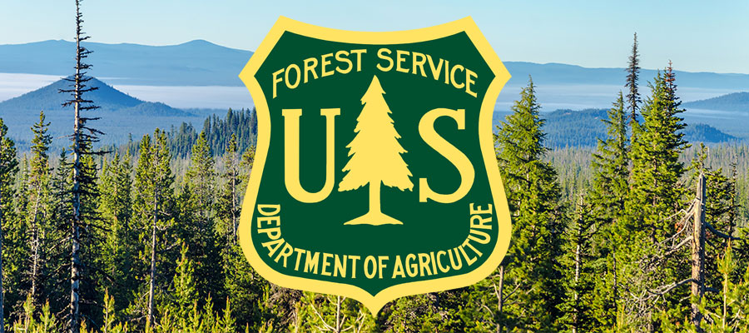
Partners
Texas Forest Service
USDA Forest Service
Image Credit: Texas Forest Service
Image Credit: USDA Forest Service
Notes:
The partners for our project were Tom Spencer and Curt Stripling from the Texas Forest Service and William “Bill” Hargrove from the United States Department of Agriculture Forest Service. All of the support from our partners was greatly appreciated.
http://deschutescollaborativeforest.org/wp-content/uploads/2015/07/forest-service-deschutes.jpg
http://texasforestservice.tamu.edu/

Slide 5
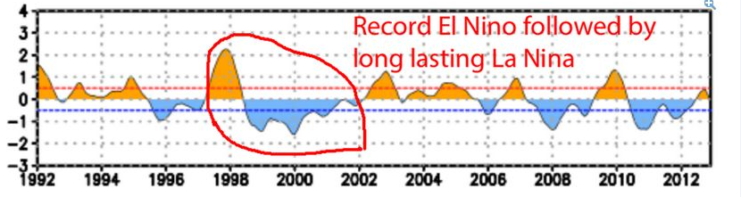
Community Concerns
Environment
Texas vegetation are highly susceptible to wildfires.
The risk of severe wildfires related to weather phenomena
Wildfire risk has increased due to climate change and recent development.
The combination of El Nino and La Nino events, which this can lead to more intense fire seasons.
The Texas Forest Service is tasked with evaluating and reducing potential fire risk.
Image Source: Business Insider
Notes:
Wildfires effect the environment and are a large part of nature allowing for renewal and change. Texas vegetation, especially grasslands and shrub lands, are highly susceptible to seasonal wildfires during prolonged periods of severe drought. In recent years, the risk of severe wildfires in Texas has been related to weather phenomena such as climate change and recent urban expansion into wildland areas. To help prevent wildfires, the TFS is tasked with evaluating and reducing potential fire risk to better manage and distribute resources. The task is made more difficult due to the vast and varied Texas L
landscape. This image shows a combination of El Nino and La Nino events, which this combo can lead to more intense fire seasons.
http://www.businessinsider.com/biggest-el-nio-killer-la-nia-coming-2015-11

Slide 6


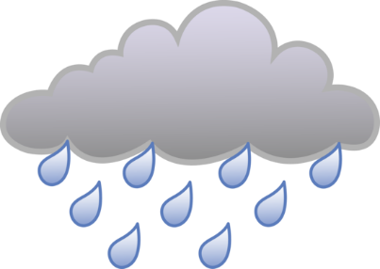
Background
Increased Biomass
Increased Fuel Loads
Notes:
Abnormally wet years can increase grassland vegetation biomass. If a dry year follows, this increased biomass will contribute to increased fuel loads leading to more frequent and intense fires. Therefore there is a need to develop fire risk assessment products from satellite data that can be produced and posted near real time.

Slide 7



Background
2 MILES
In 2011, 31,453 wildfires burned 4 million acres & destroyed 2,947 homes
80% of wildfires occur within 2 miles development areas
Six of the 10 largest documented wildfires in state history occurred in April 2011
Notes:
According to the Texas Forest Service, in 2011 roughly 31,000 wildfires burned 4 million acres and destroyed approximately 3,000 homes. 80% of wildfires in Texas occur within 2 miles of developed areas. 6 of the 10 largest documented wildfires in the history of the state occurred in April of 2011.
Making the 2011 wildfire season the worst in the history of the lone star state. Image Source: http://www.jpl.nasa.gov/images/earth/fire/20150409/wildfire1.jpg

Slide 8

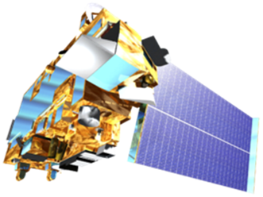
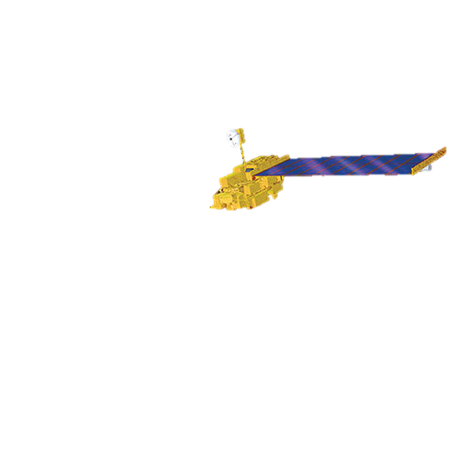
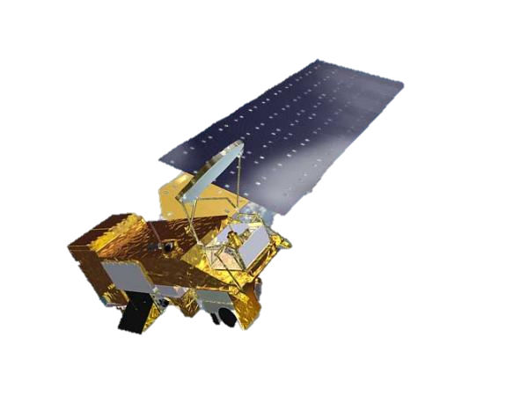
NASA Satellites/Sensors
Notes:
NASA Earth Observations provide a good platform for evaluating wildfire fuel. The sensor MODIS off the Terra and Aqua satellites were used along with Landsat 8 OLI.

Slide 9
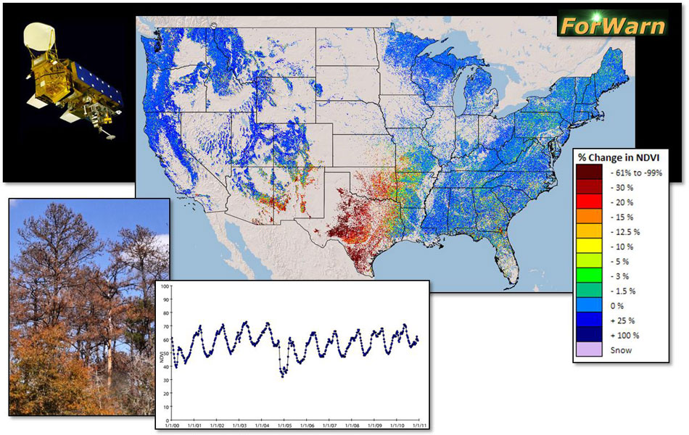
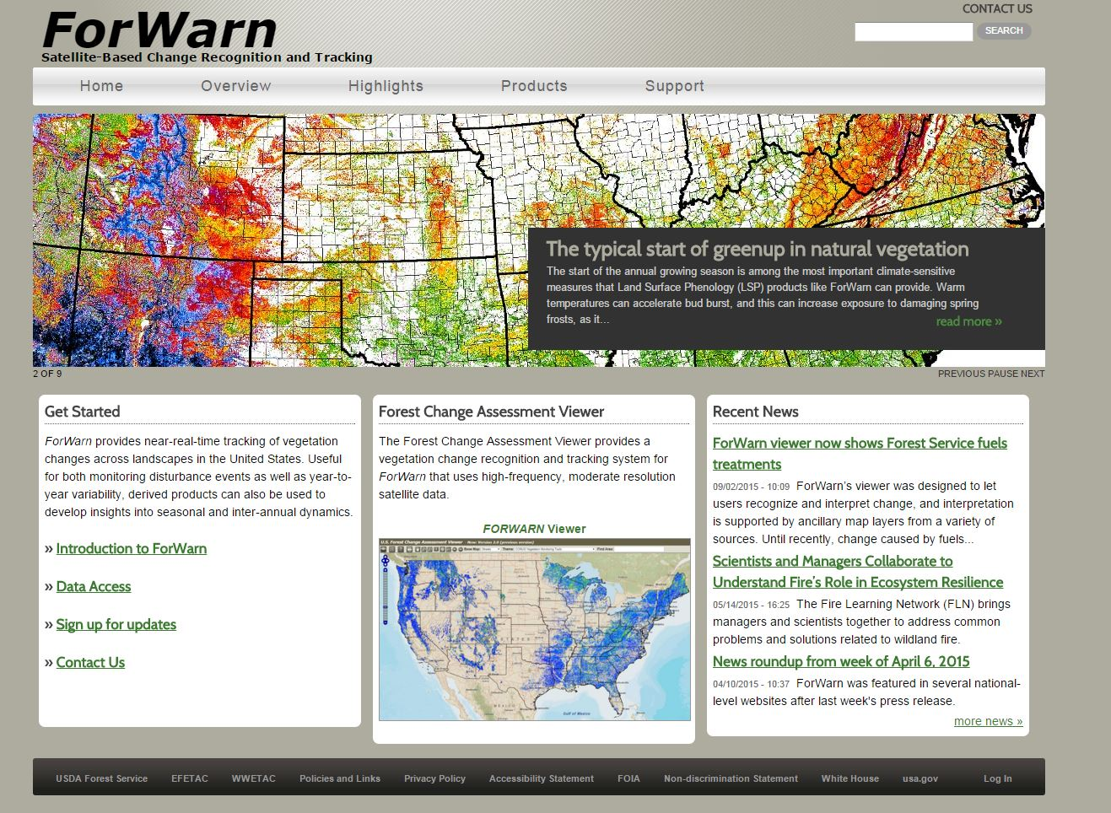
Texas Wildfire Risk Assessment
Image Credit: USDA Forest Service
Notes:
Methods for wildfire management have typically relied on models based on Landsat data to produce comprehensive fuel load and fuel type maps at 30 meter resolution . The Texas Forest Service uses MODIS data processed by FORWARN to assess wildfires using 13 fuel models. Since wildfires continue to threaten people and property across Texas, heightened awareness of wildfire risk, prevention and mitigation are becoming increasingly important to ensure safety.

Slide 10
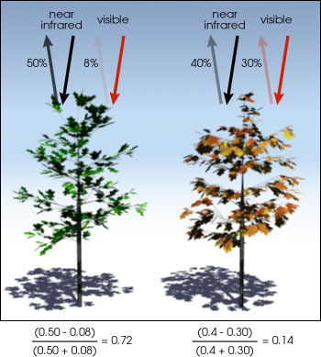
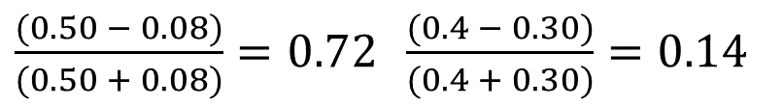
NDVI
near infrared
near infrared
visible
visible
Normalized
Difference
Vegetation
Index
NDVI = (NIR-Red/NIR+Red)
8%
40%
30%
50%
Measure plant productivity based on greenness of vegetation
Image Credit: NASA
$\frac{(0.50 − 0.08)}{(0.50 + 0.08)}=0.72 \frac{(0.4 − 0.30)}{(0.4 + 0.30)}$ $=0.14$
Notes:
In order to make these fuel maps sensitive to fluctuations NDVI was used.
NDVI
(Normalized Difference Vegetation Index) which is useful for quantifying the greenness of vegetation by comparing the amount visible and infrared wavelengths reflected back from the Earth to a satellite sensor.
http://earthobservatory.nasa.gov/Features/MeasuringVegetation/Images/ndvi_example.jpg

Slide 11
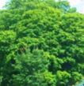
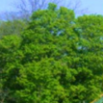
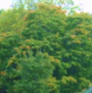
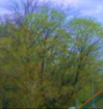
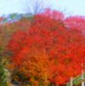



Maximum Vegetation Index Value
NDVI
NDVI
Left 80% Max
Right 80% Max
Left 20% Max
Right 20% Max
Left Minimum
Right Minimum
Spring
Growing Season
Fall
Images Credit: Steve Norman, USFS ForWarn
Notes:
The nation wide MODIS-derived phenology data set. Creates an NDVI curve that has 14 layers at 231m resolution. These 14 layer images contain seven NDVI and corresponding day of year values. Left 20% is the beginning of season, left 80% is the onset of maximum greenness aka greenup, MAX is the peak of the growing season, right 80% is the beginning of brown down and right 20% is the end of season. Relative fuel loads and dryness can be estimated by measuring the responses over the course of the year.

Slide 12
Methodology
Precipitation
What precipitation conditions create hazardous wildfire conditions?
Phenology
What phenological parameters do different areas have in common?
Soils
Do soil types drive the swings in phenology?
Notes:
Our basic methodology consisted of three phases.
1) What precipitation conditions create hazardous wildfire conditions?
2) What phonological parameters do different areas have in common?
3) Do soil types drive the swings in phenology?

Slide 13
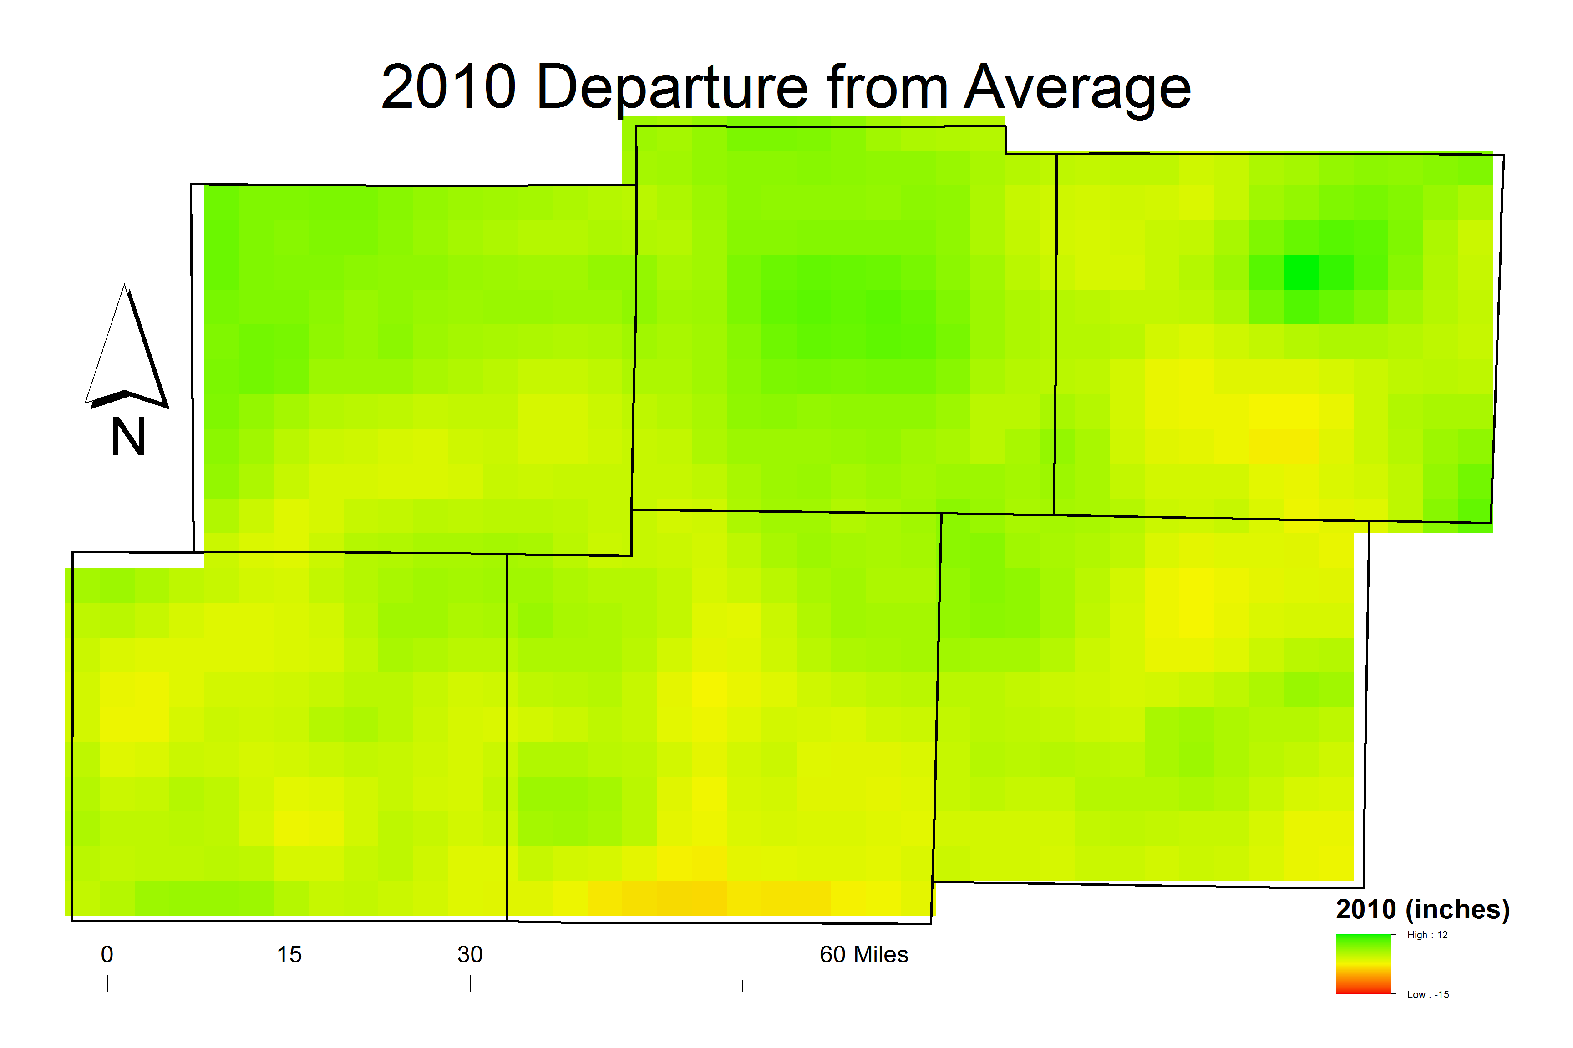
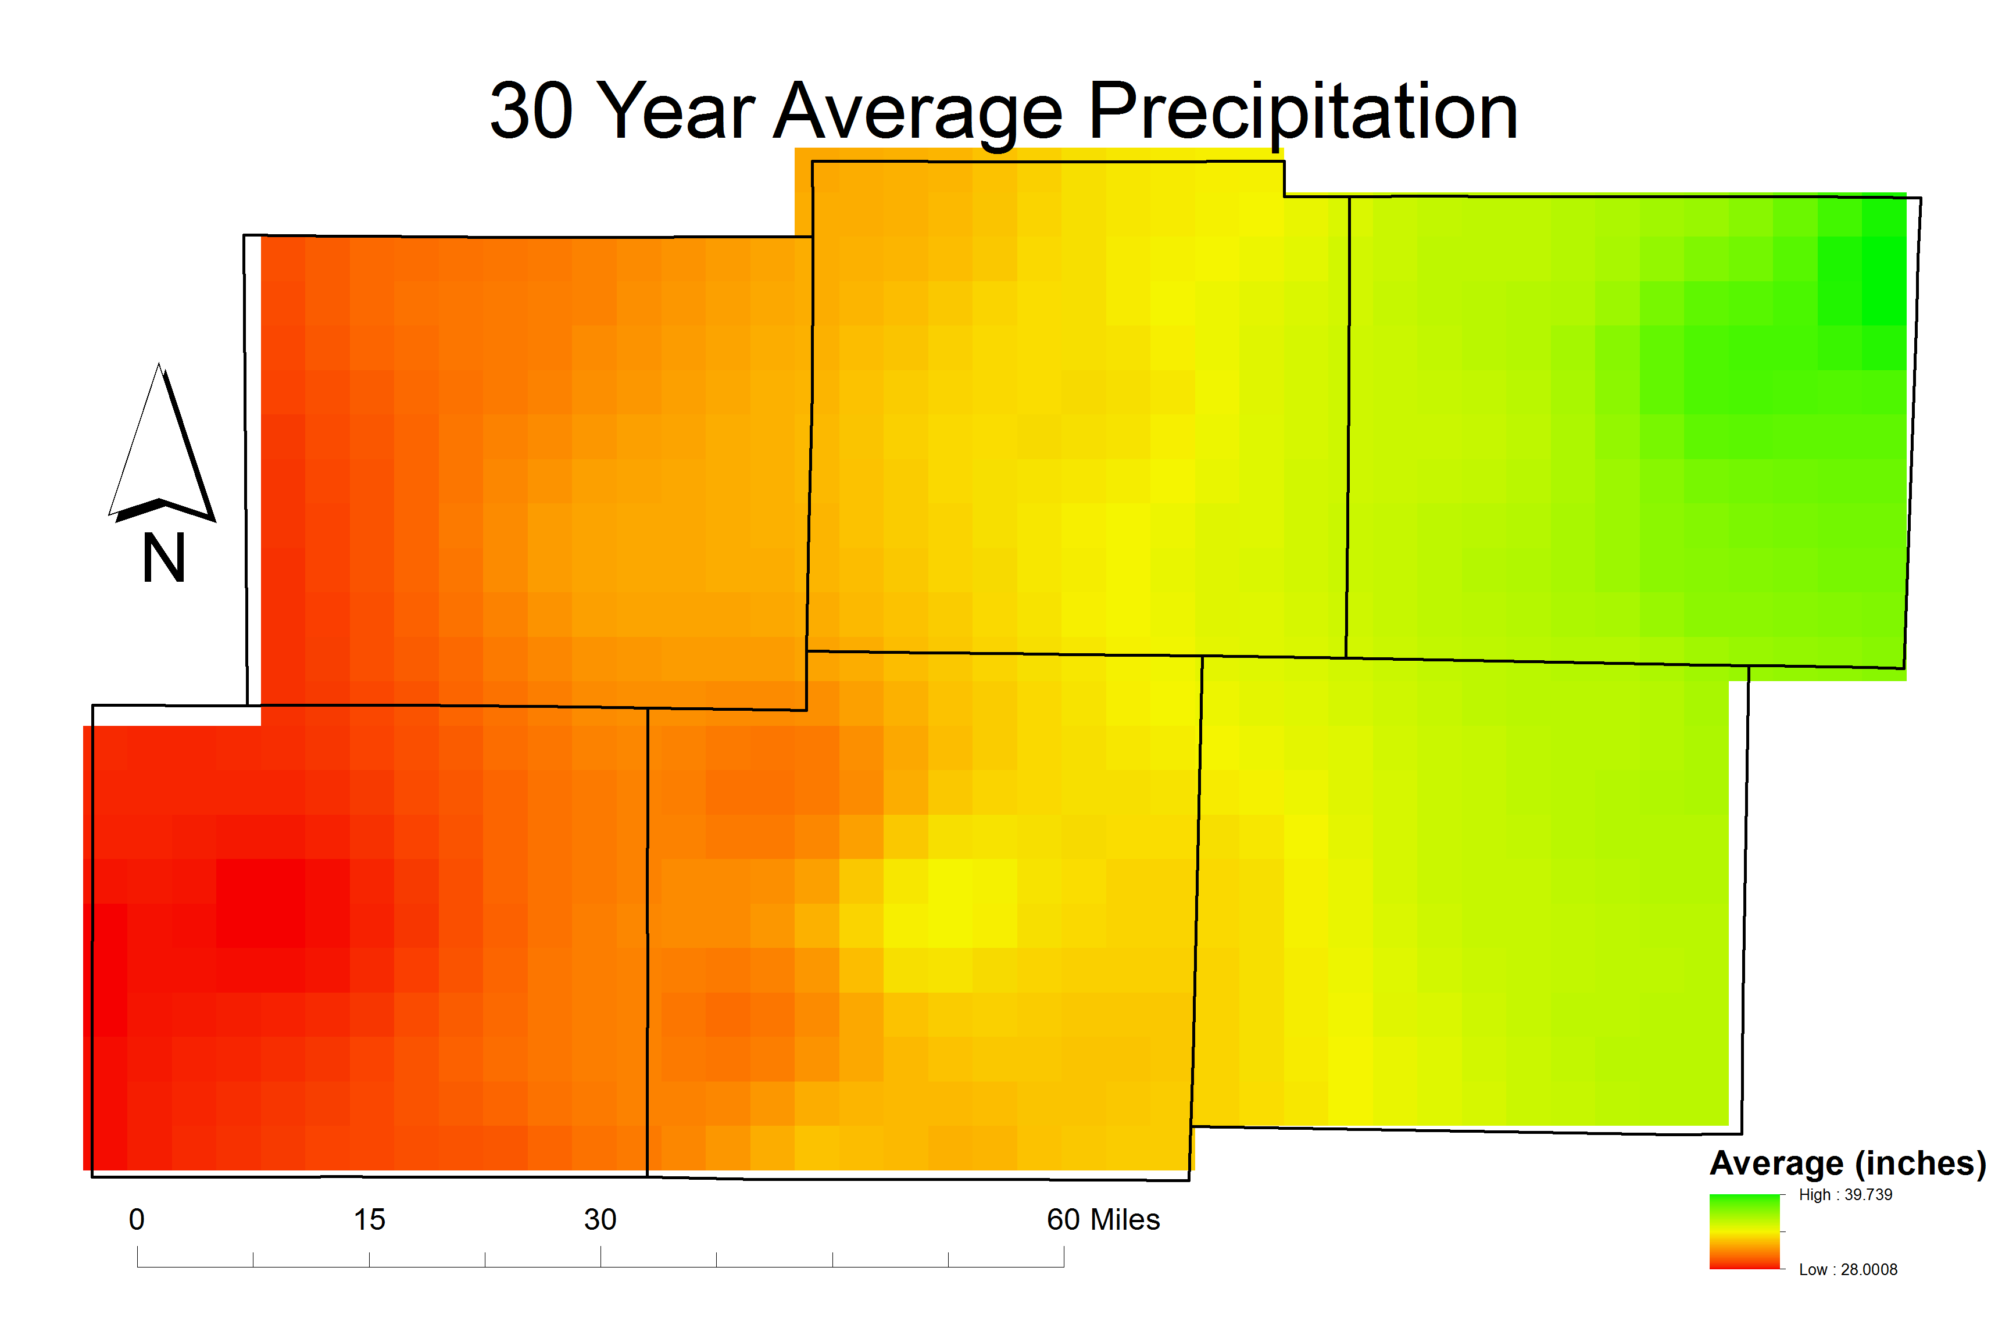
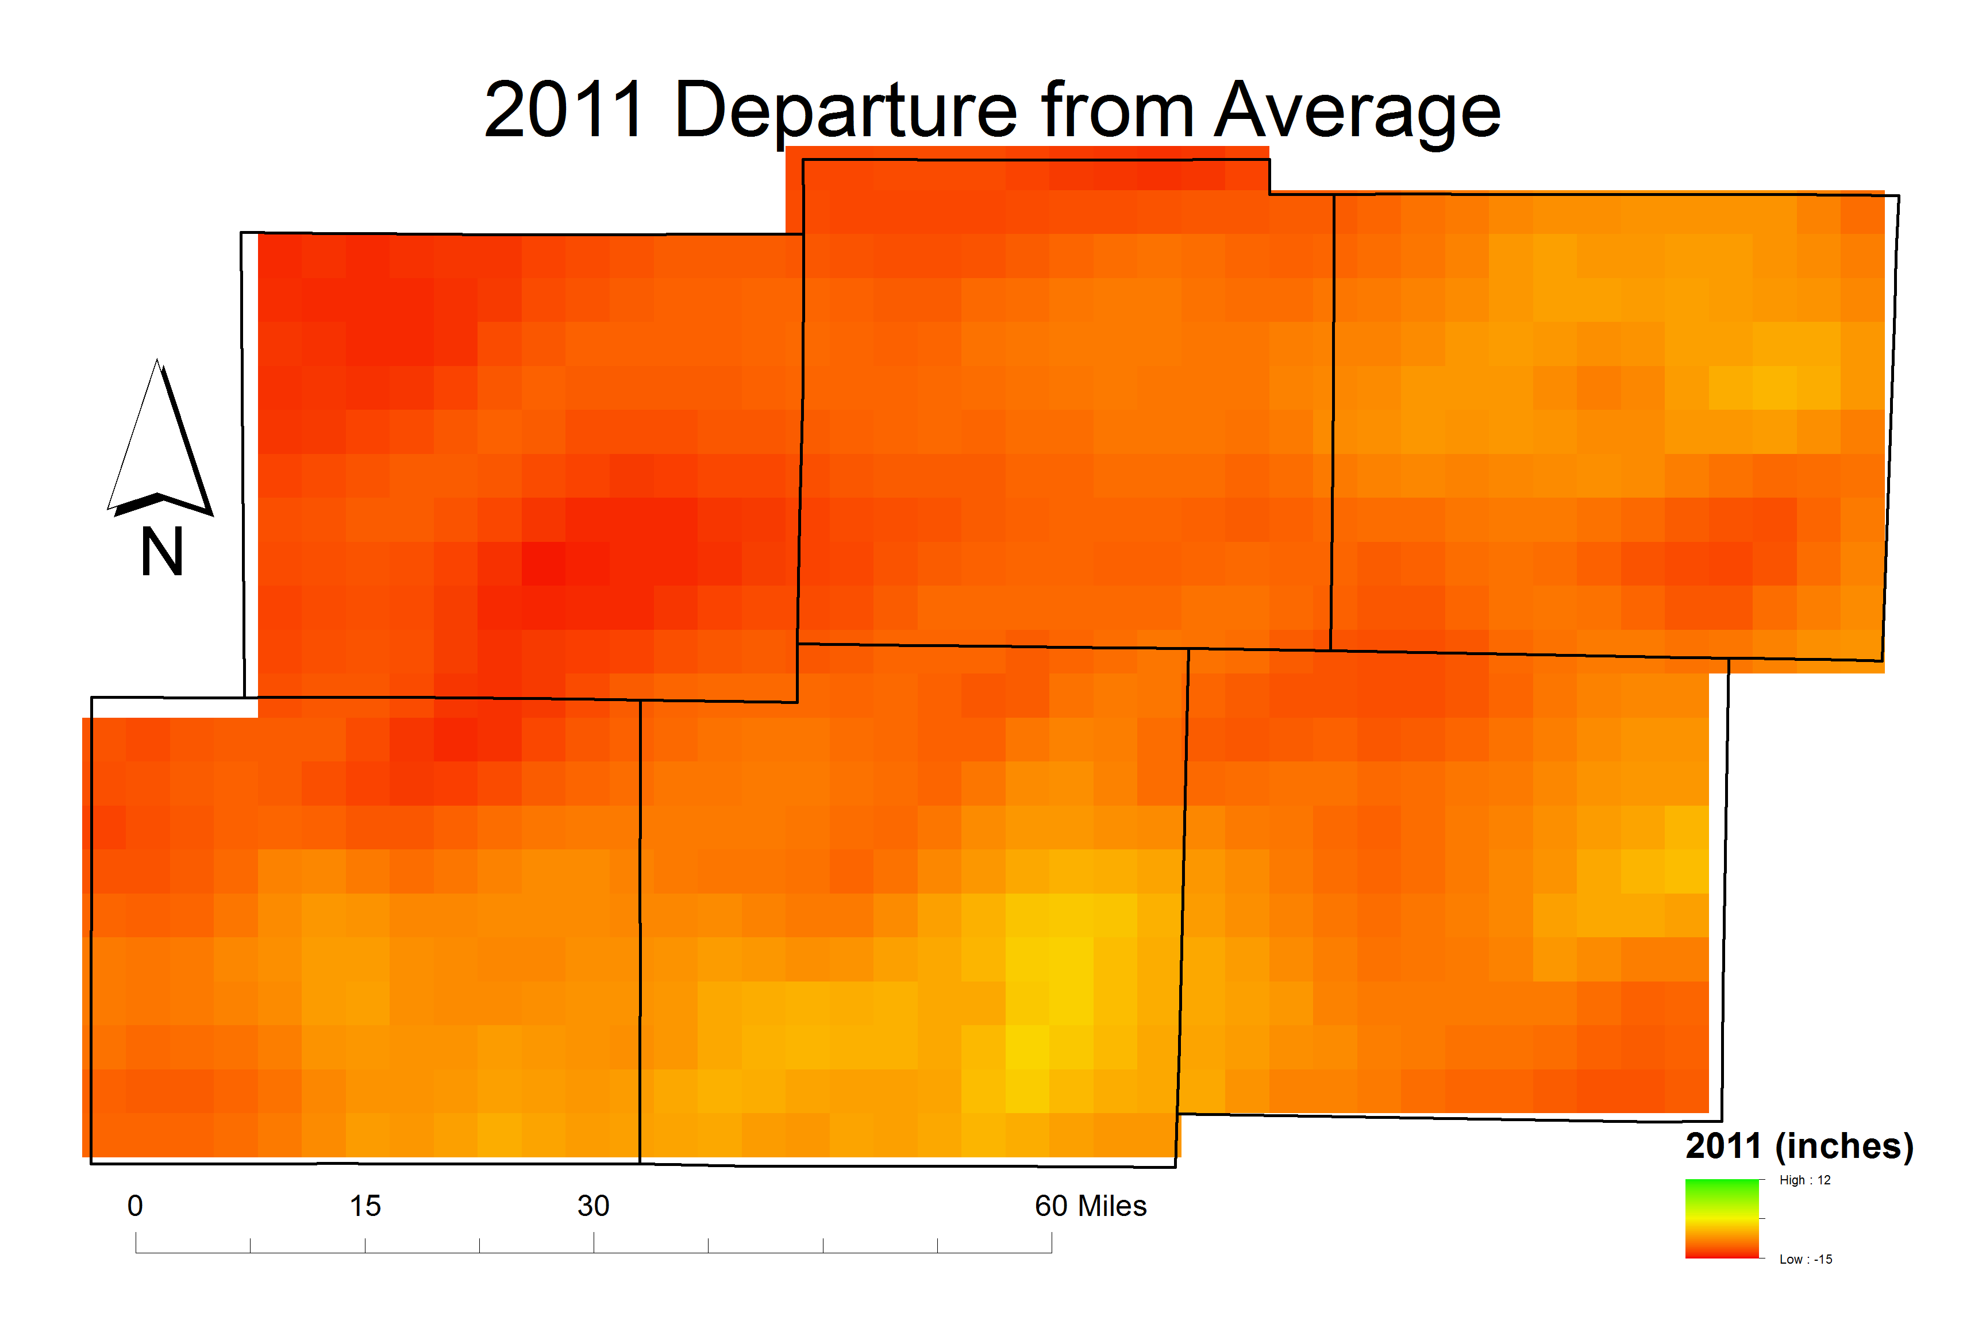
Methodology Climatology
Average Precipitation – 28-40 in/year
2010 – 4 inches above normal
2011 – 10 inches below normal
Notes:
We knew from previous terms that a wet year followed by a dry year led to increased wildfires. Prism climate data were analyzed for the study area to find back-to-back wet and dry years. 2010 and 2011 provided the largest year-to-year variation. 2010 was slightly wetter than normal while 2011 was exceptionally dry.

Slide 14
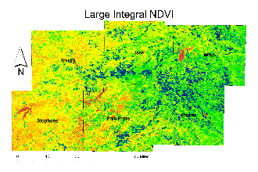
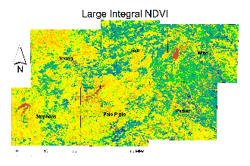
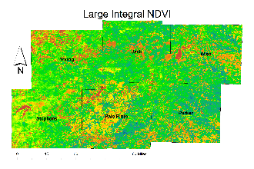
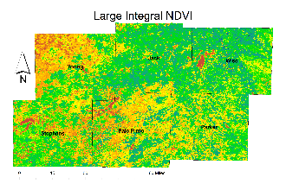
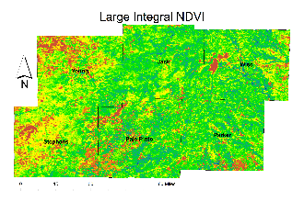
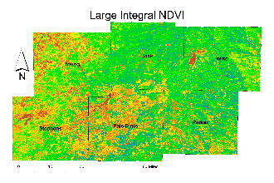
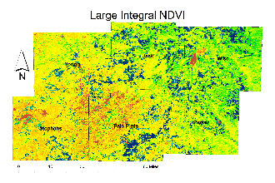
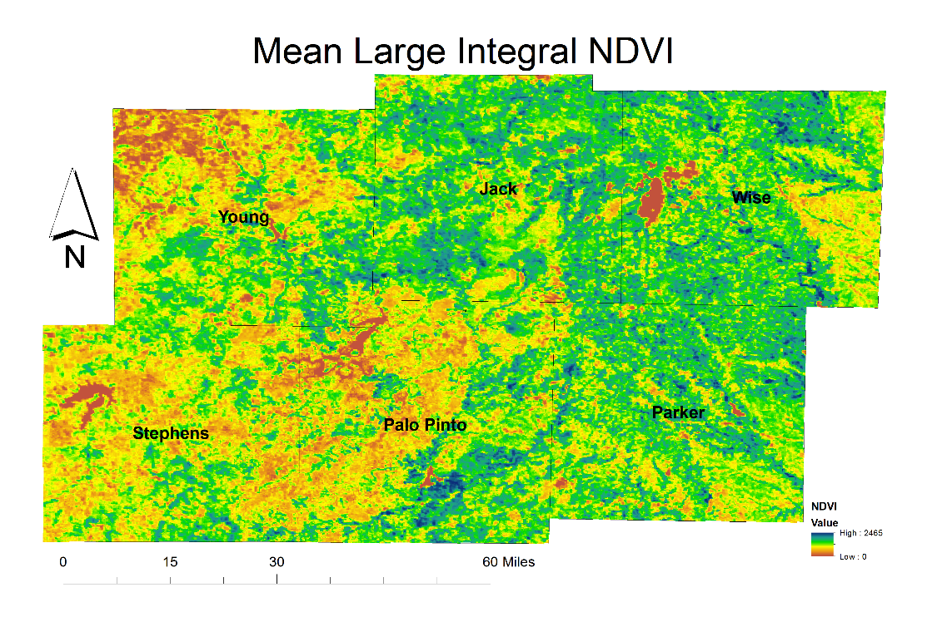
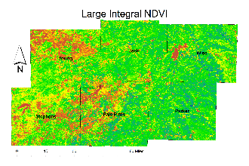
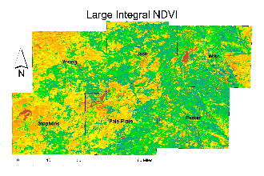
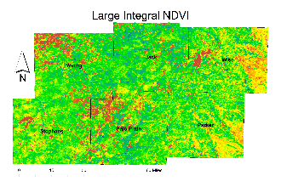
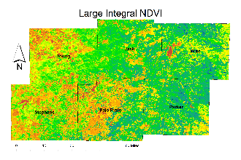
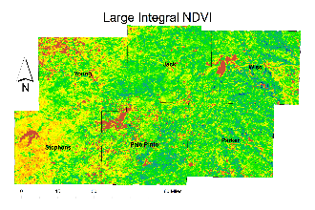
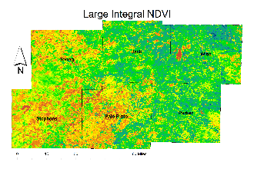

Methodology Phenology
NDVI and DOY averaged for study period
Median filter applied to DOY
NDVI
25000
0
Notes:
Once the main years were determined, we needed to have a baseline for the phenology. MODIS phenology data from 2000-2014 were averaged for both day of year and NDVI values to establish a baseline. The results were smoothed using the median filter in ArcGIS. This allowed us to see general trends in phenology.

Slide 15
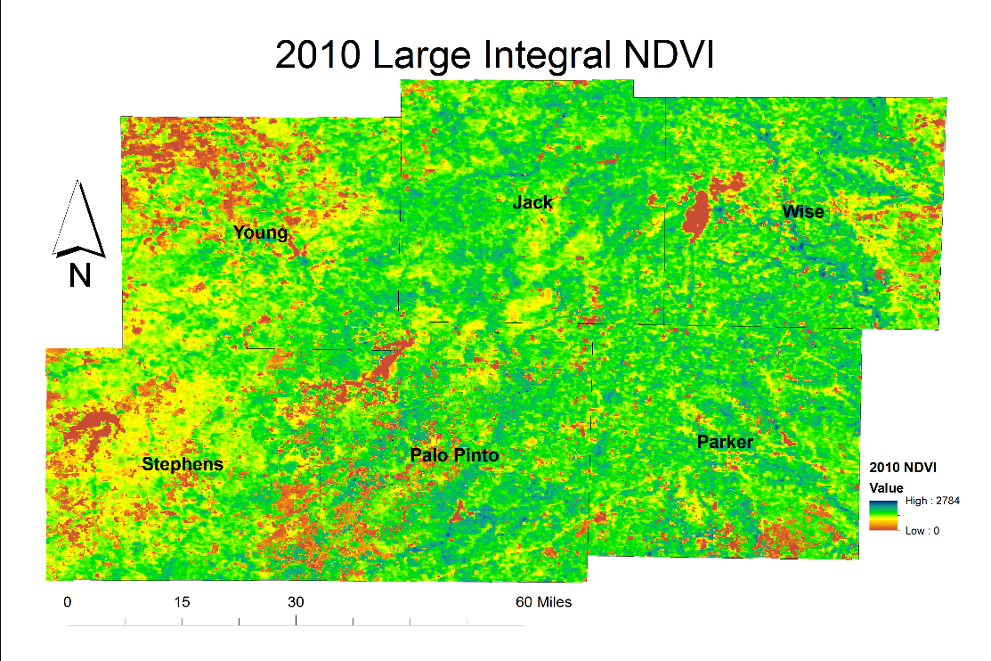
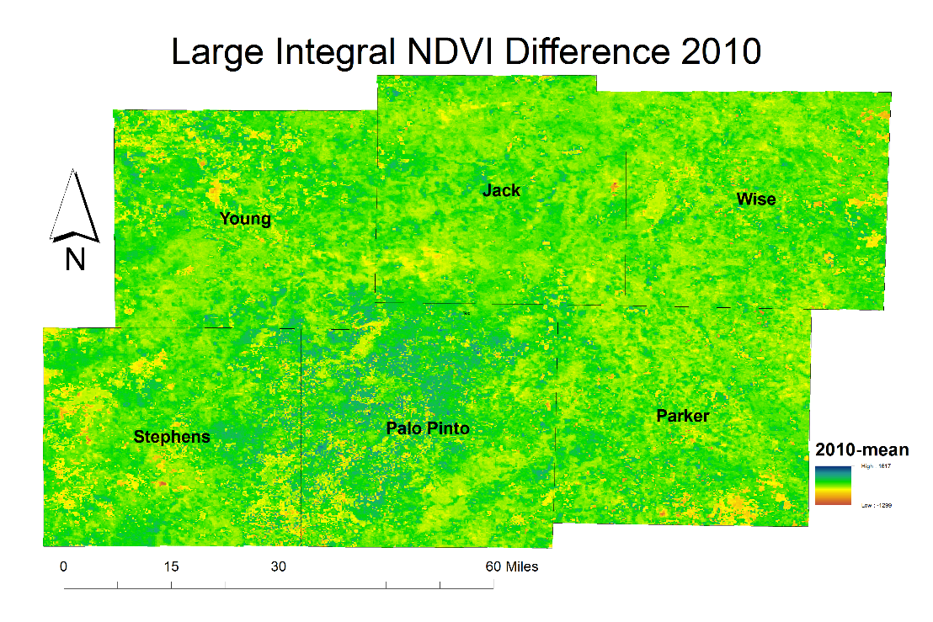

Methodology
Phenology
Parameters from each year were compared to the mean
Notes:
Using the raster calculator in ArcGIS and with change detection function in ERDAS IMAGINE, images were compared to the mean as well as previous years. This image shows the 2010 large integral NDVI difference from average. Greens indicate a positive change while reds indicate a negative change.

Slide 16
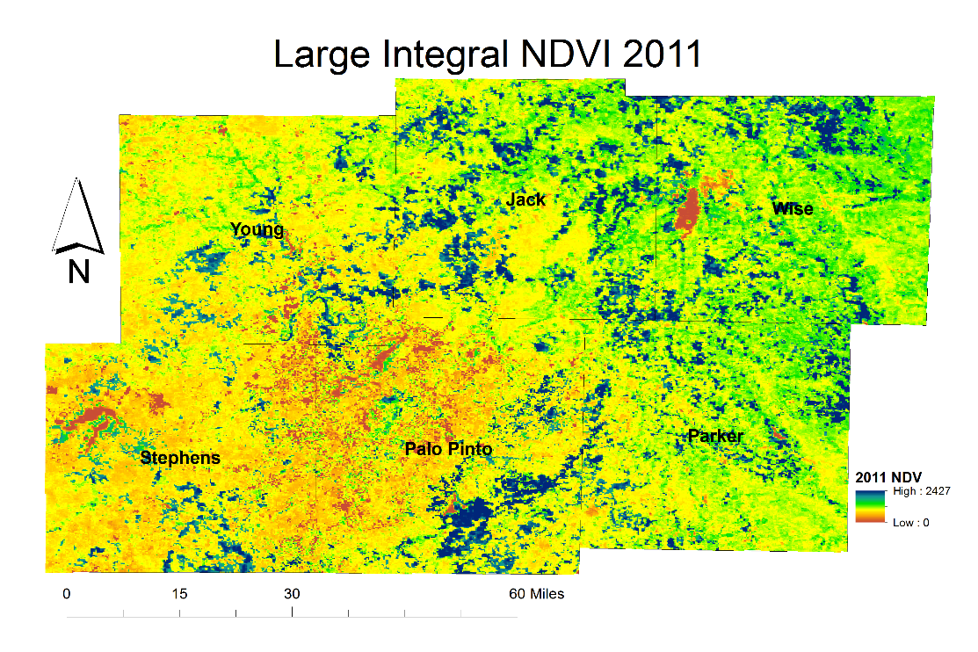
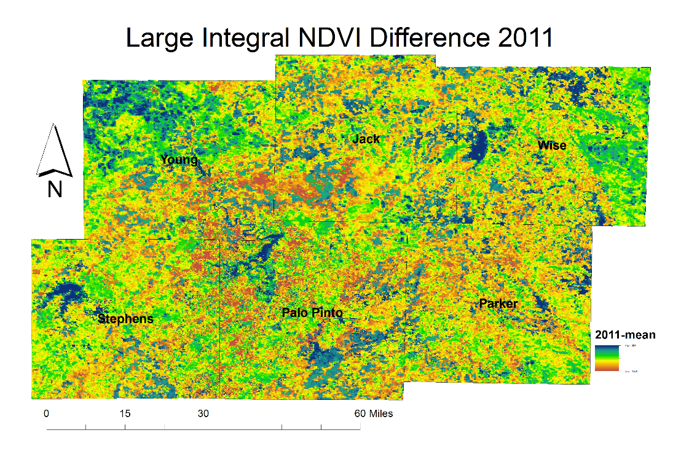
Methodology
Phenology
Parameters from each year were compared to the mean
Notes:
This image shows the 2011 large integral NDVI difference from average. Greens indicate a positive change while reds indicate a negative change. As you can see, there are many more shades of red in the resulting image. The greens and blues in the northwestern corner of the study area are in a heavily agricultural area that is heavily irrigated.

Slide 17
Methodology
Phenology
Parameters from each year were compared to subsequent years
Notes:
Again, here is a side by side comparison of 2010 to 2011. You can see just how much lower the NDVI values were throughout the year.

Slide 18
Methodology Phenology – Large Integral NDVI
2001
2002
2003
2004
2005
2006
2007
2008
2009
2010
2011
2012
2013
2014
Notes:
As our team looked through the data, an area in the south-central portion of the study area stood out as different from the surrounding area.

Slide 19
Methodology Phenology – Large Integral NDVI
2001
2002
2003
2004
2005
2006
2007
2008
2009
2010
2011
2012
2013
2014
Notes:
Interestingly, this area is very clearly seen during a dry or normal precipitation year, but during a very wet year it disappears almost entirely indicating that the vegetation becomes proportionally more productive during a wetter than average year.
Our team sought a method to identify what makes this area respond differently than other areas.

Slide 20
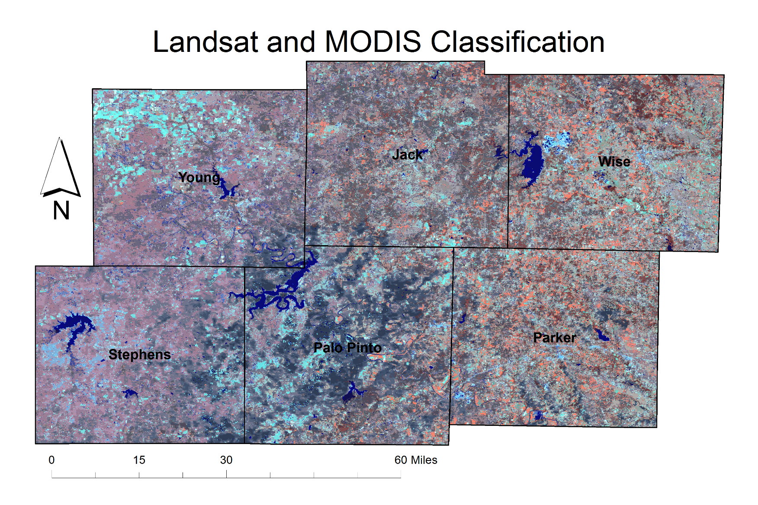
Methodology
Landsat and MODIS land cover classification
Notes:
An unsuoervised classification was preformed using ERDAS IMAGINE on an image stack containing 14 layers of 2014 MODIS phenology data as well as the red, near infrared, and shortwave infrared bands of 2015 Landsat 8 imagery.
The color table is based on class-specific Landsat false color RGB values
Again, the south-central portion of the study area appeared to have different characteristics to the surrounding area.

Slide 21
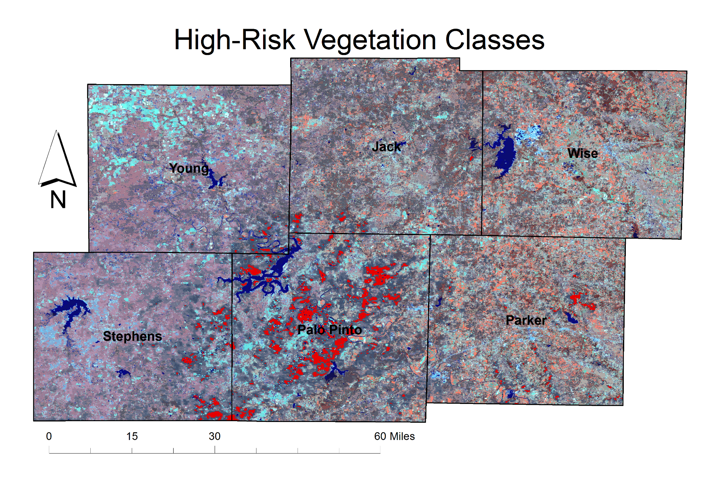
Methodology
Classification
High-Risk Vegetation classes
Notes:
We began selecting classes in the south-central portion of the study area.

Slide 22
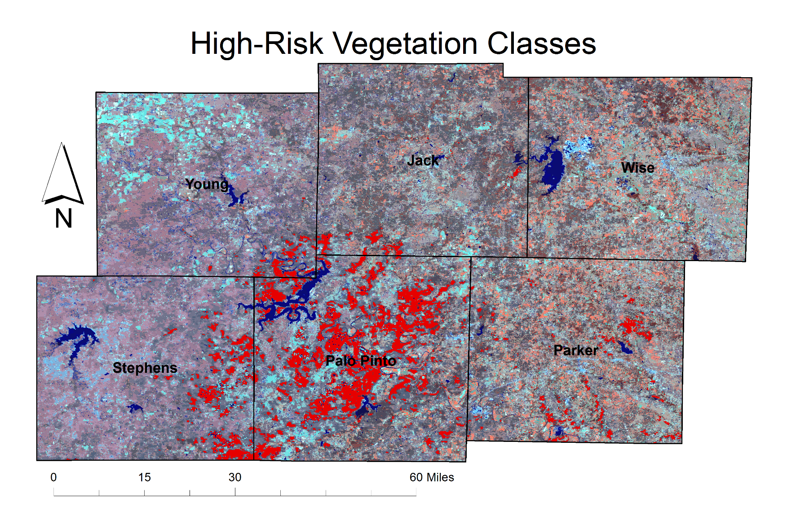
Methodology
Classification
High-Risk Vegetation classes
Notes:
As we selected more classes…

Slide 23
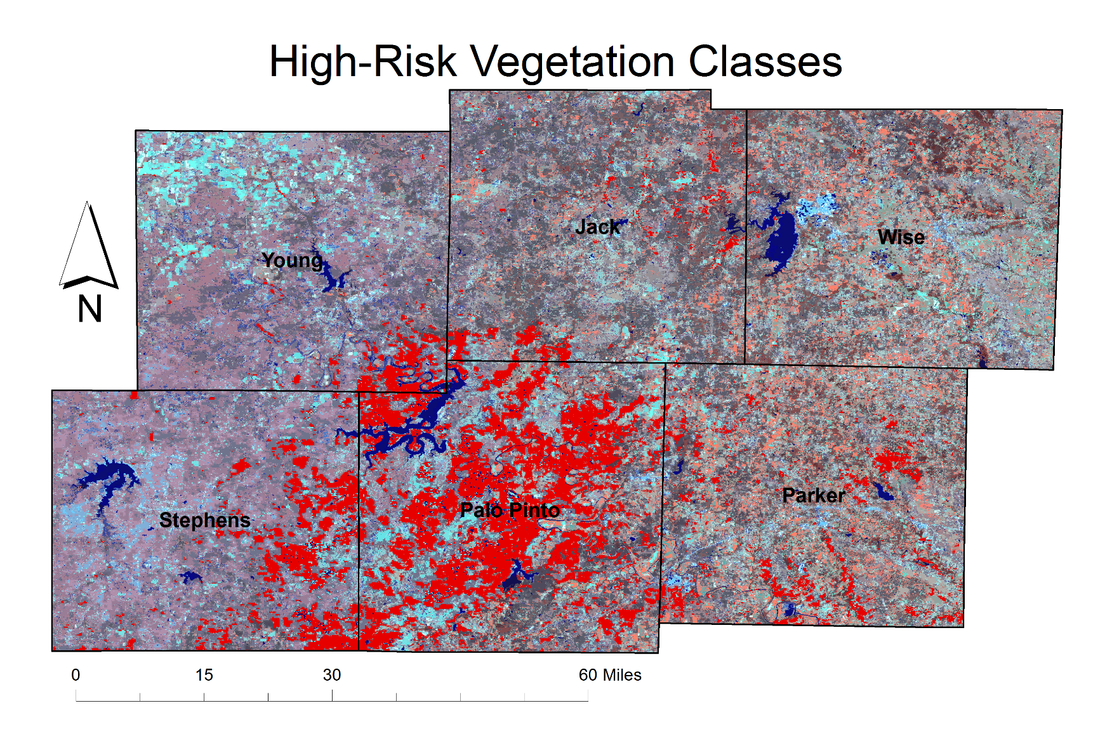
Methodology
Classification
High-Risk Vegetation classes
Notes:
A clear picture began to emerge…

Slide 24
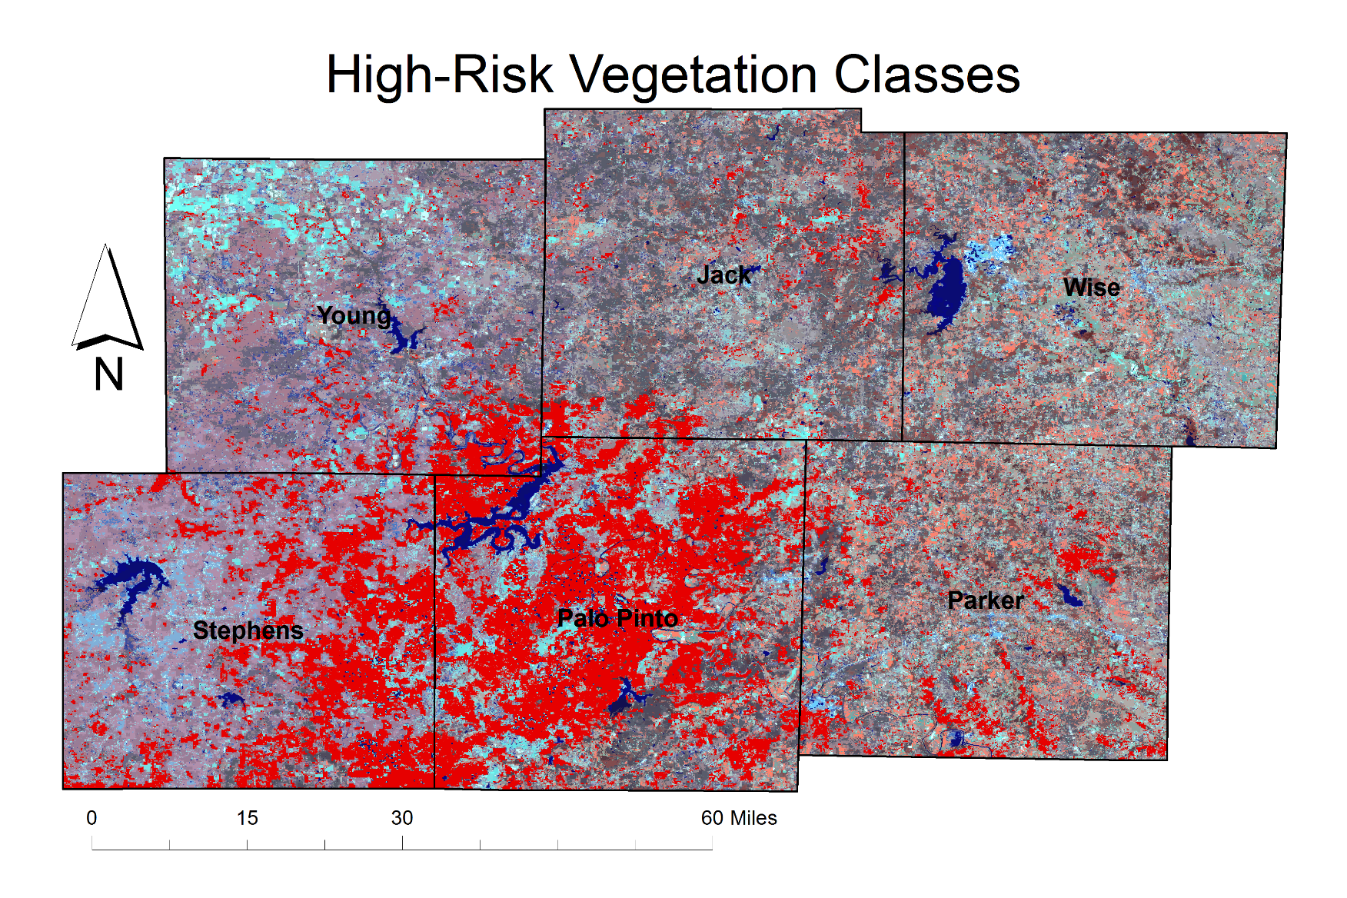
Methodology
Classification
High-Risk Vegetation classes
Notes:
Of an area with similar Landsat reflectance and MODIS phenology characteristics. Of course there are some outliers, but the bulk of these four classes fall within Palo Pinto and Stephens counties.

Slide 25
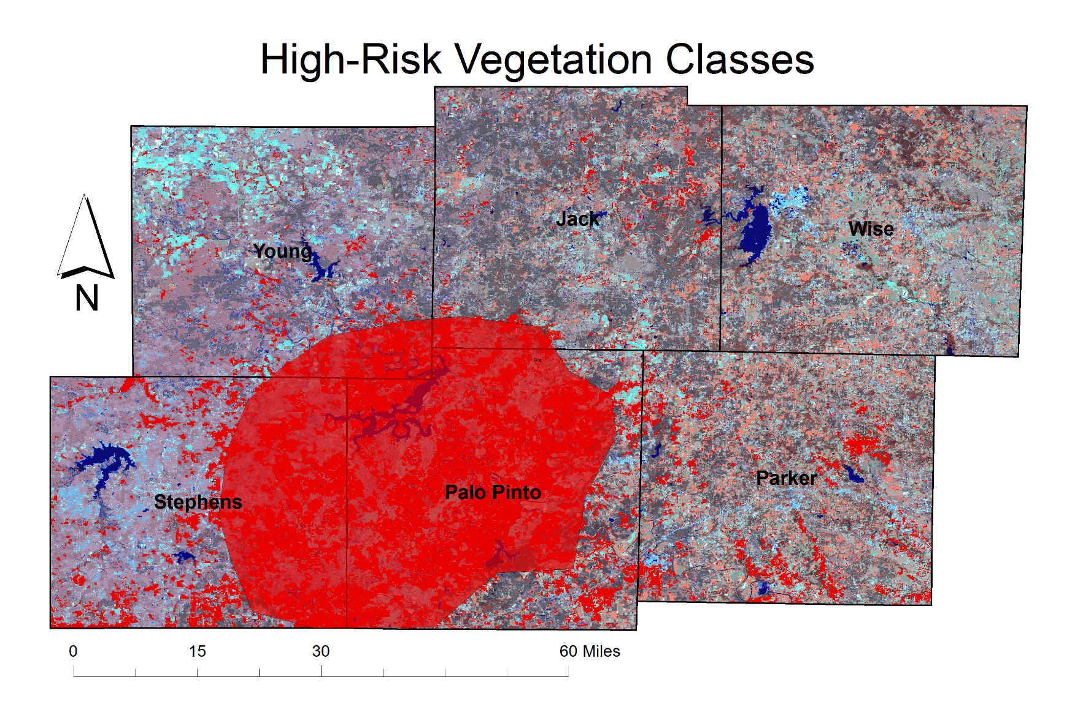
Methodology
Classification
High Risk Area
High-Risk Vegetation classes
Notes:
We highlighted this area as a “High Risk Area.”

Slide 26
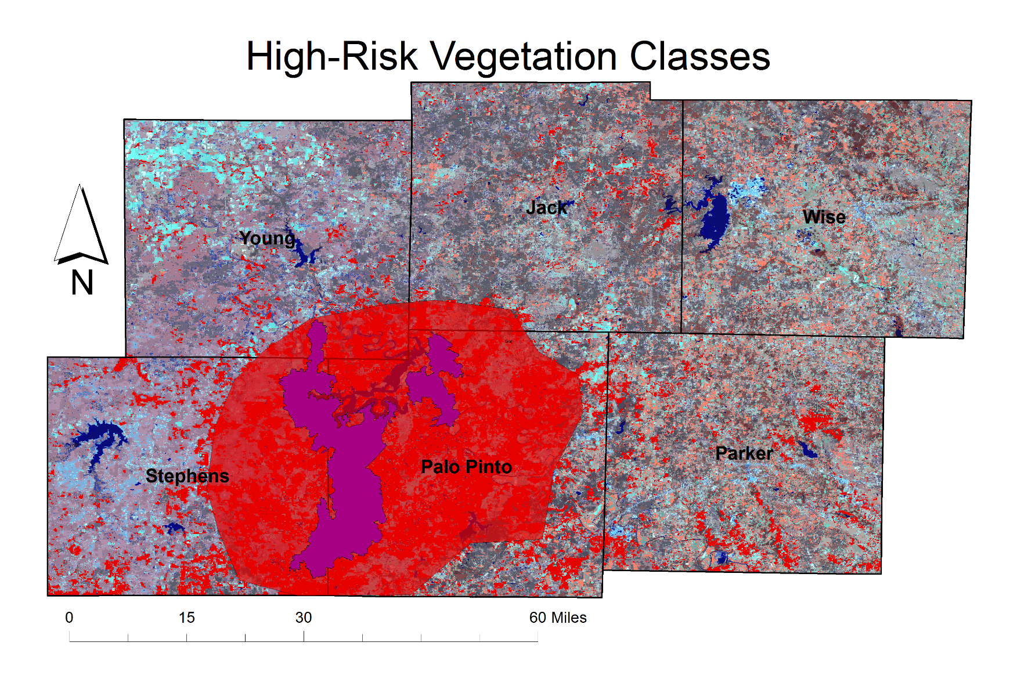
Methodology
Classification
High Risk Area
Possum Kingdom Complex Fire, 2011
High-Risk Vegetation classes
Notes:
Shown is the Possum Kingdom Complex Fire from 2011.
Our team began to look for some commonalities that could be driving this area to experience more pronounced changes in phenology from year to year.

Slide 27
Methodology Climatology
Average Precipitation – 28-40 in/year
2010 – 4 inches above normal
2011 – 10 inches below normal
Notes:
We looked at precipitation data and there was no apparent anomaly to support more growth and more severe drought in the high-risk area.

Slide 28
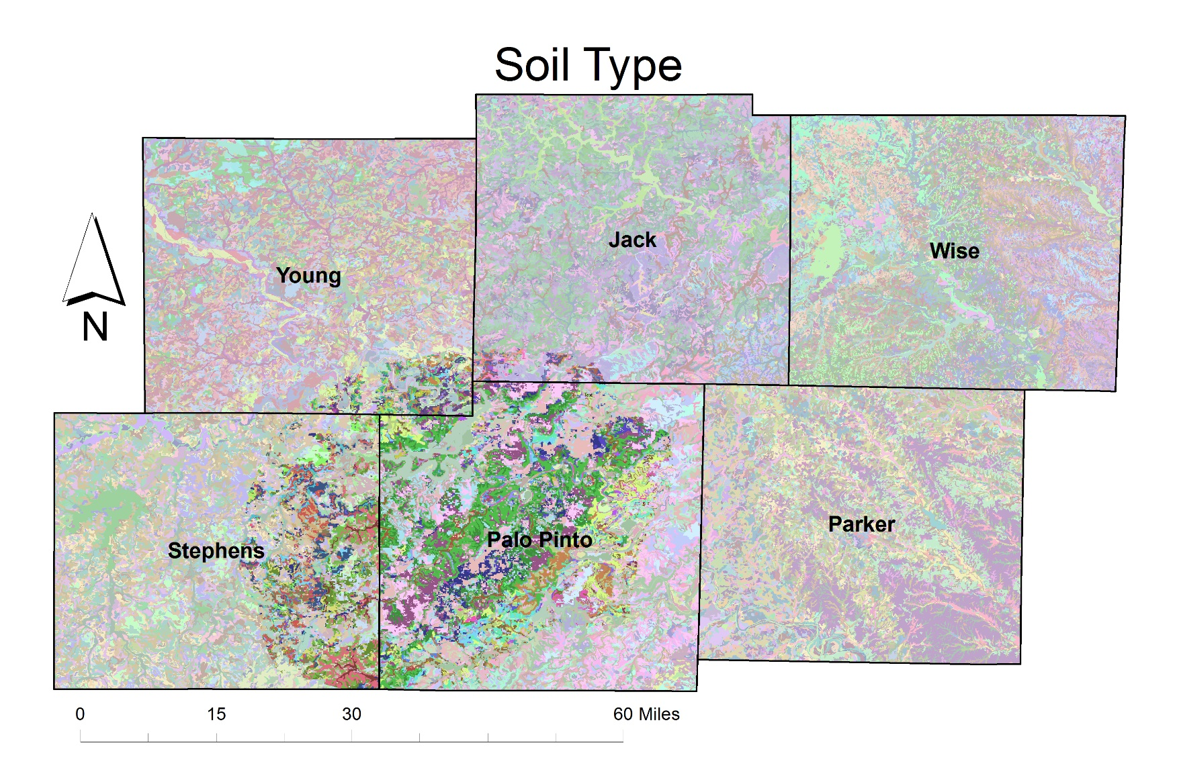
Methodology
Soils
Notes:
Since the driving factor didn’t appear to come from above, our team looked below to the soils in the area.
Soils in the high-risk area tend to be a loam or clay-loam with a large percentage of rock and stones in some areas. The clay in this soil holds water longer during a wet year allowing for a longer and more productive growing season, while the rocky soil provides enough aeration to prevent root rot. However, during a drought year, what little rainfall occurs may run off due to the clay-loam’s packed nature leading to low production and shortened growing season.

Slide 29
NDVI
Season Max NDVI
Left 80% Max
Right 80% Max
Left 20% Max
Right 20% Max
Left Minimum
Right Minimum
Spring
Growing Season
Fall
Images Credit: Steve Norman, USFS ForWarn
Notes:
Now that we had a driving factor behind the difference in phenology in the high-risk area, our team looked to quantify it for our partners.
Again, this is the MODIS-derived phenology data set. It depicts an NDVI curve throughout the growing season. These 14 layer images contain seven NDVI and corresponding day of year values. Relative fuel loads and dryness can be estimated by measuring the responses over the course of the year.

Slide 30
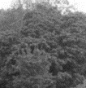




NDVI
Season Max NDVI
Left 80% Max
Right 80% Max
Left 20% Max
Right 20% Max
Left Minimum
Right Minimum
Spring
Growing Season
Fall
Images Credit: Steve Norman, USFS ForWarn
Notes:
We chose to focus on three parameters; Left 80% where the growing season gets going strongly, Max NDVI, and right 20%, which we thought would be indicative of a fire being able to burn through an area. Since we were in search of a product that could be used in near real time, yearly integral NDVI were only used to look at overall trends in vegetation.

Slide 31
Results
Selected phenology parameters for high-risk area
NDVI values scaled by 10,000
2010 considerably more productive than mean
2011 considerably less productive than mean
Notes:
This shows the average NDVI Magnitude for the selected classes of vegetation within the high-risk area. Shown are the mean of 2000-2014 in blue along with 2010 in green and 2011 in brown. NDVI values are scaled by 10,000.
2010 was considerably more productive than mean while 2011 was considerably less productive than the mean

Slide 32
Results
Selected phenology parameters for high-risk area
Day of year values
2010 had a much longer growing season than mean
2011 had a much shorter growing season than mean
Notes:
This shows the day of year at which the NDVI values occurred for the selected classes of vegetation within the high-risk area. Shown are the mean of 2000-2014 in blue along with 2010 in green and 2011 in brown.
2010 had a much longer growing season than mean while 2011 had a much shorter growing season than mean. The growing season in 2011 was nearly 100 days shorter than 2010.

Slide 33
Results
Selected phenology parameters for high-risk area
Notes:
Here are both graphs side-by-side. Again, just to reiterate how much more productive 2010 was than 2011. Much longer growing season, much higher NDVI values. This all indicates much more biomass available to die off over the winter and be burned during the 2011 fire season.

Slide 34

Results
High Risk Area
If by mid-May the NDVI value has not reached close to 0.6 within the majority of the High-Risk Area, there is a greater risk of wildfires.
If the previous year had a growing season near 200 days long combined with a max NDVI of 0.7, the fuel load may contribute to more severe wildfires.
Notes:
We came up with two key points that our partners may want to keep in mind in future fire seasons:
If by mid-May the un-scaled NDVI value has not reached close to 0.6 within the majority of the High-Risk Area, there is a greater risk of wildfires.
If the previous year had a growing season near 200 days long combined with a max NDVI of 0.7, the fuel load may contribute to more severe wildfires in the current year.

Slide 35
Conclusion
High Risk Area
There is a high-risk area within the study area that has an enhanced phenological response to both wet and dry years relative to the surrounding area.
This high risk may be driven more by soil type than climate (though the latter does contribute to risk).
This area should experience greater risk for large, damaging wildfires given a La Nina climatic event after a previously lush year (e.g., 2011 versus 2010).
As yearly climate swings grow more pronounced and growth continues in the area, this risk may escalate.
Notes:
There is a high-risk area within the study area that has an enhanced phenological response to both wet and dry years relative to the surrounding area.
This enhanced response is driven more by soil type than climate.
In a typical el Nino cycle this area has a greater risk for large, damaging wildfires.
As yearly climate swings grow more pronounced and growth continues in the area, this risk will escalate.

Slide 36




Limitations and Future Work
Look at all points in the growing season “NDVI” curve
Consider temperature on a monthly basis
Timing of first freeze
Look at current El Nino to assess wildfire risk and impacts of this climatic event
Assess alternative MODIS/Landsat data fusion methods (e.g., STAR FM)
Notes:
STAR FM-Landsat data provides data with details for monitoring land surface and changes. However, the 16-day revisit cycle is limiting because the growing season is rapidly evolving . Also, if there are cloudy areas, which occurs quite often, there maybe only a few images of the growing season. Meanwhile, MODIS sensors aboard the Terra and Aqua satellites provide daily global observations valuable for capturing rapid surface changes. To better utilize Landsat and MODIS data, one solution is to combine the spatial resolution of Landsat with the temporal frequency of MODIS.
To combine Landsat and MODIS data, a Spatial and Temporal Adaptive Reflectance Fusion Model (STARFM) can be used.

Slide 37
Advisors
Joseph Spruce, NASA Stennis Space Center
Dr. Kenton Ross, NASA Langley Research Center

Slide 38
Partners
Tom Spencer, Texas Forest Service
Curt Stripling, Texas Forest Service
Williams “Bill” Hargrove, USDA Forest Service
Benjamin Beasley, NASA DEVELOP at Stennis Space Center
Alex Holland, NASA DEVELOP at Stennis Space Center
Kristen Kelehan, NASA DEVELOP at Stennis Space Center
Others

Slide 39
References
"US Forest Service." US Forest Service. Web. Oct. 2015.
"Texas A&M Forest Service Home Page." Texas A&M Forest Service Home Page. Web. Nov. 2015.
National Wildfire Coordinating Group. "National Fire Danger Rating System (NFDRS)." Van Nostrand's Scientific Encyclopedia 2005. Web. 11 Oct. 2015.
Hargrove, William, Joe Spruce, Gerry Gasser, Forrest Hoffman, and Danny Lee. "A New National MODIS-Derived Phenology Data Set Every 16 Days, 2002 through 2006." USDA Forest Service - Eastern Forest Threat Assessment Center, *NASA Stennis Space Center, and Oak Ridge National Laboratory.
All images courtesy of NASA unless stated otherwise.

Slide 40

Questions?

