Slide 1
CENTRAL PARK ECOLOGICAL CONSERVATION
Assessing Tree Health Conditions in New York City’s Central Park with Earth Observation Data
Jack Graziano
Ikram Morso
John Hocknell
Kayla Paramore
Pop-Up Project – Hunter College | Summer 2024
Notes:
Hello everyone and thank you for coming to our presentation. We are so exited to share our project – Central Park Ecological Conservation – with you. This is a feasibility study assessing tree health conditions in New York City’s Central Park with NASA Earth observation data.

Slide 2
Meet The Team
John Hocknell
Ikram
Morso
Jack
Graziano
Kayla
Paramore
Notes:
We have a lot of interesting details to discuss and we’ll start with an introduction to the project, study area, and our partner’s concerns, and then we’ll transition into our methodology, results, and conclusions. But before we get to all that juicy stuff, we’d like to introduce ourselves. (Each team member says hello and who they are).
​----------Image Information Below----------
[First headshot]​
Image Credit: John Hocknell
Image Source: [DEVELOP Team]
[Second headshot]​
Image Credit: Ikram Morso
Image Source: [DEVELOP Team]
[Third headshot]​
Image Credit: Jack Graziano
Image Source: [DEVELOP Team]
[Fourth headshot]​
Image Credit: Kayla Paramore
Image Source: [DEVELOP Team]
​

Slide 3
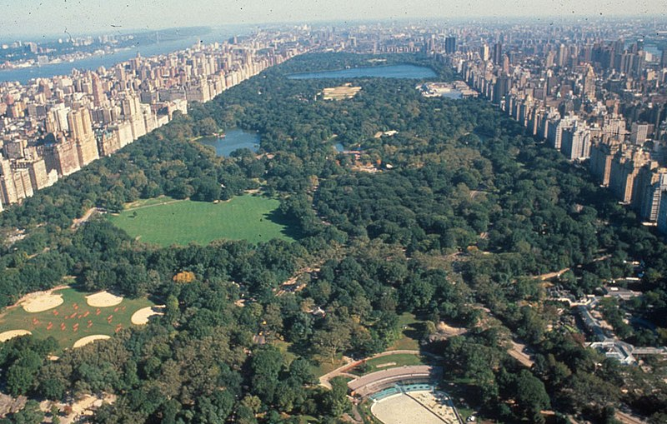
Project Partner
Mission: The preservation and celebration of Central Park as a sanctuary for all
Central Park Conservancy
Image Credit: Central Park Conservancy
Notes:
Our partner for this project was the Central Park Conservancy. For more than 40 years the Conservancy has stewarded the park, tending to its maintenance, restoration, and architectural needs that arise from its massive use. Their mission is to "preserve and celebrate Central Park as a sanctuary from the pace and pressures of city life, enhancing the enjoyment and wellbeing of all.” The Conservancy goes beyond standard park services through event planning, trash management, horticulture, turf and tree care, and so much more.
----------Image Information Below----------
[AerialSummer2]
Image Credit: [Central Park Conservancy] [CC BY 3.0]
Image Source: [https://commons.wikimedia.org/wiki/File:AerialSummer2.jpg]

Slide 4
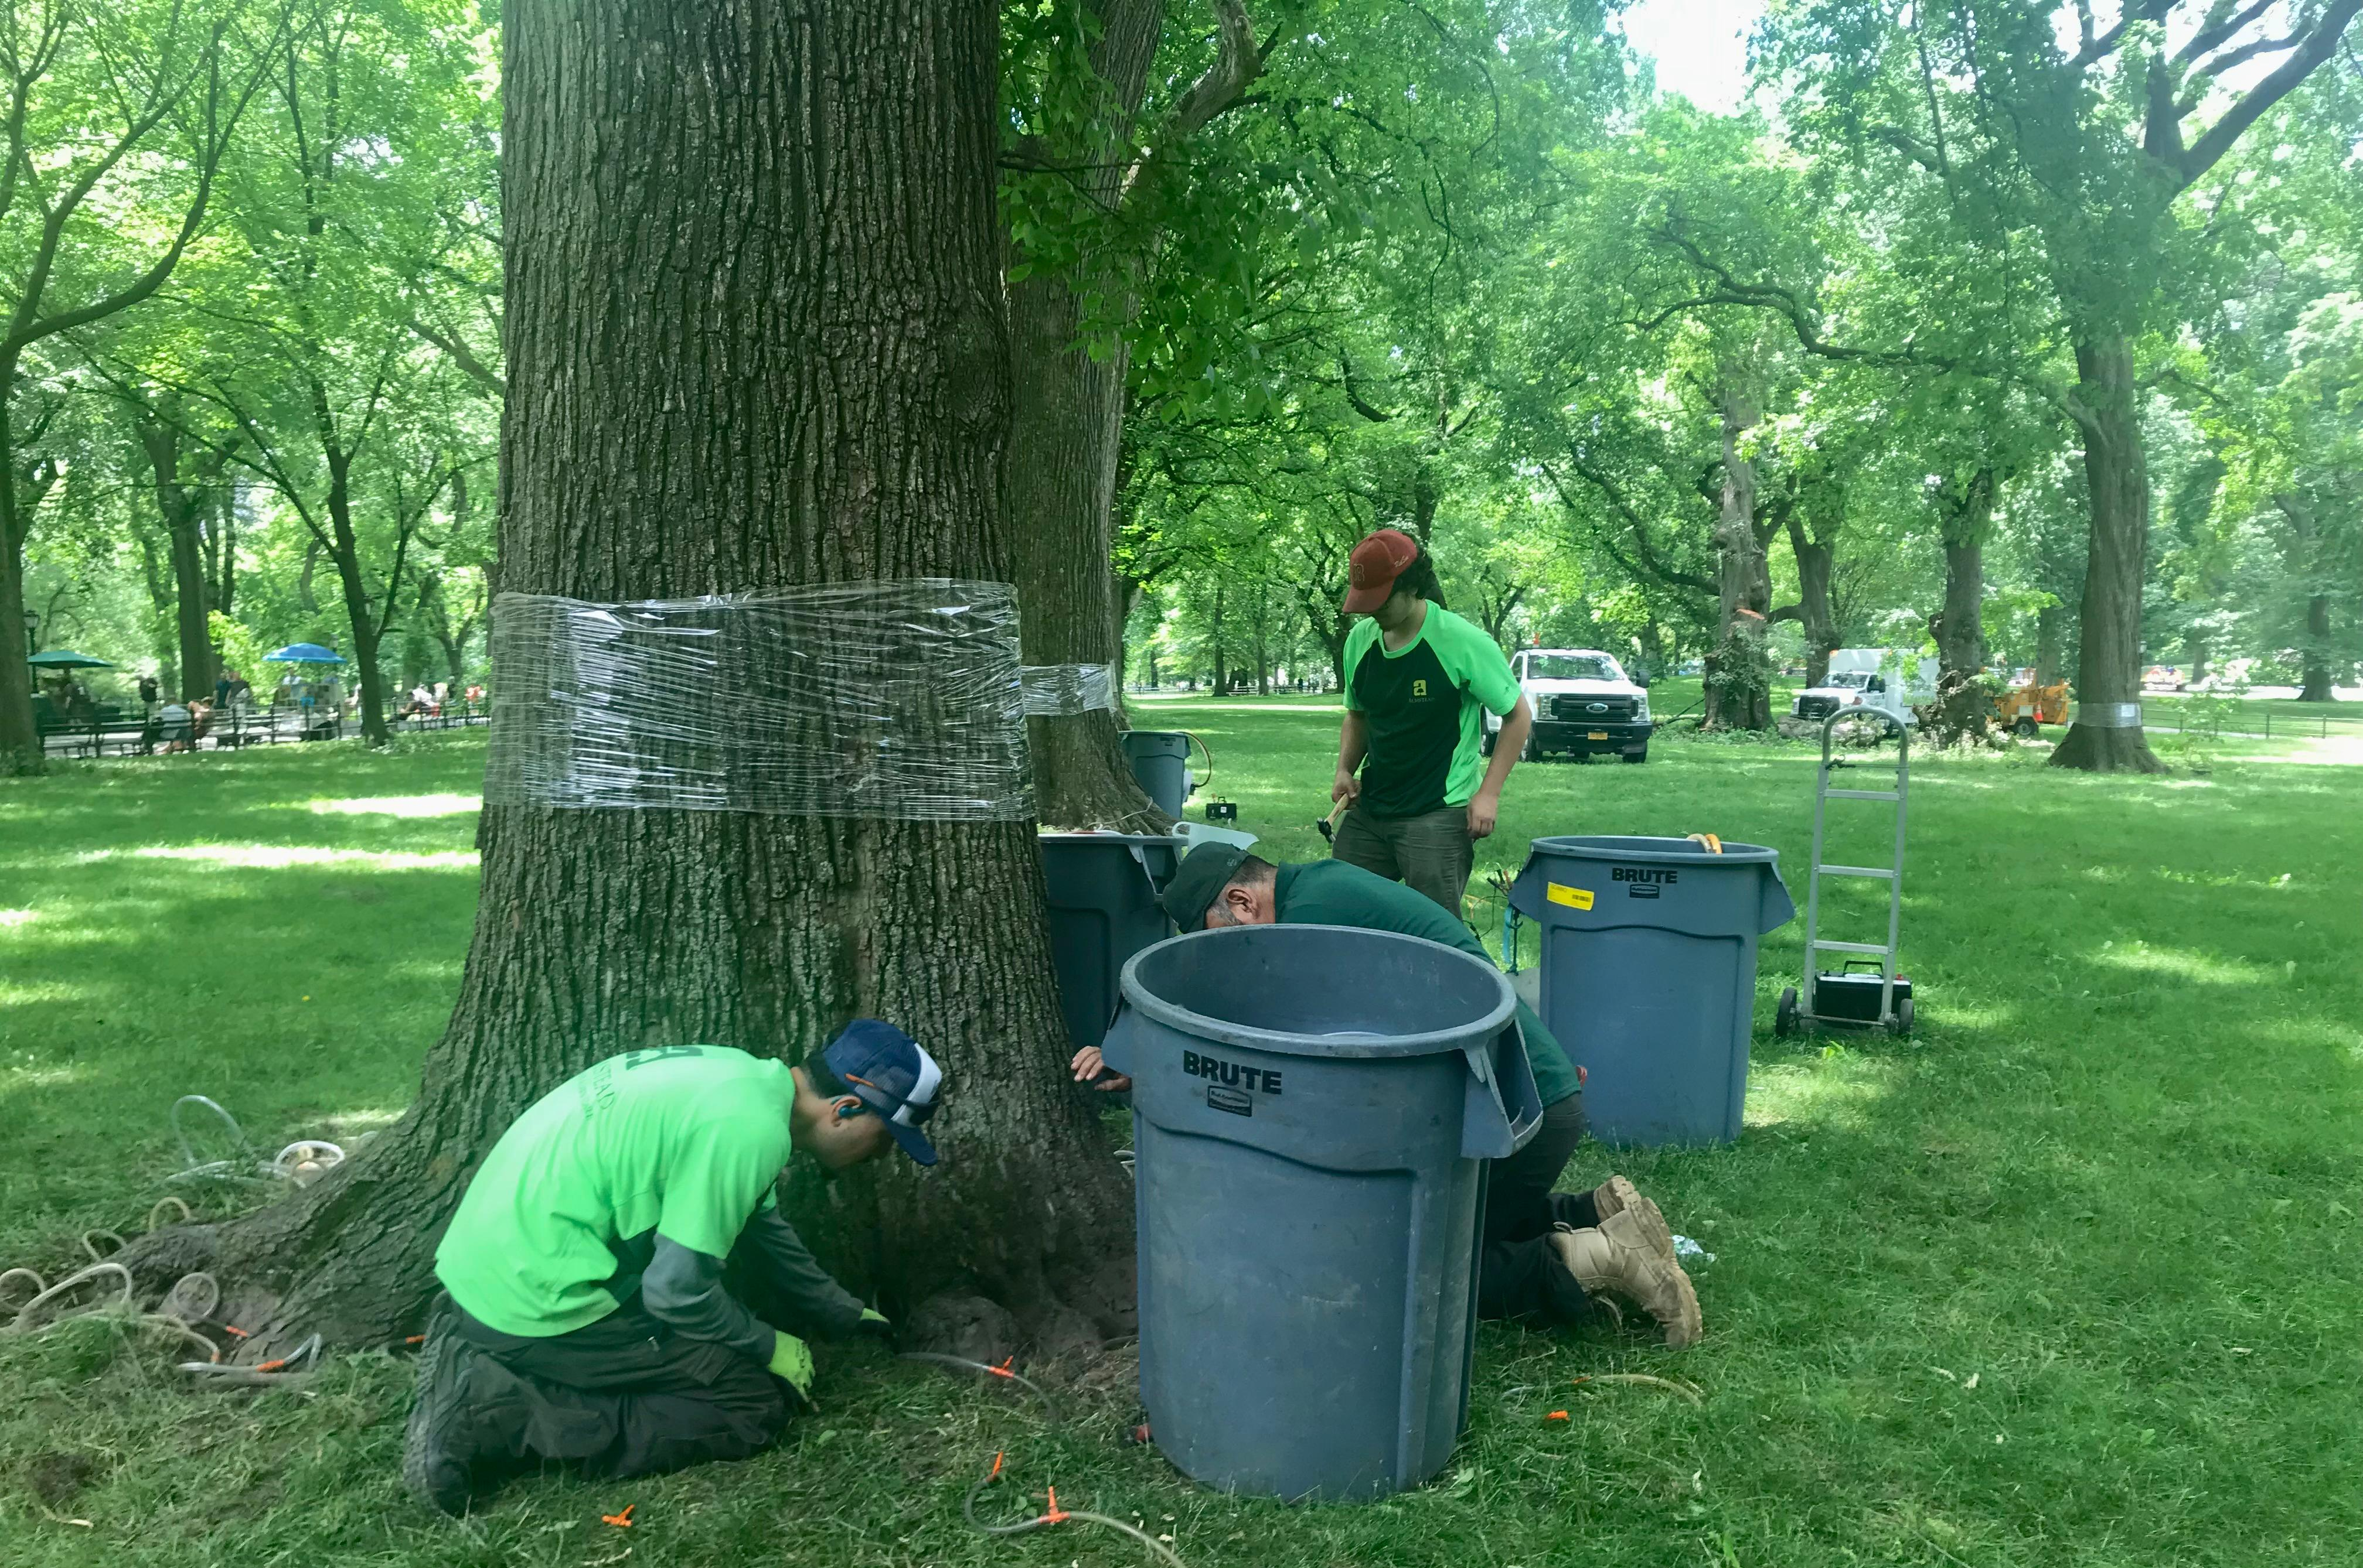
Community Concerns
Preservation of an urban ecosystem
The iconic American elm endangered by Dutch elm disease (DED)
Integration of remote sensing techniques to inform decisions about forest and pest management
Image Credit: Kayla Paramore
Notes:
The Conservancy established its relationship with DEVELOP and initiated this project over several key concerns. Essential to their mission is preserving the unique urban ecosystem of the park. There are over 18,000 trees in the park composed of 170 species that provide vital ecosystem and human services. However, preservation is complicated by diseases and pests that threaten the urban forest. One species, the American elm, is vulnerable due to the spread of an invasive fungus that causes Dutch elm disease (DED). The fungus is spread through insect vectors like the Elm bark beetle, and the resulting DED infection is swift and severe. The American elm is a culturally significant tree species loved for its grand canopies and shade that once lined the streets of many American cities, but it has been endangered due to the devastating spread of DED. However, thanks to the efforts of the Conservancy, Central Park is home to one of the largest and last remaining collections of American elm in the world.
Caring for these elms is not a simple or easy task. The Conservancy takes an active approach to monitoring and preventing the spread of DED in what is known as integrated pest management. This approach uses up to date and comprehensive information on the life cycles of pests like Elm Bark beetle and their interactions with the environment. The Conservancy seeks to further mitigate the impacts of the beetle and DED by integrating remote sensing techniques into its decision-making process. The goal is to be able to use Earth observations to make more informed decisions about forest and pest management. The Conservancy is also concerned with the timing of land surface phenological processes and how this is affected by climate change.
----------Image Information Below----------
[Pest management in The Mall at Central Park]
Image Credit: [Kayla Paramore]
Image Source: [DEVELOP Team]

Slide 5
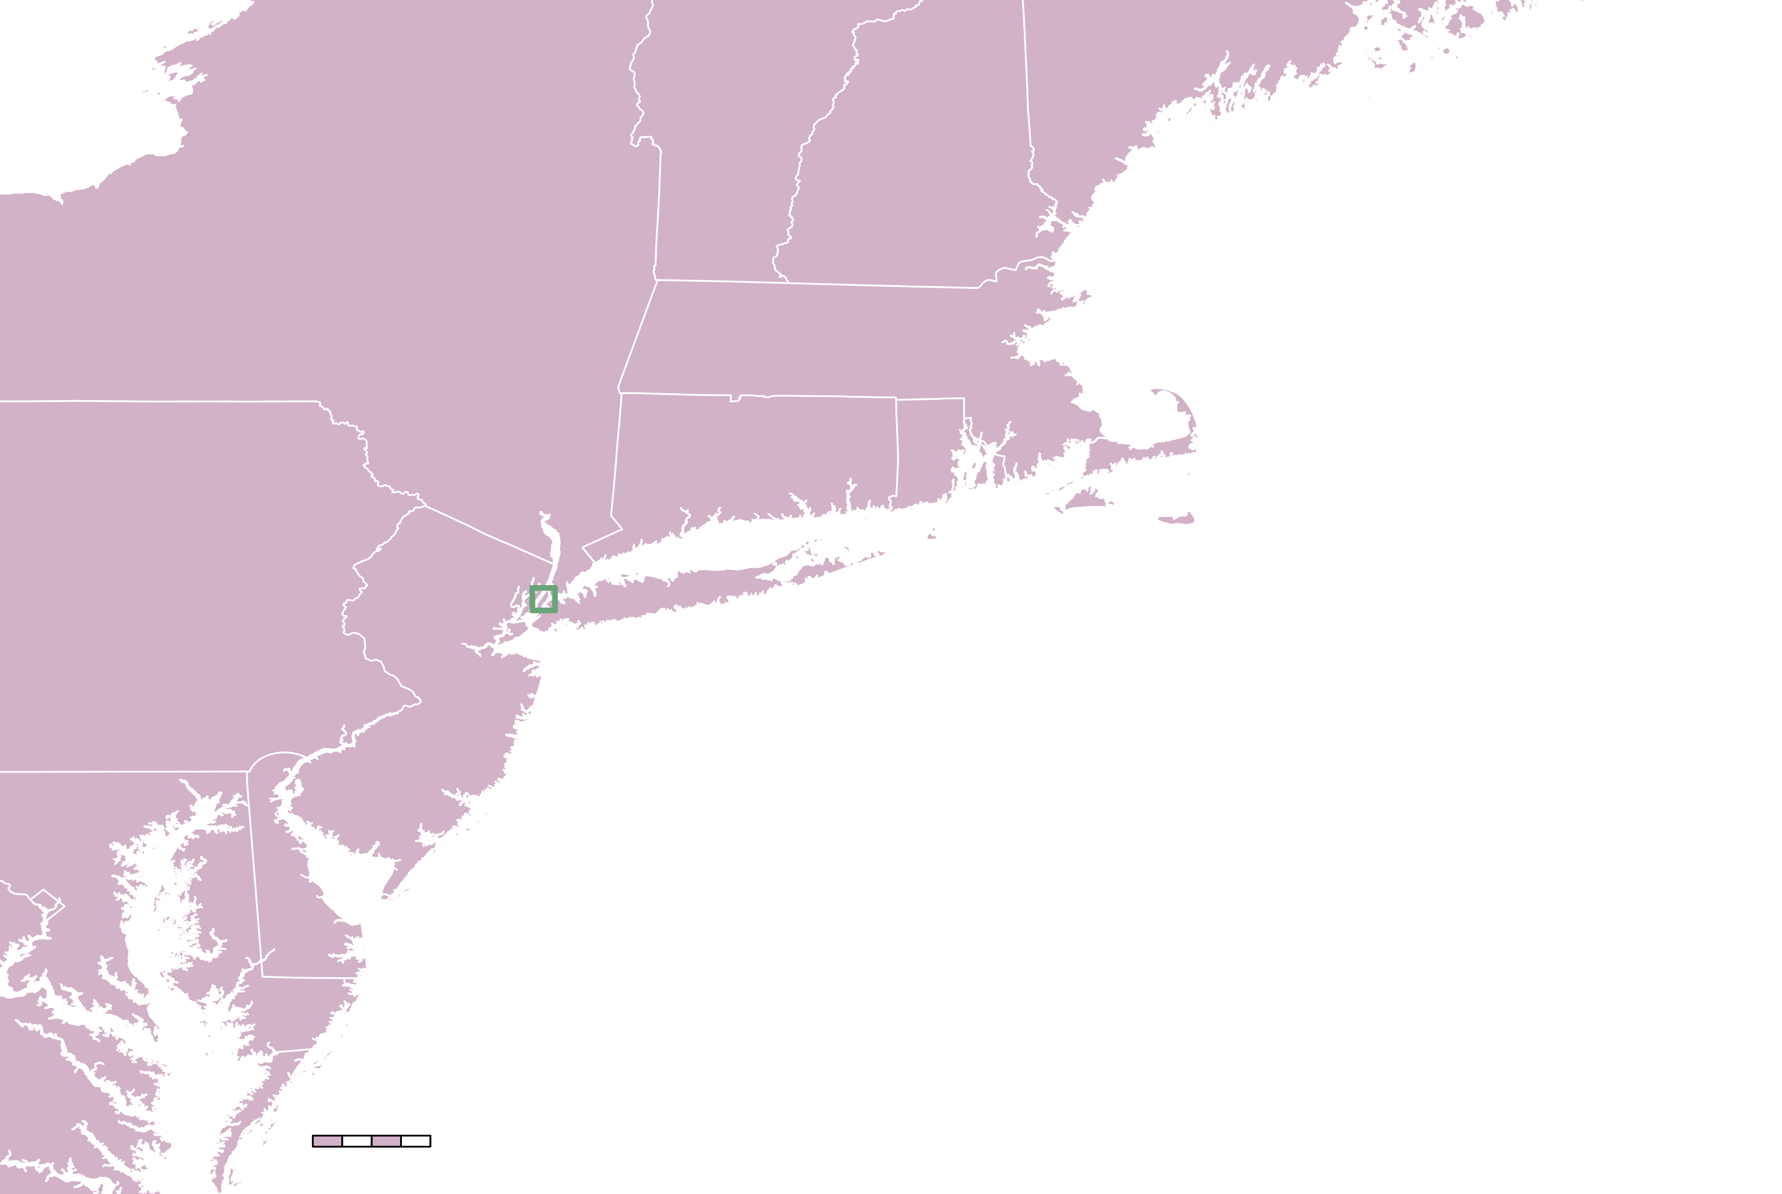
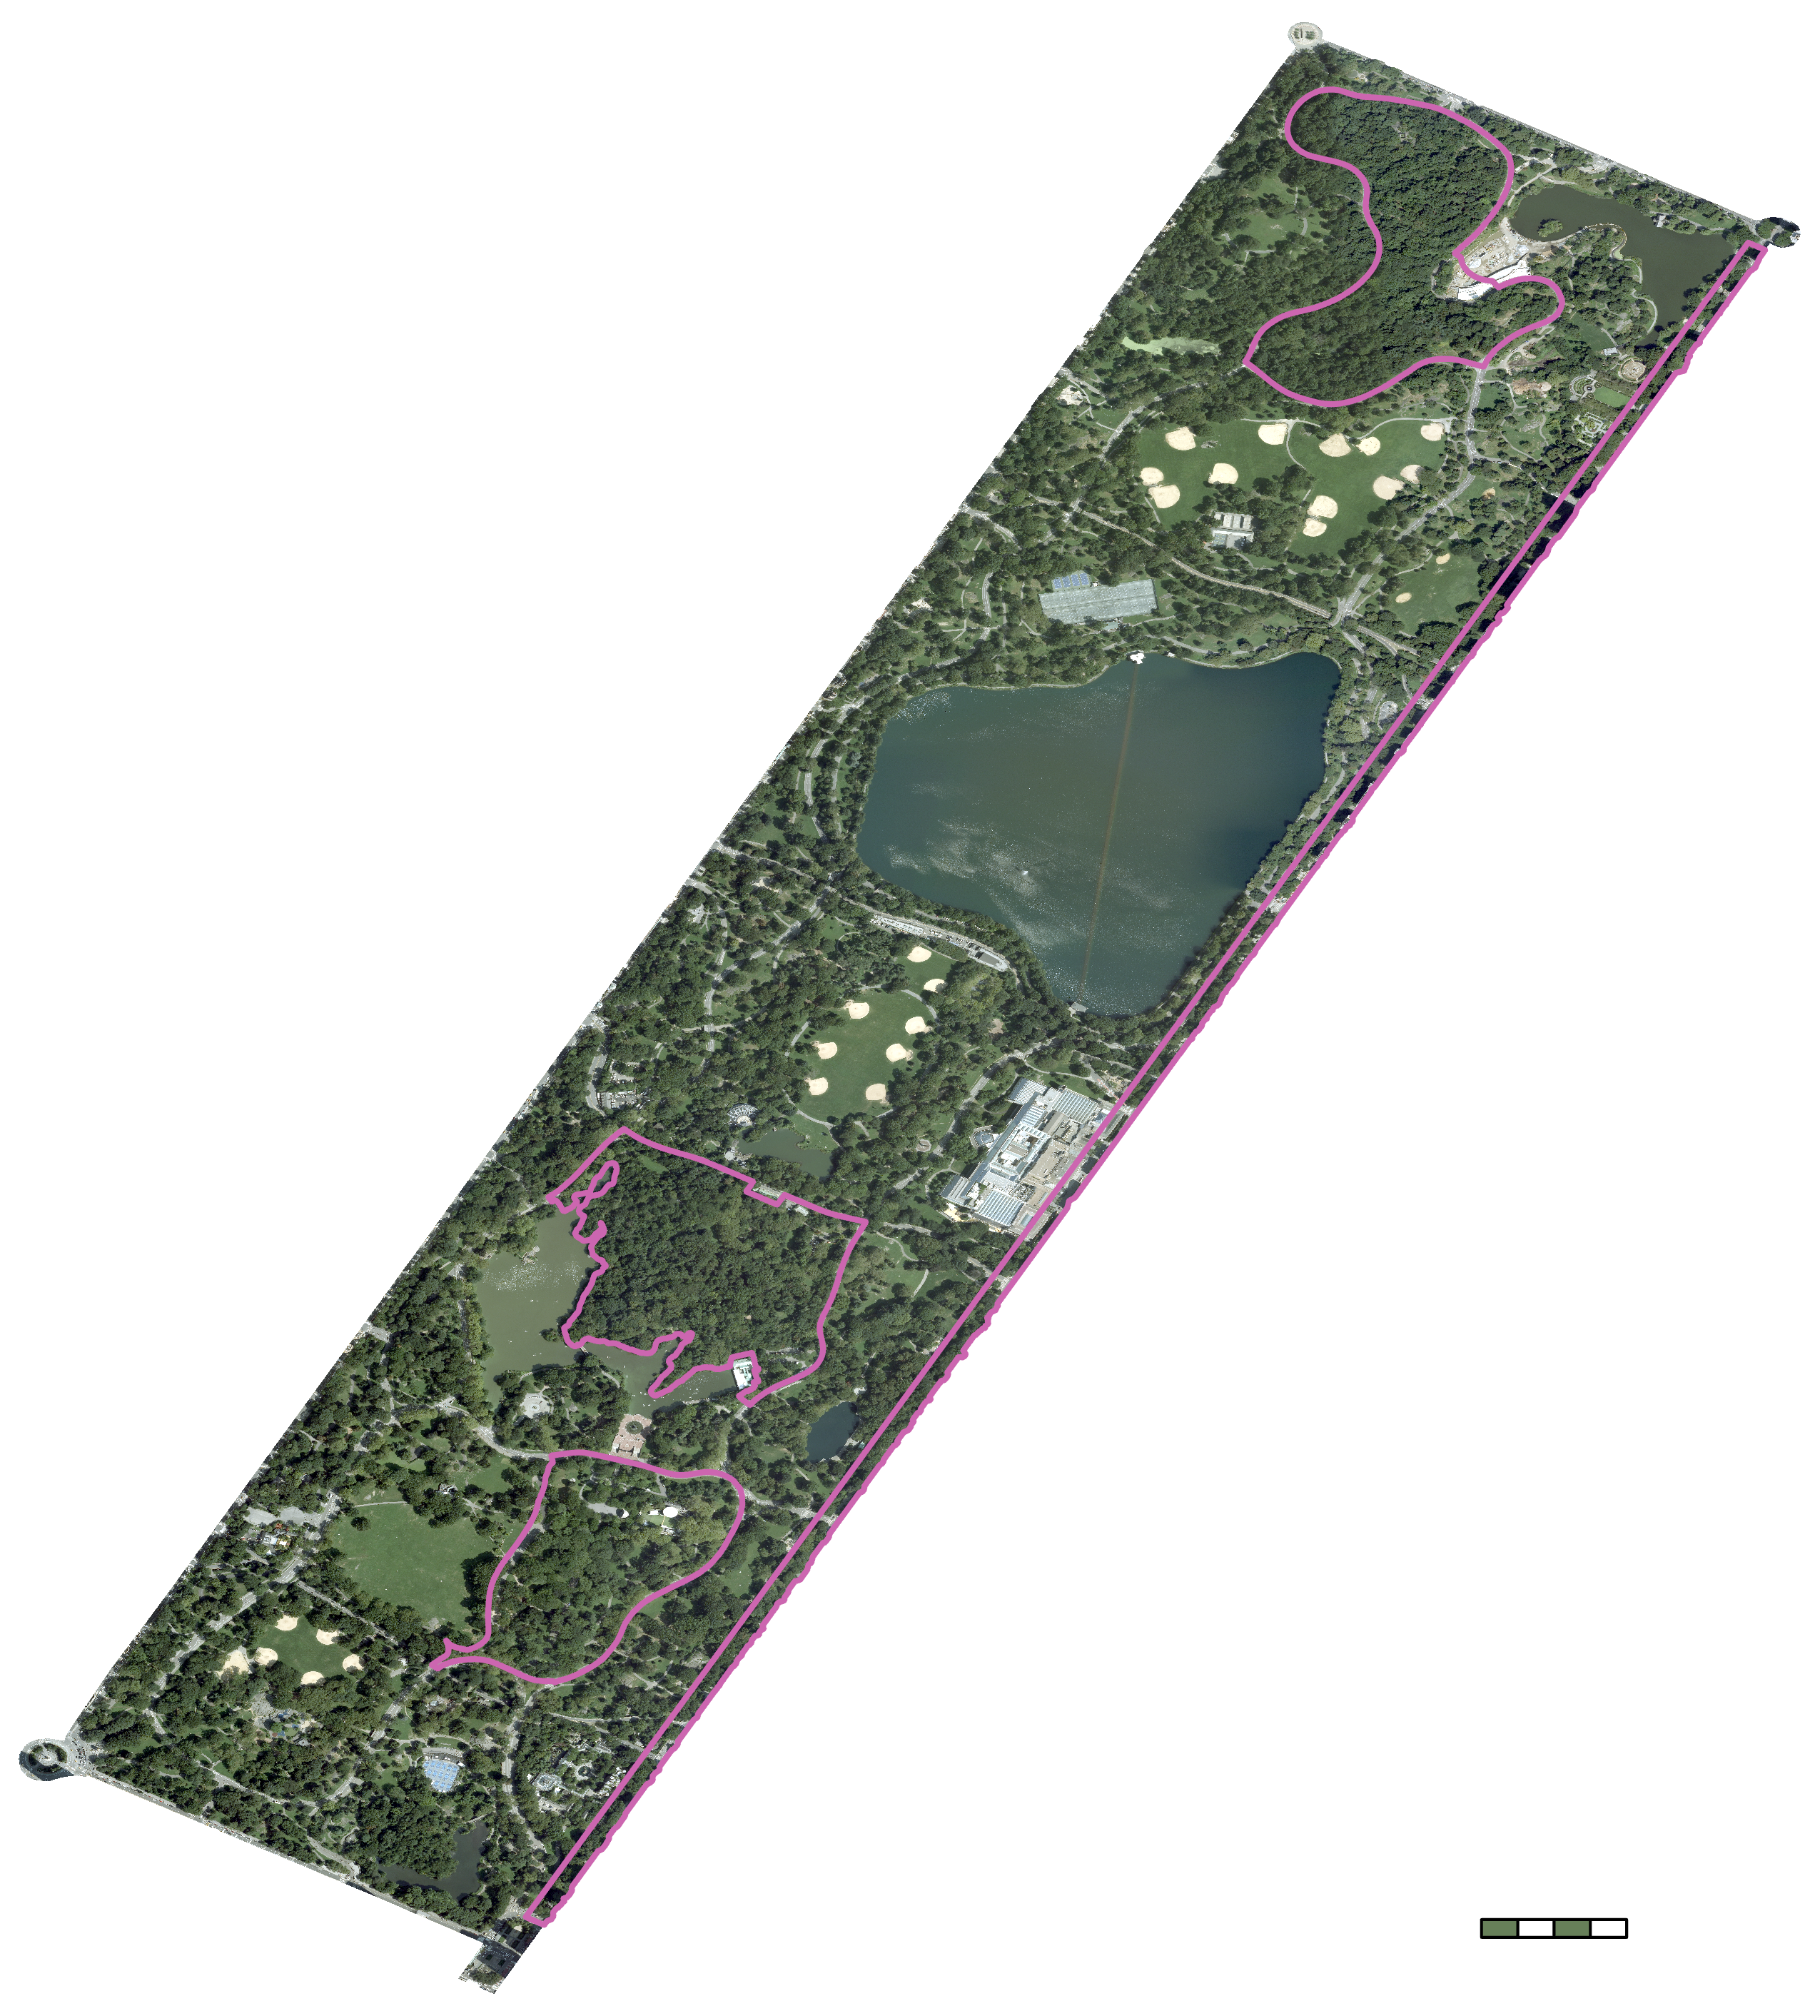
Central Park
The
North
Woods
The Ramble
Fifth Avenue
Study Area
843-acre park
Approximately 1,600 elms concentrated among four zones
Study Period: 2014 – 2023
The Mall
─ Areas of
interest
N
0
50
0
1000
miles
feet
Basemap Credit: US Census
Basemap Credit: NAIP
Notes:
Our study area encompassed all 843 acres of the park. Central Park itself has been a part of New York’s cityscape for more than 160 years, and every year it receives more than 42 millions visitors. The Park provides vital ecological services for the city and its residents, regulating heat, absorbing and filtering rainwater, producing oxygen, and storing carbon. Since our project was interested in detecting DED, we focused our analysis on four areas of the park with high concentrations of American elm – The Mall, The North Woods, The Ramble, and Fifth Avenue. Our study period goes back to 2000, looking at changes in the vegetative health of the park over a 23-year period with a focus on the vegetative season in the spring and summer months.
----------Image Information Below----------
[Left map]
Map Credit: DEVELOP Team
Layer Credits: US Census state polygons
[Right map]
Map Credit: DEVELOP Team
Image Credits: USDA NAIP imagery accessed from USGS

Slide 6
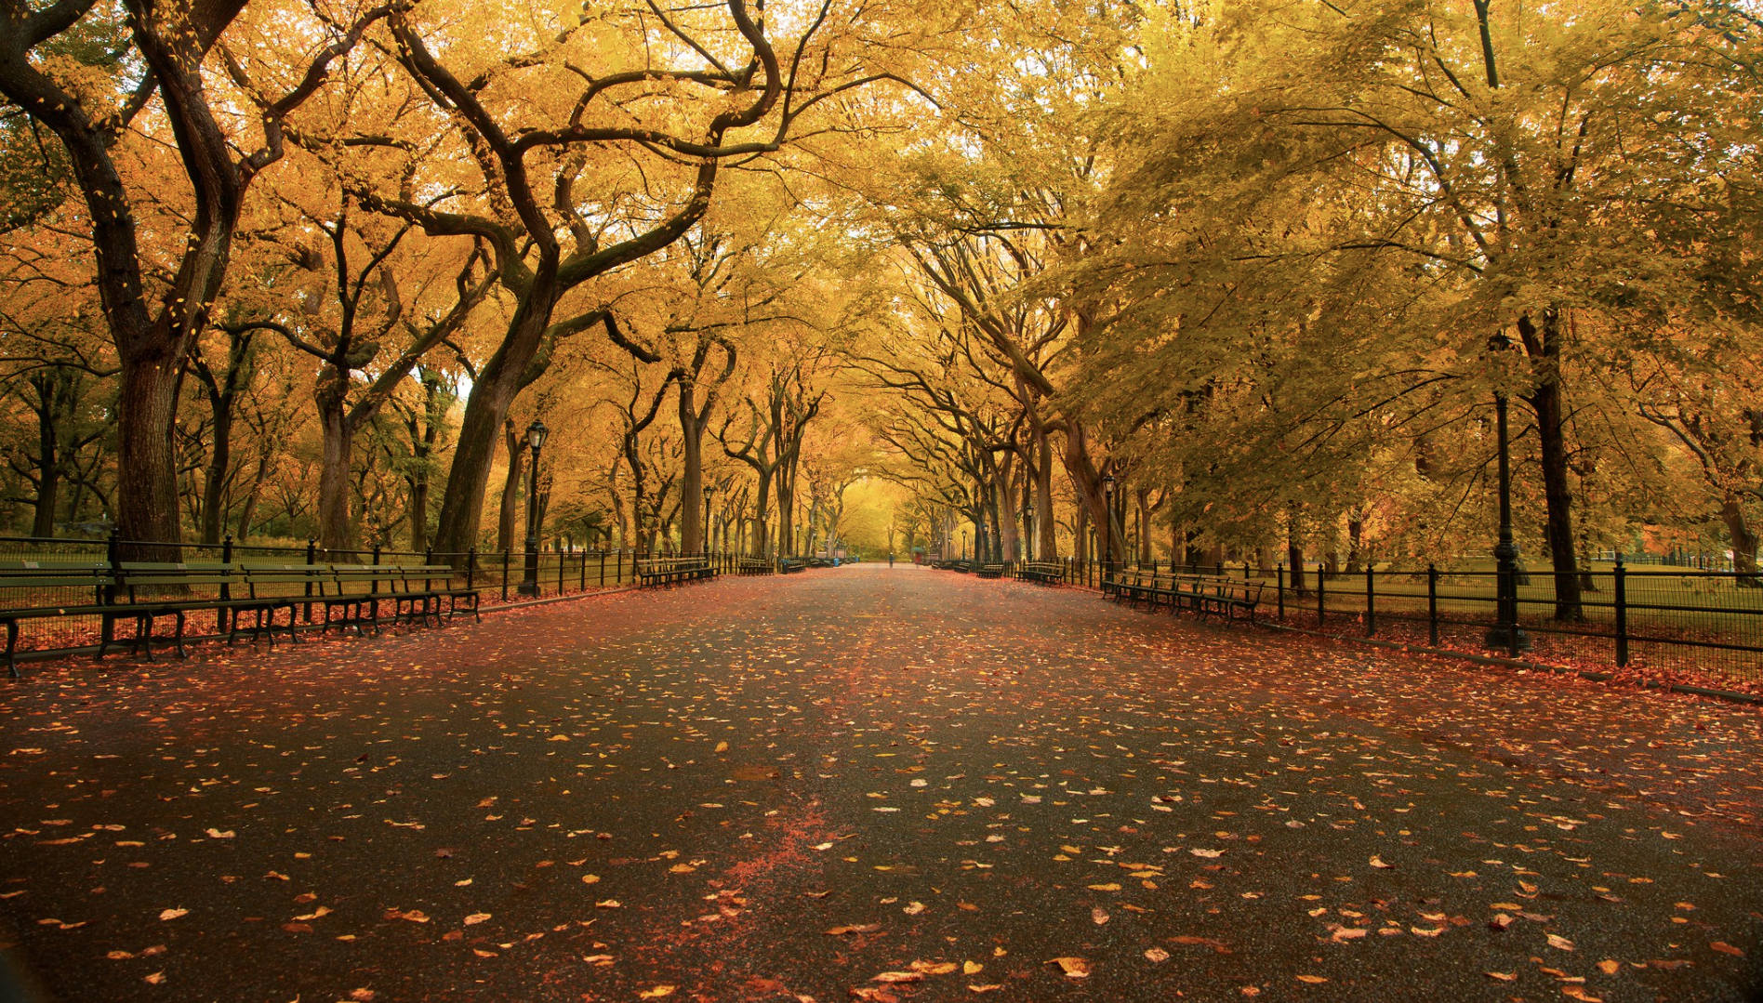
Objectives
1
Quantify changes in phenology from
2014 to 2023 using Landsat 8/9​
2
Understand the spread factors of DED
Validate the detection of tree health status and DED occurrences
3
Image Credit: Chris Ford
Notes:
The first objective of our project was to monitor and quantify changes in land surface phenology and tree health from 2014 to 2023 using imagery from Landsat 8 and 9. Since DED is spread by insect vectors like the elm bark beetle, it was also our objective to understand this spread, its phenology, and how its timing relate to temperature and precipitation. Our final objective was to validate the detection of tree health status via remote sensing with known occurrences of DED recorded by the Conservancy.
----------Image Information Below----------
[American Elms]
Image Credit: [Chris Ford] [CC BY-NC 2.0]
Image Source: [https://www.flickr.com/photos/chrisschoenbohm/6288866486]

Slide 7
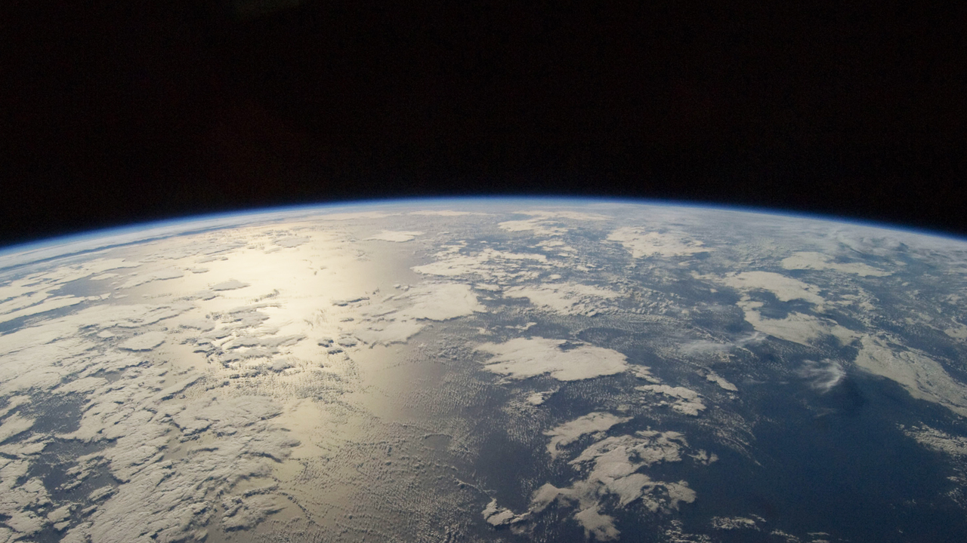
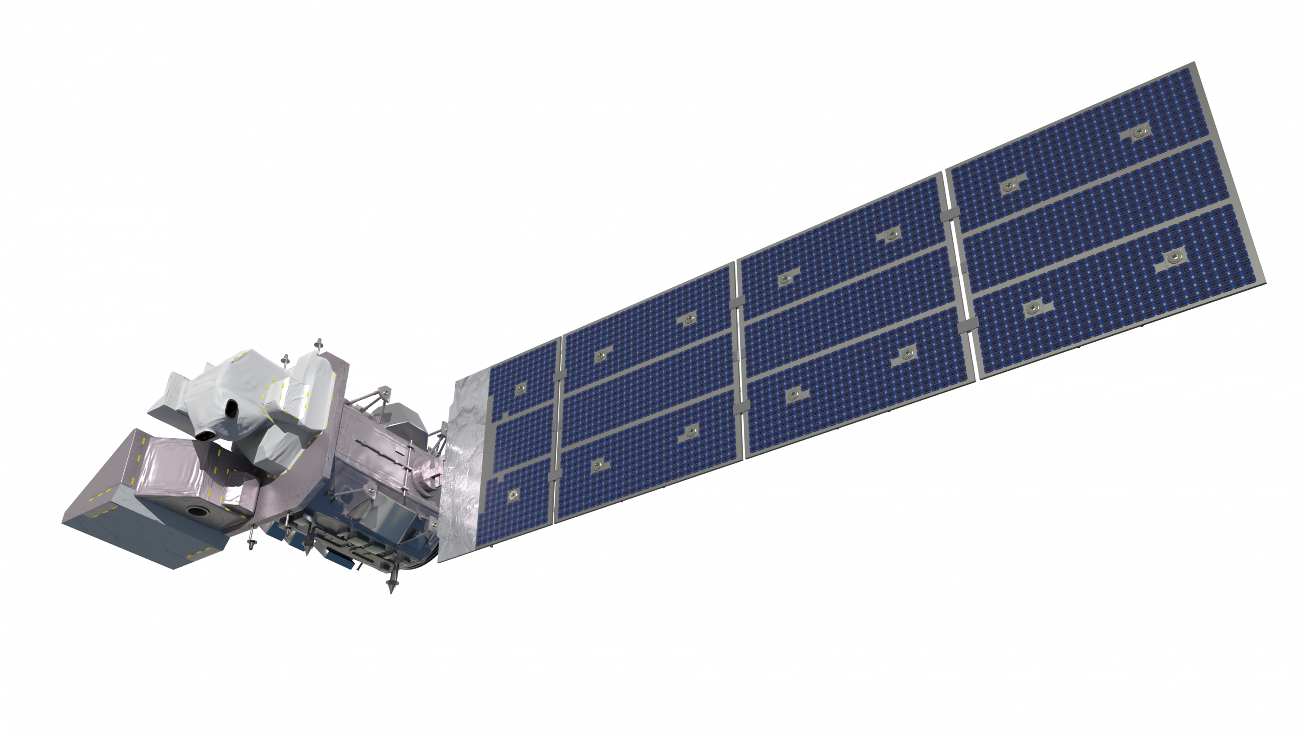
Earth Observations
Landsat 9
Landsat 8
Operational Land Imager-2 (OLI-2)​
Operational Land Imager (OLI)​
Image Credit: NASA
Notes:
In our study we mainly utilized two satellite data collections. We utilized Landsat 8 and 9. Landsat 8 and 9 both have spatial resolutions of 30m2. This roughly means that each pixel of the image represents a real world space of 30x30m2. Furthermore, since these sensors offer the highest ratio of temporal to spatial resolution, we decided this would be the best path forward for determining whether or not this project would be feasible utilizing NASA data.
----------Image Information Below----------
[Earth Image]
Image credit: NASA Johnson Space Center/Image Science & Analysis Laboratory
Image source: https://svs.gsfc.nasa.gov/11348/
[Landsat 8]
Image source: NASA
Image credit https://science.nasa.gov/multimedia/spacecraft-icons/
[Landsat 9]
Image source: NASA
Image credit https://science.nasa.gov/multimedia/spacecraft-icons/

Slide 8
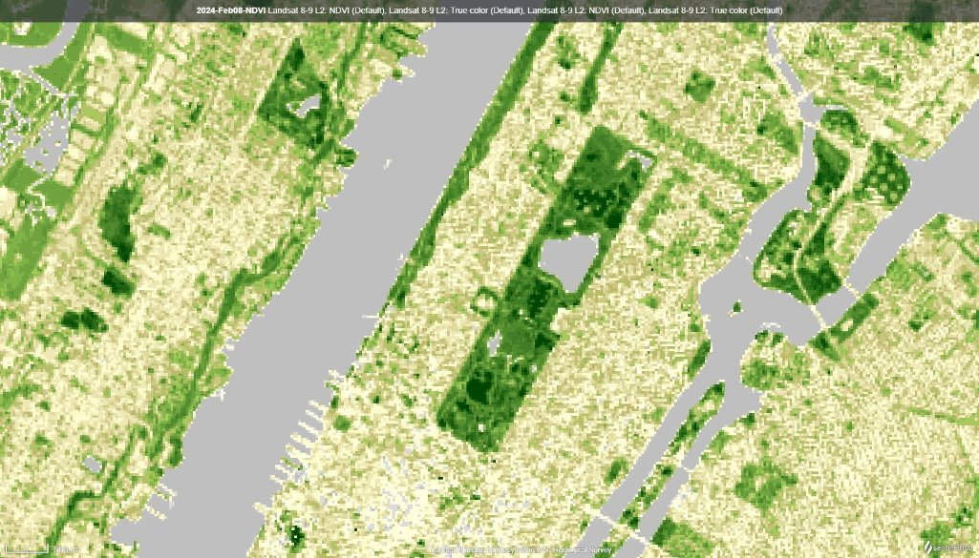
Remote Sensing Data Products: NDVI
Normalized Difference Vegetation Index (NDVI)
HEALTHY
STRESSED
50% NIR
8% RED
40% NIR
30% RED
NDVI = 0.72
NDVI = 0.14
NIR - RED
February 8, 2024
Legend
NDVI =
July 2, 2024
1
NIR + RED
0.5
Icon Credit: Sketchify
Image Credit: EO Browser
0.001
Notes:
NDVI is an acronym for the normalized difference in vegetation index. In simple terms, this uses specialized instruments on the satellite, specifically the red wavelength and the near infrared wavelength to analyze the health or condition of vegetation. NDVI is a ratio that ranges from –1 to 1. An NDVI of 1 indicates very strong, healthy vegetation where as an NDVI at –1 indicates no vegetation, bare soil, concrete, or asphalt. This is a standard index that GIS users employ to analyze and study vegetation over time. The data used to create the maps on this slide are from Landsat 8 & 9 NDVI.
----------Image Information Below----------
[Satellite Images]
Image credit: EO Browser
Image source: sentinel-hub.com, https://apps.sentinel-hub.com/eo-browser/?zoom=14&lat=40.78434&lng=-73.97249&themeId=DEFAULT-THEME&visualizationUrl=U2FsdGVkX1%2FCO3CLNWB36IvoOyyMs9oQQ0PBN5Mhwwt6Gg%2BOlj7GkFxbSjZD8yCQvaOB7zsmETrco266W5aQFp5wmbX92653DThxOhgqsGxdaD44aVqP1hNKRoSKzZIv&datasetId=AWS_LOTL2&fromTime=2024-07-02T00%3A00%3A00.000Z&toTime=2024-07-02T23%3A59%3A59.999Z&layerId=4-NDVI
[Branch Icons]
Image credit: @sketchify
Image source: https://www.canva.com/icons/MAE1wtTVfEg-hand-drawn-leaf/

Slide 9
In Situ Data Products: Weather Data
Temperature
Max Temp + Min Temp
Growing Degree Days (GDD) =
- Base Temperature
2
Max Temp + Min Temp
Elm Bark Beetle GDD =
- 52F
2
Notes:
Growing degree days are used to determine the growth and periodicity of different animals and vegetation. Simply put, GDD is a unit that calculates the cumulative amount of heat that has been experienced throughout a season. Often this is calculated as [ (Max Temp + Min Temp) / 2 ]-Base Temp. The emergence of elm bark beetles can be predicted utilizing this method, therefore the onset of DED occurrences can also be predicted using the periodicity of elm bark beetles' life cycle.
GDD was calculated using daily minimum and maximum temperatures recorded over our study period at the NOAA/NWS weather station located within Central Park. The daily temperature summaries for this station can be found here: https://www.ncdc.noaa.gov/cdo-web/datasets/GHCND/stations/GHCND:USW00094728/detail.
[Corn, Beetle, Pumpkin]
Icon Credits: Microsoft Office Clip Art

Slide 10
Methodology
Remote Sensing Data
In Situ Data
Data Acquisition
Landsat 8
Landsat 9
Weather Station
CPC Surveys
NDVI
Temperature Precipitation
Tree Health Status
Data Analysis
Vegetation Seasonal Trends & Peaks
Cumulative
Growing Degree Days
DED Occurrences
Data Validation
Land Surface Phenology
Validate DED Detection
Decision Making
Forest Change Detection
Central Park Pest Prediction/Management Plan
Notes:
The NDVI imagery was used in our study in two ways. First, as shown on the left side of the diagram, NDVI was used to analyze land surface phenology, or in other words, to monitor seasonal changes in the park. The ten year catalog of images were made into a time series and from this, seasonal metrics like the start of season and peak vegetation were calculated. These metrics were then compared over time to see how the timing of seasons may or may not be changing in Central Park.
Second, The Landsat 8/9 NDVI data was used along with weather data and Central Park's record of Dutch Elm Disease cases in the park, to attempt to build a model that could help to identify cases of Dutch Elm Disease. First, temperature data was gathered to calculate Growing Degree Days, which are used in agriculture to determine when in the year invasive pests will reach maturity. Second, the growing degree days and precipitation data were compared to Central Park's record of past cases of DED to attempt to identify any patterns. Then, the critical step: the team performed systematic sampling and statistical analysis in order to validate whether or not Landsat was able to detect past cases of Dutch Elm Disease.
(If validation is successful, a prediction model integrating these variables is developed to forecast beetle attacks and recommend preventive measures. If validation is unsuccessful, recommendations are made for data and methodological improvements.)
Both of these workflows were designed to provide more information to aid in Central Park's 7-Year Tree Management Plan.

Slide 11
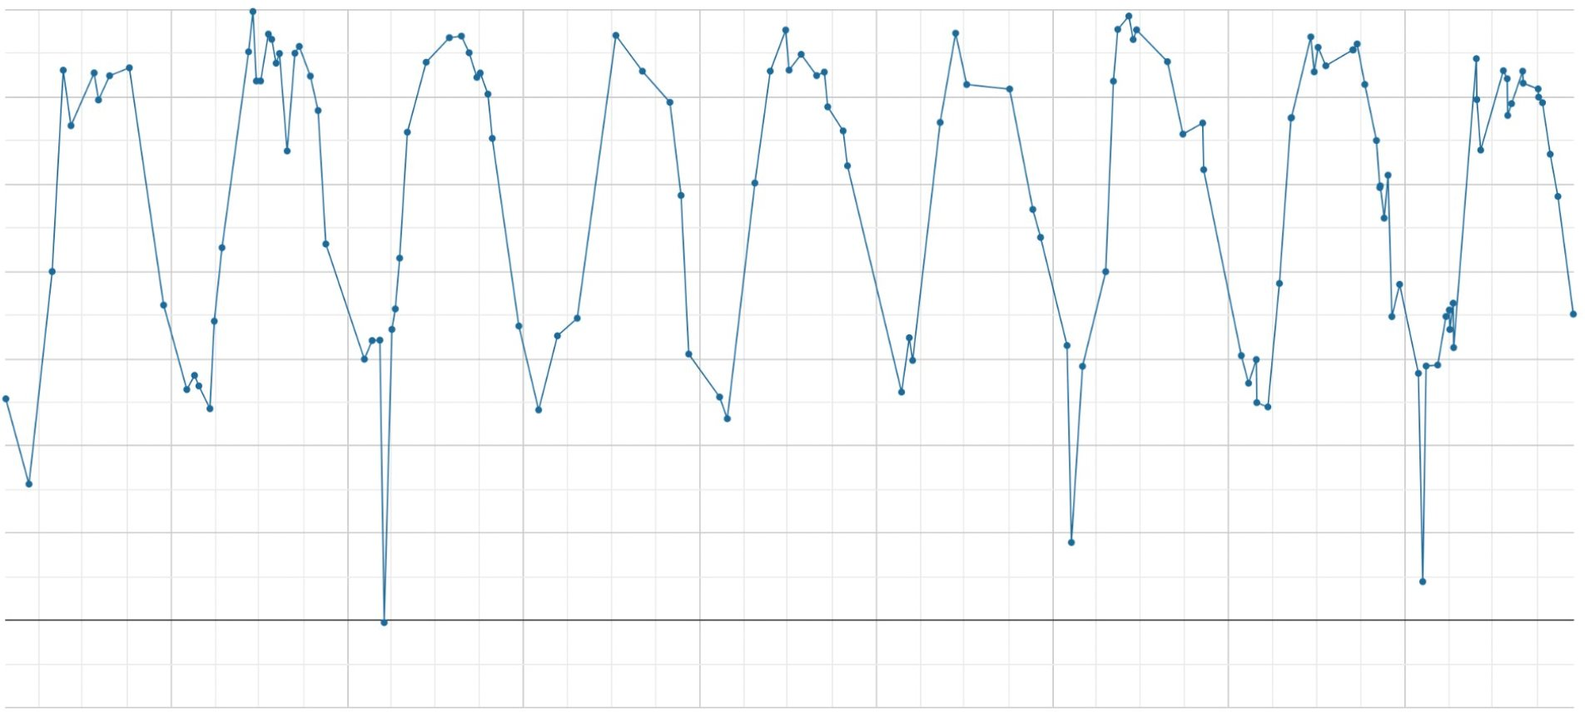
Results | Land Surface Phenology
Central Park NDVI Time Series – Landsat 8 & 9
Maximum
0.7
0.6
Analyzing GIS data temporally by average pixel values ​
0.5
NDVI
0.4
0.3
0.2
Minimum
0.1
2016
2017
2018
2019
2020
2021
2022
2023
YEAR
Notes:
These are the NDVI values for the whole park since 2015. You can see that an increase in NDVI begins each year in the spring, and the values reach their lowest points around January and February. You can begin to see the phenological timing of the park, and which years had early or late vegetative growth. Encircled areas of the graph denote overall maximum and overall minimum.

Slide 12
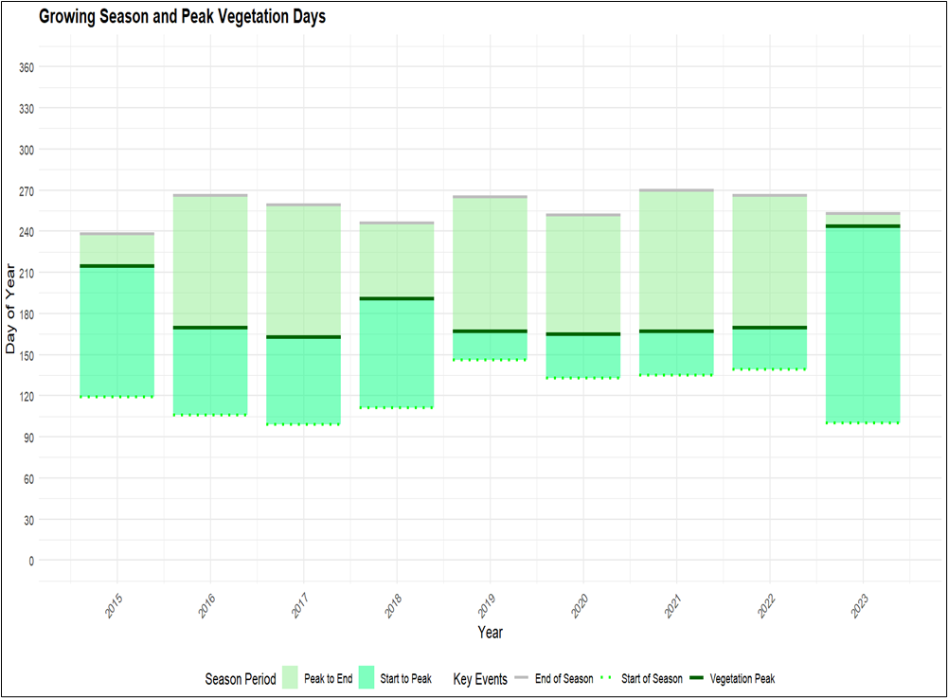
Results | Land Surface Phenology
Estimated Growing Season and Peak Vegetation Days
360
330
300
270
Peak to End
240
Start to Peak
210
End of Season
180
Day of Year
Vegetation Peak
150
Start of Season
120
90
60
30
0
2015
2016
2017
2018
2019
2020
2021
2022
2023
Year
Notes:
This chart shows the beginning and end of the vegetative season each year. Peak greenness of each season is marked by the dark green line with in each bar. The start of season held relatively steady from 2019 to 2022, but looking across the eight year period, start of season has fluctuated by more than a month, according to NDVI data.

Slide 13
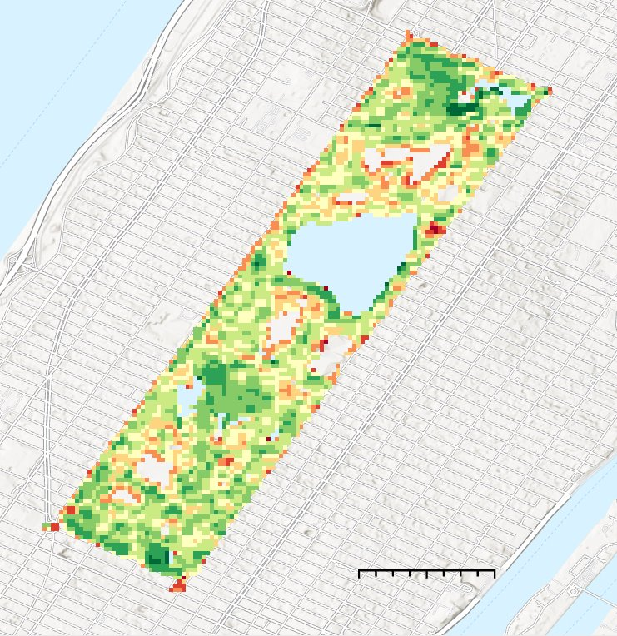
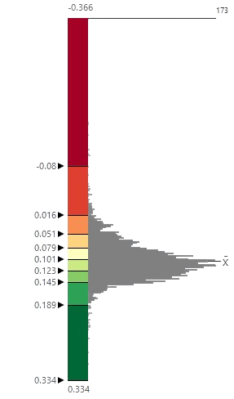
Results | Land Surface Phenology
173
-0.366
Decrease in NDVI
2019 Vegetative Season Compared with the
10-year Mean
-0.08
0.016
0.051
0.079
No
Change
0.101
0.123
0.145
0.189
N
1km
Increase in NDVI
0
0.5
0.334
Basemap Credits: NYC OpenData, New Jersey Office of GIS, Esri, TomTom, Garmin, SafeGraph, GeoTechnologies, Inc, METI/NASA, USGS, EPA, NPS, US Census Bureau, USDA, USFWS,
Notes:
This map shows how the vegetative season of 2019 (from April through September) compared to the 10-year baseline, which was the average of all vegetative seasons. Most of the park experienced a small increase in NDVI. You can particularly see signs of this increase in some of the more natural areas of the park. Certain smaller areas of the park did decrease in NDVI compared to the average baseline.
Basemap credits: NYC OpenData, New Jersey Office of GIS, Esri, TomTom, Garmin, SafeGraph, GeoTechnologies, Inc, METI/NASA, USGS, EPA, NPS, US Census Bureau, USDA, USFWS,

Slide 14
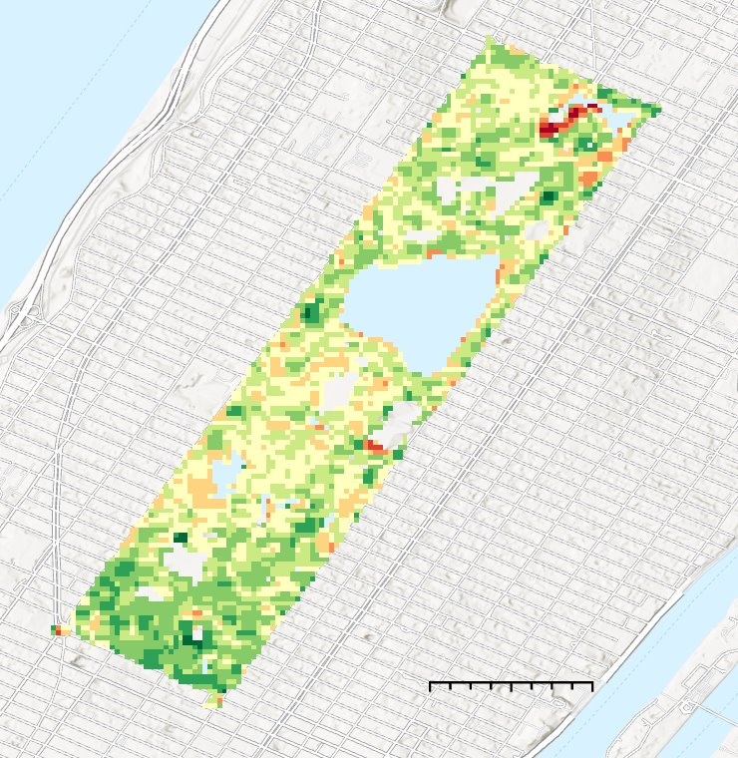
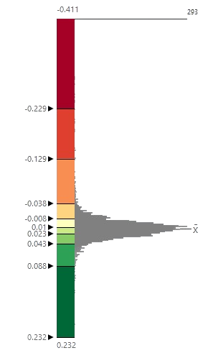
Results | Land Surface Phenology
-0.411
293
Decrease in NDVI
-0.229
2023 Vegetative Season Compared with the
10-year Mean
-0.129
-0.038
-0.008
No
Change
0.01
0.023
0.043
0.088
N
0
0.5
1km
Increase in NDVI
0.232
Basemap Credits: NYC OpenData, New Jersey Office of GIS, Esri, TomTom, Garmin, SafeGraph, GeoTechnologies, Inc, METI/NASA, USGS, EPA, NPS, US Census Bureau, USDA, USFWS,
Notes:
This map compares 2023 to the 10 year mean of all vegetative seasons. Most of the park experienced a small increase in NDVI. You can particularly see signs of this increase in some of the more natural areas of the park. Certain smaller areas of the park did decrease in NDVI compared to the average baseline.
Basemap credits: NYC OpenData, New Jersey Office of GIS, Esri, TomTom, Garmin, SafeGraph, GeoTechnologies, Inc, METI/NASA, USGS, EPA, NPS, US Census Bureau, USDA, USFWS,

Slide 15
Results | Central Park Zones Phenology
Mean NDVI for Each Year by Zone
The Ramble
Fifth Ave
Central Park
North Woods
The Mall
0.6
NDVI
0.4
0.2
2013
2014
2015
2016
2017
2018
2019
2020
2021
2022
2023
YEAR
Notes:
This chart shows which years had the greenest vegetation. 2016, 2019 and 2021 were years that the park was particularly thriving. This could be due to environmental factors like temperature and precipitation levels. It could also be because of different management and care techniques.

Slide 16
Results | Central Park Zonal Phenology
Max Zonal NDVI Over Time
The Ramble
Central Park
Fifth Ave
North Woods
The Mall
0.95
Max NDVI
0.8
0.75
2014
2016
2018
2020
2022
YEAR
Notes:
This chart shows which years had the greenest vegetation. 2016, 2019 and 2021 were years that the park was particularly thriving. This could be due to environmental factors like temperature and precipitation levels. It could also be because of different management and care techniques.

Slide 17
Results | Central Park Zones Phenology
Seasonal Trends in NDVI Utilizing Mean Time Series
0.8
0.6
Non-Vegetative Season
Vegetative Season
NDVI
0.4
2
4
6
8
10
Months
The Ramble
Fifth Ave
Central Park
North Woods
The Mall
Notes:
Looking at the different areas of the park, you can see that they all follow a similar seasonal trend, which makes sense. But you can also see that certain areas of the park have consistently higher NDVI values throughout the year, particularly the natural areas like The Ramble and the North Woods.

Slide 18
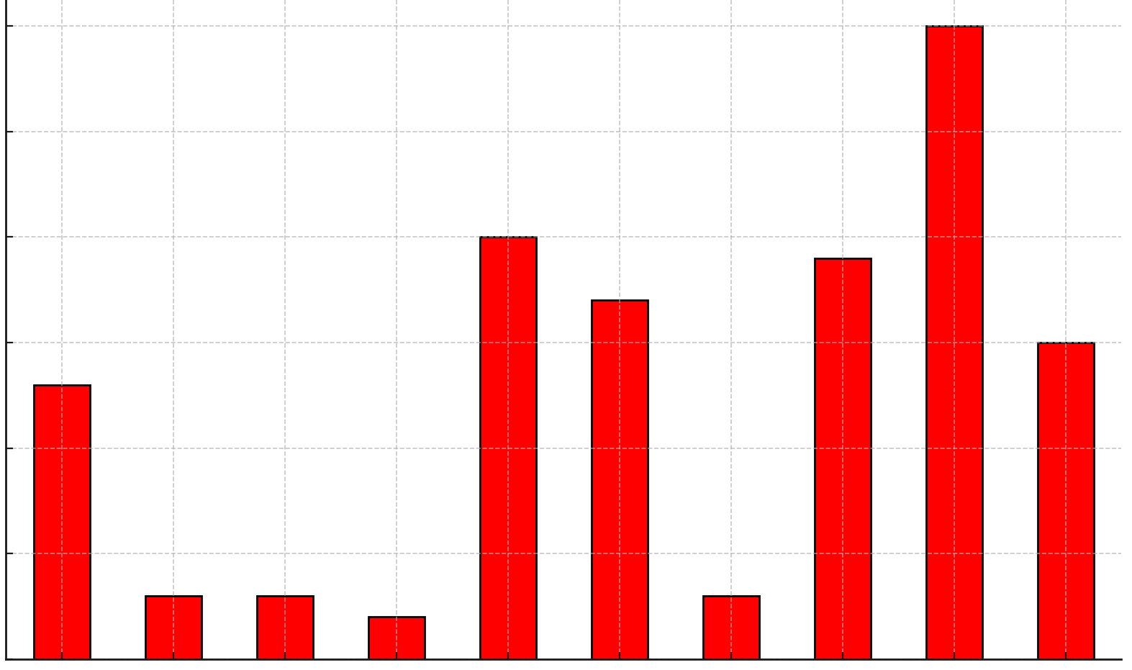
Results | Dutch Elm Disease Spread
Elm Trees Affected by DED by Year for all of CP
30
What is affecting this spread? ​
25
20
Occurrences
15
Specific amount of cumulative growing degree days?​
10
5
Specific amount of precipitation?
2015
2016
2017
2018
2019
2020
2021
2022
2023
2024
Years
Notes:
As we move on we would first like to introduce the data that was provided to us by the conservancy. We carefully examined this data and once more would like to thank Sean and Yanina for their help in acquiring this dataset. After looking through the data and doing a bit of cleaning we created this bar chart so that we could hone in on certain years that had more serious DED outbreaks. As you can see from the graph 2019 and 2023 were amongst the hardest years for the park in managing DED occurrences. DED occurrences are visually confirmed by park management and can include infection at any point on the tree including its limbs, branches, or roots. With this knowledge we compared park-level NDVI before and after the 2019 and 2023 events respectively.

Slide 19
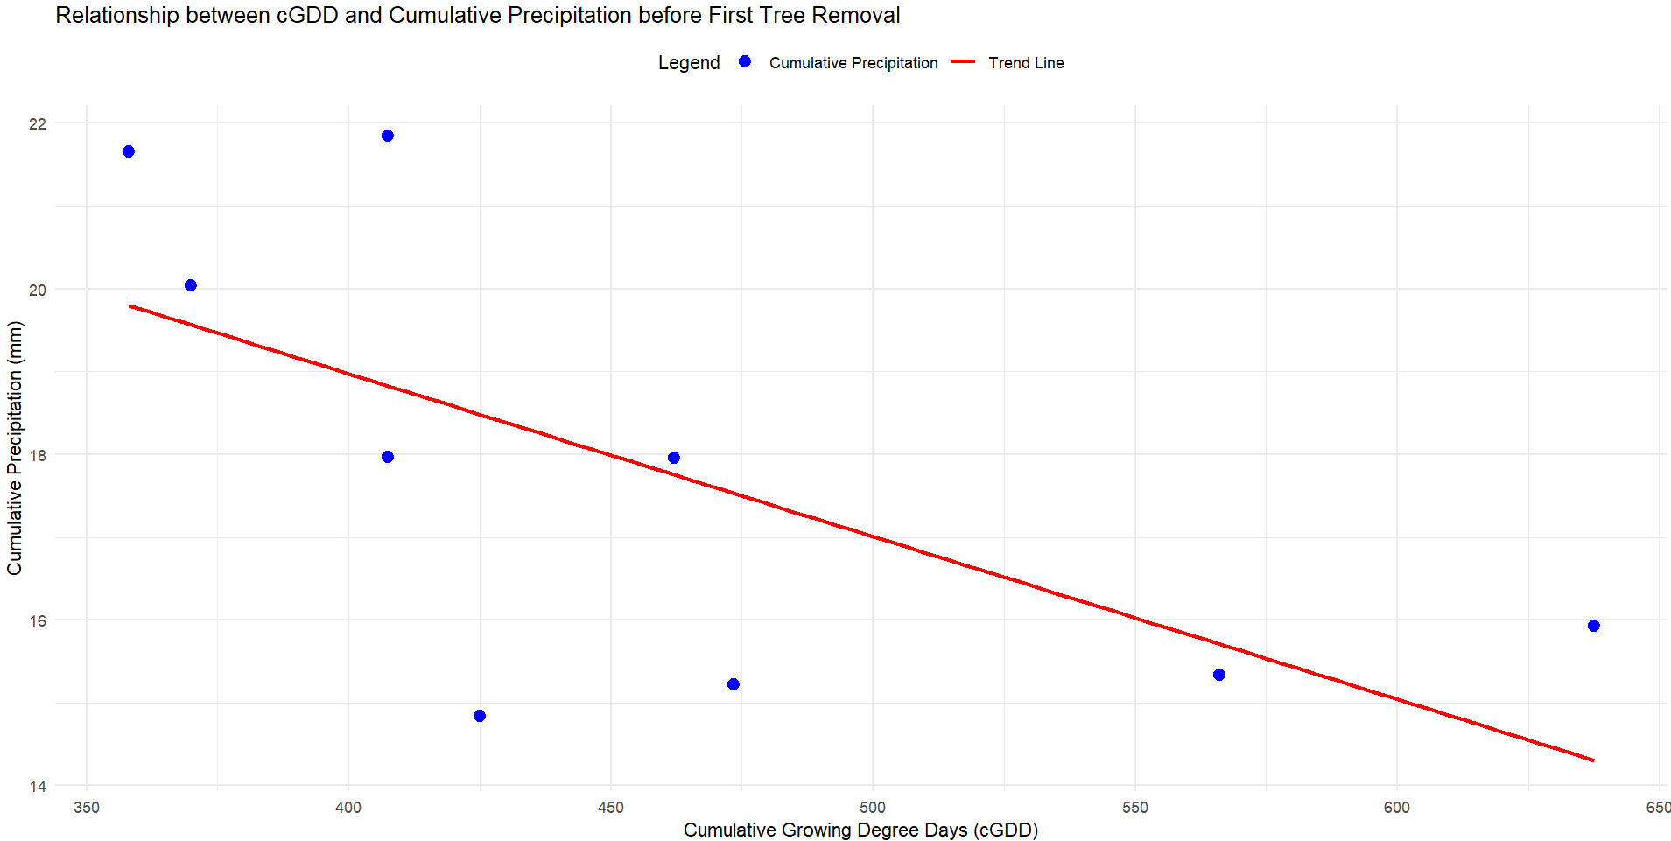
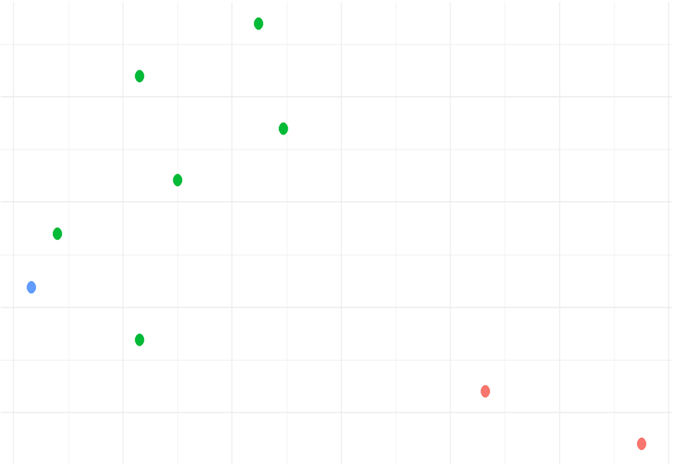
Results | DED Spread Factors
Relationship between cGDD and Precipitation
Validating the Relationship using DRY vs WET Year
2024
22
2022
20
2020
18
Cumulative Precipitation (mm)
Tree Removal Timing
Wet Year – Low GDD
16
2018
14
2016
Dry Year – High GDD
350
400
450
500
550
600
650
350
400
450
500
550
600
650
Cumulative Growing Degree Days
Cumulative Growing Degree Days
Cumulative Precipitation
Trend Line
Year Type:
Dry
Normal
Wet
Notes:
To answer that question, we calculated cumulative precipitation from the start of each year until the day before the first elm tree removal (2015-2023) and compared it with cumulative growing degree days (GDD) using scatter plots.
We observed a negative correlation between cumulative precipitation and GDD before elm tree removal.
So we had to validate the findings with 30 years of precipitation data, to classify years as wet, normal, or dry, and incorporating GDD and removal dates.
We discovered that years with high GDD (late removals) had drier winters, while years with low GDD (early removals) had wetter winters. For normal years, GDD required for beetle spread in Central Park ranged between 400-470.
This underscores the importance of considering both precipitation and temperature factors in managing and predicting beetle outbreaks.

Slide 20
Results | Pixel vs Mean Analysis
Analyzing GIS data temporally by pixel level analysis​
Provide more details about the spatial variability:
30 m x 30 m
N
0
0.5
1km
Basemap Credits: NYC OpenData, New Jersey Office of GIS, Esri, TomTom, Garmin, SafeGraph, GeoTechnologies, Inc, METI/NASA, USGS, EPA, NPS, US Census Bureau, USDA, USFWS,
Notes:
Before we move forward with our presentation in understanding the capability of remote sensing to capture the unhealthy trees before their removal, we would like to briefly introduce the type of analysis that we performed. Since this kind of information can be difficult to conceptualize we included a picture on this slide. Up until this point you could have been thinking of the park as a single identity that we are studying. The study is clearly composed of pixels, we can see the small boxes that make up Central Park and how they all have different colors or values. From here on we are now treating each pixel as its own 30 meter by 30 meter study area. In doing so we can study individual or groups of trees, which would help in observing the pixel's change of NDVI throughout the vegetative season, and this can help to monitor the health status of Elm trees. [ASK A CLARIFYING QUESTION TO MAKE SURE THE AUDIENCE UNDERSTANDS]
Basemap credits: NYC OpenData, New Jersey Office of GIS, Esri, TomTom, Garmin, SafeGraph, GeoTechnologies, Inc, METI/NASA, USGS, EPA, NPS, US Census Bureau, USDA, USFWS,

Slide 21
Results | Pixel Level NDVI Detection
Pixel Level NDVI Change Detection (April – September)
0.4
0.4
0
Change in NDVI
0
-0.4
-0.6
2014
2016
2018
2020
2022
Date
Notes:
Each dot resembles a single 30m2x30m2 area of the park. The NDVI for just this small area was taken for each acquisition creating this scatter plot. On the bottom we tracked how the pixel changed over time. This is done by subtracting the 2nd value from the 1st value to detect the change in NDVI between satellite data acquisitions. Values that represent an increase in NDVI from the previous reading are indicated in deep green while inversely negative values are represented using a dark red. We created this graph to explore areas that had slight decrease in NDVI as we hypothesized that DED would appear as a small NDVI drop in a few pixels within the whole park.

Slide 22
Results | Validation – Logistic Regression
The validation of Landsat 8 and 9 detection using the in situ data (CPC data):
NASA EO detect unhealthy tree canopies with 71% accuracy and healthy tree canopies with 41% accuracy
Recall
Precision
F1. score
0.47
0.37
0.41
Healthy Tree Canopies​
0.67
0.76
0.71
Unhealthy Tree Canopies​
Notes:
The final step of our project was implementing a validation step to ensure that our data was accurate. The validation process consisted of running a logistic regression model. The regression model analyzed the elm canopy’s NDVI. Based on the conservancy data, we told the model where the sick and healthy trees were located. Finally, we ran the model which will then be able to determine whether or not a tree or pixel is considered sick or healthy. The results of the linear regression show that Landsat 8 and 9 were able to detect healthy trees with 41% accuracy and unhealthy trees with 76% accuracy.
243 pixels points, 150 pixels were classified as unhealthy and the remained were considered healthy, this was according to in-situ data. Those 243 pixels were used to train the model and the complete elm canopy pixel dataset was used to evaluate the model. The crowns of the trees being used were not taken into account in the analysis.
The average elm tree canopy spread is 34.89 feet.

Slide 23
Errors & Uncertainties
Time
Space
Methods
Assessing disease impacts alongside pest management interventions
Accuracy of the validation and performance model​
Natural spatial variability of forest
phenology​
Notes:
-Natural variability of forest phenology make analyzing start of season and end of season dates on a yearly time scale difficult. Landsat 8 and 9's temporal resolution had many images within our study area however, there were still not enough to understand yearly phenology with certainty.
-Validation errors could have occurred in two areas. The first is in the operation in which the datasets were joined. Due to slight differences in geographical coordinates of the tree sites and tree task, the team rounded these datasets to the fourth decimal. After this, the data was joined to pixel data which also had different geographical coordinates. This could have misaligned pixels with tree sites and tasks. The second area where an error could have occurred is if dates were incorrectly looped in the logistic regression model. This could have extended the study area beyond the team set cut-off limit for analyzing the pixels for a certain year.
-Finally, due to time constraints, analyzing each image to ensure that the tree tasks aligned with our datasets, we could be detecting a drop in NDVI both due to the removal of a tree and the DED occurrence. We attempted to avoid this issue by only analyzing the NDVI of pixels up to the first remove operation.

Slide 24
Feasibility & Partner Implementation
NASA Earth observations can be used to quantify changes in urban forest greenness phenology
Through validation with in situ data, NASA Earth observations can detect unhealthy tree pixels
Satellite-based forest health monitoring can be used with phenology and DED surveys to improve pest management decisions
Further research is needed to further product validation and improve predictive modeling results needed to aid proactive management
Notes:
NASA Earth Observations (EO) effectively monitor vegetation and land surface phenology, using indices from different satellite bands to understand vegetation change patterns.
These indices can detect spatial and temporal changes and anomalies, aiding in pest and disease detection, as demonstrated by Landsat 8 and 9 in identifying unhealthy trees before elm removals.
This methodology is reproducible for future use, supporting Central Park Conservancy’s management and decision-making. Results may vary based on satellite/sensor type, vegetation indices, and validation methods. Pest predictive models can be applied and enhanced with remote sensing data, weather information, and additional data sources like soil moisture and in-situ surveys.

Slide 25
Conclusions
1
Land surface vegetation greenness phenology fluctuates year to year
2
Differences in NDVI are distinguishable between different forested areas in the park
3
Pixel-based analysis validation results suggest show that Landsat 8 and 9 are potential methods for further assessing the relationship between DED occurrences and NDVI at the pixel level
Notes:
In this slide we will discuss the conclusions of our feasibility study. Firstly, we will discuss the variable change that was observed land surface phenology. As was seen in the graph on Slide 16, the peak of the season seems to be fairly uneven, occurring at different points throughout the year but generally between Days 145-160. Furthermore, we can observe through the graph on Slide 15 that the slope of the increase in NDVI drastically increases between months 4 and 5 showing that this is generally where start of season is observed. Secondly, we will discuss the zonal statistical differences. These results were in line with our hypothesis. We thought that if the zone contained more old forest growth, then the NDVI would be greater than an area with monocultures or isolated elm trees. This was observed with the ramble and the north woods having the highest average NDVI throughout the time series while fifth avenue and the mall consistently had the lowest NDVI values. Finally, we will discuss the pixel based analysis and how its results show that this study area is feasible and should be open to further exploration.
[Trees on Hills]
Microsoft Office Clip Art

Slide 26
Lead: Ella Haugen (Virginia – Langley)
Science Advisors:
Mehdi Heris (CUNY Hunter College)
Joseph Spruce (Analytical Mechanics Associates)
Dr. Kenton Ross (NASA Langley Research Center)
Science Manager: Amanda Clayton (NASA Langley Research Center)
The Central Park Conservancy:
Sean Cameron
Yanina Kupava

