Slide 1
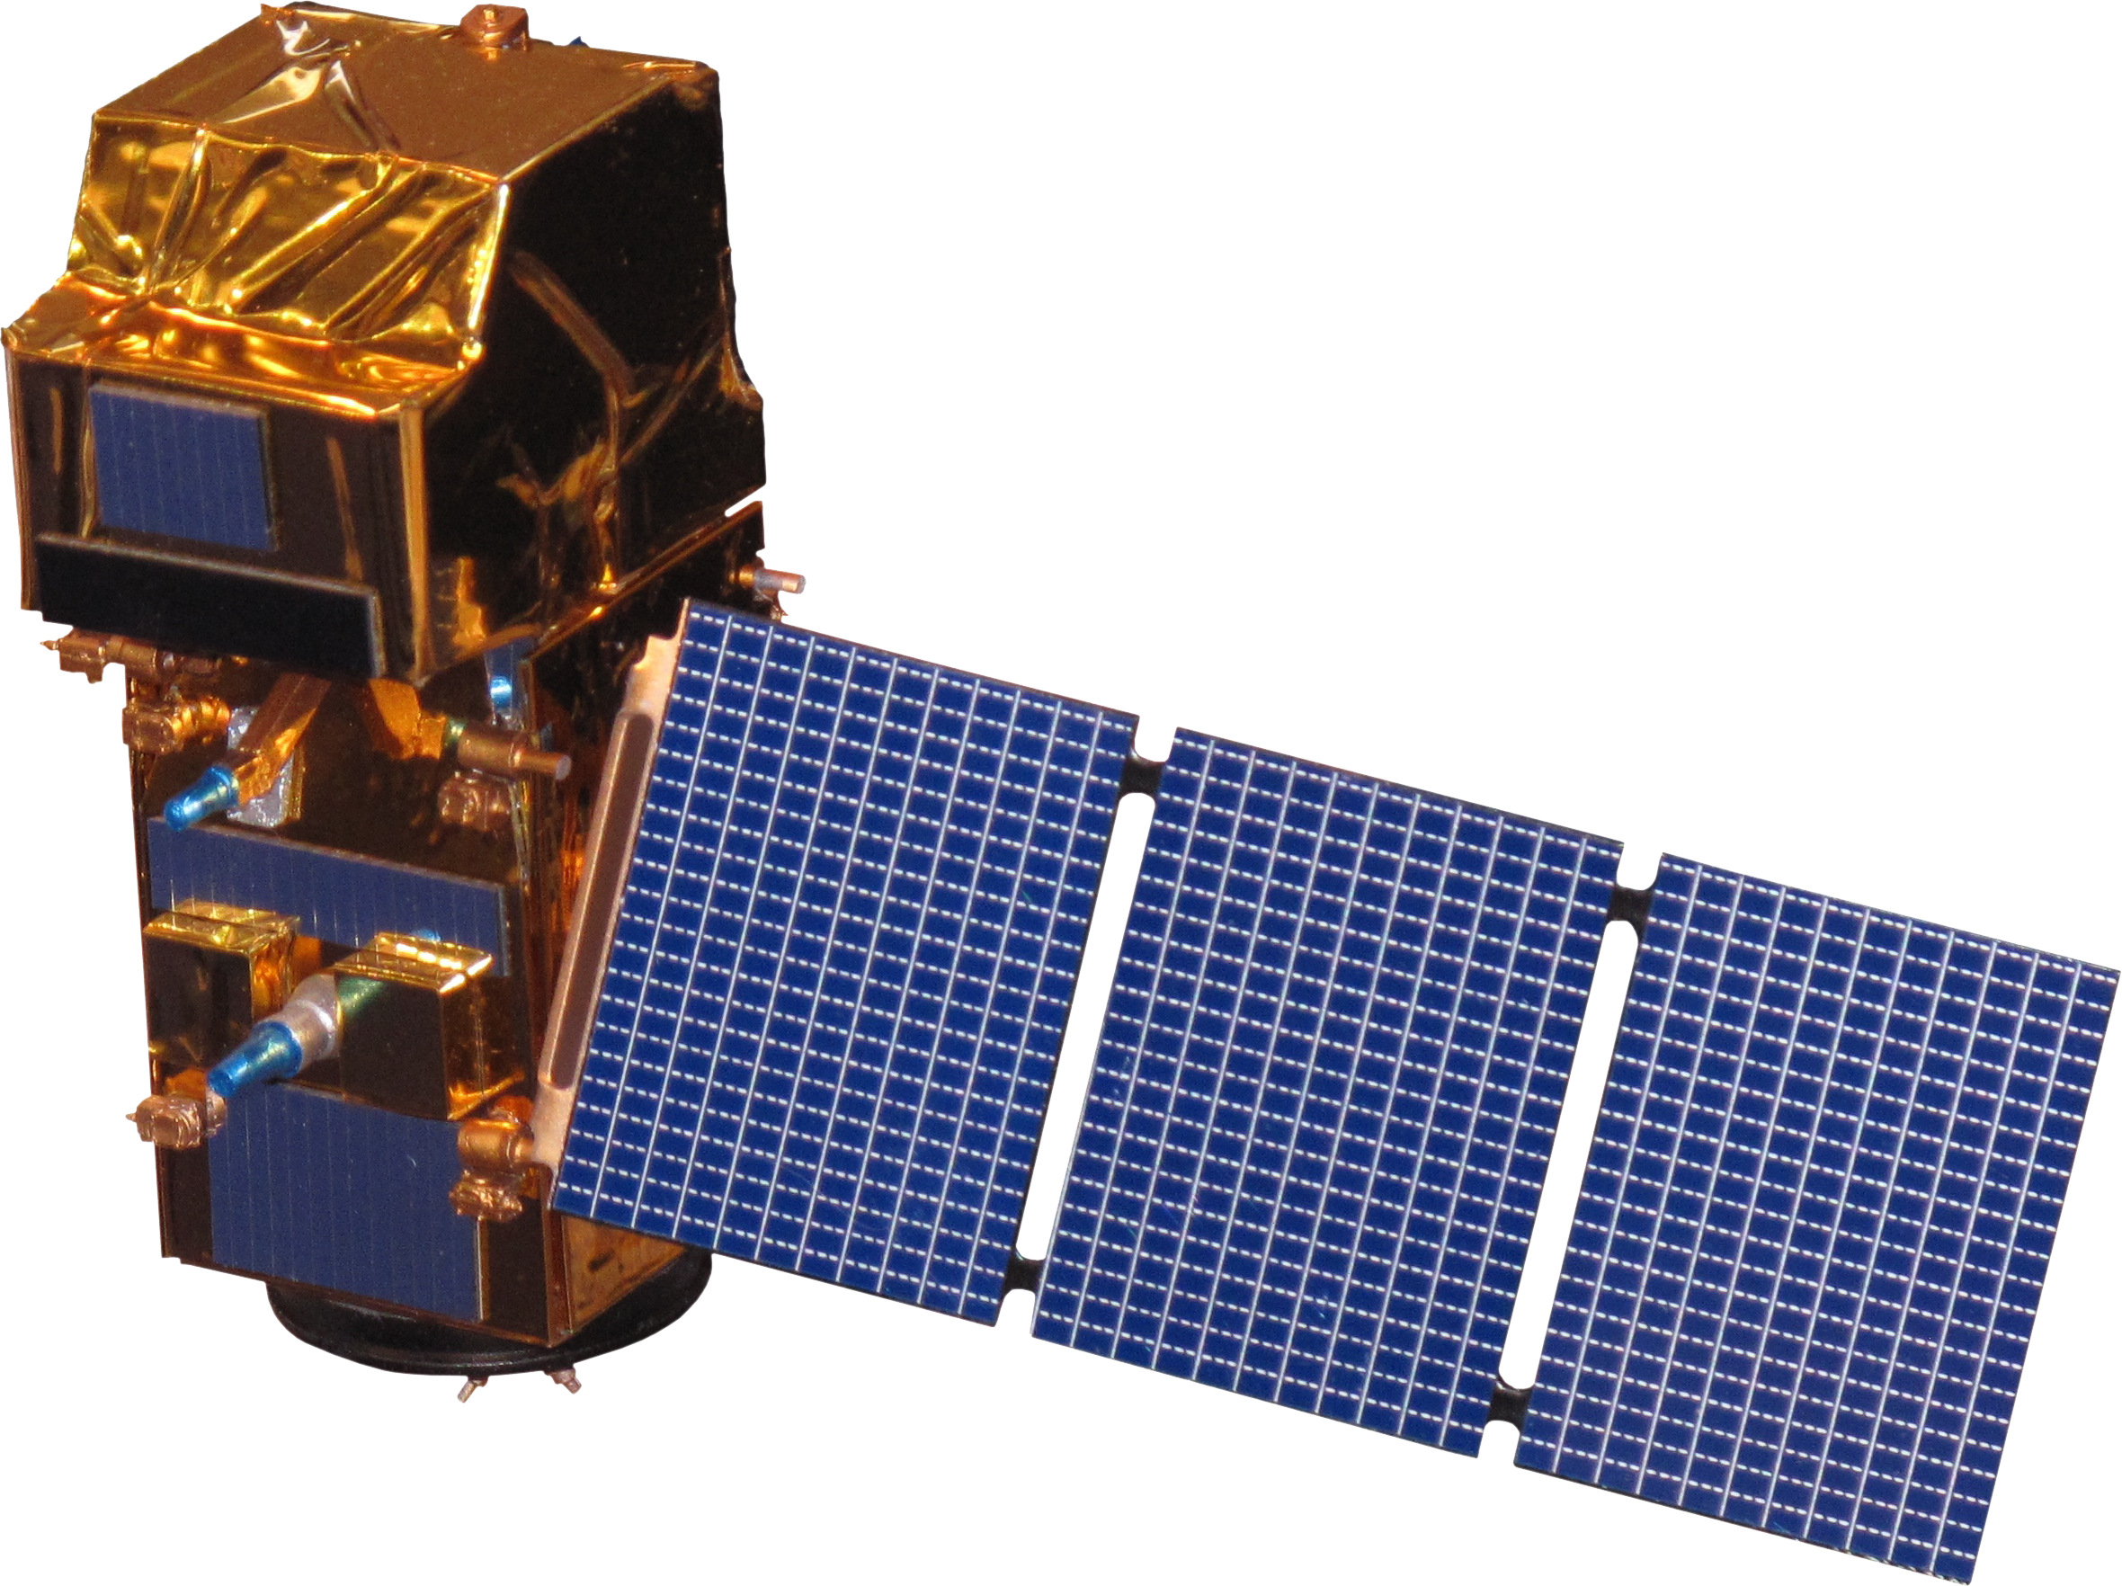
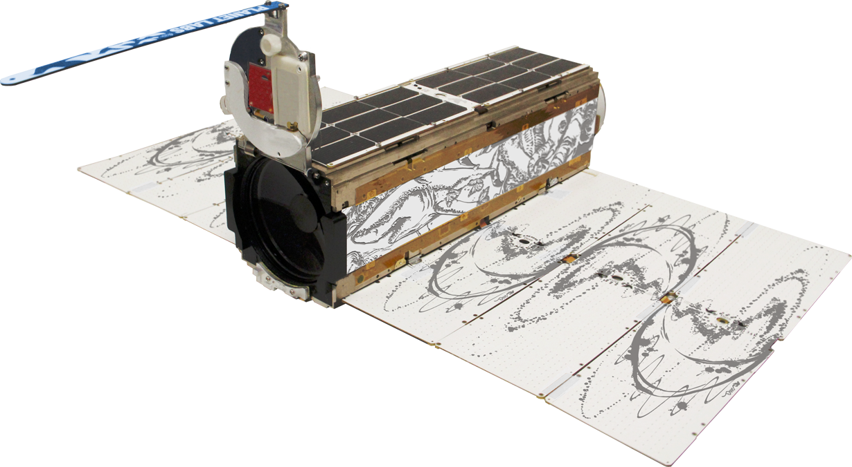
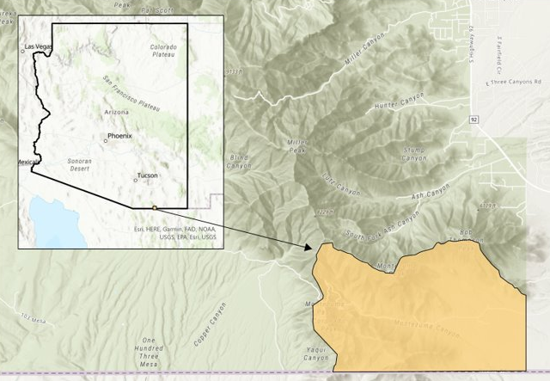
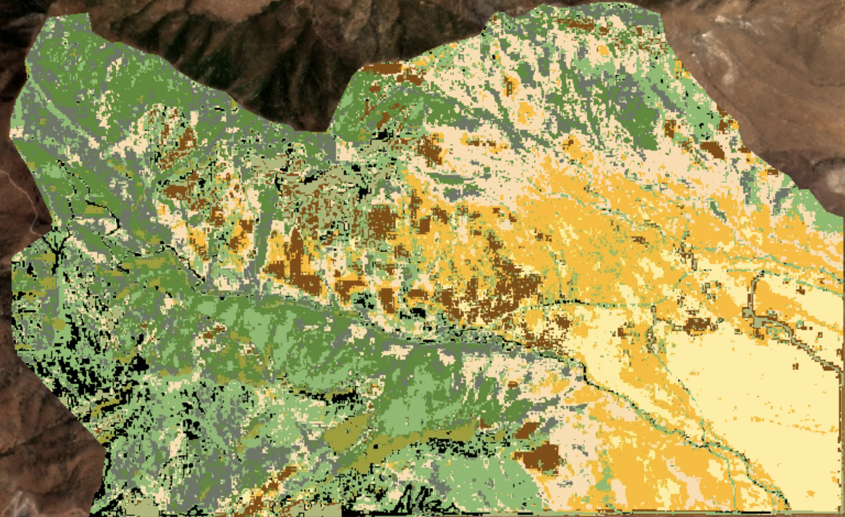
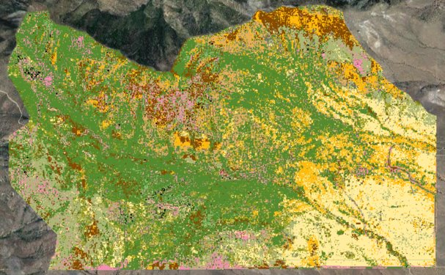
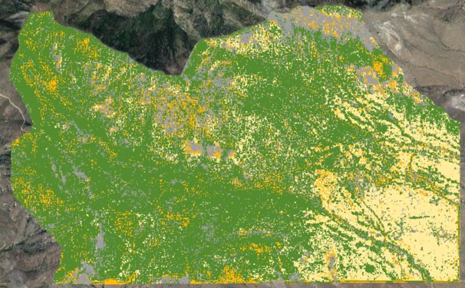
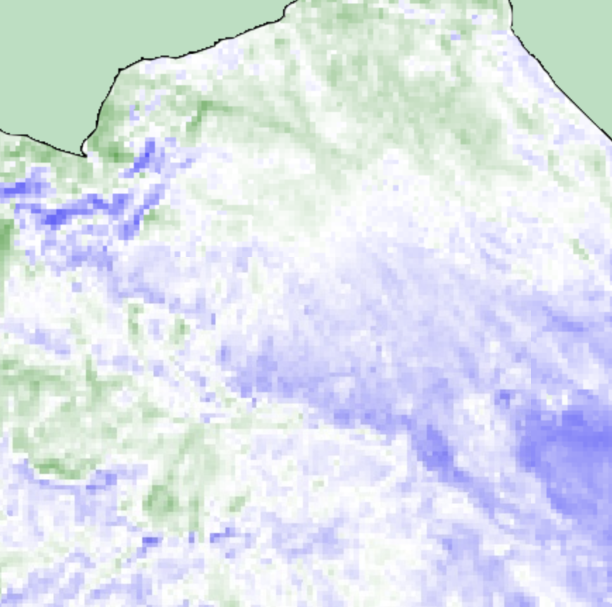
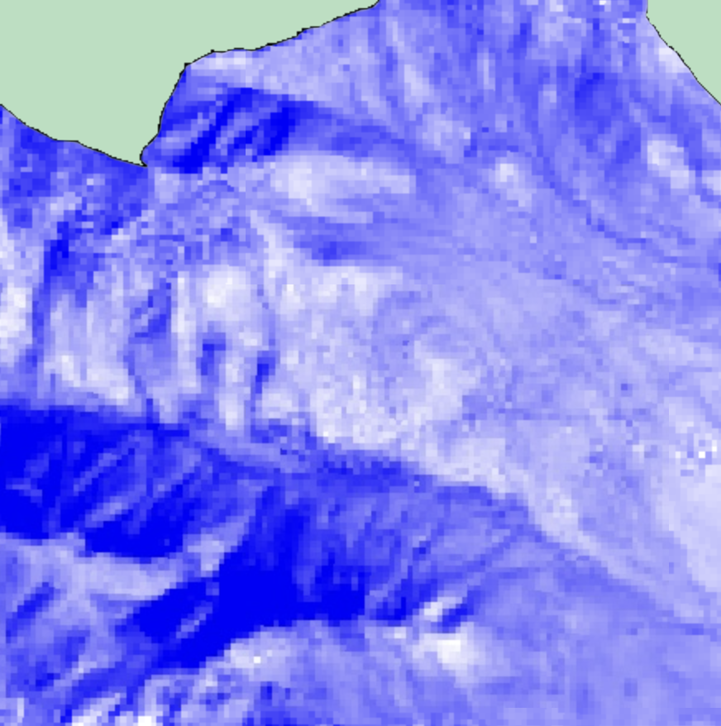
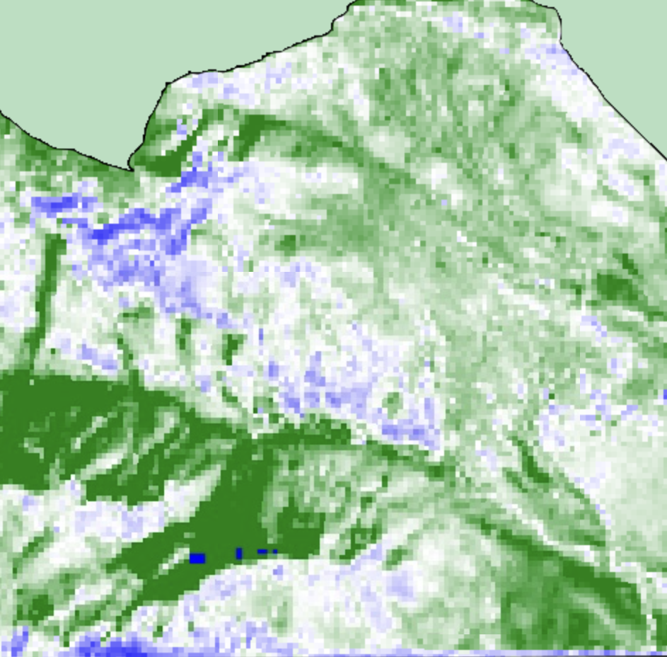
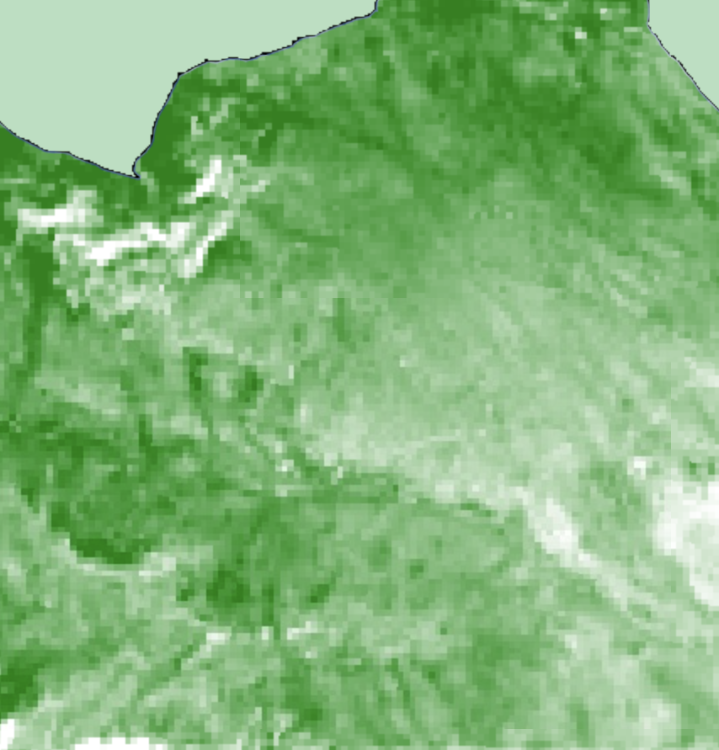
Coronado Ecological Conservation
Assessing Vegetation Change Due to Border Wall Construction and Shifting Social Trials in Southern Arizona
Abstract
Objectives
Species monitoring is essential in mitigating the impacts of plant invasion, such as radical changes in an area’s ecosystem, degraded soil health, increased wildfire severity, landslides, and increased flooding. NASA DEVELOP partnered with the National Park Service (NPS) to investigate invasive species in disturbed lands: specifically, areas affected by off-trail walking and US-Mexico border construction activities. The team assessed how construction has impacted the distribution of Lehmann’s lovegrass and Russian thistle invasives throughout Coronado National Memorial, AZ from 1986 to 2022. Using data from Landsat 5 and 8, Sentinel-2, the National Agriculture Imagery Program, and PlanetScope, the team computed vegetation indices including the Normalized Difference Vegetation Index, Normalized Difference Moisture Index, Modified Soil Adjusted Vegetation Index 2, Enhanced Vegetation Index, and Tasseled Cap Wetness, Brightness, and Greenness transformations as vegetation health indicators to input into various machine learning algorithms. To minimize noise, the team conducted Principal Component Analysis on the vegetation indices and spectral bands before running k-means++ clustering and random forest classification algorithms. Between all datasets, we found the median area fully overtaken by invasive plants was 5.37% of the park’s total area in 2022. The NPS will use the end products to help increase restoration efforts in disturbed areas with high concentrations of invasive plants. The NPS’s collection of ground data for 2022–2023, in conjunction with future data collection, will notably improve the accuracy of classification models, leading to more precise monitoring of invasive spread over time.
Assess vegetation health and extent
Visualize vegetation change in maps and time-series
Produce landcover classifications
Identify invasive species using classification models
Project Partners
National Park Service, Coronado National Monument
Earth Observations
Landsat 5 TM
Landsat 8 OLI
Sentinel-2 MSI
Image Credit: Planet Labs
Study Area
Results
Planet Scope DOVEs
Coronado National
Memorial
K-Means++
Random Forest 13 Classes
Random Forest 4 Classes
U.S.-Mexico border
W
N
E
S
0.20
0.18
0.16
0.14
0.12
0.10
0.08
0.06
0.04
0.02
0.00
Landsat 5 & 8 Median Time Series (1986–2022)
13 Class Landcover:
Developed
Rock Outcrop
Partially Invasive Grassland
Median MSAVI-2
Border Wall Construction
Mostly Invasive Grassland
Peak Fire
Shrub Savanna
Horseshoe Fire
Shrubland
0 .5 1 2 3 4
Wooded Grass Native
Miles
Wooded Grass Partial Invasive
1988 1990 1992 1994 1996 1998 2000 2002 2004 2006 2008 2010 2012 2014 2016 2018 2020 2022
Tree Savanna
Methodology
Year
Forest
Asphalt
Gravel
TC Wetness
Russian Thistle
Filtered imagery
Study period
Cloud Cover
Clipped
Coronado Boundary
Masked for Clouds
NDVI
Google Earth Engine
EVI
TC Greenness
Principal Component Analysis
NDMI
TC Brightness
MSAVI-2
Conclusions
Unsupervised Classification: k-means++
Supervised Classification: Random Forest
Principal component analysis effectively reduced the necessary number of inputs for machine learning algorithms
Random Forest proved to be a useful method of invasive species detection, especially at a 4-class level with Sentinel and Landsat
Steep drops in vegetation health occurred corresponding to disturbance events like wildfire and border wall construction
Team Members
Acknowledgements
Carson Schuetze
Project Lead
Josie Bourne
Charles Robinette
Tyler Guigneaux
Dr. Marguerite Madden
UGA, Center for Geospatial Research
Joseph Spruce
Science Systems and Applications, Inc.
Sarah Payne
Fellow, NASA DEVELOP National Program
National Park Service: Robert Matthewman (GIS Intern), Nicole Gonzalez (Biologist), Jessica Garcia (Physical Scientist), JoAnn Blalack (Integrated Resource Manager)
Athens – Georgia
Notes:
Planet Scope DOVEs Image Credit: Planet Labs

