Slide 1
UHEAT
Urban Development
Increasing Capabilities and Updating the Urban Heat Exposure Assessment for Tempe (UHEAT) Tool
Akshay Agrawal
Myung Sik Cho
Vanessa Machuca
Zainab Farid
Pop-Up Project
Notes:
Hello everyone and thank you for joining us for our Spring Closeout. My name is Akshay Agrawal and I am joined by Myung Sik Cho, Vanessa Machuca, and Zainab Farid. We are the UHEAT Urban Development Team and have spent the past 10 weeks working on Updating and Expanding the Urban Heat Exposure Assessment for Tempe – or UHEAT – Tool.

Slide 2
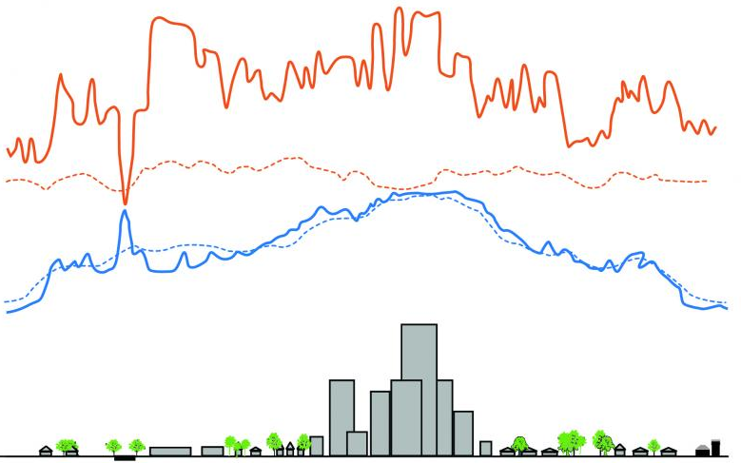
BACKGROUND
Excessive heat ~ mortality and other heat-related diseases
Urban heat island effect
Socioeconomic status = different heat-related risks
Impacts of excessive heat should be measured for reducing the negative impacts
Consider vulnerability and exposure
Maps = which areas should be prioritized to heat-related policy
UHEAT 1.0: heat-related information and map for Tempe, AZ
NASA DEVELOP Arizona Urban Development Fall 2020
Day
(4 pm)
Temperature
Night
(2 am)
Rural
Suburban
Pond
Industry &
Warehouses
Urban
Residential
Downtown
Urban
Residential
Park
Suburban
Rural
Surface Temperature (Day)​
Air Temperature (Day)
Surface Temperature (Night)​
Air Temperature (Night)
Image credit: Environmental Protection Agency
Notes:
Excessive heat poses a large risk to communities throughout the world. Many urban centers experience what is known as the urban heat island effect, wherein surface temperature in the city is elevated compared to surrounding area. Vulnerable community members, like the elderly and those located in areas lacking proper cooling infrastructure, are at particular risk to heat.
It is thus critical for city planners to be able to pinpoint areas in a city to target with heat mitigation. This can include planting more trees, providing cooling centers, and directing funding to improve cooling infrastructure, like air conditioning.
In the Fall of 2020, the Tempe, AZ, Urban Development NASA DEVELOP team developed the Urban Heat Exposure Assessment for Tempe – or UHEAT – Tool. We'll refer to this as UHEAT 1.0.
------------------------------Image Information Below ------------------------------
Image credit: Environmental Protecti0n Agency
Image source: https://www.epa.gov/heatislands/learn-about-heat-islands
* Part of image modified. Enlarged text, made editable

Slide 3
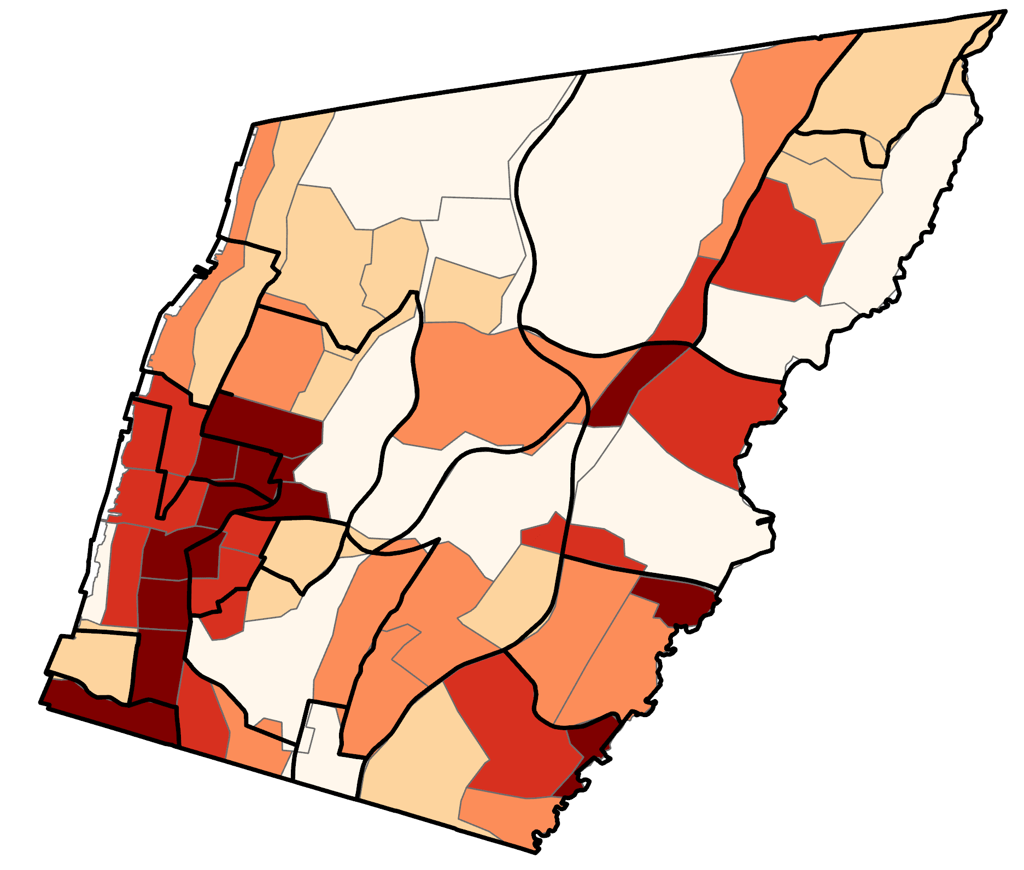
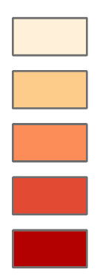
UHEAT 1.0
The Urban Heat Exposure Assessment for Tempe (UHEAT) Tool
R-Studio
Socioeconomic variables
R-Studio
Principal component analysis
Heat vulnerability, exposure, and priority scores by census tract
Census data
Google Earth Engine
Biophysical variables
variables
1
2
3
4
5
Earth observations
components
Outdated EO and no option for user-provided data
R licensing issues and code is not generalized
No user interface
Notes:
The UHEAT Tool takes Earth observation and the census data and uses these to calculate socioeconomic variables – like % poverty – in R, and biophysical variables – like land surface temperature – in Google Earth Engine. It then runs a principal component analysis on those variables in R to determine the relationships between these variables. This information is then used to calculates three different heat scores: the heat vulnerability score (HVS), heat exposure score (HES), and heat priority score (HPS). The vulnerability score takes only socioeconomic variables into account, while the exposure scores takes only biophysical variables into account, and the priority score considers all variables. These scores are calculated for each census tract of the city of interest. The tool outputs a CSV file score values for all census tracts, which can then be used to generate a score map for the city.
There a few ways in which UHEAT 1 could be improved.
##### CLICK TO ANIMATE #####
First of all, the tool uses outdated Earth observation data and does not offer the option for users to upload their own data
##### CLICK TO ANIMATE #####
Second, most of the code is in R, which present licensing issues. And the code needs to be generalized to any US city.
##### CLICK TO ANIMATE #####
Finally, the tool does not have a user interface. Users need to interact with the code to run the tool.
------------------------------Image Information Below ------------------------------
Clipart provided by PowerPoint
PCA Heatmap and Heat Score Map
Image Credit: Fall 2021 Yonkers Urban Development NASA DEVELOP Team
Image Source: Final Presentation Slides

Slide 4
PROJECT OBJECTIVES
Generalize the tool for application to other communities within the United States
Create an open-source user interface for greater accessibility
Extend the tool to account for
additional factors and integrate higher resolution Earth observations
Notes:
We sought to update and expand UHEAT 1 in three ways.
##### CLICK TO ANIMATE #####
First, generalize the tool for application to other communities within the United States
##### CLICK TO ANIMATE #####
Second, create an open-source user interface for greater accessibility
##### CLICK TO ANIMATE #####
Third, extend the tool to account for additional factors and integrate higher resolution Earth observations
------------------------------Image Information Below ------------------------------
Clipart provided by PowerPoint

Slide 5
UHEAT 2.0
The Urban Heat Exposure Assessment Tool
Python
socioeconomic variables
Python
Principal component analysis
Heat vulnerability, exposure, and priority scores by census tract
Census data
Updated EO
+
user input
Google Earth Engine
biophysical
variables
variables
1
2
3
4
5
components
Packaged in a graphical user interface
Notes:
We renamed the tool to the Urban Heat Exposure Assessment Tool, which we will refer to as UHEAT 2. The tool follows the same workflow at UHEAT 1, with some key changes to fulfill our three objectives.
##### CLICK TO ANIMATE ##### (border around the updated EO and user input box)
First of all, we updated the Earth observations used in the tool, and include the option for users to input their own canopy cover and impervious surface data. If the user does not provide this data, the tool defaults to data from the National Land Cover Database and the Global Impervious Surface Area (GISA) GEE community dataset (https://samapriya.github.io/awesome-gee-community-datasets/projects/gisa/).
##### CLICK TO ANIMATE ##### (border around the two python-related boxes)
Socioeconomic variable calculation and the principal component analysis are now carried out in Python rather than in R. We did this to avoid licensing conflicts inherent to using R, and thus to make this tool open source. The code was also modified to be generalizable to any US city.
##### CLICK TO ANIMATE ##### (yellow arrow and note about user interface)
Finally, the entire tool is wrapped in a graphical user interface, using Plotly Dash. Users will not interact with the underlying code at all. This makes the tool accessible to users with little to no coding experience.
------------------------------Image Information Below ------------------------------
Clipart provided by PowerPoint
PCA Heatmap and Heat Score Map
Image Credit: Fall 2021 Yonkers Urban Development NASA DEVELOP Team
Image Source: Final Presentation Slides

Slide 6
Satellites and Sensors
Landsat 8 OLI & TIRS​
(Collection 2)​
surface reflectance &
daytime land surface temperature
Aqua MODIS​
nighttime land surface temperature
Image credit: NASA
Notes:
For Earth observations, we used surface reflectance data Landsat 8 Optical Land Imager – or OLI - and Thermal Infrared Sensor – or TIRS, as well as surface reflectance, land surface temperature, and emissivity data from the Aqua Moderate Resolution Imaging Spectroradiometer - or MODIS. We use Collection 2 of the Landsat 8 data, updated from the Collection 1 data used in UHEAT 1. These data were used to derive most of the biophysical variables used in UHEAT 2.
------------------------------Image Information Below ------------------------------
Aqua satellite image:
Image Credit: NASA
Image Source: https://science.nasa.gov/get-involved/toolkits/spacecraft-icons
Landsat 8 satellite image:
Image credit:NASA/Goddard Space Flight Center Conceptual Image Lab
Image Source: https://www.usgs.gov/media/images/landsat-8

Slide 7
HEAT SCORES
Biophysical Variables
dLST, nLST, NDVI, NDBI, NDWI, albedo, canopy cover, % imperviousness
Heat Exposure Score
Heat Priority Score
Socioeconomic Variables
total population, median income, % minority, % poverty, % >65, % >65 & alone, % alone
Heat Vulnerability Score
Alone (%)
Notes:
Specifically, using biophysical variables from Earth observations and socioeconomic variables from Census were used to calculate heat scores, which are heat exposure, vulnerability, and priority score.
For heat exposure score, only biophysical variables, such as daytime and nighttime land surface temperature, normalized differences of vegetation index, built-up areas index, and water index, albedo, canopy cover, and imperviousness were used .
For heat vulnerability score, only socioeconomic variables, which are total population, median income, percentage of minority, poverty, over than 65 years old, people living alone, and over than 65 years old who live alone.
For heat priority score, both biophysical and socioeconomic variables were used in calculation.
------------------------------Image Information Below ------------------------------
Clipart provided by PowerPoint

Slide 8
METHODS
GEE Python API
Biophysical Variables:
Aqua MODIS
Nighttime LST
Daytime LST
Albedo
Landsat 8
NDWI
NDVI
NDBI
Image credits: NASA
Notes:
In processing biophysical variables, we used Google Earth Engine API, named 'ee' in python.
We used Landsat 8 Collection 2 for deriving most variables, except for nighttime land surface temperature, because they can provide better spatial details.
Since MODIS can observe nighttime land surface temperature, but Landsat cannot, we obtained nighttime LST from MODIS.
------------------------------Image Information Below ------------------------------
Aqua satellite image:
Image Credit: NASA
Image Source: https://science.nasa.gov/get-involved/toolkits/spacecraft-icons
Landsat 8 satellite image:
Image credit: NASA/Goddard Space Flight Center Conceptual Image Lab
Image Source: https://www.usgs.gov/media/images/landsat-8

Slide 9
METHODS
Census:
UHEAT 1.0
UHEAT 2.0
API key
GPL License
Pull ACS 5-Year data Using Tidy Census package in R
MIT License
Pull ACS 5-Year data directly from Census Server
Python
Conversion
URL formatting + requests package
Notes:
The UHEAT 1.0 tool acquired American Community Survey 5-year data using the TidyCensus package in R. Our focus was to make the tool more accessible and open-source. Since R as a tool is governed by a GPL license we preferred converting the tool to python since it presented more opportunities to use open source packages. In UHEAT 2.0 American Community Survey 5-year data is directly pulled from the Census data servers using an API key and URL formatting through the open source requests package in python.

Slide 10
METHODS
s
Principal Component Analysis:
PCA Criteria
Spreadsheet Variables
Select
Components
Score by
Census Tract
Kaiser Criterion
Components
High
Amount of Variance
Horn’s Parallel
Analysis
Low
Variables
Notes:
To construct the three heat indices we use principal component analysis. Firstly variables specific to a heat index are taken and subjected to three principal component analysis methods i.e. Kaiser criteria, amount of variance and scree plot or horn's parallel analysis. These three methods recommend the ideal number of principal components that we can use and the user is able to interpret and select the number of components that they wish to proceed with through the user interface. Once the components are selected a score is derived for each census tract which can be used to map and observe heat vulnerability, priority and heat exposure in an area.
PCA Heatmap
Image Credit: Fall 2021 Yonkers Urban Development NASA DEVELOP Team
Image Source: Final Presentation Slides

Slide 11
RESULTS
Notes:
Now that you're acquainted with the methodology and objectives behind the UHEAT tool, we'd like to give you a glimpse into the UHEAT user interface. Each page is equipped with a drop-down menu, and a "next" button leading to the next page.

Slide 12
RESULTS
PC selection page: User selects the number of PCs to include in the final PCA, based on three PC selection criteria
Notes:
While the user interface eliminates the need for users to interact with any code, making the tool widely accessible, we still wanted to make the score calculation process as transparent as possible. For example, users have the power to select how many principal components they want to include in the final PCA. The PC selection page displays the results of the three PC selection criteria. And then the user selects the number of components from a drop-down menu.

Slide 13
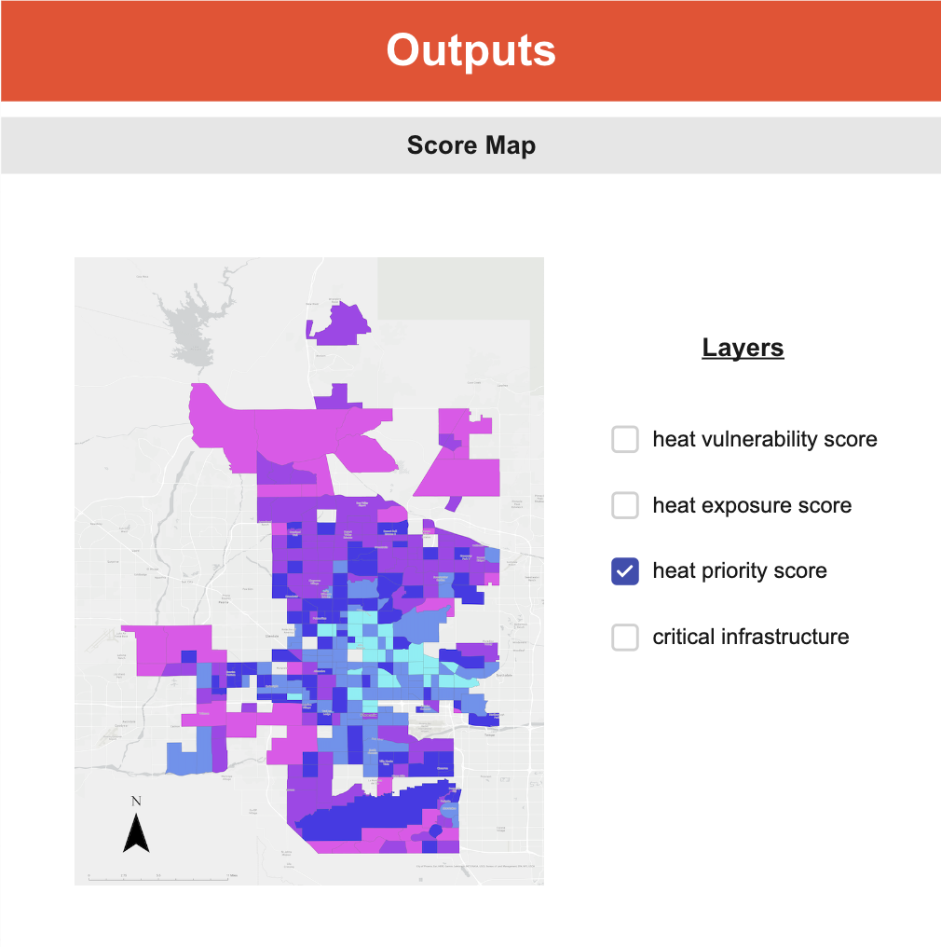
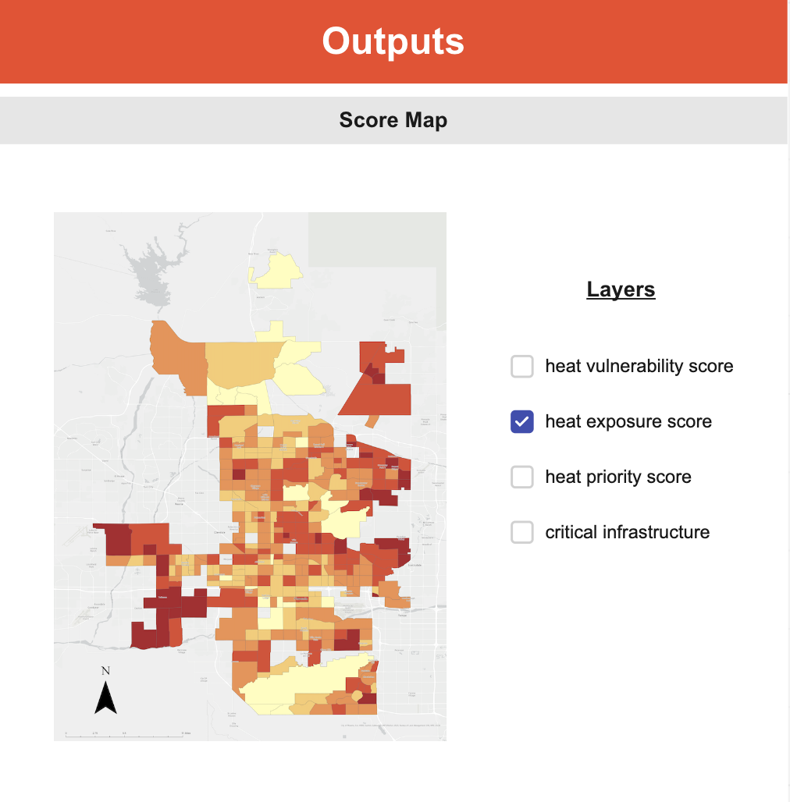
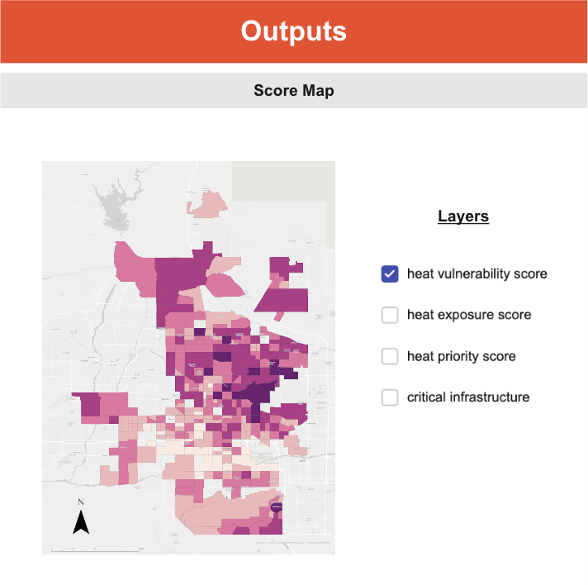
RESULTS
Outputs page: Heat score maps, variable importance plots, map/data export
Notes:
On the last page, the tool displays outputs in the form of heat score maps and variable importance plots, as well as map and data export options. Users can select what score they would like to view, and overlay a critical infrastructure layer atop. Here is what those maps look like, with a layer selection bar to the right.

Slide 14
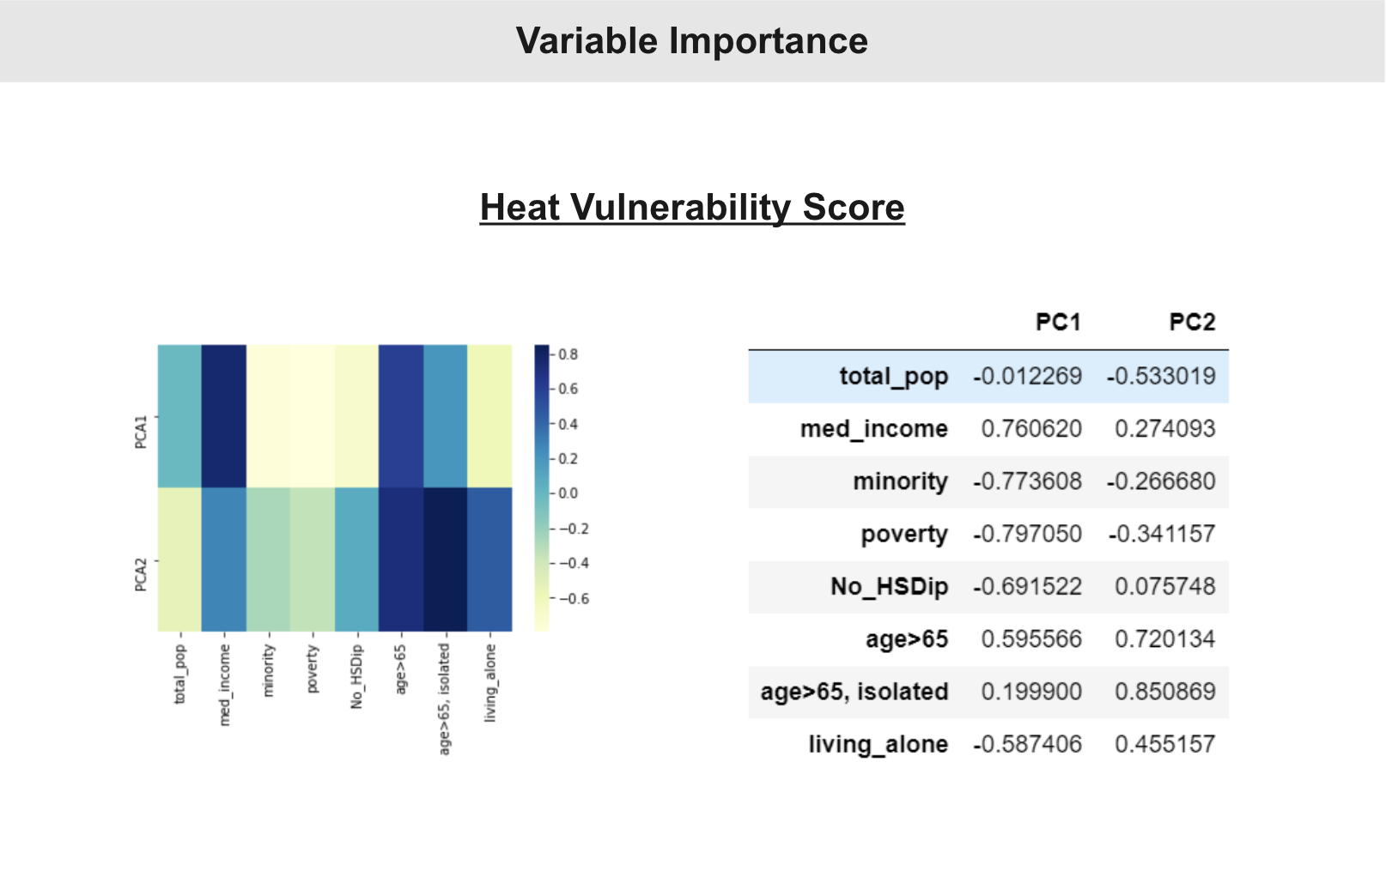
RESULTS
Outputs page: Heat score maps, variable importance plots, map/data export
Notes:
We also added variable importance outputs, complete with variable vs. PC heat maps and a loadings tables for each score.

Slide 15
UHEAT Development Process
Notes:
This is the first time that NASA DEVELOP has included technology and innovation teams focused on tool development. So it was a learning experience for everyone involved! We'd like to now share some of the tools and strategies we used to develop UHEAT 2.0.

Slide 16
AGILE Software Development
1. Planning
The UHEAT 2.0 team employed AGILE methodology to complete this project.
AGILE involves:
1. Individuals and interactions over processes and tools
2. Working software over comprehensive documentation
3. Customer collaboration over contract negotiation
4. Responding to change over following a plan
2. Check-ins
4. Retrospectives
3. Reviews
A SPRINT IN AGILE
Notes:
Early in the term, one of our science advisors suggested we use the Agile software development system. We found that AGILE principles aligned with our goals and aspirations for UHEAT 2.0. AGILE involves:
- Individuals and interactions over processes and tools
- Working software over comprehensive documentation
- Customer collaboration (in this case, Dr. Hondula from the Phoenix city government) over contract negotiation
- Responding to change over following a plan, meaning that we incorporated feedback from our technical and science advisors as we built the UHEAT 2.0 tool
------------------------------Image Information Below ------------------------------
Image Credit: PACKT
Image Source:

Slide 17
AGILE Software Development
What this looked like for UHEAT 2.0
These were not strict roles as we intended to work as collaboratively as possible.
Some examples include:
Myung Sik Cho automated the GEE code
Akshay Agrawal took the lead on the PCA methodology
Vanessa Machuca spearheaded design and organization
Zainab Farid tested the code for Google Earth Engine and tested PCA within SPSS
Caroline Williams & Dr. Kent Ross provided suggestions on various tools and methodologies to use
Fellow
Project Lead
Project Manager
Product Owner
Lead Python
Developer
Tester
Lead GEE
Lead
Notes:
One of the best parts of working with AGILE was that you can customize it to your team!
AGILE methodology recommends having specialized roles like project manager, product owner, developer and tester. Whilst we took ownership of certain components of the tool, for example Myung and Zainab were mainly responsible for GEE, and Vanessa and I were conducting principal component analysis, we often collaborated and assisted each other with various tasks, particularly when we had to submit deliverables.
------------------------------Image Information Below ------------------------------
Clipart provided by PowerPoint

Slide 18
AGILE Software Development
RESOURCES AND TOOLS USED FOR COLLABORATION​
TRELLO
MIRO
Such tools helped us employ principles of AGILE software development:​
welcome changing requirements, even late in development​
deliver working software frequently​
the best architectures, requirements, and design emerge from self-organizing teams​
​
Notes:
AGILE methodology comprises of twelve principles; three of our favorite included welcoming changing requirements, even late in development, delivering working software frequently, and an awareness that the best architectures, requirements, and design emerges from self-organizing teams. Some resources and tools we used to facilitate a collaborative workflow include GitLab, Trello, Miro and Microsoft teams and we would highly recommend using these for better organization!
------------------------------Image Information Below ------------------------------
Clipart provided by PowerPoint

Slide 19
User Interface Development
home.py
auth.py
upload.py
selection.py
signs.py
output.py
app.py
Page Owner
page design/layout/gridding
universal callbacks
integration
visualization
Knowledge Leader
Notes:
When the time came for us to develop the Plotly Dash user interface, we decided to assign every team member two roles: page owner and knowledge leader. As page owners, each of us was responsible for constructing a subset of the 6 pages included in the tool. For example, Zainab created the page where users can upload their own data. As knowledge leaders, each of us became super informed in one subject matter. For example, Vanessa was in charge of page design, layout, and gridding. Whenever a team member had a question, they went to the knowledge leader who could best address it. After we each designed our own pages, we came together and complied the pages into a single application, coordinated using an app.py file.
------------------------------Image Information Below ------------------------------
Clipart provided by PowerPoint

Slide 20
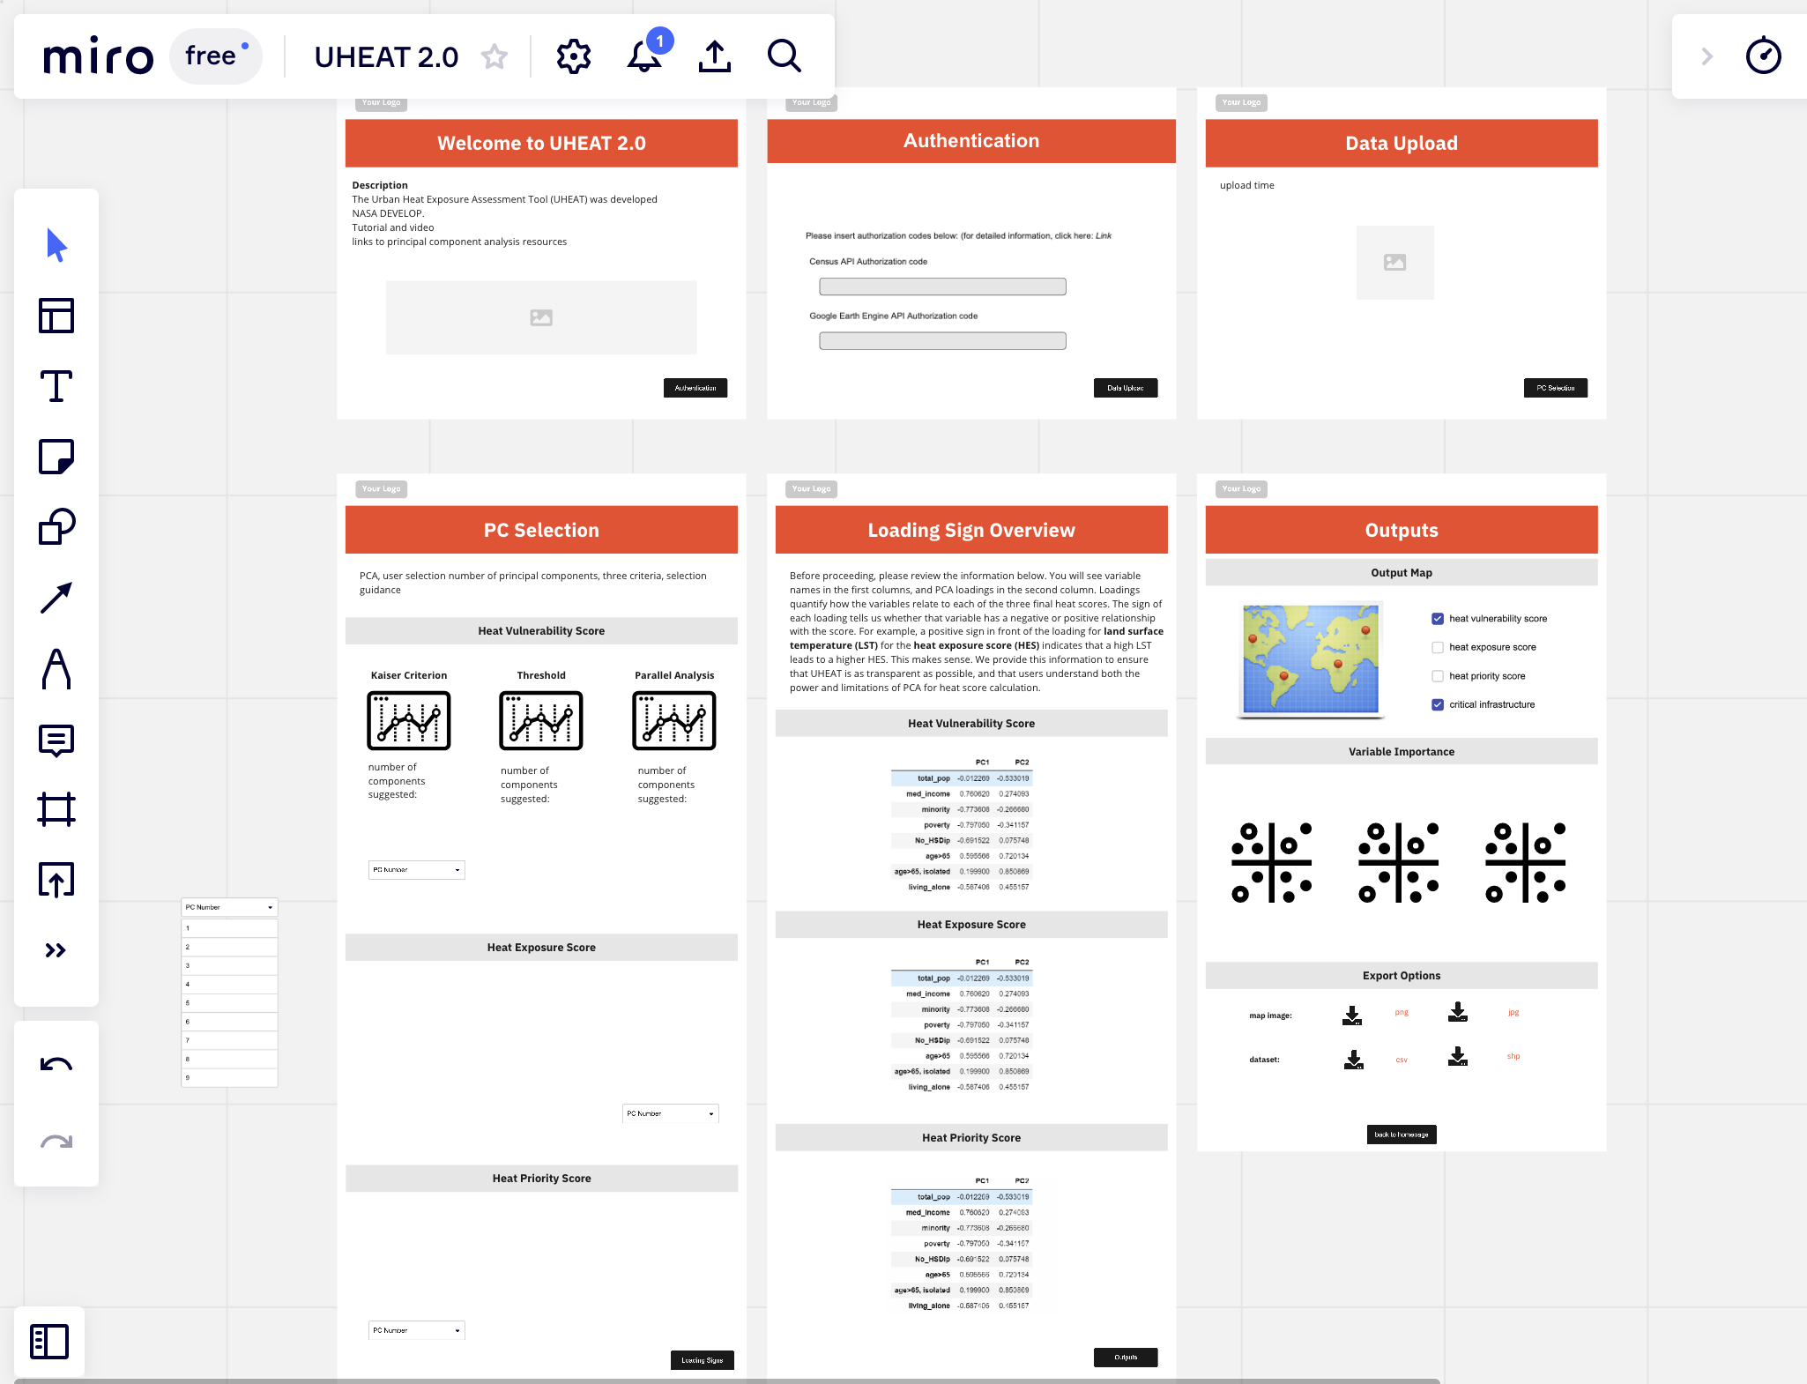
User Interface Development
Notes:
We collaboratively designed the pages of the application using Miro. Pictured here are our basic designs for the 6 pages. These designs were then translated into the Plotly Dash code which can be written in pure python code.

Slide 21
CONCLUSIONS
This project developed UHEAT 2.0
Automated UHEAT 1.0 processes
Solved R-studio licensing issues
Added a user interface for better accessibility
Updated outdated earth observations
Generalized UHEAT 1.0 for all cities in United States
Accommodates user uploaded data
Notes:
In conclusion, this project developed UHEAT 2.0.
Specifically, first, it integrates all codes into Python using various APIs, and automates all processes.
Second, we solved the licensing issues by translating R scripts into Python.
Third, it is easier to use through the user interface without accessing to code directly.
Fourth, we updated the tool to use recent version of Earth observations.
Fifth, UHEAT 2.0 covers entire US. Sixth, it can receive the data from user side for the case that users have a better one.
Finally, the tool accommodates user uploaded data
Through our new tool, UHEAT 2.0, we believe that we can provide straightforward way to monitor the heat-related information, such as heat vulnerability, exposure, and priority, on any city in US.
------------------------------Image Information Below ------------------------------
Image Data Source: NASA MODIS; https://lpdaac.usgs.gov/products/mod11a1v006/

Slide 22
FUTURE WORK
Customize methodology by region, based on climate zones
Include alternatives to PCA for better generalization
Create guidelines for better PCA interpretation
Provide options to include a variety of user-provided layers
Improve GEE processing times
Notes:
Given the time constraints, we were not able to include more features within our UHEAT tool. Future teams may want to look into developing customized methodology that accounts for different regions of the United States based on climate zones,
##### CLICK TO ANIMATE #####
Include methodologies beyond PCA for better generalization – some that we wanted to explore include hotspot analysis, clustering and the decision-tree algorithm.
##### CLICK TO ANIMATE #####
The PCA analysis is a heuristic method, thus interpretation is open to the user. Running it in Python and then in statistical software like R and SPSS may give different results, and thus future DEVELOPers can focus on creating more comprehensive guidelines.
##### CLICK TO ANIMATE #####
While we added the option of adding critical infrastructure, canopy cover and impervious surface layers, perhaps even more data could be integrated that could give more insight into the effects of urban heat island effect and mitigation efforts.
##### CLICK TO ANIMATE #####
Lastly, GEE processing can be worked on to facilitate faster processing time.
------------------------------Image Information Below ------------------------------
Clipart provided by PowerPoint

Slide 23
Science Advisors
Dr. David Hondula, Arizona State University
Dr. Kent Ross, NASA Langley Research Center
Technical Advisor
Hayley Pippin, Senior Fellow at NASA Ames Research Center
NASA DEVELOP
Caroline Williams, NASA DEVELOP Fellow
Blake Steiner, University of Arizona, NASA DEVELOP alumnus
Fall 2020 Arizona Urban Development Team
Notes:
We would like to acknowledge our science advisors Dr. David Hondula and Dr. Kent Ross, and our technical advisor, Hayley Pippin for all their sound insight and feedback. Lastly, we'd like to thank our Fellow, Caroline Williams without whom we could not have had a successful term. Finally, we'd like to thank the previous NASA DEVELOP teams who developed UHEAT 1.0, and Blake Steiner for walking us through UHEAT 1.0 and provided with some great initial feedback. Thank you!

