Slide 1
Arizona Health
& Air Quality
Enhancing Extreme Heat Intervention and Preparedness Activities in Maricopa County, AZ
Amy Stuyvesant (Team Lead)
Emma Baghel
Geordi Alm
April Rascon
Rocky Garcia
Bernardo Gracia
Notes:
Good Afternoon. My name is Amy Stuyvesant and I am the team lead for the Arizona Health and Air Quality project where we are looking at enhancing extreme heat intervention and preparedness activities in Maricopa County, AZ.

Slide 2
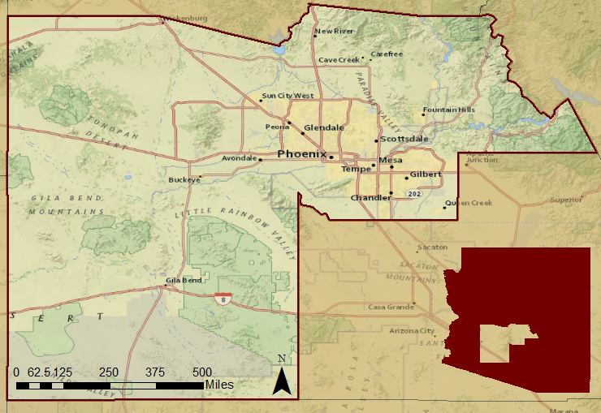
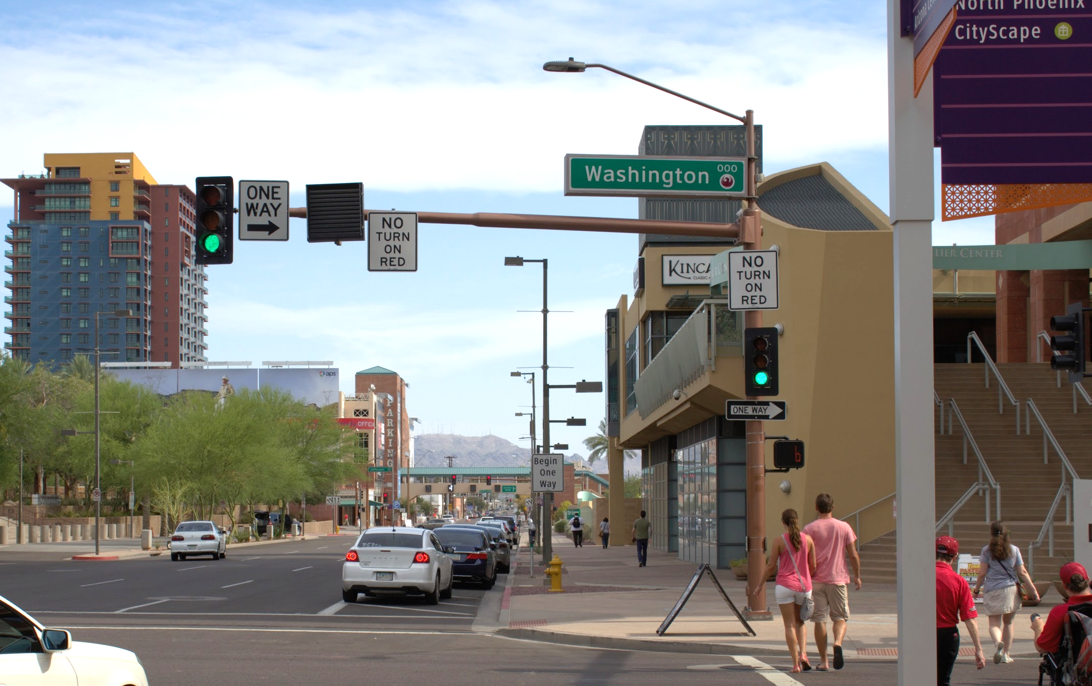





Study Area and Dates
Maricopa County
Arizona
Downtown Phoenix
Photos by Geordi Alm (ASU)
Study Dates: May - September, 2005 - 2015
Notes:
Basemap: ESRI basemaps
Our study areas takes place in the southwest portion of Arizona. This includes the major city of Phoenix that provides us with interesting data based on its Urban Heat Index effects. Our time period includes the summer months, May - September, for 2005 - 2014.

Slide 3
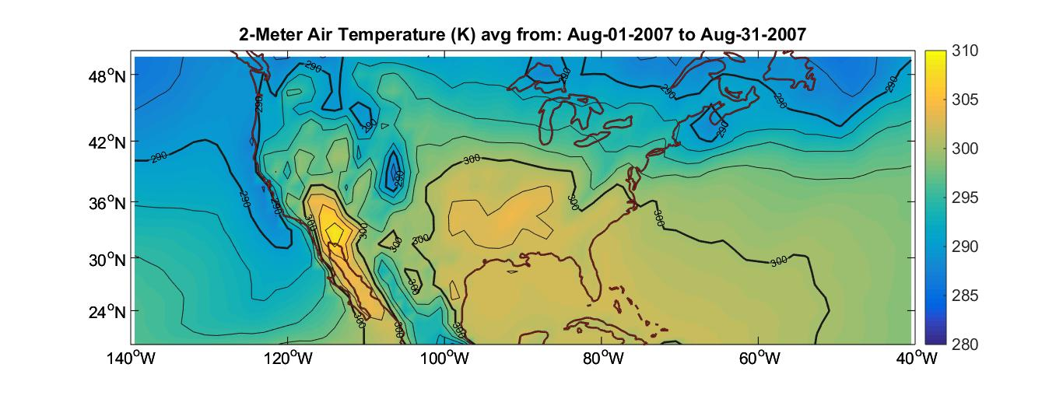
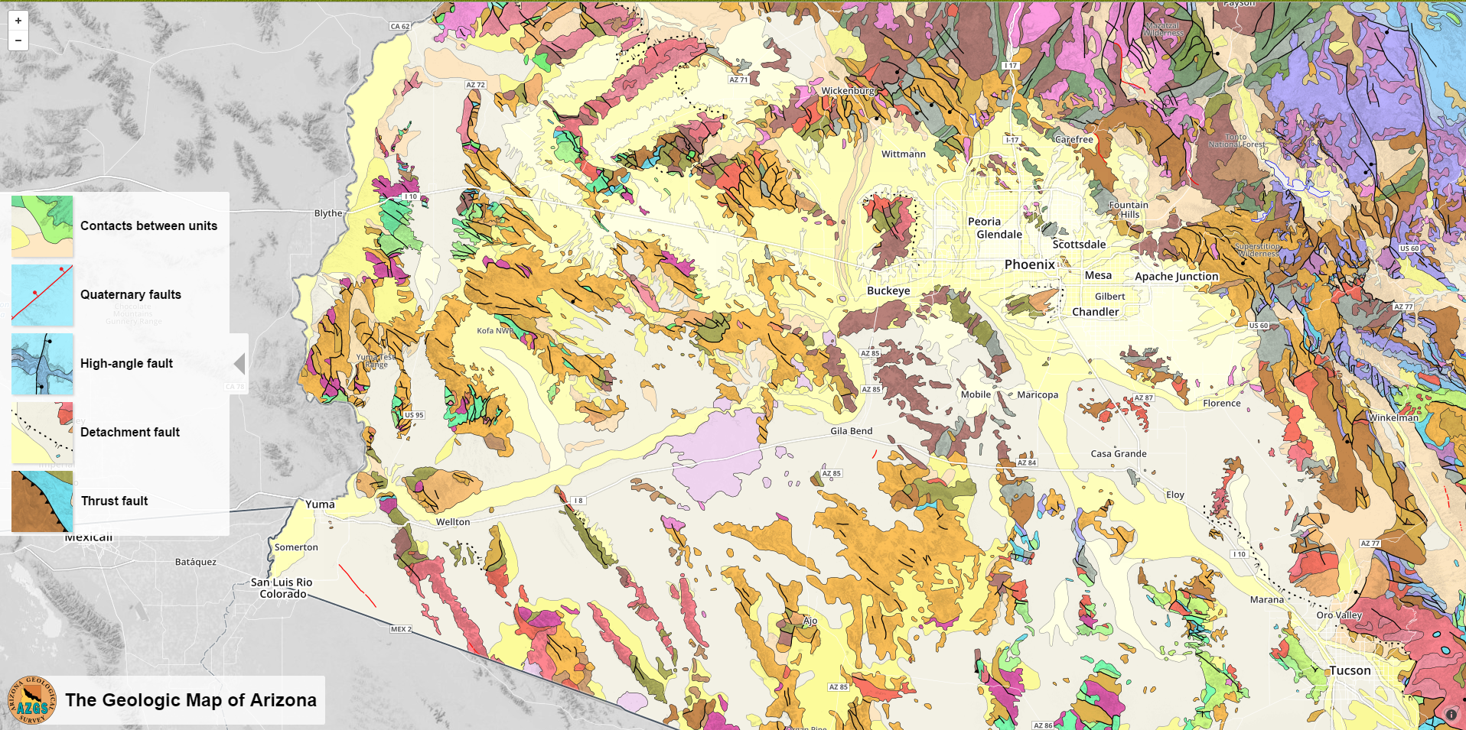
Image Credit: AZGS
Community Concern
Extreme heat is a chronic health hazard and is expected to become more dangerous with increased urbanization
Civilians most affected: those without air conditioning, proper insulation, low-income, newcomers, homeless, minorities, and socially isolated
Notes:
(Source authors: Greene et al., 2011, Hartz et al., 2012, and Zhang et al. 2013, MCDPH, 2014, Harlan, 2006, Johnson & Wilson, 2009)
Extreme heat causes heat related and heat caused deaths throughout Maricopa County, where nearly 100 people die each year and nearly 1000s suffer from heat related illnesses. These effects are not distributed equally throughout the city or among demographic groups, where the civilians most affected include those without air conditioning or proper insulation, low-income, newcomers, homeless, minorities, and the socially isolated. While these deaths are tragic, they are preventable.

Slide 4
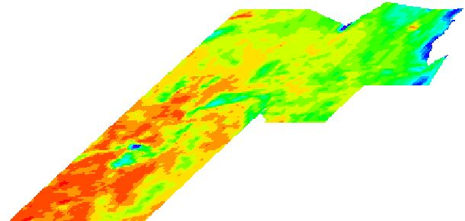
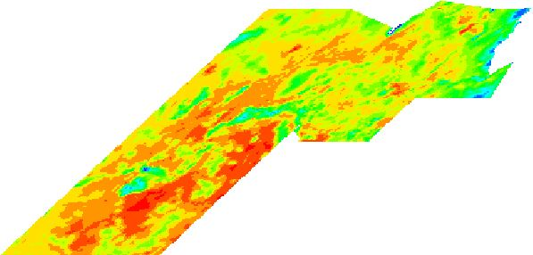
Objectives
Analyze days with extreme heat anomalies
  Understand where, how, and why daily variations occur
Establish how users of heat relief resources correlate with socioeconomic vulnerability
Determine where, when, and how relief efforts should intervene
Surface Temperature on May 21, 2005
Surface Temperature on July 2, 2005
Notes:
Our project fills knowledge gaps associated with the variability within the UHI effect, particularly on a day-to-day basis. We aimed to look at extreme heat anomalies, or days reaching temperatures above 104F, in order to to then understand where, how, and why these variations occur. As you can see in these images, the hottest areas in the county differ by day. On top of this, previous studies have used statistical regressions to assume demographic patterns. We have access to survey results that will more accurately calculate these demographic trends. Together, we will be able to provide a more detailed look into the UHI variable effect on top of locating communities most at risk so that the MCDPH’s adaptive capacity may effectively anticipate needs for relief efforts.

Slide 5




NASA Satellites and Methods
Aqua MODIS
Surface Temperature Averages
Daily surface temperature data per census tract for statistical comparisons
Landsat 8
Spatial Consistency Analysis
Average Comparisons
Land use classification of the urban environment
Terra ASTER
Nuances within UHI
Land use classification of the urban environment
Notes:
We primarily used Aqua MODIS to gather surface temperature values on a daily basis. We used weather station data to isolate dates where air temperature was above 104F as dates of interest from our study. Images on these dates were then averaged by census tract for surface temperature. Although air temperature is more relevant to what people feel, surface temperature provides insight into where and why UHI effects occur. We then compared in two ways: 1) in a spatial consistency analysis to determine if the 30% hottest tracts are consistently hot throughout the season and 2) how the measures of average surface temperature compare to each other within a season, between years, and between days. This will reveal both spatial nuances and actual surface temperature nuances within the UHI effect. Our project is also using Landsat 8 and Terra ASTER to determine accuracy of classifying land surfaces under the hottest tracts to begin answering why such variations occur, which will be expanded upon next term.

Slide 6

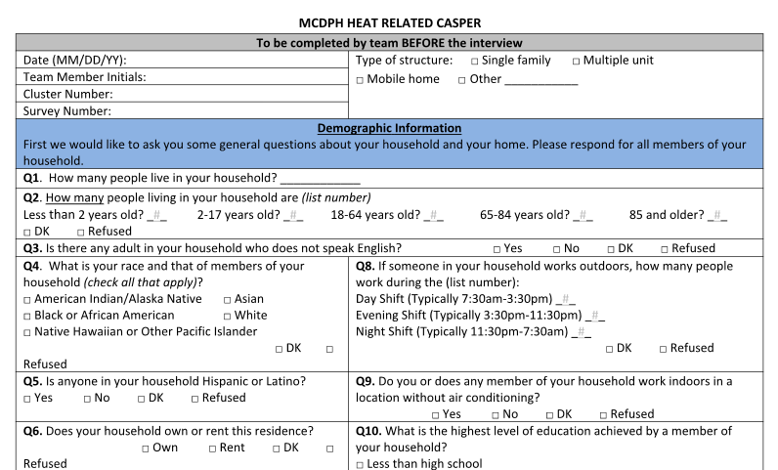
Survey Analysis
Methods
Comm. Health & Emergency Response Survey
Likelihood of AC Use
Raw CASPER Results
Comparison to Assumed Patterns
Likelihood of Hearing Warning Message
Notes:
With the survey results we ran various regressions to answer questions regarding the likelihood of AC use (against things like income, non-native english speaker, and education). We also looked at what factors made someone more or less likely to hear deployed warning messages. We added a spatial component by mapping clusters of survey respondents and their answers. This map represents the distributions of surveys throughout Phoenix and surrounding areas.

Slide 7
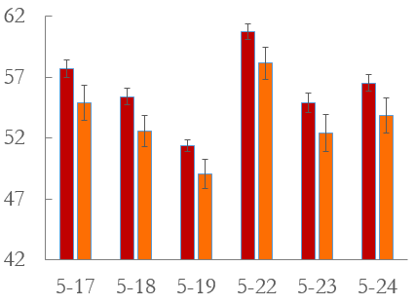
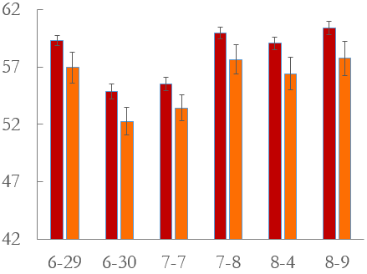
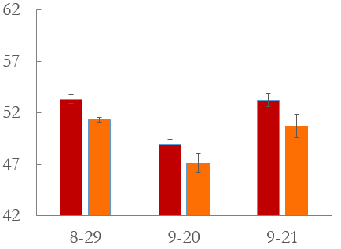

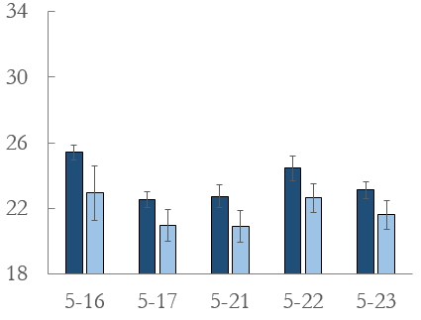
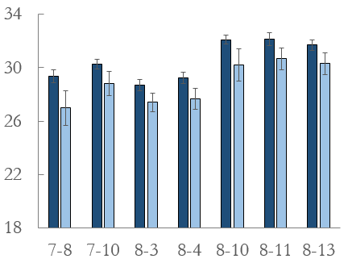
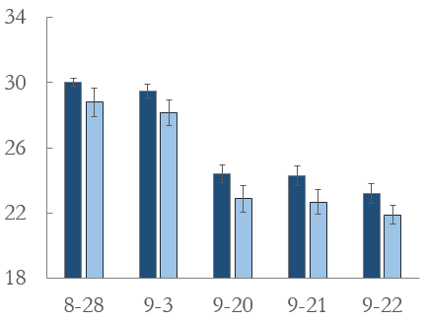

Results
Day - 2012
Early Season
Mid Season
Late Season
Average Surface Temperature (C)
Night - 2012
Date May - September 2012
Notes:
While we did establish that there is a significant association of the amount of extreme heat days between month and year and that the surface temperatures varied within a season and between years, the take away results refer to the daily surface temperature comparisons. Here we have the top 30% hottest census tracts compared to the rest of the tracts in the county on a day by day basis for the year 2012 both for daytime thermal imagery and nighttime. We found that for daytime across years, May tended to exhibit the most variability, with as much as 10 degrees celsius difference in the hottest tracts between days. Some years, not pictured here, also demonstrated that the gap between the hottest 30% and the rest of the census tracts generally was larger in May compared to other parts of the season. For nighttime surface temperature, we found the variations between days to be more consistent, with a clear increase in the mid season and a lag into the late season not apparent in the day time values.

Slide 8
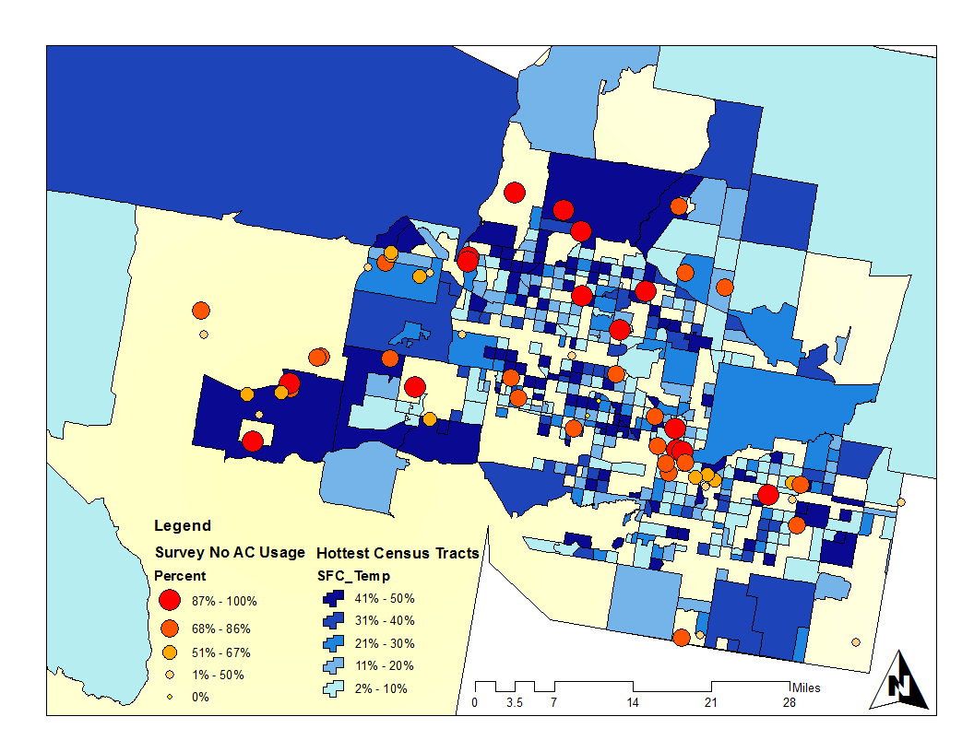
Results
Census tract average surface temperatures vary between days and how often a tract registers as occurring in the hottest 30%
Effect of Households with a Non-English speaker on Choosing not to Use A/C for Any Reason
Consistency of Daily Top 30% Hottest Census Tracts
and Survey Response for no A/C Use Due to Cost
(June - September 2006)
Notes:
Our spatial analysis of consistency overlaid with survey responses relaying that respondents felt there was something preventing them from using their AC created this map for 2012. The darker census tracts represent tracts whose daily average surface temperature consistently ranked in the top 30% hottest throughout the whole season and the points represent those who answered ‘yes’ to the question about no AC use. These responses are in surface block clusters, so the darker the red the higher percent of respondents answering yes in a cluster (usually 7 homes in a cluster). The left circle represents a rural neighborhood, the top circle includes a lot of retirement homes, and the right circle approximates the downtown area. Additionally, a linear regression on income and AC use showed that as income decreases, the likelihood of not using AC decreases/increases by X%, shown in this figure.

Slide 9
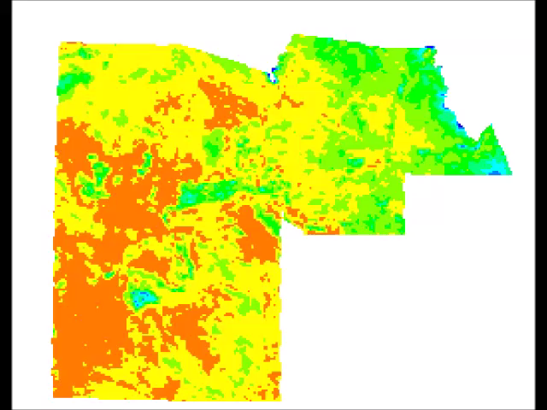
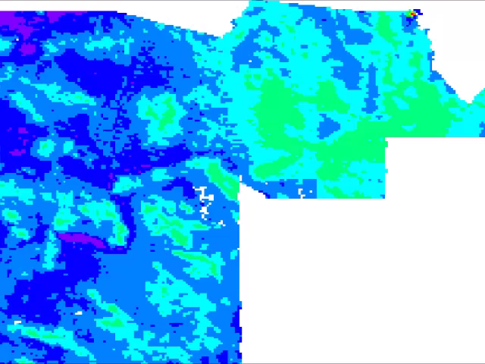
Conclusions
Day
Night
Within and between extreme heat dates, average values vary for day and night - adaptive capacity
  Day: Early season varies the most
  Night: more consistent and lag into late season
Efforts should focus on census tracts both consistently ranking in top 30% and showing disadvantage for relief efforts
Notes:
These animations show daily images for surface temperature, left, and daily surface temperature images for night, right. We established that within a season, the hottest census tracts are not always the hottest. On top of this, surface temperatures are not consistent throughout the season, where some months are consistently higher than other months and some days have greater variability in relation to one another. The nighttime effect should not be neglected, as there is a very clear increase in average temperature in the mid season and a lag into the later season. While daily temperatures may cool earlier in the season, the area is not providing necessary relief at night, possibly amplifying the health risk. Knowing this pattern, the MCDPH can strategically aim their warning messages at the riskier areas in that part of the season. This will hopefully allow more individuals to know when to seek cooling centers and when the event will be amplified and sustained by a stronger UHI potential.

Slide 10
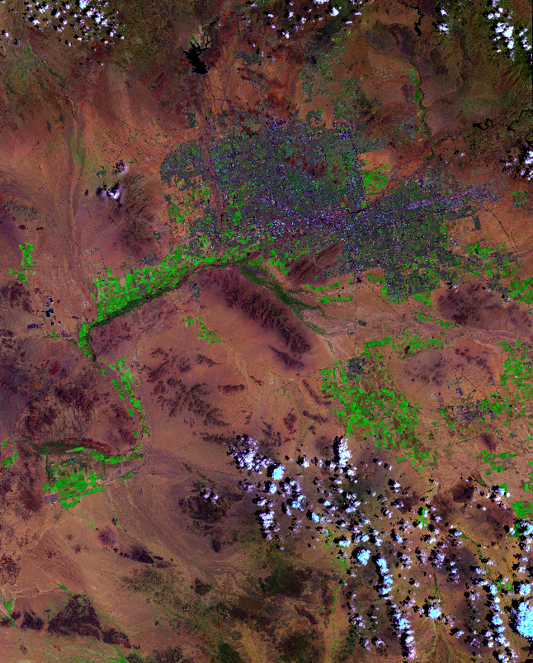
Future Work
Employ land use classification to answer why shifts occur
Synoptic upper air circulation and surface weather type classifications
Landsat 8 Bands 7-5-1 RGB
Notes:
Our project aimed to answer the “how” and “when/where” questions of variations in the UHI effect. Future studies would benefit by increasing this analysis to tackle the “why” questions, such as quantifying surface feature classifications under each heat anomaly to determine any patterns. On top of that, we see potential for this project to continue even further and provide insight into longer term bigger focus solutions that tackle other DEVELOP areas of interest, such as energy and water resources. Over time, we would like to see this information used as a means to provide a suitability analysis for the effective placement of solar panels (or at least to get the conversations heading this way in how solar panels can help save lives in Maricopa) with the idea being that cleaner energy reducing negative climate forcings and solar panels specifically are less water intensive and can inherently cool buildings more efficiently when placed on rooftops by creating an inverse insulation effect.

Slide 11
Advisors
Dr. David Hondula - Arizona State University:
Geographic Science and Urban Planning
Dr. Kenton Ross - NASA DEVELOP National
Science Advisor
Partners
Arizona Department of Health Services
ASU Environmental Remote Sensing and Informatics
Lab
ASU Center for Policy Informatics
Others
Emily Adams - NASA DEVELOP LaRC Center Lead
Dan Wozniak - NASA DEVELOP LaRC Assistant Center
Lead
Jeff Ely - NASA DEVELOP Geoinformatics Scientist
Grant Mercer - NASA DEVELOP LaRC 2015 Summer
Participant

Slide 12
Association - Month and Year
There is an association of the amount of extreme heat days between month and year.
 | Study Years
Month | 2005 | 2006 | 2007 | 2008 | 2009 | 2010 | 2011 | 2012 | 2013 | 2014
May | 5 | 7 | 2 | 3 | 4 | 0 | 0 | 6 | 0 | 6
June | 12 | 27 | 20 | 19 | 8 | 19 | 15 | 22 | 29 | 25
July | 28 | 22 | 21 | 25 | 26 | 27 | 24 | 22 | 22 | 25
August | 13 | 13 | 20 | 20 | 24 | 21 | 27 | 20 | 21 | 15
September | 8 | 2 | 12 | 5 | 10 | 18 | 14 | 7 | 11 | 10
Total # of Days | 66 | 71 | 75 | 72 | 72 | 85 | 80 | 77 | 83 | 81
2005
2014
Notes:
THIS IS THE START OF BACK UP SLIDES IN CASE THERE ARE ANY QUICK QUESTIONS THAT NEED FIGURE REFERENCE, THEY ARE STILL BEING WORKED ON AS WE CREATE MORE FIGURES

Slide 13
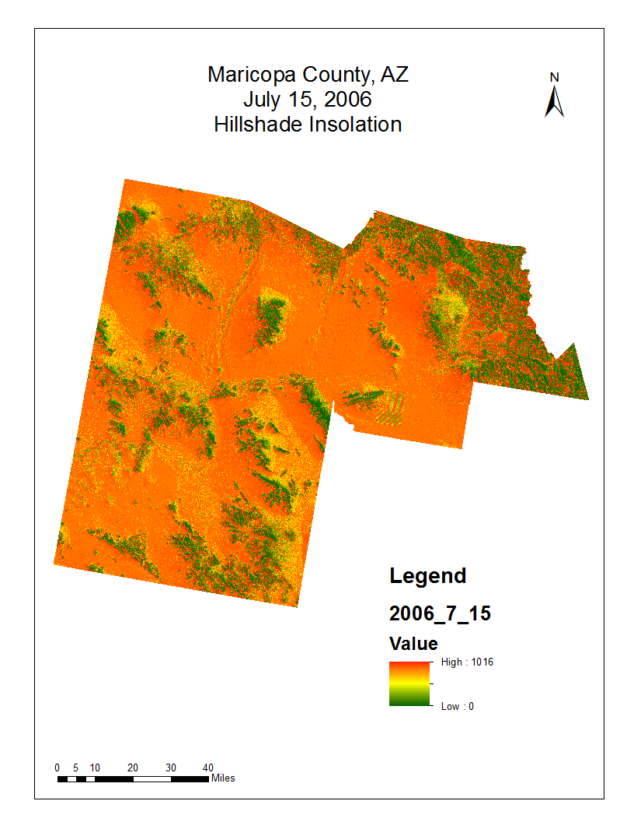
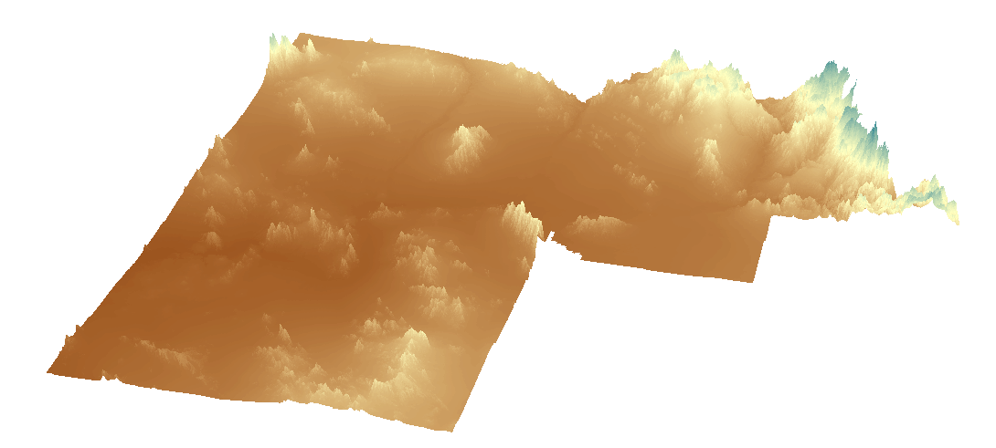
Insolation

Slide 14
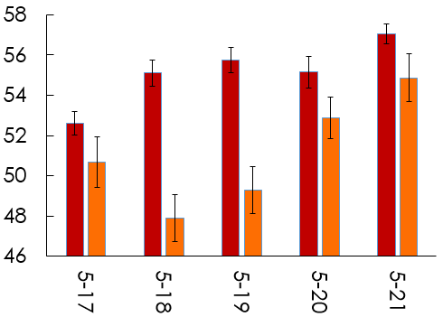
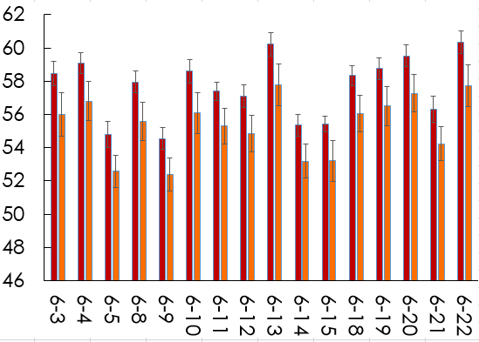
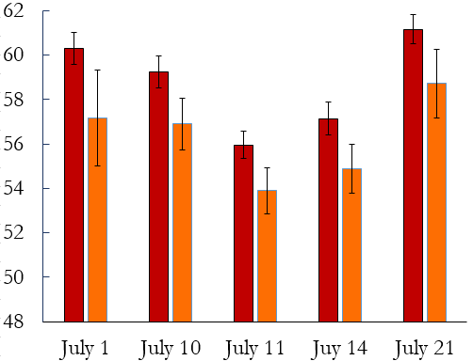
Daily Variations

Slide 15
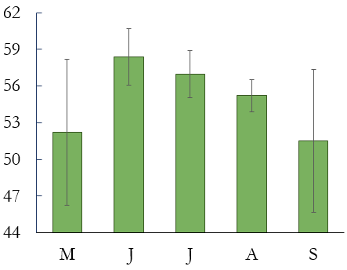
Seasonal Variation

Slide 16
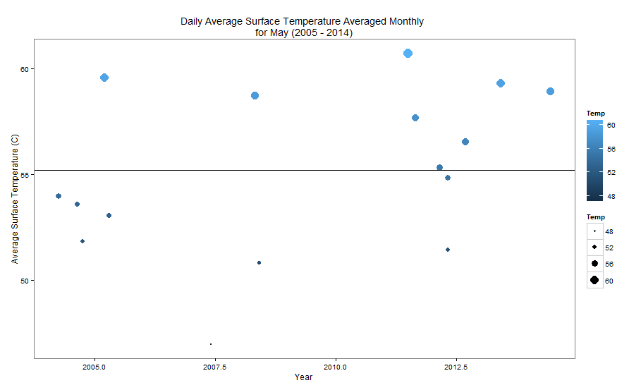
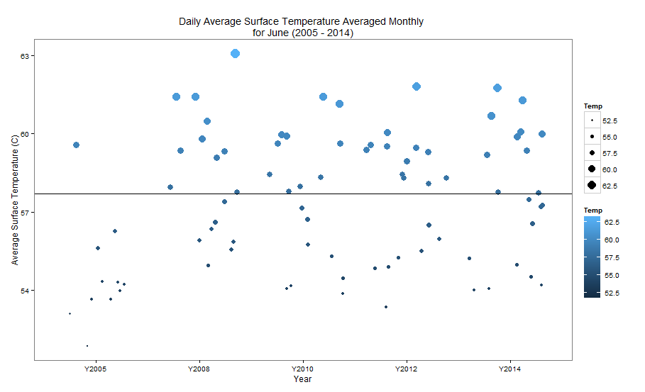
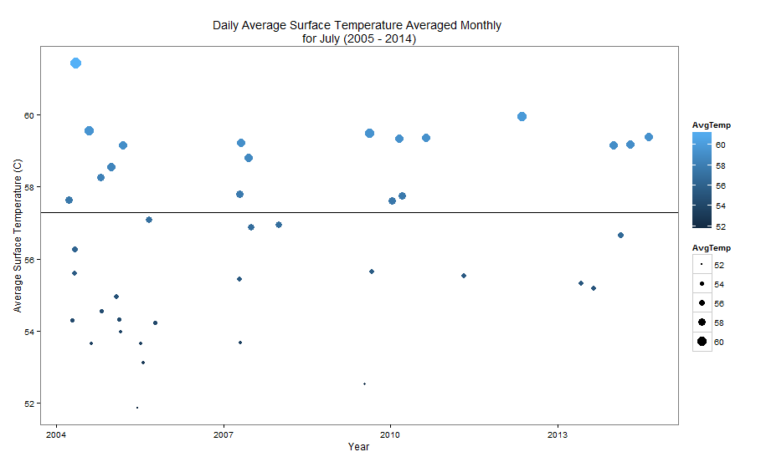
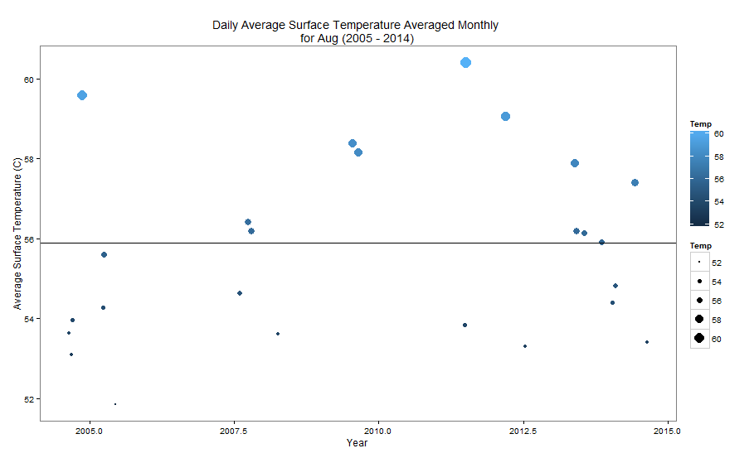
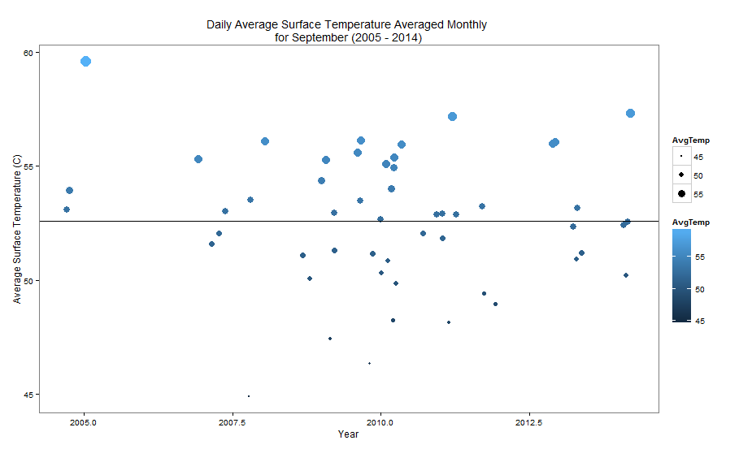
Yearly Variation

Slide 17
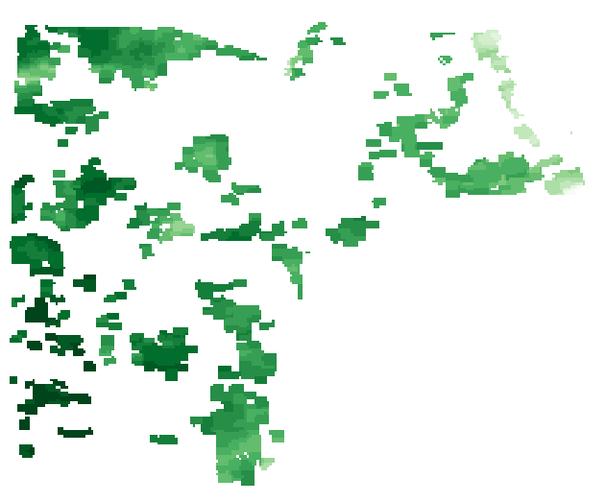

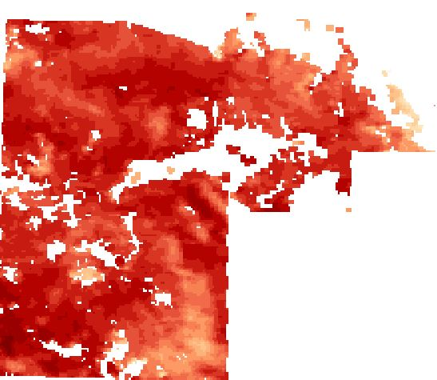
Limitations
Large amount of NA values from clouds in July and August
Allowed images with <= 22.5% cloud cover
> 22.5%
> 22.5%
< 22.5%
Surface Temperature August 12, 2007
Surface Temperature July 26, 2009
Surface Temperature July 30, 2014
Notes:
Satellites have different pass over times and therefore do not allow for a direct apples-to-apples comparison between images. We chose the Aqua satellite because the pass over times 1030 am and pm, more closely proximate the true maximum temperature in a daily cycle. However, when then using the Landsat 8 satellites, these pass over times are closer to the other MODIS sensor satellite, Terra. We are aware that there are diurnal effects throughout a day, so we did a satellite comparison between Aqua and Terra to see how much of a difference this makes. On top of that, August proved to be a very cloudy month over all years, meaning that even though the count of extreme heat days was high, the actual days used for averages was much lower. We justified leaving these out based on the idea that cloudier days generally would not result in hotter surface temperature, therefore the average would not be thrown off by a large magnitude.

