Slide 1
Virginia Water Resources II
Utilizing NASA Earth Observations to
Identify Harmful Algal Blooms in the Chesapeake Bay
Arika Egan (Project Lead)
Jessica Jozwik
Zachary Tate
Tyler Rhodes
Jakub Blach

Slide 2
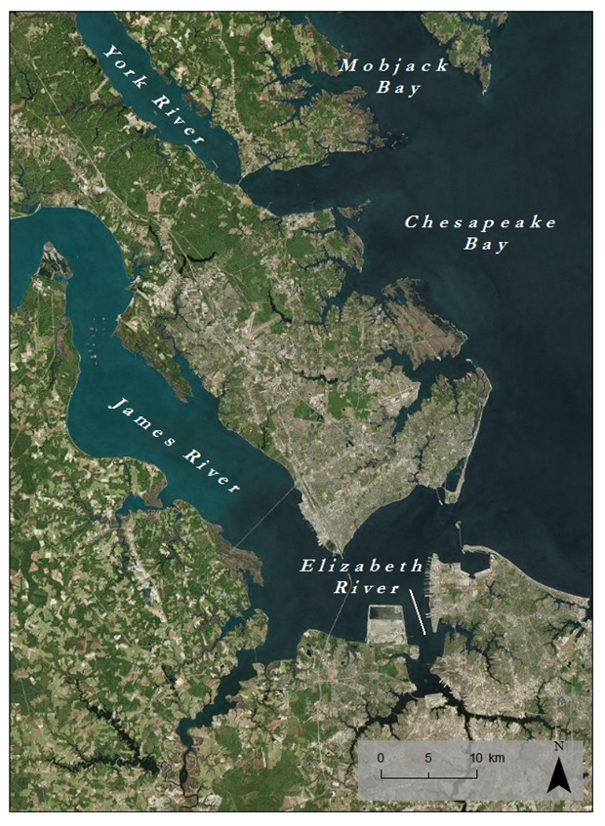
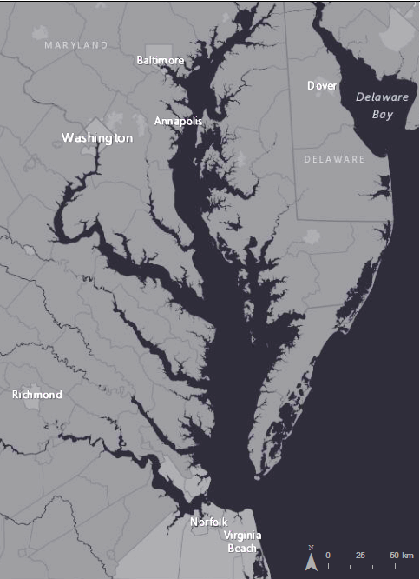
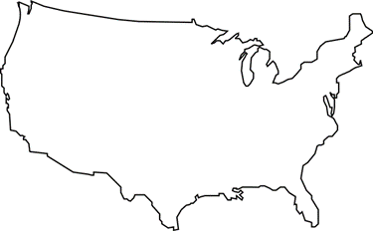
Study Area
Study Area:
Lower Chesapeake Bay
Study Period: August 17th, 2015
Notes:
Our Study Area is comprised of Virginia’s Lower Chesapeake Bay, The James River, The York River, The Elizabeth River, and Mobjack Bay.
We used observational and in-situ data from August 17th, 2015
Sources: ArcGIS Basemaps

Slide 3
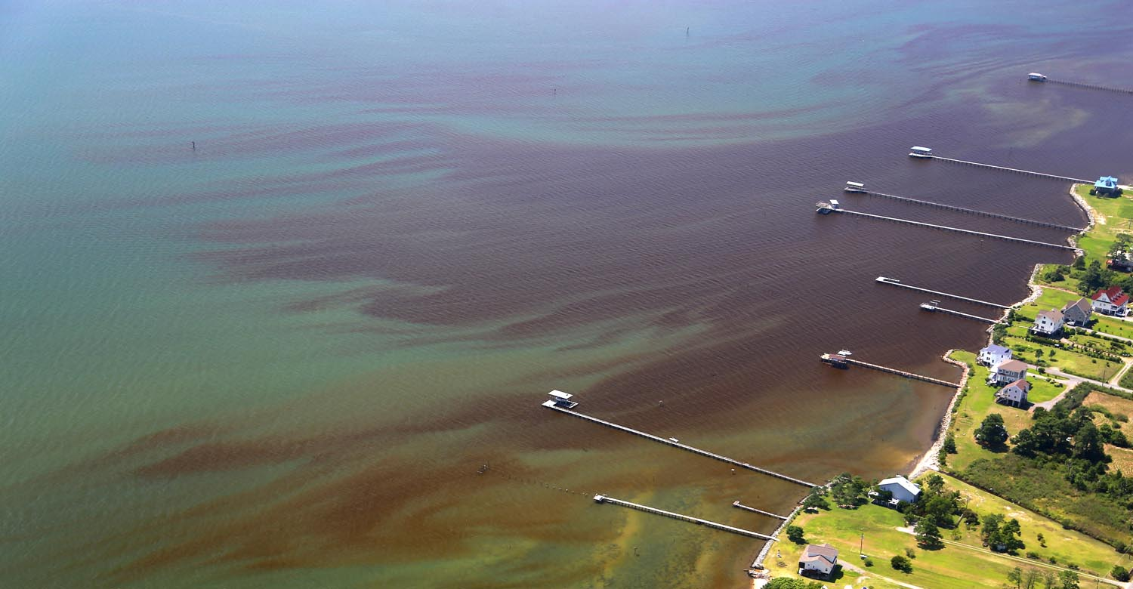
Harmful Algal Blooms (HABs)
Population Growth
Nutrient Runoff
Excessive Growth of Algae
Image Credit: Wolfgang Vogelbein, York River, 8-17-2015
Notes:
The population of the Chesapeake Bay now pushes 18 million people.
Increasing population has lead to an increase in nutrient runoff into the Bay. Agricultural and urban runoff, vehicle emissions, sewage treatment plants, and the burning of fossil fuels all are responsible for nutrient loading in the Chesapeake Bay.
Increased nutrients promote excessive growth of algae.
Image source: Directly provided by VIMS

Slide 4
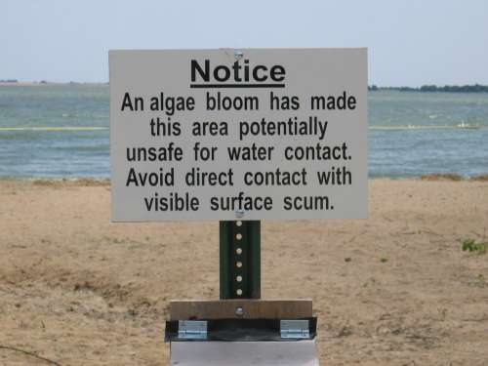
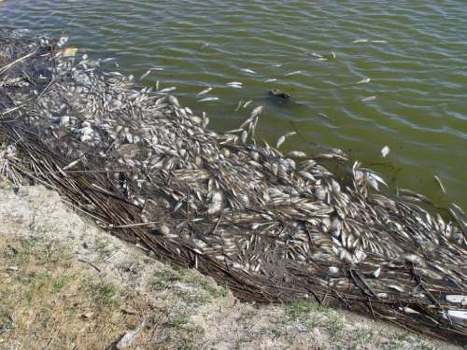
Community Concerns
Degrade water quality
Reduce Sunlight
Deplete oxygen
Produce toxins
Threaten
Fishing industry
Tourism industry
Ecological health
Human health
Jennifer Graham. Harmful Algal Blooms. 10/19/2015
Mike Hooper. Dead Fish Washed Ashore during Golden Alga Toxic Bloom. 10/19/15
Notes:
HABs block the penetration of sunlight through the water column, reducing the amount of available light for photosynthesis and plant growth.
As they die and decompose, they deplete dissolved oxygen in the water that is necessary to sustain animal life.
Certain species produce toxins that can mutate fish, cause human illness, and give off unpleasant smells.
As a result, the fishing industry is harmed, beaches are closed, human health is threatened, and areas of the Bay are less capable of sustaining plant and animal life.
Image credit: Provided directly from VIMS

Slide 5
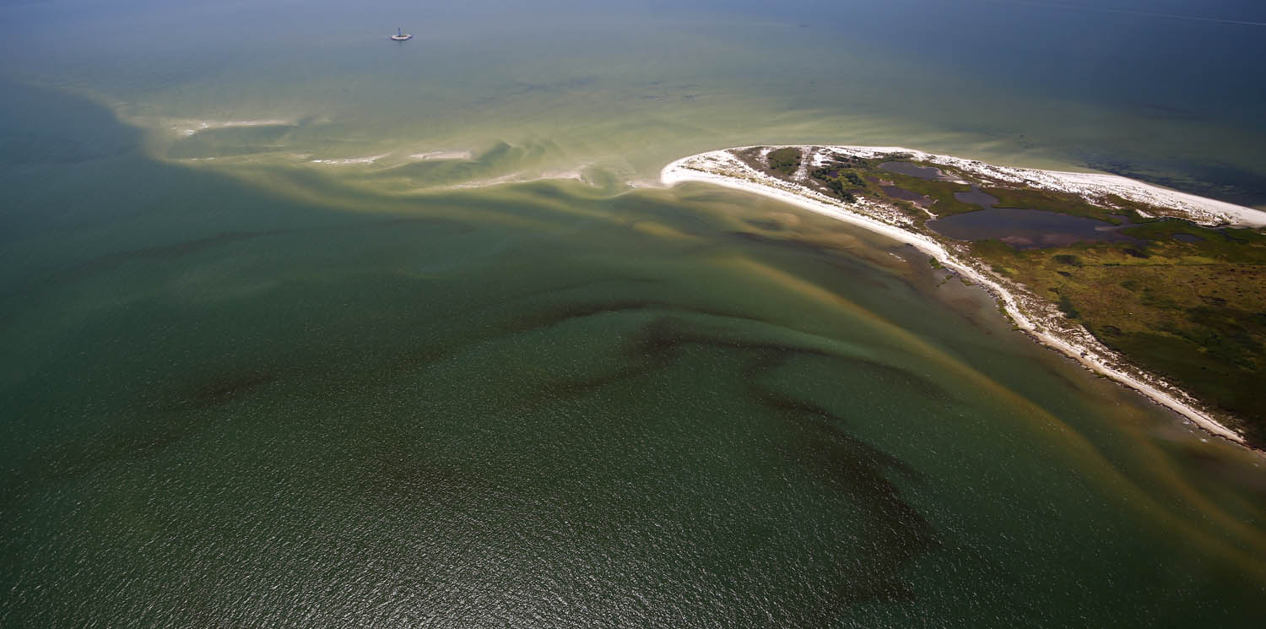
HAB Task Force
  Detect and study
HAB Hotline
  Report
VA Health Department
  Respond
Current Methods
Image Credit: Wolfgang Vogelbein, York River, 8-17-2015
Notes:
There are two ways HABs are Detected: Through HAB Task Force Testing and Reports to the HAB Hotline
HAB TASK FORCE:
Comprised of VIMS, DEQ, ODU, VA Dept of Health and VA Marine Resources Commission
Responsible for Detecting and studying HABs.
Maintains 20 fixed testing stations throughout the bay. Test water quality parameters and genetic testing of phytoplankton monthly from May-November
24 HOUR HAB HOTLINE
1. Relies on community members to report suspicious smells, colors, or fish kills.
There is currently no reliable method of real-time monitoring of HABs in the Chesapeake Bay. Researches must coordinate data collection cruises to gauge severity and duration of HABs, and must organize costly flyovers to study magnitude of the blooms. We thus seek to remedy this by…
Image Credit: Provided to us directly from VIMS

Slide 6
Objectives
Develop
an algorithm to combine Landsat 8 and in situ data to estimate chlorophyll-a concentrations
Create
a python tool that processes raw Landsat 8 OLI images and produces a chlorophyll-a hotspot map
Cultivate
a better understanding of the causes and impacts of HABs
Improve
routine and emergency assessment of HABs
Notes:
The goal of this project was to create a python tool to be used in ArcGIS that will produce a map of chlorophyll concentration for the Chesapeake Bay Watershed. It will do this by taking in Landsat 8 data and processing it with an algorithm created during this project.
By identifying the locations of HABs, our partners will be able to analyze the area to better understand the cause of the bloom.
New Landsat imagery of the watershed is produced every 16 days. The speed of this production, combined with the estimation tool, will allow our partners to more effectively monitor HABs when they occur. This is more efficient than the current system of routine monitoring and civilian reports of HABs.
This tool will better help determine the size, duration, frequency, and cause of HABs. These data are important factors in policy writing and can help improve regulations to prevent HABs.

Slide 7

NASA Earth Observations
Landsat 8 OLI
Notes:
Landsat 8 OLI: Downloaded with USGS Earth Explorer. Path 14 Row 34 and Path 15 Row 34 captured our study area. 30m resolution

Slide 8
Methodology I
Landsat 8 OLI/TIRS reflectance bands
VECOS in situ water quality data
NOAA bathymetry data
Acquisition
Create masks for land, clouds, shallow water and turbid water
Match Landsat and VECOS data
Combine layers into exported table
ArcGIS
Run linear and nonlinear regressions
Use best fit regression model as predictive model
R
Notes:
The data we used were Landsat 8 OLI/TIRS Reflectance bands, VECOS in situ water quality data and NOAA Bathymetry data.

Slide 9
Methodology I
Landsat 8 OLI/TIRS reflectance bands
VECOS in situ water quality data
NOAA bathymetry data
Acquisition
Create masks for land, clouds, shallow water and turbid water
Match Landsat and VECOS data
Combine layers into exported table
ArcGIS
Run linear and nonlinear regressions
Use best fit regression model as predictive model
R
Notes:
First, we needed to create masks for our images to ensure our results were not impacted by land, clouds, shallow water or turbid water.

Slide 10
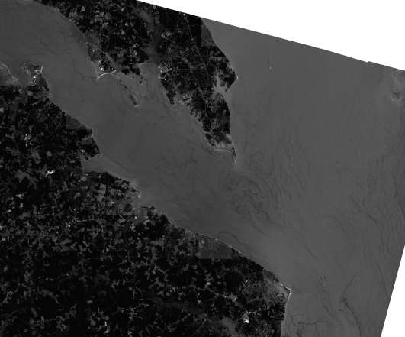
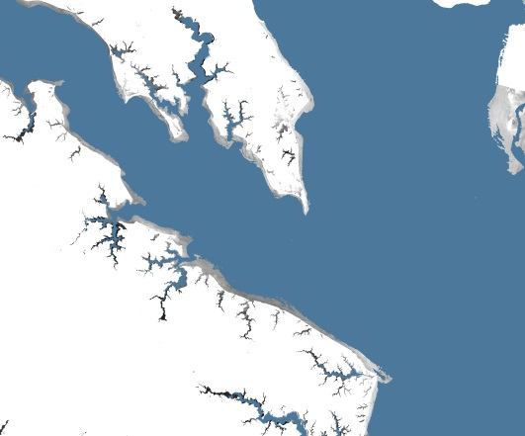
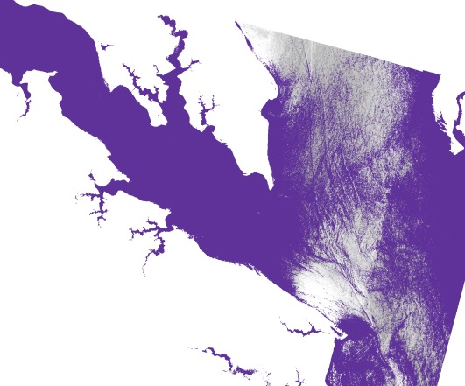
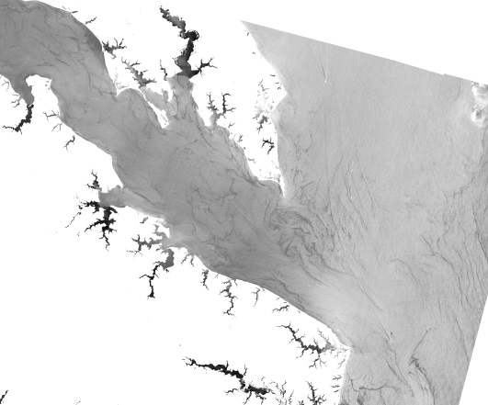
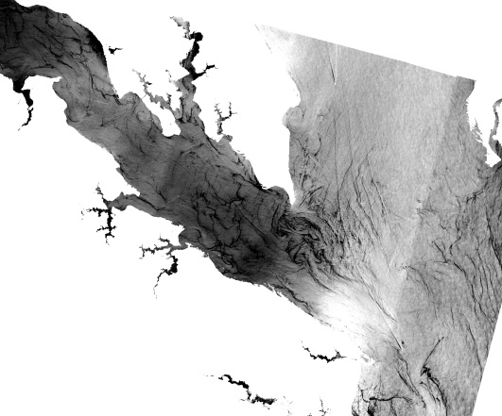
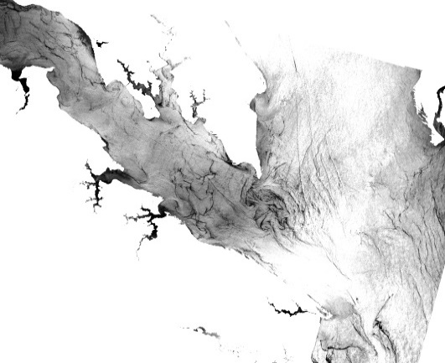
Masks
1
2
3
Land and cloud pixels are removed
Shallow (<2m) pixels are removed
High sediment concentrations are removed
Notes:
We started with Raw Landsat data. The first image on the top left is Landsat 8 Band 1 from August 17th, 2015. Land pixels are removed by creating a water mask with the Normalized difference vegetation index. Clouds are removed using a cloud mask provided by EarthExplorer.
Next, using Bathymetry provided by NOAA, pixels corresponding to a depth of 2 meters or less are removed. The top middle image shows the bathymetry mask over the land and cloud removed image from the bottom left. The result is the bottom middle image.
Finally, high sediment concentrations are removed, using a model that calculated the Normalized Difference Turbidity Index. The top right image shows the sediment mask over the land, cloud, and shallow pixel removed image of the bottom middle. The final result is an image with land, clouds, shallow pixels, and high sediment concentrations removed, shown on the bottom right.
Image credit: NASA DEVELOP Wise County

Slide 11
Methodology I
Landsat 8 OLI/TIRS reflectance bands
Aqua MODIS chlorophyll-a
VECOS in situ water quality data
NOAA bathymetry data
Acquisition
Create masks for land, clouds, shallow water and turbid water
Match Landsat and VECOS data
Combine layers into exported table
ArcGIS
Run linear and nonlinear regressions
Use best fit regression model as predictive model
R
Notes:
We then tried to match the Landsat image with the VECOS data. However…

Slide 12
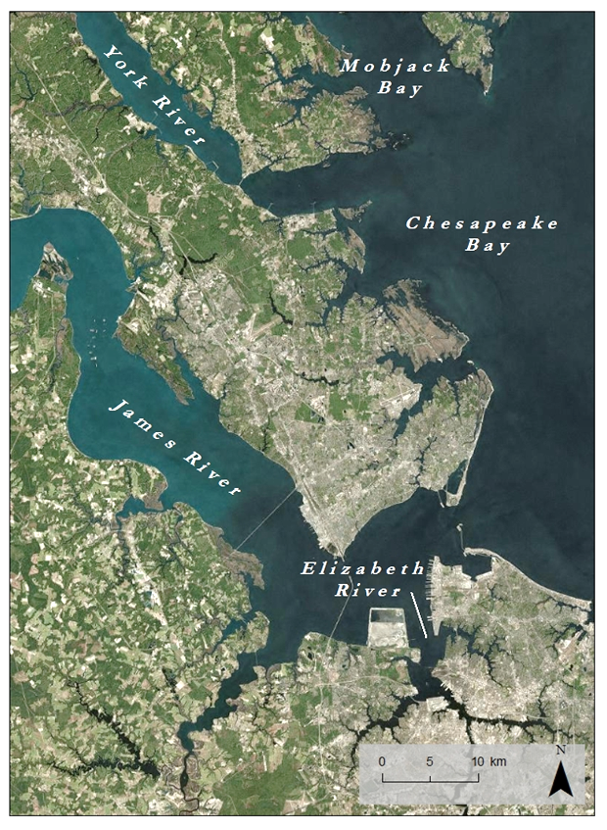
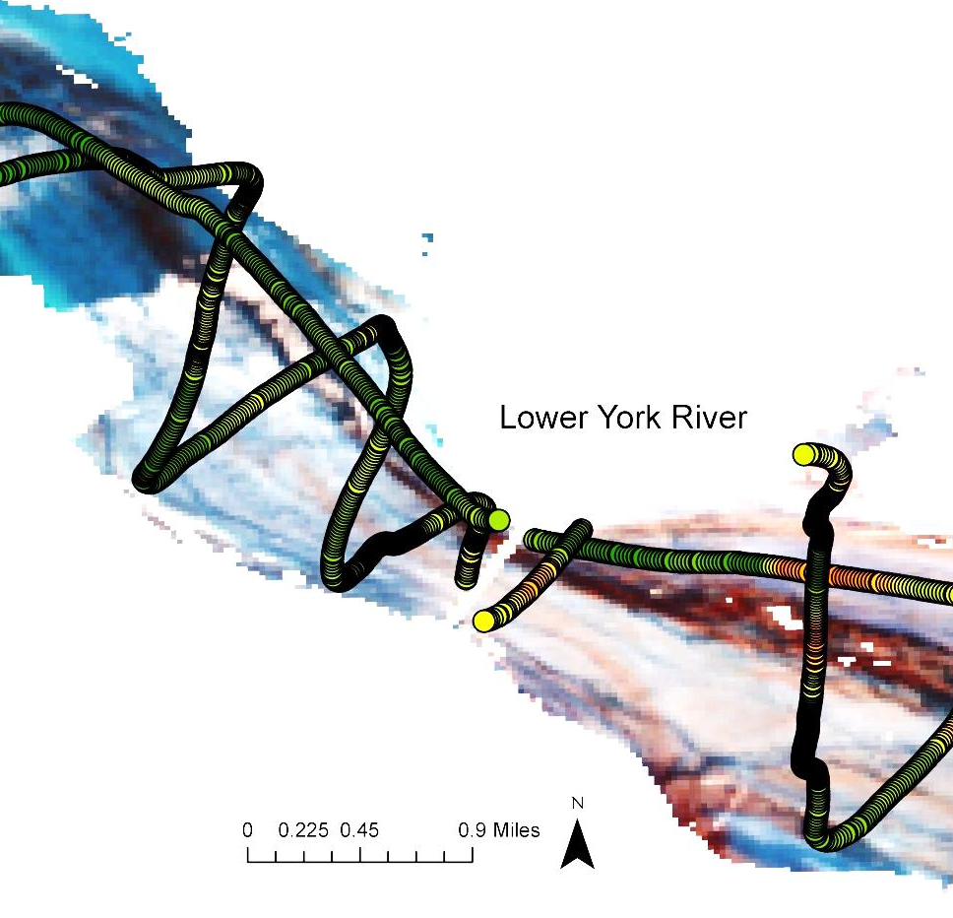
Initial Results
Notes:
Notice the data flow trail in the image on the left. The image the dataflow is overlaid on is a color composite of Landsat bands 5, 4, and 3, a typical combination for highlighting chlorophyll. On the image, higher chlorophyll values are in red. The image has been slightly enhanced to show where a few data inconsistencies lie. The data does not match up in the image in several places, most obviously at the locations circled in purple. Even if the 543 composition doesn’t report accurate concentrations, the range of values should report where there is more and less chlorophyll. The Landsat range doesn’t match up with the VIMS range.
When plotting in R, the data was very inconsistent, with R squared values no greater than 0.2.
Image credit: NASA DEVELOP Wise County
Source: ArcGIS Basemaps

Slide 13
Methodology I
Landsat 8 OLI/TIRS reflectance bands
Aqua MODIS chlorophyll-a
VECOS in situ water quality data
NOAA bathymetry data
Acquisition
Create masks for land, clouds, shallow water and turbid water
Match Landsat and VECOS data
Combine layers into exported table
ArcGIS
Run linear and nonlinear regressions
Use best fit regression model as predictive model
R
Notes:
Despite the visual discrepancies, we still tried to find a model that would predict chl-a. We ran 171 linear and non-linear regressions in R to do so.

Slide 14
Initial Results
Formula | R² | Adj R² |  | formula | R² | Adj R²
~exp(b1/b2) +b1+ b2+ b3+b4 | 0.1868 | 0.1855 |  | ~exp(b4/b3) +b1+ b2+ b3+b4 | 0.1889 | 0.1877
~exp(b1/b2) +b1+ b2+ b3+b5 | 0.1796 | 0.1783 |  | ~exp(b4/b3) +b1+ b2+ b3+b5 | 0.1884 | 0.1871
~exp(b1/b2) +b1+ b2+ b3+b6 | 0.1613 | 0.16 |  | ~exp(b4/b3) +b1+ b2+ b3+b6 | 0.1905 | 0.1892
~exp(b1/b2) +b1+ b2+ b3+b7 | 0.1621 | 0.1608 |  | ~exp(b4/b3) +b1+ b2+ b3+b7 | 0.1902 | 0.189
~exp(b1/b2) +b1+ b2+b3+b4+b5 | 0.1872 | 0.1857 |  | ~exp(b4/b3) +b1+ b2+b3+b4+b5 | 0.1893 | 0.1878
~exp(b1/b2) +b1+ b2+b3+b4+b6 | 0.1878 | 0.1863 |  | ~exp(b4/b3) +b1+ b2+b3+b4+b6 | 0.1909 | 0.1895
~exp(b1/b2) +b1+ b2+b3+b4+b7 | 0.1877 | 0.1863 |  | ~exp(b4/b3) +b1+ b2+b3+b4+b7 | 0.1907 | 0.1892
~exp(b1/b2) +b1+ b2+b3+b4+b5+b6 | 0.1959 | 0.1942 |  | ~exp(b4/b3) +b1+ b2+b3+b4+b5+b6 | 0.2011 | 0.1994
~exp(b1/b2) +b1+ b2+b3+b4+b5+b7 | 0.1962 | 0.1945 |  | ~exp(b4/b3) +b1+ b2+b3+b4+b5+b7 | 0.2009 | 0.1992
~exp(b1/b2) +b1+ b2+ b3+b4+b5+b6+b7 | 0.1968 | 0.1949 |  | ~exp(b4/b3) +b1+ b2+ b3+b4+b5+b6+b7 | 0.202 | 0.2
Notes:
We ran a total of 171 models using all different kinds of band ratios and different mathematical relationships, including linear, logarithms, and exponentials. The above table is a sample of the models we ran, as well as the best model we found, further showing the inconsistency of the data.

Slide 15
Methodology II
Acquisition
Raw Landsat 8 OLI Image
NOAA Bathymetry Data
ArcMap
Create masks for land, clouds, shallow water and turbid water
Create two different maps
  Combine bands 5 4 3
  Normalized Difference Vegetation Index
Chesapeake Bay Chlorophyll-a Hotspot Identifier Tool
Python
Notes:
Due to this data inconsistency and a lack of time, we decided to create some visual choropleth maps using two combinations. One uses the typical 543 band combination highlighting chlorophyll, and one is a display of the NDVI of an image, calculated from bands 5 and 4. We had to mask out pixels corresponding to depths of 2 meters or less, as well as pixels corresponding to high amounts of sediment. Shallow water reflects a lot of light and can be misinterpreted as areas of high chlorophyll concentration.
Default stretches were created for the regions listed and saved as .xml files in ArcMap. These stretches can be directly applied to the final band compositions to highlight chlorophyll concentrations.

Slide 16
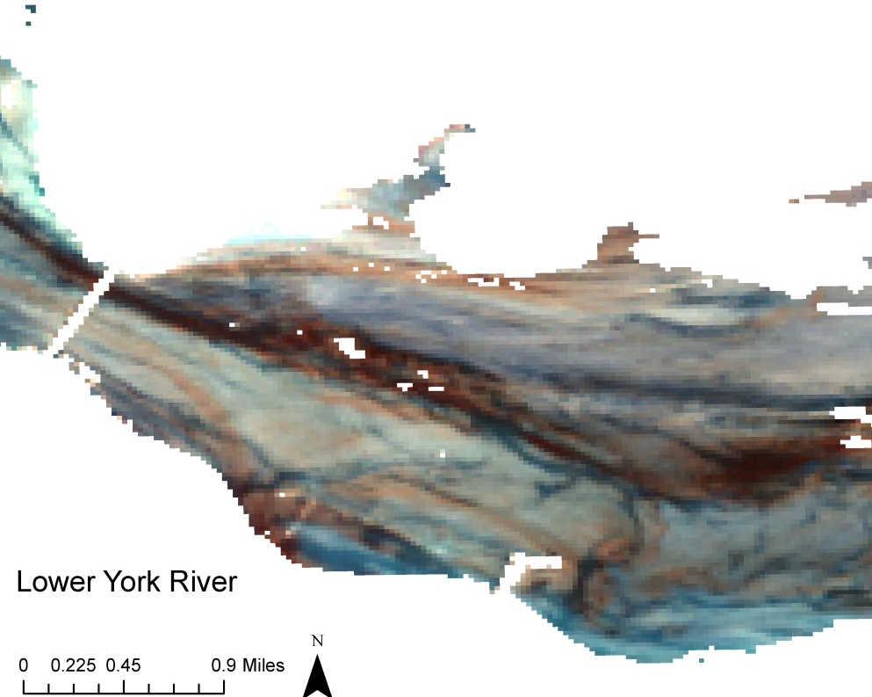
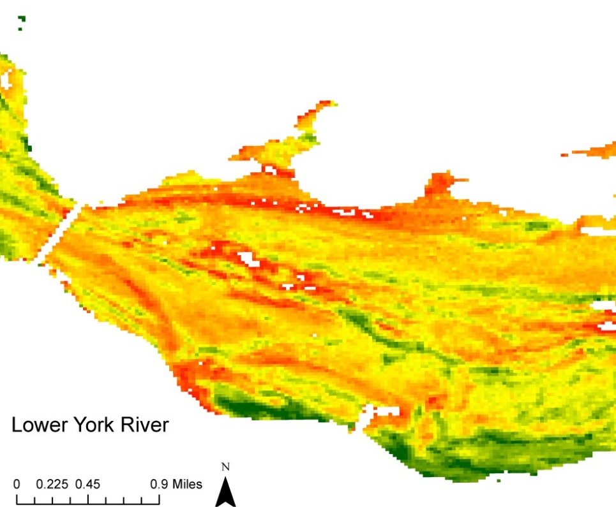
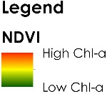
Results and Conclusions
1 Mile
1 Mile
543 Color Composite
NDVI
Notes:
We cross calibrated in situ data with Landsat 8 data, only to find that the data did not match up well enough to form any working algorithm. We instead created a tool that takes in raw Landsat 8 data, removes land, cloud, shallow, and high sediment concentration pixels. It then creates two images of different band combinations. The user can use these final images, apply a preconfigured stretch to the NDVI, and view chlorophyll concentrations.
The NDVI image has a 20% min clip applied to it.
Image credit: NASA DEVELOP Wise County

Slide 17
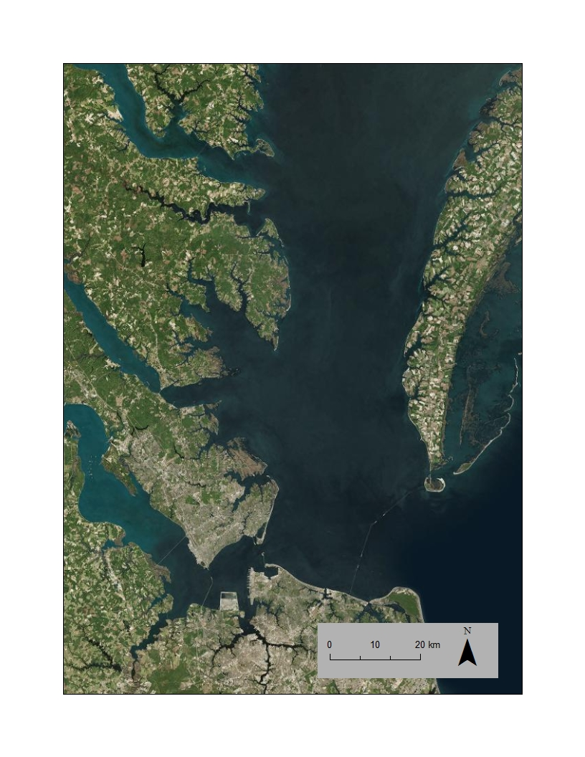
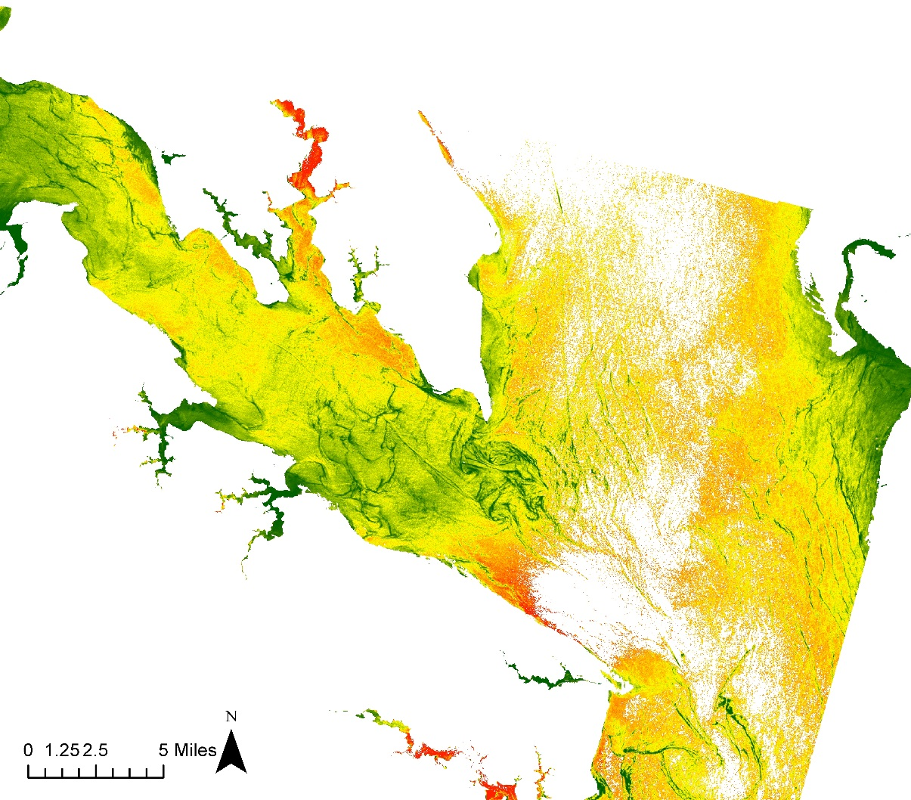

Results and Conclusions
Chesapeake Bay with the Potomac River in red
NDVI highlighting chl-a
in the Potomac River
Notes:
Our partner noticed that there are sections of the Potomac River, located north of our initial study area, that are indicating high concentrations of chl-a. Next bloom season, VIMS can include the Potomac River in their monitoring and in-situ data collecting.
Source: ArcGIS Basemaps

Slide 18
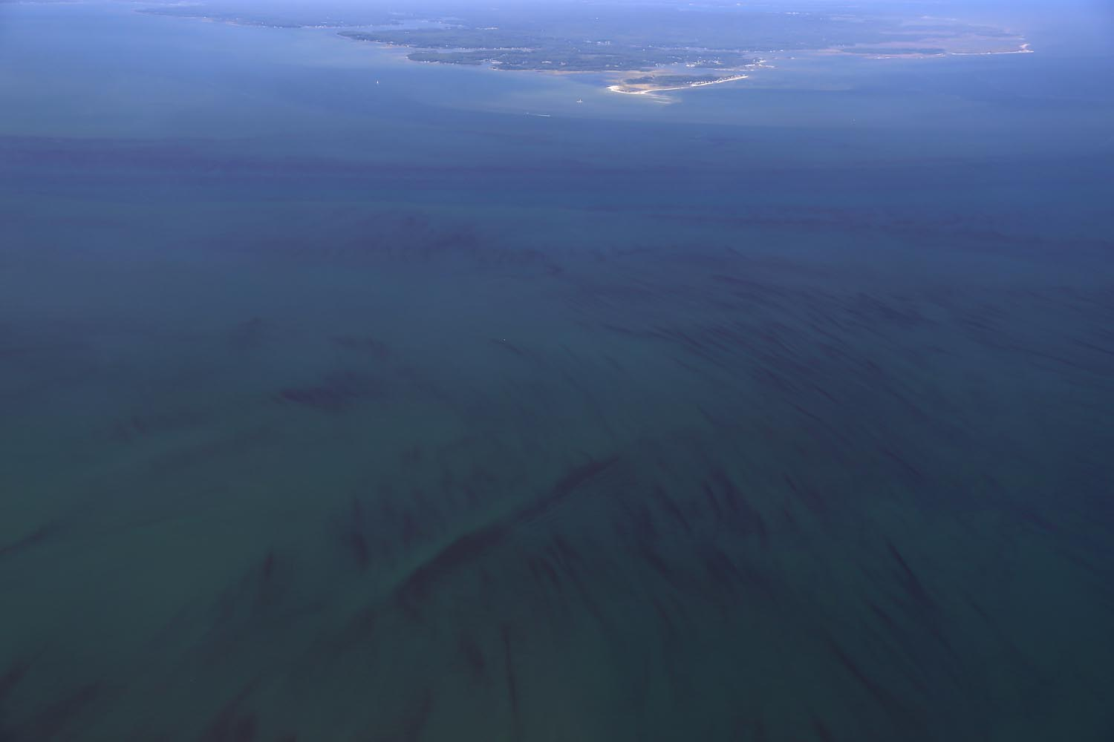
Uncertainties
Not calibrated with in situ data
Relative chlorophyll-a concentrations
NDVI vs 543
Subjectivity in the stretch applied
Future Work
Collect in situ data and calibrate model
Create tool for specific areas
Wolfgang Vogelbein, York River, 8-17-2015
Notes:
Because the code is not calibrated with in situ data, the displayed results are only relative. They do not provide a prediction gradient. Therefore, the colored values in the images will range from low to high, no matter what the chlorophyll concentration is. For example, on a day with very little chlorophyll through out the whole bay, the areas with the most concentration will be colored red on the final images.
We’re also not sure which image results are better: The NDVI or the 543 color composition. The NDVI is meant to display vegetation, which chlorophyll fits under. The 543 color composition is also meant to display chlorophyll, but it’s typically used on land scenes. We’re not sure how it displays chlorophyll on water.
The preconfigured stretches applied to the NDVI are only a few options out of many. Since the image are visually created, they can be stretched in multiple ways, depending on how much detail is desired. It’s uncertain what the proper stretch should be.
Image credit: Provided directly from VIMS

Slide 19
Acknowledgements
Dr. Kim Reece, Virginia Institute of Marine Science
Russ Baxter, Virginia Deputy Secretary of Natural Resources for the Chesapeake Bay
Will Hunley, Hampton Roads Sanitation Department
Todd Egerton, Old Dominion University
Partners

Slide 20
Acknowledgements
Dr. Kenton Ross, NASA DEVELOP
Robert VanGundy, University of Virginia’s College at Wise
Dr. DeWayne Cecil, Global Science and Technology, Inc.
Advisors
Dr. Sarah Lubkin, Past Contributor
Cassandra Morgan, Past Contributor
Melanie Salyer, NASA DEVELOP Wise County
Jeremy Smith, NASA Langley Research Center
Craig Nickol, NASA Langley Research Center
Others

