Slide 1
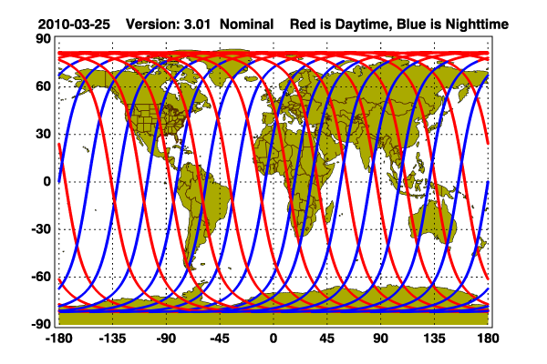
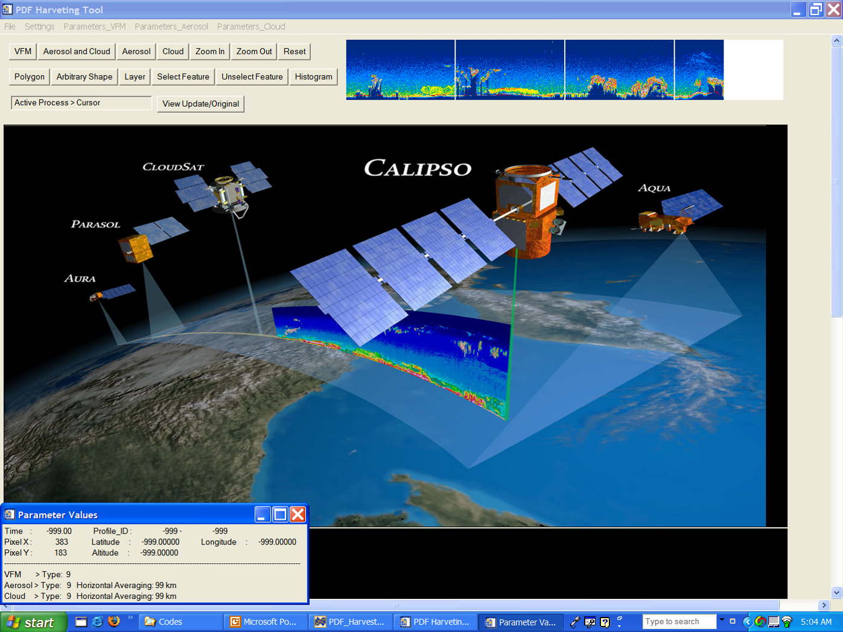
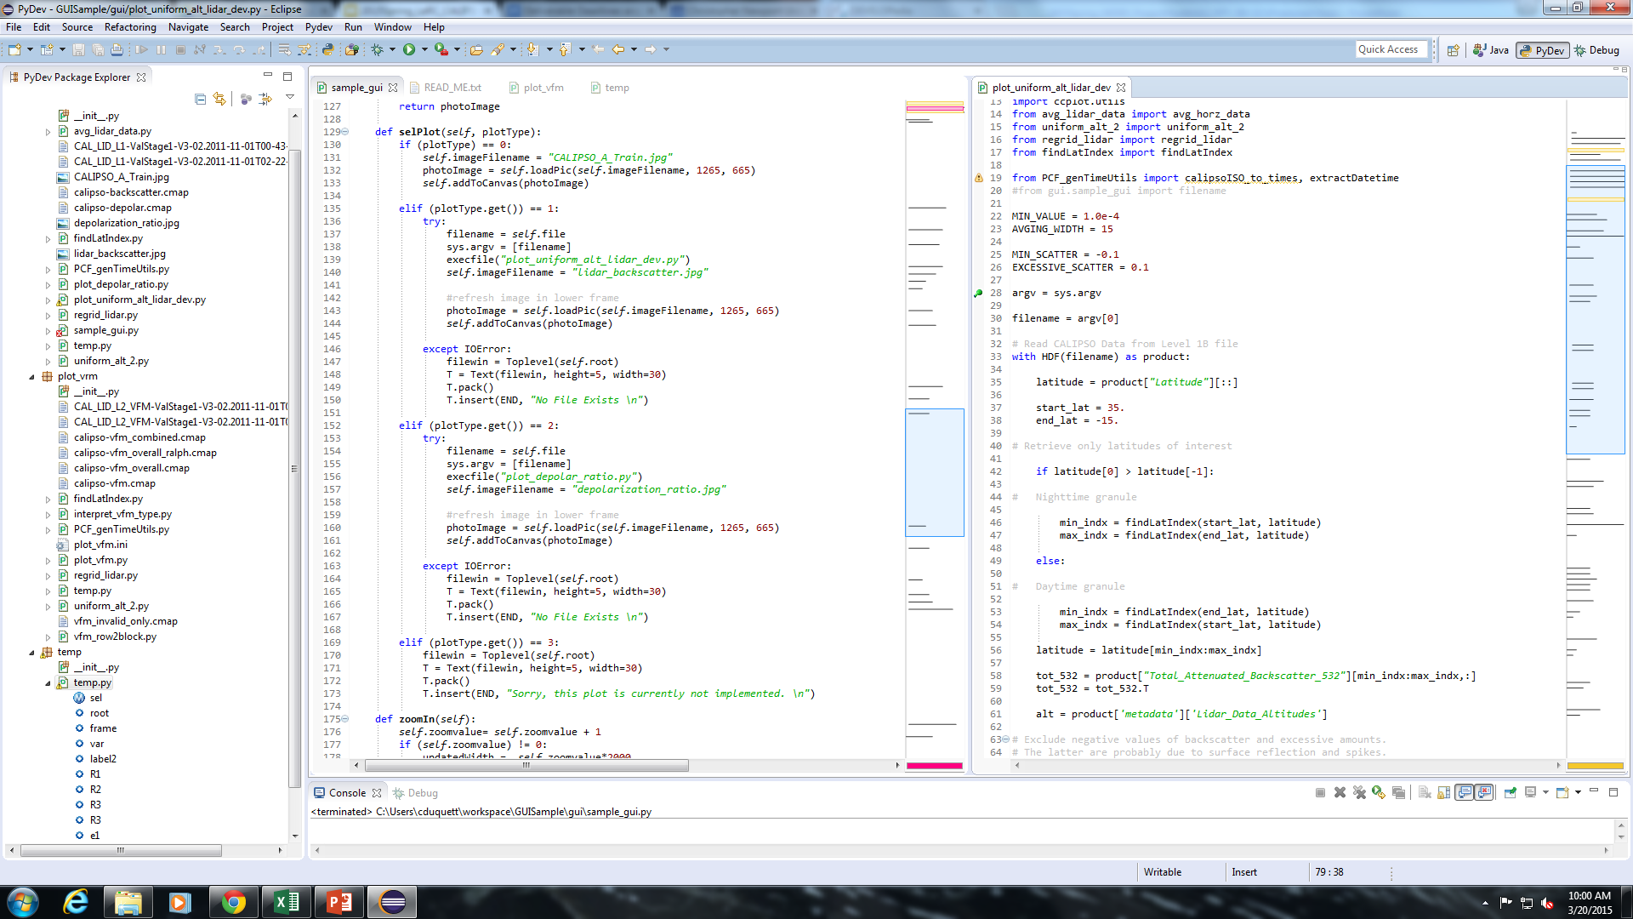
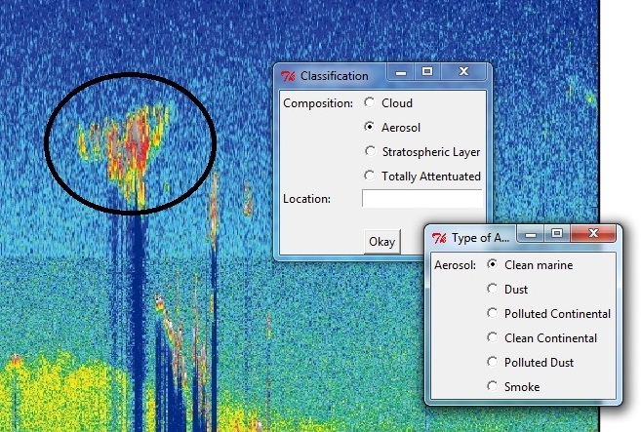
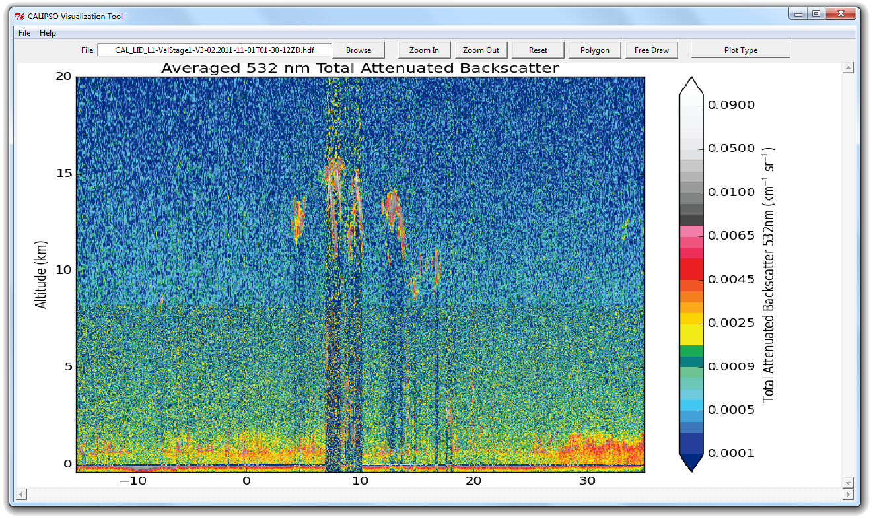
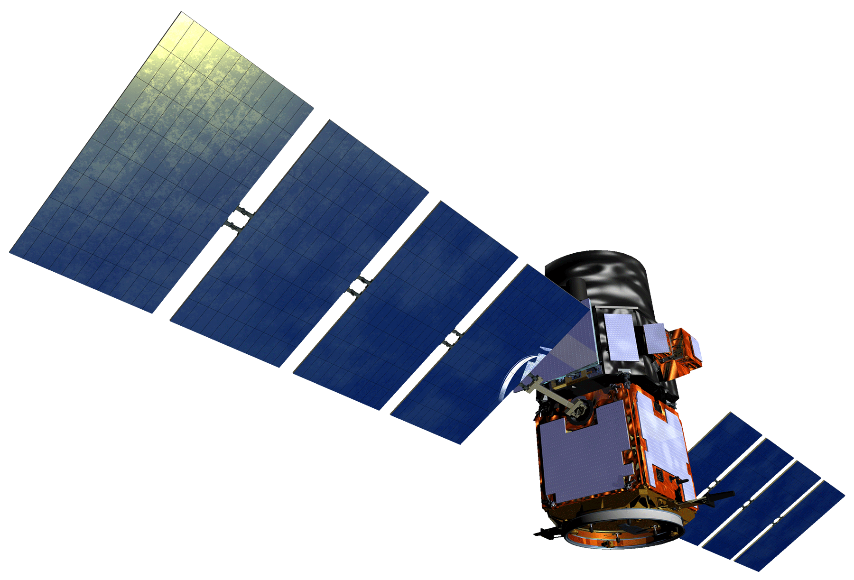
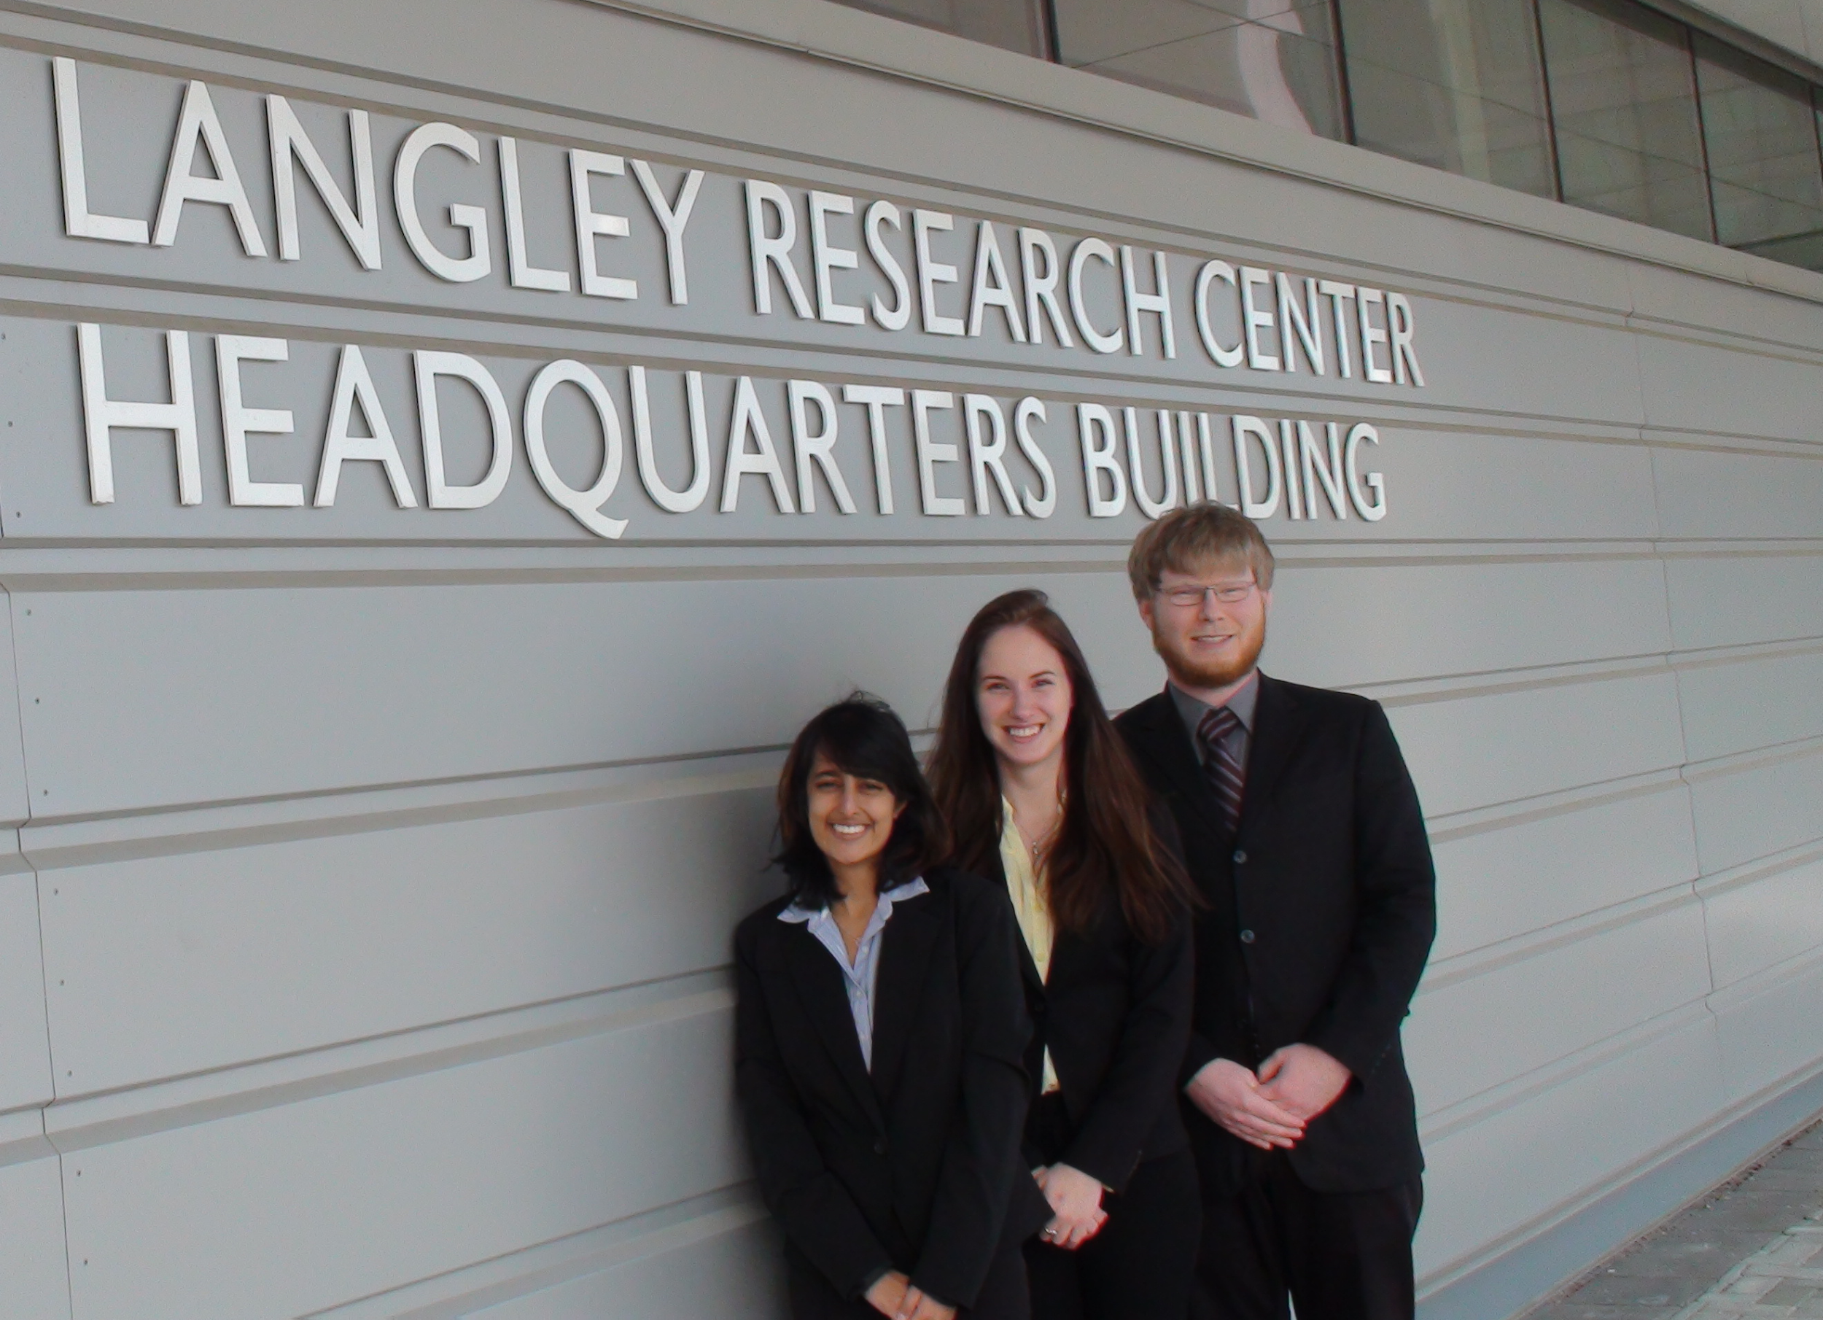
CALIPSO Health & Air Quality
Creating tool to help identify Smoke Plumes Observed with CALIPSO to Improve Future Research and Decision-making
Jordan Vaa (Team Lead), Ashna Aggarwal, Courtney Duquette
NASA Langley Research Center
The Cloud-Aerosol Lidar and Infrared Pathfinder Satellite Observations (CALIPSO) mission has been providing researchers with information about the global distribution of aerosols and clouds since 2006. Aboard the CALIPSO satellite is the Cloud-Aerosol Lidar with Orthogonal Polarization (CALIOP) , which sends laser pulses of 532 nm and 1064 nm into the Earth’s atmosphere. By measuring backscatter, researchers are able to map the distribution of aerosols (such as pollutants, dust, and smoke) and clouds. However, it remains difficult to track specific objects as they progress through the environment, since some types of aerosols are more difficult to identify than others. To solve this issue, the Langley DEVELOP team created a tool that will allow researchers to identify, select, and categorize aerosol objects. The objects are then exported to an easily accessible database. This method will allow researchers to follow key objects as they move through time and space. The CALIPSO science team will use this tool to identify smoke plumes and explore their compositions. The composition of smoke plumes varies significantly depending on the fuel type. Monitoring how these compositions change with time will help researchers understand the impact of smoke on air quality downstream of a source fire.
Create a tool for the visualization and selection of objects within CALIPSO data files
Groom data for storage in a database in order to facilitate searching based on data characteristics
The original tool, built in IDL
Utilizing Python, specifically the Tkinter module, a new interface was built
Unimplemented selection and classification tools
CALIPSO
Future Plans
Implement selection and classification features, as well as export and save functions
Build database to store selection data
Build web-based application to access database
LaRC CALIPSO
Dr. Charles Trepte
Brian Magill
National Institute of Aerospace
Dr. Amber Soja
Dr. Kenton Ross
DEVELOP National Science Advisor
From left to right:
Ashna Aggarwal, Courtney Duquette, Jordan Vaa

