Slide 1
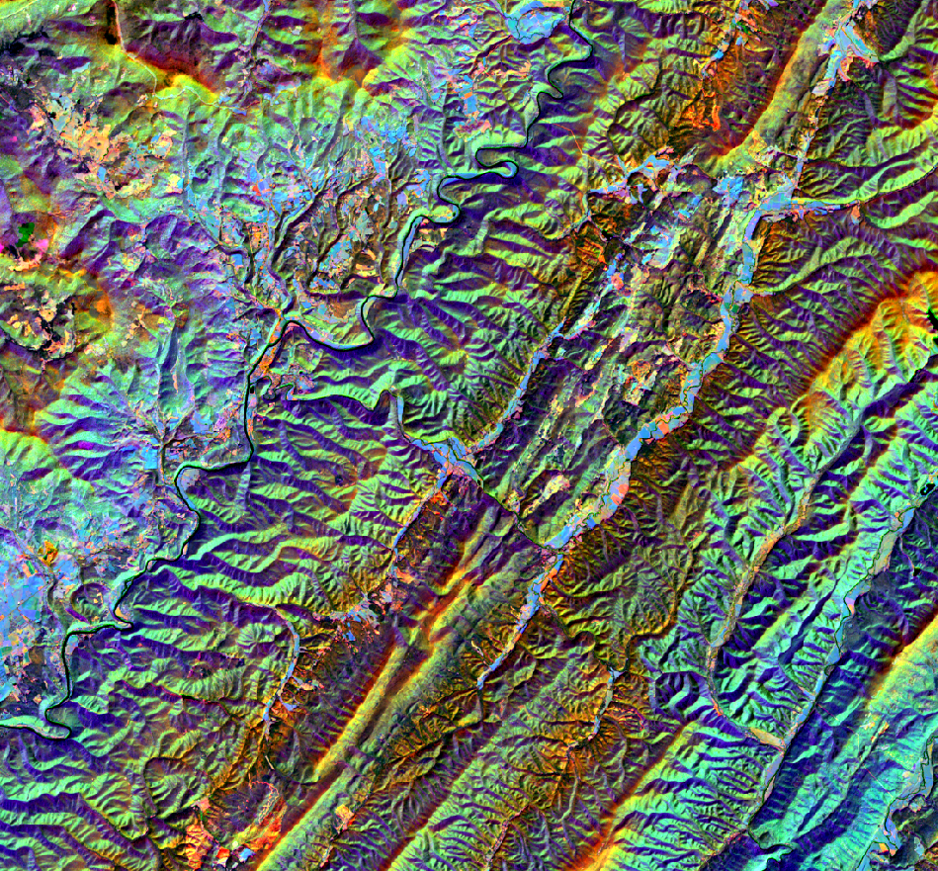
West Virginia National Forest Ecological Forecasting
Forecasting red spruce Restoration Using NASA Earth Observations to Support the USFS Monongahela National Forest
John Dialesandro
Mason Bull
Tia Francis
Katherine Yut
Idaho – Pocatello | Summer 2019

Slide 2
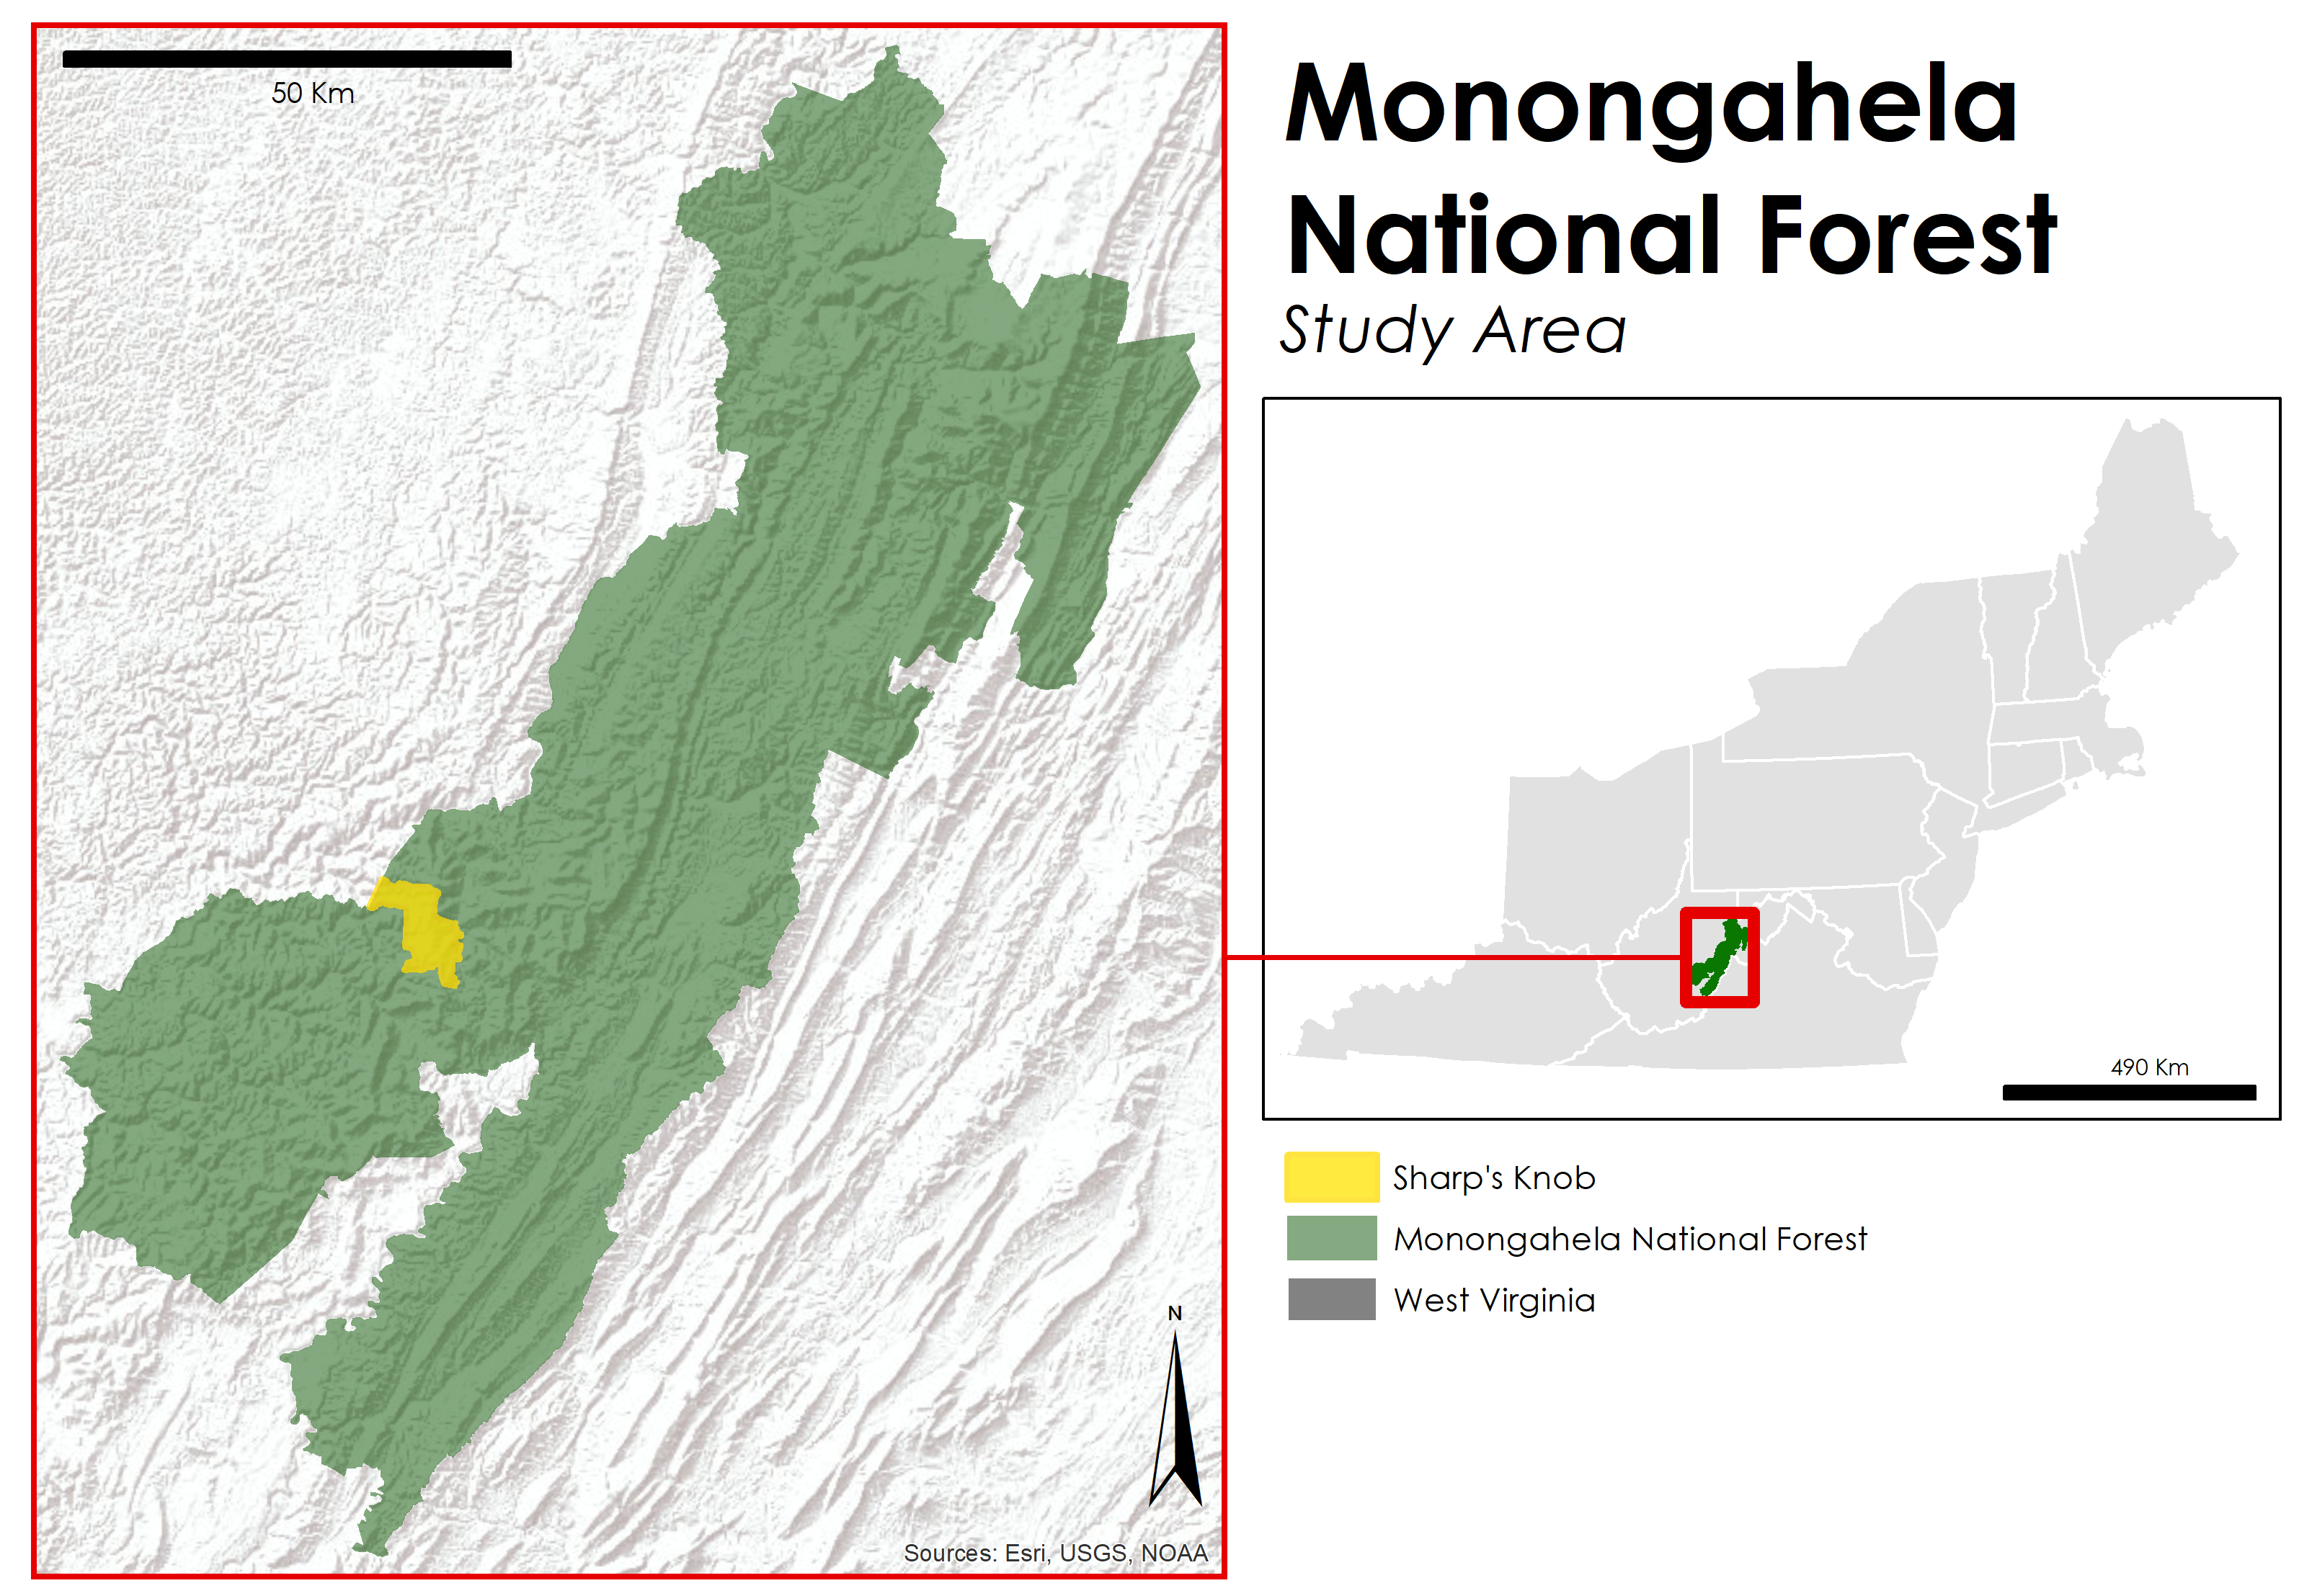
Study Area
Monongahela Forest
Location: Alleghany Highlands, WV
Total area: 6,889km²
Elevation: 304 to 1,481m
Landsat Tiles: Path 17 Rows 33 and 34
Sharp’s Knob
Area: 52km²
Elevation: 1,381m
Notes:
The project study area is the Sharp’s Knob Red Spruce Restoration Area, located in the Monongahela National Forest (MNF). MNF is located in eastern West Virginia, with the spine of the southern Appalachians running through its center.

Slide 3
Project Background
Wildfires
Extensive logging
Strip mining
Coal mining
Non-native restoration/growth
Native
restoration
1800
1850
1879
1920
1970
1989
2013
2018
Historical red
spruce dominance
Establishment
of Monongahela National Forest (MNF)
MNF purchases former strip mines
Sharp’s Knob Project
launch
Notes:
Historically, dominant canopy cover within MNF consisted of red spruce. However, extensive coal mining and logging, combined with intense wildfire seasons during the late 19th and early 20th centuries resulted in a widespread conifer-to-hardwood transition. MNF was established in 1920, however our study site was not purchased by the USFS until 1989. Due to this, Sharp’s Knob experienced heavy strip mining – an incredibly destructive form of coal mining – in the 70s and 80s. Before the USFS purchased the land, mining companies would often restore these lands with nonnative hardwoods. red spruce restoration efforts – many of which focusing on former strip mines – have been heavily pursued by the USFs since 2013 with the launch of the Lambert Restoration area. The Sharp’s Knob project was launched in May 2018.

Slide 4
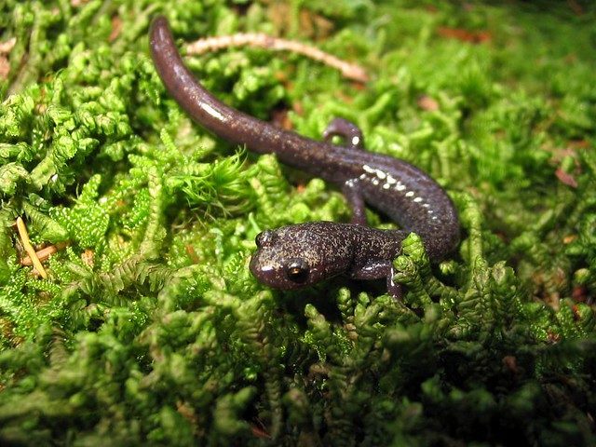
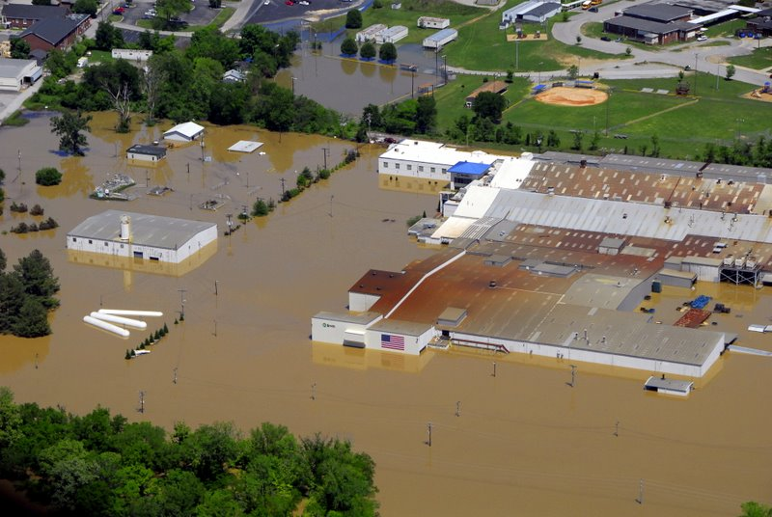

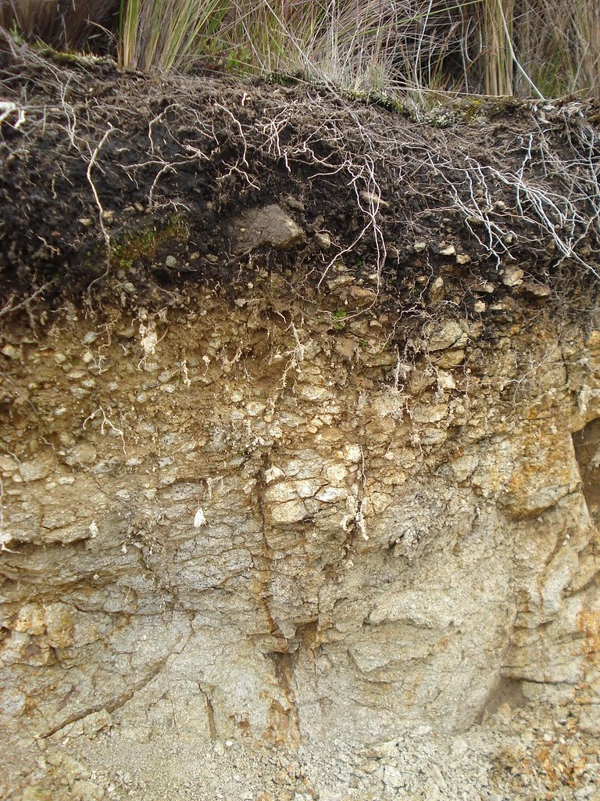
Community Concerns
Soil Organic
Carbon Stocks
Water Quality
Biodiversity
Flood
Management
M.V. Leon
Image Credit (Left to Right): K. Wixted, J. Harneis, US Army Corps of Engineers, M.V. Leon
Notes:
Red spruce restoration is a critical concern to MNF staff due to its ecological importance within West Virginia’s forests. red spruce provide shelter and food for the cheat mountain salamander and the northern flying squirrel, two endangered species of the MNF. Additionally, red spruce stands facilitate soils that are more absorbent than those associated with hardwoods. Due to this, these soils are important for providing clean drinking water and flood management. Finally, red spruce are critical for the sequestering of soil carbon. Current literature estimates that red spruce restoration to historical extent in West Virginia alone could replace 6.6Tg of carbon in the soil.
Image sources:
Cheat Salamander image: https://www.flickr.com/photos/kwixted0/251777454/; CC BY 2.0
Water image: https://www.flickr.com/photos/julien_harneis/589718393/; CC BY-SA
Flood image: https://www.flickr.com/photos/nashvillecorps/4604746814/in/photolist-oUGCKP-pz6Z6S-aKT2i4-fjzC5r-qpbPAc-26vgihh-6XB49a-z1VJNG-9Kg5Va-ffTQHx-q7WSXn-81UwNs-yQ1yAo-yzGLwb-bGiQJF-a7Ay1h-oGC9gy-pDGDDR-dSi8Se-6fg5ja-mS5qtA-dSoJzU-bGiQEZ-q7VpWx-eZ97fa-29hNhyf-frfGxE-o64fgL-dRSvnf-oYRnCc-dSdq5Q-gfVH86-9aWsSN-995JLq-994HYp-dRStD5-mS2wbx-dRUQnM-9wmCvJ-nmgFsM-995z2Y-dRLY7e-dRSmoo-6Eh5CK-yT8Zyx-22yGAPr-997BdL-7vnqLS-DHHA2v-dRVaWp;; CC BY-SA 2.0
Soil image: https://www.flickr.com/photos/miguelveraleon/2708283904; CC BY 2.0

Slide 5
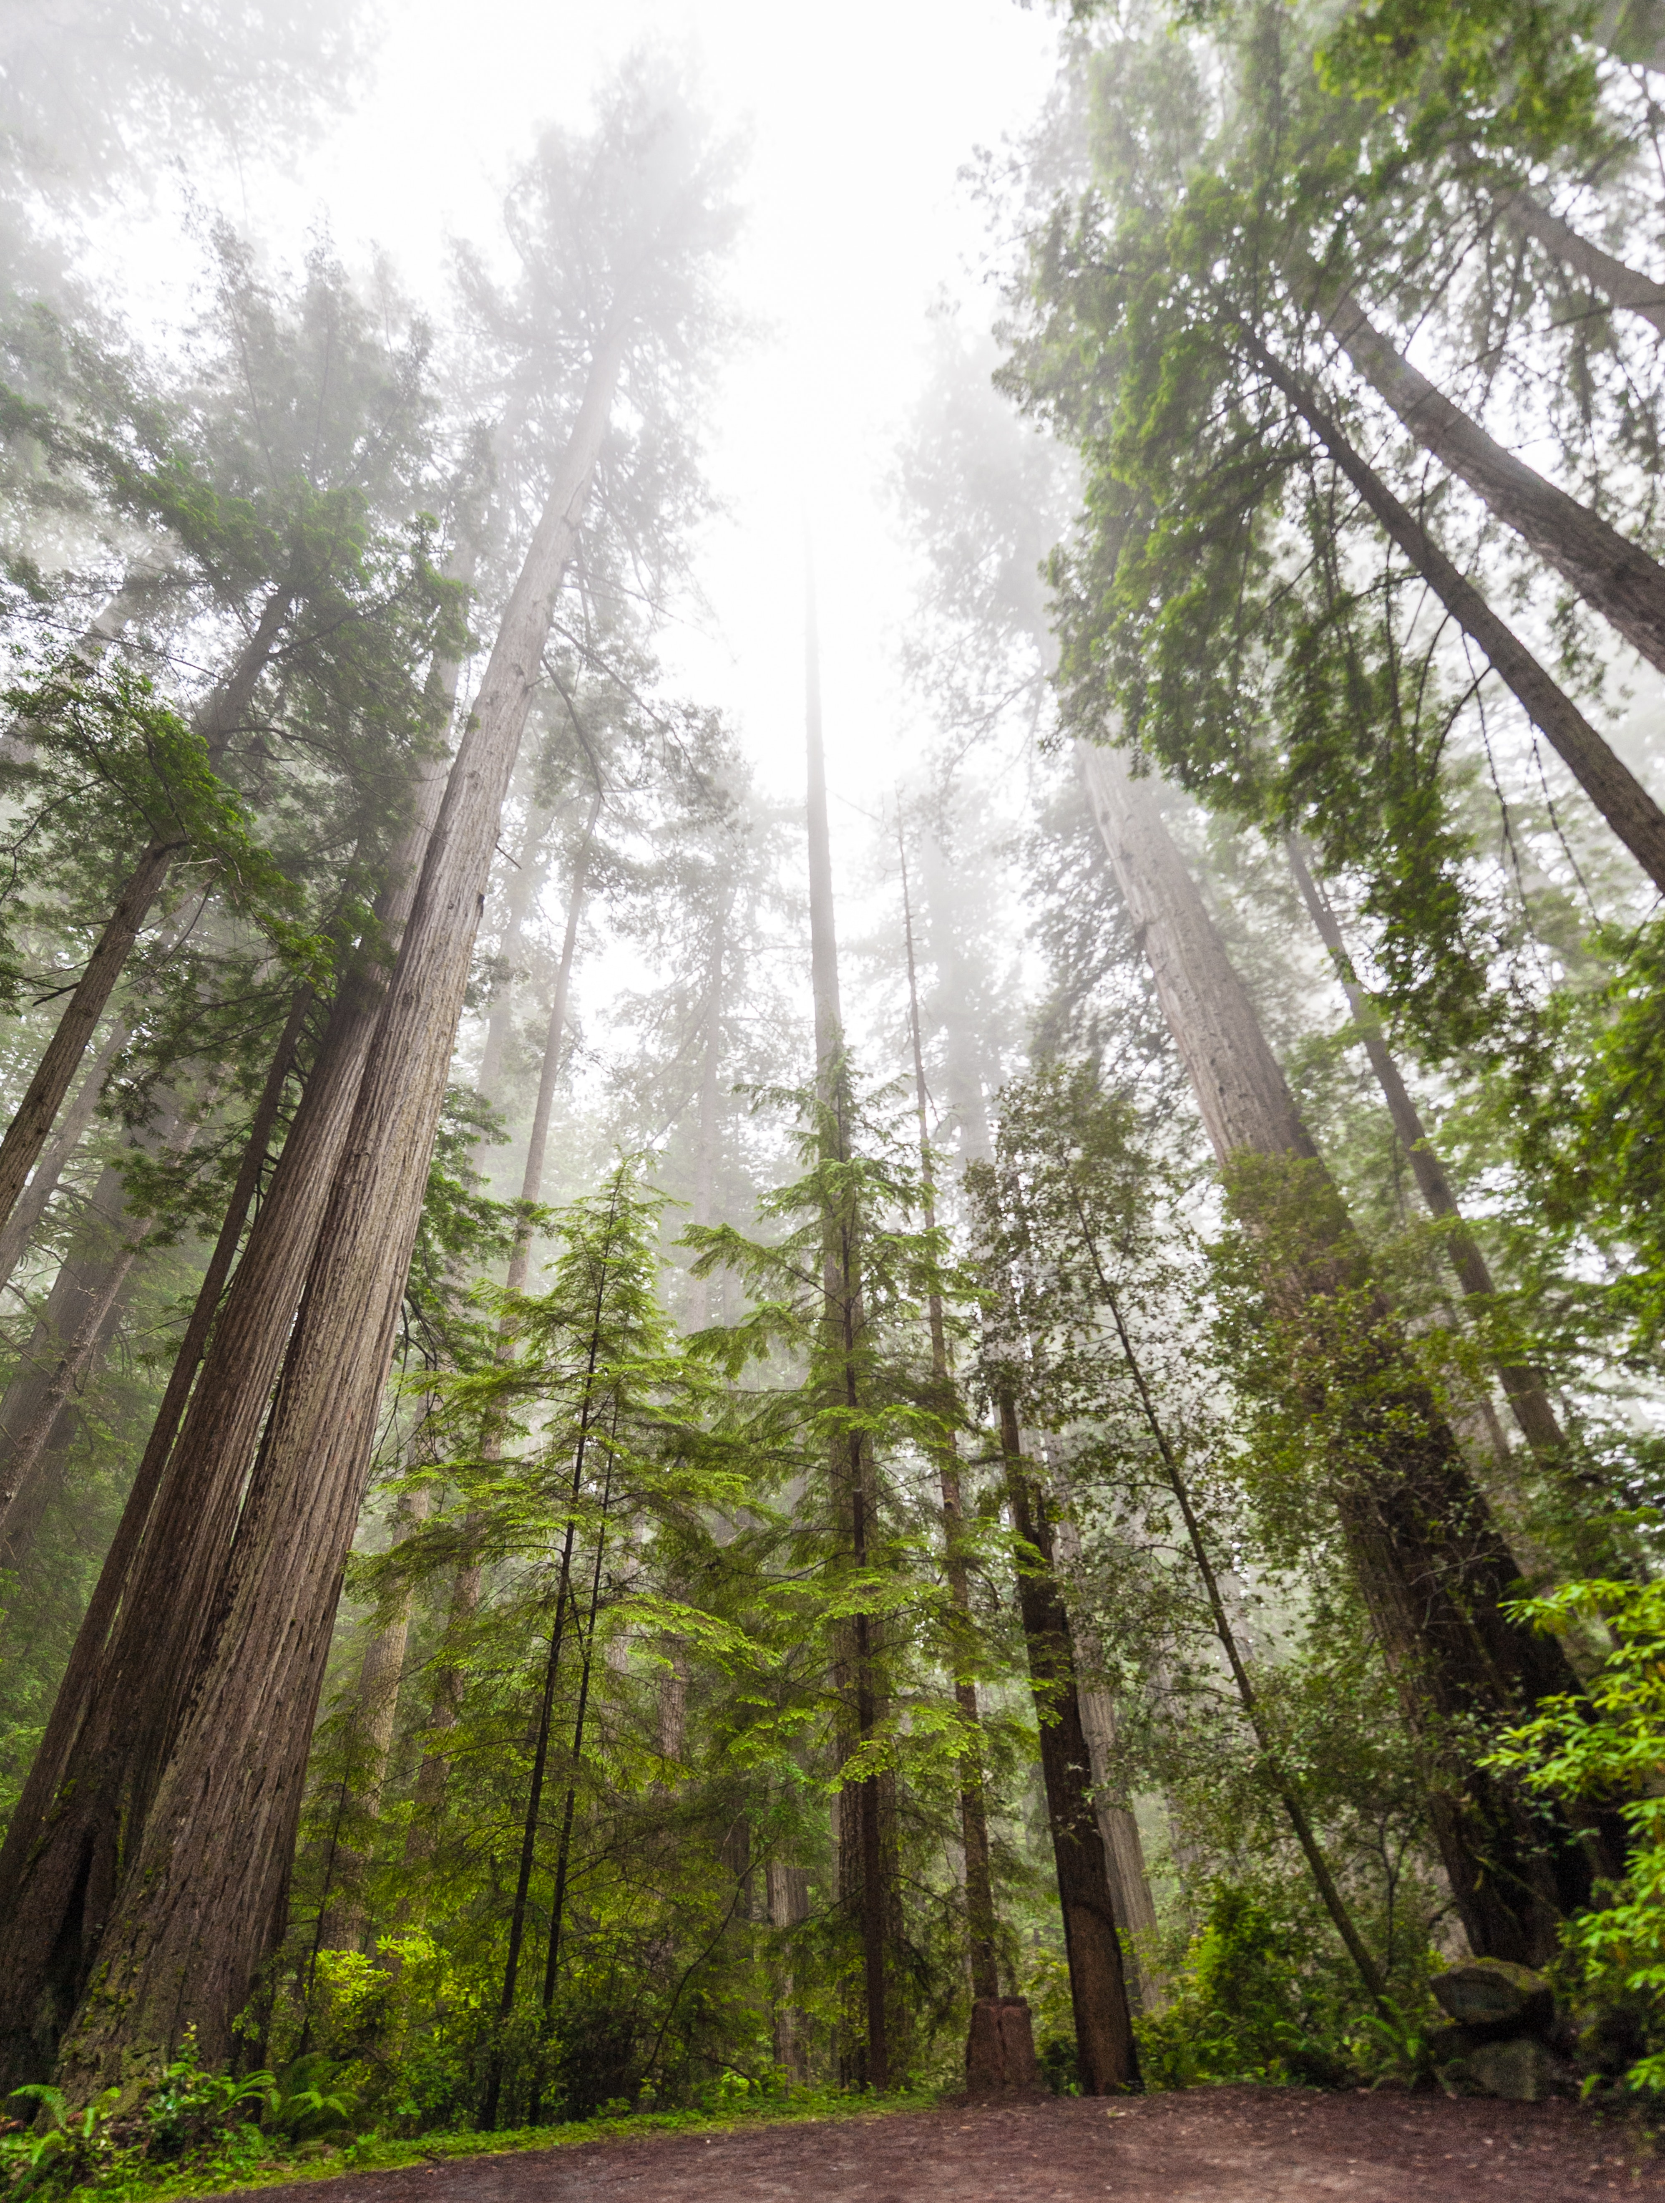


Partners
USFS, Monongahela National Forest
Amy Coleman - South Zone Scientist
Stephanie Connolly - Forest Soil Scientist
Sam Lammie – GIS Analyst USFS
USFS, Northern Institute of Applied Climate Science (NIACS)
Patricia Leopold - Climate Change Outreach Specialist
Image credit: Z. Li
Notes:
Our project will focus on using remote sensing and NASA EOS to identify current and historical red spruce stands, in addition to forecasting future red spruce extent. We are partnered with two branches of the USFS: The Monongahela National Forest and the Northern Institute of Applied Sciences.
Image Source: https://www.pexels.com/photo/green-leafed-plant-1784577/; CC BY 2.0

Slide 6
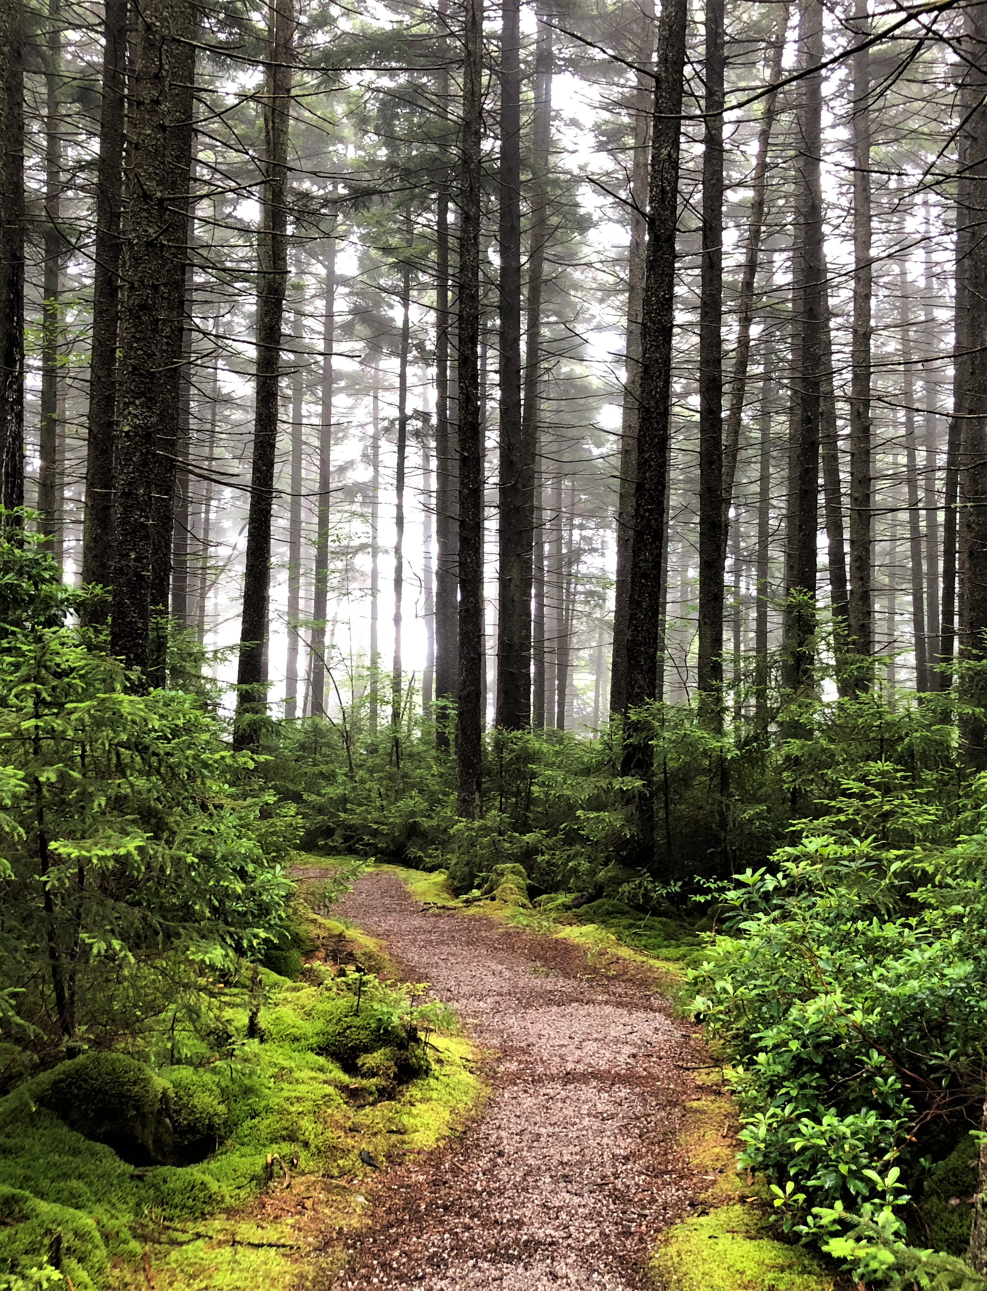
Objectives
IDENTIFY historical extent of red spruce from 1989 to 2018
CREATE maps of red spruce locations and suitable locations
FORECAST site suitability and forest cover to 2040
PRODUCE a tutorial of workflow for partners to reproduce processes
Image credit: USFS
Notes:
Our project had four primary objectives to aid MNF in their red spruce restoration projects. First, we aimed to identify the historical spread of red spruce from 1989 to 2018. Using this, we then aimed to create maps of red spruce locations and suitable locations for future restoration efforts. Using inputs from the previous objectives, we then wanted to forecast red spruce extent to 2040. Finally, our partners are interested in reproducing our results for other study sites, so our final objective is a tutorial of our methodology.
Image Credit: USFS Monongahela National Forest
Image Source: https://www.flickr.com/photos/165530715@N03/48002672817/; Public Domain

Slide 7




SATELLITES & SENSORS
SRTM
Shuttle Radar Topography Mission
Landsat 5
Thematic Mapper
Landsat 8
Operational Land Imager
Notes:
In order to identify and classify red spruce extent, we used imagery from the Landsat 5 Thematic Mapper and Landsat 8 Operational Land Imager, along with ancillary data from the Shuttle Radar Topography Mission.

Slide 8
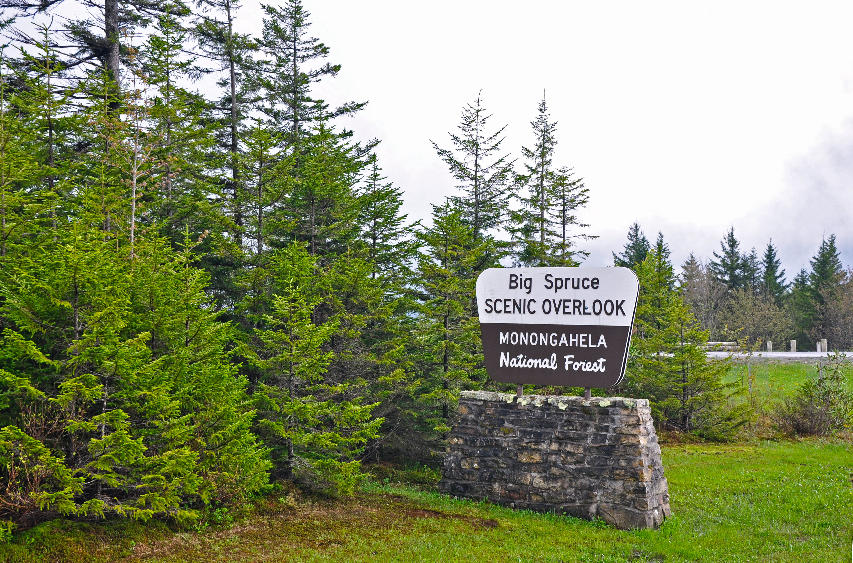
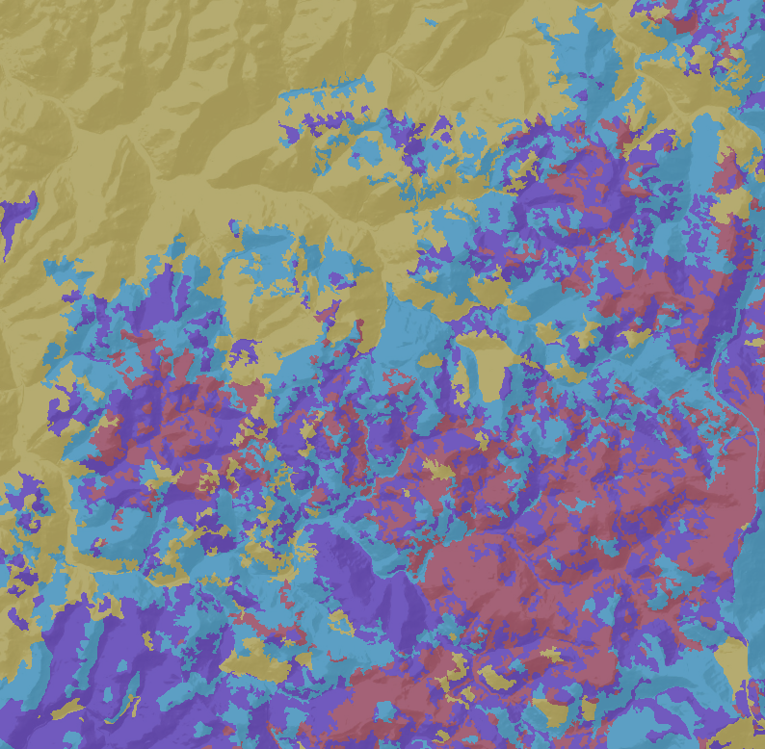
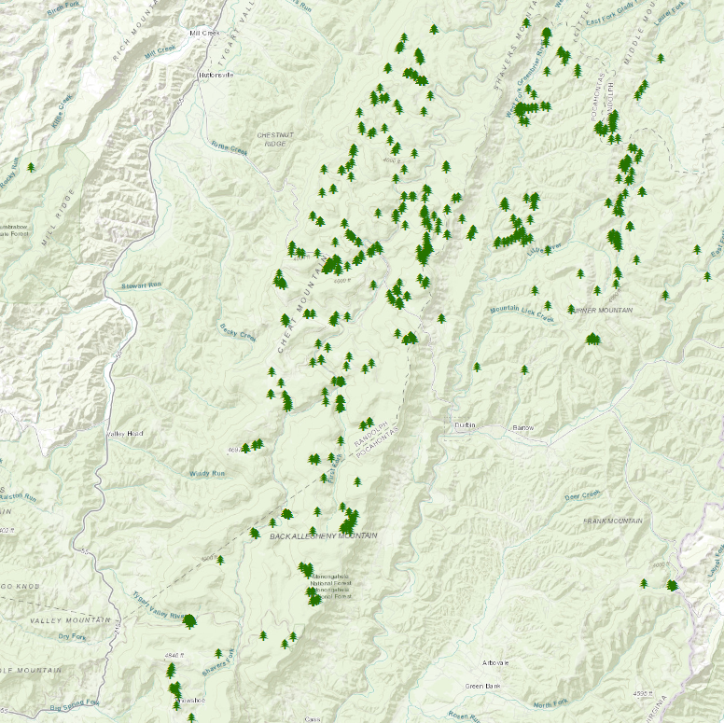

Partner Data
Aerial Imagery
Validation Points
Unprocessed high spatial resolution aerial imagery covering WV
In situ point locations of red spruce trees
Shapefiles
Forest Cover
Polygon boundaries of Monongahela National Forest and Sharp’s Knob
Polygon classification of dominant forest type
Image Credit (Left to Right): USFS Monongahela NF, NASA DEVELOP, NASA DEVELOP, S. Ramsaier
Notes:
Additionally, we received critical data from our partners at the Monongahela National Forest. In particular, they provided shapefiles of the National Forest and Sharp’s Knob, In situ point data for known and validated red spruce locations, forest cover polygons of dominant canopy cover type, and 1ft, unprocessed aerial imagery of West Virginia.
Image Sources:
Monongahela photo: https://www.flickr.com/photos/165530715@N03/48002574838/; Public Domain
Validation points photo: NASA DEVELOP team using partner data
Forest Cover photo: NASA DEVELOP team using partner data
Aerial Imagery: https://www.flickr.com/photos/steffen_ramsaier/33949720268/; CC BY-NC-ND

Slide 9
Software
Google Earth Engine Image acquisition, training data collection
ENVI 5.5 Data processing, image derivatives generation, and layer stacking
ArcGIS Data visualization, habitat suitability
TerrSet Image classification and land cover change forecasting
Notes:
Additionally, we received critical data from our partners at the Monongahela National Forest. In particular, they provided shapefiles of the National Forest and Sharp’s Knob, In situ point data for known and validated red spruce locations, forest cover polygons of dominant canopy cover type, and 1ft, unprocessed aerial imagery of West Virginia.
Image Sources:
ArcGIS: https://www.flickr.com/photos/165530715@N03/48002574838/; Public Domain
Validation points photo: NASA DEVELOP team using partner data
Forest Cover photo: NASA DEVELOP team using partner data
Aerial Imagery: https://www.flickr.com/photos/steffen_ramsaier/33949720268/; CC BY-NC-ND

Slide 10
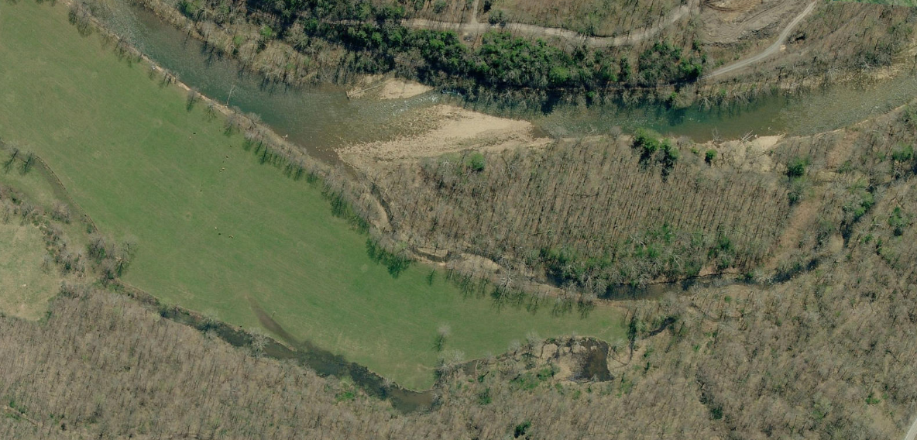
Methodology
Training Data
Red spruce
Deciduous tree
Grass
Soil
Water
Urban
6
1
5
4
2
3
Notes:
In order to classify land cover type, we conducted a supervised classification (CTA) in Idrisi TerrSet. This involves collecting training data for each of our classes in order to train the algorithm. Our classes consist of red spruce, deciduous tree, grass, soil, water, and urban. This aerial imagery
Image Credit: NASA DEVELOP team using the unprocessed aerial imagery from MNF

Slide 11
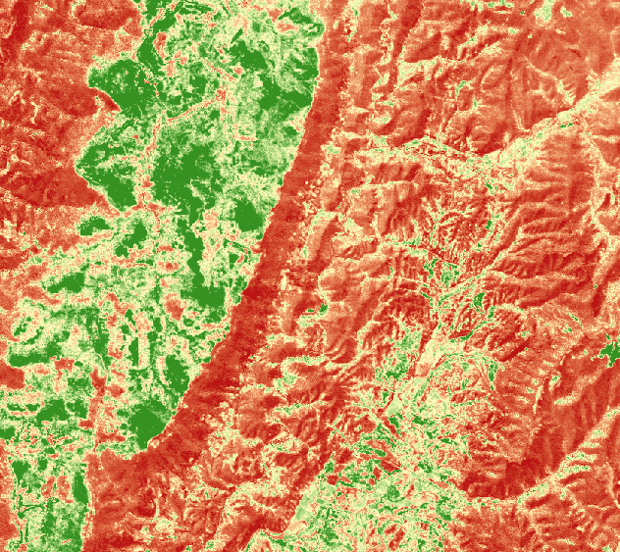
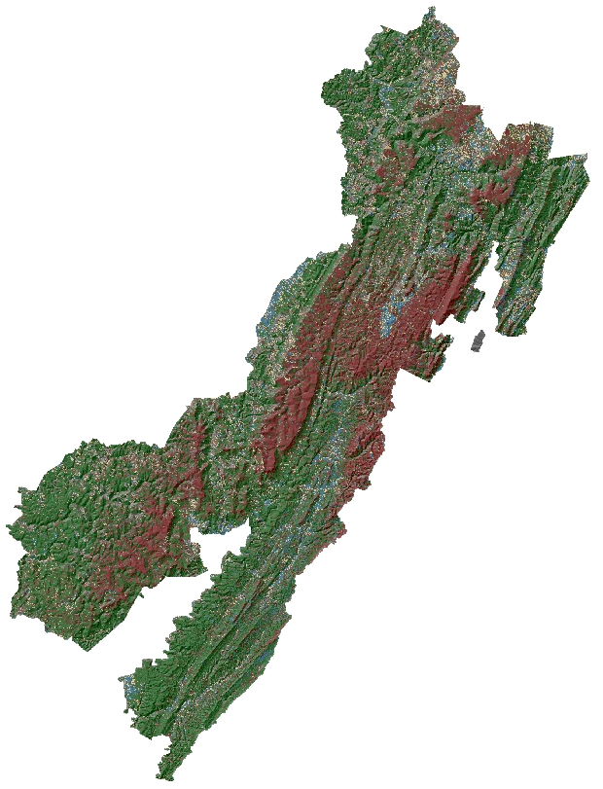
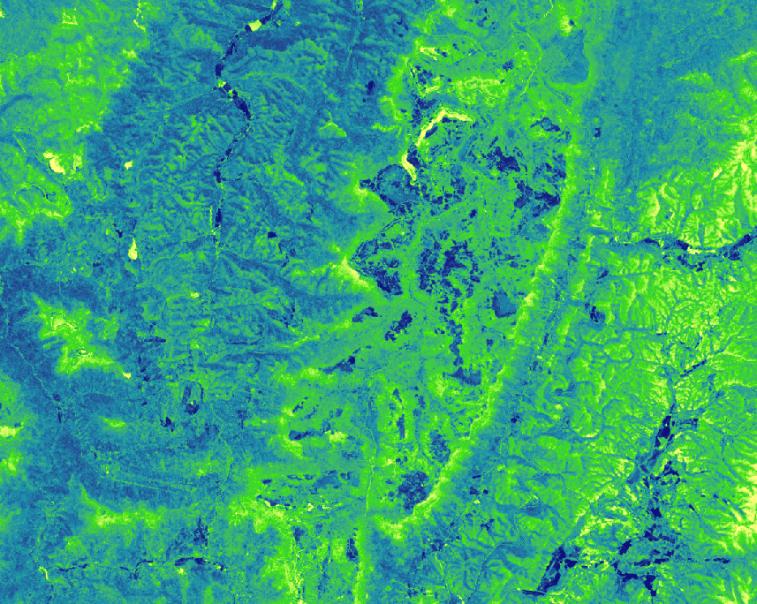
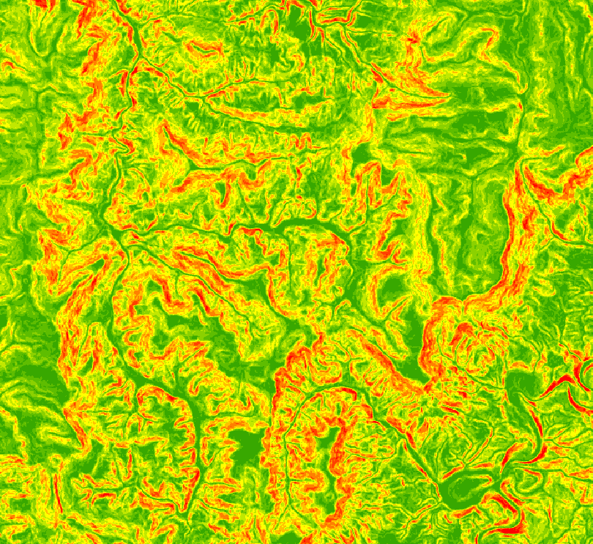
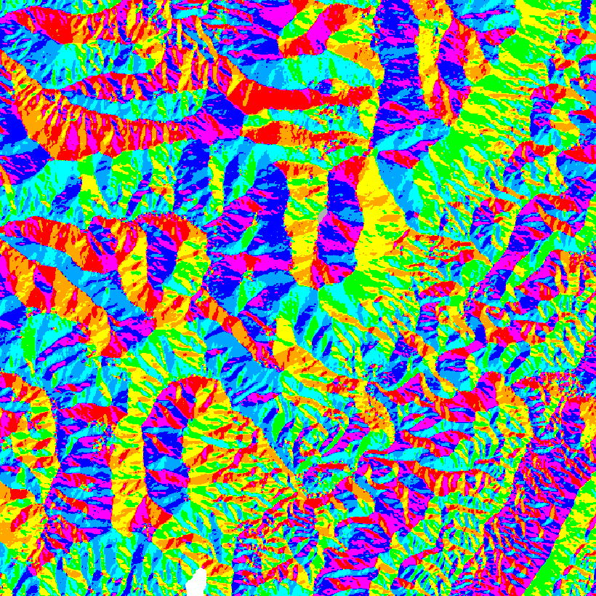
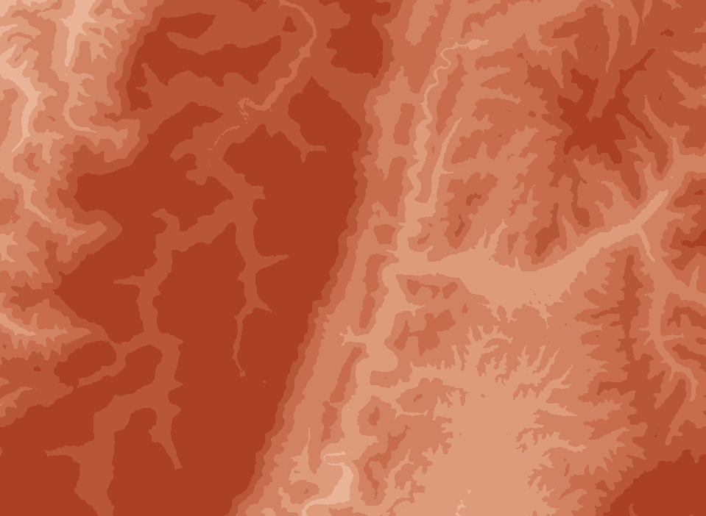
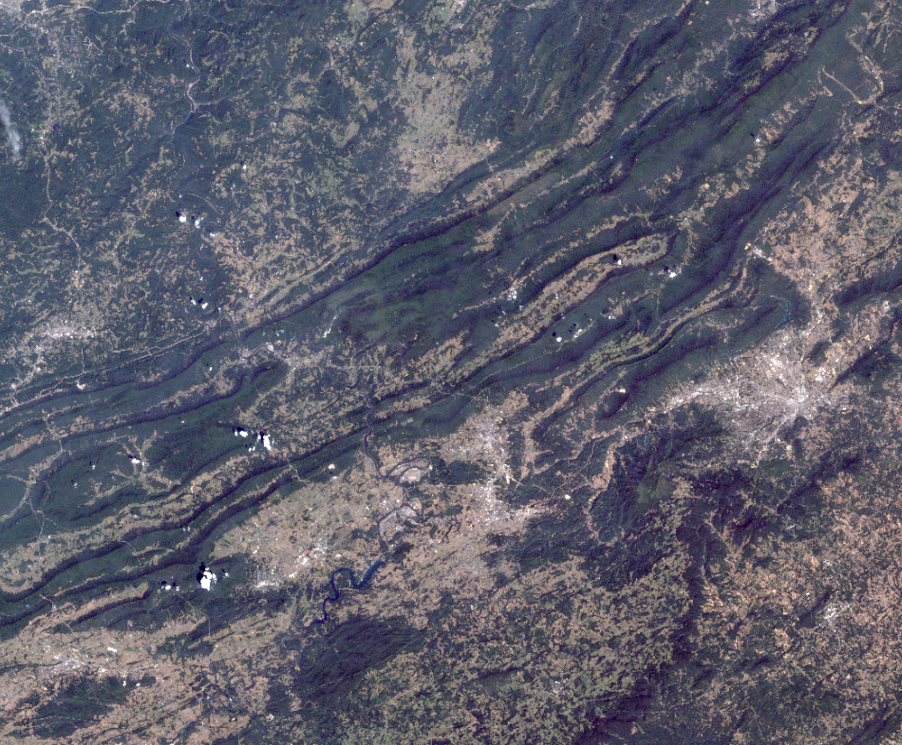


Methodology
NDVI
NDMI
Slope
Aspect
Elevation
Multispectral bands (blue to ${SWIR}_{2}$)
CTA
Red spruce
Deciduous
Grass
Soil
Water
Urban
Notes:
We used a suit of image derivatives to make a stack composite as inputs into the machine learning Classification Tree Analysis for land cover in Terrset.
Image Credits: NASA DEVELOP Team

Slide 12
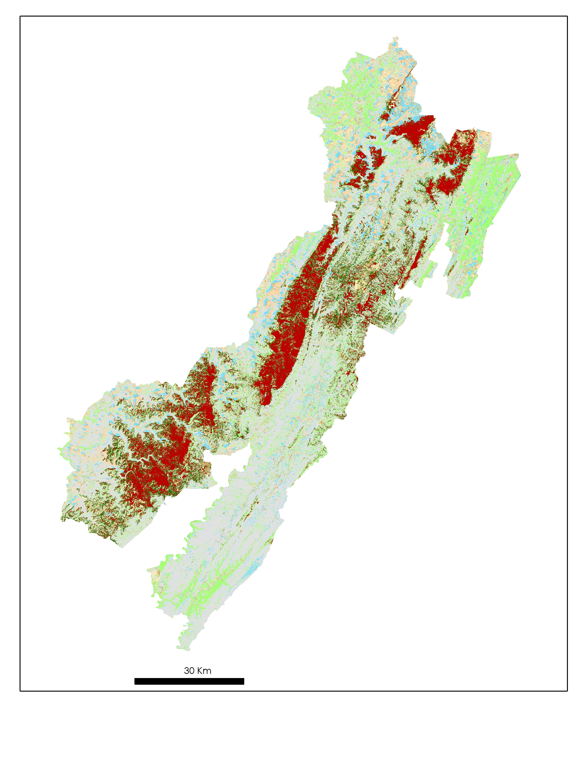
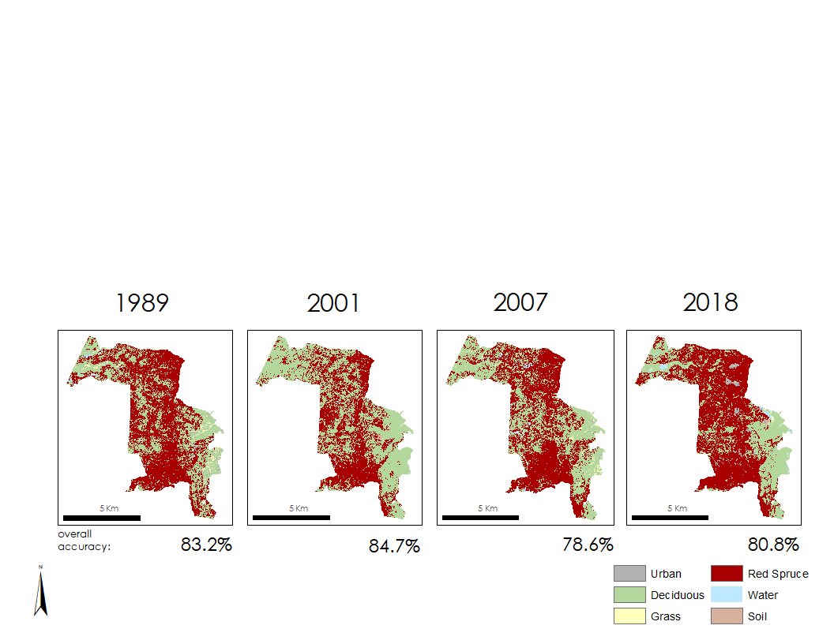
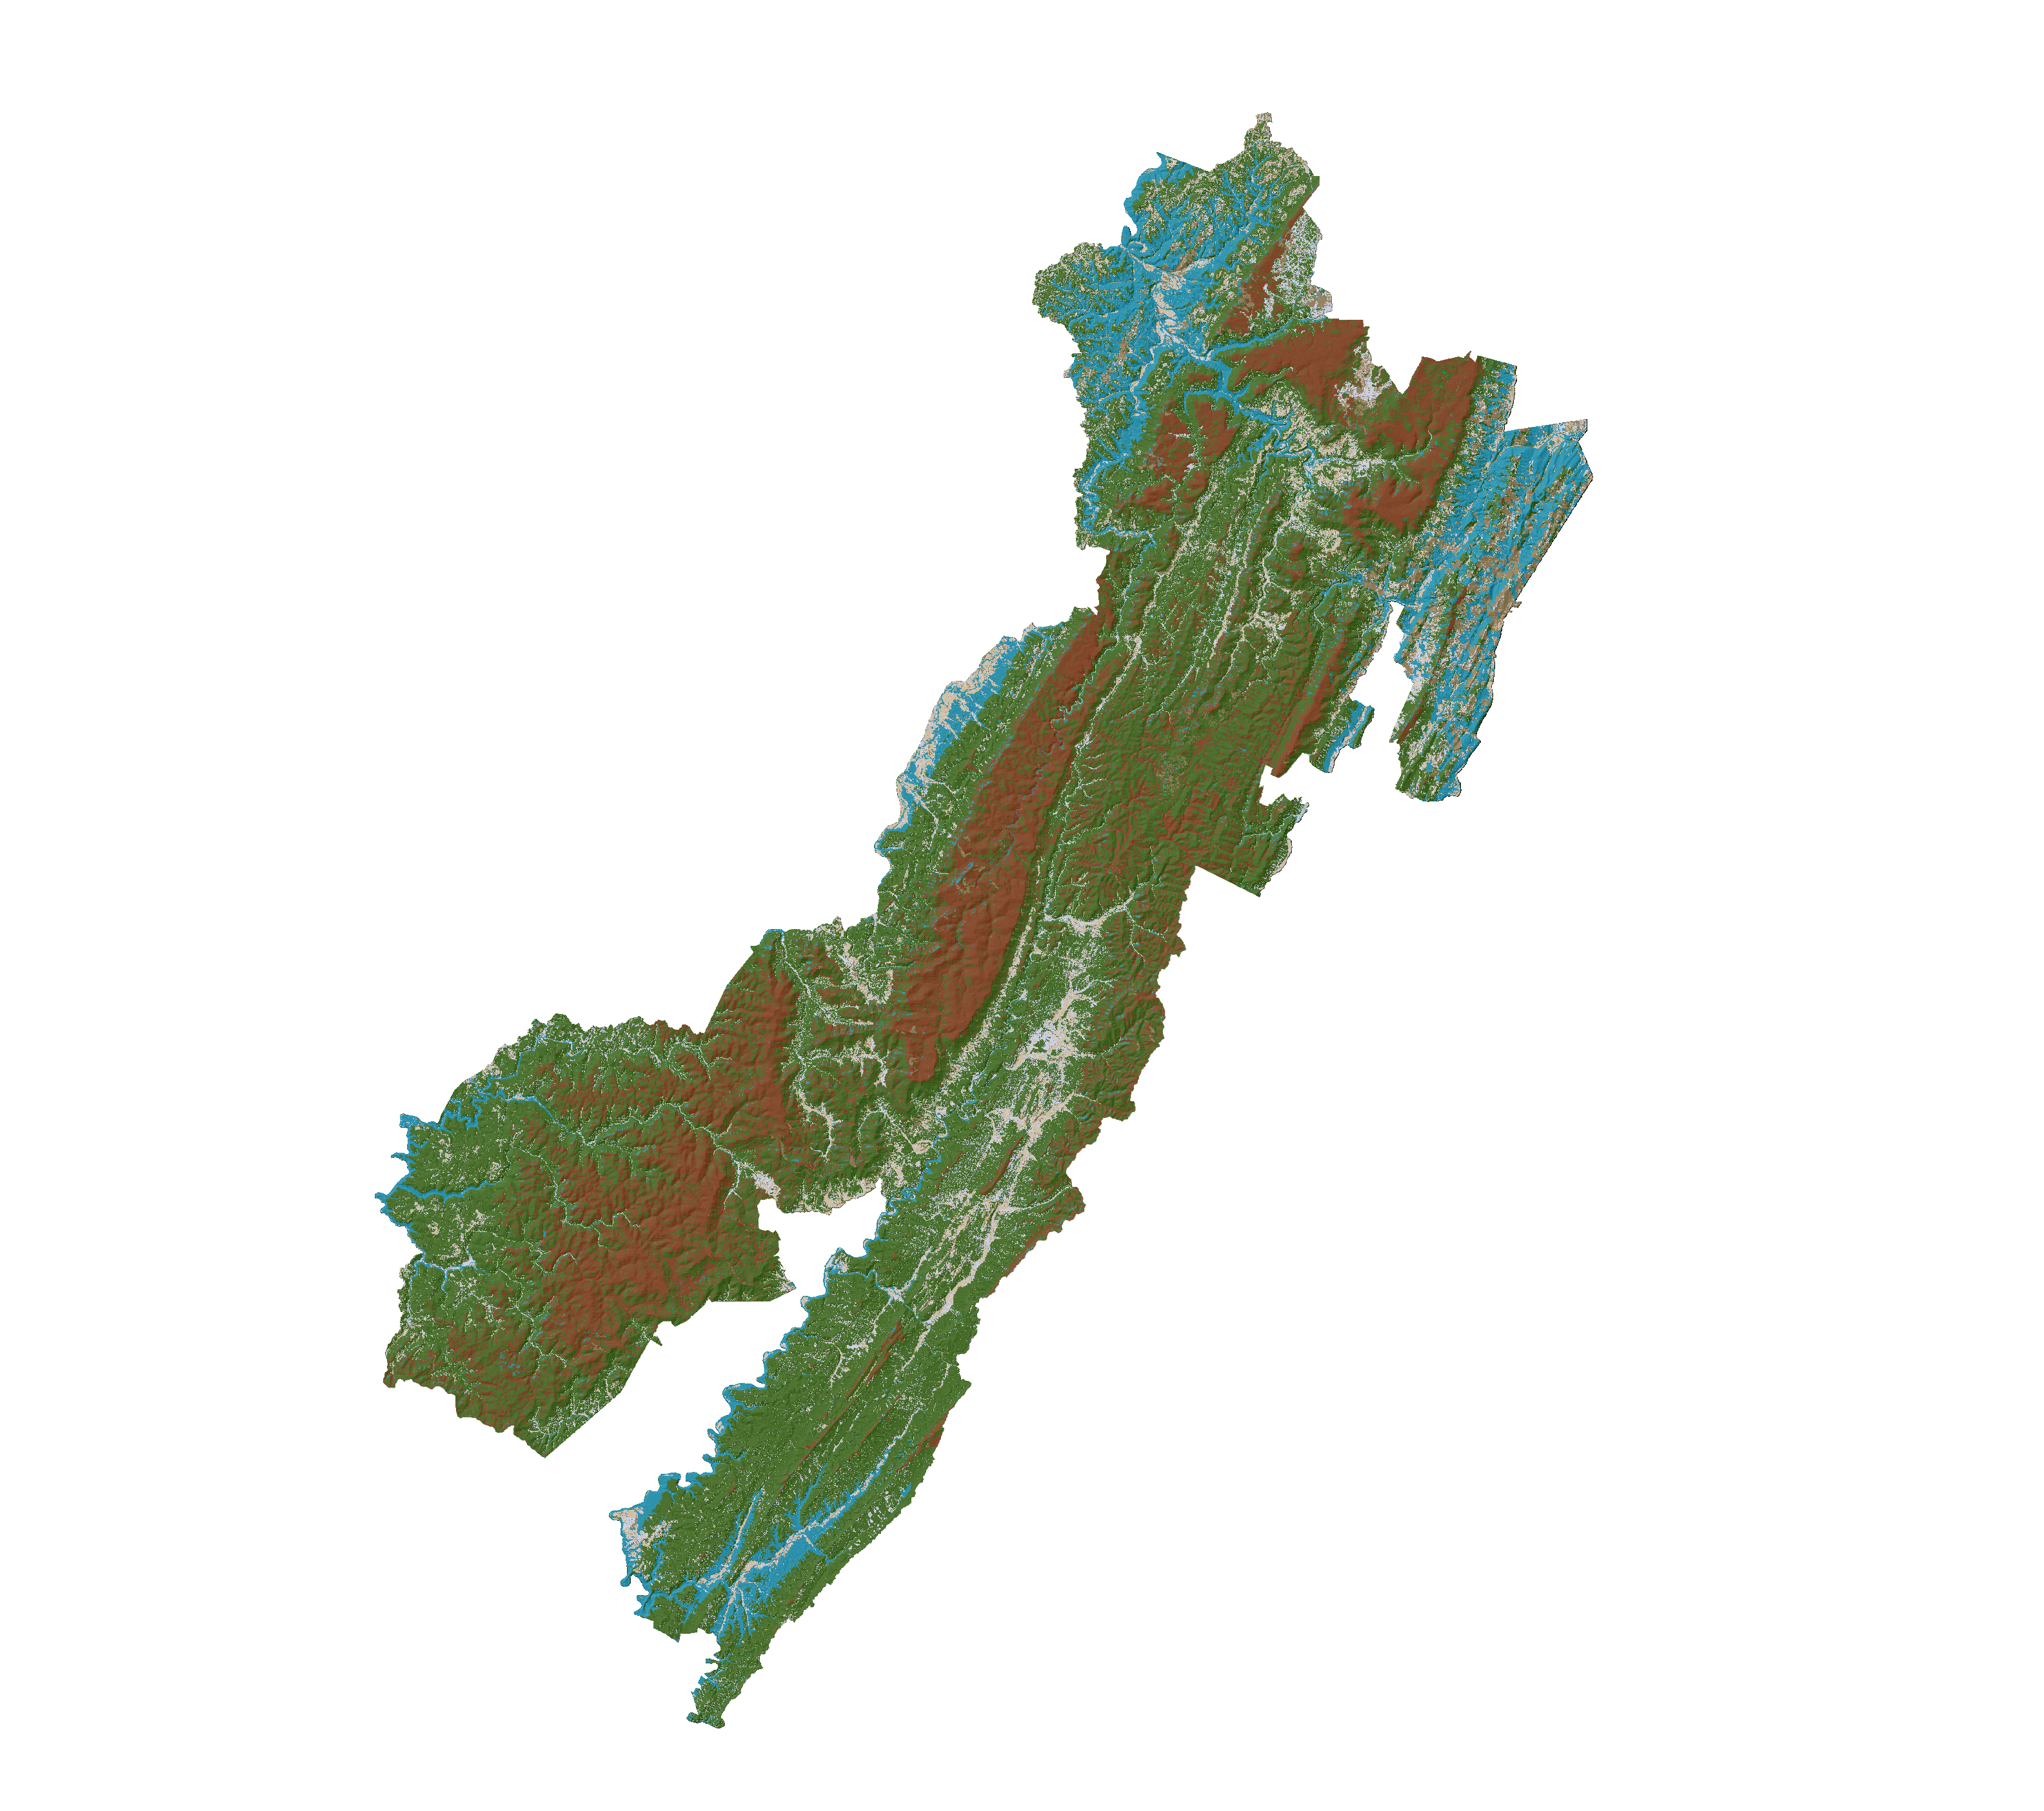
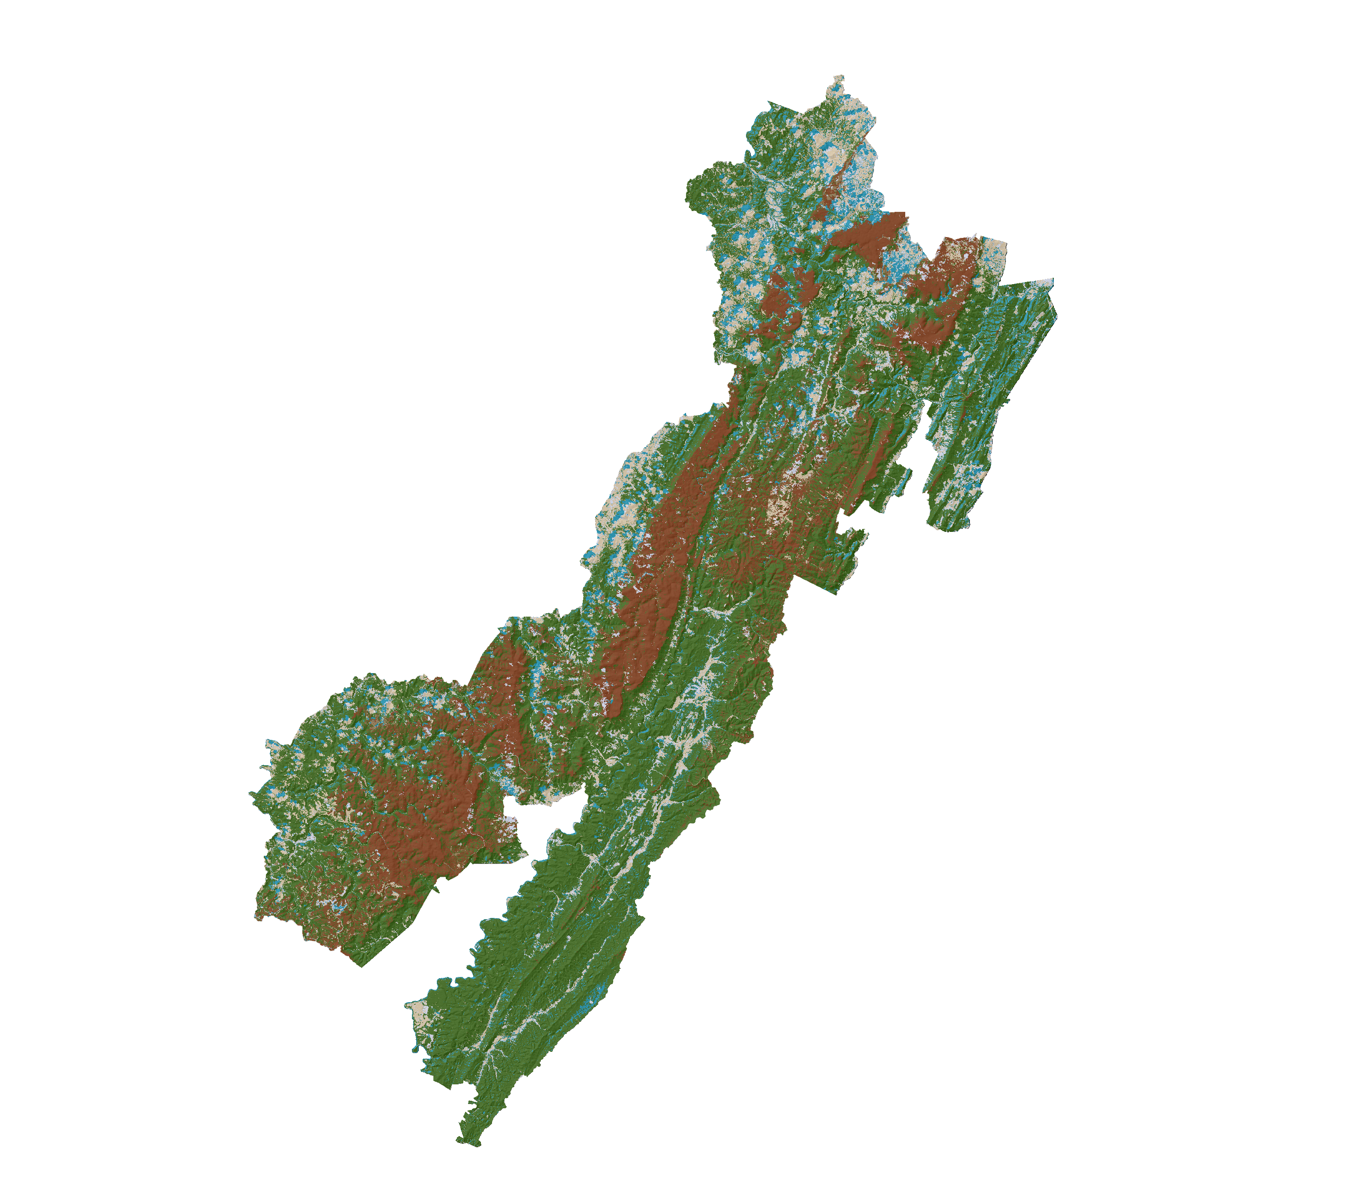
Time Series Analysis
2018 to 2040
LAND CHANGE MODELER
Persistent Spruce
Persistent
Change to Grass
Change to Soil
Change to Spruce
1989
2018
Change to Urban
Change to Water
Change to Decid
Notes:
Our Classifications from our years of imagery of the earliest and latest image was then inputed into our change analysis workflow within Terrset to determine the land cover change that has occurred across our six land cover classes.

Slide 13
Fuzzy Logic Modeling
Inputs | Fuzzy Memberships
Elevation | Linear
Slope | Small
Frost Days | Large
Growing Degree Days | Small
Average Annual Temperature | Small
Average Annual Precipitation | Large
Distance to Road | Linear
Soil pH | Small
Used for site suitability analysis
Three different membership classes used
  Linear
  Large
  Small
Notes:
Now that we know where red spruce is, was and could be, we wanted to use this information to find suitable habitats for red spruce. To do this, we used a fuzzy logic model. To put it simply, a fuzzy logic model works by transforming the raw values of our data inputs into a spectrum that ranges from 0 to 1. Values of 0 represent pixels that are absolutely not suitable, while values of 1 represent pixels that are absolutely suitable for red spruce. To get into a little more detail, a fuzzy logic model is broken down into three steps, with the most important step being assigning a membership type to each variable. This membership type determines the equation used for that transformation from 0 to 1.
In addition to a linear membership class, we also used two other classes: large and small. A large membership class transforms large raw data values into values closer to 1 and small data values closer to 0. For red spruce, an example of a data layer we used this class for is frost days.

Slide 14
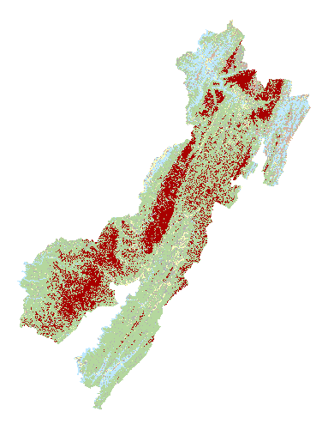
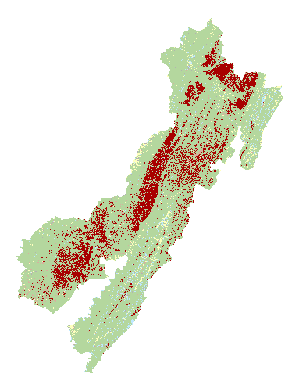
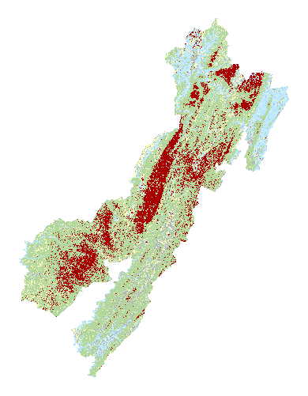
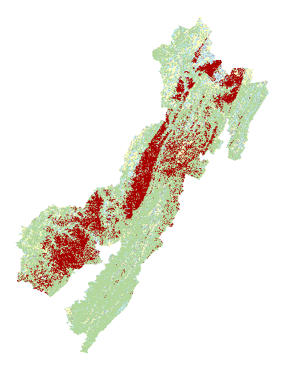
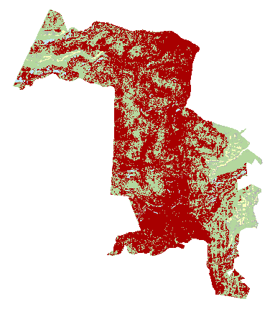
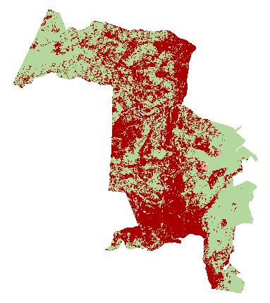
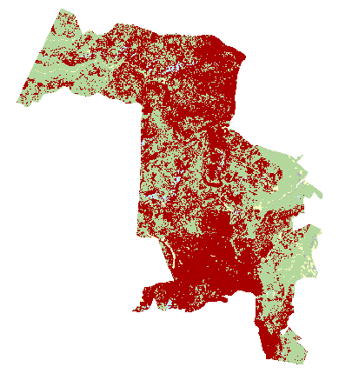
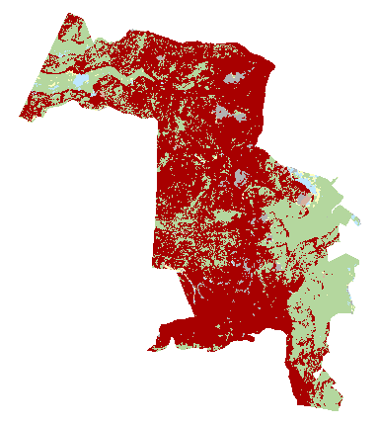
Results: Time Series Analysis
CLASSIFICATION TIME SERIES
1989
2001
2007
2018
Red spruce extent has increased by:
  12.7% (or 17,777 hectares) between 1989 and 2018 across the entire forest
  8% (238 hectares) in Sharp’s Knob
Monongahela NF
50
Km
50
Km
50
Km
50
Km
Sharp's Knob
5
Km
5
Km
5
Km
5
Km
overall
83.2%
84.7%
78.6%
80.8%
accuracy:
Urban
Red Spruce
Deciduous
Water
Grass
Soil
Notes:
Overall we saw an increase of red spruce during our study period for both the sharp’s Knob restoration area, and the entire Monongahela National Forest. Red spruce initially declined between 1989 and 2001 but rebounded to increase its overall extent between 2001 and 2018.

Slide 15
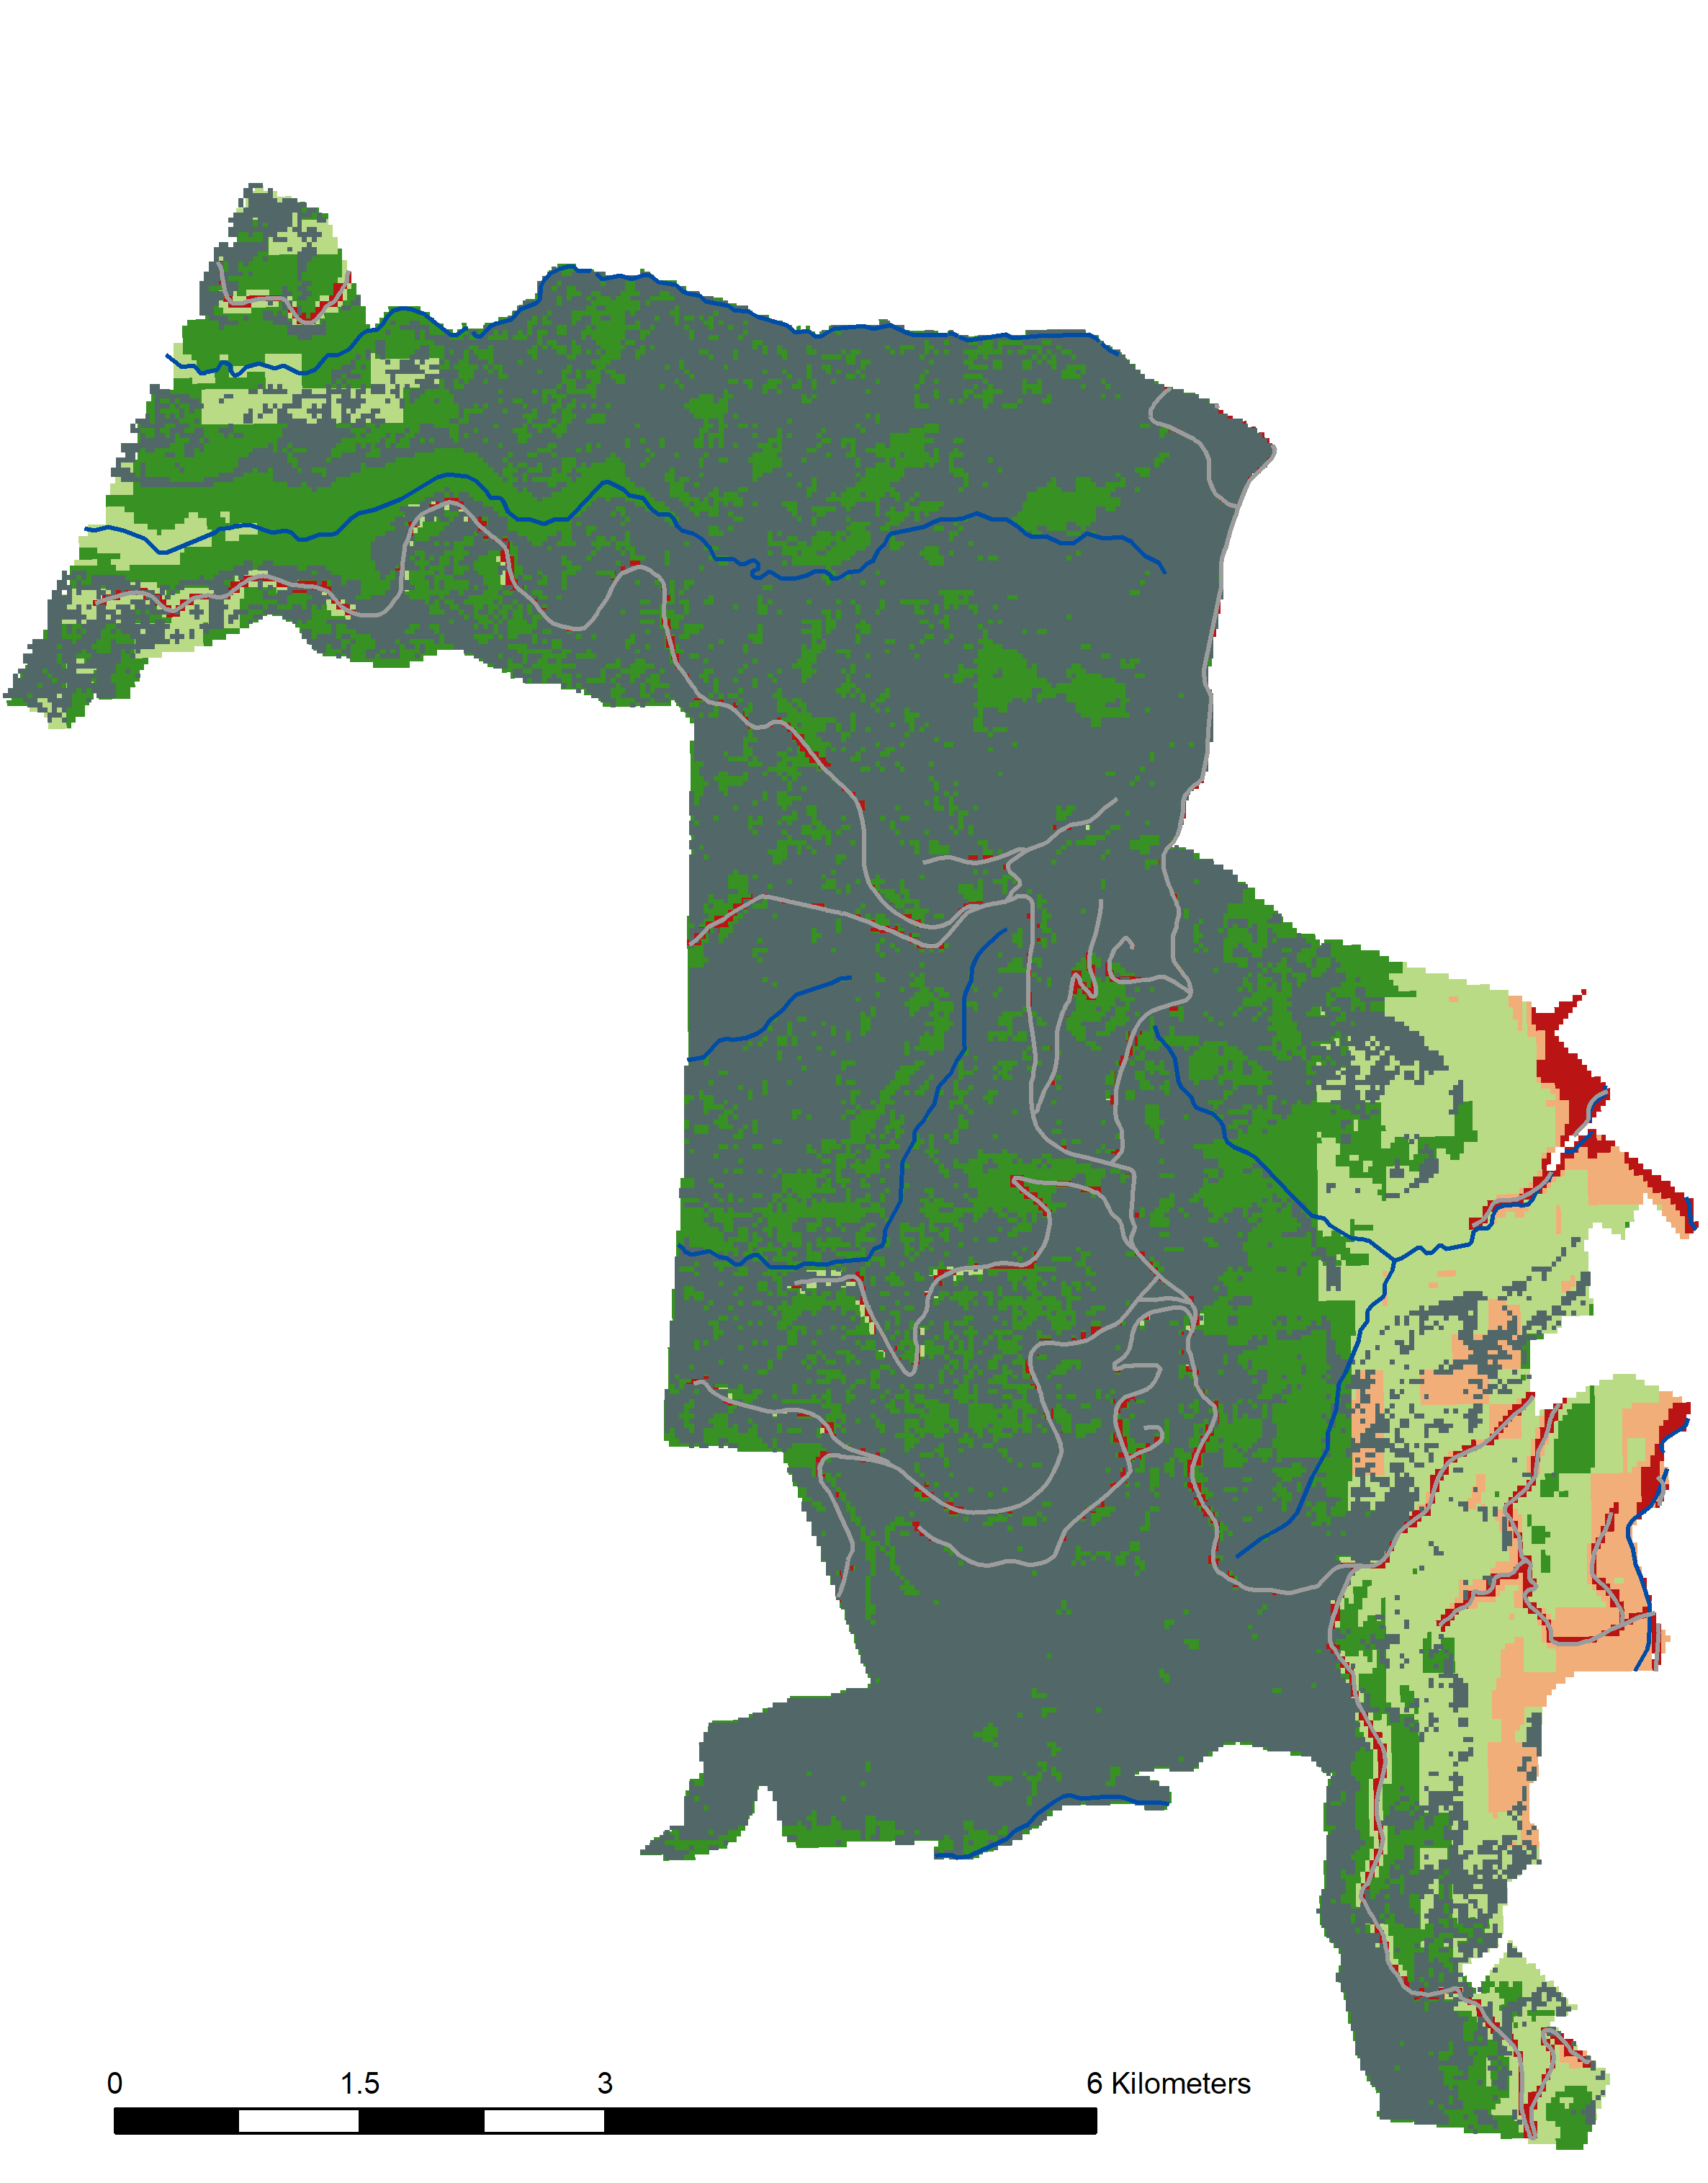
Results: Site Suitability
Habitat Suitability:
Sharp’s Knob Restoration Area
1,040 hectares suitable for future restoration projects
  Not presently classified as red spruce by our CTA model
  Very high or high suitability based on the fuzzy suitability model
Low Suitability
Moderate Suitability
High Suitability
Very High Suitability
Red Spruce Extent
Roads
Streams
0
1.5
3
6
Kilometers
Notes:
After executing our habitat suitability model, we were able to determine what areas of Sharp’s Knob were suitable for restoration. In the map on the right of your screen, dark green areas represent very high suitability areas and light green areas represent high suitability areas. In order to visualize how our results intersect with existing red spruce, we extracted areas determined to be red spruce by our classification model and added it to our habitat map in gray. From this, we determined 1,040 hectares are suitable as restoration sites. We got to this number by figuring out the number of hectares that are not classified as red spruce by CTA but are considered as high or very high suitability

Slide 16
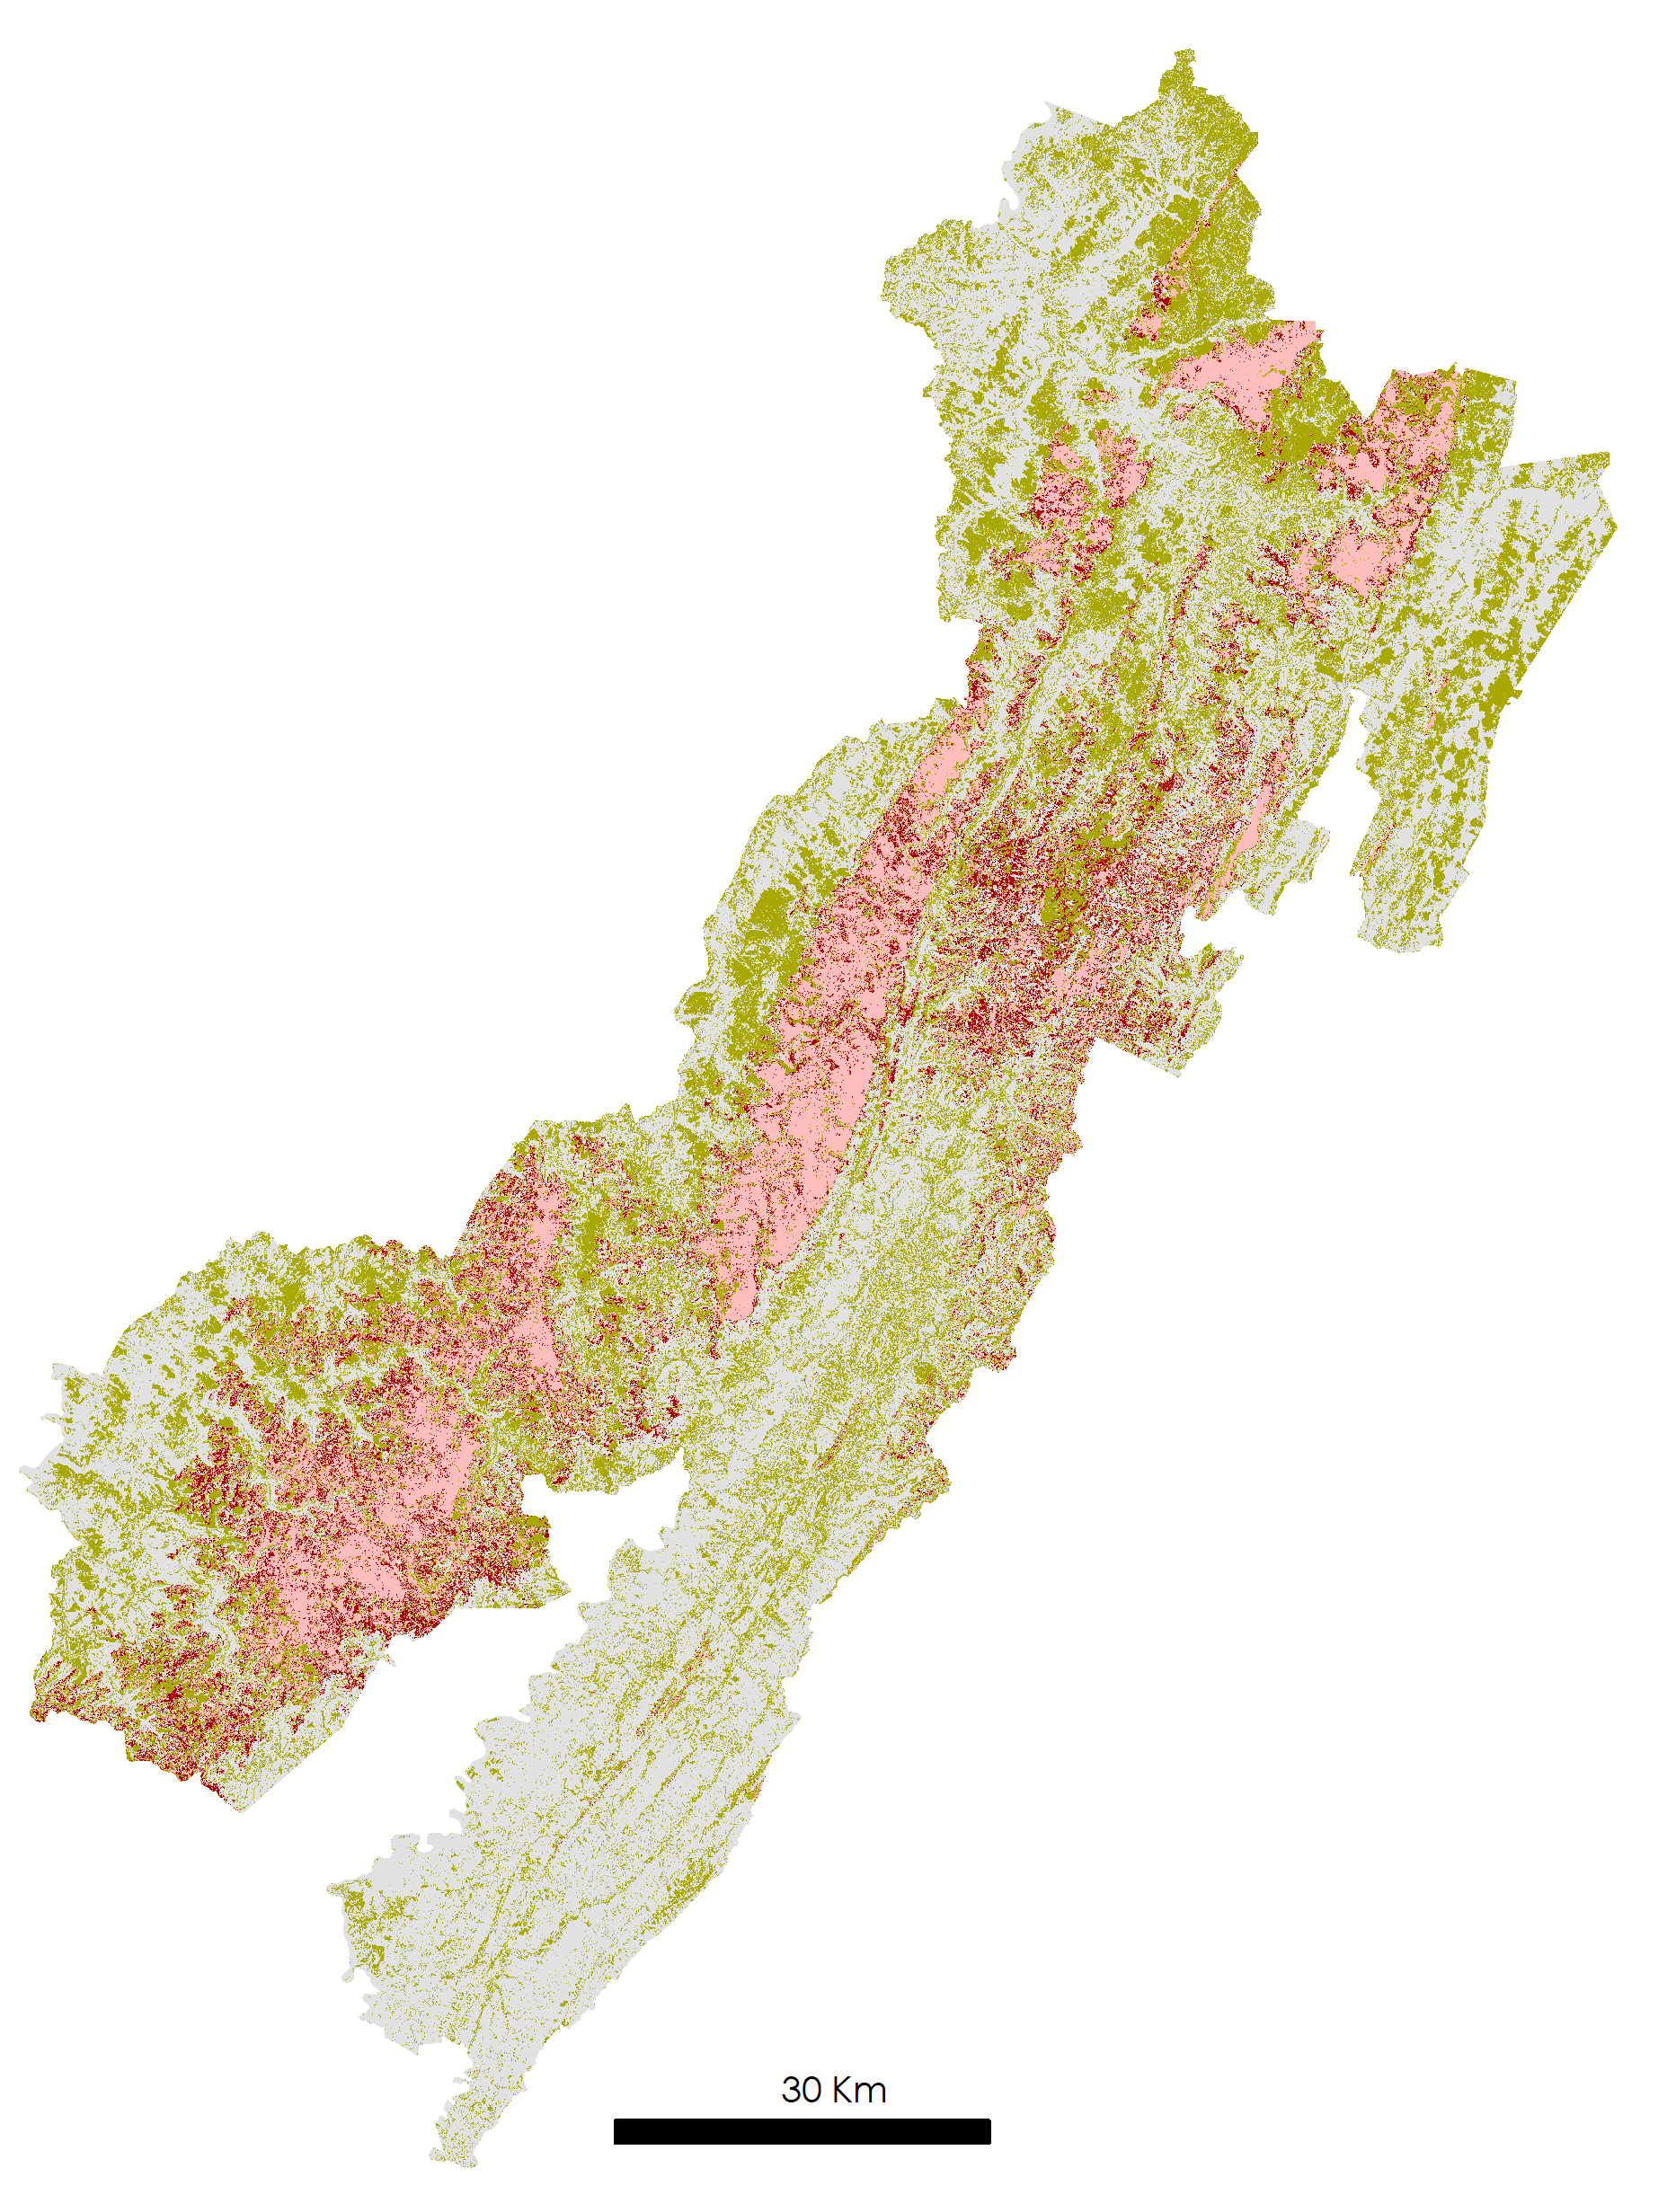
Results: Forecast Modeling
2018 to 2040
Without active management practices red spruce stands are not expected to reclaim their historical extent
Change to spruce
No change
Persistent spruce
Change other
Notes:
Using Land Change Modeler within Terrset we were able to forecast where red spruce would emerge based on the previous 30 years. The model shows regrowth growing on the periphery of existing red spruce with nearly red spruce areas remaining so.

Slide 17
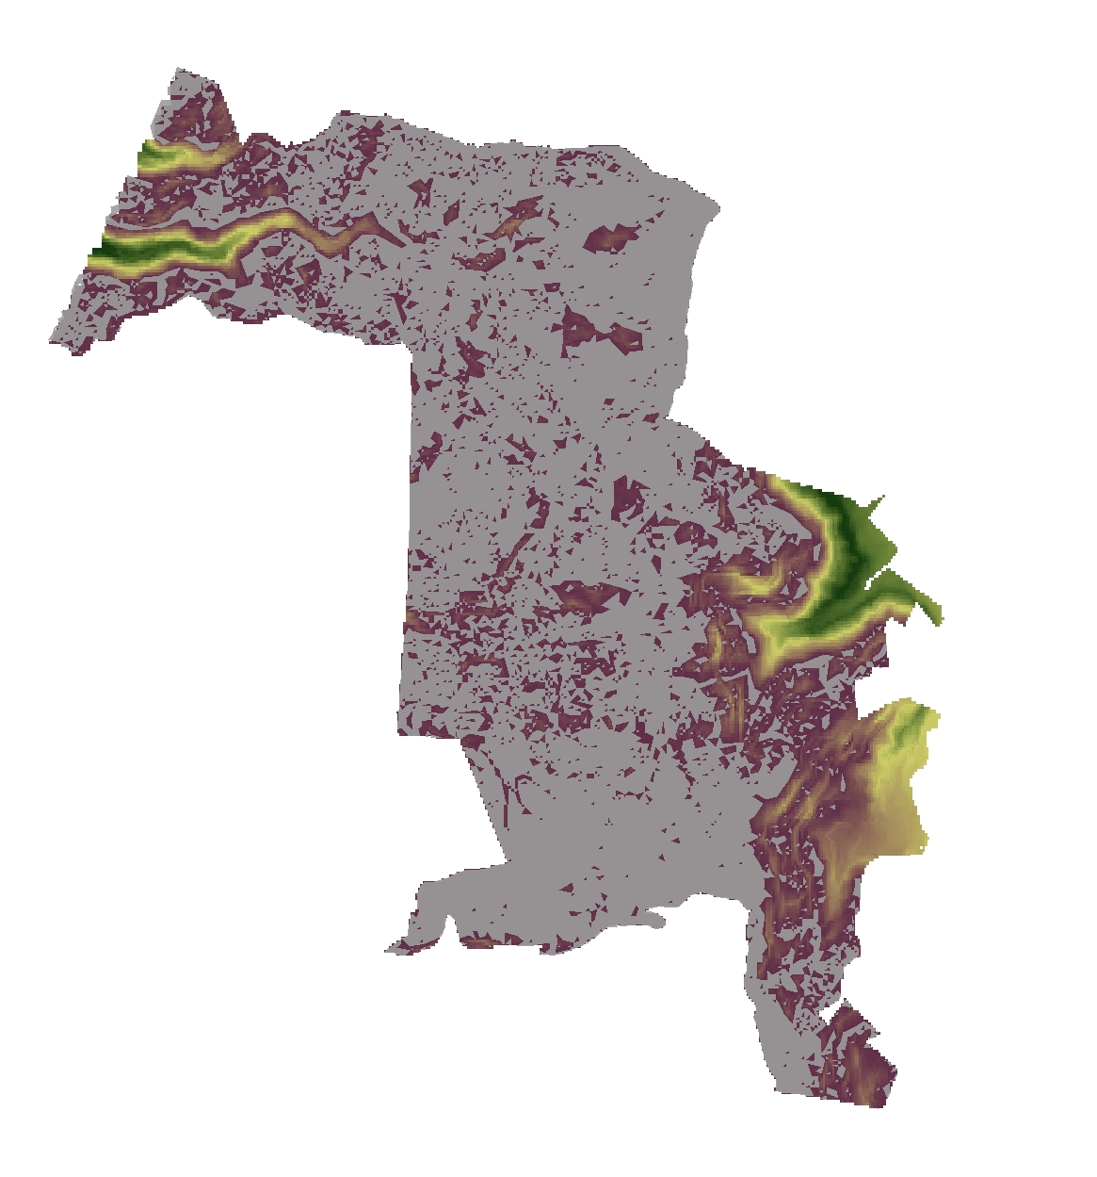
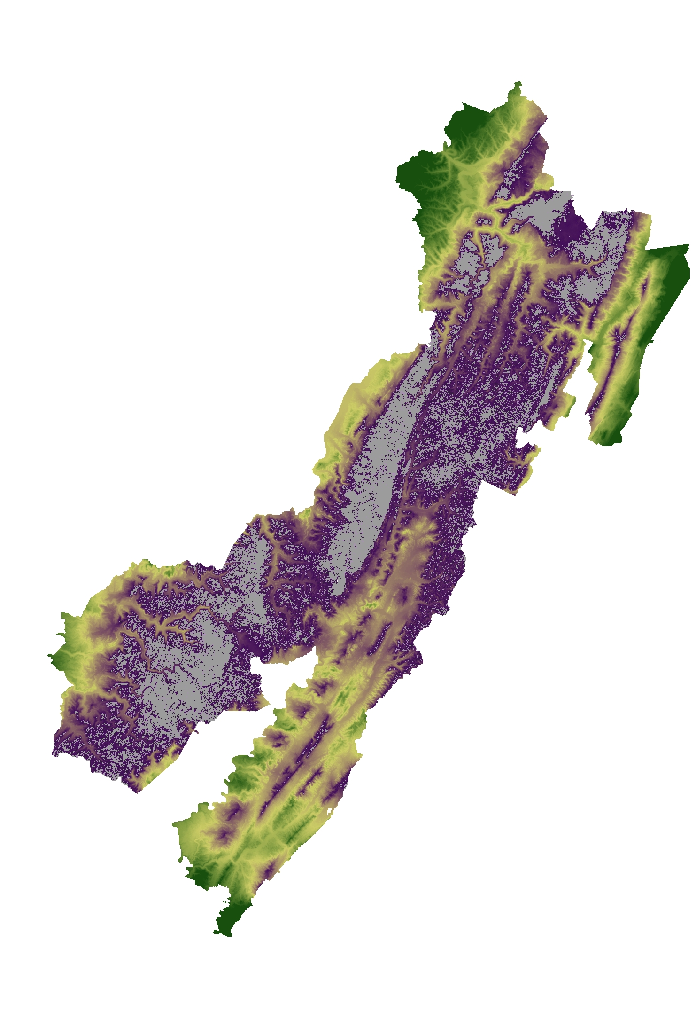
Results: Prioritizing Connectivity
Areas of highest connectivity potential based on Euclidean distance between existing spruce and the suitability of land between spruce
Several areas within Sharp’s Knob could be restored to connect existing red spruce stands and greater larger continuous areas
Spruce Core
Low
High
Notes:
Areas of red spruce restoration that would untie or connect existing red spruce and create corridors are of higher priority than that of areas that would not connect habitat. Connectivity potential was mapped in ArcGIS using Euclidean distance between existing red spruce as well as the suitability of land between the red spruce

Slide 18
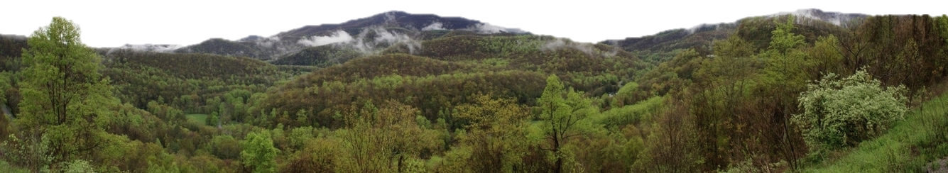
Conclusions
Medium resolution, multispectral imagery from Landsat can be successfully used to identify and classify red spruce stands in the Monongahela National Forest.
According to our forecasting model, without active management practices red spruce stands cannot be expected to reclaim their historical extent despite a surplus of suitable habitat in the National Forest.
Within Sharp’s Knob, nearly all areas are suitable for red spruce restoration.
J. Van Gundy
Notes:
Landsat 5 and 8 can be used to map red spruce extent as well as used in unison with other inouts to forecast habitat. The Sharp’s knob area in particular has almost all highly suitable land.
Image source: https://www.flickr.com/photos/jvangundy/3533141179/in/pool-themon/; CC BY-NC-ND 2.0

Slide 19
Acknowledgements
Keith Weber, Idaho State University, GIS TReC, DEVELOP Science Advisor
Catherine Jarnevich, USGS Fort Collins Science Center
Joseph Spruce, Science Systems and Applications, Inc
Amy Coleman, USFS Monongahela National Forest South Zone Ecologist
Sam Lammie, USFS Project Management Professional, GISP
Stephanie Connolly, USFS Forest Soil Scientist
Kristen Dennis, DEVELOP Intermountain West Center Lead
Notes:
We would like to acknowledge the following people for their great help!

Slide 20

Thank You and Questions?

