Slide 1

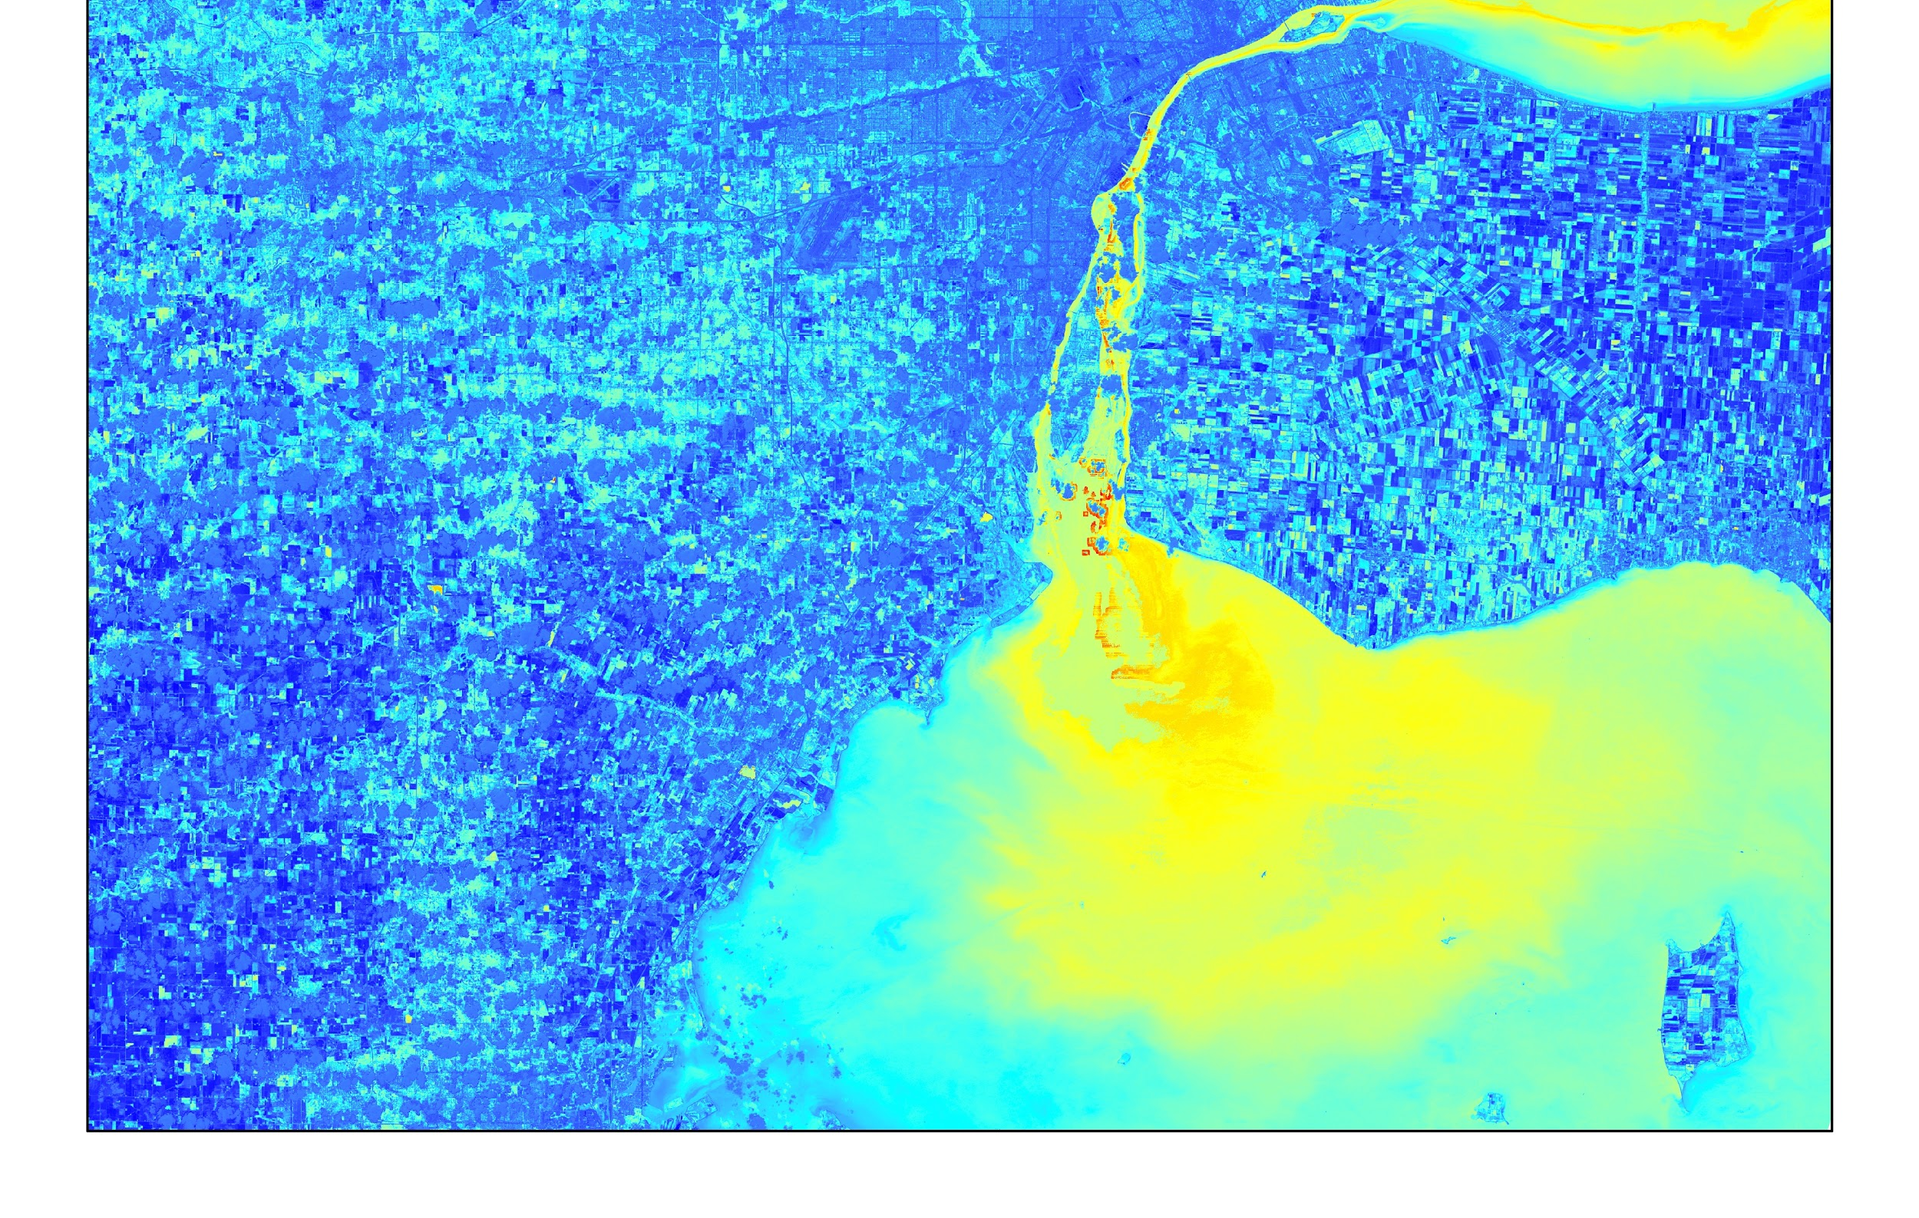

Rachel Green
(Point of Contact)
John Dilger
LAKE ERIE WATER RESOURCES
Rachel Johnson
Utilizing Satellite Multispectral and Airborne Hyperspectral Imagery to Identify Annual and Seasonal Trends of Harmful Algal Blooms and Resulting Water Quality in Lake Erie’s Western Basin
NASA Ames Research Center
2017 Spring
Notes:
Hello, we are the Lake Erie Water Resources Team, and our project is “Utilizing Satellite Multispectral and Airborne Hyperspectral Imagery to Identify Annual and Seasonal Trends of Harmful Algal Blooms and Resulting Water Quality in Lake Erie’s Western Basin.”

Slide 2
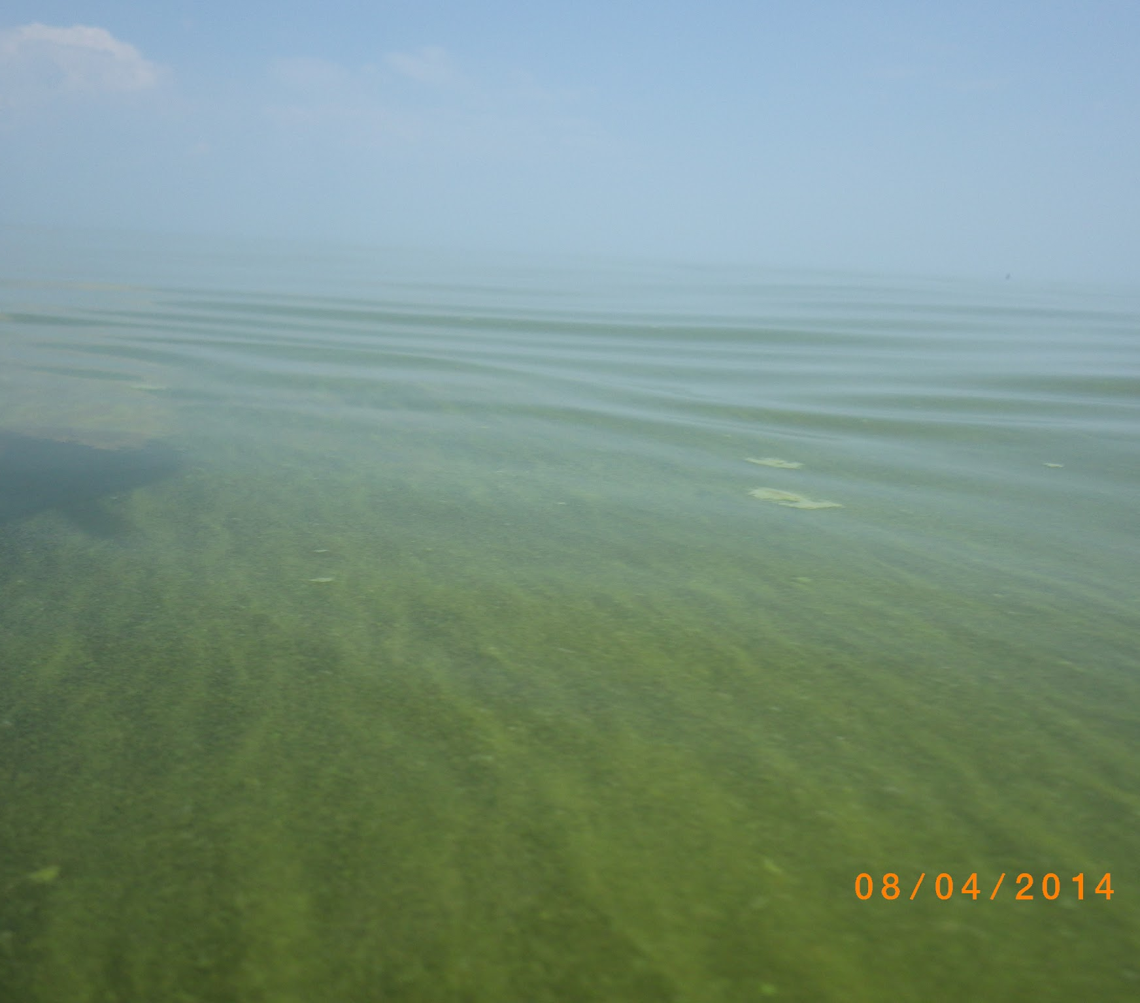
Components
Study area & period
Community concerns
Objectives
Methodology
NASA satellites/sensors used
Results
Errors & uncertainties
Conclusion
Future Work
Acknowledgements
Image Credit: University of Toledo Lake Erie Center
Notes:
Here is a quick overview of the topics we will be covering this morning.
Image Source: University of Toledo Lake Erie Center

Slide 3
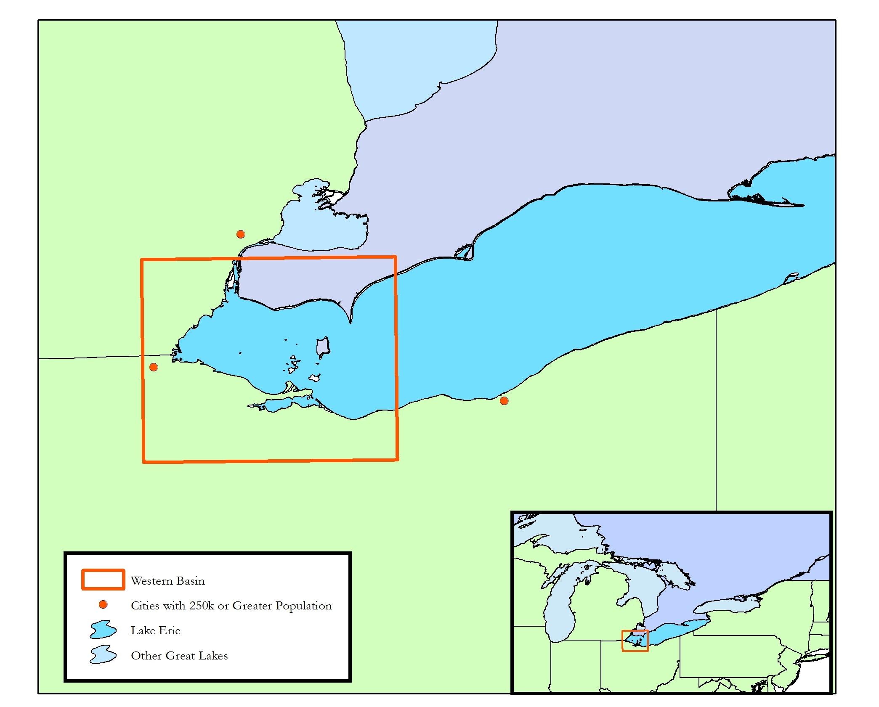
Study Area & Period
Area
Western Basin of Lake Erie
Period
March to October 2015
March to November 2016
Notes:
Our focused study area was the western basin of Lake Erie during the late summer and early autumn months of 2015 and 2016.
Lake Erie is the 12th largest lake by area in the world, but the smallest, shallowest, warmest, and most productive of the Great Lakes.
Of the three basins (central, eastern, and western), the western basin is the shallowest with an average depth of 24’, roughly 35’ shallower than the central basin and 55’ shallower than the eastern basin on average.
22,720 square miles of surrounding land area drain directly into the lake.
The Generation II Hyperspectral Imager was flown daily March through October 2015, and daily March through November 2016.
Image: Lake Erie Water Resources
Content source: http://www.lakeeriewaterkeeper.org/lake-erie/facts/

Slide 4
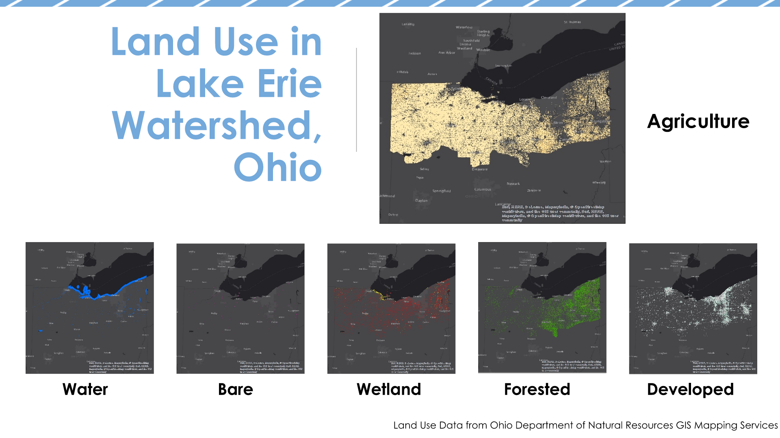
Land Use in Lake Erie Watershed, Ohio
Land Use Data from Ohio Department of Natural Resources GIS Mapping Services
Notes:
Highest land use is agriculture particularly in the western basin region.
The blooms have largely been influenced by fertilizer runoff. The increase in nutrients from the fertilizer cause the algal blooms to grow.

Slide 5
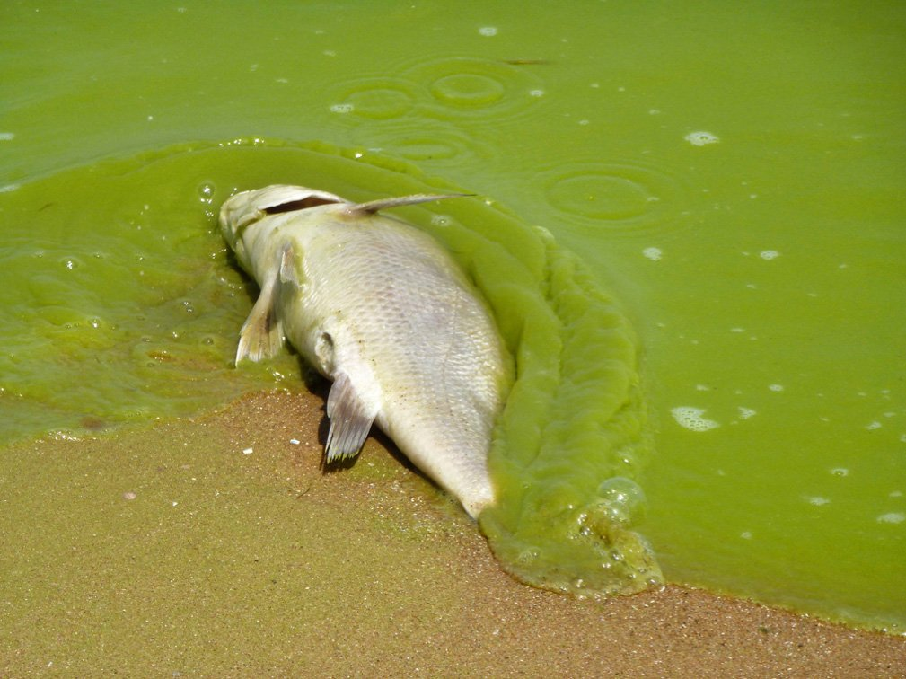
Community Concerns
Rising lake temperatures
Increased eutrophication
  Nitrogen & phosphorus
More frequent harmful algal bloom (HAB) events
  Overgrowths of algae in water
Health threats to humans, fish, and wildlife from contact with cyanobacterial toxins
Economic losses
Image Credit: Tom Archer
Notes:
Cyanobacterial toxins found in Lake Erie pose a health threat to those who come in contact with them and have been linked to causing various health issues including skin irritation, liver and kidney failure or cancer, nervous system damage, and even death. Rising lake temperatures and increased eutrophication have produced more frequent HAB events in Lake Erie. The provides roughly 10,000 fisheries jobs, $1 billion in economic revenues to the surrounding regions, and potable water to 11 million residents. (Source: Lake Erie Water Keeper)
Image credit: http://www.huffingtonpost.com/2014/08/04/lake-erie-algae-bloom-2014-_n_5647824.html

Slide 6

Community Concerns
Impact
  Carroll Township: emergency water shutdown
  September, 2013
  Toledo: do-not-drink advisory
  August, 2014
    Half a million residents in Maumee Bay Area without access to potable tap water
Image Credit: Ohio EPA
Notes:
In 2013, Caroll Township, along Lake Erie had an emergency shutdown for several days of its water supply due to abnormally high levels of toxic microcystins.
In 2014, a harmful algal bloom event led to the shutdown of municipal drinking water in Toledo, Ohio for several days.
This event impacted half a million residents of the Maumee Bay Area.
Image Credit: http://www.epa.state.oh.us/HABAlgae.aspx

Slide 7
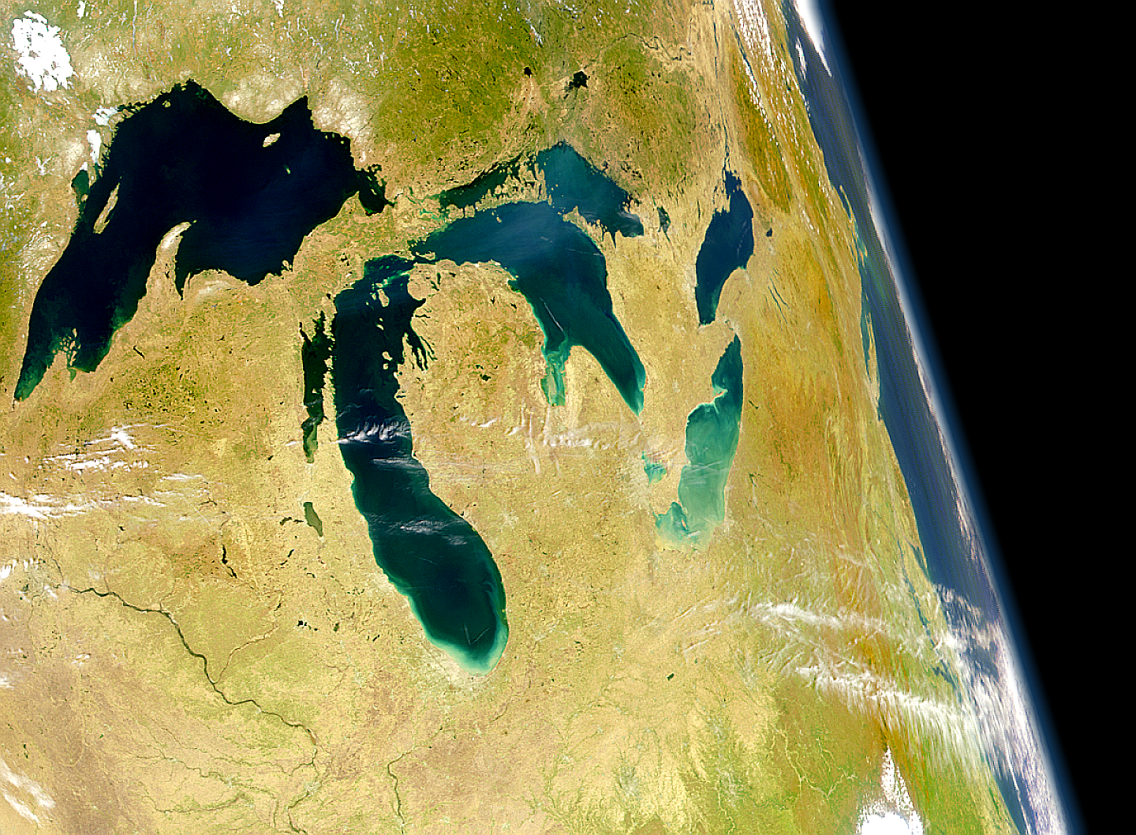
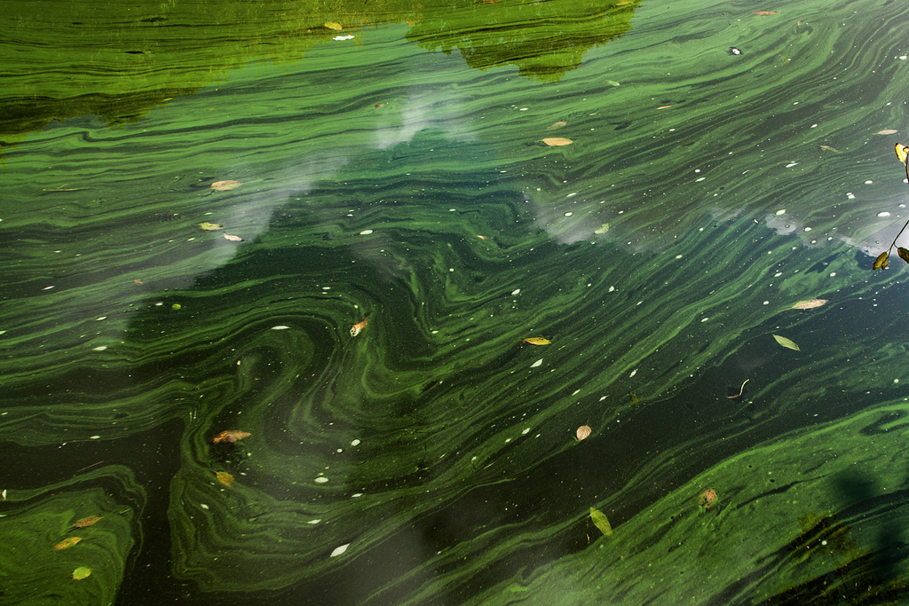
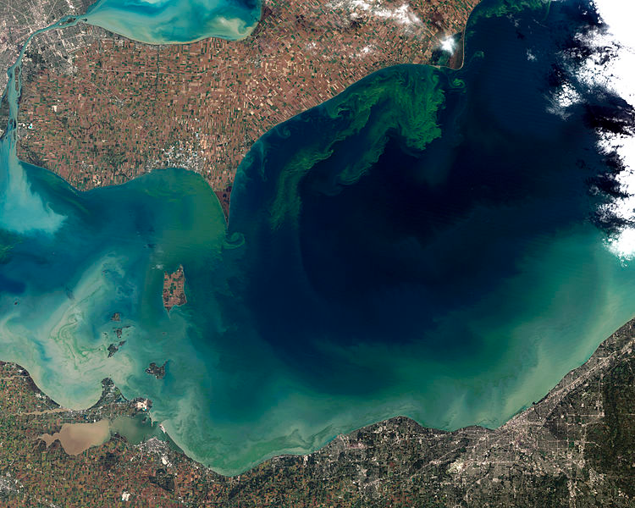
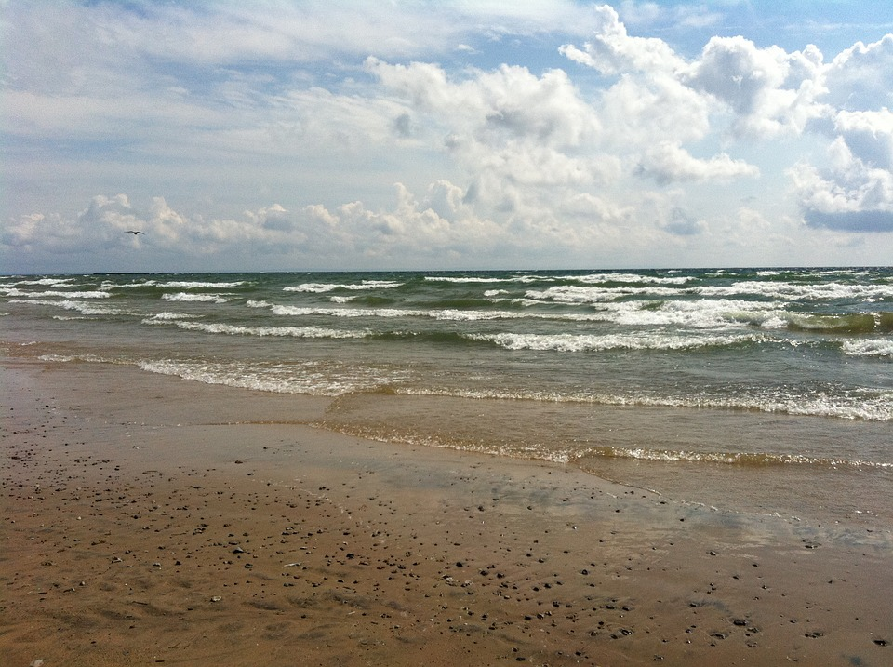
Objectives
Determine most effective sensor
Implement algorithms
Conduct comparative analysis
Provide statistical analysis and enhanced algorithm
Image Credit: the SeaWiFS Project, NASA/Goddard Space Flight Center, and ORBIMAGE
Image Credit: Bob McKay
Image Credit: Jesse Allen and Robert Simmon
Image Credit: Max Pixel
Notes:
Determine whether hyperspectral airborne imagery can be used as a more effective tool to monitor and predict microcystin production compared to multispectral satellite imagery or in situ measurements
Implement remote sensing algorithms to test their strength in detecting harmful algal blooms
Conduct a comparative analysis of airborne hyperspectral imagery versus NASA Earth observations when considering monitoring and predictability of microcystin production in Lake Erie.
Provide statistical analysis of algorithm performance validated with in situ data and enhanced algorithm for bloom detection.
Image Source (top right): https://c1.staticflickr.com/3/2831/10362341084_65623f3674_b.jpg
Image Source (top left): https://commons.wikimedia.org/wiki/File:SeaWiFS_Image_of_Great_Lakes_from_Space.png
Image Source (bottom left): https://commons.wikimedia.org/wiki/File:Toxic_Algae_Bloom_in_Lake_Erie.jpg
Image Source (bottom right): http://maxpixel.freegreatpicture.com/Lake-Erie-Water-Beach-Shore-Waves-Wave-Lake-Sand-76425

Slide 8
Methodology
Earth observations
Algorithms
Comparative Statistics &
Regressions
HSI
  Mishra et. al 2009
  Cyanobacteria Index
MODIS
  Chlorophyll-a
  Cyanobacteria Index
Landsat 8
  NDTI
  Phycocyanin detection Vincent et al. 2004
  NIR with SAC Wang and Shi, 2007
Glenn Hyperspectral Imager II
Comparative
and statistical analysis of sensor performance
and algorithm accuracy
Pre-Processing
(Empirically corrected to reflectance, SeaDAS, masking, projections)
NOAA Great Lakes
Environmental
Research Laboratory
Aqua MODIS
Ohio State University Stone Lab
Landsat 8 OLI
Notes:
Here is an overview of the methodology. We will be running through the process step by step.

Slide 9
Methodology
Earth observations
Algorithms
Comparative Statistics &
Regressions
HSI
  Mishra et. al 2009
  Cyanobacteria Index
MODIS
  Chlorophyll-a
  Cyanobacteria Index
Landsat 8
  NDTI
  Phycocyanin detection Vincent et al. 2004
  NIR with SAC Wang and Shi, 2007
Glenn Hyperspectral Imager II
Comparative
and statistical analysis of sensor performance
and algorithm accuracy
Pre-Processing
(Empirically corrected to reflectance, SeaDAS, masking, projections)
NOAA Great Lakes
Environmental
Research Laboratory
Aqua MODIS
Ohio State University Stone Lab
Landsat 8 OLI
Notes:
Or first step in the process was acquiring our Earth observation imagery...

Slide 10

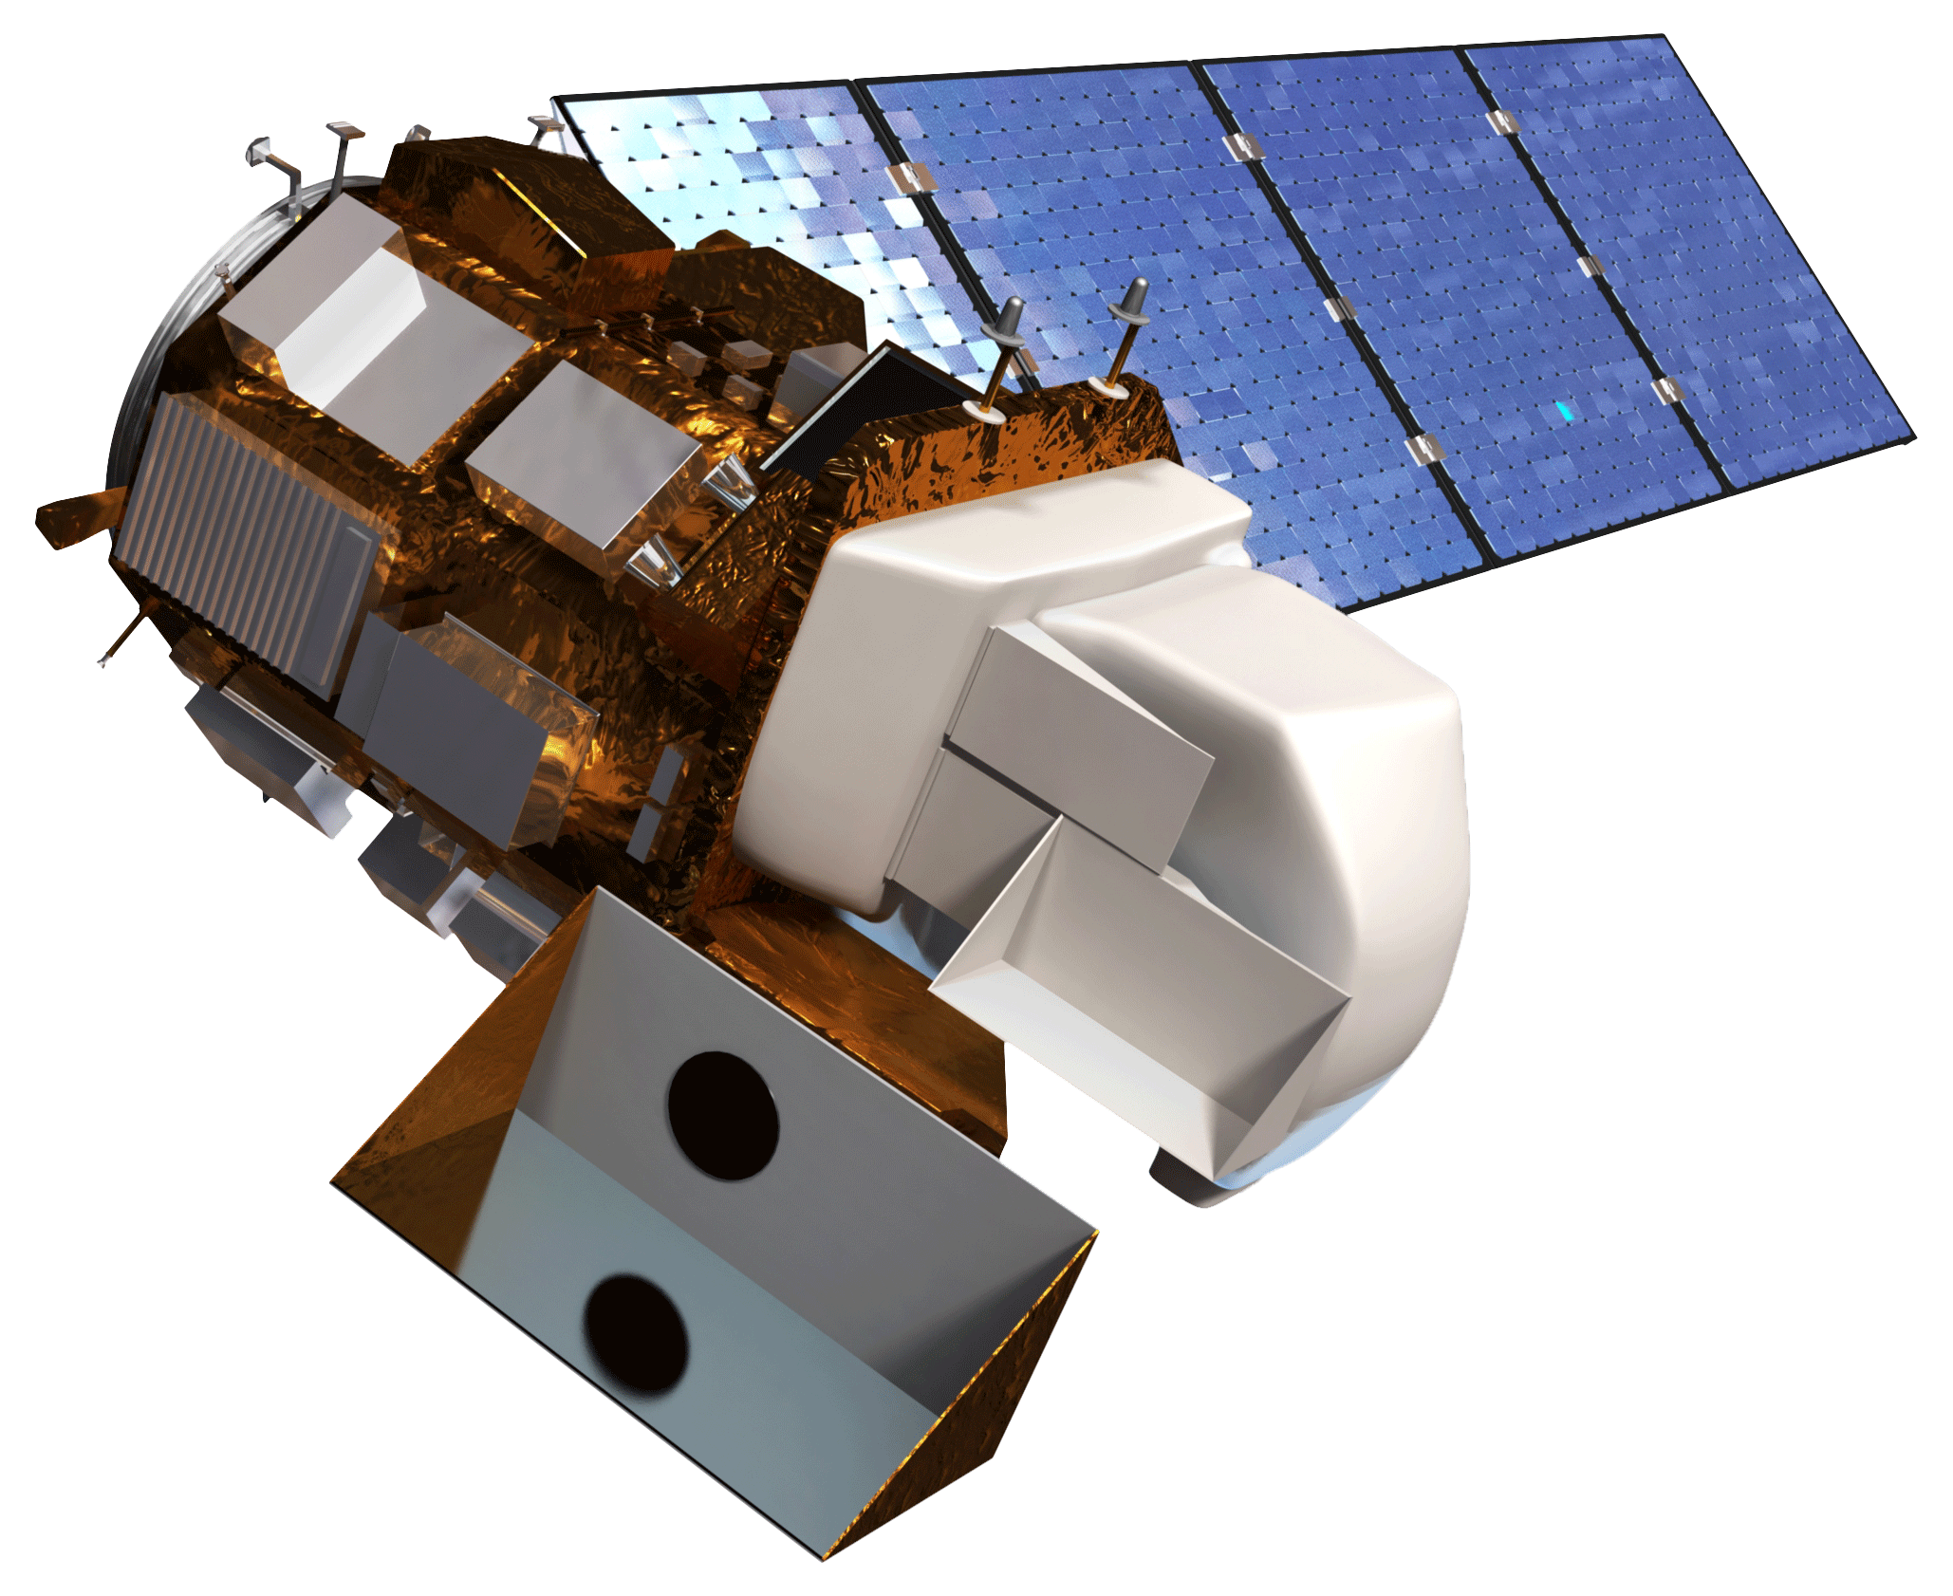
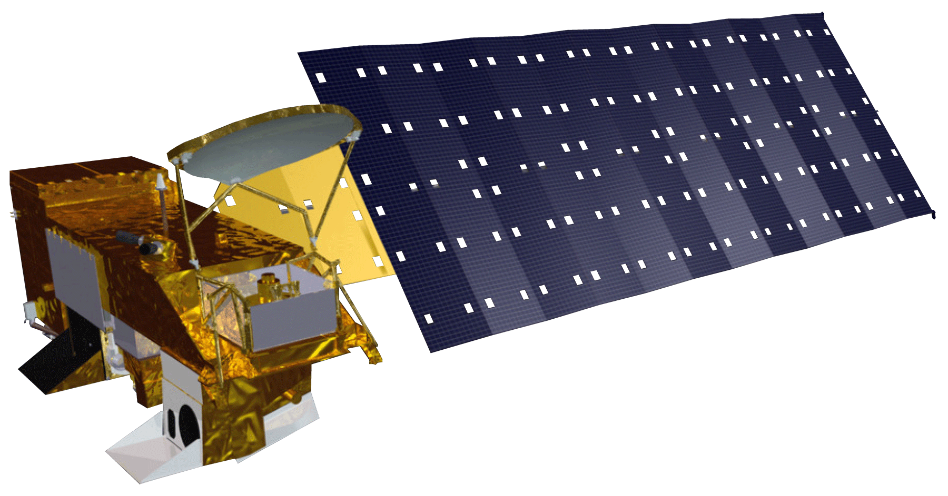
Earth Observations Used
Glenn HSI II
Aqua MODIS
Landsat 8 OLI
Image credit: NASA
Notes:
For this project we looked at imagery over the Western Basin of Lake Erie from NASA Glenn Research Center’s Hyperspectral Imager, Aqua MODIS, and Landsat 8 Operational Land Imager.
HSI – Obtained from Glenn Research Center via Ohio Supercomputer
Aqua MODIS—Downloaded from Earth Data
Ocean color product from Ocean Web
Landsat 8 OLI—At surface reflectance, USGS Earth Explorer ESPA (Earth Science Processing Architecture)
Image source: https://www.nasa.gov/press/2014/august/nasa-glenn-and-partners-studying-lake-erie-algal-bloom/

Slide 11
Temporal Range
Data | 3-Aug 2015 | 21-Sep 2015 | 7-Oct 2015 | 18-May 2016 | 19-Jun 2016 | 7-Sep 2016
Landsat 8 | x | x | x | x | x | x
Aqua MODIS | x | x | x | x | x | x
HSI |  | x
In Situ sampling | x | x |  |  | x
comparison chart of satellite and in situ dates
 | MODIS | Landsat 8 | HSI
Spectral Resolution | 36 | 11 | 170
Spatial Resolution | 1 km | 30 m | 1 m
Temporal Resolution | Daily | 16 days | flexible
Historical Archive | 2002 – present | 1972 – present | 2013 – present
Image Credit: Monet
Notes:
Looking at our three sources of imagery, we can see the variance in spectral, spatial, and temporal resolution. When weighing the costs/benefits of these sensors it was important to keep in mind throughout the process how these factors influence our ability to accurately detect the rapid changes in algal bloom movement and pick up the cyanobacteria formation in particular. It is also notable that while HSI offers us many more bands, higher resolution, and flexible temporal resolution, the data is not freely and openly accessible to the public.
From our temporal resolution we then selected cloud free/minimal dates for Landsat & MODIS
Here we looked at where the temporal range of our data lined up and focused in on certain dates that correlated well
The table shows that we had three days with Landsat, HSI, MODIS, and in situ data. While this is technically true, we only had enough in situ data to validate September 21, 2015. August 3, 2015 and June 19, 2016 had too few sample sites to perform any statistical analysis.

Slide 12
Methodology
Earth observations
Algorithms
Comparative Statistics &
Regressions
HSI
  Mishra et. al 2009
  Cyanobacteria Index
MODIS
  Chlorophyll-a
  Cyanobacteria Index
Landsat 8
  NDTI
  Phycocyanin detection Vincent et al. 2004
  NIR with SAC Wang and Shi, 2007
Glenn Hyperspectral Imager II
Comparative
and statistical analysis of sensor performance
and algorithm accuracy
Pre-Processing
(Empirically corrected to reflectance, SeaDAS, masking, projections)
NOAA Great Lakes
Environmental
Research Laboratory
Aqua MODIS
Ohio State University Stone Lab
Landsat 8 OLI
Notes:
Once we had all of the data, we then had to process our hyperspectral imagery from radiance to reflectance using the empirical line method. Our Landsat and MODIS data had to be clipped and masked to our study area and reprojected so that they were congruent and comparable.
While this step took the longest time it was essential for us to be able to plug in our algorithms that John will now explain!

Slide 13
Methodology
Earth observations
Algorithms
Comparative Statistics &
Regressions
HSI
  Mishra et. al 2009
  Cyanobacteria Index
MODIS
  Chlorophyll-a
  Cyanobacteria Index
Landsat 8
  NDTI
  Phycocyanin detection Vincent et al. 2004
  NIR with SAC Wang and Shi, 2007
Glenn Hyperspectral Imager II
Comparative
and statistical analysis of sensor performance
and algorithm accuracy
Pre-Processing
(Empirically corrected to reflectance, SeaDAS, masking, projections)
NOAA Great Lakes
Environmental
Research Laboratory
Aqua MODIS
Ohio State University Stone Lab
Landsat 8 OLI
Notes:
Now the fun part! The Algorithms...

Slide 14
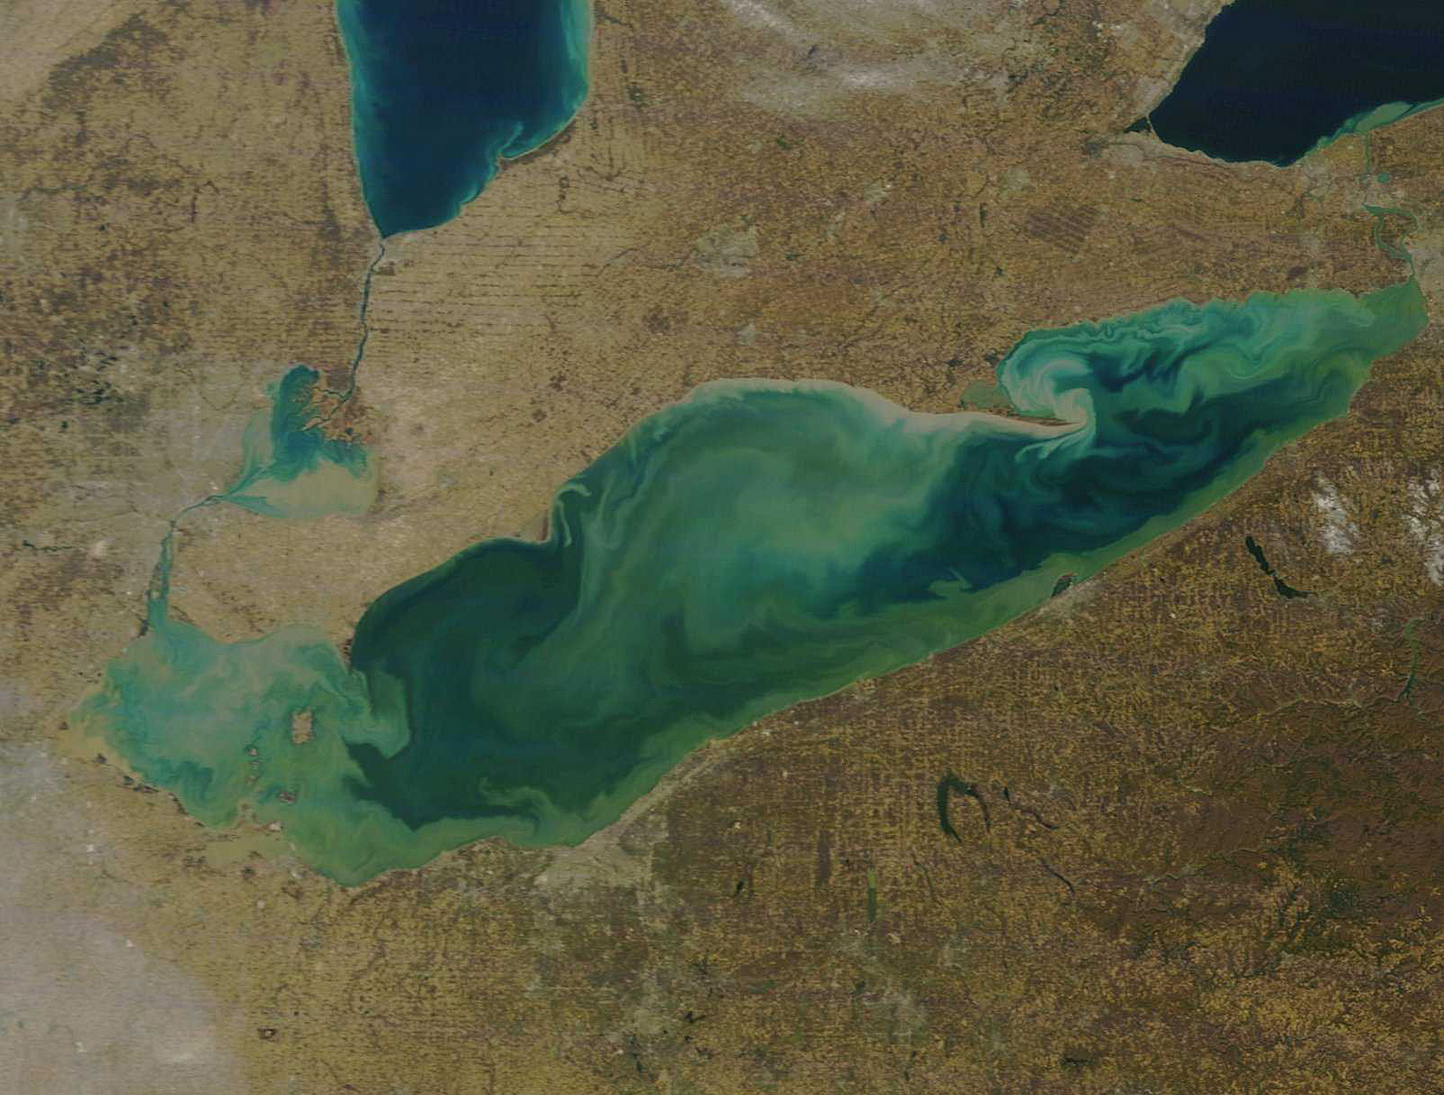
Analysis: Spatial Statistics
Glenn Hyperspectral Imager II
Cyanobacteria Index (CI)
600 to 700 Band Ratio
Landsat 8 - OLI
Normalized Difference Turbidity Index (NDTI)
Green to Blue Ratio
NIR with Simple Atmospheric Correction
Phycocyanin detection with Single Band Ratio
Phycocyanin detection with Spectral Ratio
Dissolved Microcystin algorithm
Aqua MODIS
Cyanobacteria Index (CI)
Chlorophyll-A
Image Credit: NOAA GLERL
Notes:
There is a wealth of literature detailing the multiple algorithms that have been used to detect HABs
we choose to apply multiple algorithms to each of our earth observation parameters
some were simple band ratios; such as the 600nm to 700nm ratio for phycocyanin detection with Glenn’s HSI or
implementing the Blue green ratio as an indication of phycocyanin with landsat 8
While others like MODS Chlorophyll-a algorithm were acquired from NASA’s ocean Biology Processing Group
Image source: https://www.flickr.com/photos/noaa_glerl/albums/72157639592150973

Slide 15
Methodology
Earth observations
Algorithms
Comparative Statistics &
Regressions
HSI
  Mishra et. al 2009
  Cyanobacteria Index
MODIS
  Chlorophyll-a
  Cyanobacteria Index
Landsat 8
  NDTI
  Phycocyanin detection Vincent et al. 2004
  NIR with SAC Wang and Shi, 2007
Glenn Hyperspectral Imager II
Comparative
and statistical analysis of sensor performance
and algorithm accuracy
Pre-Processing
(Empirically corrected to reflectance, SeaDAS, masking, projections)
NOAA Great Lakes
Environmental
Research Laboratory
Aqua MODIS
Ohio State University Stone Lab
Landsat 8 OLI
Notes:
Next was to consolidate in situ data from the Ohio State University’s Stone Lab and NOAA Great Lakes Environmental Research Lab

Slide 16
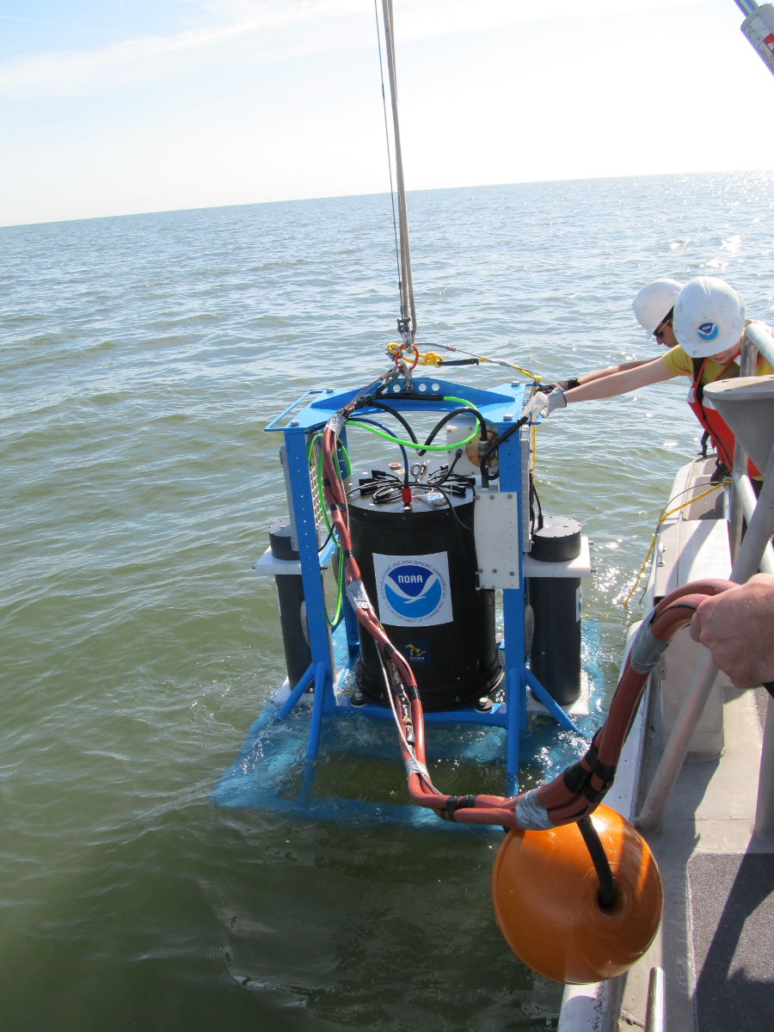
In Situ Data: NOAA GLERL
Acquired weekly in situ datasets (2008-2016)
Particulate and dissolved microcystin
Extracted phycocyanin
Extracted chlorophyll-a
Turbidity
Image credit: NOAA GLERL
Notes:
NOAA has weekly datasets that had many water quality parameters of interest including particulate and dissolved microcystin, extracted phycocyanin, extracted chlorophyll-a and turbidity.

Slide 17
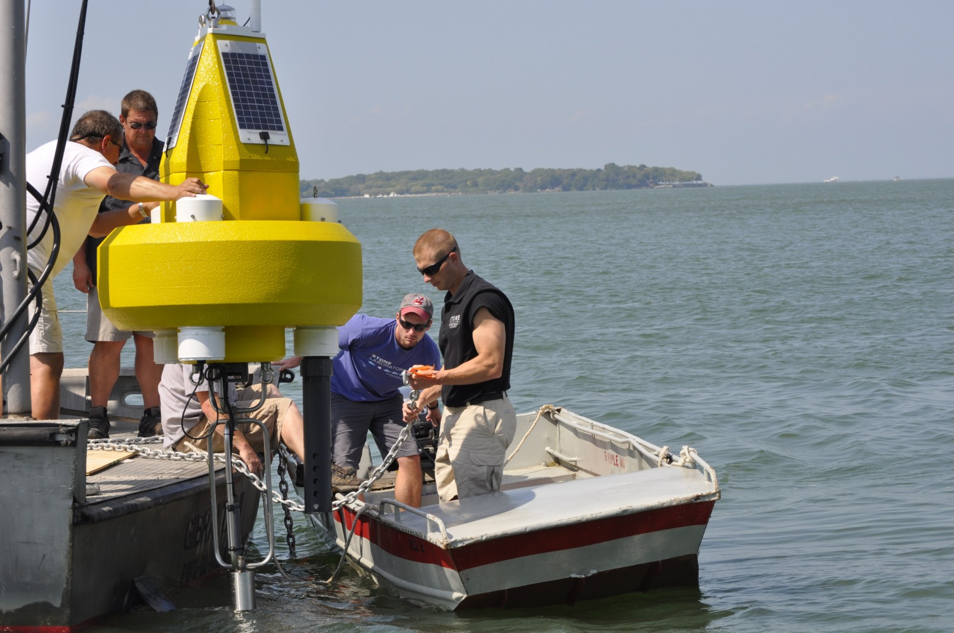
In Situ Data: Ohio EPA and Ohio State University Stone Laboratory
Acquired in situ datasets (2013-2016)
Extracted Chlorophyll-a
Total Microcystin
Image credit: OSU Stone Lab
Notes:
Image Source: https://ohioseagrant.osu.edu/research/live/water
The Ohio State University also had in situ datasets relevant data for the period of time we were studying with water parameters including extracted chlorophyll-a and total microcystin

Slide 18
Methodology
Earth observations
Algorithms
Comparative Statistics &
Regressions
HSI
  Mishra et. al 2009
  Cyanobacteria Index
MODIS
  Chlorophyll-a
  Cyanobacteria Index
Landsat 8
  NDTI
  Phycocyanin detection Vincent et al. 2004
  NIR with SAC Wang and Shi, 2007
Glenn Hyperspectral Imager II
Comparative
and statistical analysis of sensor performance
and algorithm accuracy
Pre-Processing
(Empirically corrected to reflectance, SeaDAS, masking, projections)
NOAA Great Lakes
Environmental
Research Laboratory
Aqua MODIS
Ohio State University Stone Lab
Landsat 8 OLI
Notes:
Next we plotted our theoretical values with the in situ data and generated linear regressions.
Additionally, we used R-studio to run a multivariable linear regression using the theoretical values from each algorithm against water quality parameters of interest.

Slide 19
Methodology
Earth observations
Algorithms
Comparative Statistics &
Regressions
HSI
  Mishra et. al 2009
  Cyanobacteria Index
MODIS
  Chlorophyll-a
  Cyanobacteria Index
Landsat 8
  NDTI
  Phycocyanin detection Vincent et al. 2004
  NIR with SAC Wang and Shi, 2007
Glenn Hyperspectral Imager II
Comparative
and statistical analysis of sensor performance
and algorithm accuracy
Pre-Processing
(Empirically corrected to reflectance, SeaDAS, masking, projections)
NOAA Great Lakes
Environmental
Research Laboratory
Aqua MODIS
Ohio State University Stone Lab
Landsat 8 OLI
Notes:
And lastly we analyzed our findings and created final maps and imagery.

Slide 20
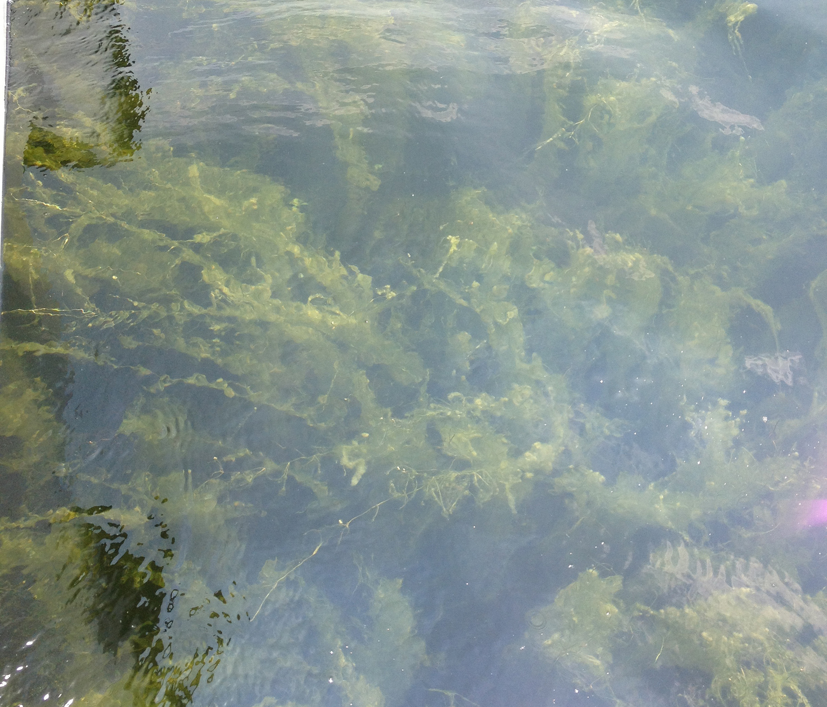
Terminology
Credit: NOAA GLERL
Cyanobacteria: phylum of algae in Lake Erie
Microcystis: genus
Microcystin: toxin
Phycocyanin: pigment specific to cyanobacteria
Chlorophyll-a: pigment in all algae
Notes:
Oh, before we get into the results here is some terminology to remember. Cyanobacteria is the phylum of algae in Lake Erie, microcystis is the genus of cyanobacteria, microcystin is the toxin produced by microcystis, phycocyanin is the pigment specific to cyanobacteria, and chlorophyll-a is a pigment found in all algae and plants.

Slide 21
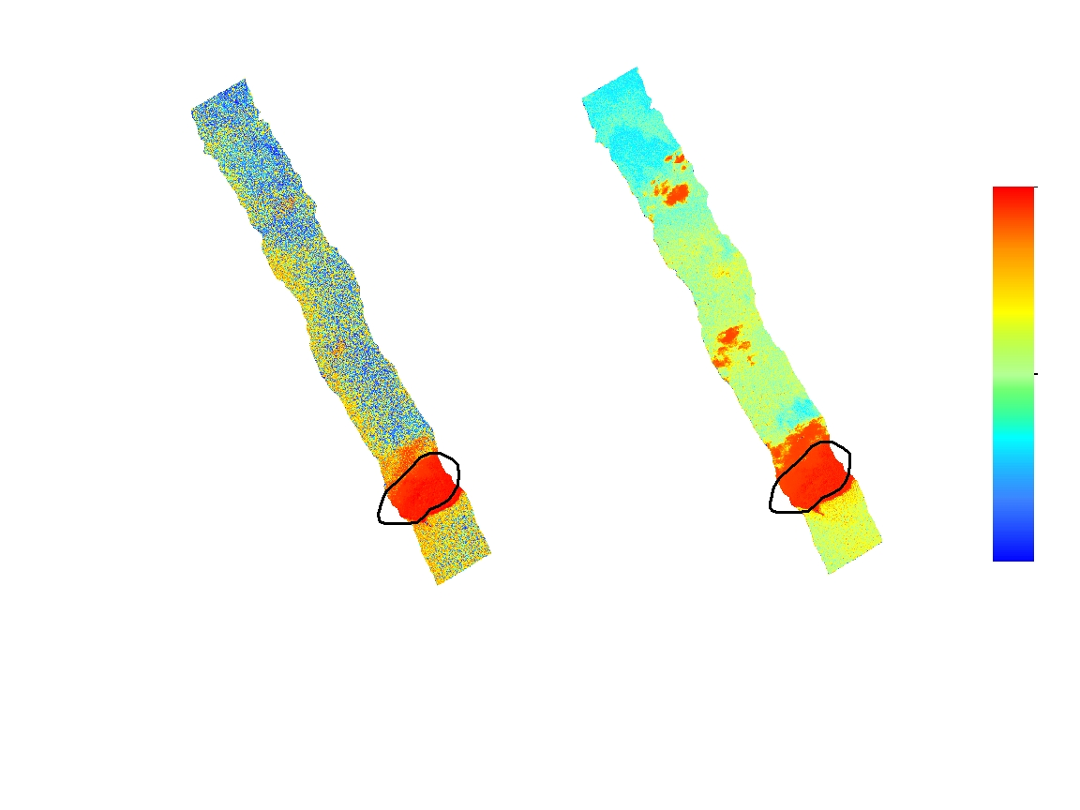
Results: Glenn Hyperspectral Imager II
Algorithms:
CI and b700/b600
Phycocyanin detection
Cyanobacteria detection
Indicative of MODIS and Landsat
Variance in noise
High
Med
Low
Cyanobacteria Index
b700 b600ᐨ¹
Notes:
Here is a sample of the results of the hyperspectral imagery
On the left is a swath with the cyano bacteria index applied depicting cyanobacteria levels
on the right is 700 to 600nm band ratio depicting phycocyanin levels
Also, As a note, the lower portion of this swath which is encircled, is an island
Unfortunately we could not obtain in situ data for validation however
The HIS is indicative of modis and landsat scenes with in the same area
Although the algorithims are explaining different paramters the CI seems to have more noise and doesn’t depict potentional regions of intrest as clearly as the band ratio does

Slide 22
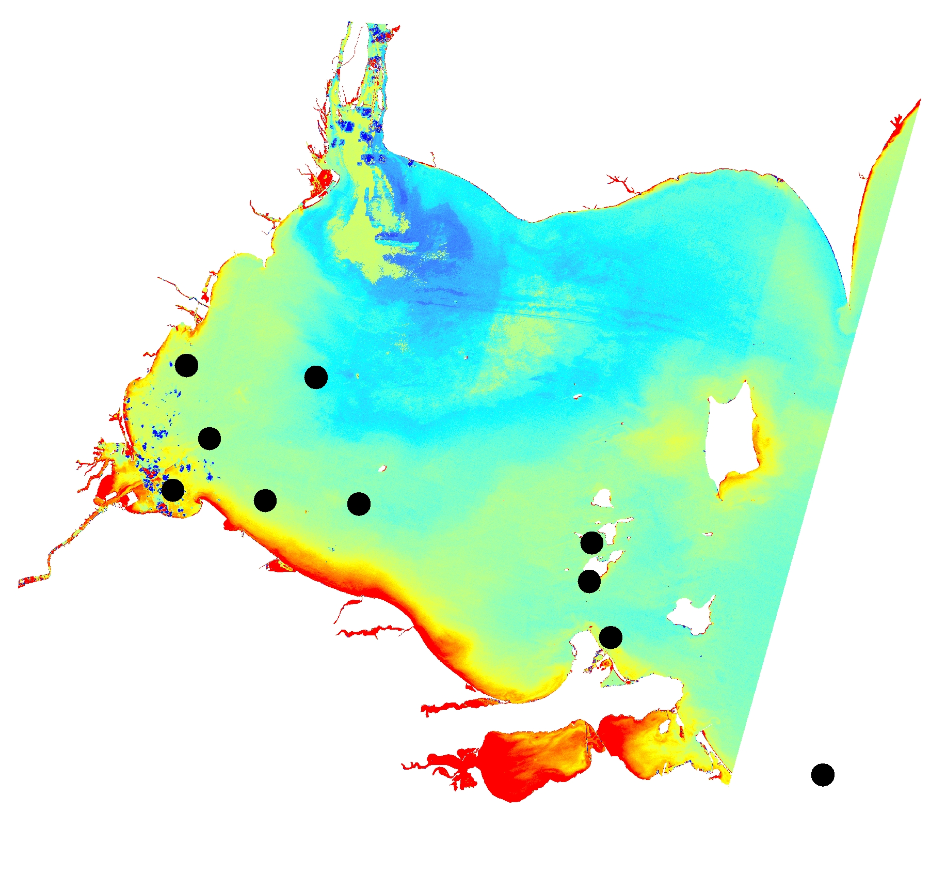
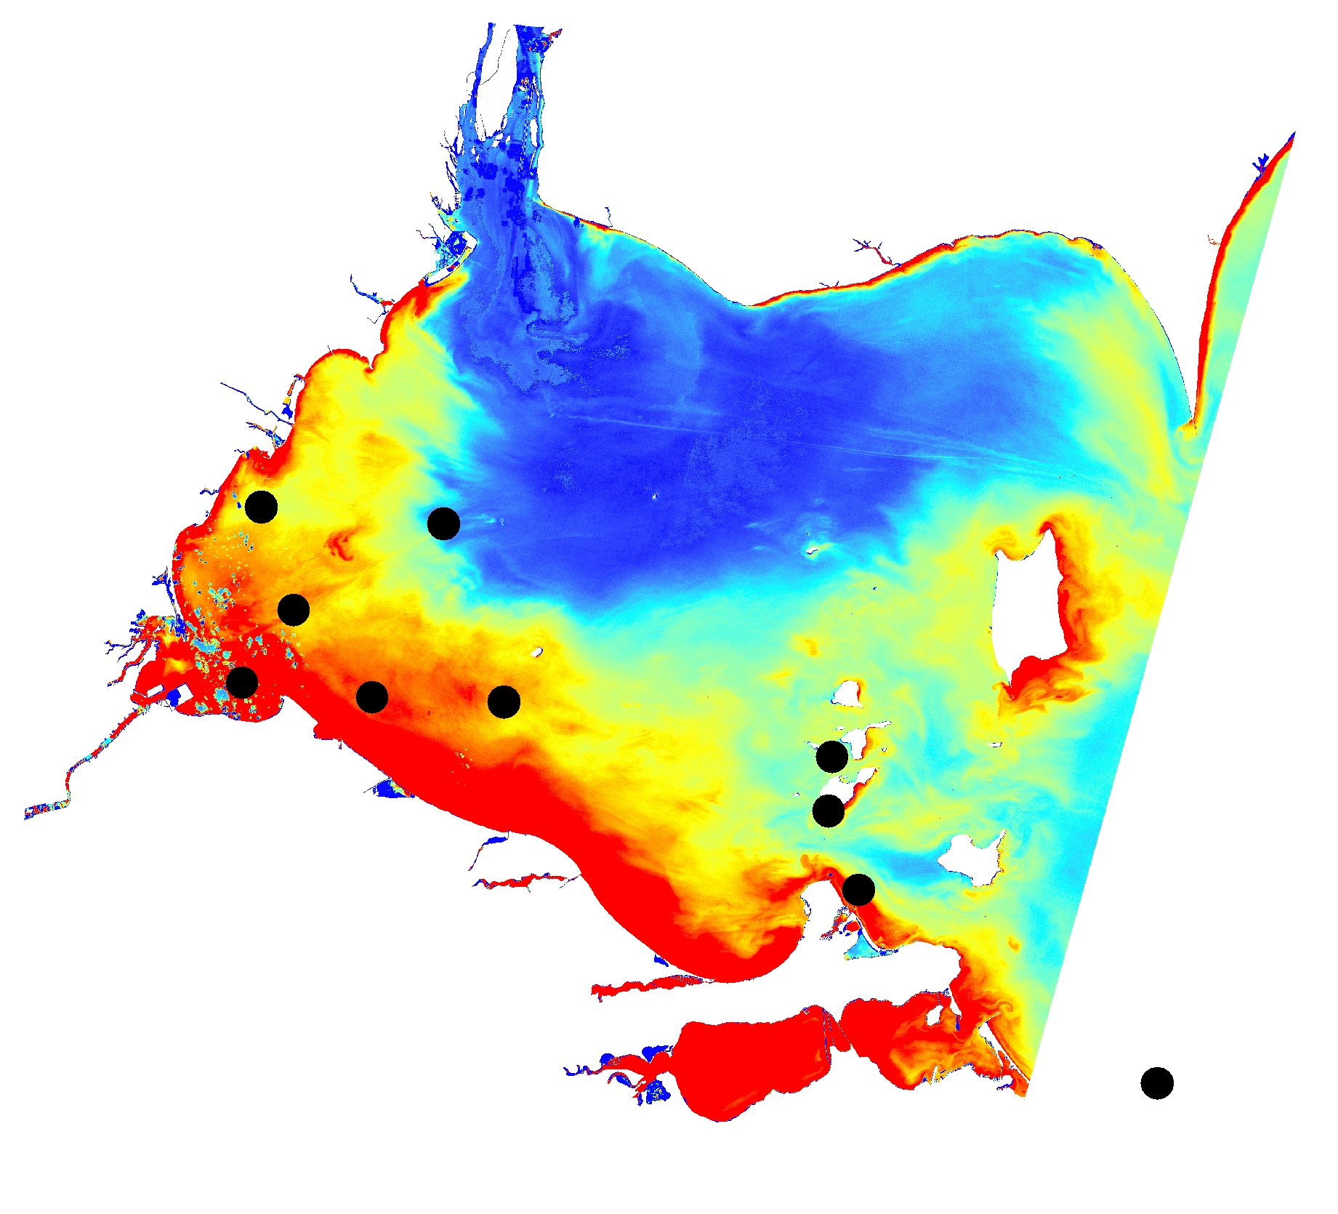
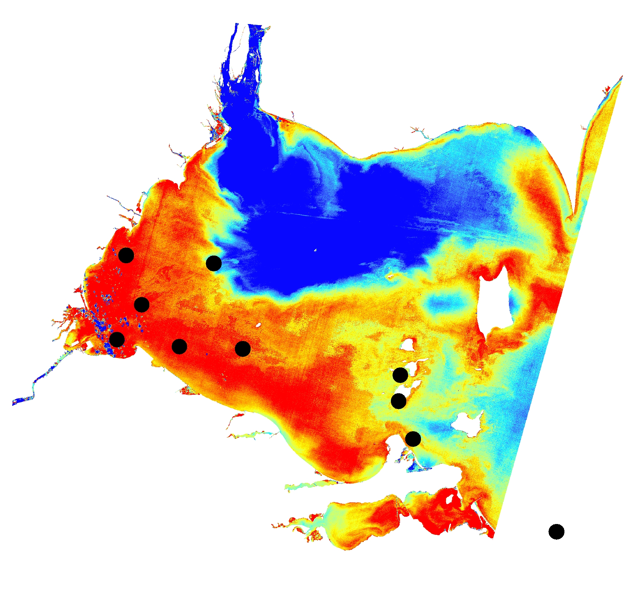
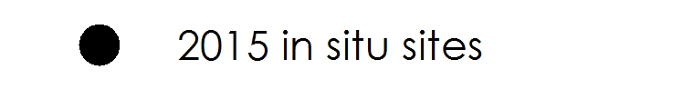
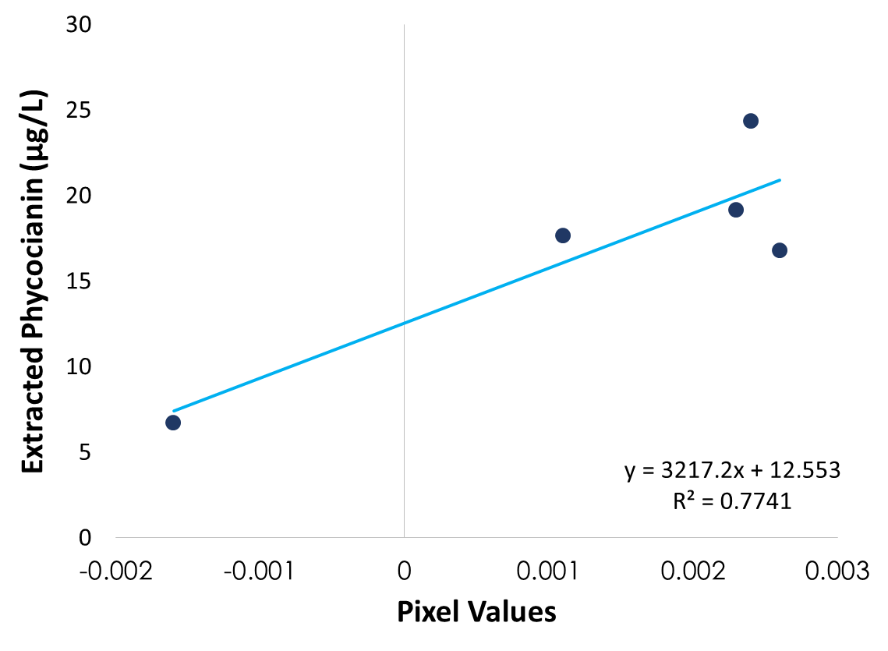
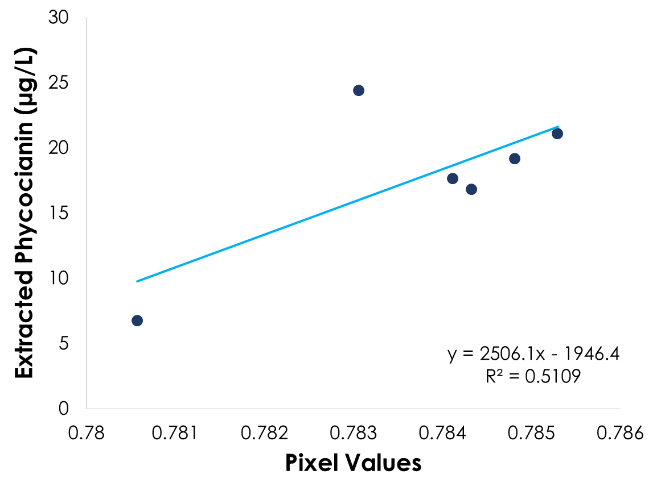
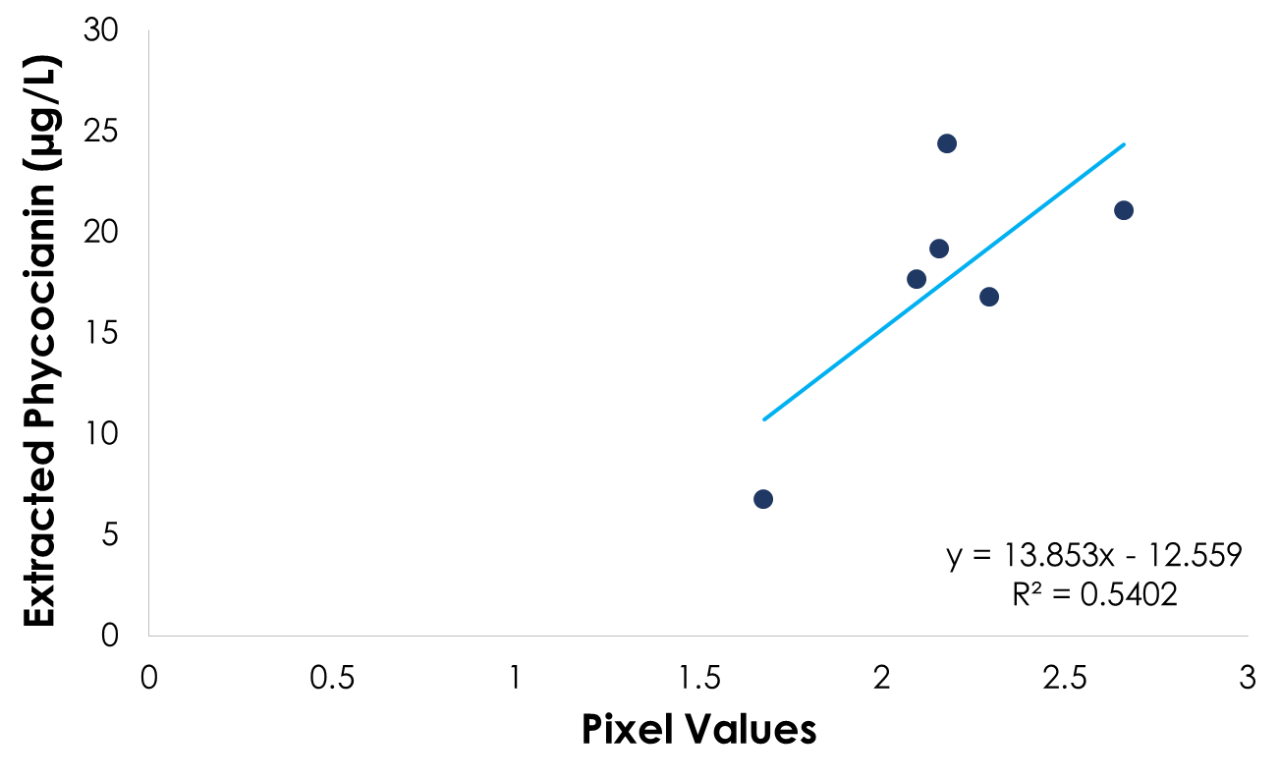
Results: Landsat 8 - OLI
Near Infrared with Simple
Atmospheric Correction
Phycocyanin Detection
Green to Blue Band Ratio
High
Med
Low
y = 3217.2x + 12.553
R² = 0.7741
Notes:
Five algorithms for algal bloom detection were applied to Landsat Imagery. Shown here are three algorithms applied to an image on September 21st, 2015. These algorithms were compiled from previous literature on bloom detection using Landsat. Here we can see that the areas in red are where the algorithm is predicting high levels of HABs occur. And when we look at how this matches with the in situ data, the Near infrared with simple atmospheric correction showed the strongest correlation to in situ data. Overall, the results of these algorithms suggest that Landsat imagery has the potential to model blooms as we can see some relationship in the R-sq values, although limited sample points to validate, and there are additional limitations which will be discussed later.

Slide 23
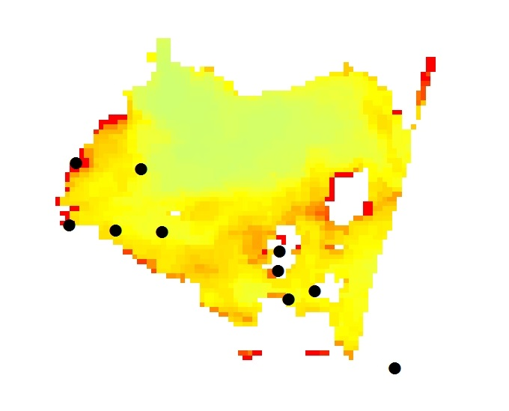
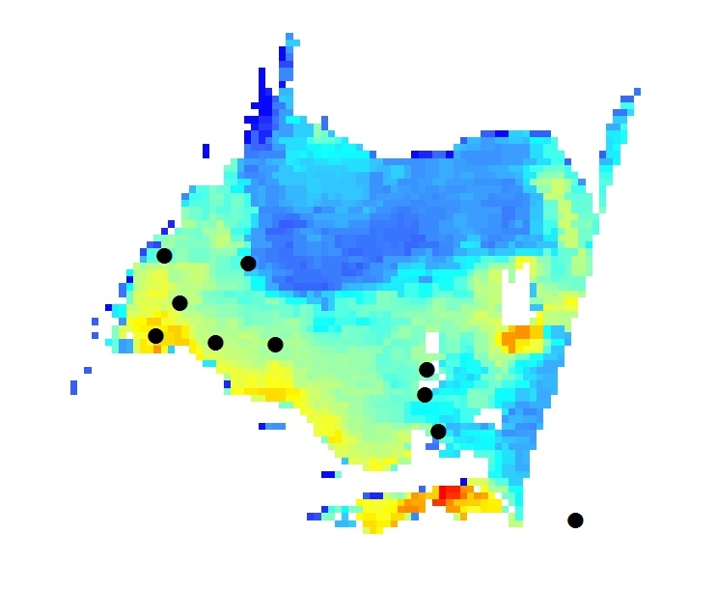
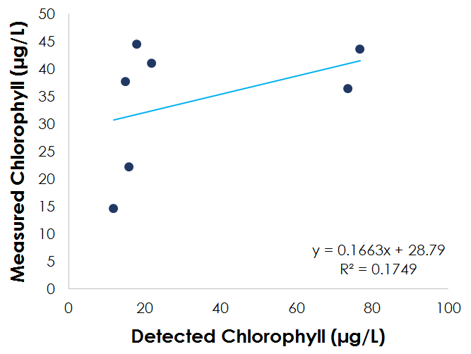
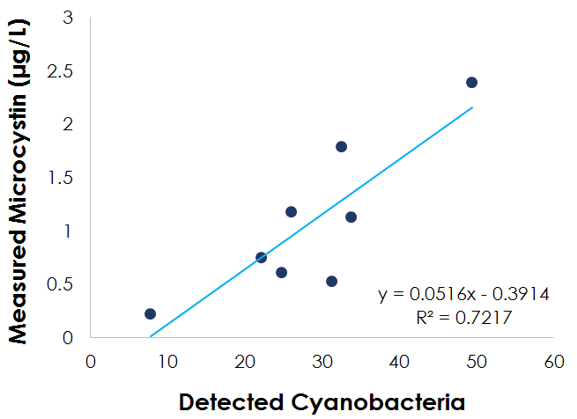
Results: Aqua MODIS
Chlorophyll-a
Cyanobacteria Index
Algorithms:
Chlorophyll-a algorithm not strongly correlated with in situ extracted chlorophyll-a measurements
Cyanobacteria Index (CI) is strongly correlated to measured total microcystin
High
Med
Low
Notes:
Used MODIS Ocean Color product with Chl-a algorithm applied.
Raster pixel values compared to Extracted Chlorophyll measurements from NOAA GLERL and Stone Lab
R^2 value very low; 0.17
CI applied to Aqua MODIS Ocean Reflectance product (L2G)
Aqua MODIS was better able to detect microcystin (R^2 value high; 0.7) measured by NOAA GLERL and Stone Lab
Limitations: Only 7-8 data points and only 1 day

Slide 24
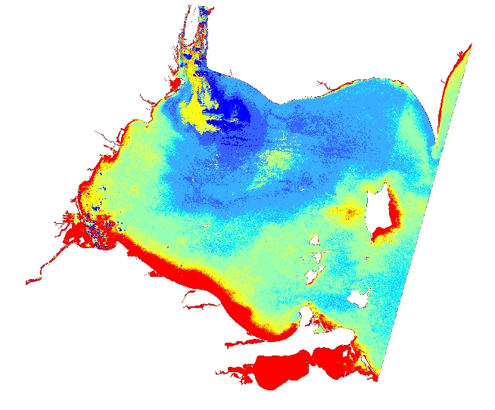
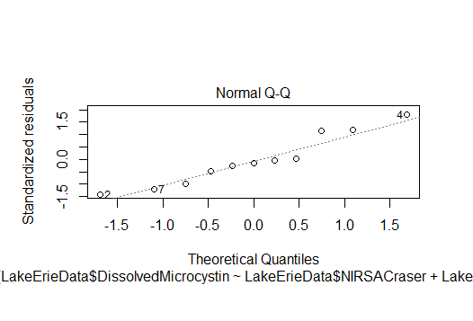
Multivariable Regression Analysis
Landsat 8 OLI
R-Studio
  Variable matrix to show linear correlations between algorithms
  Dissolved Microcystin
Best fit for NDTI and NIR-SAC
  R² = 0.71
High
Med
Low
■ = 1 µg/L dissolved microcystin
Notes:
The results of the MvRA yield a method for estimating dissolved microcystin
Landsat 8 NDTI and NIR-SAC algorithms were the inputs
R
In R we ran a Variable matrix to show linear correlations between our algorithm parameters and various water quality parmeters for HABs
we looked at total microcystin, dissolved microcystin, chlorophyll a, phycocyanin level and others in relation to the landsat and MODIS values.
NDTI and NIR-SAC were found to have the most significant fit with an R sqr of 0.71
Areas shown in red meet or exceed the WHO suggestion of 1 ug/L of dissolved microcystin
NDTIraster"( -0.1876903) + "NIRSACraster"( -0.1876903) + 0.1070049

Slide 25
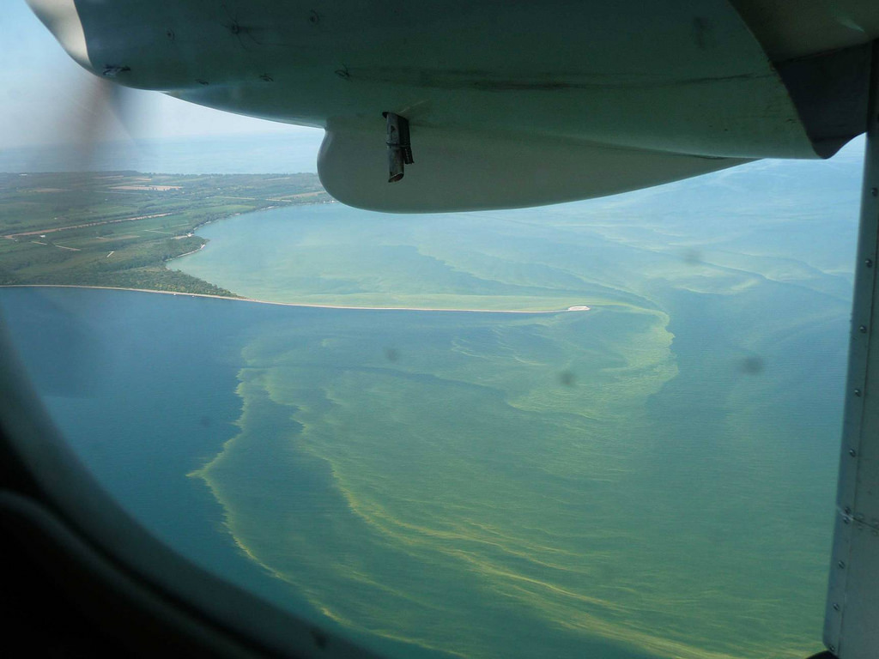
Errors & Uncertainties
Limited temporal suitability of Earth observation imagery
In situ measurements & revisit time
  Rapid changes in HAB movement
Incongruent water sample collection between organizations
Refining algorithms
Waterbody specific algorithms
Clouds & Cloud masking
Image Credit: NOAA GLERL
Notes:
From all of this, we must acknowledge our potential sources of error and areas of uncertainty.
1) As we saw in the temporal resolution chart, we were only able to study one day in depth due to the limited temporal suitability of the Earth observation imagery.
2) Our validation process could also have benefitted from more data collection points and more frequent data in order to monitor the rapid changes in HAB movement across the lake.
3) We were also not able to obtain any in situ data for our hyperspectral imagery which is why we were not able to validate the accuracy of the algorithms applied.
4) The in situ data between the two organizations we obtained data from, NOAA GLERL and OSU Stone Lab also used slightly varying measurements of microcystin and other parameters.
5) The algorithms we used had to be adjusted in some cases as they were originally designed for outdated sensors (ex. Landsat 5/7) or coastal HABs as opposed to freshwater.
6) The clouds in the Landsat imagery and the Aqua MODIS ocean reflectance imagery were not masked. The Aqua MODIS ocean color product was masked. In both cases, clouds or masked clouds will interfere with the algorithm performance. If masked, the algorithm can sometimes mistake large concentrations of algae for clouds.
Image source: https://www.flickr.com/photos/noaa_glerl/albums/72157639592150973

Slide 26
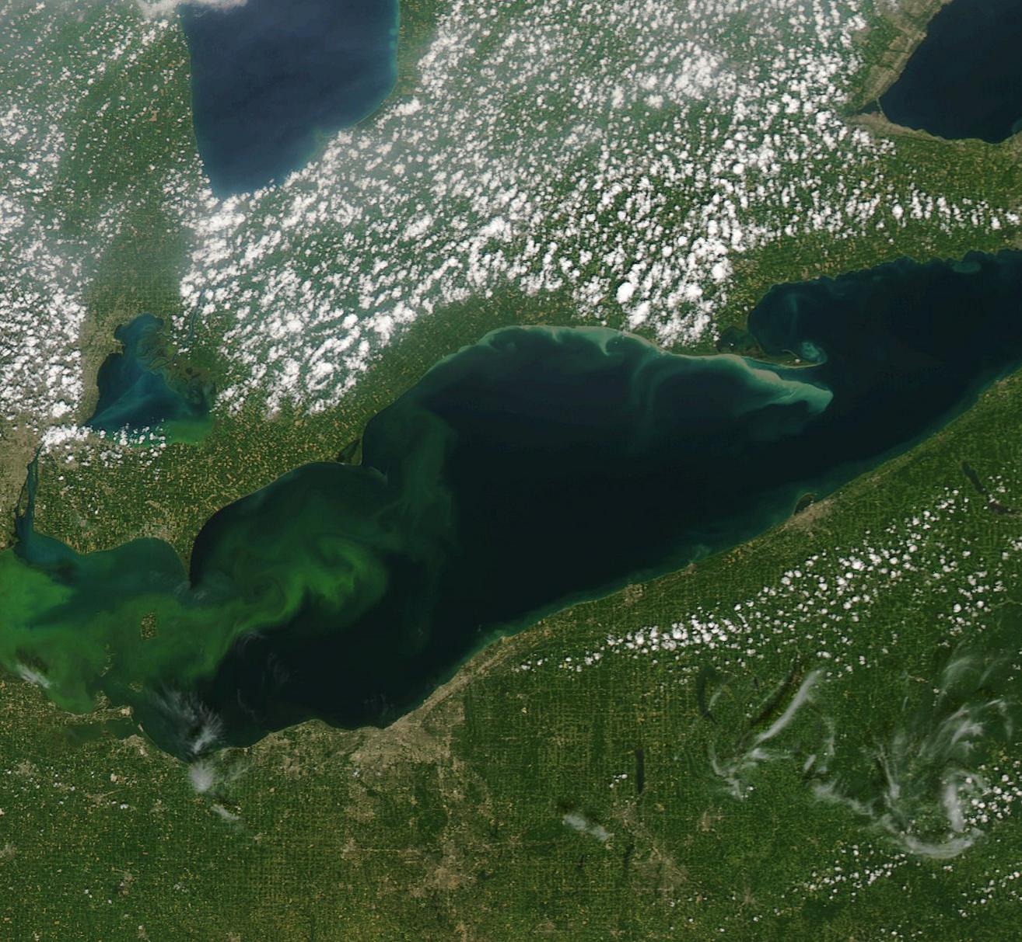
Conclusions
Earth Observations Comparisons
HSI
  Excellent spatial and temporal resolution
  Processing feasibility
Aqua MODIS
  Able to more accurately detect microcystin than chlorophyll-a
  Limited by spatial resolution
Landsat 8 OLI
  Results indicate that it is capable of detecting phycocyanin
  Limited by temporal resolution
Temporal and spatial differences
Processing feasibility
  HSI
Spectral differences
  Incompatible algorithms
Credit: NOAA GLERL
Notes:
Despite the errors and uncertainties, Landsat 8 results suggest that the senson is capable of detecting phycocyanin, but it’s usability for real time tracking of HABs is limited by its temporal resolution (16 days).
Aqua MODIS algorithm results indicate that it can detect microcystin, but its coarse spatial resolution increases the uncertainty in the results
Hyperspectral imagery offers a significant advantage in enhancing HAB research by providing imagery below cloud cover, very high resolution and relatively flexible temporal resolution as it is taken from an aircraft.
However, HSI imagery comes in large, difficult to handle files that are time-consuming to process.
By combining or refining existing algorithms, the detection accuracy of phycocyanin levels can continue to be improved.
Image source: https://www.flickr.com/photos/noaa_glerl/23680076055/in/album-72157639592150973/
HSI comes in very large data files because there are so many spectral bands

Slide 27
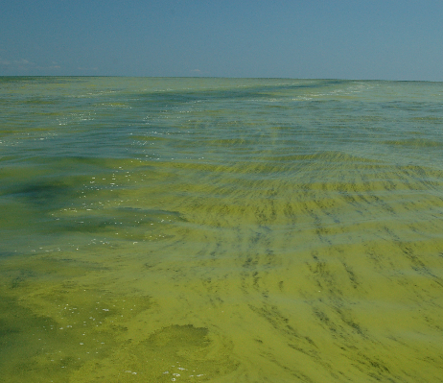
Conclusions
Remote sensing of the phycocyanin pigment
Hyperspectral offers significant benefits for detection as well as limitations
Multivariable linear regression: Feasibility
Credit: NOAA GLERL
Notes:
Remote sensing of algal blooms offers the ability to differentiate algal taxonomy by analyzing the spectral signature of each taxa’s accessory pigments such as the concentration of the light-harvesting pigment phycocyanin.
Hyperspectral imagery offers a significant advantage in enhancing HAB research by providing imagery below cloud cover, very high resolution and relatively flexible temporal resolution as it is taken from an aircraft.
By combining or refining existing algorithms, the detection accuracy of phycocyanin levels can continue to be improved.
More consistent and constant monitoring is needed both remotely and in situ (for validation) in order to monitor the rapid daily and even hourly changes of these events.
Image source: https://www.flickr.com/photos/noaa_glerl/23680076055/in/album-72157639592150973/
Multivariable linear regression shows promise for a novel way of detecting dissolved microcystin but needs further testing and in situ data for stronger validation

Slide 28
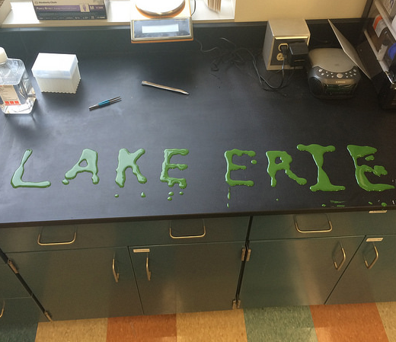
Future Work
Consistent and constant monitoring
In situ sampling for hyperspectral imagery–validation
Applying algorithms to imagery before & after bloom period
Further improvement of Dissolved Microcystin equation by validating accuracy with historical data
Credit: NOAA GLERL
Notes:
More consistent and constant monitoring is needed both remotely and in situ (for validation) in order to monitor the rapid daily and even hourly changes of these events.
Algorithms used to detect algal blooms can be applied to imagery outside of the bloom period to obtain more complete time series.
Further test multiple linear regression algorithm with historical data to determine accuracy and make any neccessary improvements.

Slide 29
NASA Glenn Research Center – Project Partners
John Lekki
Carol Tolbert
NOAA Great Lakes Environmental Research Laboratory – Project Partners
Andrea Vander Woude
DEVELOP Science Advisors
Dr. Juan Torres-Perez, Bay Area Environmental Research Institute
Dr. Sherry Palacios, Bay Area Environmental Research Institute
DEVELOP Management
Brittany Zajic, NASA Ames Research Center DEVELOP Center Lead
Jenna Williams, NASA Ames DEVELOP Assistant Center Lead

Slide 30


Partners
Kent State University

