Slide 1
NASA DEVELOP National Program
Participant Expectations:
Tips for Success, Guidelines & Best Practices

Slide 2

Handbook
Provides participants with the policies and procedures of DEVELOP, as well as an overview of NASA’s Applied Sciences & Capacity Building elements, rules of conduct, operational guidelines, information about deliverables and resources available.
Read the handbook and fill out and sign the signature pages your first day in the office. Your Center Lead will collect and return the following forms to NPO:
Statement of Understanding & Agreement
Media Release
Drug Free Work Place and Sexual Harassment
Non-disclosure Agreement
Patent, Copyright & Intellectual Property Agreement
Travelers’ Responsibility Agreement
Emergency Contact Information
The handbook is the best resource for information,
if you have a question - check there first!

Slide 3
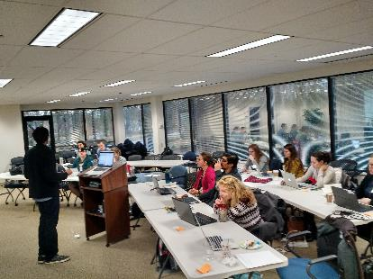
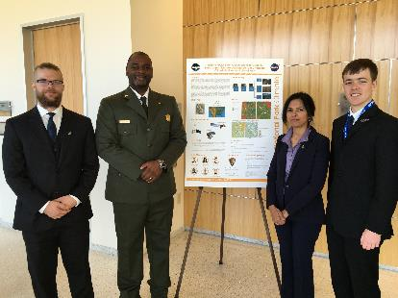
Tips for Success: Flexibility
Be flexible & nimble
Have an open mind
Be ready to present what you are doing at the drop of a hat
Be able to adapt
Accept change will happen
Expect the unexpected!
“A tree that is unbending, is easily broken.”
-- Lao Tzu --

Slide 4

Tips for Success: Organization
Stay organized
Know when things are due
Keep track of your files
Pay attention to detail
Nomenclature matters
Be strategic – identify objectives, identify potential solutions and paths forward
“A place for everything and everything in its place.”
-- Benjamin Franklin --

Slide 5
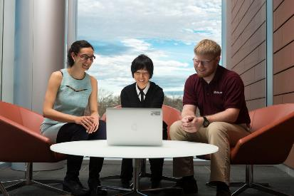
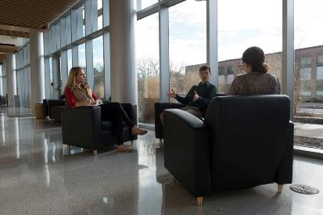
Tips for Success: Collaboration
Two heads are always better than one - collaborate!
Teamwork is key – get to know your team
Do not discriminate, learn from those who are different than you
Network Network Network - it’s all about who you know – talk to your teammates, participants at your node and other nodes, NPO, advisors, partners, etc!
“Coming together is a beginning; keeping together is progress; working together is success.”
-- Henry Ford --

Slide 6
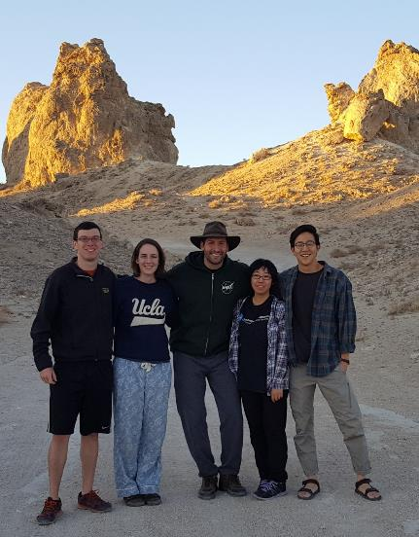
Tips for Success: Going Above & Beyond
Go above and beyond
Help where you are needed
Be willing to accept tasks that arise unexpectedly
Look for innovative solutions and ideas
Try new things
Explore the opportunities that DEVELOP has for you!
“There are no traffic jams along the extra mile.”
-- Roger Staubach --

Slide 7
Tips for Success: Respect
Be mindful and respectful of those around you – you represent the DEVELOP Program and your node
Demonstrate integrity
Respect others property – do not steal or damage materials
Act fairly and promote harmony in the work place by showing common courtesy to others
Encourage a positive working environment
“Respect for ourselves guides our morals, respect for others guides our manners.”
-- Lawrence Sterne --

Slide 8
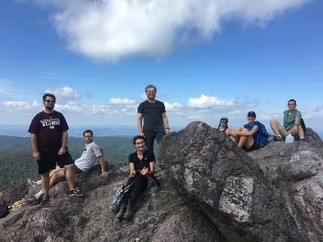
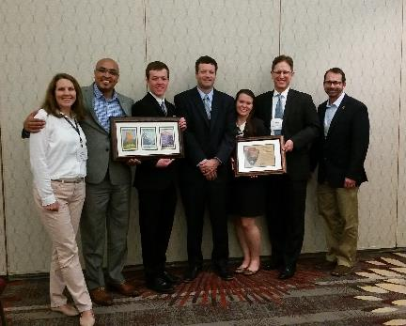
Tips for Success: Stay Positive & Learn
Maintain a positive attitude – a person’s productivity is directly affected by the attitudes of the people around them, so striving for a positive outlook in the work place is of the utmost importance
Have fun and learn!
Use this opportunity to build your résumé with new skills
Don’t give up! Keep at it. DEVELOPers never say die.
“Perpetual optimism is a force multiplier.”
-- Colin Powell --

Slide 9
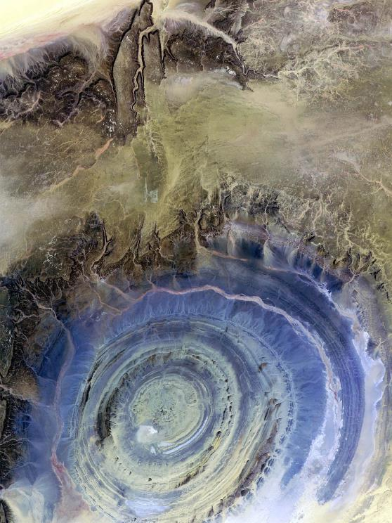
Tips for Success: Follow Guidelines
Be on time for work!
Attend meetings and lectures as directed
Never plagiarize – it is punishable by law
Just say no to drugs
Harassment of any type will not be tolerated
Profanity and lewdness are not permitted
Abide by the dress code
ALL research is the property of DEVELOP – you must have permission from your Center Lead and NPO BEFORE submitting or presenting your project anywhere
DEVELOP participants are expected to follow rules and regulations of their team’s location, their sponsoring grant organization, and DEVELOP

Slide 10
Professionalism
DEVELOP’s signature is based on professionalism, respect & collaboration
Professionalism: “the conduct, aims, or qualities that characterize or mark a profession or a professional person”
DEVELOP is an opportunity for all participants to improve in their professionalism!
Appearance
Demeanor
Reliability
Competence
Ethics
Poise
Organizational Skills
Written Correspondence
Phone Etiquette
Accountability

Slide 11



Professionalism & Dress Code
Business Casual:
  Pants: Khakis or slacks
  Skirts: Appropriate business skirts at/near knee length
  Dresses: Appropriate length (at/near knee) dresses, no spaghetti straps
  Shirt: Collared shirts, polo shirts, blouses, sweaters
  Shoes: Dress shoes (no sandals, no sneakers, no flip flops)
  Accessories & Make Up: Be conservative
Why?
DEVELOP’s signature is that of professionalism and respect. We respect ourselves, our partners, and NASA. We go above and beyond. We stand out from our peers. We strive for excellence in all things we do.
Formal Presentations:
Formal Suits (Dark Colored - Black, Navy, Gray) & Dress Shoes
  Dress Code Don’ts:
  Jeans, tennis/running shoes (except on designated days)
  Pants that droop and display underwear
  Shorts
  Shirts shorter than 3 inches above the knee when seated
  Halter tops or exposed midriffs
  Revealing, too tight clothing
  Shirt straps narrower than 2 inches wide
  Sweat pants, sweatshirts, T-shirts
  Attire with vulgar, violent or explicit language or images
  Multiple body piercings, hats, bandanas, etc.
  No flip-flops of any kind
  Unkempt attire

Slide 12
Use of Government Equipment (@NASA)
US Government computers are for authorized users only
It is NASA's policy to permit limited personal use of Government office equipment, including information technology (IT)
The limited personal use of Government office equipment by NASA employees and contractors shall not interfere with official business, violate existing laws, and should involve only minimal additional expense to the Government
Unauthorized use of the computer accounts and computer resources to which you are granted access is a violation of Federal Law; constitutes theft; and is punishable by law
Misuse of assigned accounts and accessing others' accounts without authorization is strictly forbidden
Failure to abide by these provisions may constitute grounds for termination of access privileges, administrative action, as well as civil or criminal prosecution
NASA 2540.1G & NPR 2810.1A: http://insidenasa.nasa.gov/ocio/policy/policy_direct/index.html

Slide 13
Privacy
Expect NO privacy when using a government computer or emailing a government email address.
Strict computer use policy in effect - every keystroke is stored, every NASA email is public domain.
NASA Policy:
NASA employees and contractors do not have a right to expect privacy while using Government office equipment at any time, including accessing the Internet and using email.
The Government maintains call details and network access records to monitor telephone activity and Internet access.
The Government also employs monitoring tools to track system performance and improper usage.
This applies to those emailing a NASA email as well.
NASA 2540.1G & NPR 2810.1A: http://insidenasa.nasa.gov/ocio/policy/policy_direct/index.html

Slide 14
Computer Usage
Online Policies:
Internet should be used for official purposes only, meaning absolutely no games, commercial radio or music/video downloads.
No Facebook, Twitter, etc. unless it’s for DEVELOP purposes!
Due to bandwidth considerations, streaming audio and video are prohibited unless for official business (project related is ok).
Limited personal emails are acceptable as long as they do not interfere with work.
Be mindful of the websites you visit and links you click on.
Be aware and careful of phishing attempts.
Software:
Installation of legally licensed software is permitted if the software is necessary to complete your project - but you must have approval from your Center Lead.
Do not make copies of proprietary software.
If you have questions regarding permissibility of software, please contact your Center Lead or IT Senior Fellow.

Slide 15

Cell Phone Usage
Ringers should be set to silent or vibrate during work hours
Cell phone usage should be kept to a minimum, including texting
Personal phone calls should be made during lunch or before/after work

Slide 16
Participant Reporting
Participant Info Sheet
This is a spreadsheet used to maintain accurate participant records & report demographic stats about program (e.g. diversity, education).
Personal Growth Assessments
These are two online assessments (entrance & exit) that collect information relating to participant skill levels and expectations, which help to gather the impact of DEVELOP, and provide valuable feedback to nodes and the program.
  Entrance Assessment - week 1
  Exit Assessment - week 9
Exit Survey
This is an anonymous online survey that we ask all participants to take. It is DEVELOP’s performance review and allows for a national perspective on the program, leadership, and advisors. It helps DEVELOP evolve and improve, and we value your input greatly!
  Link emailed - week 10
Performance Reviews
DEVELOP’s main objective is to assist participants in developing both professionally and personally. Part of this process is giving feedback in performance reviews at the middle and end of the term. Please consider this process constructive and take any feedback as goals for improvement.
  Midterm Review - typically weeks 5 or 6
  End of Term Review - typically weeks 9 or 10

Slide 17
Annual Alumni Survey
A recent development for the program has been the establishment of an annual survey to assess the impact of DEVELOP, enhance the network of alumni engaged with the program, and assess the career fields that participants progress into. DEVELOP looks forward to surveying you in the near future!
Before you leave this term, please make sure that DEVELOP has the best email address to reach you. The survey goes out every June.
The Alumni Survey Provides:
Metrics for reporting to NASA HQ
Indicators for DEVELOP’s Results Framework
“Success Stories” for newsletters and other highlight activities
Method for signing up to receive The DEVELOPer Newsletter
Information to invite alumni to special events

Slide 18
Dealing with Personnel Issues
Things will arise!
#1 – don’t put anything in writing. Should a personnel issue arise, immediately and verbally communicate the situation up the chain
Do not send emails about the situation - remember that NASA emails are NOT private
Maintain a positive work environment where participants feel comfortable coming to you with issues they are having with other DEVELOPers
If someone up the chain is the issue, skip that link in the chain
If you need counseling for how to respond to a specific situation talk to NPO
SSAI Rep: Karen Allsbrook
Wise Rep:
Lauren Childs-Gleason
NPO
Center Lead
Project Lead
Team Member

Slide 19
Payments & Taxes
Participants are paid on a step scale based on education level
  In order for a participant to qualify for the next step pay rate, the individual must be currently taking classes or graduated at that grade level
    Example, a participant who finishes their sophomore year in the spring is only eligible to move to the next pay step in the fall once he/she begins taking junior level classes
Taxes are NOT withheld from participants’ consulting checks
  It is the participant’s responsibility to pay any taxes if and when they are due. What does this mean to me?
    It means you will owe money on the income earned while at DEVELOP.
    You should familiarize yourself with IRS and state-specific requirements regarding independent consultants and consult a tax specialist regarding your specific tax situation. Be aware you may be penalized by the IRS/State for not paying quarterly taxes.
    NASA, SSAI and Wise County cannot give you tax advice – do your research and talk to a professional.
  One exception: Foreign nationals who are from countries that do not have a tax treaty with the United States will see an automatic 30% of their payment withheld by their funding organization and sent to the IRS.
    To see which countries have tax treaties with the US visit this website - www.irs.gov/publications/p519/ar02.html#en_US_2013_publink1000222821.

Slide 20

Thank You!
Have a great term!

