Slide 1
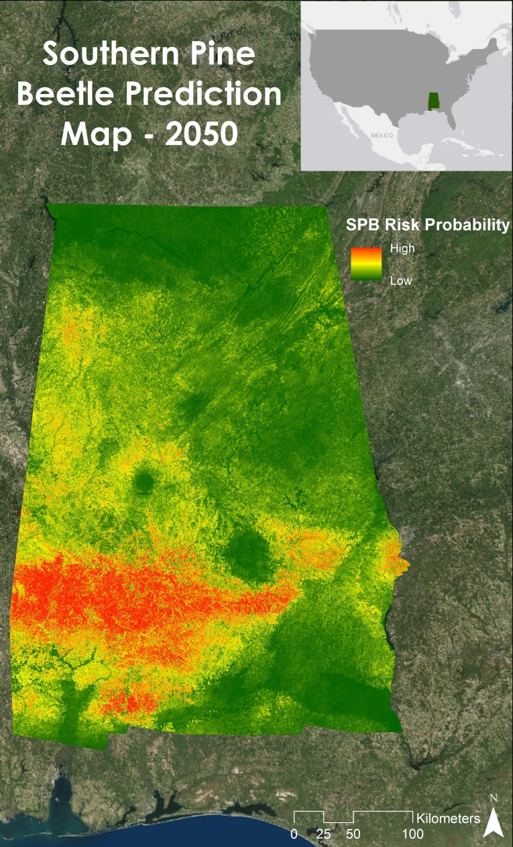
Alabama Ecological Forecasting
Assessing Southern Pine Beetle Epidemics in Alabama’s Bankhead National Forest Using NASA Earth Observations
Authors: Ryan Schick (Project Lead), Kelsey Herndon, Maggi Klug, Leigh Sinclair
Case Study
The Southern Pine Beetle (SPB), Dendroctonus frontalis, is an opportunistic species that attacks stressed trees weakened by drought, storm damage, or fire. In 2000, about 18,600 acres of pine forest were damaged throughout the Bankhead National Forest due to SPB. The United States Department of Agriculture (USDA) Forest Service currently uses expensive manned aerial surveys, such as aerial photography and Light Detection and Ranging (LiDAR), as well as Moderate Resolution Imaging Spectroradiometer (MODIS) ForWarn and Forest Disturbance Monitor data to help with mitigation efforts. This project used remotely sensed data to identify SPB infested areas throughout Alabama and determine outbreak patterns. Landsat 5 Thematic Mapper (TM) and Landsat 8 Operational Land Imager (OLI) were used to derive a Normalized Difference Vegetation Index (NDVI) and a Green-Red Vegetation Index (GRVI) to show vegetation health and a Normalized Moisture Difference Index (NMDI) to show the surrounding drought conditions. Shuttle Radar Topography Mission Version 2 (SRTM-v2) Digital Elevation Models (DEM) were used to understand how elevation and slope affect SPB susceptibility. Present SPB data and various environmental variables were analyzed using the Princeton University Maximum Entropy model (MaxEnt) to assess areas susceptible to a SPB outbreak by creating a SPB Prediction Map for 2050. Additionally, this project determined where mitigation efforts should be focused by creating a Near Real-Time SPB Susceptibility Model. A Historical SPB Coverage Map was created to understand patterns of previous attacks. The USDA Forest Service used these methodologies and maps to reduce costs and time associated with SPB suppression in Bankhead National Forest and Alabama.
Concern
Southern Pine Beetles (SPB) cause hundreds of thousands of dollar in damage to pine trees each year. In addition to the financial damages, the dead trees left behind by a SPB outbreak can increase the risk and severity of forest fires by increasing the fuel load available to burn. Damages caused by the beetles may result in limited diversity in surrounding plants, as well as harm other animals’ habitats, such as that of the near-threatened Red-cockaded Woodpecker.
Decision Support
This project created Historical Southern Pine Beetle Coverage Maps, a Southern Pine Beetle Prediction Map, and a Near Real-Time Southern Pine Beetle Susceptibility Model. The Historical Southern Pine Beetle Coverage Maps located previous SPB infestations throughout Alabama by using in-situ data to assist in creating the SPB Prediction Map and Near-Real Time SPB Susceptibility Model. The SPB Prediction Map was created using the Maximum Entropy Distribution Model (MaxEnt) to show outbreak risk in 2050. The Near Real-Time SPB Susceptibility Model determines which areas are susceptible to a SPB outbreak in near real-time by automatically downloading and analyzing the most recent Landsat satellite imagery. These products helped project by having a better idea where to focus mitigation efforts.
SPB Prediction Map for 2050 using MaxEnt
DEVELOP Location
NASA Marshall Space Flight Center
Earth Observations
Landsat 5, Landsat 8, SRTM-v2
Partners
USDA Forest Service
Advisors
Dr. Jeffrey Luvall [NASA at The National Space Science and Technology Center],
Dr. Robert Griffin [University of Alabama in Huntsville]

