Slide 1
Southern Rockies Ecological Forecasting II
Tracking Mule Deer for Wildlife Corridors between Seasonal Habitats in the Southern Rockies
Tyler Rhodes (Project Lead)
Allison Chappell
Michael Sclater
Maggie Jenkins
Amanda Flake
Cody Walker

Slide 2
Community Concerns
Mule deer are economically and ecologically important to the Southern Rockies
Where are the Mule deer going?
Image Credit: Creative Commons

Slide 3
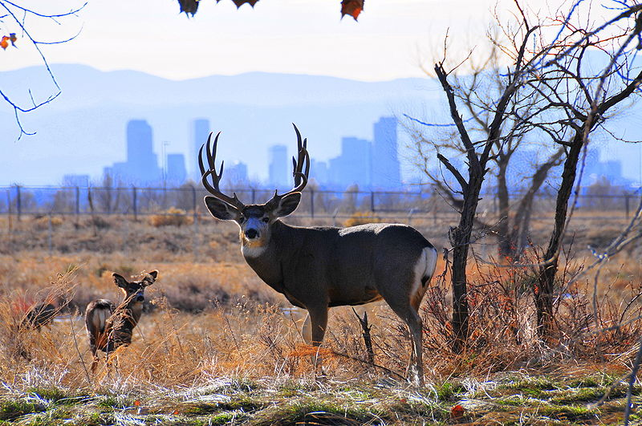
Community Concerns
Increasing anthropogenic features have altered seasonal migration and have caused population loss
Image Credit: Creative Commons

Slide 4
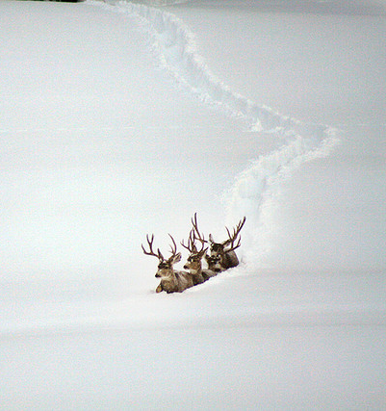
Snow’s Impact
Snow depth in mule deer habitat effect the migration routes
Image Credit: Creative Commons

Slide 5
Objectives
Improve understanding of mule deer migration
Determine how anthropogenic features affect migration
Document ideal conservation areas
Develop migratory corridors to maintain the current population
Image Credit: Oregon Dept. of Fish & Wildlife

Slide 6
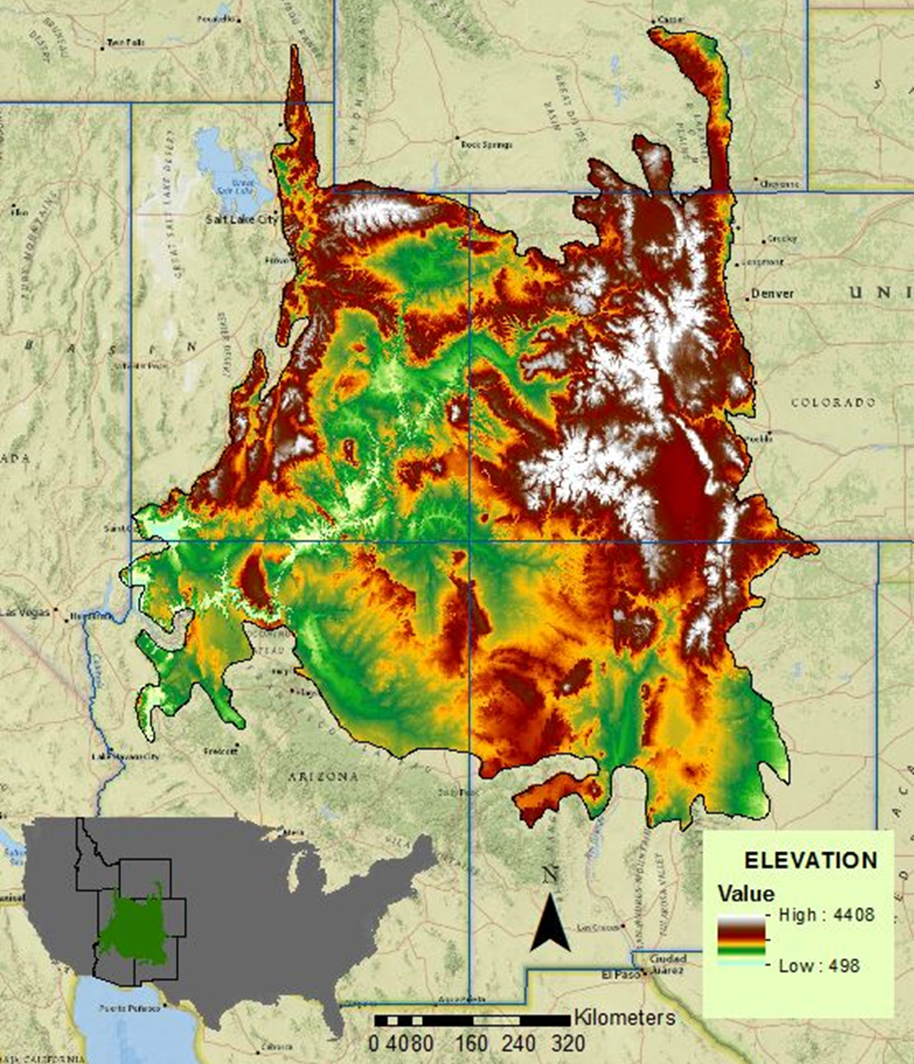
Study Area
Southern Rocky Mountains
Arizona, Colorado, Idaho, New Mexico, Utah, Wyoming
516,754 km²

Slide 7
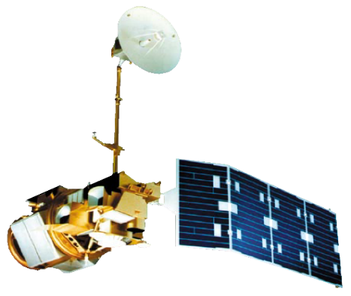
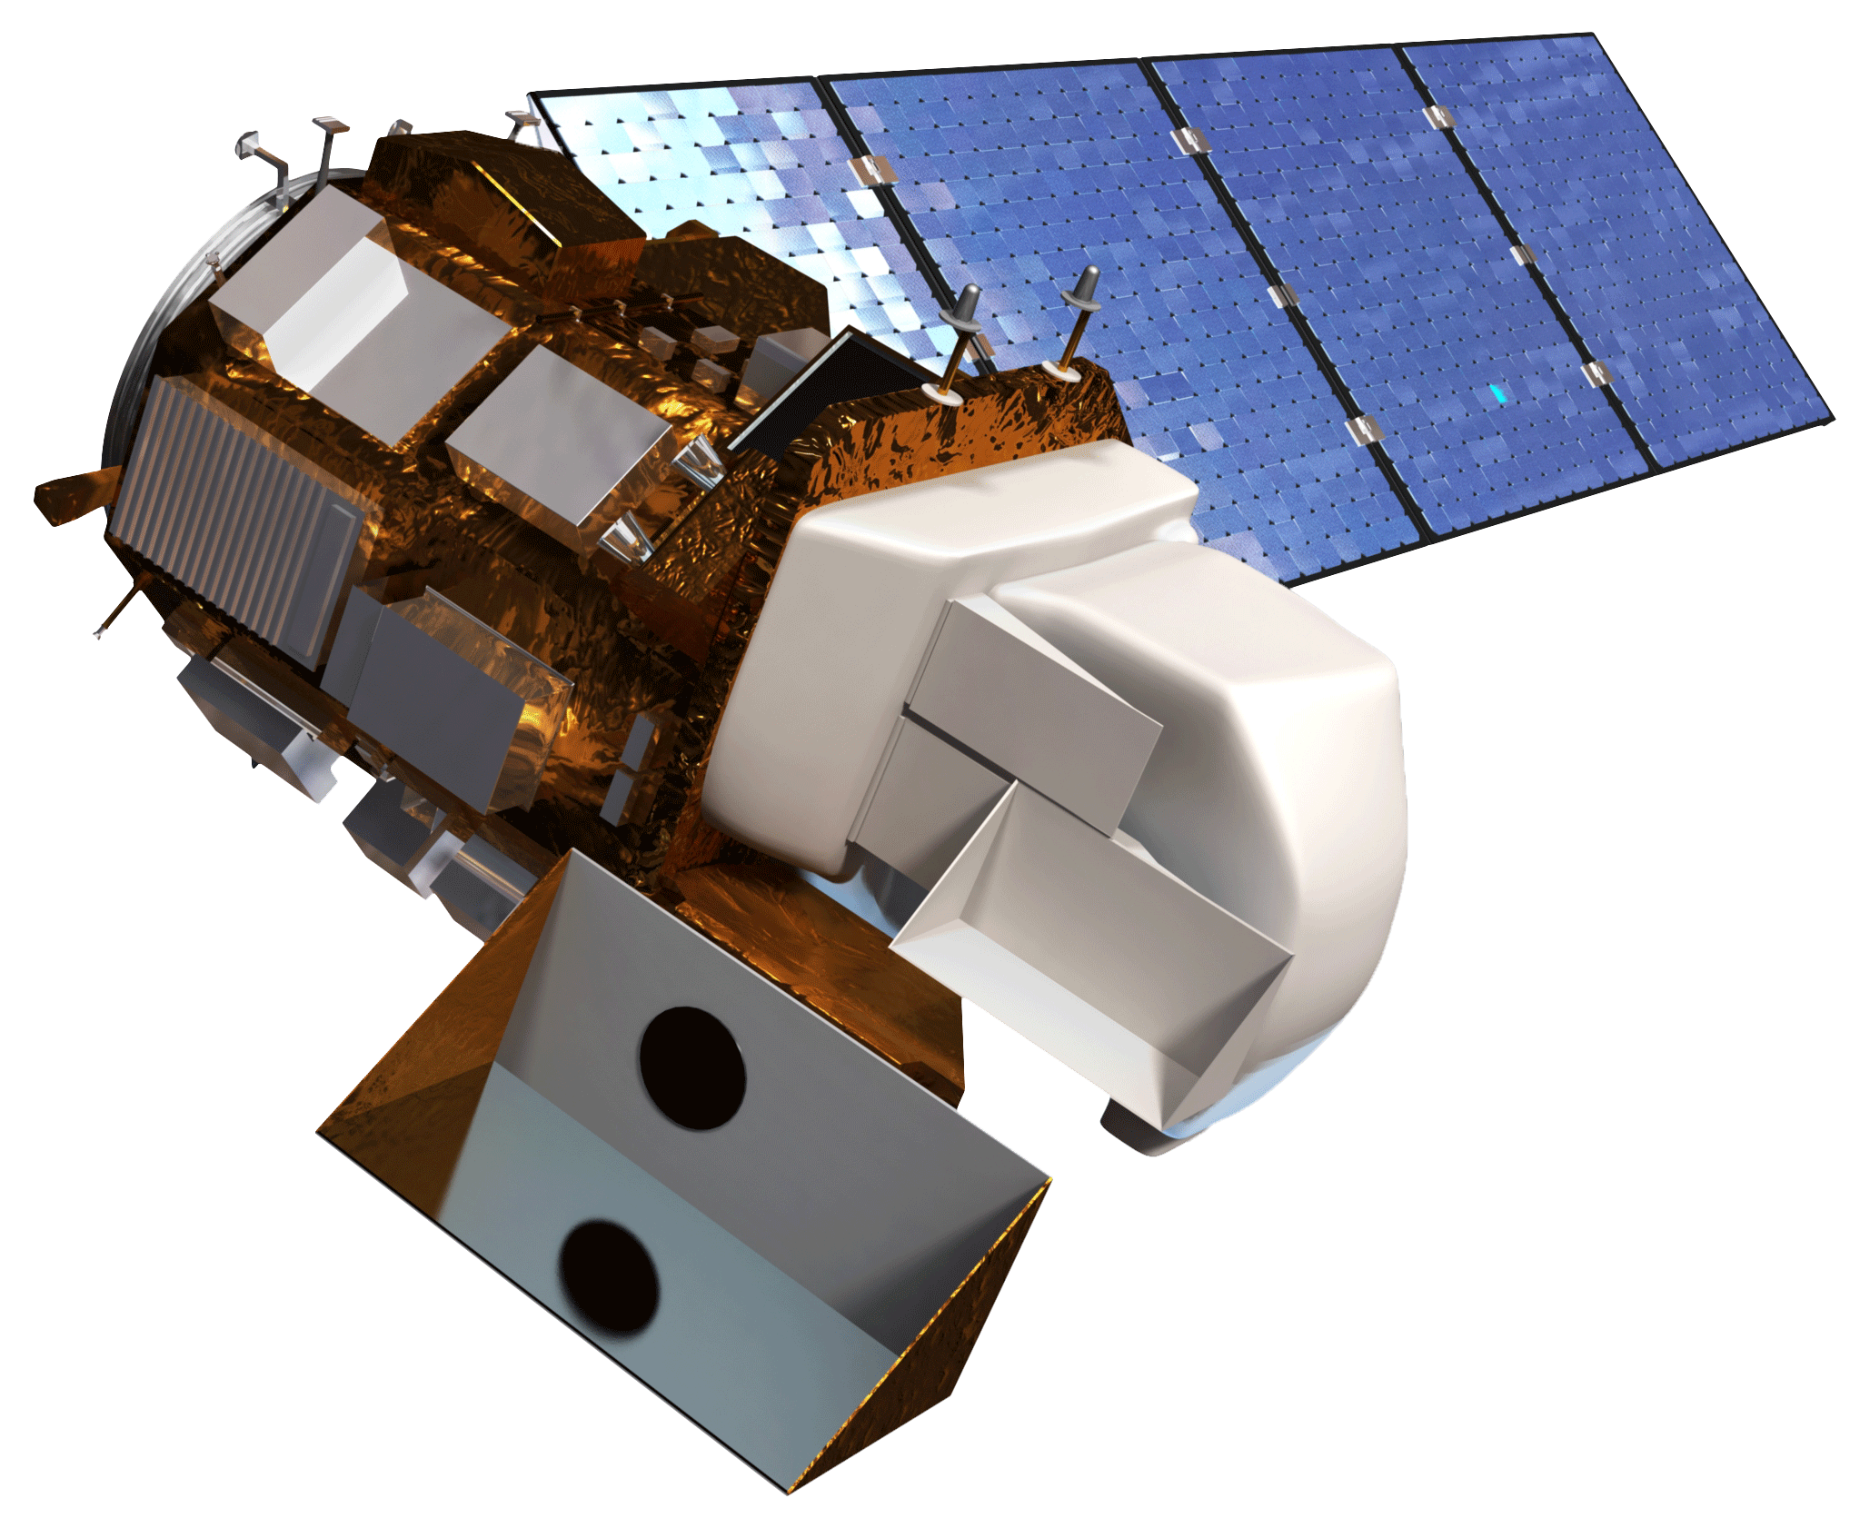
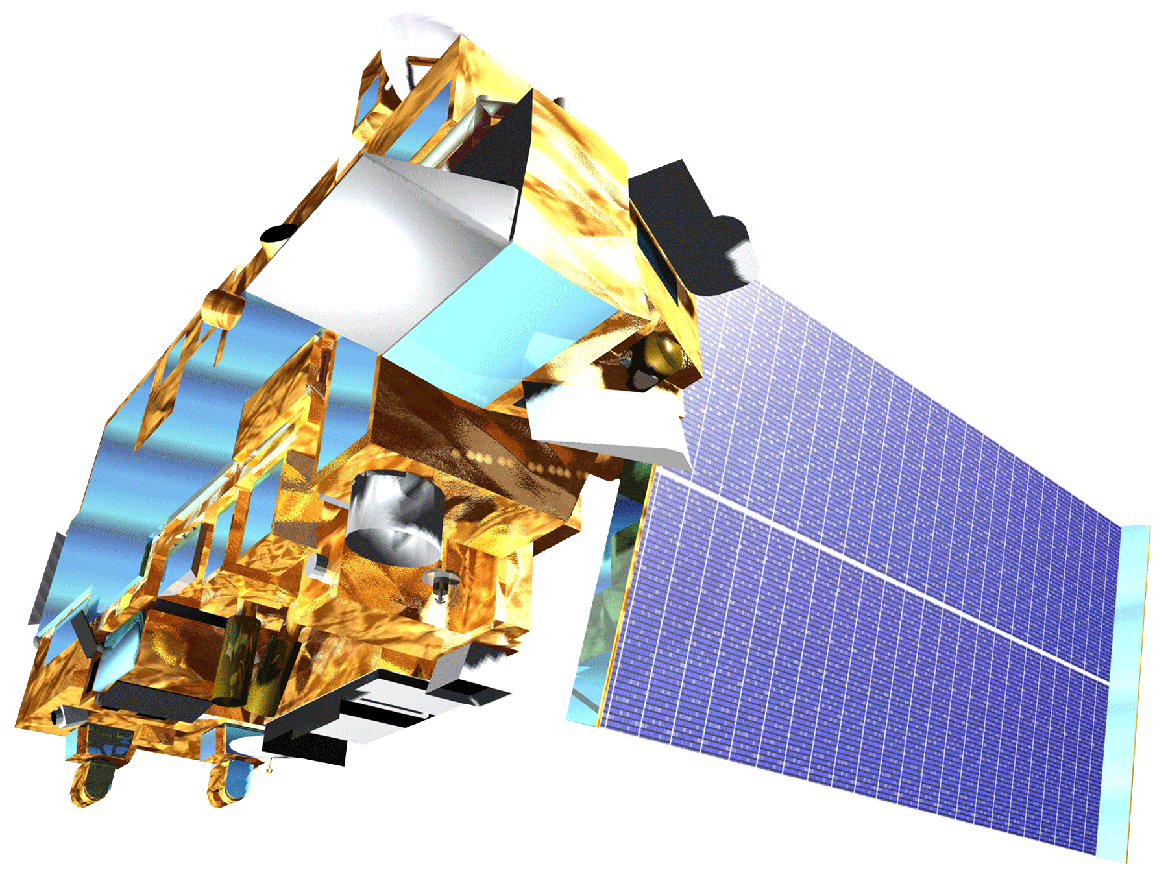
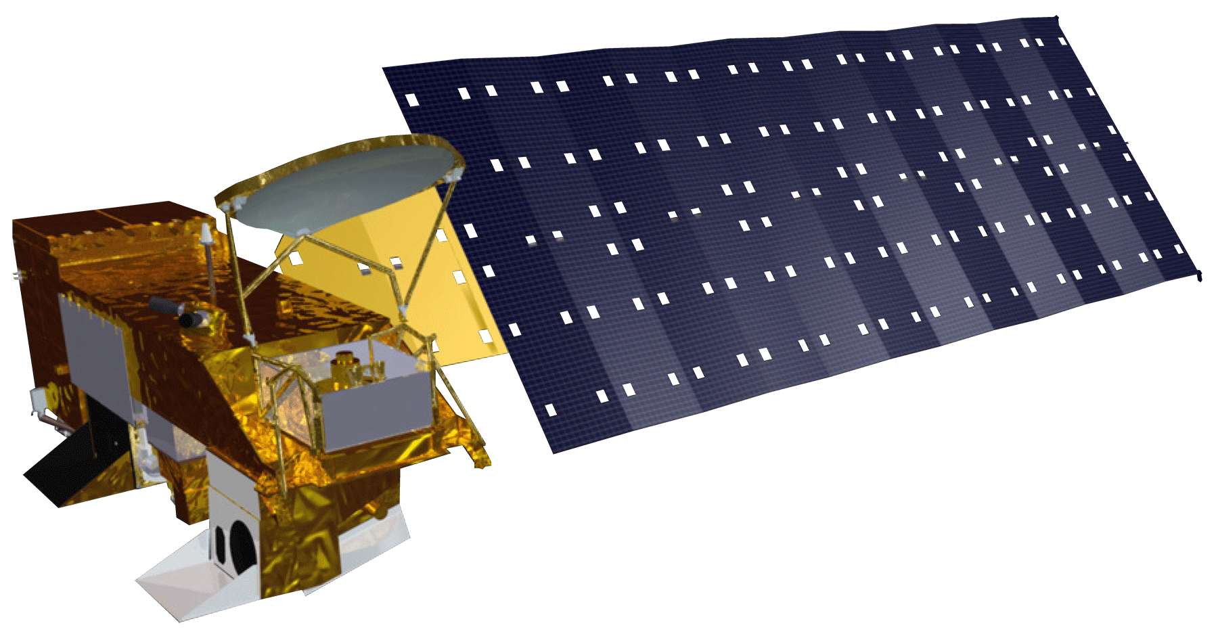
Earth Observations
Landsat 5 TM
Landsat 8 OLI
Terra
Aqua

Slide 8
Methodology
NLCD
Landsat
Aster
Prism
Acquisition
Used ERDAS Imagine with MODIS images to create vegetation phenology
Created DEM/ slope using ArcGIS
Processing
Added NLCD, Vegetation phenology, climate data, DEM/slope, NDVI snow data and clipped to study area for the final mule deer corridor map.
Analysis

Slide 9
Results – Mule Deer Habitat Maps

Slide 10
Results – Snow’s Impact Maps

Slide 11
Conclusions

Slide 12
Errors and Limitations

Slide 13
Future Work

Slide 14
References

Slide 15
Advisor
Dr. Kenton Ross
NASA DEVELOP National Program Science Advisor
Partners
Southern Rockies Landscape Conservation Cooperative
John Rice
Mule Deer Western Association of Fish and Wildlife Agencies (WAFWA) Working Group
Jim Heffelfinger
Others
Emily Adams
NASA DEVELOP Langley Center Lead
Rebekke Muench
NASA DEVELOP Langley Assistant Center Lead
Past Contributors from Fall 2015
Ross Reahard (Project Lead), Teresa Fenn, Jeri Wisman

