Slide 1
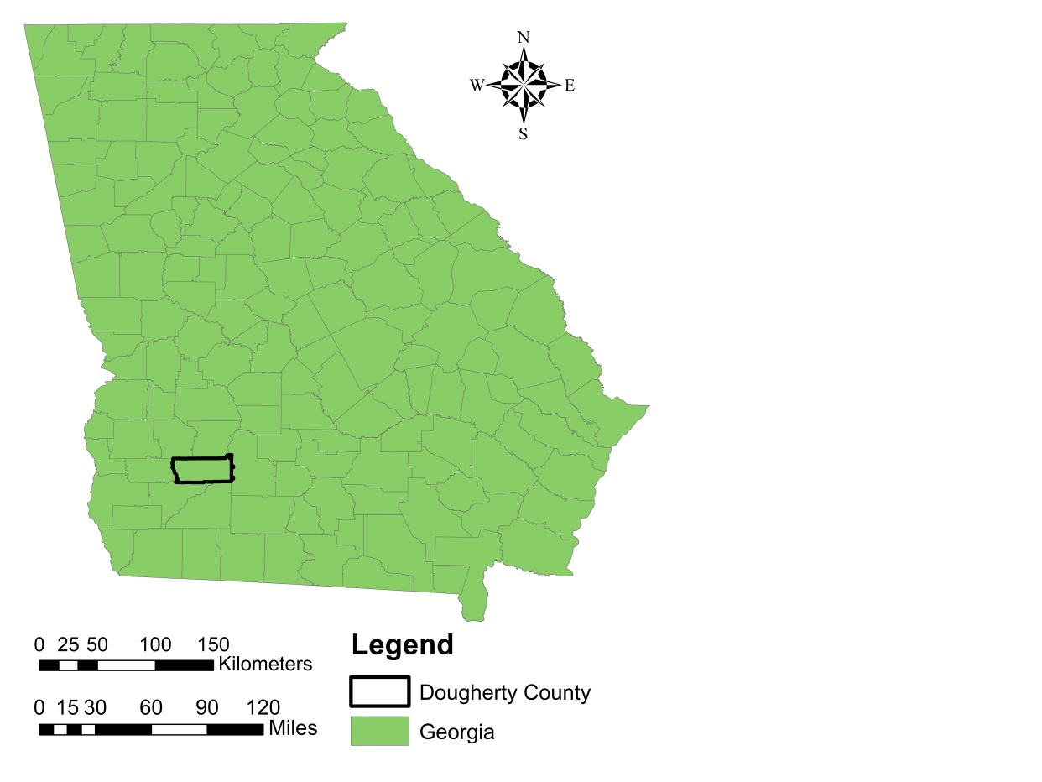
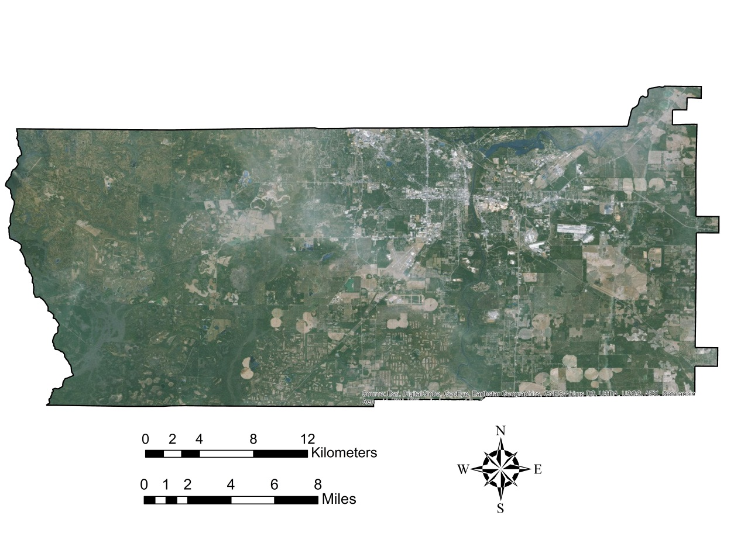
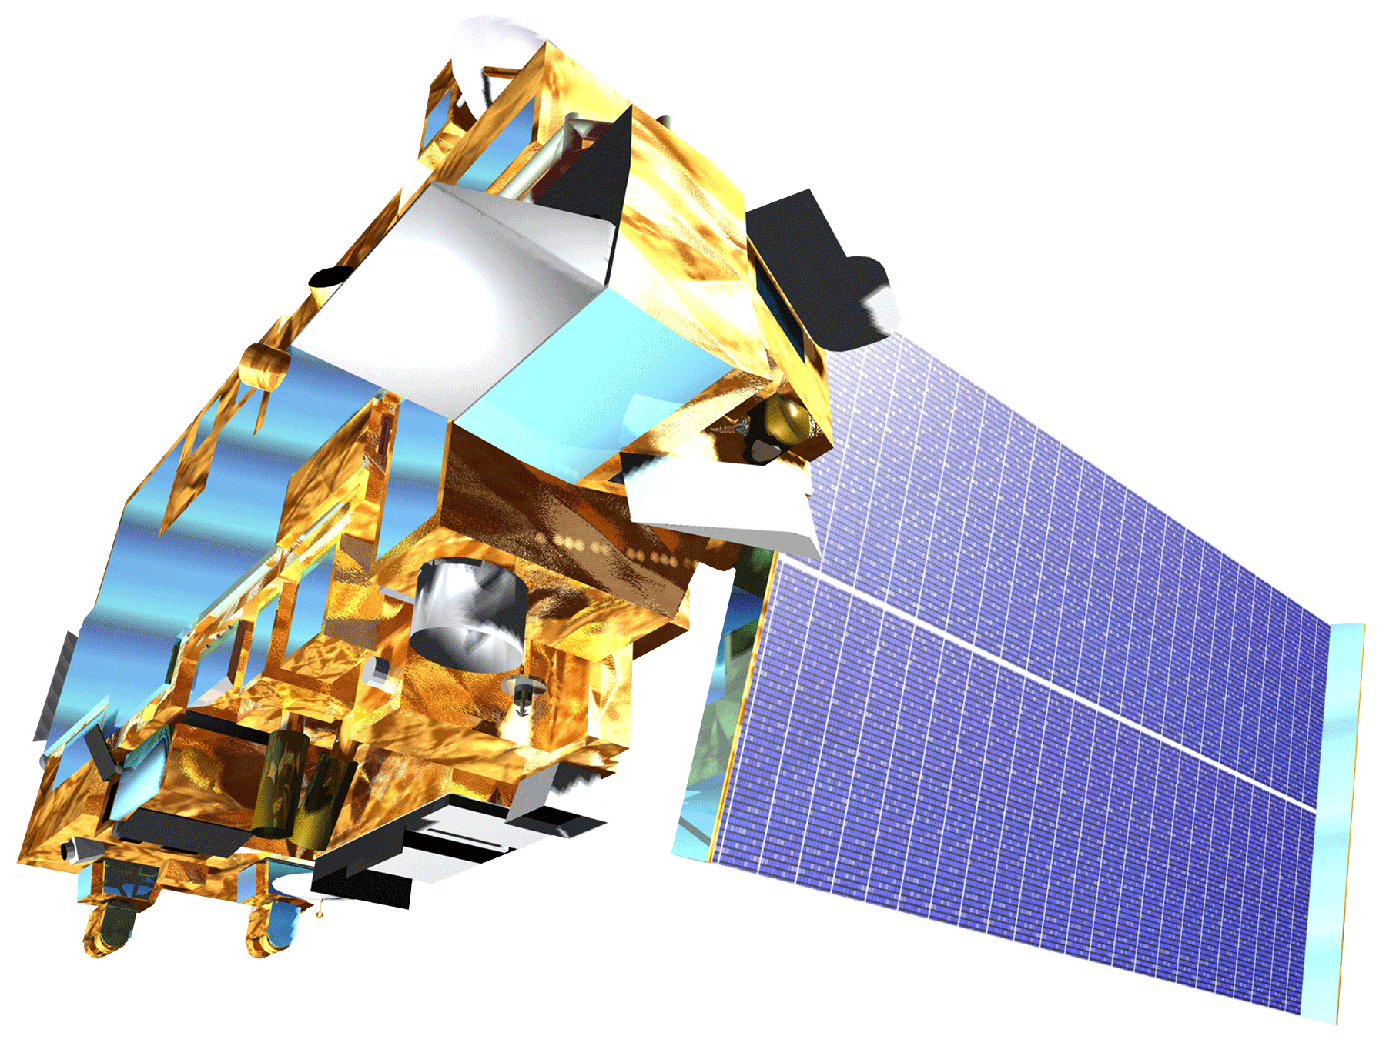
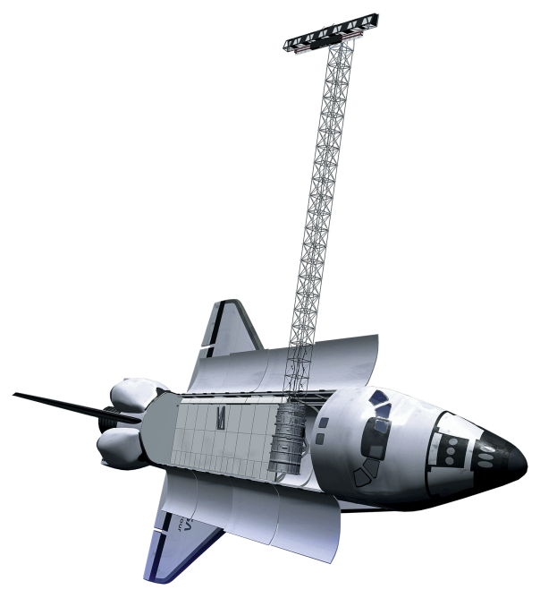
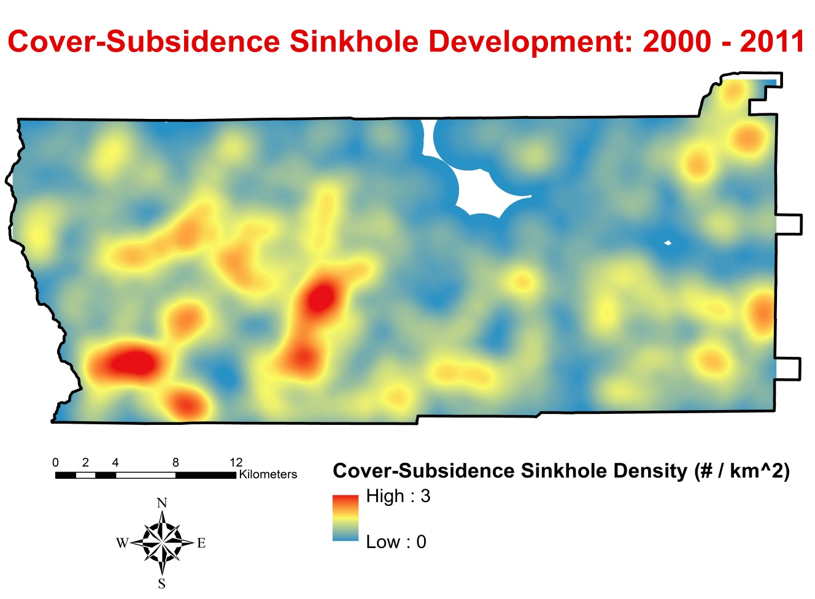
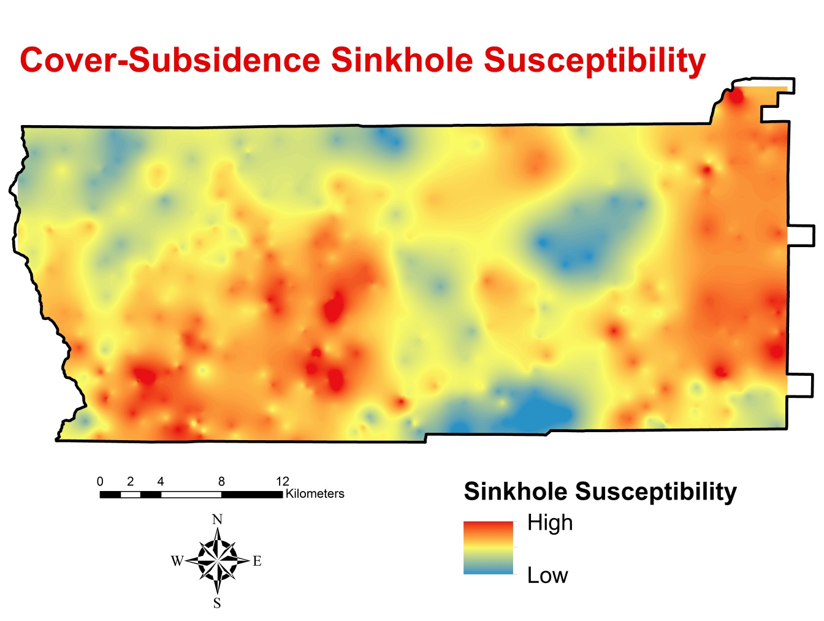
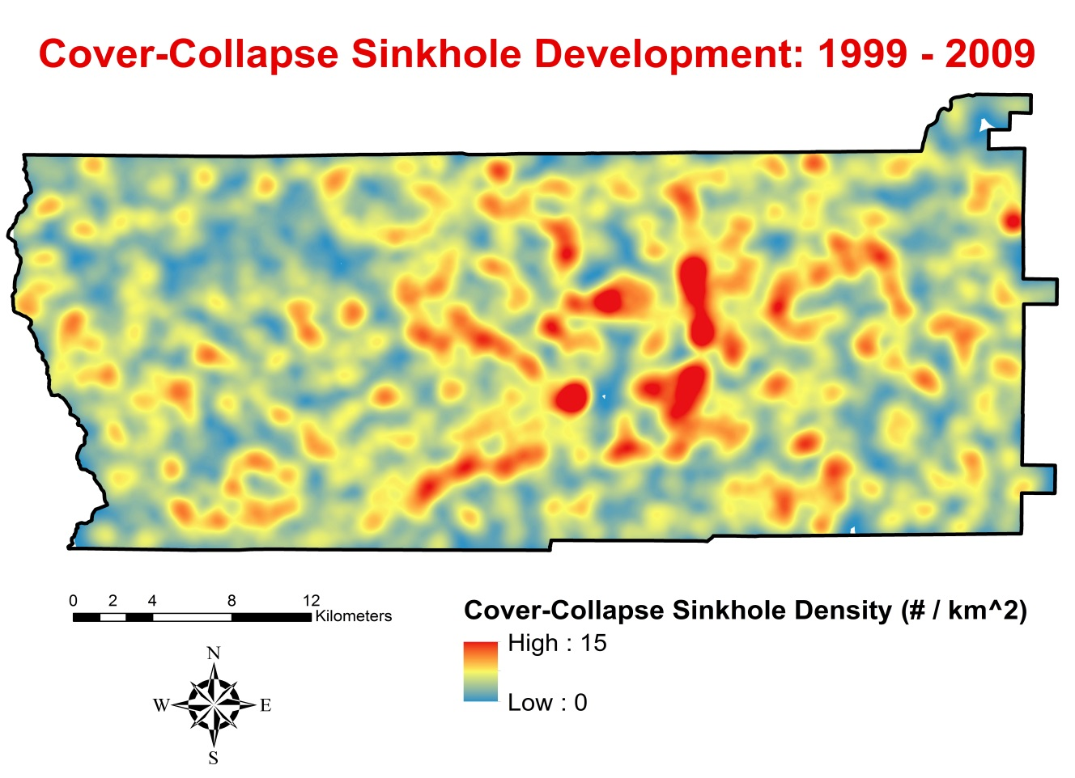
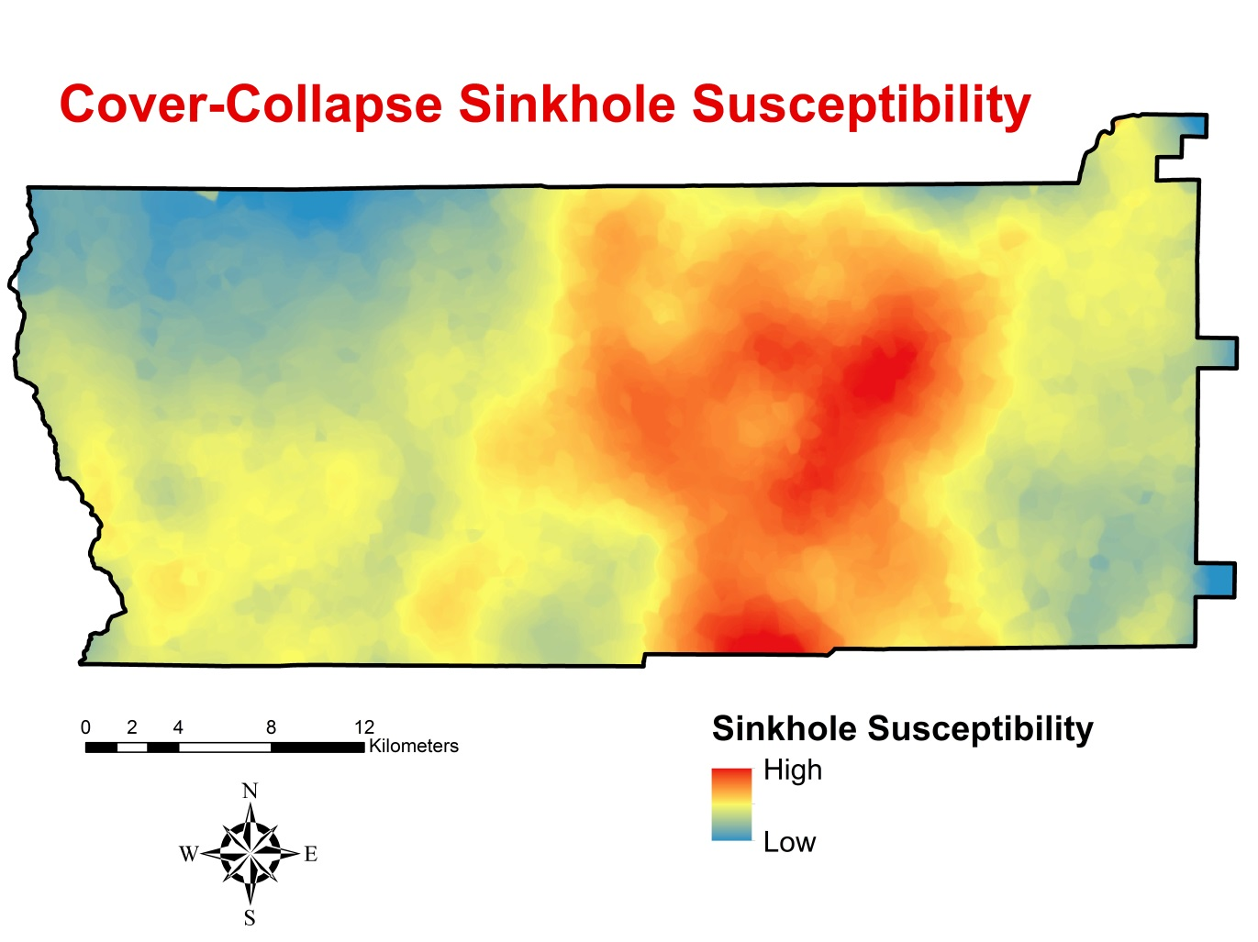
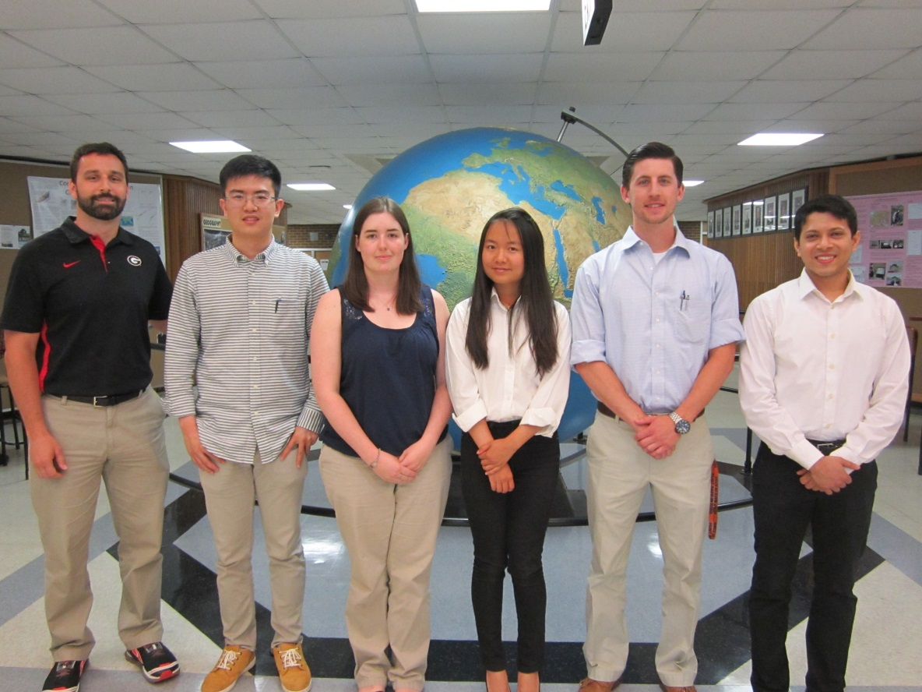
Georgia Disasters and Water Resources
Utilizing NASA Earth observations to monitor sinkhole development and identify risk areas in Dougherty County, GA
Matthew Cahalan (Project Lead), Mohamed Amin, Kimberly Berry, Tunan Hu, Wenjing Xu, and Dr. Adam Milewski (Science Advisor)
NASA DEVELOP at University of Georgia
Abstract
Objectives
Located in southwest Georgia, Dougherty County has a growing populace in an agricultural region that relies heavily on groundwater resources. Partly due to escalated groundwater extraction, this area has experienced an increase in sinkhole development over the last decade. Sinkholes pose a threat to infrastructure development, groundwater pollution, and land use operations. The NASA DEVELOP Georgia Disasters and Water Resources team partnered with the City of Albany and Dougherty County Planning and Development Services (PDS) and the Southwest Georgia Water Resources Task Force (SGWRTF) to assess past sinkhole development and identify areas susceptible to future sinkhole formation. Sinkhole mapping was completed utilizing a time-series of elevation data (1999 – 2011) from NASA’s SRTM and ASTER missions, as well as European Remote-Sensing (ERS-1 and 2) satellite-derived elevation data. The sinkhole inventory maps and spatial statistical techniques (i.e., geographically-weighted regression) were employed to quantify the factors most influential in sinkhole development. With those results, the susceptibility of every area within Dougherty County to future sinkhole formation was identified. The results of this applied science project will enable the PDS and SGWRTF to make informed decisions on current and future land use, safe infrastructure development, and sustainable water resource management.
Generate sinkhole inventory maps between 1999 and 2011 for Dougherty County, Georgia, using an automated sinkhole detection algorithm developed by the research team
Analyze the factors influencing the spatiotemporal distribution of sinkholes to improve the predictive capabilities for future sinkhole development
Produce a sinkhole susceptibility map to aid in current and future land use decisions, infrastructure development, and water resource management
Study Area
Methodology
DEM Data download
Sinkhole
Mapping
Sinkhole Formation Factor Analysis
Independent Variables:
Overburden thickness
Land use type
Land use change
Distance to fractures
Distance to streams
Distance to wetlands
Distance to ponds
Distance to roads
Elevation
Slope
Aspect
Aquifer fluctuations
NASA SRTM NASA ASTER
ERS-1 and 2
ArcGIS ModelBuilder Algorithm
Ordinary Least Squares
Validation
Geographically Weighted Regression
Earth Observations
Temporal Difference Maps
Sinkhole Density Maps
Sinkhole Susceptibility Map
Results
Terra
Advanced Spaceborne Thermal Emmision and Reflection Radiometer
(ASTER)
Shuttle Radar Topography Mission
(SRTM)
Independent Variables | Cover Subsidence | Cover Collapse
Distance to fractures | 0.179 | 0.000*
Distance to rivers | 0.587 | 0.000*
Distance to wetlands | 0.000* | 0.000*
Distance to roads | 0.018* | 0.115
Distance to lakes | 0.000* | 0.075
Overburden Thickness | 0.000* | 0.000*
Precipitation | 0.253 | 0.112
Land use | 0.010* | 0.407
Land cover change | 0.003* | 0.082
Aquifer Fluctuations | 0.000* | 0.000*
Fracture orientation | 0.456 | 0.572
Conclusions
The automated sinkhole mapping algorithm developed by the team is an efficient and accurate way to delineate both cover-subsidence and cover-collapse sinkholes with DEMs of varying resolution.
Based on the regression results, different factors affect the formation of the two types of sinkholes analyzed in this study. These results can be used to analyze sinkhole formation mechanisms.
The geographically weighted regression models explained 81% and 93% of cover-subsidence and cover-collapse sinkhole density.
The sinkhole susceptibility prediction surfaces compared well to the measured sinkhole density results.
Figure 1- Ordinary least squares (OLS) regression results. Independent variables with asterisk are statistically significant for explaining sinkhole density.
GWR Statistics Summary | Cover Subsidence | Cover Collapse
Observations | 579 | 2,913
R² | 0.81 | 0.93
R² Adjusted | 0.64 | 0.79
Figure 2- Geographically weighted regression (GWR) overall model results for explaining cover-subsidence and cover-collapse sinkhole density using 8 explanatory, or independent, variables.
Team Members
Acknowledgements
Project Partners
We would like to extend our appreciation to the NASA DEVELOP National Program Office and the entire DEVELOP community for supporting this project.
We would like to acknowledge our main contacts from our partner organizations, Paul Forgey and Randy Weathersby.
We would like to thank Jim Stolze for allowing us access to the Albany Municipalities’ well field to survey sinkholes, enhance our validation techniques, and gather footage for the team’s VPS.
We would like to thank the NASA South Dakota Space Grant Consortium for aiding in this project by providing grant support to Kimberly Berry.
City of Albany and Dougherty County Planning and Development Services
Dougherty County, Georgia
Albany Utilities
Albany, Georgia
Southwest Georgia Water Resources Task Force
Albany, Georgia
Athens, Georgia
From left to right: Dr. Adam Milewski, Tunan Hu, Kimberly Berry, Wenjing Xu, Matthew Cahalan, and Mohamed Amin
University of Georgia

