Slide 1
Antarctica Climate
Applying NASA Earth Observations to Assess the Seasonal and Inter-annual Variability of Sea Ice Dynamics in McMurdo Sound, Ross Sea, Antarctica
Elizabeth Benyshek (Project Lead)
Christopher Cameron
Caren Remillard
Eduardo Rendon
Notes:
This project was completed during the Fall 2015 term at the UGA NASA DEVELOP node. Antarctica Climate Team: Elizabeth Benyshek, Sean Cameron, Caren Remillard, and Eduardo Rendon

Slide 2
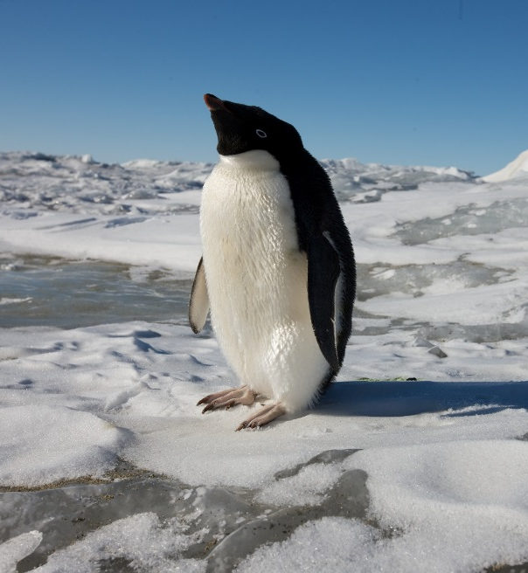
What Is Sea Ice?
Frozen ocean water
Forms, grows, and melts in the ocean
Approximately 15% of world’s oceans are covered by sea ice
Why Is Sea Ice Important?
Influences global climate
Affects the movement of ocean waters
Provides a resting and birthing place
for species in the Arctic and Antarctic
Image Credit: Dr. Sally E. Walker
Notes:
Sea ice is simply frozen ocean water. It forms, grows, and melts in the ocean. In contrast, icebergs, glaciers, ice sheets, and ice shelves all originate on land. Sea ice occurs in both the Arctic and Antarctic.
-Sea ice reflects sunlight, keeping temperatures in the polar regions cool. If gradual warming temperatures continue to melt sea ice over time, more solar energy will be absorbed, perpetuating this cycle.
-Cold, dense, polar water sinks and moves along the ocean bottom toward the equator, while warm water from mid-depth to the surface travels from the equator toward the poles.
-Some species depend entirely on the presence of sea ice to survive. Many give birth and nurse their pups on the ice, and they look for food near the ice edge and under the ice.

Slide 3
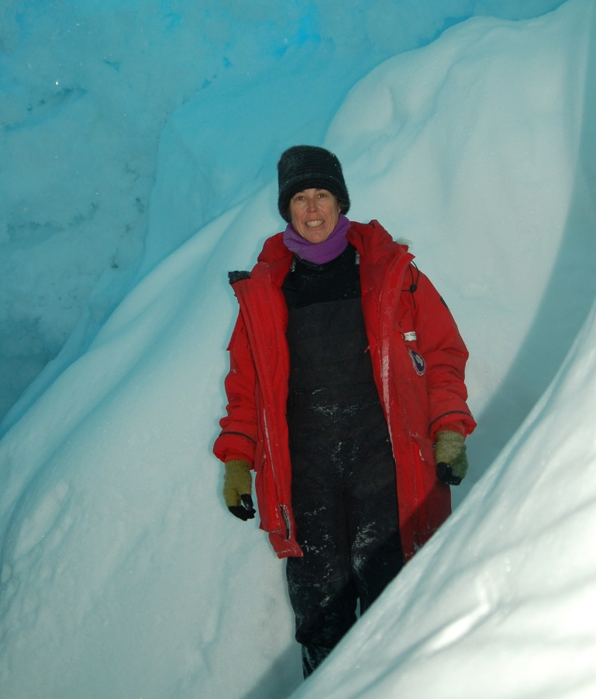
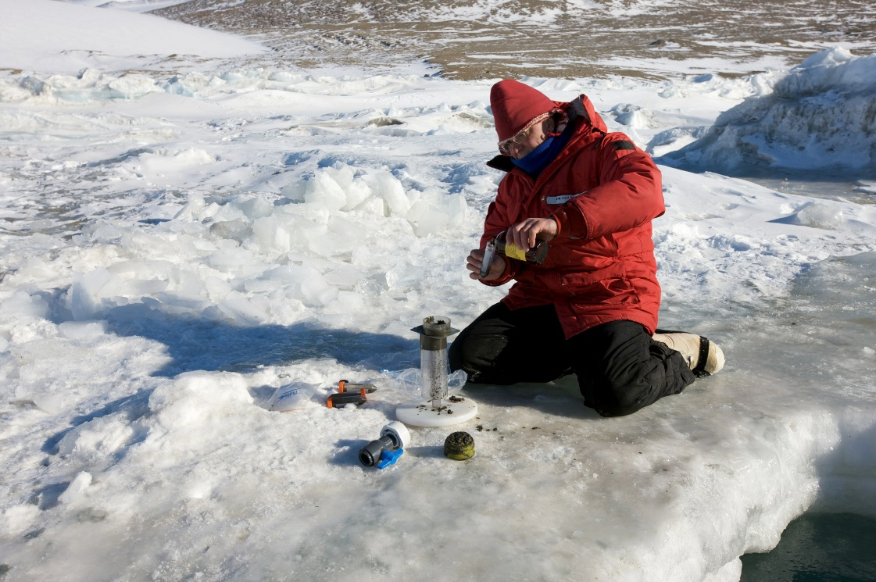
Project Partners
Dr. Sally E. Walker, Department of Geology, University of Georgia
Dr. Samuel Bowser, The Wadsworth Center: New York's State Public Health Laboratory
Image Credits: Dr. Sally E. Walker
Notes:
Project Partners Dr. Sally Walker and Dr. Sam Bowser are funded by NSF Polar Programs to conduct field work in McMurdo Sound. Dr. Bowser has made biannual trips to this region since 1990. Their work focuses on the ecophysiology, phylogenetics, and population dynamics of benthic communities inhabiting Explorers Cove and surrounding regions. Partners were interested in the addition of remote sensing data to improve their understanding of changing sea ice conditions in relation to ecological health and productivity.

Slide 4
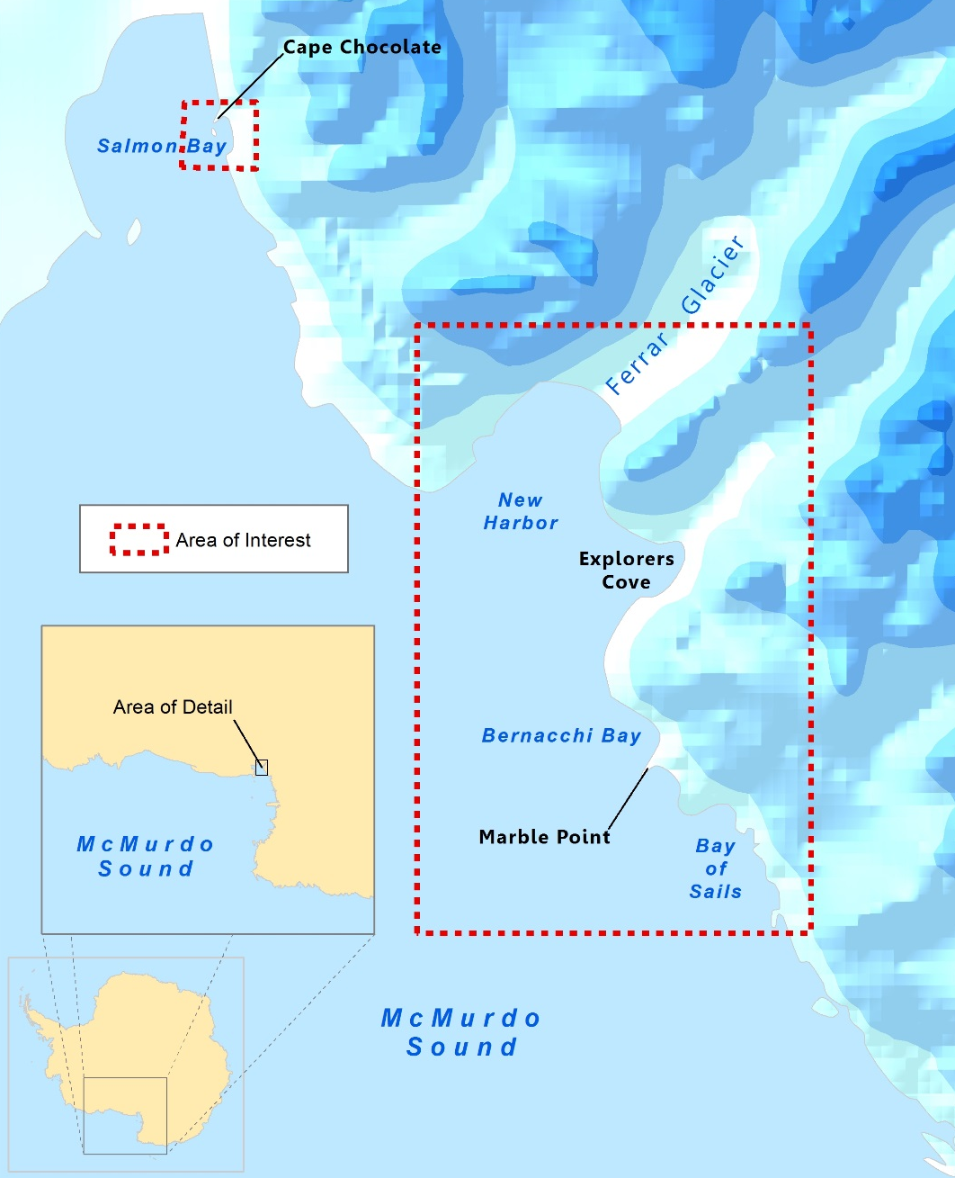
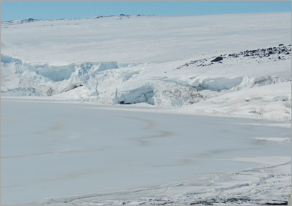
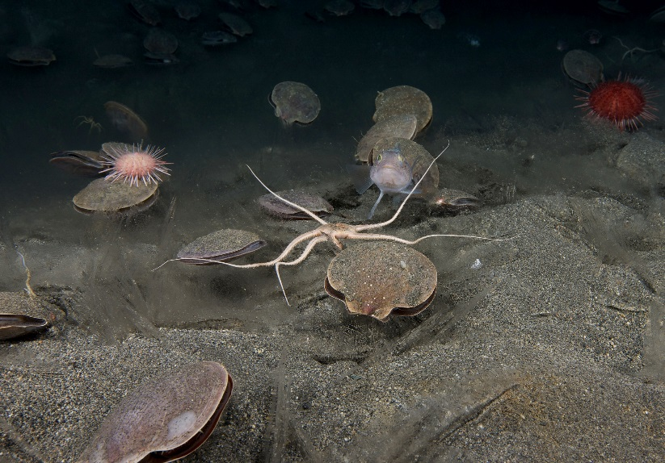
Study Area
Image Credits: Dr. Samuel Bowser
Image Credits: Dr. Sally E. Walker
Image Credit: Brandon Adams & Caren Remillard
Notes:
The western coast of McMurdo Sound, Antarctica is rich in economically-important species. Our partners are specifically interested in sea ice dynamics in the regions of Explorers Cove, Ferrar Glacier, and Bay of Sails. We studied sea ice parameters from October 2003-December 2008 in this region of interest.

Slide 5
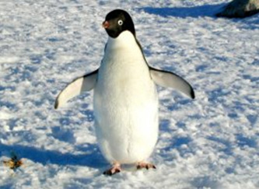
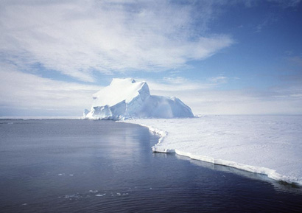
Antarctic Seasons
Season | Months
Spring | October – December
Summer | January – February
Fall | March – April
Winter | May – September
Image Credit: NASA
Image Credit: NASA
Notes:
Some scientists consider Antarctica to have only two seasons: summer and winter.
But it can be divided further into the four seasons we are familiar with…
After the winter darkness, spring hits Antarctica and the sun causes an explosive growth of phytoplankton in areas of mineral upwelling.
During summer, wildlife activities are highest. Penguin chicks hatch and as ice recedes concentration of seals and whales increase.
In fall, nightly darkness returns as the sun sinks below the southern horizon.
In winter, Antarctica is on the side of Earth tilted away from the sun. Then, the continent is always dark.

Slide 6
Objectives
Provide project partners with information about sea ice variability to enhance their understanding of how ecological health and productivity are affected by changing conditions in McMurdo Sound
Examine ICESat datasets from 2003 to 2008 to characterize seasonal and inter-annual variability in sea ice thickness
Examine Terra datasets to characterize seasonal and inter-annual variability in sea surface temperature, ice surface temperature, and sea ice extent
Image Credit: Dr. Sally E. Walker
Notes:
Our objective was to provide project partners with multi-annual and seasonal sea ice variability to enhance their understanding of how ecological health and productivity are affected by changing sea ice conditions in McMurdo Sound. We did this by examining ICESat and Terra datasets from 2003-2008 to characterize variability in sea ice conditions. Parameters included sea ice thickness, sea surface temperature, ice surface temperature, and sea ice extent.

Slide 7
Image Credit: Dr. Sally E. Walker
Community Concern
The Antarctic coast of McMurdo Sound experiences important changes in ice dynamics as both glaciers and sea ice undergo melt-freezing cycles
Compounded changes in local ice regimes can affect vulnerable ecological communities in Explorers Cove and surrounding regions
Notes:
Sea ice is a vital component to ecological communities along the Antarctica coast. Melt-freezing cycles of both sea ice and glaciers promote important changes in ice dynamics that can affect these vulnerable communities. Changes in sea ice regimes can directly effect nutrient supply leading to changes in both productivity and population densities.

Slide 8
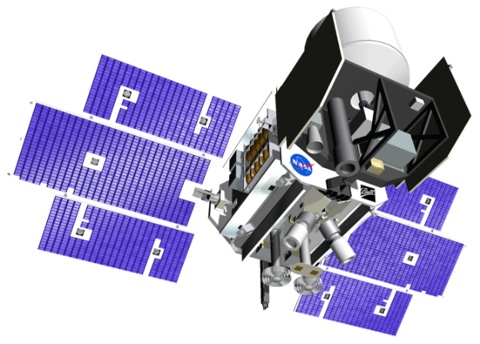
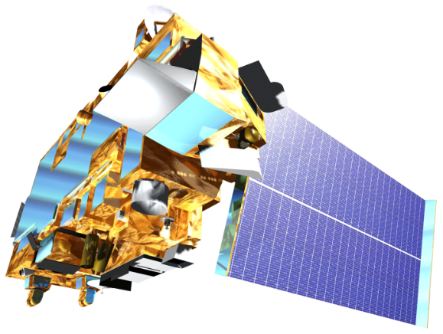
ICESat, GLAS
Terra, MODIS
NASA Earth Observing Systems
ICESat and Terra satellites were utilized in this project to characterize sea ice variability in western McMurdo Sound, Antarctica
Notes:
NASA’s Terra satellite views the Earth's surface every day. The MODIS sensor onboard Terra tracks a wide array of Earth’s system interactions between the atmosphere, ocean, land, snow, and ice. We chose Terra because data acquired from MODIS promotes understanding of energy balance and climate regimes. Terra also provided an abundance of sea ice datasets to chose from. Our team analyzed MODIS-derived sea and ice surface temperature data from 2003 to 2008 in conjunction with sea ice extent data to gain a better understanding of the seasonality in McMurdo Sound.
Our team also utilized NASA’s Ice, Cloud and land Elevation Satellite, known as ICESat. Using three laser sensors, ICESat acquired a large volume of data from 2003 to 2008. ICESat was especially valuable to us since its orbit inclination ensured a high concentration of observations at the polar latitudes. ICESat allowed us to examine sea ice topography and calculate changes in thickness.

Slide 9
Methodology
Data Acquisition
Data Processing and Analysis
End-Products
ICESat/GLAS
Cryosphere Science Research Portal
Extraction and aggregation of seasonal data
Seasonal sea ice topography maps
Terra/MODIS
National Snow and Ice Data Center and NASA’s Giovanni
Georeferencing and extraction of sea and ice surface temperature data
Multi-annual and seasonal temperature maps
Notes:
ICESat sea ice thickness data was obtained from the Cryosphere Science Research Portal and aggregated to seasonal data to create seasonal sea ice topography maps.
Terra sea surface temperature data was obtained from NASA’s Giovanni then georeferenced to create seasonal sea surface temperature maps.
Terra ice surface temperature and extent data was obtained from National Snow and Ice Data Center and georeferenced to create multi-annual and seasonal ice surface temperature maps.

Slide 10
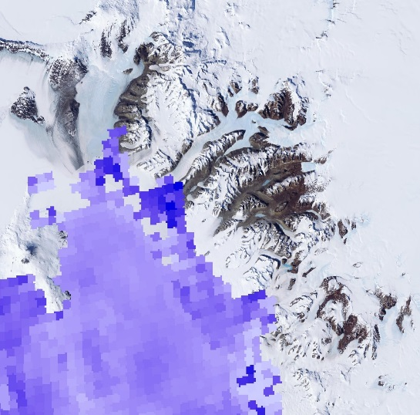
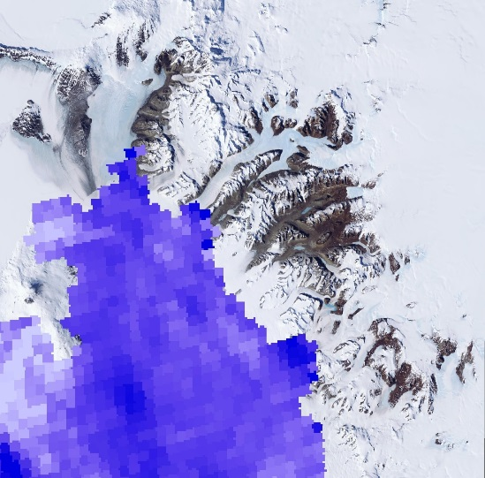
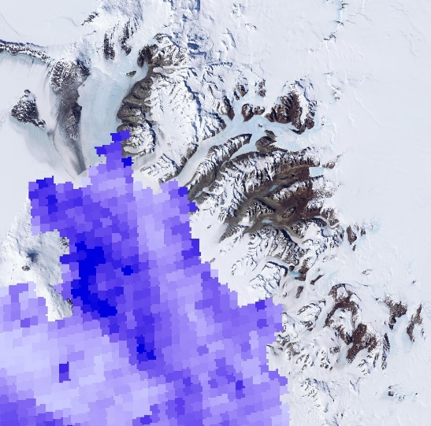
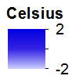
Results: Sea Surface Temperature (SST)
December 2003
December 2004
December 2005
December 2006
December 2007
December 2008
Notes:
Overall SST increased, but 2004 displayed particularly high temperatures for the month of December.

Slide 11
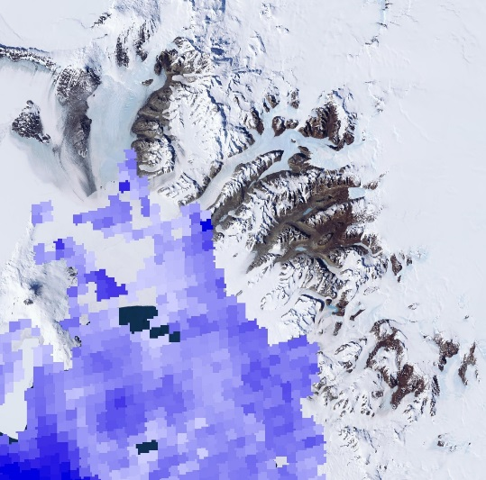
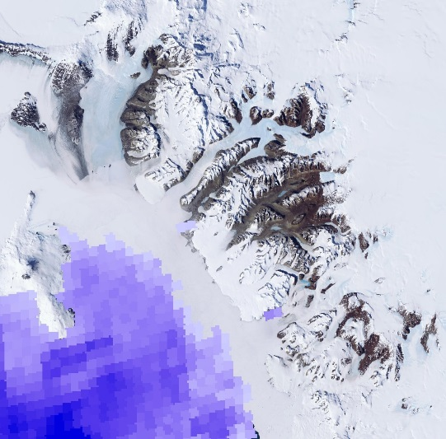
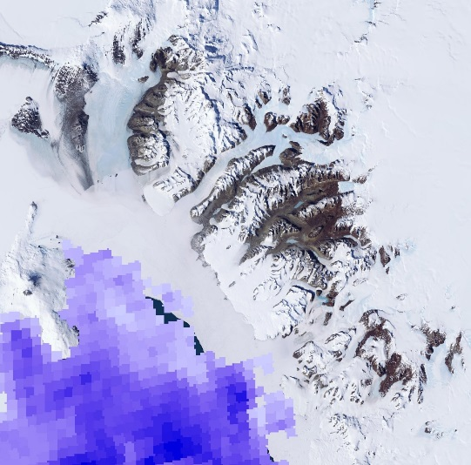
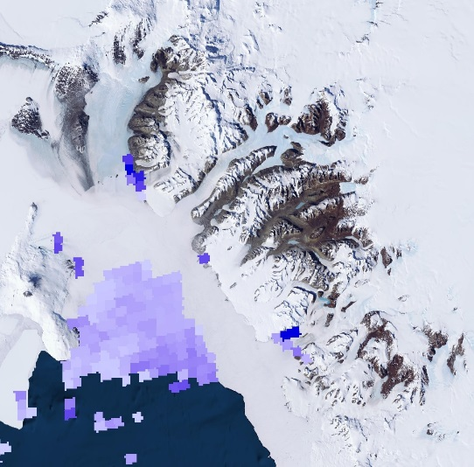
Results: Sea Surface Temperature (SST)
January 2006
February 2006
March 2006
November 2006
December 2006
Notes:
Throughout 2006, there were fewer changes between SST as compared to seasonal changes.

Slide 12
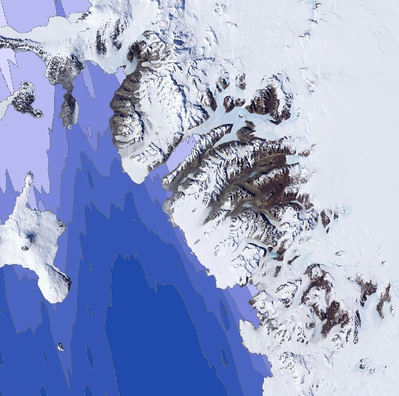
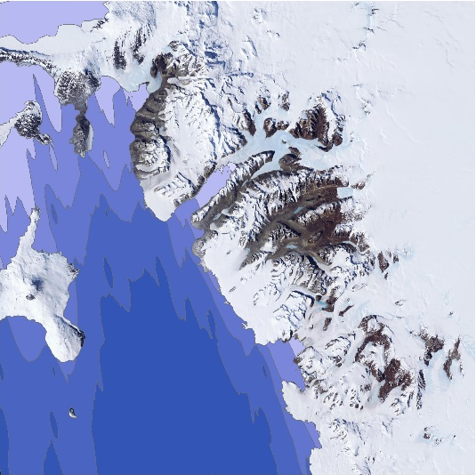
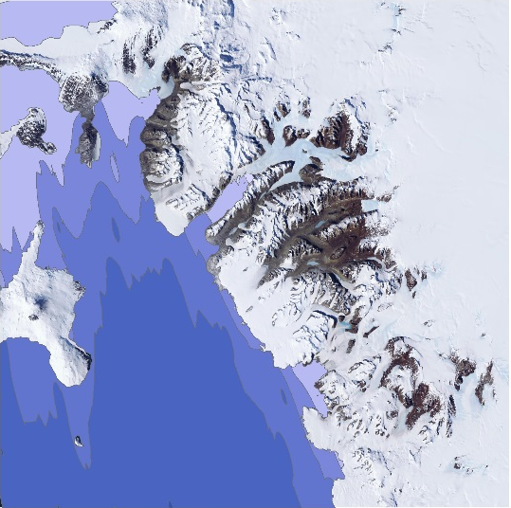
Results: Sea Ice Thickness
Spring 2003
Spring 2004
Spring 2005
Spring 2006
Spring 2007
Notes:
Sea ice thickness decreased between 2003 and 2007 by a little less than one third of a meter.

Slide 13
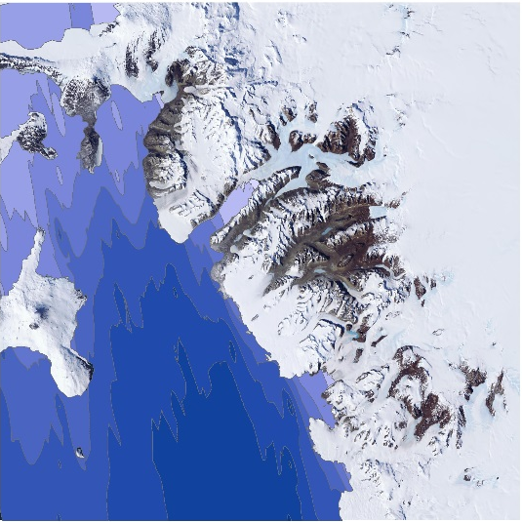
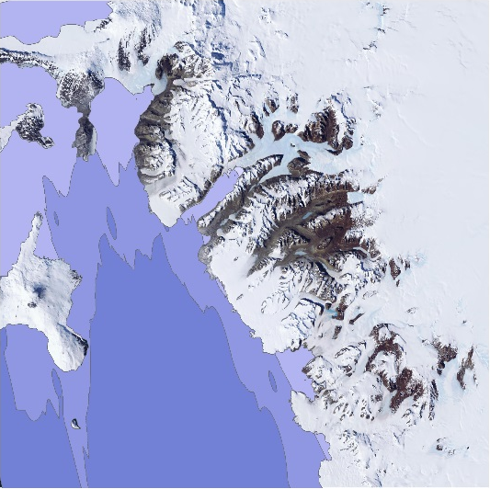
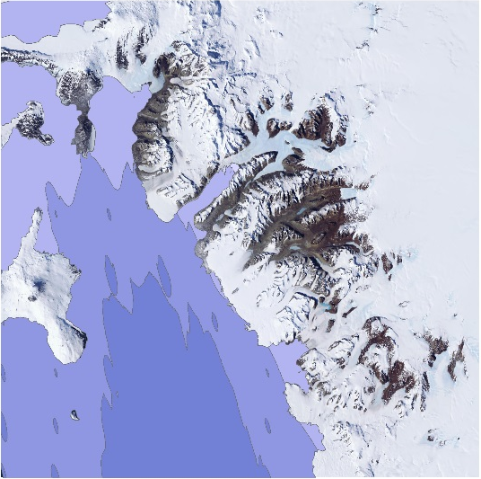
Results: Sea Ice Thickness
Summer 2004
Summer 2005
Summer 2006
Summer 2007
Summer 2008
Notes:
Summer sea ice thickness decreased from 2004-2008 by approximately half a meter.

Slide 14
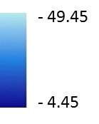
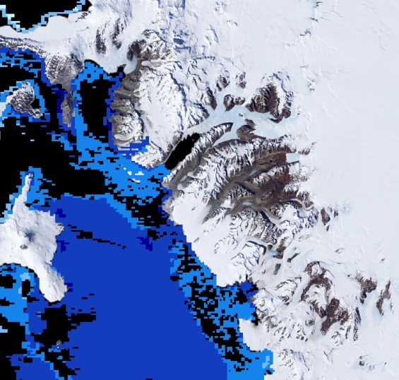
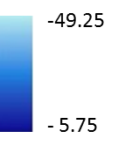
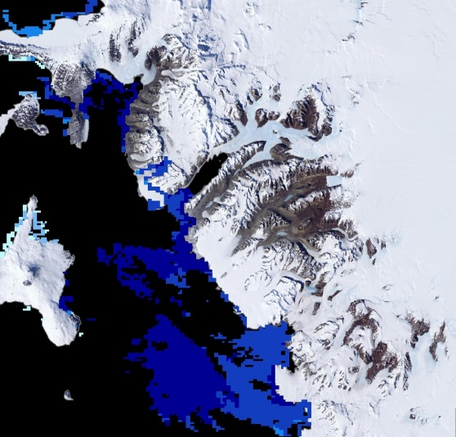
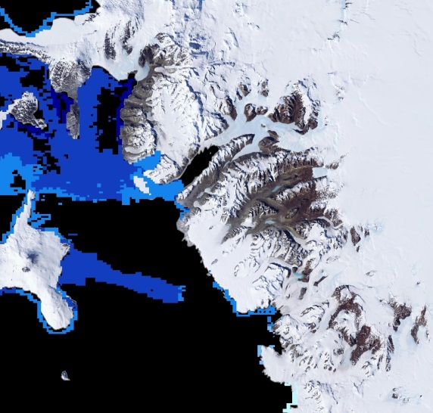
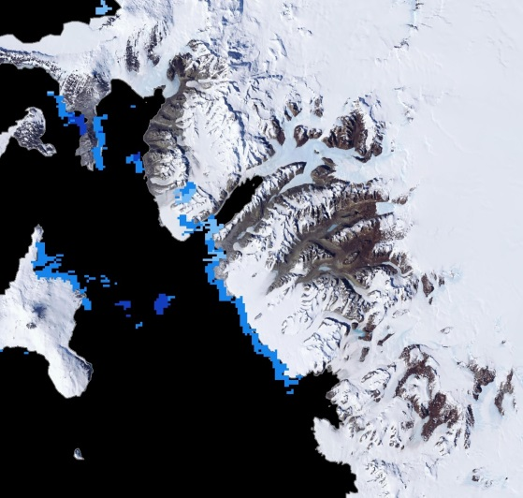
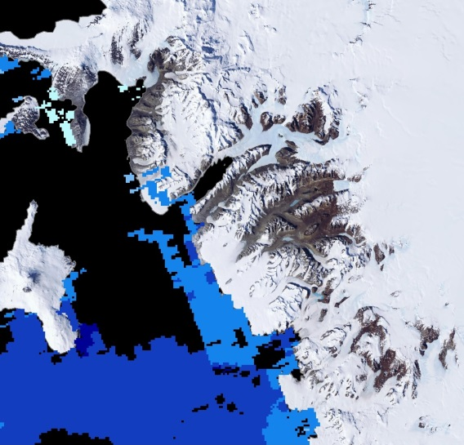
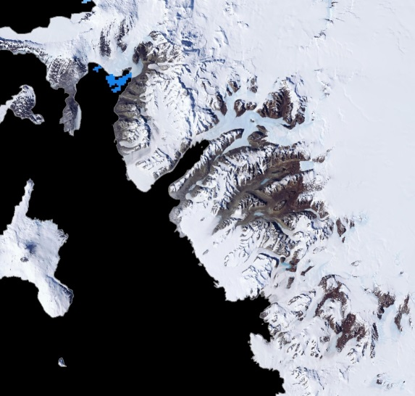
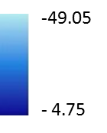
Results: Ice Surface Temperature (IST)
Celsius
October 2003
October 2004
October 2005
October 2006
October 2007
October 2008
Notes:
There minimal changes in IST between the October months from 2003-2008, but you can see the availability of data is highly variable.

Slide 15
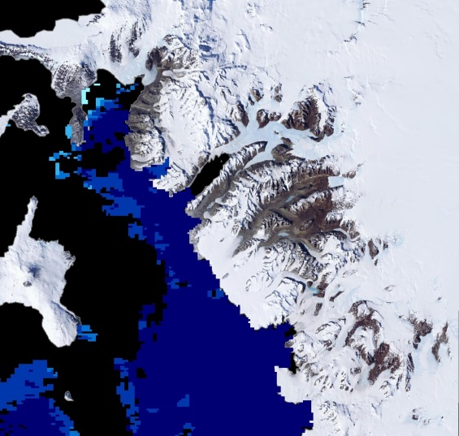
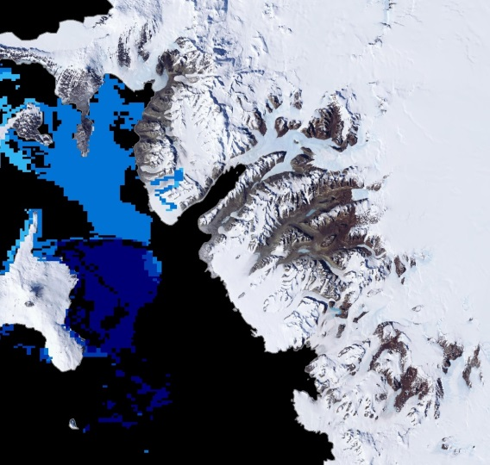
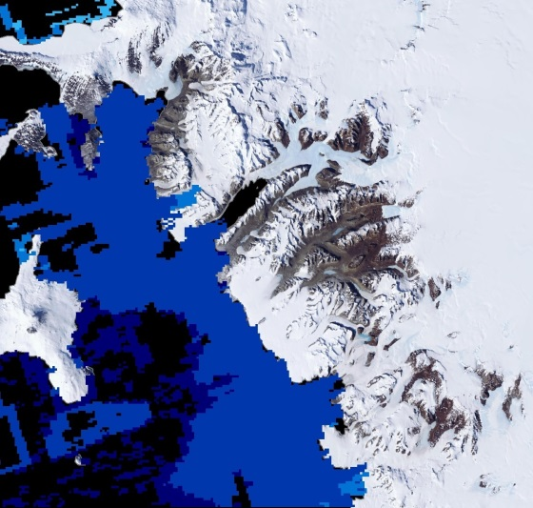
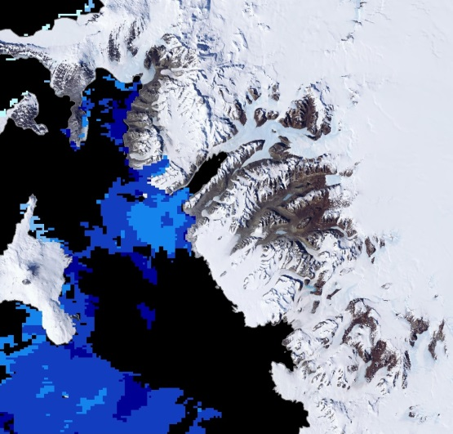
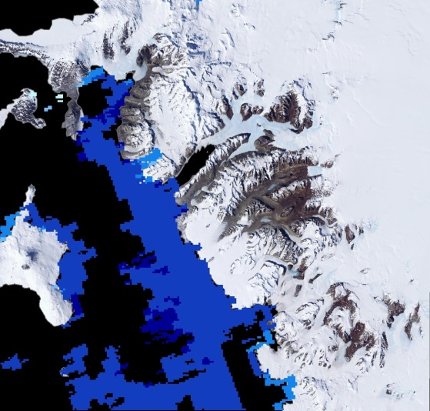
Results: Ice Surface Temperature (IST)
Celsius
January 2006
February 2006
March 2006
November 2006
December 2006
Notes:
From these maps you can see the changes in ice surface temperature for the year 2006. In the Summer, IST decrease from Jan-Mar. In the Spring, it increase from Nov-Dec.
Summer IST was highest at 5.75 °C and lowest at -49.25 °C from 2003-2008. On the other hand, the highest temperature in Spring was 14.45 °C. However, we might not need to consider it since it seems to be an outlier. So, the "second highest" was 6.05 °C and lowest at -56.15 °C.

Slide 16
Results: Spring Variability
Notes:
You can see the inverse relationship between sea surface temperature, in gray, and sea ice thickness, in light blue, on this graph. As surface temperatures of the ocean surrounding sea ice in McMurdo Sound decrease during Spring seasons, ice thickness increases. Ice surface temperature, in dark blue, decreases from 2003-2005, then increases from 2005-2007.

Slide 17
Results: Summer Variability
Notes:
Summer seasons show a slightly different trend. From 2004 to 2006 sea surface temperature (gray) increases, decreasing sea ice thickness (light blue). As sea surface temperatures begin to decrease from 2007 to 2008, ice thickness continues to decrease. This is likely due to the ice setting of prior Spring season when temperatures were warmer, as seen on the previous slide. Ice surface temperature (dark blue) increases from 2004-2006, then decreases from 2006-2008, in contrast to the Spring trend.

Slide 18
Results: Sea Ice Extent
Notes:
In Spring season, the overall trend sea ice extent increased from 2004-2008. Summer sea ice extent decreased from 2004-2005, but showed a positive trend from 2005-2007.

Slide 19
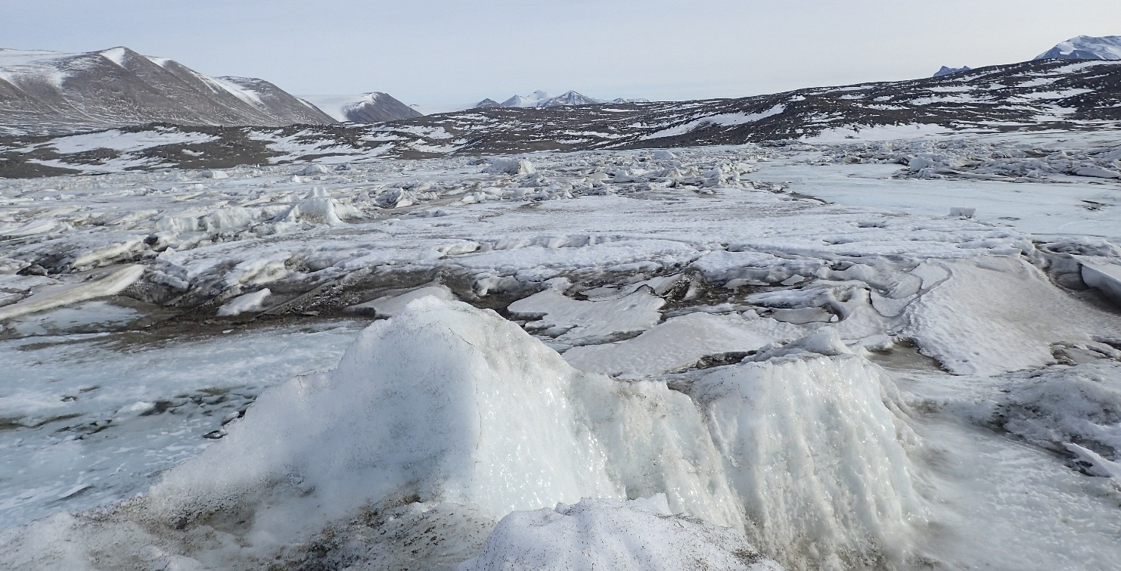
Results: Changing Sea Ice
Image Credit: Dr. Samuel Bowser
Change in Sea Ice Area (km²)
 | 2003 - 2004 | 2004 - 2005 | 2005 - 2006 | 2006 - 2007 | 2007 - 2008
Spring | 21.33 | 20.67 | -4.67 | 32.00 | -27.00
Summer | N/A | -45.00 | 55.00 | 2.67 | -24.00
Notes:
For Spring, average sea ice area for our region of interest exhibited a 65 km² change from maximum to minimum extent between 2003 and 2008. Sea ice area showed the highest increase from 2006-2007.
For Summer, average sea ice area exhibited a 58 km² change from maximum to minimum extent. This trend is less established, but the increase from 2005-2006 was a great 55 km². Though this change my not seem drastic out of an average 22,000 km² sea ice area, it has a great impact on the ecological communities.
Relatively small area changes can have dramatic effects on local ecological communities.

Slide 20
Conclusions
Terra sea surface temperature data showed a positive trend from 2003 to 2008
ICESat data for McMurdo Sound revealed an overall decrease in sea ice thickness from 2003 to 2008
Spring sea ice surface temperature decreased from 2003 to 2005 and increased from 2005 to 2007. Summer sea ice surface temperature increased from 2004 to 2006 and decreased from 2006 to 2008
Results will improve project partners’ understanding of changing sea ice conditions in relation to ecological health and productivity
Notes:
The overall trend in relative SST and sea ice extent was positive, while sea ice thickness was negative. As surround ocean temperatures increase, ice thickness has an inverse response.
Spring IST decreased from 2003-2005 and increased from 2005-2007. Summer IST increased from 2004-2006 and decreased from 2006-2008.
Results will improve project partners’ understanding of changing sea ice conditions in relation to ecological health and productivity

Slide 21
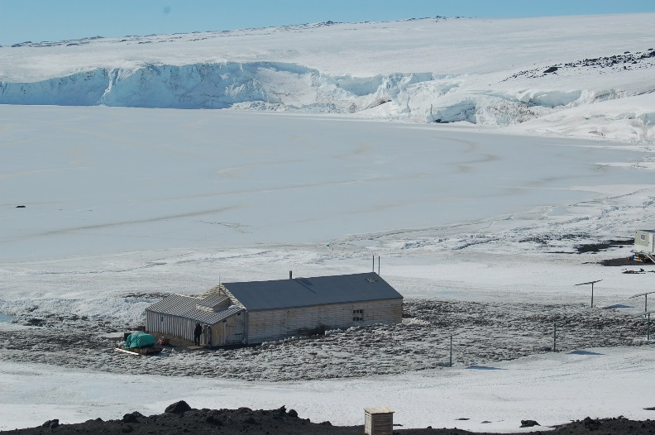
Errors & Uncertainties
Varying data resolution
Ice surface temperature and extent were scaled
IST (Kelvin) = 0.01 (calibrated data – offset)
Project analyzed Terra MODIS daytime
ICESat sea ice thickness does not
include snow and platelet ice
Five year time span
Data Set | Temporal Resolution | Spatial Resolution
Sea Surface Temp | Monthly | 4 km
Sea Ice Thickness | Bi-monthly | 25 km
Ice Surface Temp | Daily | 1 km
Sea Ice Extent | Daily | 1 km
Image Credit: Dr. Sally E. Walker
Notes:
The resolution of our dataset was not consistent. SST was on a 4km grid, while IST and extent were 1km. Thickness data was derived from a 25km point grid.
ICESat campaigns were characterized in seasons as Spring being October and November and Summer being February and March, except in 2007 when the campaign was March and April.
Daily IST and extent data was obtained for the 5th, 15th, and 25th of every month to get an overall understanding of the ice setting. More accurate results can be obtained from analyzing every day of every month. There was also a scaling factor applied to the values of the dataset creating a degree of uncertainty.
Terra MODIS datasets were obtained for daytime only, but it is dark in Antarctica for all of winter.
ICESat thickness data only measures actual sea ice, but in reality there is a layer of snow above and platelet ice below from the expulsion of saline water.
The five year time span our team analyzed is not sufficient to make climatic conclusions about McMurdo Sound, Antarctica.

Slide 22
Future Work
The IceBridge and ICESat 2 campaigns will further enhance knowledge of sea ice in the polar regions and provide expanded temporal data coinciding with MODIS observations
Spatial expansion to consider sea ice dynamics of all of McMurdo Sound or the Ross Sea
Analysis of the Antarctic Oscillation Index (AAO) in correlation with sea ice results
Image Credit: Dr. Sally E. Walker
Image Credit: Dr. Gilles Allard
Image Credit: Dr. Sally E. Walker
Notes:
ICESat 2 is tentatively launching in 2017 and will record the same data as the original ICESat. IceBridge bridges the gap between ICESat 1 and ICESat 2. This campaign will allow for the continuation of temporal coverage that can coincide with MODIS observations.
Expanding spatial coverage to all of McMurdo Sound or the Ross Sea will enhance overall understanding of the sea ice dynamics of this region.
Analysis of the Antarctic Oscillation Index will provided further understanding of ocean interaction with sea ice dynamics.

Slide 23
Advisors
Dr. Sally E. Walker, Department of Geology, University of Georgia
Dr. Adam Milewski, Department of Geology, University of Georgia
Partners
Dr. Samuel Bowser, The Wadsworth Center: New York's State Public Health Laboratory
Dr. Sally E. Walker, Department of Geology, University of Georgia
Others
Brandon Adams, Center for Geospatial Research, University of Georgia
Rachel Rotz, Department of Geology, University of Georgia
Linli Zhu, Geoinformatics Fellow, NASA DEVELOP

