Slide 1
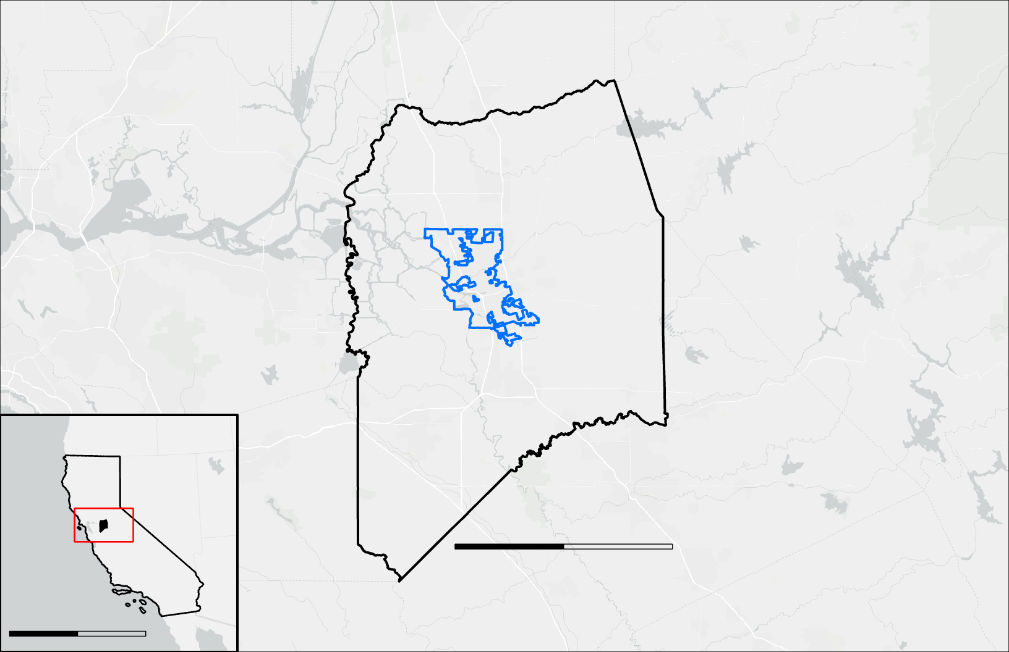
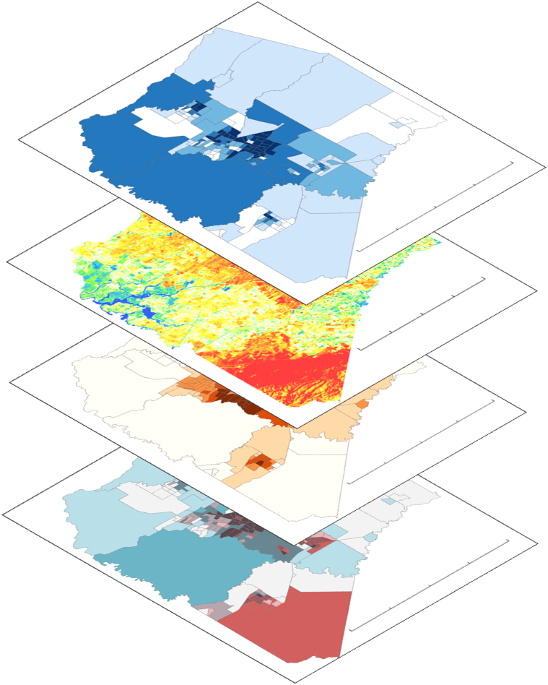
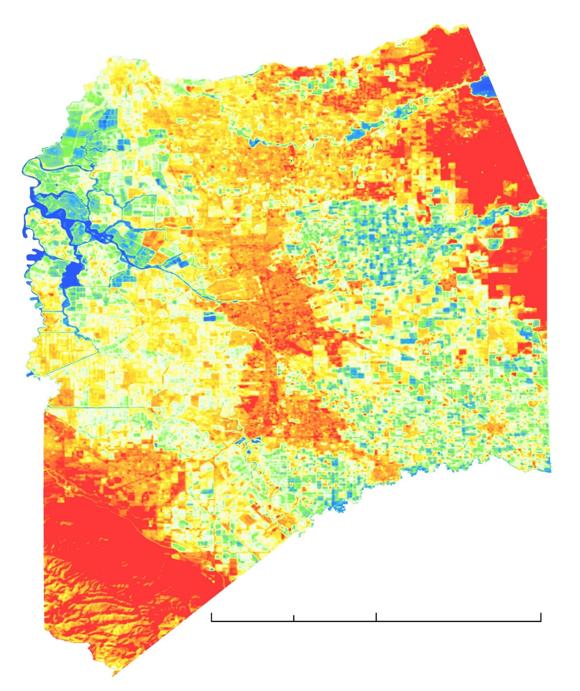
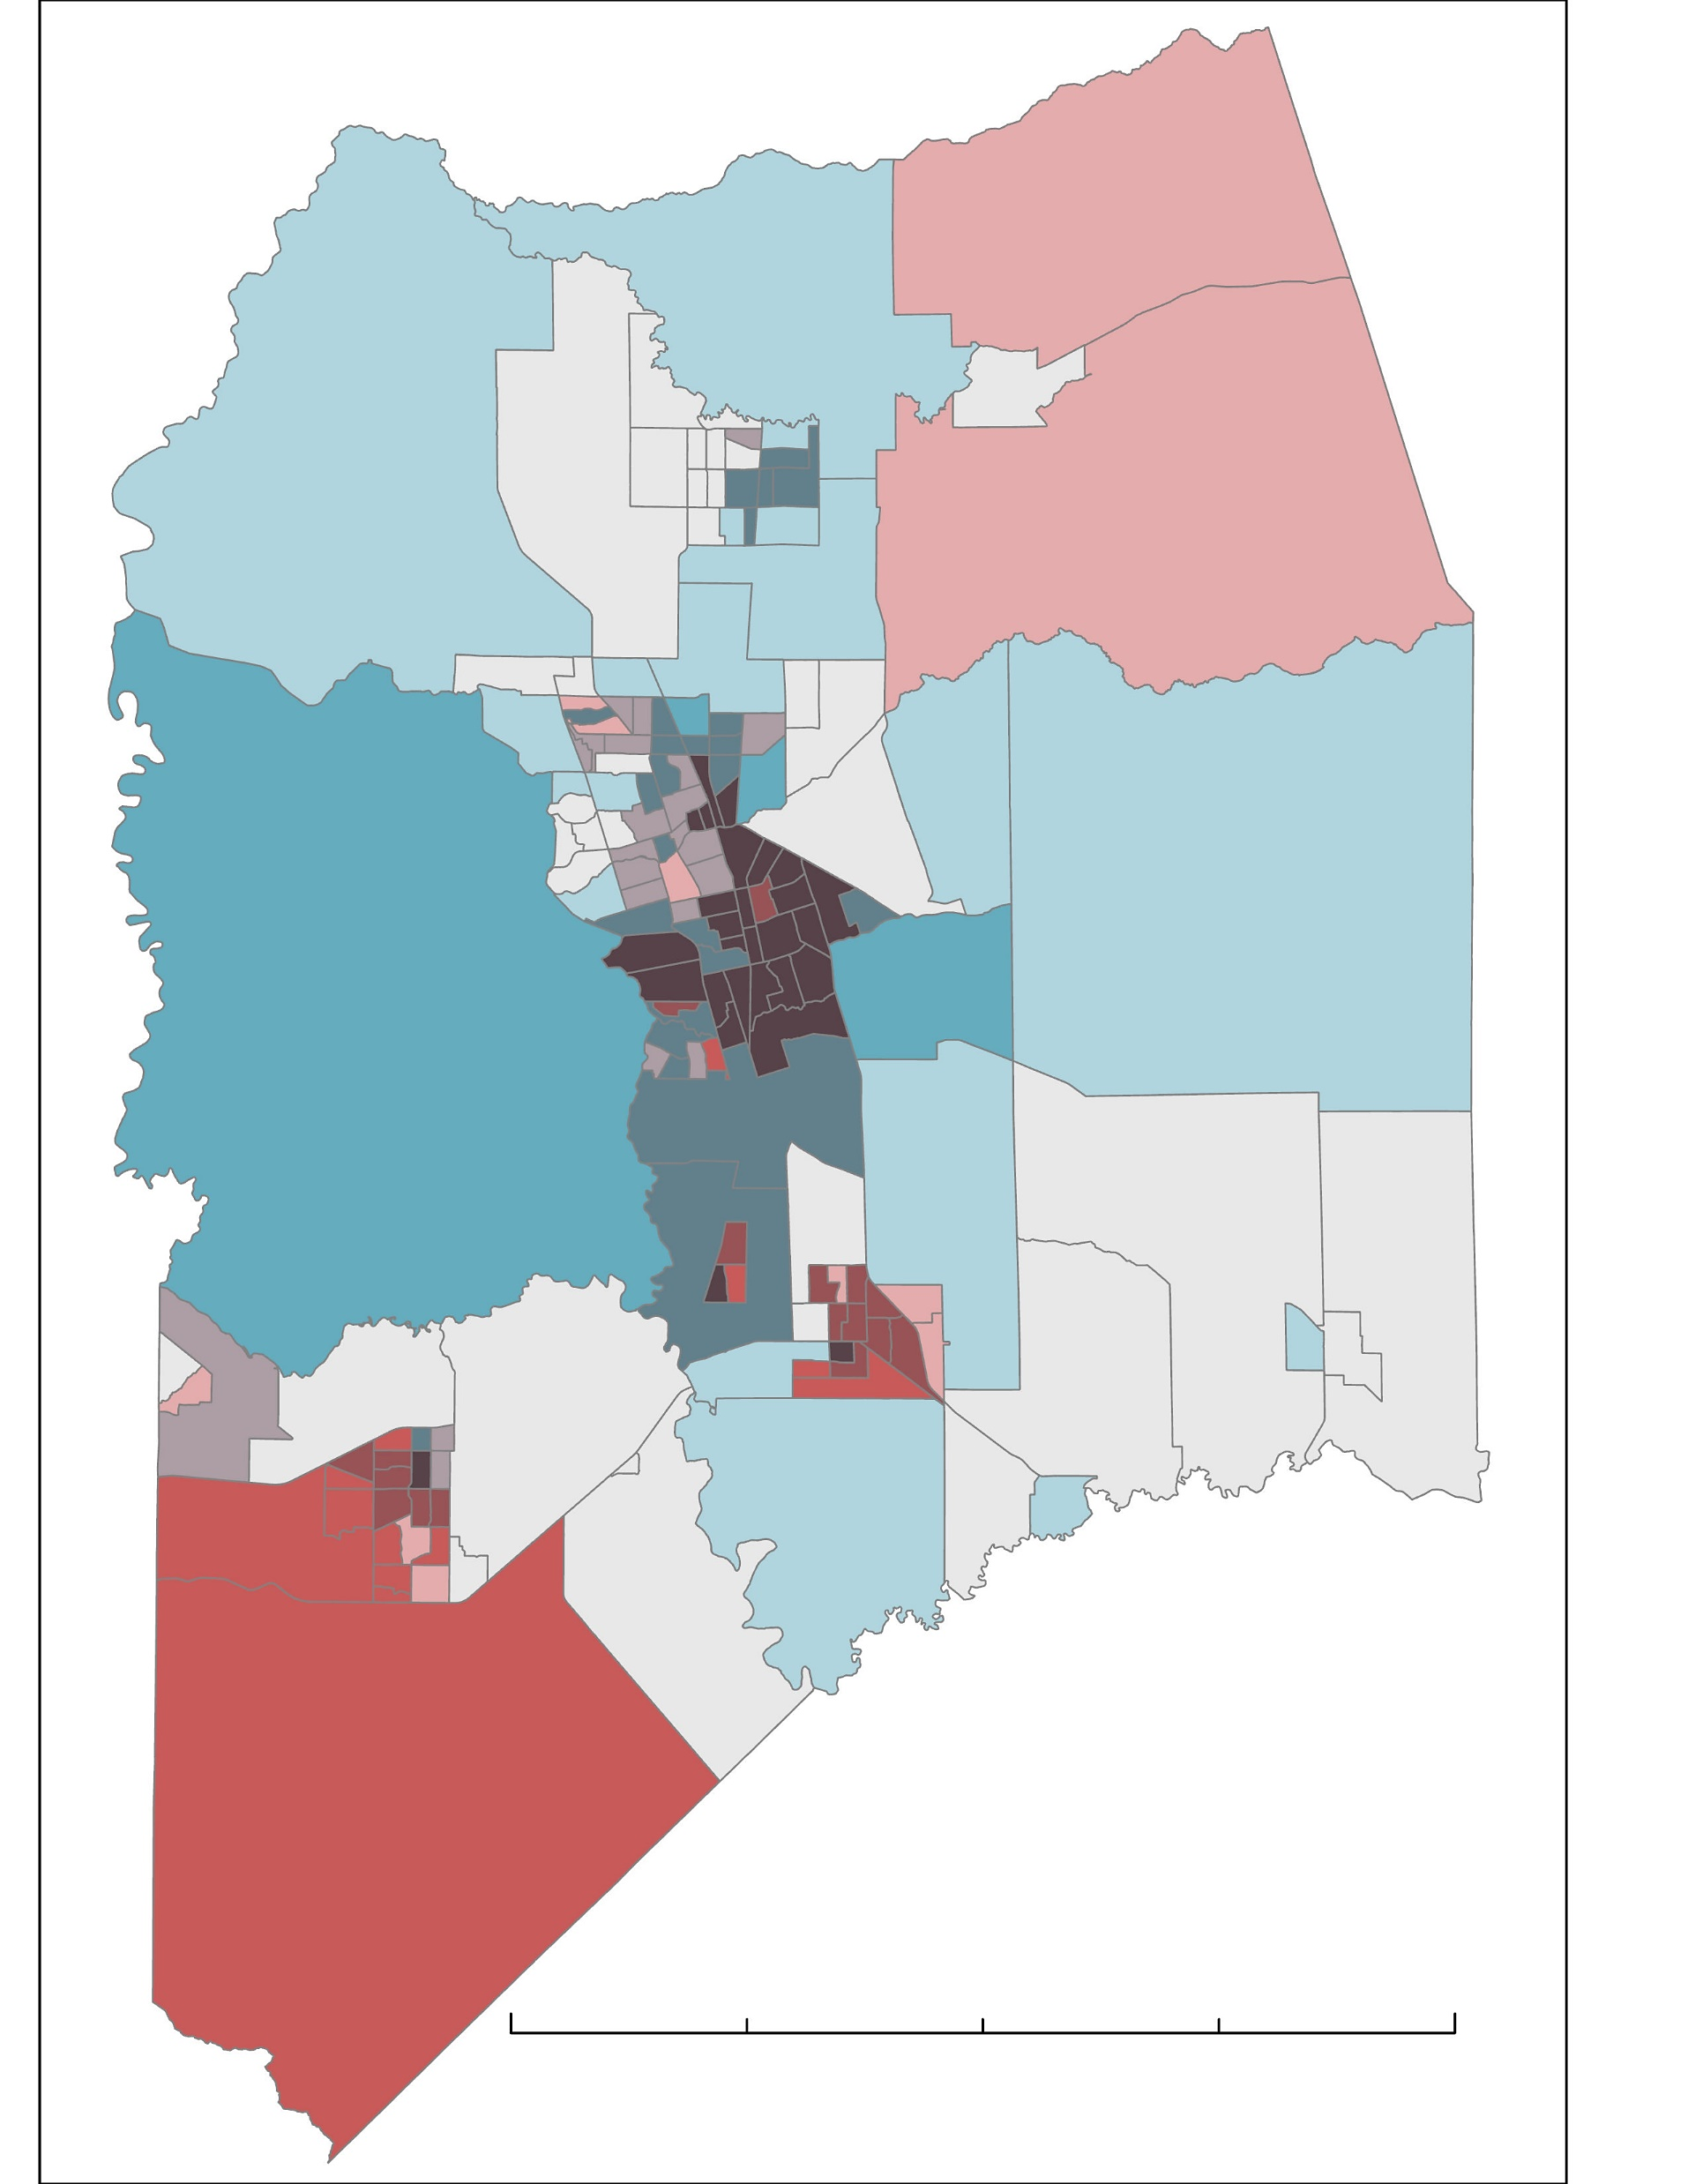
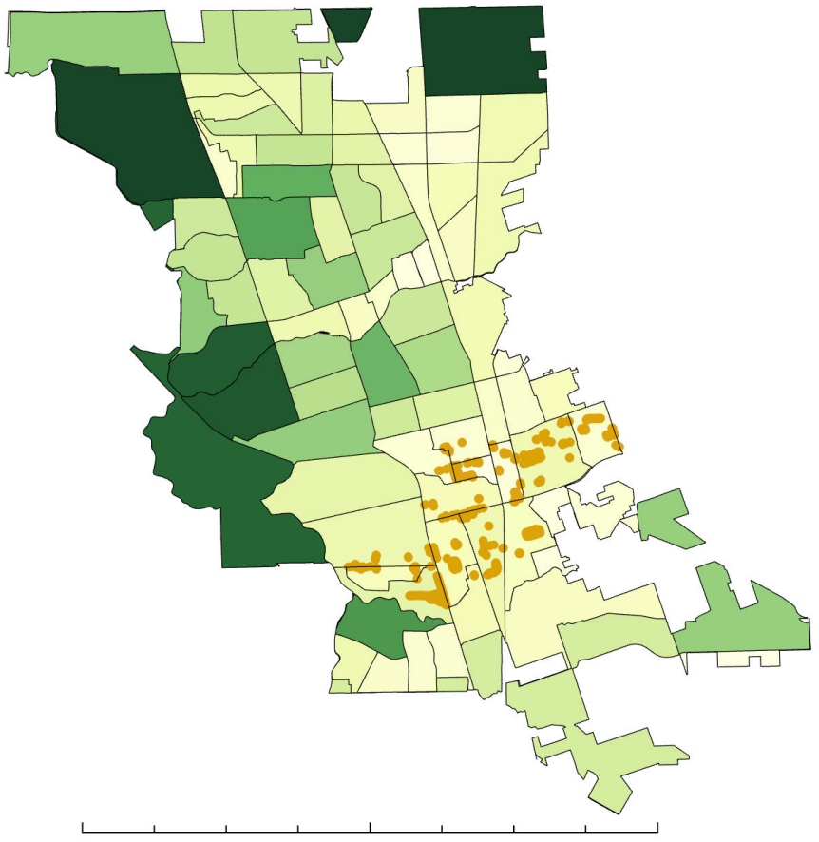
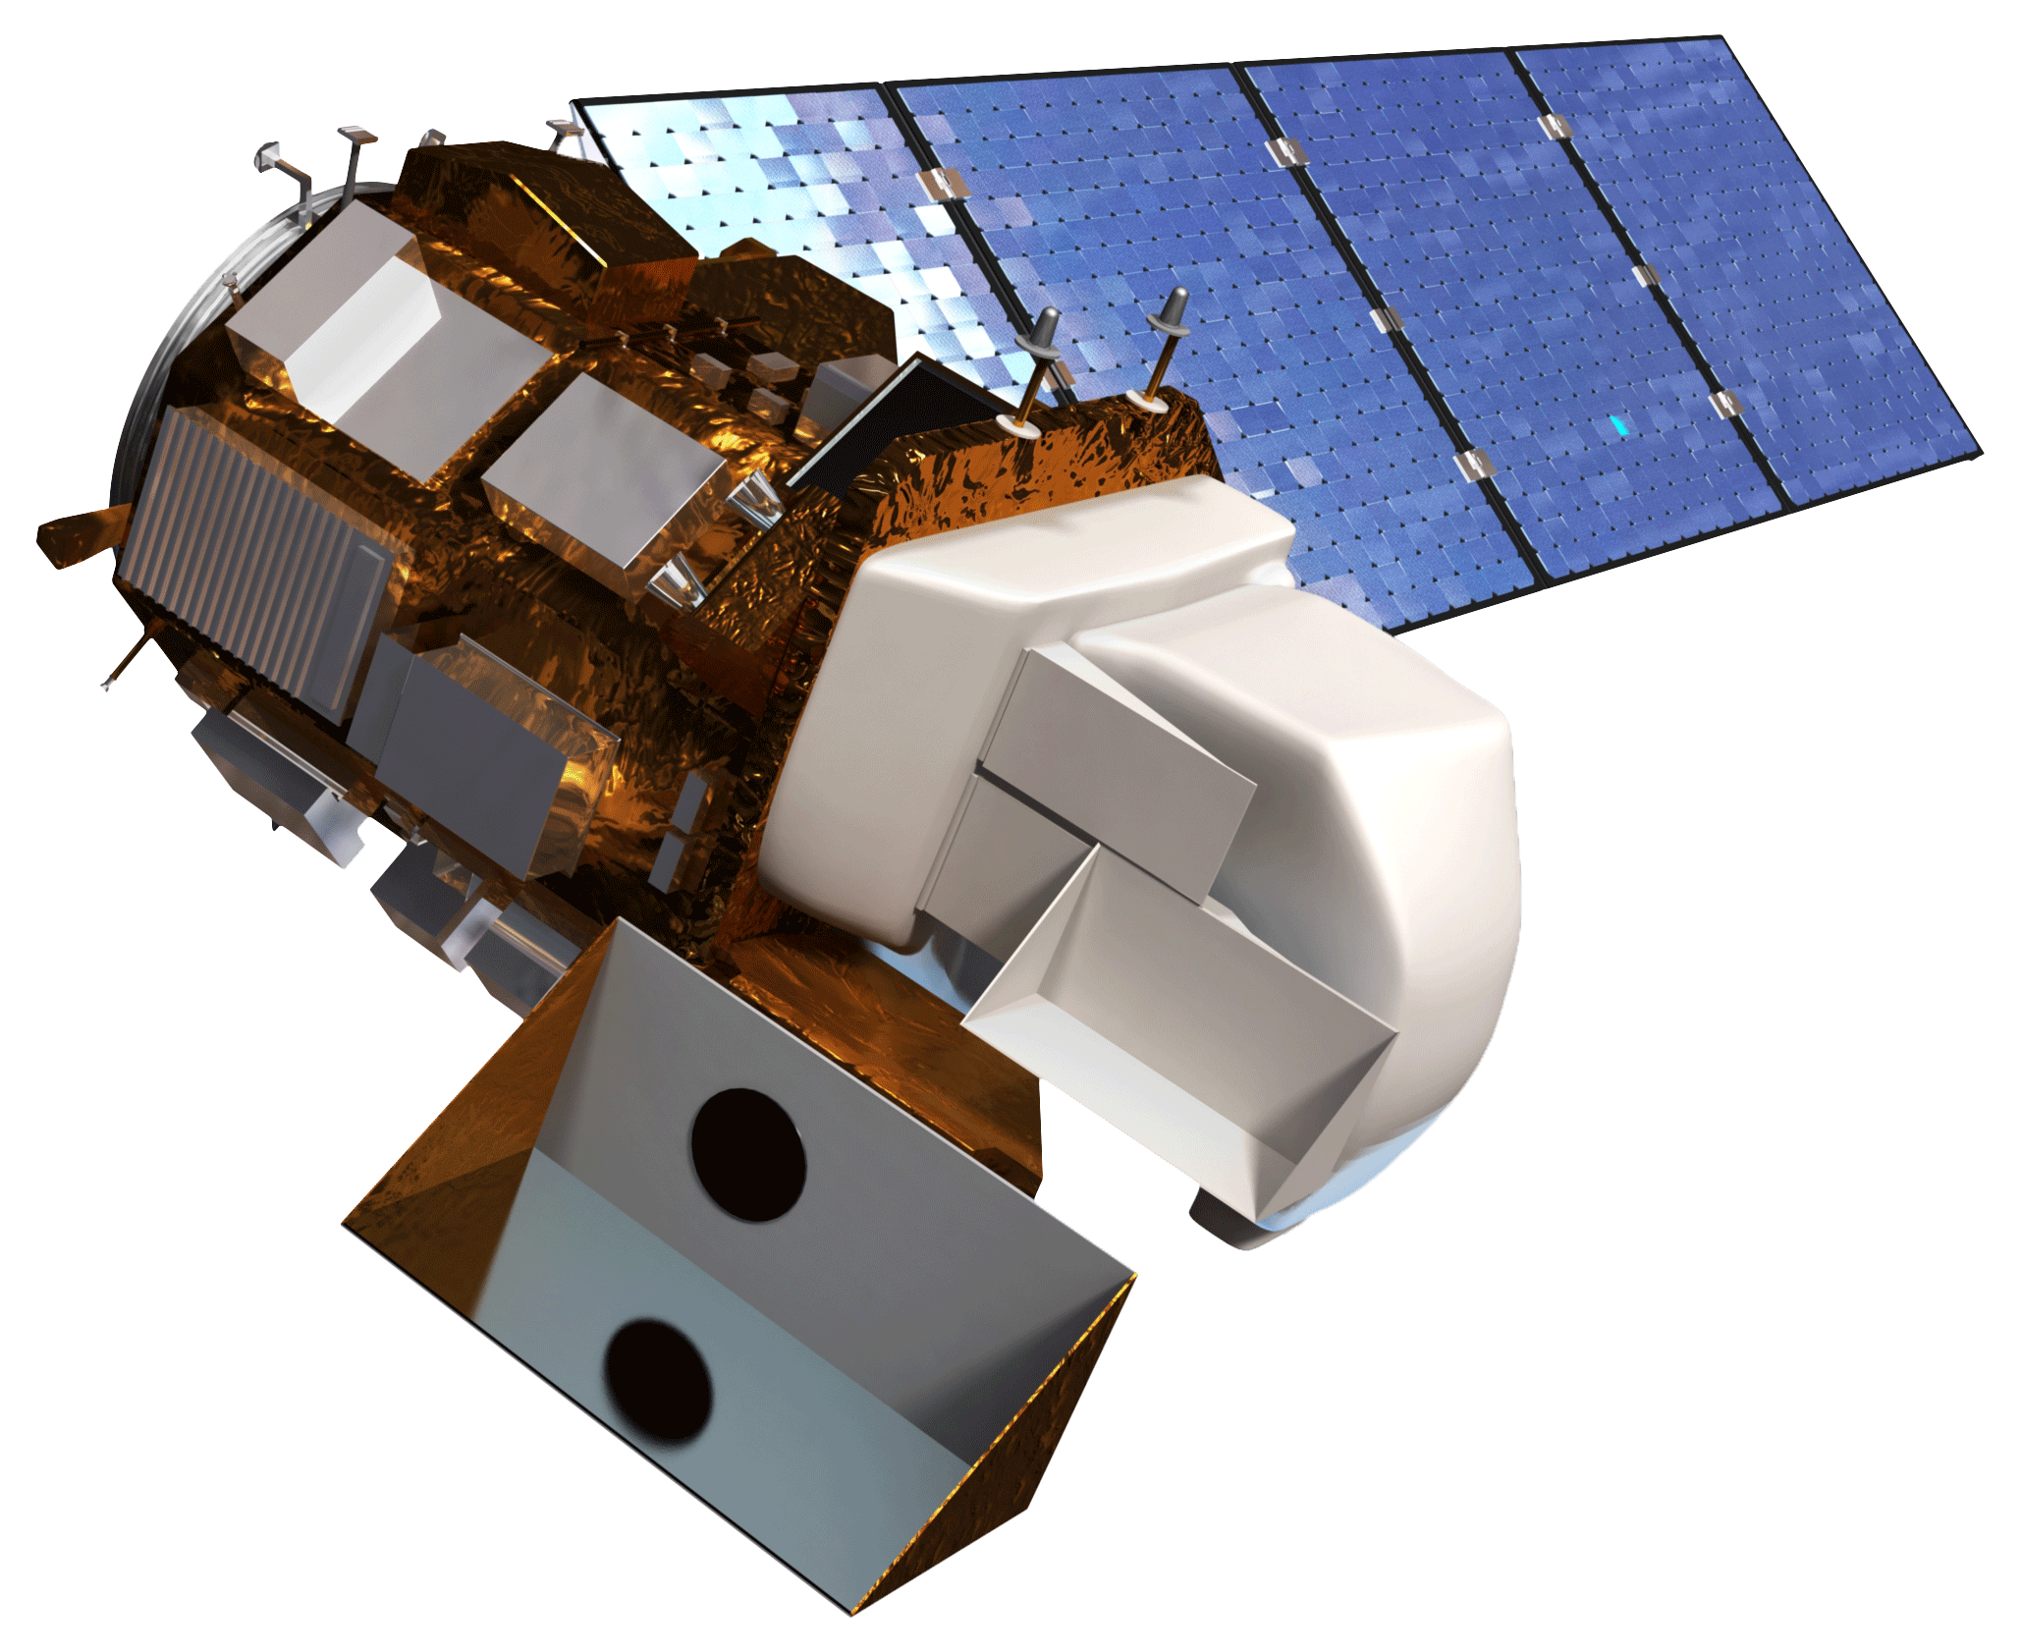
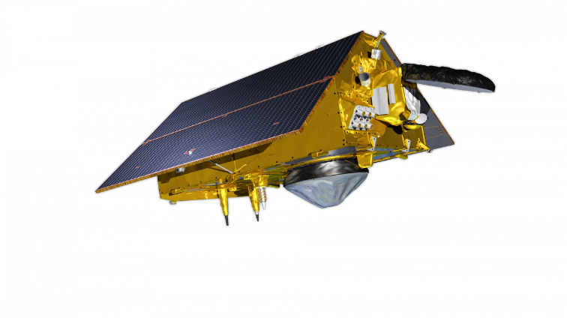
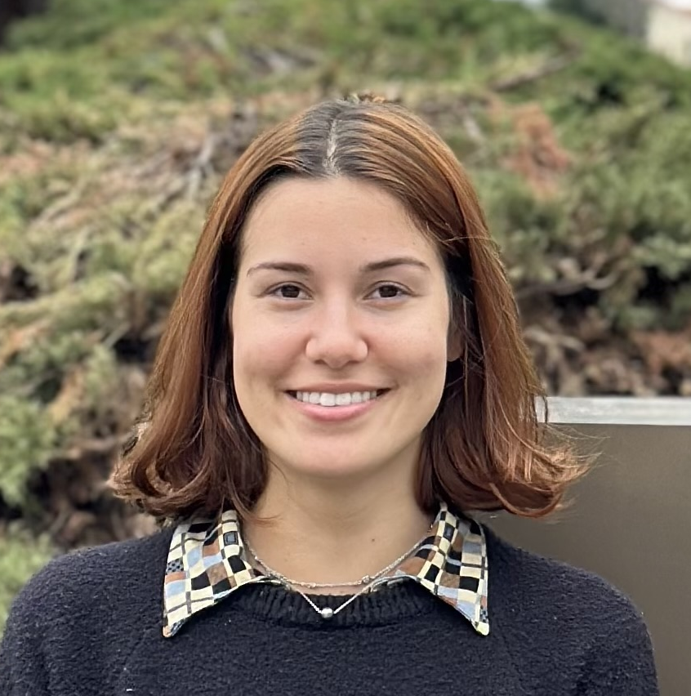
San Joaquin Valley Health & Air Quality II
Assessing Urban Heat Island Distribution and its Intersections with Air Quality to Understand Converging Vulnerabilities
Project Synopsis
Study Area
Lying within the San Joaquin Valley of California, the city of Stockton experiences Environmental Justice issues that stem from historic disenfranchisement. To address these issues, a local non-profit organization, Little Manila Rising (LMR), partnered with DEVELOP to investigate urban heat and air quality. Our team further expanded LMR’s capabilities of integrating Earth observations in their mission to achieve multi-faceted equity in Stockton by providing a detailed understanding of urban heat and its convergences with air quality.
N
N
OR
Stockton City Limits
Pacific
Ocean
NV
San Joaquin County Border
Methodology
0
305
CA
AZ
0
20
40
Kilometers
610
Kilometers
Objectives
Social Vulnerability Map
Produce a social vulnerability index (SVI) based on sociodemographic variables
Land Surface Temperature Map
Identify areas of extreme heat within San Joaquin Valley and map them against the socially vulnerable regions
Air Quality Map
Locate neighborhoods experiencing increased concentrations of NO₂, taking note of overlap with our SVI
Heat and
Air Quality
Vulnerability Map
Create a brochure with visualizations and descriptions to help inform the impacted community
Results
N
LMR
N
Land Surface Temperature (LST) Map
Trees Planted
Heat and air quality vulnerability map that details census tracts that are uniquely susceptible to high heat and poor air quality.
High
Low
= Stockton
N
60 °C
High
SVI
LMR has planted trees in areas that contain very low tree canopy cover.
23 °C
Low
LST/NO₂
High
0
7.5
15 km
0
20
40 km
0
20
40 km
Conclusions
Project Partners
Earth Observations
We found that areas with excessive urban development and high social vulnerability experience hotter land surface temperatures.
NO₂ concentrations are typically higher along major roadways and urban areas, coinciding with the elevated land surface temperatures.
Residents of Stockton experience converging heat and air quality disparities more than other areas in San Joaquin County.
Little Manila Rising
Landsat 8 TIRS
Sentinel-5 Tropomi
Team Members
Acknowledgements
Our sincerest gratitude to Dr. Morgan Gilmour, Dr. Joshua Dimon, Dr. Xia Cai, Dr. Kenton Ross, Dr. Juan Torres Perez, Lisa Tanh, Gloria Alonso, Maya Hall, and Lauren Webster. Their advice, constructive feedback, time, and excitement for this project along the way has been very much appreciated.
Thank you to Jonathan Szeto, Jasper Beardslee, Piper Christian, Bethany MacCarter, and Alma Quintero for all their hard work in the first term of this project.
Shea Rousseau
Project Lead
Tyler Padua
Carlo Gomez
Gabriela Colombo
California – Ames | Spring 2024

