Slide 1
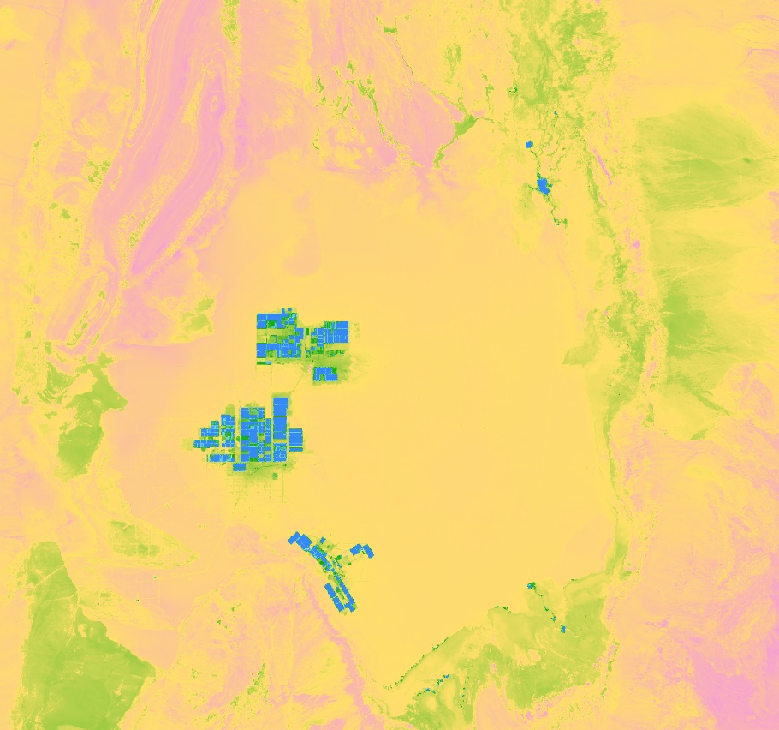
CHILE WATER RESOURCES
Monitoring the Extent and Distribution of Saline Systems in Chile’s Atacama Desert Utilizing NASA Earth Observations
Catherine Breen
Genevieve Clow
Gina Cova
Monica Zhang
California – Ames | Spring 2019
Notes:
We are the Chile Water Resources team, and we studied the extent and distribution of Saline Systems in Chile’s Atacama Desert utilizing NASA Earth Observations.
Map Source: NASA DEVELOP ARC Chile Water Resources
Base Layer Source: Google Earth Engine

Slide 2
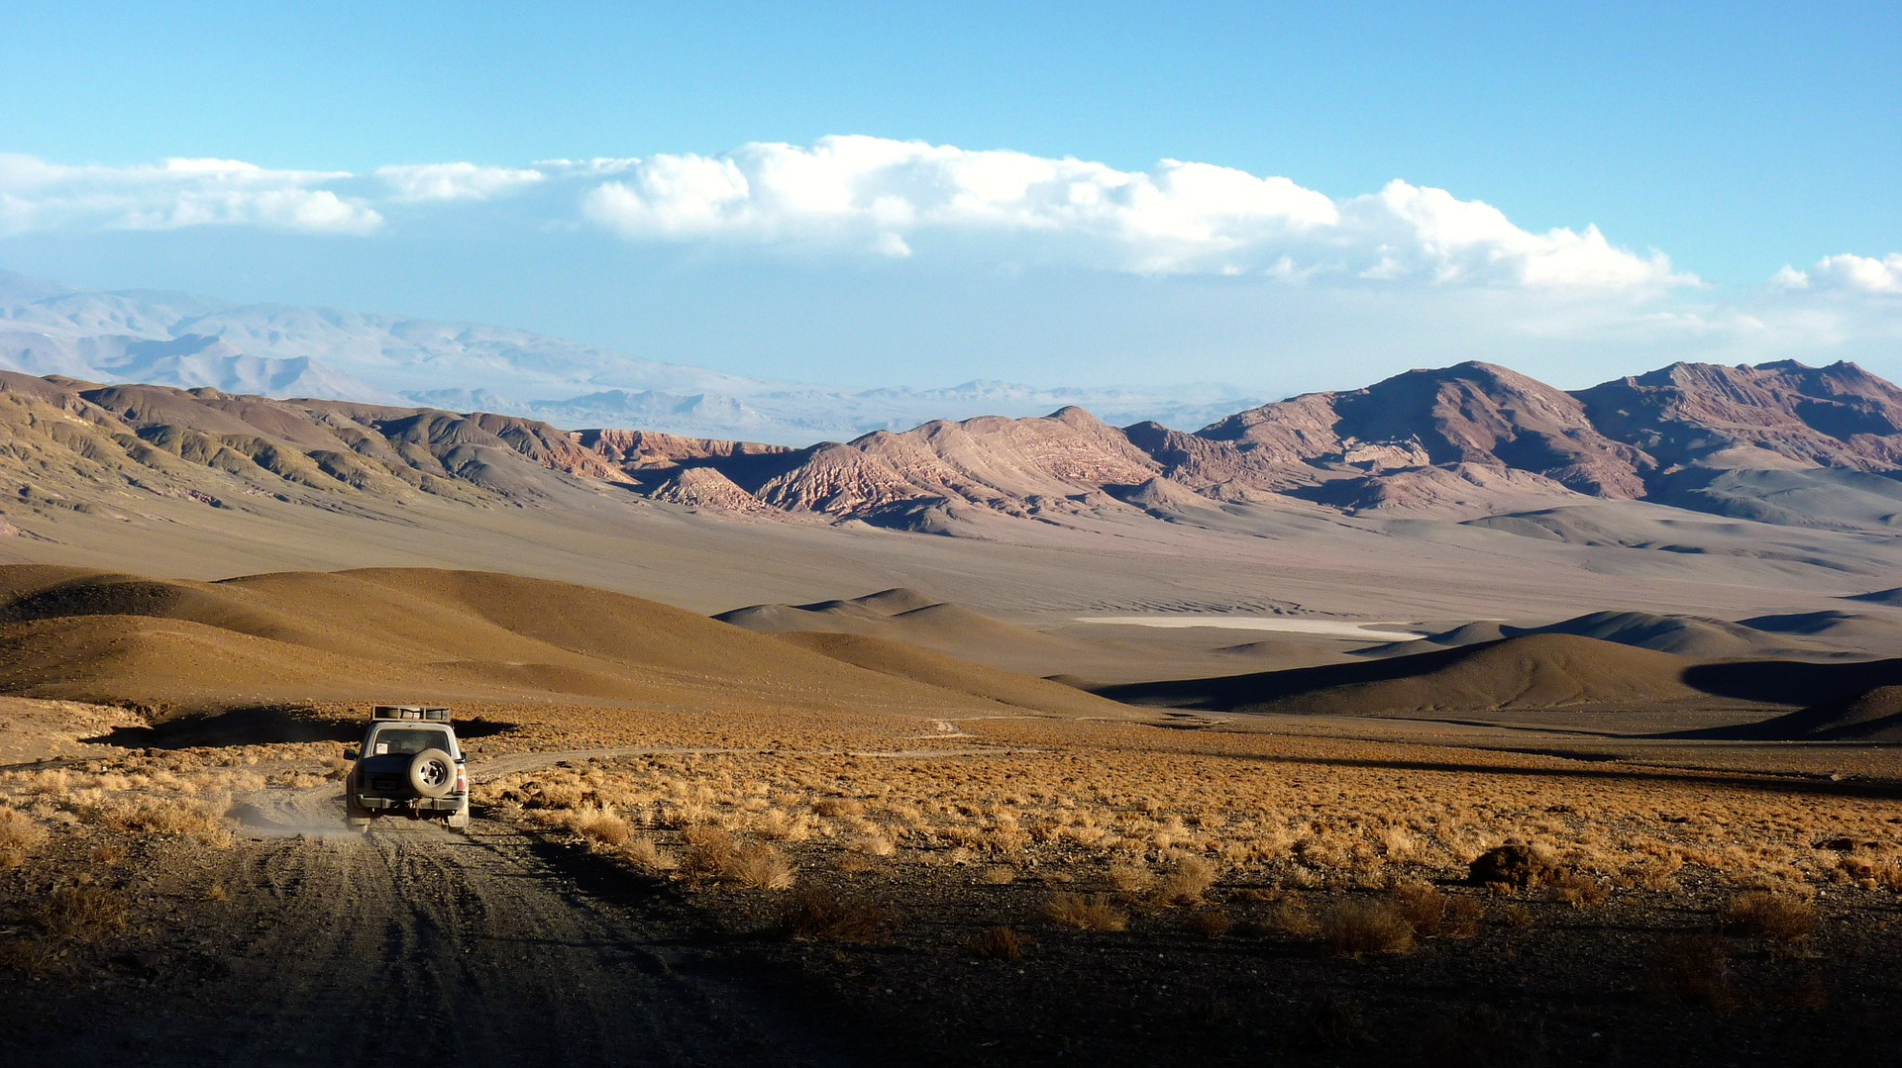
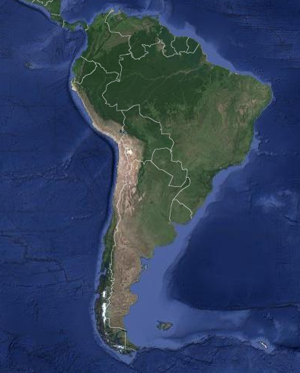
Introduction to the Atacama
Driest non-polar region on Earth
Precipitation ranges from 0.15 to 155 mm (0.006 to 6 inches) per year (Houston, 2006)
Home to indigenous communities and unique ecosystems
Atacama Desert
Image credits: Google Earth Engine; Sebadeval (Pixabay)
Notes:
Speaker: Monica
The Atacama Desert in Northeastern Chile is the driest non-polar region on Earth. A variety of conditions, including atmospheric air currents, ocean currents, and its location between two mountain ranges, results in little rainfall for the area, with precipitation amounts ranging from 0.15 to 155 mm per year, or .006 inches to 6 inches. Despite the dry conditions, it is home to indigenous communities, such as the Atacameños and Aymara, as well as unique ecosystems.
Houston, J. (2006). Variability of precipitation in the Atacama Desert: its causes and hydrological impact. International Journal of Climatology, 26, 2181-2198. https://doi.org/10.1002/joc.1359
Map: Chile Water Resources Team (Google Earth Engine)
Background: Sebadeval (Pixabay License), https://pixabay.com/photos/landscape-truck-andes-dessert-74572/

Slide 3
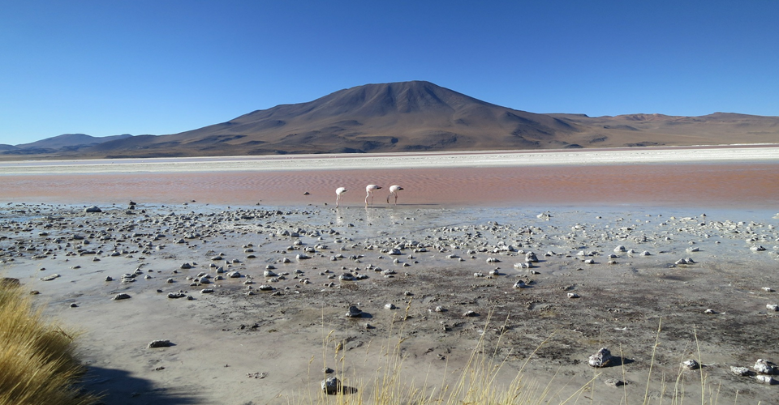
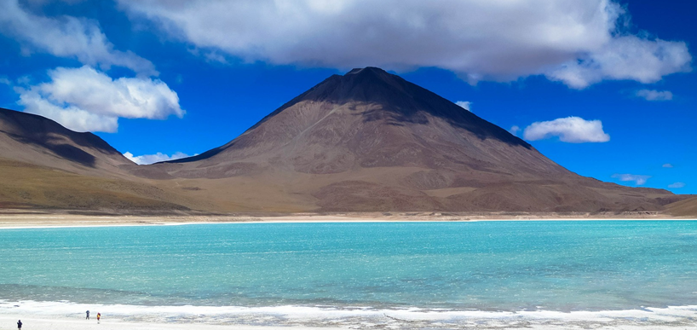
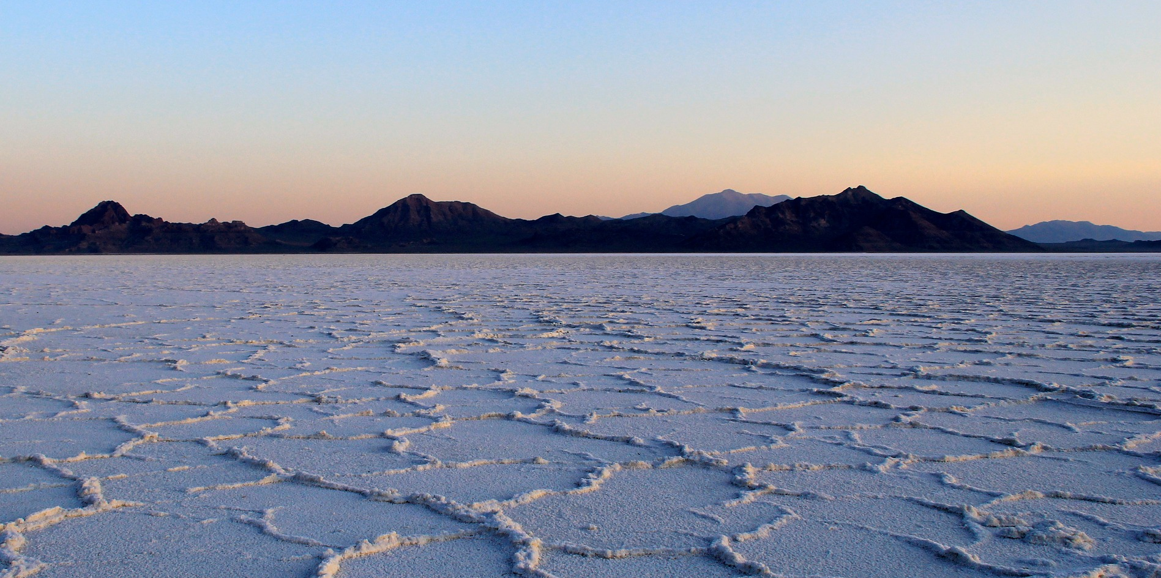
Saline Systems (Salares)
Marshes
Saline Lakes
Salt Flats
Ephemeral Pools
Image credits: TravelCoffeeBook, Whitfieldlink, & IPFOTOYGRAFIA (Pixabay)
Notes:
Speaker: Monica
The topography, low precipitation, and high rates of evaporation contribute to formation of saline systems, also known as salares in Spanish, which include salt marshes, salt flats, permanent saline lakes, and ephemeral pools. Lakes are permanent, while ephemeral pools are temporary. Marshes are characterized by vegetation and surface water, while salt flats are covered with a thick, dry crust that may have highly saline water underneath. How these systems form is whenever there is rain, water runs down from the slopes and tends to collect in pools because of how the landscape is shaped. But because it’s typically so dry, the water evaporates quickly, leaving highly concentrated pockets of salt and minerals.
Image sources:
Marshes: Pixabay, Pixabay License, TravelCoffeeBook; https://pixabay.com/photos/atacama-desert-chile-flamingos-594605/
Saline Lakes: Pixabay, Pixabay License, TravelCoffeeBook; https://pixabay.com/photos/volcano-salt-lake-atacama-desert-594603/
Salt Flats: Pixabay, Pixabay License, whitfieldink; https://pixabay.com/photos/sunrise-salt-flats-landscape-flat-2379007/
Ephemeral Pools: Pixabay, Pixabay License, IPFOTOYGRAFIA; https://pixabay.com/photos/nature-desert-atacama-chile-salar-3942295/

Slide 4
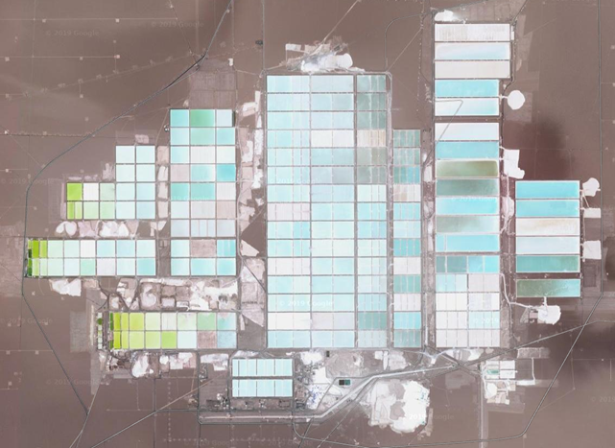
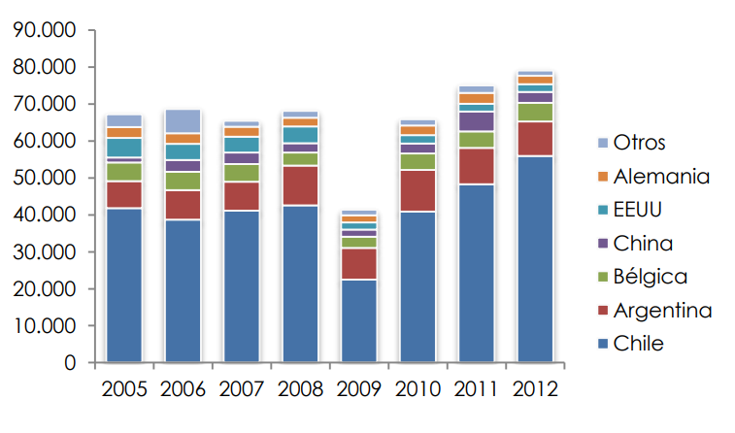
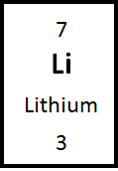
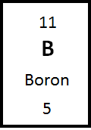
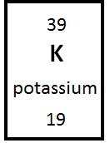
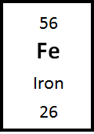
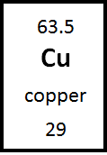
Mining in the Atacama
Minerals of mining interest: lithium, boron, potassium, copper
30% of the world’s lithium reserves
Largest exporter of lithium carbonate
Source: GTIS citado en Roskill (2013)
Image credits: Google Earth Engine; Chile Water Resources Team
Notes:
Speaker: Monica
Minerals found in saline systems include lithium, boron, and potassium, all of which are valuable commodities. There are also precious minerals in the surrounding desert soil, such as copper, making the Atacama Desert a mining hotspot. Lithium is especially important to Chile, because the country holds 30% of the world’s lithium reserves and is the world’s largest exporter of lithium carbonate which you can see on the graph: Chile is the large blue section of each bar 71% in 2012 and exports more each year than all other countries combined. Demand for lithium is predicted to grow due to increased demand for lithium ion batteries that power electric cars and many electronics, so mining in the Atacama will likely continue to be a key part of Chile’s economy in the years to come .
Image: Chile Water Resources Team, Google Earth
Source for bar graph: http://www.sernageomin.cl/wp-content/uploads/2017/09/Mercado-Internacional_Potencial-del-Litio-en-salares-del-norte-de-chile.pdf
Elements: Chile Water Resources Team, Powerpoint

Slide 5
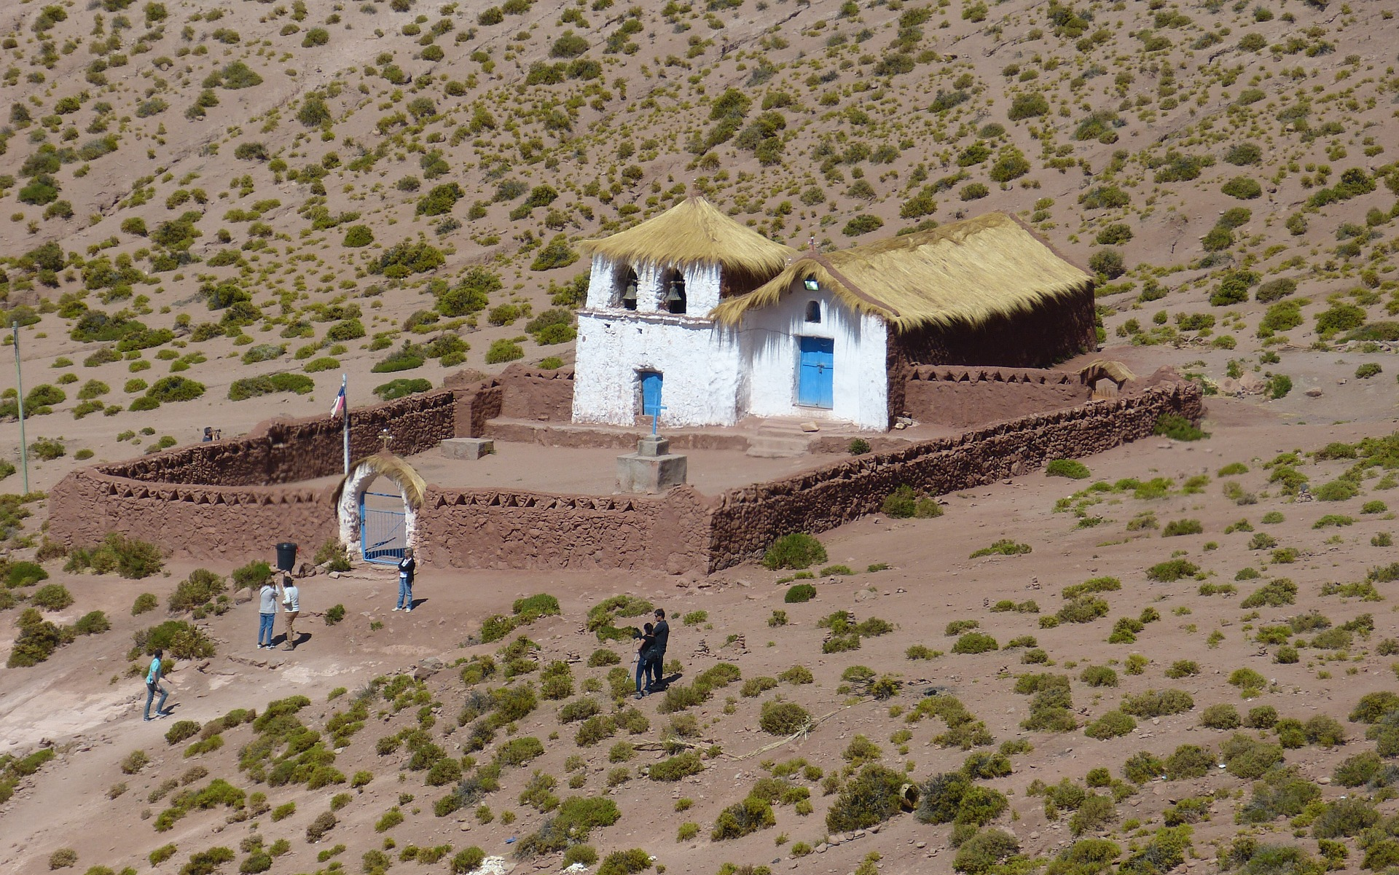
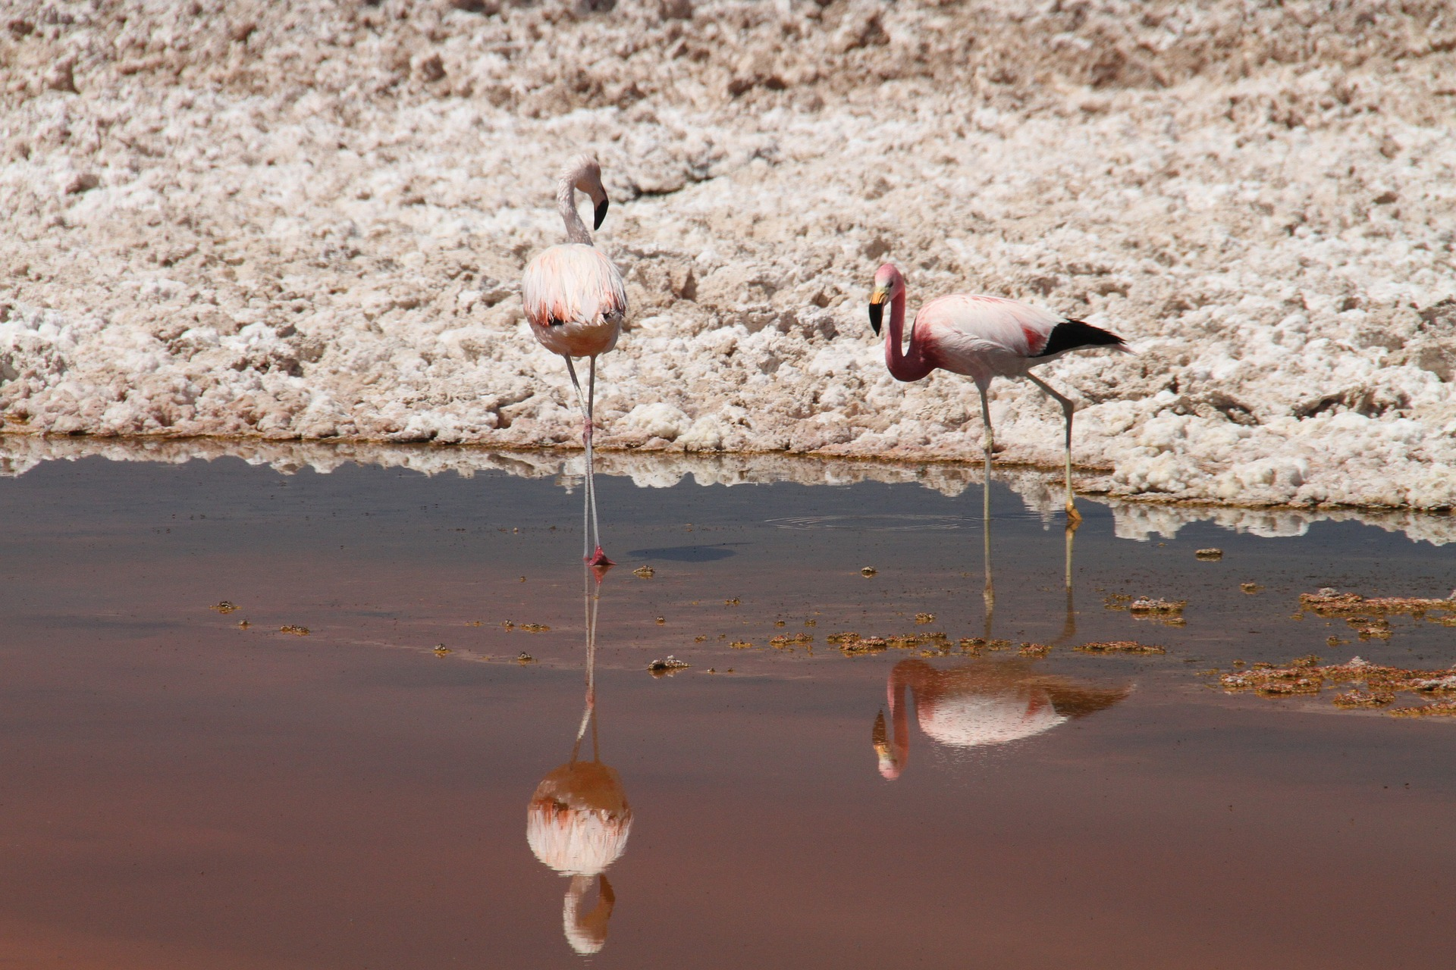
Community Concerns
Water availability is threatened by mining and changing climate
Remote location makes monitoring difficult
Changes in saline systems are poorly understood
Prudent water management is of critical concern
Image credits: Palco & Monica Volpin (Pixabay)
Notes:
Speaker: Monica
However, mining requires large amounts of water, which is clearly a precious resource in the desert. It’s estimated that 500,000 gallons of water from saline systems is extracted to make one ton of lithium. Water availability is also threatened by climate change, which imperils these ecosystems, and consequently the indigenous communities, rural communities, and wildlife, such as the rare Andean flamingo, that depend on them. Given the high demand for water and threats to its availability, prudent water management of the region is critical, but how and if saline systems have changed over time is poorly understood because these areas are remote/difficult to reach . This is where remote sensing comes in: the ability to examine satellite imagery makes long-term monitoring much more feasible.
Images:
House: Pixabay, Pixabay License, Palco: https://pixabay.com/photos/chile-south-america-nature-1038359/
Flamingoes: Pixabay, Pixabay License, Monica Volpin: https://pixabay.com/photos/flamingos-pink-atacama-desert-chile-1024547/

Slide 6
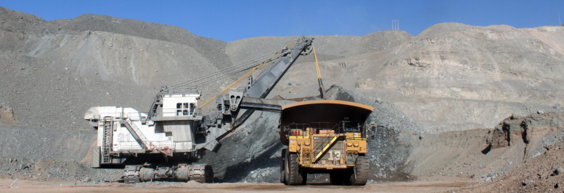
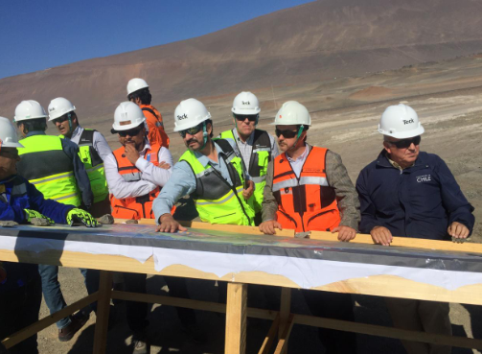
Project Partners
Servicio Nacional de Geologia y Mineria (SERNAGEOMIN)
La Universidad de la Serena, Chile
Remote sensing expertise and data contribution
Conduct and disseminate geological research
Supervise mining activities
Motivation for project:
Gain understanding of saline systems
Inform future policy decisions related to mining and water use
Image credits: SERNAGEOMIN
Notes:
Speaker: Gina
We partnered with both the Chilean Servicio Nacional de Geología y Minería, which conducts geologic research and supervises mining activities for the country, and a professor and remote sensing expert at la Universidad de la Serena. Both provided datasets to guide the project design. This project allows both SERNAGEOMIN and la Universidad to gain a better understanding of how saline systems in the Atacama Desert are changing, so that they can provide information to other government agencies and mining companies on the effects of mining in the region.
Image Credit (written permission given by partners):
Mining equipment: SERNAGEOMIN; http://www.sernageomin.cl/mineria/
Group of miners: SERNAGEOMIN; http://www.sernageomin.cl/mineria/

Slide 7
Project Objectives
Classify land types throughout the Atacama using multiple spectral indices
Analyze how extent and distribution of Atacama Desert saline systems have changed over time
Provide decision-making support to project partners by creating a Saline Analysis Tool (SalT) in Google Earth Engine (GEE) that can be used in future years to monitor the extent and health of saline systems
Notes:
Speaker: Gina
Our project objectives were to classify land types throughout the Atacama using multiple spectral indices, analyze how extent and distribution of Atacama Desert saline systems have changed over time, and create a Saline Analysis Tool in Google Earth Engine that can be used in future years to monitor the extent and health of saline systems, providing decision making support to the project partners.

Slide 8
Methodology

Slide 9
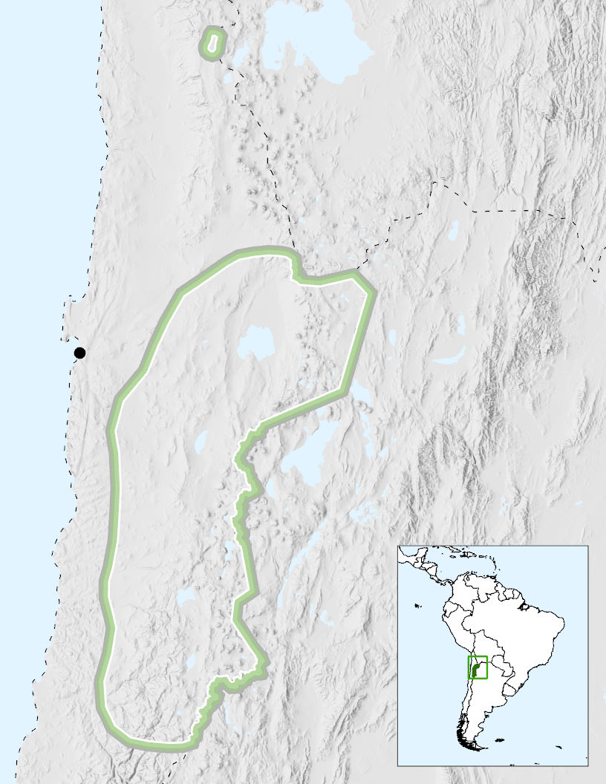
Study Design
N
Study Area
Study area: Northeastern Chile
Years: 1986 to 2018
Months: September to November (greenest season in the Atacama)
Antofagasta
0
140 km
Image credit: Chile Water Resources Team
Notes:
Speaker: Gina
Our study area in northern Chile was identified by the partners as containing the saline systems of interest. We used imagery from 1986 to 2018 to see how the desert landscape and saline systems have changed over time. We created cloud-free composites for our tool and resulting analysis using imagery from September to November -- we chose the greenest season in this region so that the land classes would be more distinguishable.
Map Source: NASA DEVELOP ARC Chile Water Resources, ArcGIS (Esri)

Slide 10
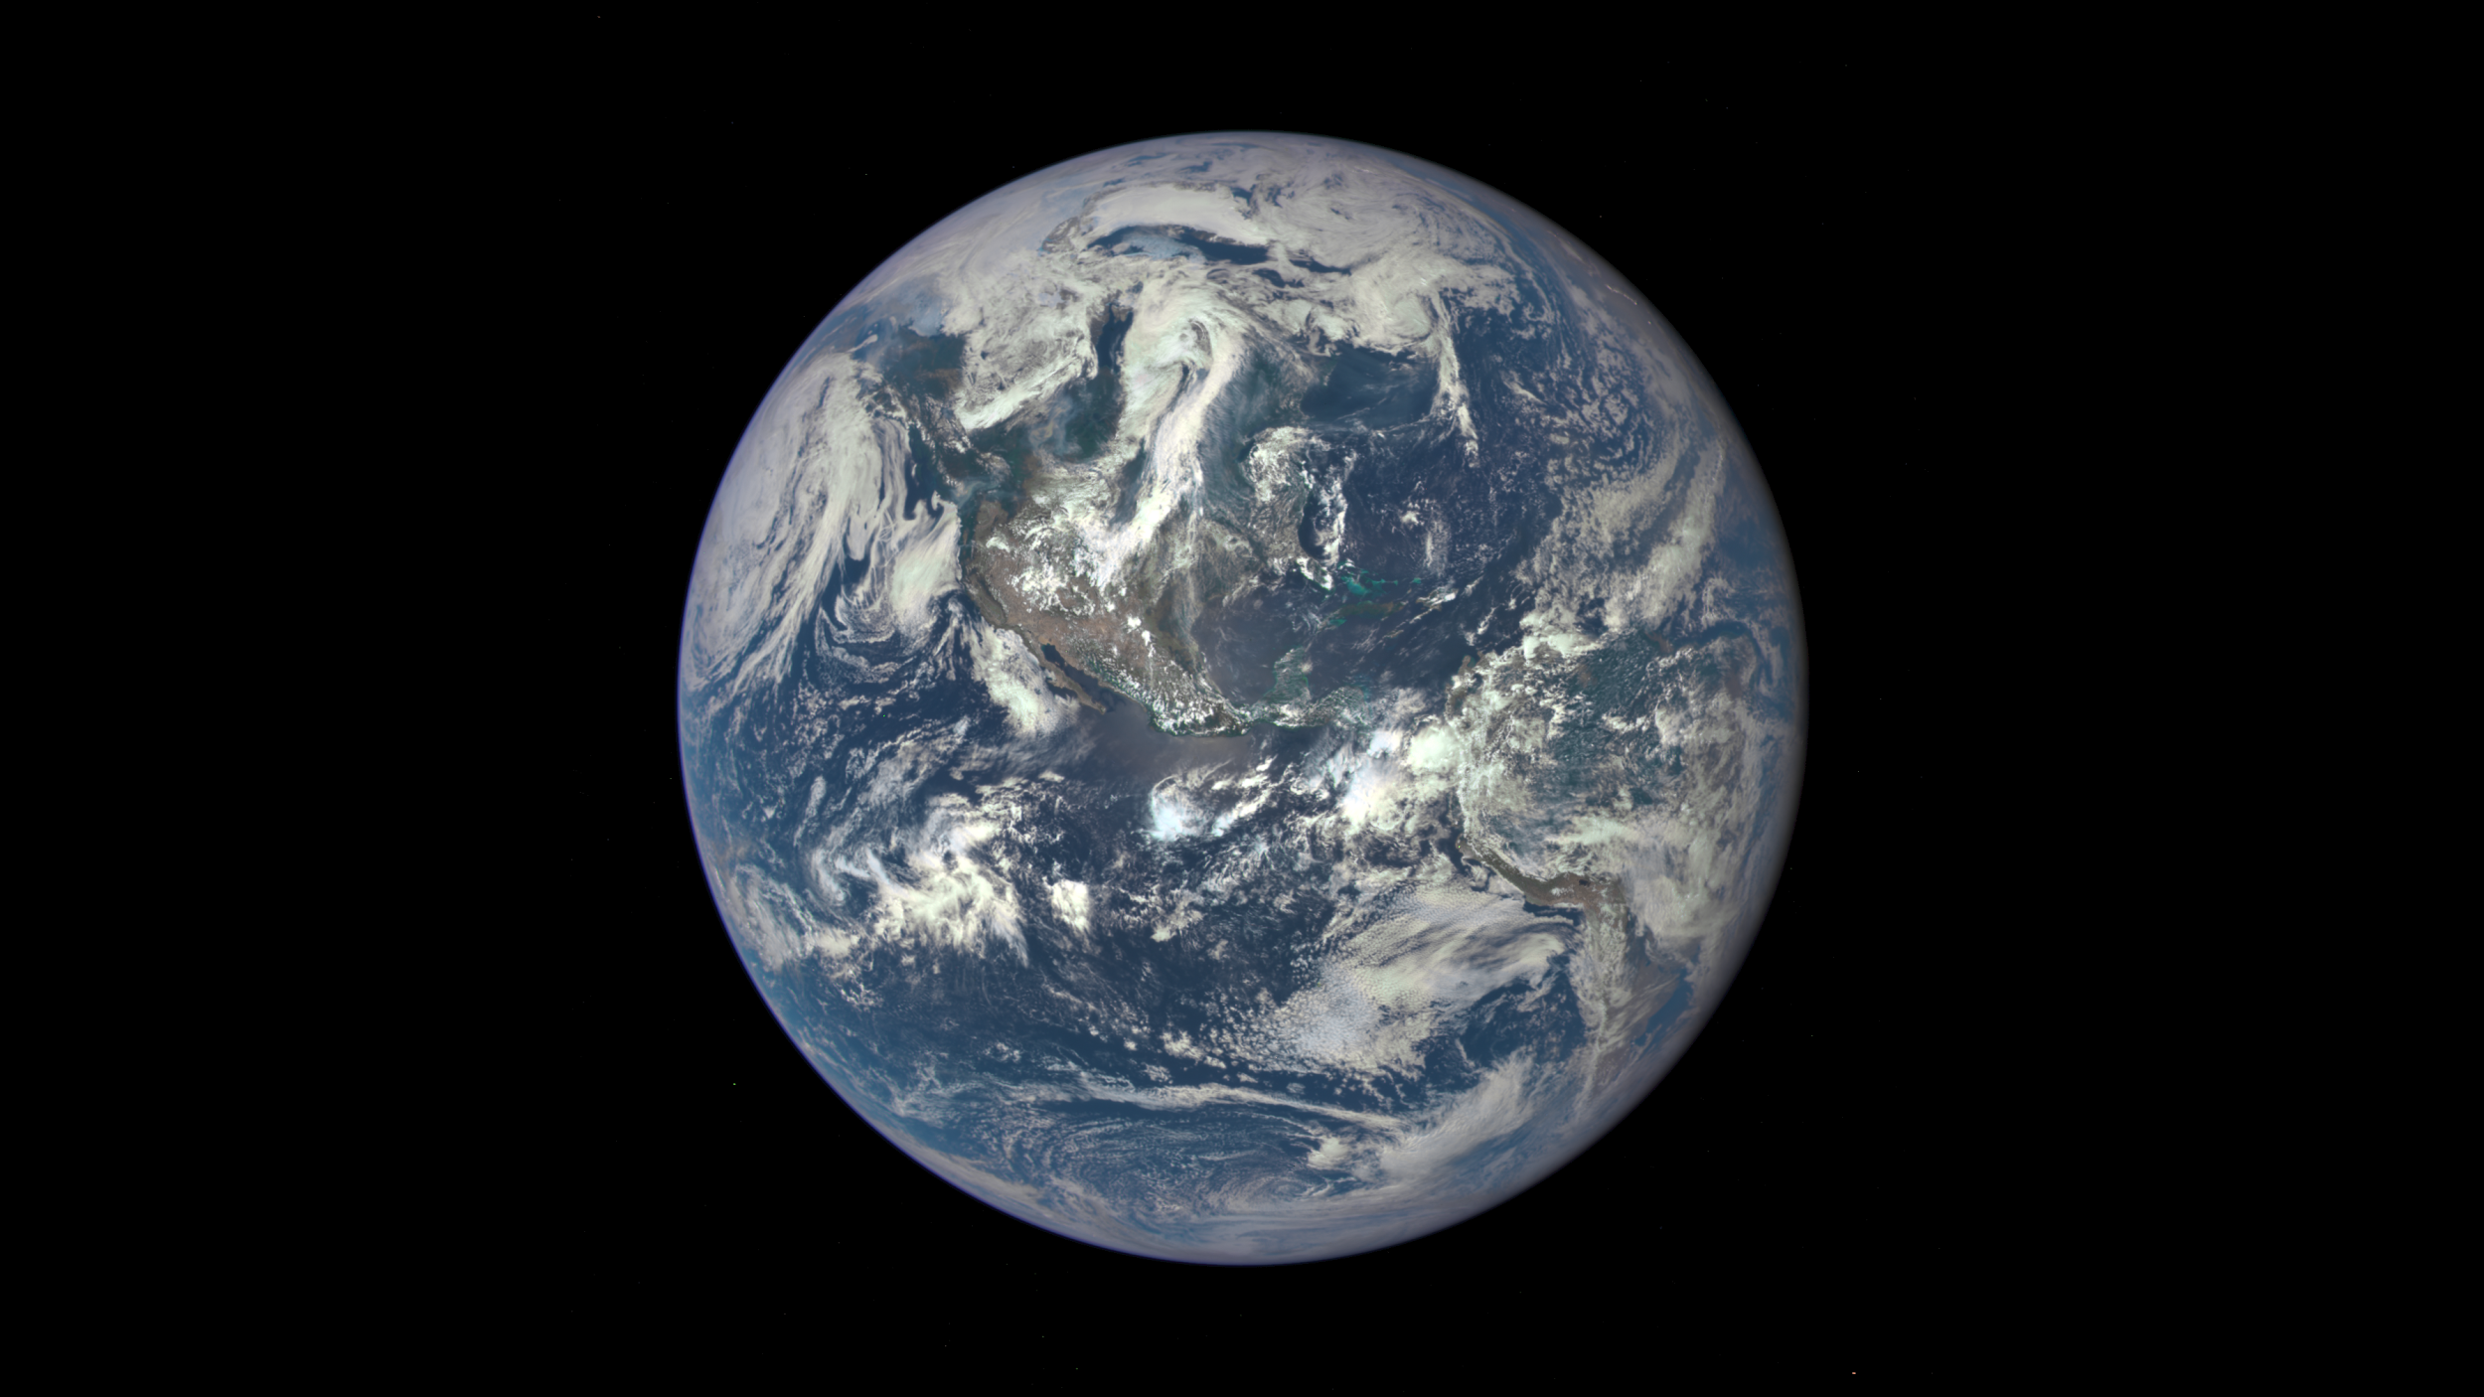
NASA Earth Observations
Landsat 8 OLI and TIRS
SRTM
Satellite/Sensor | Dates
Landsat 5 Thematic Mapper (TM) | 1986 to 2012
Landsat 8 Operational Land Imager (OLI), Thermal Infrared Sensor (TIRS) | 2013 to 2018
Shuttle Radar Topography Mission (SRTM) | 2000
Landsat 5 TM
Image credits: Earth, Landsat 5, Landsat 8, & SRTM (NASA)
Notes:
Speaker: Genevieve
We used Landsat 5 and Landsat 8 for our 30 year time series analysis. For years prior to 2013, we used Landsat 5 Thematic Mapper imagery. After 2013, we used Landsat 8 Thermal Infrared Sensor and Operational Land Imager. There was no Landstat 5 data for 2002 or 2012 in our study region, so these two years were removed from our analysis. Tier 1 surface reflectance data was used. A cloud score was applied, based on brightness and temperature, and then the images were mosaicked together based on which pixels were least cloudy.
We also used data from the Shuttle Radar Topography Mission for our digital elevation model, which was used in our land classification to differentiate between snow and salt flats
Earth image: https://landsat.gsfc.nasa.gov/sentinel-2a-launches-our-compliments-our-complements/
Landsat 5: DEVELOPedia, http://www.devpedia.developexchange.com/dp/images/6/69/01_Landsat5.png
Landsat 8: DEVELOPedia, http://www.devpedia.developexchange.com/dp/images/c/c2/03_Landsat8.png
SRTM: DEVELOPedia, http://www.devpedia.developexchange.com/dp/images/a/ab/12_SRTM.png

Slide 11
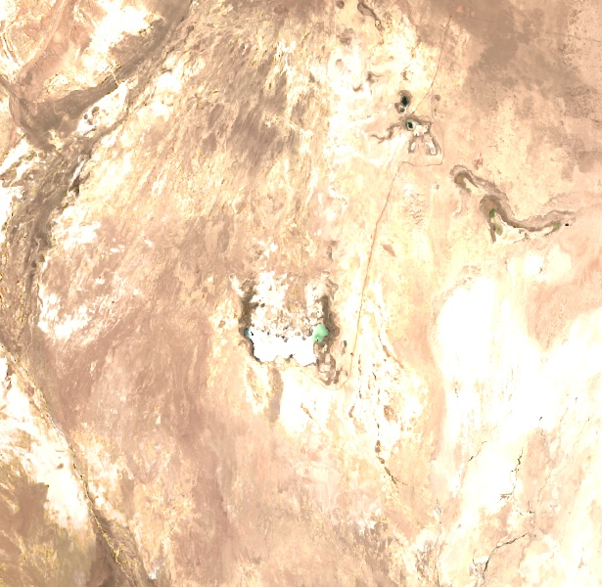
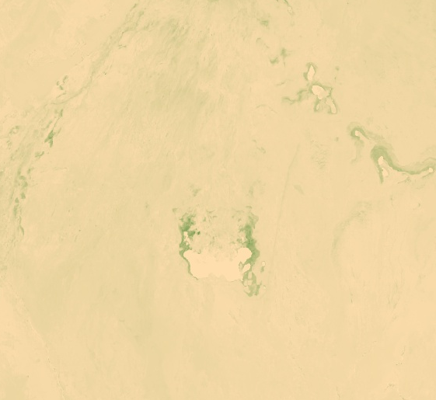
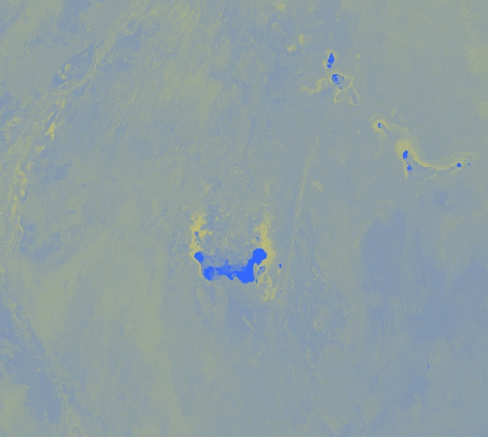
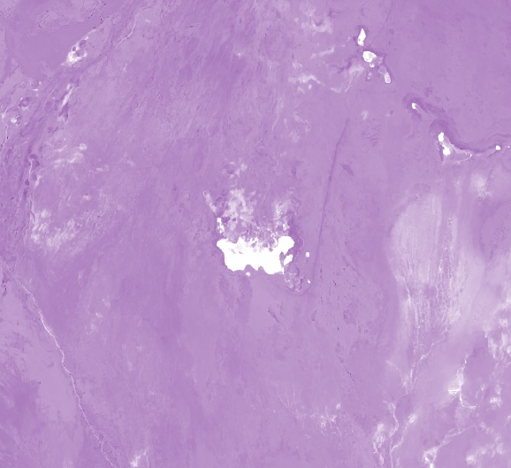
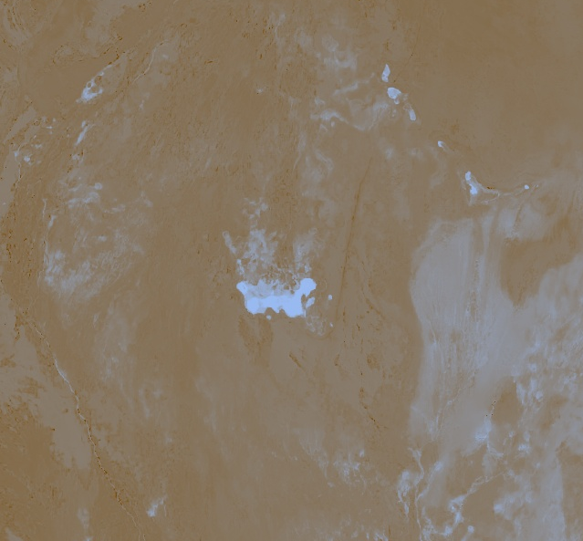
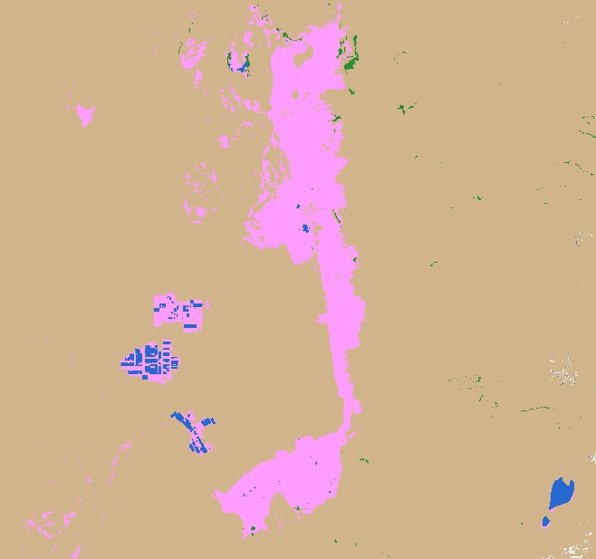
Land Classification
Landsat 8 and Landsat 5 Imagery
NDVI
NDWI
NDSI
(snow)
NDSI
(soil)
NDSI
(salinity)
Land Classification
Classes: vegetation, water, salt flats, barren, snow
Image credits: Chile Water Resources Team (Google Earth Engine)
Notes:
Genevieve
To study how the saline systems have changed over time, we performed a land classification through Google Earth Engine. The land classes we used were vegetation, water, salt flats, barren, and snow. Because our goal is to create a monitoring tool that is easy to use, we used spectral index thresholds to classify our imagery.
Images: Chile Water Resources Team, Google Earth Engine

Slide 12
Spectral Indices
Normalized Difference Vegetation Index (NDVI)
NDVI = (Near Infrared - Red) / (Near Infrared + Red)
Normalized Difference Water Index (NDWI)
NDWI = (Green - Near Infrared) / (Green + Near Infrared)
Normalized Difference Snow Index (NDSI – snow)
NDSI = (Green - Shortwave Infrared 1) / (Green + Shortwave Infrared 1)
Normalized Difference Soil Index (NDSI – soil)
NDSI = (Shortwave Infrared 2 - Green) / (Shortwave Infrared 2 + Green)
Normalized Difference Salinity Index (NDSI – salinity)
NDSI = (Red - Near Infrared) / (Red + Near Infrared)
Image credits: Chile Water Resources Team (Google Earth Engine)
Notes:
Genevieve
Here are the equations for the 5 spectral indices that were used to differentiate between the land classes. NDVI shows areas with high vegetation. NDWI shows areas with bodies of water. NDSnI picks up snow. NDSoI picks up barren land. NDSaI is used to show salinity.
We found that not all of them were useful for distinguishing the classes.
NDVI: Rouse et al. 1974
NDWI: Goa 1996
NDSnI: Valovcin, F. R., 1978
NDSoI: Deng et al. 2015
NDSaI: Azabdaftari and Sunar 2016
Images: Chile Water Resources Team, Google Earth Engine

Slide 13
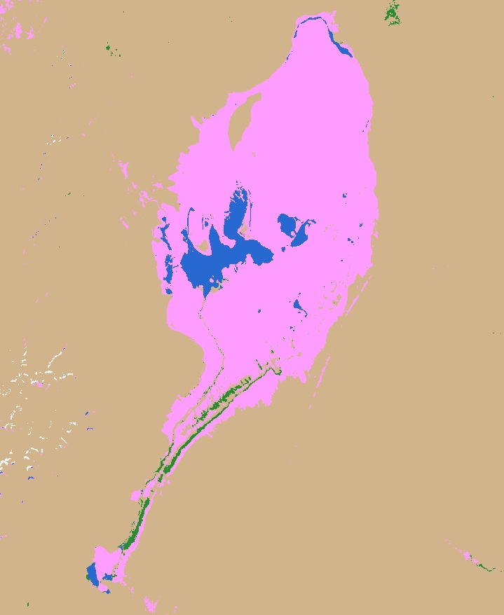
Spectral Indices Thresholds
Thresholds were calculated for 1986, 1999, and 2017
Advantages of thresholds over supervised classification:
No need for partner to enter training points each year
More convenient for future analysis
2017
N
Land Class | Threshold
Vegetation | NDVI > 0.2
Water | NDWI > 0
Barren | NDVI < 0.2
Snow | DEM > 4550 m, NDWI > 0, NDWI < 0.4, BLUE > 1,500
Salt Flats | DEM < 4550 m, NDWI < 0.1, NDSI (soil) < 0.1, BLUE > 2000
4 km
Land Classification
Barren/Other
Vegetation
Water
Salt
Snow
Image credit: Chile Water Resources Team (Google Earth Engine)
Notes:
Genevieve
We ended up using NDVI, NDWI, and NDSI (soil), in addition to reflectance in the blue band and a DEM to differentiate between snow and salt.
After testing out the 5 spectral indices, we determined which ones would be able to successfully differentiate between land classes by creating training data points. For each index, we created histograms for each land class to see if the index could distinguish between them. The histograms were created for three years, at the beginning, middle, and end of our study period, to ensure that they were consistent over time.
The benefits of this methods are that there is no need for the partner to enter training points for each year that they want to study, which will make our tool convenient to use. Additionally, there is a lack on in situ data for the Atacama, so it is difficult to accurately collect training points.
Image Credits: Chile Water Resources Team (Google Earth Engine)

Slide 14
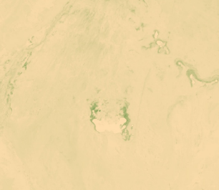
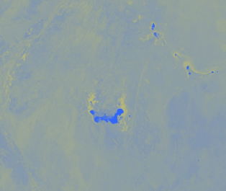
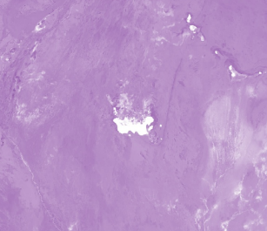
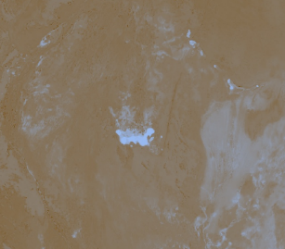
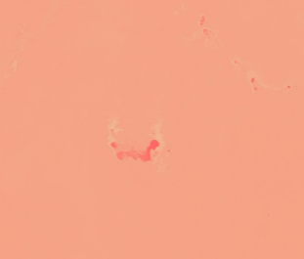
Methods Summary
Google Earth Engine - Saline Analysis Tool (SalT)
Spectral Indices
Outputs
Charts of NDVI and NDWI over time
NDVI
NDWI
Land Classification
Landsat 5 and Landsat 8 imagery
NDSI
(snow)
Time Series Maps
NDSI
(soil)
Calculate thresholds for land cover types
Barren/Other
NDSI
(salinity)
Vegetation
Water
Salt
Snow
Notes:
Speaker: Genevieve
This slide summarizes our methodology and shows how it fits into the Google Earth Engine Tool. The outputs of the tool include land classification for each year, which we have used to create time series maps. We also used the NDVI and NDWI outputs to calculate the average NDWI and NDVI for each study site, which will give us some indication of how vegetation and water have changed over time.
Images: Chile Water Resources Team, Google Earth Engine

Slide 15
Results

Slide 16
Changes in Water and Vegetation
Graph credits: Chile Water Resources Team
Notes:
Speaker: Gina
In order to gain understanding of the overall changes in water and vegetation over time, we calculated the average NDWI and NDVI, respectively. Each site was averaged individually to see if there is regional change, and the entire study site was also used to show overall trends. We noticed that the signals were not consistent across sensors, so to account for this difference we standardized the values by dividing them by a reference pixel. Total annual precipitation is plotted in grey so that we can see if any of the trends in NDVI and NDWI might be related to precipitation. We do not see a significant change in either NDVI or NDWI over time. However, this chart does show us how variable they can be depending on the year.
Graphs: Chile Water Resources Team (Excel)

Slide 17
Salar de Huasco
Graph credits: Chile Water Resources Team
Notes:
Speaker: Catherine
To take a closer look at the vegetation and the salt flat change over time, here is vegetation and water trend for the Salar de Atacama, one of the largest salts with the highest levels of mining. We measured vegetation and water using two methods: Percent vegetation and average NDVI, or percent water and average NDWI. Percent vegetation is the number of vegetation pixels divided by the total number of pixels in that region. The average NDVI value is the average NDVI (of those pixels or of the whole region). This is the same method for water. We used both approaches since there was no in situ data to verify our results. So, two approaches helps to approach any likely trends.
For the vegetation, there is high fluctuation, but this may be due to the weak signal. The desert is barren, and there is a very small amounts of vegetation. Both our precent vegetation and average NDVI are low values, so fluctuations may seem more dramatic.
The vegetation fluctuates at low values. Salar de Huasco is located farther north than the other study sites, and shows a slightly different trend. The water also shows fluctuations, with a gradual increase.
Graphs: Chile Water Resources Team (Excel)

Slide 18
Salar de Atacama
Graph credits: Chile Water Resources Team
Notes:
Speaker: Catherine
Here is vegetation and water trend for the Salar de Atacama, one of the largest salts with the highest levels of mining.
There is an upward trend in our water data. Our land classification grouped water in mining pools and water in natural pools in the same class, and this upward trend reflects the increase in mining during the 90s. It suggests that water was pulled from groundwater into mining pools.
Graphs: Chile Water Resources Team (Excel)

Slide 19
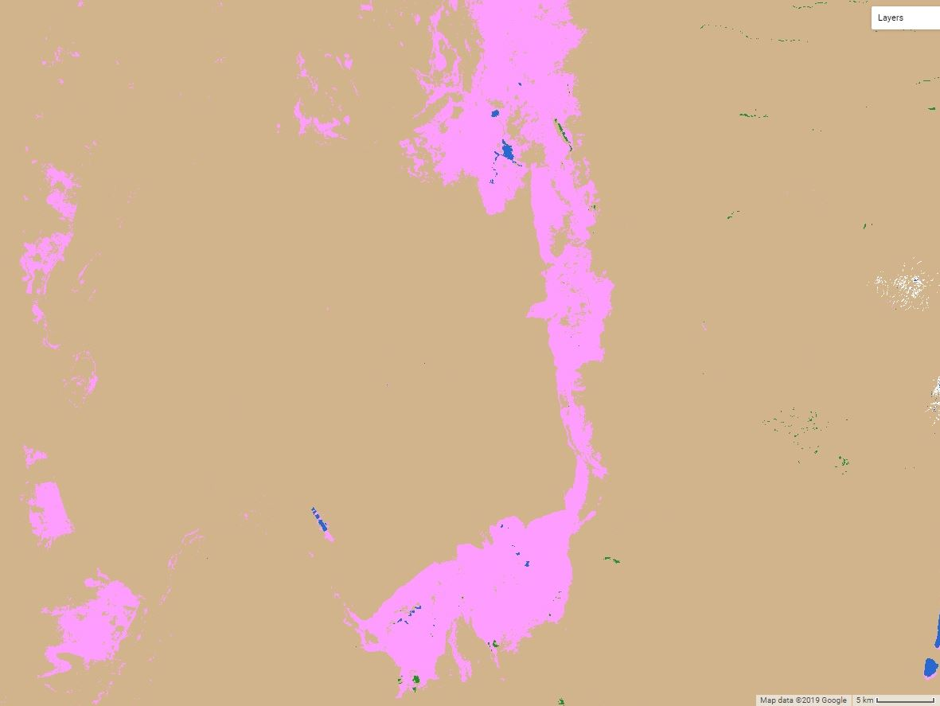
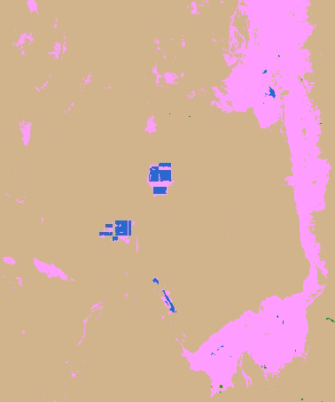
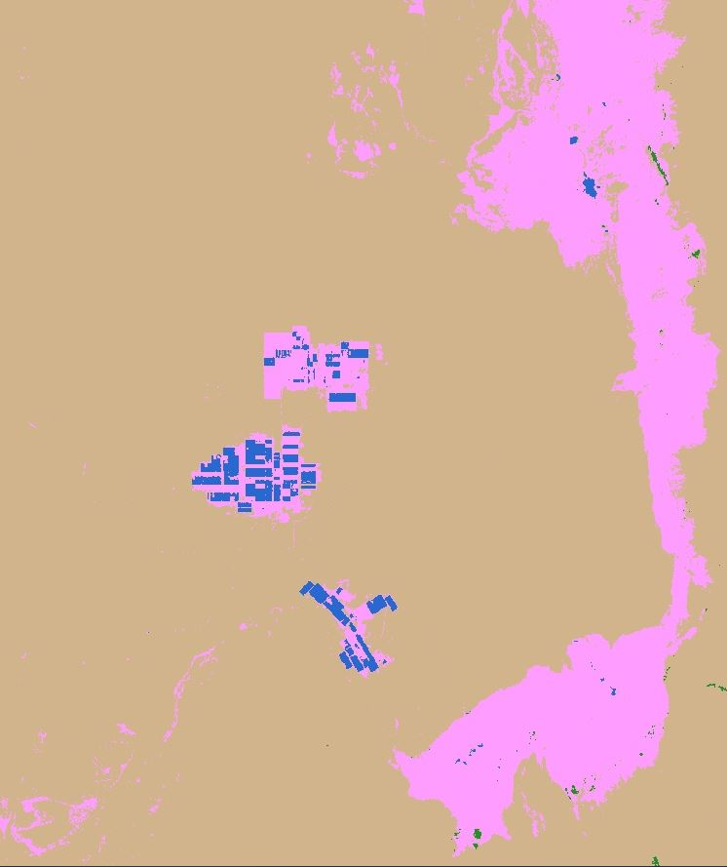
Salar de Atacama: Mining Progression
1986
2000
2018
N
N
N
Land Classification
Barren/Other
Vegetation
Water
Salt
Snow
5 km
5 km
Image credits: Chile Water Resources Team (Google Earth Engine)
Notes:
Speaker: Catherine
Our land classification allowed us to expedite the ability to track the development of mining. Lithium mining occurs when water is pulled from natural water sources into man-made rectangle-shaped pools. This is a snapshot from the Salar de Atacama, or the Atacama Salt Flat, one of the largest salt flats in the country, and with the most mining activity today.
Our classification and thresholding reveals the mining activity in the center of the screen, even picking up on the shapes of the rectangle mining pools. The increase in size of the blue rectangles matches the expected increase in mining activity in the 90s, which expands up until today.
Image Credits: Chile Water Resources Team (Google Earth Engine)

Slide 20
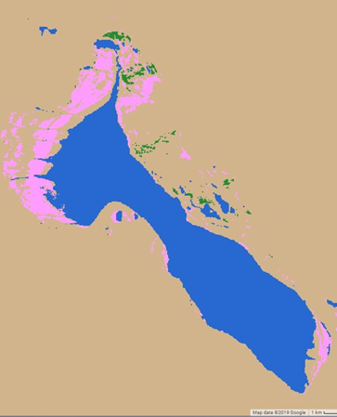
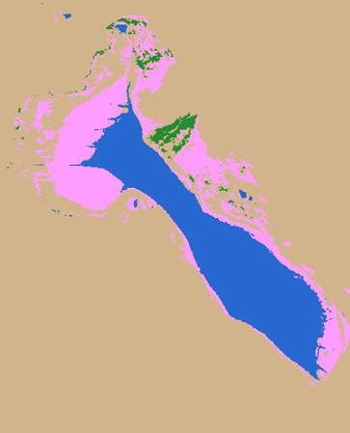
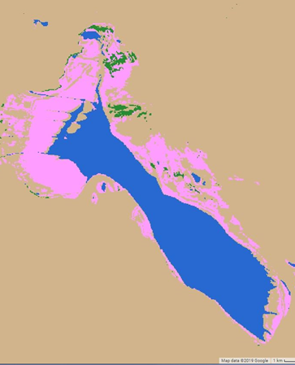
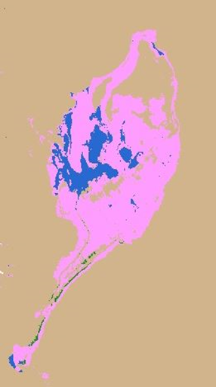
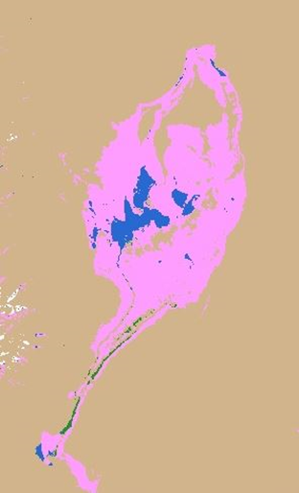
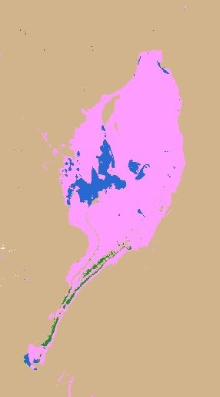
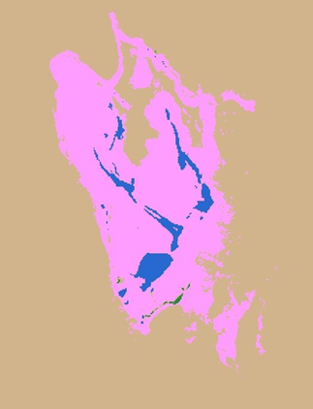
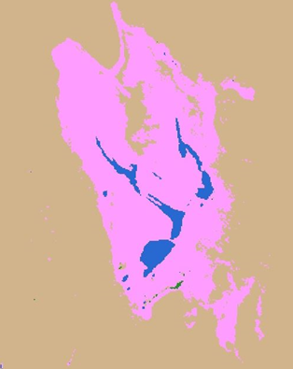
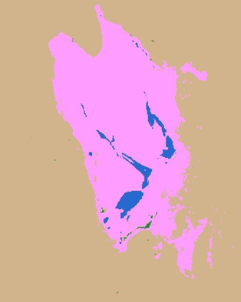
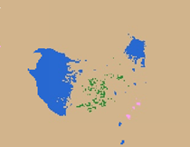
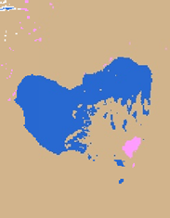
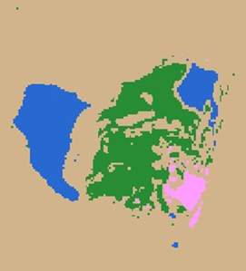
Changes in Natural Pools
Land Classification
Barren/Other
Vegetation
Water
Salar de Tara
Salar de Maricunga
Salt
N
Snow
N
1986
1997
2018
1986
1997
2018
1 km
1 km
Salar de las Parinas
N
Salar de Eulogio Escondida
N
1986
1997
2018
1986
1997
2018
1 km
1 km
Image credits: Chile Water Resources Team (Google Earth Engine)
Notes:
Speaker: Catherine
Here we have classification from three separate years spaced evenly throughout our time period: 1985, 1999, and 2017. The region we are looking at is [identify if it is the northern or southern end of our study site]. Blue is water -- for both saline lake and man-made mining pools -- green is vegetation, yellow is barren, and pink is salt flat. We expected to see a visual decrease in the extent of the size of the saline systems, which is what we see here. It’s possible that the increase in vegetation is a result of the absence of water. The decrease in water possibly lead to algae.
Image Credits: Chile Water Resources Team (Google Earth Engine)

Slide 21
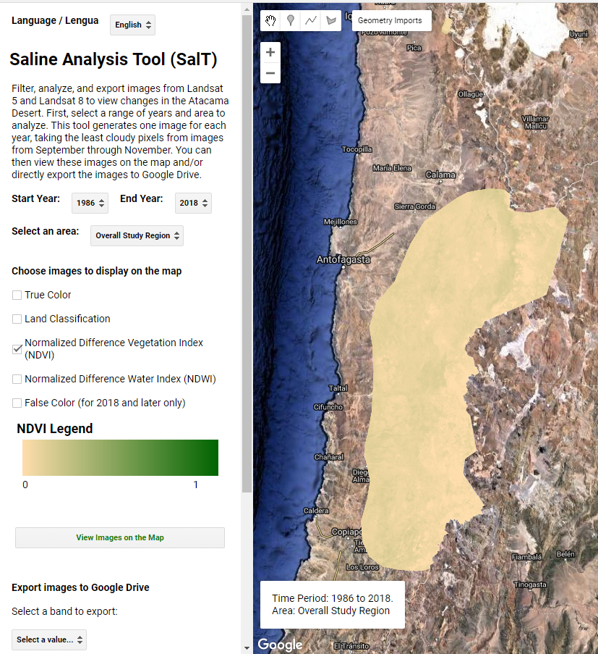
Saline Analysis Tool (SalT)
The Google Earth Engine Tool will be used for future monitoring
A graphical user interface (GUI) provides maps of land classification and other analyses
Available in both English and Spanish
Image credit: Chile Water Resources Team (Google Earth Engine)
Notes:
Speaker: Monica
Our final tool, or SalT, includes a geographical user interface, also known as a GUI. In addition to assessing analysis of past saline system change, with the capacity to be updated with new Landsat and Sentinel imagery, the SalT tool will be able to assess future change in saline systems. The tool was developed in both Spanish and English. It has the power to analyze small and large regions, depending on the user’s interest. It is also available in both Spanish and English to accelerate the Chilean agency’s ability to apply this tool for future monitoring.
Image Credits: Chile Water Resources Team (Google Earth Engine)

Slide 22
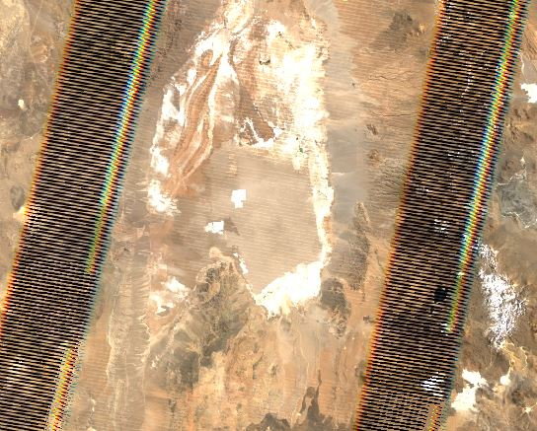
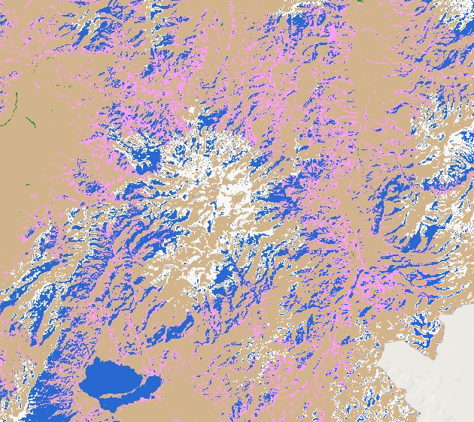
Uncertainties and Future Work
(1)
Artifacts in Landsat 5 data from combining multiple scenes (may overestimate NDVI and NDWI for some years) (1)
No in situ data to validate land classification results
No Landsat 5 data for 2002 or 2012
Accuracy is poor in the mountains (2)
Snow and salt are hard to distinguish
DEM threshold does not work for every year
Future Work
Statistical analysis
Ground truth data
Study impacts of temperature and mining
(2)
Image credits: Chile Water Resources Team (Google Earth Engine)
Notes:
Speaker: Catherine
Artifacts, shown by these tracks, appeared in some of our Landsat 5 images. They occur when GEE combines multiple scenes into one image. These values may have confounded and overestimated our NDVI and NDWI values. Next steps would be to determine ways to validate these results. We had one database from areas of salt flats from 1999, but no shapefiles to exactly compare land classifications. We took average threshold values, but and applied across images, but they may not be consistent through time. Snow made our results inaccurate in the mountains because it is difficult to distinguish between snow and salt flats. We tried to mitigate this issue by using a DEM to separate them by elevation, but this method fails when there is more snow than usual, which causes snow at lower elevations to be classified as salt.
Image Credits: Chile Water Resources Team (Google Earth Engine)

Slide 23
Conclusions

Slide 24
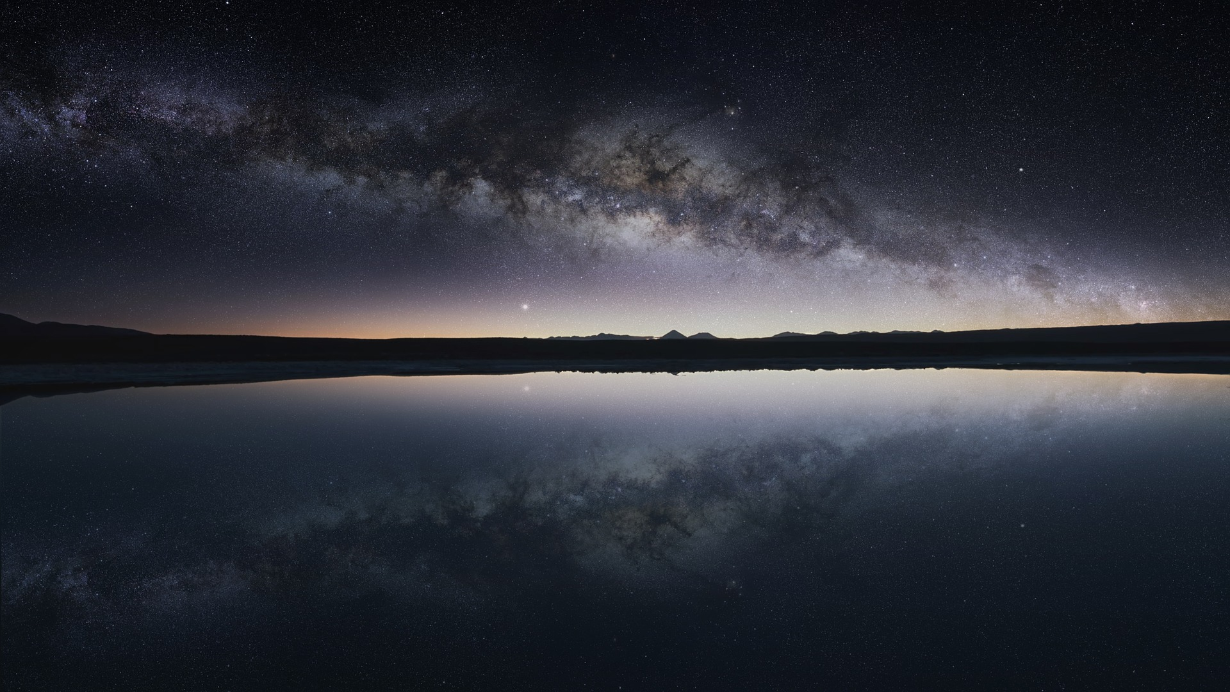
Summary of Findings
Thresholding of multiple spectral indices accelerated the ability to classify through time without training points for each year
Overall NDWI and NDVI show no significant trends, although some sites indicate that water levels are changing
The Saline Analysis Tool (SalT) enables rapid generation of land classification, NDVI, and NDWI maps over a 30 year time period and can be used for future monitoring by the partner organization
Image credit: Andrew-Art (Pixabay)
Notes:
Speaker: Genevieve
Successfully created google earth engine tool for future monitoring.
Some locations show water level change over time: i.e. Salar de Tara, Salar de Maricunga, Salar de Eulogio Escondida
It is difficult to determine change in vegetation and water over time, because of
Pixabay: Andrew-Art, Pixabay (Pixabay License), https://pixabay.com/photos/the-atacama-desert-chile-salar-flats-2832866/

Slide 25
Image credit: Michelle Branco (Pixabay)
Partner Benefits
Increased accessibility of NASA Earth observations
Tool for continuous monitoring in the future
Ability to incorporate this information into future water management decisions
Image credit: Chile Water Resources Team
Notes:
Speaker: Genevieve
The primary benefit to the end user is increased accessibility to NASA Earth observations. By providing a GUI, we have ensured that the tool is accessible to people who do not have coding experience. Additionally, GEE enables rapid generation of the analysis types over time, and reduces the amount of effort required from the end user to produce results.
The tool provides the means for continuous monitoring and will contribute to future SERNAGEOMIN land and water management decisions. For example, this tool can be used to identify areas that appear to be changing more than others as they identify places to mine.
Image Top: Michelle Branco, Pixabay (Pixabay License): https://pixabay.com/photos/atacama-chile-desert-3837858/
Image Bottom: Chile Water Resources Team, PowerPoint

Slide 26
Paula Olea Encina, Geographer (SERNAGEOMIN)
Dr. Ricardo Cabezas, Professor (Universidad de La Serena, Chile)
Dr. Juan Torres-Perez, Science Advisor (Bay Area Environmental Research Institute, NASA Ames Research Center)
Dr. Kenton Ross, Science Advisor, (NASA Langley Research Center)
John Dilger, Science Advisor (Spatial Informatics Group, LLC)
Farnaz Bayat, DEVELOP Center Lead (NASA Ames Research Center)
Jerrold Acdan, DEVELOP Project Coordination Fellow (NASA Ames Research Center)
Notes:
Speaker: Genevieve
Paula Olea Encina, Geographer (SERNAGEOMIN) Dr. Ricardo Cabezas, Professor (Universidad de La Serena) Dr. Juan Torres-Perez, Science Advisor (Bay Area Environmental Research Institute, NASA Ames Research Center) Dr. Kenton Ross, Science Advisor, (NASA Langley Research Center) John Dilger, Science Advisor (Spatial Informatics Group, LLC) Farnaz Bayat, DEVELOP Center Lead (NASA Ames Research Center) Jerrold Acdan, DEVELOP Project Coordination Fellow (NASA Ames Research Center)

