Slide 1
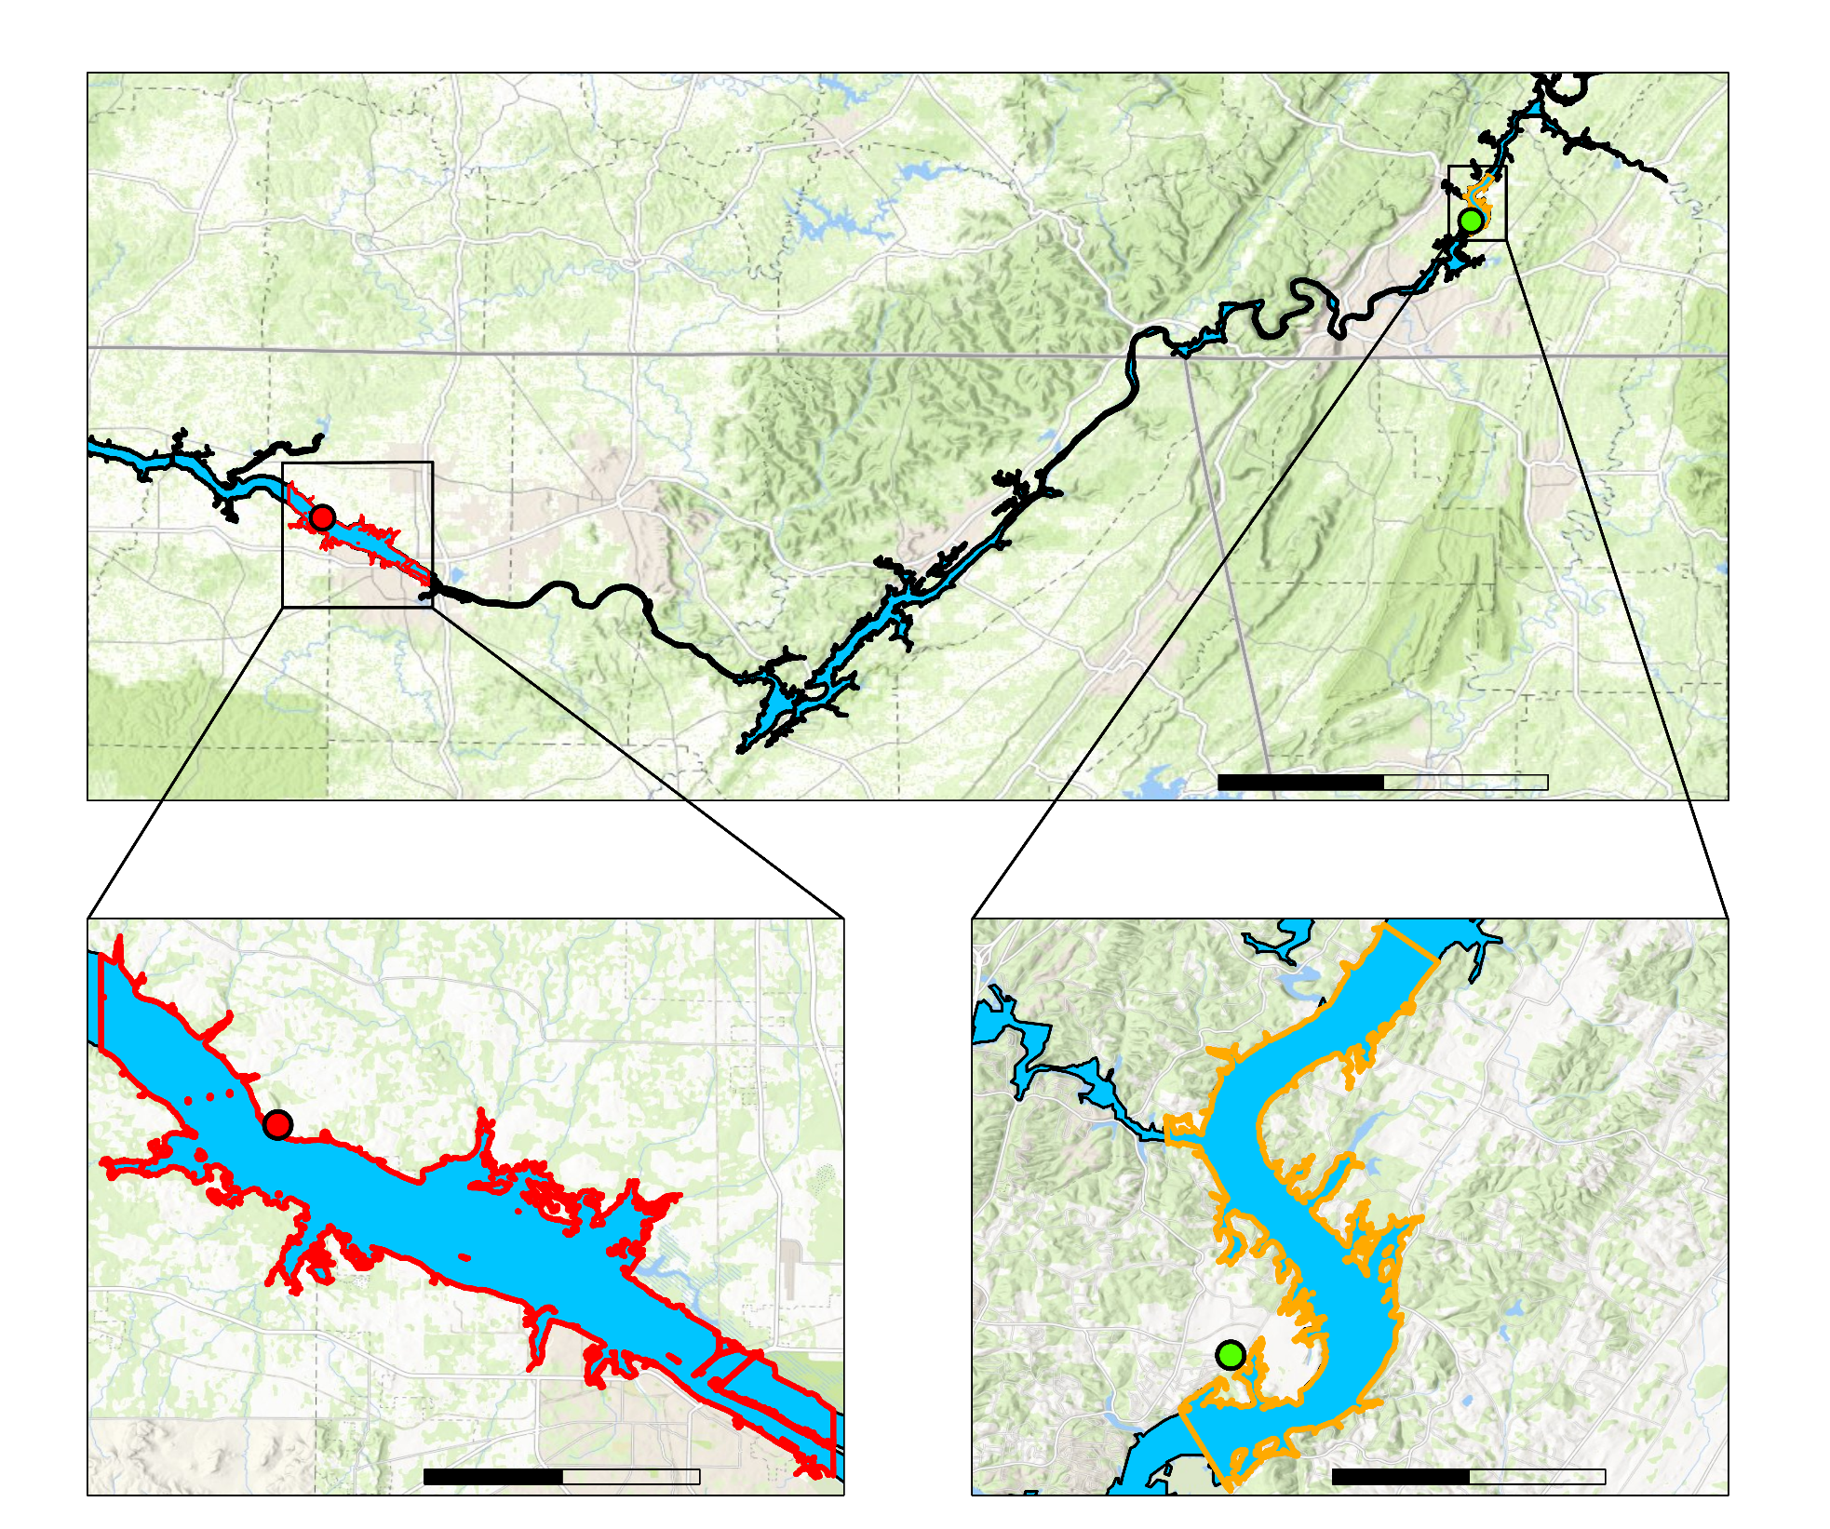
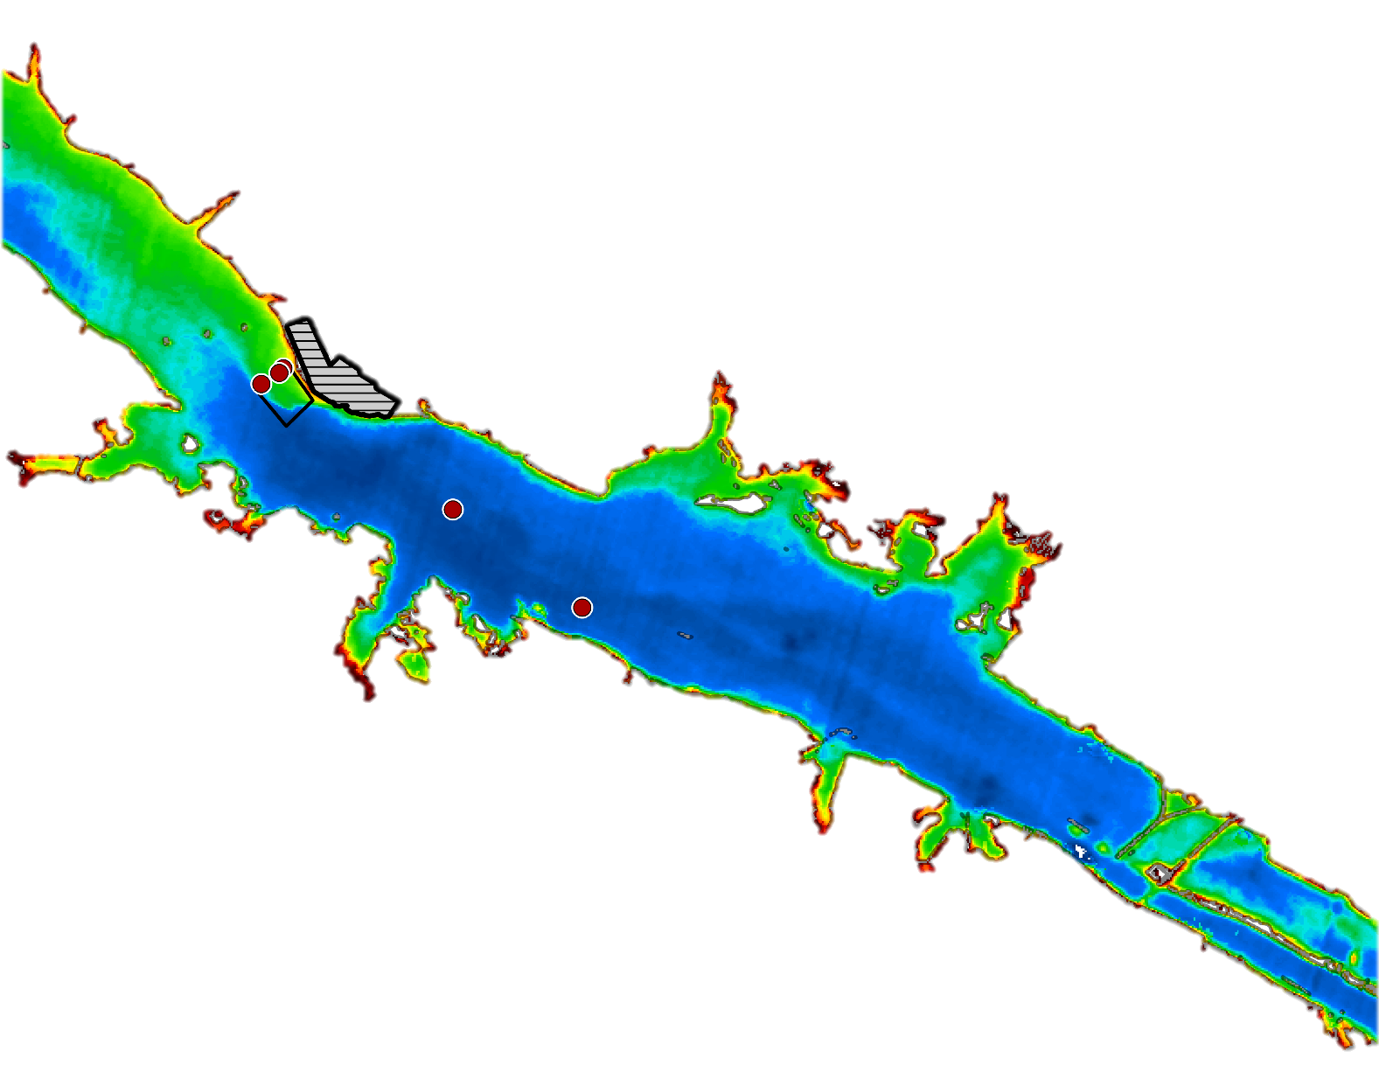
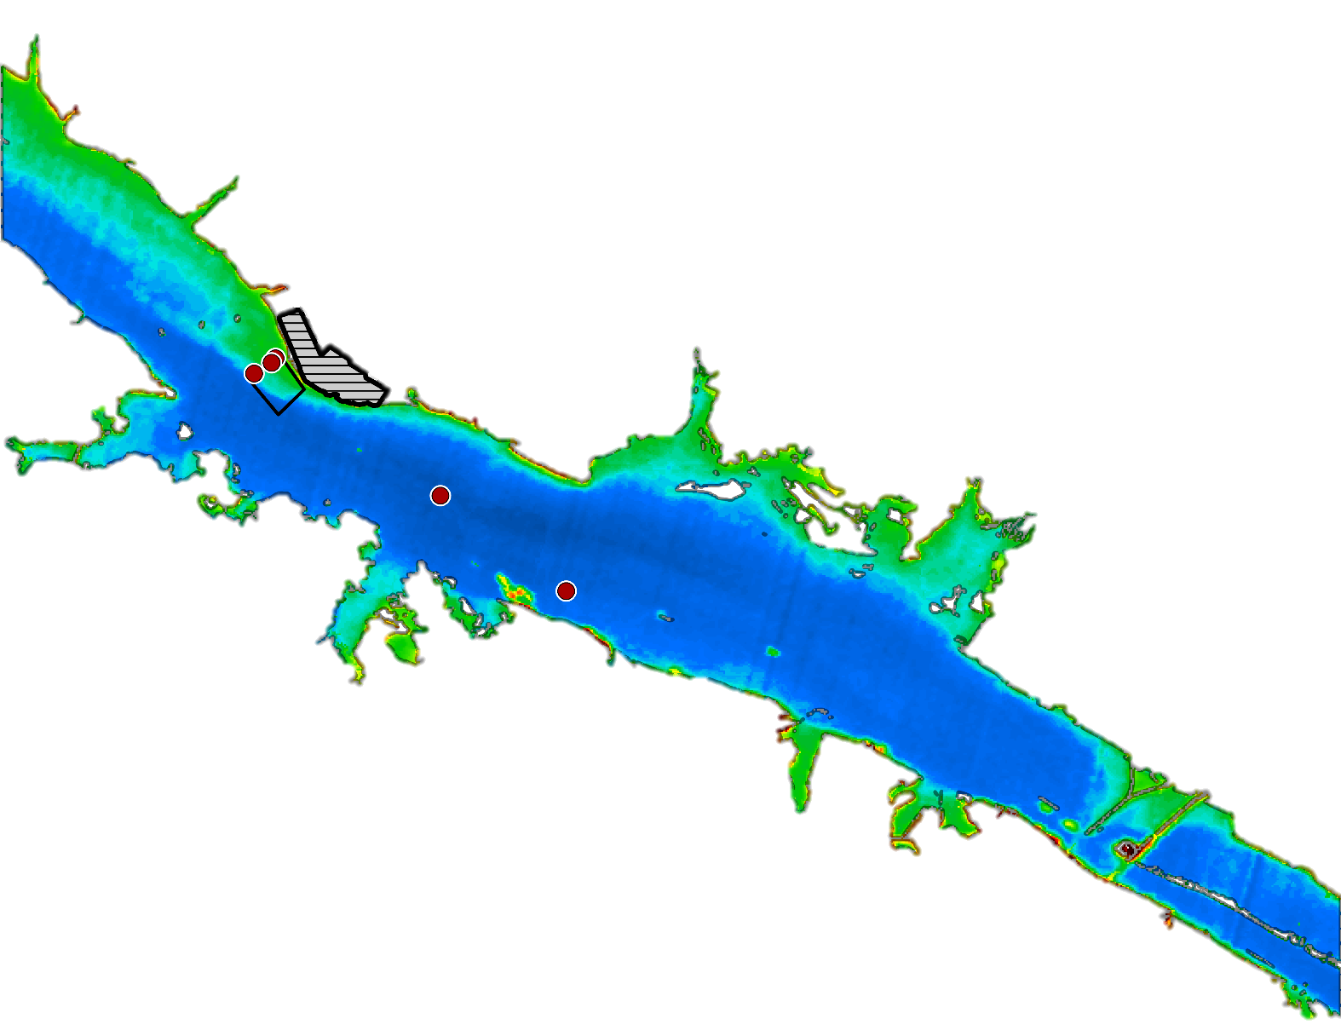
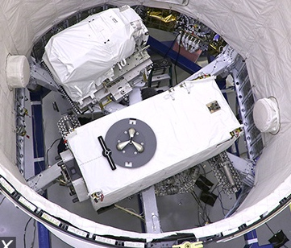
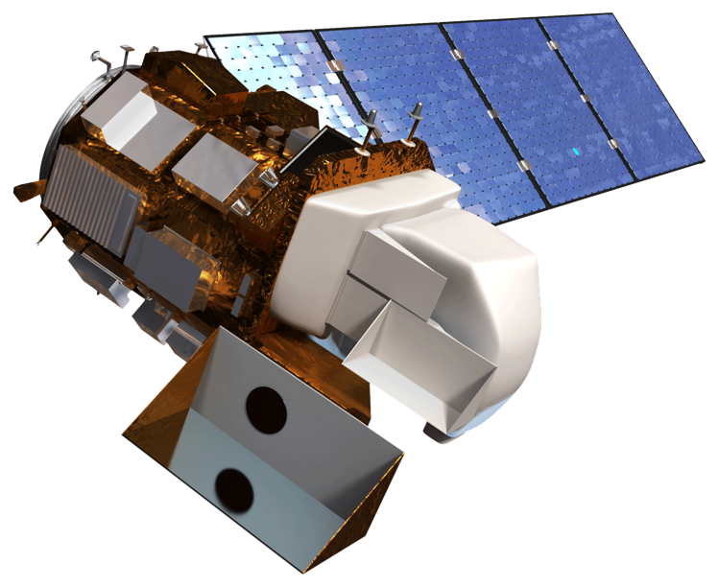
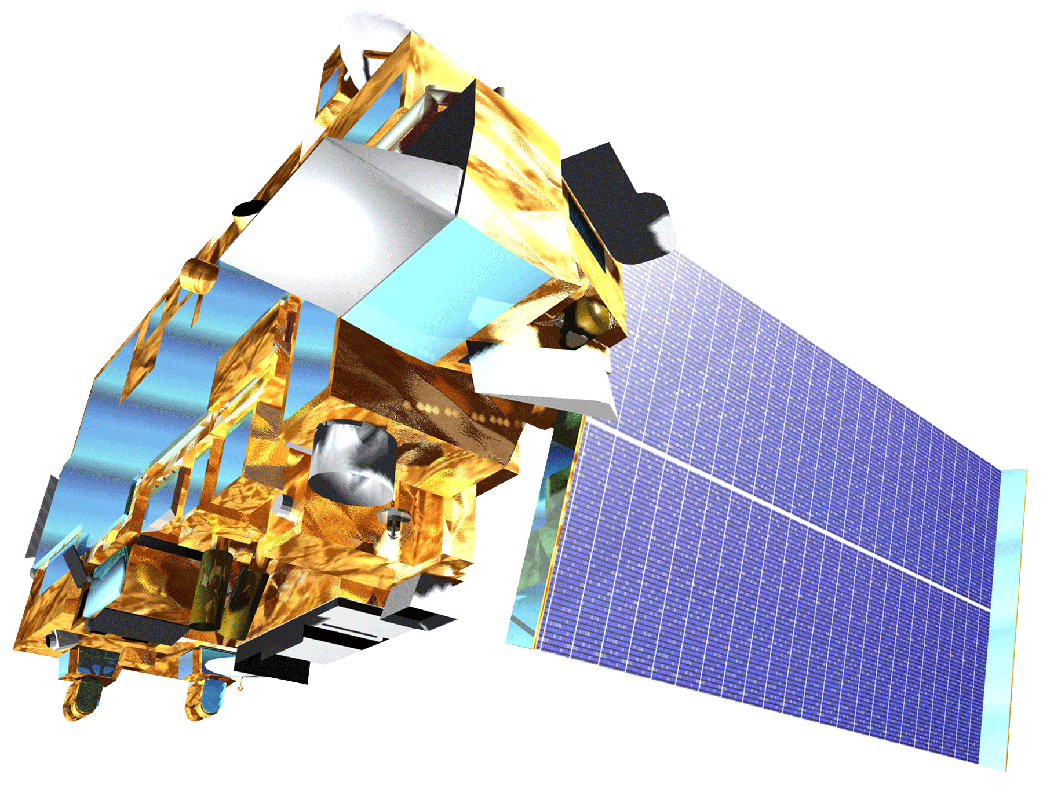
Assessing the Hydrothermal Outputs of Nuclear Power Plants Along the Tennessee River with NASA Earth Observations
Abstract
Objectives
Tennessee Valley Energy
Aquatic ecosystems are susceptible to biodiversity loss due to increased water temperatures, which can select for heat-tolerant species and lead to a loss of locally adapted species that have a narrow temperature range. Regulations concerning heated effluent from nuclear power plants are administered by the Environmental Protection Agency (EPA) in order to avoid damage to surrounding ecosystems. This project utilized thermal infrared data from NASA’s Advanced Space borne Thermal Emission and Reflection Radiometer (ASTER), Ecosystem Space borne Thermal Radiometer Experiment on Space Station (ECOSTRESS), and Landsat 8 Thermal Infrared Sensor (TIRS) along the Tennessee River to help improve river temperature predictive models used by the Tennessee Valley Authority’s (TVA) Browns Ferry Nuclear Plant (BFNP). To do this, the team highlighted spatial and temporal variation in river surface temperature as a result of seasonal change, flow rate, ambient air temperature, and plant power output. Results from the BFNP study area indicated that from 2013 to 2018, the change in water temperature between upstream and downstream locations (ΔT) increased by 3.546°F (p<0.01), and from 2018 to 2019, the ΔT decreased by 2.22°F (p<0.01). However, it is unclear if this variation can be attributed to the BFNP expansion. The results also demonstrated that river flow rate had the greatest impact on ΔT (p<0.001), while air temperature and power output did not significantly affect ΔT. These visualizations provided a new perspective on the behavior of thermal effluent at different locations along the Tennessee River, at different flow rates, and after the BFNP power upgrade.
Visualize yearly and seasonal water surface temperatures through time-series maps to identify surface temperature spatial variation over time
Compare satellite performance between BFNP and Sequoyah Nuclear Plant (SNP)
Analyze river flow rate, air surface temperature, and power output on water surface temperatures through statistical analyses
Improve the TVA’s effluent model by showing spatial variation in river surface temperature
Illustrate the feasibility of using NASA Earth Observations to monitor water surface temperatures through a tutorial
Study Area
N
Tennessee
Alabama
Georgia
0 20 40
Tennessee River
Methodology
Miles
Browns Ferry Study Area
Data Acquisition
Image Processing
Statistical Analysis
End Products
Sequoyah
Study Area
AppEEARS
Earthdata
EarthExplorer
Georeference
Values to ºF
Raster Calculator
Model Builder
ANOVA
Tukey’s HSD
Regression
One tailed t-test
Seasonal & Yearly Time Series
Facility Comparison
Model Comparison
Tutorial
Story Map
BFNP
0 3 6
SNP
Results
Miles
0 2 4
Miles
Satellite Comparison (BFNP)
∆T vs. Flow
Landsat R² = 0.98
ASTER R² = 0.96
ECOSTRESS R² = 0.96
R² = 0.46
P-value = 0.0035
Low Flow
80ºF
60ºF
Browns Ferry Nuclear Plant
Mixing Zone
Temperature Station
High Flow
Temperature Accuracy at BFNP
Temperature Accuracy at SNP
0 3 6
Miles
N
Earth Observations
Conclusions
NASA Earth observations can benefit thermal effluent model calibration; however, cannot replace in situ temperature reporting for compliance.
River flow rate has a significant impact on river surface temperature. Earth Observations are able to demonstrate spatial trends at varying flow rates.
Project Partners
ISS ECOSTRESS
Landsat 8 TIRS
Terra ASTER
Tennessee Valley Authority
Team Members
Acknowledgements
Dr. Jeffrey Luvall (NASA Marshall Space Flight Center)
Dr. Robert Griffin (The University of Alabama in Huntsville)
Maggi Klug (The University of Alabama in Huntsville)
Helen Baldwin (NASA SERVIR)
Christine Evans (The University of Alabama in Huntsville)
Cole Krehbiel (Innovate! Inc., Contractor to the U.S. Geological Survey)
Colleen Montgomery (Tennessee Valley Authority)
Lana Bean (Tennessee Valley Authority)
Dr. Matthew Boyington (Tennessee Valley Authority)
Lisa Dong
Project Lead
Jessica Ding
Rachel Smith
Samuel Tatum
Alabama – Marshall Space Flight Center | Fall 2019

