Slide 1
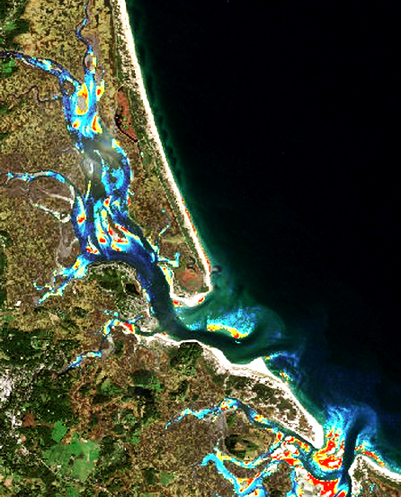
PLUM ISLAND ESTUARY WATER RESOURCES
Utilizing NASA Earth Observations to Assess Marine Sediment Fluxes in the Plum Island Estuary
Zachary Bengtsson
Bogumila Backiel
Sydney Neugebauer
Ruizhe Guo
Kimberly Johnson
Notes:
Image credit: USGS, GloVis, Date: 07/09/2017

Slide 2
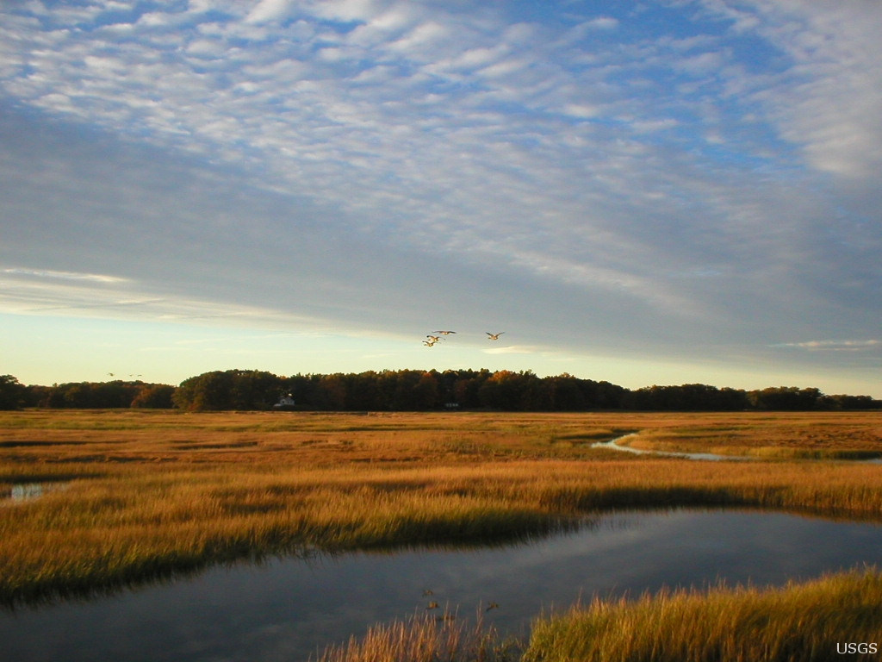
Components
Background
Partners
Community Concerns
Objectives
Study Area/Period
Earth observations
Methodology
Results
Conclusions
Errors & Uncertainties
Future work
Credit: USGS
Notes:
Presentation elements
Image Source: https://www.usgs.gov/media/images/tidal-marshland-plum-island-estuary-massachusetts; USGS, Matthew Kirwan.

Slide 3
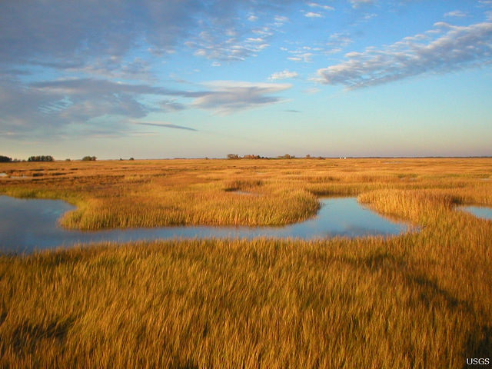
Background
Ecosystem services:
Water quality
Storm protection
Carbon sequestration
Erosion control
Recreation
Threats:
Sea level rise
Human development
Credit: USGS Flickr
Notes:
A salt marsh is a coastal grassland periodically flooded with saltwater by tides. Salt marshes are important ecosystems to human communities. They provide many valuable ecosystem services, including water quality improvement, carbon sequestration, erosion control, protection from storm surges, and recreation opportunities like birding and kayaking. However, these systems are threatened by rising sea levels. To cope with this, salt marshes require a sufficient supply of sediment to build and maintain their structure. Human development often disrupts sediment supply by preventing natural erosion. Development also limits the distance marshes can migrate landward from sea level rise. It’s important to have an understanding of sediment dynamics in salt marshes to evaluate areas of concern.
Image source: USGS Flickr, https://www.flickr.com/photos/usgeologicalsurvey/15834090594/in/photolist-q8cRtY

Slide 4
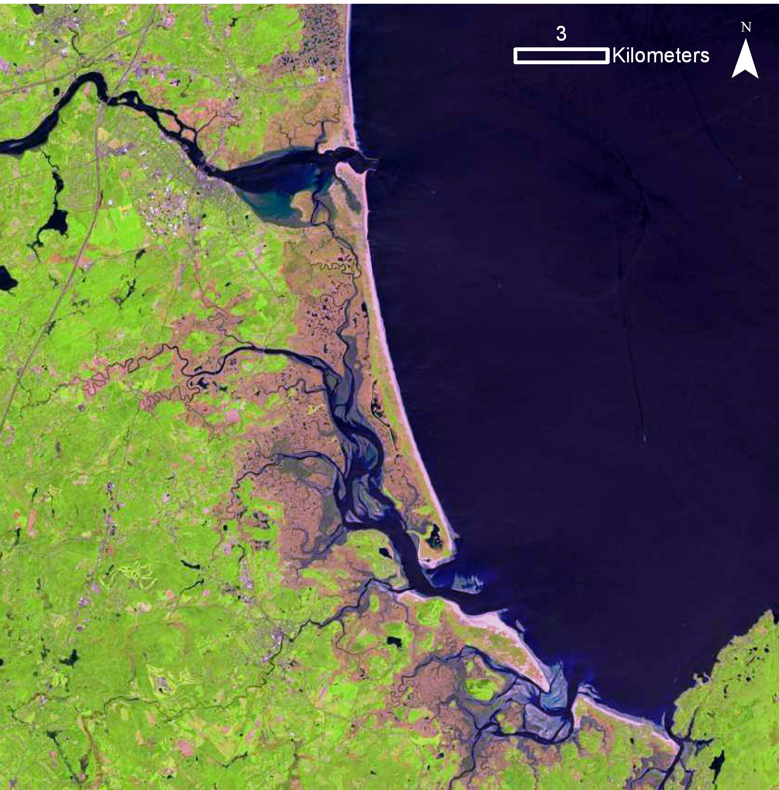
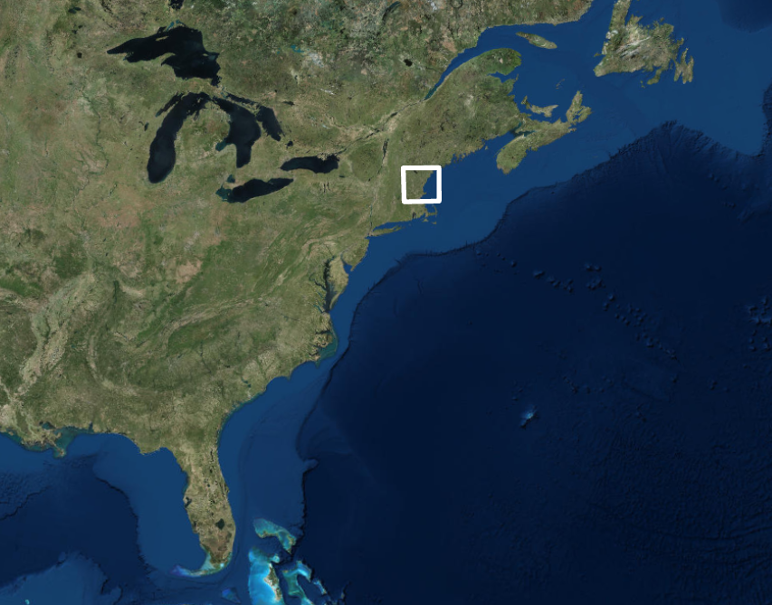
Study Area
Plum Island Estuary (PIE)
56 km north of Boston
Fed by Ipswich, Parker, Rowley & Merrimack rivers
Salt marshes, islands & tidal creeks
Study Site
Atlantic Ocean
Gulf of Maine
Credits: NASA and Esri, DigitalGlobe, GeoEye, Earthstar Geographics, CNES/Airbus DS, USDA, USGS, AeroGRID, IGN, and the GIS User Community
Notes:
For our project, we studied salt marshes at The Plum Island Estuary, which is located in northeast Massachusetts, about 56 kilometers north of Boston. The estuary is 25 kilometers long and fed by the Ipswich, Parker, Rowley & Merrimack rivers. The estuary’s salt marshes are dominated by smooth cordgrass and marsh hay. The rest of the estuary contains islands and tidal creeks. Over four thousand acres of the area are protected by the Parker River National Wildlife Refuge. Image source: https://glovis.usgs.gov/; Landsat 8; NASA, Date: 05/24/2017 (main map) Esri, DigitalGlobe, GeoEye, Earthstar Geographics, CNES/Airbus DS, USDA, USGS, AeroGRID, IGN, and the GIS User Community (inset map)
Technical notes:
smooth cordgrass - Spartina alterniflora
marsh hay - Spartina patens

Slide 5
Partners
USGS Woods Hole Coastal and Marine Science Center, Dr. Neil Ganju
Long Term Ecological Research Network (LTER), Plum Island Ecosystems, Dr. Anne Giblin
U.S Fish and Wildlife Service, Park River National Wildlife Refuge, Nancy Pau
Notes:
Our project was completed in collaboration with BU faculty and three governmental partners (USGS, USFWS, and PIE LTER). The USGS, our primary partner, currently measure sediment at point locations within the estuary. However, these measurements are limited. Our partners were interested in the use of remote sensing to expand their research into a landscape level analysis while using point measurements to develop an algorithm and validate our results.

Slide 6
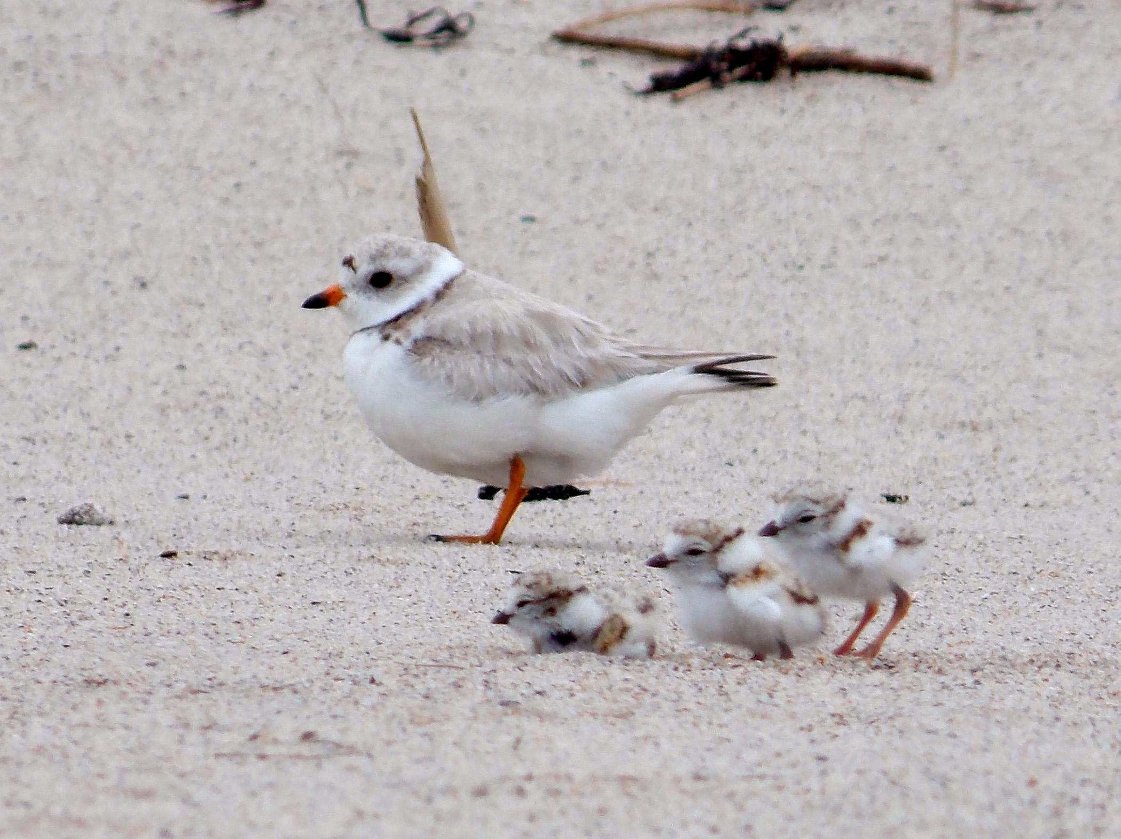
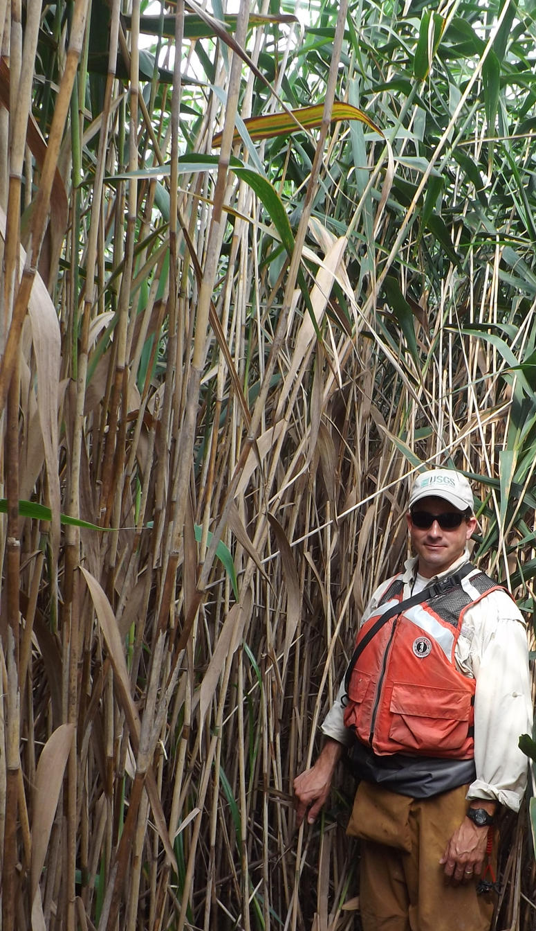
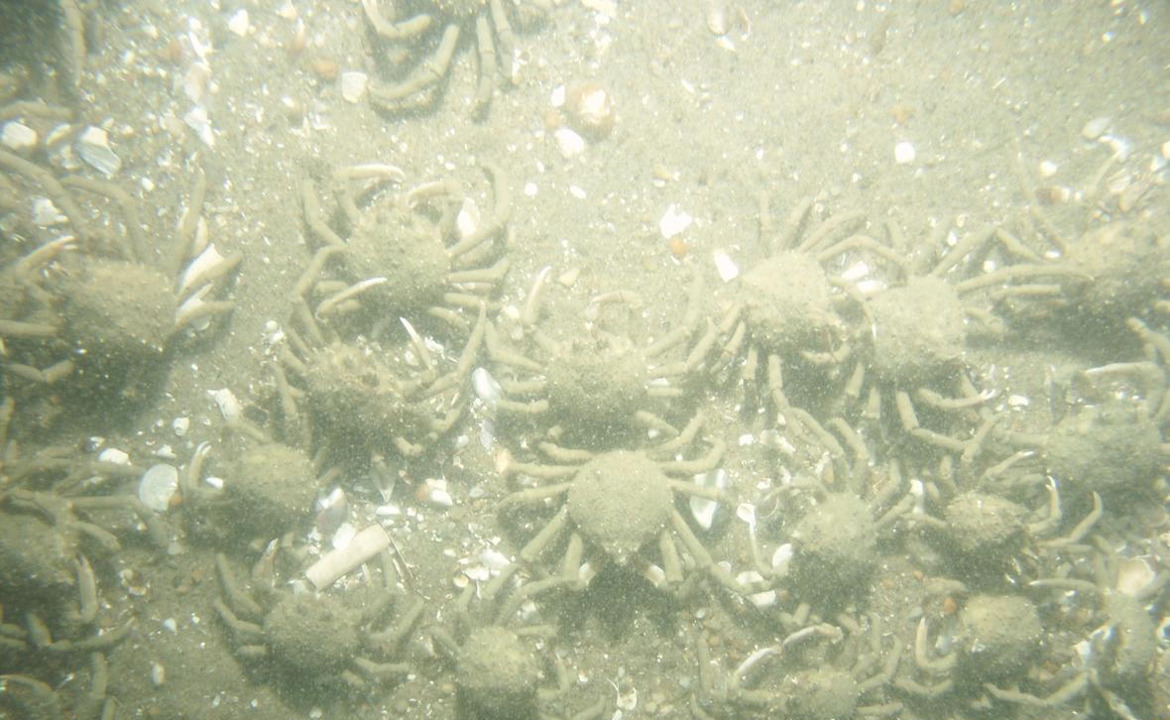
Community Concerns
Coastal resilience
Water quality
Ecological habitat
Invasive species
Conservation & restoration
Credit: Kaiti Titherington/USFWS
Credit: USGS
Credit: USGS
Notes:
The topic of our project addressed various community level concerns. Salt marshes protect inland human communities from storm surge during hurricanes and other large storms, making marsh conservation important to community resilience against storms. Marshes reduce the amount of nutrient pollution in water, which improves overall water quality. Fishermen, recreationists, and ecologists are interested in maintaining marsh ecosystems and protecting freshwater habitats for fish, clams, migratory birds, and other organisms. Marshes are also threatened by the spread of invasive plant species, like Phragmites (picture on the right) and Pepperweed. These concerns influence the allocation of limited resources to the conservation and restoration efforts in the area. Wide-scale analysis that does not require lengthy field sampling, such as analysis of remote sensing data, can provide valuable information for researchers and stakeholders with fewer resources. Image source: https://www.flickr.com/photos/usfwsnortheast/14383105915; Kaiti Titherington/USFWS https://www.usgs.gov/media/images/phragmites-australis ; USGS https://www.usgs.gov/media/images/plum-island-seafloor; USGS

Slide 7
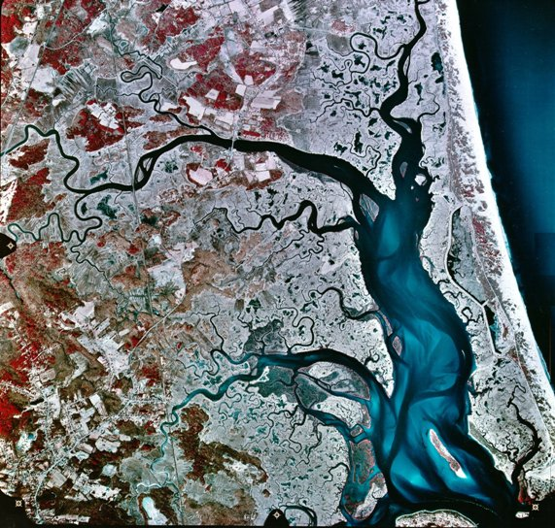
Objectives
Develop methodology for evaluating SSC from remote sensing data
Determine suspended sediment concentration from satellite imagery
Observe SSC along a transect in the estuary’s main channel
Create a time series of SSC
Credit: USGS, National Aerial Photographic Program 1992
Notes:
The project had 4 objectives. The first objective was to create a methodology that used Earth observations to determine suspended sediment concentration. Our second goal was to visualize and measure sediment supply over a greater area of the marsh using satellite imagery. Using this methodology, our third objective was to obtain the SSC values along points in the estuary’s main channel. The fourth objective was to calculate these parameters over a period of 4 years and create a time series of suspended sediment concentration.
Image source: http://pie-lter.ecosystems.mbl.edu/content/current-research ; USGS National Aerial Photographic Program 1992 – Licensing info for images retrieved from this program: https://eros.usgs.gov/about-us/data-citation

Slide 8
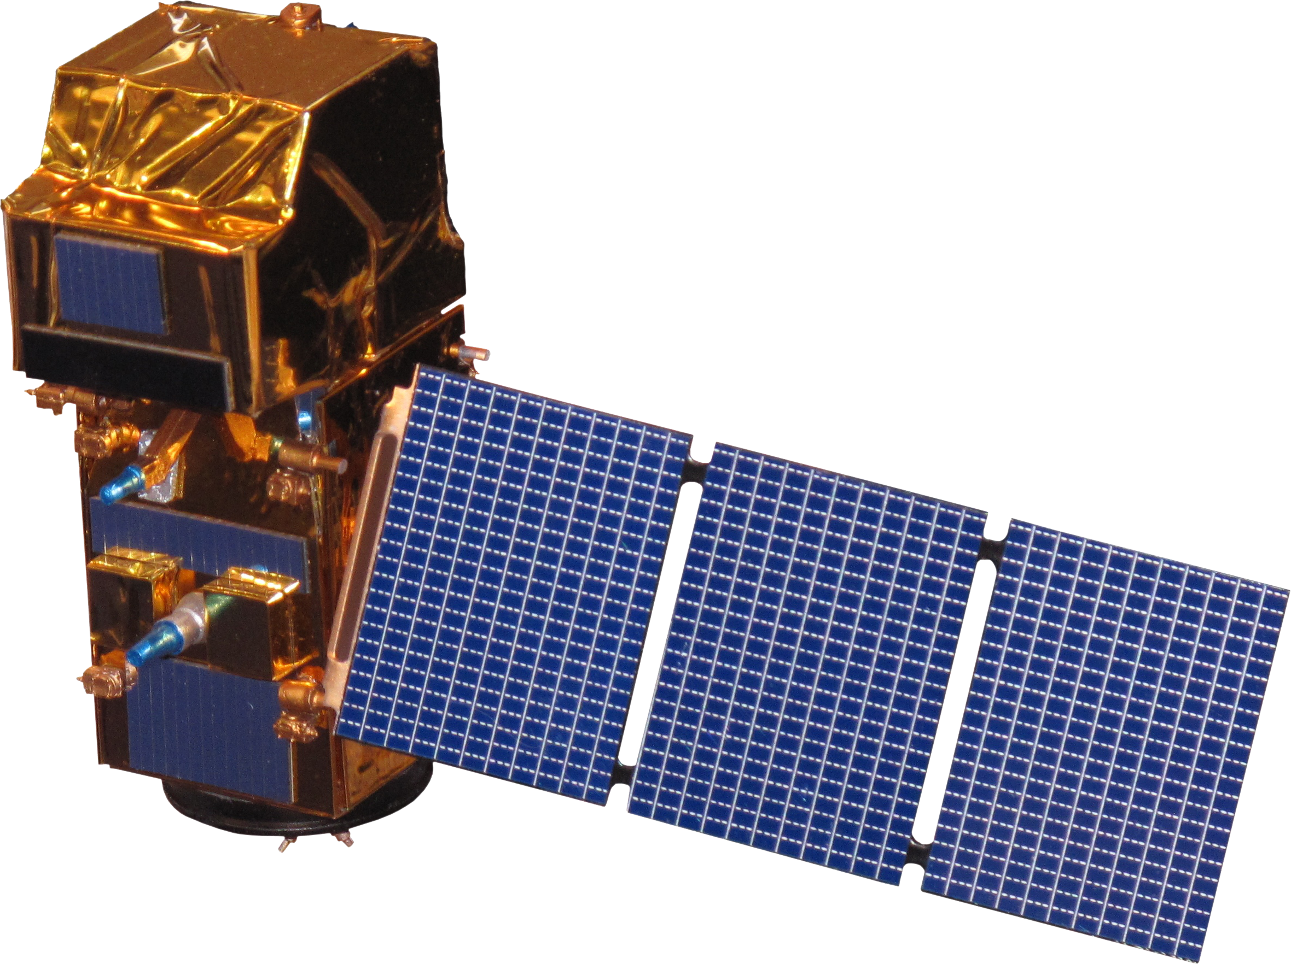
Earth Observations
Landsat 8
Sentinel-2
Launched February 2013
30 m spatial resolution
16 day temporal resolution
Operational Land Imager (OLI)
Launched June 2015
10-20 m spatial resolution
10 day temporal resolution
Multispectral Imager (MSI)
Notes:
We used data gathered from two satellites, NASA’s Landsat 8 and the ESA’s Sentinel-2. Landsat 8 was launched in 2013 and produces images with 30 meter spatial resolution. Sentinel 2 was launched in 2015 and produces 10-20 meter resolution images.
Image: NASA

Slide 9
Study Period
2013 - Present
2013
2014
2015
2016
2017
2018
Landsat 8 data
Remote sensing
Sentinel-2 data
Field work
In situ data
Notes:
Our study period was 2013 to the present. The remote sensing data were gathered from April 2013 to December 2017, but the months of the year varied due to the availability of images without cloud cover. Landsat images range from April 2013 to October 2017. Sentinel-2 ranged from August 2015 to December 2017. The in-situ measurements used for algorithm development were from 2017. These field measurements are point locations in the estuary. Further measurements are anticipated for summer 2018 as a continuation of this project.

Slide 10
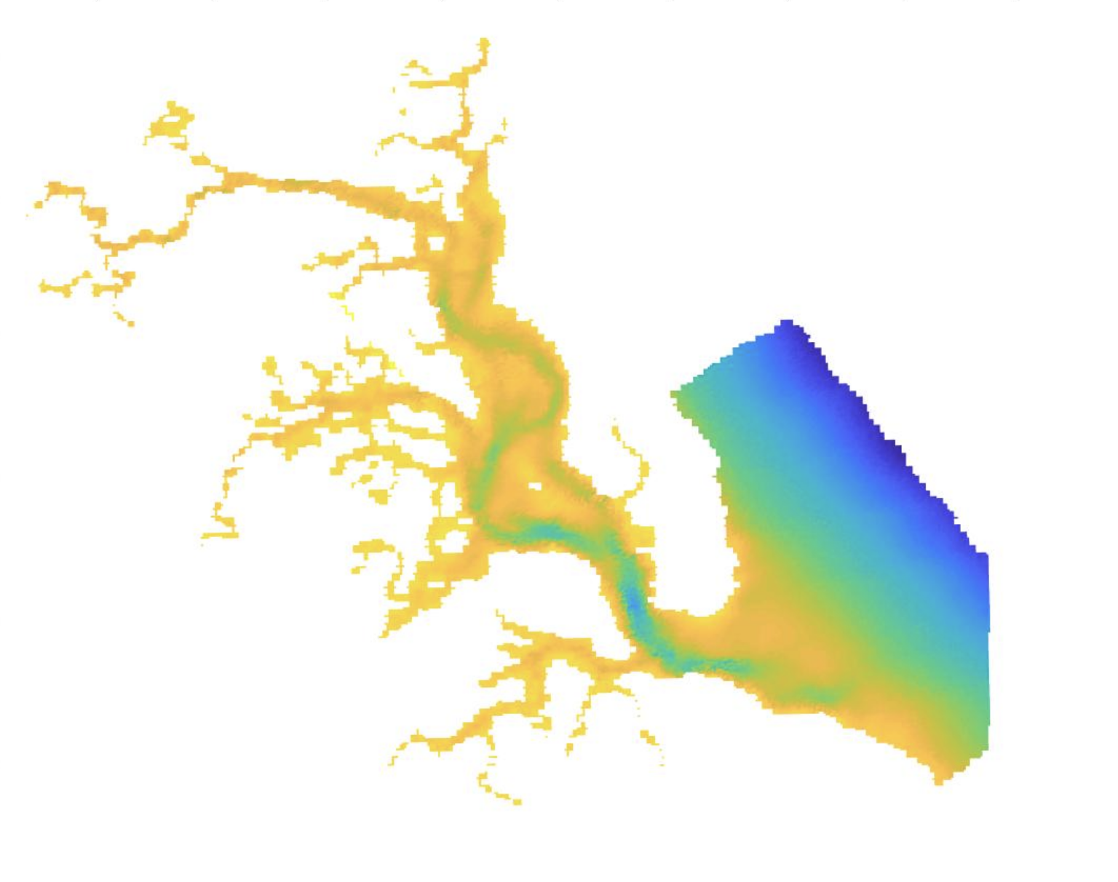
Methodology
Data Acquisition:
Level 1 data downloaded from GloVis (Global Visualization Viewer)
Data Processing:
Atmospheric correction of imagery completed using ACOLITE
Bathymetry mask creation using MATLAB
Credit: PIE LTER, Projected in MATLAB
(Visual of Plum Island Estuary Bathymetry)
Notes:
Landsat 8 and Sentinel-2 data was downloaded from USGS GloVis. We selected images that had no cloud cover obstructing PIE, and showed both high and low tides. This resulted in 21 Landsat images and 7 Sentinel images. The raw, level 1, data was processed and underwent atmospheric correction in ACOLITE, gains were applied for Landsat 8. Gains were not available for Sentinel-2. All bands were processed for remote sensing reflectance. MATLAB was used to create a depth mask to exclude shallow areas and exposed tidal flat from sediment concentration analysis. For creating the mask, interpolation was needed, as original bathymetry data was collected by LiDAR and the resolution is 20m which is different from satellite imagery resolution. After creating the mask, any area with a depth shallower than 3 meters was eliminated from analysis.
Image source: Bathymetry generated using data from Plum Island Ecosystems Long Term Ecological Research Network, Projected in MATLAB

Slide 11
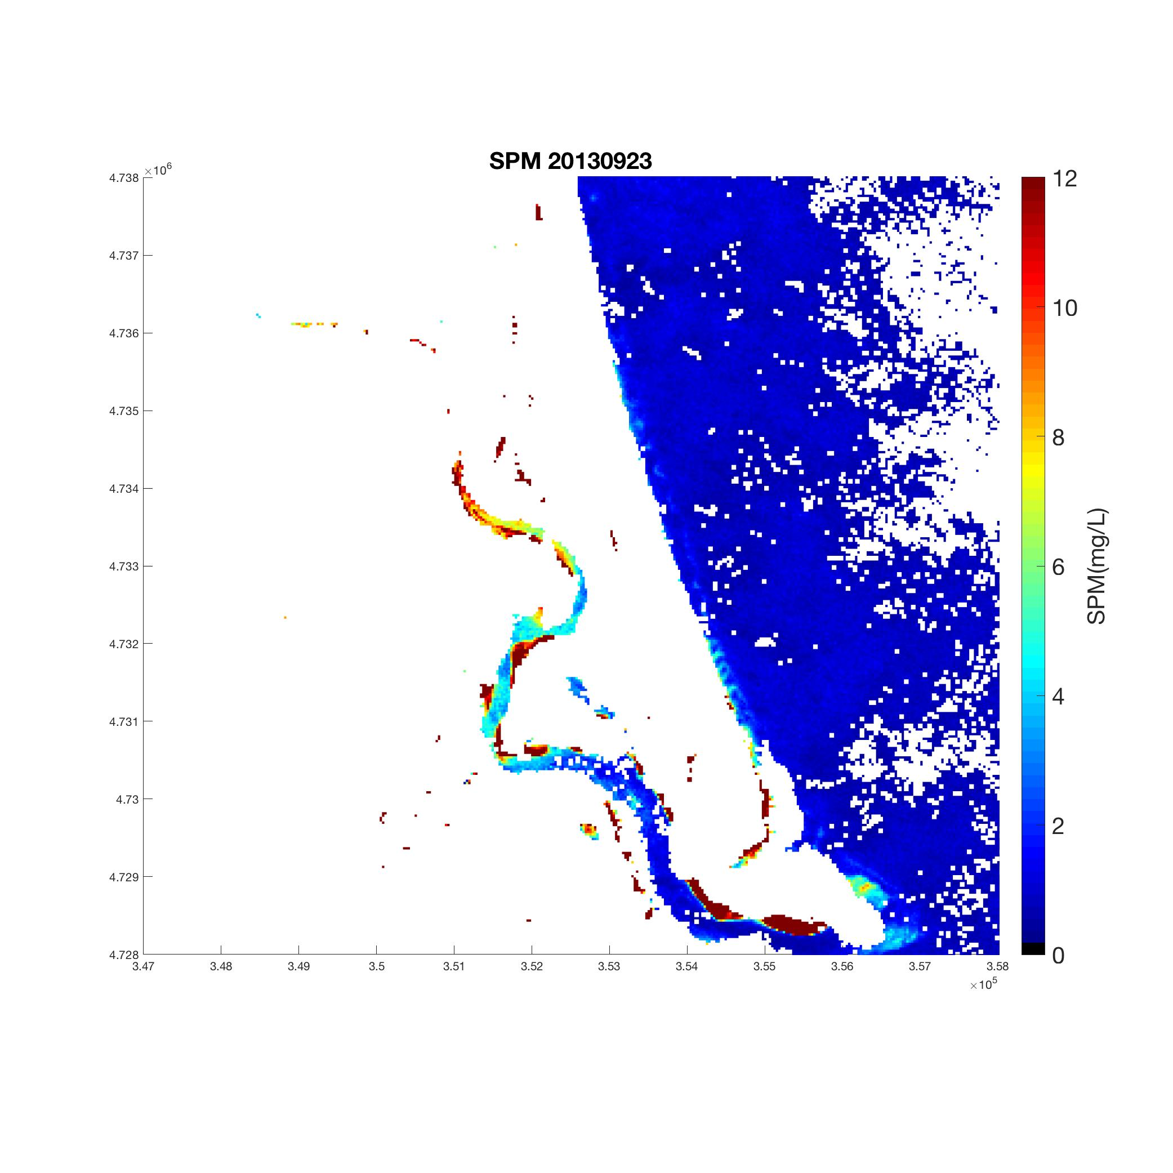
Methodology
Algorithm:
Empirical algorithm created in R to yield suspended sediment concentrations
Based on small number of in situ data points from Plum Island Estuary and other area
Used remote sensing reflectance at 655nm for Landsat 8 imagery and 664nm for Sentinel-2 imagery
SSC 2013-09-23
SSC (mg/L)
Credit: USGS, Projected in MATLAB
(SSC data projected after algorithm application)
Notes:
We created an empirical algorithm based on a small number of in-situ data points collected in Plum Island Estuary and the nearby open ocean. Several reflectance wavelengths and their ratios were tested for each sensor. Adjusted R squared and RMSE (root-mean-squared error) were used to evaluate the algorithm. The final algorithm determined is polynomial, and is based on remote sensing reflectance at a wavelength of 665 nm for Landsat 8 and 664 nm for Sentinel-2. This algorithm allowed us to estimate suspended sediment concentrations over a larger area and period of time.
Image Credit: Imagery from USGS GloVis, Projected in MATLAB, Date: 09/23/2013

Slide 12
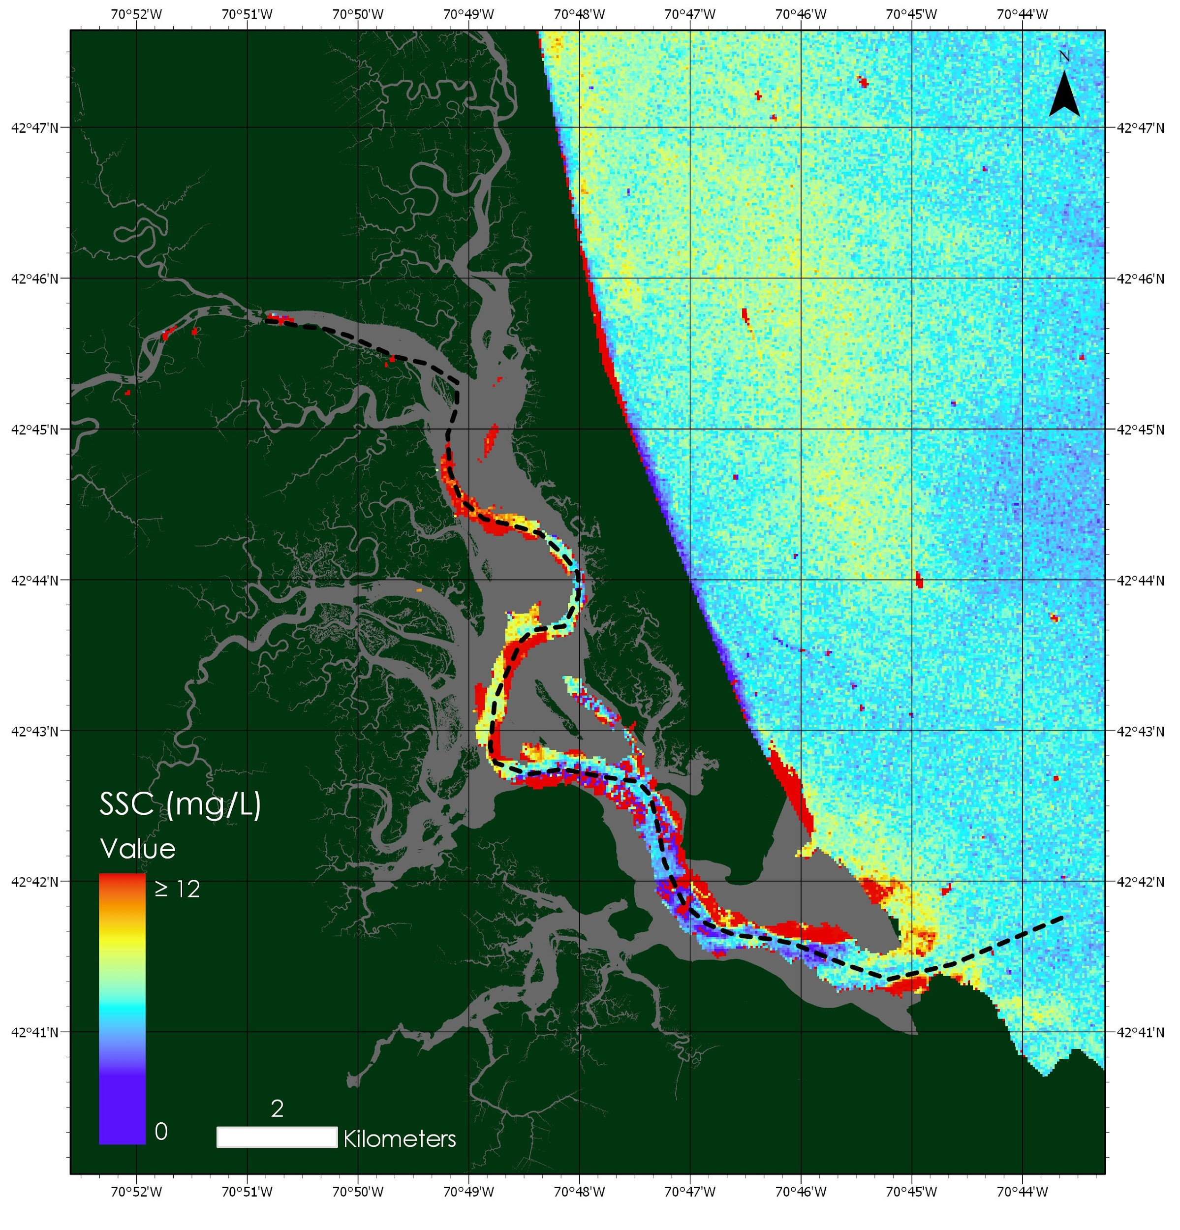
Methodology
Product Generation:
Applied algorithm to imagery and visualized transect data using MATLAB
Collected concentration data from pixels along main channel transect using SeaDAS
Created maps of SSC using ArcGIS Pro
Credit: NASA, mapped in ArcGIS Pro
Notes:
After creating the algorithm, we applied it to all imagery using MATLAB and visualized the results by creating maps of SSC in ArcGIS Pro. We used SeaDAS to draw a transect line through the main channel in the estuary, and collected SSC point measurements from these points. Using MATLAB, we graphed these point measurements versus distance from the top of the estuary into the open ocean. Outliers, designated as SSC measurements greater than 30 mg/L, were omitted from this data. Similarly, all SSC values greater than 12 appear as red pixels on the maps. These red pixels may denote very high SSC or residual topography missed by our bathymetry mask (which uses data from 2010).
Image: USGS, projected in ArcGIS Pro, Date: 8/28/2015

Slide 13
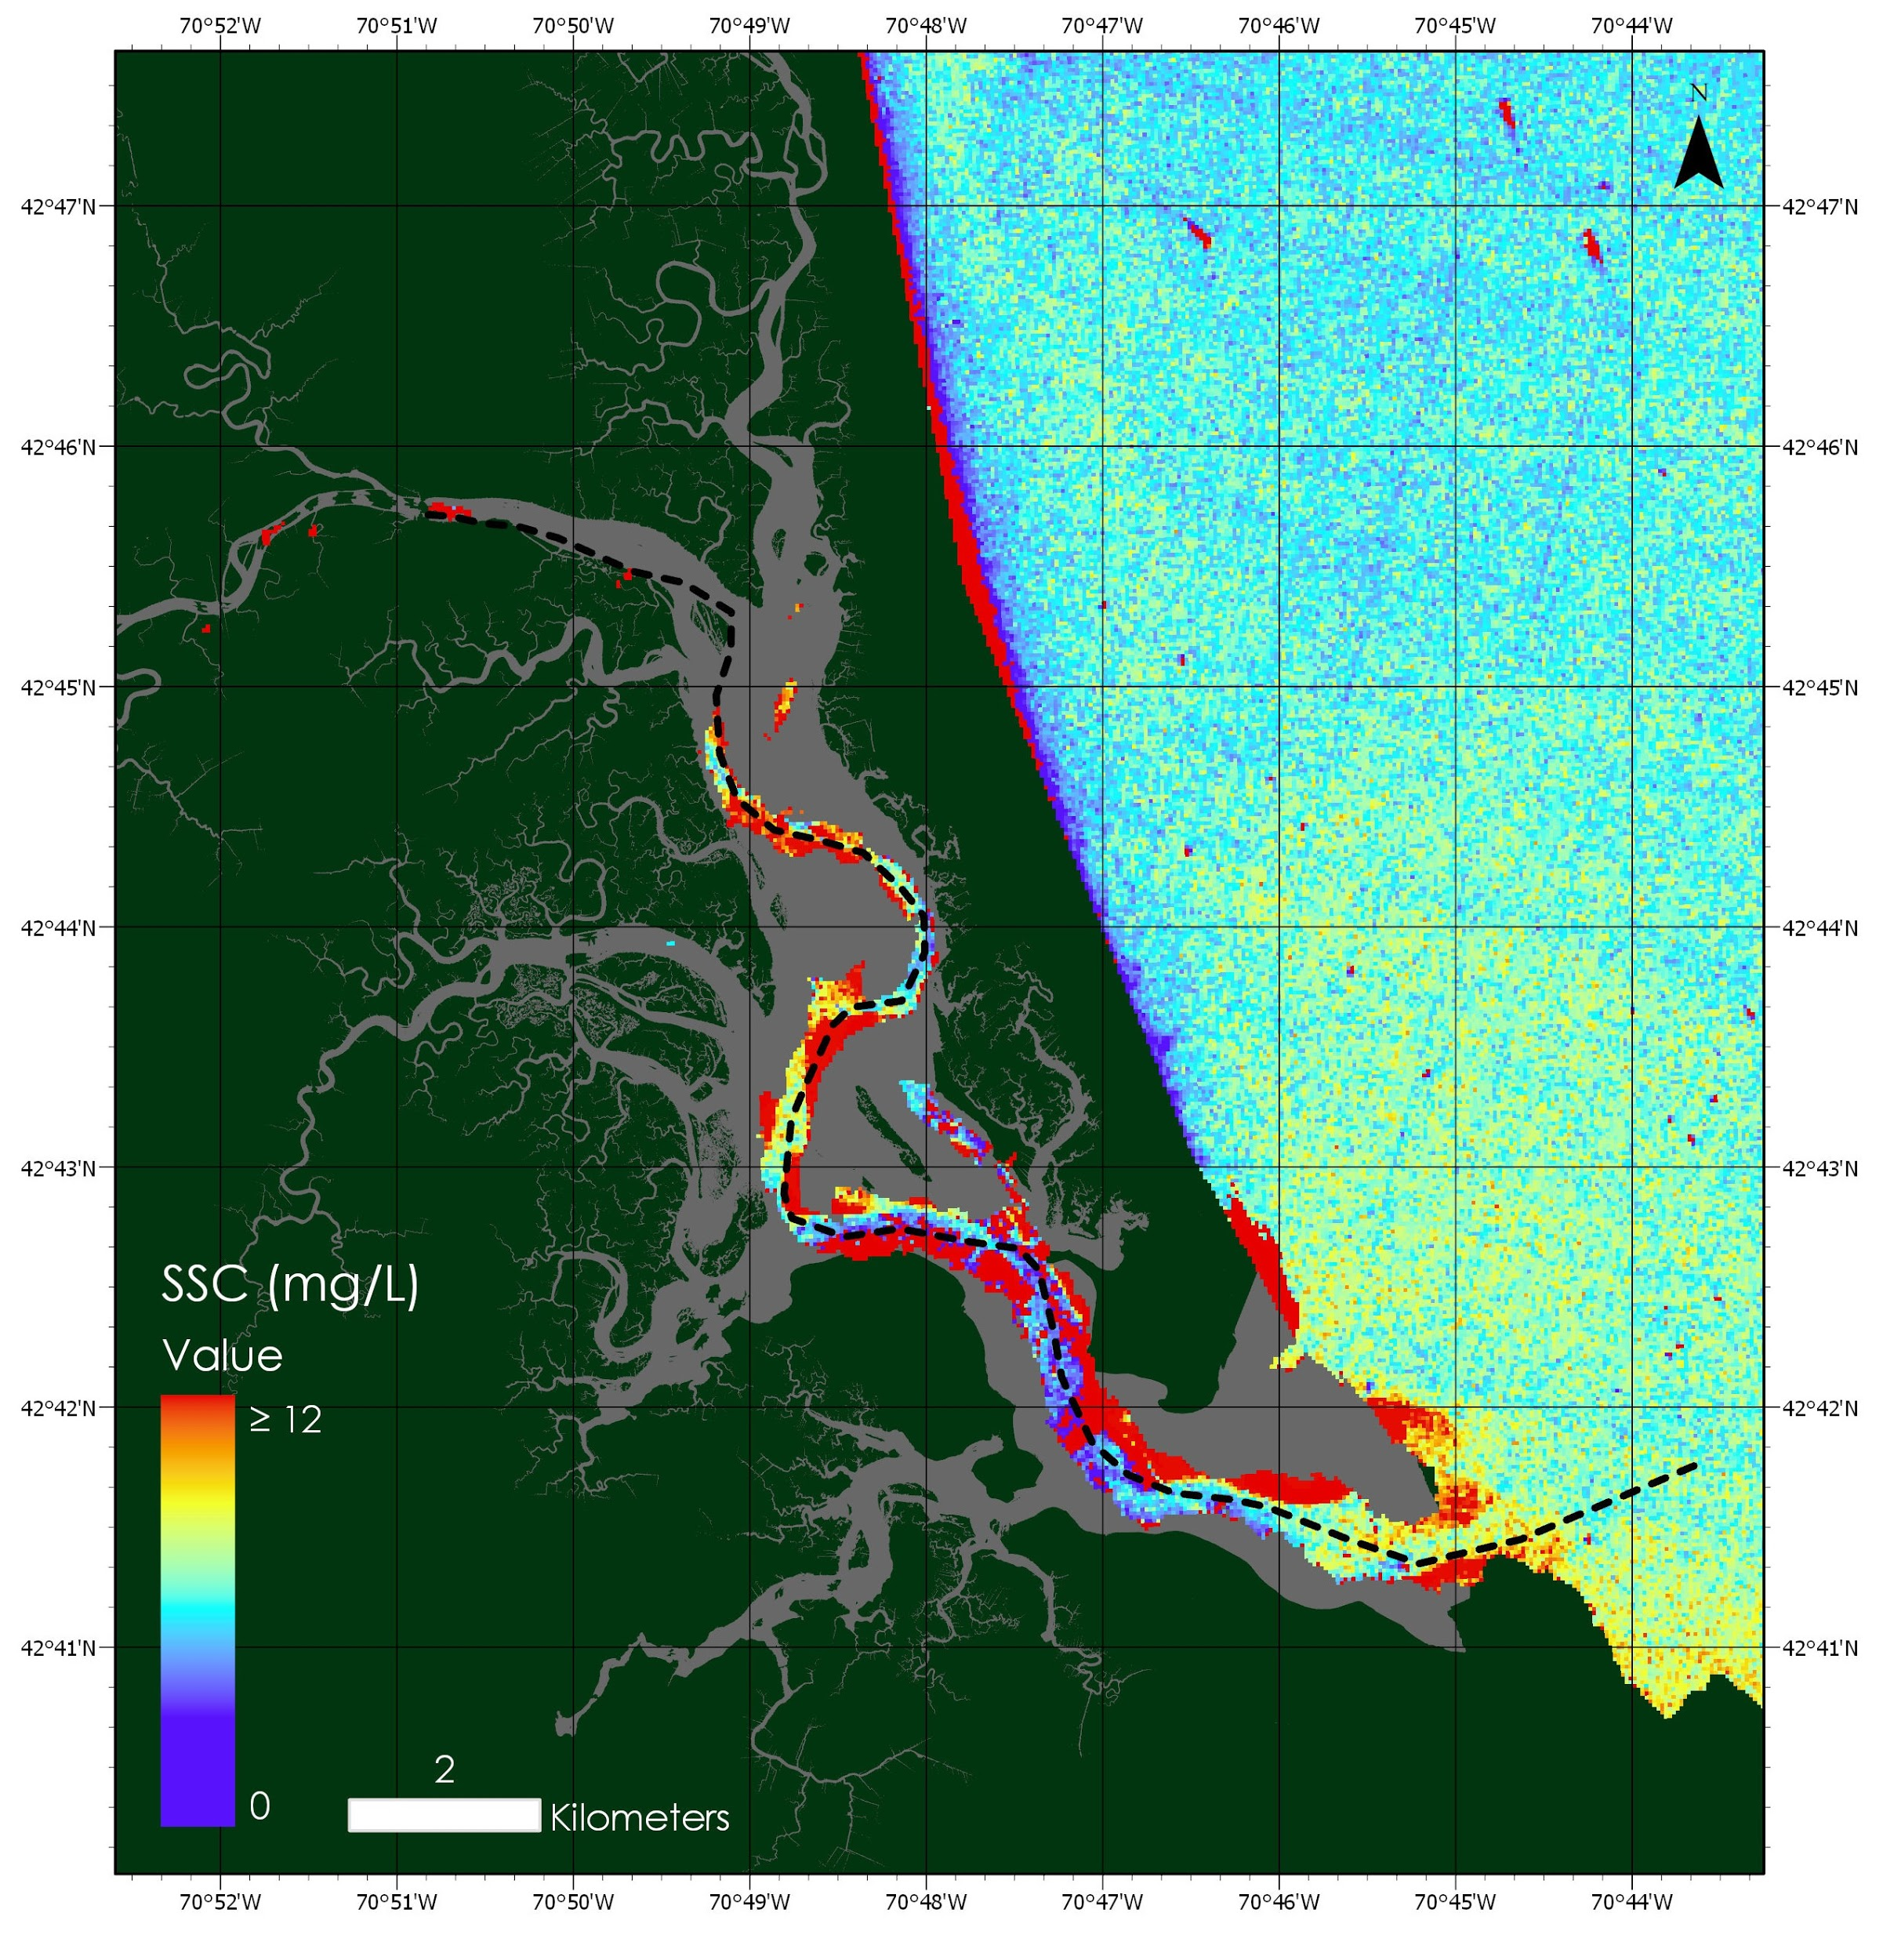
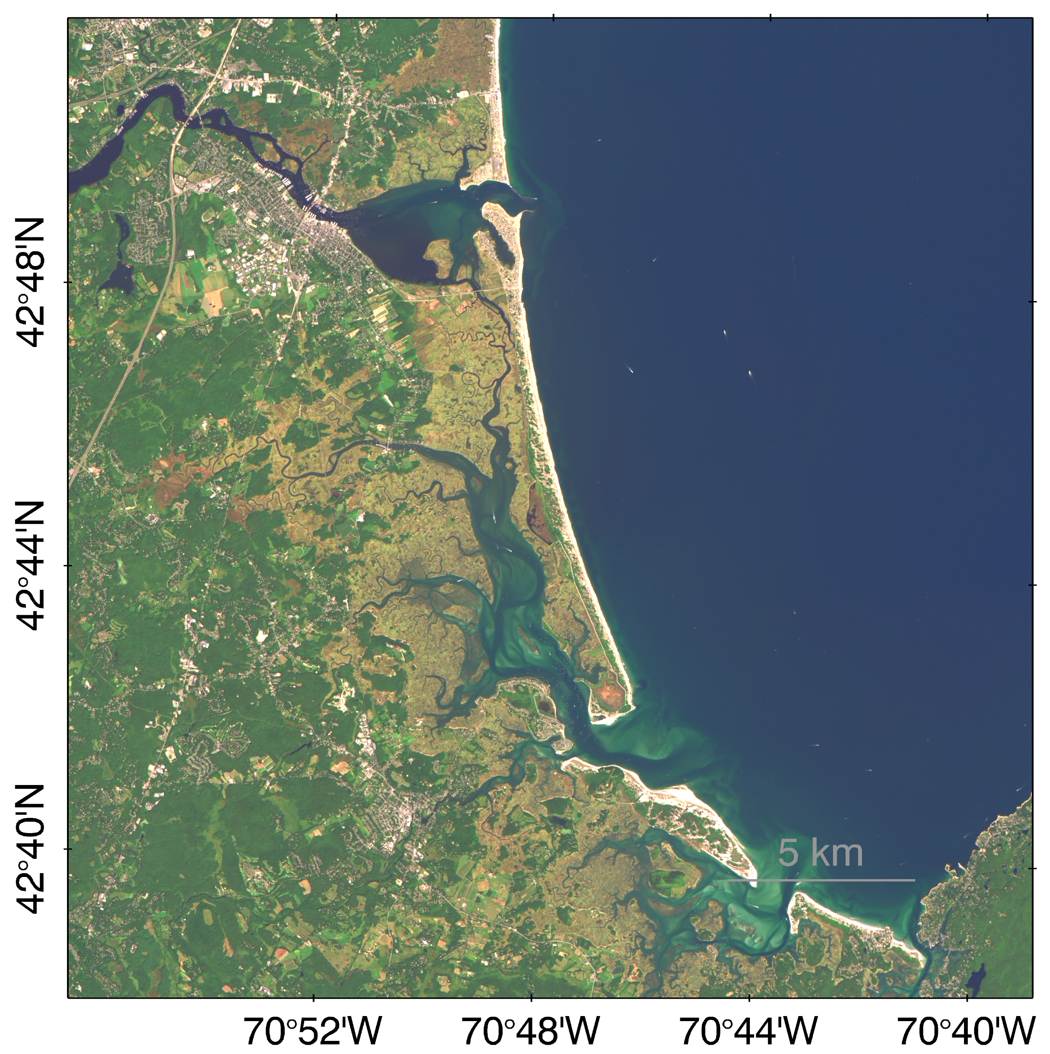
Results
Landsat 8
8/25/2014
Notes:
Our final products include a SSC map displaying the transect, a true color image (TCI) with atmospheric correction, and a graph showing distance vs. SSC along the transect. These products were provided for each date we used in our analysis. Here you will see the SSC map and TCI for a Landsat 8 image taken on 08/25/2014. As you can see, SSC data is shown only in the main channel of the estuary. Data is masked in those areas shallower than 3 meters due to the likelihood that bottom reflectance at shallower depths can interfere with accurate SSC calculation. We are skeptical that red pixels are an accurate representation of SSC. These red areas are likely a product of bottom reflectance or exposed mud flat reflectance.
Image: USGS, projected using ArcGIS and ACOLITE, Date: 8/25/2014

Slide 14
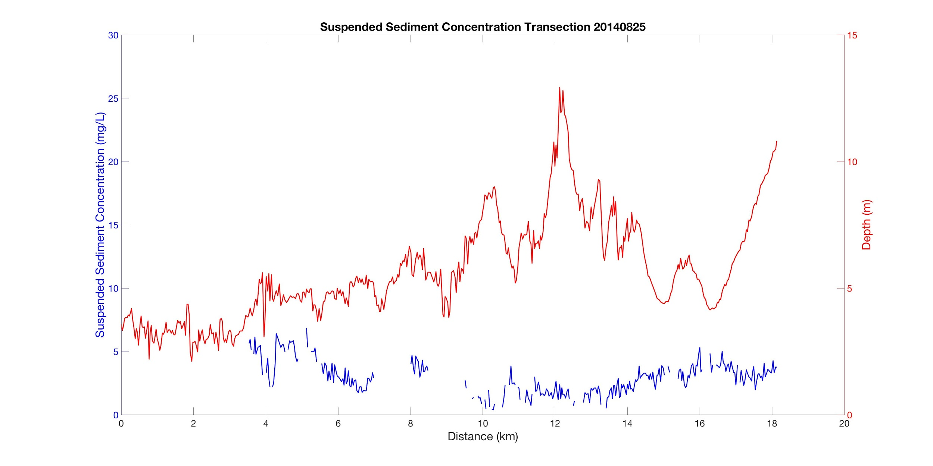
Results
Landsat 8
8/25/2014
Wind Speed: 3.637 m/s
Wind Direction: 276.5°
Tide: 0.94 m
Notes:
This graph shows distance vs. SSC, as well as distance vs. elevation. The transect starts at 0 km and runs the length of 20 km from the top of the estuary, out into the ocean. Depth and SSC are displayed on the same graph to allow the observer to take potential bottom reflectance into account. Outliers over 30 mg/L were eliminated from these graphs. This visualization allows the observer to estimate sediment concentrations along the main channel of the estuary.

Slide 15
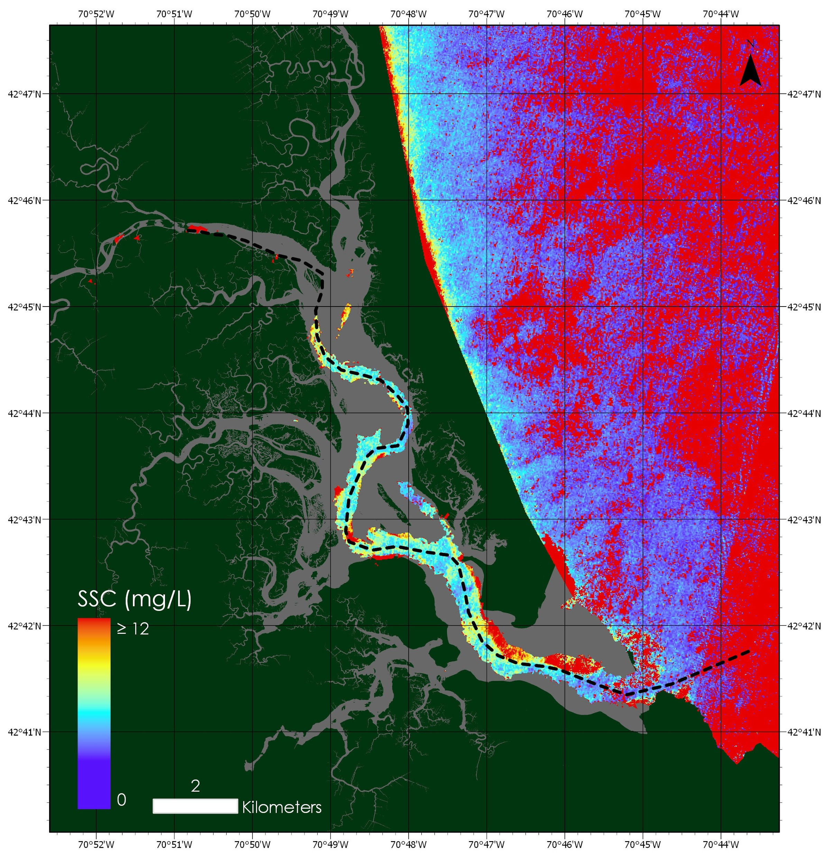
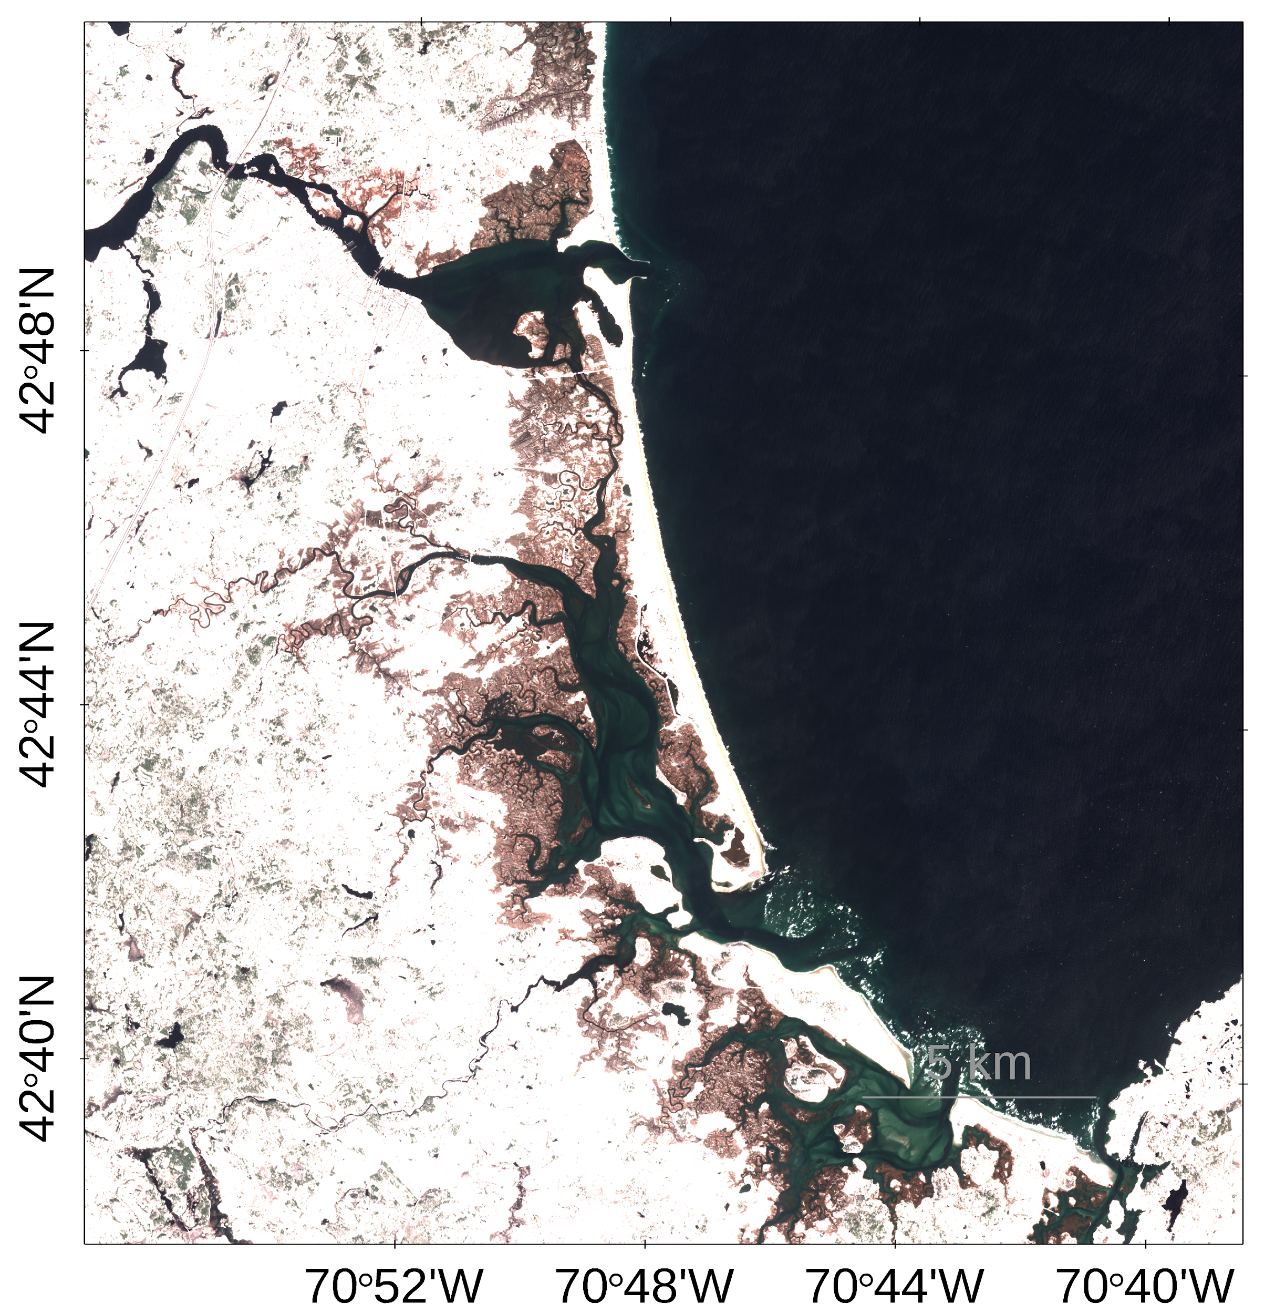
Results
Sentinel-2
4/5/2016
Notes:
These are the same products for Sentinel-2 on 04/05/2016. The SSC map in this case is slightly more clear, with less red pixels.
Image: USGS, projected using ArcGIS and ACOLITE, Date: 04/05/2016

Slide 16
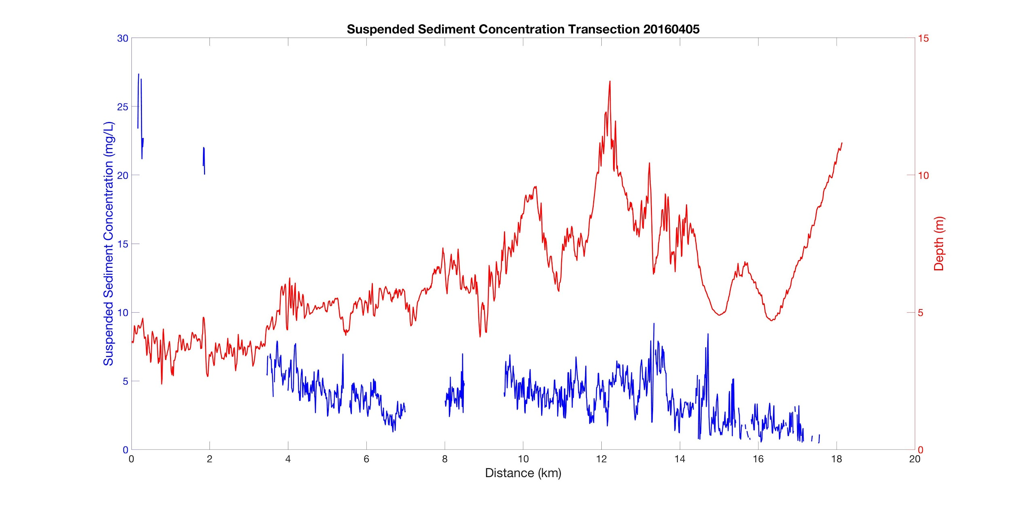
Results
Sentinel-2
4/5/2016
Wind Speed: 2.3 m/s
Wind Direction: 21.8°
Tide: 1.45 m
Notes:
In this case, a decreasing trend in SSC concentration from the beginning to end of the transect appears to be present. We have these products for 28 dates and have compared these maps and graphs over the course of our study period.

Slide 17
Conclusions
In general, it appears suspended sediment concentration decreases along the transect
The applied algorithm is able to derive SSC from remote sensing data, but some of the results still show bottom effect
Atmospheric corrections need to be refined in order to eliminate noise and negative impacts of aerosol
Calculation of SSC in the Plum Island Estuary is feasible for areas deep enough to avoid issues with bottom reflectance
Notes:
A general trend appears to be that SSC decreases from within the estuary, outward to the ocean. This statement is purely observational and has not been tested using any statistical methods. The algorithm created was able to derive SSC from remote sensing reflectance data. However, results continued to show evidence of bottom effect which negatively impacted results. Atmospheric correction needs to be refined to decrease noise and aerosol interference. Successful calculation of SSC appears to be feasible within the estuary, as long as areas deep enough to avoid bottom reflectance are targeted.

Slide 18
Errors and Uncertainties
No gains applied for Sentinel-2 atmospheric correction
Algorithm is based on limited in situ data points
Algorithm is empirical and lacks certainty in optically complex water
May need more accurate or recent bathymetry data
Image Credit: Monet
Credit: USGS, GloVis
Notes:
Limitations in the current version of ACOLITE and SeaDAS prevented us from adjusting the gains when completing the atmospheric correction of Sentinel-2 imagery. Our algorithm for calculating suspended sediment lacks accuracy in these optically complex water, since it is empirical and only a small number of in situ data points were used in its creation. We used a pared-down number of satellite images (28 in total between Landsat 8 and Sentinel-2) because large number of images had to be eliminated due to cloud cover. Additionally, peaks in the transect data and areas of our maps with consistently high SSC values may still be showing the effects of bottom reflectance or topography, which could be corrected by using more recent bathymetry data, as our current mask uses data from 2010.
Image credit: USGS, GloVis, Date: 07/09/2017

Slide 19
Future Work
Incorporate additional Earth observations
Adjust masking methodology to control for bottom reflectance and topography
Use a larger number of in situ data points for algorithm development
Include additional features in analysis, such as the mouth of the Merrimack River, to assess sediment dynamics
Image Credit: Monet
Notes:
Future work on this project will potentially use more imagery from other NASA sensors. Masking methods will be adjusted to better control for features impacting accurate assessment of SSC reflectance. More in situ data will be collected in the coming months to improve the accuracy of the suspended sediment concentration algorithm. Evaluation of nearby potential sediment sources (like the Merrimack River) can provide insight into how the Plum Island Estuary maintains sediment supply.
Image credit: Zach’s image taken in the field

Slide 20
Acknowledgements
We would like to thank the following individuals for their participation in our project:
Our partners:
Dr. Neil Ganju, USGS
Dr. Anne Giblin, PIE LTER
Nancy Pau, USFWS
Our advisers:
Dr. Sergio Fagherazzi, Boston University
Dr. Cedric Fichot, Boston University

