Slide 1
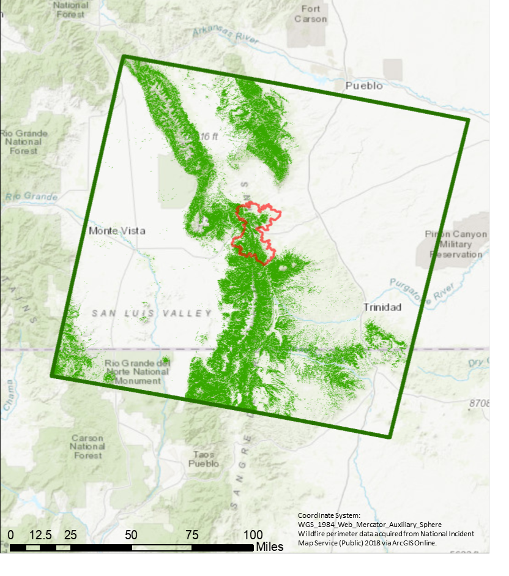
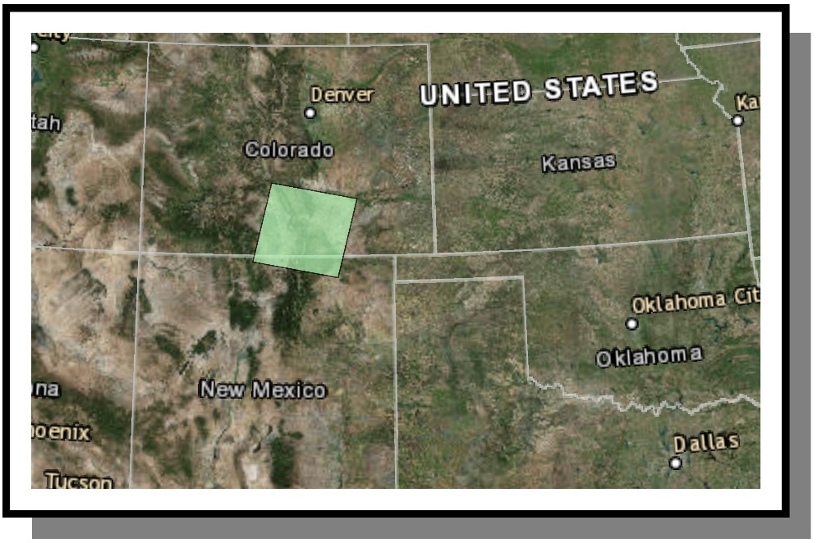
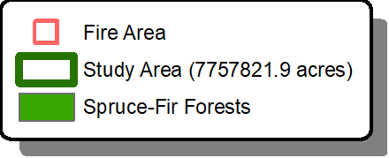

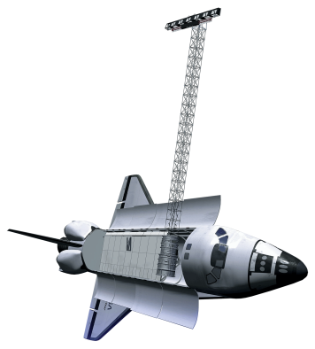
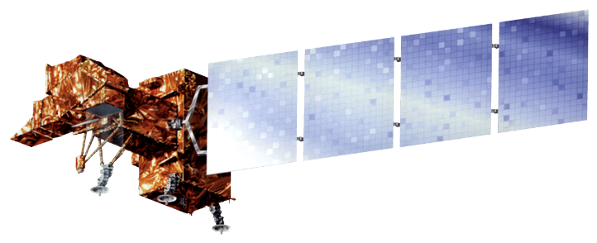

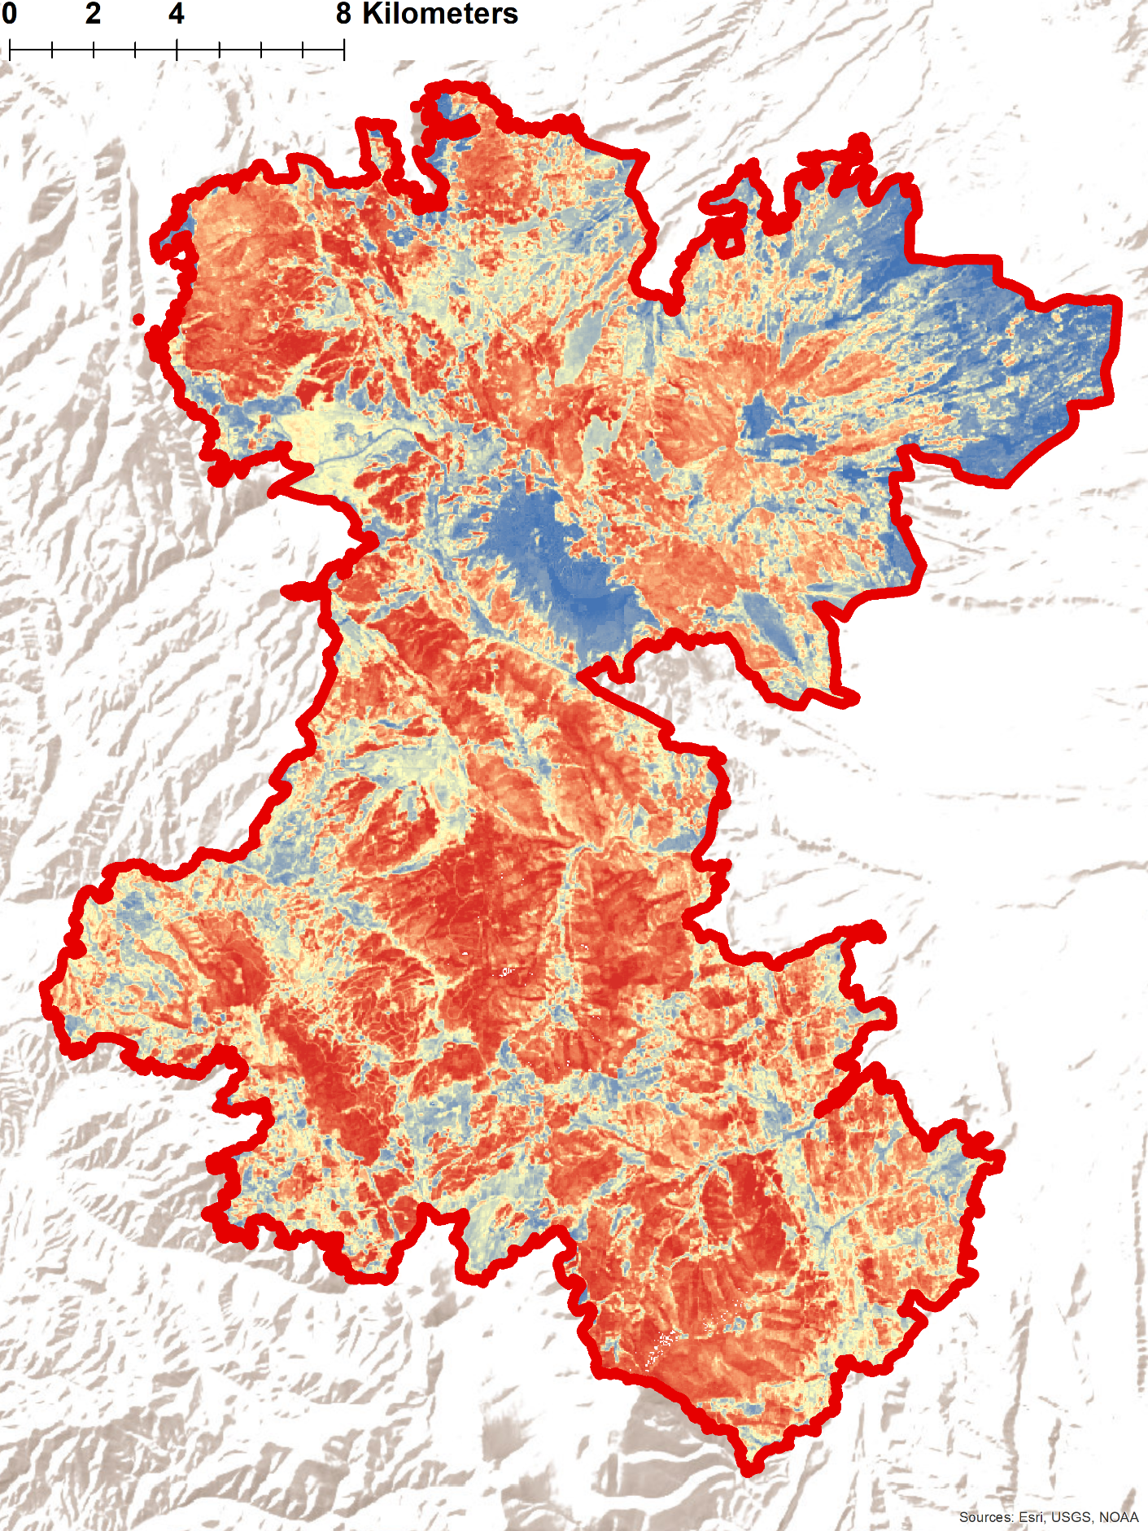
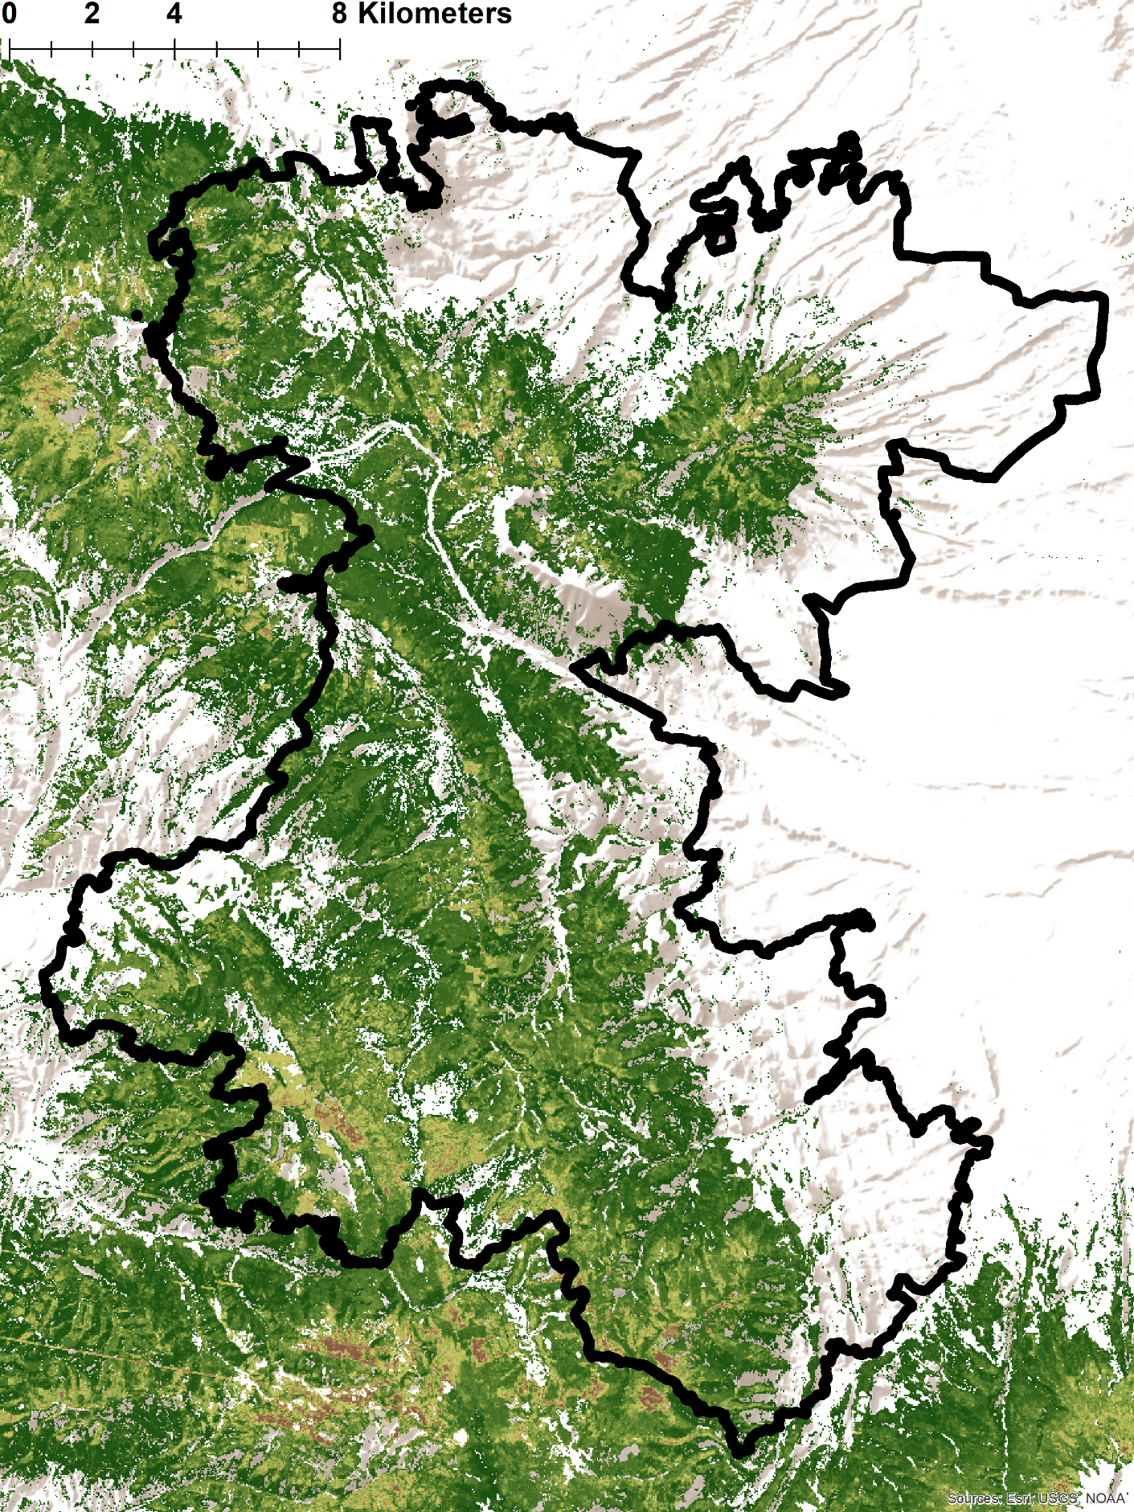
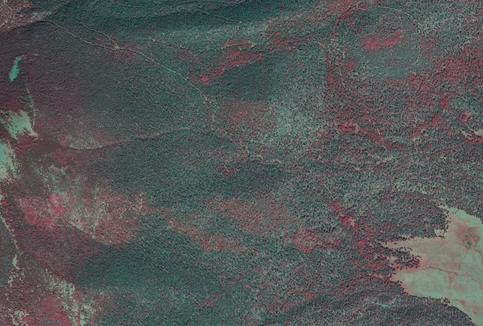
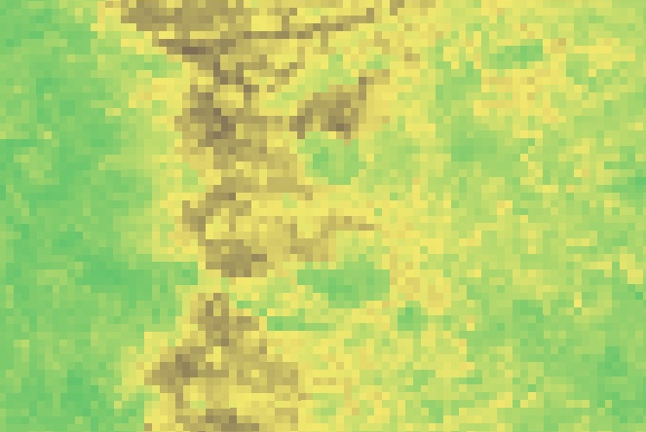
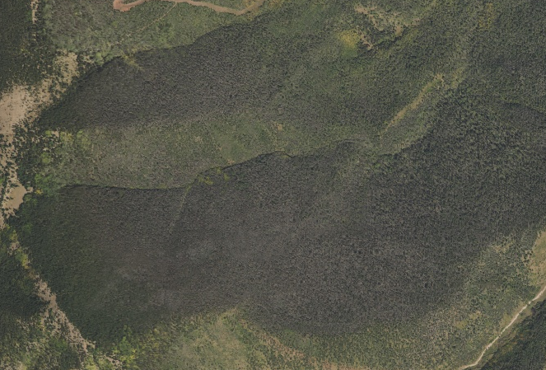
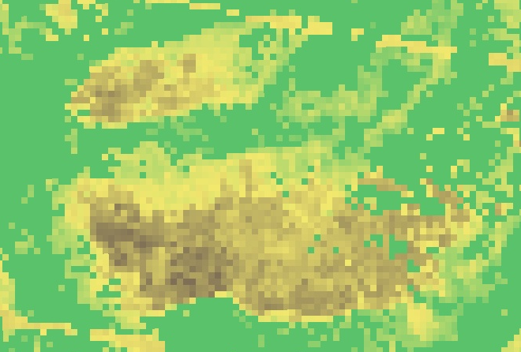




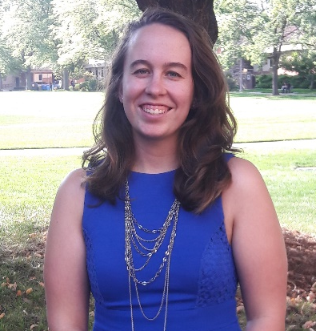
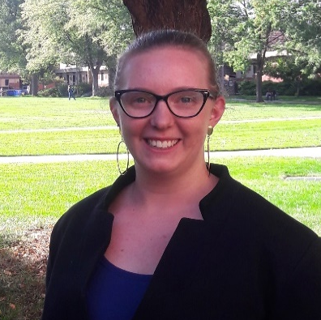
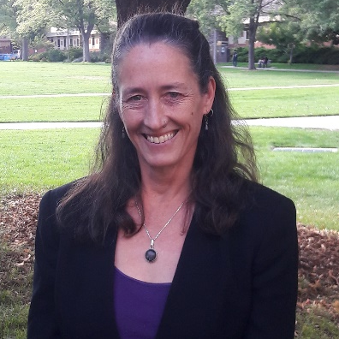
Using NASA Earth Observations to Quantify Tree Mortality and Burn Severity to Inform Management on Ranches and Open Lands
Abstract
Objectives
Both wildfires and forest insect outbreaks have increased in frequency and severity in recent years. Western spruce budworm (Choristoneura freemani), a widespread defoliator in western US forests, has affected over 6,000 hectares of forest in south-central Colorado since 1998. Aaron Swallow, an environmental ranch manager in southern Colorado, is concerned that fuel loading from budworm-related tree mortality will increase the risk of catastrophic wildfire on the lands he manages. To address this concern, we selected a study area encompassing the 2018 Spring Creek Fire footprint. Then, we used NASA Earth observations to: 1) analyze and map regional tree mortality prior to the 2018 Spring Creek Fire; 2) quantify and map burn severity for the Spring Creek Fire; and 3) model the relationship between pre-fire tree mortality and burn severity of the fire. We identified key predictor variables with the Variable Selection Using Random Forests (VSURF) R package and modeled pre-fire tree mortality using the randomForest R package. Burn severity was mapped using the Relativized Burn Ratio (RBR). The maps created from this project provided our partners with a comprehensive assessment of tree mortality, facilitating future restoration and management efforts. Additionally, an accompanying methods tutorial will enable our partners to replicate this analysis for other years, locations, and forest disturbances.
Model and map tree mortality across the study region prior to the 2018 Spring Creek Fire
Quantify and map burn severity of the 2018 Spring Creek Fire
Explore the relationship between pre-fire tree mortality and burn severity using a random forests model
Study Area
Methodology
Sampling
Processing
Modeling
GEE, ArcMap
GEE
R
Spring Creek Fire Perimeter
Plotted U.S. Forest Service Aerial Detection Survey data to identify budworm outbreak dates
Processed spectral indices for predictors
Study Area (~7 million acres)
Employed the VSURF (Variable Selection Using Random Forests) package to identify important predictor variables for tree mortality
Host forest types for budworm
Generated digital ocular sampling locations using 1m NAIP imagery to sample tree mortality
Quantified burn severity of the Spring Creek Fire using RBR (Relativized Burn Ratio)
Earth Observations
Modeled tree mortality using the randomForest package and a one-step and two-step approach
Results
2018 Spring Creek Fire: Burn Severity
Tree Mortality One-Step Model Fall 2017
Landsat 8 OLI
SRTM
Landsat 7 ETM+
Landsat 5 TM
1m NAIP Imagery
Tree Mortality Model Results
One-step approach
False Color
Two-step approach
Low Burn Severity
High Burn Severity
Low Mortality
0.05%
High Mortality
49.50%
True Color
Low Mortality
Moderate Mortality
High Mortality
Conclusions
Project Partners
We used a one-step and two-step approach to model tree mortality – both identified mortality within our study area but varied in their ability to accurately identify low mortality.
The Spring Creek Fire burned at predominantly high severity.
Based on our burn severity model, we could not say whether tree mortality affected burn severity of the Spring Creek Fire.
Colorado State Forest Service
Tercio and Trinchera Ranch
Team Members
Acknowledgements
Dr. Catherine Jarnevich (United States Geologic Survey – Fort Collins Science Center)
Dr. Paul Evangelista (Colorado State University, Natural Resource Ecology Laboratory)
Tony Vorster (Colorado State University, Natural Resource Ecology Laboratory)
Brian Woodward (Colorado State University, Natural Resource Ecology Laboratory)
Nicholas Young (Colorado State University, Natural Resource Ecology Laboratory)
Sophia Leiker
Project Lead
Kristin Davis
Kristen Dennis
Leorah McGinnis
Christa Torrens
Colorado & New Mexico Disasters
Colorado – Fort Collins| Fall 2018

