Slide 1
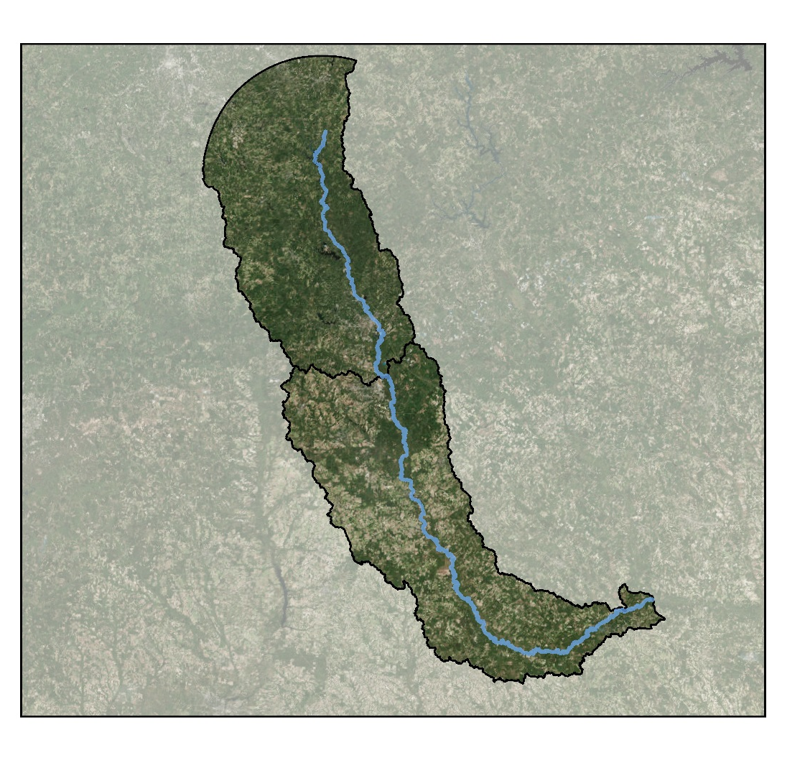
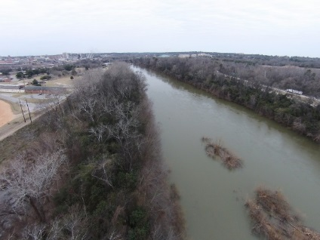
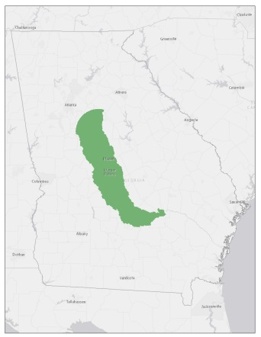
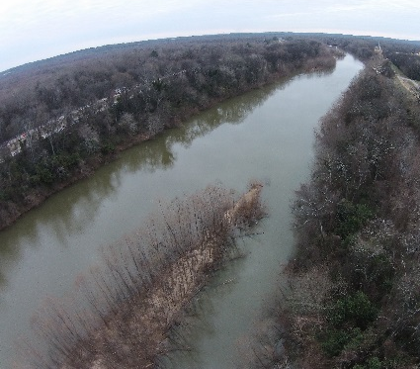
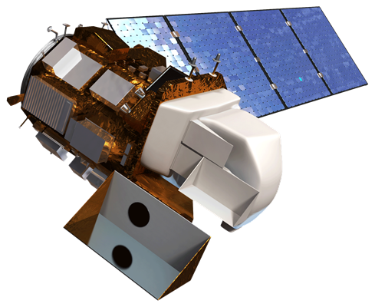
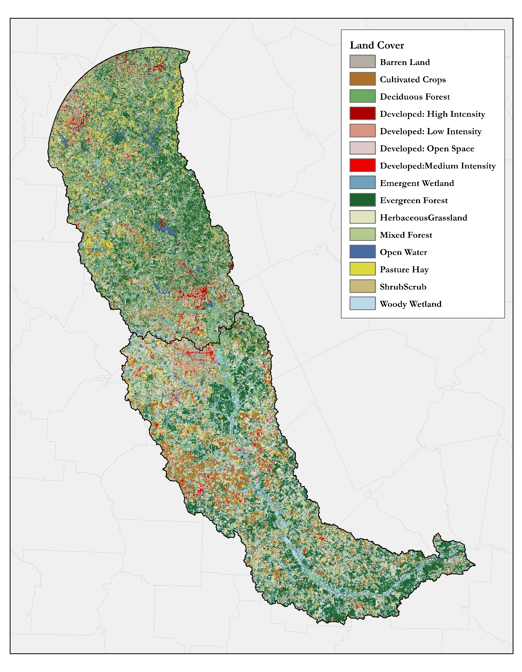
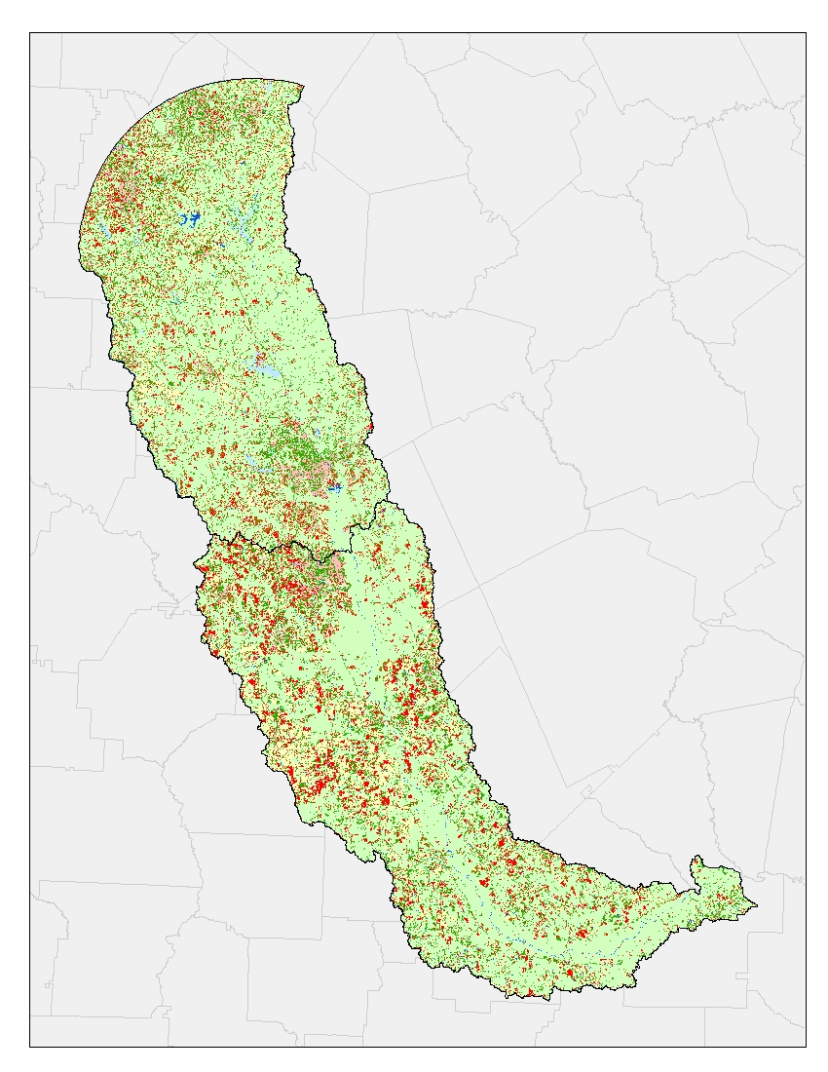
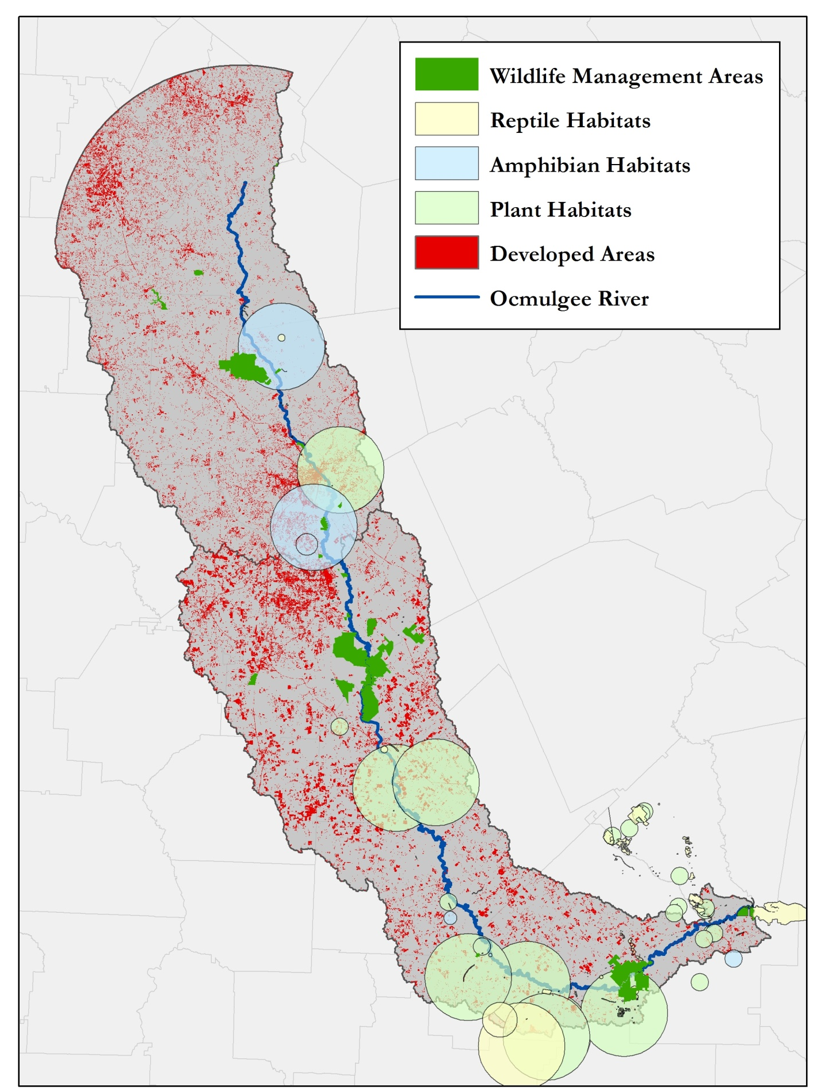
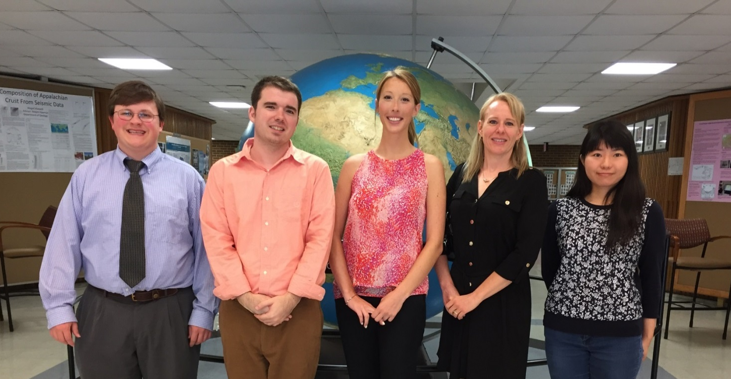
Ocmulgee Ecological Forecasting II
Utilizing NASA’s Earth observations for forecasting land use change and wildlife disturbances along the Ocmulgee River corridor
Christopher Cameron (Project Lead), Andrew Herring, Ayn Remillard, Zhan Shi
NASA DEVELOP at University of Georgia
Abstract
Objectives
The Ocmulgee River corridor is home to unique species such as Atlantic sturgeon, short nosed sturgeon, black bear, and millions of migratory birds. It also holds a rich archeological record of Native American settlement. Over the years, this area has experienced increasing urbanization pressure. The NASA DEVELOP Ocmulgee River Water Resources and Ecological Forecasting team partnered with the Georgia Department of Natural Resources (GA DNR) to conduct a project focused on conserving the Ocmulgee River corridor. The goal of this project was to analyze land cover trends over the past 15 years using National Land Cover Dataset (NLCD) classifications and recent Landsat 8 images to predict future changes within the Ocmulgee River valley. With this goal in mind, a current land cover map was created and the team performed a time-series analysis. Threatened and endangered species habitats and hydrologic characteristics were overlaid with the classification maps to identify areas of concern. Using the results of this project, the GA DNR will be able to prioritize conservation of high risk areas and identify areas of future concern.
Produce a 2014 land cover dataset using Landsat 8 imagery
Quantify land cover change in the Ocmulgee River Valley
Assess historic trends in land cover from 2001 to 2014
Predict land cover changes within the Ocmulgee Corridor
Model effects of land cover change on ecological habitats
Identify priority wildlife conservation areas for state agencies
Study Area
Methodology
DATASETS
ANALYSIS
PRODUCTS
Landsat 8 Imagery
2014 Land Cover Supervised Classification
Land Cover Change Predictions
Historic Land Cover (NLCD)
Ecological Forecasting
Earth Observations
Macon, GA
Land Cover Change Detection
Threat and Opportunity Assessment
Ecology and Wildlife
Results
Conclusions
Landsat 8 OLI
The supervised classification technique provided a more accurate and controlled characterization of the land cover, aligning well with the National Land Cover Dataset.
Land cover change detection from 2001 to 2014 showed increasing developed areas coinciding with urban sprawl around major cities.
Rare plant, amphibian, and reptile communities appear to be the most sensitive to increasing development based on their proximity to mapped urban areas.
Review of our change analysis and ecological data reveals that many of the existing wildlife management areas are situated in locations that would allow GA DNR to expand their conservation efforts to include these habitats.
2014 land cover classification
2001-2014 land cover change detection
Urban encroachment on wildlife habitat
Project Partners
Team Members
Acknowledgements
The Georgia Department of Natural Resources, Wildlife Resources Division (GA DNR)
The University of Georgia, Center for Geospatial Research (UGA-CGR)
Science Advisors:
Dr. Thomas Jordan (UGA-CGR)
Dr. Marguerite Madden (UGA-CGR)
Project Partners:
Thomas Litts (GA DNR)
Melanie Riley (GA DNR)
Past Contributors:
Peter Hawman (DEVELOP)
Gail Miller (DEVELOP)
Steve Padgett-Vasquez (DEVELOP)
Caren Remillard (DEVELOP)
Simmone Simpson (DEVELOP)
Left to right: Andrew Herring, Christopher Cameron, Ayn Remillard, Melanie Riley (GA DNR), and Zhan Shi
University of Georgia

