Slide 1
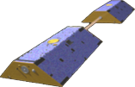
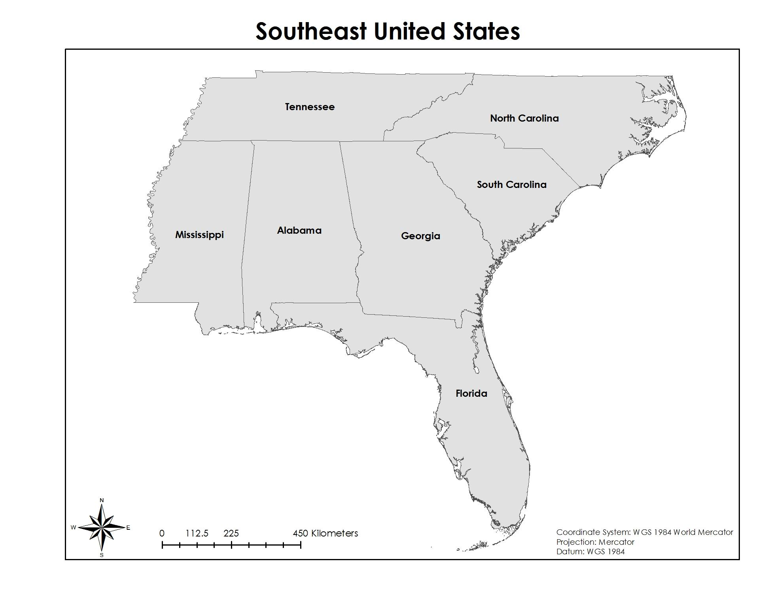
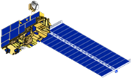
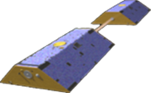
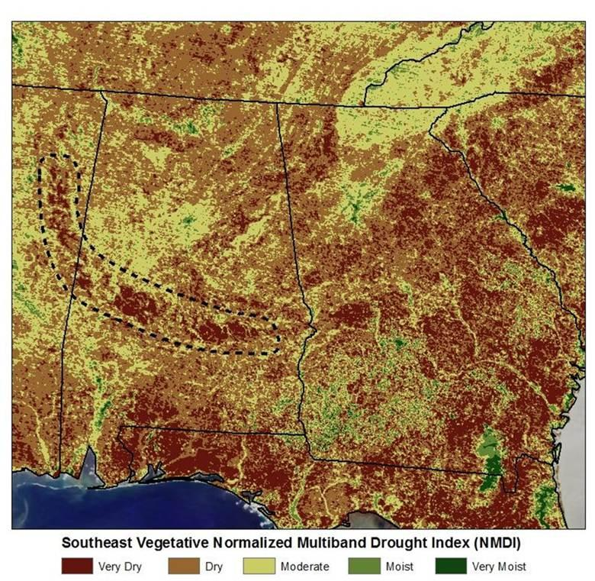
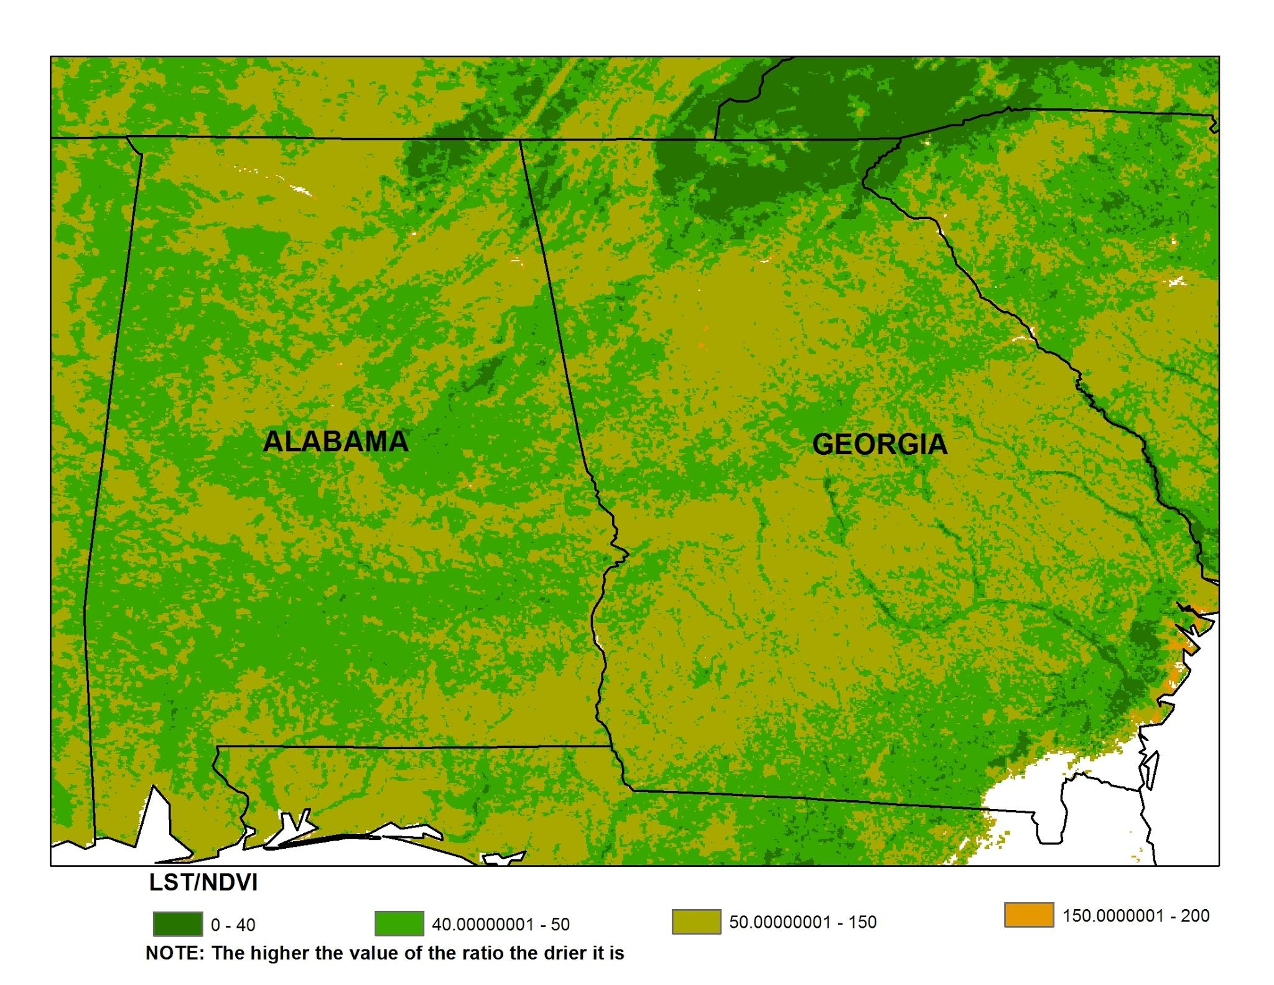
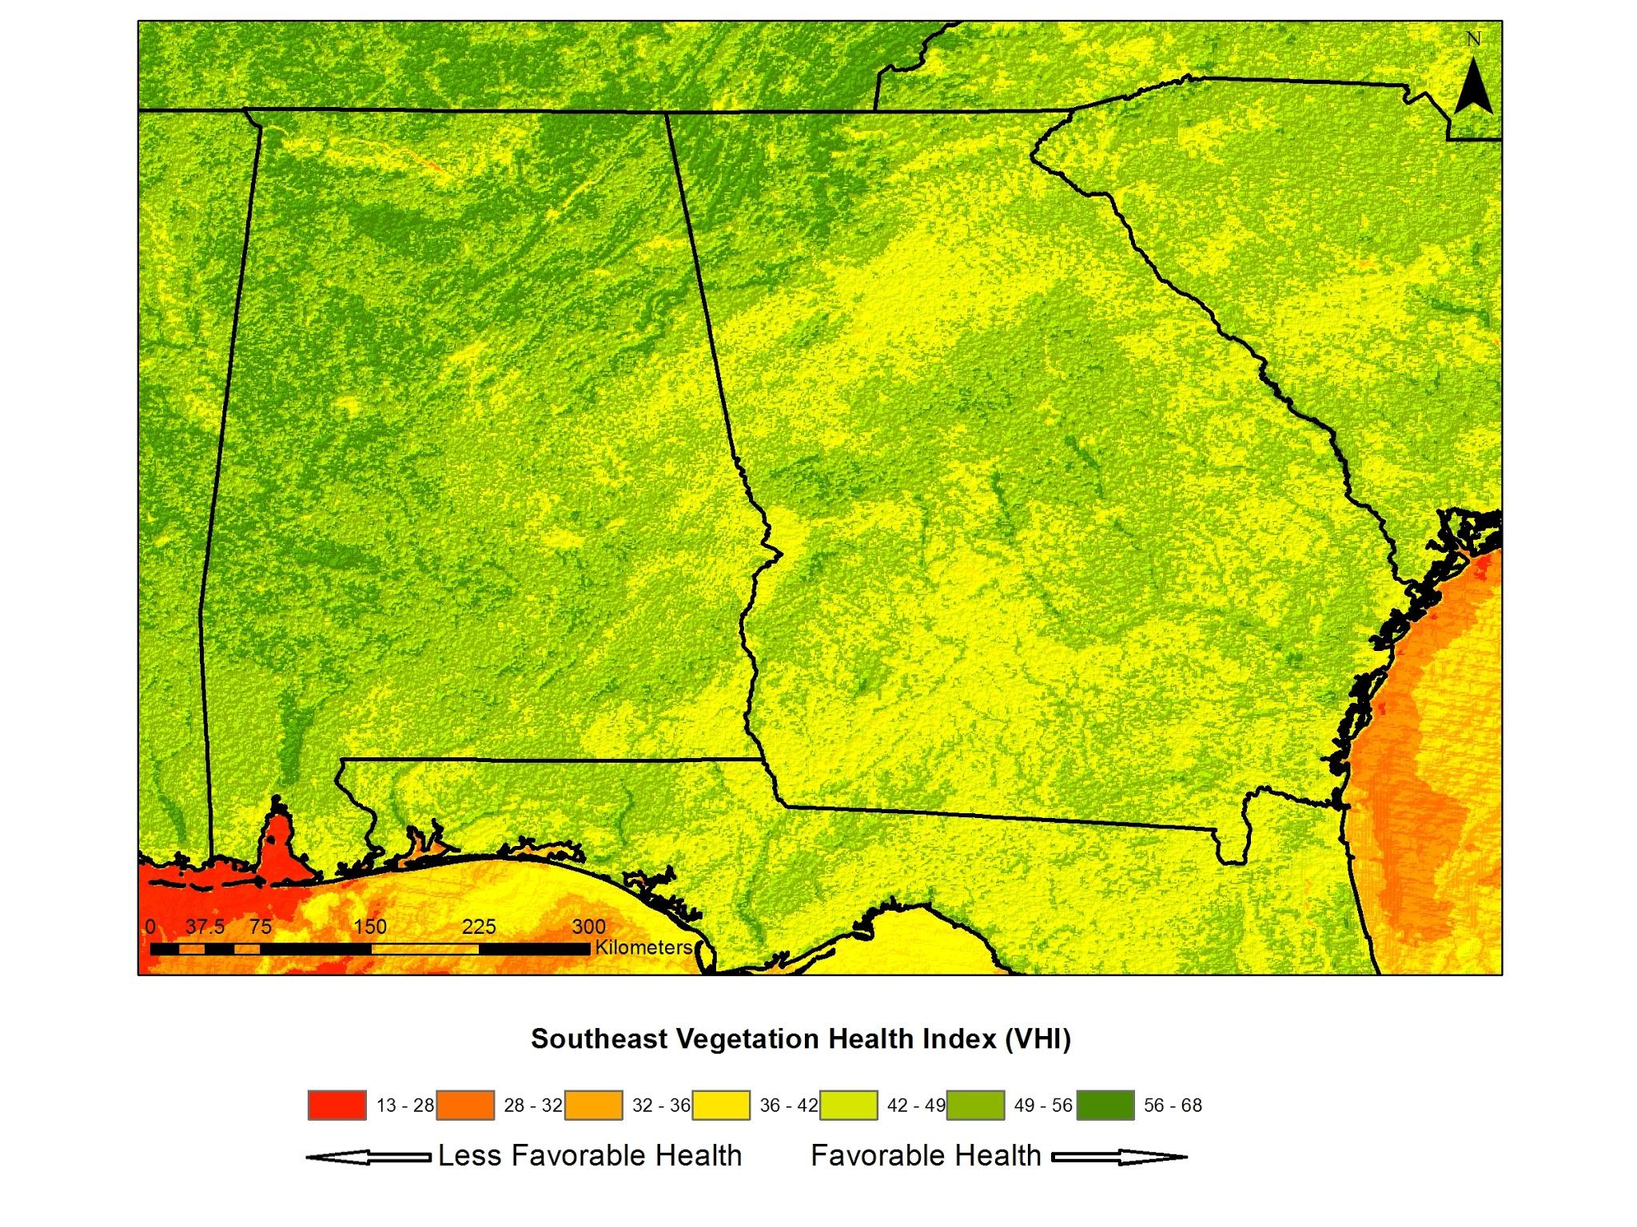
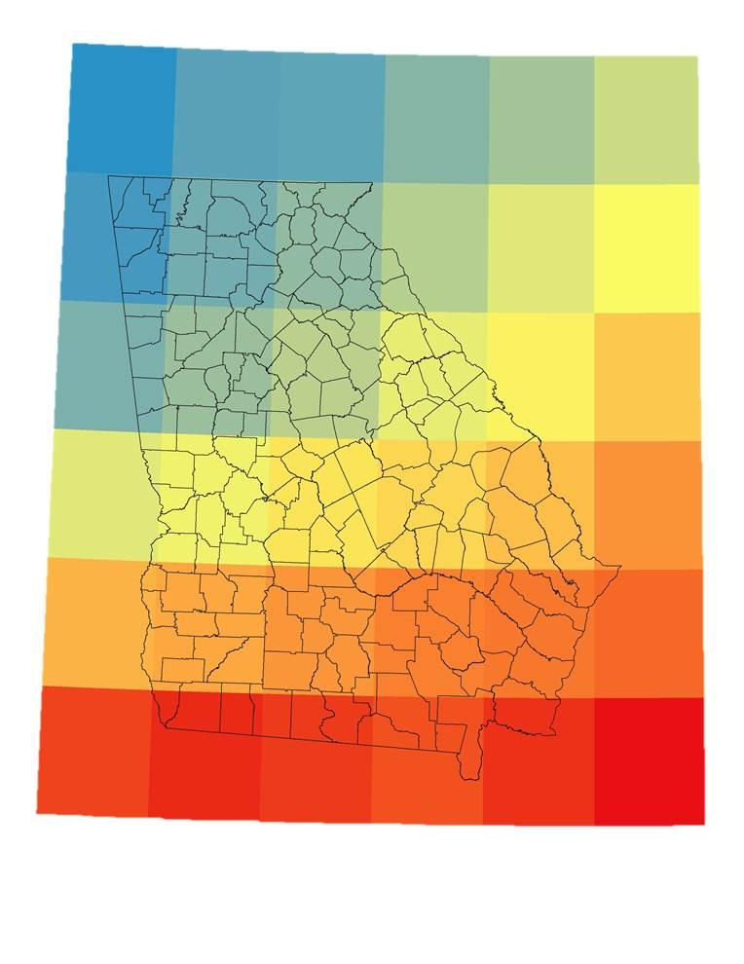
Southeast U.S. Water Resources Development of an Alternative Drought Monitoring System using NASA Earth Observation-Derived Drought Indices and Groundwater Storage Estimates for Improved Water Resource Monitoring in the Southeastern United States
Kaylin Bugbee (University of Alabama in Huntsville), Samuel Ayers (University of Alabama in Huntsville), Leigh Baggett (University of Alabama in Huntsville), Modeste Muhire (Michigan Technological University)
Marshall Space Flight Center
Several western states grow nearly half of all U.S. fruits, vegetables, and nuts. However, due to the scarcity of western water resources, Southeastern agricultural production is expected to increase. This increase in production may lead to a higher demand and strain of water resources. Drought monitoring tools must be developed in order to improve crop and water resource management in the Southeast. Current monitoring methods utilize averaged weekly stream flow conditions to identify drought areas. However, this method often overlooks areas prone to micro-level droughts. To address this issue, alternative drought monitoring methods using NASA Earth observation data are investigated. Drought indices, including the Normalized Multi-band Drought Index (NMDI), the Land Surface Temperature (LST) - Normalized Difference Vegetation Index (NDVI) ratio (LST/NDVI), and the Vegetation Health Index (VHI), are calculated using Terra’s Moderate Resolution Imaging Spectroradiometer (MODIS). Groundwater withdrawals are also estimated using the Gravity Recovery and Climate Experiment (GRACE) instrument. Additionally, the drought indices are cross-checked with water stress values from the Grid Decision Support System for Agrotechnology Transfer (GriDSSAT) crop model. The drought indices investigated in this project can be used to create an easily accessible model that will serve as a decision support tool for water monitoring agencies such as the United States Geological Survey (USGS). This tool will ultimately improve knowledge of drought conditions which will lead to more reliable water usage management practices and agricultural planning.
Develop alternative drought monitoring indices derived from NASA Earth Observations for the Southeast U.S.
Develop an alternative method to monitor changes in groundwater storage using GRACE data
Compare alternative drought indices and groundwater storage estimates with USGS water withdrawal data and GriDSSAT water stress values
Drought monitoring system
MODIS data processing
using ENVI and ArcMap
Drought indices calculation
( LST/NDVI, NMDI, VHI)
MODIS derived drought indices comparison with USGS metered irrigation data
Southeast United States
USGS meter data processing using ArcMap
Irrigation usage at each meter
Ground water storage monitoring system
GRACE data processing using ArcMap
Groundwater anomalies values
Groundwater anomalies comparison with USGS water resources data
Terra’s
MODIS
GRACE
USGS meter data processing using Excel and ArcMap
Ground and soil water resource changes
Map 1: Southeast Vegetative Normalized Multiband Drought Index
Map 2: Southeast Land Surface Temperature/Normalized Difference Vegetation Index (LST/NDVI) Ratio
Drought indices derived by satellite datasets lack the radiometric resolution needed to accurately depict irrigational withdrawals
Satellite derived drought indices can be used to identify the effectiveness of irrigation and to improve crop yields
Map 3: Southeast Vegetation Health Index
Map 4: Annual Changes of Gravitational Anomalies
Georgia Water Science Center, United States Geological Survey
Earth System Science Center, University of Alabama in Huntsville
Mr. Lynn Torak (USGS)
Mr. Cameron Handyside (University of Alabama in Huntsville)
Dr. Jeffrey Luvall (NASA GHCC)
Dr. Rob Griffin (University of Alabama in Huntsville)
Logo
Samuel Ayers, Leigh Baggett, Modeste Muhire, and Kaylin Bugbee
Notes:
----- Meeting Notes (5/31/12 13:25) -----
*

