Slide 1
Gear Order Catalog

Slide 2
: $12
Options: Also available with 20th anniversary logo
All logos available in black or white ink.

Slide 3
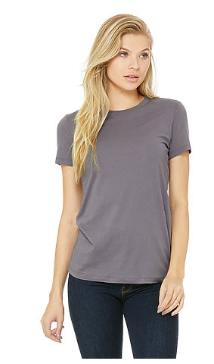
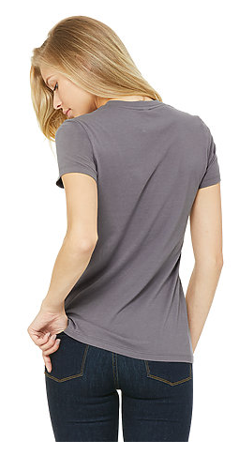
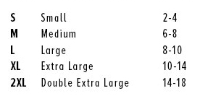
Ladies Bella T-Shirt: $15
Options: Map logo, 20th Anniversary logo, or round logo on back
Ink Color: white or black
Storm
Soft Cream
Heather Aqua
Deep Teal
Heather Grass Green
Ocean Blue
Military Green
Heather Purple
Navy
Heather Raspberry
Black Heather
Heather Maroon
Cardinal
Solid White Blend
Kelly
Solid Black Blend
Shown: Storm
Leaf
Deep Heather
Soft, vintage tee!
Her go-to tee fits like a well-loved favorite, featuring a slim feminine fit, crew neck, short sleeves and superior Airlume combed and ring-spun cotton that acts as the best blank canvas for printing. Offered in a variety of solid and heather cvc colors. Features: Sideseamed. Slim fit. Shoulder taping. Longer body length.
Plum
Gold
Aqua
Heather Red
Dark Grey Heather
Heather True Royal
https://www.bellacanvas.com/product/6004/Womens-The-Favorite-Tee.html

Slide 4
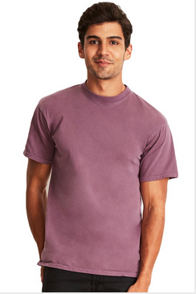
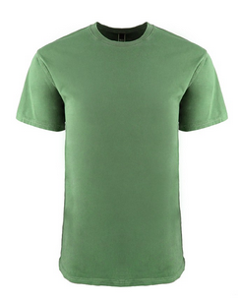
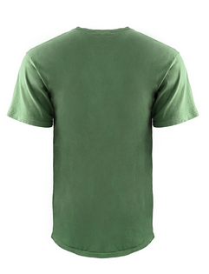
Next Level T-Shirt: $15
Soft, vintage tee!
Options: Map logo, 20th Anniversary logo, or round logo on back
Colors: white or black
Black
White
Blonde
Blue Jean
DETAILS:
Fabric: Inspired Dye
24 Single 185g/5.4oz 100% Combed Ring-Spun Cotton
Neck: CREW NECK
Binding: 1x1 Baby Rib Set-in Collar with Front Cover Stitch. Twill Tape at Back Neck.
Label: Tear away
SIZES: XS S M L XL 2XL 3XL
Clover
Guava
Lead
Ocean
Peri Blue
Shown: Clover
Shown: Shiraz
Shadow
Shiraz
Smoked Paprika
https://www.nextlevelapparel.com/unisex/inspired-dye-crew.html

Slide 5
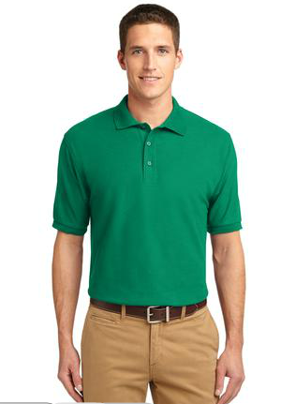
Port Authority (PA) Polo: $20
Banana
Eggplant
Port Authority® Silk Touch™ Polo. An enduring favorite, our comfortable classic polo is anything but ordinary. Has superior wrinkle and shrink resistance, and a silky soft hand.
5-ounce, 65/35 poly/cotton pique
Flat knit collar and cuffs
Metal buttons with dyed-to-match plastic rims
Double-needle armhole seams and hem
Side vents
Options: Available with embroidered DEVELOP logo text in black or white.
Adult Sizes: XS-6XL
Bark
Hibiscus
Black
Kelly Green
Red
Burgundy
Light Pink
Royal
Clover Green
Light Stone
Steel Grey
Cool Grey
Maui Blue
Teal Green
Shown: Kelly Green
Dark Green
Mint Green
Texas Orange
Navy
Ultramarine Blue
https://www.companycasuals.com/CompanyCasuals/b.jsp?prodimage=default&id=53829&parentid=
Deep Berry

Slide 6
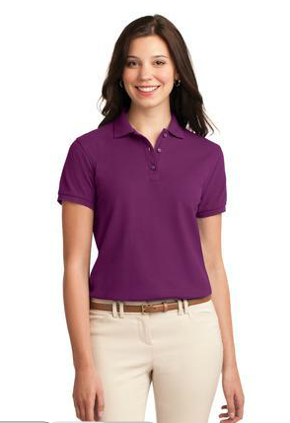
Ladies Port Authority (PA) Polo: $20
Banana
Eggplant
Port Authority® Silk Touch™ Polo. An enduring favorite, our comfortable classic polo is anything but ordinary. Has superior wrinkle and shrink resistance, and a silky soft hand.
5-ounce, 65/35 poly/cotton pique
Flat knit collar and cuffs
Metal buttons with dyed-to-match plastic rims
Double-needle armhole seams and hem
Side vents
Options: Available with embroidered DEVELOP logo text in black or white.
Adult Sizes: XS-6XL
Bark
Hibiscus
Black
Kelly Green
Red
Burgundy
Light Pink
Royal
Clover Green
Light Stone
Steel Grey
Cool Grey
Maui Blue
Teal Green
Dark Green
Mint Green
Texas Orange
Shown: Deep Berry
Navy
Ultramarine Blue
https://www.companycasuals.com/CompanyCasuals/b.jsp?prodimage=default&id=53830&parentid=6863710
Deep Berry

Slide 7
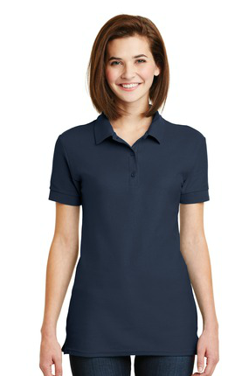
Ladies Gildan Polo: $20
Gildan Ladies 6.6-Ounce 100% Double Pique Cotton Sport Shirt.
6.6-ounce, 100% combed ring spun cotton double pique knit
90/10 cotton/poly (Sport Grey)
Missy contoured silhouette
Heat transfer label
Contoured welt collar and welt cuffs
Rolled forward topstitched shoulders
3-button placket clean-finished placket with reinforced bottom box
Dyed-to-match buttons
Side seamed with side vents
Double-needle bottom hem
Options: Available with embroidered DEVELOP logo text in black or white.
Ladies Sizes: S-3XL
Black
Heliconia
Navy
Red
Sapphire
Sport Grey
White
https://www.companycasuals.com/CompanyCasuals/b.jsp?id=12002611&prodimage=imglib/catl/2016/f4/82800L_heliconia_model_front_012016.jpg&swatch=Heliconia&parentId=7794670
Shown: Navy

Slide 8
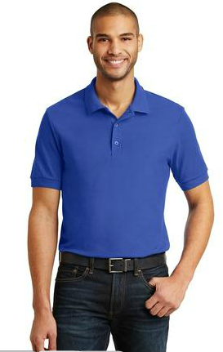
Gildan Polo: $20
Gildan 6.6-Ounce 100% Double Pique Cotton Sport Shirt.
6.6-ounce, 100% combed ring spun cotton double pique knit
90/10 cotton/poly (Sport Grey)
Heat transfer label
Contoured welt collar and welt cuffs
Rolled forward topstitched shoulders
3-button placket clean-finished placket with reinforced bottom box
Dyed-to-match buttons
Side seamed with side vents
Double-needle bottom hem
Options: Available with embroidered DEVELOP logo text in black or white.
Adult Sizes: S-3XL
Black
Navy
Red
Royal
Sapphire
Sport Grey
White
https://www.companycasuals.com/CompanyCasuals/b.jsp?id=12002551&parentId=7794670
Shown: Royal

Slide 9
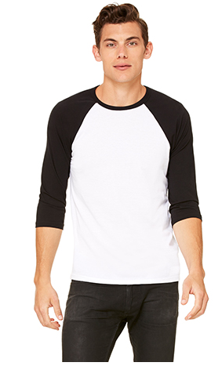
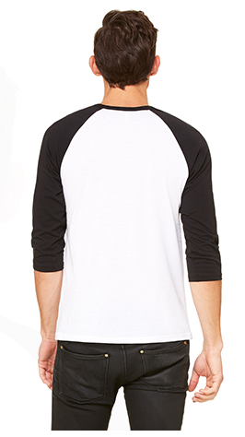
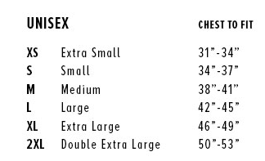
Baseball Tees
$15
White/ Heather Olive
White Fleck/ Charcoal-Black Triblend
Options: Map logo, 20th Anniversary logo, or round logo on back
Ink Color: white or black
Deep Heather/ Black
Grey/ Navy Triblend
White/ True Royal
White/ Navy
White/ Maroon
White/ Red
Black/ True Royal
White/ Black
Grey/ Emerald Triblend
White/ Kelly
White/ Asphalt
Shown: White/ Black
White/ Denim Triblend
The classic baseball tee with raglan 3/4 sleeves takes on a fresh update with a super soft blends of combed and ring-spun cotton, modern fit, three-quarter contrast raglan sleeves and crew neck with contrast trim. Features: Contrast raglan sleeves and neck trim. Sideseamed. Retail fit. Unisex sizing. *Disclaimer: Neons are brighter than they appear online
White/ Neon Yellow
Black Marble/ Black
White/ Neon Pink
White Fleck/ Navy Triblend
White/ Neon Orange
Grey/ Maroon Triblend
White/ Neon Blue
https://www.bellacanvas.com/product/3200/Unisex-34-Sleeve-Baseball-Tee.html

Slide 10
: $15
Options: Also available with 20th anniversary logo
All logos available in black or white ink.

Slide 11
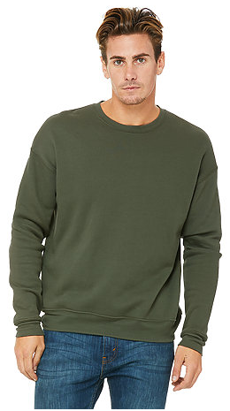
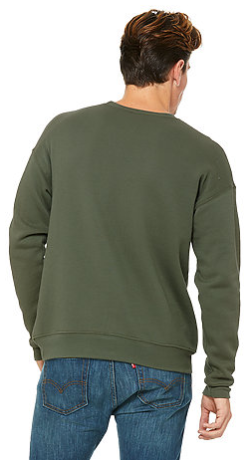
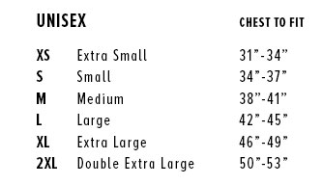
Bella Sweatshirt: $23
A classic pullover sweatshirt in comfy, super-soft fleece designed for warmth and breathability. Featuring an on-trend drop-shoulder seam and a unisex retail fit. Finished with ribbed cuffs and waistband. Offered in poly-cotton sponge fleece. Features: Side-seamed, retail fit, unisex sizing, dropped shoulder, ribbed cuffs and waistband. Fabrication: 52% Airlume combed and ring-spun cotton, 48% polyester fleece, 32 single 6.5 oz.
Peach
Mauve
Heather Stone
Military Green
Storm
Black
Options: Map logo, 20th Anniversary logo, or round logo on back
Ink Color: white or black
Red
Navy
Deep Heather
True Royal
Dark Grey Heather
White
Shown: Military Green
https://www.bellacanvas.com/product/3945/Unisex-Sponge-Fleece-Drop-Shoulder-Sweatshirt.html

Slide 12
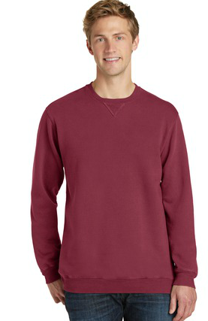
P&C Crewneck Sweatshirt: $23
With aged-to-perfection color, this soft, comfortable sweatshirt is essential and authentic.
8.5-ounce, 80/20 ring spun cotton/poly fleece
100% cotton face
The pigment-dying process infuses each garment with unique character. Please allow for slight color variation. Special consideration must also be taken when printing white ink on pigment-dyed cotton.
Options: Map logo, 20th Anniversary logo, or round logo on back
Ink Color: white or black
Adult Sizes: S-4XL
Amethyst
Merlot
Blue Moon
Mist
Coal
Pewter
Denim Blue
Safari
Fruit Punch
Tidal Wave
Shown: Merlot
https://www.companycasuals.com/CompanyCasuals/b.jsp?id=10958276&prodimage=imglib/catl/2015/f10/PC098_merlot_model_front_042015.jpg&swatch=Merlot&parentId=16655

Slide 13
: $25
Options: 20th Anniversary logo, or round logo on back
Ink Color: white or black

Slide 14
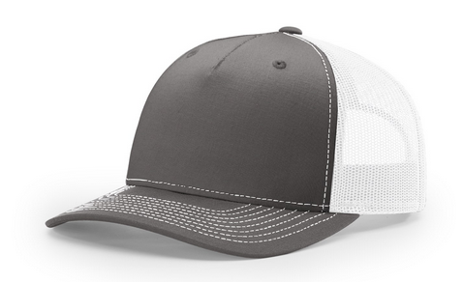
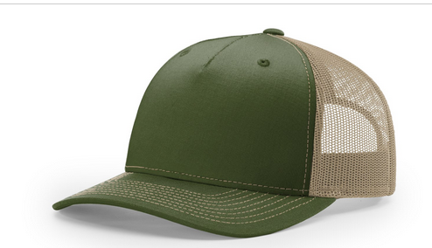
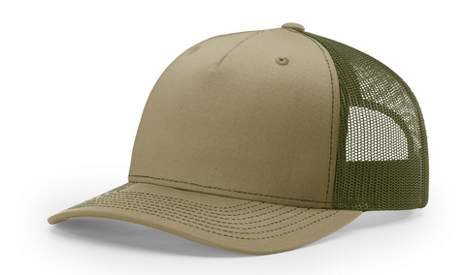
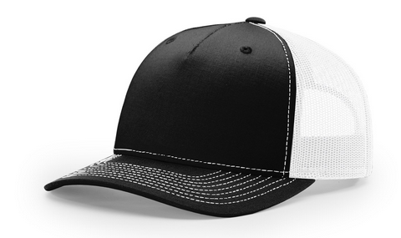
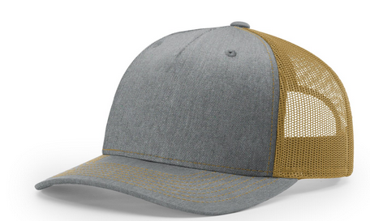
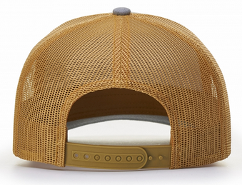
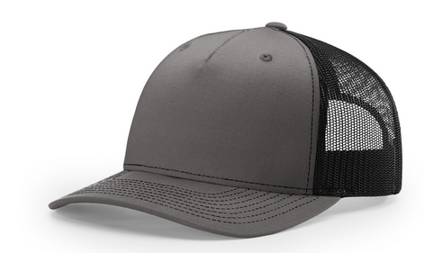
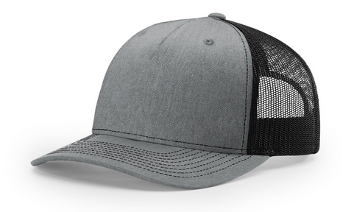
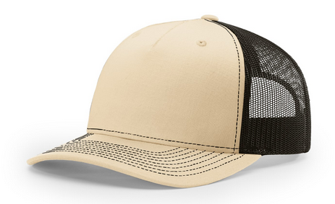
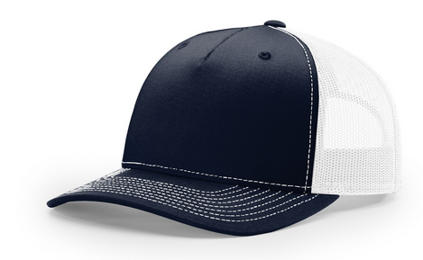
Five Panel Trucker Hat: $18
Heather Grey/ Amber Gold
Charcoal/ White
Army Olive/ Tan
Pale Khaki/ Loden
Black/ White
Charcoal/ Black
Heather Grey/ Black
Khaki/ Coffee
Navy/ White
Classic trucker cap style built with the Richardson quality and fit of our best-selling style now comes in a seamless front, 5-panel construction option.
Shape: MidPro
Fabric: Cotton-Poly/Nylon Mesh
Visor: Precurved
Sweatband: Cotton
Fit & Size:
Adjustable Snapback
One Size Fits Most
Options: Available with embroidered DEVELOP logo text in black or white.
https://richardsonsports.com/headwear/collections/mesh-back/112fp.html

Slide 15
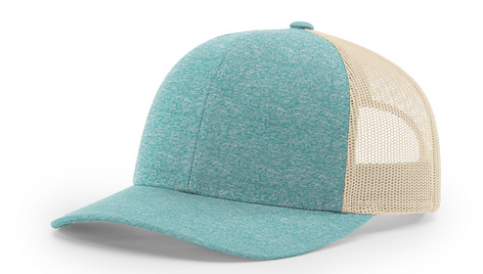
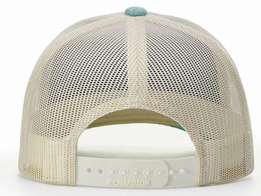
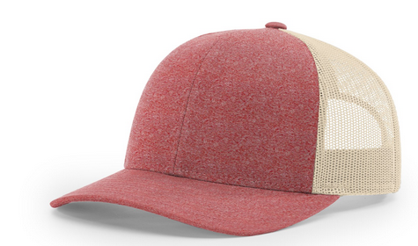
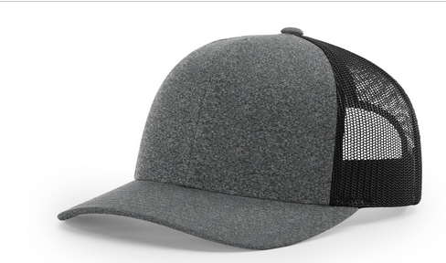
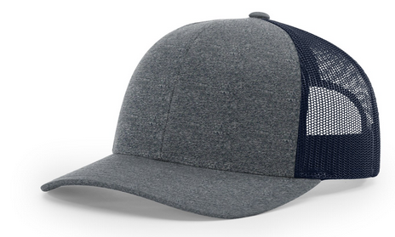
Low Pro Trucker Hat: $18
Green Teal Heather/ Birch
Red Heather/ Birch
Navy Heather/ Navy
Black Heather/ Black
Modeled after their best-selling hat, they designed this cap to have a lower profile and more tailored fit.
Shape: Casual Structured
Fabric: Cotton-Poly/Nylon Mesh
Visor: Precurved
Sweatband: Cotton
Fit & Size:
Adjustable Snapback
MD-LG (6 7/8 - 7 5/8)
SM (6 1/2 - 7 1/4)
Options: Available with embroidered DEVELOP logo text in black or white or the color of the mesh for selected hat (i.e. birch, navy, black).
https://richardsonsports.com/headwear/collections/mesh-back/115ch.html

Slide 16
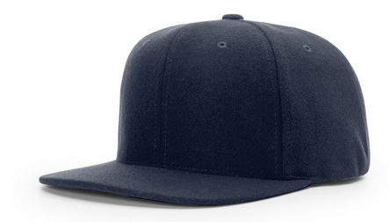
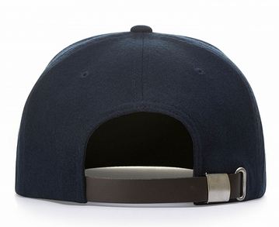
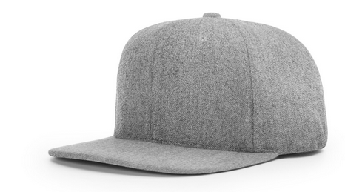
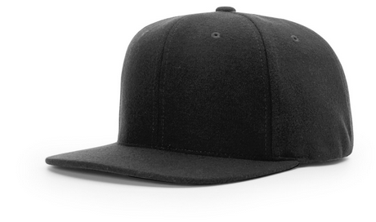
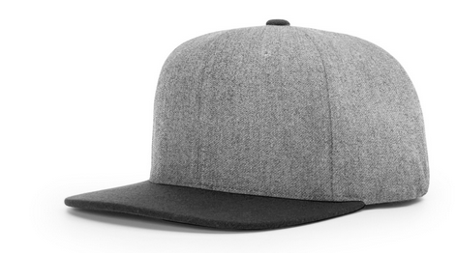
Melton Wool Cap: $22
Navy
Heather Grey/ Black
Black
Heather Grey
Melton wool, a high-quality brass buckle on the leather strapback, and a flat visor give this classic shaped cap some premium style.
Shape: HiPro Structured
Fabric: Melton Wool
Visor: Flat
Sweatband: Cotton
Fit & Size: Adjustable Leather, Backstrap
Size: One Size Fits Most
Options: Available with embroidered DEVELOP logo text in black or white.
https://richardsonsports.com/headwear/collections/street/921.html

Slide 17
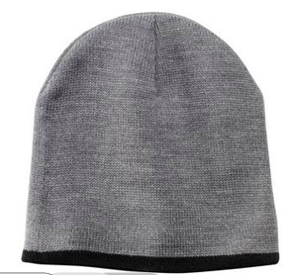
Beanie: $12
Athletic Oxford
Navy
Athletic Oxford/ Black
Navy/ Natural
Shown: Athletic Oxford/ Black
Athletic Red
Neon Blue
Options: Available with embroidered DEVELOP logo text in black or white.
Notes: If second color is listed, the second color is the color of the trim. If only one color is listed, beanie is one solid color.
Size: One Size Fits Most
Athletic Royal
Neon Green
Black
Neon Orange
Black/ Natural
Neon Pink Glo
Natural/ Navy
Neon Yellow
https://www.companycasuals.com/CompanyCasuals/b.jsp?id=17690&prodimage=imglib/catl/CP91UAOBK03MS.jpg&swatch=Athletic++Oxford%2FBlack

Slide 18
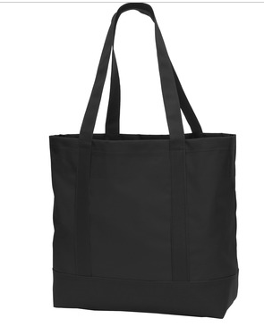
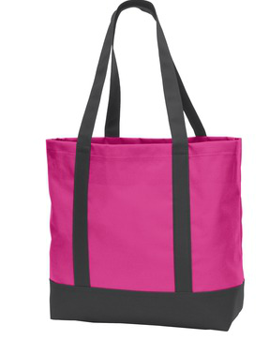
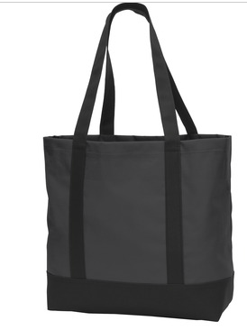
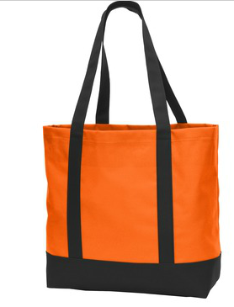
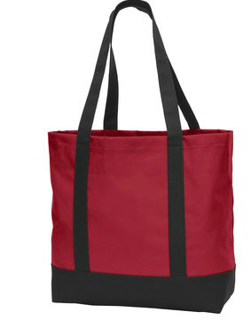
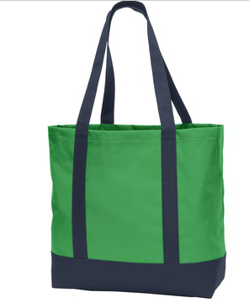
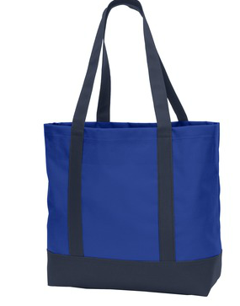
Day Totes: $10
Black/ Black
Tropical Pink/ Dark Charcoal
Dark Charcoal/ Black
Neon Orange/ Black
Chili Red/ Black
Classic Green/ Navy
Twilight Blue/ Navy
Options: Map logo, 20th Anniversary logo, or round logo on back
Colors: white
https://www.companycasuals.com/CompanyCasuals/b.jsp?id=10941340&prodimage=imglib/catl/2015/f10/BG406_twilightbluenavy_front.jpg&swatch=Twilight+Blue%2F+Navy&parentId=7794701

Slide 19
Now available with: Round logo or 20th anniversary logo

