Slide 1
Southwest
Water Resources
Monitoring Surface Water Extents of Remote Stock Ponds in the Southwestern United States Using Earth Observing Systems for Enhanced Water Resources Management
Rainey Aberle, Rebecca Bernat, Michael Corley, Lukman Fashina, & Kyle Paulekas
Idaho - Pocatello
Notes:
(Rebecca)
Hello everyone, and welcome to the Southwest Water Resources presentation from the summer 2021 NASA DEVELOP term. We are one half of the Idaho-Pocatello DEVELOP node and we are excited to share our work with you today.

Slide 2
Presentation Outline
Background
Study Area | Community Concerns | Objectives | Partner Organizations
Methodology
Data Acquisition | Data Processing | Data Analyses
Results
Method Accuracy | Time Series Map | Water Extent Monitoring Tool
Conclusions
Key Findings & End Products | Future Work
Notes:
(Rebecca)
As a brief outline for what we will be covering in this presentation, we will first go over the Background of the project, including the Study Area, Community Concerns, Objectives, and our Partner Organizations. We will then walk through the Methodology of our Data Acquisition, Processing, and Analyses. Then, we will discuss the Method Accuracy, Time Series Map, and Water Extent Monitoring Tool resulting from our work, and we will end with our key findings and Future Work.

Slide 3
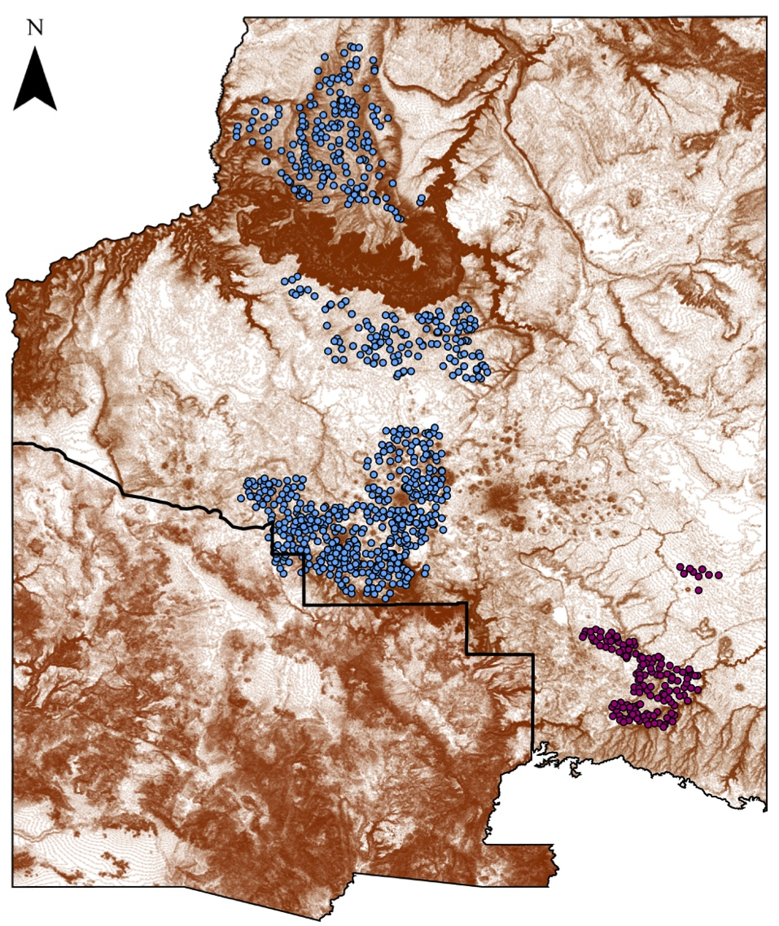
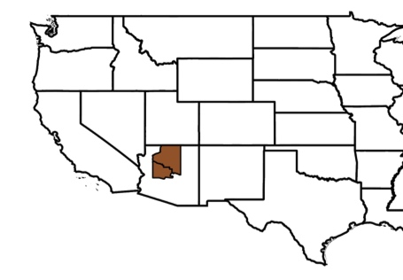
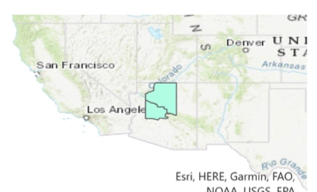
Northern Arizona
Kaibab and Coconino National Forests
Characterized by desert shrub, ponderosa pine, and sub-alpine fir
Manages 800+ stock ponds
0
40
80
Area of study
Miles
Counties
Bar T Bar Ranch ponds
Kaibab National Forest ponds
Background
Methodology
Results
Conclusions
Notes:
(Rebecca)
Our study area is located primarily in the Kaibab and Coconino National Forests in northern Arizona. The region is characterized by a range of vegetation types, including desert shrubs, ponderosa pines, and sub-alpine fir. The forest also holds over 800 stock ponds which provide critical water supply for the local wildlife and land and livestock managers. In the figure on the right, you can see several hundreds of identified stock pond points in the Kaibab National Forest represented by the blue dots and near the Bar T Bar ranch in purple.
Study Area Map – Southwest Water Resources (Base: ESRI, HERE, Garmin, FAO, NOAA, USGS, EPA)

Slide 4
Community Concerns
Land and livestock management
Due to their remote locations, it is difficult to monitor regional stock ponds to inform management decisions.
Food security
Insufficient hydrologic monitoring data may lead to community-wide food insecurity.
Ecosystem health
Stock ponds play a crucial role in ecosystem health because they provide for the local wildlife.
Images: PowerPoint, Microsoft 365
Background
Methodology
Results
Conclusions
Notes:
(Kyle)
The focus of this DEVELOP project is a direct response to several concerns communicated by communities in the southwest U.S.
Firstly, land and livestock management: stock ponds in the region cover a wide geographic spread and are often in remote locations, which can take several hours for land and livestock managers to travel to. Because the water levels of these stock ponds vary annually and seasonally, this makes it difficult to monitor water levels frequently enough to make informed management decisions.
Insufficient hydrologic data prevents accurate and efficient cattle management decisions. These decisions may impact surrounding communities by increasing food insecurity.
Lastly, varying water levels in stock ponds and other water bodies impact local wildlife from big game to small amphibians--each species playing a role in ecosystem health.

Slide 5
Project Objectives
Develop a more efficient method
to monitor regional stock pond surface extents using Earth observations
Create a
time series
of automatically delineated regional areal extents of water in recent years
Design a tool
for near-real time water level monitoring within regional grazing allotments
Images: PowerPoint, Microsoft 365
Background
Methodology
Results
Conclusions
Notes:
(Kyle)
To address these concerns, the team developed three primary objectives for the project.
(1) Develop a more efficient method to monitor regional water levels using Earth observations, which have not previously been used by the community.
(2) Create a time series of automatically delineated surface water body extents in recent years. This will shed light on both the temporal and spatial trends in water levels.
(3) Create a tool for near-real time stock pond water level monitoring for grazing allotments which the community can use as more data are collected in years to come.

Slide 6
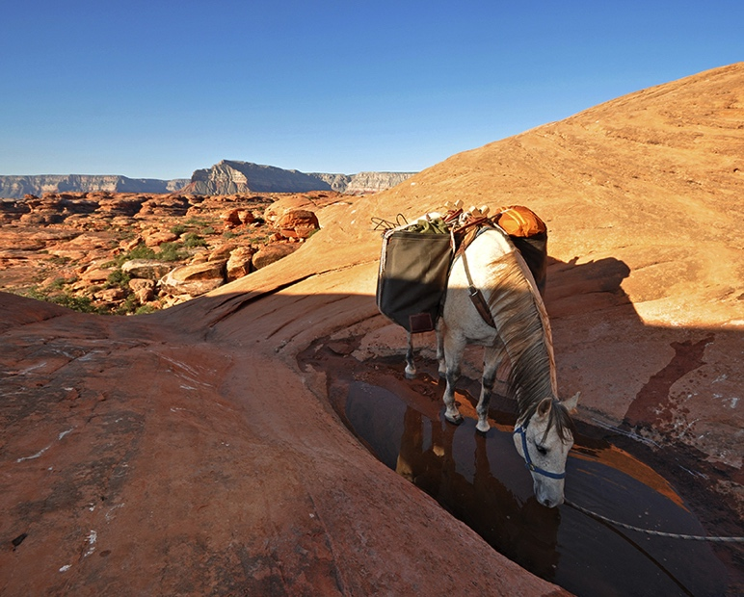
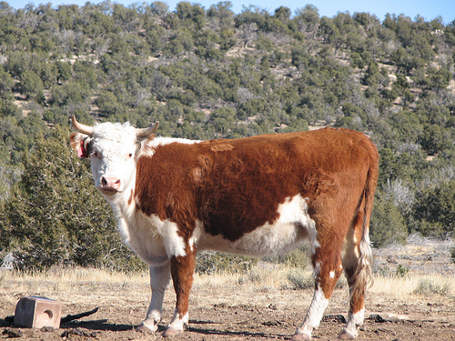
Partner Organizations
End Users
Kaibab National Forest Range Management Program, U.S. Forest Service
Arizona Game and Fish Department
Diablo Trust
Collaborators
Rocky Mountain Research Center, U.S. Forest Service
Images: USFS, USDA
Background
Methodology
Results
Conclusions
Notes:
(Kyle)
To reach each of these objectives and to engage with the needs and interests of the community, we have partnered with several organizations. End Users, who will directly engage with the end products, include the Kaibab National Forest Range Management Program, U.S. Forest Service, the Arizona Game and Fish Department, and Diablo Trust, a non-profit organization which conducts research and collaborates with the local ranching community. We also collaborated with the Rocky Mountain Research Center of the U.S. Forest Service to create our end products.
------------------------------Image Information Below ------------------------------
Top: Kanab Creek Wilderness, Kaibab National Forest, U.S. Forest Service, USDA: https://www.fs.usda.gov/attmain/kaibab/specialplaces
Bottom: Kaibab National Forest, U.S. Forest Service, USDA: https://www.fs.usda.gov/detail/kaibab/landmanagement/?cid=stelprdb5109713

Slide 7
Methodology Overview
Data Acquisition
Data Processing
Data Analysis
Background
Methodology
Results
Conclusions
Notes:
(Michael)
Moving into the Methodology, we addressed our project objectives in three overarching steps: Data Acquisition, Data Processing, and Data Analyses, which we will now discuss in detail.

Slide 8
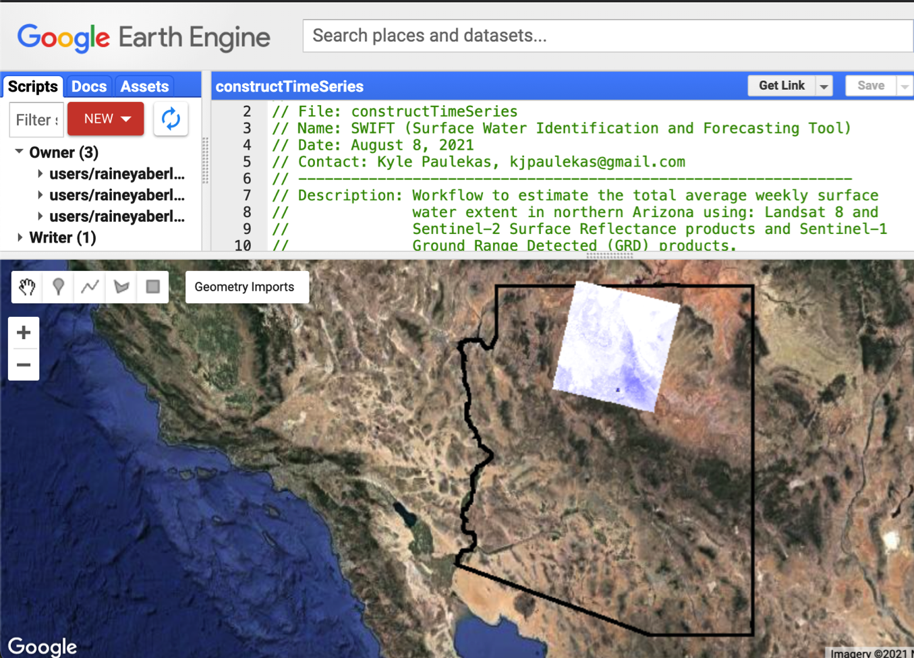
Data Acquisition: Google Earth Engine
Cloud-based raster computing
Accessible libraries for satellite imagery
Free for scientists, researchers, and developers
Graphical User Interface capability
Google Earth Engine JavaScript API, displaying Landsat 8 surface reflectance true color imagery for the southwest U.S.
Background
Methodology
Results
Conclusions
Notes:
(Michael)
All Data Acquisition, Processing, and Analyses were conducted in Google Earth Engine, or GEE, which provides cloud-based raster computing resources and accessible satellite imagery libraries. We also selected GEE because it is free for scientists, researchers, and developers, which was an important component of the end product handoff to partners. GEE also has the capability to produce a Graphical User Interphase, which we used to produce the Surface Water Identification Forecasting Tool.

Slide 9
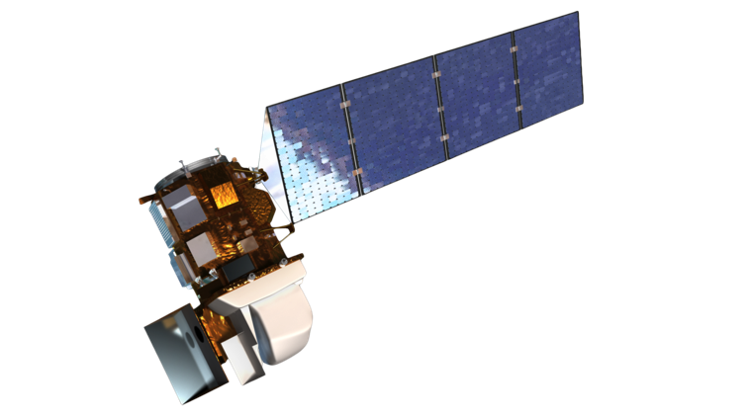
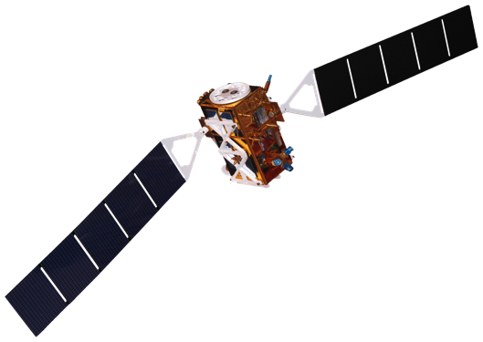
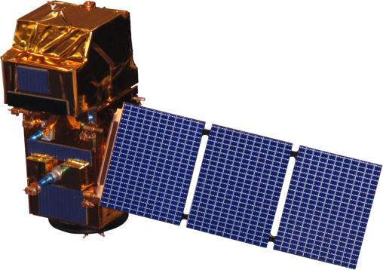
Data Acquisition: Satellite Imagery
Landsat 8 Operational Land Imager (OLI)
Surface Reflectance Tier 2 Products
Resolution: 30 m, 2013-2021
Sentinel-1 C-Band Synthetic Aperture Radar (SAR)
Ground Range Detected Products
Resolution: 10 m, 2014-2021
Sentinel-2 Multi Spectral Instrument (MSI)
Level 2-A Products
Resolution: 10 m, 2015-2021
Images: NASA, ESA
Background
Methodology
Results
Conclusions
Notes:
(Michael)
NASA's Landsat 8 OLI satellite mission was used in conjunction with the European Space Agency's Sentinel-1 and 2 missions. The Landsat 8 and Sentinel-2 missions provided optical imagery for this study; meanwhile Sentinel-1 provided radar imagery for aide in stock pond delineation.
Sentinel products were used in this project to compensate for the lower 30-meter spatial resolution of Landsat 8 imagery.
------------------------------Image Information Below ------------------------------
Top image by NASA: https://landsat.gsfc.nasa.gov/landsat-8/landsat-8-overview
Center image by RAMA from Wikimedia Commons (CC0): https://commons.wikimedia.org/wiki/File:Sentinel_2-IMG_5873-white_(crop).jpg
Bottom image by RAMA from Wikimedia Commons (CC0): https://commons.wikimedia.org/wiki/File:Sentinel_1-IMG_5874-white.jpg

Slide 10
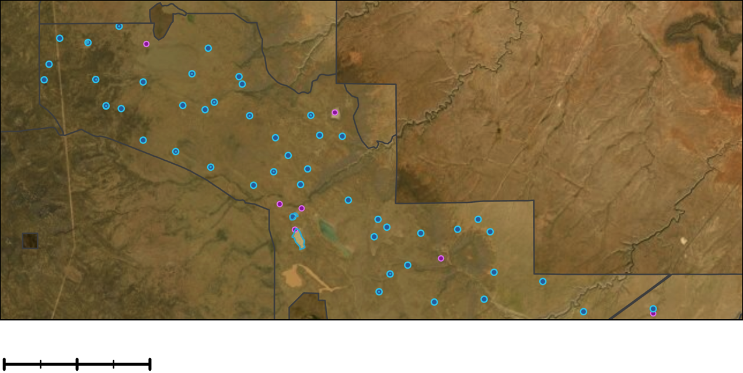
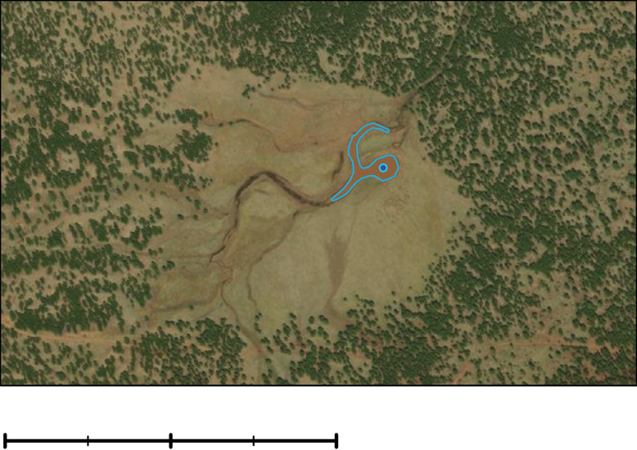
Data Acquisition: Ancillary Datasets
Stock Ponds Locations
USFS stock pond point locations
Bar T Bar Ranch point locations
Training and Testing Points
Stock pond extents
Water and Non-Water points
1.5
3
6
Miles
Federal Grazing Allotments
Stock Pond Extents
Bar T Bar Ranch Ponds
USFS Ponds
0.13
0.25
0.5
Miles
Background
Methodology
Results
Conclusions
Notes:
(Michael)
Using partner provided GPS locations of nearly 1000 stock ponds in the region of interest, the team digitized stock pond extents and over 300 Water and Non-Water points using high-resolution imagery. These stock pond extents and points were used as inputs to train and to test the classification model, which we will discuss in a later slide.
During partner handoff, these shapefiles were shared with a standardized validation site data entry log to facilitate the efficiency of future accuracy assessments.

Slide 11
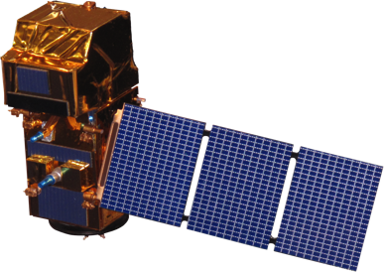
Data Processing: Image Pre-processing
Landsat 8
Sentinel-2
Sentinel-1
Cloud Masking
Border Noise Correction
Compute Band Indices:
Speckle Filtering
AWEI_{sh}
Automated Water Extraction Index, shadow-corrected
TCW
Tasseled-Cap Wetness
MNDWI
Modified Normalized Difference Water Index
NDVI
Normalized Difference Vegetation Index
Radiometric Terrain Normalization
Background
Methodology
Results
Conclusions
Images: NASA, ESA
Notes:
(Michael)
In order to conduct analyses on the imagery available from each satellite through Google Earth Engine, we ran them through several pre-processing steps.
For both Landsat 8 and Sentinel-2 Surface Reflectance products, we applied a cloud masking algorithm to minimize the impact of cloud cover. We then computed several band indices commonly used for identifying surface water bodies, including the Automated Water Extraction Index corrected for shadows (AWEIsh), the Tassled-Cap Wetness (TCW), the Modified Normalized Difference Water Index (MNDWI), and the Normalized Difference Vegetation Index (NDVI), which we used for analyses. We will touch more on this step later in the presentation.
For Sentinel-1 radar imagery products available through Google Earth Engine, we applied a workflow from previous work, which results in Analysis-Ready Data. These steps include Border Noise Correction, Speckle Filtering, and Radiometric Terrain Normalization. The details for each of these steps can be found in the published work from Mullissa and others (2021).
------------------------------Image Information Below ------------------------------
Left image by NASA: https://landsat.gsfc.nasa.gov/landsat-8/landsat-8-overview
Center image by RAMA from Wikimedia Commons (CC0): https://commons.wikimedia.org/wiki/File:Sentinel_2-IMG_5873-white_(crop).jpg
Right image by RAMA from Wikimedia Commons (CC0): https://commons.wikimedia.org/wiki/File:Sentinel_1-IMG_5874-white.jpg

Slide 12
Data Processing: Image Classification
Water
Non-water
Random Forest Classification
Training Data
Background
Methodology
Results
Conclusions
Notes:
(Michael)
Using the band indices for optical imagery and intensity values for the radar imagery, we then classified water pixels using a Random Forest Classification algorithm. This classification model uses the image pixels we identified as 'water' or 'non-water' on a particular date to train the model. This model is then applied to the entire image collection to classify 'water' and 'non-water' pixels.

Slide 13
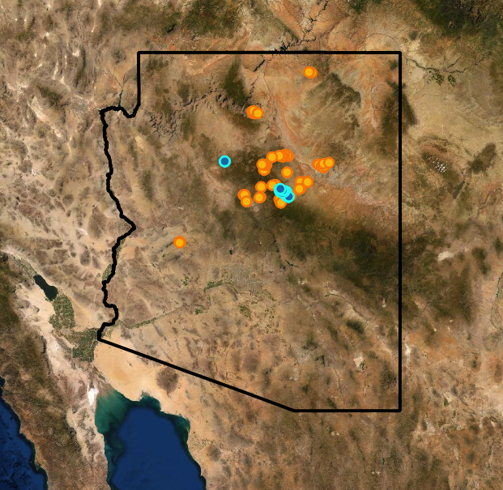
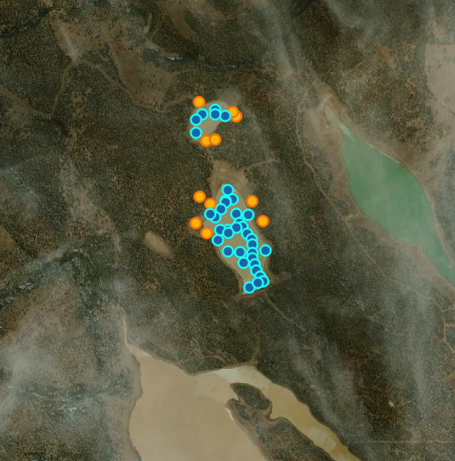
Data Analysis: Accuracy Assessment
Cross-validation
303 points: 80% training, 20% testing
Several metrics tracked for training and testing points
Overall Accuracy
Kappa Index Agreement
Confusion Matrix
0
150
Miles
Non-water
Water
Arizona Border
0
1.0
Miles
Background
Methodology
Results
Conclusions
Notes:
(Rainey)
To assess the accuracy of this classification method, we used high-resolution imagery to identify over 300 points and visually classified them as 'water' and 'non-water' on a particular day. We then used 80% of these points to train the classification model and tested its accuracy on the remaining 20% of points. In the figure on the left, you see the points used for validation with orange representing 'non-water' and blue representing 'water' observations. Some examples of water features are outlined in blue on the right.
We tracked the overall accuracy, confusion matrix, and kappa statistics for both the training and testing points.

Slide 14
Accuracy Assessment: Optical Imagery
Testing
Landsat 8
Overall Accuracy: 93%
Kappa Index of Agreement: 88%
Confusion Matrix
 | Water | Non-Water
Water | 34 | 2
Non-Water | 2 | 27
Sentinel-2
Images: NASA, ESA
Background
Methodology
Results
Conclusions
Notes:
(Rainey)
For the optical imagery, we generally see high accuracy in classification. The overall accuracy is 93% for the testing data. The Kappa Index of Agreement attempts to account for correct classifications by chance by comparing our results to a random classification. We see 88% for the Kappa Index of Agreement.
The confusion matrices shown demonstrate the properly classified pixels for Water (W) and Non-Water (NW) along the diagonals, with false positives and false negatives on the opposite diagonal.
Top image by NASA: https://landsat.gsfc.nasa.gov/landsat-8/landsat-8-overview
Bottom image by RAMA from Wikimedia Commons (CC0): https://commons.wikimedia.org/wiki/File:Sentinel_2-IMG_5873-white_(crop).jpg

Slide 15
Accuracy Assessment: Radar Imagery
Testing
Overall Accuracy: 88%
Kappa Index of Agreement: 76%
Confusion Matrix
Sentinel-1
 | Water | Non-Water
Water | 27 | 4
Non-Water | 2 | 18
Image: ESA
Background
Methodology
Results
Conclusions
Notes:
(Rainey)
For the radar imagery, we a bit lower accuracy. The overall accuracy is 88% for the testing data, whereas the Kappa index of agreement is 76%. The confusion matrix here shows 45 pixels correctly classified as Water and Non-Water out of the 51 total testing points.
Image by RAMA from Wikimedia Commons (CC0): https://commons.wikimedia.org/wiki/File:Sentinel_1-IMG_5874-white.jpg

Slide 16
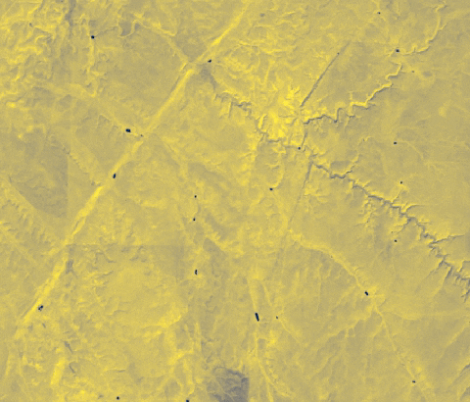
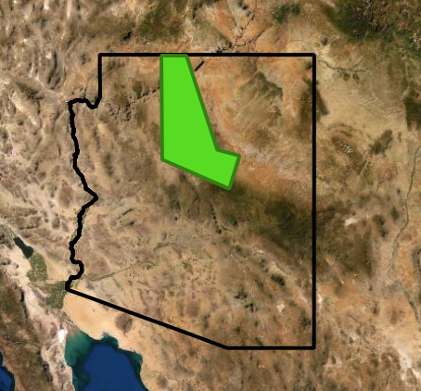
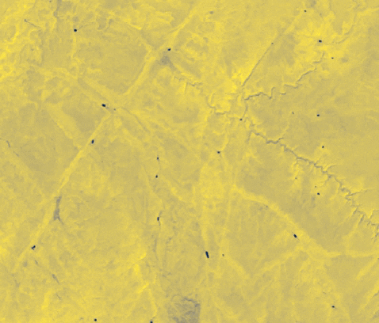
Water Extent Time Series
AWEI_{sh}
MNDWI
0
200
0
4
Miles
Miles
Study Region
Arizona Borders
Dry
Wet
Background
Methodology
Results
Conclusions
Notes:
(Rainey)
Here we have two time series showing the indices Automated Water Extraction Index corrected for shadows (AWEIsh) and the Modified Normalized Difference Water Index (MNDWI) in optical imagery in September of 2015 to 2020. Here, we can see slight differences between the indices, as well as the issue of cloud cover for one date, which the radar imagery helps to overcome.

Slide 17
Water Extent Time Series
Surface Area of Water (km²)
0
200
Miles
Study Region
Arizona Border
Background
Methodology
Results
Conclusions
Notes:
(Rainey)
One of the two objectives of this project was to create a historical time series of water levels throughout the region. We did this by looking at the overall monthly trends in the designated study area. You can see preliminary results here, although I won't present any analyses from these data just yet – the rest of the temporal coverage is currently in export. These represent total areal extents in the region in square meters over time. What is shown is primarily from imagery captured in March.

Slide 18
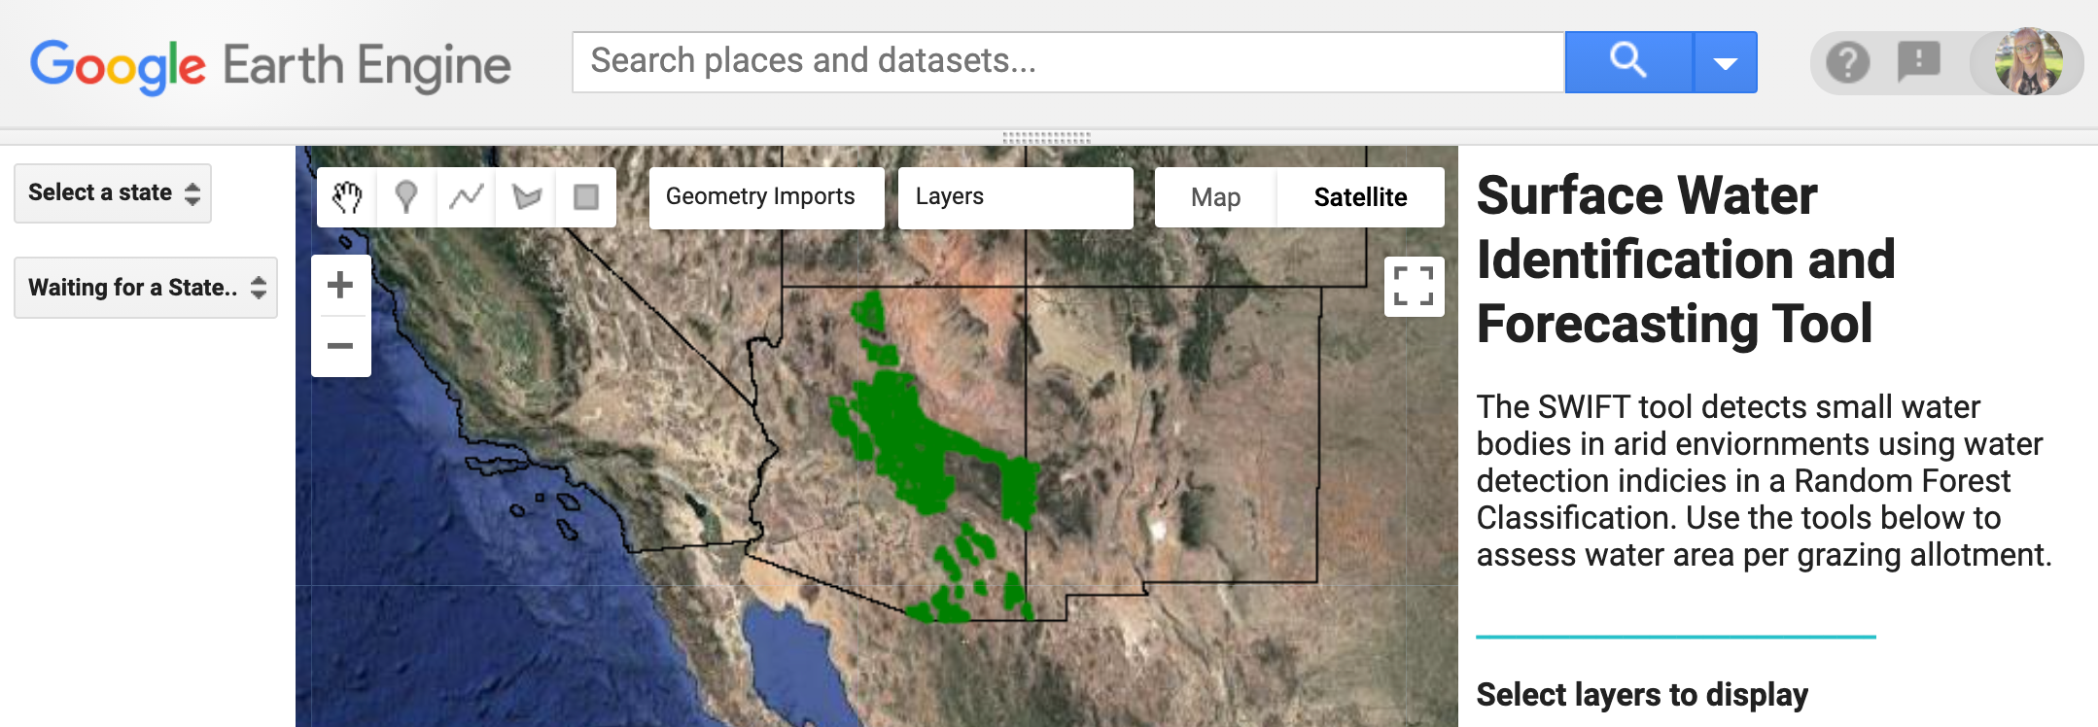
Water Extent Monitoring Tool
Background
Methodology
Results
Conclusions
Notes:
(Lukman)
The other objective of this project was to create a water extent monitoring tool.
We call this tool the Surface Water Identification and Forecasting Tool, or SWIFT.
The GEE Graphical User Interface allows end users to collect near real-time conditions of water extents throughout the region and in specific grazing allotments. This substantially reduces the time and cost required to monitor stock ponds through in situ observations. Our partners plan to use this to develop adaptive land, wildlife, and livestock management strategies in years to come.
Google Earth Engine Graphical User Interface, Southwest Water Resources Team

Slide 19
Key Findings & End Products
Landsat 8
Sentinel-2
Sentinel-1
DATA
Spectral Band Indices
Backscatter Intensity, Instrument Angle
SURFACE WATER DETECTION
Time Series Maps
Surface Water Identification Forecasting Tool (SWIFT)
PRODUCTS & UTILITY
Background
Methodology
Results
Conclusions
Notes:
(Lukman)
This study has (successfully) deployed Earth observation technologies which include: Landsat 8, & Sentinels-1&2 imagery, with appropriate water indices methods and ancillary datasets to develop useful maps and tool to:
address stakeholders’ livestock care and land management concerns among others, and
ultimately guiding them in making faster and more data-informed decisions at low cost, and environmentally-friendly optimization of routine operations.

Slide 20
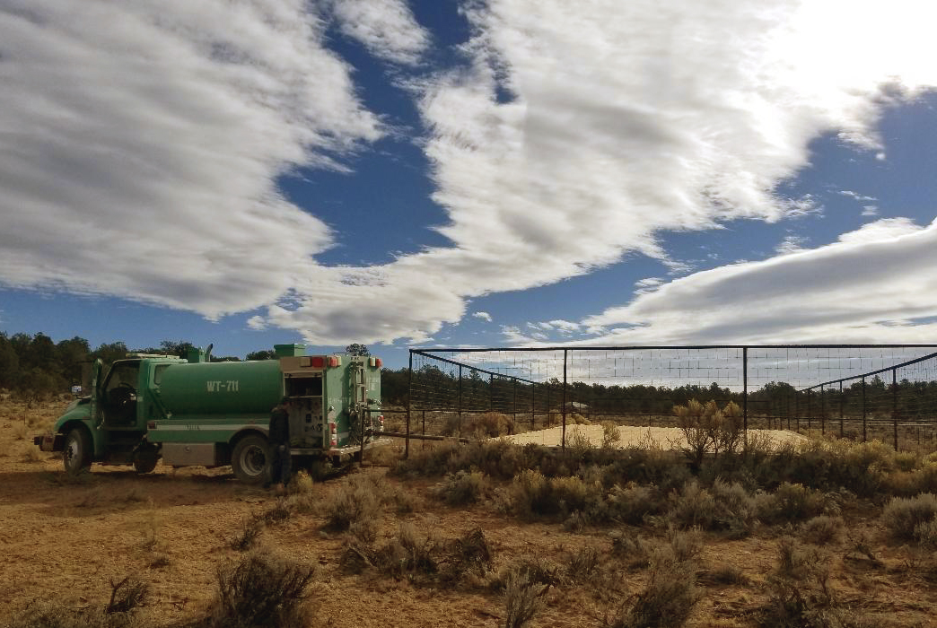
Potential Errors and Limitations
Cloud cover, snow and ice
Potential commission errors
Decreased temporal and spatial coverage
Muddy waters leads to potential omission errors
No ground observations for validation of classifications
Image: USFS
Background
Methodology
Results
Conclusions
Notes:
(Lukman)
Along with our successes, potential errors include:
Potential commission errors, decreased temporal and spatial coverage of data due to cloud cover, snow, and ice
Muddy or sediment-heavy water bodies being classified as vegetation rather than water cover.
However, the addition of the Sentinel-1 classified image collection can help to overcome these issues in the
In addition, we lack ground observations for validation of our remote observations. Our partners have discussed increasing in situ observations at several sites, which could be implemented in the future to increase confidence in the method.
------------------------------Image Information Below ------------------------------
Kaibab National Forest, USFS: https://www.fs.usda.gov/detail/kaibab/news-events/?cid=FSEPRD590920

Slide 21
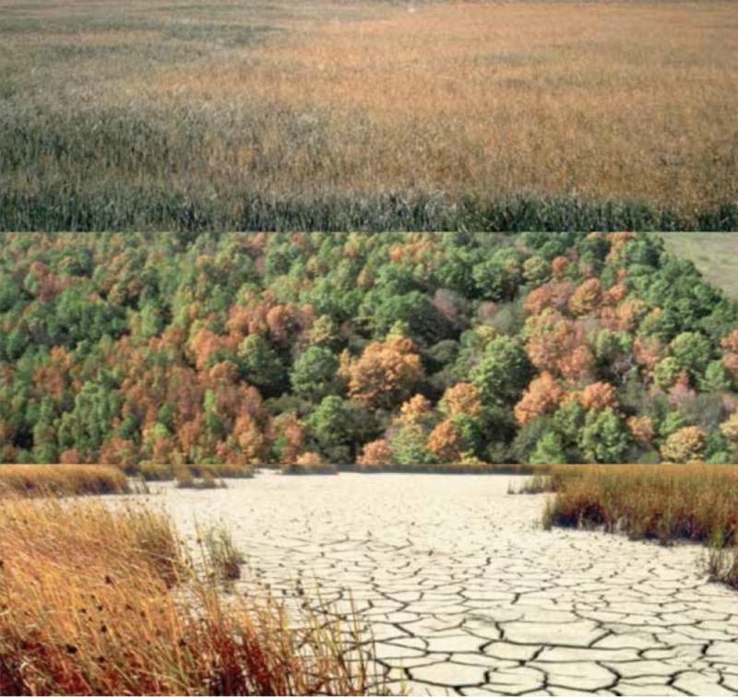
Future Work
Expand the study in response to increasing drought severity
Vulnerable regions: California, Utah, Idaho
Potential additional partners: BLM districts, state lands, and private organizations
Incorporate data from upcoming NASA satellite missions
NASA-ISRO SAR (NISAR)
Surface Water and Ocean Topography (SWOT)
Image: USFS
Background
Methodology
Results
Conclusions
Notes:
(Lukman)
Vulnerable regions: California, Utah, Idaho
Potential additional partners: BLM districts, state lands, and private organizations that manage grazing land.
NASA satellite missions launching in 2022: NASA-ISRO SAR (NISAR) and Surface Water and Ocean Topography (SWOT)
Will require research regarding possible application for small water body detection
------------------------------Image Information Below ------------------------------
Kaibab National Forest, USFS: https://www.fs.usda.gov/detail/kaibab/news-events/?cid=FSEPRD590920
"How is drought affecting the forests and rangelands of the United States?" Karin Riley and others (2016), Rocky Mountain Research Station, USFS: https://www.fs.usda.gov/rmrs/projects/how-drought-affecting-forests-and-rangelands-united-states

Slide 22
Partners
Science Advisors
Iric Burden (Kaibab National Forest, Range Program, USFS)
Steve Cassady (AZ Game and Fish)
Lisa Bolten (Diablo Trust)
Kit Metzger (The Flying M Ranch)
Bob Prosser (Bar T Bar Ranch)
Keith Weber (Idaho State University GTReC)
Seungbum Kim (NASA JPL Radar Remote Sensing)
Collaborators
Matt Reeves (Rocky Mountain Research Center, USFS)
Additional thanks to Brandy Nisbet-Wilcox (NASA DEVELOP Fellow), Rebekke Meunch (NASA SERVIR), Stephanie Granger and Forrest Melton (NASA Western Water Applications Office)
This material contains modified Copernicus Sentinel data (2015-2021), processed by ESA. ​
This material contains modified Copernicus Sentinel data (2015-2021), processed by ESA. ​
Notes:
(Lukman)
We would like to thank a host of people who contributed to this project. Firstly, our partners: Iric Burden, Steve Cassady, Lisa Bolten, Kit Metzger, and Bob Prosser. We would also like to acknowledge our science advisors and collaborators: Keith Weber, Sab Kim, and Matt Reeves. Finally, we extent additional thanks to Brandy Nisbet-Wilcox, Stephanie Granger, Forrest Melton, and Rebekke Muench for their support in the development and progress of the project.
Thank you for your attention and we are now happy to take any questions from the audience.

Slide 23
Reference
Mullissa, A., Vollrath, A., Odongo-Braun, C., Slagter, Balling, J., Gou, Y., Gorelick, N., & Reiche, J. (2021). Sentinel-1 SAR Backscatter Analysis Ready Data Preparation in Google Earth Engine. Remote Sensing, 13(10), 1954. https://doi.org/10.3390/rs13101954

