Slide 1
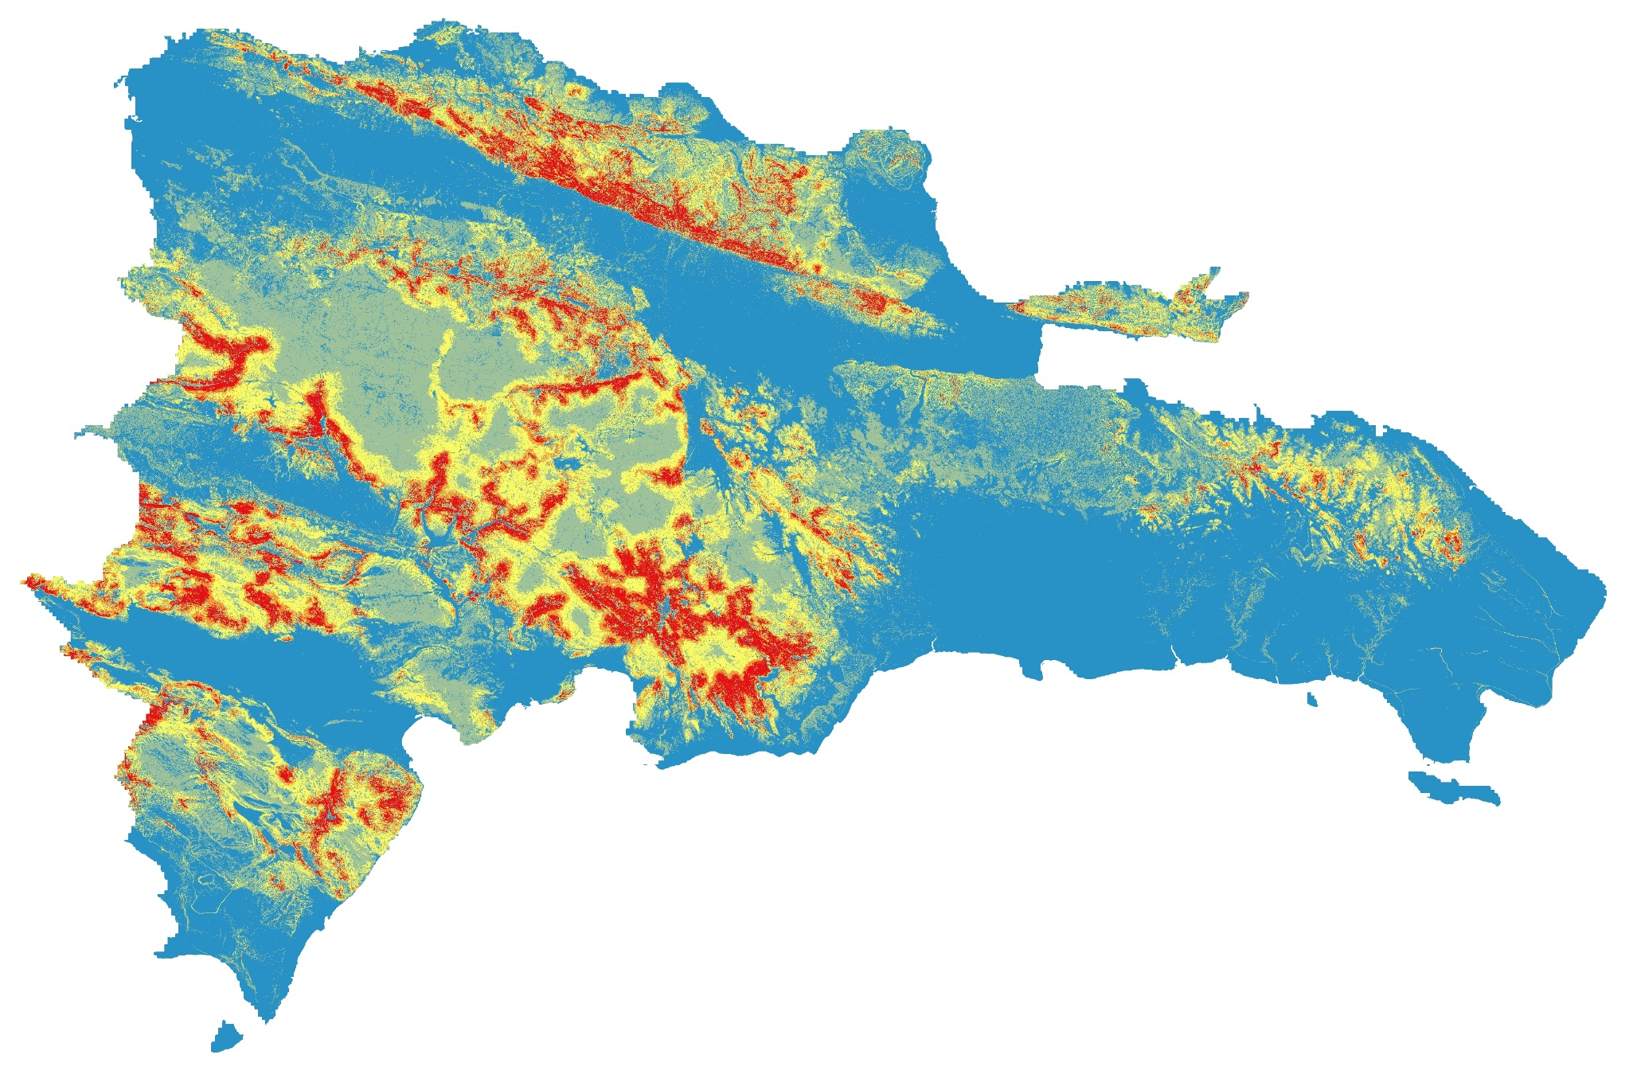
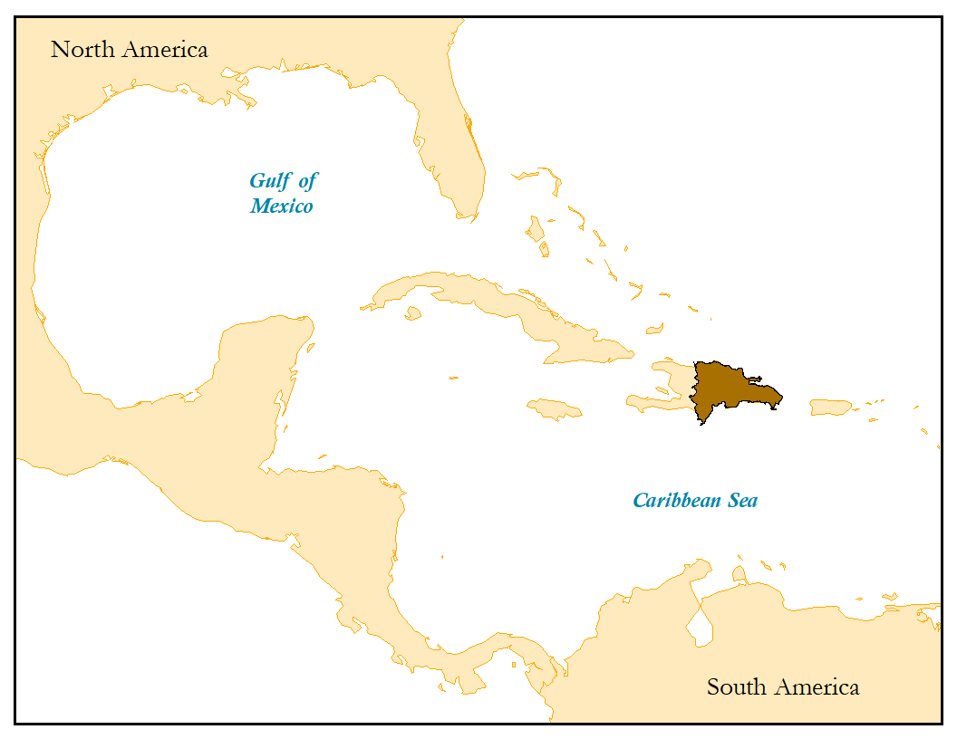
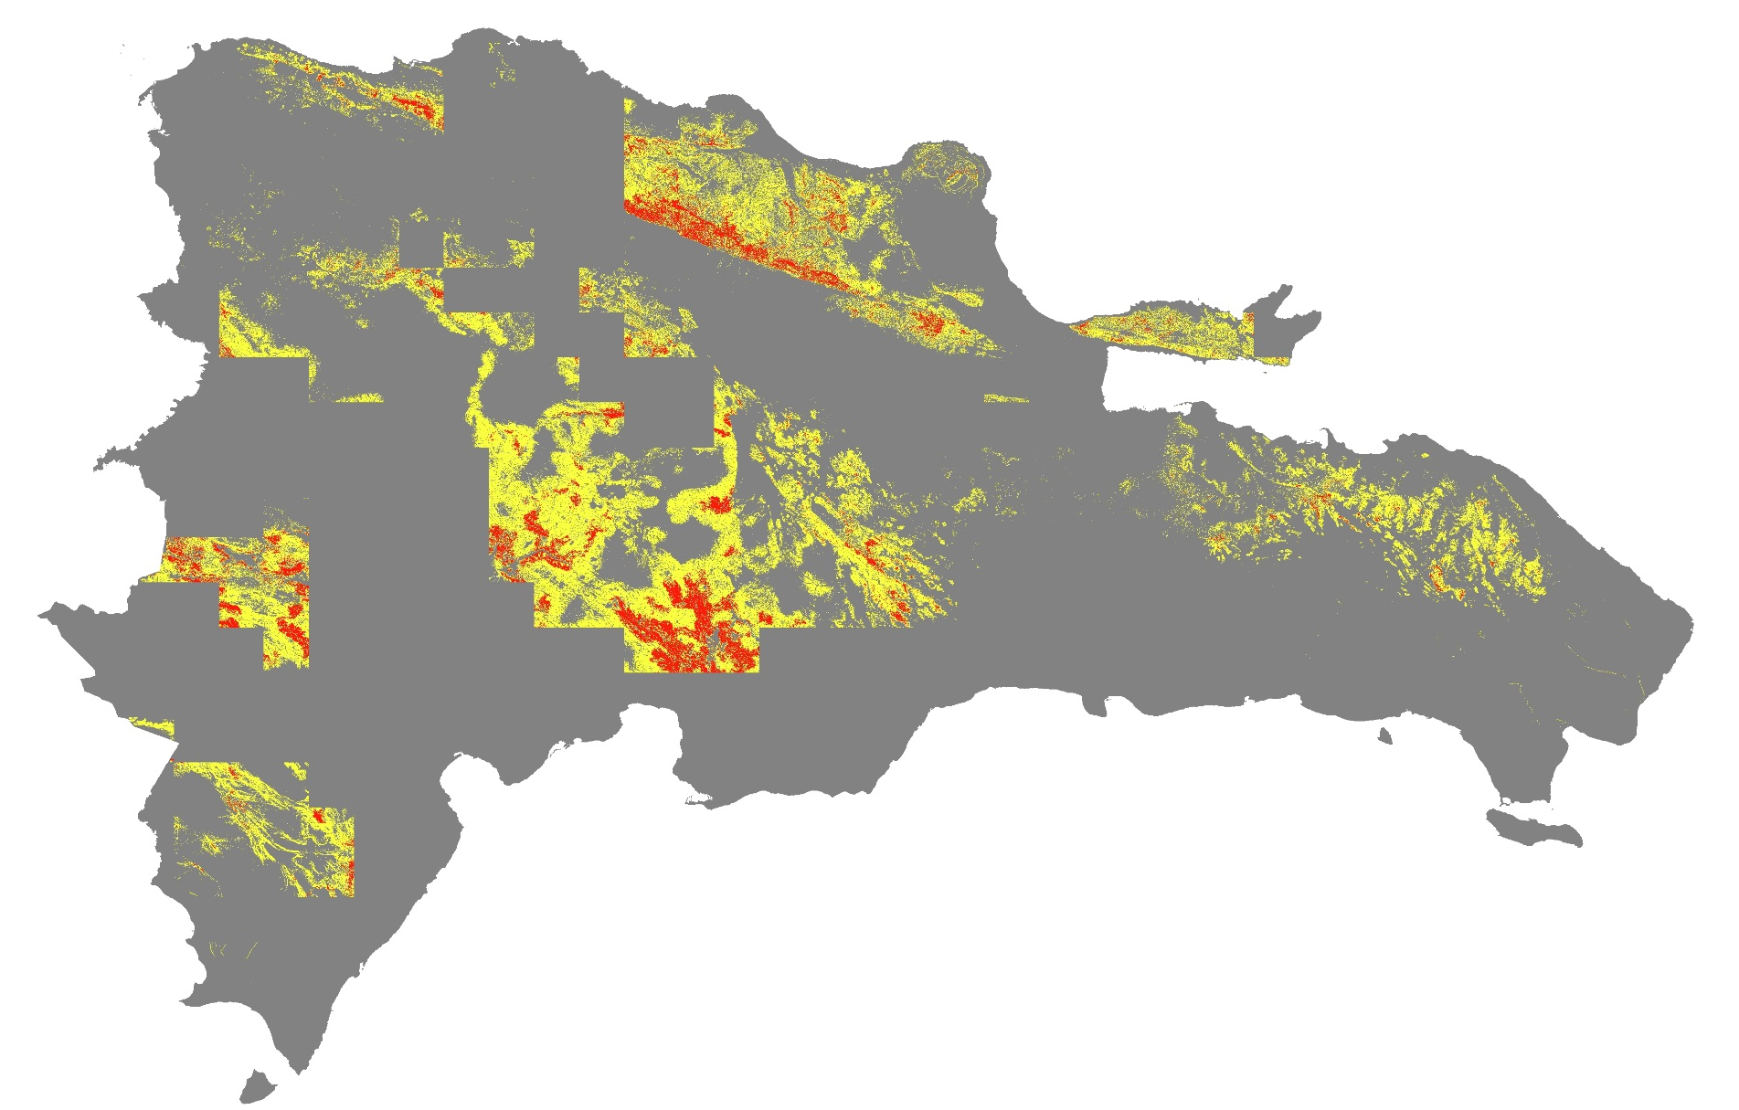
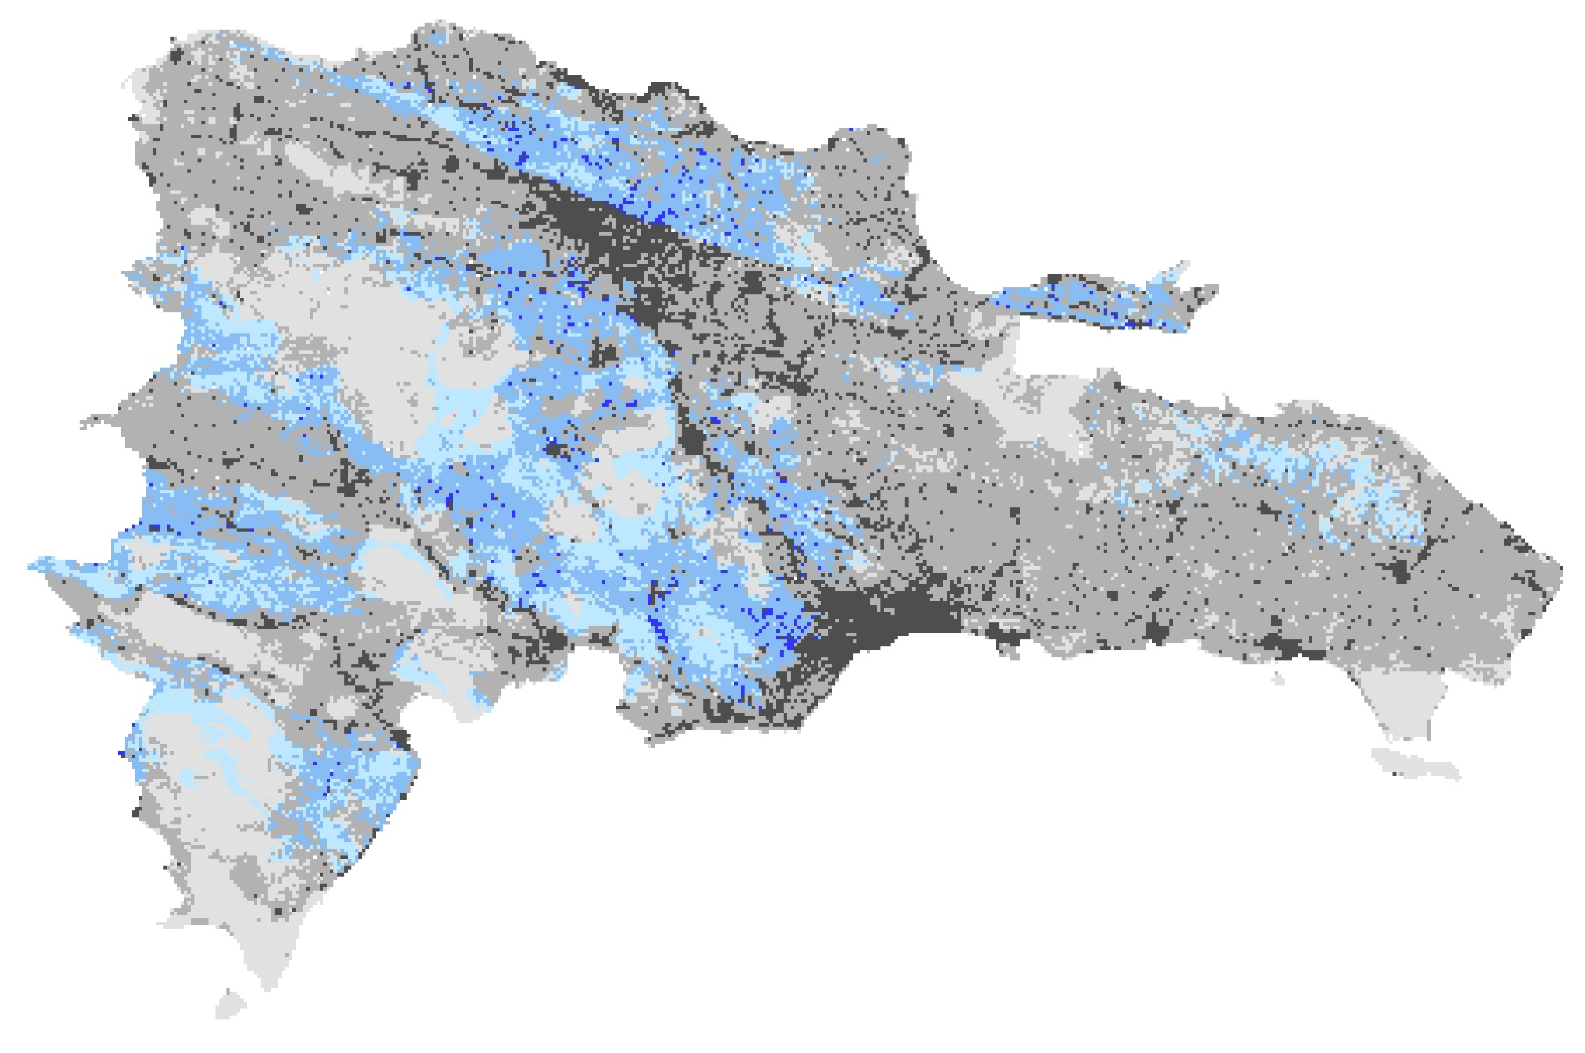
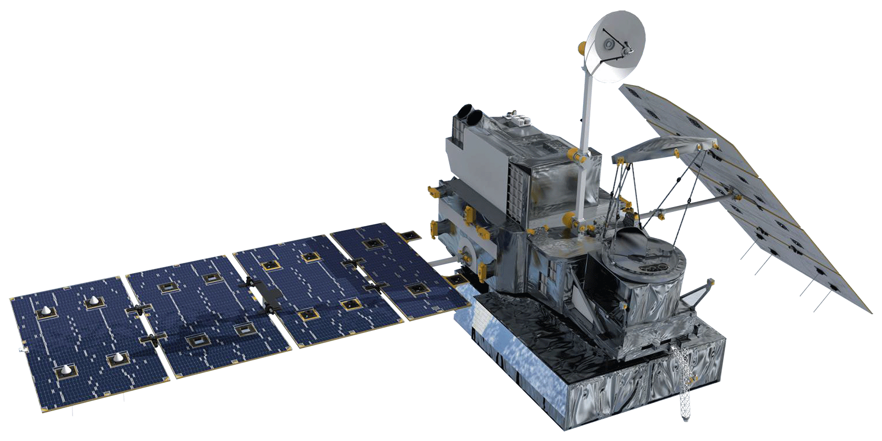
Mapping Landslide Susceptibility and Exposure in the Dominican Republic Using NASA Earth Observations
Abstract
Objectives
Dominican Republic Disasters
Rainfall-triggered landslides associated with tropical storms cause devastating damage to the communities in the Dominican Republic and surrounding Caribbean islands. With the predicted increase in the frequency and intensity of storms, the region would benefit from reliable disaster monitoring. Partnering with Servicio Geológico Nacional (SGN) and Oficina Nacional de Meteorología (ONAMET), the team created local landslide susceptibility maps and used them in combination with NASA Earth observations as inputs to the Landslide Hazard Assessment for Situational Awareness (LHASA) model to visualize potential landslide activity in near real-time. Susceptibility maps were based on slope derived from elevation data from the Shuttle Radar Topography Mission (SRTM), geology, road networks, fault lines, and forest loss. In LHASA, each map was combined with near real-time rainfall data from the Global Precipitation Measurement (GPM) mission. Using model outputs, the team identified areas of moderate and high potential landslide activity in a northern region of interest identified by our partners. Additionally, exposure maps were generated using a bivariate method that combined susceptibility with population and critical infrastructure data. The team created a LHASA standard operating procedure document for the end users at SGN and ONAMET. The partners can use this to update the susceptibility maps as new data becomes available and run the LHASA model independently to monitor near real-time landslide potential.
Implement the LHASA model in the Dominican Republic for near real-time monitoring of potential rainfall-triggered landslide activity
Incorporate local geological data in susceptibility modeling for customized landslide monitoring
Produce landslide susceptibility and exposure maps to identify regions prone to disasters
Increase partner knowledge and skills in the implementation of the LHASA model for landslide monitoring by providing a standard operating procedure document
Results
1
Landslide Susceptibility
High
Low
0
50
100
km
Study Area
2
LHASA
output
Region of Interest
Nowcast
High Hazard
0
50
100 km
Elevation (m)
Moderate Hazard
0
1500
3000
Landslide
Exposure
Landslide potential for sample date, January 11, 2019
Project Partners
3
Servicio Geológico Nacional (Dominican Republic)
Oficina Nacional de Meteorología (Dominican Republic)
High
Susceptibility
Methodology
Low
High
Low
1
Inputs
Tool
Goal
Population
(per km²)
Landslide
Susceptibility
Geology, Slope, Elevation
Forest Loss, Distance to Faults & Roads, Clay %
Fuzzy Overlay & Fuzzy Membership
Where is the highest/lowest landslide potential?
2
Inputs
Tool
Goal
Near real-time Landslide Potential
Susceptibility Map,
GPM IMERG precipitation
LHASA model
Where is there a high/moderate risk for rainfall to trigger a landslide?
3
Inputs
Tool
Goal
Conclusions
Landslide Exposure
Landslide Susceptibility,
Population,
Points of Interest
Bivariate mapping
Who/what is located in areas of high/low landslide potential?
Based on a frequency ratio analysis of landslide susceptibility variables, slope was the most influential factor in determining landslide potential.
The global LHASA model can be catered to a specific country or region through the integration of local data.
Bivariate mapping helps to depict the intersection of population and susceptibility for heuristic identification of areas where people are exposed to landslide risk.
This research would benefit from an exhaustive landslide inventory and local rain gauge data for further model validation.
Earth Observations
GPM
IMERG
SRTM
Team Members
Acknowledgements
Dr. Santiago Muñoz, Servicio Geológico Nacional
Dr. Andrés Campusano, Oficina Nacional de Meteorología
Dr. Dalia Kirschbaum, Goddard Space Flight Center
Dr. Kenton Ross, Langley Research Center
Thomas Stanley, Goddard Space Flight Center
Robert Emberson, Goddard Space Flight Center
Sydney Neugebauer, DEVELOP Virginia – Langley node
Sarah Aldama
Project Lead
Chelsea Dandridge
Kyung “Robin” Kim
Gigi Pavur
Virginia – Langley | Summer 2019
Notes:
Thank you to our partners at SGN and ONAMET for their support and collaboration: Dr. Santiago Muñoz and his colleagues at SGN and Sergio Dr. Andrés Campusano at ONAMET. The team would also like to acknowledge Dr. Dalia Kirschbaum and Dr. Kent Ross for their guidance over this project. Additionally, we would like to acknowledge Dr. Thomas Stanley, Dr. Robert Emberson, Garrett Benz, and Dr. Pakur Amatya for their contributions and support with this project. A special thanks as well to our Center Lead, Sydney Neugebauer.

