Slide 1
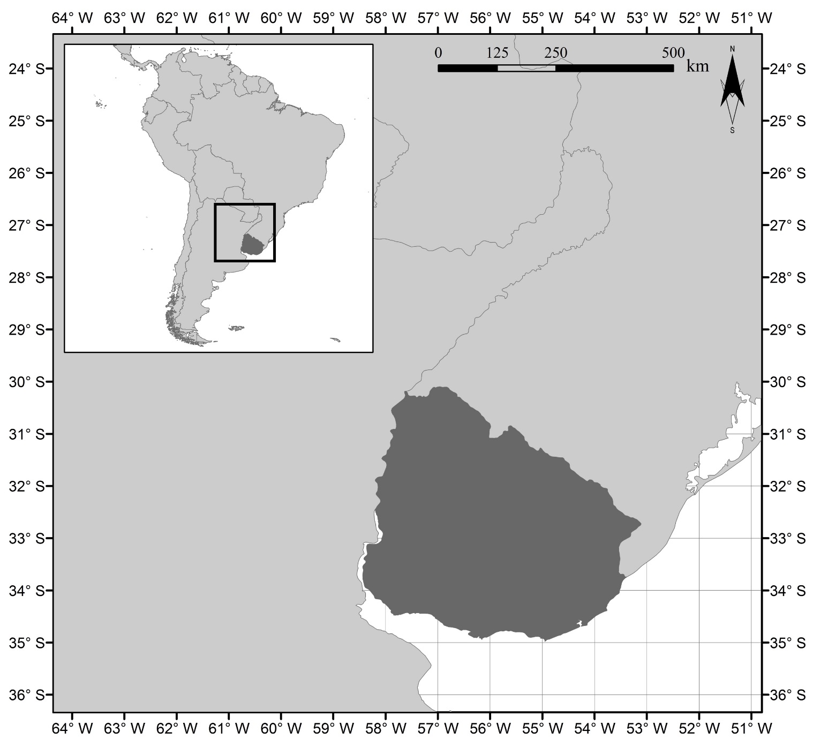
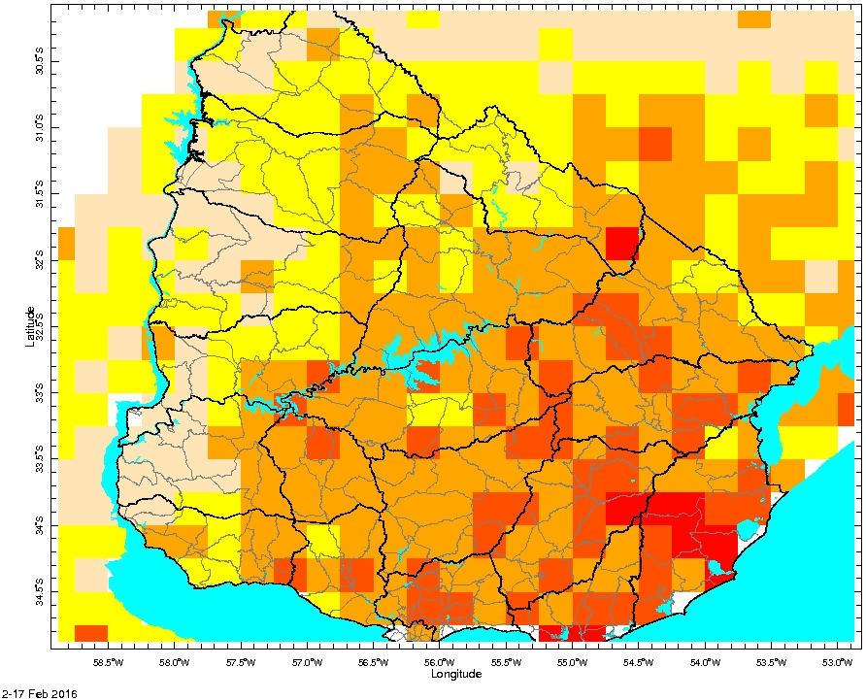
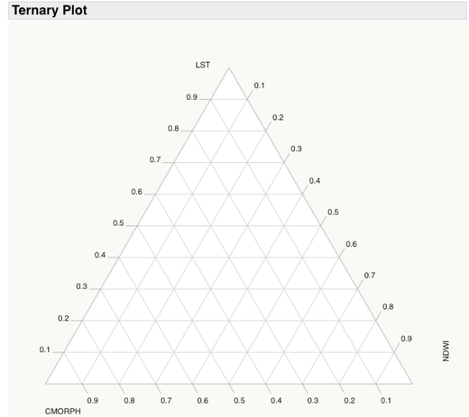
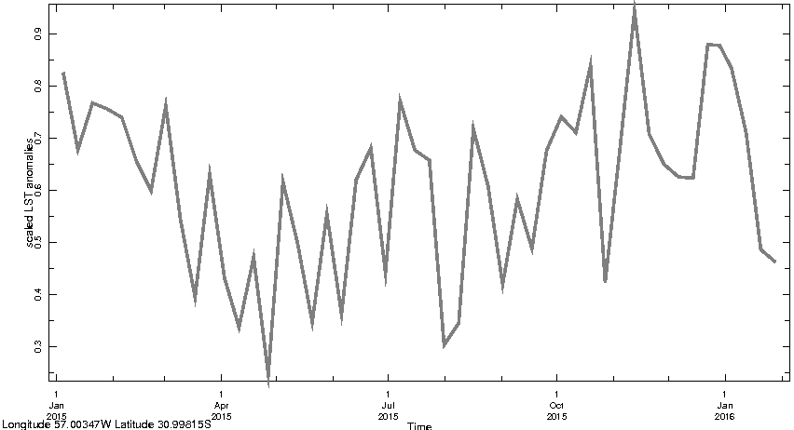
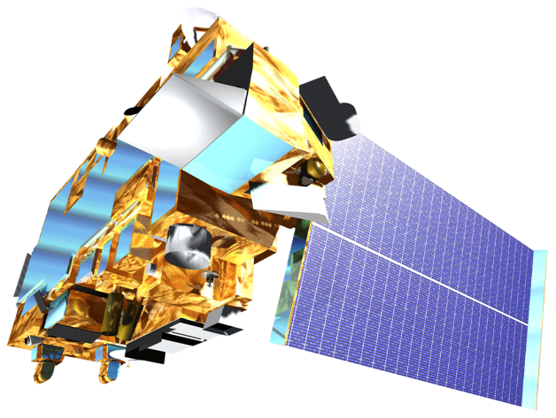
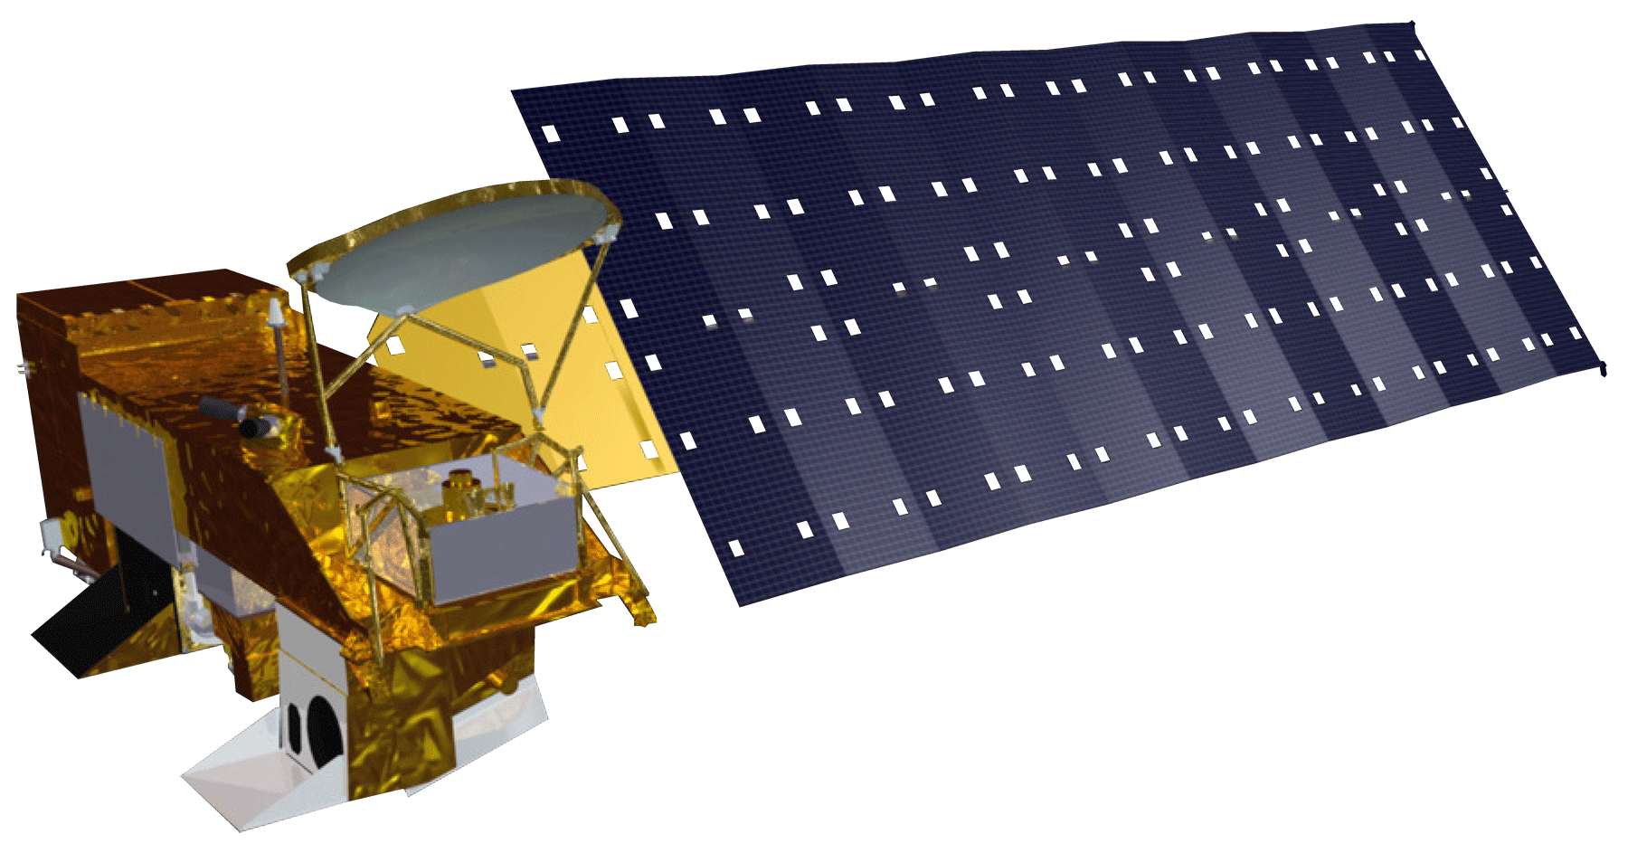
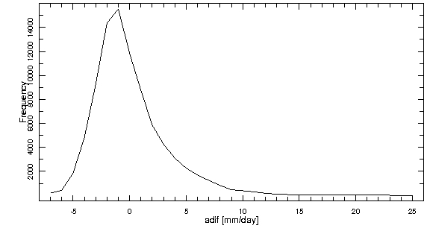
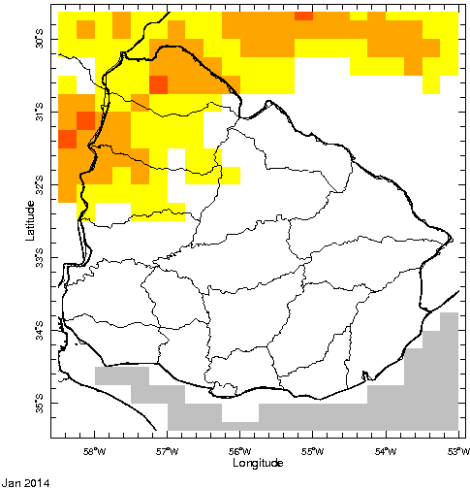
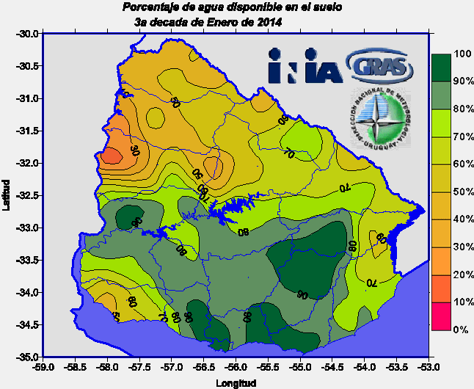
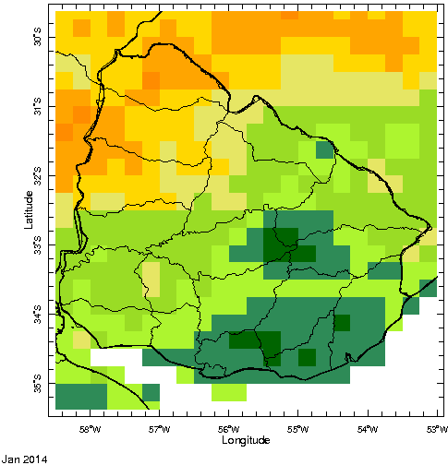
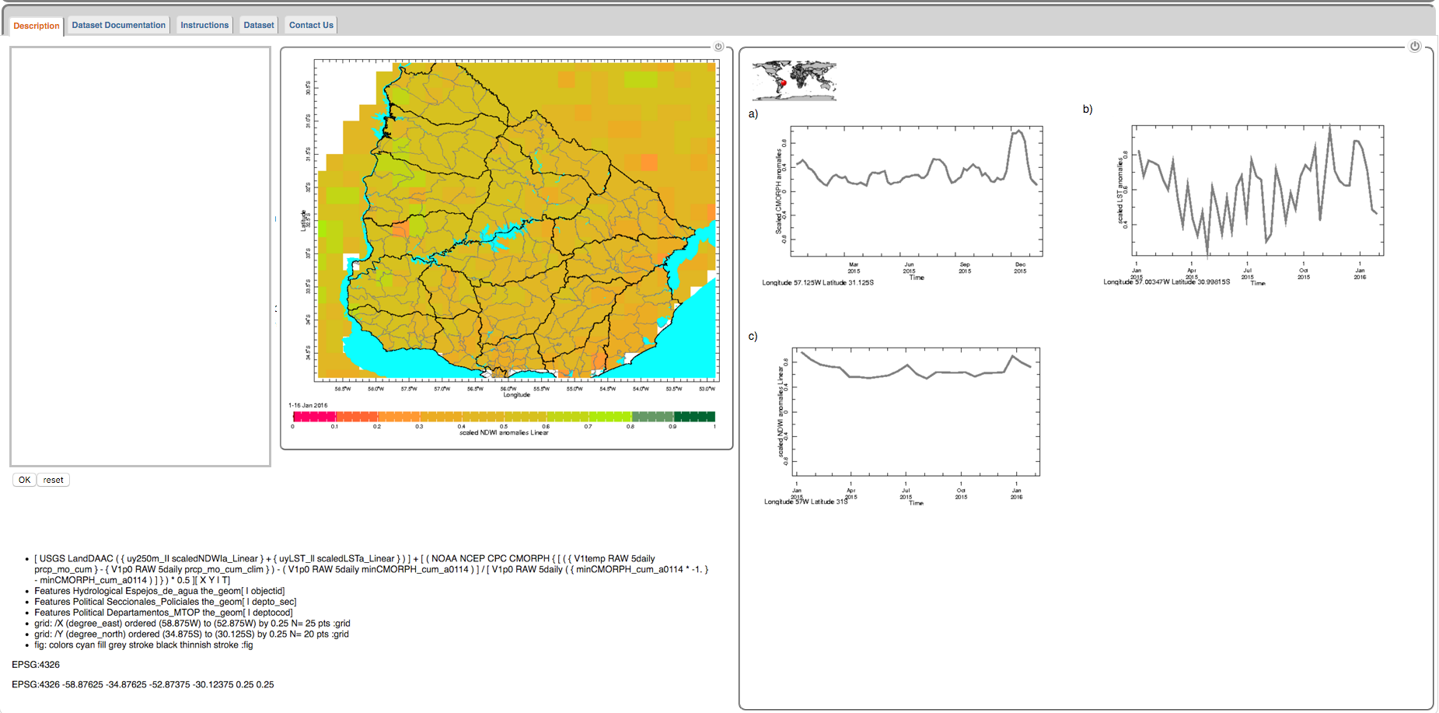
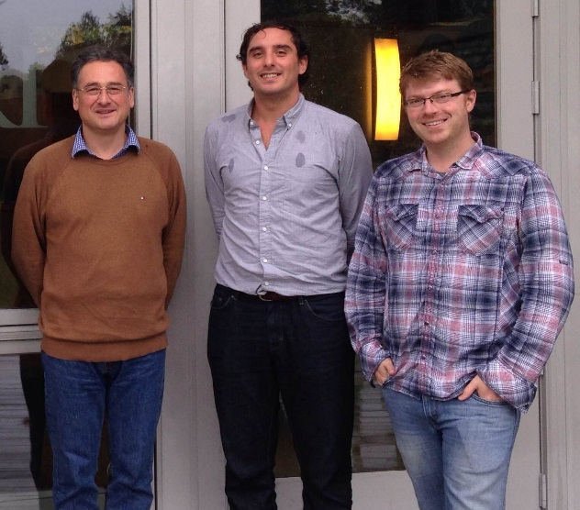
Uruguay Agriculture III
Deconstructing a drought severity index based on NASA earth observations into its principle components for better end-user assessment of the driving factors behind local scale drought
Jerrod Lessel (Project Lead), Andrew Kruczkiewicz
DEVELOP National Program at the International Research Institute for Climate and Society
Abstract
Objectives
The importance of monitoring drought is indispensable for Uruguay whose economic viability is strongly tied to agriculture and whose energy sector relyies heavily on hydroelectric power. As such, the development of a remotely sensed drought-monitoring tool that can aid government agencies in disseminating drought information to local stakeholders will be helpful in sustaining these important economic sectors. This third and final term of the Uruguay Agriculture project sought to create new visualization techniques for end-users at the Instituto Nacional de Investigacion Agropecuaria (INIA) to view the principle components of the drought severity index (DSI) that was created over the previous two terms of the project. The DSI uses remotely sensed products and is based off of the methodology from Rhee et al. (2010). It uses the climatological anomalies of NASA’s Moderate Resolution Imaging Spectrometer (MODIS) daytime land surface temperature (LST) data, precipitation data from the Climate Prediction Center Morphing Technique (CMORPH), and MODIS Normalized Difference Water Index (NDWI) data. This term investigated the usefulness of creating different methods of presenting the components of the DSI in order to better inform end-users of how the drought is affecting their specific region of interest. The method which proved the most useful was to display the time series for each component within the DSI. This gave a reasonable visualization of how each parameter affects the drought on a local scale while also indicating whether or not there is resilience in the vegetation even during periods of drought. A new color scheme for the maps was also employed in order to address the end-user concerns of the maps appearing to show more extreme drought conditions than was actually occurring. This new color scheme matched that of the percent available water maps which had been previously used by the end-users as the best method with which to monitor drought. This modified DSI has the potential to aid INIA and the Ministry of Agriculture of Uruguay in informing land managers, insurance providers, and policy makers in drought preparation and mitigation practices.
Test whether a different scaling method would resolve the end-user described issue of over estimating the degree of drought severity from the drought severity index (DSI)
Create different visualization methods for the principle components of the DSI in order to better understand the driver of the drought
Investigate the benefits of each of the visualization methods of the DSI components to help understand the drivers of specific drought types
Study Area
Methodology
South America
Test
Change the scaling method within the DSI
Create
Use different methods of visualizing the components of the DSI
Investigate
Research the benefits of the different visualization methods
(CMORPH – CMORPH_{min})
(CMORPH_{max} – CMORPH_{min})
Brazil
CMORPH_{-min}
Argentina
Uruguay
The proposed change to the scaling method within the DSI
Example of a DSI map using the original scaling method
Study Period: January 2003 through December 2014
Earth Observations
Results
Examples of proposed component visualization methods for DSI
Terra
Aqua
Correlation Values | January | February | March | April | May | June | July | August | September | October | November | December
Using CMORPH (-min) | 0.711 | 0.793 | 0.736 | 0.610 | 0.647 | 0.245 | 0.489 | 0.392 | 0.426 | 0.729 | 0.753 | 0.838
Using CMORPH (max) | 0.780 | 0.817 | 0.792 | 0.723 | 0.723 | 0.264 | 0.456 | 0.404 | 0.444 | 0.749 | 0.798 | 0.875
Conclusions
After changing the scaling method within the precipitation parameter (CMORPH), it was shown that the correlation values against the percent available water data were higher for the original method instead of the newest method.
Since the new scaling method was shown to not be more effective than the original scaling method it was determined that the most efficient course of action was to change the color scheme to match that of the percent available water maps.
The use of ternary diagrams within the interactive map was shown to be an ineffective way of visualizing the individual components for the DSI. This was primarily due to a lack of pattern emergence for the normalization method used to create the ternary diagrams.
The most useful component visualization method for the interactive map was found to be showing the time series (for the previous 12 months) for each of the components in the map.
End-users can use this interactive map to select their region of interest and see how the different components of the DSI are driving drought in their area.
Frequency chart showing the asymmetric distribution of the CMORPH values.
Since changing the scaling method resulted in worse correlation values, the decision was made to change the color scheme to match the percent available water charts from INIA.
Distribution of the DSI components on a ternary plot do not present any practical pattern due to the normalization method of the plot.
LST
Screenshot of new interactive DSI map with time series visualizations of DSI components (precipitation, LST, and NDWI).
CMORPH
NDWI
Team Members
Project Partner
Acknowledgements
From left to right:
Pietro Ceccato
Andrew Kruczkiewicz
Jerrod Lessel
INIA
Instituto Nacional de Investigacion Agropecuaria
We wish to give special thanks to our outstanding science advisor Dr. Pietro Ceccato for his counseling and insights throughout the term. We also wish to thank Walter Beathgen and Guadalupe Tiscornia for all of their extensive help throughout the term.
International Research Institute for Climate and Society

