Slide 1
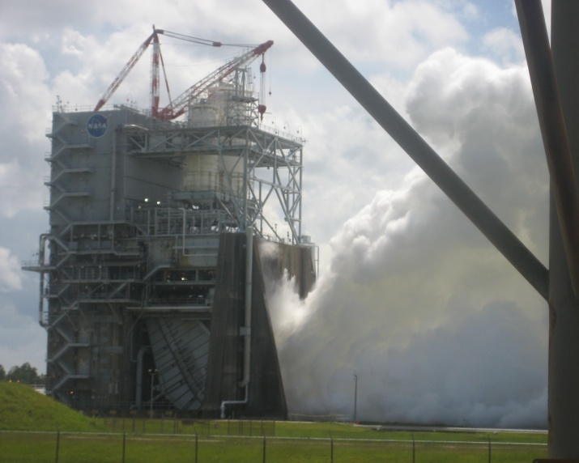
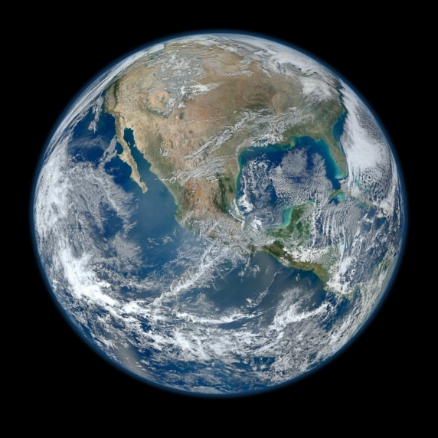
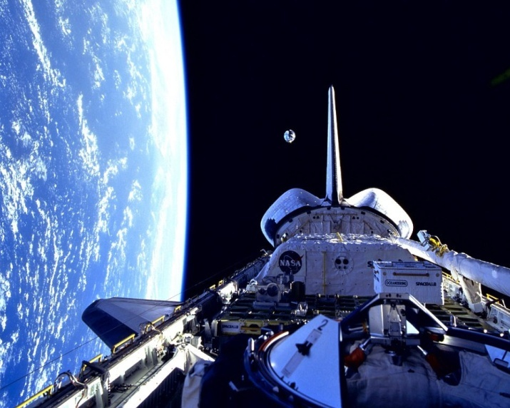
DEVELOP National Program
About NASA & DEVELOP:
History, organization, Personnel

Slide 2
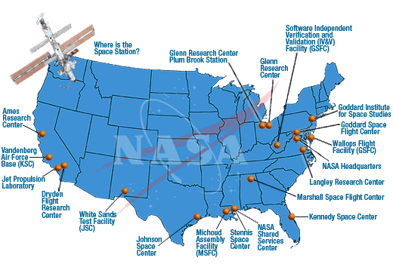
NASA History
"An Act to provide for research into the problems of flight within and outside the Earth's atmosphere, and for other purposes." With this simple preamble, the US Congress and President Dwight D. Eisenhower established the National Aeronautics and Space Administration (NASA) on July 29, 1958.
NASA began operations on October 1, 1958, absorbing into itself the earlier National Advisory Committee for Aeronautics (NACA) intact: 8,000 employees, an annual budget of $100 million, three major research laboratories - Langley Aeronautical Laboratory, Ames Aeronautical Laboratory, and Lewis Flight Propulsion Laboratory - and two smaller test facilities.
NASA quickly incorporated other organizations into the new agency, notably the space science group of the Naval Research Laboratory in Maryland, the Jet Propulsion Laboratory managed by the California Institute of Technology for the Army, and the Army Ballistic Missile Agency in Huntsville, Alabama, where Wernher von Braun's team of engineers were engaged in the development of large rockets. Expansion continued with a multitude of supporting facilities (right).
NASA Centers
History: http://history.nasa.gov/centers.html

Slide 3
NASA Organization
Administrator
Deputy Administrator
Associate Administrator
Chief of Staff
Deputy Associate Administrator
Associate Deputy Administrator
Senior Advisor to the Administrator for Strategy and Policy Implementation
Advisory Groups
NAC and ASAP
Chief Financial Officer*
Chief Scientist
Inspector General
Chief Information Officer*
Chief Technologist
Diversity and Equal Opportunity
Legislative and Intergovernmental Affairs*
Office of Strategy and Policy
Office of Evaluation
Office of Agency Council Staff
Chief Engineer
Chief, Safety and Mission Assurance
Education
Communications*
Chief Health and Medical Officer
International and Interagency Relations
Small Business Programs
General Counsel
Mission Support Directorate
Aeronautics Research Mission Directorate
Human Exploration and Operations Mission Directorate
Ames Research Center
Johnson Space Center
Human Capital Management
Armstrong Flight Research Center
Kennedy Space Center
Strategic Infrastructure
Science Mission Directorate
Space Technology Mission Directorate
Glenn Research Center
Langley Research Center
Headquarters Operations
Goddard Space Flight Center
Marshall Space Flight Center
NASA Shared Services Center
Reporting Structure
 | Administrator
 | Deputy Administrator
 | Associate Administrator
Procurement
Jet Propulsion Laboratory
NASA Management Office
Protective Services
Stennis Space Center
Note:
* Center functional office directors report to Agency functional AA.
Deputy and below report to Center leadership.
March 2014
NASA Organization Chart: http://www.nasa.gov/about/org_index.html#.VBNBWvldWbM

Slide 4
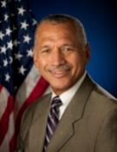
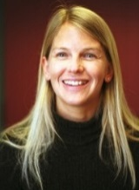
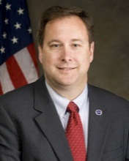
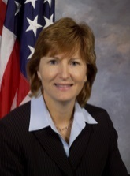
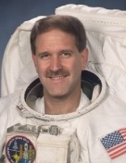
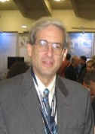
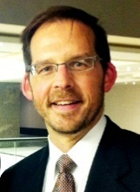
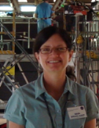
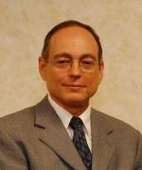
NASA Chain of Command
NASA Administrator
Charles F. Bolden, Jr.
Deputy Administrator
Dava Newman, Ph.D.
Associate Administrator
Robert M. Lightfoot, Jr.
Charles Bolden
Dr. Dava Newman
Robert Lightfoot
Associate Deputy Administrator
Lesa Roe
Science Mission Directorate
John Grunsfeld, Ph.D.
Earth Science Division
Mike Freilich, Ph.D.
Lesa
Roe
Dr. John Grunsfeld
Dr. Mike Freilich
Applied Sciences Program
Lawrence Friedl
Capacity Building Program
Nancy Searby, Ph.D.
DEVELOP National Program
Mike Ruiz
Lawrence Friedl
Dr. Nancy Searby
Mike
Ruiz

Slide 5
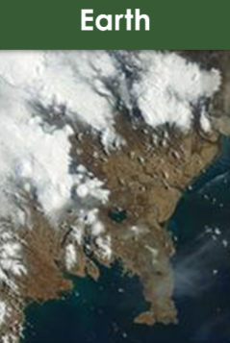
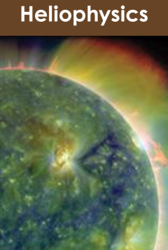
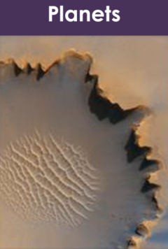
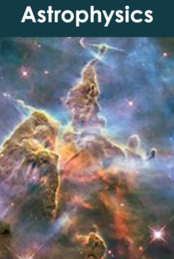
Science Mission Directorate
“Exploring near… and far… for the benefit of all.”
NASA leads the nation on a great journey of discovery, seeking new knowledge and understanding of our planet Earth, our Sun and solar system, and the universe out to its farthest reaches and back to its earliest moments of existence. NASA's Science Mission Directorate (SMD) and the nation's science community use space observatories to conduct scientific studies of the Earth from space to visit and return samples from other bodies in the solar system, and to peer out into our Galaxy and beyond.
Earth
Heliophysics
Planets
Astrophysics
NASA Science Mission Directorate Website: http://science.nasa.gov/

Slide 6
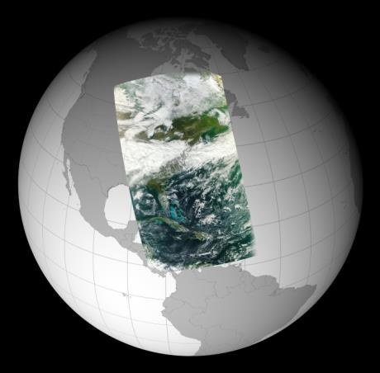
Earth Science Division
“Advancing Earth System Science to meet the challenges of climate and environmental change.”
Earth is a complex, dynamic system we do not yet fully understand, and like the human body, is comprised of diverse components that interact in complex ways. Our planet is changing on all spatial and temporal scales. The purpose of NASA's Earth science program is to develop a scientific understanding of Earth's system and its response to natural or human-induced changes, and to improve prediction of climate, weather, and natural hazards.
Research Encompasses:
The global atmosphere
The global oceans including sea ice
Land surfaces including snow and ice
Ecosystems
Interactions among the atmosphere, oceans, land and ecosystems, including humans
NASA Earth Science Division Website: http://science.nasa.gov/earth-science/

Slide 7
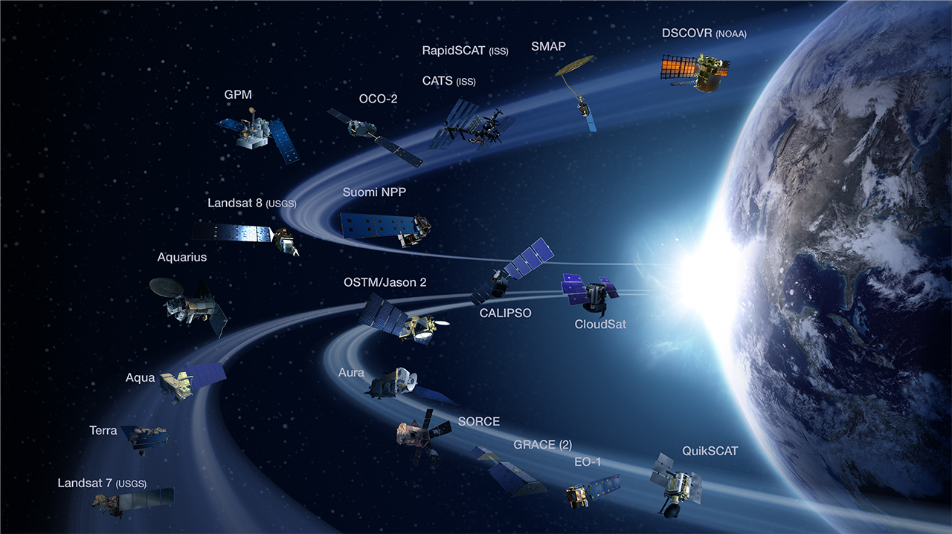
NASA Earth Observing Satellites
NASA Earth observations include a coordinated series of 17 polar-orbiting and low
inclination satellites for long-term global observations.

Slide 8
EO v. EOS
Current NASA Satellite Missions: (aka Earth Observations)
Aqua
Aquarius
Aura
CALIPSO
CloudSat
EO-1
GPM
GRACE
Landsat 7
Landsat 8
OSTM/Jason-2
OCO-2
QuikSCAT
SORCE
SMAP
Suomi NPP
Terra
NASA’s Earth Observing System (EOS): EOS is a subset of the full suite of NASA Earth observing missions focused on long-term global observations of the land surface, biosphere, solid Earth, atmosphere, and oceans to improve understanding of the Earth as an integrated system.
Current EOS Missions:
Aqua
Aura
Landsat 7
Landsat 8
OSTM/Jason-2
QuikSCAT
SORCE
Terra
NASA Earth Science Missions: www.nasa.gov/missions/current/index.html

Slide 9
Applied Sciences Program
“Discovering Innovative & Practical Applications of NASA Earth Science”
The Applied Sciences Program serves as a bridge between the data and knowledge generated by NASA Earth Science and the information and decision-making needs of public and private organizations. The goal of the program is to discover and demonstrate innovative uses and practical benefits of NASA Earth science data, scientific knowledge, and technology.
ASP is organized thematically around 9 application areas and 4 capacity building elements that aim to improve domestic and international skills and capabilities in the use of NASA Earth science.
Ecological
Forecasting
Health &
Air Quality
Water
Resources
Agriculture
Disasters
Weather
Climate
Energy
Oceans
Applied Sciences Program Website: www.nasa.gov/applied-sciences

Slide 10
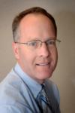
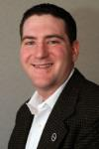
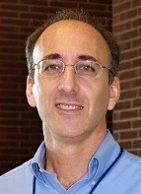
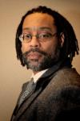
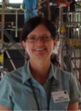
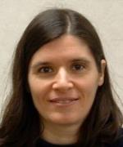
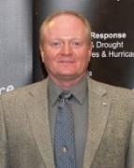
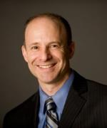
Who’s Who of Applied Sciences
Lawrence Friedl
Director
Lawrence Friedl
Director
Lucien Cox
Operations Manager
Kathy Carroll
Office Manager
ASP Program Managers (NASA HQ)
National
Application Areas
Capacity Building
Dr. Nancy Searby
Brad Doorn
Water
Woody Turner
Eco
John Haynes
Health/AQ
David Green
Disasters
Lucien Cox
Operations
Manager
Nancy Searby
Capacity
Building
John Haynes
Health & Air Quality
Dan Irwin
SERVIR
ASP Capacity Building Element Leads
Dr. Brad Doorn
Water Resources
Mike Ruiz
DEVELOP
Woody Turner
Eco Forecasting
Duane Armstrong
GOMI
Dr. David Green
Disasters
Ana Prados
ARSET
Ana Prados
ARSET
NASA Goddard
Mike Ruiz
DEVELOP
NASA Langley
Duane Armstrong
GOMI
NASA Stennis
Dan Irwin
SERVIR
NASA Marshall

Slide 11
Capacity Building Program
SERVIR Coordination Office (MSFC): Building international capacity with hubs in East Africa, Hindu Kush-Himalaya, Mesoamerica
Gulf of Mexico Initiative, GOMI (SSC): Building Gulf region’s capacity for local issues
Applied Remote SEnsing Training, ARSET (GSFC): Online and hands on basic/advanced training to build domestic skills
DEVELOP (LaRC National Office): Dual workforce/local government capacity building using collaborative feasibility projects
Capacity Building : www.nasa.gov/applied-sciences/capacitybuilding

Slide 12
Where DEVELOP Fits @ NASA
NASA Administrator
Associate Administrator
Mission Directorates
Human Exploration and Operations
Space Technology
Mission Support
Aeronautics Research
Science
Joint Agency Satellite Div.
Heliophysics Division
Earth Science Division
Planetary Science Div.
Astrophysics Division
Applied Sciences Program
Capacity Building Program
You Are Here!
DEVELOP National Program

Slide 13
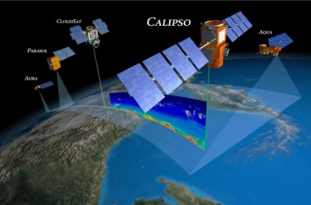
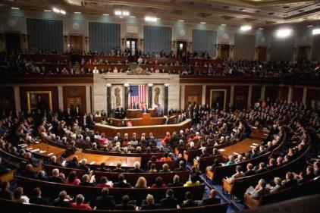
The DEVELOP Elevator Speech
So what is DEVELOP?
DEVELOP, part of NASA’s Applied Sciences Program, addresses environmental and public policy issues by conducting interdisciplinary feasibility projects that apply the lens of NASA Earth observations to community concerns around the globe. Bridging the gap between NASA Earth Science and society, DEVELOP builds capacity in both participants and partner organizations to better prepare them to address the challenges that face our society and future generations. With the competitive nature and growing societal role of science and technology in today’s global workplace, DEVELOP is fostering an adept corps of tomorrow’s scientists and leaders.
NASA’s Applied Sciences’
DEVELOP National Program
Measurements
and Predictions
Communities
DEVELOP’s Website: http://develop.larc.nasa.gov

Slide 14
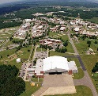
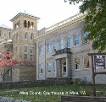
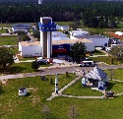
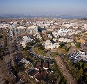
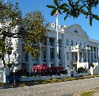
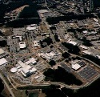
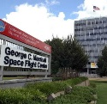
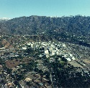
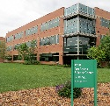
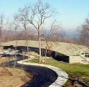
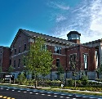
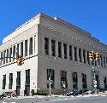
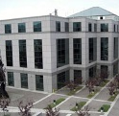
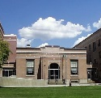
DEVELOP History
DEVELOP began in 1998
In 1998, three interns at NASA Langley Research Center co-authored the white paper “Practical Applications of Remote Sensing” (Bauer et al., 1998). At that time, the Digital Earth Initiative, a federal interagency project dedicated to creating a virtual representation of the Earth to further human understanding of the world, was piloting an effort to increase public access to federal information about the Earth and the environment. A proposal combining NASA’s Digital Earth Initiative and the students’ paper advocated the formation of a program, and in 1999 DEVELOP was officially formed.
Beginning in 2001, new offices were established across the country and expansion has continued to today. DEVELOP is always looking for new opportunities to expand the DEVELOP network and those benefiting from DEVELOP activities.
Langley
Summer
Est. 1998
Wise
Summer
Est. 2001
Stennis
Fall
Est. 2002
Ames
Summer
Est. 2003
Mobile
Fall
Est. 2003
Goddard
Fall
Est. 2008
Marshall
Summer
Est. 2008
JPL
Summer
Est. 2008
Ft. Collins
Spring
Est. 2012
IRI
Spring
Est. 2013
UGA
Summer
Est. 2013
Richmond
Summer
Est. 2014
NCEI
Summer
Est. 2014
Idaho
Summer
Est. 2015

Slide 15
DEVELOP’s Mission, Vision & Core Values
MISSION
VISION
Integrating NASA Earth observations
with society to foster future innovation and cultivate the professionals of tomorrow by addressing diverse environmental issues today.
Shaping the future by integrating Earth observations into global decision making.
COLLABORATION
Cultivating teamwork, multi-disciplinary solutions, and open communication to bridge the gap between science and society
INNOVATION
Fostering rapid feasibility projects to harness ingenuity and demonstrate the applications of Earth science
PASSION
Pursuing all endeavors with energy, excitement, and enthusiasm to sustain a high level of excellence and respect
DISCOVERY
Exploring the potential of NASA’s investment in Earth science to make the extraordinary possible

Slide 16
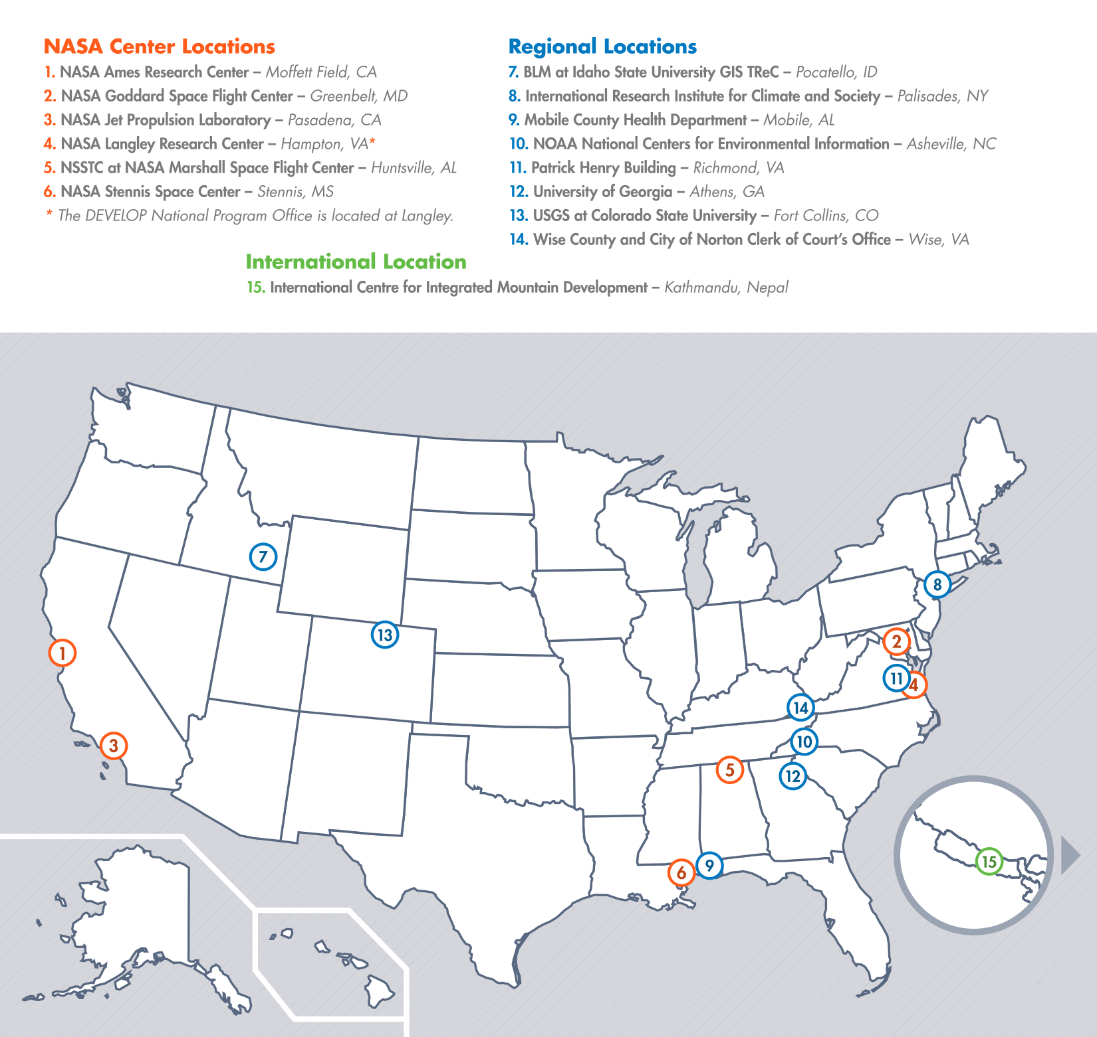
DEVELOP Locations
Newest Node Opening
Pocatello, Idaho
NASA Center Locations
Can only accept US citizens (exception: MSFC)
Contracted through SSAI, Inc.
Regional Locations
Can accept foreign nationals (exception: NCEI)
Contracted through Wise County, VA
Please Note:
Locations evolve

Slide 17
DEVELOP Chain of Command
NPO
National Level
Center Lead
Science Advisor
Mentor
Center Level
Assistant Center Lead
Fellow
Office Level
Project Lead
Project Level
Project Team
Team Level

Slide 18
National POCs
Karen Allsbrook
Mike Bender
Lauren Childs-Gleason
Jamie Favors
Lindsay Rogers
Dr. Kenton Ross
Mike Ruiz
Jennifer Tindell
DEVELOP
Senior Fellows
Beth Brumbaugh
Jeff Ely
Chris McKeel
Tiffani Miller
Merna Saad
DEVELOP
NPO
DEVELOP
Fellows
Amber Brooks (ARC)
Georgina Crepps (MCHD)
Amberle Keith (MSFC)
Peter Hawman (UGA)
Daniel Jensen (JPL)
Chippie Kislik (ARC)
Jerrod Lessel (IRI)
Christine Rains (JPL)
Lance Watkins (NCEI)
Ames
Andrew Nguyen (CL)
Chippie Kislik (ACL)
IRI
Jerrod Lessel (CL)
Alex Sweeney (ACL)
Mobile
Georgina Crepps (CL)
UGA
Caren Remillard (CL)
Peter Hawman (ACL)
DEVELOP Node Leadership
Goddard
Kiersten Newtoff (CL)
Amanda Rumsey (ACL)
Marshall
Leigh Sinclair (CL)
Amberle Keith (ACL)
Stennis
Ross Reahard (CL)
Wise County
Jordan Bates (CL)
BLM-ISU
Jeff May (CL)
JPL
Gwen Miller (CL)
Christine Rains (Co-ACL)
Daniel Jensen (Co-ACL)
NOAA NCEI
Lance Watkins (CL)
Fort Collins
Brian Woodward (CL)
Steve Chignell (ACL)
Langley
Emily Adams (CL)
Daniel Wozniak (ACL)
Richmond
Cassandra Morgan (CL)

Slide 19
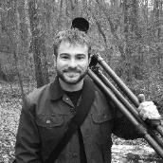
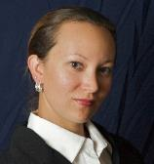
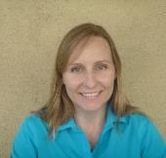
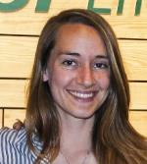
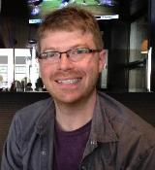
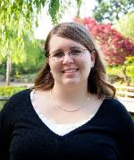
FY15 Fellows Class
What is a DEVELOP Fellow?
A recent college graduate who spends one year with DEVELOP growing both personally and professionally, and contributing to the program as a whole. Each Fellow serves in a dual-role, splitting their time between their node and NPO-related tasks.
Project Coordination Team
Communications Team
Peter Hawman (UGA)
Amberle Keith (MSFC)
Christine Rains (JPL)
Chippie Kislik (ARC)
Jerrod Lessel (IRI)
Impact Analysis
Geoinformatics Team
Georgina Crepps (MCHD)
Amber Brooks (ARC)
Daniel Jensen (JPL)
Lance Watkins (NCEI)

Slide 20
Question? Contact…
Contracts & Payroll
Status Reports / Invoices
Applications
SSAI Personnel Issues
Travel
Deliverables & Deadlines
Quadcharts & Telecons
Conferences & Close Outs
Software & Website
Wise Personnel Issues
International Activities
Govt./Legislative Affairs
Project Hand-Offs
Project Ideas/Requests
Project Proposals
Contact
Karen Allsbrook
Contact
Lauren Childs-Gleason
Contact
Jamie Favors
Poster and PPT Templates
DEVELOP Logos
Recruiting Materials
Designing Anything
Imagery
Partner History/Analyses
Node Tracking/Reporting
Social Media & Podcasts
VPS/Videos & Transcripts
Ambassador Corps
Publications
Newsletter
Recruiting/Outreach
Project Tracking/Archiving
Alumni Survey
Contact
Chris McKeel
Contact
Beth Brumbaugh
Contact
Tiffani Miller

Slide 21
THANK YOU!
Joining the DEVELOP family means being part of NASA’s Legacy.
Learn it. Know it. Live it.

