Slide 1
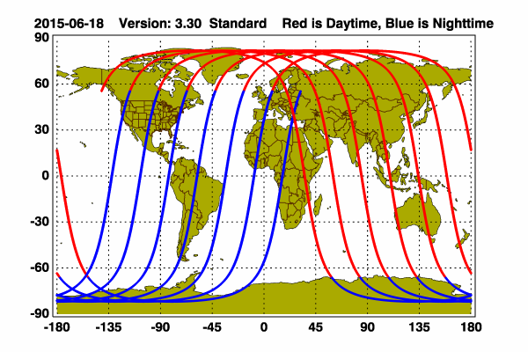
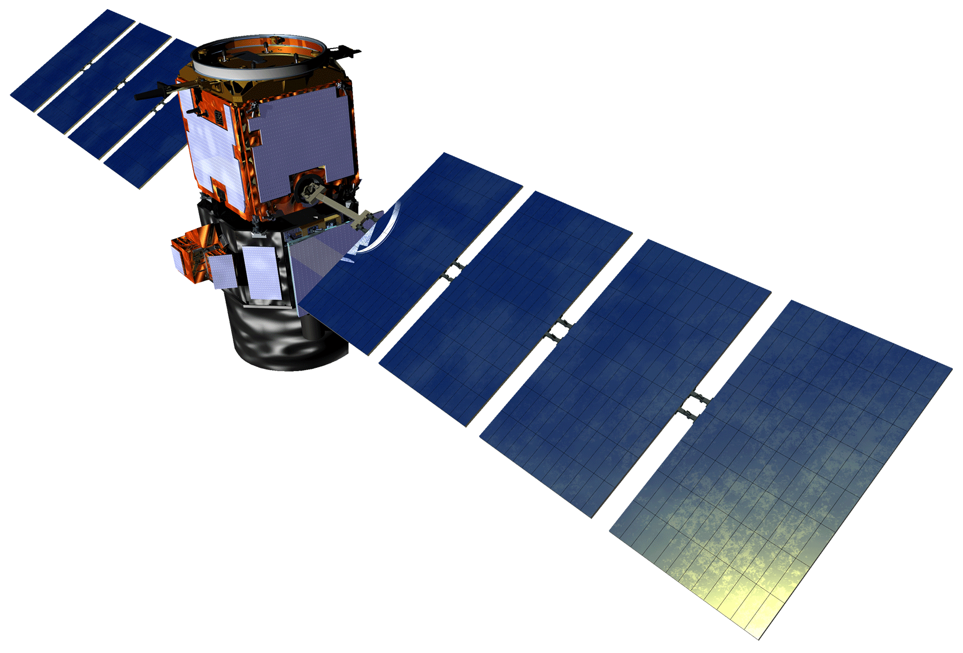
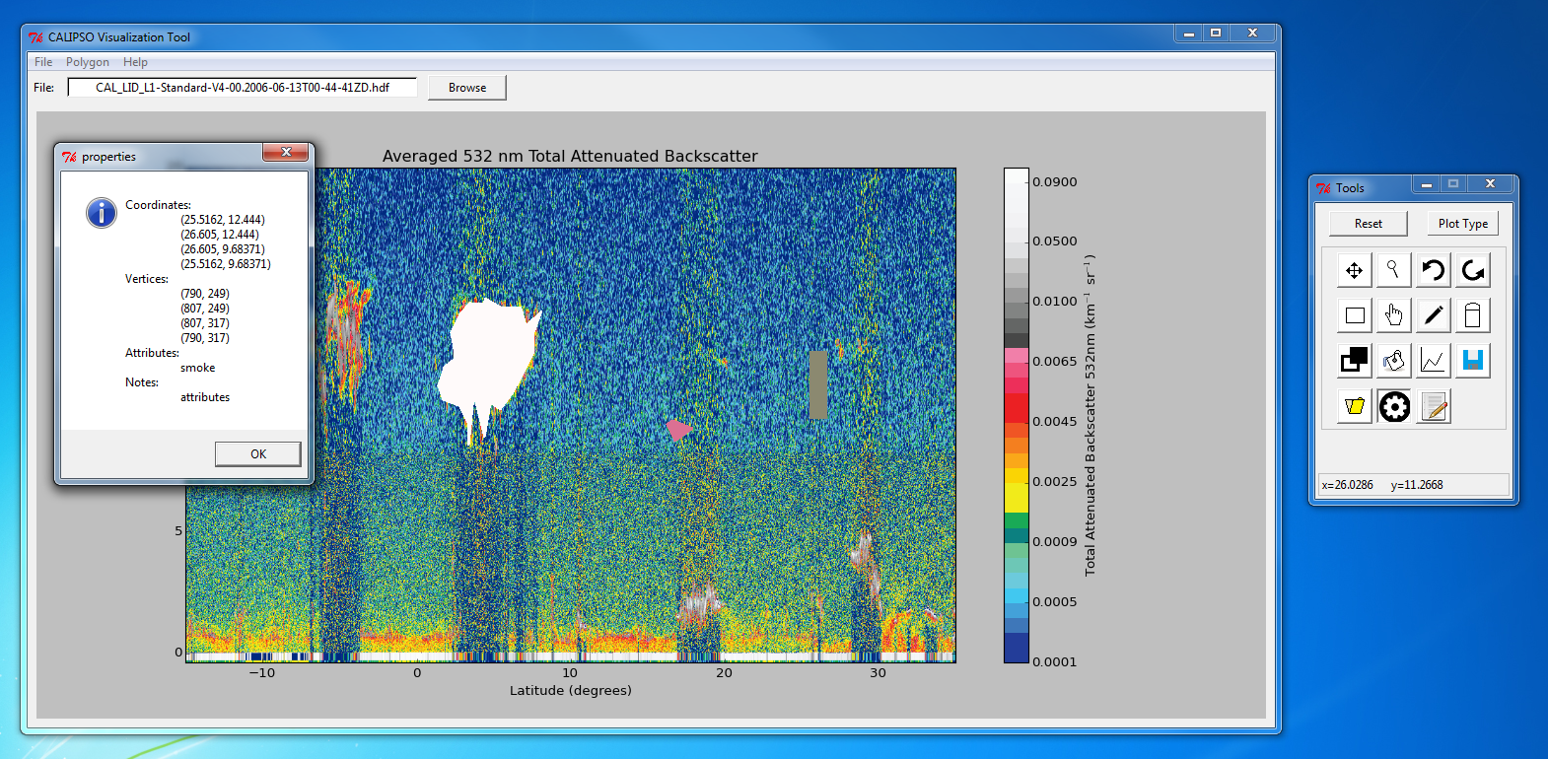
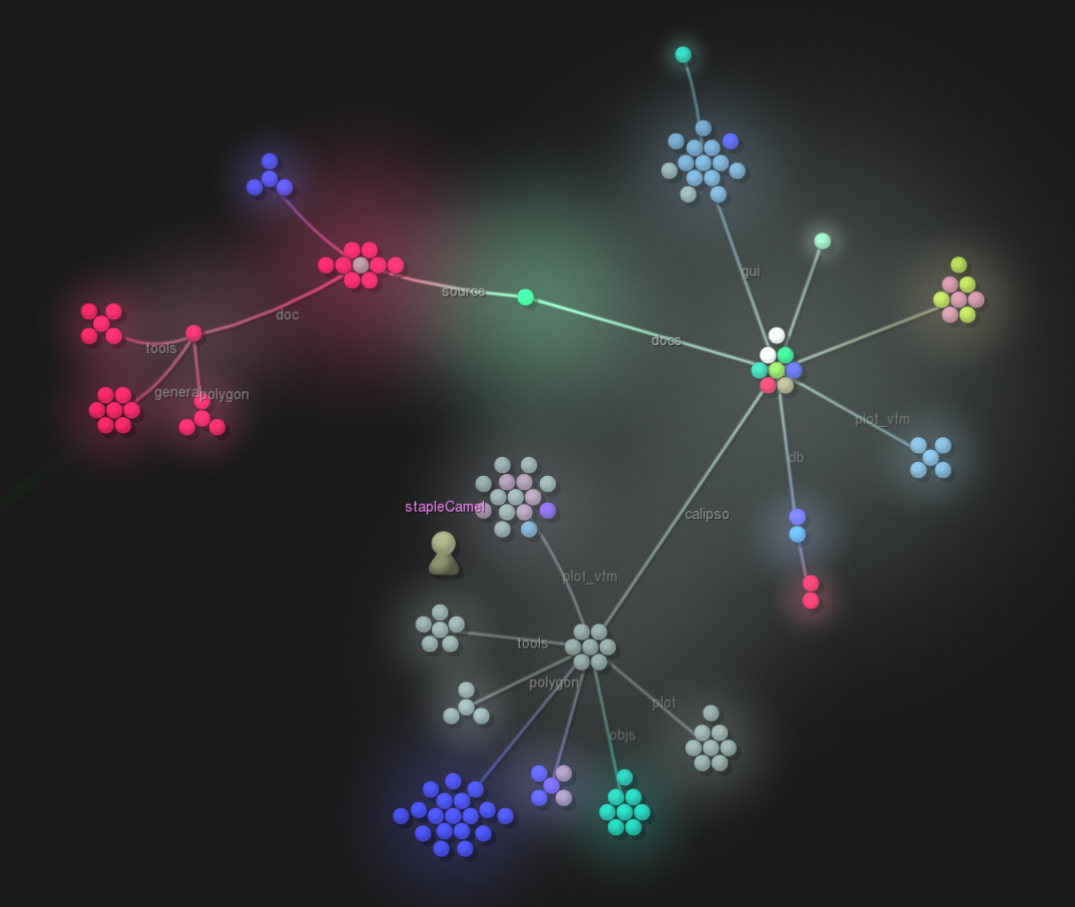
CALIPSO Cross-Cutting
Interfacing CALIPSO data through a graphical user interface
Grant Mercer (Project Lead), Nathan Qian
NASA Langley Research Center
Abstract
Objectives
Keep this blank for now.
Body text point size should be at least 24.
Caption text point size should be at least 16.
Feel free to rename, move, and resize sections as needed.
Add features to help Earth scientists track and identify aerosols
Shape drawing
Saving and loading from database
Create an open source CAlIPSO visualization tool
Study Area
Methodology
Calipso
Displays Interface
PolygonList
Holds list of PolygonDrawers
Handles shape manipulations requests
PolygonDrawer
Draws shape
Store shapes’ internals
CALIPSO Image Viewer
DatabaseManager
Creates and maintains the database
PolygonReader
Reads shapes from JSON
Earth Observations
dbPolygon
Converts shape into database entry
Legend
Association
Aggregation
Composition
Cloud-Aerosol Lidar and Infrared Satellite Observation (CALIPSO)
Results
Conclusions
Use bullets.
Use complete sentences with periods.
Team Members
Project Partners
Acknowledgements
Use a professional-looking photo.
Individual headshots are ok, if they aren’t pixelated and are all the same size.
Include a caption that states the team members’ names.
CALIPSO Science Team
Dr. Charles Trepte
Dr. Amber Soja
CALIPSO Health and Air Quality LaRC Spring 2015
Jordan Vaa (Team Lead)
Ashna Aggarwal
Courtney Duquette
CALIPSO Science Team
Dr. Charles Trepte
Dr. Amber Soja
NASA DEVELOP National Program
Jeffry Ely
Dr. Kenton Ross

