Slide 1
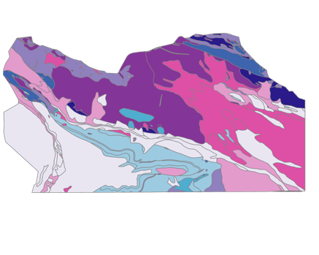
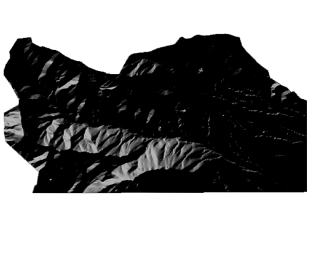
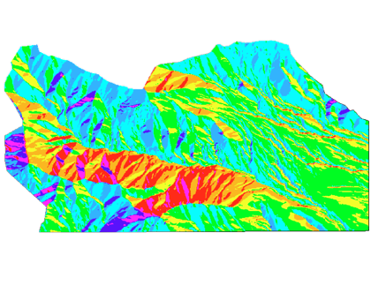
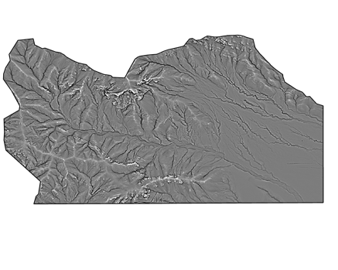
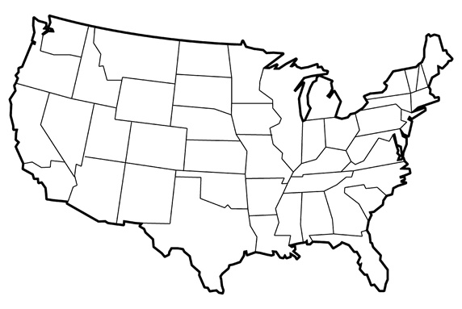
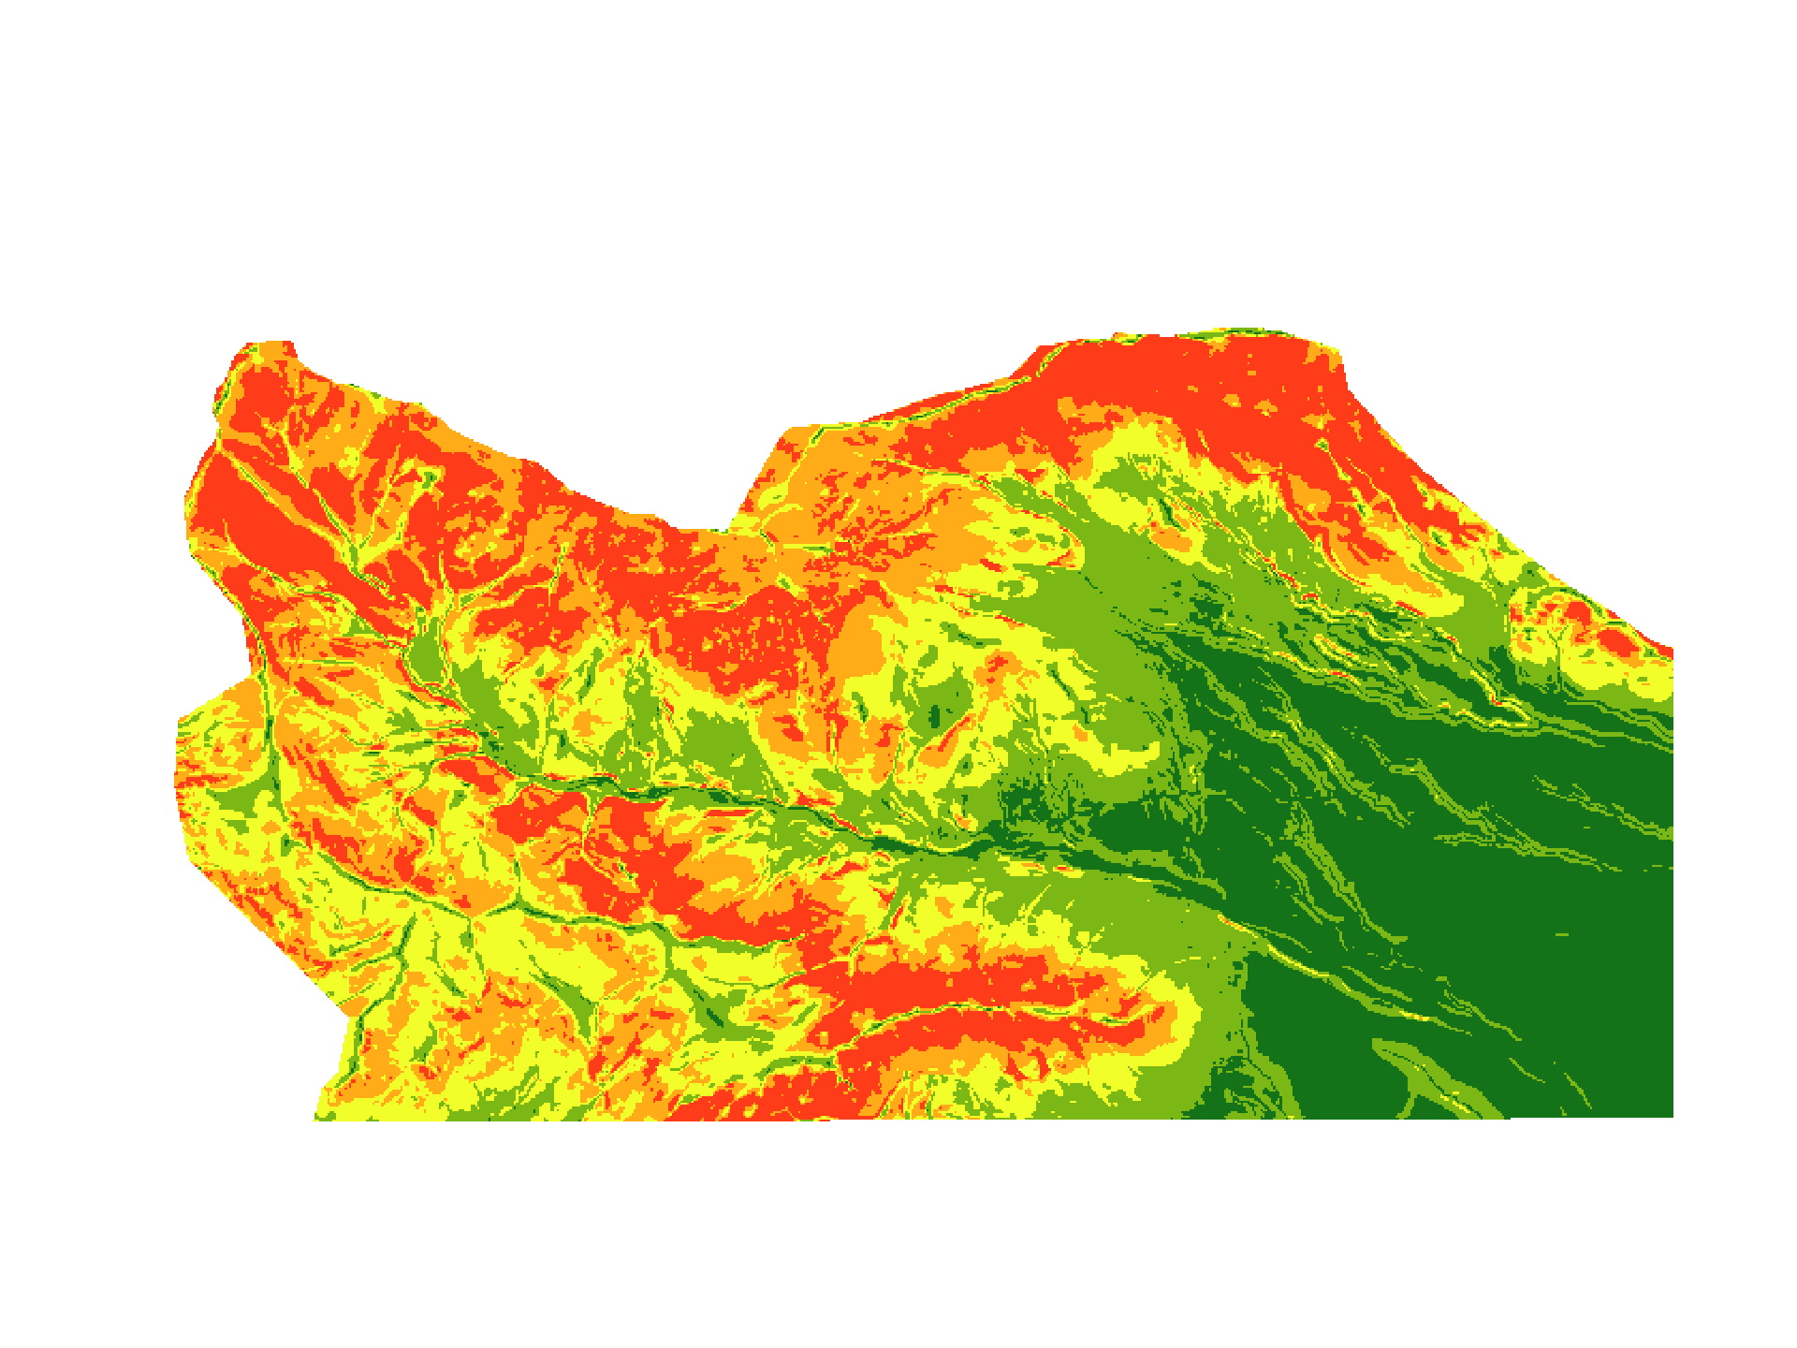
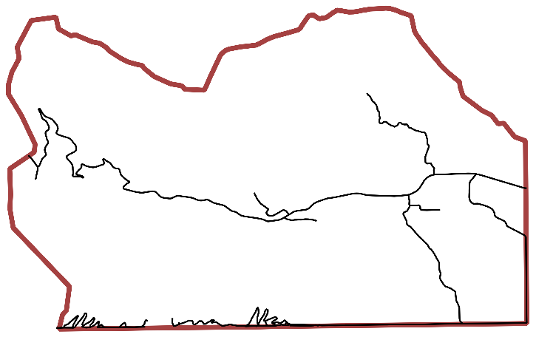
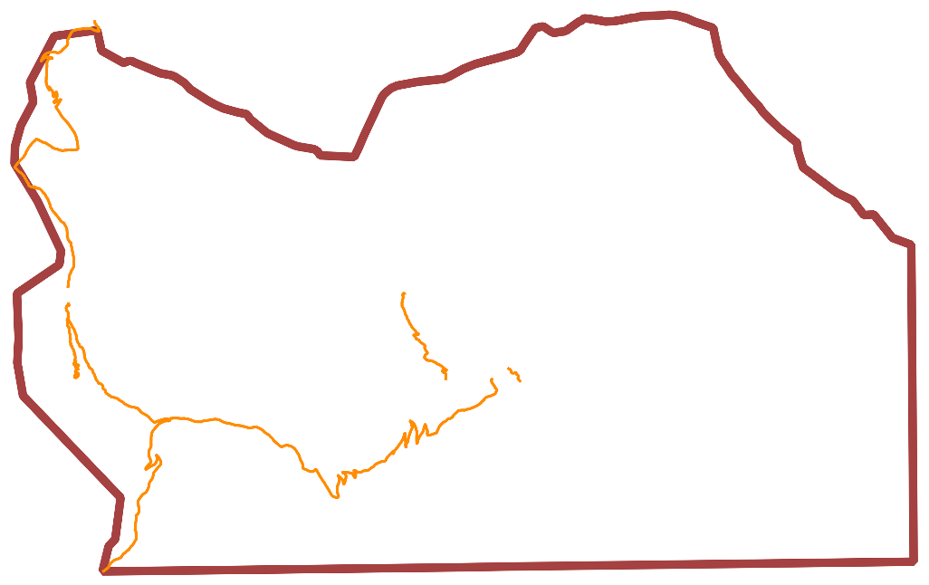
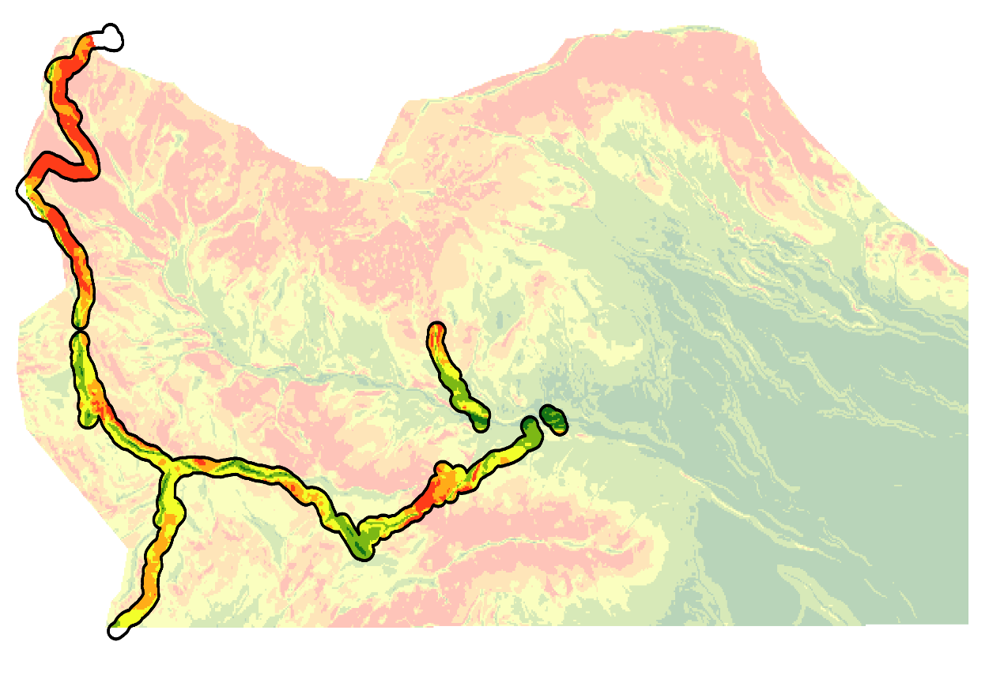
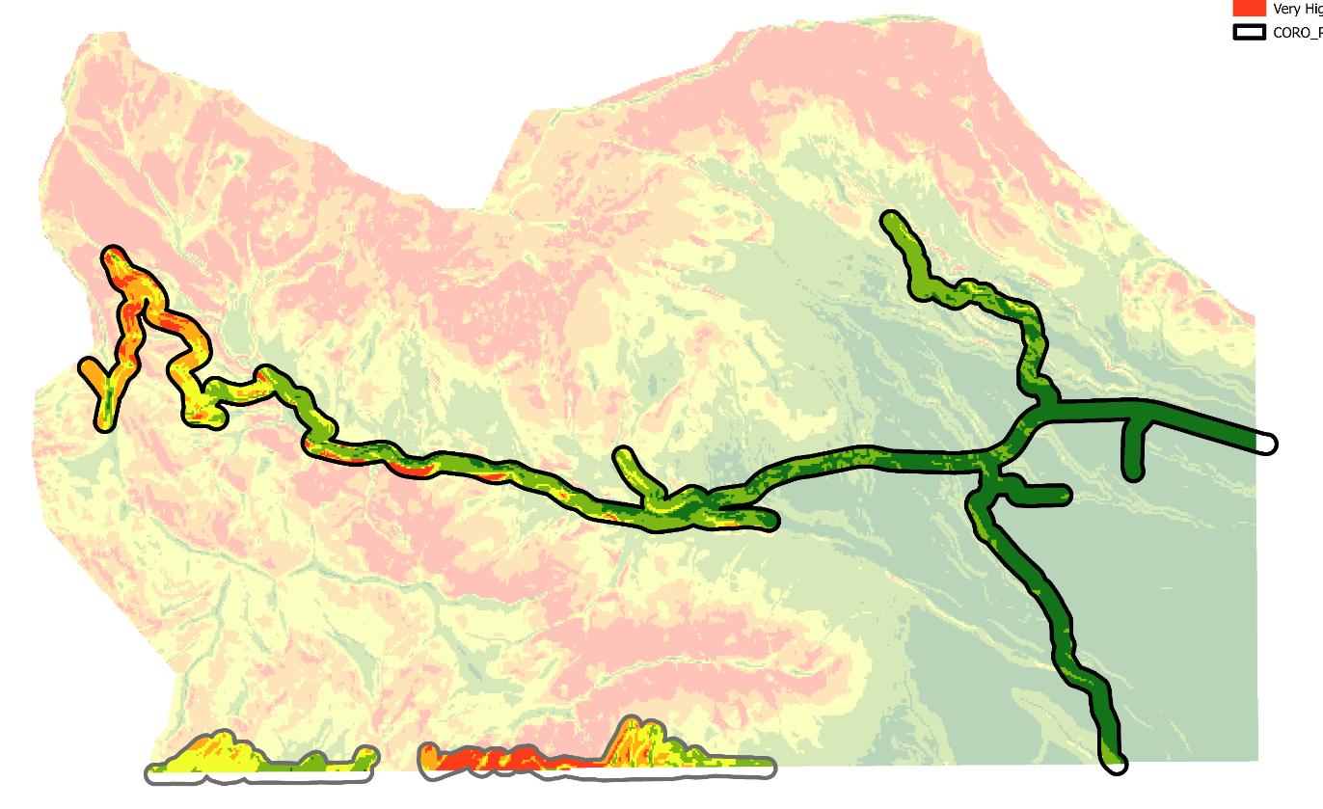
Coronado Disasters
Investigating Geohazards & Slope Failure Susceptibility Utilizing NASA Earth Observations
Project Synopsis
Study Area & Earth Observations
NASA DEVELOP partnered with the National Park Service’s Coronado National Memorial (CORO) located in Hereford, Arizona to conduct a feasibility assessment of Earth observations for identification of geohazards and slope failure susceptibility. Leveraging remote sensing methods and data between 2019 and 2023, the study aimed to provide change detection maps, a slope failure prioritization model, and susceptibility maps. With an emphasis on prioritizing mitigation efforts and monitoring high-risk areas, the project addresses a critical gap in remediation strategies and aims to enhance the conservation and safety of the region.
N
Objectives
CORO is situated along the United States' southern border, featuring recently established but still incomplete border barriers and roads.
Develop a change detection map to determine focus for damage mitigation
Identify areas most susceptible to slope failures
Prioritize safety and remediation in most vulnerable areas
Geology
LiDAR
Aspect
3DEP
NAIP
Project Partner
Landsat 8 & 9
Sentinel-2
World View 2 & 3
0 km
5 km
National Park Service, Coronado National Memorial
Results
Methodology
(A)
34.6
Debris aggregation
(yellow)
Change Detection Map (A): DEM whole image subtraction
Road cut in mountainside
(purple)
2023
2020
-36.2
Slope Susceptibility Map (B): Fuzzy overlay (gamma)
2 Kilometers
Distance to Faults
(B)
Susceptibility
Border Construction
0.15%
Very Low
10%
8%
35%
17%
30%
Low
Erosion Risk
Moderate
High
Very High
2.8%
Roads
0.32%
8%
12%
34%
43%
Plan Curvature
Slope
Trails
0.32%
Slope Failure Prioritization Model (C): Fuzzy overlay results + Assets
Kilometers
18%
26%
27%
21%
5%
0
4
Roads
(C)
Trails
Border Construction and Roads
Trails
Border Construction
Team Members
Susceptibility
Very Low
Low
Moderate
5
5
High
0
Kilometers
0
Kilometers
Very High
No Data
Andrea Slotke
Project Lead
Mikki Arimitsu
Alexander Behzadi
Maggie Drelichman
Conclusions
Acknowledgements
Spatial and temporal resolution proved to be limiting factors for analysis, limiting the use of NASA Earth observation products.
Local datasets proved most useful
The end products can be used for decision making by highlighting areas to prioritize for in situ monitoring and determining areas to pursue remediation.
Project Partners: Jessica Garcia, National Park Service, Southeast Arizona Group
Advisors: Thomas Stanley (NASA GSFC/UMBC), Sean McCartney (NASA GSFC/SSAI)
Special Thanks: Stephanie Willsey (NASA GSFC/AMA), Pukar Amatya (NASA GSFC/UMBC)
Maryland – Goddard | Spring 2024

