Slide 1
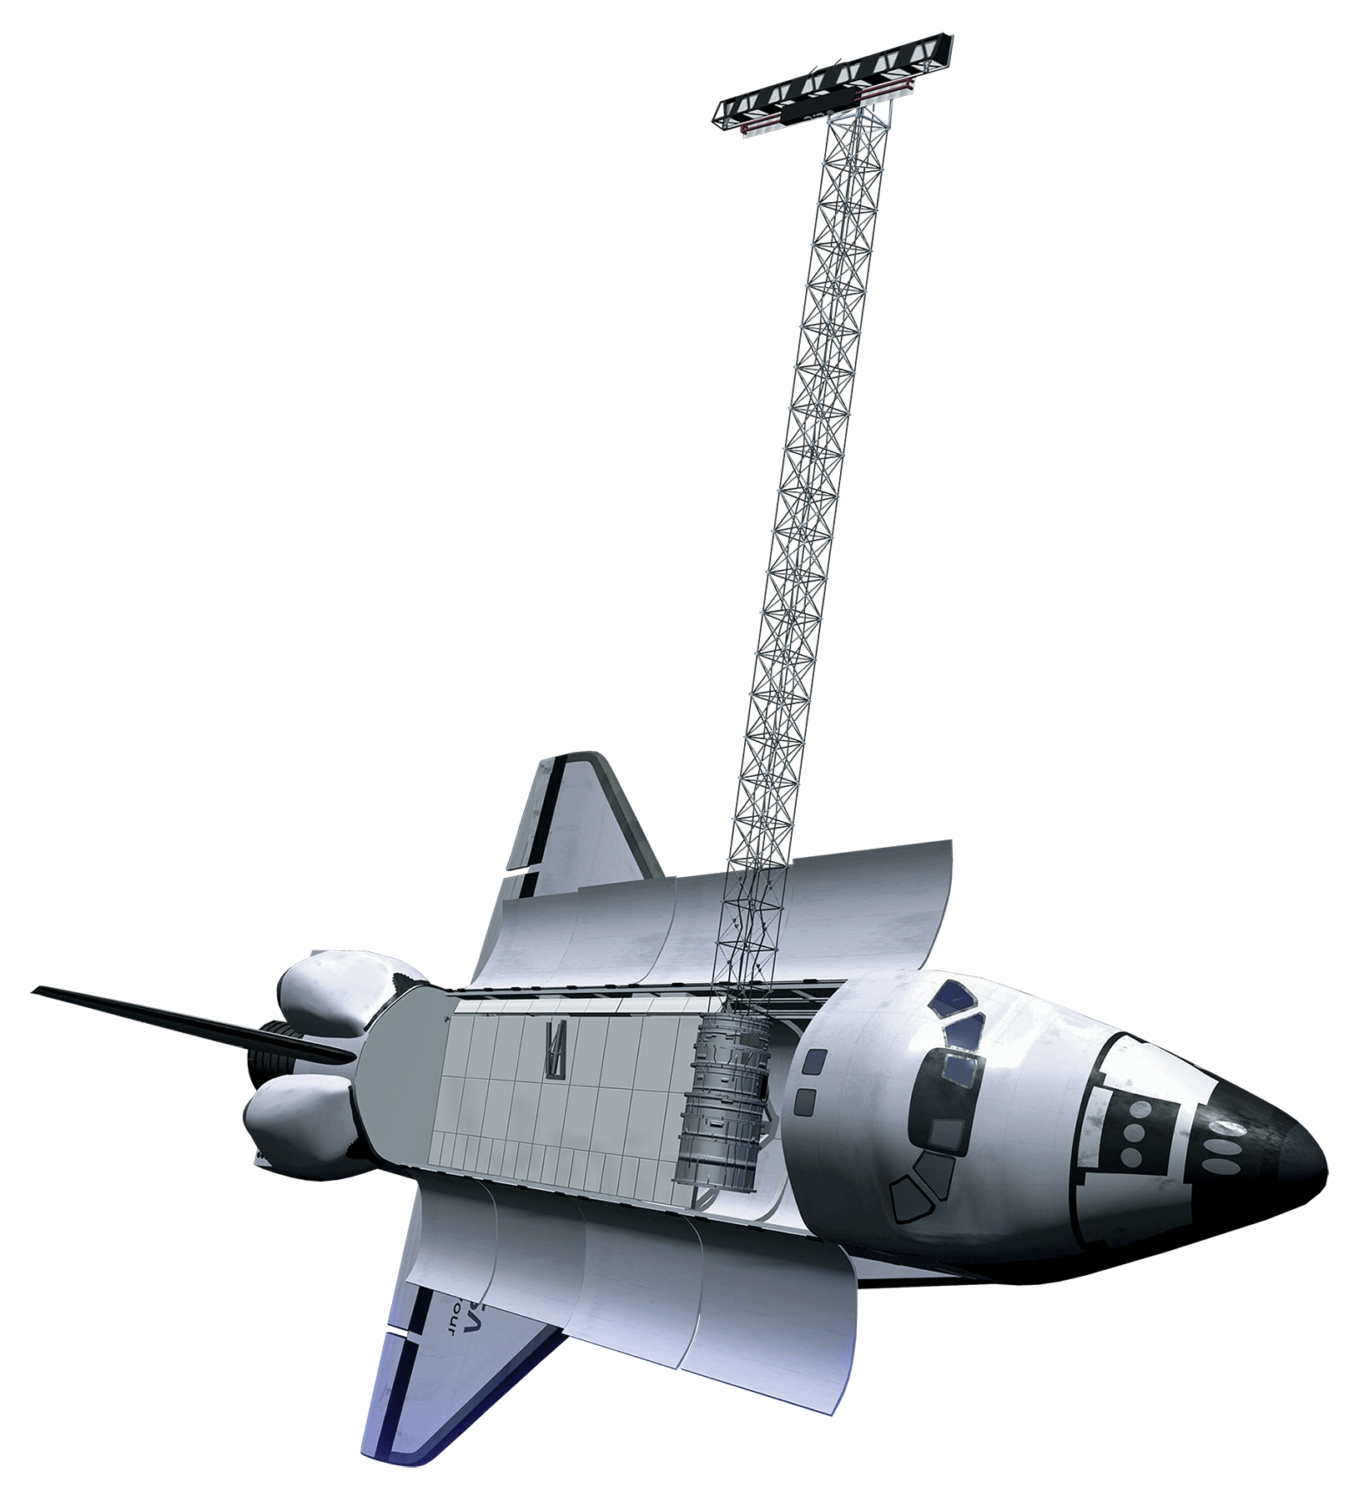
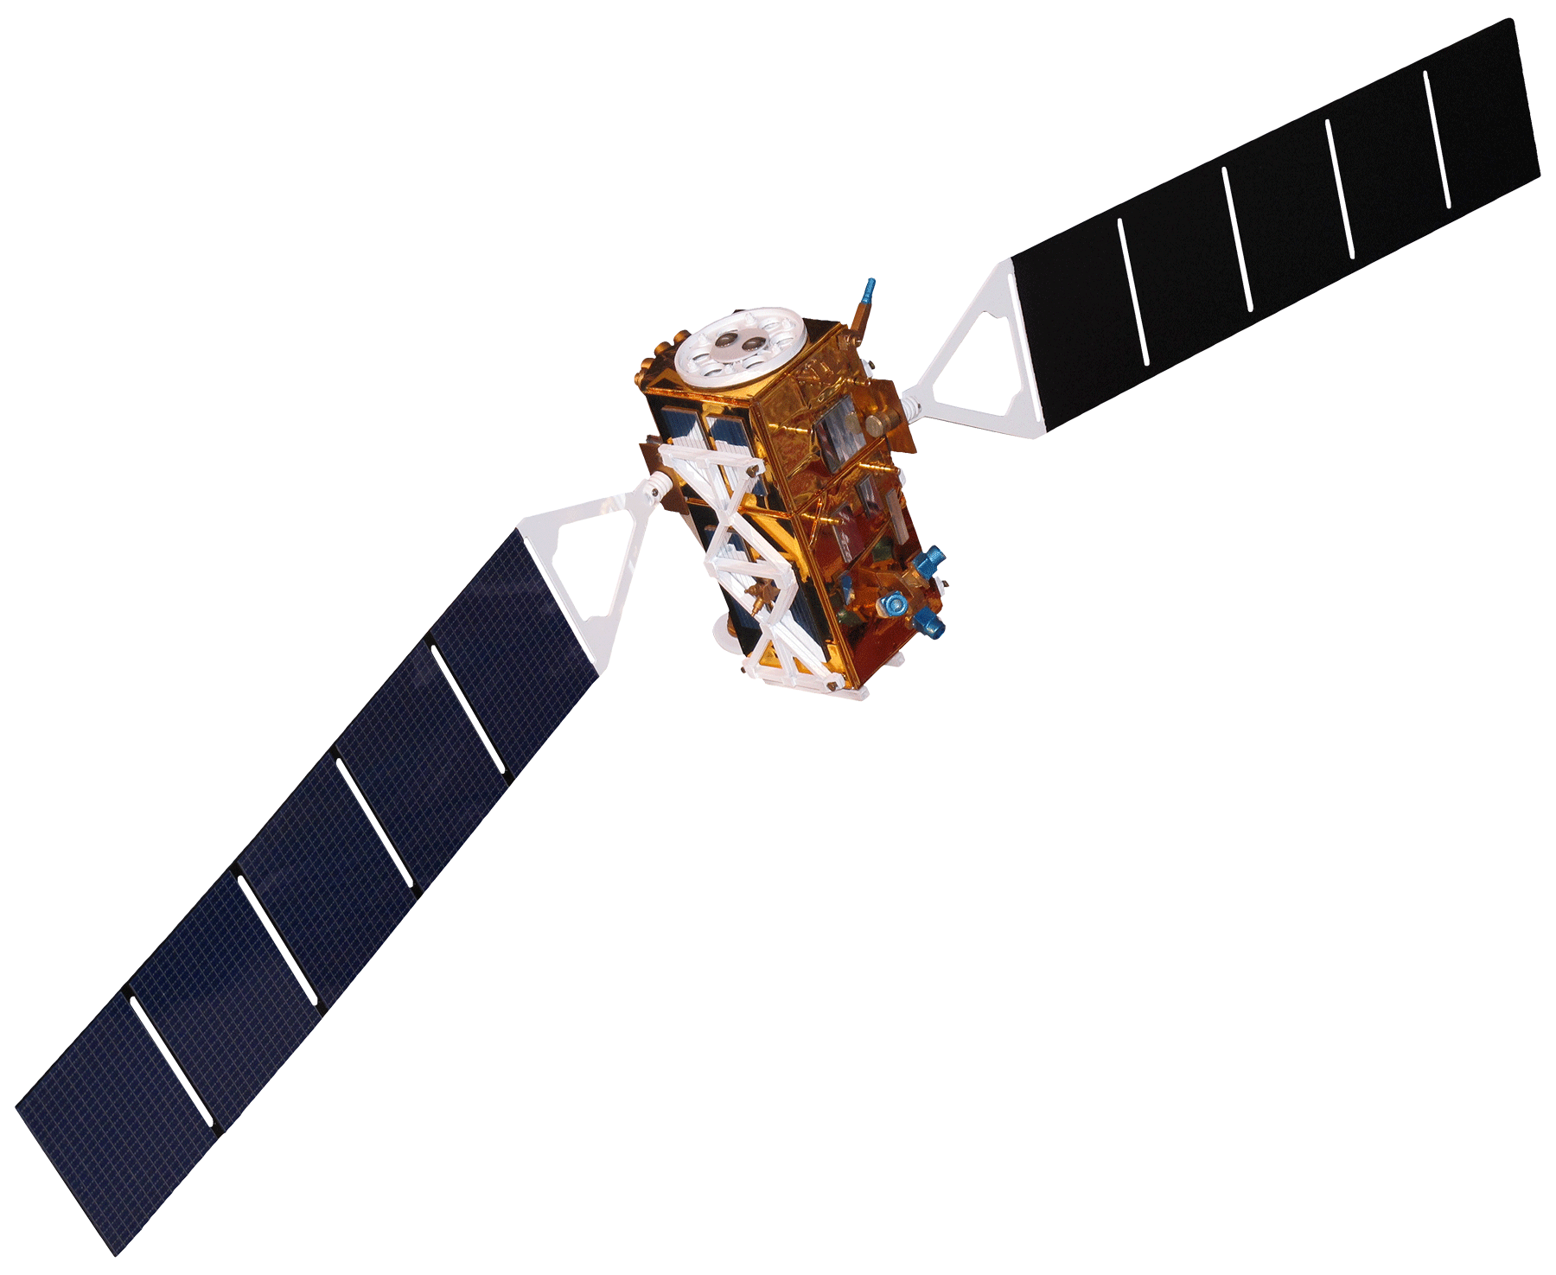
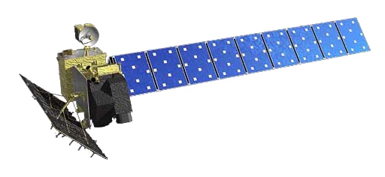
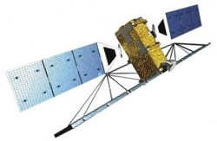
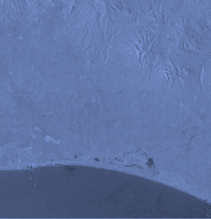
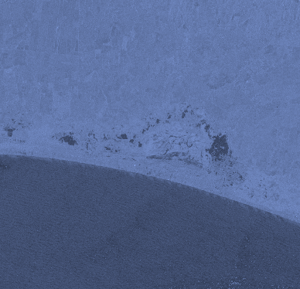
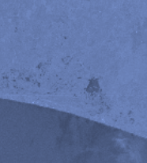
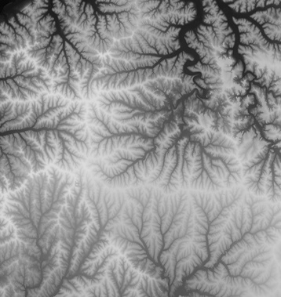
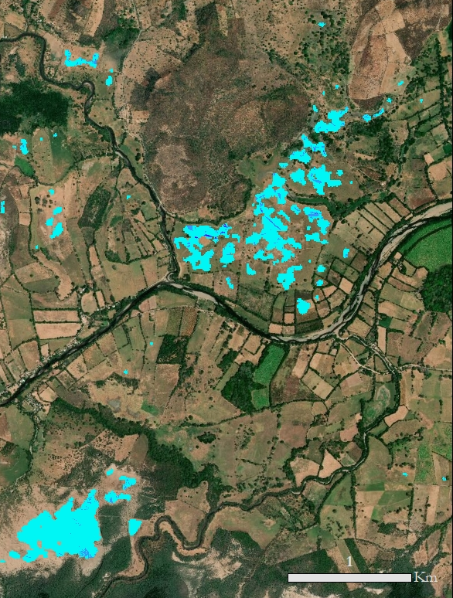
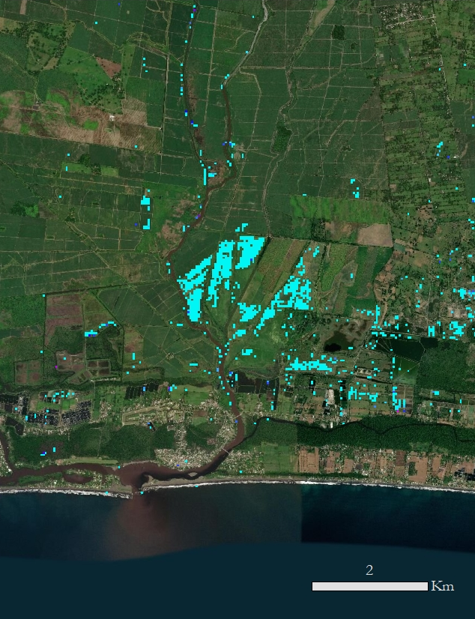
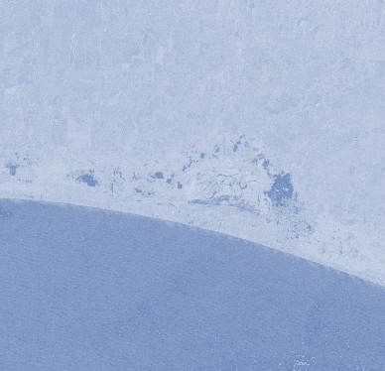
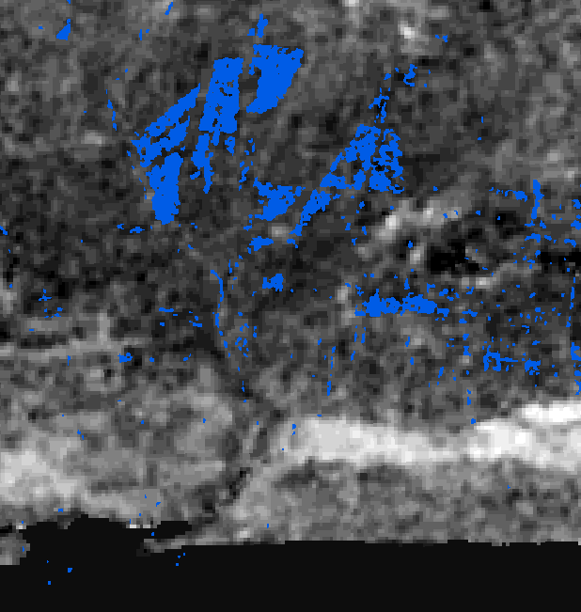
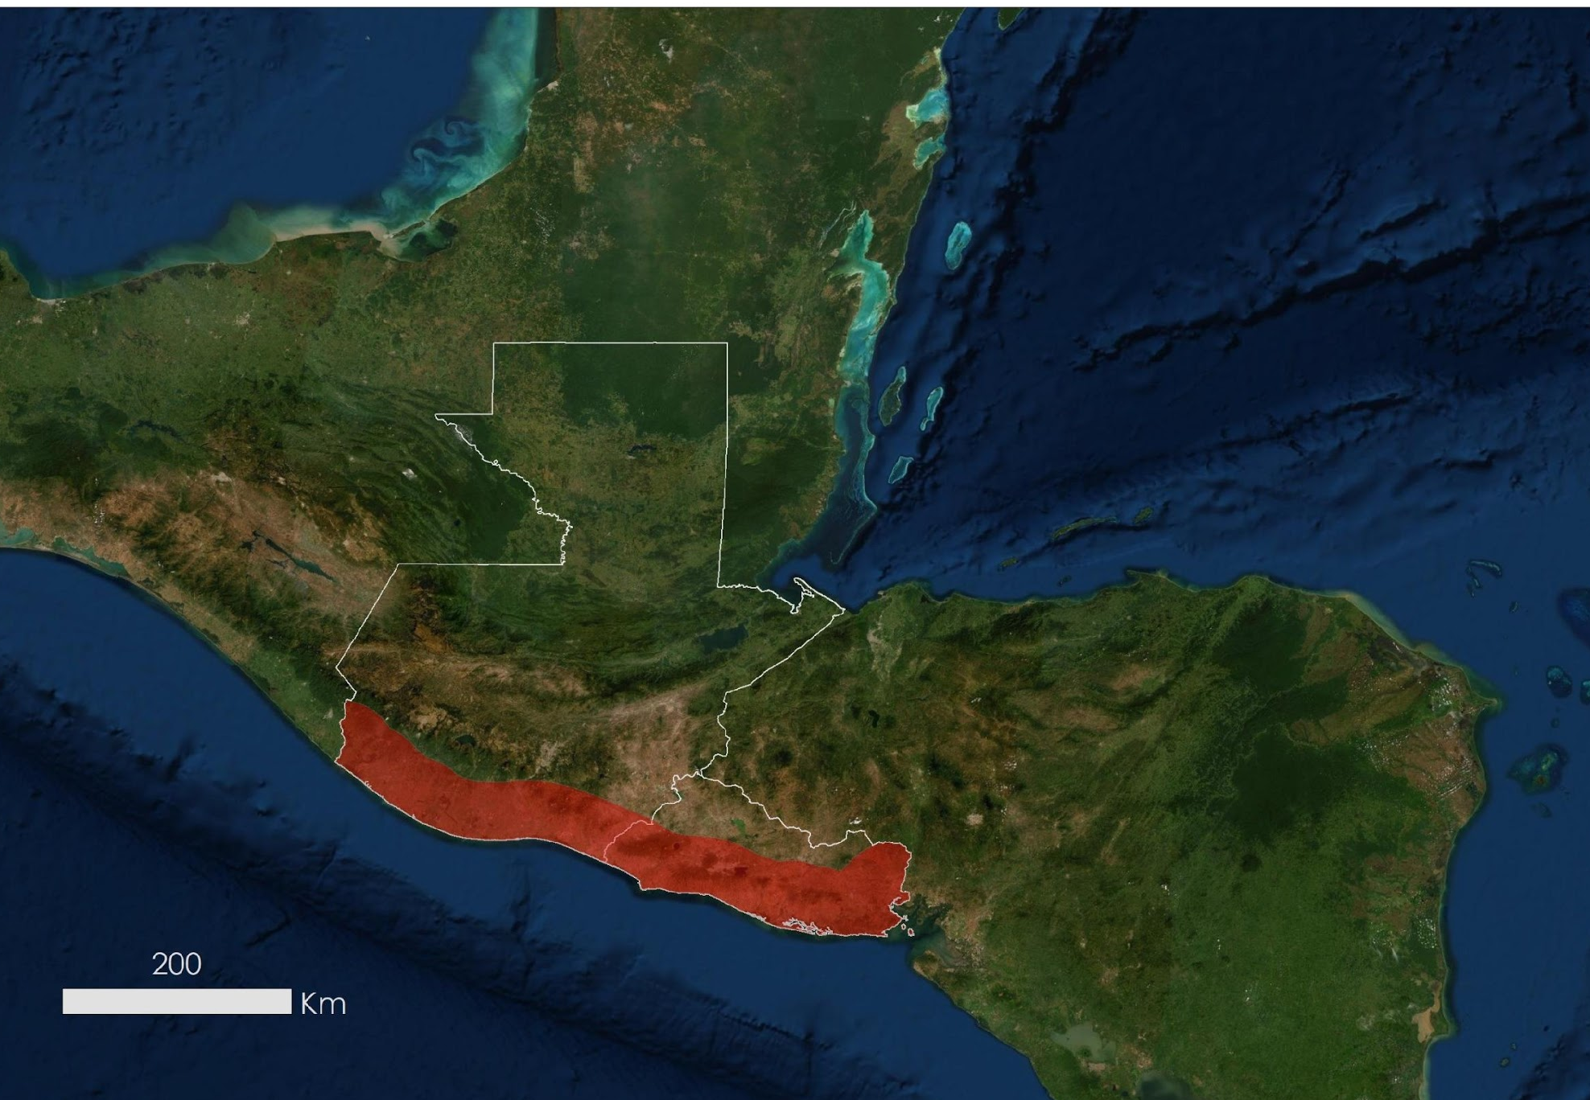





Employing NASA Earth Observations to Map Historic Flooding in Guatemala and El Salvador
Abstract
Objectives
Central America is one of the world’s most vulnerable regions to natural disasters, including landslides and precipitation-driven flooding. In an effort to support disaster management and emergency response planning, this project developed a methodology that employed Earth observations to map historic flooding extents near the Pacific coast of Guatemala and El Salvador. Radar-based techniques were used to detect inundation impact to areas near rivers. Specific Earth observations consisted of moderate resolution remote sensing systems such as the Shuttle Radar Topography Mission (SRTM), the ALOS Phased Array type L-band Synthetic Aperture Radar (PALSAR), RADARSAT-2, and the C-band synthetic aperture radar (SAR) sensor aboard Sentinel-1. End users for this project consisted of Guatemala’s Coordinadora Nacional para la Reducción de Desastres (CONRED) and the Instituto Nacional de Sismología, Vulcanología, Meteorología, e Hidrología (INSIVUMEH), and El Salvador’s Observatorio Ambiental, all of which focus on disaster monitoring and response. This research was intended for the broader benefit of the Central American political and economic organization known as Sistema de la Integración Centroamericana (SICA), with the aim of integrating NASA Earth observations into its environmental decision making.
Inform agencies about past inundation events for better disaster preparedness
Support emergency response efforts with maps and analysis based on SAR data
Provide tutorials for our partners to replicate this methodology and assess future impact to transportation infrastructure
Earth Observations
SRTM
Sentinel-1 C-SAR
ALOS PALSAR
RADARSAT-2
Methodology
Results
Reference
Stack
El Salvador Flooding
October 29, 2017
Guatemala Flooding
September 27, 2017
Flood Images
Stack
Normalized Difference Flood Index (NDFI)
Digital Elevation Model Inputs
Central America Transportation & Infrastructure
Flood Extent Raster (NDFI)
Floodwater
Depth
Floodwater
Depth
N
Floodwater Depth Estimation
High: 5.0 m
N
High: 2.3 m
Low: 0
Low: 0
Study Area
Conclusions
For near real time flood monitoring, we successfully employed NDFI and flood depth estimation methods using extent and elevation data as an alternative to input-intensive hydrological modeling methods.
These methods can provide a rapid understanding of compromised roads based on where flood extent intersects with infrastructure.
Radar data was the most useful method for assessing precipitation-driven flooding in the study area, particularly L-band synthetic aperture radar.
Project Partners
Guatemala
Coordinadora Nacional para la Reducción de Desastres (Guatemala)
Instituto Nacional de Sismología, Vulcanología, Meteorología, e Hidrología (Guatemala)
Observatorio Ambiental, Ministry of Environment and Natural Resources (El Salvador)
NASA SERVIR Science Coordination Office
N
El Salvador
Team Members
Acknowledgements
Madison Murphy (Center lead - Marshall Space Flight Center)
Dr. Rob Griffin (University of Alabama in Huntsville)
Dr. Jeff Luvall (NASA at National Space Science and Technology Center)
Dr. Emil Cherrington, Betzy Hernandez, Africa Flores, Francisco Delgado, and Helen Baldwin (NASA SERVIR)
Maggi Klug (University of Alabama Huntsville)
Sean McCartney (NASA ARSET)
Jordan Bell (NASA SPoRT) and Kel Markert (NASA SERVIR) for technical support
Vanesa Martín
Project Lead
Gentry Patterson
Carly Muir
Samuel Heagney
Alabama – Marshall | Summer 2019

