Slide 1
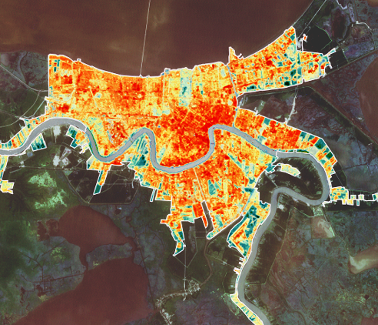
2018 Fall | Alabama – Mobile
NEW ORLEANS HEALTH & AIR QUALITY
Monitoring the Urban Heat Island Effects on the Health of Residents in New Orleans, Louisiana Metropolitan Area with Landsat Land Surface Temperature Products
Madison Murphy
Alahna Moore
Charles Christonikos
Ann Rodden
Notes:
Image credit: New Orleans Health and Air Quality team

Slide 2
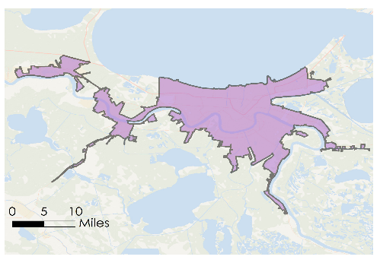
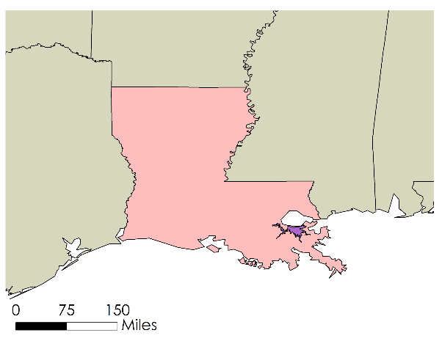
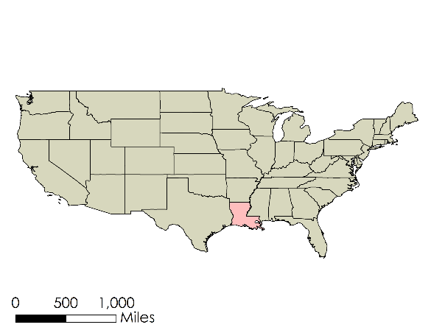
Study Area: New Orleans, LA
Area: 350 mi²
Metropolitan Area Population: 1,275,000
August Temperatures
Average High: 93°F
Average Low: 75°F
Record High: 102°
Notes:
Our research focused on the Greater New Orleans metropolitan area, which includes New Orleans Parish and the neighboring cities of Metairie and Kenner. The New Orleans metropolis is a major U.S. port city and cultural hub, home to approximately 1,275,000 people. According to the U.S. Census Bureau as of 2017, 59.8% of the city’s residents are African-American, followed by 30.6% White, 5.5% Hispanic or Latino, and 4.1% other racial and ethnic groups. Situated at the mouth of the Mississippi River with Lake Pontchartrain to the north and the Gulf of Mexico to the south, New Orleans largely sits below sea level, making it vulnerable to frequent and severe flooding.
New Orleans is prone to high summer temperatures; average high temperature for the month of August in the city is 93 degrees Fahrenheit, 102 degrees Fahrenheit being the record August high. The New Orleans Health and Air Quality team used NASA Earth observations to study the extent and severity of the urban heat island effect within the Greater New Orleans metropolitan area between the years of 2000 and 2018
Map credit: New Orleans Health and Air Quality team

Slide 3
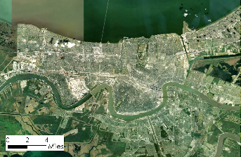
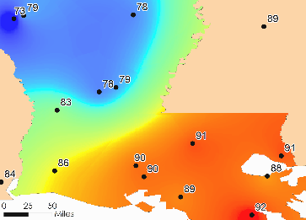
Community Concerns
URBAN HEAT ISLAND
GRAY INFRASTRUCTURE & HUMAN ACTIVITY
URBAN SPRAWL
+
=
Image Credit: Pexels via Pixabay
Notes:
The urban heat island effect occurs when grey, paved surfaces found in cities absorb and trap heat during the day time, increasing the overall temperature of cities relative to nearby rural areas. Cities with little to no trees or green space within them are most affected by the urban heat island effect due to the absence of natural cooling effects from shade and the evaporation of water from soil and leaves via evapotranspiration. Urban heat islands pose a risk to human health and well being by exposing urban residents to excessive heat, increasing the likelihood of experiencing heat stroke, dehydration, and respiratory illnesses caused by poor air quality.
A city’s size, morphology, and land cover composition determine how intensely it will experience the urban heat island effect, and which its areas will be most affected by concentrated extreme heat. Many local governments and communities are taking action to reduce the urban heat island effect through strategies such as increasing urban tree and vegetation cover, installing green or reflective roofing and pavement, and planning for smart growth practices.
Image source (1): https://pixabay.com/en/new-orleans-city-orleans-louisiana-993232/ (CC 0 1.0 – Public Domain)
Image source (2): map created by DEVELOP team, basemap source: ESRI, DigitalGlobe, GeoEye, Earthstar Geographics
Image source (3): map created by DEVELOP team

Slide 4
Community Concerns
urban heat island (noun) /ˈərbən hēt ˈīlənd/ :
an urban or metropolitan area that is significantly warmer than surrounding rural areas due to the presence of impervious surfaces, industry, and human activities that can contribute to heat-related health crises
URBAN HEAT ISLAND
Notes:
A city’s size, morphology, and land cover composition determine how intensely it will experience the urban heat island effect, and which its areas will be most affected by concentrated extreme heat. Many local governments and communities are taking action to reduce the urban heat island effect through strategies such as increasing urban tree and vegetation cover, installing green or reflective roofing and pavement, and planning for smart growth practices.
Image source (1): https://pixabay.com/en/new-orleans-city-orleans-louisiana-993232/ (CC 0 1.0 – Public Domain)
Image source (2): map created by DEVELOP team, basemap source: ESRI, DigitalGlobe, GeoEye, Earthstar Geographics
Image source (3): map created by DEVELOP team

Slide 5
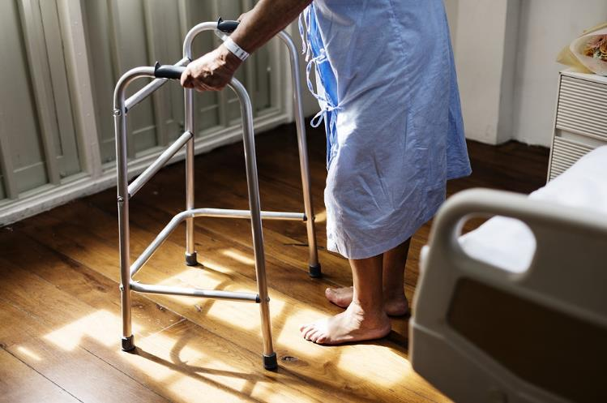
Community Concerns: Human Health
More frequent heat wave events can lead to higher rates of hospitalizations and heat-related mortality
Urban Heat Islands = higher surface temperatures in the daytime, less night time cooling, and higher air pollution levels
Populations most vulnerable:
children (<5 years)
the elderly (>65 years)
people with pre-existing chronic conditions
disabled persons
URBN HEAT ISLAND
Image Credit: Pexels via Pixabay
Notes:
On average, heat is the number one cause of weather-related deaths in the United States and are projected to become more severe and frequent in the near future. Those living in areas prone to the urban heat island effect experience higher surface temperatures during the day, less cooling at night, and higher levels of air pollution. More frequent heat wave periods increase rates of hospitalizations for heat exhaustion, stroke, respiratory illnesses, and death. Those most vulnerable to severe heat exposure are those below 5 years old, those above 65 years old, those with pre-existing respiratory and cardiovascular conditions, and disabled persons.
Image source 1: https://pixabay.com/en/care-diagnose-disease-health-3031259/

Slide 6
Community Concerns: Human Health
Apparent Temperature | Heat-stress risk with physical activity and/or prolonged exposure
90° - 104° | Heat cramps or heat exhaustion possible
105° - 129° | Heat cramps or heat exhaustion likely. Heatstroke possible
130° + | Heatstroke very likely
Source: Princeton University, 2018
Prolonged exposure to temperatures 90°F or above impacts human health → we delegated these values as “hot spots”.
Notes:
Prolonged exposure to temperatures of 90 degree Fahrenheit or above is detrimental to human health, especially in urban environments during heat wave events. Areas prone to the development of urban heat islands experience concentrated severe heat, further compounding the effects of heat exposure on the human body. For our project, we used 90 degrees Fahrenheit and above as our threshold to identify regions of New Orleans that displayed anomalous and harmful temperature trends.

Slide 7
Partner: Louisiana Public Health Institute
“It’s important to understand that health is much more than clinical health. It’s about where you live, where you work, where you commute from and to, where your recreation activities are. That’s where the relationship with you guys comes in: getting a better understanding of climate and ultimately how climate affects health.”
- Dr. Thomas Carton, Louisiana Public Health Institute
Dr. Thomas Carton,
Chief Business Development Officer, LPHI
Notes:
The New Orleans Health and Air Quality team partnered with the Louisiana Public Health Institute, an organization whose mission is to “uncover complimentary connections across sectors to combine social, economic, and human capital needed to align action for health”. The Louisiana Public Health Institute studies possible determinants of health using statistical evidence along with the needs of impacted communities to promote and inform public health policy. Through their work, LPHI partners with local and regional organizations to use environmental evidence to inform risk mitigation strategies that assist local communities’ resiliency to public health threats.
LPHI is familiar with NASA Earth observations and geospatial analysis tools, but does not have firsthand experience using remote sensing applications. The application of NASA Earth observation data could greatly enhance LPHI’s capability to predict and prevent heat related illness within the city of New Orleans, identify causes of Urban Cool Islands, and aid in planning initiatives that will reduce heat concentration within the city.
Image source: NASA DEVELOP Alabama - Mobile Node

Slide 8
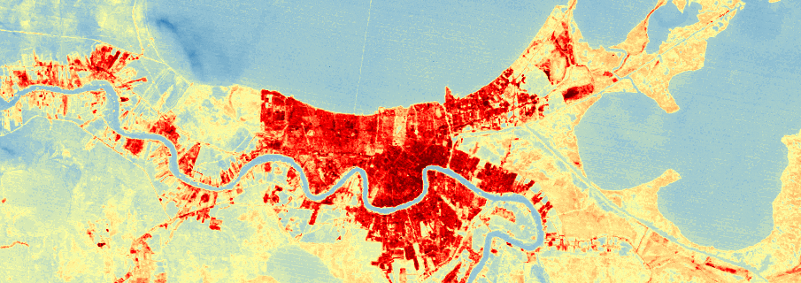
Project Objectives
Image Credit: Monet
Perform temporal and spatial analysis to identify heating patterns in New Orleans
Identify regions experiencing anomalous temperatures (≥ 70° F or ≤ 90° F)
Classify land cover to quantify density of gray infrastructure and vegetated space
Create Heat Vulnerability Assessment by calculating combined influence of:
Land Surface Temperature
Land cover classifications (% Urban land)
Census demographic data
Notes:
The primary objective of this research was to design a process with which to examine spatial and temporal changes in Land Surface Temperature within New Orleans for a time period spanning nearly two decades. We sought to identify patterns of change between land surface temperature and land cover type in order to elucidate correlations between high temperature and impervious, gray infrastructure.
In order to tailor this research to our partner’s needs, we cross-examined annual land surface temperature products with a social vulnerability dataset generated by identifying and ranking demographic sectors that may be more sensitive to heat illness and injury. From this process we formed a hypothesis that will inform future analysis using clinical data from the Louisiana Public Health Institute to examine the spatial relationship between “hot spot” areas and the number of heat related hospitalizations.

Slide 9
Study Period
Land Surface Temperature
2000
2006
2012
2018
Land Cover Classification
2000
2006
2018
Notes:
The team calculated 1 land surface temperature (LST) image for each year between 2000 and 2018. A total of 7 LST images were calculated for the most recent year of 2018.
We chose to classify three years for land cover, the first year of the study period, 2000, the year after Katrina (2006), and the final and most recent year of 2018.

Slide 10
Sensors Used
Landsat 5 TM
2000 - 2011
Landsat 7 ETM+
2012
Landsat 5, 7, 8: NDVI, land cover classification, LST
Landsat 8 OLI / TIRS
2013 - 2018
Image Credit: NASA
Notes:
For this research, we primarily used imagery collected by sensors onboard the Landsat suite of satellites. For the years 2000 - 2011, we utilized data collected by Landsat 5 Thematic Mapper. For the year 2012, data was collected via Landsat 7 enhanced thematic mapper, and for the years 2013 - 2018 we utilized data from Landsat 8 Operational Land Imager and Thermal infrared Sensor.

Slide 11
Methodology
Landsat Imagery
Brightness Temperature
NDVI
Land Surface Temperature Products
Aggregated Heat Vulnerability Assessment
Landsat Imagery
Land Cover Classification
Land Cover Change Map Products
Vulnerability Variables
Percentile Rank Data for Index Creation
Vulnerability Map Products by Variable
Notes:
Three datasets were used to assess heat vulnerability. First, we processed Landsat multispectral and thermal imagery to create Land Surface Temperature products. Secondly, we classified land cover using true color Landsat imagery. Finally, we created a social vulnerability index shapefile that identified areas with demographic characteristics that would render a group vulnerable to heat related illness.

Slide 12
Methodology
Land Surface Temperature Products
Landsat Imagery
Brightness Temperature
NDVI
Aggregated Heat Vulnerability Assessment
Landsat Imagery
Land Cover Classification
Land Cover Change Zonal Statistics
Vulnerability Variables
Percentile Rank Data for Index Creation
Vulnerability Zonal Statistics
Notes:
Now we will break down each of the 3 components that made up our end product of the aggregated heat vulnerability assessment. Our first focus will be on the Land Surface temperature products.

Slide 13
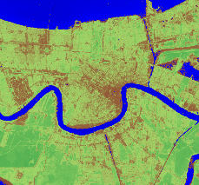
Methodology: Land Surface Temperature
Landsat
Image: Summer 2000-2018
NDVI
% VEG
EMISSIVITY
LST
THERMAL BAND
Notes:
A variety of map images were combined using raster calculator in order to create an aggregated heat vulnerability assessment. First normalized difference vegetation indices were generated by raster calculating the red and near infrared bands of Landsat imagery. From the NDVI, we derived the percent vegetation and emissivity of the scene. The thermal band imagery was normalized and then divided by the emissivity raster dataset, which produced our final land surface temperature products. LST data was overlaid onto the most recent land cover classification map, and then social vulnerability data was placed at the top of the stack in order to confirm our hypothesis that areas with high social vulnerability will also have more gray infrastructure and therefore higher temperatures.

Slide 14
Methodology: Calculating Land Surface Temperature
Landsat Thermal Band
Spectral Radius (TOA)
Top of Brightness Conversion*
Top of Brightness Temperature (BT)
Atmospheric
Correction*
LST Single Band Method
NDVI
Threshold Method
NDVI
Emissivity (∈)
Convert values to degrees Fahrenheit
Land Surface
Temperature (°F)
Land Surface Temperature
(Kelvin)
*Performed using SCP plug-in in QGIS
Notes:
The team utilized ArcMap Pro and QGIS to generate the two inputs needed to calculate land surface temperature for each scene in our analysis using the Land Surface Temperature Single Band method: emissivity (∈) and top of brightness temperature (BT). Using the SCP plugin in QGIS, an atmospherically corrected thermal band image was produced to arrive at top of brightness temperature, with other bands used to derive emissivity from normalized difference vegetation index (NDVI) calculations. The two inputs were used in a land surface temperature equation to produce LST images in Kelven, which were then converted to degree Fahrenheit to be used in final analysis.

Slide 15
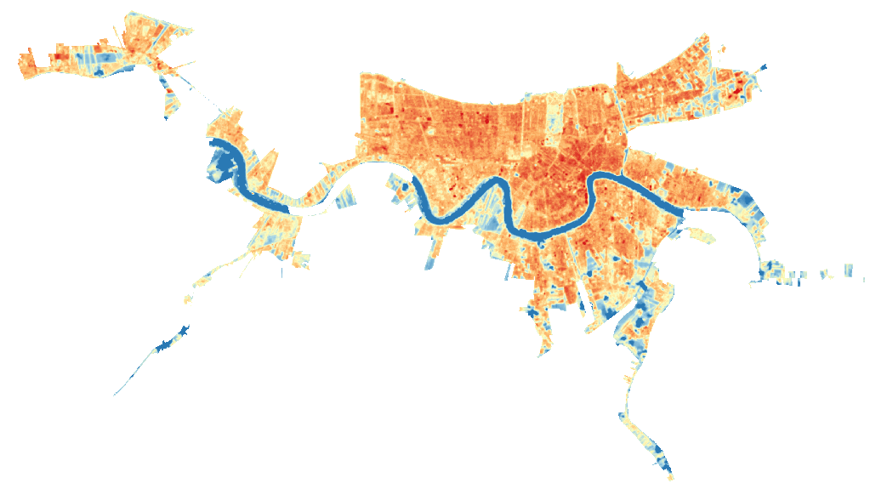
Results: Land Surface Temperature
70° F
75° F
110°F
105°F
80° F
LST for July 2018
Circles are around identified “hotspot” areas
85° F
102°F
105°F
90° F
103°F
95° F
100° F
Notes:
Our LST outputs displayed areas of greatest relative temperatures in red, and lowest relative temperature in blue for each given date. The use of this color ramp allowed us to visualize “hot spot” areas of severe heat within our study area, such as those identified above in July 2018.

Slide 16
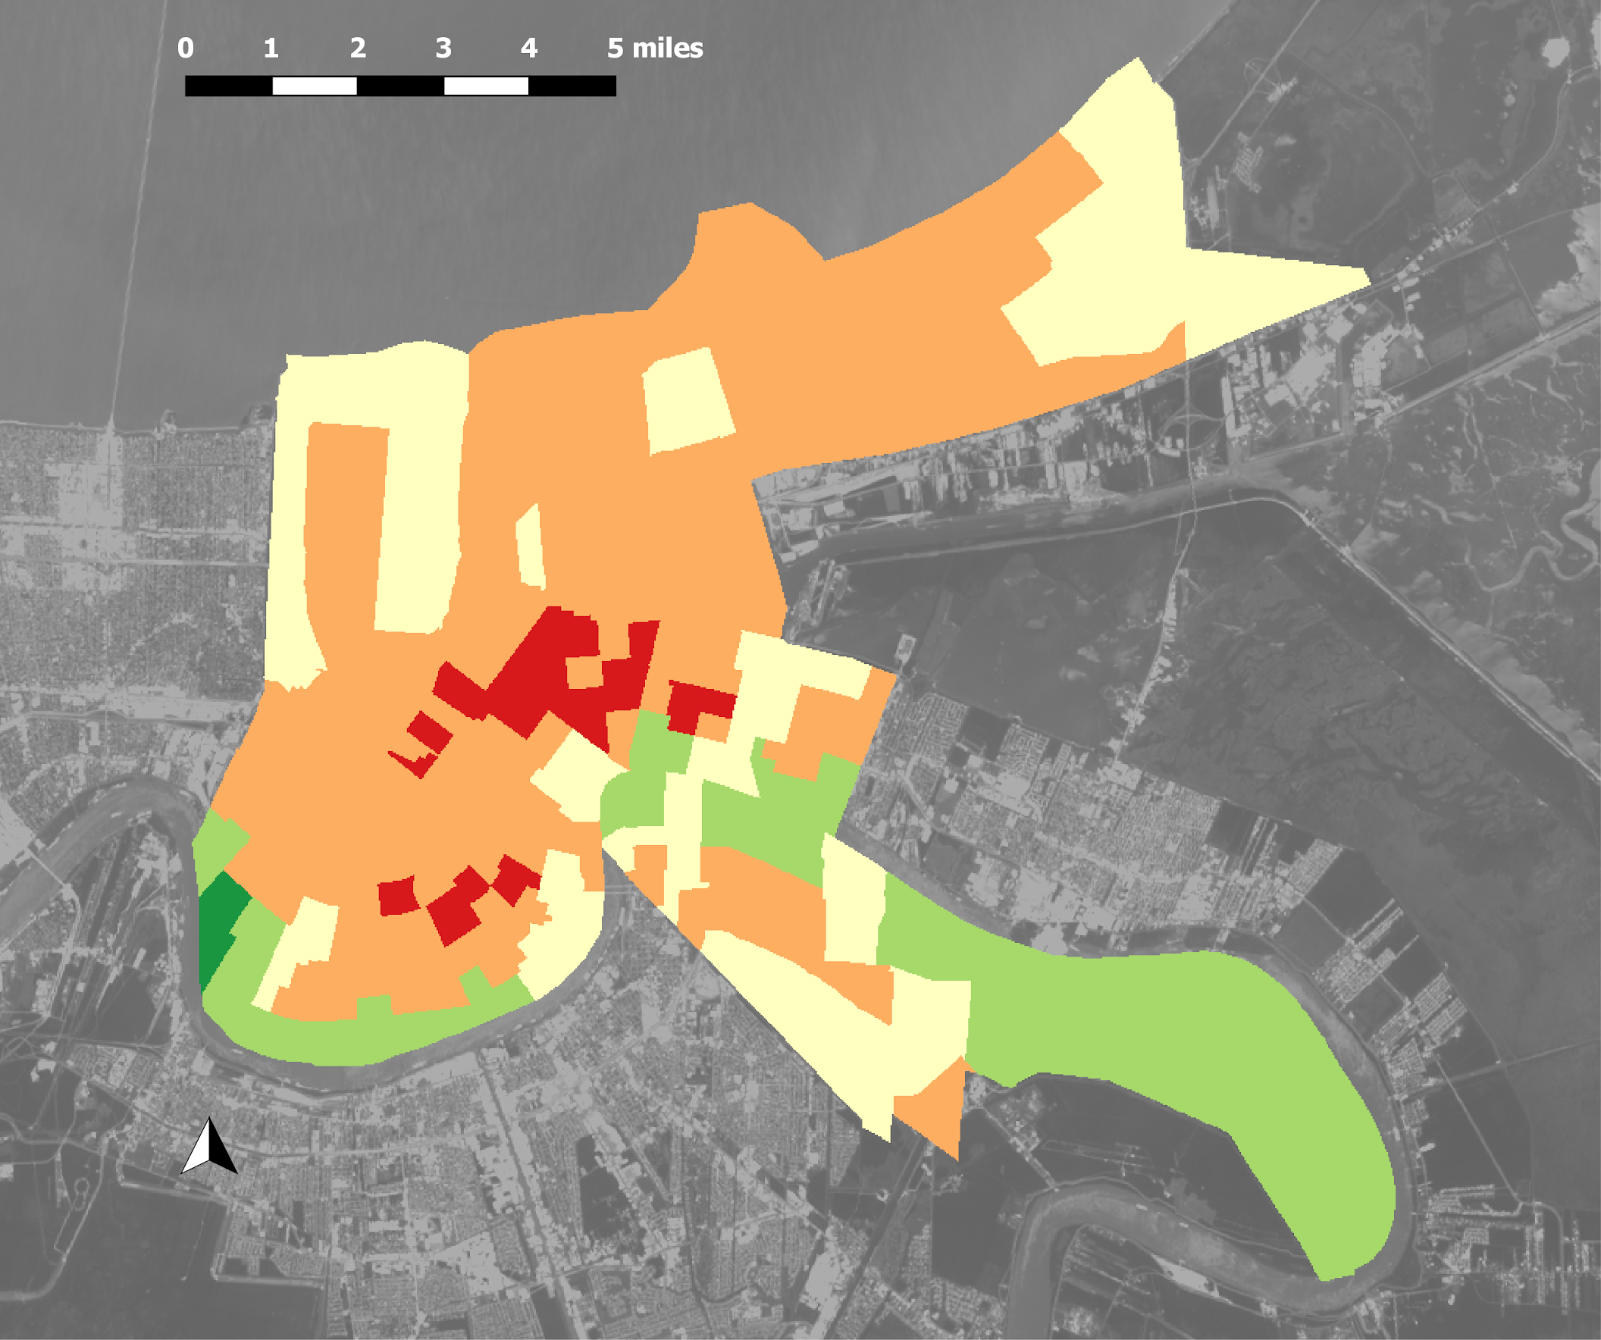
Results: Land Surface Temperature: Zonal Statistics
Zonal stats for LST 2018:
mean temperature per Census tract
Least Vulnerable
Zonal statistics were calculated using mean temperature per Census tract:
75° - 80° = 1
80° - 85° = 2
85° - 90° = 3
90° - 95° = 4
95° - 100° = 5
Most Vulnerable
Notes:
The team used the Zonal Statistics tool in ArcMap Pro to calculate mean land surface temperature for each social vulnerability region analyzed. Areas in red indicate areas with a higher than average temperature, the hottest of which are located in the most dense and developed zones of the city.

Slide 17
Methodology
Landsat Imagery
Brightness Temperature
NDVI
Land Surface Temperature Products
Land Cover Change Zonal Statistics
Aggregated Heat Vulnerability Assessment
Landsat Imagery
Land Cover Classification
Vulnerability Variables
Percentile Rank Data for Index Creation
Vulnerability Zonal Statistics
Notes:
Our second focus will be on the Land cover change products.

Slide 18
Methodology: Land Cover Classification
Classified Image: Urban / Vegetated
Zonal statistics
Classified Image (mean temp. / census tract)
Unsupervised
Classification
Classified
Image
(20 classes)
Water mask & Reclassification
Notes:
Once land cover classifications were computed for the selected years, the area per class was calculated. This metric was compared for each of the four selected years in order to quantify the amount of land cover change that occurred within a 6 year period. Visual analysis was used to determine where the change occurred.

Slide 19
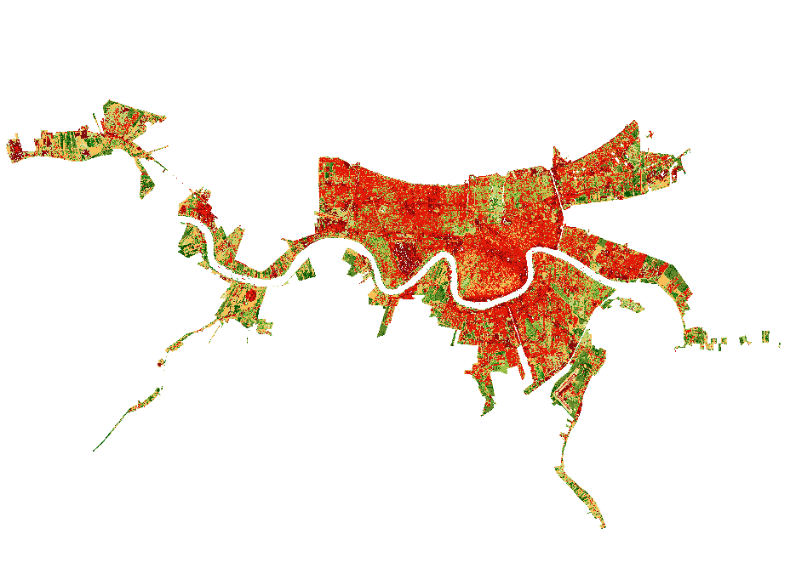
Results: Land Cover Classification
Open Water
Forested
Wetlands
Developed, Medium Developed, Low Open land
Forested, Dense
Developed, Vegetated Developed, High
Vegetated & Urban Classification for 2000
Notes:
The full land cover classification generated by our team for the year 2000 was produced using an unsupervised classification process, resulting in 20 unique land cover types ranging from untouched vegetation to highly developed urban area. After consolidating more discrete land cover types into larger vegetated and urban land cover groups, our team was able to visually distinguish the extent of paved, impervious surfaces versus more untouched, undeveloped parts of New Orleans.

Slide 20
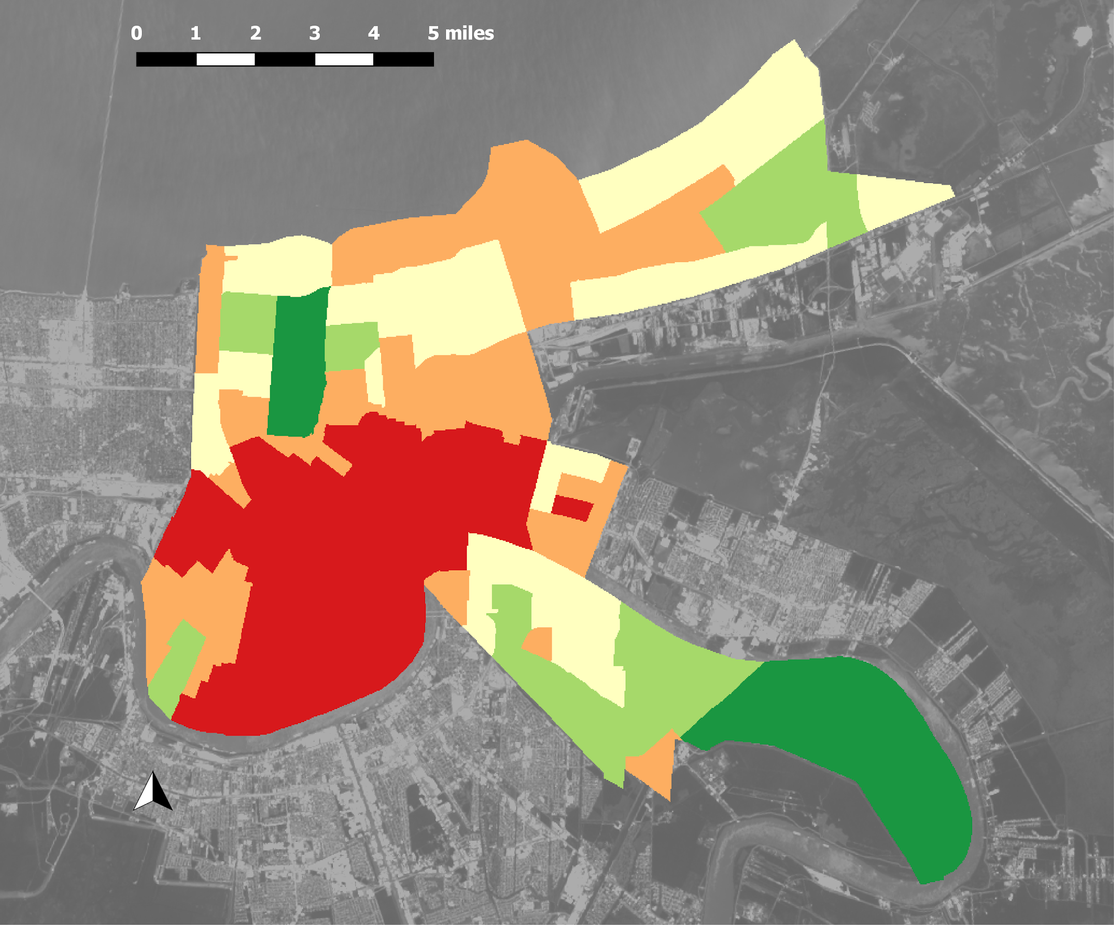
Results: Land Cover Classification: Zonal Statistics
Zonal stats for Land Cover:
% Urban density per Census Tract
Land Cover was reclassified so: 0 = Vegetation
1 = Urban
Then zonal statistics were calculated to find mean per census tract, and the score was ranked:
0 - .2 = 1
.2 - .4 = 2
.4 - .6 = 3
.6 - .8 = 4
.8 - 1 = 5
Least Vulnerable
Most Vulnerable
Notes:
In order to gain a clearer understanding of general landcover regions in New Orleans, we applied zonal statistics that put simplified land cover classes from 1 to 5 into each region defined by our social vulnerability index.

Slide 21
Methodology
Landsat Imagery
Brightness Temperature
NDVI
Land Surface Temperature Products
Aggregated Heat Vulnerability Assessment
Landsat Imagery
Land Cover Classification
Land Cover Change Map Products
Vulnerability Zonal Statistics
Vulnerability Variables
Percentile Rank Data for Index Creation
Notes:
Our third and final focus will be on the Social Vulnerability products.

Slide 22
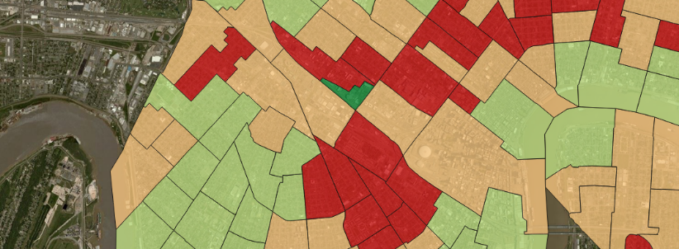
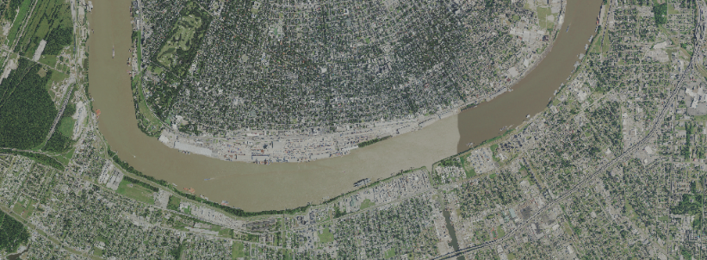
Social Vulnerability Index: Ancillary Datasets
SOVI
Based on 2015 U.S. Census data
Social Vulnerability score: 0 - 52
High scoring tracts had large populations that were:
Under 5 or over 65 years old
Without a higher education degree
Low income / below poverty line
Linguistically isolated
SOVI DATA COURTESY OF UNO CHART, the FTA, & the City of New Orleans
USDA National Agricultural Imagery Program (NAIP)
1-meter resolution imagery
Used to confirm the results of land cover classification from 30-meter Landsat imagery
IMAGERY COURTESY OF USDA NAIP
Notes:
In addition to Landsat imagery, we utilized two ancillary datasets to examine land cover and demographic factors that may contribute to a high rate of heat related illness. We overlaid land surface temperature products with a Social Vulnerability Index dataset created by the University of New Orleans Center for Hazards Assessment, Response, and Technology, the Federal Transit Administration, and the City of New Orleans. This data divided the metropolitan area into census tracts and then ranked each tract based on the number of individuals residing within that tract that identified themselves in a way that would make them exceptionally vulnerable to the impacts of Urban Heat Island effect. High ranking tracts had large populations that were over 65 or under 5 years old, lacking higher education, low income, or linguistically isolated.
Secondly, we confirmed the results of land cover classifications created using Landsat imagery by performing a side by side visual comparison of land cover classifications and 1 meter imagery from the U.S. department of Agriculture’s National Agricultural Imagery Program. The high spatial resolution of this imagery made it simple to confirm that the classifications generated using Landsat imagery correctly identified the land use and land cover type.

Slide 23
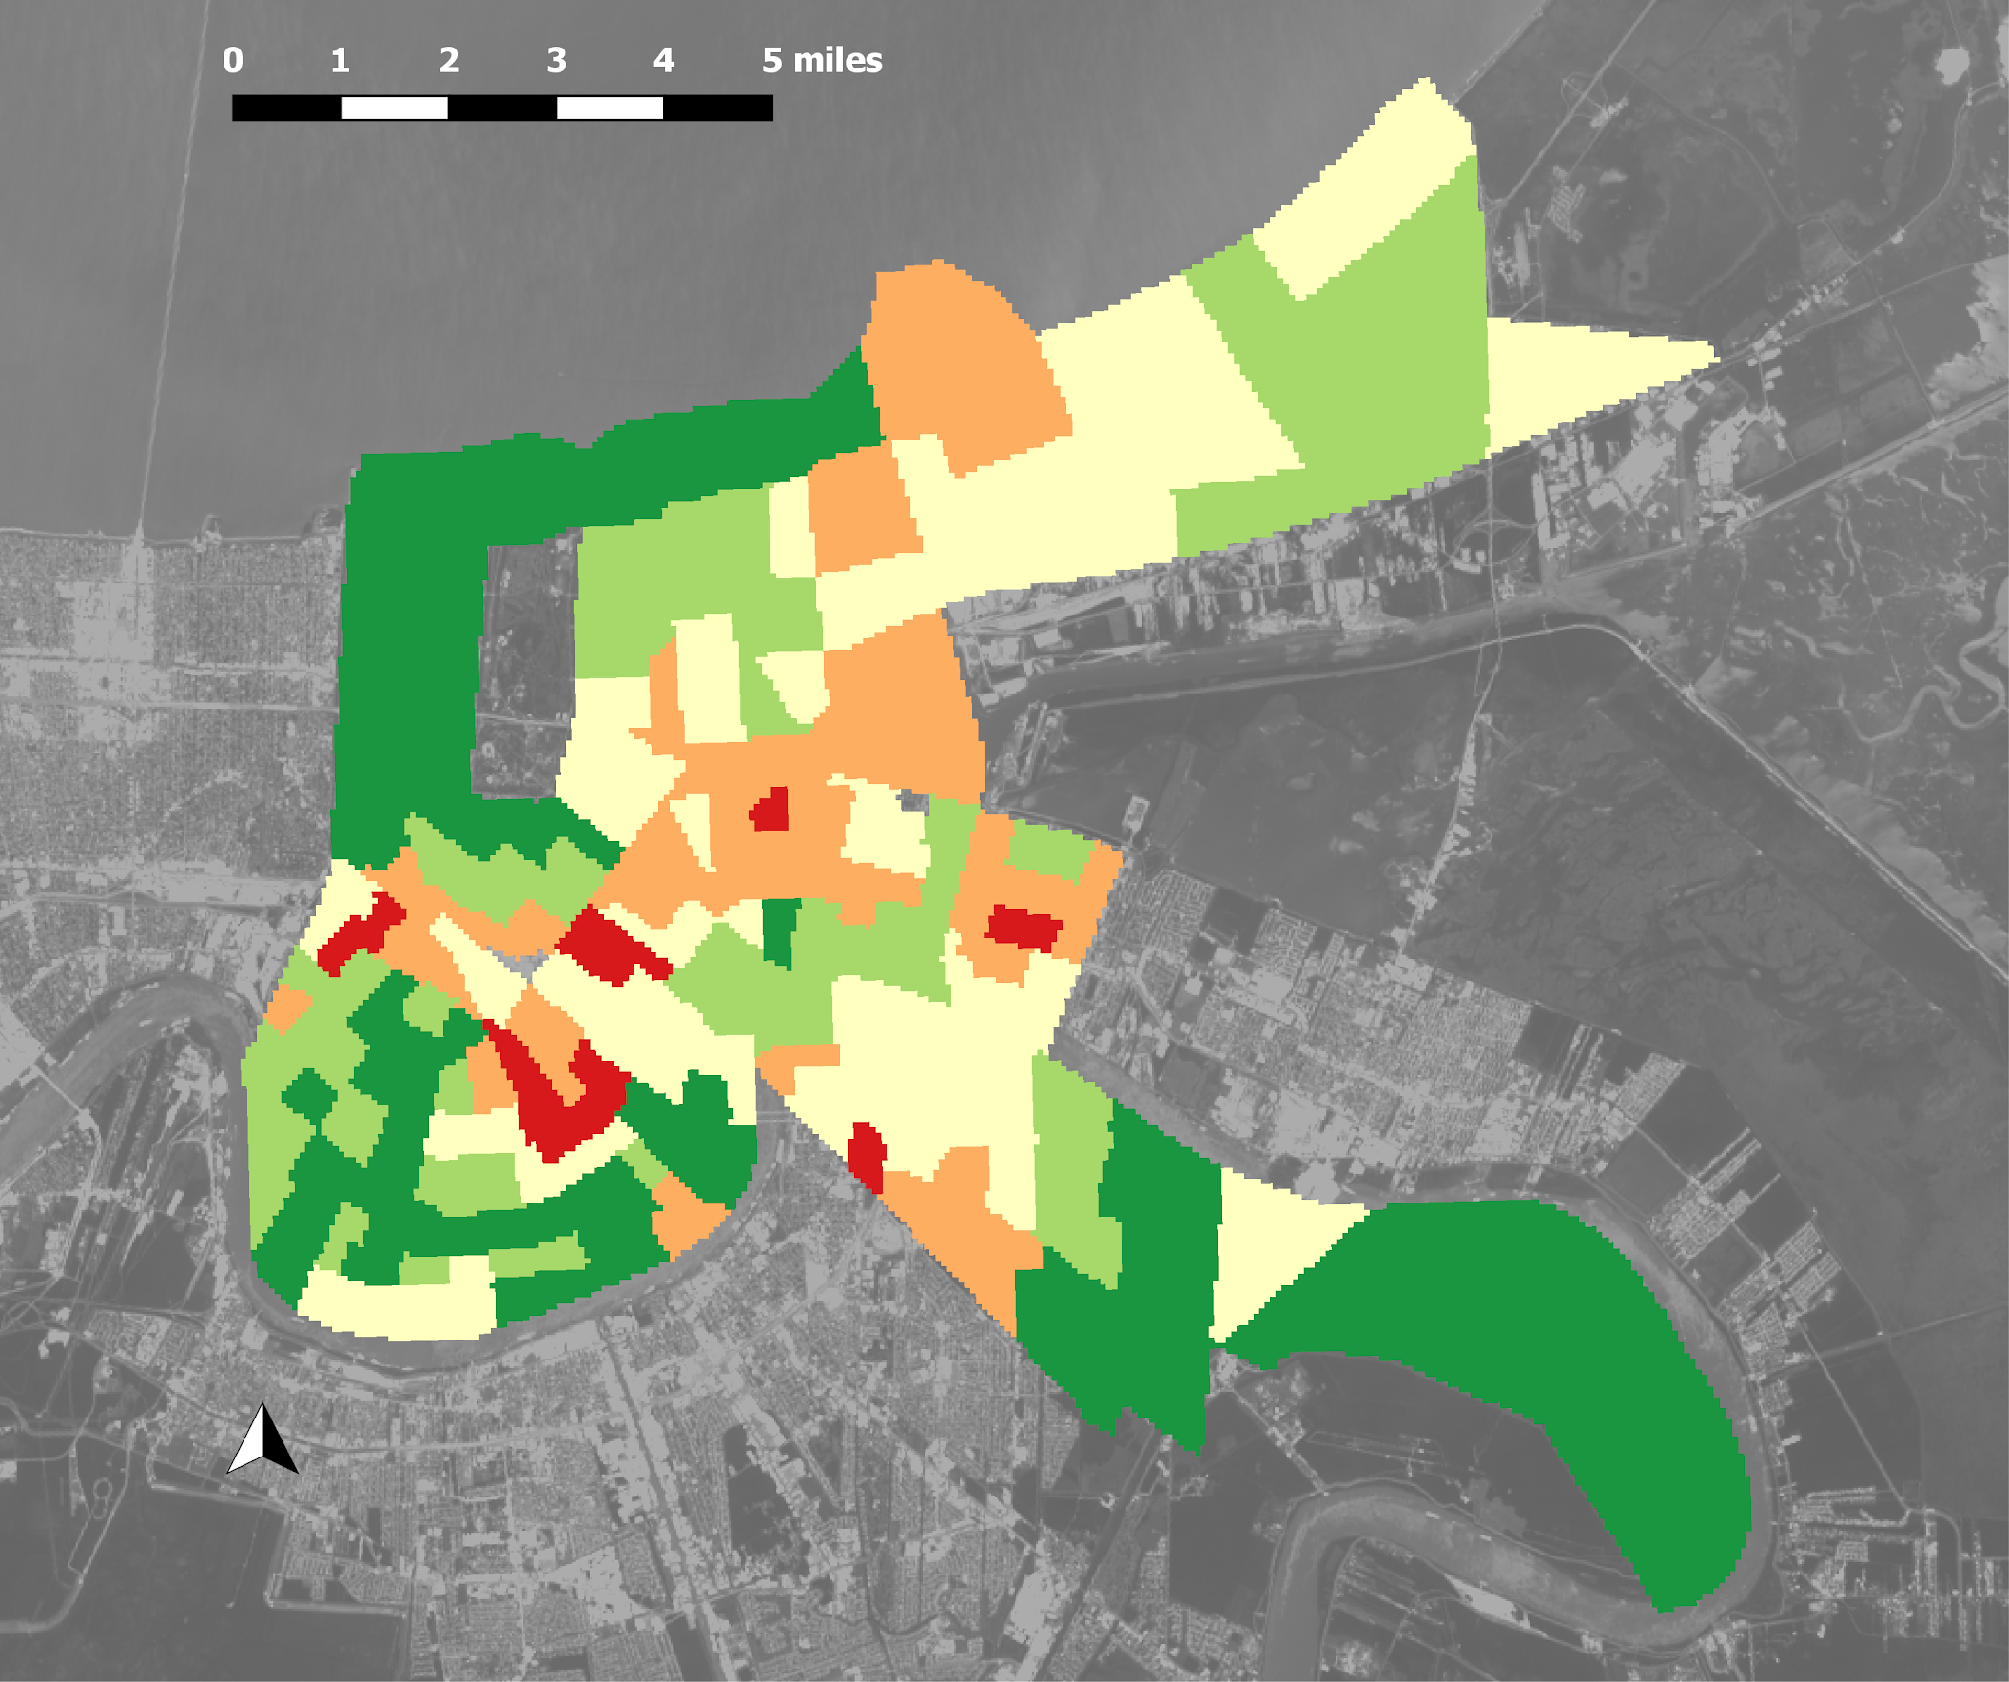
Results: Social Vulnerability Index
Social Vulnerability Index: Ranked
Raw social vulnerability scores were reclassified into 5 groups via QGIS natural breaks:
0 - 25 = 1
25 - 32 = 2
32 - 38 = 3
38 - 45 = 4
45 - 52 = 5
Least Vulnerable
Most Vulnerable
Notes:
XXX

Slide 24
Methodology
Landsat Imagery
Brightness Temperature
NDVI
Land Surface Temperature Products
Aggregated Heat Vulnerability Assessment
Landsat Imagery
Land Cover Classification
Land Cover Change Map Products
Vulnerability Variables
Percentile Rank Data for Index Creation
Vulnerability Map Products by Variable
Notes:
Finally, using the three components of Land Surface, Land Cover, and Social Vulnerability, our team created a product that can analyzed each aspect that may affect health of city residents. This end product encompases each product into one aggregated heat vulnerability assessment.

Slide 25
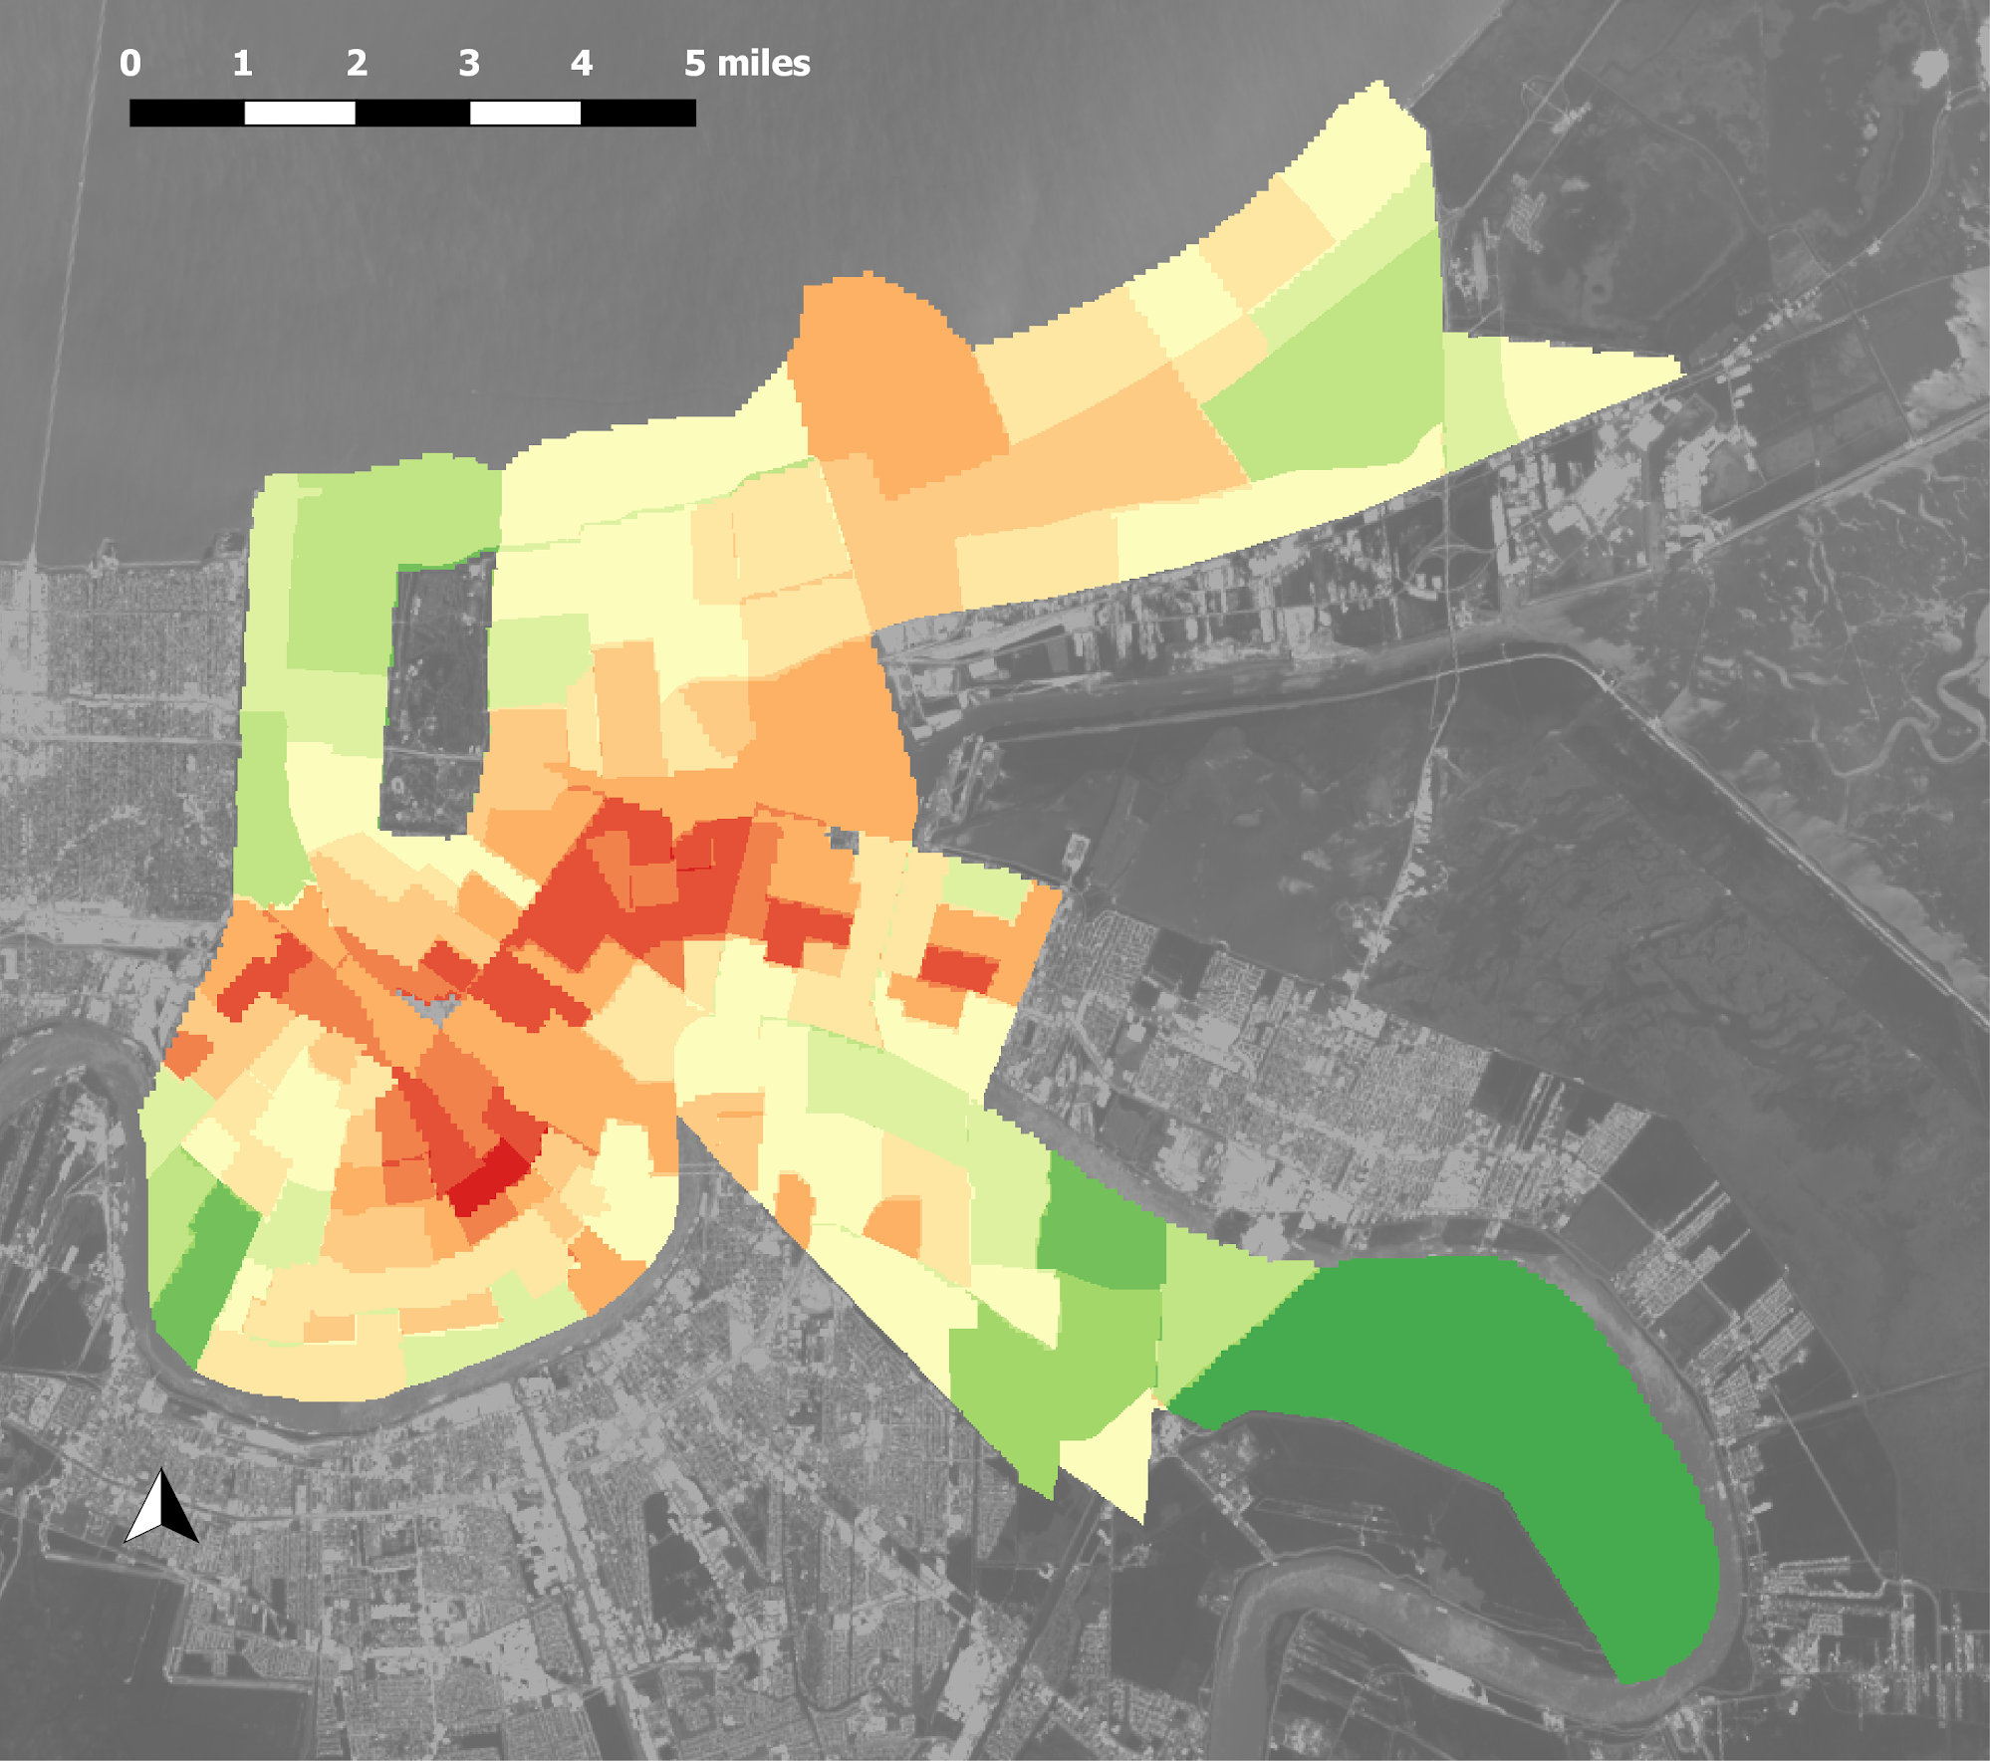
End Product:
Aggregated Heat Vulnerability Analysis
Social Vulnerability Map
Land Cover Classification Map
LST Map +
+
Least Vulnerable
Each tract from each input assigned a scale and ranked from 1 to 5 based on unique values.
Each input given weight of .33 and aggregated to assign each overall vulnerability score between 5 (most vulnerable) and 1 (least vulnerable).
Most Vulnerable
Notes:
Our end product combined our LST, land cover classification, and social vulnerability map products to arrive at an aggregated heat vulnerability analysis map. Each social vulnerability region from each of the three maps was assigned a scale and ranked from 1 to 5 based on unique values. Each layer was given equal weighting before being aggregated to generate an overall heat vulnerability score; areas considered most vulnerable were assigned a rank of 5 (red), and those least vulnerable a rank of 1 (green).

Slide 26
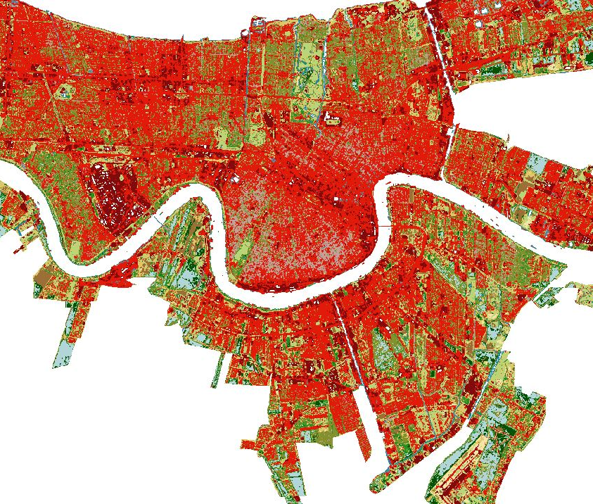
Conclusion
Landsat LST and land cover data were used to assess severe heat impacts on the city’s communities.
The hotspots on the LST maps tended to be in areas with impervious surfaces.
The proximity of vegetation appears be associated with lower temperatures more than proximity to water.
Notes:
Our research and end products supported our hypothesis that the most developed areas of New Orleans would be most susceptible to the urban heat island effect, and less developed, vegetated areas would be cooler. Our products will help LPHI understand which areas of New Orleans are most affected by severe heat, and will help plan and inform future climate risk mitigation and public health initiatives.

Slide 27
Limitations
Landsat revisit schedule is only once every 16 days, limiting dates available for analysis.
Cloud cover on Landsat imagery further limited data availability.
We utilized a user-friendly semi-automated classification plug-in for QGIS for preprocessing.
Notes:
Our analysis was hampered by certain data and processing limitations. The selection of imagery and dates was affected by the varying collection intervals of each sensor used, and further limited by the availability of cloud-free imagery for New Orleans. Additionally, the team used an unsupervised semi-automated classification plug-in in QGIS for pre-processing rather than manually performing atmospheric correction for each of our images.
Virtual Raster Stack credit: New Orleans Health and Air Quality team (Landsat 8, 2016Mar13)

Slide 28
Future Work
New Orleans Health & Air Quality
Term 1
Land Cover Classification and
LST Products
Socioeconomic Data
Comparisons
Term 2
Expansion to nearby Mobile, Alabama
Air temperature
in situ validation
Application with LPHI clinical medical data
Notes:
Expand this project to Mobile, AL
Our research methodology will help future projects study LST in other cities
Further application with clinical medical data
This will aid in finding relationships to heat related illnesses and corresponding hot spots
Ground truthing investigation
Validate and compare LST estimations

Slide 29
Acknowledgements
Joe Spruce, Lead Science Advisor, Science Systems and Applications, Inc.
Dr. Kenton Ross, Science Advisor, NASA Langley Research Center
Bernard H. Eichold II, M.D., Dr. P.H., Mentor, Mobile County Health Department
Thomas Carton, PhD., Chief Business Development Officer, Louisiana Public Health Institute
Helen Baldwin, Center Lead, NASA DEVELOP Alabama - Mobile and Alabama - Marshall Space Flight Center nodes
Kathrene Garcia, Communications Fellow, NASA DEVELOP Alabama - Marshall Space Flight Center node
Notes:
We would like to give credit to several people that gave valuable time and effort into this project.

Slide 30
Thank you!
Alahna Moore
Ann Rodden
Madison Murphy
Project Lead
Charles Christonikos
Notes:
Thank you for your time and attention! We would like to open up the floor to any questions.

