Slide 1
Arizona Health & Air Quality II
Enhancing extreme heat intervention and prevention activities in Maricopa County Arizona
Dan Finnell (Project Lead)
Teresa Fenn
Richard Muench
Ashley Brodie

Slide 2
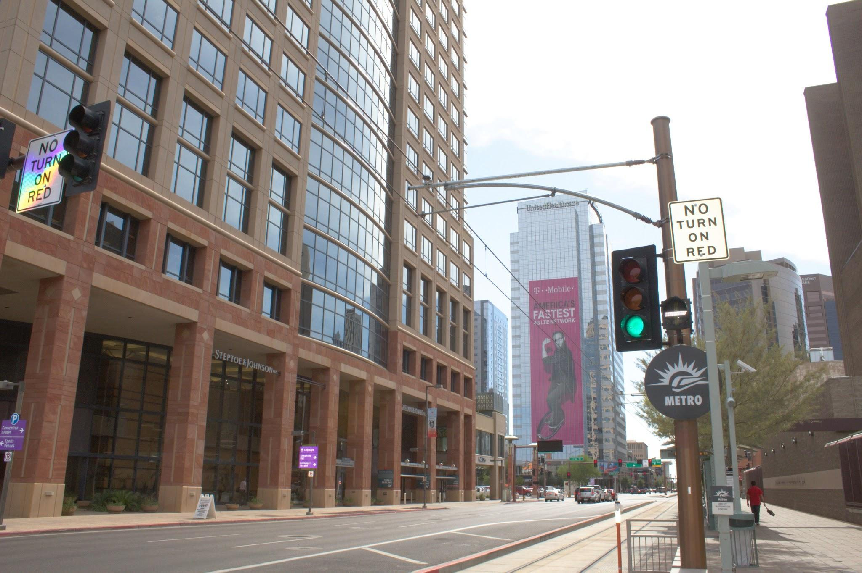
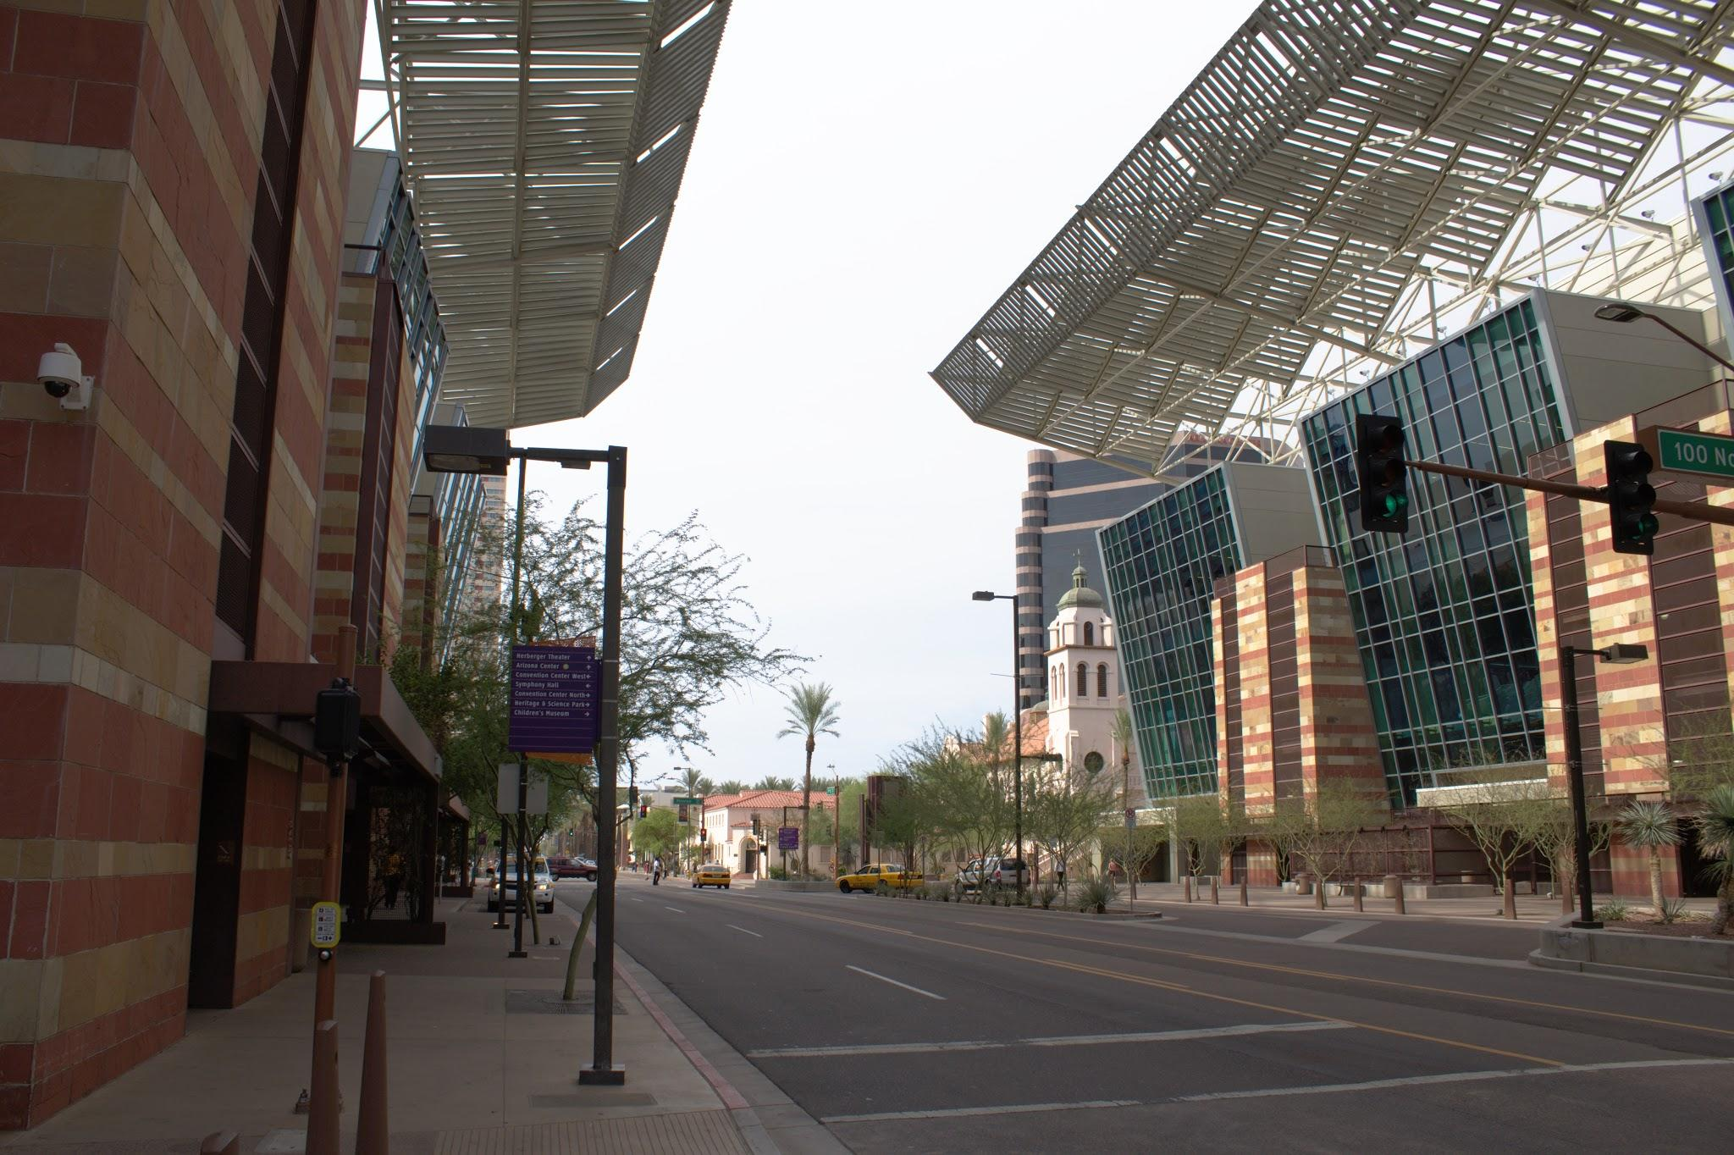
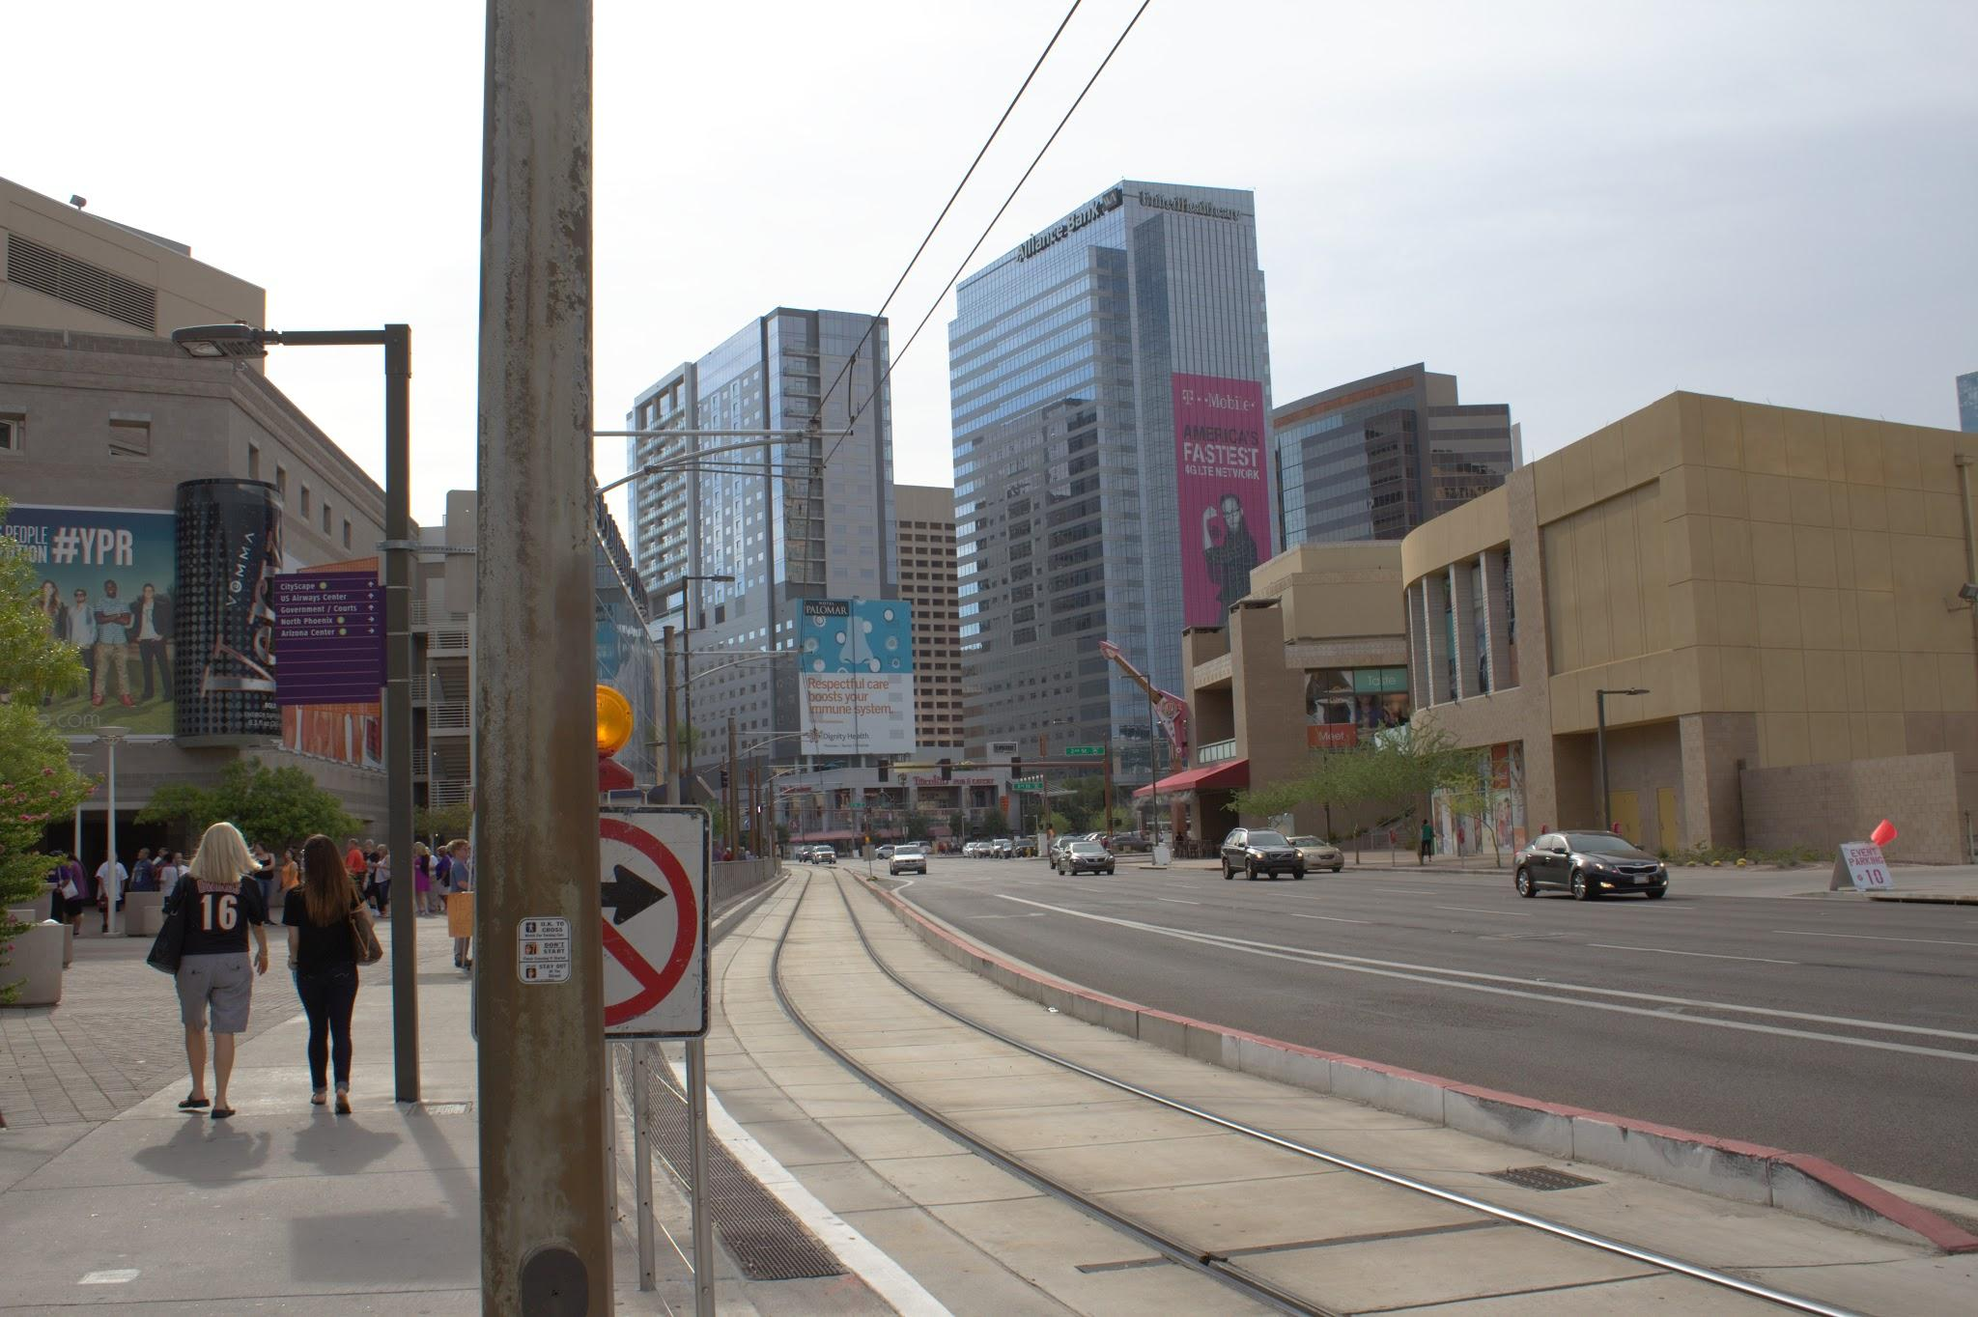
Study Area
Maricopa Co, AZ

Slide 3
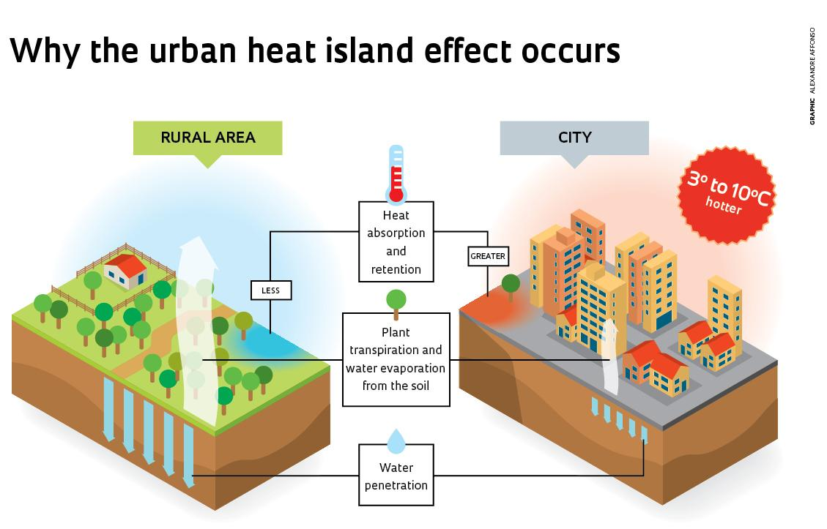
Background
Maricopa Co., AZ experiences prolonged periods of extreme heat in excess of 104°F
Phoenix and the surrounding metropolitan areas are also undergoing continued growth
The increased temperature coupled with infrastructure acts as an urban heat island(UHI)
Vulnerable populations include males, elderly, poor, homeless, socially isolated, and minorities
Notes:
image credit: http://revistapesquisa.fapesp.br/wp-content/uploads/2013/05/p44_Ilhas.jpg?34d172

Slide 4
Objectives
Automation of a Python based decision support tool
Connection to OPeNDAP URL/API to gain near real-time access of Land Surface temperature imagery
Assist Maricopa Co. residents stay safe and cool during the intense summer heat
Image Credit: Monet

Slide 5
General Guidelines III
Include speaker notes for each slide (see below).
Include a visual on each slide, if possible.
Arrange content to minimize white space.
Notes:
These notes should be thorough enough for someone not familiar with the project to clearly present the material.
Image Source: http://commons.wikimedia.org/wiki/File:Claude_Monet_-_The_Magpie_-_Google_Art_Project.jpg

Slide 6
Maps & Logos
Maps
Import the legend separately.
Make sure all text is legible and editable.
Cite base layer source in speaker notes.
Notes:
Image credit: http://fox41blogs.typepad.com/.a/6a0148c78b79ee970c019affb87142970d-500wi

Slide 7
Photos & Figures I
You may only use images taken by your team, provided by your partners (as long as you have permission from them), from a Federal Agency, from the new DEVELOP stock imagery collection on DEVELOP’s Flickr page, or Creative Commons images.
Obtain a media release form from all people in photos that your team has taken — no children!
All image sources should be cited using a consistent format and should be visible on the slide.

Slide 8
Photos & Figures II
Please do not include the image URL in the source text box but rather place it in the notes section below.
If you use a border for your images include it on all photographs to keep your presentation consistent.
Keep all images and text boxes editable, including individual elements of flowcharts.
Background images are discouraged. If you use one, make sure that your text remains clear and legible.

Slide 9
Acknowledgements
List advisors, partners, and others who have contributed in any way to the project.
If your project is a multi-term one, acknowledge past contributors.
Choose one of the two following slides as an acknowledgements page. Feel free to modify them as needed to fit your content.
Image Credit: Monet
Notes:
Image Source: http://commons.wikimedia.org/wiki/File:Claude_Monet_-_The_Magpie_-_Google_Art_Project.jpg

Slide 10
Advisors
Kate Goodin (Maricopa County Department of Public Health)
Dave Hondula (Arizona State University)
Dr. Kenton Ross (NASA DEVELOP National Program)
Lance Watkins (Arizona State University)
Partners
Arizona Department of Health Services (ADHS)
Phoenix Heat Relief Network
National Weather Service Phoenix Forecast Office
Center for Policy Informatics (CPI) at Arizona State University
Others

Slide 11
Advisors
Partners
Others

