Slide 1
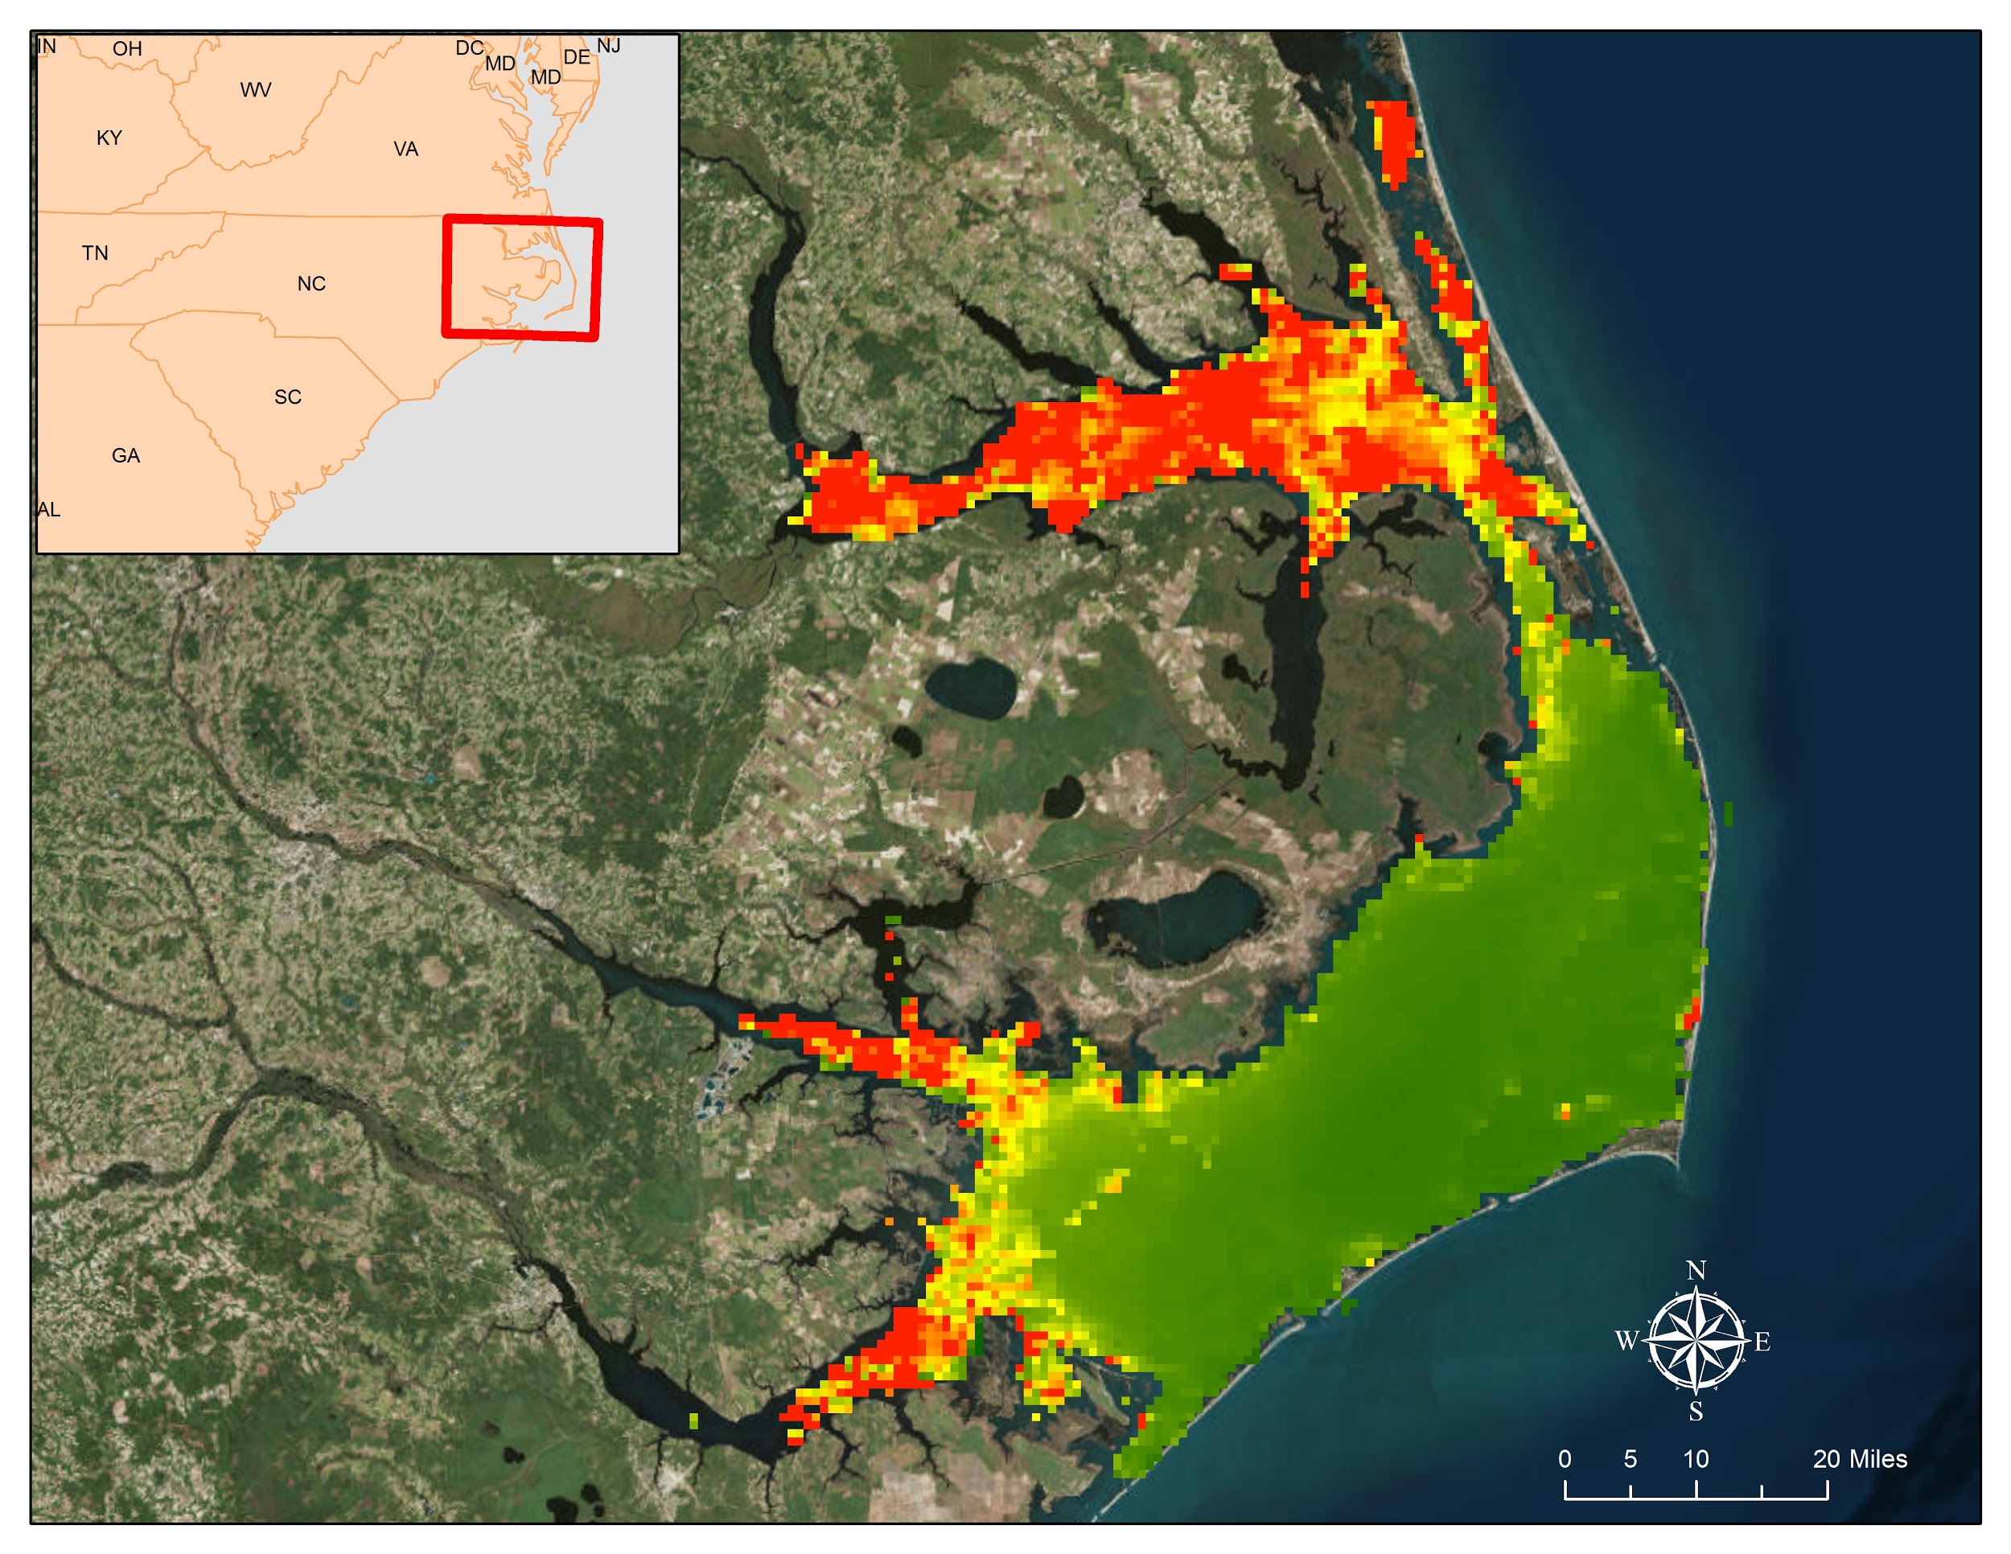
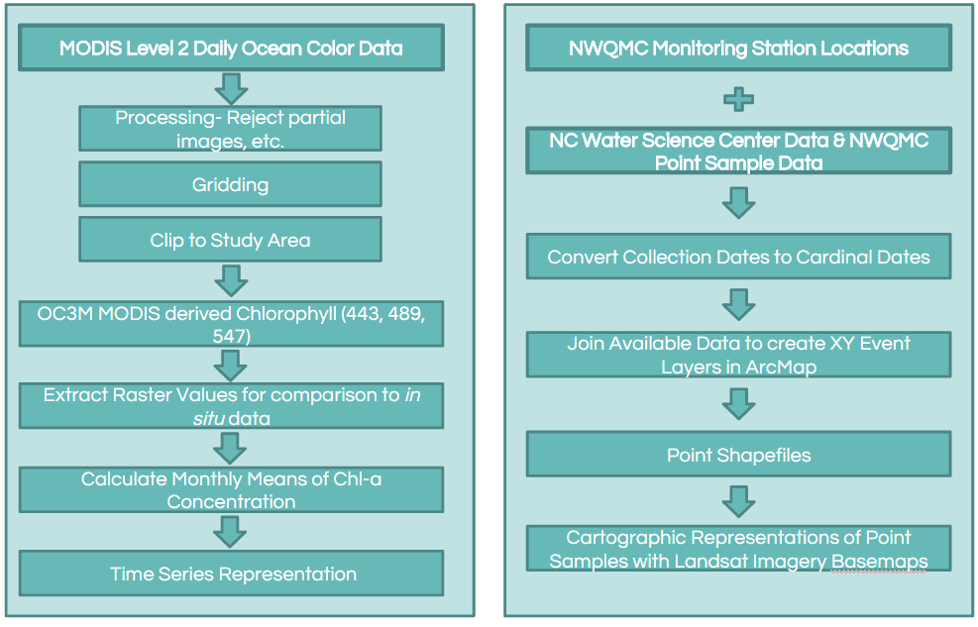
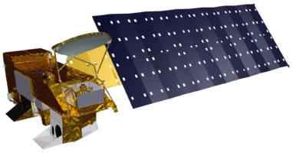


North Carolina Water Resources
Utilizing NASA Earth Observations to Explore Extent of Harmful Algal Blooms
in the Albemarle and Pamlico Sounds
Chad Smith (Team Lead), Jelly Riedel, Keith Benjamin, Daniel Wozniak, Matthew Carter
Langley Research Center
Harmful algal blooms (HABs) cause significant ecological damage to aquatic systems by disrupting water chemistry, producing toxins, and blocking sunlight to submerged vegetation and other organisms. In the Albemarle and Pamlico Sounds, the USGS North Carolina Water Science Center biologists monitor HABs by taking point samples throughout the region, but they lack a method to monitor the spatial extent of HABs throughout the entire sound during the year. For this project, Aqua Moderate Resolution Imaging Spectroradiometer (MODIS) Level 2 OC3M-derived chlorophyll data was downloaded from NASA Goddard Space Flight Center’s Ocean Color SeaDAS Website via a Linux operating system. The OC3M algorithm used multispectral reflectance bands available from Aqua MODIS to calculate concentrations of chlorophyll-a, which is used as a proxy for the presence of algae. Chlorophyll concentration values from these layers were then extracted from days with spatially and temporally corresponding in situ water samples for comparison. Then, images of monthly chlorophyll means were processed into a time-series video representation of algae extent throughout the sounds. End-users were able to use the ten year time series to supplement their in situ data to assess HAB behavior throughout the region.
Provide a ten year time series representation of harmful algal blooms (HABs) in the Albemarle-Pamlico National Estuary
Compare MODIS-derived Chl-a estimates with in situ data
Aqua, MODIS
Of 3135 total in situ chlorophyll sample points, only 628 were able to be compared with available MODIS chlorophyll concentrations. Plotting in situ data versus MODIS data showed very weak correlation. After sorting and indexing the sample sets, a plot of sample index versus chlorophyll concentration showed major divergence above sample index 500. In this case, the sample index is purely arbitrary and only serves visualization.
The RMS calculated with [2] of the original dataset was 79.78mg*m^-3 and MATLAB’s fitlm returned an RMS confidence of 72.7mg*m^-3. Restricting RMS calculation to the first 400 sample indices reduced RMS to 15.5059mg*m^-3 and fitlm RMS reduced to 10.8mg*m^-3. By raising the MODIS sensor values to the two-thirds power [3] and applying the fitlm function the RMS error further reduced to 2.92.
Chlorophyll A≈MODIS[chlor a]〖^(2/3)〗,chlor a<22.4 mg/(m〖^3〗) [3]
This suggests that the MODIS sensor has the greatest accuracy in determining case to water chlorophyll a when its values lie below 22.3811 mg*m^-3.
MODIS OC3M-derived chlorophyll demonstrated poor correlation with in situ measurements
Further research needed to establish estuary-specific remote sensing algorithms to detect chlorophyll
U.S. Geologic Survey North Carolina Water Science Center, Dr. Michelle Moorman & Sharon Fitzgerald, Biologists
Albemarle-Pamlico
National Estuary Partnership
Dr. Bill Crowell, Dean Carpenter & Jim Hawhee
Dr. Kenton Ross
National Program Science Advisor
Jeffrey Ely
Geoinformatics Scientist
Nathan Owen
DEVELOP Langley Center Lead
Keith Benjamin, Chad Smith, Matthew Carter, Jelly Riedel, Dan Wozniak

