Slide 1
Lower Illinois River Valley
Ecological Forecasting
Inundation Mapping of the Lower Illinois River Valley Using Synthetic Aperture Radar and Optical Satellite Imagery for Wetland Conservation and Restoration Prioritization Efforts
Vanessa Machuca
Dana Myers
Hannah Rigdon
Christiana Saldana
Summer 2022 | California – JPL
Notes:
Hello everyone and thank you for joining us for our Summer Closeout. My name is Vanessa Machuca and I am joined Dana Meyer, Hannah Rigdon, and Christiana Saldana. We are the Lower Illinois River Valley Ecological Forecasting Team and have spent the past 10 weeks mapping inundation in the Lower Illinois River Valley using synthetic aperture radar and optical satellite imagery for wetland conservation and restoration prioritization efforts.

Slide 2
Project Partners
End Users
The Great Rivers Land Trust (GRLT)
Collaborators
National Great Rivers Research & Education Center
American Geophysical Union Thriving Earth Exchange
Principia College
Notes:
We partnered with the Great Rivers Land Trust (GRLT) for this work. The GRLT purchases land for conservation and restoration purposes, preserving that land in perpetuity. They consider a variety of factors when deciding which land parcels to purchase including
-soil quality
-vegetative cover
-proximity to waterways
They were interested in including a remotely sensed measure of inundation in this set of criteria. Such a product would allow them to delineate wetlands, and even tell if an target agricultural land parcel has the potential to be converted back to wetland. Ultimately, they aim to buy up lands that would have otherwise been targets for future development (preserve land before it is lost to develop) , as well as already-developed land that can be restored.
We collaborated with partners at the National Great Rivers Research and Education Center, American Geophysical Union Thriving Exchange, and Principia.
------------------------------Image Information Below ------------------------------
Clipart provided by PowerPoint

Slide 3
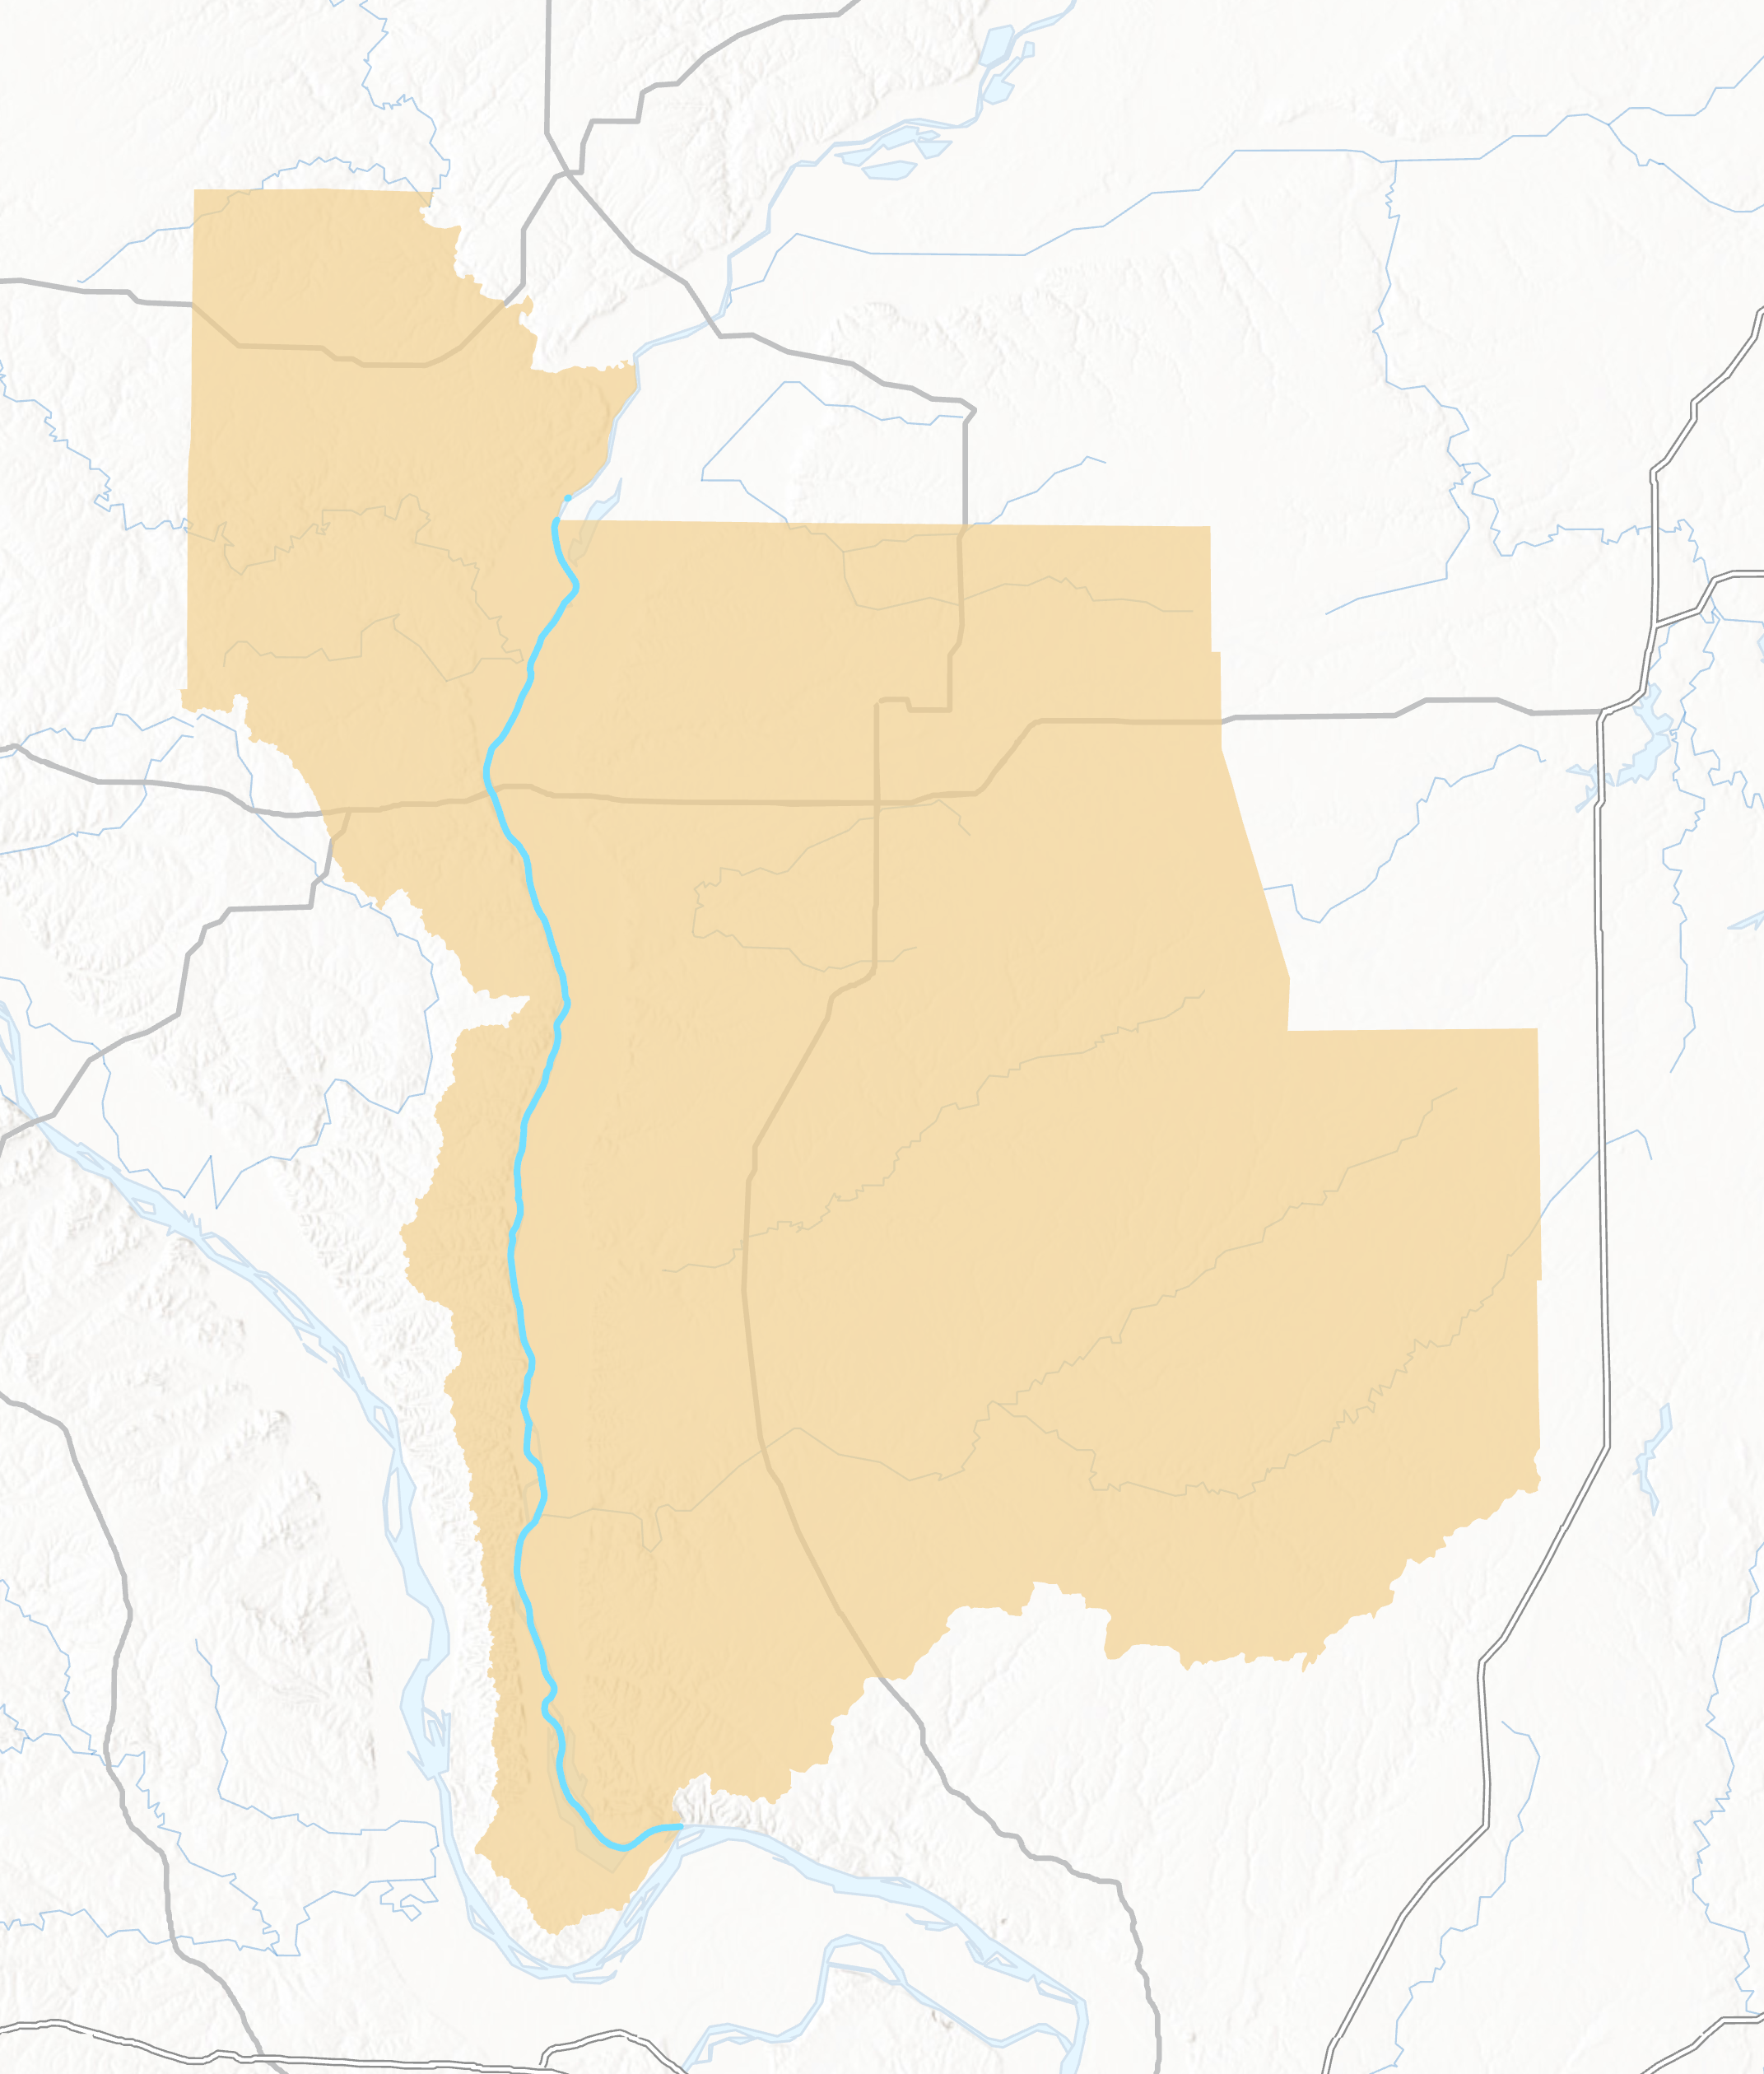
Study Area
Illinois
Location
Lower Illinois River Valley, Illinois, USA
Study Period
2019 and 2020 (March-November)
Avoid snow cover
Lower Illinois River Valley
Illinois River
0 10 20 40 km
Notes:
Our partners are interested in purchasing lands within the Lower Illinois River Valley watershed. This land has experienced heavy agricultural development over many decades. There are levees along most of Illinois River to protect these agricultural fields, save for the northernmost portion which falls under a wildlife refuge as so experienced natural inundation. The Great Rivers Land Trust is particularly interested in purchasing lands that would otherwise have been targeted for development, as well as agricultural lands that have the potential for conversion back to wetlands.
We carried out our study over 2020, a drought year, and 2019, an extreme flood year. We excluded the winter months of November through March to avoid snow cover, as snow compromises the synthetic aperture radar data we used.
------------------------------Image Information Below ------------------------------
Basemap Credit: Esri, CGIAS, USGS, Missouri DNR, HERE, Garmin, SafeGraph, FAO, METI/NASA, USGS, EPA, NPS
Basemap Sources:

Slide 4
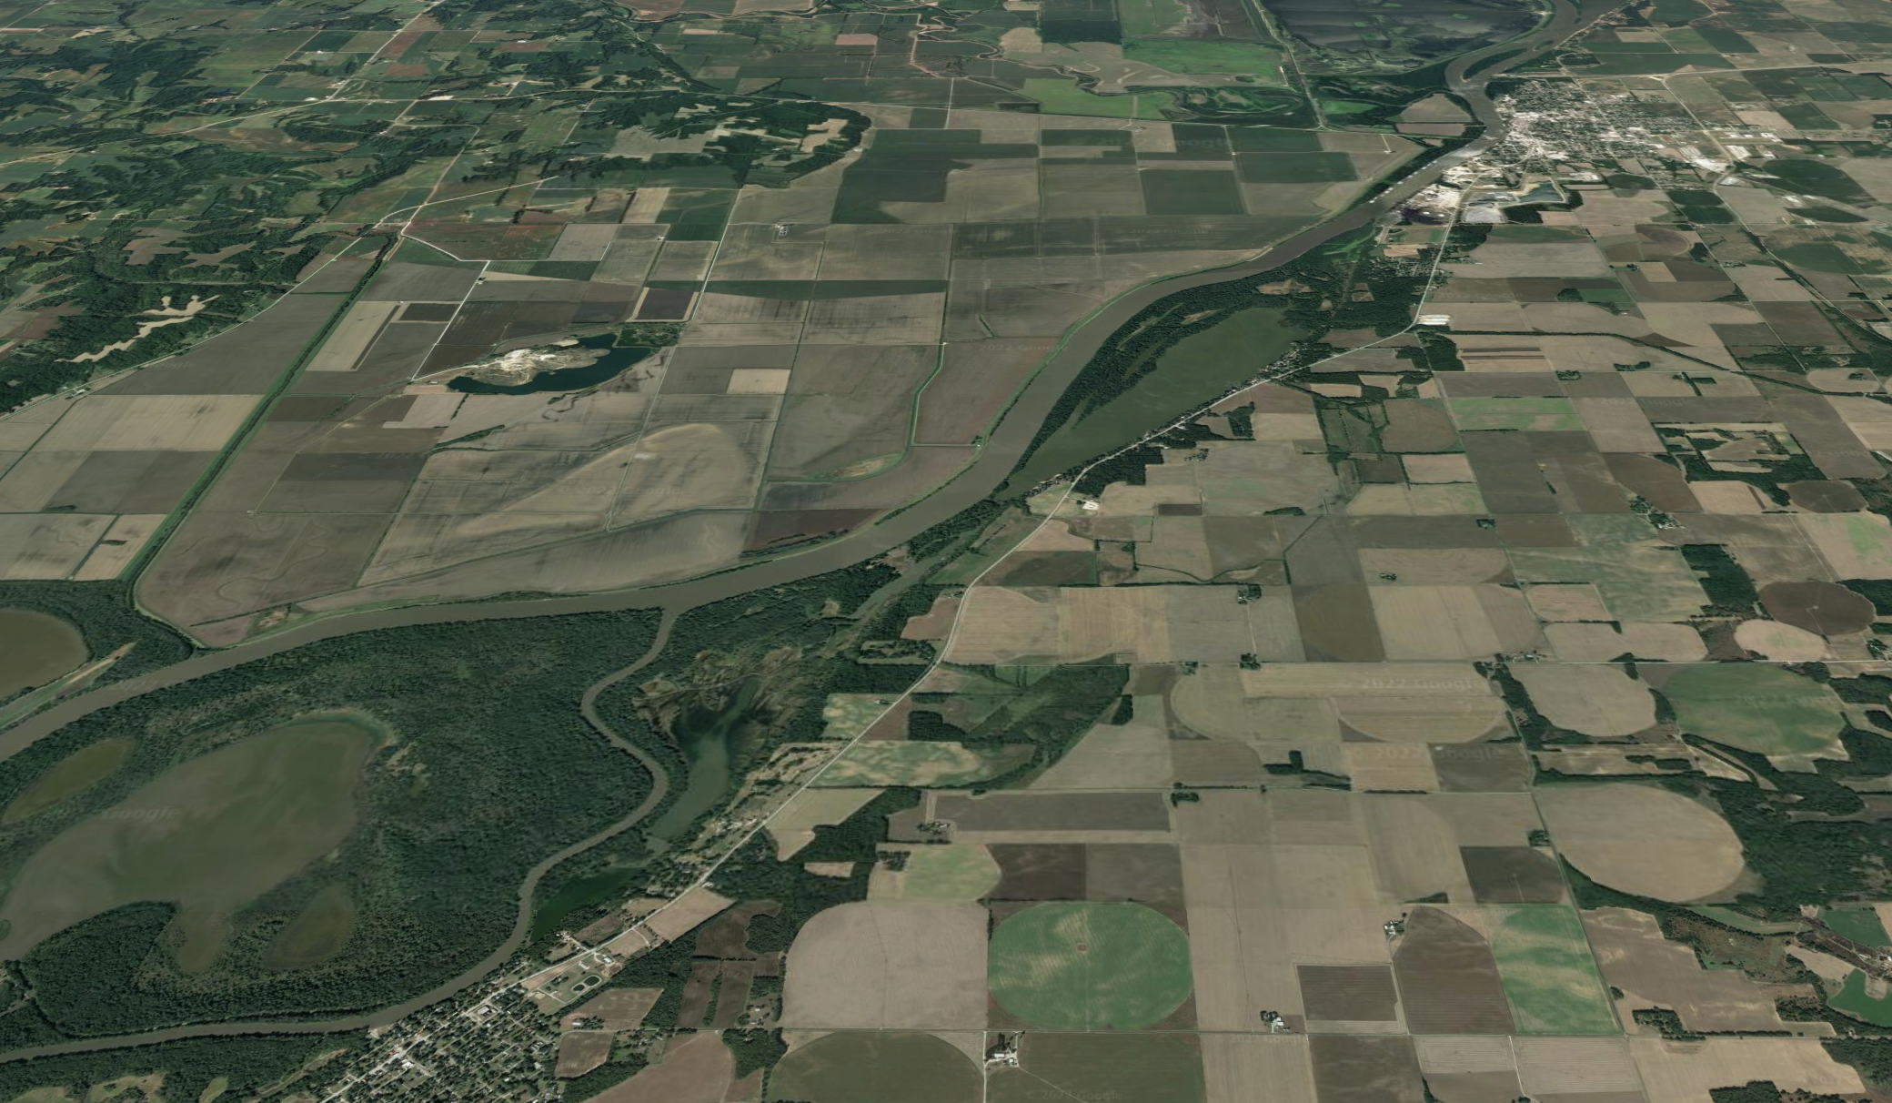
Community Concerns
Wetlands degraded by urbanization and agriculture
Healthy wetlands provide ecosystem services
Wetland preservation =
Opportunities for restoration and open spaces
Improvement of local communities' ability to withstand climate change related events
Image Credit: Google Earth
Notes:
While the definition of a wetland varies, inundation is a valuable metric in delineation of the important ecosystems.
Wetlands are important because they provide habitat for sensitive and native species, as well as ecosystem services like erosion control, flood prevention, and water filtration
Wetlands in agricultural hubs such as the Lower Illinois River Valley are impacted by both development and agriculture. The Illinois River is a tributary of the Mississippi River; which ends where the Mississippi, Missouri and Illinois River converge, further supporting concern for this ecologically significant area. Much of the “floodplain forests” along the Illinois River watershed have been converted to agricultural fields, introducing pollution through agricultural run-off. This area is a major producer of wheat, corn and soybeans, highlighting increased complexity in initiating preservation projects due to potential impacts on such an important sector of Illinois’s economy.
Providing additional areas for recreation is also important, as this area is already popular for hunting and fishing. Our partners indicated that the importance of creating and preserving public access to open-space and recreational opportunities became increasingly apparent during the pandemic.
----------Image Information Below----------
Image Credit: Google Earth
Image Source: NASA DEVELOP Team

Slide 5
Project Objectives
1
2
Generate inundation extent and duration layers.
Compare various metrics for detecting inundation.
3
Determine feasibility of incorporating remotely sensed products into land acquisition decision-making practices beyond the study period.
Notes:
Our objectives were to
1. Generate inundation extent and duration layers of the Lower Illinois River Valley over 2019 and 2020
2. Compare various metrics for detecting inundation and develop a methodology for integrating metrics into a single map of inundation extent
3. Determine feasibility for the GRLT to further incorporate remotely sensed products into their land acquisition decision-making practices beyond the study period
------------------------------Image Information Below ------------------------------
Clipart provided by PowerPoint

Slide 6
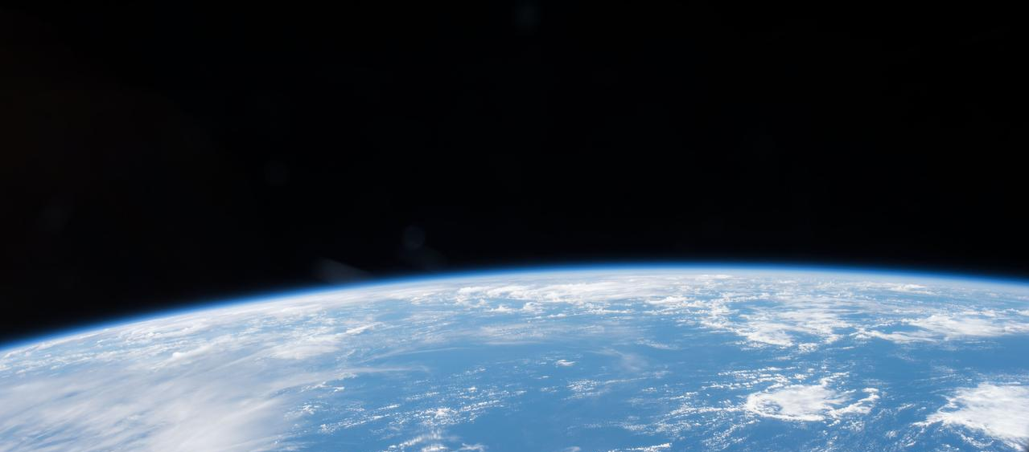
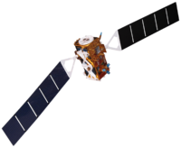
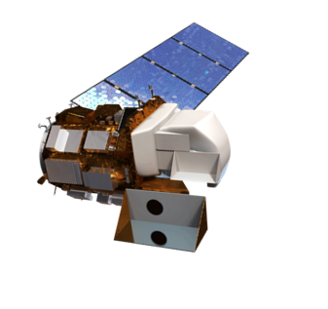
Satellites and Sensors
Landsat 8 OLI
(Collection 2)​
surface reflectance
Sentinel-1 C-SAR
surface roughness & backscatter
Image Credits: NASA, ESA
Notes:
We used optical data from Landsat-8 OLI and C-SAR data from Sentinel-1 in this project.
The C-band synthetic aperture radar (C-SAR) instrument on board Sentinel-1 provided surface roughness and backscatter data used to generate our primary inundation metric.
We used a dynamic surface water extent (DSWE) product derived from the Operational Land Imager (OLI) onboard Landsat 8 to constrain and validate our primary C-SAR inundation metric.
------------------------------Image Information Below ------------------------------
Background satellite image:
Image Credit: NASA
Image Source: https://images.nasa.gov/details-iss042e013697
Sentinel-1 satellite image:
Image Credit: ESA
Image Source: TBD
Landsat 8 satellite image:
Image credit: NASA/Goddard Space Flight Center Conceptual Image Lab
Image Source: https://www.usgs.gov/media/images/landsat-8

Slide 7
Synthetic Aperture Radar (SAR)
longer wavelength
= "see" through vegetation and clouds
object types give off unique signals
different polarizations
VV = noisy
VH = open water
VV/VH = inundated vegetation
Notes:
Synthetic aperture radar is a form of active remote sensing. This means that is observes objects by providing own artificial radiant energy source – like shining a flashlight on something in a dark room. But SAR uses energy from the longer end of the electromagnetic spectrum, rather than visible light.
### CLICK TO ANIMATE ###
SAR operates by sending short pulses of microwaves to the earth, and then recording what gets bounced back. These microwaves penetrate canopy and cloud cover, and are not influenced by the time of day. This makes SAR a useful way of observing inundation extent under vegetation – like what occurs in wetlands. C-SAR operates at a relatively short wavelength, so does not penetrate forest canopy. That said, it does penetrate sparser vegetation and is therefore still useful for detecting inundated vegetation.
### CLICK TO ANIMATE ###
What gets bounced back depends on the various physical characteristics of the object being observed. To be able to detect various objects, SAR uses different polarization schemes, which refers to the direction light is being emitted and received. VH (Vertically emitted Horizontal received) is great at detecting open water, which is what we used it in our work. Meanwhile, VV (Vertical(ly) emitted Vertical(ly) received) is a little noisy. BUT it can be used in conjunction with VH to detect inundated vegetation. These signals can be sensitive to topography and other forms of interference, though. This is why other data need to be used to validate SAR-derived metrics (in our case, river gage measurements and optical data for open water ).
------------------------------Image Information Below ------------------------------
Clipart provided by PowerPoint

Slide 8
Dynamic Surface Water Extent (DSWE)
Landsat surface reflectance
Robust measure of water extent since it accounts for
Elevation
Land cover types
5 classes
Focused on surface water (high and moderate confidence)
Used as a validation metric for our open water classification
diagnostics
water detected
Landsat level-2 pixel QA
clouds removed
elevation data
terrain shadow mask
land cover data
land cover mask
Final DSWE
Notes:
While SAR data is extremely powerful, it can also be difficult to interpret, can be distorted by topography, and often displays lots of noise. It is necessary, then, to validate whatever results we derive from our SAR data. In this project, we used dynamic surface water extent, or DSWE, to validate our open water classification (that is, what the SAR instruments "sees" as open water). DSWE is a product produced by the USGS that we downloaded from Earth Explorer for use in our work. It is a robust measure of open water since it accounts for elevation and land cover. Here is a brief overview of what goes into DSWE
### CLICK TO ANIMATE ###
Landsat surface reflectance is run through various tests - "diagnostics" - in order to detect water. This produces images of where water exists.
### CLICK TO ANIMATE ###
This data then undergoes a "cloud mask" built from what's called the "pixel QA" in Landsat 8 data. What this means, is that all clouds were removed or "masked out".
### CLICK TO ANIMATE ###
That data is then subjected to a terrain shadow mask using elevation data and a land cover mask from land cover data. This means that shadows from terrain are removed, along with urban landcover. Users can choose to use either of the two previous, less processed bands and subject those to their own processing. But we decided to use the most processed images for this project.
DSWE is broken up into 5 different classes: not water, high confidence open water, moderate confidence open water, high confidence partial surface water, and moderate confidence partial surface water. We used the high and moderate confidence open water classifications to validate our own open water classification. That is, we compared our results to DSWE to determine how accurate our results are.
------------------------------Image Information Below ------------------------------
Clipart provided by PowerPoint

Slide 9
Methodology: Workflow
INPUT
PROCESSING
THRESHOLDING
CLASSIFICATION
OUTPUT
Sentinel-1
C-SAR
Refined Lee Filter
select 10 test sites
classify across study area
Calculate VV/VH ratio
determine inundation thresholds
accuracy assessment
extent and duration maps
validation
Landsat 8 DSWE
Notes:
This is the general workflow we followed.
Processing:
We first took the Sentinel-1 C-SAR data and passed it through a refined lee filter to reduce noise. Then isolated the VV and VH polarizations and calculated VV/VH from them.
We then chose 10 1km by 1km sites within our study area. The sites are distributed along the Illinois River and each cover some portion of the River, so as to contain pixels we know are open water. For each site, we grouped together pixel values into possible inundation categories - "thresholding". We then used DSWE to validate the open water pixel value grouping using DSWE.
By the end of this thresholding step, we had 3 categories of C-SAR values. Using this, we classified C-SAR images across our study area for 2020 and 2019. We then used a confusion matrix to determine the accuracy of this final classification against the DSWE ground truth.
We then generated our final extent and duration maps.
------------------------------Image Information Below ------------------------------
Clipart provided by PowerPoint

Slide 10
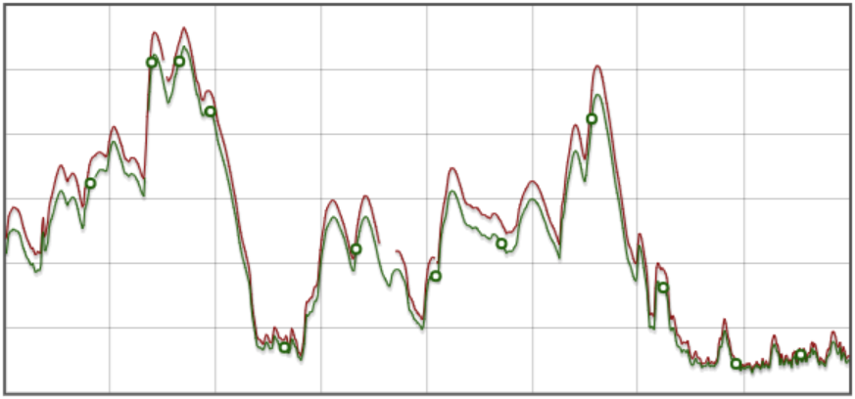
Methodology: Thresholding
open water
25
river gage
(height, ft)
15
inundated vegetation
not inundated vegetation
5
Apr19
Oct19
Apr20
Oct20
Sample Site VH
Sample Site VV/VH
Pixel Count
Pixel Count
1,500
1,500
1,000
1,000
500
500
0
0
-30
-20
5
10
15
Pixel Value
Pixel Value
Notes:
The aim of our classification was to group pixel values into three values-- open water, inundated vegetation, and not inundated/open water. To do so, we needed to get a general idea of the full range of pixel values present in our C-SAR imagery so that we could pick out thresholds or pixel ranges for each class of landcover type. First, we used local river gauge data to identify temporal periods of high flood and low flood and filtered C-SAR imagery for those dates. Then, we mapped the full range of pixel values using histograms to try to pick out three distinct groups of values and get a better sense of what pixel values might make up our different categories.
------------------------------Image Information Below ------------------------------
Clipart provided by PowerPoint
Graph from USGS National Water Information System
https://waterdata.usgs.gov/nwis/dv?referred_module=sw&site_no=05585500%2C05586100&format=gif_mult_sites&PARAmeter_cd=00065&begin_date=2019-01-01&end_date=2020-12-31

Slide 11
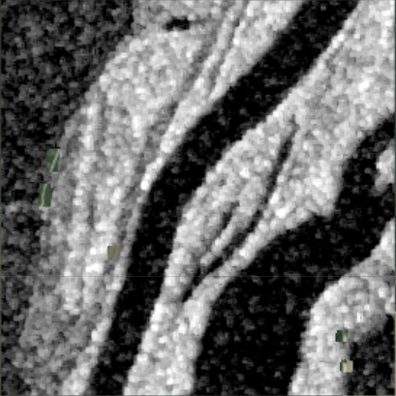
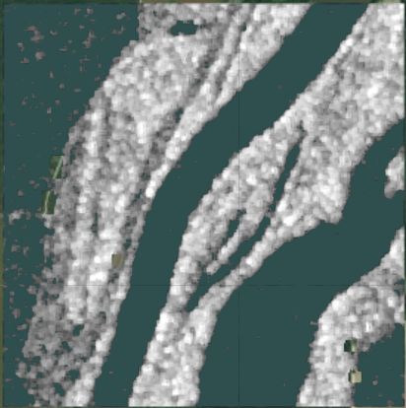
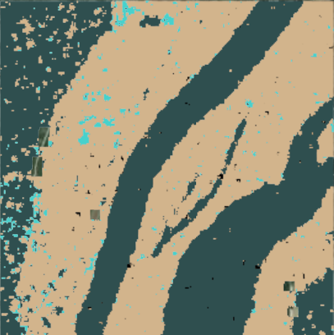
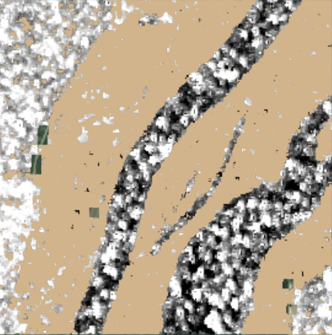
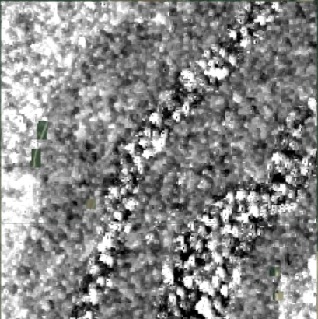
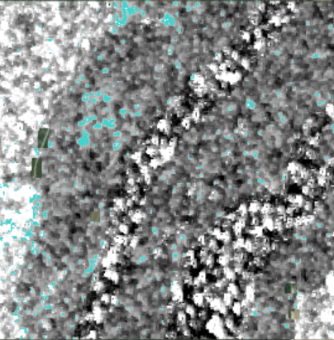
Methodology: Creating Classifications
VH Polarization
open water
VV/VH Ratio
not inundated
vegetation
inundated vegetation
Notes:
To create our classifications, we utilized the VH polarization band of the Sentinel-1 C-SAR to isolate open water pixels to create our open water classification.
Then we used the VV/VH ratio (calculated by dividing the VV polarization band by the VH polarization band) to highlight inundated vegetation. In this visualization, inundated vegetation appears in brighter pixels than the not inundated vegetation.
After determining the open water and inundated vegetation pixels, everything else was classified as not inundated vegetation.
Our resulting classification is shown in the example to the right, where open water is dark blue, inundated vegetation is light blue, and not inundated vegetation is tan.
These classifications were then used to calculate the minimum and maximum extent of inundation.
VH polarization = open water
Open water mask
Visualize VV/VH ratio with mask applied
Inundated vegetation image visualization
------------------------------Image Information Below ------------------------------
Clipart provided by PowerPoint

Slide 12
Methodology: Generating Extent
Minimum Extent
Maximum Extent
if pixel is classified as either inundated vegetation OR open water in all images
then classify it as wet
if pixel is classified as either inundated vegetation OR open water at any point
then classify it as wet
wet land
dry land
Notes:
We then generated minimum and maximum extent from individual classified images. Minimum extent encompassed all pixels that were classified as either inundated vegetation or open water across all images. This indicates that they are permanently "wet land". Maximum extent encompassed all pixels that were classified as either inundated vegetation or open water AT ANY POINT. This metric tells us how far inundation can possibly reach.
------------------------------Image Information Below ------------------------------
Clipart provided by PowerPoint

Slide 13
Methodology: Generating Inundation Duration
count the number of times a pixel is classified as inundated vegetation and/or open water across a period
Classification
inundated vegetation
max # of images
open water
not inundated vegetation
min # of images
Notes:
To generate inundation duration, we counted up the number of times a pixel is classified as inundated vegetation and/or open water across a time period. In today's presentation, we will only show you the maps of open water duration – that is, the number of times pixels were classified as open water. But we will continue referring to these as "inundation duration" maps, as they still provide information on inundation. The duration values are in units of images. That is, they range from the minimum to the maximum number of images that a pixel can be classified as open water.
------------------------------Image Information Below ------------------------------
Clipart provided by PowerPoint

Slide 14
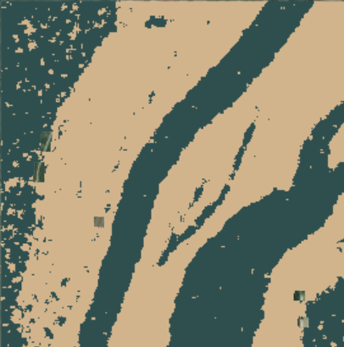
Results: Validation
DSWE
C-SAR classification
open water
not open water
Notes:
For DSWE Open Water we used two classes from DSWE's 9 classes: water (high confidence) and water (moderate confidence)
For the C-SAR classification we isolated the our open water pixels as values from the VV/VH ratio <-23
As you can tell, our classification picked up more open water pixels than the DSWE classification
In the following slide, we compared pixel by pixel the results from our classification to the DSWE classification to get our overall accuracy
------------------------------Image Information Below ------------------------------
Clipart provided by PowerPoint

Slide 15
Results: Confusion Matrix
Overall Accuracy: 86%
Reference: DSWE
Not Open Water
Open Water
Sum
4,421
2,182
6,603
Open Water
Predicted: C-SAR Classification
1,607
18,336
19,943
Producer's Accuracy
Water - 67%
Not water – 92%
Not Open Water
6,028
20,518
26,546
Sum
User's Accuracy
Water – 73%
Not water – 90%
Notes:
The number of pixels that agreed for open water for both our classification and DSWE are shown in the blue box in the upper left corner of our matrix
The number of pixels that agreed for not open water for both our classification and DSWE are shown in the tan box in the middle of our matrix
By adding the values of the blue box and tan box and dividing by the overall number of pixels (26,552.43), we get our overall accuracy as 91%!
This means that our classification was correctly identifying open water pixels and not open water pixels 91% of the time.
The next part of this presentation will focus on how we used our classifications to calculate inundation extent and inundation duration for this project.
------------------------------Image Information Below ------------------------------
Clipart provided by PowerPoint

Slide 16
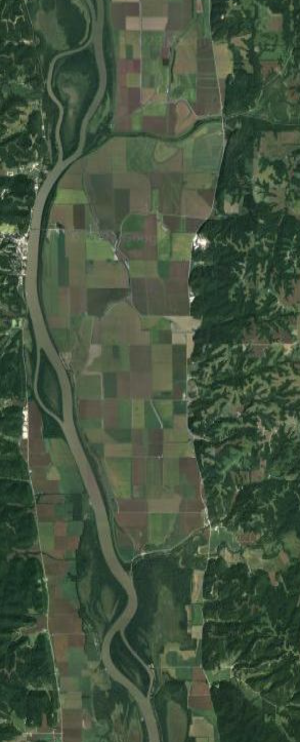
Results: Focus Area
0 10 20 40 km
0 2 km
Notes:
The area of interest for this project was quite large, so for the purpose of this presentation we will be focusing on a small part of the Lower Illinois River Valley towards the south end, captured in the bounding box shown.
------------------------------Image Information Below ------------------------------
Clipart provided by PowerPoint

Slide 17
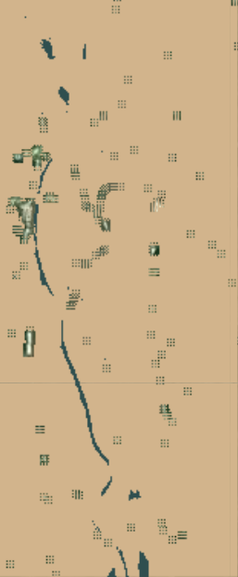
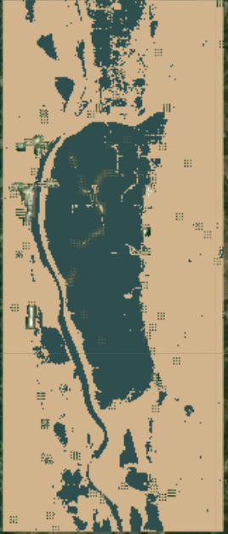
Results: Inundation Extent 2019 (Flood Year)
March - November
Min
Max
Wet land
Dry land
0 2 km
0 2 km
0 2 km
Notes:
These are our final extent maps 2019 for the entire Lower Illinois River Valley, across our study period of March-November, and for each year separately. Dark blue indicates the pixels that were classified as only open water, inundated vegetation, or both during the study period (i.e. never dry land). The tan brown indicates the pixels that are only ever classified as dry land (i.e. never an open water or inundated vegetation pixel throughout the entire study period). The missing pixels are masked out urban areas as defined by the National Land Cover Database. 2019 was a dramatic flood year where some levees were overtopped by river water, as indicated by the dark blue patch that appears during the maximum extent map to the right of the Illinois River.
------------------------------Image Information Below ------------------------------
Clipart provided by PowerPoint

Slide 18
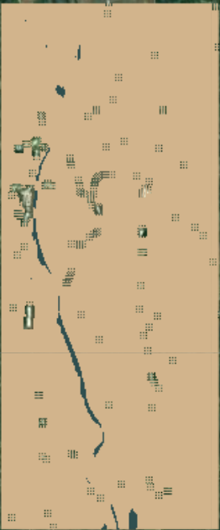
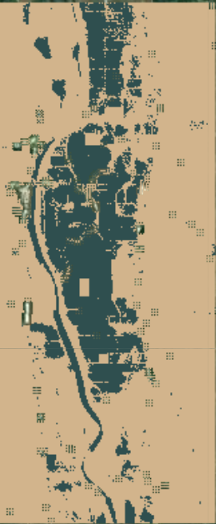
Results: Inundation Extent 2020 (Drought Year)
March - November
Min
Max
Wet land
Dry land
0 2 km
0 2 km
0 2 km
Notes:
These are our final extent maps 2020 for the entire Lower Illinois River Valley, across our study period of March-November, and for each year separately. 2020 was a marked drought year. Dark blue indicates the pixels that were classified as only open water, inundated vegetation, or both during the study period (i.e. never dry land). The tan brown indicates the pixels that are only ever classified as dry land (i.e. never an open water or inundated vegetation pixel throughout the entire study period). The missing pixels are masked out urban areas as defined by the National Land Cover Database.
------------------------------Image Information Below ------------------------------
Clipart provided by PowerPoint

Slide 19
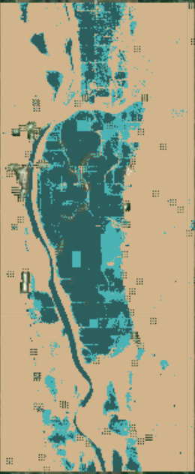
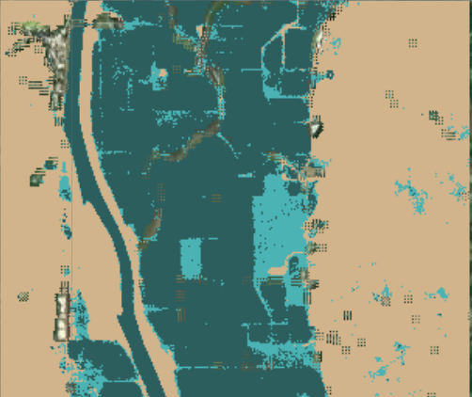
Results: 2019-2020 Inundation Extent Difference
Wet land both years
Wet land 2019 only
Dry land
0 1 km
0 2 km
Notes:
Here we highlight the differences in wet land between the 2019 flood year and 2020 drought year. The lighter blue shows the patches of area that were flooded (I.e. wet land) in 2019 but not in 2020. Dark blue represents areas where both 2019 and 2020 were consistently wet land. In the following slides, we will show our results for how long patches of area were wet land with inundation duration maps during our study periods.
------------------------------Image Information Below ------------------------------
Clipart provided by PowerPoint

Slide 20
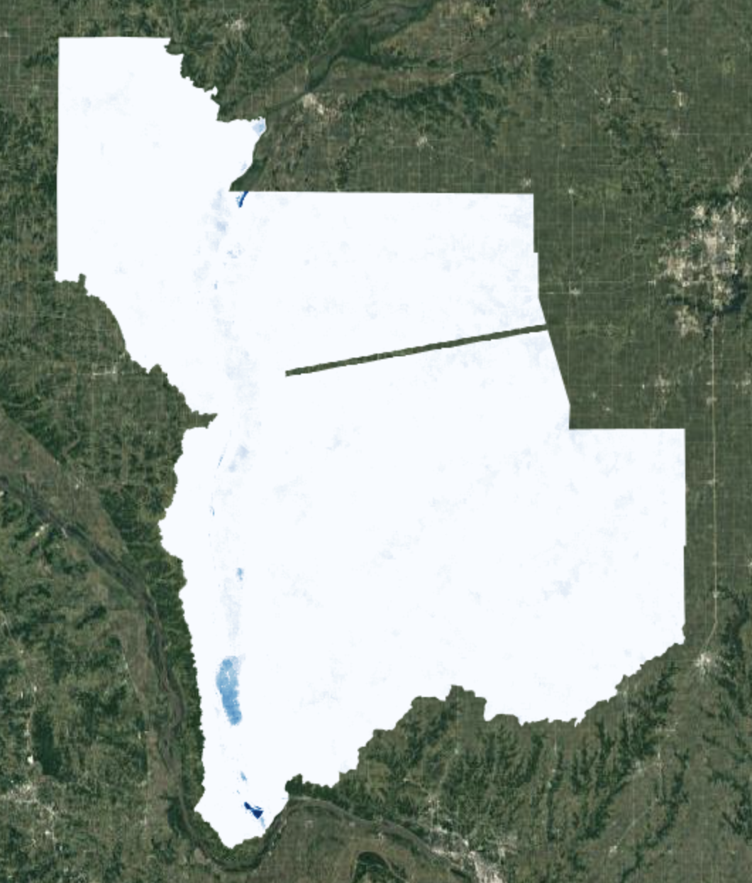
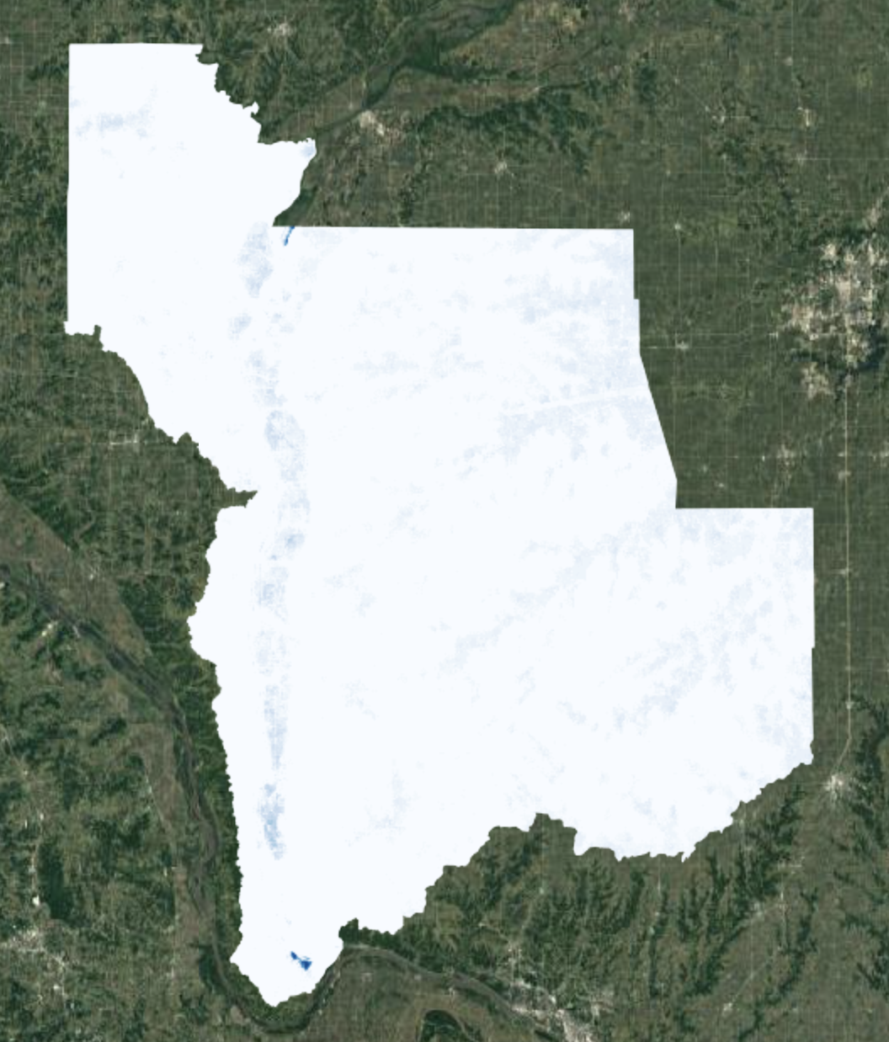
Results: Final Inundation Duration Maps
40 images
2019 (flood)
2020 (drought)
0 images
0 10 20 40 km
0 10 20 40 km
Notes:
These are our final inundation duration maps for the entire Lower Illinois River Valley, across our study period of March-November, and for each year separately. White indicates the minimum number of images that a pixel was classified as "open water" in – in this case, 0. And the dark blue indicates the maximum number of images in which a pixel was classified as "open water" in. In this case, it is 40 images. This will of course change depending on the size of the time period you're looking at. We will now zoom into some interesting features.
### CLICK TO ANIMATE ###
Notice this patch of dark blue in the 2019 map that is not present in the 2020 map. This makes sense, given that 2019 was a severe flood year, while 2020 was a drought year.
------------------------------Image Information Below ------------------------------
Clipart provided by PowerPoint

Slide 21
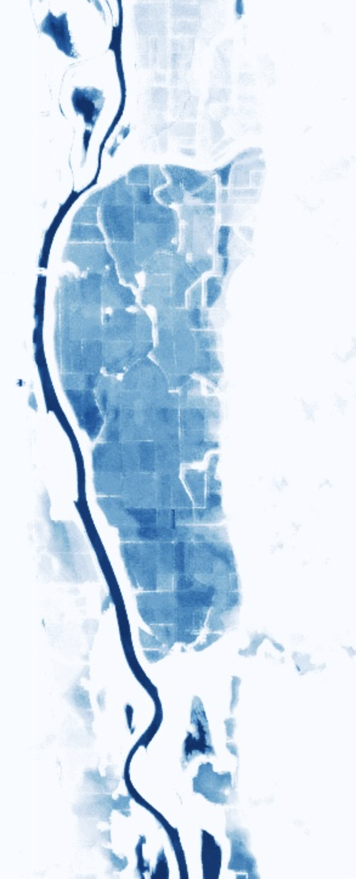
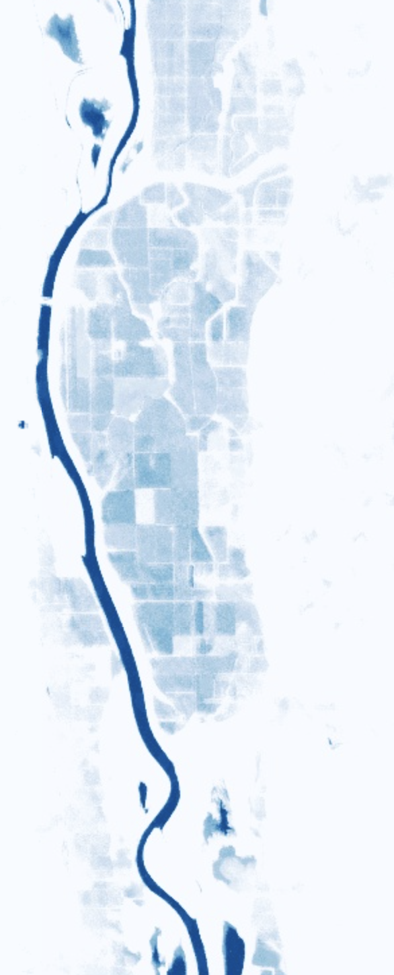
Results: Inundation Duration Insights
March - November
40 images
2019
2020
0 images
0 2 km
0 2 km
0 2 km
Notes:
Here is that patch, zoomed in. The left image is 2019, middle is 2020, and on the left is a satellite image for reference.
That ribbon of dark blue is the Illinois River. There are darker spots near the top and bottom of the images as well, indicating areas that were often classified as open water. And then there's that dark patch that is far stronger in 2019 than in 2020. I will now add a layer indicating levees to contextualize these images.
ALTERNATE SCRIPT IF WE DELETE SLIDE 20:
We will now move on our inundation duration results. for the entire Lower Illinois River Valley, across our study period of March-November, and for each year separately. White indicates the minimum number of images that a pixel was classified as "open water" in – in this case, 0. And the dark blue indicates the maximum number of images in which a pixel was classified as "open water" in. In this case, it is 40 images. This will of course change depending on the size of the time period you're looking at. We will now zoom into some interesting features.
That ribbon of dark blue is the Illinois River. There are darker spots near the top and bottom of the images as well, indicating areas that were often classified as open water. And then there's that dark patch that is far stronger in 2019 than in 2020. I will now add a layer indicating levees to contextualize these images.
------------------------------Image Information Below ------------------------------
Clipart provided by PowerPoint

Slide 22
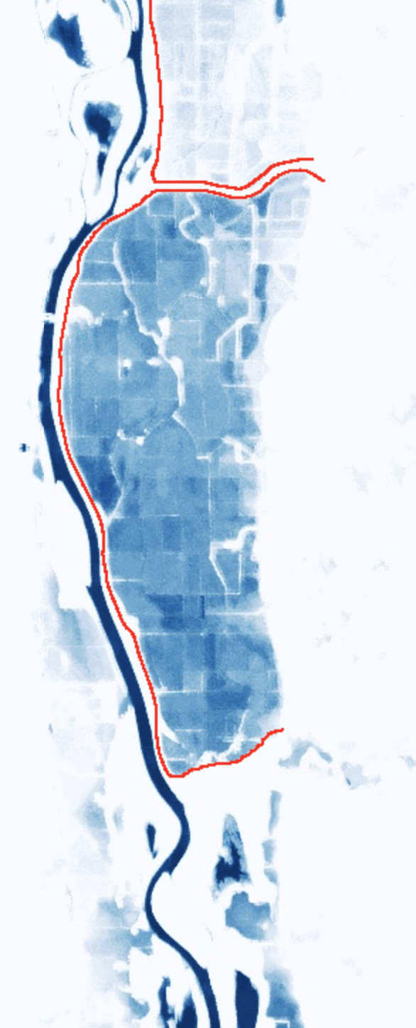
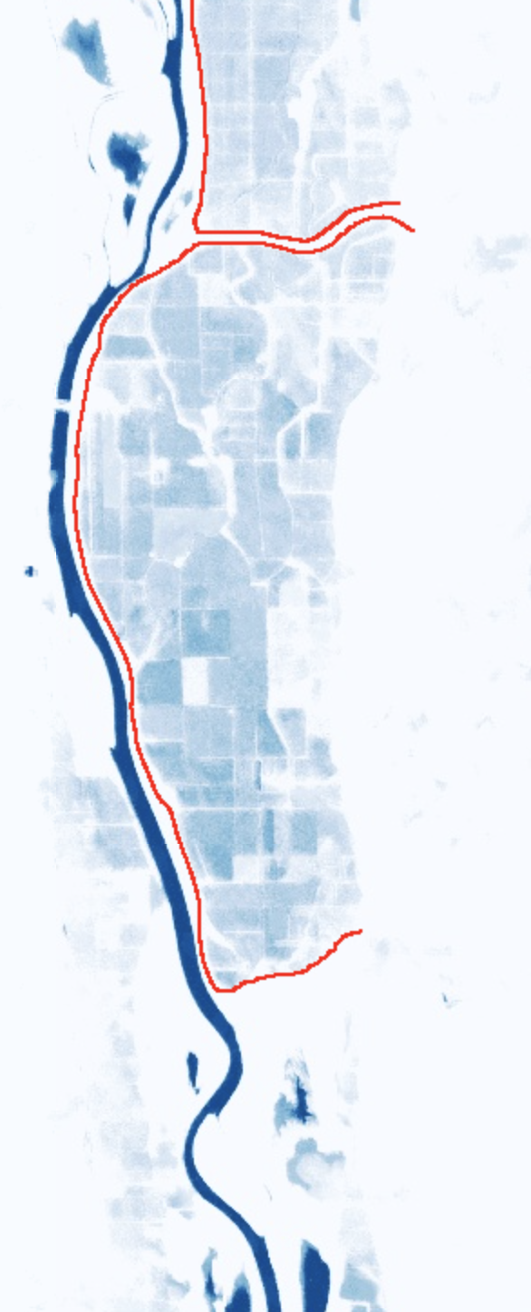
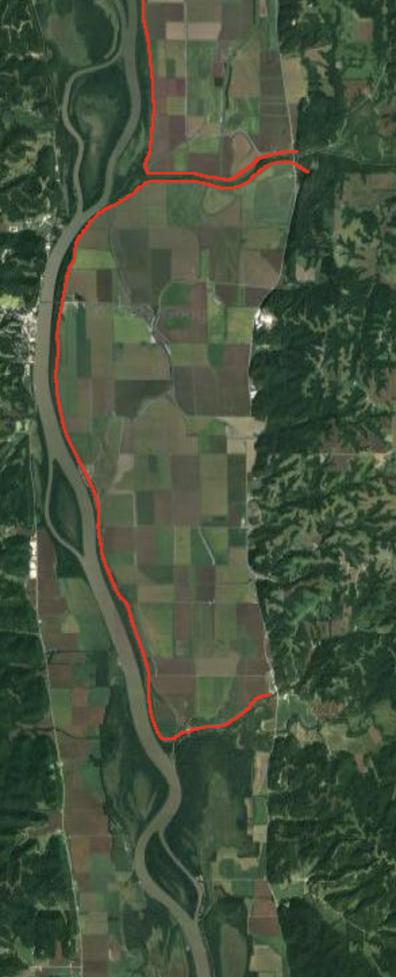
Results: Inundation Duration Insights
March - November
40 images
2019
2020
0 images
0 2 km
0 2 km
0 2 km
Notes:
Levees are earthen walls used to keep flooding from reaching agricultural fields. They are indicated by red lines in these three images. This reveals that those instances of open water in 2019 were localized to one specific levee district. This indicates that a levee failed in this district during the severe flooding of 2019, allowing water from the Illinois River to accumulate in the agricultural land within. According to our partners, standing water can remain in agricultural land for months before it is eventually pumped out. These lands act like bowls, since they are bordered by levees on most sides, and by elevated land elsewhere, as can be seen in the satellite image. The levees in the district above seem to have remained intact, as we don't see evidence of standing water.
------------------------------Image Information Below ------------------------------
Clipart provided by PowerPoint

Slide 23
Results: Inundation Duration Insights
March - November
40 images
2019
2020
0 images
0 2 km
0 2 km
0 2 km
Notes:
The area circled includes "state fish and waterfowl management areas" and a State Park, which contain no levees. In both 2019 and 2020 open water persisted in a few defined areas, however, the maps do not indicate significant inundation elsewhere. This is explained by the areas ability to shed flood water more efficiently, as there are no levees holding the water back after they've been breached.
------------------------------Image Information Below ------------------------------
Clipart provided by PowerPoint

Slide 24
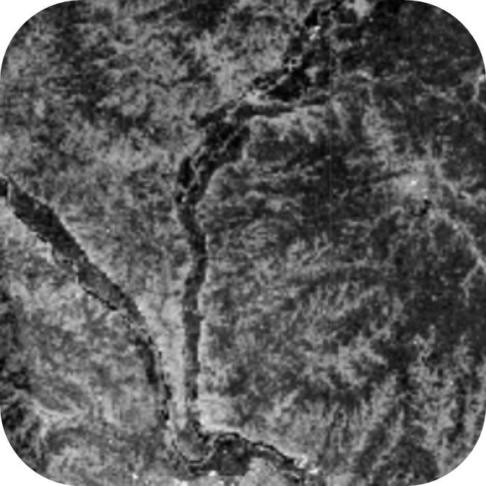
Conclusions
Inundation extent and duration detected using Sentinel-1 C-SAR imagery
Comprehensive data layers and maps generated for partner use
Final products provide insight on inundation in leveed lands
Image Credit: Google Earth
Notes:
In conclusion, we generated inundation extent and duration maps using Sentinel-1 C-SAR imagery across 2019 and 2020. These maps provide valuable insight on inundation patterns, including in the swaths of leveed land within the Lower Illinois River Valley. Our partners can use these maps to delineate wetlands in the Lower Illinois River Valley and inform purchasing practices into the foreseeable future. These maps can also be useful for other projects our partners choose to pursue, as well as provide justification for grant requests to various governmental agencies.
------------------------------Image Information Below ------------------------------
Image Credit: Google Earth
Image Source: NASA DEVELOP Team

Slide 25
Errors and Uncertainties
Missing inundated vegetation from C-band limitations
C-SAR inundation metric thresholding
Signal interference from agricultural and urban activity
Notes:
The accessibility of C-band synthetic aperture radar made it the best product to incorporate into our analysis, but there are some limitations to the sensor's ability to pick up inundation in more vegetated or forested landscapes. Longer sensor wavelengths can penetrate deeper into the forest canopy, but C-band SAR's medium-sized wavelength allows for low to medium visibility in more vegetated areas. Therefore, it is possible that there were more densely vegetated areas like forested floodplains or inundated shrubby areas that were too dense for the sensor to detect inundation.
### CLICK TO ANIMATE ###
Additionally, there is a certain margin of error in our thresholding methodology. We know from our results that the thresholds we applied to different landcover groups were not perfect and sometimes included pixels that did not belong in that class and excluded others that did. Therefore, the boundaries between different classes should be interpreted more as soft estimates, rather than hard lines of what is inundated and what is not.
### CLICK TO ANIMATE ###
Interpretation of our results is also made complicated by agricultural activities in our study area, as well as the similarity in the signatures of inundated vegetation and urban areas. There is a high amount of infrastructure present in the study area, and our partner's supplemental knowledge of the local area, including functioning of levees, levee districts, and general agricultural practices was essential in our ability to interpret and give meaning to our results.
------------------------------Image Information Below ------------------------------
Clipart provided by PowerPoint

Slide 26
Future Work
Normalize inundation duration values
Develop inundated vegetation validation methodology
Forecast future inundation patterns
Expand use of products to other land trusts
Notes:
As explained earlier, our inundation duration values indicate the number of images in which each pixel was classified as open water. This metric does not account for cases in which two images were generated in a day, and is also relative to the amount of time that duration was calculated over. It is necessary, then, to normalize our current metric to account for these potential sources of uncertainty.
### CLICK TO ANIMATE ###
Future work could also involve establishing a validation metric for inundated vegetation, as we were only able to validate open water classifications using DSWE. There is currently no robust way for inundated vegetation classifications using SAR data to be validated.
### CLICK TO ANIMATE ###
It would be useful to forecast future inundation patterns under different climate scenarios. This might involve incorporating water level data, as well integrating parameters for variation between how water recedes from floodplain forests versus leveed agricultural lands.
### CLICK TO ANIMATE ###
Finally, our partners indicated that this application could be useful to other land trusts, as inundation extent is a valuable metric not confined to the parameters of any specific riparian area. Therefore, future work could build toward standardizing these methods for use by other organizations.
------------------------------Image Information Below ------------------------------
Clipart provided by PowerPoint

Slide 27
Partners
Alley Ringhausen, Executive Director, Great Rivers Land Trust
David Holman, GIS Consultant, Great Rivers Land Trust
Dr. Marie Farson, Assistant Professor, Principia College
Zavia Jenkins, Community Science Fellow, AGU Thriving Earth Exchange
Dr. Lyle Guyon, Terrestrial Ecologist, Education Center
Advisors
Dr. Bruce Chapman, NASA Jet Prop-ulsion Laboratory, California Institute of Technology
Benjamin Holt, NASA Jet Propulsion Laboratory, California Institute of Technology
NASA DEVELOP
Erica Carcelén, NASA DEVELOP Fellow
This material contains modified Copernicus Sentinel data 2019-2020, processed by ESA.
Maps throughout this work were created using ArcGIS® software by Esri. ArcGIS® and ArcMap™ are the intellectual property of Esri and are used herein under license. All rights reserved.
Notes:
Thank you to our partners for their enthusiasm and direction during this process. Thank you to our advisors for their guidance. Thank you to our Fellow Erica Carcelen for being our advocate and keeping us on track!

