Slide 1
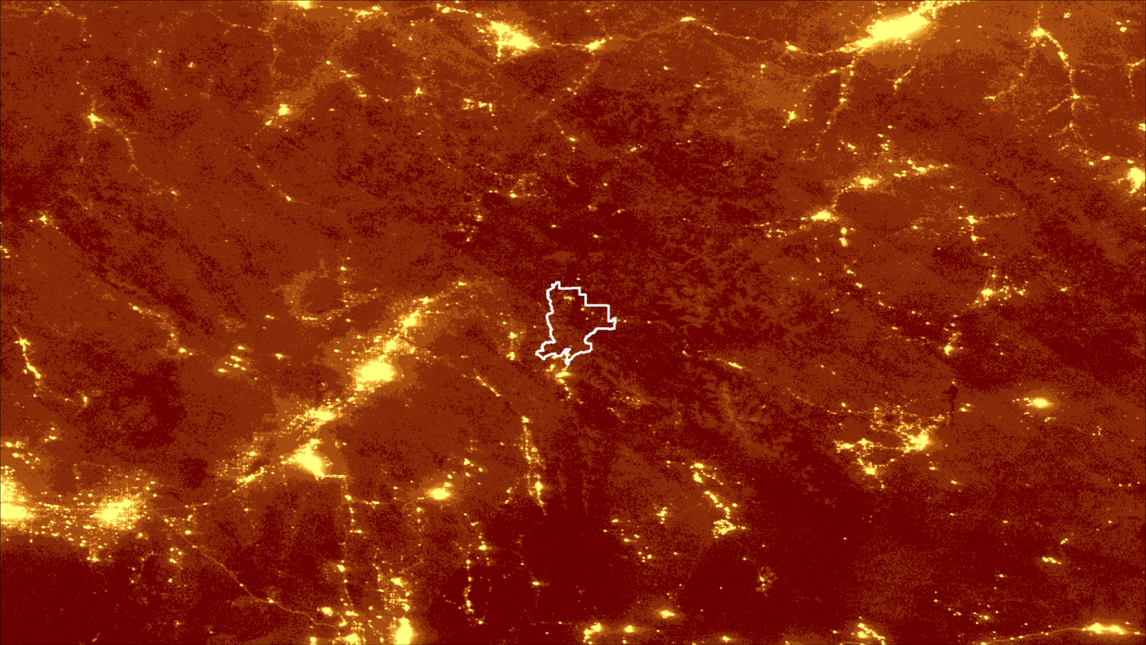
Benjamin Marcovitz (Project Co-Lead)
Veronica Warda (Project Co-Lead)
Aubrey Hilte
Christine Stevens
Eric White
WYOMING CROSS-CUTTING
Utilizing NASA Earth Observations to Detect Changes in Nighttime Sky Brightness in Grand Teton National Park
Wise County Clerk of Circuit Court’s Office
2017 Spring
Notes:
Greetings
My name is Veronica Warda, co-project lead
And I am Benjamin Marcovitz, co-project lead
And I am Aubrey Hilte,
And I am Christine Stevens.
Eric White could not be here today.
We are the Wyoming Cross-Cutting team. This is the first of three terms and we utilized NASA Earth Observations to detect changes in Nighttime Sky Brightness in Grand Teton National Park.
Image Source: Wyoming Cross-Cutting Team

Slide 2
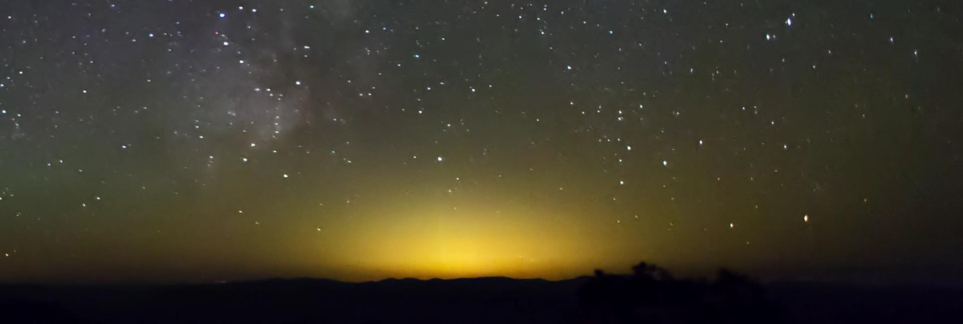
Background
Light pollution is defined as inappropriate or excessive artificial light that obscures the view of the stars
Image Credit: National Park Service
Notes:
When thinking about environmental pollution, light is not typically the first type of pollutant that comes to mind. Many people may have never given much thought to the constant brightness that surrounds us.
Light pollution can be seen as a dome of light that crowds out an otherwise beautiful, clear sky. This excessive artificial lighting impacts the natural environment in a variety of ways that
dramatically alter quality of life for humans and wildlife alike.
Historically, the brightest objects in the night sky were the moon and the stars; Today the brightest objects many of us observe are cities and highly urban areas.
Image Source: https://www.youtube.com/watch?v=NOZlhTCW3gM or the video citation used in VPS

Slide 3
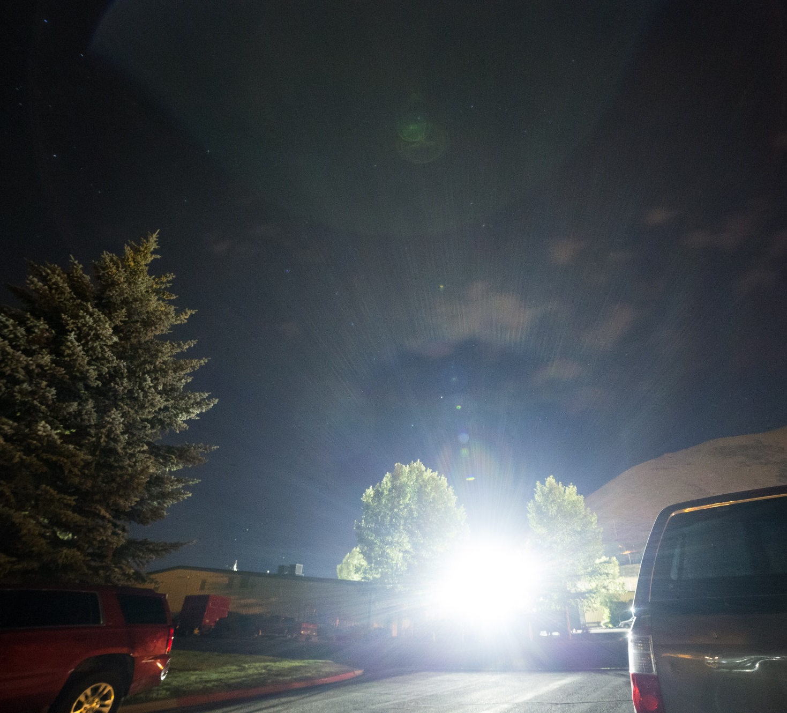
Community Concerns
Image Credit: National Park Service
99% of United States residents live under light polluted skies
Light pollution affects humans
Loss of night sky heritage
Detriment to human health
Energy waste
Notes:
Presently, 99% of United States residents live under skies that are to some extent degraded (Falchi et al., 2016).
Encroaching anthropogenic light from surrounding communities reduces the once pristine view of the Milky Way.
A clear view of the stars has been an integral part of human history for hundreds of years, guiding travelers and inspiring works of art. As anthropogenic light blocks out the stars, this cultural heritage is lost. Light pollution increases the risks for sleep disorders, depression, and diabetes in humans. Additionally, approximately $2 billion is wasted each year on extraneous lighting (International Dark-Sky Association, 2017).
Image Source: https://www.nps.gov/subjects/nightskies/wilderness.htm

Slide 4
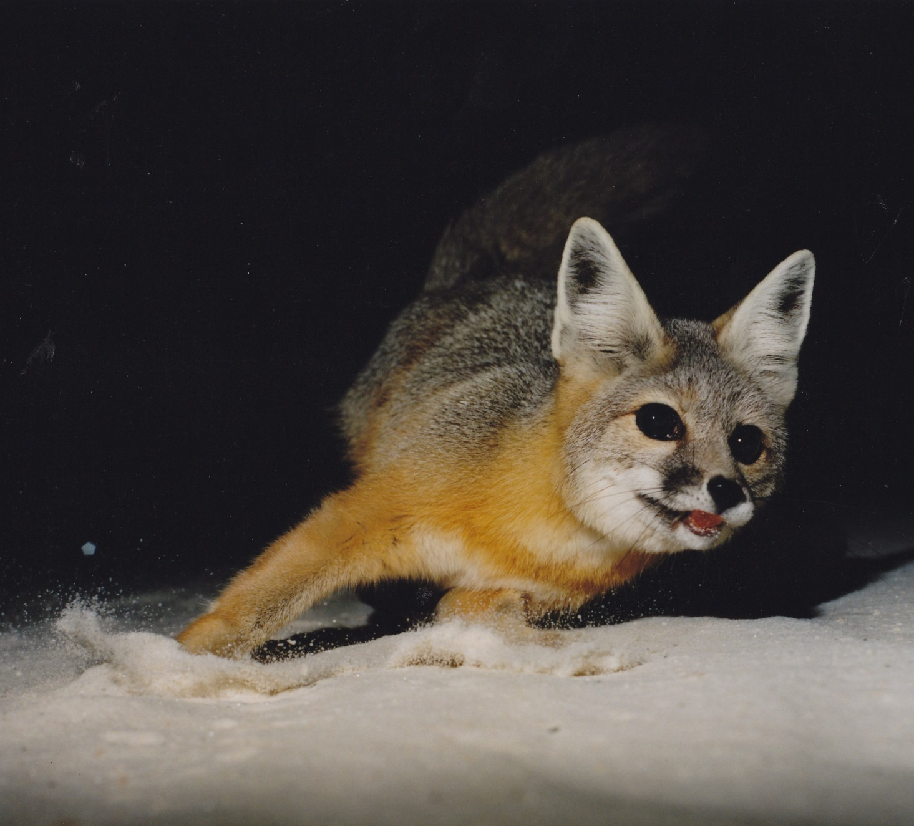
Community Concerns
Light pollution covers to 46.9% of all land in the United States
Light pollution disrupts natural patters of ecosystems by changing
Migratory patterns
Breeding behaviors
Feeding habits
Image Credit: National Park Service
Notes:
Light pollution is also detrimental to the natural environment. Close to half of all land cover in the United States is vulnerable to the effects of light pollution (Falchi et al., 2016).
Excessive, synthetic lighting alters natural habitats, leading to dangerous disruptions in migratory patterns, breeding behaviors, feeding habitats, and circadian rhythms in wildlife (Longcore & Rich, 2004).
The National Park Service is concerned with the harmful impacts of light pollution in preservation of human culture and the well-being of wildlife.
Image Source: https://www.nps.gov/whsa/learn/nature/kit-fox.htm

Slide 5
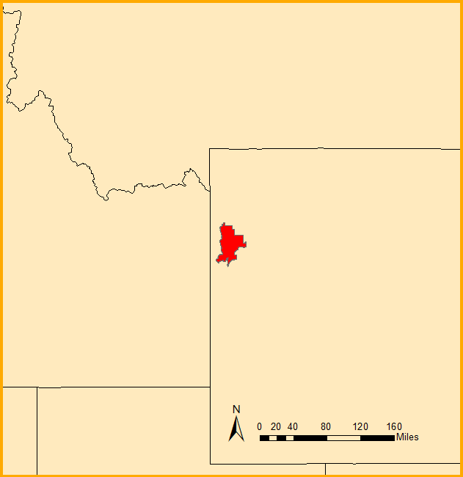
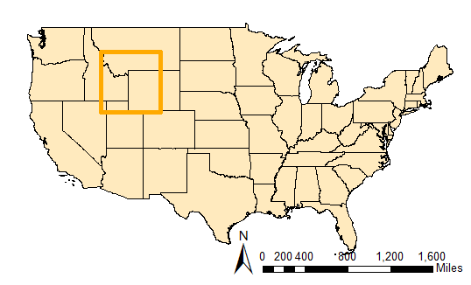
Study Area
Grand Teton National Park
Established in 1950
Covers over 310,000 acres
2.5 million visitors in 2016
Astro-tourism
Incorporates 6 states within 300km of the park
ID, MT, WY, CO, UT, NV
MONTANA
Grand Teton National Park
Image Credit: NPS
IDAHO
WYOMING
UTAH
Map Credit: Wyoming Cross-Cutting Team
Notes:
Our study area for this project consisted of Grand Teton National Park in northwestern Wyoming and parts of the six surrounding states.
The low humidity and isolation of Grand Teton National Park allow for a vast array of flora and fauna to persist within the park. The park offers optimal conditions for stargazing, making it the ideal location for astro-tourists to enjoy the uniqueness of the vibrant, dark night sky.
Research shows that light can scatter up to 200km from a source; with over 600,000 people living within close proximity to the park, efforts towards preserving the region’s dark night skies are vital, so we extended our study area to include a 300km buffer containing 6 of the surrounding states (Falchi et al., 2016; US Census Bureau, 2010).
Image Source: https://www.nps.gov/grte/learn/nature/geology.htm
Base Map: US Census Bureau

Slide 6
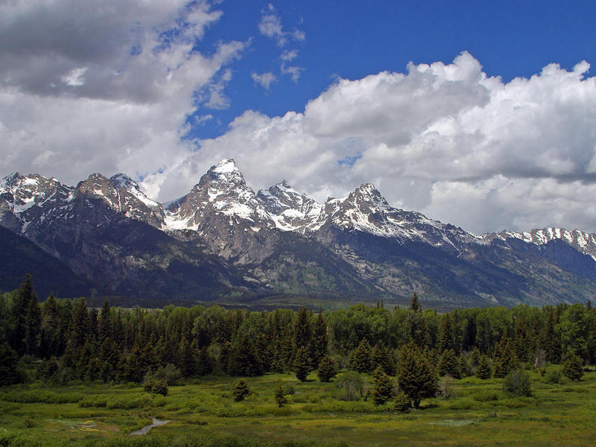
Partners
National Park Service
Est. 1916
Study Area
International Dark-Sky Association
Est. 1988
International Dark Sky Park
Wyoming Stargazing
Est. 2013
In situ measurements
Image Credit: Wyoming Public Media
Notes:
Our team partnered with the National Park Service (NPS) Intermountain Region and Grand Teton National Park, as well as the International Dark-Sky Association, and Wyoming Stargazing to assess the status of light pollution with the park.
The NPS was established in 1916 with the goal of protecting and preserving natural resources for the benefit of current and future generations (National Park Service, 2017).
The International Dark-Sky Association (IDA) expanded upon this assessment of light pollution through its efforts in establishing of Dark-Sky Parks. The IDA follows strict guidelines to grant such status, evaluating levels of sky glow, taking inventory of light fixtures, informing visitors about light pollution, and creating policies to reduce artificial light in and around parks. The IDA is working with Grand Teton National Park to help Grand Teton National Park establish Dark-Sky status (International Dark-Sky Association, 2017).
Wyoming Stargazing is a Non-governmental Organization established in 2013 to promote astro-tourism in the area around Grand Teton National Park. The organization gathers in-situ measurements of light pollution in Grand Teton National Park and nearby communities to assist the park’s efforts towards achieving Dark-Sky status (Wyoming Stargazing, 2017).
Image Source: Wyoming Public Media http://wyomingpublicmedia.org/term/state-land-section

Slide 7
Objectives
Identify sources of anthropogenic sky brightness
Evaluate and inform anthropogenic light mitigation practices
Derive an equation to mathematically model scattered light in and near Grand Teton National Park
New World Atlas of Artificial Night Sky Brightness (2016)
Image Credit: Falchi et al., 2016
Notes:
Our main goals for this project were to quantify sources of anthropogenic sky brightness within Grand Teton National Park, as well as evaluate and inform anthropogenic light mitigation practices in the neighboring communities.
Finally, our team sought to derive a mathematical model for use in future projects. Our efforts towards achieving this were based on a detailed model produced in the “New World Atlas of Artificial Night Sky Brightness” (Falchi et al., 2016). The model produced in the New World Atlas combined VIIRS DNB data and a mathematical model to predict sky glow, or the dome of light viewed from the ground as a result of light pollution.
Image Source: Falchi et al., 2016

Slide 8
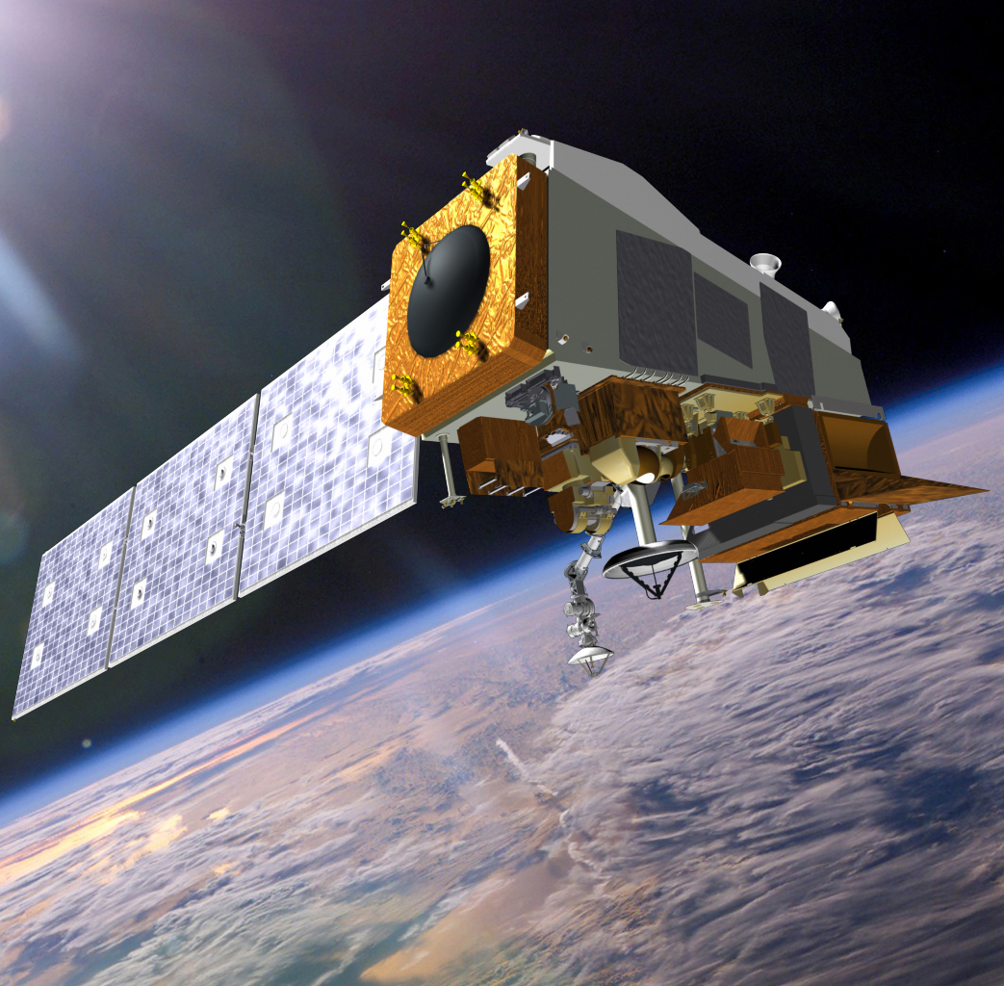
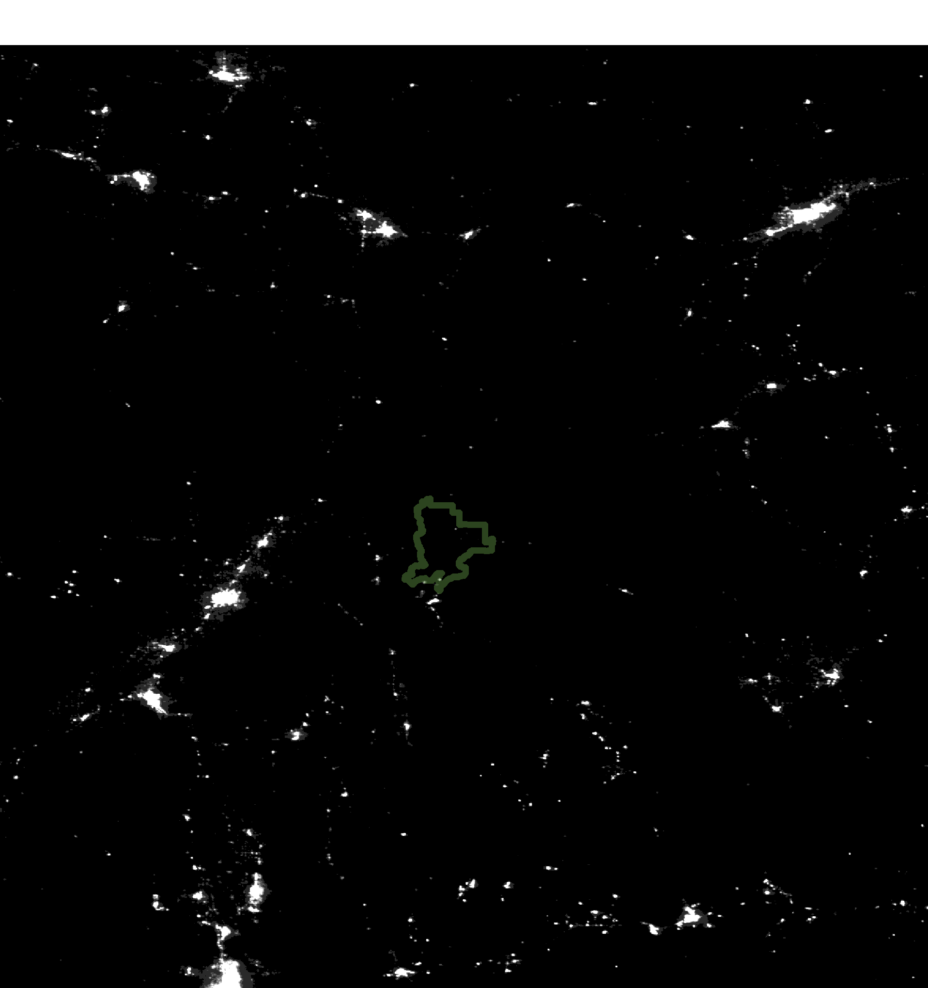
VIIRS Day/Night Band
Detects light from 500 nm - 900 nm wavelengths
NCEI Earth Observations Group:
Monthly composite images
Stray light (striping) removed
Moonlight removed
Summer months sampled to shield from snow-cover glare
Image Credit: National Aeronautics and Space Administration (NASA)
Map Credit: Wyoming Cross-Cutting Team
Notes:
The research conducted in this project utilized NASA Earth observation data from the VIIRS sensor on the Suomi NPP satellite.
VIIRS Day/Night Band detects light at various wavelengths, passing over Earth at approximately the same time each night.
Monthly composited images were processed to remove stray light, lightning, lunar illumination, cloud cover and temporary lights (i.e. aurora, fires, and boats).
-ADVANCE SLIDE FOR ANIMATION-
We combined data for the months of June, July, August, and September. These months were chosen because they have little snow and do not display significant brightness.
We sampled summer months to diminish brightness seen by the sensor (possibly due to a higher albedo).
Image Source: https://www.nasa.gov/sites/default/files/thumbnails/image/img_press_140106_suomi-npp.jpg

Slide 9
Calculating Sky-Glow
Light from nearby sources is perceived as sky-glow from the ground
Large cities cast a dome of light that can be seen from far away
Image Credit: NPS
Image Credit: National Park Service
80
60
40
20
N
0
180
210
240
270
300
330
0
30
60
90
120
150
Kingman 97 km
Bullhead 145 km
Las Vegas 151 km
Moapa 97 km
Mesquite 91 km
St. George 110 km
Phoenix 316 km
Notes:
The essential challenge of this project was the gap between what VIIRS measures (radiance) and what we see from the ground (sky-glow). What we see on this slide is a panoramic view of artificial light. This measurement was taken from Grand Canyon National Monument, and it shows several domes of light over distant cities. Las Vegas is a full ninety miles away, but it still significantly brightens the night sky. Phoenix is two-hundred miles away, but there is still a dim glow on the horizon.
Notice also that there are two angles of measure here. The measurement along the bottom is the compass angle, and the measure along the left side is the angle in the sky, with the viewer’s horizon at bottom and the zenith (the top of the sky) at the top of the photo.
Image Source: https://www.nps.gov/subjects/nightskies/science.htm
Notes: The purpose of the next three slides is to lead the viewers through our methodology with minimal math and physics.

Slide 10
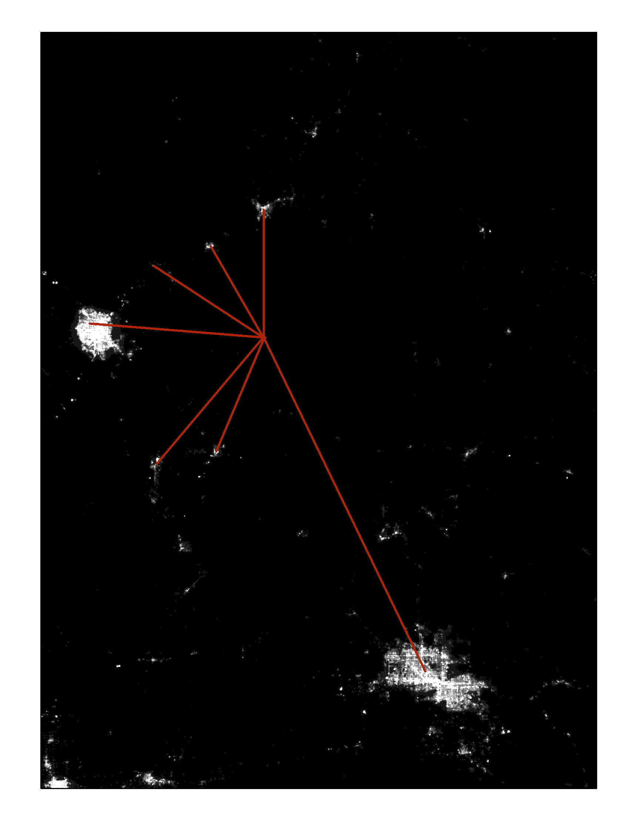
N
Phoenix, AZ
St. George, UT
$$O$$
Mesquite, NV
Kingman, AZ
Moapa, NV
Bullhead City, AZ
Las Vegas, NV
Map Credit: Wyoming Cross-Cutting
Calculating Sky-Glow
VIIRS Day/Night Band measures light emitted at night
These lights are visible from space
Indirect measure of sky-quality
Notes:
Now we can see the same scene from a VIIRS image. The Observer’s location is marked, and the red lines extend to the light sources that we saw in the earlier photo. Notice now that this is an overhead view, and there is only one angle, the compass angle.
Map Credit: Wyoming Cross-Cutting Team

Slide 11
Building A Model
N
Phoenix, AZ
Physics: Light scatters from point-to-point
Geometry: The night sky is a three-dimensional object
St. George, UT
$$O$$
Mesquite, NV
Kingman, AZ
Moapa, NV
Bullhead City, AZ
Las Vegas, NV
Map Credit: Wyoming Cross-Cutting Team
Image Credit: National Park Service
N
210
240
270
300
330
0
30
60
90
120
150
Kingman, AZ
Bullhead City, AZ
Las Vegas, NV
Moapa, NV
Mesquite, NV
St. George, UT
Phoenix, AZ
Notes:
There are two differences between VIIRS’ measure of radiance, at the top, and the in situ measure of sky-glow at the bottom.
First, sky-glow is diffuse. The physics of the atmosphere mediate what each light source looks like at different places.
The second difference is geometry; sky-glow appears in three-dimensions, and VIIRS can only measure two of those dimensions.
Image Source: https://www.nps.gov/subjects/nightskies/science.htm

Slide 12
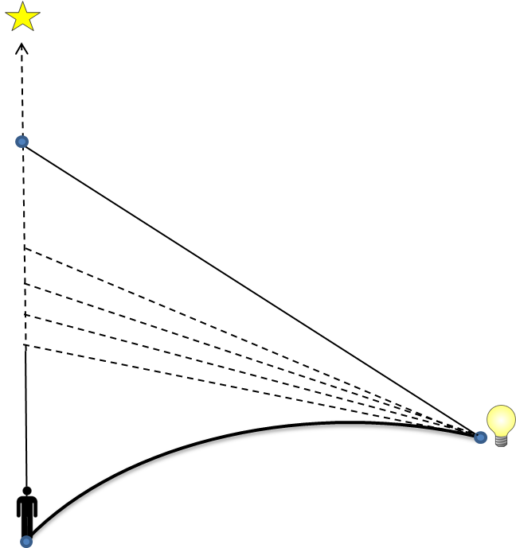
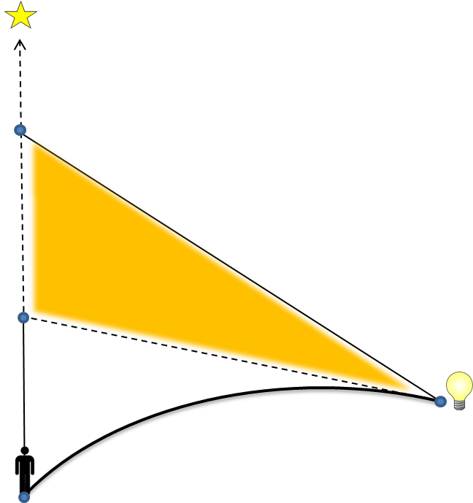
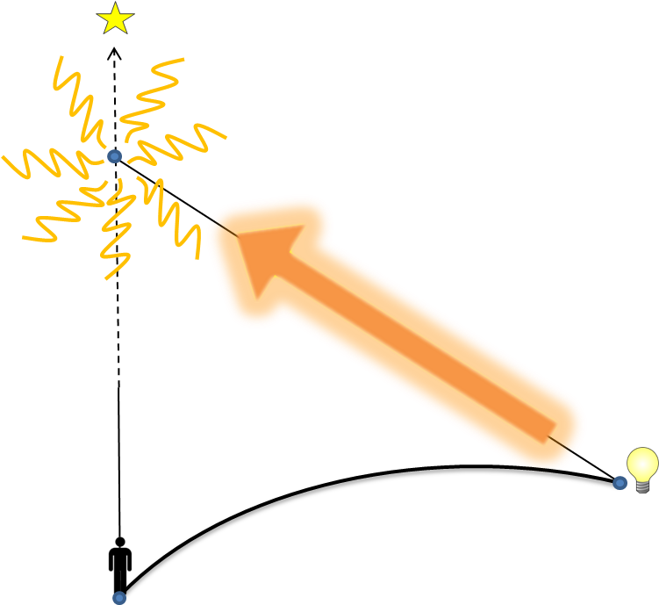
Building A Model
Source
Source
Source
VIIRS DNB gives brightness at the source.
Source light scatters in all directions
The exact amount scattered by each path can be calculated
Adding up all values estimates sky-glow from a single point
Target
Target
Target
Image Credit: NPS
Notes:
We are not the pioneers in this area, but our goal is to recreate the work in the New World Atlas.
Our model calculates sky-glow from point to point. We consider a target being the area under one VIIRS pixel, and a nearby light source up to 195 kilometers away. We use quantities we can calculate, like distance, angle, and curvature of the Earth to imagine paths for a beam of light to go from the source to the target. It turns out there are lots of these possible paths, in lots of directions. We use a computer to figure how bright each beam should be, and then add these all up.
Image Source: Wyoming Cross-Cutting Team

Slide 13
Building A Model
N
“Tally up” scattered light
Calculate overall sky health
Phoenix, AZ
$$Q$$
$$h$$
$$D$$
Las Vegas, NV
$$β$$
C
$$O$$
Map Credit: Wyoming Cross-Cutting Team
Notes:
If we’re able to add up all these sources nearby, we can look at the areas surrounding our pixel and get an idea of the overall quality of the night sky. We can also tell how much a particular light source is degrading the quality of the night sky.
Now that we have a model and processed data we should talk about what will happen next.
Image Sources: Wyoming Cross Cutting Team

Slide 14
Future Directions
Map Credit: Wyoming Cross-Cutting Team
Legend
Night Sky Brightness Ratios
0-0.01
0.01-0.02
0.02-0.04
0.04-0.08
0.08-0.16
0.16-0.32
0.32-0.64
0.64-1.28
Produce map using mathematical model and VIIRS DNB data
Improvements to Falchi et al 2016 model include
Low snow cover months
Sky quality predictions at angles outside of zenith
Non-static model of sky brightness
Image Credit: Monet
Notes:
Now that we have a model and processed data we should talk about what will happen next. In the following terms, the teams will have the opportunity to combine the mathematical model and the VIIRS images to produce a map of predicted sky-glow. The image depicts the ratio of artificial brightness to natural brightness and is a good example of what we hope to produce in the following terms. The next step is to make improvements to the New World Atlas (NWA) model. The NWA model was produced with only the second half of 2014, this means that winter months were included in the analysis. Snow cover is known to cause more scattering so the team was able to choose only months without snow (Falchi et al., 2016). The NWA model depicts sky-glow directly overhead of the observer, the model produced by this team would allow for the prediction of sky-glow at nearly any azimuth and altitude. The last improvement that we would like to see in the future, is to produce a model that is not static like the NWA. The next term will be able to combine the VIIRS monthly composites with the mathematical model to produce a sky-glow map like the one above taken from the work produced in the New World Atlas of Artificial Sky Brightness.
Image Source: Falchi et al 2016
----------
The team would like to make some improvements to the Falchi et al model
+the falchi paper used late fall-early winter months in their model which are known to have snow cover at least in northern regions and high alpine environments, the team now has the option to choose months with little to no snow.
+the model created would allow for the prediction of sky quality outside of the zenith
+the next term would like to create a model that is not static like the Falchi et al 2016 paper.
The next term will need to understand the limitations of the VIIRS DNB

Slide 15
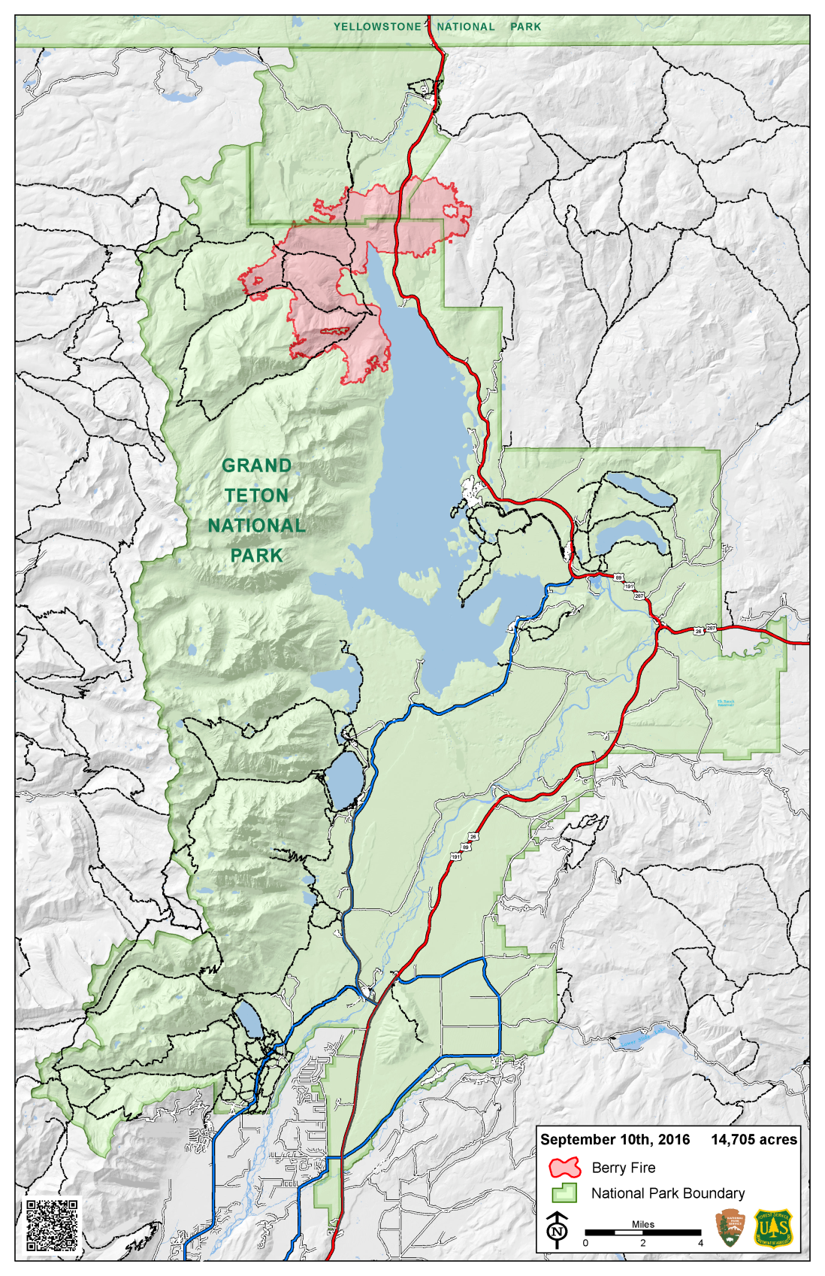
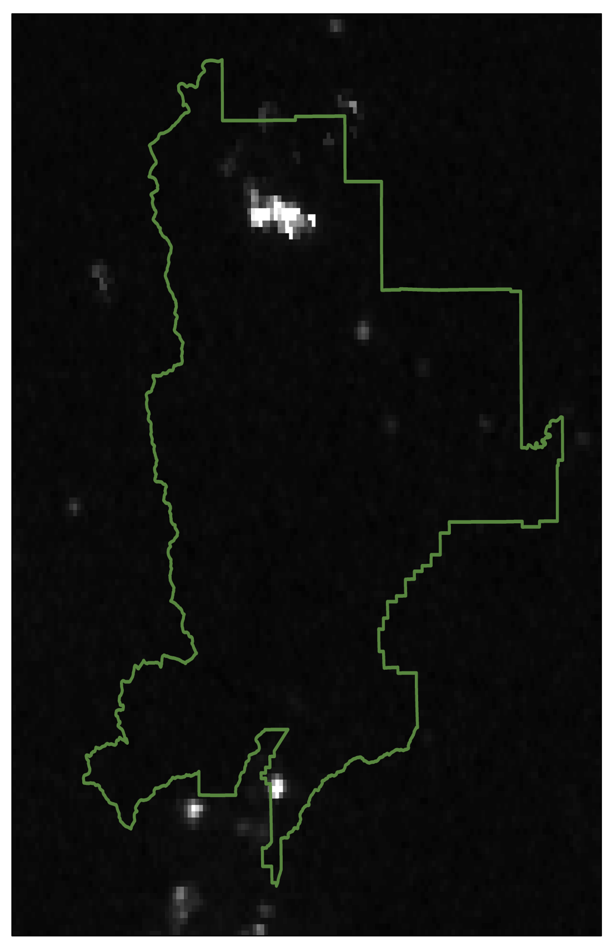
Infrared Sensitivity
VIIRS is overly-sensitive to infra-red light sources
Fires
Volcanoes
Geothermal activity
Image Credit: National Park Service Map Credit: Wyoming Cross-Cutting Team
Notes:
VIIRS DNB over predicts light sources that emit IR light, like fires, volcanoes, and geothermal activity. This sensitivity would be problematic for the sky-glow model produced by this team. For example the brightness produced by fires would appear brighter to the sensor than it would to an observer on the ground and so our model would over predict the sky brightness near the fire. Since fires are common in our study area we investigated if fires appear on the VIIRS DNB images. The Berry Fire, that is shown on this map took place in at the end of the summer in 2016 and it should be visible in our VIIRS images.
-ADVANCE SLIDE FOR ANIMATION-
And it is! So the Wyoming Cross-Cutting team was able to account for this and adjust the data compilation.
Image Source: https://inciweb.nwcg.gov/incident/map/4954/0/60109/
---------------------------
+Overly sensitive to infra-red light which would lead the sensor to over predict the amount of light produced in areas with fires, volcanoes, or geothermal activity.
+This sensitivity to IR would be problematic for our sky-glow model. The brightness that the sensor see might not be visible to humans if the light is produced in the IR range. The model would then show brighter skies than are observed.
+To see if this is a problem for our study we would want to look for sources of IR in the study area
+Fires are common in our study area and would produce infra-red light so we should see bright spots in the VIIRS data where the fires are.
+GRTE had large fire (Berry Fire) in August of 2016 so we should see that on VIIRS

Slide 16
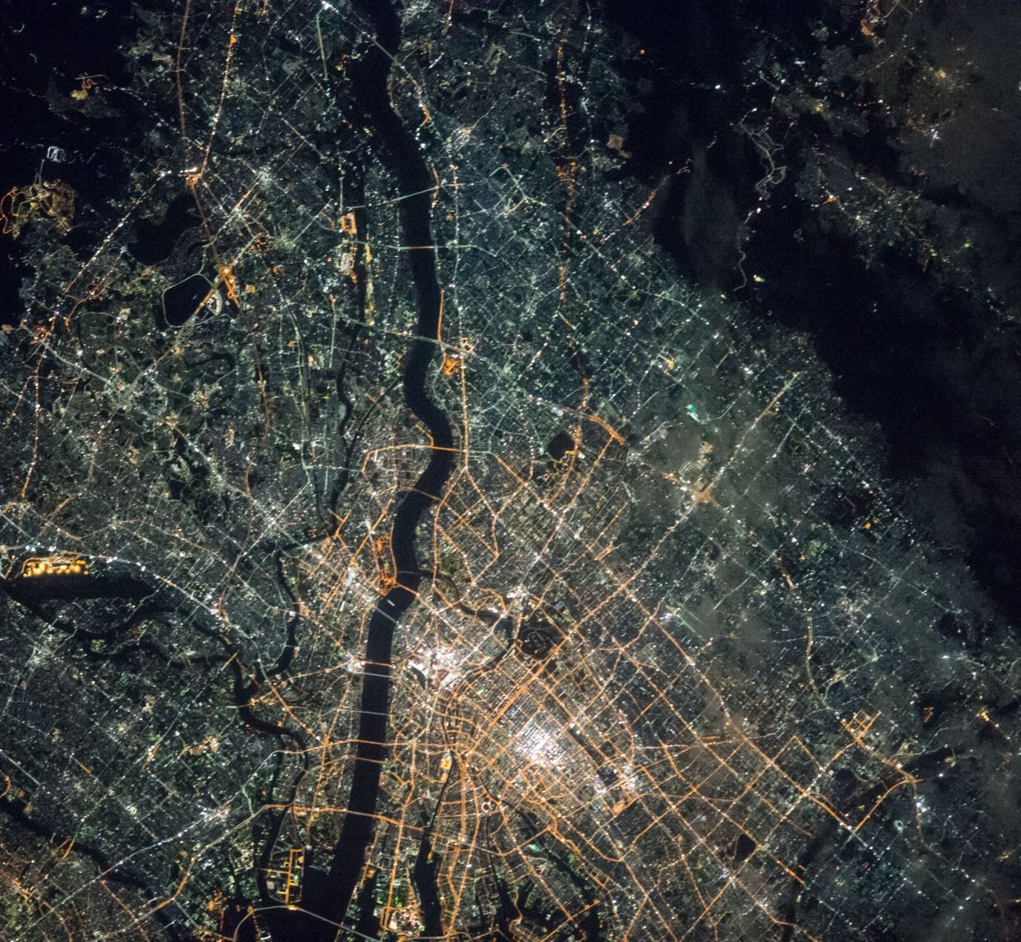
Blue Light Emitting Diode (LED)
Yellow High Pressure Sodium (HPS)
Blue Light
Image Credit: Windows on Earth
Image Credit: Windows on Earth
Notes:
Light Emitting Diode (LED) bulbs emit light with wavelengths less than 500 nm, and today, there is a push to switch to this more efficient lighting. Unfortunately, the transition to LED lighting would lead to a two fold increase the sky brightness (Falchi et al 2016). Since VIIRS DNB is “blind” to this light it would suggest a false reduction o f light pollution in cities while the human eye would see an increase. The Wyoming Cross-Cutting team has found a way to determine the effect of this “blue blindness”.
The team has requested images of the study area to be taken from the International Space Station. These images should allow future teams to assess if the blue blindness will cause a significant reduction in what the sensor can detect. If the area is yellow like the image on the right, the team should be able to continue as planned and produce a model of sky-glow with some certainty that it represents the conditions observers actually see. If the study area is blue like the image on the left, future teams will need to come up with an innovated solution to the problem.
Image Source: http://www.windowsonearth.org/Featured-Galleries/Cities-at-night/i-z4GH3jd
Image Source: http://www.windowsonearth.org/Featured-Galleries/Cities-at-night/i-b4c8jL3

Slide 17
Project Partners
John Barentine International Dark-Sky Association
Dan Greenblatt NPS, Grand Teton National Park
Randy Stanley NPS, Intermountain Region
Samuel Singer Wyoming Stargazing
Science Advisors
Bob VanGundy The University of Virginia‘s College at Wise
Dr. Kenton Ross NASA Langley Research Center
Dr. L. DeWayne Cecil NOAA NCEI, Global Science & Technology, Inc
Others
Ryan Avery Fellow, NASA Langley Research Center, SSAI
Michael Brooke Center Lead, Wise County Clerk of Circuit Court’s Office
Notes:
We would like to thank our project partners, science advisors, and our other contributors to this project.
Works Cited
Falchi, F., Cinzano, P., Duriscoe, D., Kyba, C. C. M., Elvidge, C. D., Baugh, K., … Furgoni, R. (2016). The new world atlas of artificial night sky brightness. Science Advances, 2(6), e1600377–e1600377. https://doi.org/10.1126/sciadv.1600377
International Dark-Sky Association | IDA | Light Pollution (2017). Retrieved March 23, 2017, from http://darksky.org/
Longcore, T., & Rich, C. (2004). Ecological Light Pollution. Frontiers in Ecology and the Environment, 2(4), 191. https://doi.org/10.2307/3868314
National Park Service History: National Park System Timeline. (2017). Retrieved March 23, 2017, from https://www.nps.gov/parkhistory/hisnps/NPSHistory/timeline_annotated.htm
U. S. Census. Bureau. American FactFinder. Retrieved March 23, 2017, from https://factfinder.census.gov/faces/nav/jsf/pages/index.xhtml
Wyoming Stargazing Wyoming Stargazing. (n.d.). Retrieved March 23, 2017, from http://www.wyomingstargazing.org/

Slide 18
Questions?
Notes:
Are there any questions?
-END-

